Slide 1
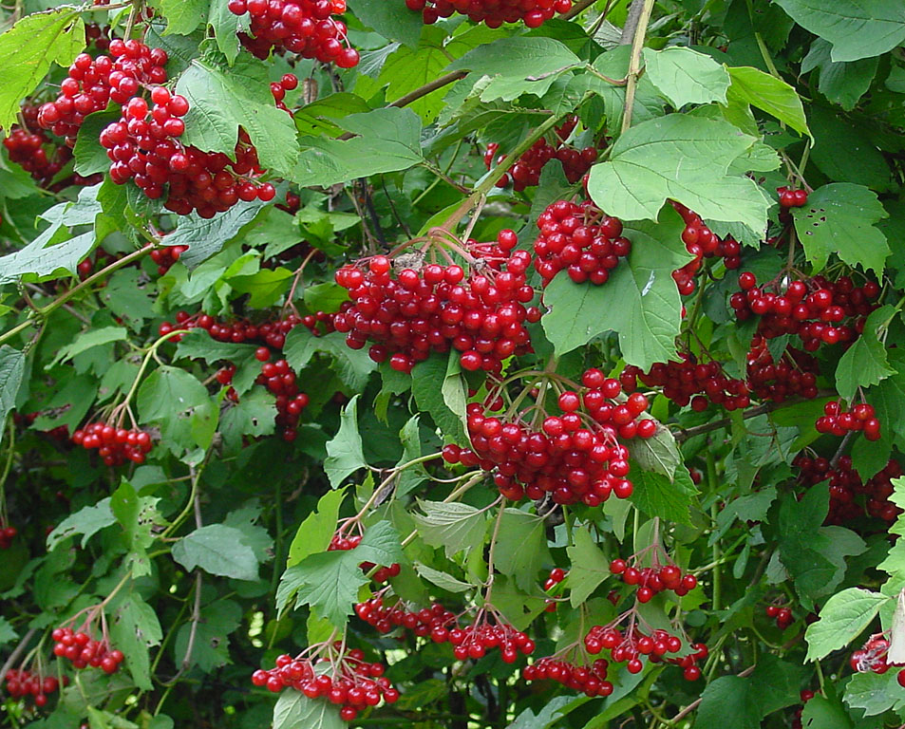
Entangled History: Ukraine and her neighbours from the Middle Ages to the present
Ой у лузі червона калина похилилася, Чогось наша славна Україна зажурилася. А ми тую червону калину підіймемо, А ми нашу славну Україну, гей-гей, розвеселимо! А ми тую червону калину підіймемо, А ми нашу славну Україну, гей-гей, розвеселимо!
Oh, in the meadow a red kalyna (Red Viburnum) has bent down low, For some reason, our glorious Ukraine is in sorrow. And we will take that red kalyna and we will raise it up, And, hey-hey, we shall cheer up our glorious Ukraine! And we will take that red kalyna and we will raise it up, And, hey-hey, we shall cheer up our glorious Ukraine!
Lecture 13
The Russian, Polish and Ukrainian Revolution

Slide 2
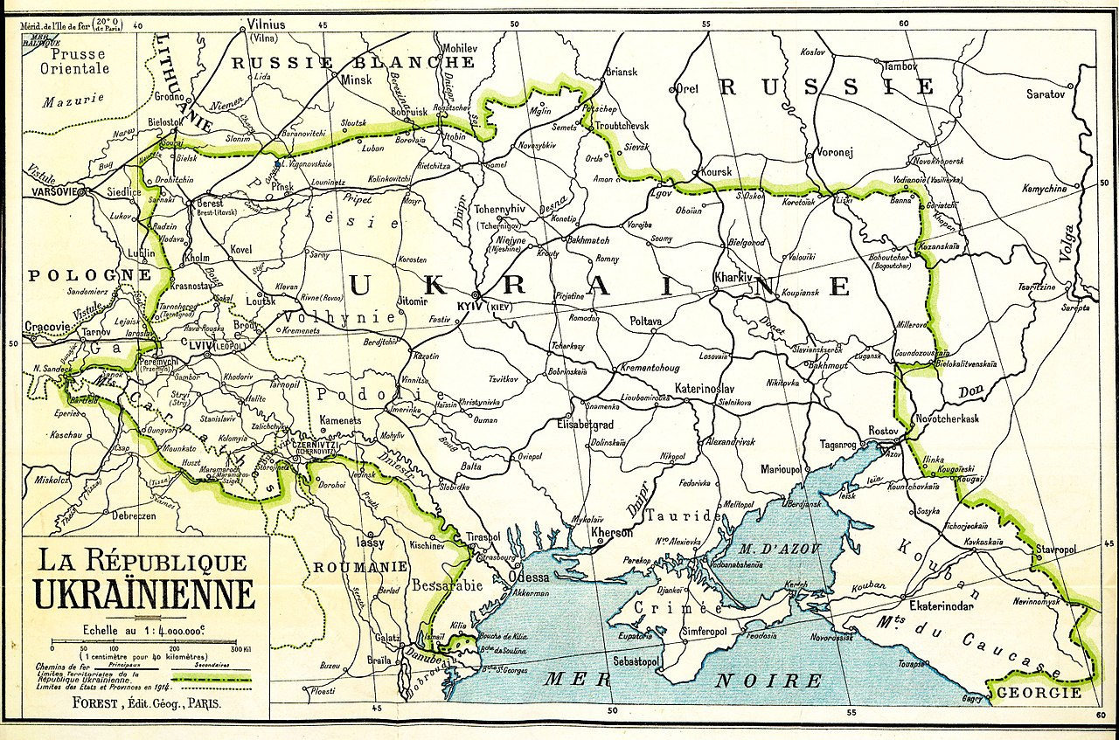
Outline
Introduction
Nationalism vs Socialism
The Ukrainian People‘s Republic
The Russian Civil War
The Polish-Ukrainian war
The Soviet-Polish war
Results
Ukraine map presented by the Ukrainian delegation at the Paris Peace Conference in a bid that was ultimately rejected

Slide 3
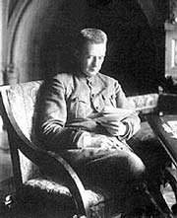
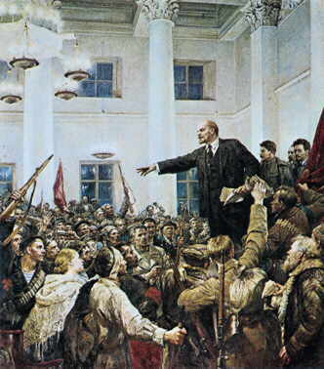
Revolutions in Russia
Alexander Kerenski
Head of the Provisional Government
Vladimir I. Lenin, leader of the Bolshevik party, after November 1917, head of the new revolutionary government

Slide 4
Consequences of the February Revolution
For Poles full independence now a realistic option
Austrian and German offers no longer very attractive
In Galicia: weakens Polish loyalty to Habsburg dynasty (also result of death of Emperor Franz Josef)
Ukrainians in Galicia: still loyal – need Austrian support against Poles – partition of Galicia and Lodomeria and creation of Ukrainian crownland
Ukrainians in Russian Empire: Divided in – loyalists, revolutionary socialists, Ukrainophiles – who attempt to get control of state structures in ethnographic Ukrainian territories of Russian Empire, unite those territories and demand autonomy in a Russian Federation
Most Jews loyal to Austria

Slide 5
First World War
Civilian population gets used to violence – military violence, violence against civilians and war destruction
Furthers nationalisation – pressure on people without clear national identity to make decisions
Growth of anti-Semitism
‘Revolution as Demobilisation and State Collapse’ (Eric Lohr and Joshua Sanders)
After two Russian revolutions, Russian and then German and Austrian-Hungarian defeat: Polish and Ukrainian independence possible
Many Poles and Ukrainians willing to fight for East Galicia – for Polish or Ukrainian independence

Slide 6
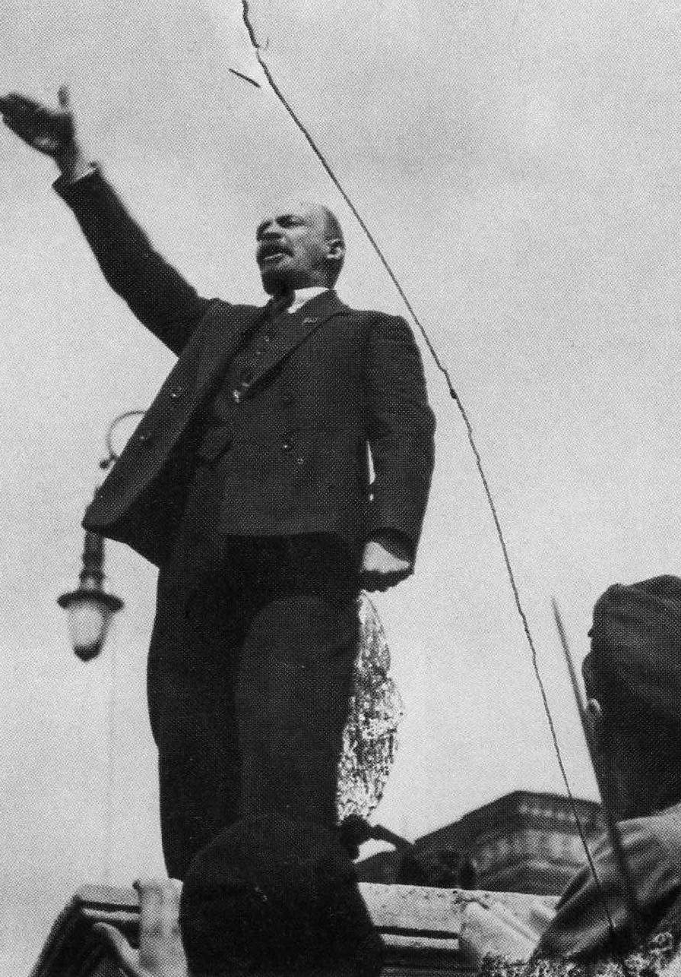
Lenin and the First World War
Imperialist war for all participating states
True socialists must not support the war effort of their country
Revolutionaries should transform the imperialist war into civil wars
World revolution beginning with the weakest imperialist state: Russia
In contrast to national movements: For them war means chance to secede and build an independent nation state

Slide 7
Two concepts: nationalism vs socialism
Two concepts: nationalism vs socialism
Socialism – revolution // Nationalism – nation state
Both strong appeal to masses: not clear which concept would prevail
Nationalists: everything will be better in nation state, all problems today are the result of imperial/foreign oppression
Principle of national self-determination
Socialists: everything will be better after socialist revolution, no need for nationalism as everyone is equal (nationalism is used by capitalists/bourgeoisie to deceive workers and peasants). Before and immediately after revolution: need to neutralize nationalism,
Lenin: recognizes right of national self-determination (but limited by interests of revolution)

Slide 8
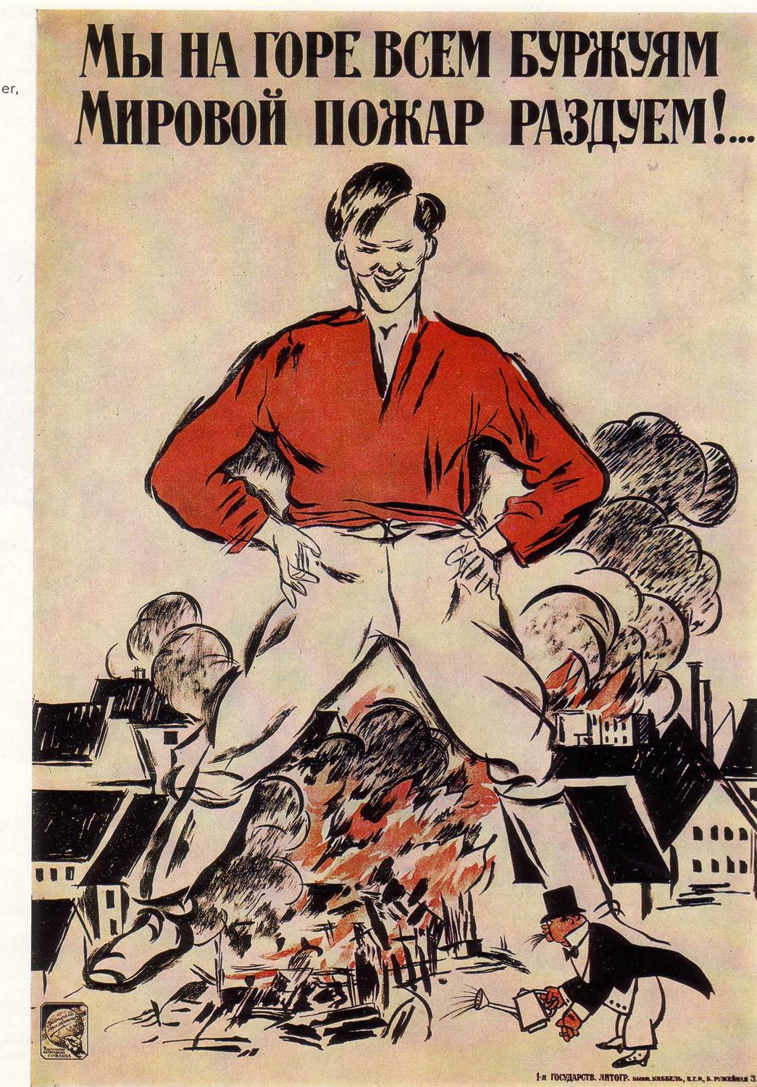
Peace, Land, Bread, Workers’ control
26 October 1917 (8 November 1917)
Decree on Peace: without annexations or indemnities
Decree on Land: peasants are allowed to divide up land
Decree on Workers’ Control: running of factories by elected workers’ committees

Slide 9
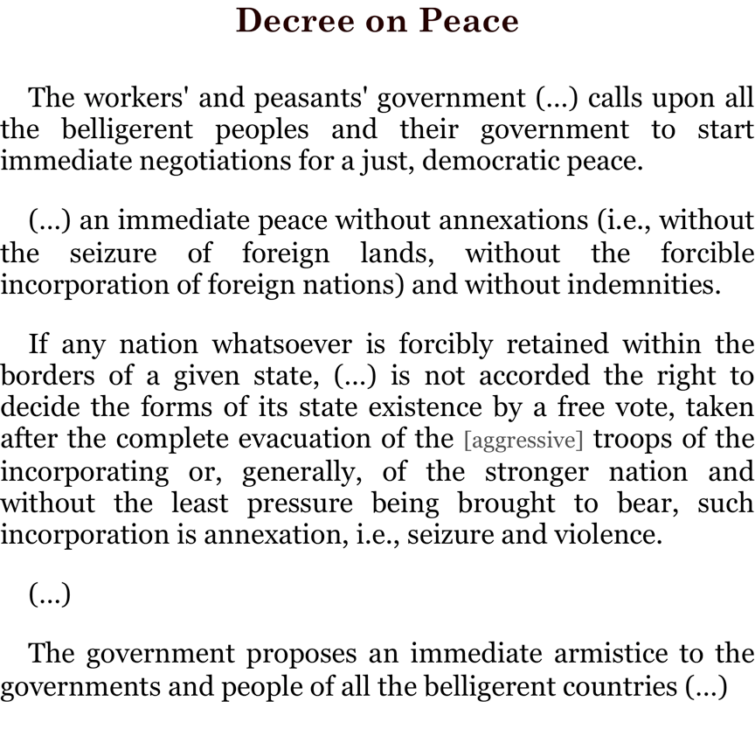
What we demand in this war, therefore, is nothing peculiar to ourselves. It is that the world be made fit and safe to live in; and particularly that it be made safe for every peace-loving nation which, like our own, wishes to live its own life, determine its own institutions, be assured of justice and fair dealing by the other peoples of the world as against force and selfish aggression.
XIII. An independent Polish state should be erected which should include the territories inhabited by indisputably Polish populations, which should be assured a free and secure access to the sea, and whose political and economic independence and territorial integrity should be guaranteed by international covenant.
Decree of the new Soviet Russian Government
8 November 1917
8 January, 1918 President Woodrow Wilson's Fourteen Points (Delivered in Joint Session of the Congress, January 8, 1918)

Slide 10
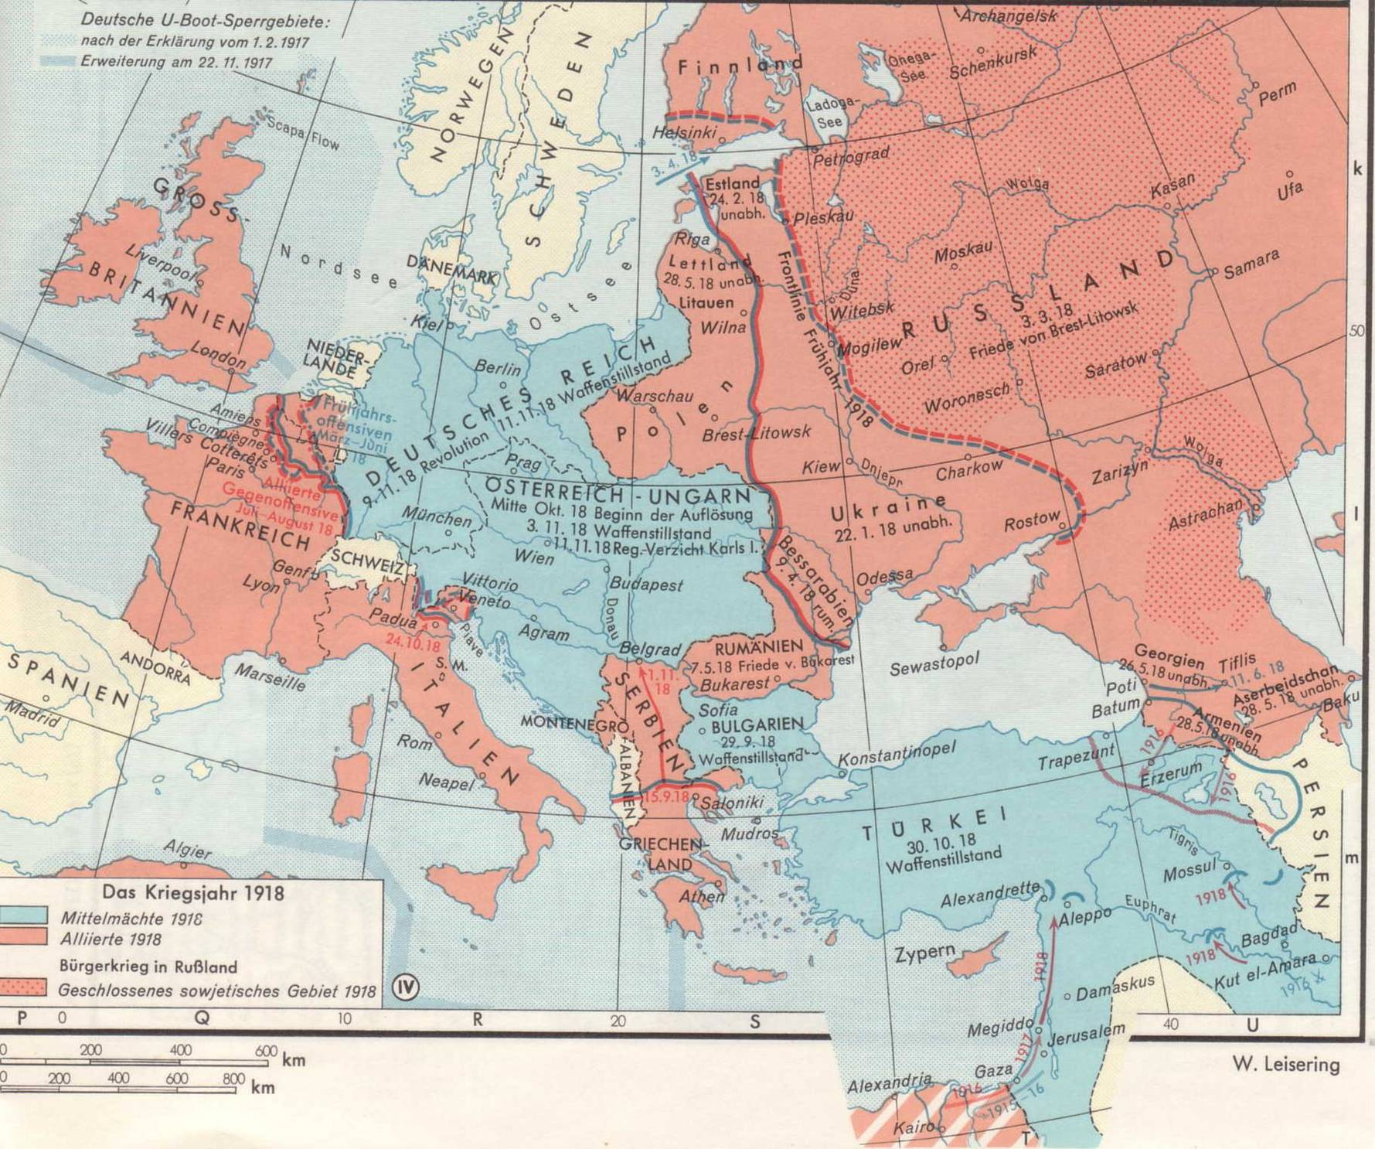

Slide 11
Central and Eastern Ukraine
March 1917 February Revolution in Petrograd: Formation of Provisional Government and Councils of Workers and Soldiers
March 1917 Formation of a Central Rada (Council) in Kyjiv/Kiev
June 1917: 1st Universal of Central Rada: Autonomy in a reformed, federal Russia
3 July 1917: 2nd Universal: Central Rada claims to represent all inhabitants of nine Ukrainian provinces
7/8 November 1917: October Revolution in Petrograd, Revolutionary government
22 November 1917: 3rd Universal: Central Rada proclaims Ukrainian People’s Republic (UNR) – but federated with Russia
22 December 1917 – Begin of peace negotiations between Central Powers and Soviet Russia in Brest-Litovsk
22/25 January 1918: Central Rada: Proclamation of independence of UNR
9 February 1918: Peace Treaty between UNR and Central Powers
3 March 1918: Peace Treaty between Soviet Russia and Central Powers
April 1918: Central Powers support Hetman Pavlo Skoropads’kyj, begin of Hetmanate
11 November 1918: Armistice on Western Front
13/14 November 1918: Directorate – re-establishing UNR

Slide 12
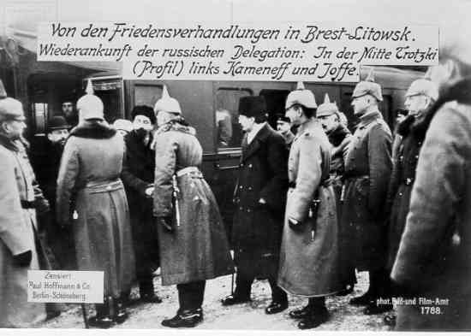
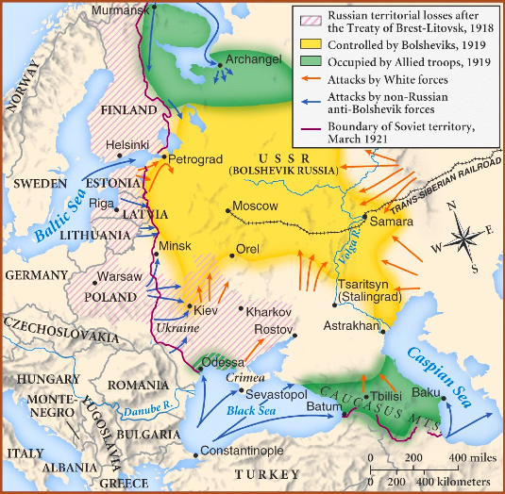
Brest-Litovsk, February 1918

Slide 13
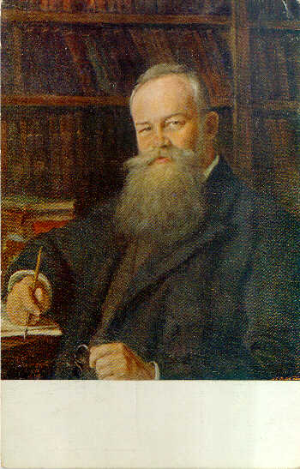
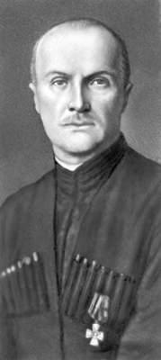
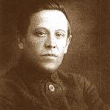
Symon Petliura
1879-1926
Mykhailo Hrushevsky
1866-1934
Pavlo Skoropadsky
1873-1945

Slide 14
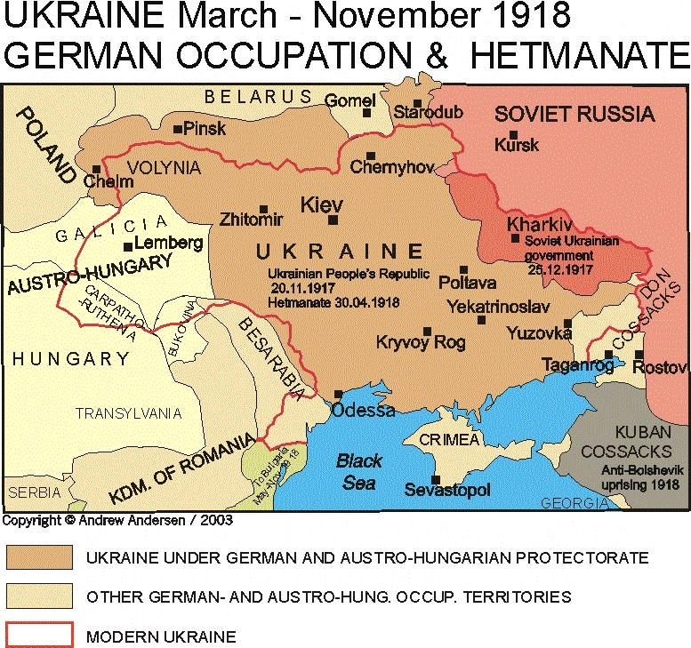

Slide 15
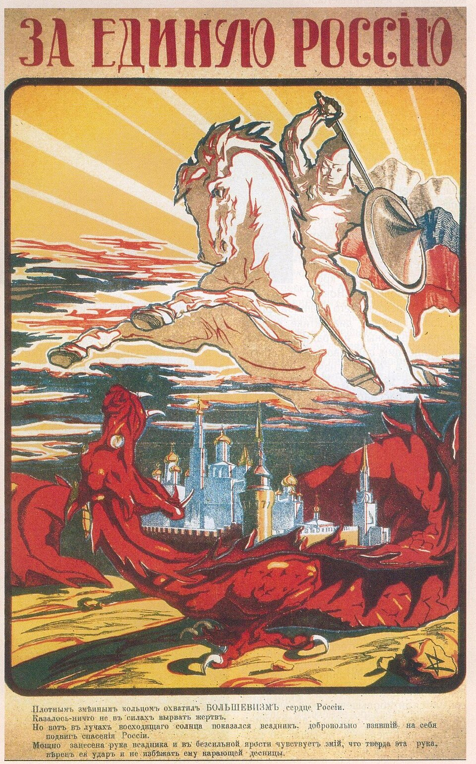
Impact of nationalities question
Ukrainian politicians: autonomy in a Russian federation, after Bolshevik Revolution – independence
Czechoslovak legion: major factor in Russian Civil War
White Armies: one and undivided Russia
Soviet Russia: national self determination (but subordinated to interest of revolution)
‘For the United Russia’ (White propaganda poster, 1919)

Slide 16
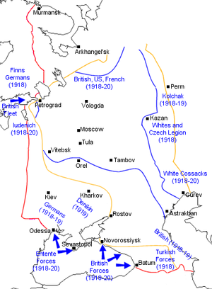
Many Wars
Whites vs. Reds
War on separate fronts surrounding Central Russia:
Denikin and Wrangel in the South
Kolchak in the East
Yudenich in the West
Whites vs. Whites
Greens (Makhno, Grigoriev and others) vs. Everyone
Russo-Polish War
Czech Legion
National Armies (Ukraine)

Slide 17
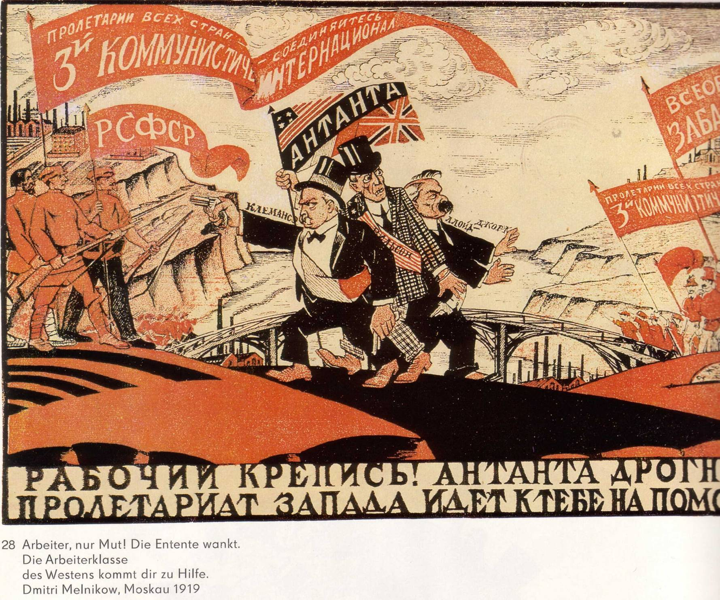

Slide 18
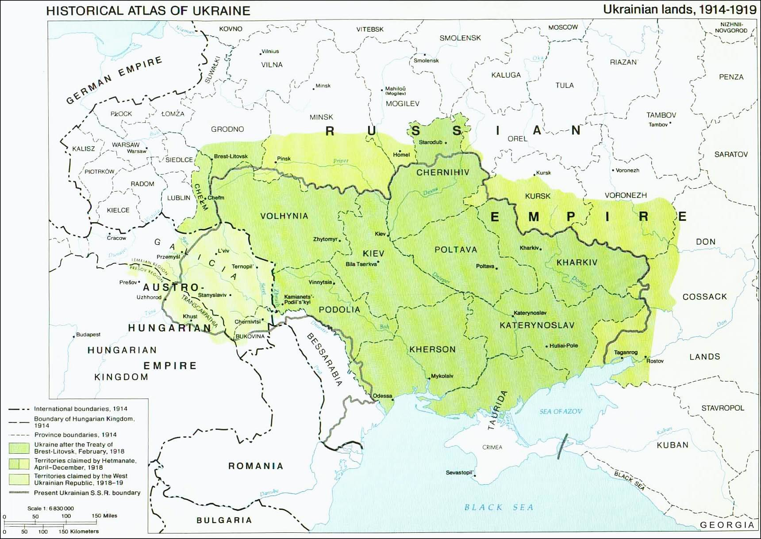

Slide 19
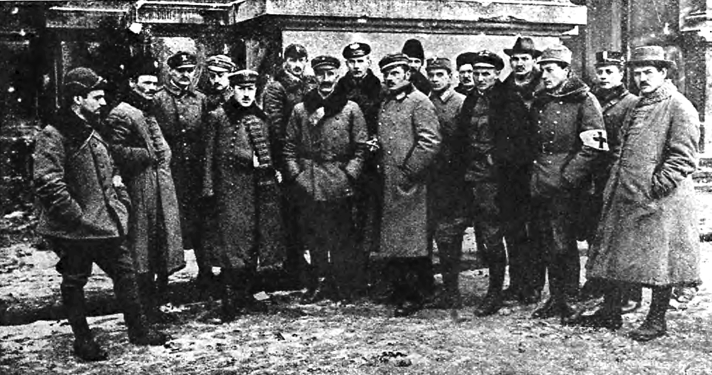
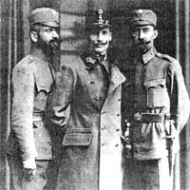
Hnat Stefaniv and two officers
Polish Supreme Command Lviv, November 1918

Slide 20
Map from Andrew Andersen, Centre for Military and Strategic Studies, University of Calgary

Slide 21
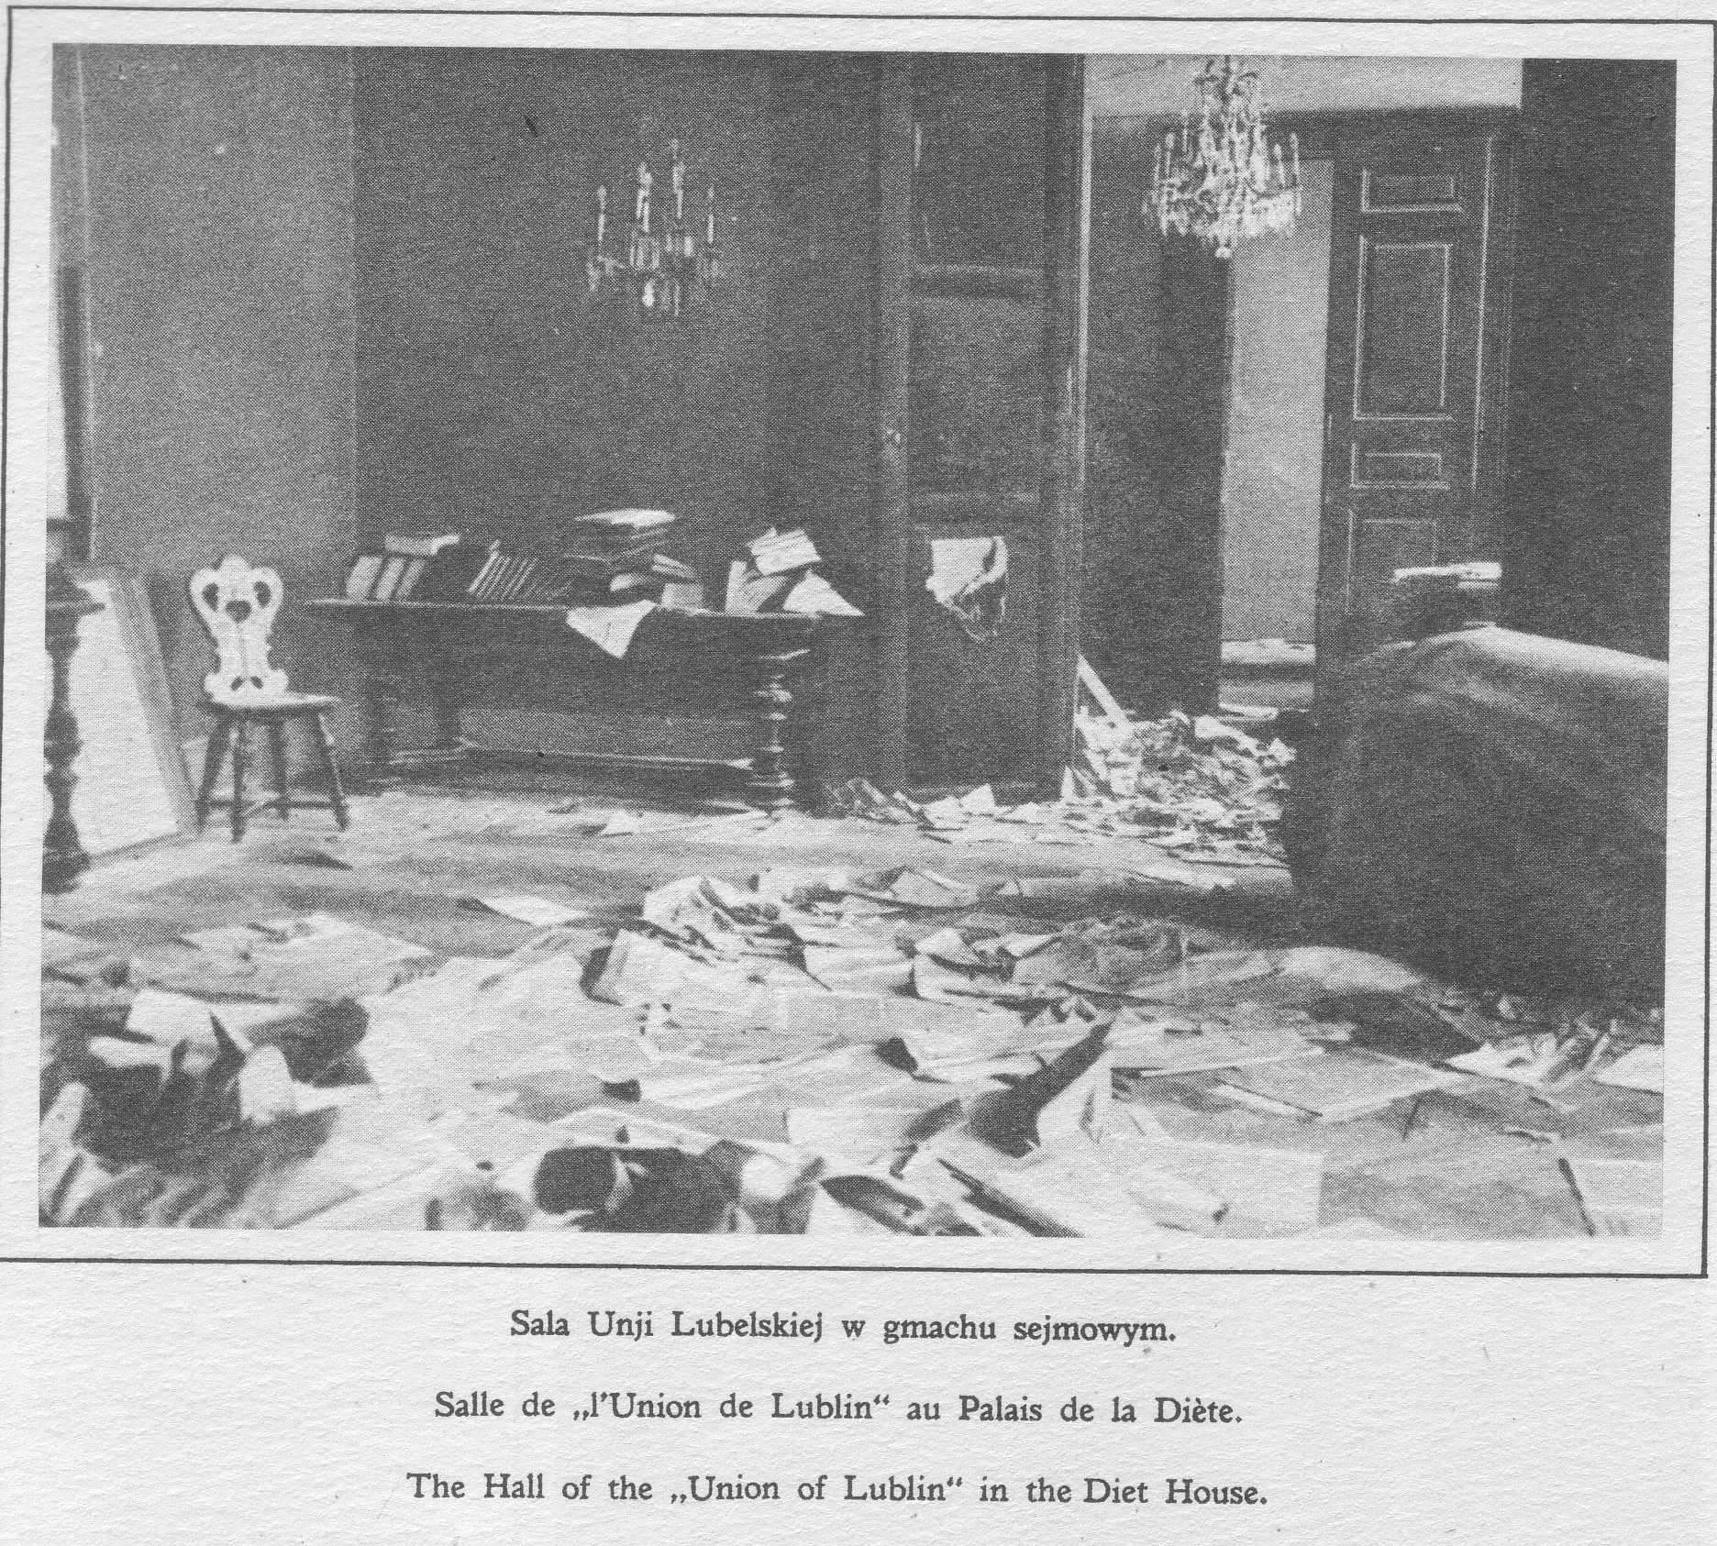
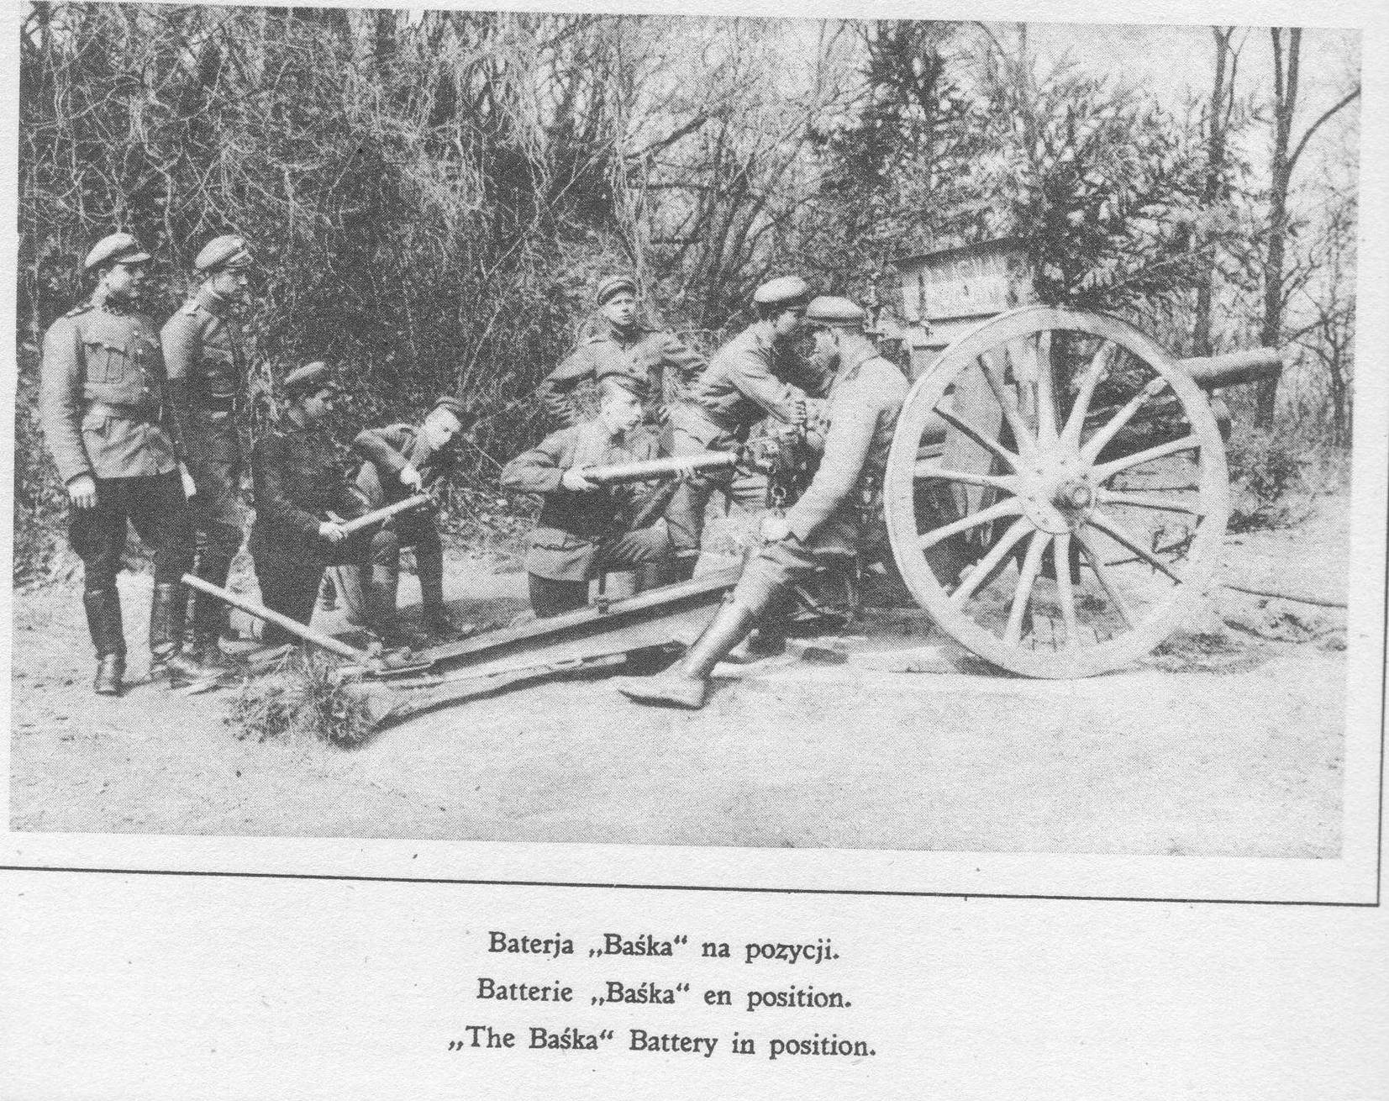
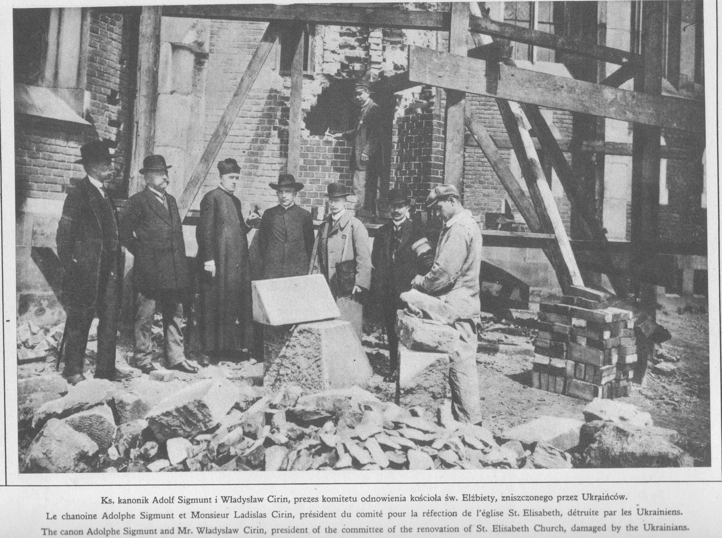
Polish-Ukrainian War 1918/19

Slide 22
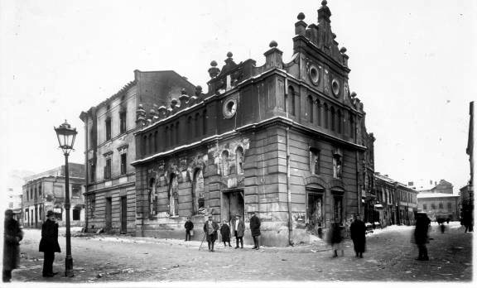
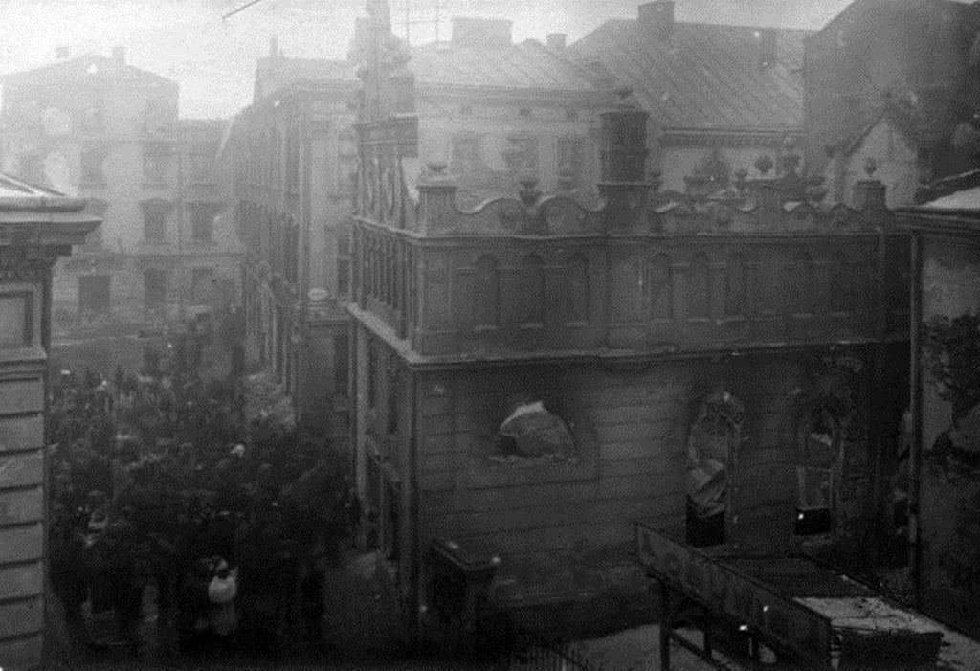
The Lwów pogrom, 22 – 24 November 1918

Slide 23
Polish-Ukrainian War
Reasons for Polish victory
Better organisation
Fresh units from Western Front (Haller Army)
No major other fronts
Numerical inferiority of Poles in East Galicia compensated by full support of rest of other parts of Poland
Support of Entente
High national mobilisation
Reasons for Ukrainian defeat
No effective support from Russian Ukraine (battlefield of Russian civil war)
Main enemy of Eastern Ukraine: Russia/Soviet Russia
Main enemy of Western Ukraine: Poland
Failure to win support of Entente

Slide 24
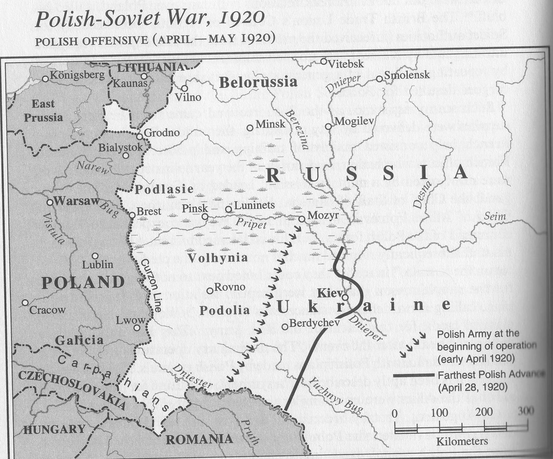

Slide 25
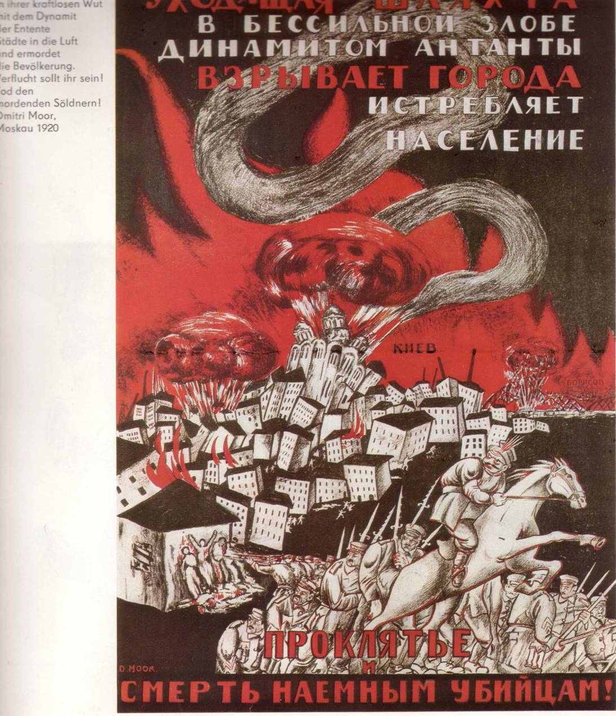
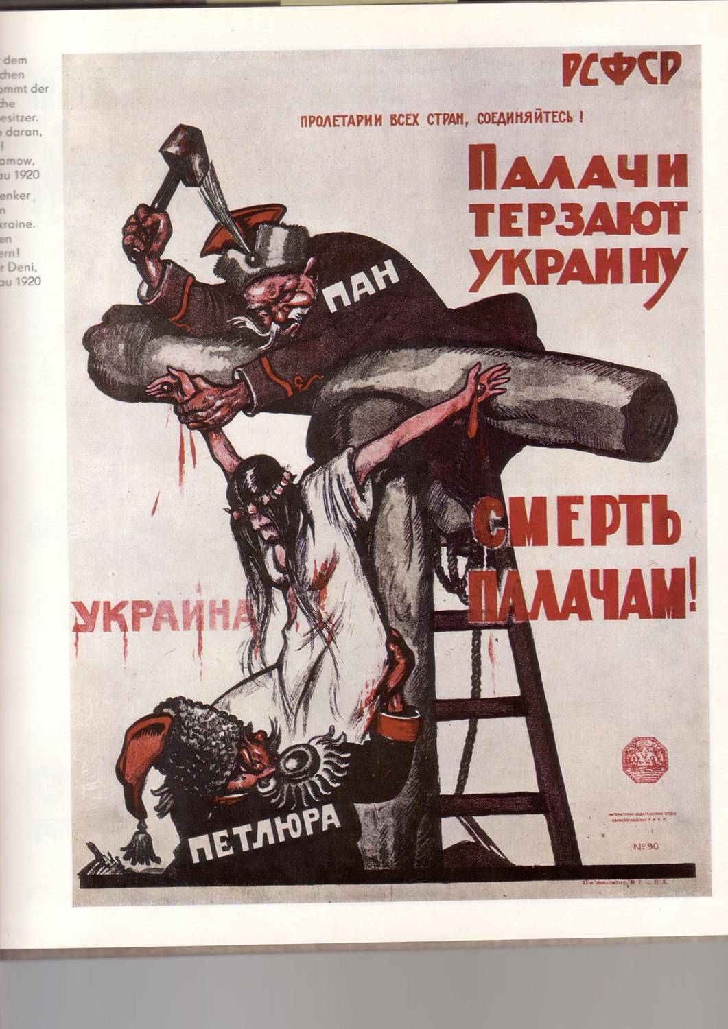
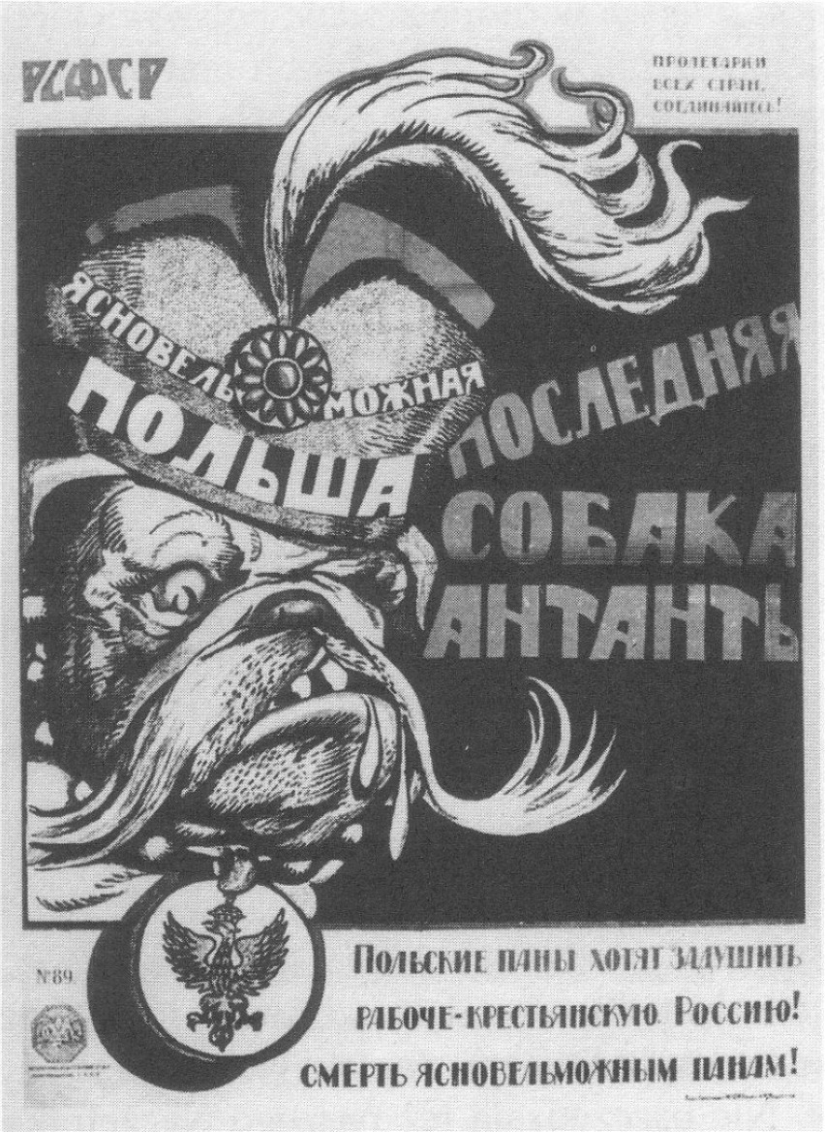
Bolshevik propaganda posters, Soviet-Polish war

Slide 26
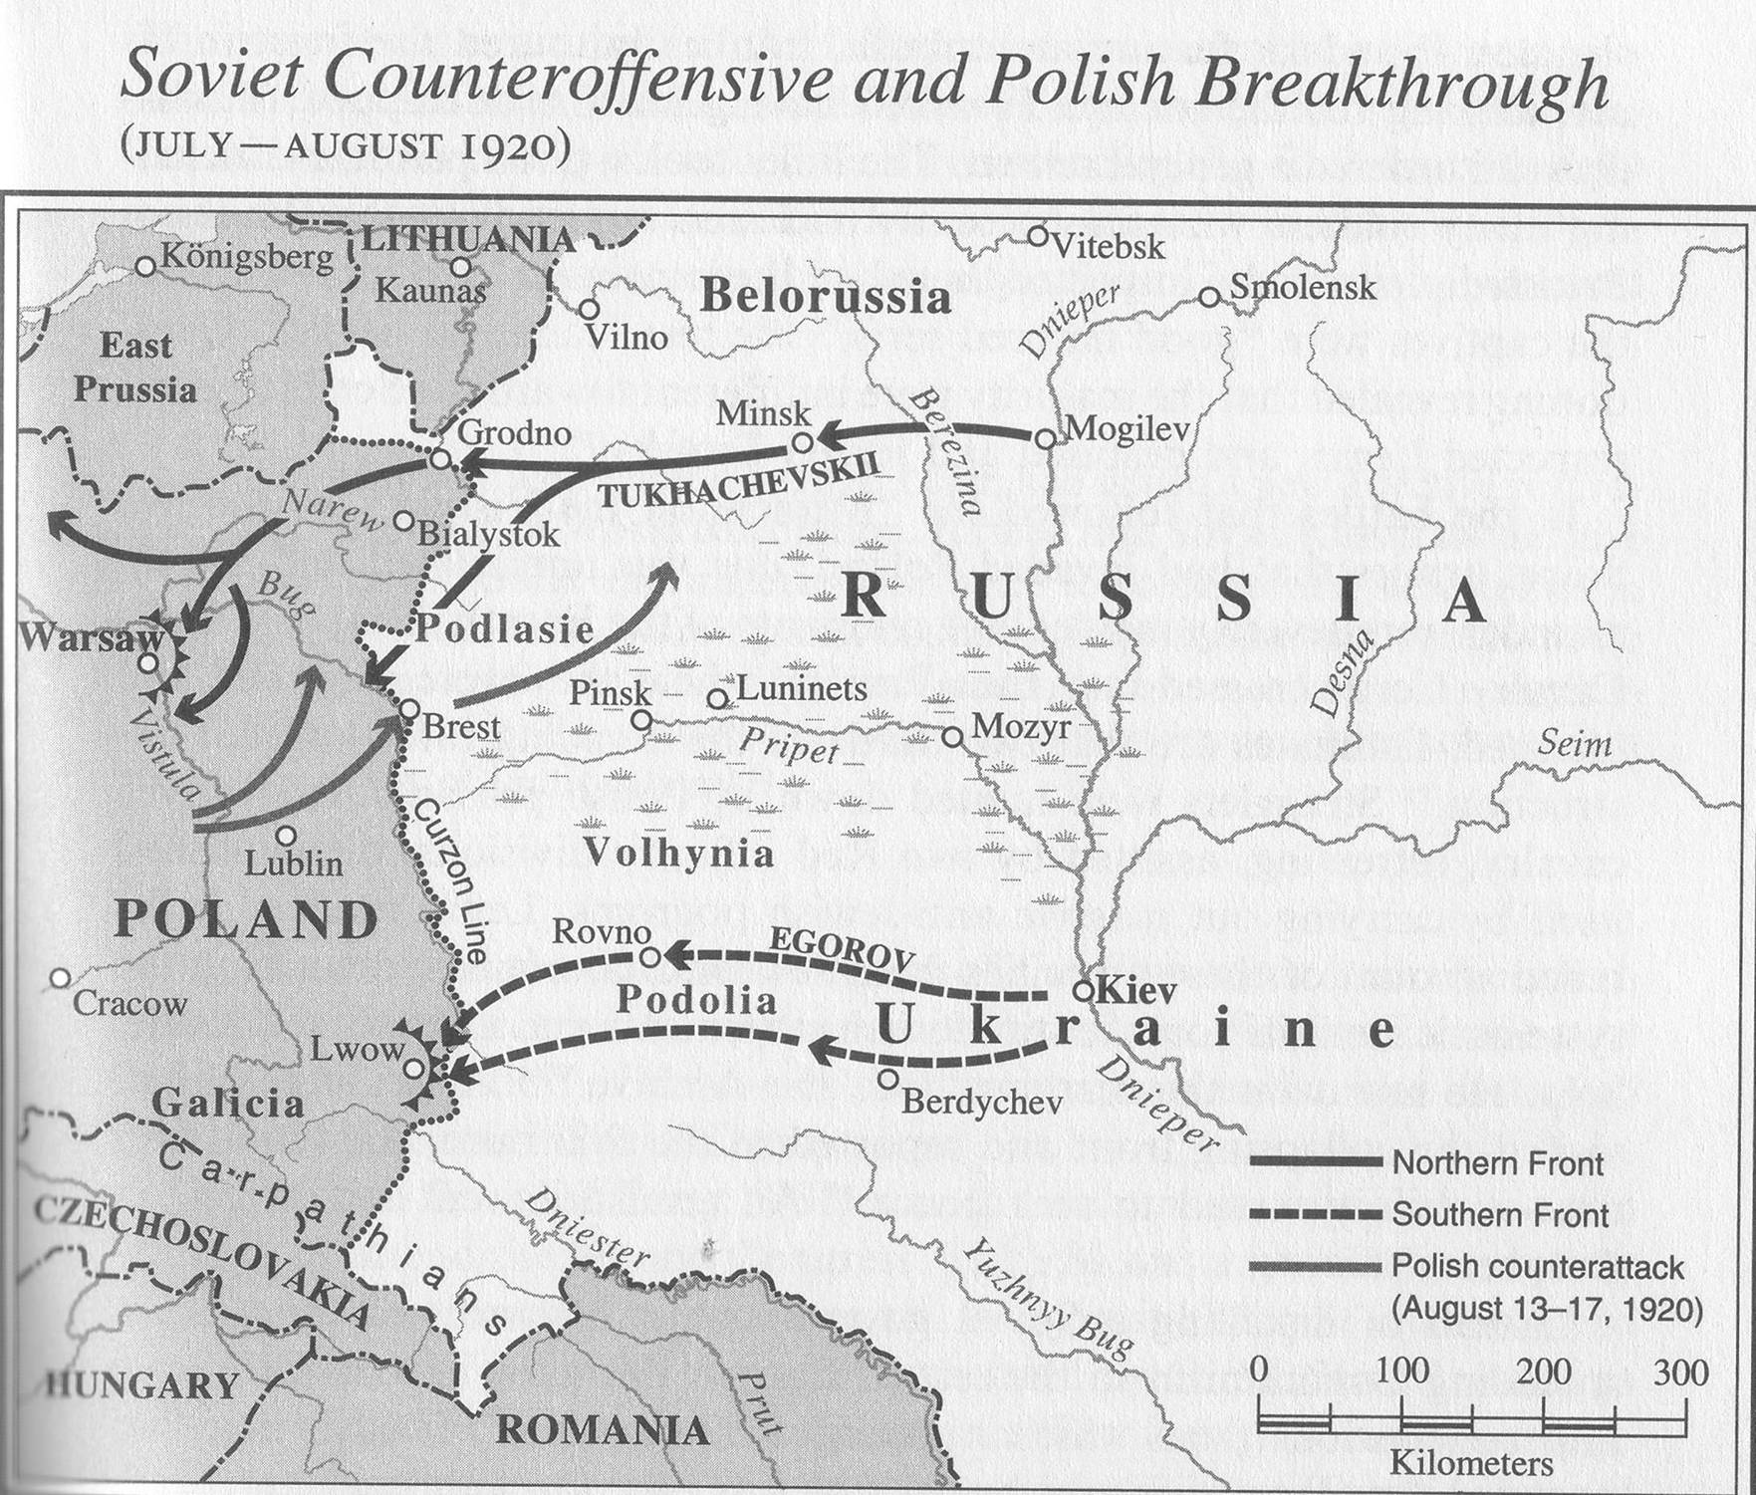

Slide 27
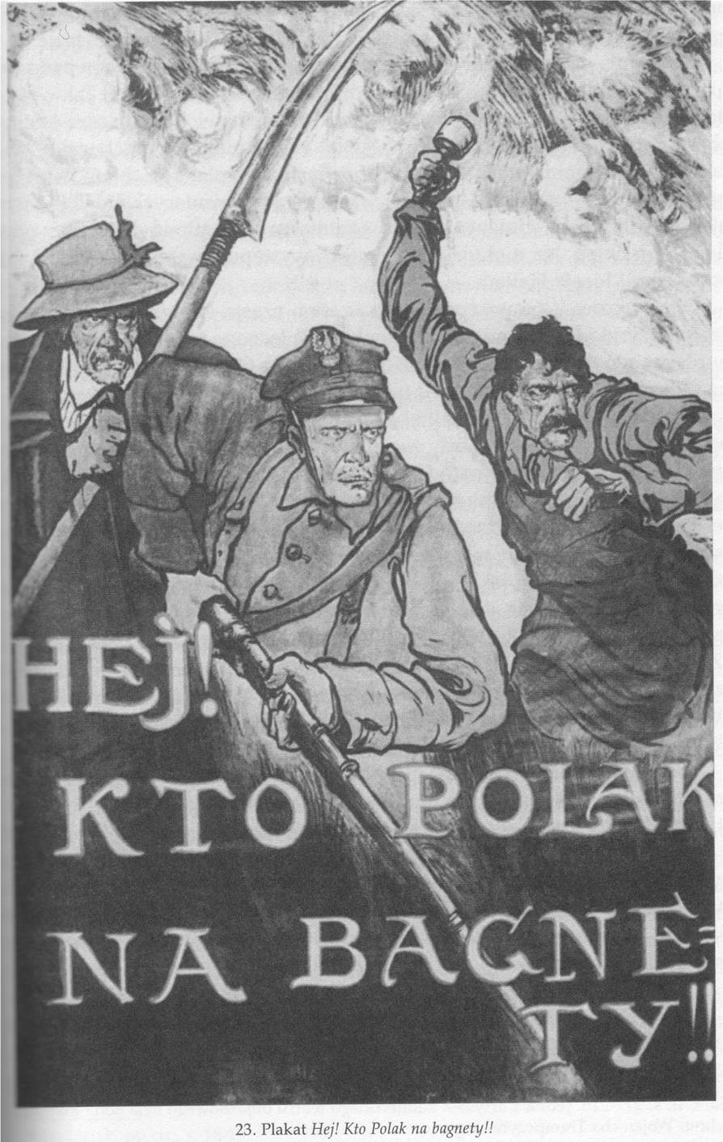
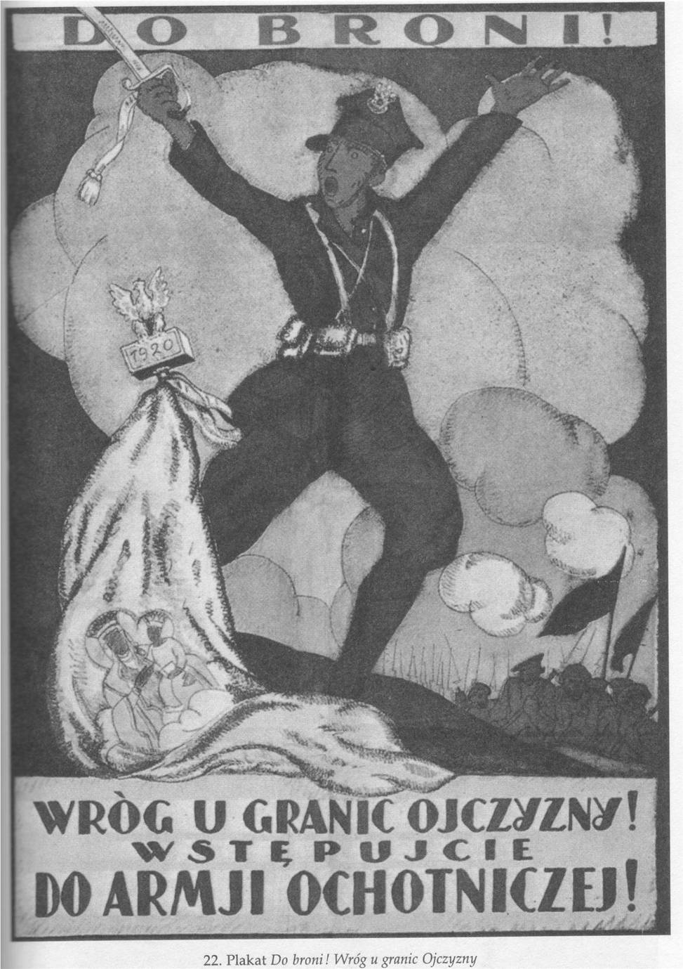
Polish propaganda posters Soviet-Polish war

Slide 28
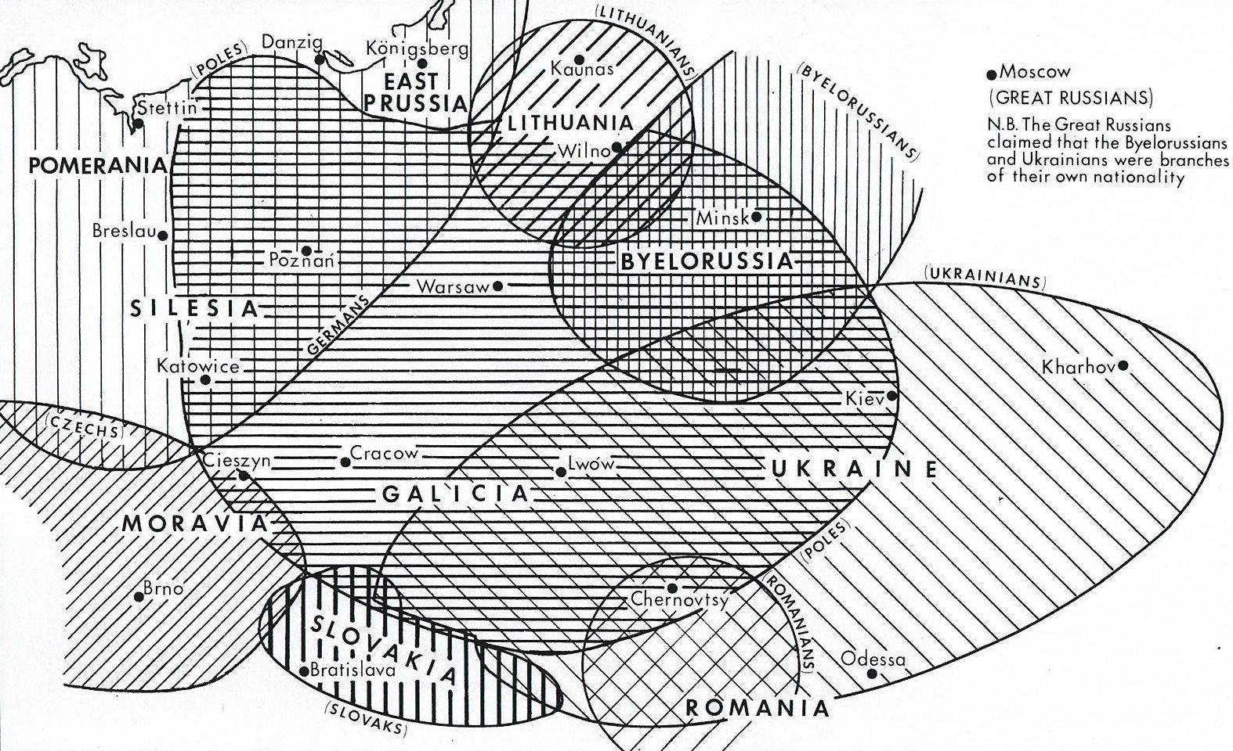
Territorial claims after the First World War (from Davies: God’s Playground...)

Slide 29
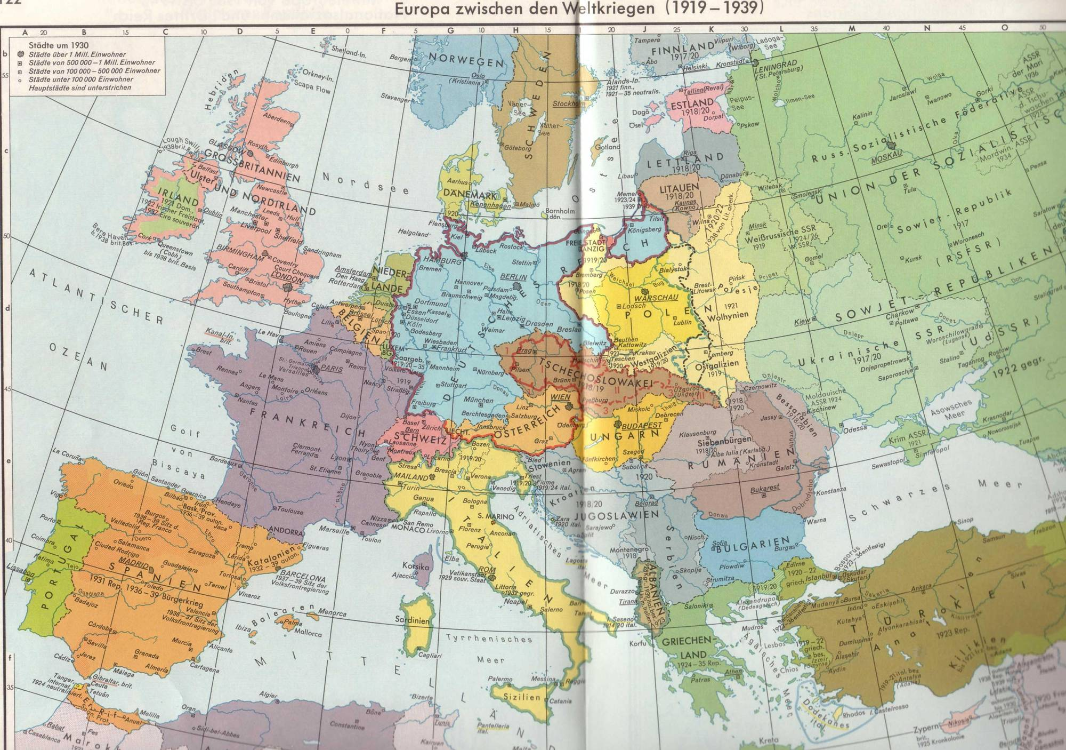
Putzger, Historischer Weltatlas, pp. 122-123

Slide 30
Eastern Europe after the Great War
Multinational states or federations with problematic legitimacy: Yugoslavia, Czechoslovakia
New nation states: Lithuania, Estonia, Latvia
Profiteers of Versailles: nation states with nationalist ideologies and considerable national minorities: Poland, Romania
Defeated countries with reduced territory, but high degree of ethnic homogeneity, where part of the nation lives outside the borders of the nation state: Hungary, Bulgaria – revisionist
Loosers of the state building wars 1918-1921: Ukrainian, Belarusian nationalists – revisionist
Revolutionary (Soviet) Russia – revisionist

