Slide 1
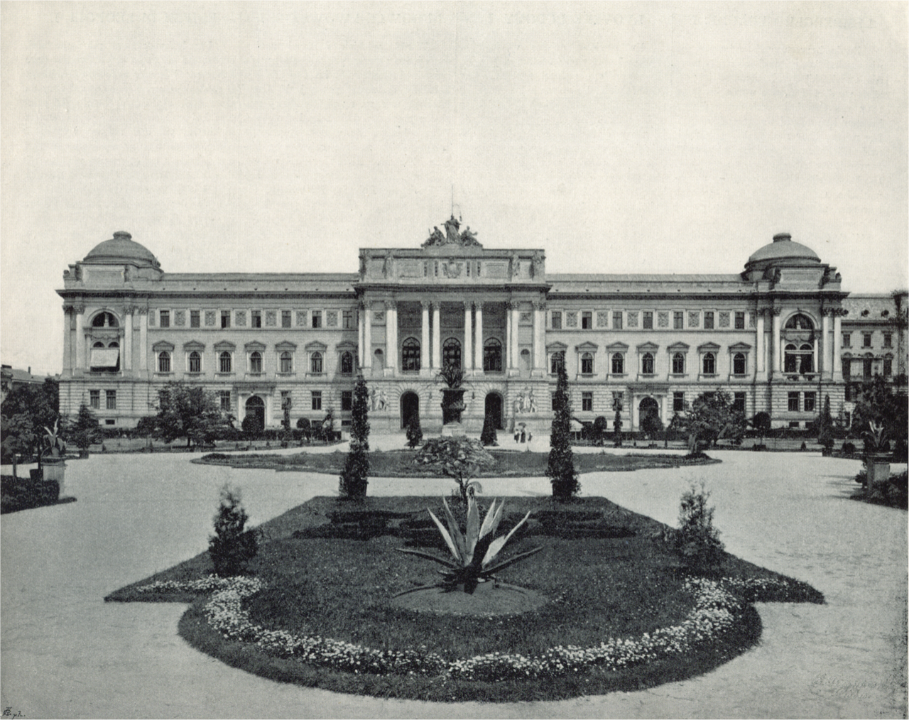
Entangled History: Ukraine and her neighbours from the Middle Ages to the present
Lecture 15
Ukrainians as a Minority in Eastern Europe
Diet of Galicia (Galician Sejm) till 1918, after that Jan Kazimierz University, today Lviv University

Slide 2
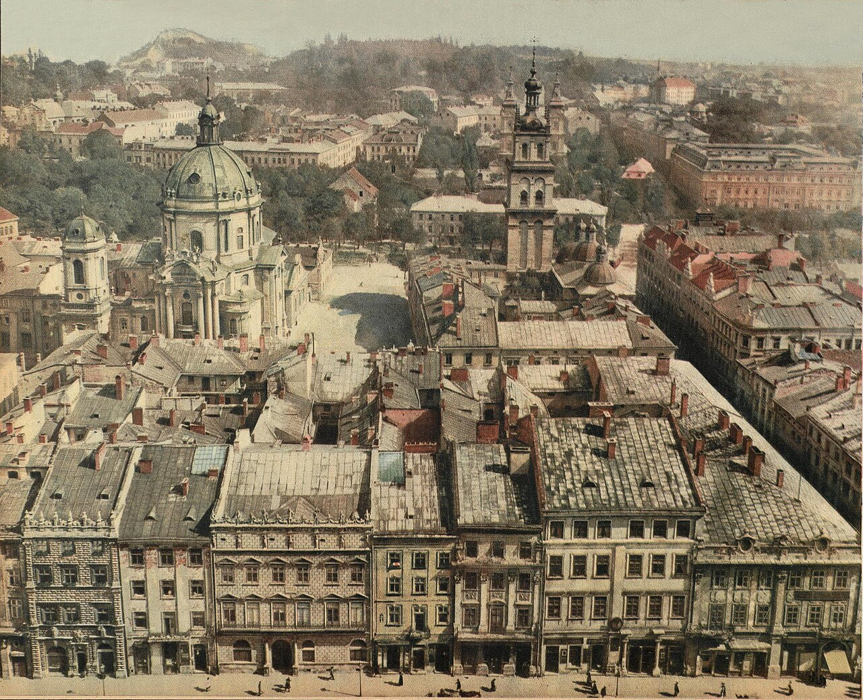
Outline
Geostrategical position
Domestic policy
Poland – a nation state?
Ukrainians in Poland
Ukrainians in Czechoslovakia
Ukrainians in Romania
Lwow/Lviv Panorama before 1924

Slide 3
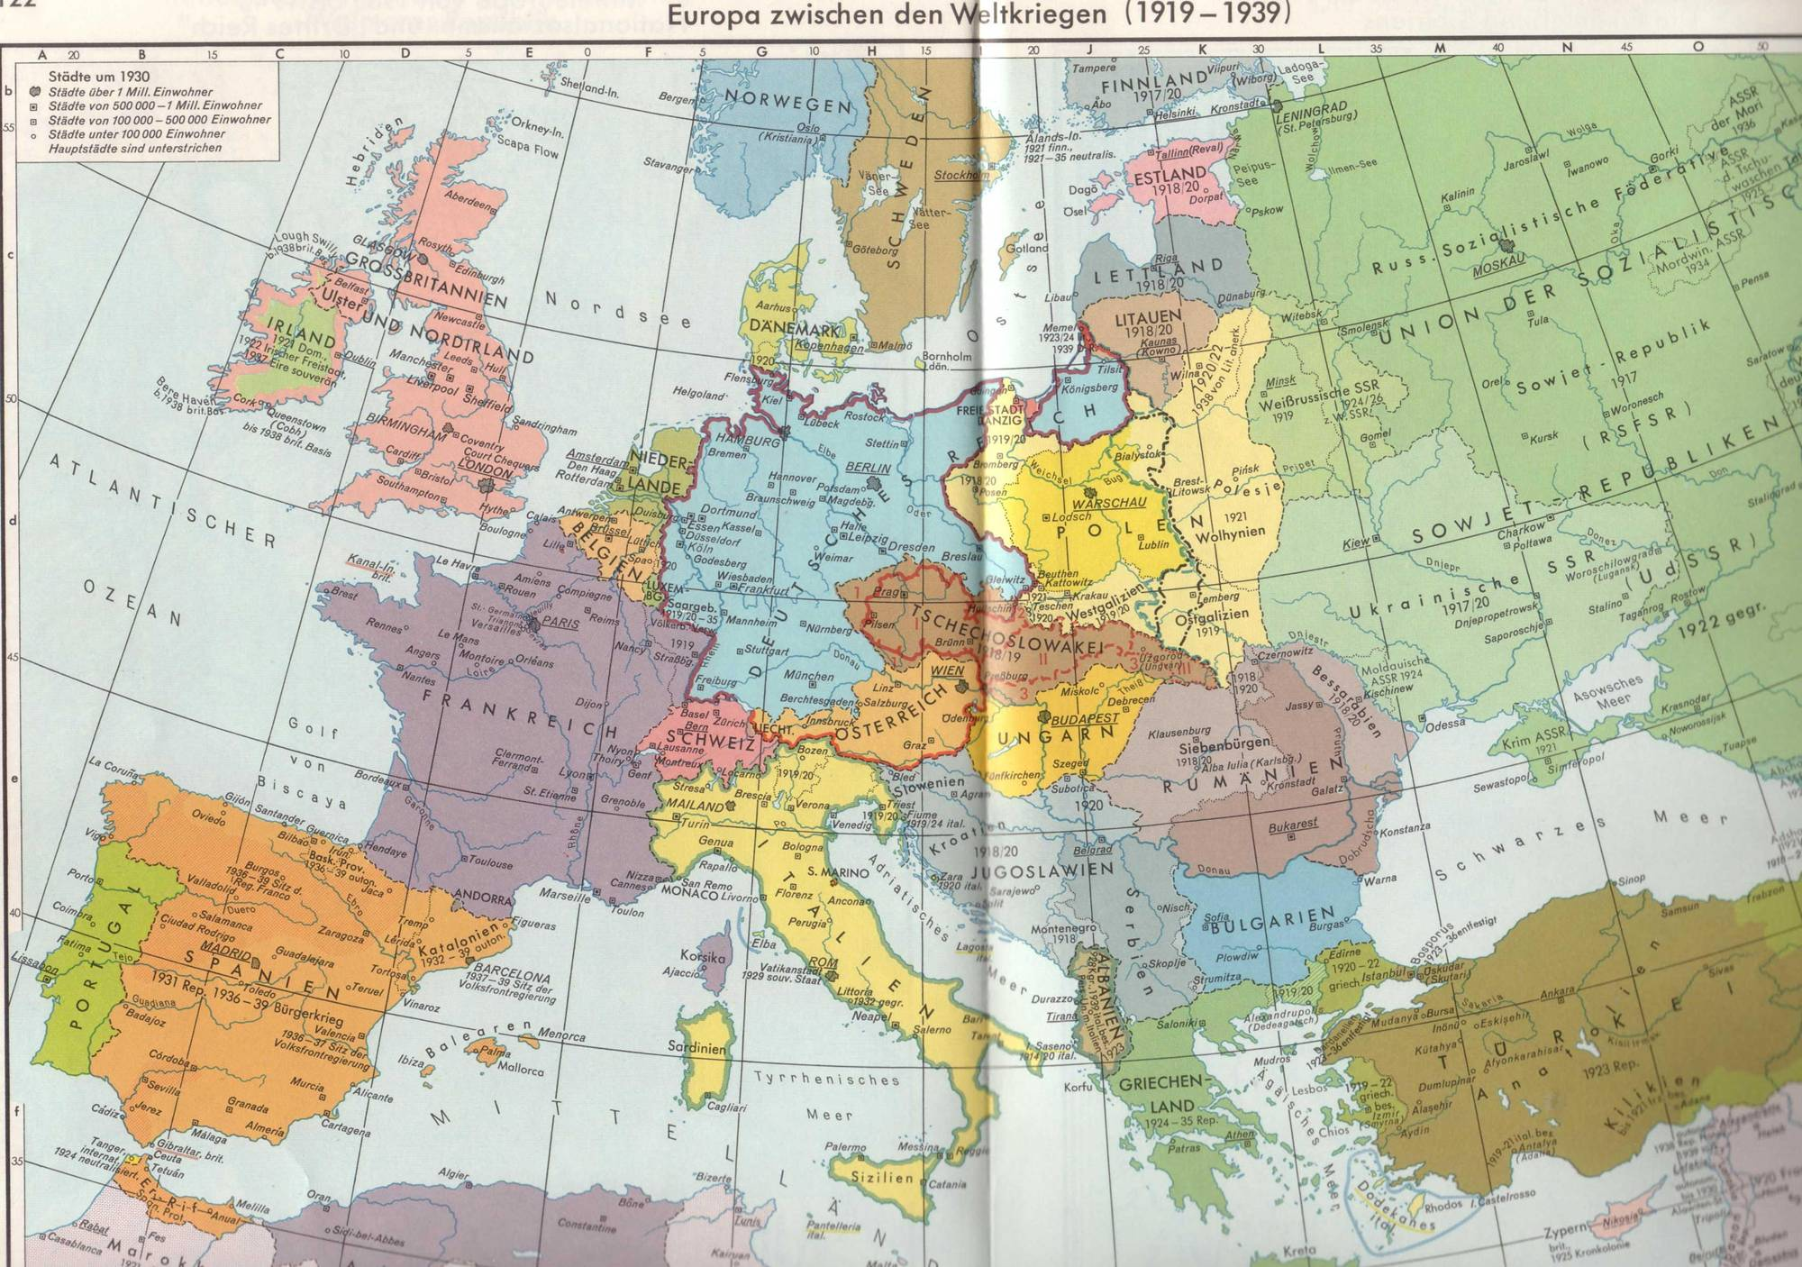

Slide 4
Second Polish Republic
398,000 sqkm with 27 Million people
Excluding 40% of territory of 1772 and 16 Million people
Including 35,000 sqkm and 3 Million people which had not been part of Poland in 1772
Dmowski in Paris: borders in West – ethnographical arguments
borders in East – historical arguments
Borders in West: result of Peace Treaties, Uprisings (Upper Silesia and Posen) and plebiscites (East Prussia, Upper Silesia)
Borders in East: Military power, followed by treaties with Eastern neighbours

Slide 5
Foreign Policy of Second Polish Republic – 1920s
Borders confirmed by Allies (in Treaty of Versailles 1919, but Eastern borders only in 1924) and Treaty of Riga, 18 March 1921 with Soviet Russia
Status quo power and member of the League of Nations
Poland has to sign Minority Treaty in June 1919, recognising rights of her minorities, pushed by Paris peacemakers
Territorial disputes with Germany (Posen/Poznań, West Prussia, Upper Silesia), Soviet Union (Western Ukraine and Western Belarus), Czechoslovakia (Teschen/Cieszyn), Lithuania (Wilna/Wilno/Vilnius)
Between two revisionist powers: Germany and Soviet Union
Allies are France (and Britain)
1925 Treaty of Locarno – Germany recognises western, but not eastern borders
1925-1932 Polish-German Trade War

Slide 6
Foreign Policy of Second Polish Republic – 1930s
1933 Hitler comes to power, Piłsudski thinks about preventive war
1934 Polish German Non-Aggression Treaty
1938 Munich Agreement between Britain, France, Italy, and Nazi Germany
2 October 1938 Polish Occupation of Teschen, following German annexation of Sudeten region
23 August 1939 German-Soviet Non-Agression Treaty ((Molotov-Ribbentrop Pact))
1 September 1939 German attack
17 September 1939 Soviet attack

Slide 7
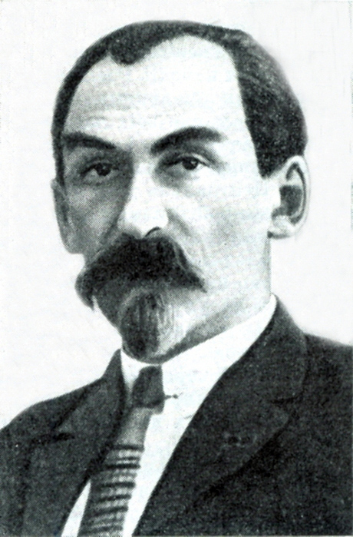
The Soviet Factor
Soviet Ukraine as a ‘Piedmont’ for all Ukrainians outside of the Soviet Union (Mykola Skrypnyk – the main advocate)
Blending social and national liberation in Ukrainian-inhabited contested borderlands of Poland, Romania, and Czechoslovakia
Exploiting national sentiments of local Ukrainians, pushing the argument of their ‘oppression’ by the governing regimes
Communist parties face persecution (Czechoslovakia – exception) – creation of legal worker and peasant-oriented parties
But: Holodomor and changes in Soviet nationality policies undermine the appeal

Slide 8
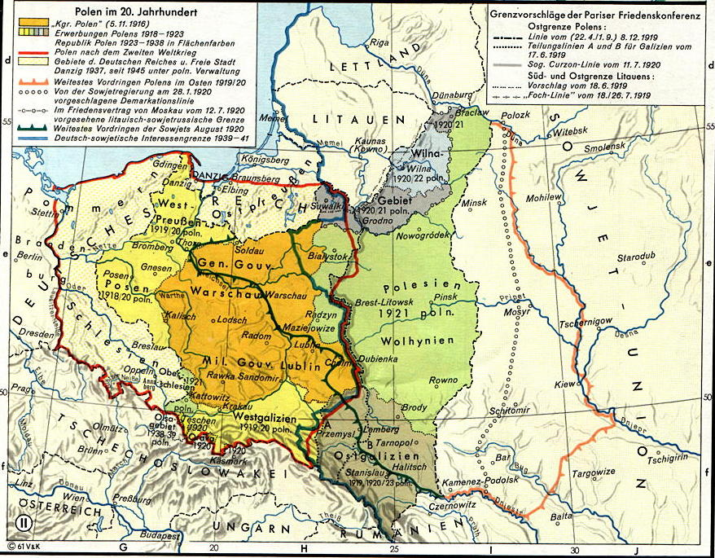
Poland in the 20th century (source: Putzger)

Slide 9
Domestic Policy
Destruction in First World War, Polish-Soviet War and Polish-Ukrainian War
Three different judicial and administrative systems
Previously, infrastructure and communication had to serve imperial interests (for example railway system: Railway Lwów – Vienna, Poznań – Berlin, Warsaw-Moscow, but not Poznań-Lwów-Warsaw)
Different mentalities after 123 years partition; Uneven development: Poland A (West) and Poland B (East)
Hyperinflation 1922/23 until new currency ‘złoty’ was introduced
Political divisions: 1921 – 1926 Poland parliamentary democracy but no party has majority. First elected president Narutowicz murdered by a national democrat
Bloc of Minorities in Sejm (Parliament): Integration of minorities and growing antisemitism
Widespread dissatisfaction with new Polish state
1926 Coup of Piłsudski: Sanacja (sanitation) regime, authoritarian
After 1930 dictatorship: 1935-1939 (after Piłsudski’s death: regime of the colonels)
Economic crisis 1930 ff

Slide 10
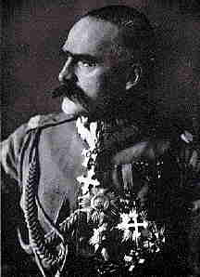
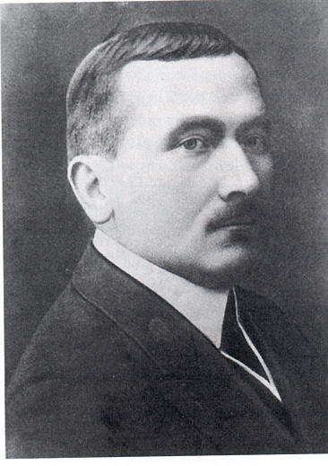
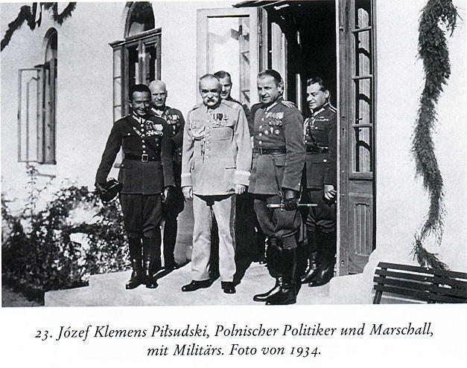
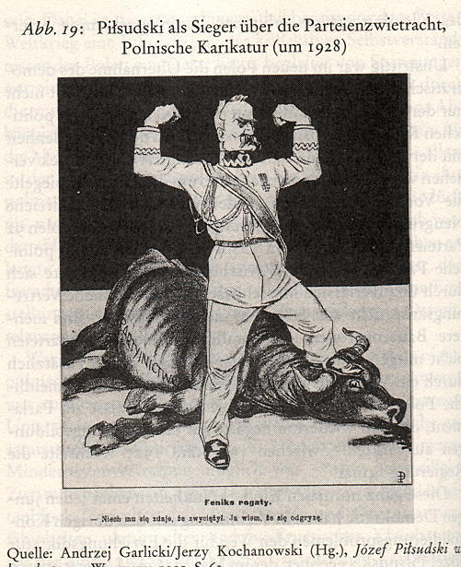
Józef Piłsudski
Roman Dmowski
Piłsudski with officers 1934

Slide 11
Poland – a nation-state?
Population by first language Based on Census 1931 | Population by faith
Total: 31,915,779 Polish: 21,993,444 Ukrainian: 3,221,975 Ruthenian: 1,219,647 Belarusian: 989,852 Russian: 138,713 Czech: 38,097 Lithuanian: 83,116 German: 740,992 Yiddish: 2,489,034 Hebrew: 243,539 Local: 707,088 Other: 11,119 Not Declared: 39,163 | Total: 31,915,779 Roman Catholic: 20,670,051 Greek Catholic: 3,336,164 Orthodox: 3,762,484 Protestant Lutheran: 424,216 Protestant Reformed: 33,295 Protestant Unite: 269,531 Protestant (gen.): 108,216 Other Christian: 145,418 Judaism: 3,113,933 Other non-Christian: 6,750 Non-believers: 6,058 Not Declared: 39,663

Slide 12
Census in Poland 1931 by nationality (estimate based on first language as an indicator of national identification)
Poles 21,993,000 68.9%
Ukrainians 4,442,000 13.9%
Jews 2,733,000 8.6%
Belarusians 990,000 3.1%
Germans 741,000 2.3%
Tutejszi 707,000 2.2%
Other 271,000 1.0%

Slide 13
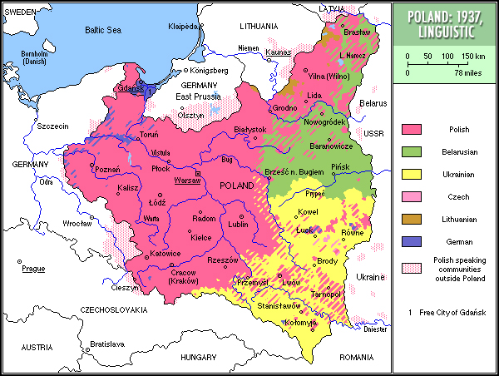

Slide 14
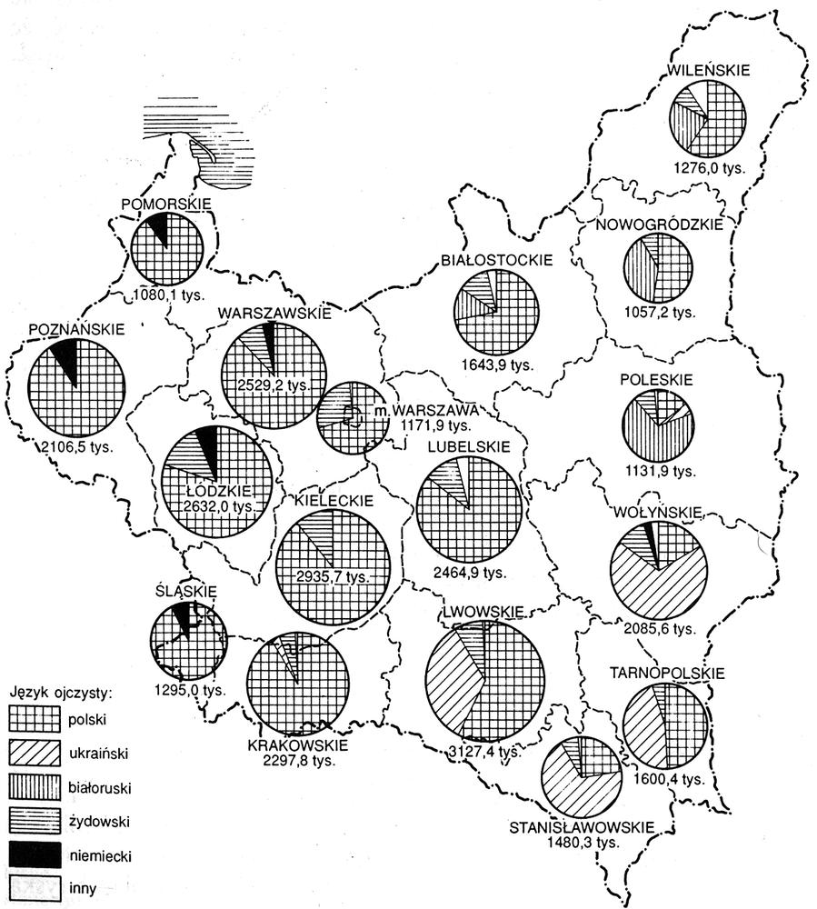
Share of languages in Polish provinces, 1931

Slide 15
Response of Ukrainians in Poland to failed state-building
Radical nationalists
Boycott of elections in Poland
Secret military organisations (UVO – Ukrainian Military Organisation)
Terrorist attacks and assassination attempts
Foundation of the Organisation of Ukrainian Nationalists (OUN, 1929)
Integral nationalism: Dmytro Dontsov
Moderates
Participation in elections
Political cooperation with other national minorities
‘Organic work’: cooperative movement
Limited cooperation with Polish authorities
Most important party: Ukrainian National-Democratic Alliance (UNDO)
But there are also a Western Ukrainian Communist Party, a Christian People’s Party, a Social-Democratic Party

Slide 16
Polish Nationality Policy in 1920s
Towards Ruthenians (Ukrainians): assimilation
Towards Jews: exclusion (National Democrats) or assimilation (Pilsudski, Socialists)
Strengthening of the Polish element in the kresy (Eastern borderlands) – Polish settlers
Preferential treatment of ethnic Poles
Closing of Ukrainian schools or transformation into bilingual schools
Polonisation of universities and public space
In Volhynia more flexible than in East Galicia

Slide 17
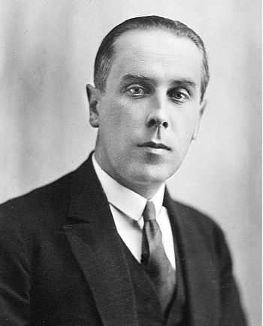
Henryk Józewski
(1892 - 1981)

Slide 18
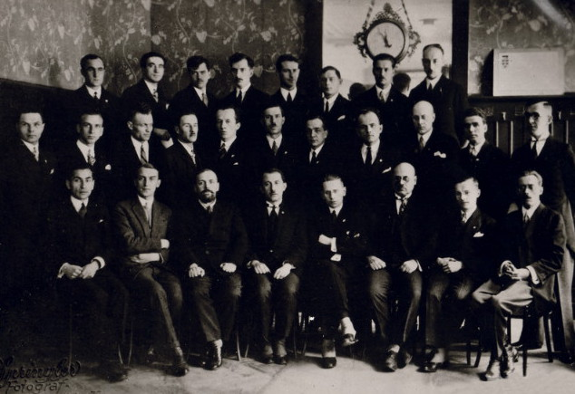
Founding congress of the Organisation of Ukrainian Nationalists, 1929 in Vienna

Slide 19
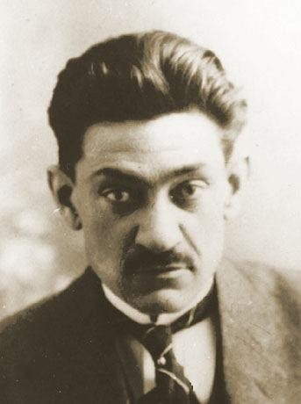
Integral nationalism
Ethnically homogenous independent Ukrainian state
Criticises Ukrainian state builders 1918-21 and their democratic principles
Not reckless enough
The end justifies the means
All is justified for achieving Ukrainian independence
Dmytro Dontsov (1883-1973)

Slide 20
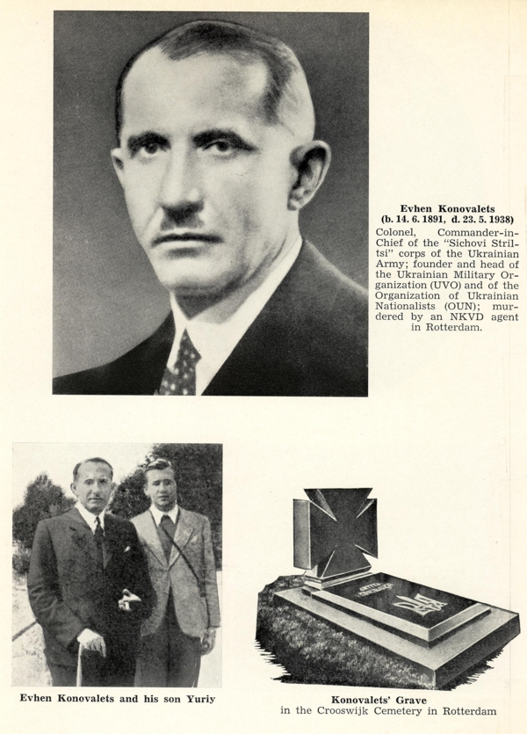
Evhen Konovalets (b. 14.6.1891, d. 23.5.1938) — Colonel, Commander-in-Chief of the "Sichovi Striltsi" corps of the Ukrainian Army; founder and head of the Ukrainian Military Organization (UVO) and of the Organization of Ukrainian Nationalists (OUN); murdered by an NKVD agent
OUN – terrorist attacks
after 1933 connections to Nazi Germany

Slide 21
Policy of the Polish government in the 1930s
‘Carrot and stick’
‘Pacification’ of Ukrainian villages in reaction to terrorist attacks 1930/31, 1938/39
Polish military settlers in kresy (eastern borderlands)
Efforts to win over moderate Ukrainians
Suppression of any resistance
Growing anti-Semitism

Slide 22
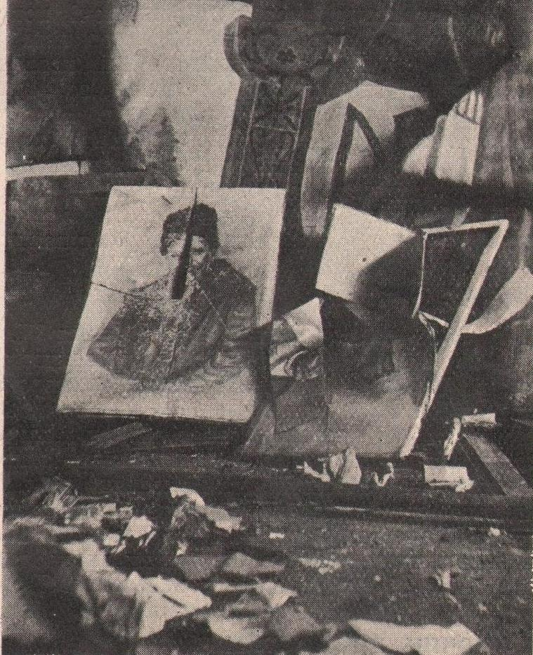
Pacifications 1930

Slide 23
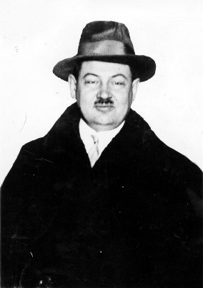
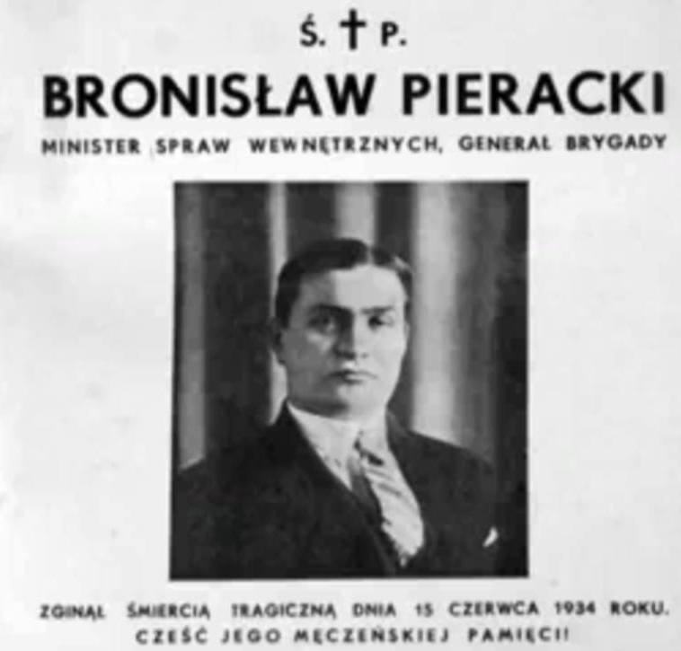
Tadeusz Holówko
(1889-1931)

Slide 24
Poles in Poland
Nation-building in their own nation-state.
Problem: Who belongs to the nation, and how to deal with ethnic minorities?
Ukrainians in Poland
Organic work or armed resistance, fight against assimilationist tendencies.
Political goals: autonomy in Poland – not a preferred option and getting increasingly unattractive – cooperation with Polish authorities for moderates necessary to protect and improve the lot of Ukrainians – for radical nationalists, everything is subordinated to the fight for an independent Ukrainian state ‘end justifies means‘
UNDO democratic and liberal – OUN for a one-party state – deeply influenced by fascism
United in the aim to achieve Ukrainian independence, including all ethnographically Ukrainian territories

Slide 25
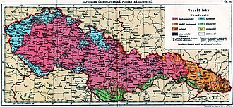
Ukrainians in Czechoslovakia
Czechoslovakia – liberal democracy not only in words
More or less free elections
Recognises ‘Rusyns’ (Ukrainians) as an important part of the state
Certain cultural freedom
Popularity of Communism among local Ukrainians
Ethnic map of Czechoslovakia in 1931 – Ukrainians/Rusyns/Ruthenians in orange

Slide 26
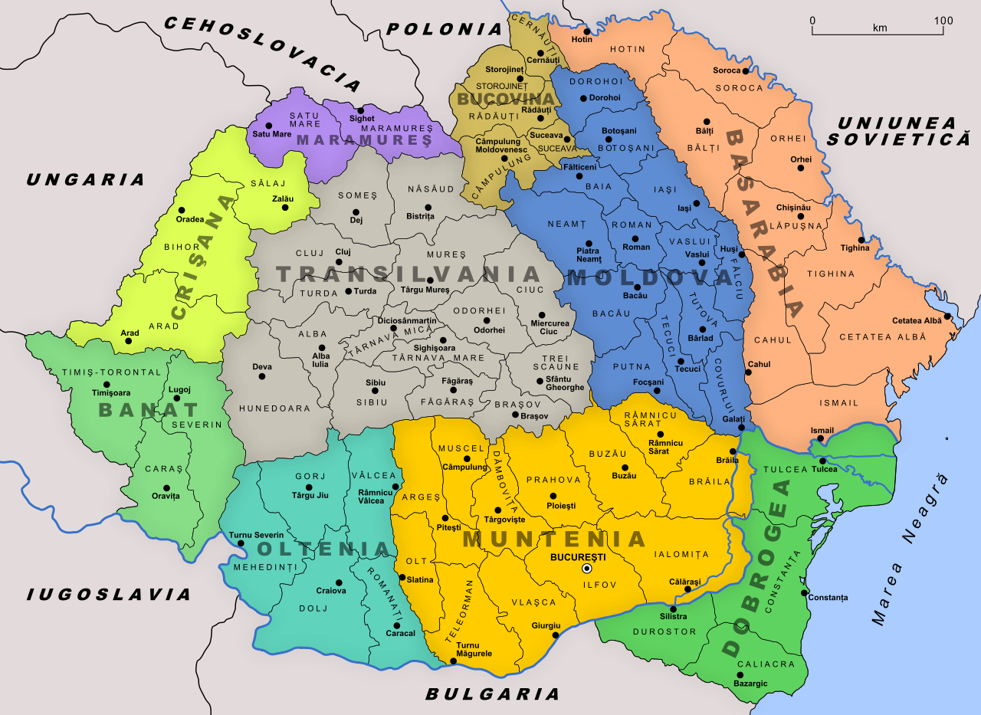
Ukrainians in Greater Romania
Ukrainians – majority in Northern Bukovina, Romanians in Southern Bukovina
Linguistic, cultural, and educational Romanianisation
Regional differences: Ukrainian education was preserved in Southern Bessarabia, but switched to Romanian in Bukovina
Ukrainians are treated as Romanians who lost their identity, which should be recovered
1930 census: approximately 600,000 Ukrainians in Romania
Administrative Map of Romania in 1930

Slide 27
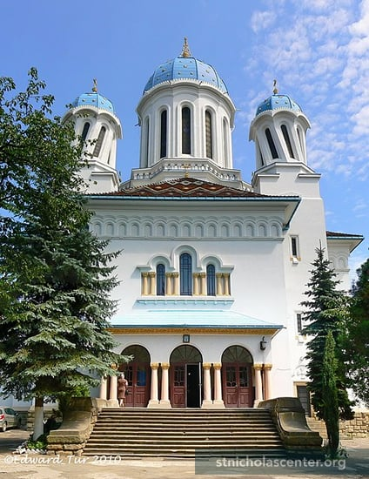
St. Nicholas Cathedral, ‘Drunken Church’, Chernivtsi/Cernauti
(built in the 1930s)
Photo: EdwardTur

