Slide 1
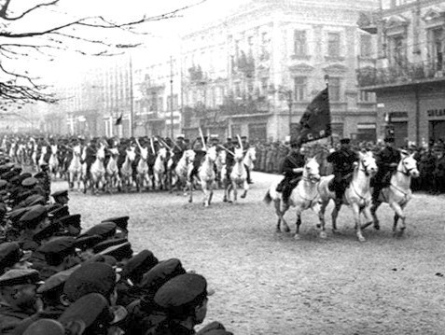
Entangled History: Ukraine and her neighbours from the Middle Ages to the present
Lecture 15
Bloodlands I: Soviet Rule
Soviet parade in Lviv, September 1939, after the city’s surrender

Slide 2
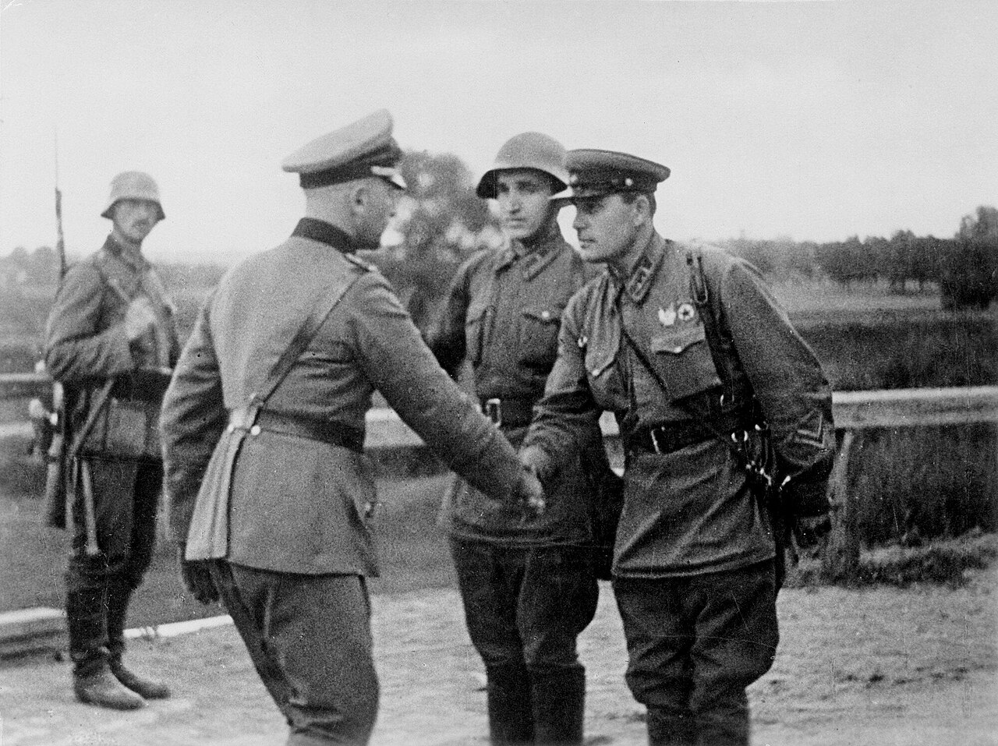
Outline
Introduction
Nazi-Soviet Pact
Soviet occupation policy 1939-1941
Ethnic relations
Conclusion
German and Soviet officers shaking hands on the demarcation line, following the invasion of Poland, September 1939

Slide 3
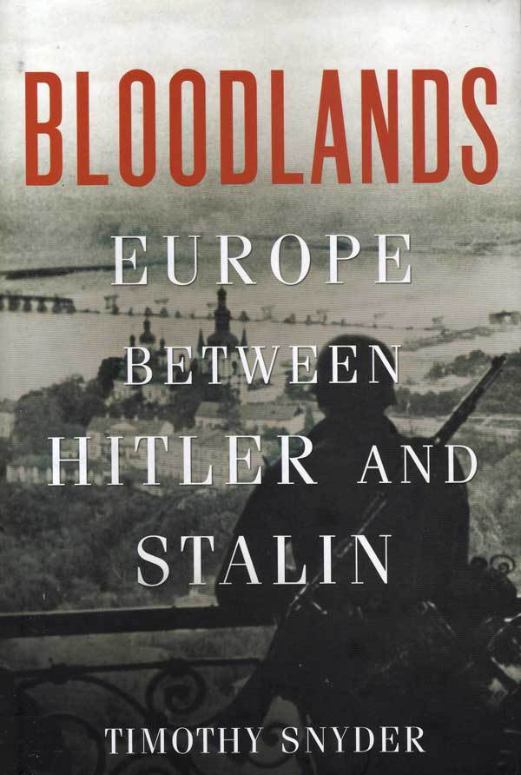
‘Bloodlands’ - region between Nazi Germany and the Soviet Union (Poland, Ukraine, Belarus, the Baltic states), where the two regimes’ policies overlapped and caused mass civilian deaths
Hitler’s and Stalin’s policies intersected, magnifying violence.
State‑Engineered Mass Killing – an era defined by deliberate state policies aimed at reshaping populations
Bloodlands as a space for radical social and demographic transformation.
Nazi–Soviet interactions intensified violence; each regime learned from, competed with, and exploited the other’s brutality
For Snyder, the difference between the regimes eventually gets blurred in the overwhelming story of violence and repression (some historians challenge that approach

Slide 4
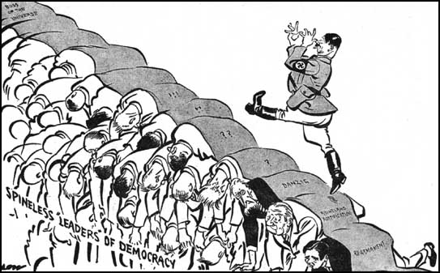
David Lowe, Evening Standard 8 July 1936

Slide 5
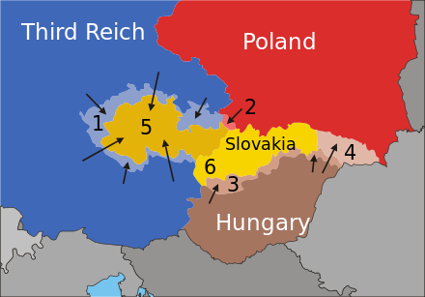
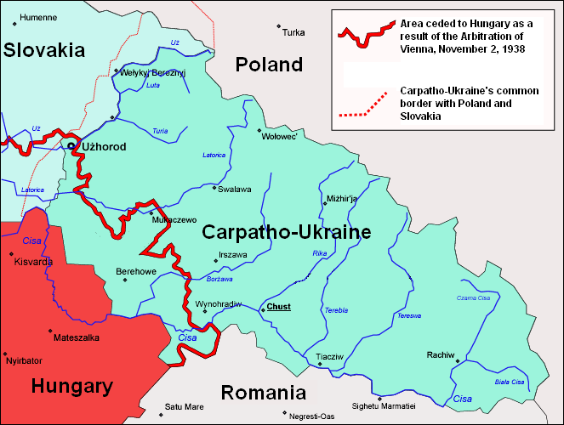
Run-up to the Second World War
1933, 30 January: Hitler becomes German Chancellor
1934: Polish-German treaty
1934: Admission of Soviet Union to League of Nations
1938, March: German invasion and annexation of Austria
1938, September: Munich Conference and Agreement
1938, October: Germany annexes Sudeten region - Poland takes Cieszyn
1939, 14 March: Slovakia independent
1939, 15 March: German occupation of remaining part of Czechia; Declaration of Independence of Carpatho-Ukraine
1939,18 March: Hungary invades Carpatho-Ukraine
1939, 23 March: Germany occupies Memel
1939: German overtures to Poland, British and French guarantees for Poland (March)
23 August 1939: German-Soviet non-agression treaty (Nazi-Soviet pact) with secret articles: Partition of Eastern Europe

Slide 6
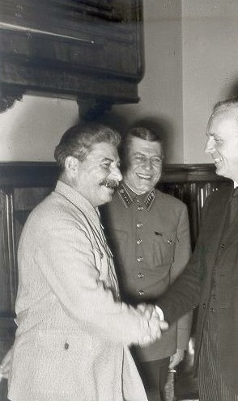
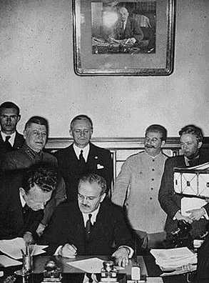
Nazi-Soviet pact, 23 August 1939
Molotov signs the German-Soviet non-aggression pact. Behind him are Ribbentrop and Stalin.

Slide 7
Text of the Nazi-Soviet Non-Aggression Pact
Article I. Both High Contracting Parties obligate themselves to desist from any act of violence, any aggressive action, and any attack on each other, either individually or jointly with other Powers.
Article II. Should one of the High Contracting Parties become the object of belligerent action by a third Power, the other High Contracting Party shall in no manner lend its support to this third Power…
Secret Additional Protocol.
Article I. In the event of a territorial and political rearrangement in the areas belonging to the Baltic States (Finland, Estonia, Latvia, Lithuania), the northern boundary of Lithuania shall represent the boundary of the spheres of influence of Germany and U.S.S.R. In this connection the interest of Lithuania in the Vilna area is recognized by each party.
Article II. In the event of a territorial and political rearrangement of the areas belonging to the Polish state, the spheres of influence of Germany and the U.S.S.R. shall be bounded approximately by the line of the rivers Narev, Vistula and San.
The question of whether the interests of both parties make desirable the maintenance of an independent Polish States and how such a state should be bounded can only be definitely determined in the course of further political developments.
In any event both Governments will resolve this question by means of a friendly agreement.
Article III. With regard to Southeastern Europe attention is called by the Soviet side to its interest in Bessarabia. The German side declares its complete political disinterestedness in these areas.
Article IV. This protocol shall be treated by both parties as strictly secret.
Moscow, August 23, 1939.
For the Government of the German Reich v. Ribbentrop
Plenipotentiary of the Government of the U.S.S.R. V. Molotov

Slide 8
Timeline 1939/40
23 August 1939: Nazi-Soviet pact
1 September 1939: German attack on Poland
17 September 1939: Soviet Army invades Eastern Poland (Western Ukraine, Western Belarus)
Justified as ‘social and national liberation’ of Ukrainian and Belarusian peasants from ‘yoke’ of Polish masters
Polish resistance, Jewish and Ukrainian population ambivalent, attacks of Ukrainian farmers on Polish (military) settlers, Arches in some villages to welcome Soviet troops – reports about attacks of Jewish communist youth on Polish soldiers
Soviet occupation and annexation of Bessarabia, Lithuania (including Vilnius), Estonia, Latvia

Slide 9
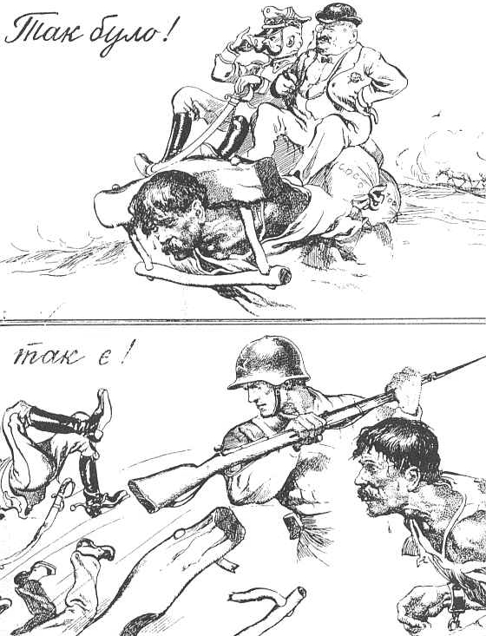
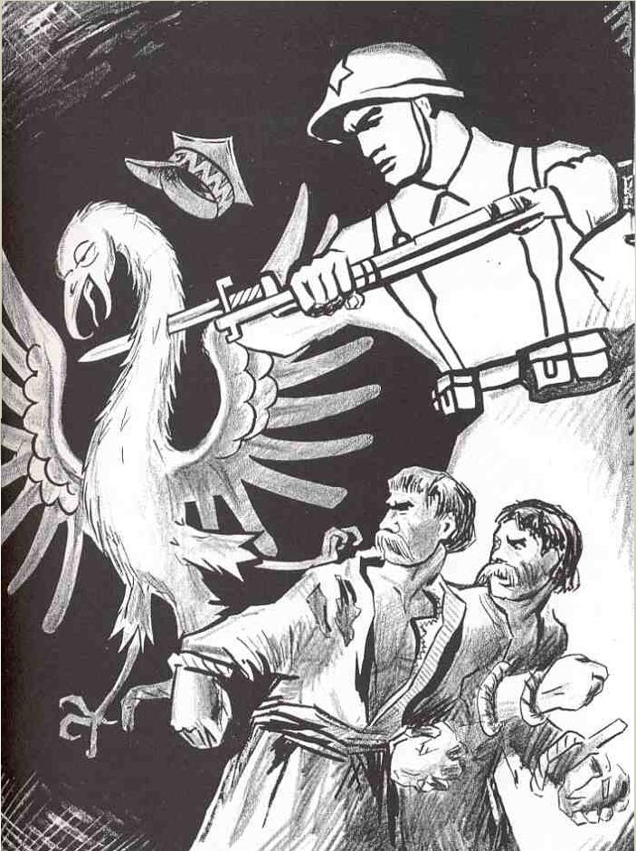
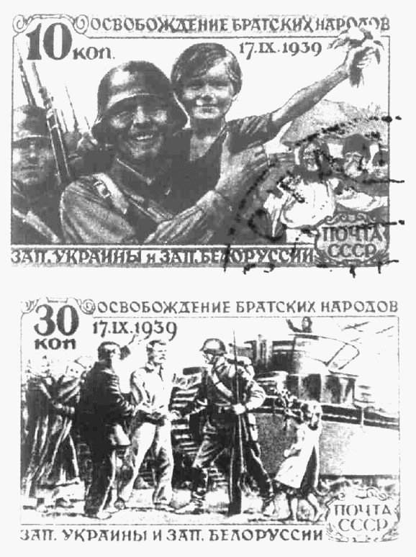
Soviet postmarks ‘Liberation of brotherly peoples of Western Ukraine and Western Belarus
Soviet poster depicting the ‘liberation’ of Ukrainian peasants from the Polish yoke
Soviet poster depicting the ‘liberation’ of Ukrainian and Belarusian peasants from Polish rule

Slide 10
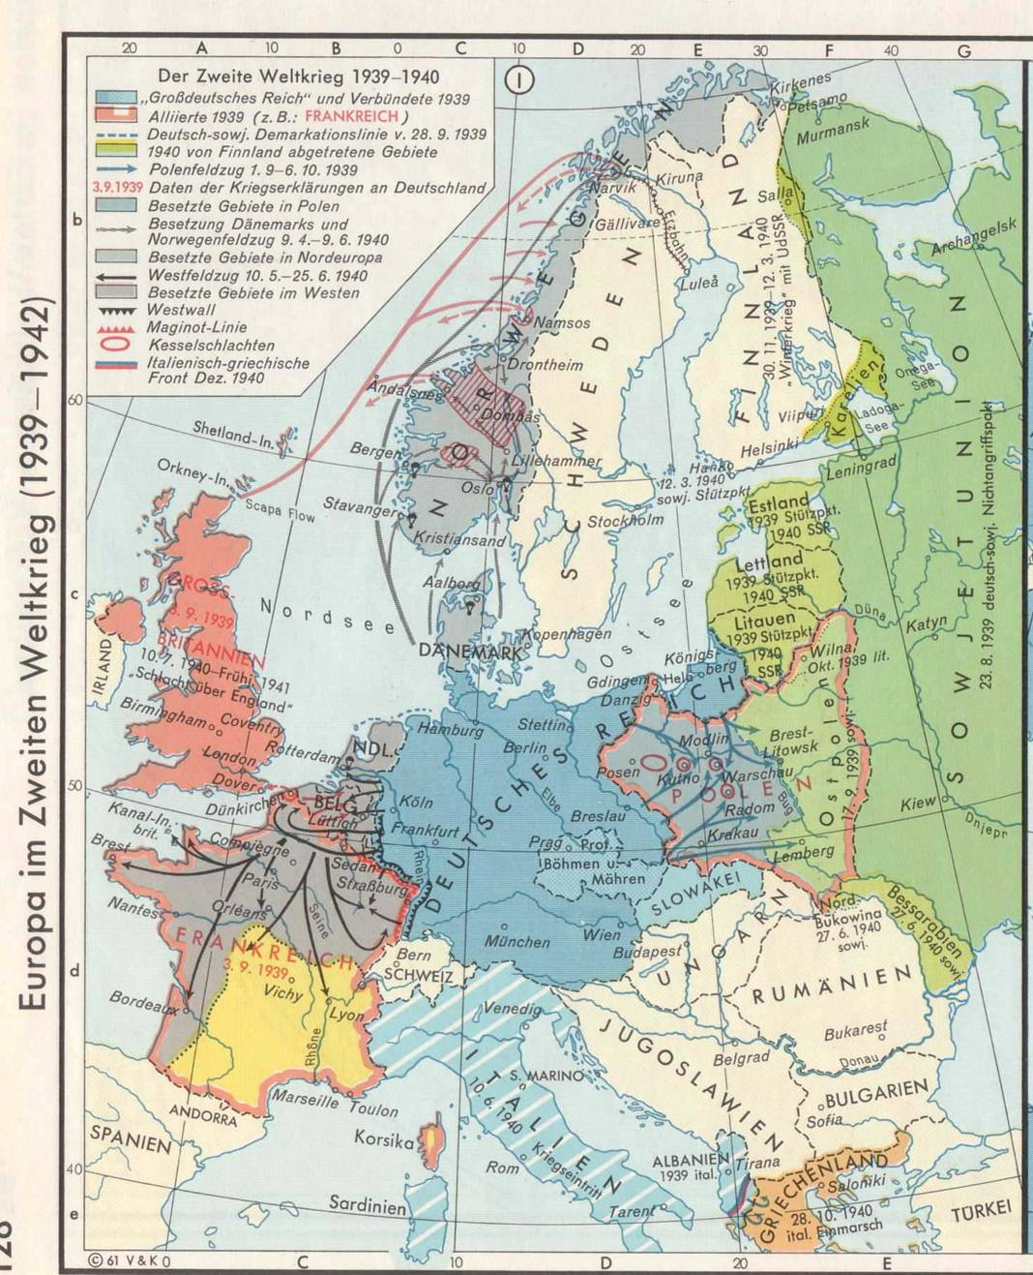
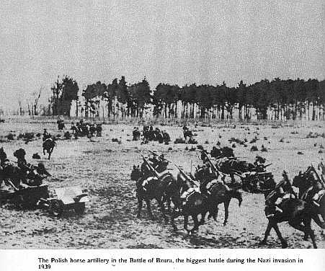
Blitzkrieg strategy

Slide 11
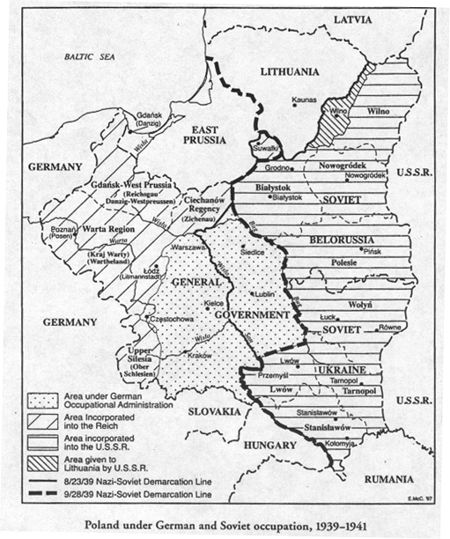
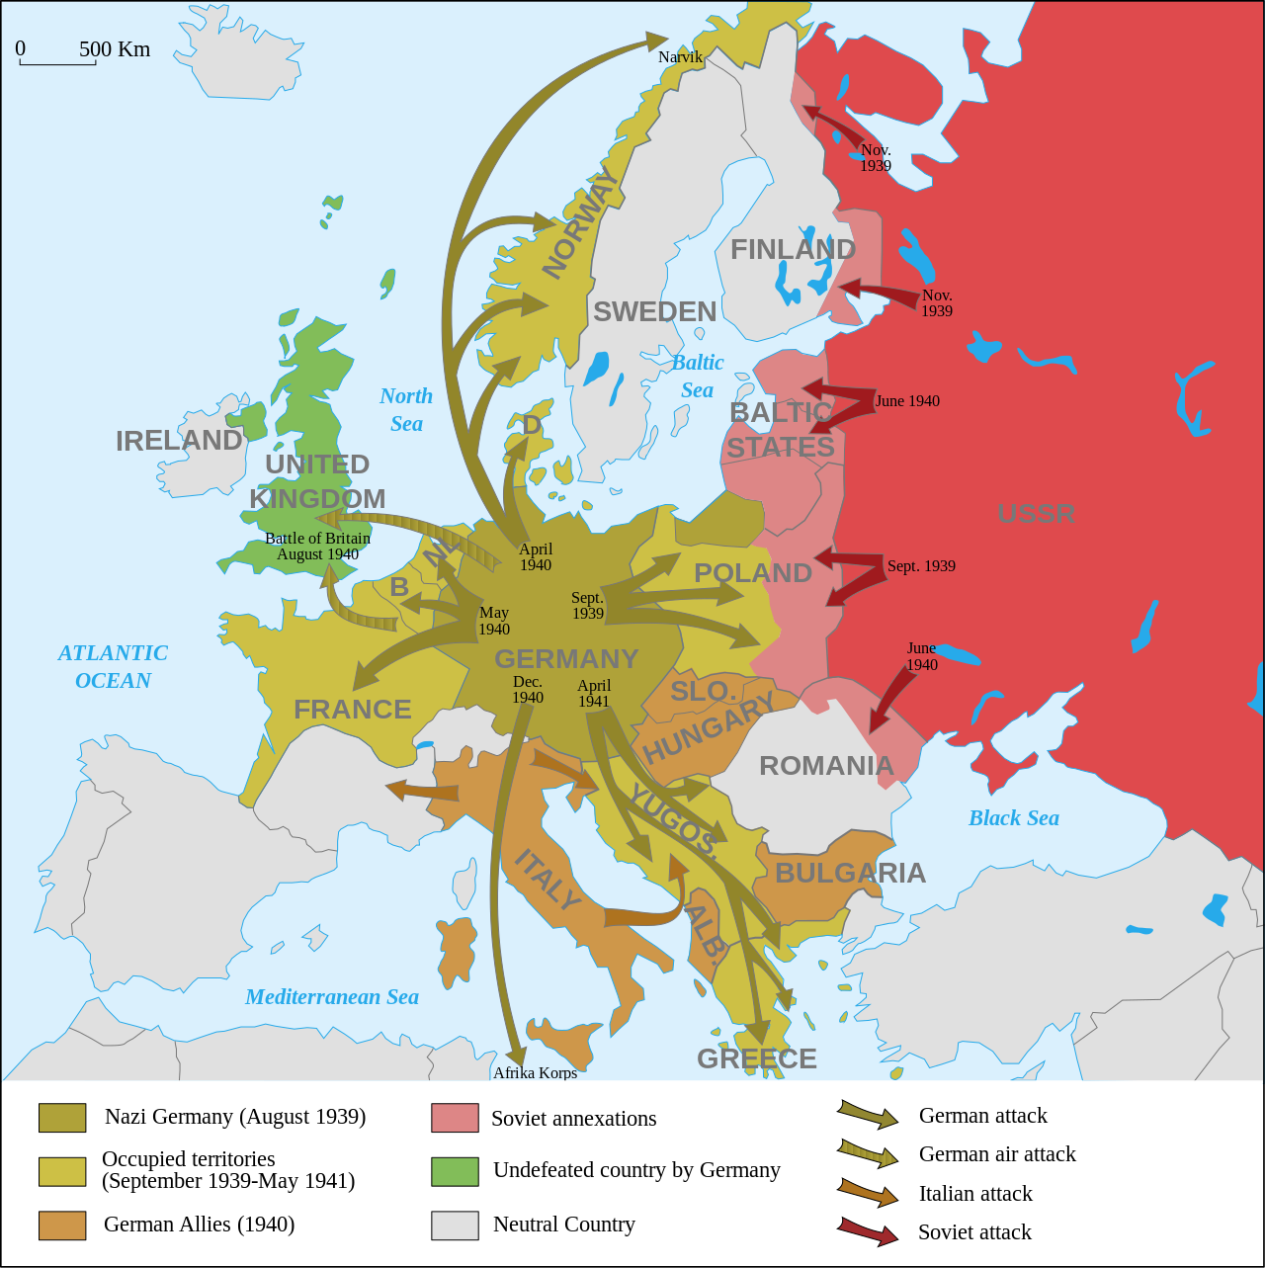
[from: Tadeusz Piotrowski, Poland's Holocaust. Note the two different German-Soviet demarcation lines of Aug. 23 and Sept. 28, 1939]

Slide 12
Sovietisation I
Terror and class war
Moscow time introduced
Influx of officials, party organisations, security forces, army from old Soviet Union
Anti-religious campaigns: closing of churches and synagogues, heavy taxes on parishes, arrest and deportation of priests
Beginning of dekulakisation
Nationalisation of means of production, banks, shops
Sovietisation of culture
Ukrainianisation
Execution and deportation of members of the pre-war elites and ‘enemies’ to the Soviet Union 1939-1941
Unfree elections and ‘referenda’: Western Ukrainian people’s assembly asks for annexation by Soviet Ukraine
Katyn and the murder of members of the Polish-pre-war elite – ‘decapitation’ of the Polish nation, preparing the field for a communist Poland

Slide 13
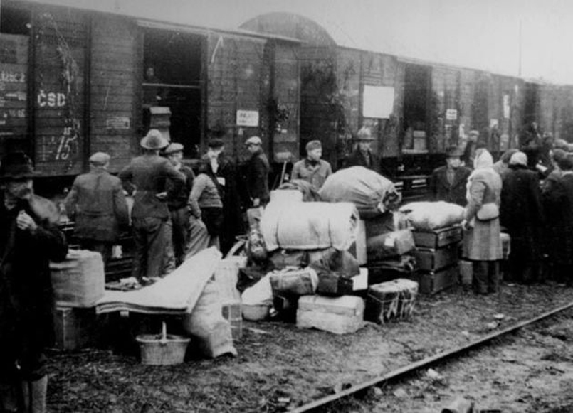
Soviet deportations 1940/41

Slide 14
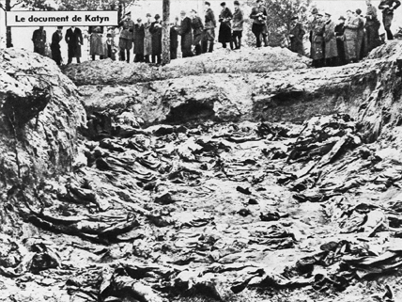
Katyn – Soviet war crime mass grave, exhumed by German Army in 1943

Slide 15
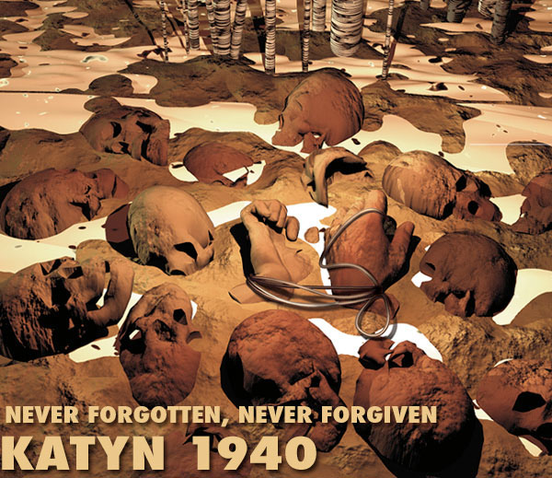
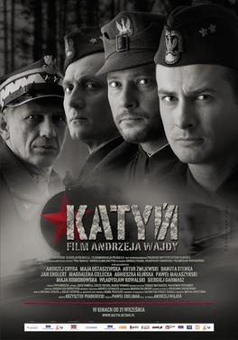
Katyn massacre part of Soviet attack on pre-war Polish elite and Polish nation
In Katyn 4400 Polish prisoners of war (Officers), intellectuals, politicians, priests shot by NKVD
http://www.electronicmuseum.ca/Poland-WW2/katyn_memorial_wall/kmw.html
In 1940 NKVD executes 20,000 – 25,000 members of Polish pre-war elite

Slide 16
Sovietisation II
Resettlement of ethnic Germans from territories now under Soviet occupation
Jews try to escape German occupation, hundreds of thousands arrive in Soviet zone of occupation – but also movement in other direction
Passportisation – deportation of tens of thousands of refugees to other parts of Soviet Union
Soviet leadership considers people in annexed territories Soviet citizens
Last wave of Soviet arrests directed against Ukrainian nationalists
When Nazi-Germany attacks on 22 June 1941 Soviet prisons full of Ukrainians (but also Jews and Poles).

Slide 17
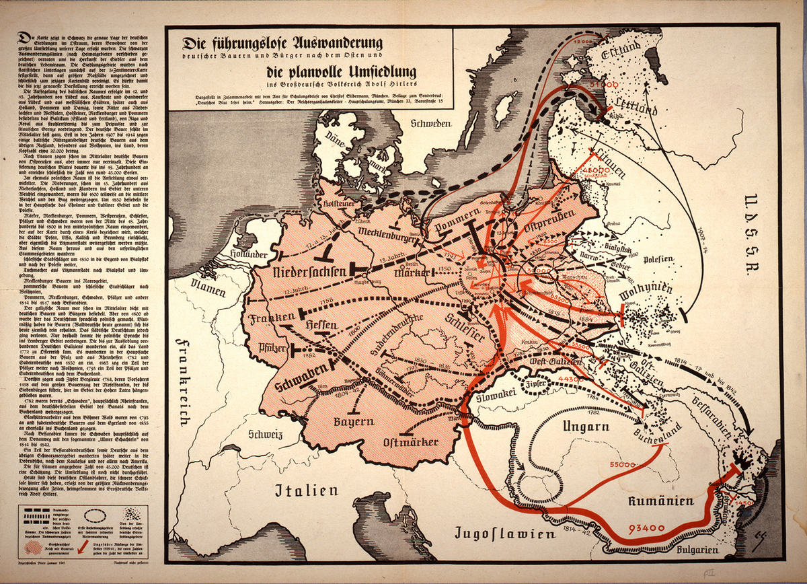
Nazi propaganda map on the resettlement of ethnic Germans 1940

Slide 18
Organisation of Ukrainian Nationalists
After Soviet attack on 17 September 1939, OUN leaders leave Western Ukraine
Division of OUN in OUN-B (Bandera) and OUN-M (Melnyk) – competing and fighting against each other
German military security (Abwehr) trains OUN members
Formation of two Ukrainian batallions in occupied Poland (Generalgouvernment) within Abwehr (with Ukrainian officers, but under German command) most prominent batallion is called Nachtigall
OUN disappointed by Nazi-Soviet collusion but leaders set their hope on a future German-Soviet war – conditional support for German war effort
Expressions of strong antisemitic views in OUN and in Lviv branch of Polish military resistance

Slide 19
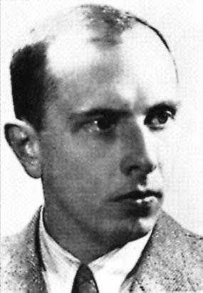
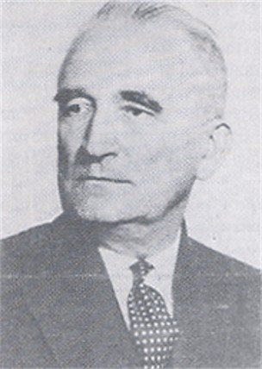
Split of the Organisation of Ukrainian Nationalists in 1940
Stepan Bandera
Leader of the Organisation of Ukrainian Nationalists, OUN-B
Andrii Melnik,
Leader of the OUN-M

Slide 20
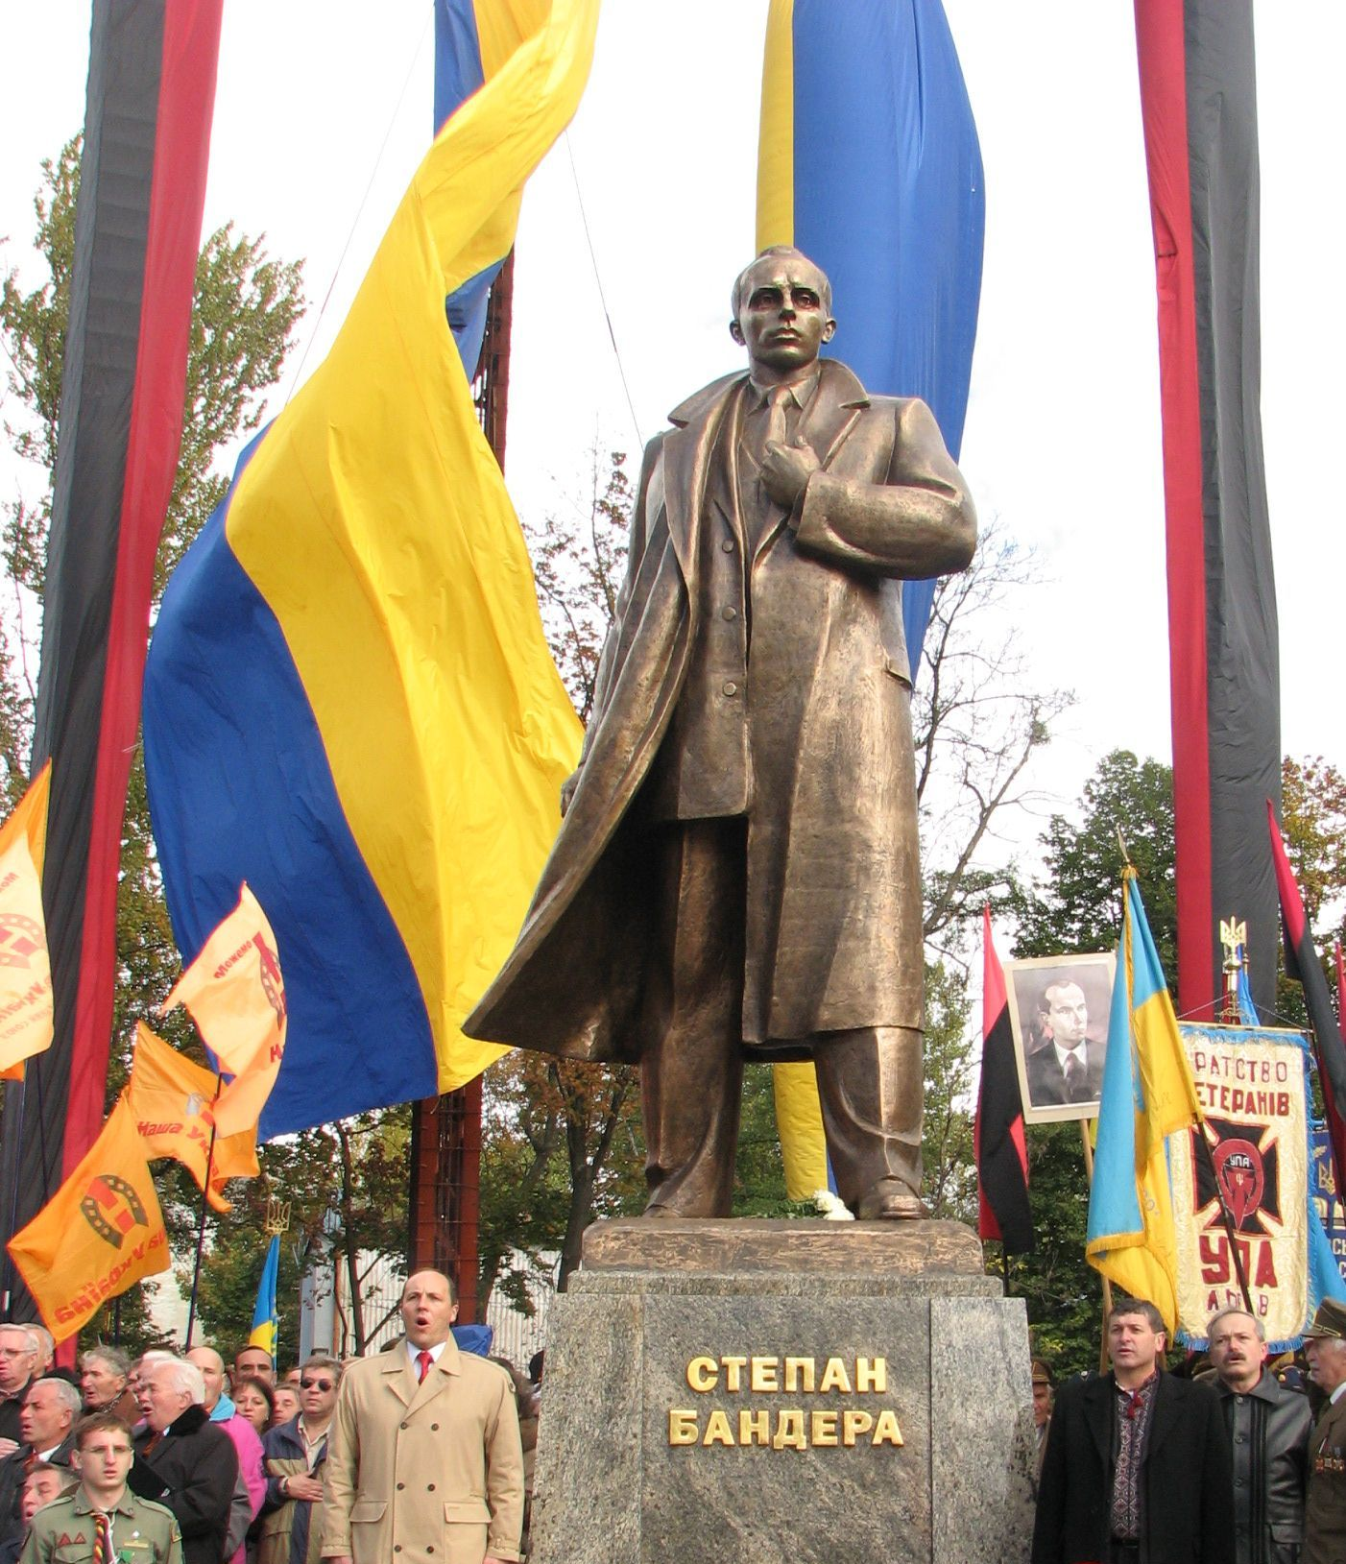
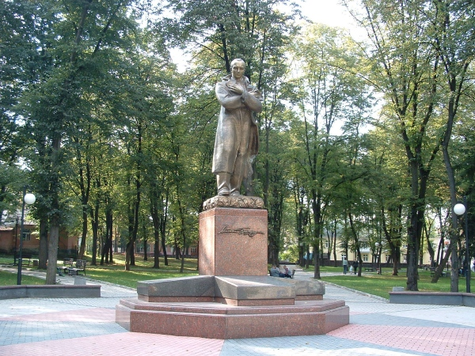
Lviv - Monument of the leader of the Organisation of Ukrainian Nationalists (B), Stepan Bandera, unveiled in November 2007 in Lviv
New monument of Stepan Bandera in Drohobych, Western Ukraine

Slide 21
Ethnic relations under Soviet occupation
Soviet militia – ethnic composition: Jews over-represented
Ukrainians theoretically privileged: ‘titular nation‘, but locals not trusted
Pre-war elites – class war: Poles overrepresented under victims, followed by Jews
Poles – proportionally most targeted
Zionists, Jewish Youth organisations, Jewish economic elite – targeted
Trying to win over Ukrainian intellectuals – also Polish intellectuals
Soviet cultural organisations turn up: collaboration of some intellectuals
Resistance difficult; Ukrainian nationalists arrested and deported
Surveillance
Material problems
Growth of anti-Jewish sentiments in gentile population (question of perception)

Slide 22
Aims of Sovietisation
Elimination of old elites and destruction of ‘bourgeois natinalism‘
Transformation of society,
Promotion of class struggle
Transformation of society in annexed territories according Soviet lines in accelerated form
Consequences for ethnic relations
Widespread dissatisfaction with Soviet rule, its representatives and collaborators in local society
Growing tensions between Poles and Ukrainians
Growing antisemitism
Growing influence of militant organisations

