Slide 1
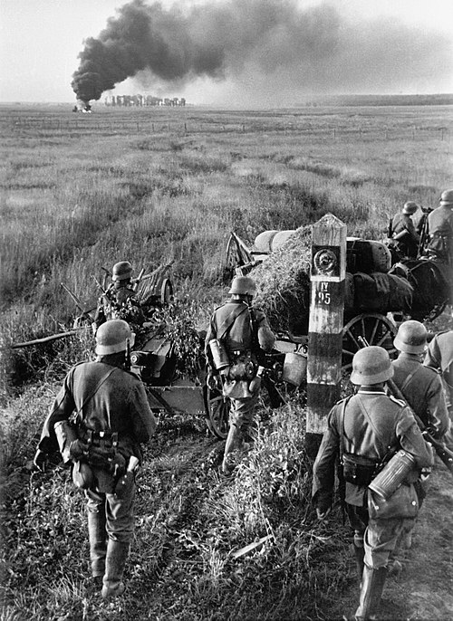
Entangled History: Ukraine and her neighbours from the Middle Ages to the present
German soldiers crossing the Soviet border in Lviv Oblast of Ukraine during Operation Barbarossa on 22 June 1941
Lecture 16
Bloodlands II: German Rule

Slide 2
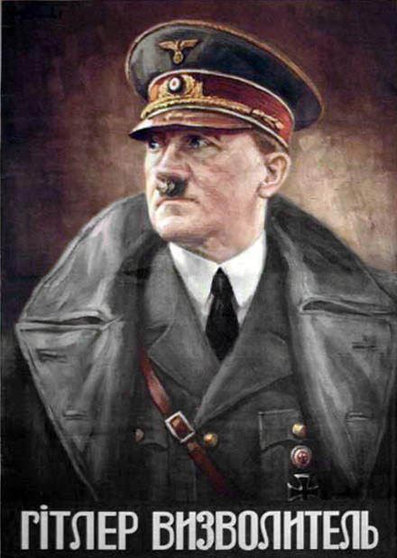
Outline
Introduction
The German attack on the Soviet Union
Poland under German occupation
Russian war experiences
Divided Ukrainian experiences
Outcome
Outlook
Nazi propaganda poster in Ukrainian that says ‘Hitler the Liberator’

Slide 3
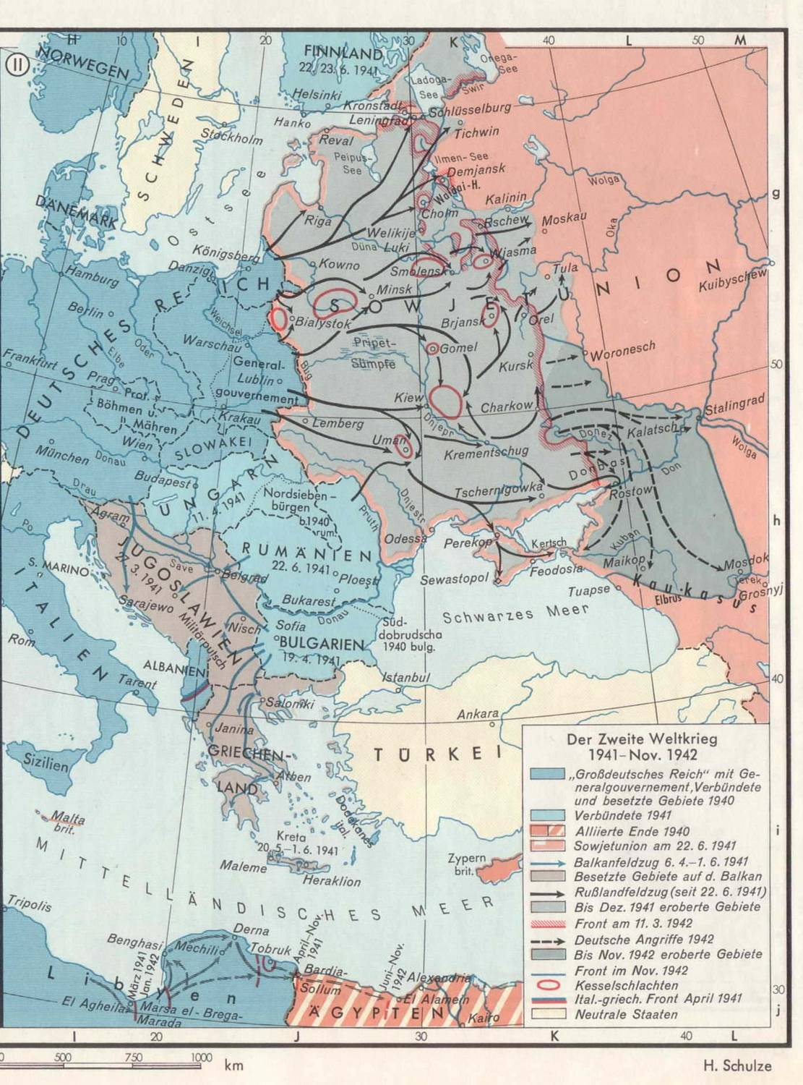

Slide 4
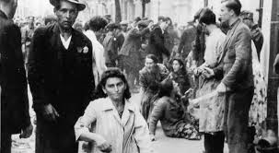
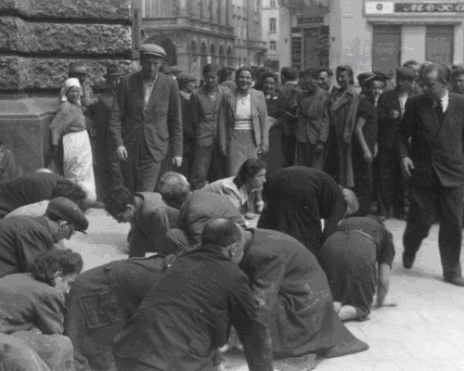
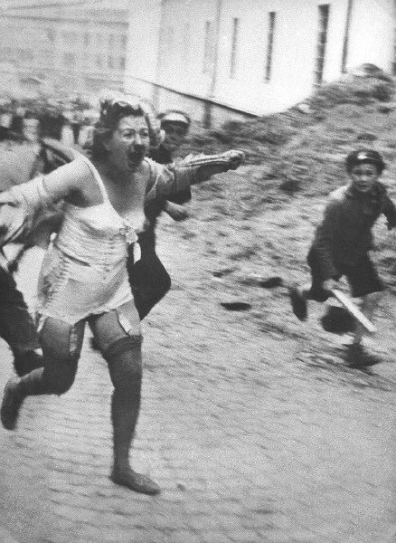
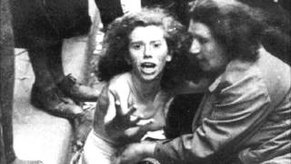
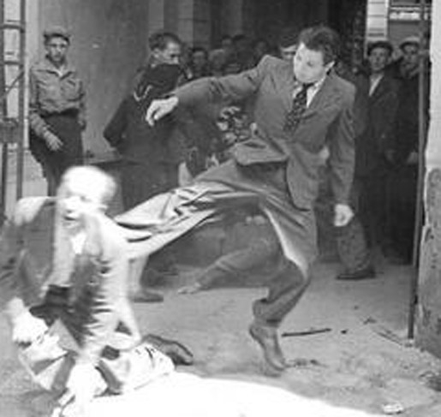
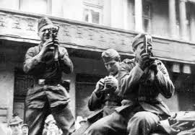
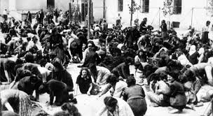

Slide 5
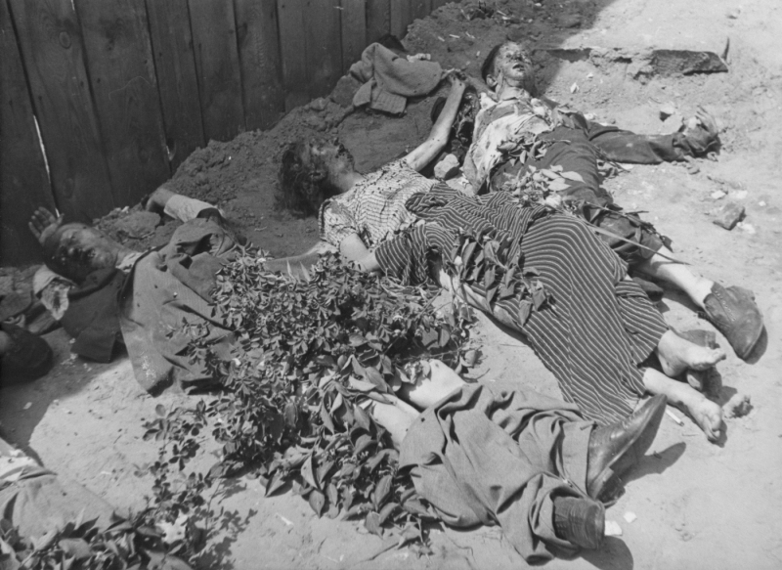
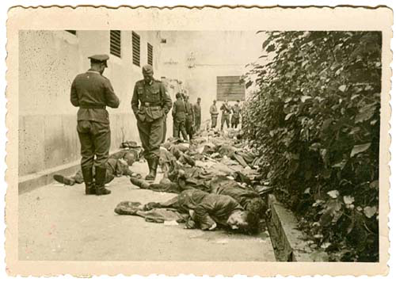

Slide 6
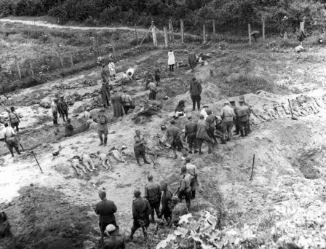
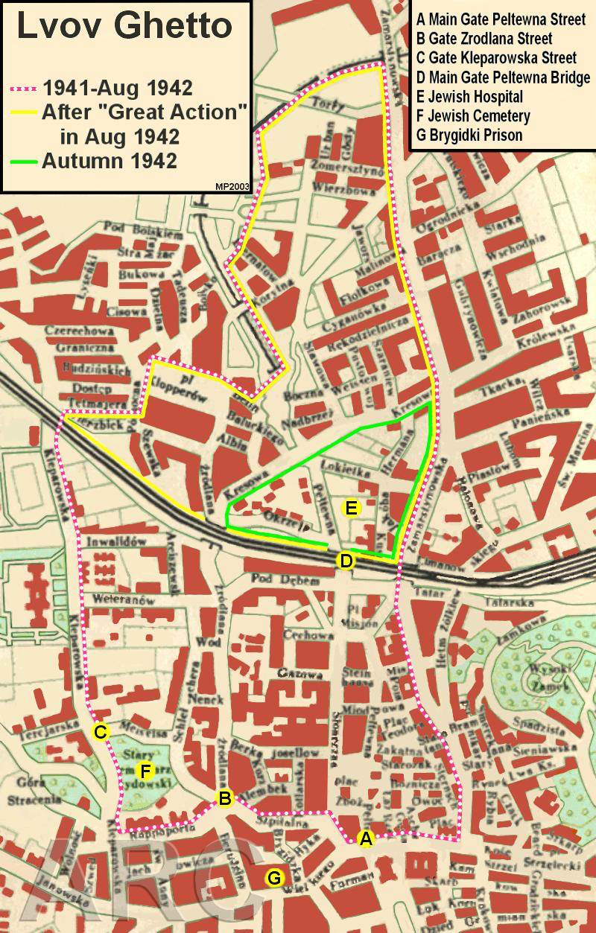
Janowski Camp, exhumation of victims 1945

Slide 7
Poland under German occupation
Oppression, concentration camps and mass killing of Poles under German occupation (about 6 million killed or died of hunger and exhaustion, about half of these – Jews)
Genocidal attack on Polish nation
Population resettlement
Polish underground state and Home Army
Collaboration and Volksliste (Poles with German ancestry)
Warsaw Uprising, August 1944

Slide 8

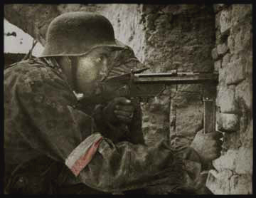
 | Go, passer-by, and tell the world That we perished in the cause, Faithful to our orders.
 | “The Warsaw Uprising of 1944 — a heroic and tragic 63-day struggle to liberate World War 2 Warsaw from Nazi/German occupation. Undertaken by the Home Army (Armia Krajowa, AK), the Polish resistance group, at the time Allied troops were breaking through the Normandy defenses and the Red Army was standing at the line of the Vistula River. Warsaw could have been one of the first European capitals liberated; however, various military and political miscalculations, as well as global politics — played among Joseph Stalin, Winston Churchill and Franklin D. Roosevelt (FDR) — turned the dice against it. This site is dedicated to all those who fought for their freedom in the Warsaw Uprising of 1944 as well as all those who, as civilians, perished in the effort.“
http://www.warsawuprising.com/

Slide 9
Russian war experiences
German attack, 22 June 1941 (Barbarossa)
German occupation and German cruelties
Hunger and suffering
Collaboration of different groups
Vlasov-Army
Great Patriotic War
Red partisans and resistance
Victorious battles: Defence of Moscow, Siege of Leningrad, Battle of Stalingrad, Battle of Kursk, Battle of Berlin

Slide 10
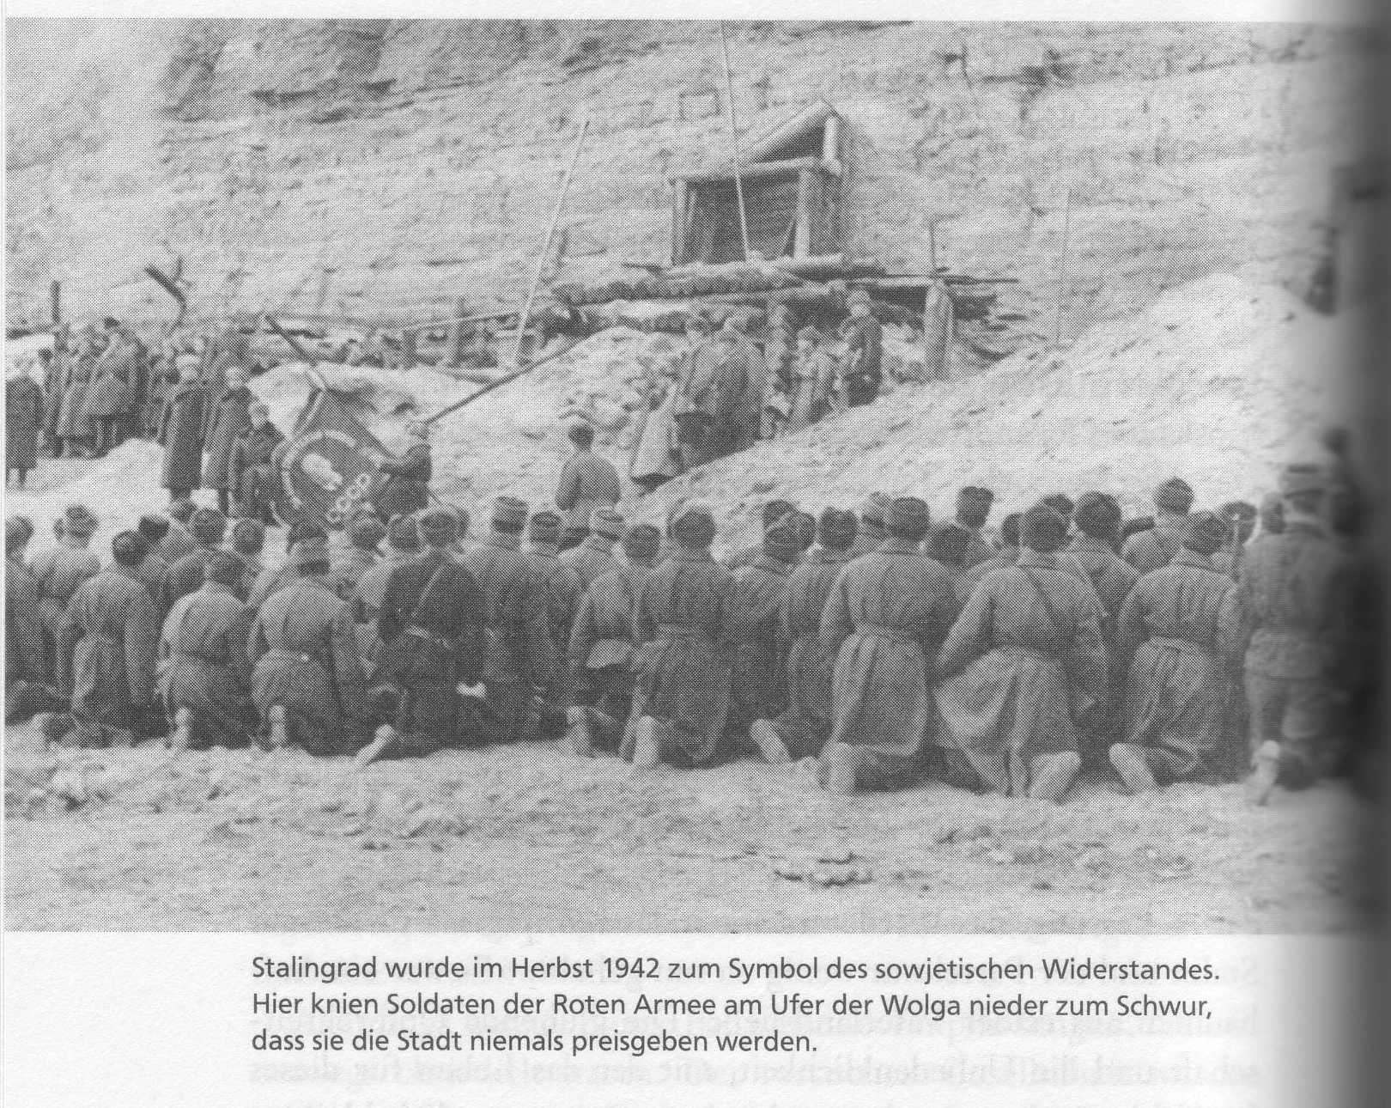
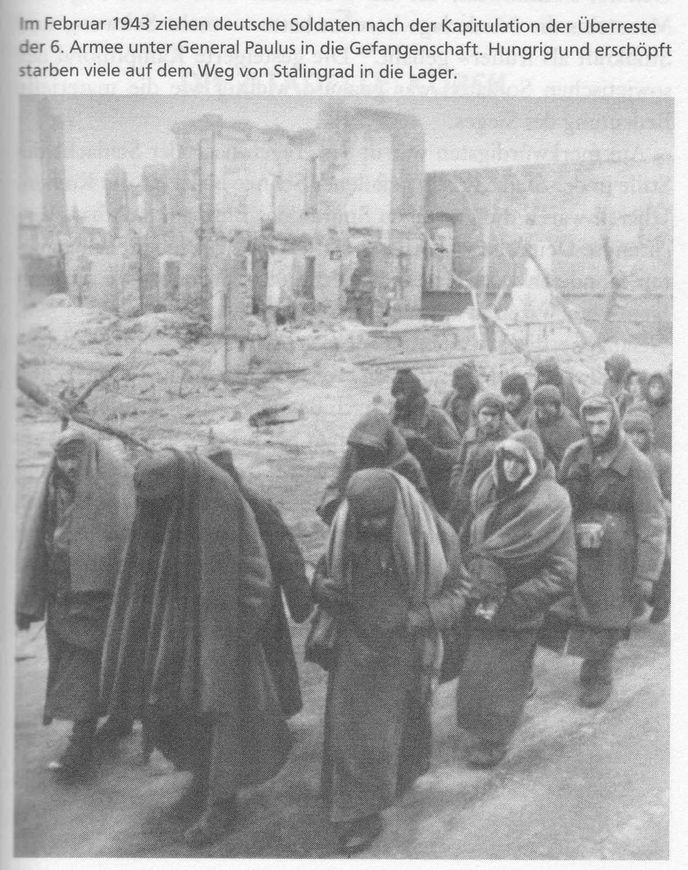
Overy, Russia‘s War
German prisoners of war after the Battle of Stalingrad

Slide 11
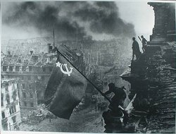

Slide 12
Ukrainian war experiences
Western Ukraine
OUN divided in OUN-B and OUN-M
Proclamation of a Ukrainian State in Lviv, June 30, 1941
Ukrainian Insurgent Army (UPA)
Collaboration and anti-Semitism
SS Division Galicia
War of nationalist partisans against the German Wehrmacht and the Red Army
Massacres of Poles in Volhynia and Eastern Galicia
Central and Eastern Ukraine
Occupation of Soviet Ukraine by the Germans
Mass killing
Collaboration and anti-Semitism
Fight of Soviet Ukrainian partisans against the Wehrmacht
Fight of Ukrainian soldiers in the Red Army
Victorious battles against the Germans

Slide 13
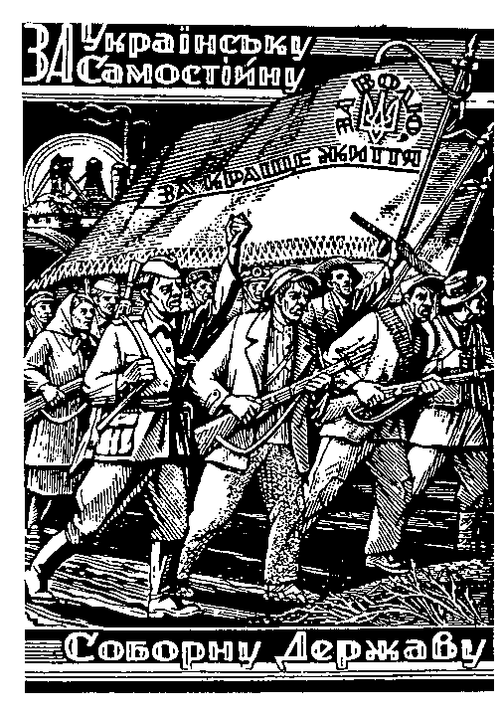
"For an independent and sovereign Ukrainian State"
On the flag: "For Liberty and a better life."
A woodcut by Nil Khasevich, an underground UPA artist

Slide 14
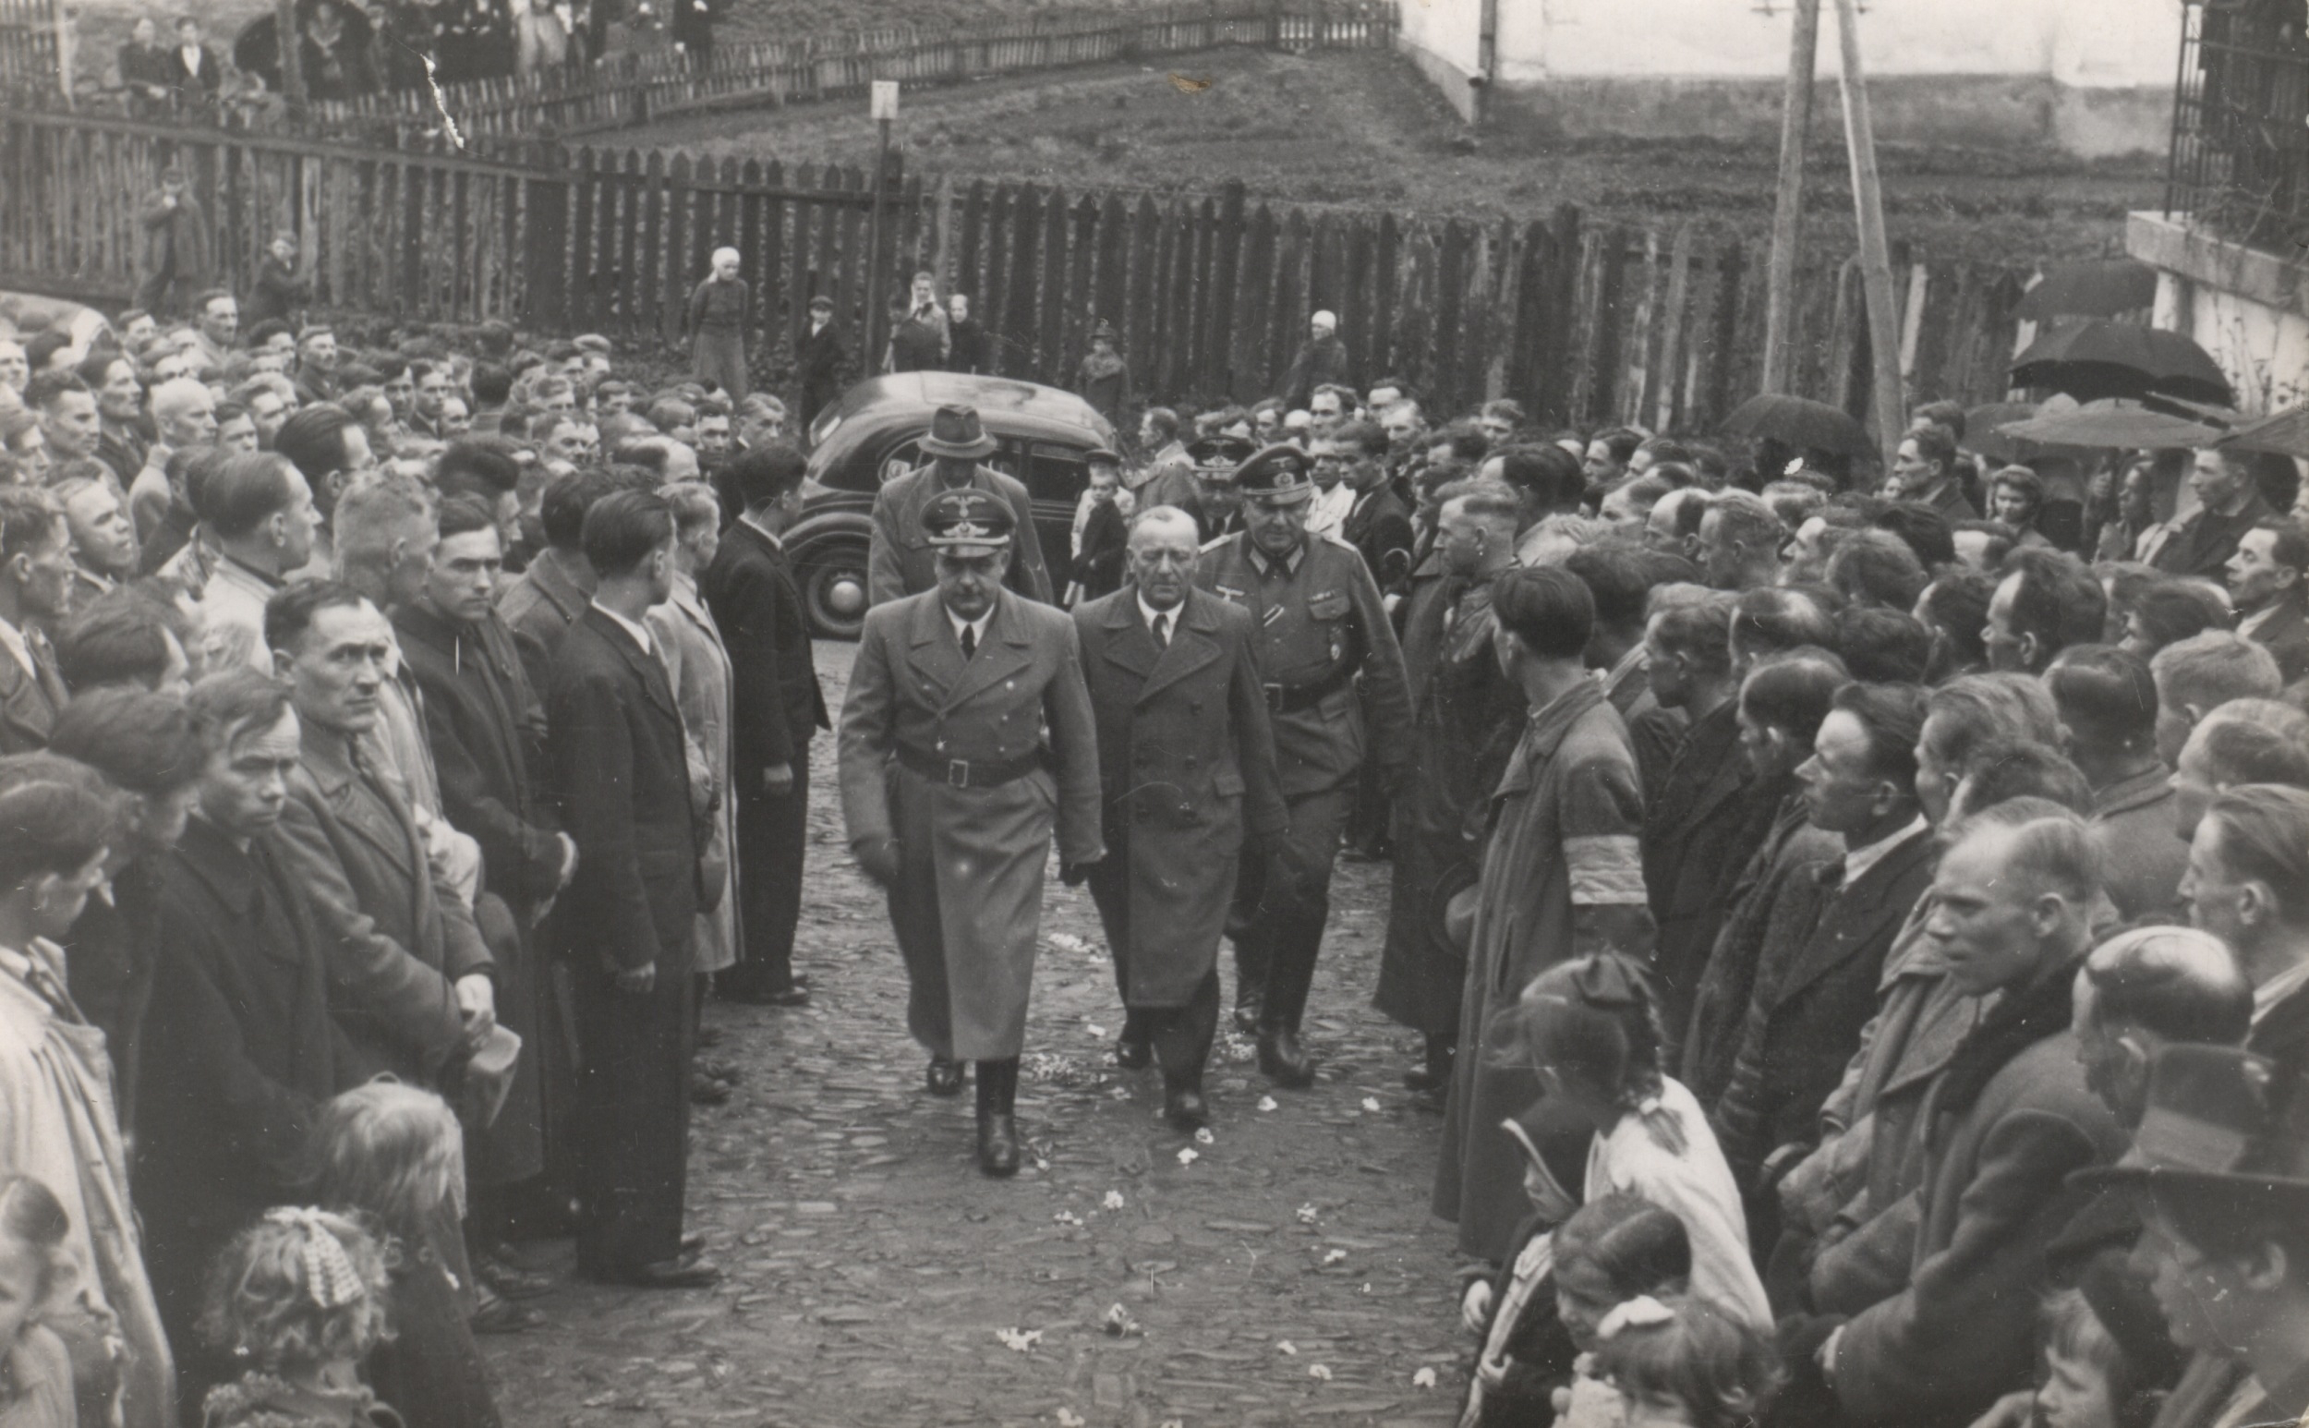
General governor Hans Frank and volunteers of the SS Division Galicia, 1943

Slide 15
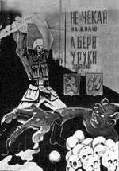
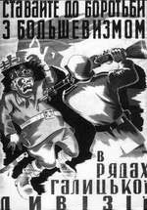
Don't wait for the fate, but take arms in
your hands.
Stand up to fight Bolshevism in the ranks of the Galicia Div.

Slide 16
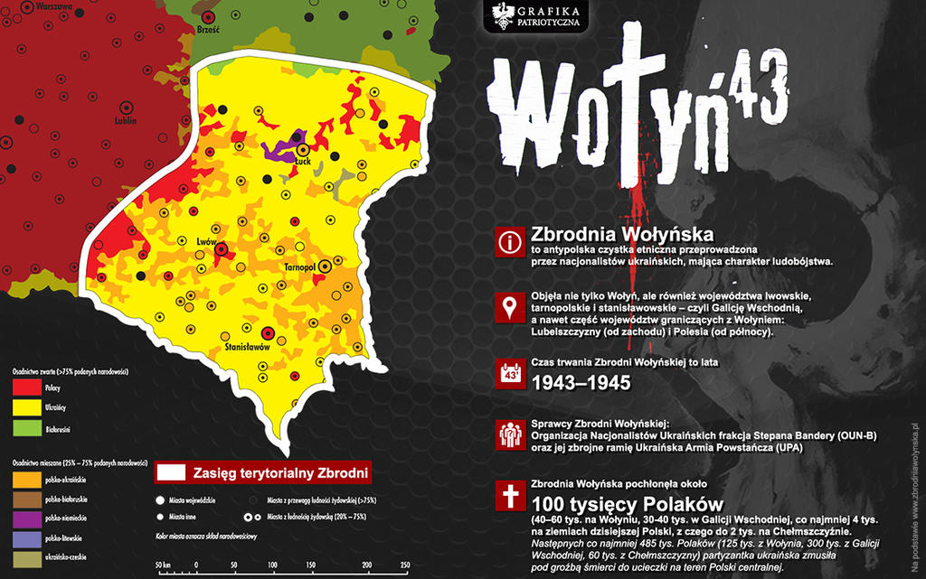
Volhynian massacres
Ca 50,000 - 70,000 Polish villagers murdered by Ukrainian nationalist partisans in Volhynia, spilling over to East Galicia
In acts of retribution by Polish auxiliary Police in Volhynia and Armia Krajowa in East Galicia several thousand Ukrainian villagers murdered

Slide 17
Nazis and Islam
An attempt to use Muslim population in the occupied regions (Crimean Tatars, North Caucasian peoples)
Motive: Muslims as ideologically and historically opposed to Bolshevism and Moscow
Controlled ‘revival’ of Islam and limited religious freedoms (also valid for other religions)
Attempts of politicisation and instrumentalisation of Islam
But: local Muslim leaders try to use this Nazi approach to their advantage rather than to pursue Nazi goals
Soviet response: deportation of entire Muslim groups, including Crimean Tatars (to Central Asia, allowed to return only during Perestroika), even though there were more Crimean Tatars in the Red Army than those who collaborated with Nazis, and some research suggest that were more Russians collaborating in Crimea with Nazis than Tatars

Slide 18
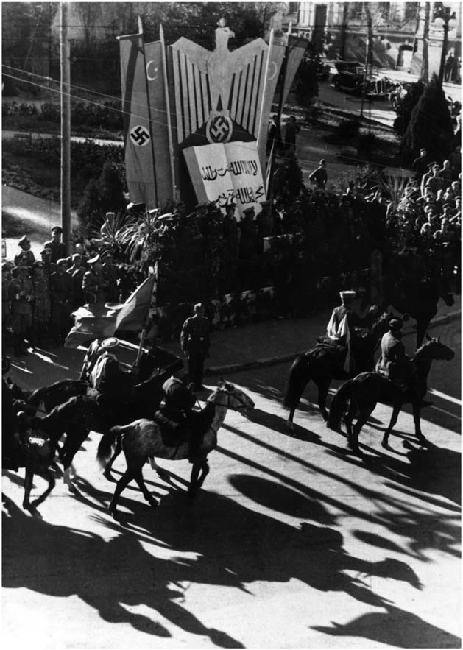
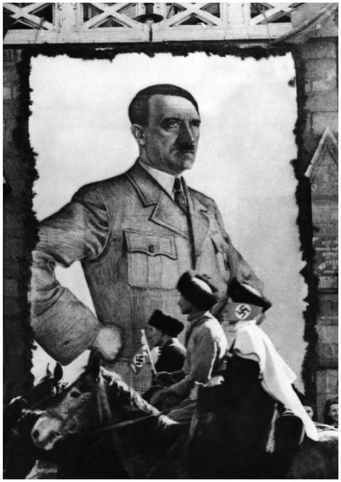
The end of Ramadan (Uraza Bairam) in Kislovodsk, Caucasus, 11 October 1942, Karachay Parade
From: David Motadel, Islam and Germany’s War in the Soviet Borderlands, 1941–5

Slide 19
Outcome of the war
Poland
Loss of Eastern Poland and expulsion of Poles
Conference of Yalta – betrayed by the Western Allies
Founding of the People’s Republic of Poland – under Soviet domination
Suffering and heroic fight with tragic outcome
Russia
Defeat of Germany
Victory of the Soviet system
Victory of the Russian nation
Suffering and heroic fight with triumphal victory

Slide 20
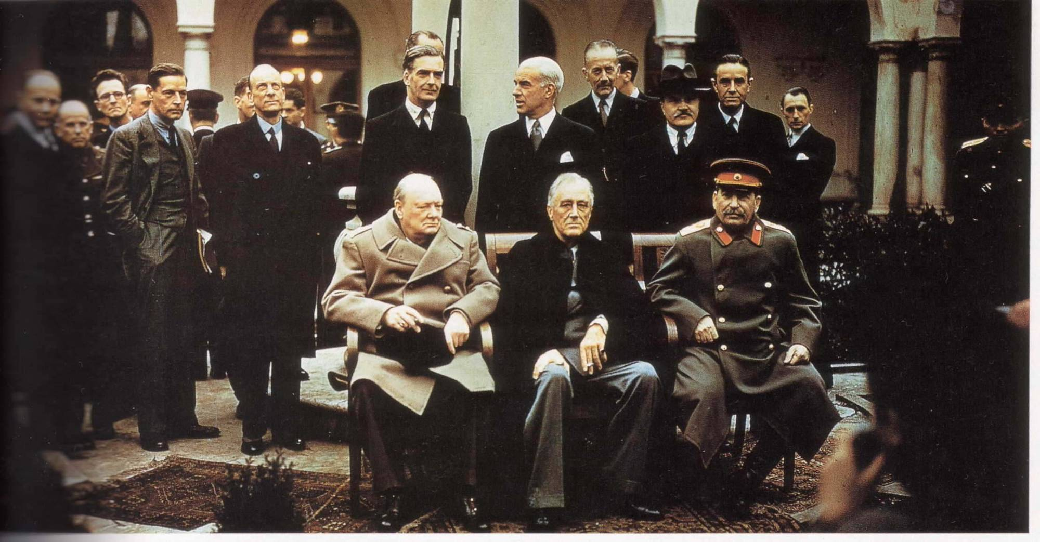
Churchill, Roosevelt and Stalin at the conference of Yalta, February 1945

Slide 21
Outcome of war
Western Ukraine
Fight against Sovietization in Western Ukraine
Mass arrests and deportations of Ukrainians to Siberia
Expulsion of Ukrainians from Poland
Akcja Wisla
Suffering and heroic fight with tragic outcome
Central and Eastern Ukraine
Liberation and Unification of Ukraine
Return of oppressive Soviet rule including a famine in 1946
Suffering and heroic fight with victory – but …

Slide 22
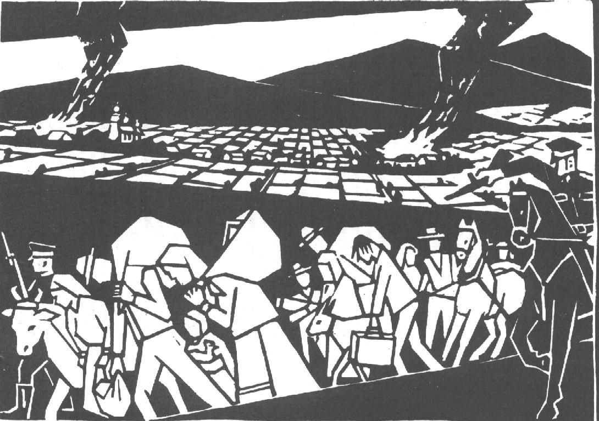
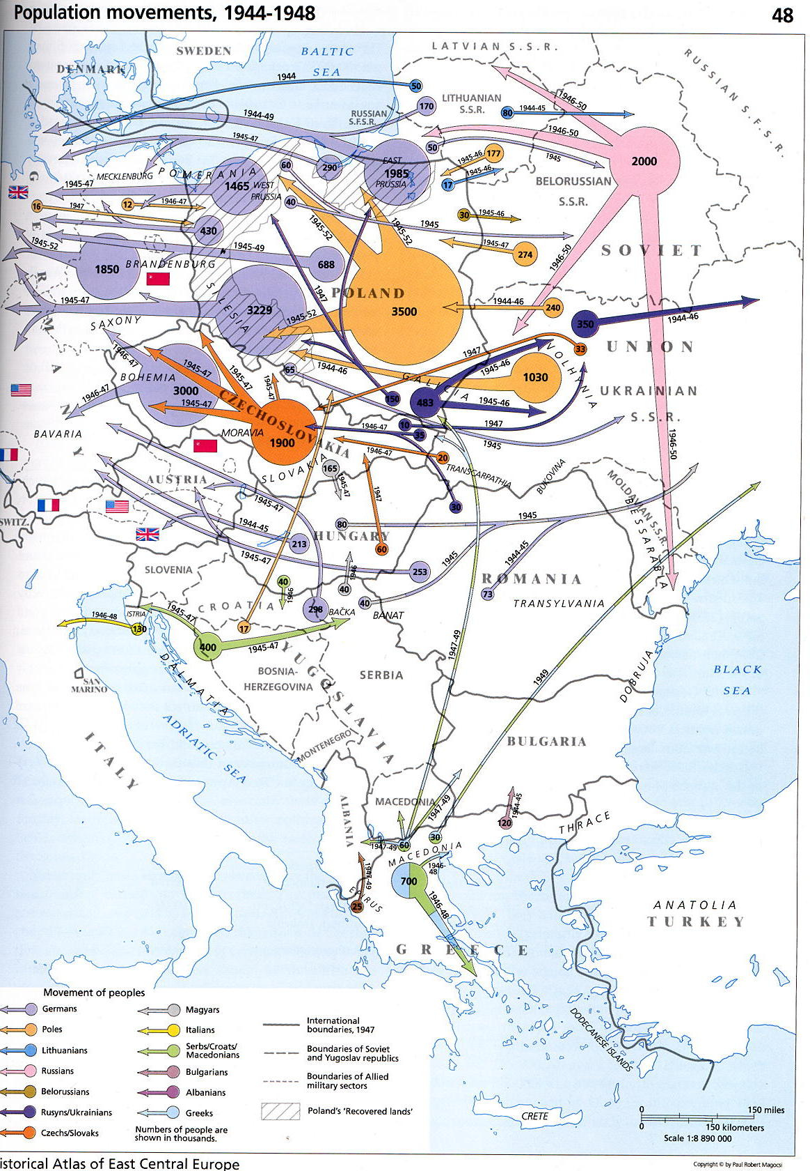
Akcja Wisla, 1947

Slide 23
Poland and the Memory of WWII
Communist Poland
Liberation by Red Army, Brotherhood with Soviet Union
People’s Republic of Poland culmination of Polish history
Polish suffering and heroism: Communist resistance within the Polish tradition of fighting for liberty
Armia Krajowa: at best marginalisation of its role, at worst accused of collaboration with the Germans
Warsaw Uprising: act of irresponsible people or even criminals – anti-Soviet dimension
Anti-German propaganda linked to pro-Russian and pro-Soviet propaganda
Collaboration and Polish anti-Semitism denied
Dominant in public space
Opposition view (exiles, church, samizdat, private memory)
Liberation by Red Army, but followed by oppression
People’s Republic – dominated by Moscow
Polish suffering and heroism: resistance of Armia Krajowa, no collaboration, in the tradition of uprisings
Warsaw Uprising: mixed feelings, but mainly positive connotation – Polish heroism against overwhelming enemy
anti-German attitudes accepted
Collaboration and Polish anti-Semitism denied
Often present in private space
Official memory only reflects part of private memory and personal experiences

Slide 24
Ukraine – the divided memory until 2014/22
Eastern Ukraine (~ in Soviet period official memory for all Ukraine)
Heroes: Red Army soldiers
Close to Soviet interpretation
Liberation and unification of Ukraine – culmination of Ukrainian history thanks to brotherhood with Soviet Union and Russian nation
Ukrainian national partisans, collaborators with Germans, German agents, traitors to Ukrainian nation
No issues with suppression of Greek-Catholic Church
Western Ukraine (exile and private)
Heroes: nationalist partisans
Official interpretation contradicts own view
Several years’ fighting against incorporation in Soviet Union
Prooblem of collaboration with Germans, Volhynian massacres and anti-Semitic attitude of integral nationalists
Ukrainian partisans recognised as soldiers and fighters for liberty, heroes of Ukraine
Forced unification of Greek-Catholic Church with Russian Orthodox Church in 1947 = attack on key component of Western Ukrainian identity

Slide 25
Memory in Ukraine: changes after 2014/2022
Changes after 2014, accelerating after Russian attack: Soviet era monuments are pulled down
Idea of brotherhood of Ukrainians and Russians destroyed: renaming of streets, removal of monuments celebrating Russian-Ukrainian friendship
Growing influence of Western Ukrainian view in Central Ukrainian but not clear yet whether there will eventually be a generally accepted view of WWII
In Russian-controlled regions: return of Soviet monuments

Slide 26
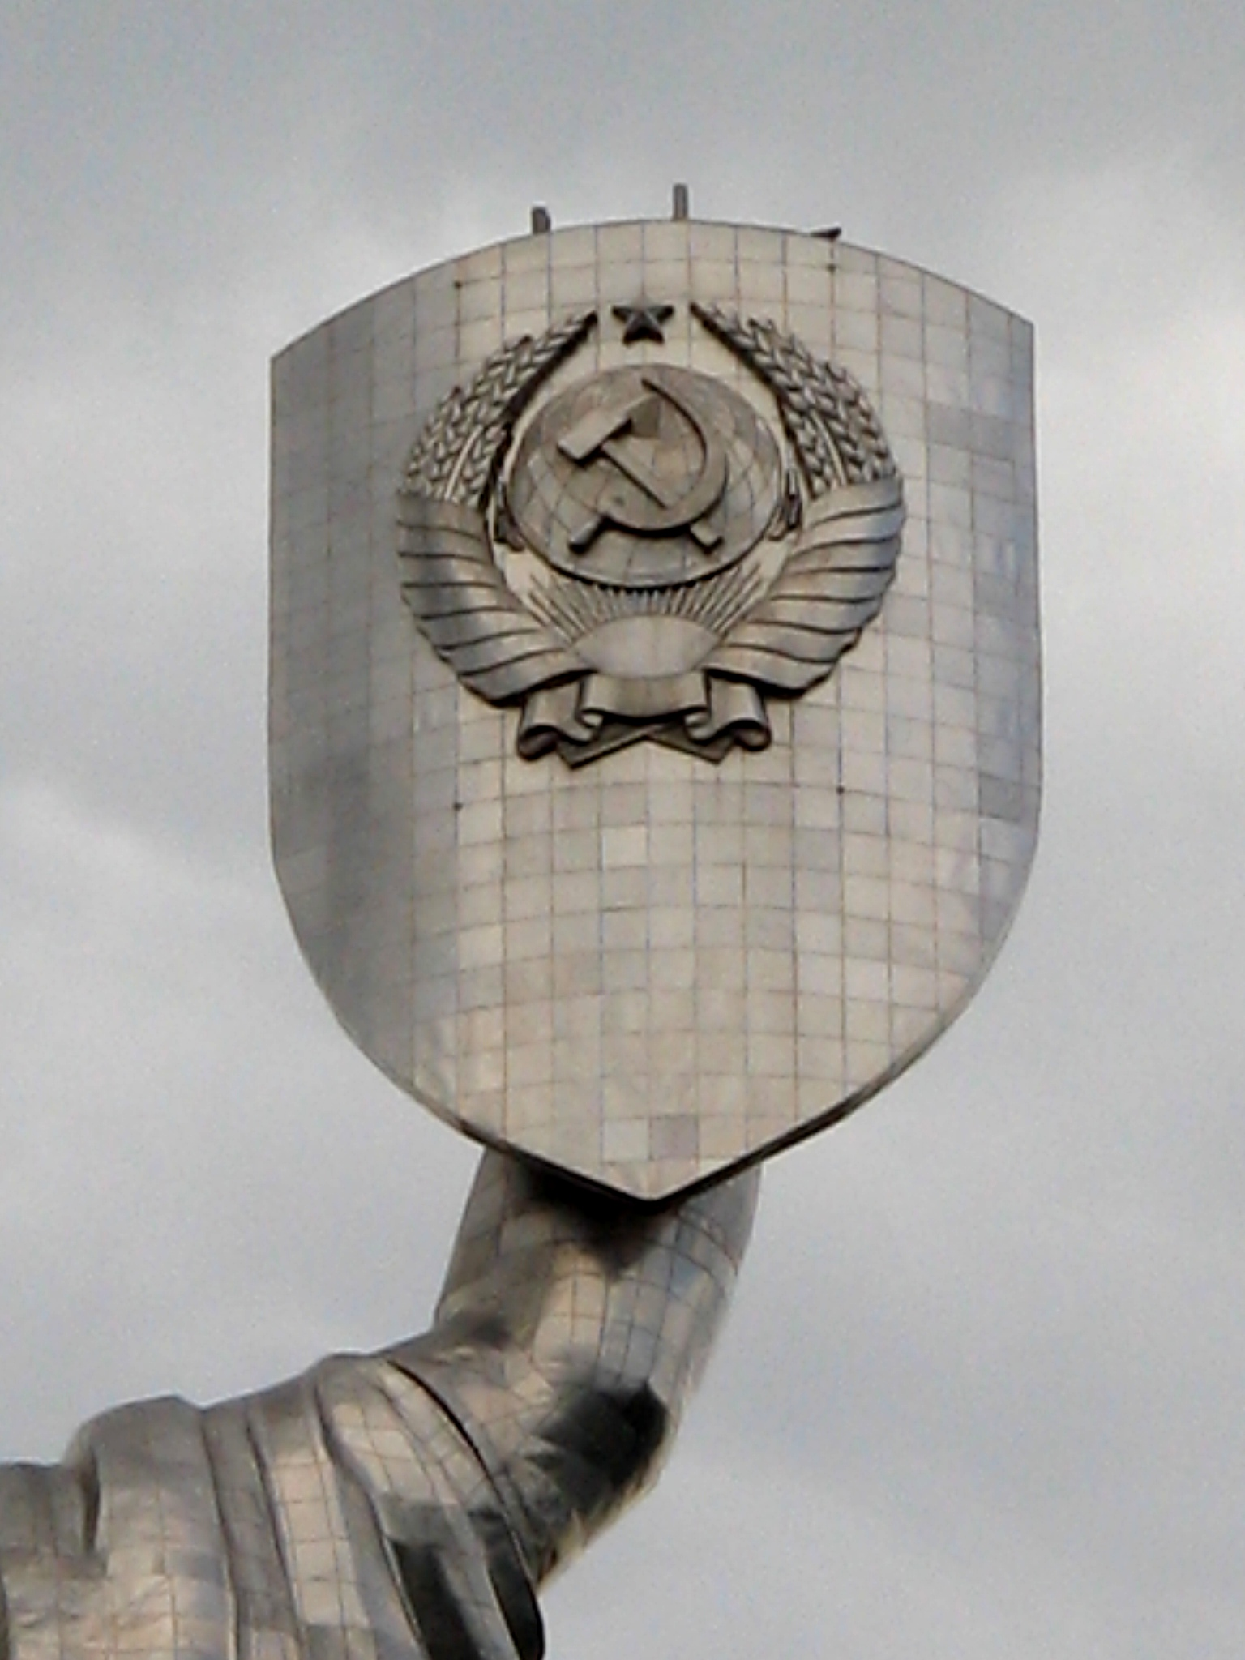
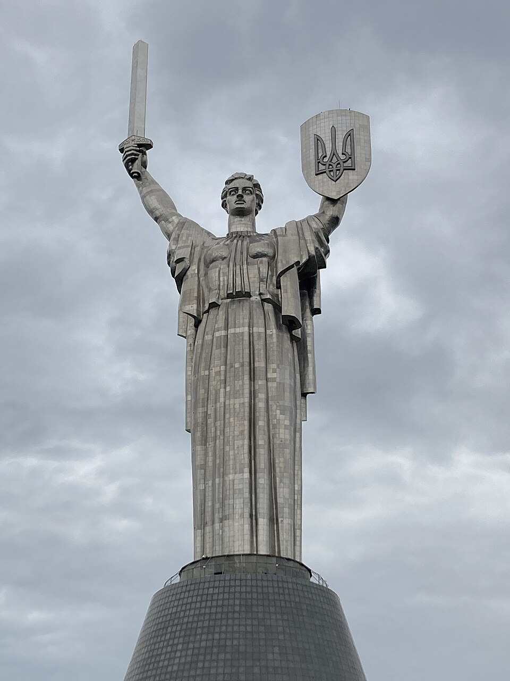
Soviet-era Motherland monument in Kyiv
Photo credit: Георгий Долгопский
Monument after 2023
Photo credit: Арманов

Slide 27
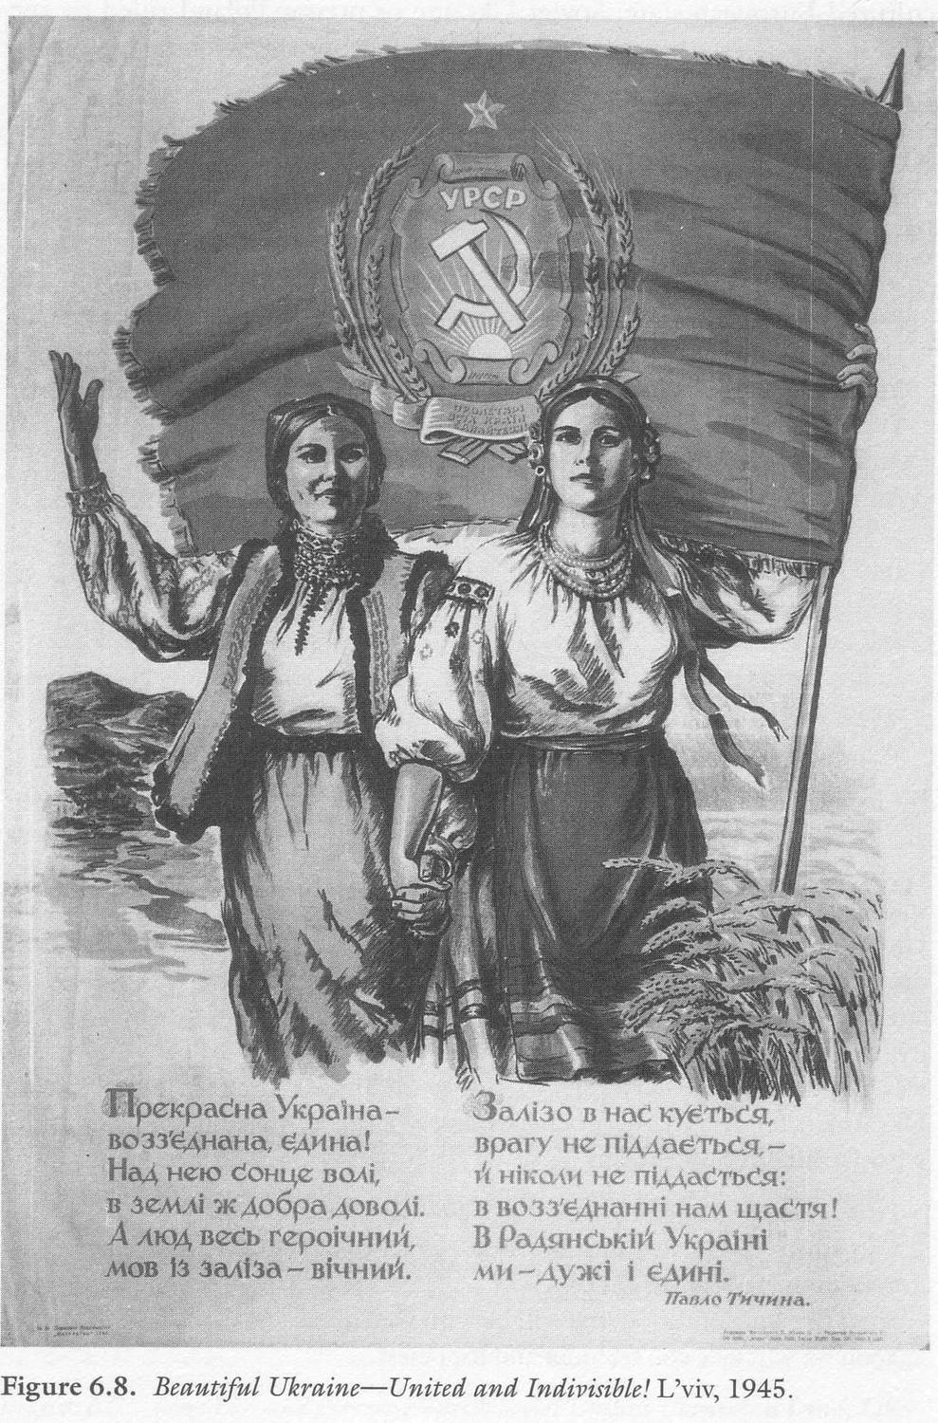
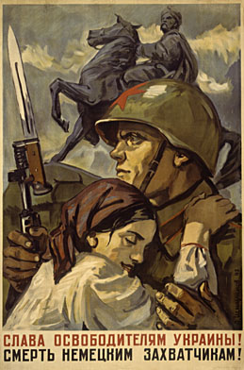
D.A. Shmarinov,
Glory to the liberators of Ukraine!
Death to the German invaders!
Moscow, Leningrad 1941

Slide 28
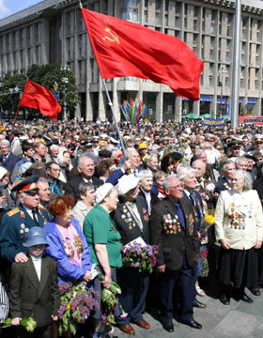
Victory Day in Kyiv 2004

Slide 29
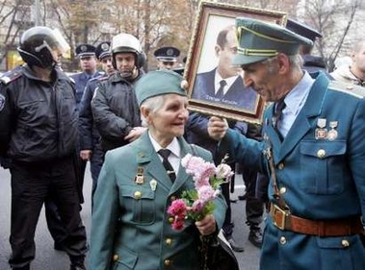
Veterans of the wartime Ukrainian Insurgent Army (UPA) talk as one holds a portrait of UPA leader Stepan Bandera during skirmishes which broke out at rallies in central Kiev on October 15, 2005, a day devoted to remembering the 63rd anniversary of the founding of UPA. Communists, leftists and some liberals denounce any notion of official recognition for the UPA, which fought both Nazi invaders and Soviet troops in the war (and was responsible for the murder of 70,000 Polish civilians, an unknown number of Jews and Ukrainians who opposed the OUN(b))

Slide 30
Poland Ukraine
Anti-semitism in Poland (pre-war)
Pogroms and mass murder (Jedwabne)
Blame Jews for Bolshevism
Szmalchowcy and ‘blue police’
Part of nationalists welcome removal of Jews from Poland
But also help for Jews
Kielce pogrom and anti-semitism after the war
“Double Memory” of the Second World War of Jews and Poles
Threatens idea of Poland as the suffering nation which did not collaborate with the Nazis
Anti-semitism in Ukraine
Pogroms and mass murder (WU)
Blame Jews for Bolshevism (WU)
Ukrainian auxiliary Police (WU)
Guards of Death camps
Integral nationalists welcome removal of Jews from Ukraine
But also help for Jews
Attack on Jews in Kiev after victory
‘Double Memory’ of the Second World War of Jews and Ukrainians
Threatens idea of Ukraine as the suffering nation, question of collaboration with Nazis difficult

