Slide 1
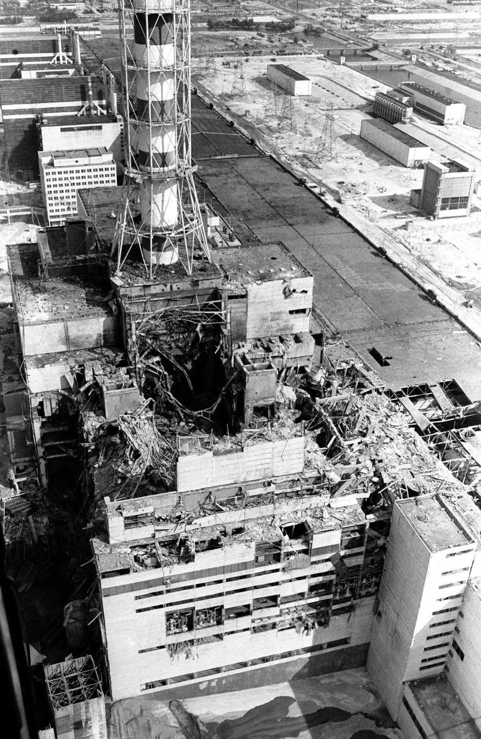
Entangled History: Ukraine and her neighbours from the Middle Ages to the present
Lecture 18
From Soviet to Independent Ukraine
Source: IAEA Imagebank

Slide 2
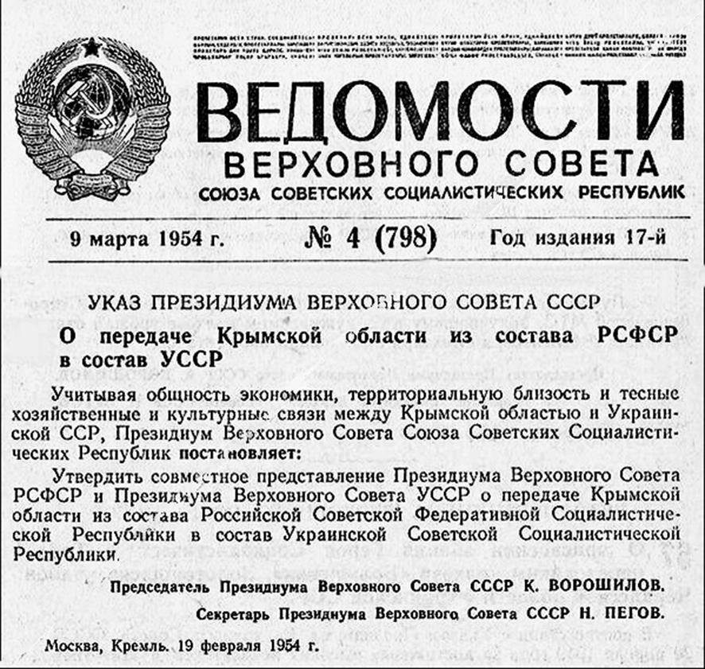
Outline
The return of Soviet power
Economic and political developments
Ukrainisation, Russification and the concept of the Soviet people
Dissidents
Final years
History policy
Decree of the Presidium of the Supreme Soviet of the USSR ‘About the transfer of the Crimean Oblast from the RSFSR to the USSR’

Slide 3
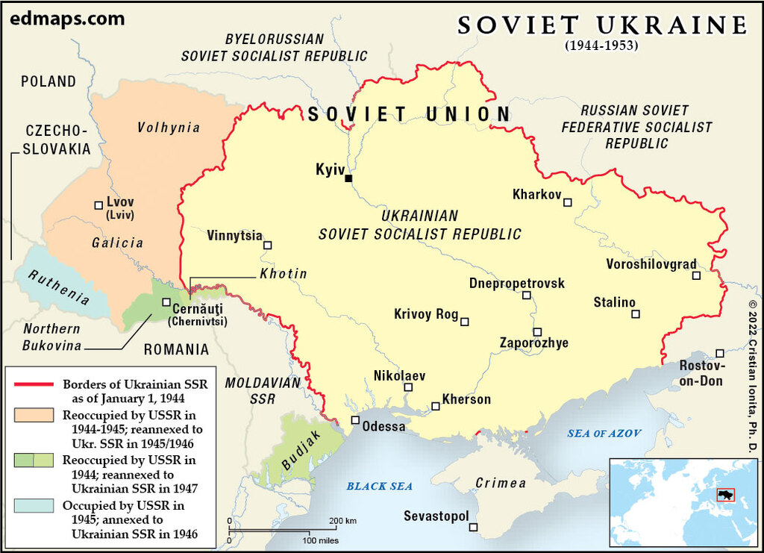

Slide 4
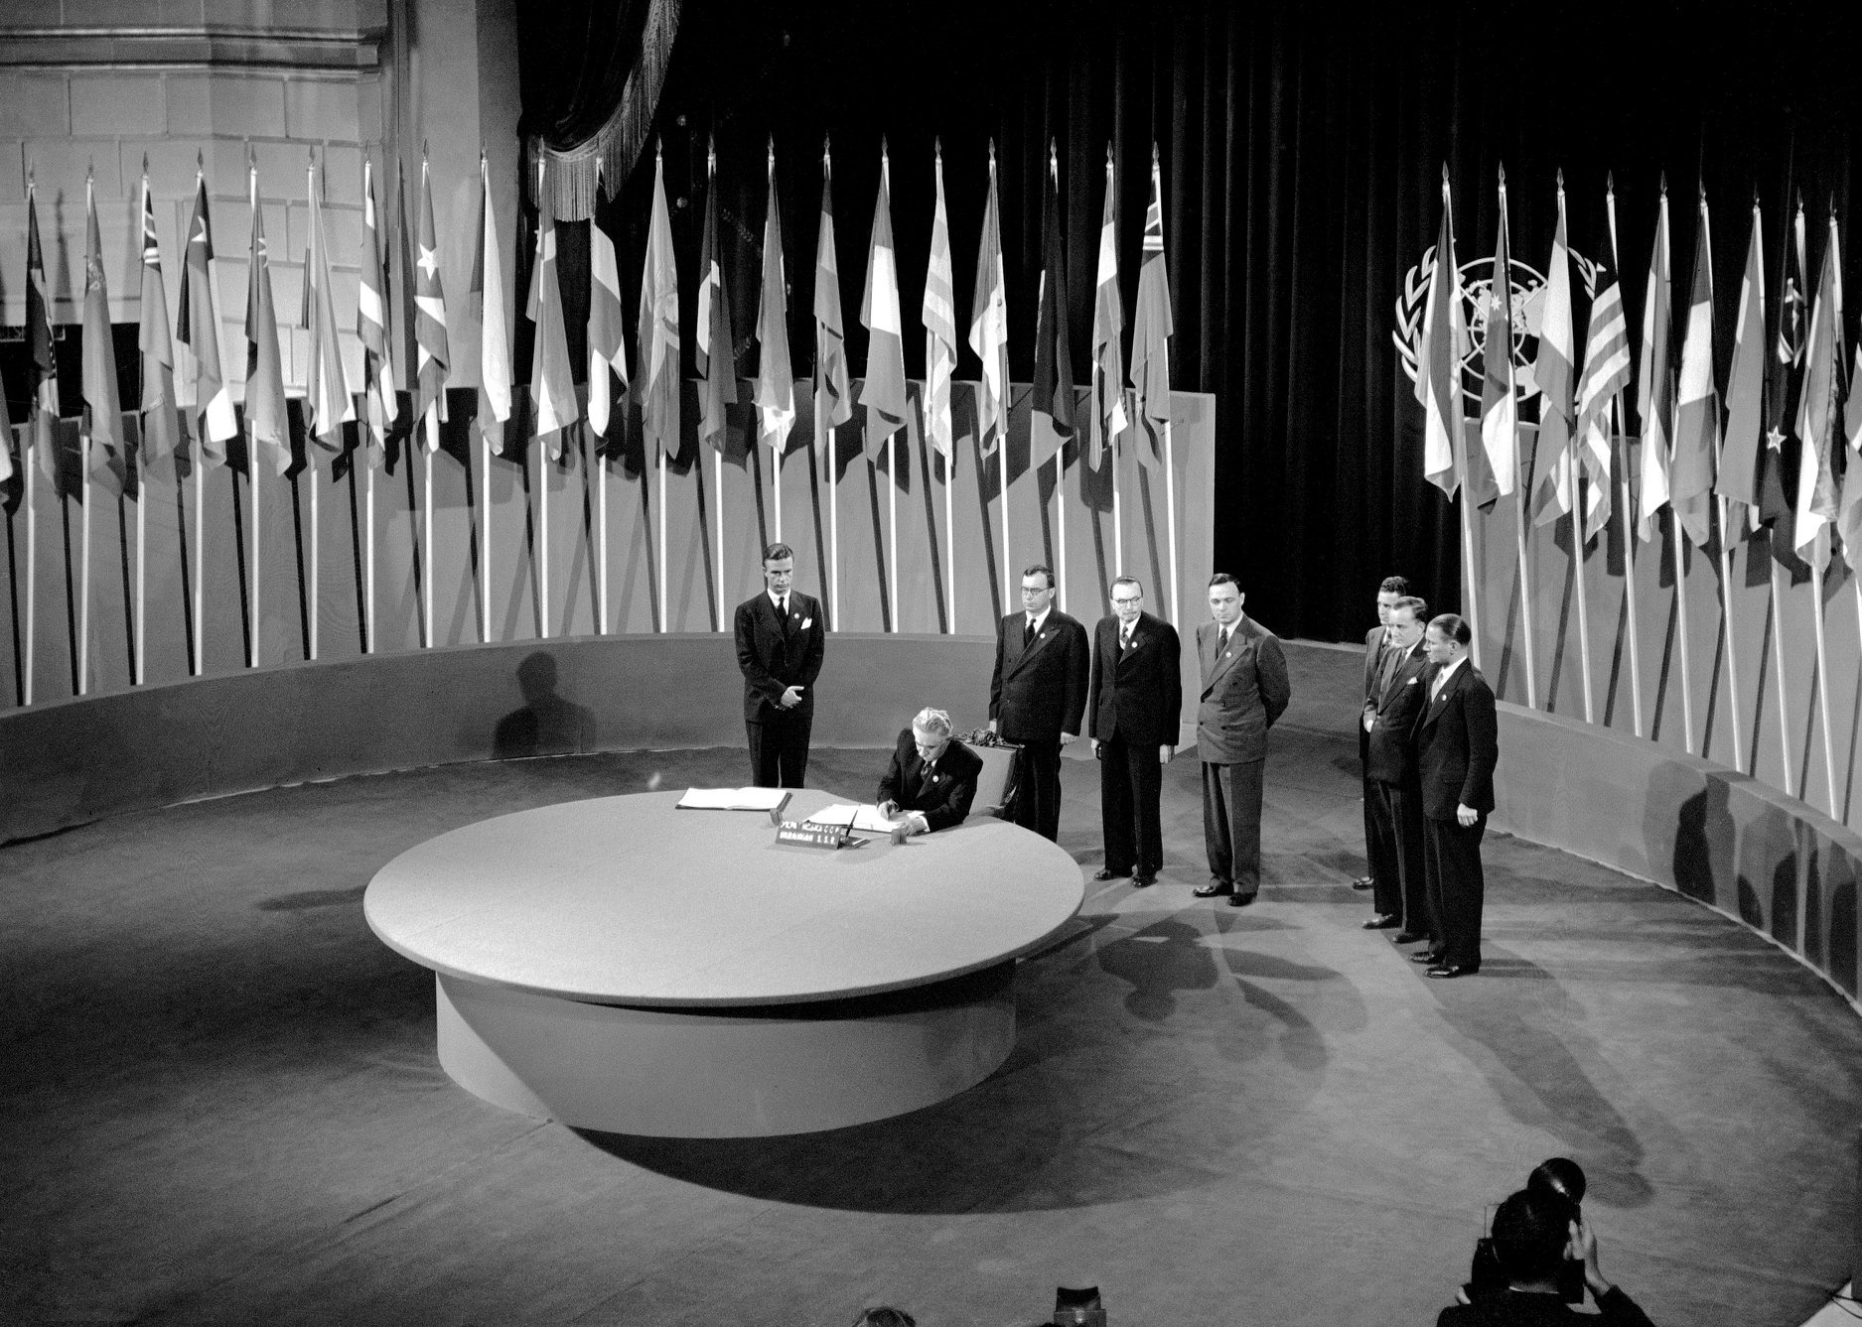
The return of Soviet power
Summer/Autumn 1944: Completing the reconquest of Ukraine
Deportation of Crimean Tatars
1945 – Ukrainian SSR becomes founding member of United Nations
Continuous resistance against Sovietisation by Ukrainian national partisans – collective punishment by Soviet authorities
1946 – Persecution and destruction of the Greek-Catholic Church
1946/47 and 1951/52 – Purges in Ukraine, Fight against Ukrainian nationalism
Propaganda – Unification of Ukraine and starting in wartime Ukraine as second nation of Soviet Union (junior partner of Russians)
1946 – Famine with approx. one million victims
1948-1950 – Forced collectivisation in Western Ukraine
1953 – Stalin’s Death
Ukrainian delegation signing of the charter on the establishment of the UN

Slide 5
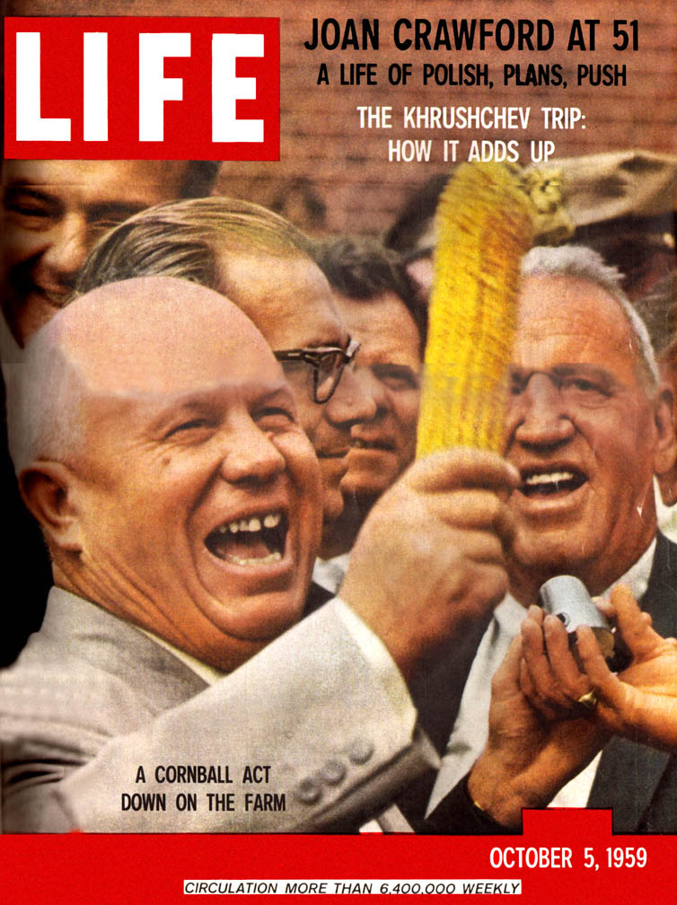
Political and economic developments
1954 – Celebration of the 300th anniversary of the ‘Re-unification of Ukraine with Russia’ – with Crimea transferred to the UkrSSR
1956 – 20th Party Congress of Soviet Communist Party: Beginning of the Thaw
Many political prisoners released from GULag
Khrushchev’s economic reforms
Limits of destalinization
Industrialisation and urbanisation
Influx of Russian workers – and renewal of Russifying impact of cities and towns
Impressive growth rates in first five-year plans but later slowing down
Negative impact and deficiencies of planned economy
Low productivity of agriculture – Soviet Union has to import food since early sixties
Stagnation under Brezhnev – dissatisfaction as elsewhere in Soviet Union with living standard – growing attraction of West

Slide 6
Ukrainisation, Sovietisation and Soviet people
Soviet style Ukrainisation
Increase in number of Ukrainian members of Communist party (but since early 1970’s decline)
Important role of Ukrainians and people born in Ukraine in Moscow (Politbureau) - ‘Dnipropetrovsk Mafia’
1958/59 – School reform – disadvantages Ukrainian (compared to Russian)
Petro Shelest becomes 1st secretary of Ukrainian Communist Party
Support for Ukrainian culture
1968 – Prague Spring
1972 - Shelest replaced by Shcherbyts’kyi as 1st secretary followed by purge in party and arrests of intellectuals (accusation of having promoted Ukrainian ‘nationalism’).
Brezhnev’s concept of Soviet people (merging, bi-lingual accepted but with Russian as unifying language)
increased Russification policy resulting in even many primary schools now Russian language schools in Central and Western Ukraine, almost complete dominance of Russian language in Eastern Ukrainian Universities – Ukrainian in danger of becoming again language of lower classes while Russian language of elite

Slide 7
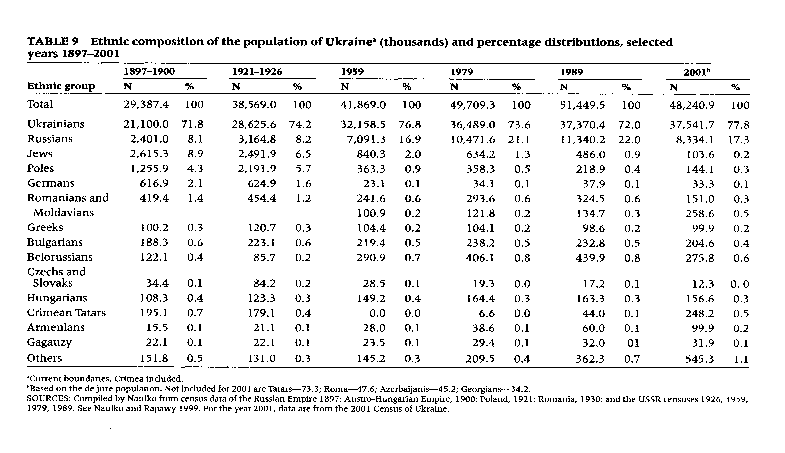
Anatole Romaniuk and Oleksandr Gladun, Demographic Trends in Ukraine: Past, Present and Future, in: Population and Development Review, June 2015, Vol. 41, No. 2, p 325

Slide 8
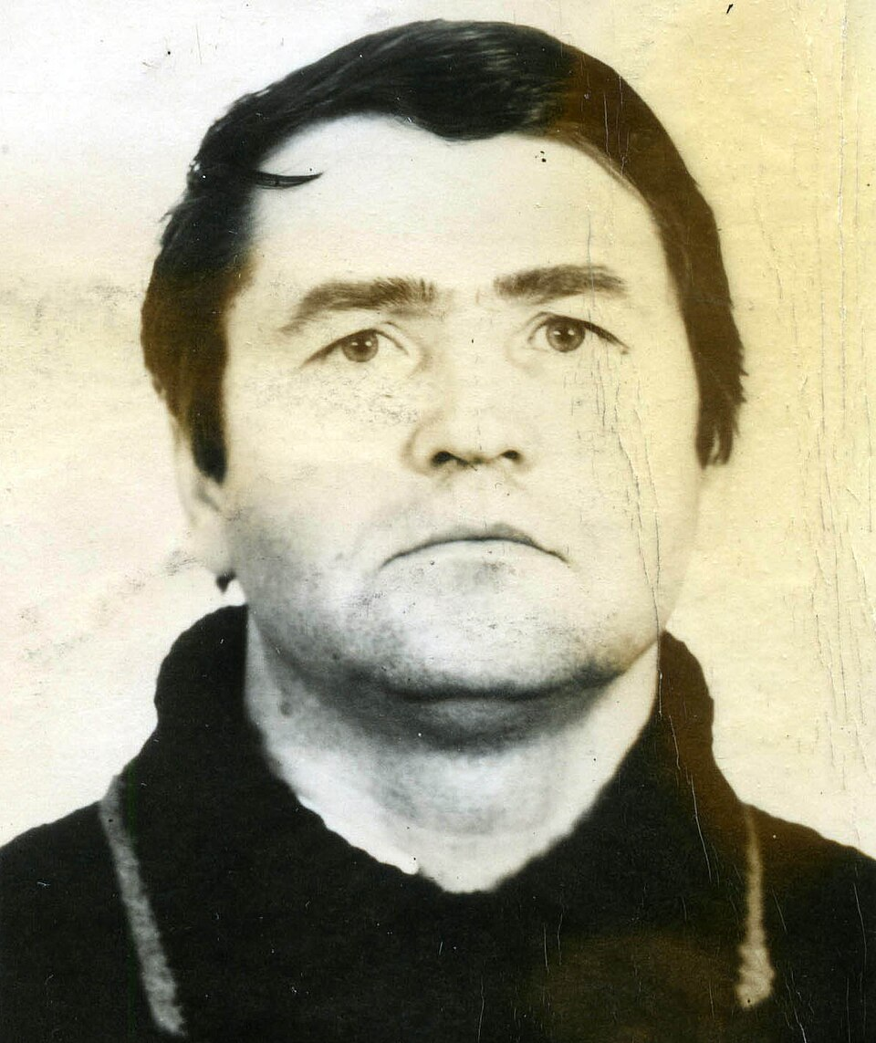
Dissidents
Soviet critical publications during Thaw
1965 – I. Dziuba (on the right) writes ‘Internationalism or Russification’
Ukrainian dissident movement part of Soviet movement but with a Ukrainian twist – protests against Russification and streamlined (Russified) version of Ukrainian history
1976 – Ukrainian Helsinki Committee
1977-1984 – Suppression of Ukrainian opposition – arrests by KGB
Many dissidents in prisons, camps or psychiatric hospitals.

Slide 9
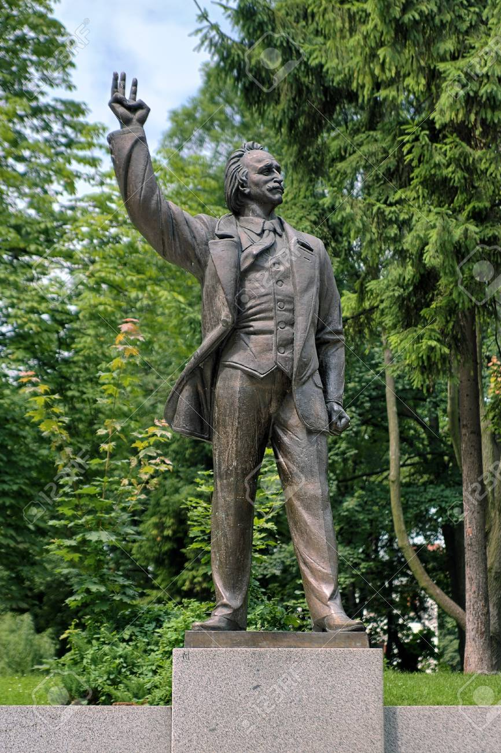
Monument of famous Ukrainian dissident Viacheslav Chornovil (1937-1999) in Lviv

Slide 10
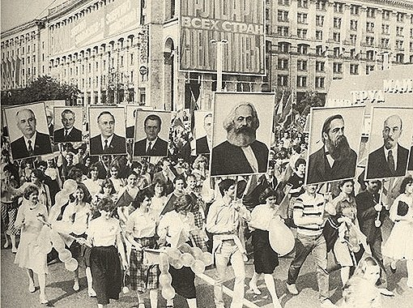
Final years I
1985 – Mikhail Gorbachev elected general secretary of the Soviet Communist Party
Glasnost’ and Perestroika
Ukrainian SSR not at forefront (Shcherbytsky kept tight control)
1986 – Chernobyl catastrophe (reactor 4 in the pic)
Re-constitution of dissident movement
1988 – Release of political prisoners
Rebuilding of Greek Catholic Church in Ukraine (had been in underground and exile)
May Day Parade in Kyiv, just several days after the Chernobyl disaster
(source: https://euromaidanpress.com)

Slide 11
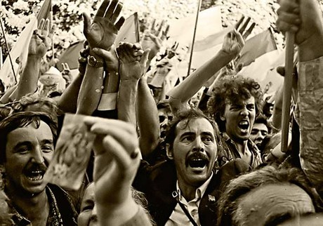
Final years II
Mass demonstrations in Western Ukraine and miner strikes in Donbas (1989)
Foundation of People’s Movement of Ukraine (Rukh)
Resignation of Shcherbytsky
Legalisation of Greek Catholic Church in Ukraine
1990 – Ukrainian becomes state language of Ukrainian SSR
16 July 1990: Ukraine declares sovereignty followed by declaration of independence on 24 August 1991
1 December 1991 – 90% of citizens of Ukraine vote for independent Ukraine
People celebrate the declaration of Ukraine's national independence near the Verkhovna Rada in Kyiv on Aug. 24, 1991 (Source: UNIAN)

Slide 12
The Great Patriotic War and Soviet history policy
Strengthened the legitimacy of the Soviet political system
Second founding myth of the Soviet Union
Part of personality cult of Stalin, replaced later by cult of Red Army and Communist Party
Celebration of Soviet (Russian) heroism in interest of both – veterans and government
Since Brezhnev: monumentalisation of war remembrance
Parades on Red Square: demonstration of strength and unity
Giving meaning to war was quite successful: acceptance of heroic fight against foreign aggression – justification for suffering, for many war veterans and also civilians: most important event of their life. Feeling of unity between regime and population.

Slide 13
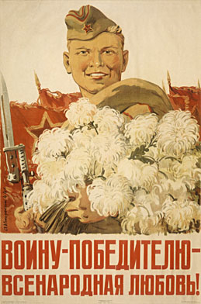
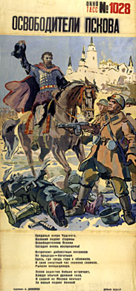
A.A. Kokorekin, The love of the whole nation for the victorious fighter, 1944
A.T. Danilichev, The Liberator of Pskov, 1944

Slide 14
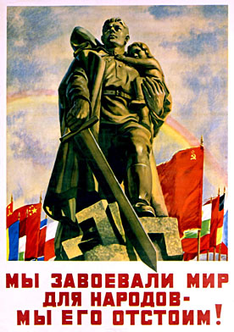
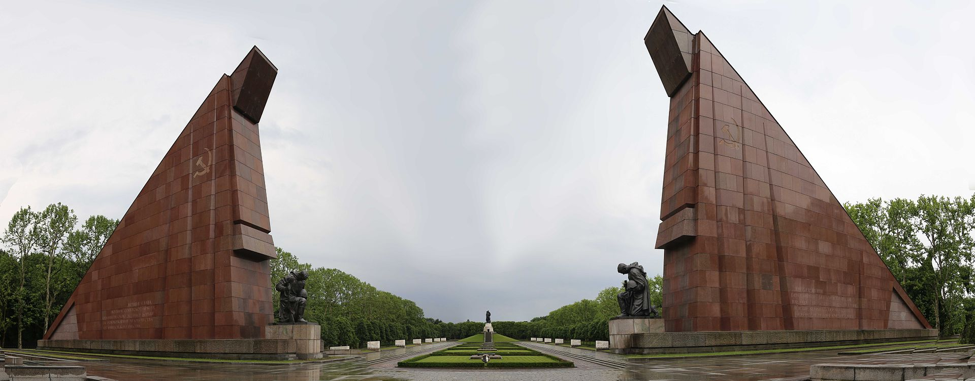
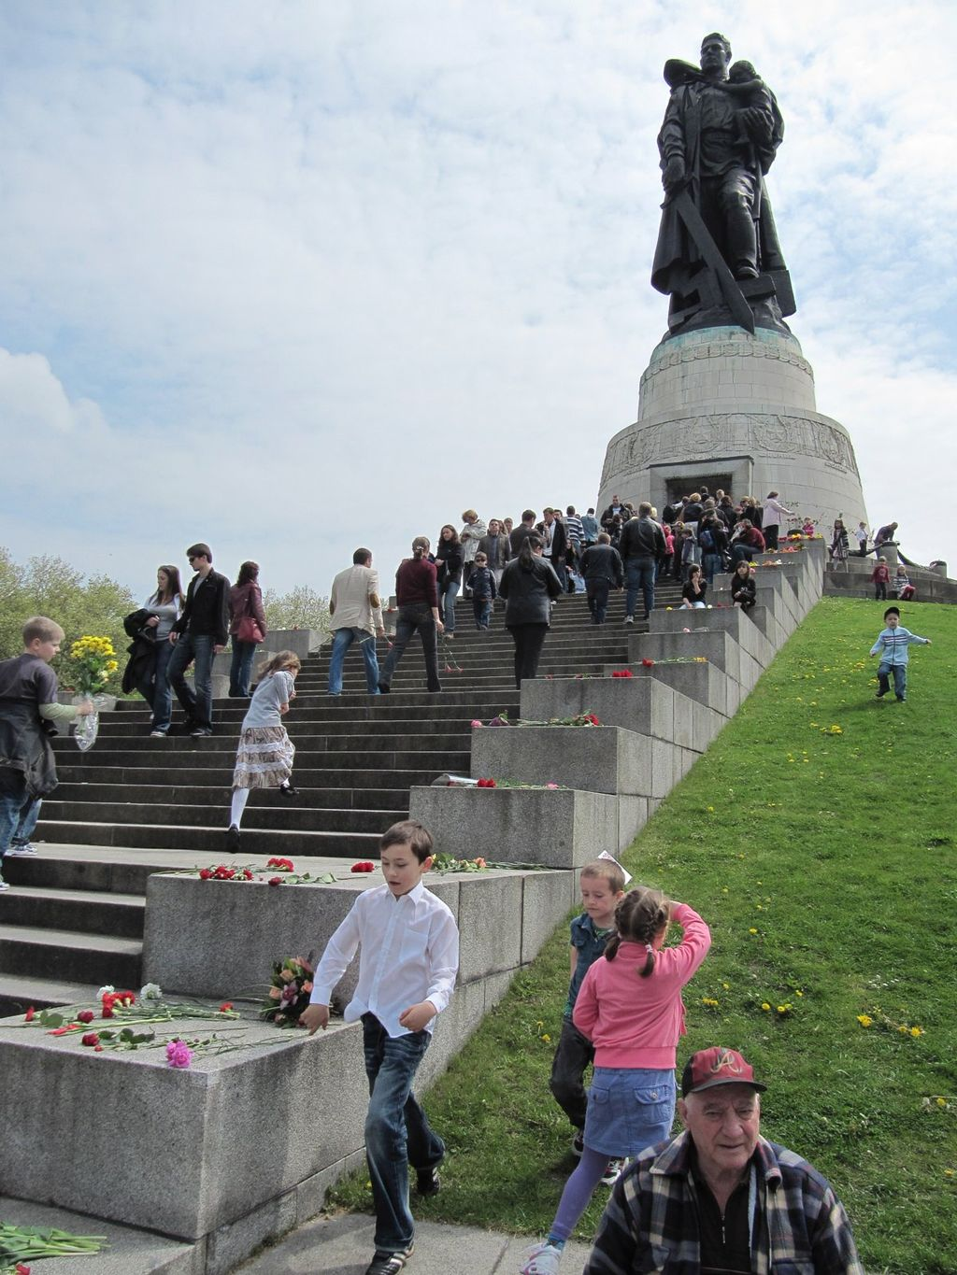
Soviet War Memorial at Treptower Park, Berlin.
N.N. Zhukov, We have fought for peace for the nations – we will defend it!
Moscow, Leningrad, 1950
Sculptor: Yevgeny Vuchetych. Unveiled 8 May 1949 to commemorate the Soviet soldiers fallen in the Battle of Berlin

Slide 15
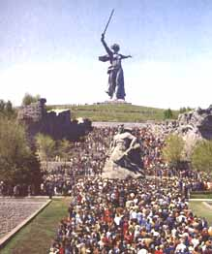
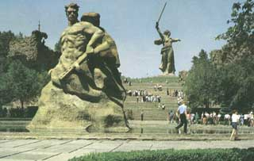
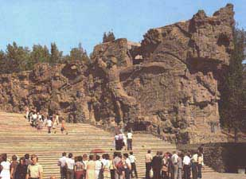
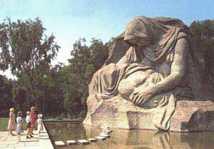

Slide 16
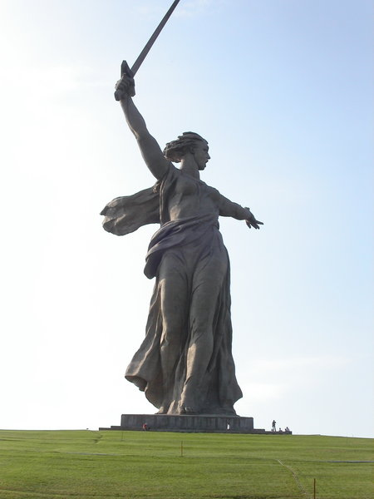
Motherland monument in Stalingrad/Volgograd, Mamayev Kurgan

Slide 17
Ukraine –divided memory
Eastern Ukraine (= in Soviet period official memory for all Ukraine)
Heroes: Red Army soldiers
Close to Soviet interpretation
Liberation and unification of Ukraine – culmination of Ukrainian history thanks to brotherhood with Soviet Union and Russian nation
Ukrainian national partisans, collaborators with Germans, German agents, traitors to Ukrainian nation
No issues with suppression of Greek-Catholic Church
Western Ukraine (exile and private)
Heroes: nationalist partisans
Official interpretation contradicts own view
Several years’ fighting against incorporation in Soviet Union
Problem of collaboration with Germans, Wolhynian massacres and anti-Semitic attitude of integral nationalists
Ukrainian partisans recognised as soldiers and fighters for liberty, heroes of Ukraine
Forced unification of Greek-Catholic Church with Russian Orthodox Church in 1947 = attack on key component of Western Ukrainian identity

Slide 18
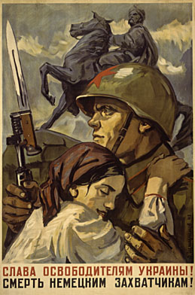
D.A. Shmarinov,
Glory to the liberators of Ukraine!
Death to the German invaders!
Moscow, Leningrad 1941

Slide 19
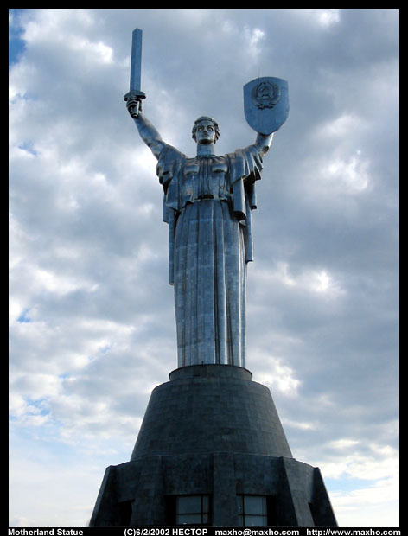
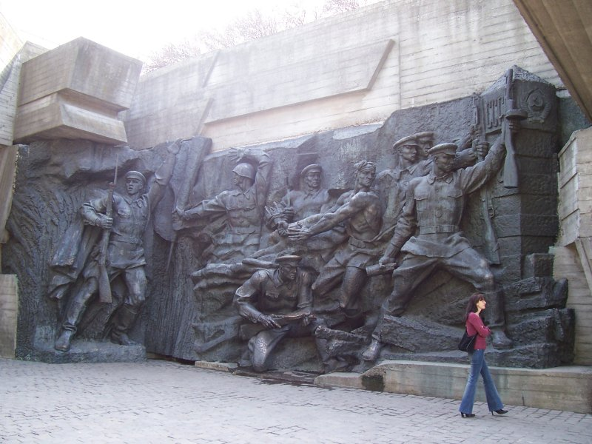
Motherland statue, Kyiv, 1981, 62 m
Previously: National Museum of the History of the Great Patriotic War of 1941-1945 years
Today (after 2015): National Museum of the History of Ukraine in the Second World War

Slide 20
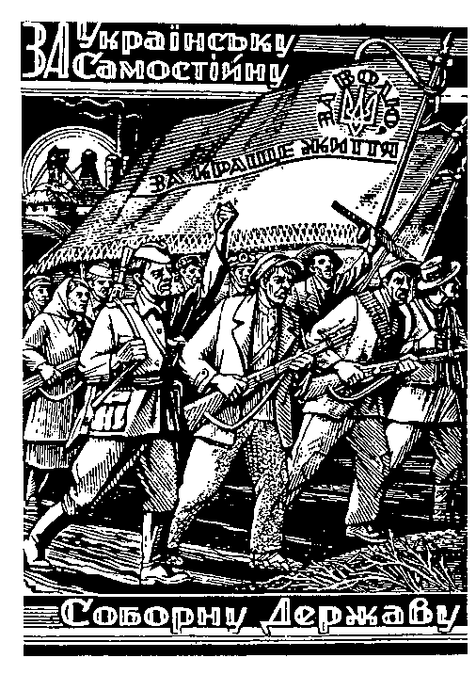
"For an independent and sovereign Ukrainian State"
On the flag: "For Liberty and a better life."
A woodcut by Nil Khasevich, an underground UPA artist

