Slide 1
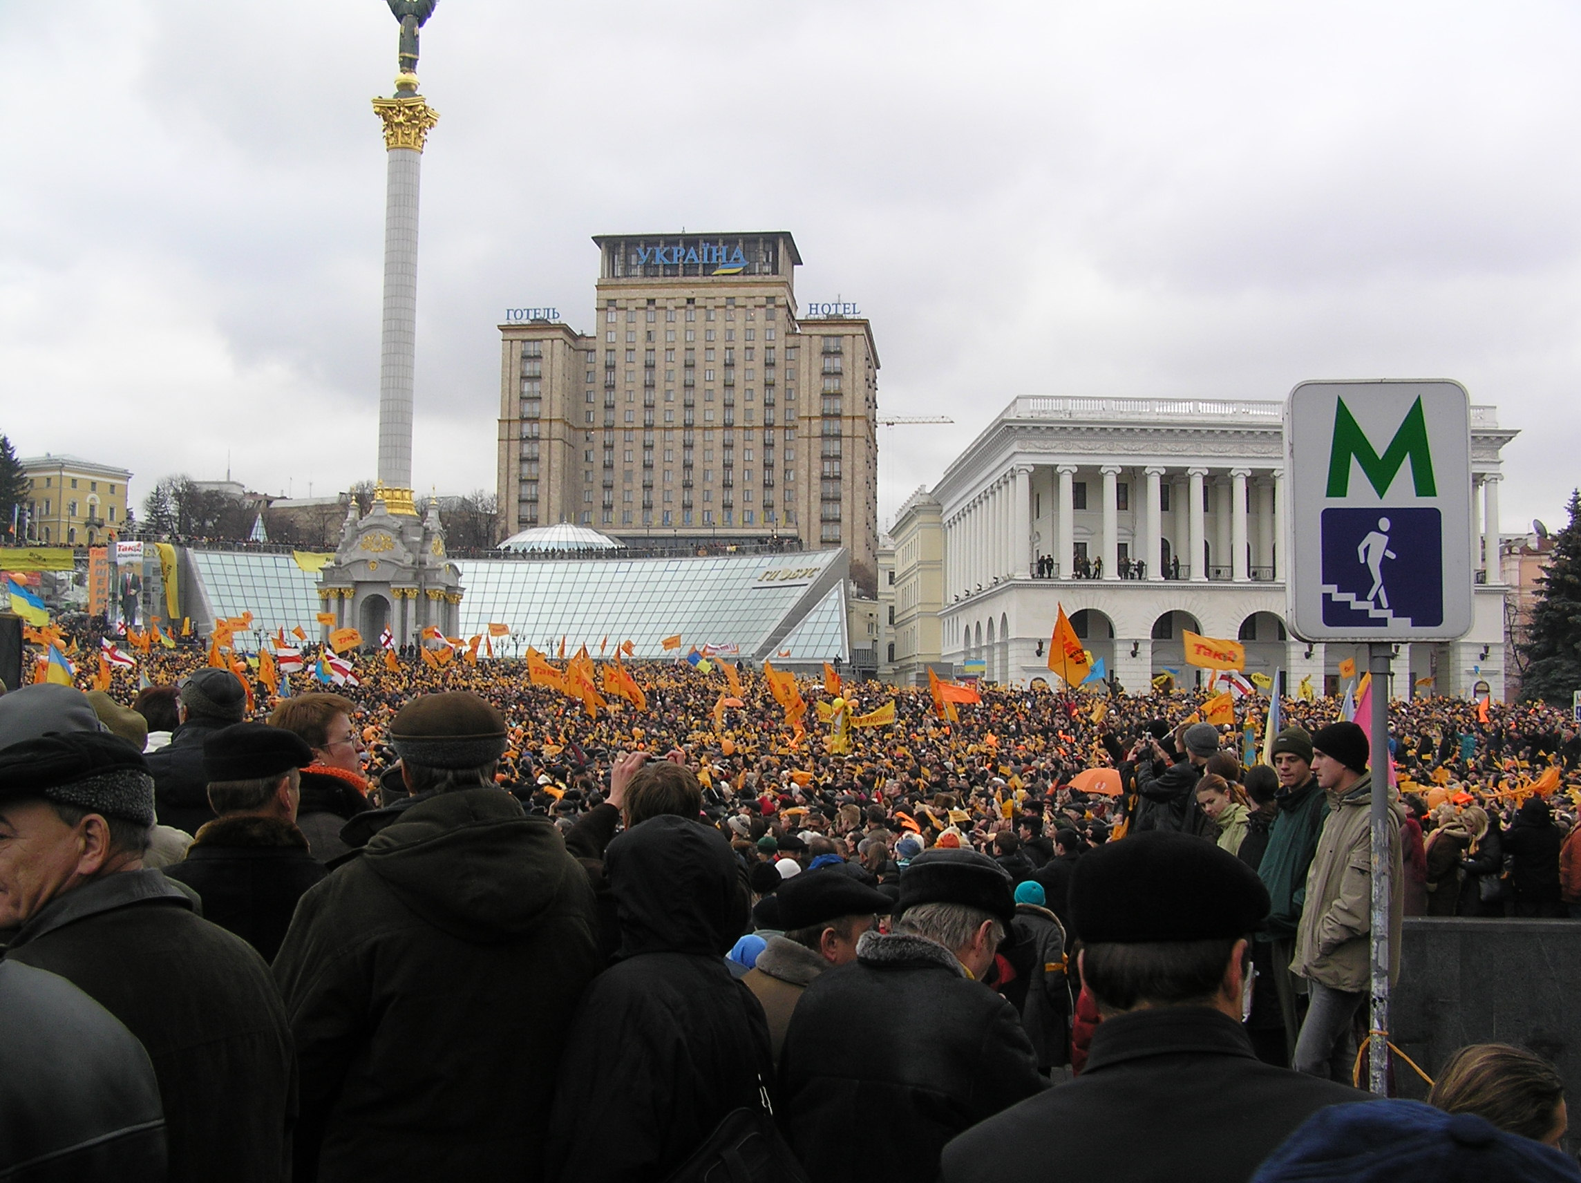
Entangled History: Ukraine and her neighbours from the Middle Ages to the present
Lecture 19
Trials, tribulations, and choices: Ukraine and her neighbours after the fall of the Soviet Union
Orange Revolution in Kyiv (author: Serhiy)

Slide 2
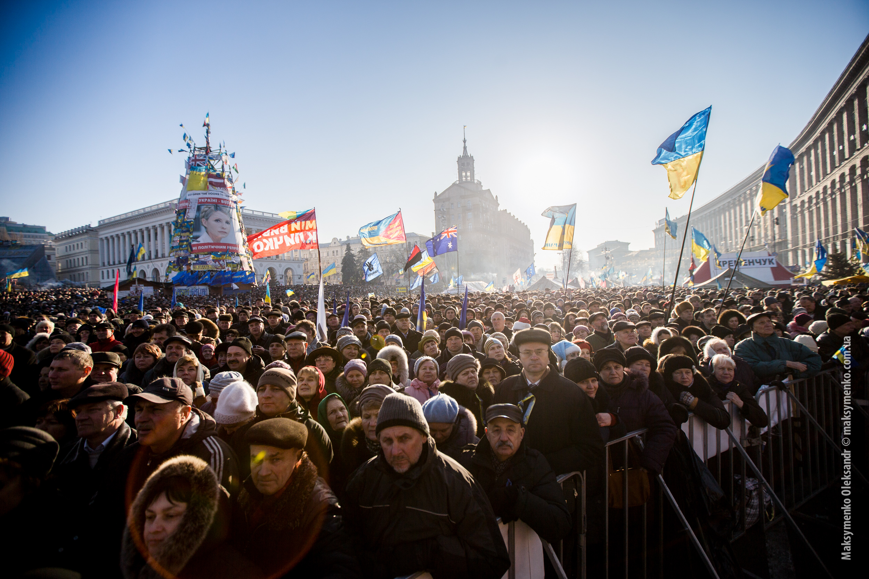
Outline
The difficult 1990s
Presidential elections
From the Orange Revolution to Euromaidan
Civic vs ethnic identity: the language issue
History and Politics in Poland, Ukraine, and Russia
Conclusion
Protesters in Kyiv on 29 December 2013 (source: Sasha Maksymenko)

Slide 3
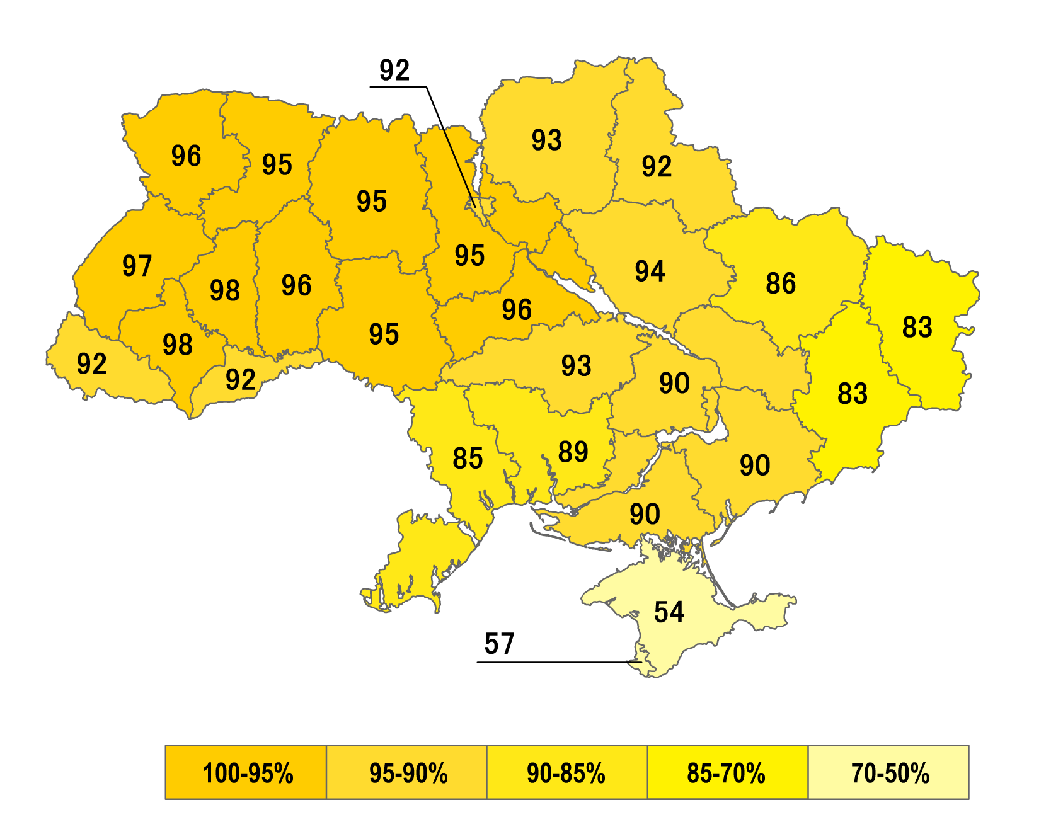
Difficult 1990s
Referendum 1 December 1991: "Do you support the Act of Declaration of Independence of Ukraine?”

Slide 4
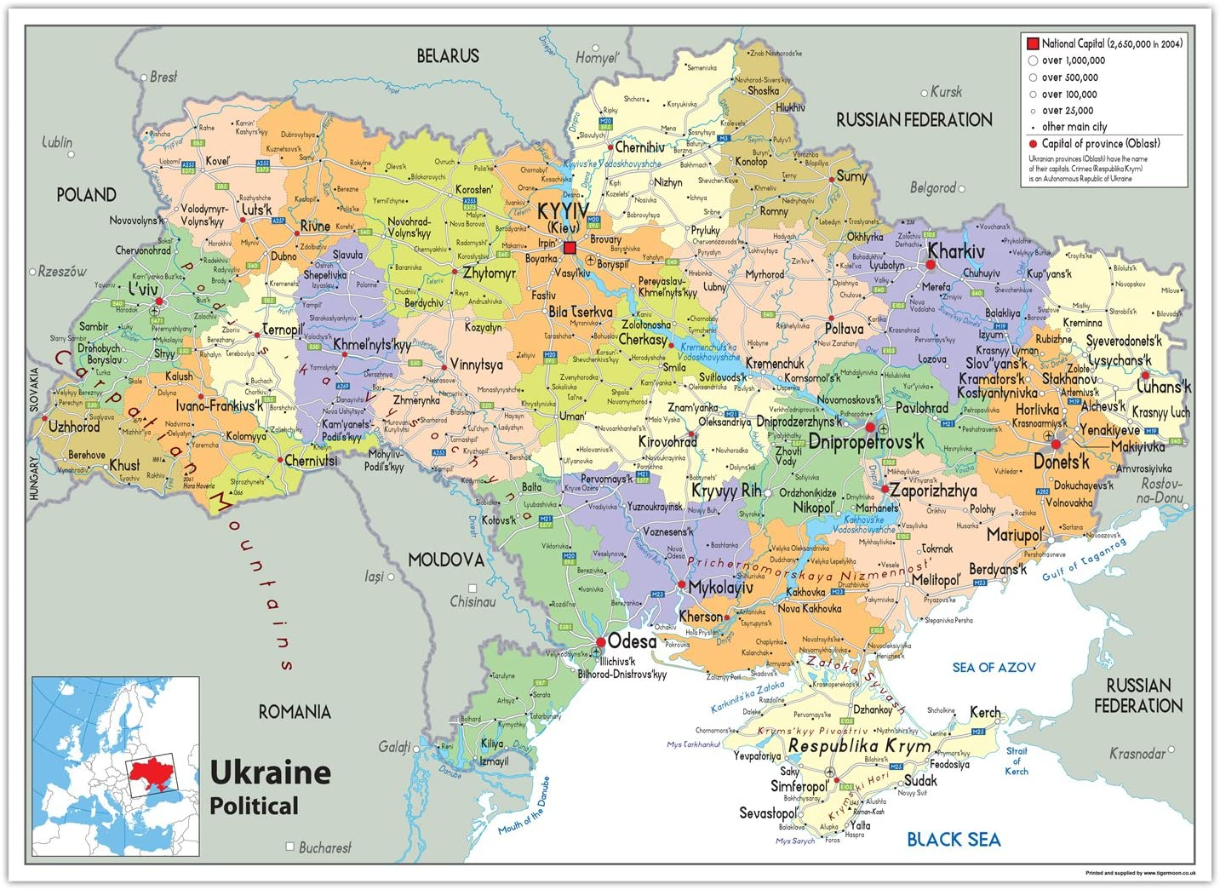

Slide 5
1990s
1991 Ukrainian independence
Continuity of elites and the influence of ‘Ukrainians abroad’
Assets: Science, technology, people and skills, black earth
Economic difficulties – lack of reforms under Kravchuk
Hyperinflation and subsidies for inefficient factories
Privatisation and the rise of the oligarchs – under Kuchma
Difficult relationship with Russia: Surrendering of nuclear weapons, Crimea and the Black Sea fleet, Russian speakers in Ukraine, energy dependency
Emigration and population decline
Corruption and abuse of power
A country divided?

Slide 6
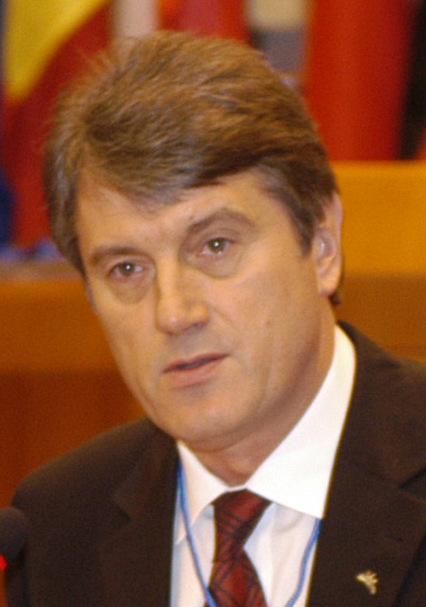
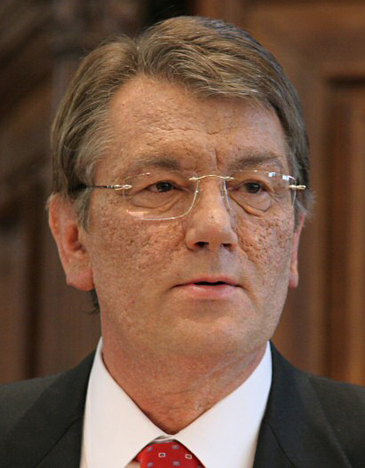
Ukrainian Presidents
Leonid Kravchuk 1991 – 1994
Leonid Kuchma 1994 – 2005
Viktor Yushchenko 2005 – 2010
Viktor Yanukovych 2010 – 2014
Petro Poroshenko 2014 – 2019
Volodymyr Zelensky 2019 – ?
Viktor Yushchenko before and after poisoning

Slide 7
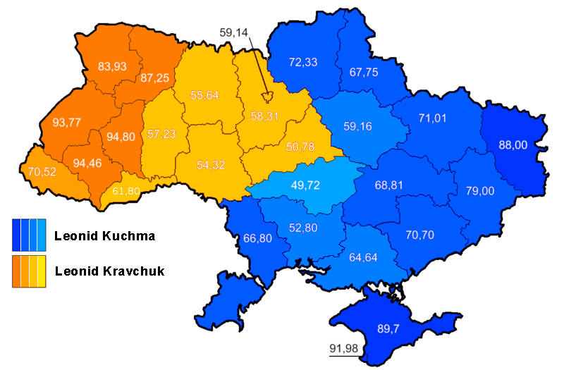
Presidential elections 1994, 2nd round, Kuchma 52.35%, Kravchuk 45.24%

Slide 8
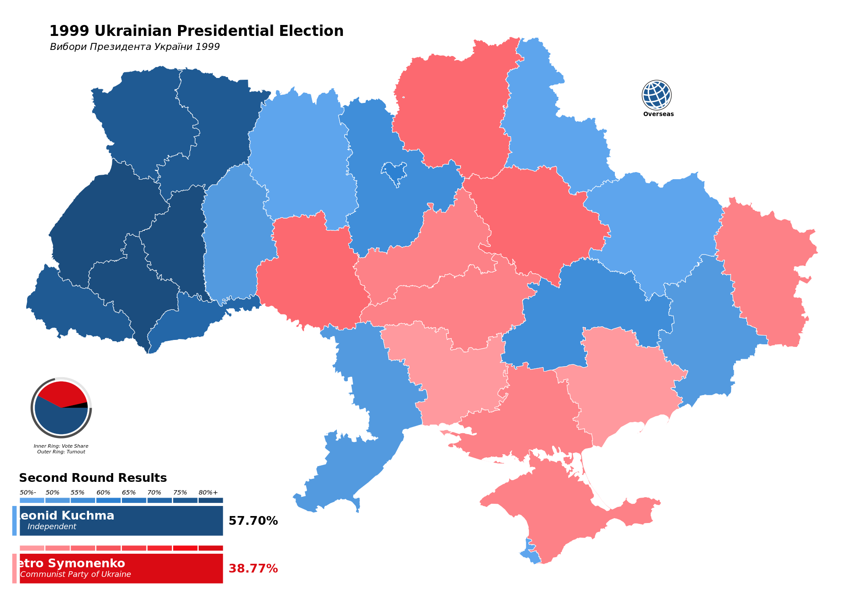

Slide 9
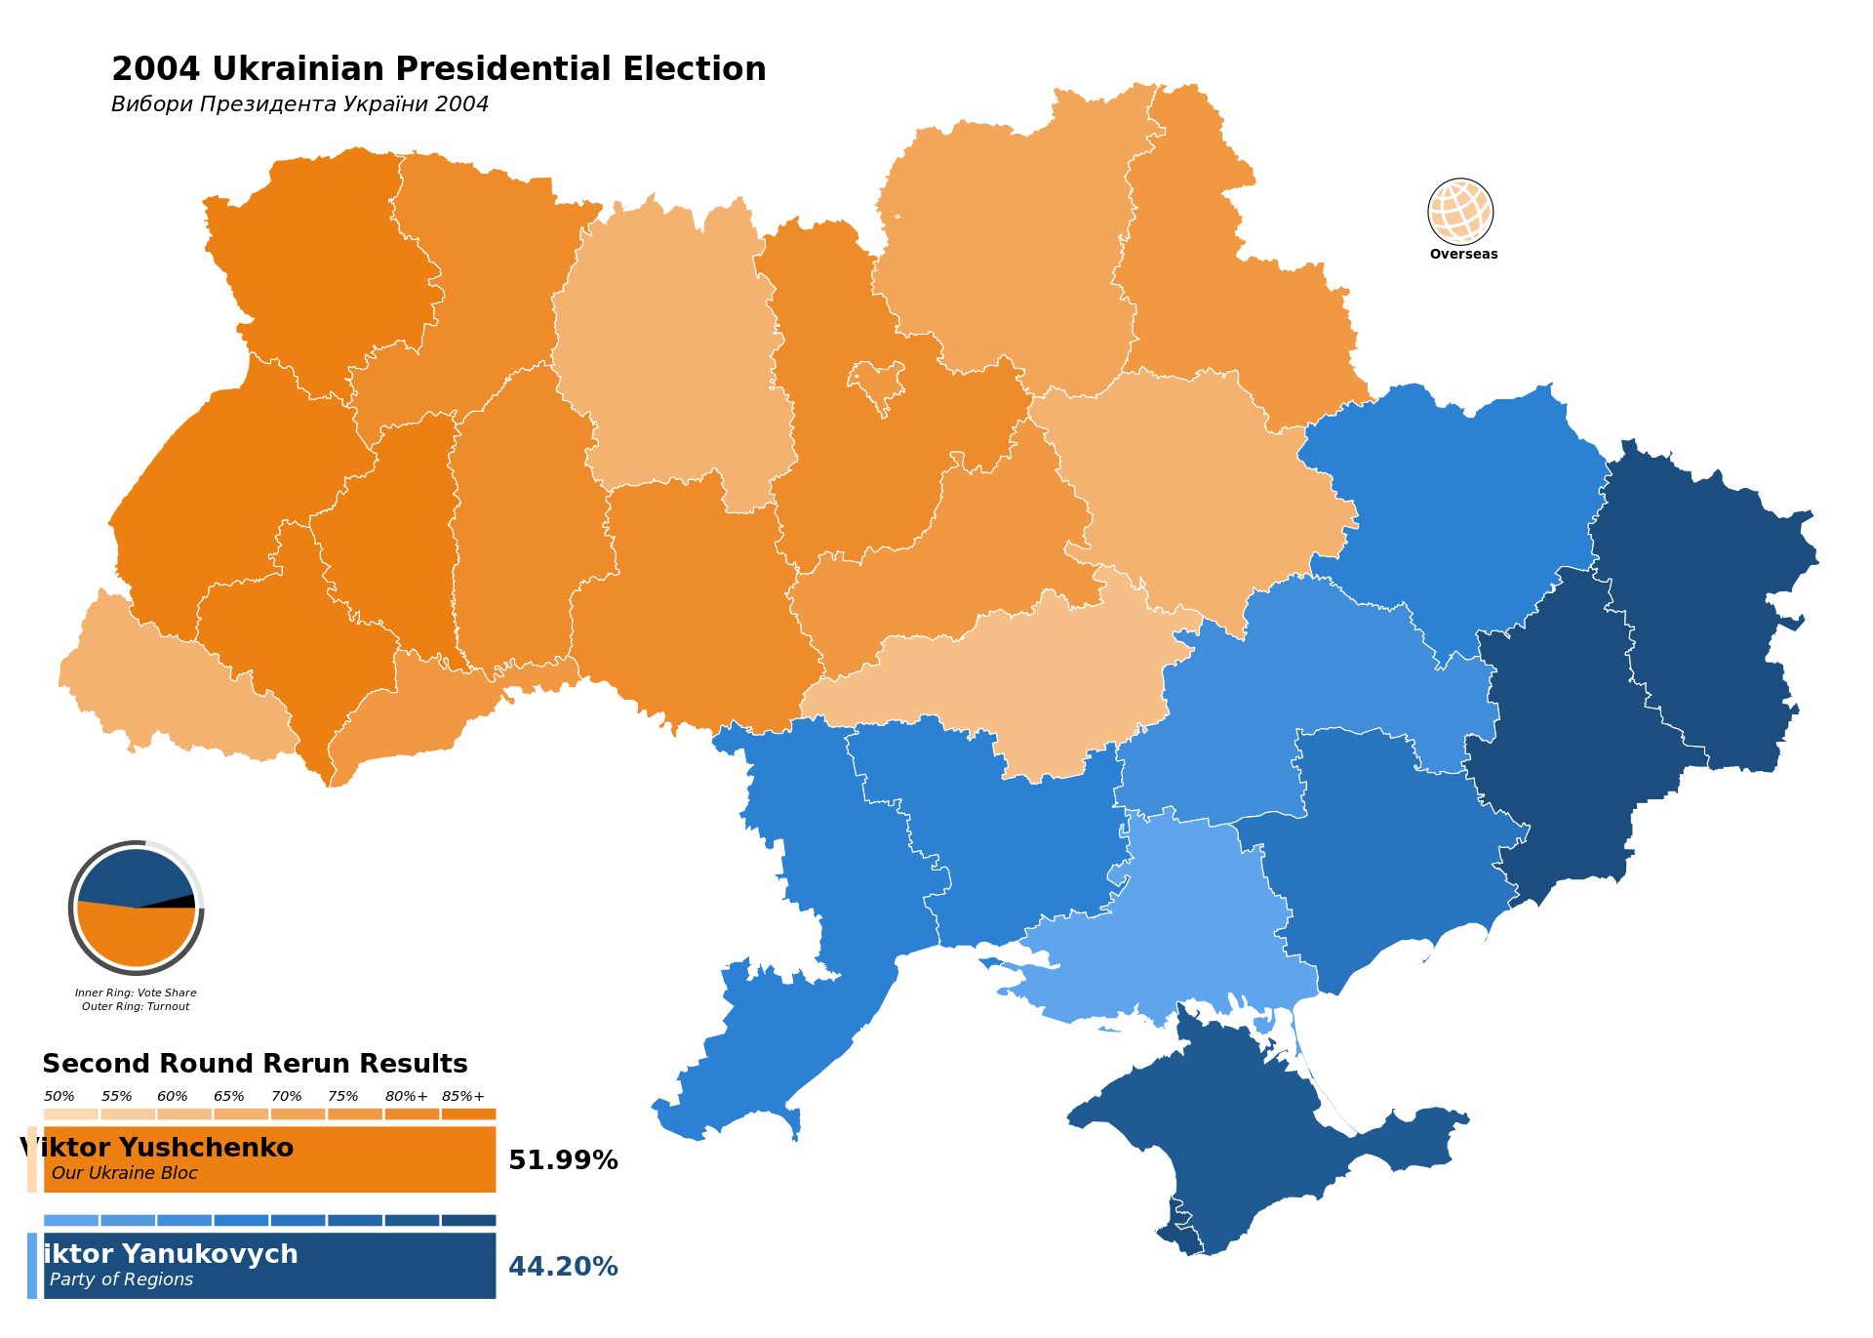

Slide 10
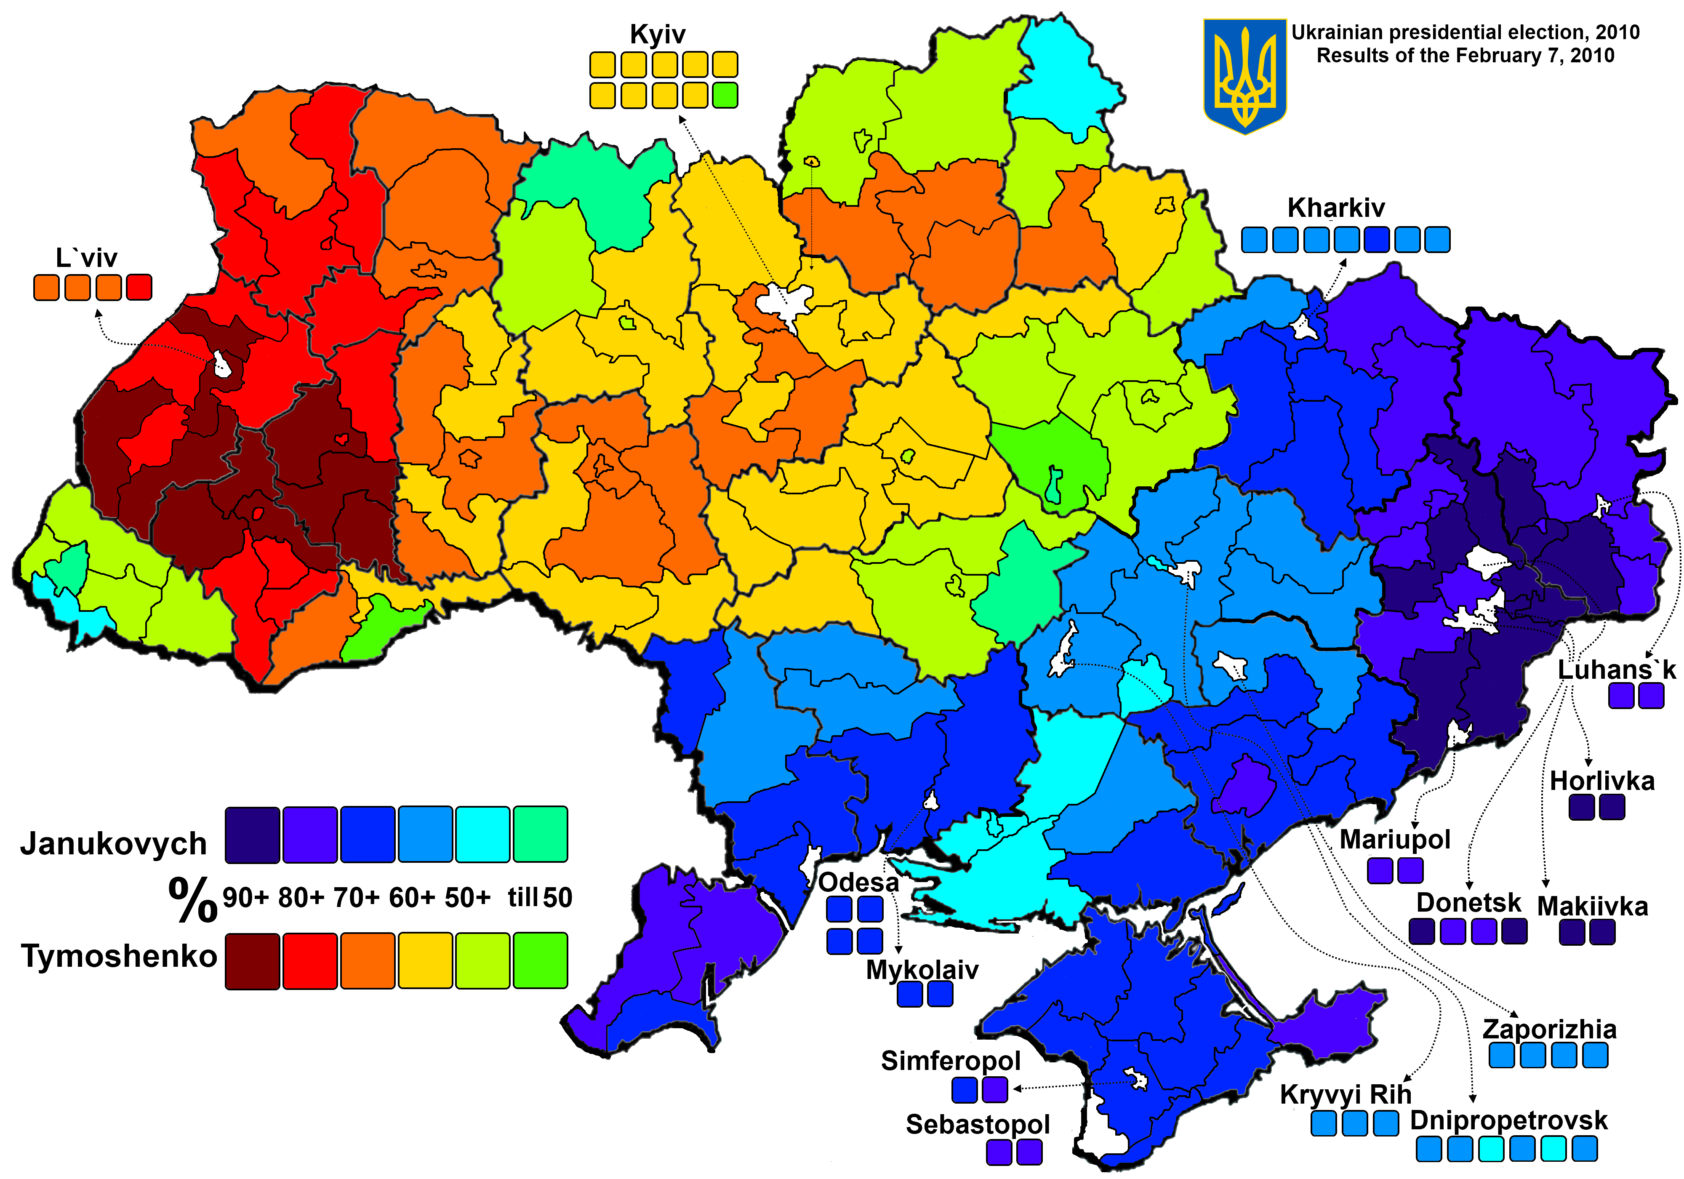

Slide 11
Ukraine: from the Orange Revolution to Euromaidan
2004 Orange Revolution after rigged presidential elections and following mass protests on Kyiv Maidan, election of Yushchenko to president
2010 Election of Yanukovych to president
November 2013 Suspension of trade deal with EU and begin of protests in Kyiv (Euromaidan)
February 2014 Yanukovych flees Kyiv
March 2014 Russian annexation of Crimea, following illegal and controlled referendum
April/May 2014 Russian-supported separatist groups in Donetsk and Luhansk regions rebel against Kyiv and proclaim People’s Republics
Since April 2014 War between Regular and paramilitary Ukrainian forces against rebel army, paramilitary troops, volunteers from Russia and regular Russian forces (initially denied by Russian government)
September 2014 Minsk agreement (ceasefire), attempt to freeze conflict along existing demarcation lines, does not hold, many (broken) ceasefires

Slide 12
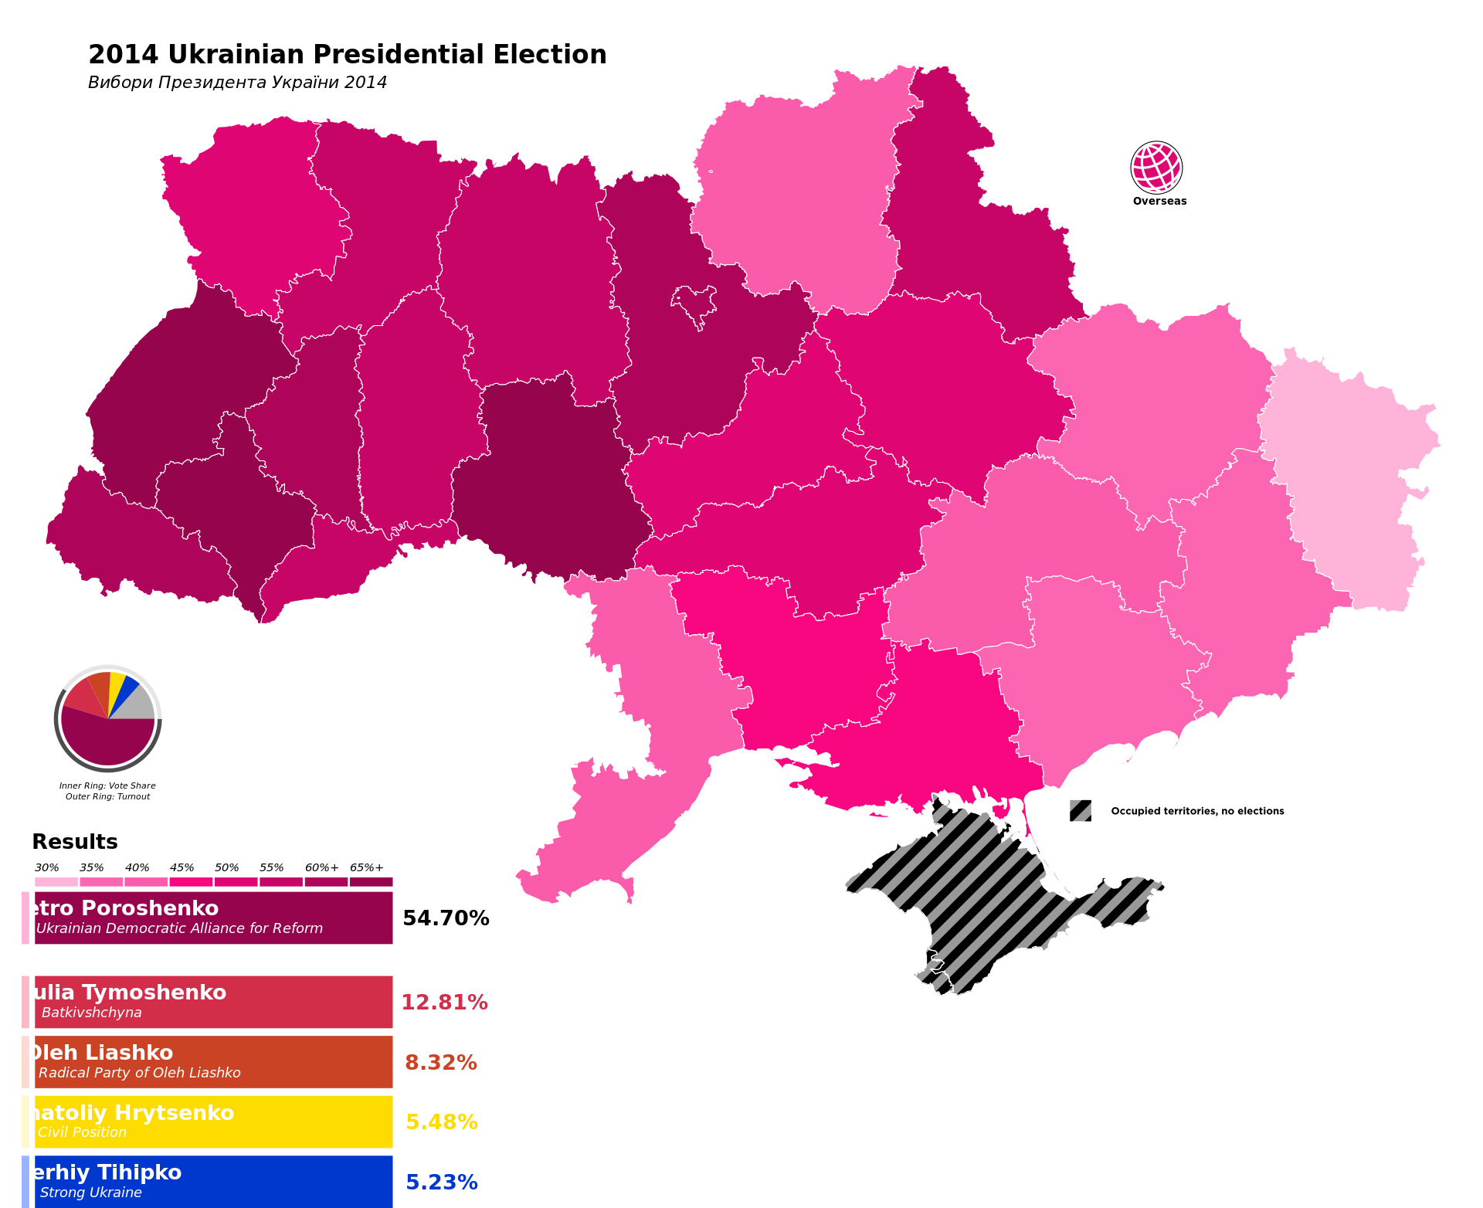

Slide 13
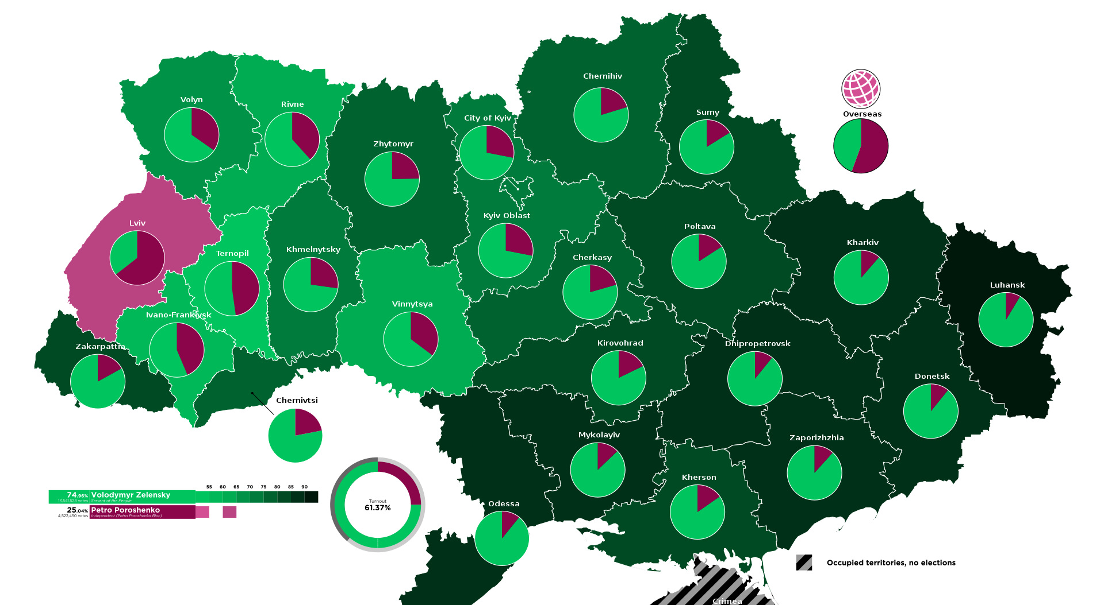
2019 presidential elections: Green: Zelensky; Red: Poroshenko

Slide 14
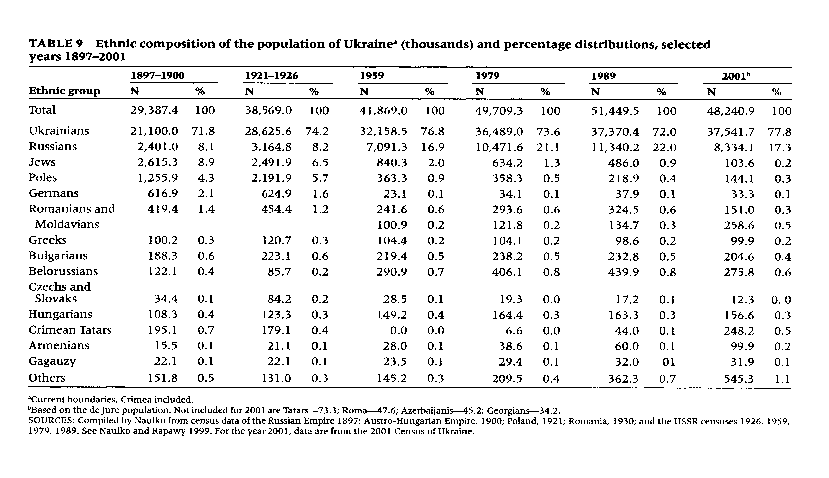
Civic vs. ethnic identity: The language issue
Anatole Romaniuk and Oleksandr Gladun, Demographic Trends in Ukraine: Past, Present and Future, in: Population and Development Review, June 2015, Vol. 41, No. 2, p 325

Slide 15
 | Total (in 1000s) | in % of results |  | 2001 in % to 1989
 |  | 2001 | 1989
Ukrainians | 37541.7 | 77.8 | 72.7 | 100.3
Russians | 8334.1 | 17.3 | 22.1 | 73.4
Belarusians | 275.8 | 0.6 | 0.9 | 62.7
Moldovans | 258.6 | 0.5 | 0.6 | 79.7
Crimean Tatars | 248.2 | 0.5 | 0.0 | 530.0
Bulgarians | 204.6 | 0.4 | 0.5 | 87.5
Hungarians | 156.6 | 0.3 | 0.4 | 96.0
Romanians | 151.0 | 0.3 | 0.3 | 112.0
Poles | 144.1 | 0.3 | 0.4 | 65.8
Jews | 103.6 | 0.2 | 0.9 | 21.3
Armenians | 99.9 | 0.2 | 0.1 | 180.0
Greeks | 91.5 | 0.2 | 0.2 | 92.9
Tatars | 73.3 | 0.2 | 0.2 | 84.4
‚Gypsies‘ (Sinti und Roma) | 47.6 | 0.1 | 0.1 | 99.3
Azeri | 45.2 | 0.1 | 0.0 | 122.2
Georgians | 34.2 | 0.1 | 0.0 | 145.3
Germans | 33.3 | 0.1 | 0.1 | 88.0
Gagauz | 31.9 | 0.1 | 0.1 | 99.9
Others | 177.1 | 0.4 | 0.4 | 83.9
Nationalities in Ukraine, 1989 and 2001

Slide 16
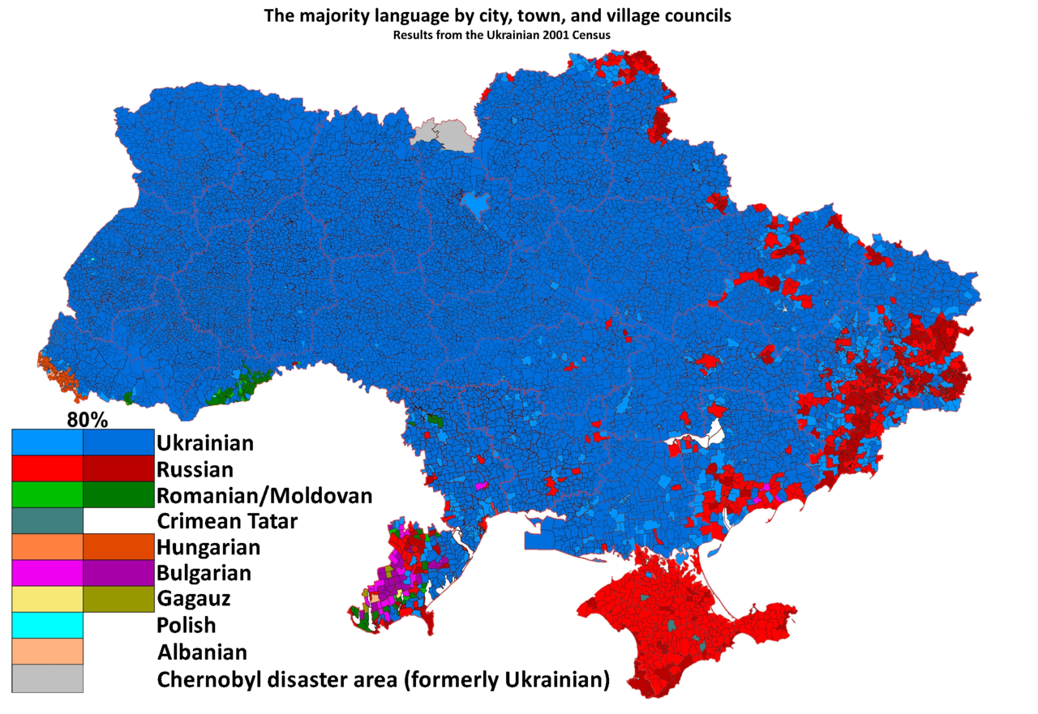
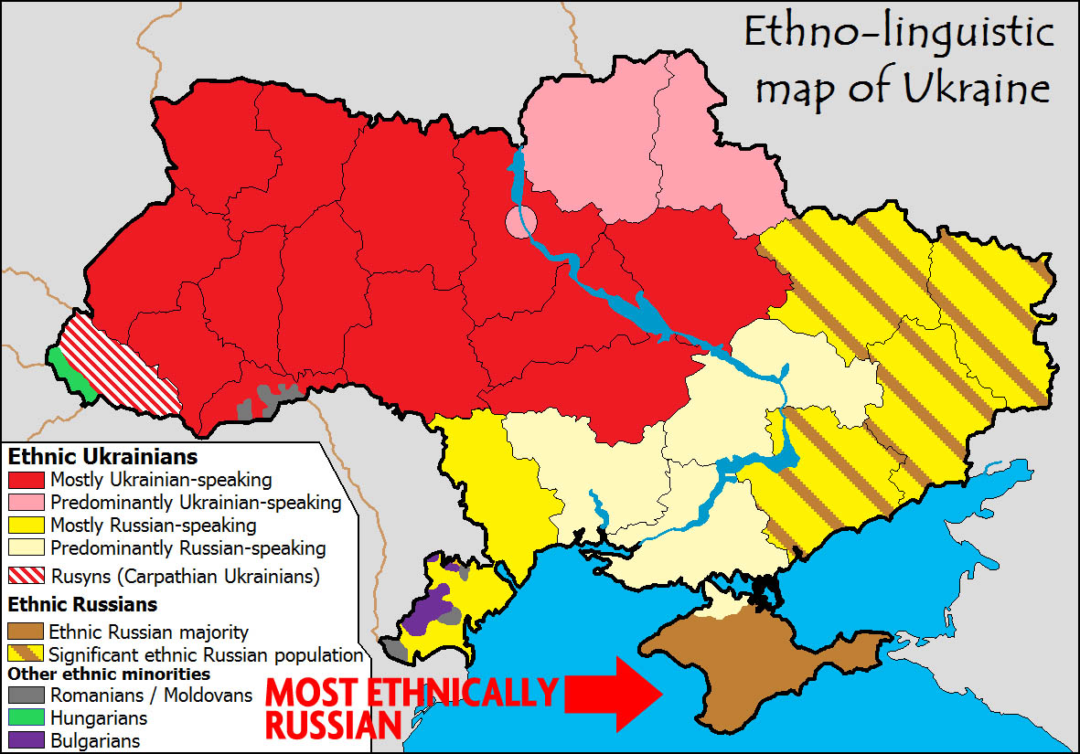
Ukraine – civic and/or ethnic nation?
Language policy – issues
Russian-Ukrainian families
Surzhyk
The role of the Ukrainian language

Slide 17
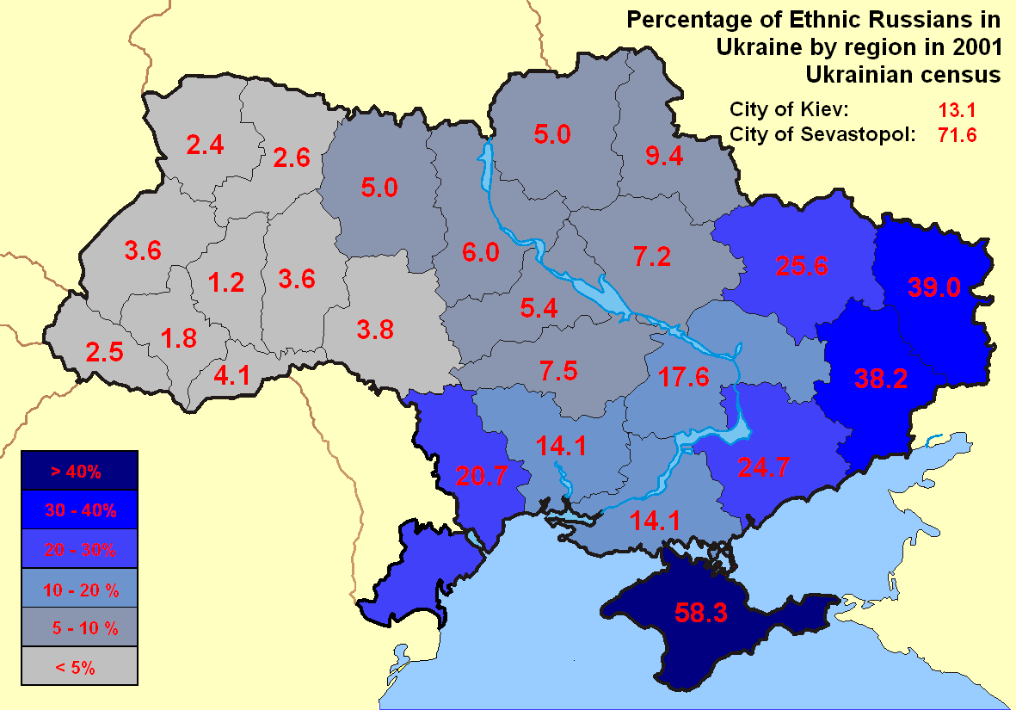
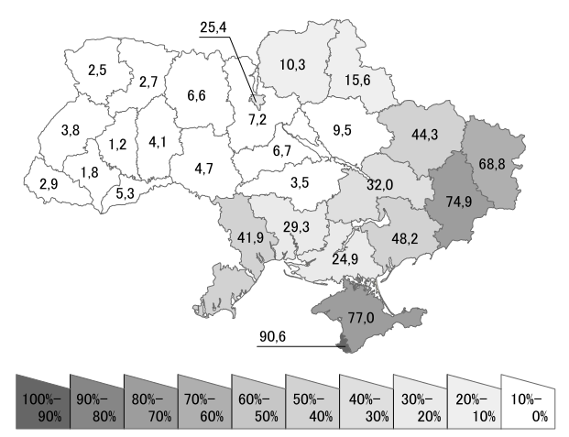
Percentage of native Russian speakers in Ukraine by region in 2001 Ukrainian census

Slide 18
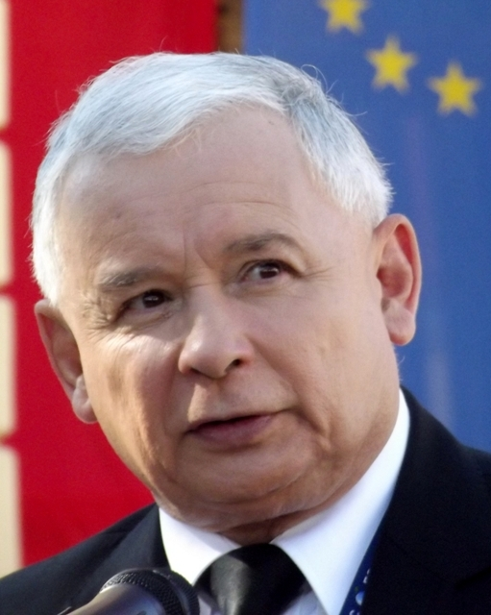
History Policy in Poland
A parliamentary republic
The Law and Justice Party in power, 2015 - 2023
A positive image of Polish history
The Institute of National Remembrance
The suffering and fighting nation
Legitimate concerns: Death camps in Poland
The contested issue of anti-Semitism in 20th century Poland
Polish ‘identity’ – Catholic and conservative moral values
Dangers of European integration and globalisation
Polish Civil Society – fight back and Tusk’s victory

Slide 19
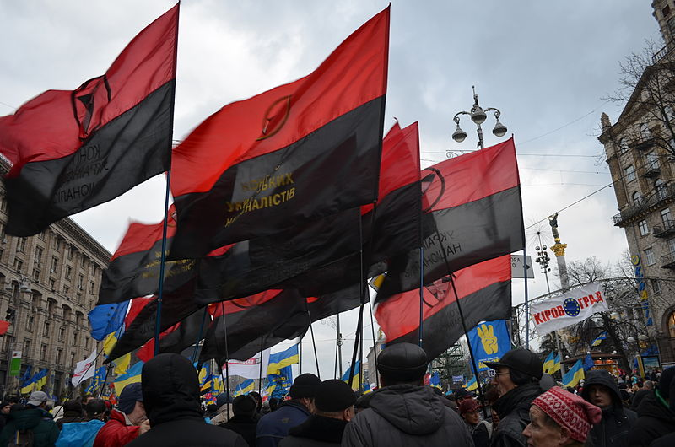
History Policy in Ukraine
Independence 1991, Orange Revolution,
2004, Euromaidan 2013/14
How to write the history of Ukraine? State, territory, people
The Institute of National Memory
Connection with Russian history
The debate on 20th century Ukrainian nationalism: Organisation of Ukrainian Nationalists, Ukrainian Insurgent Army, SS Division Galicia
The Ukrainian Famine and the Soviet past
Civil Society
History and nation building

Slide 20
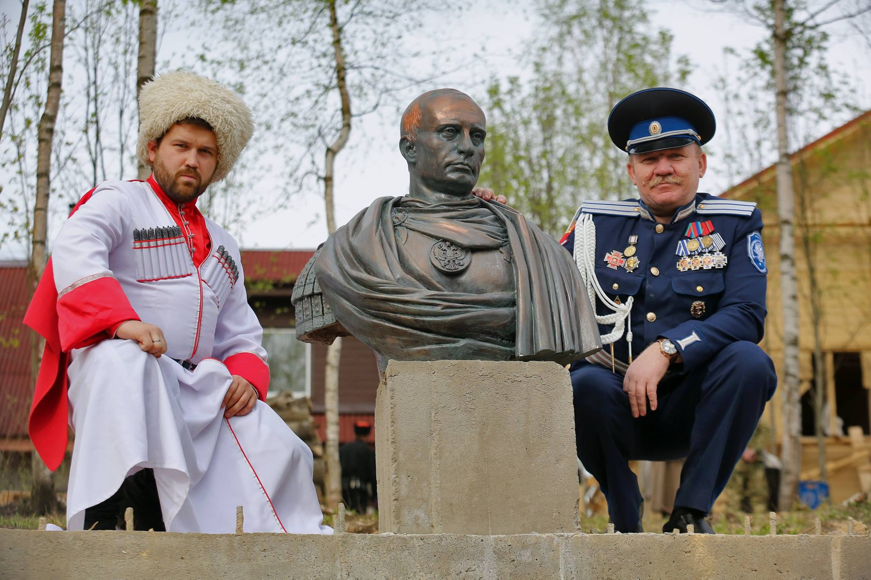
History Policy in Russia
How to write Russian history? Empire and nation
Phantom pain: the collapse of the Soviet Union
Great power status
Soviet past: positive or negative
Ukrainian History – Russian History: Complicated relationship to Ukrainian nation building and statehood
Territory: Crimea, Donetsk, Zaporizhia, Kherson and Luhansk regions – and what else?
Memorial and Civil Society
’Russian World’, Eurasianism and ‘Russia as a European Power’
Putin’s Russia – from authoritarianism to fascism?

Slide 21
Conclusion
On different trajectories: Poland, Ukraine, Russia
The burden of history
Russia withdraws from Europe
Ukrainian choices
Forging the nation

