Slide 1
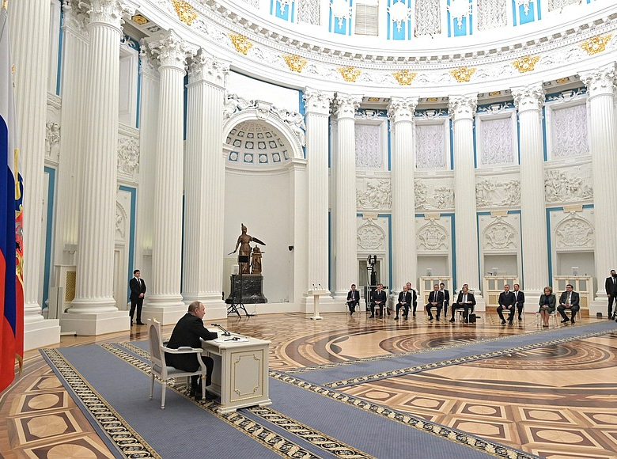
Entangled History: Ukraine and her neighbours from the Middle Ages to the present
Lecture 20
War and revision
Russia’s Security Council meeting on the recognition of the independence of the separatist self-proclaimed Donetsk and Luhansk People Republics (21 February 2022)

Slide 2
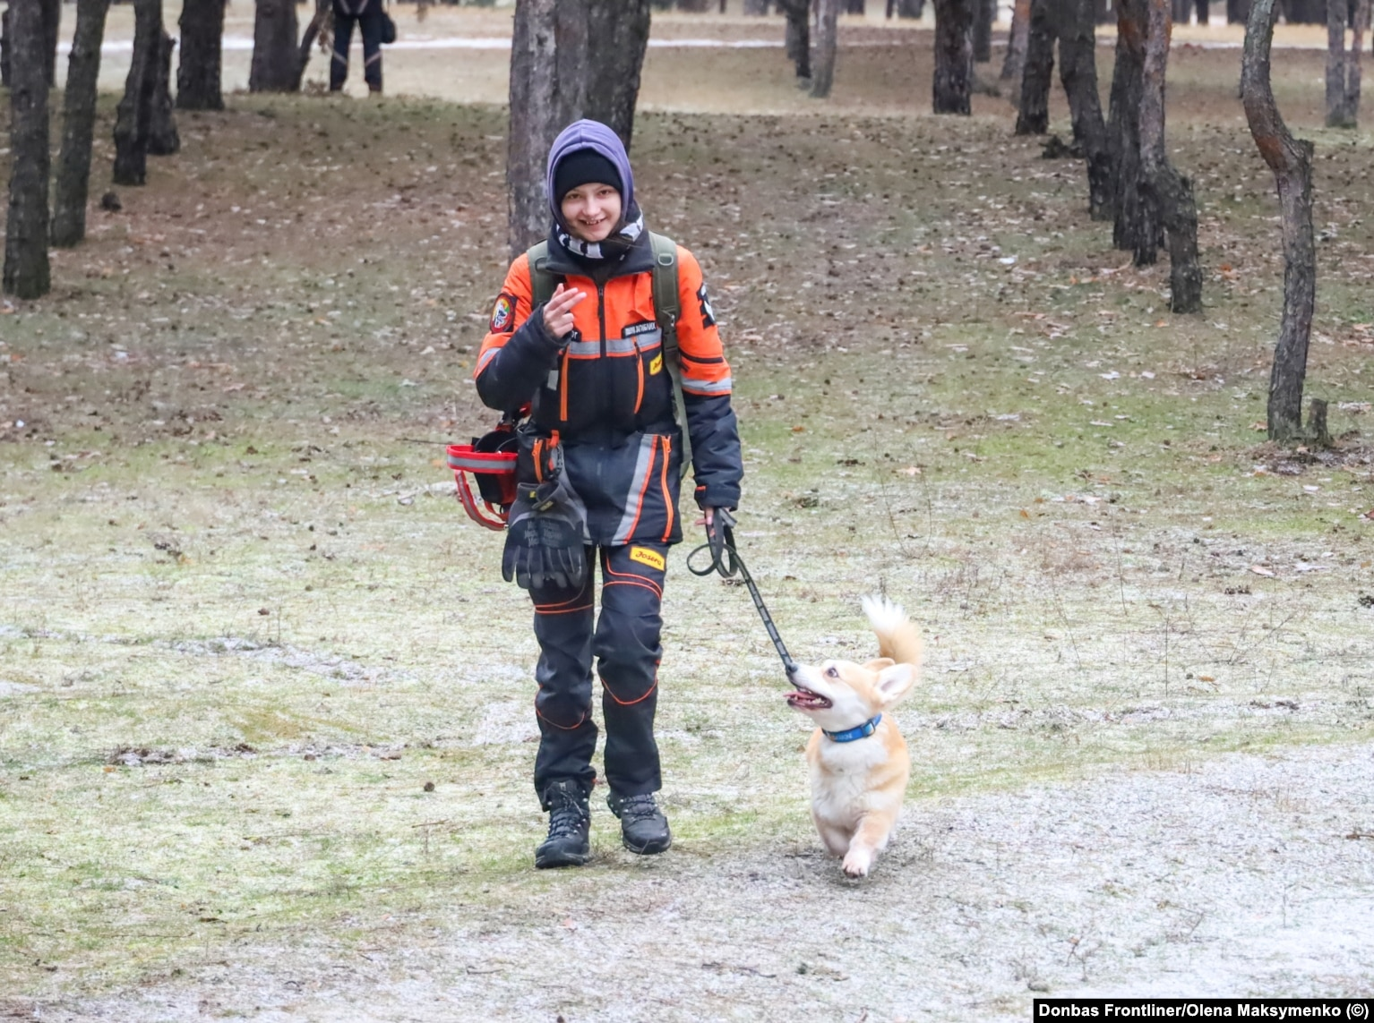
Outline
Introduction
Annexation of Crimea and war in Donbas
NATO expansion and other pretexts
The Russian invasion on 24 February 2022
Developments and Outlook

Slide 3
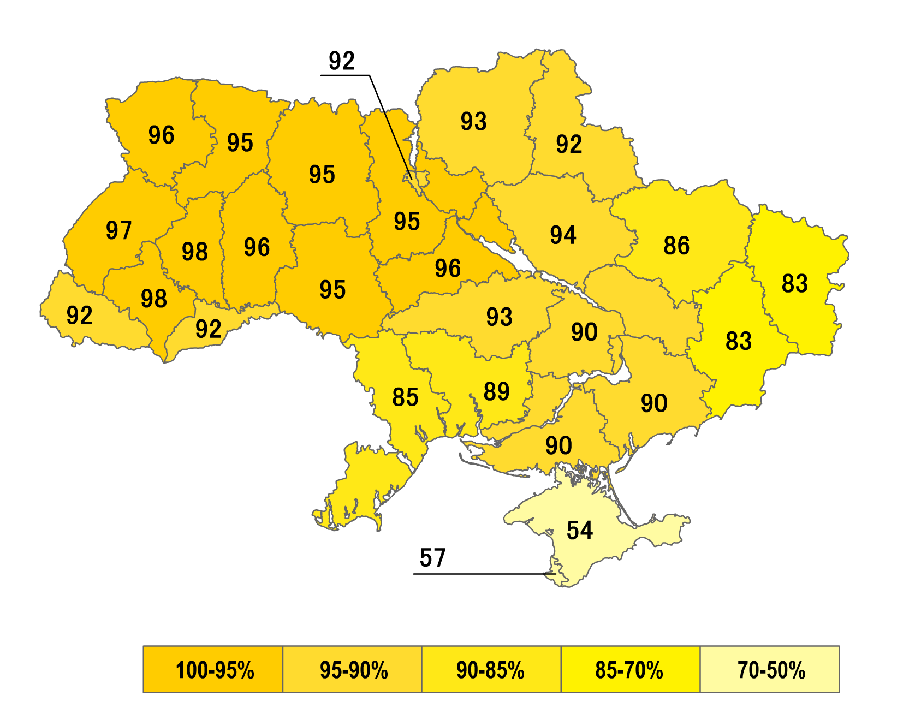
Recent Context
Declaration of independence of Ukraine on 24 August 1991 and dissolution of the Soviet Union on 31 December 1991
Orange Revolution in Autumn 2004
Revolution of Dignity or Euromaidan November 2013
Ukraine moving out of Russian orbit
War in Ukraine since 2014, Russian annexation of Crimea, proxy war in Donetsk und Luhansk
24 February 2022 full-scale Russian invasion of Ukraine

Slide 4
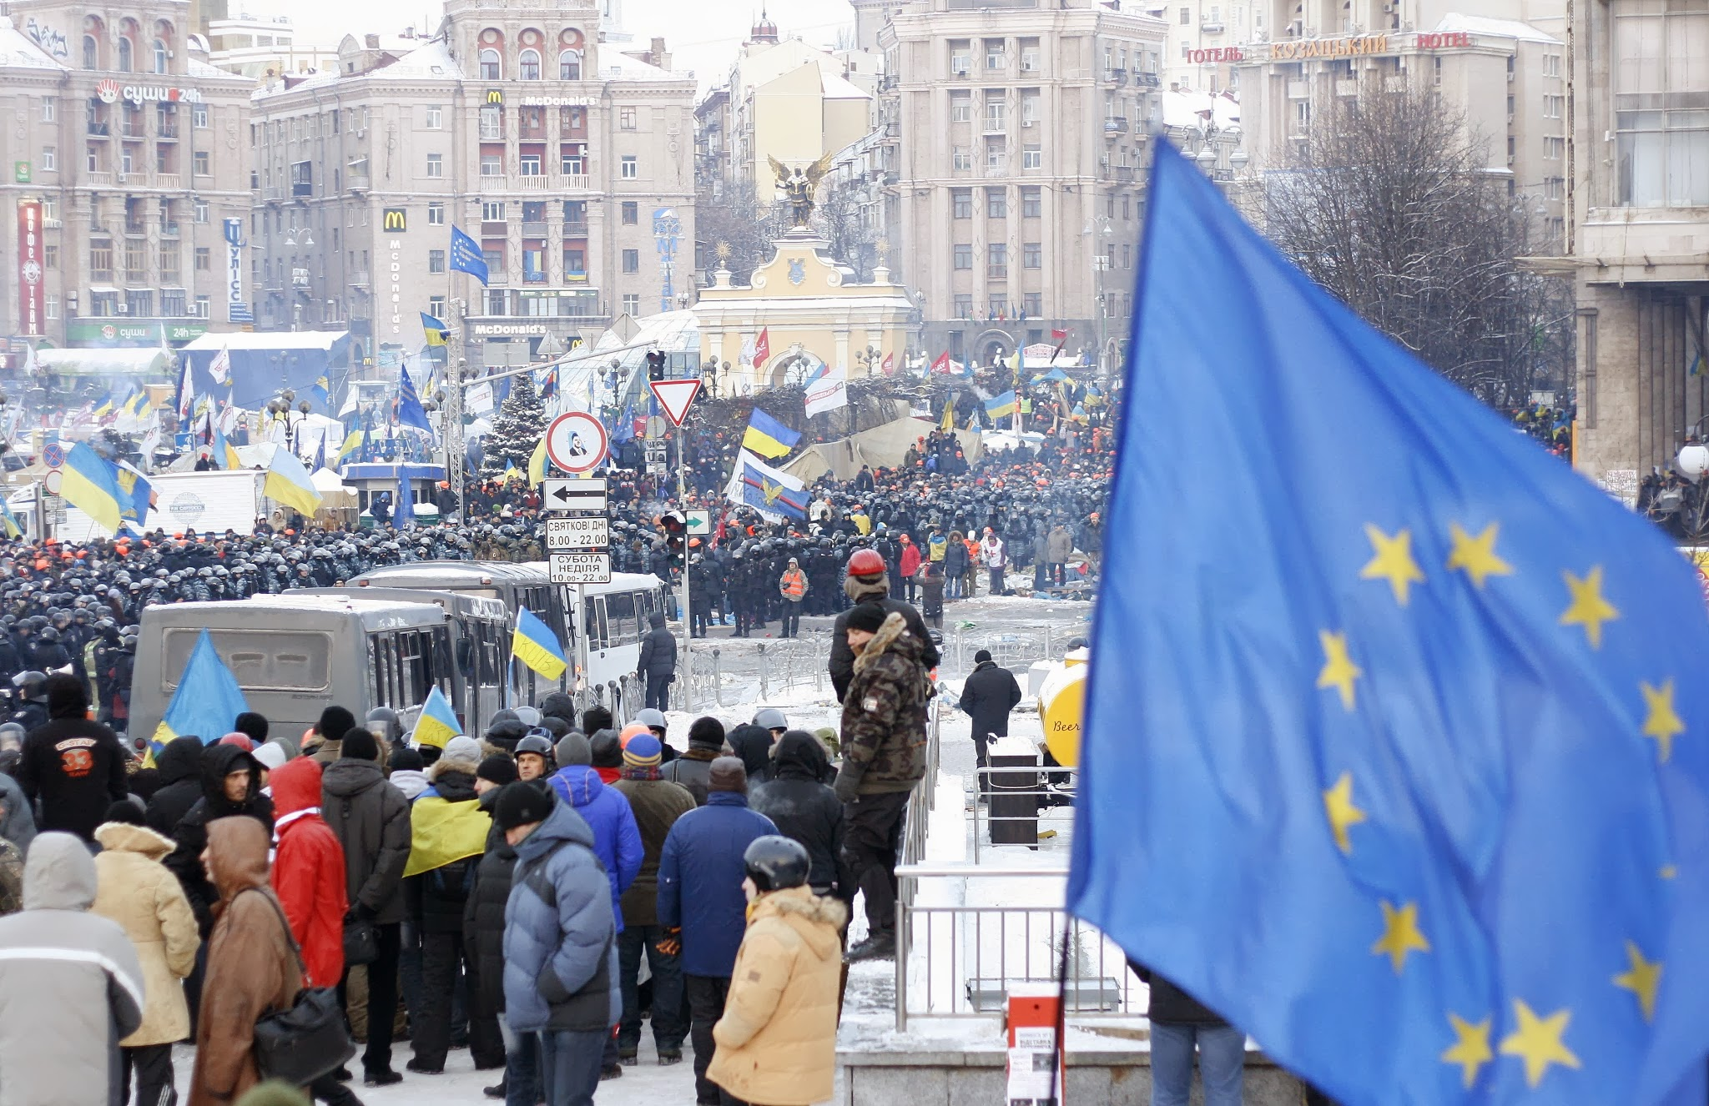
Euromaidan December 2013, Kyiv

Slide 5
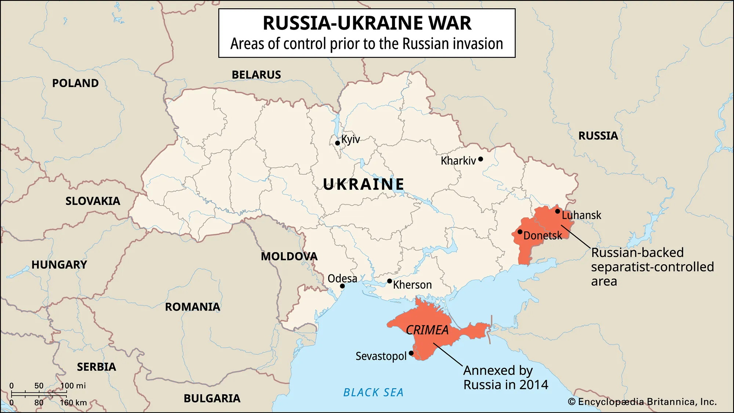
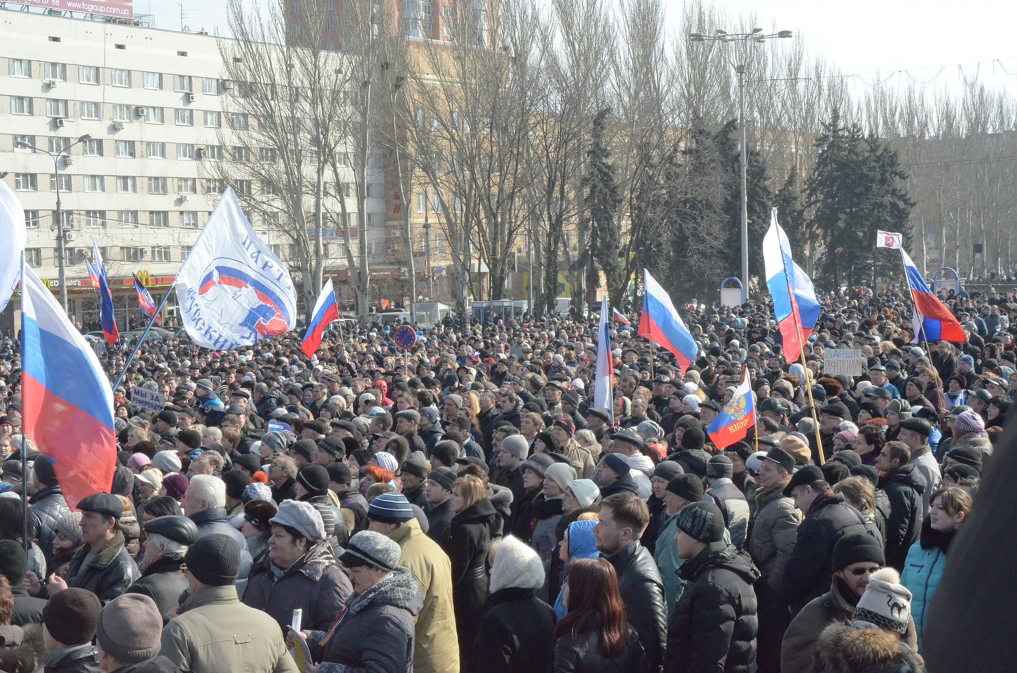
For a timeline of the conflict since 2014: https://researchbriefings.files.parliament.uk/documents/CBP-9476/CBP-9476.pdf

Slide 6
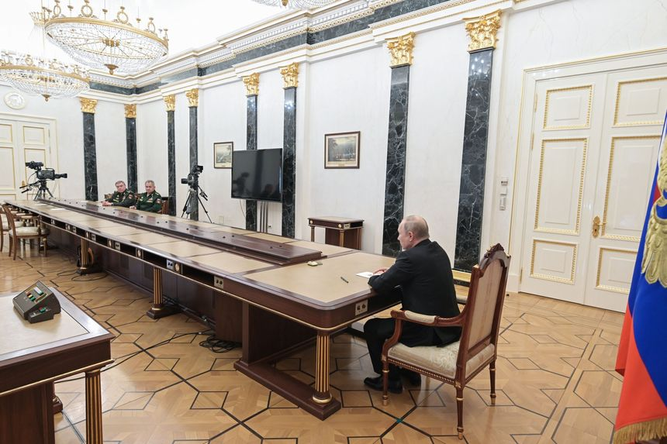

Slide 7
Pretexts
NATO expansion
Security concerns
Defence of Donetsk and Luhansk People Republics
Alleged abuse of Russians and Russian Speakers
‘Nazi’ tendencies in Ukraine (glorification of OUN and UPA; disrespect for the memory of the Great Patriotic War; but actually Putin’s actions maid some of these tendencies more but not overwhelmingly mainstream, and one can argue that there is more disrespect to the GPW memory in Russia than Ukraine)

Slide 8
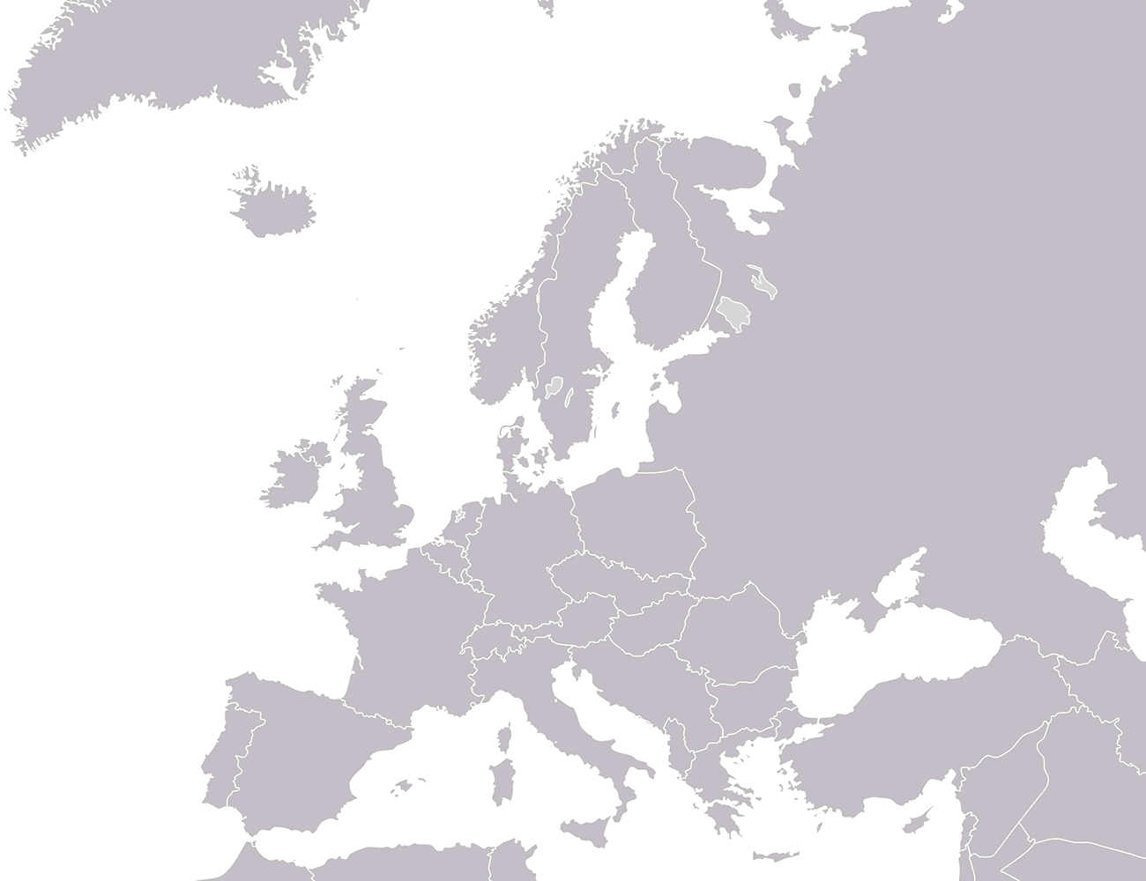

Slide 9
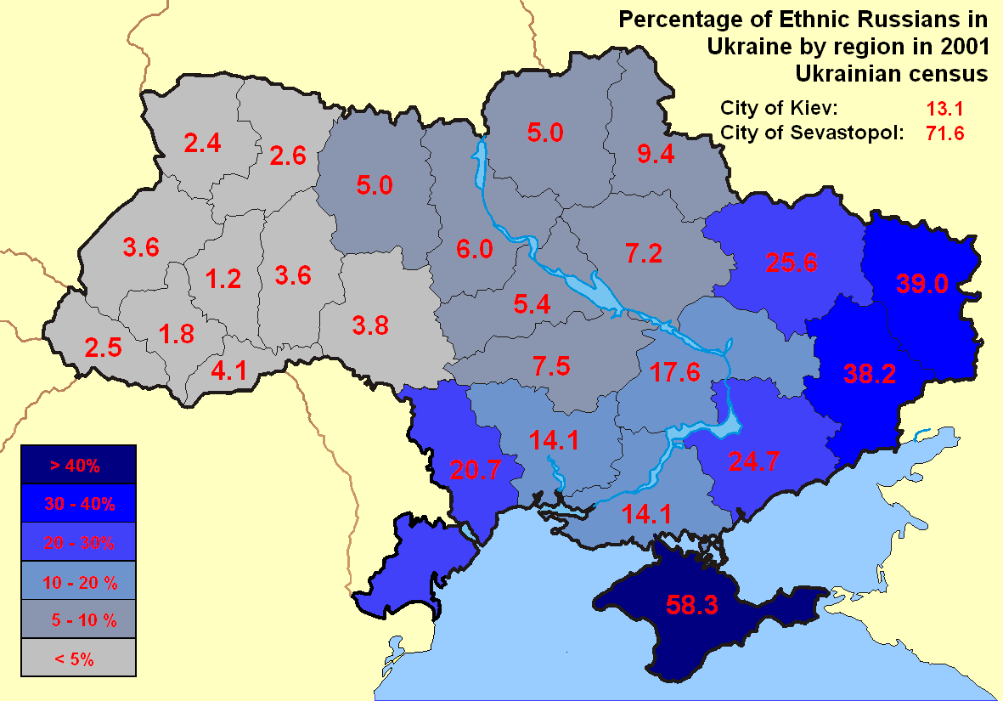
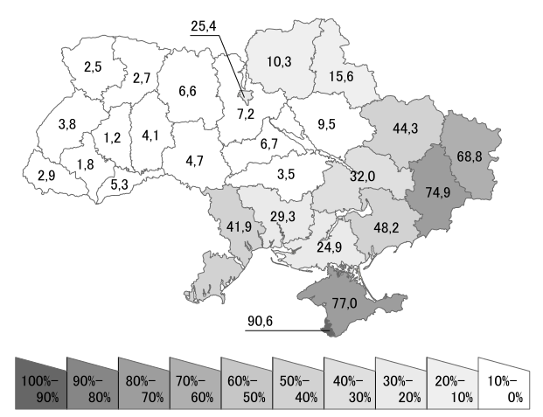
Share of people with Russian as first language in % (Census 2001)

Slide 10
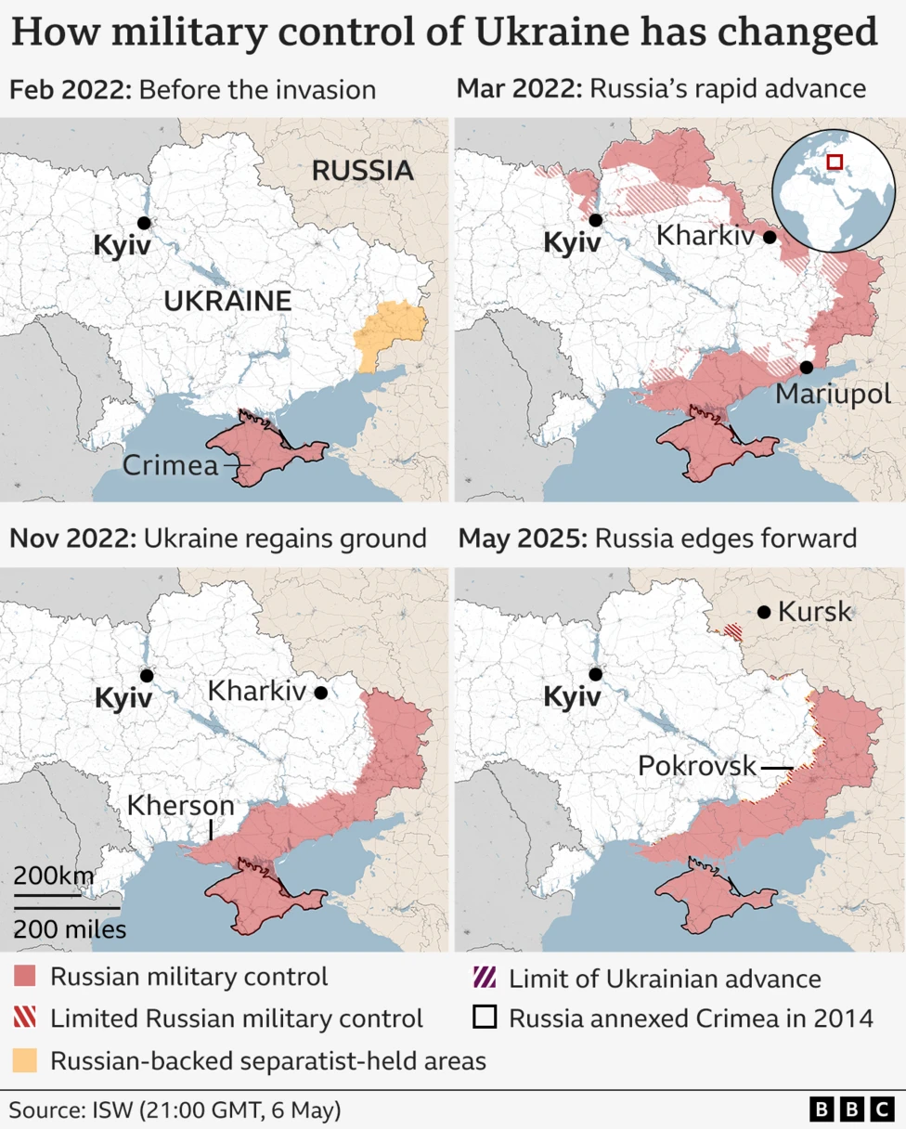
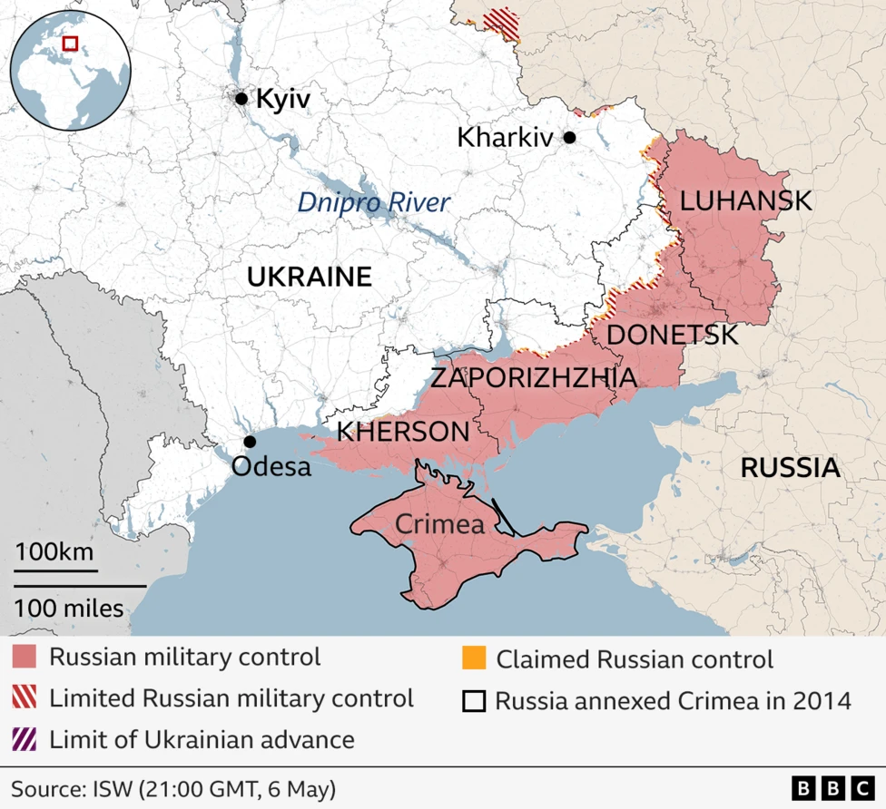
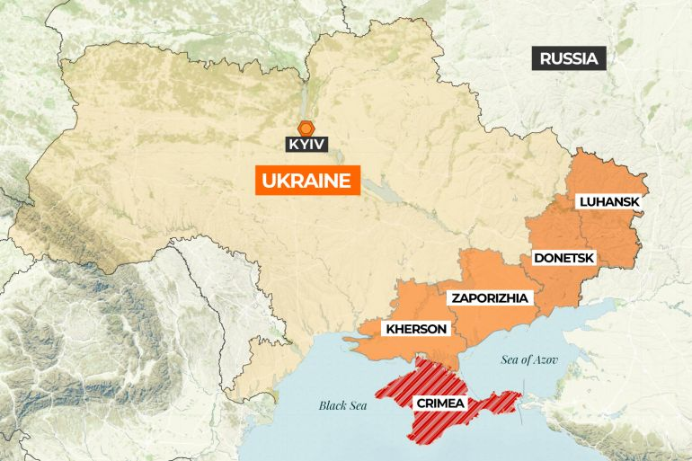
Source: Institute for the Study of War
Source: Al Jazeera

Slide 11
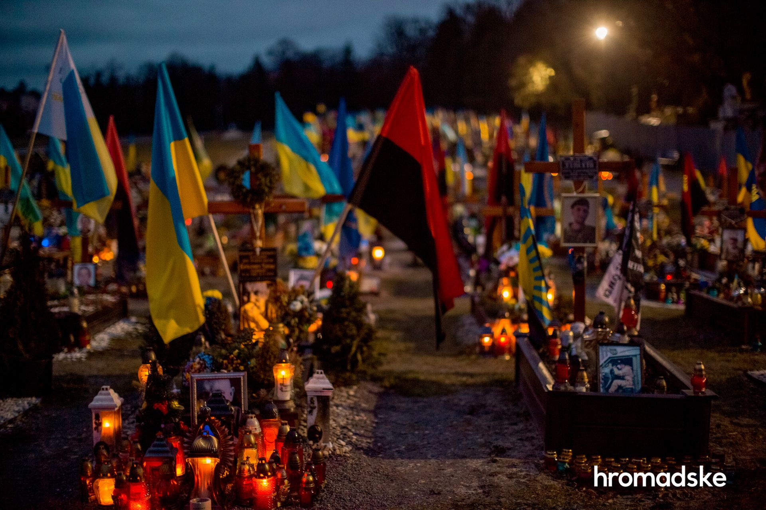
Putin’s uses history (as he understands it) to legitimise the attack on Ukraine and Russia’s land grab
Does Putin actually believe in his own statements of history, or is it just pragmatic instrumentalization/propaganda?
Ideology or security concerns? If ideology, then in what sense?
Genocidal dimension of war
kidnapping children
destroying or appropriating Ukrainian cultural heritage
denying the existence of the Ukrainian nation by
denying that Ukraine has a history outside of the framework provided by the Russian narrative,
or a future outside of the ‘Russian World’
Cemetery of fallen Ukrainian soldiers in Lviv, 2023
By Viewsridge - Own work based on: Russo-Ukrainian conflict (2014-2022).svg by Rr016 &amp; Ukraine adm location map improved.svg by Yakiv GluckTerritorial control sources:Template:Russo-Ukrainian War detailed map / Template:Russo-Ukrainian War detailed relief mapISW, CC BY-SA 4.0, https://commons.wikimedia.org/w/index.php?curid=115506141

Slide 12
Putin’s Demands
International recognition of annexation of Crimea, Kherson, Luhansk, Donetsk, Zaporizhia (including territories currently not controlled by Russia)
Guarantee that Ukraine never will join NATO
End of Western military support and demilitarisation of Ukraine
No foreign troops on Ukrainian territory
And
‚De-nazification‘
End of Western economic sanctions against Russia
Rolling back of NATO membership of
Ukraine no longer a fully souvereign country
At best an inferior (for Ukraine) ‚Finlandization‘, rather ‚Belarusification‘

Slide 13
Impact on the Ukrainian Society
Destruction of Eastern Ukraine (Donbas – defence of which, according to Putin, was one of the reasons of the full-scale invasion)
Astonishing resilience of Ukrainian soldiers and army against superior firepower
Incredible strength of horizontal links in the Ukrainian society
Internal and external migration (refugees)
War-tiredness and Millions of emigrants
Corruption (still an issue)
Military conscription
Switch to the Ukrainian language, or at least surzhyk (a debate about the place of the Russian language in the Ukrainian society)
Nationalist historical narrative becoming more mainstream
Historical and present-day links to Russia heavily questioned
‘Decommunisation’ and ‘derussification’ of public spaces

Slide 14
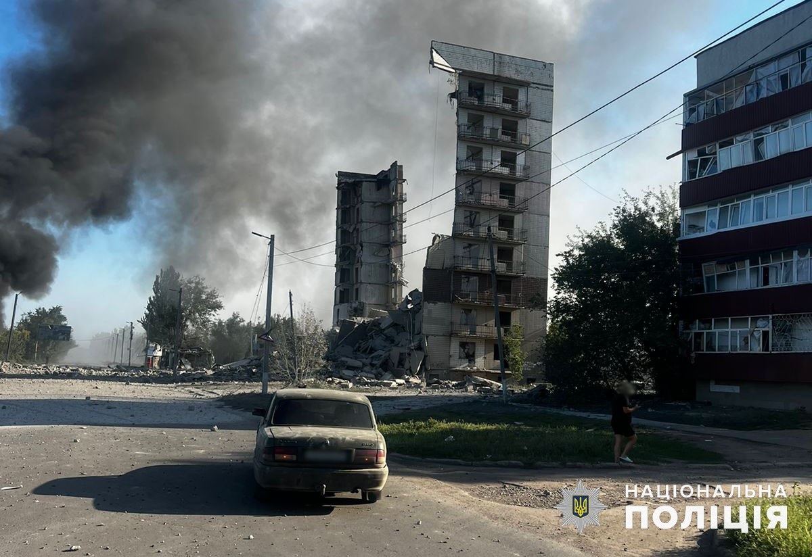
Myrnohrad after Russian bombing, 2024

Slide 15
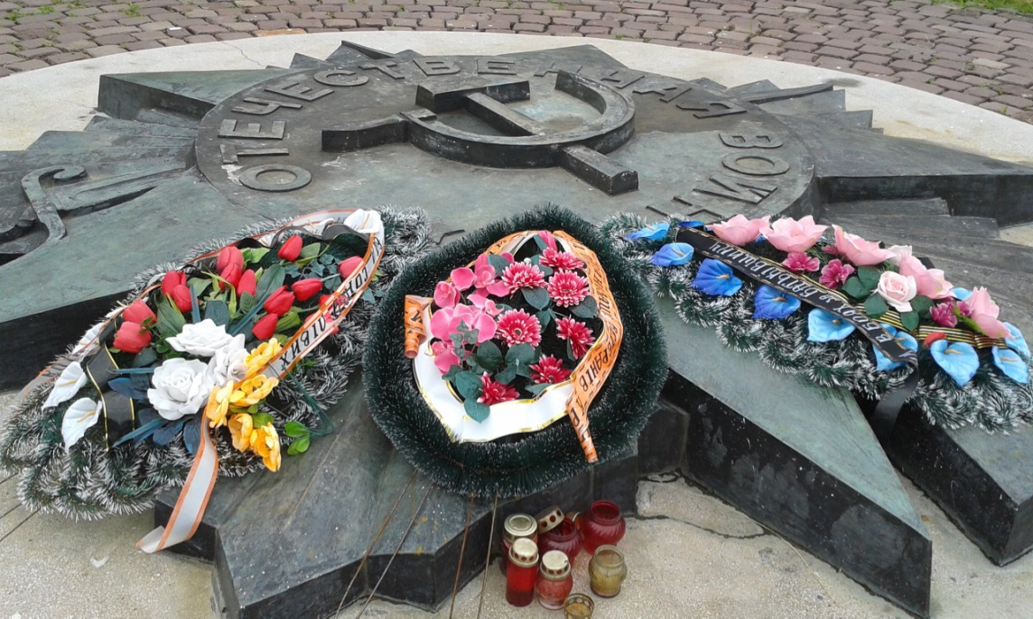
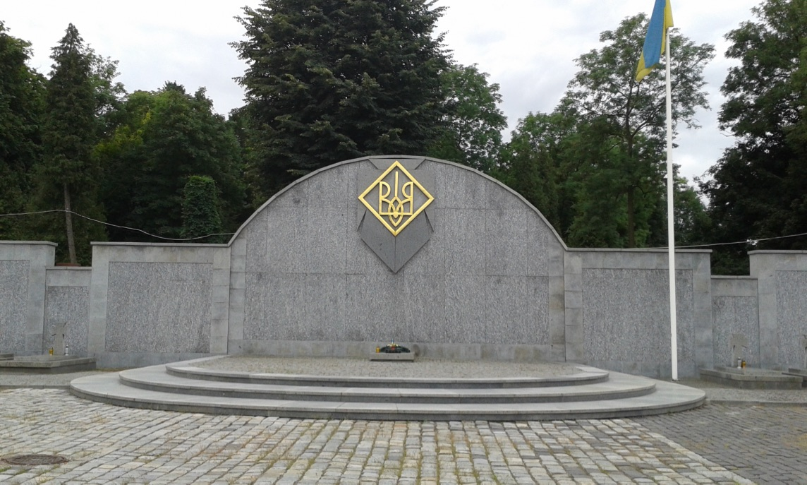
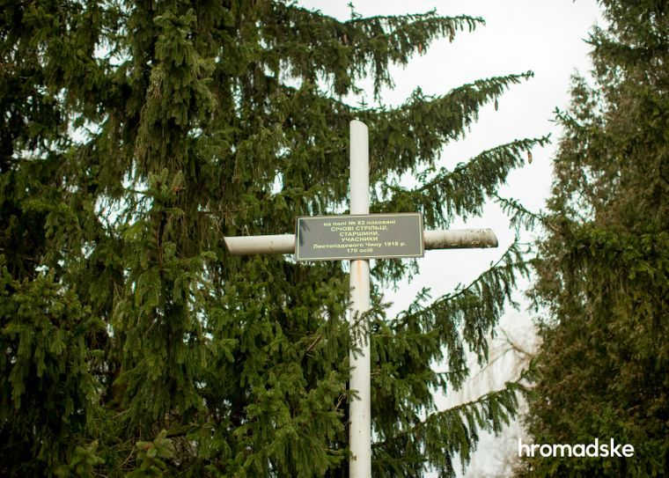
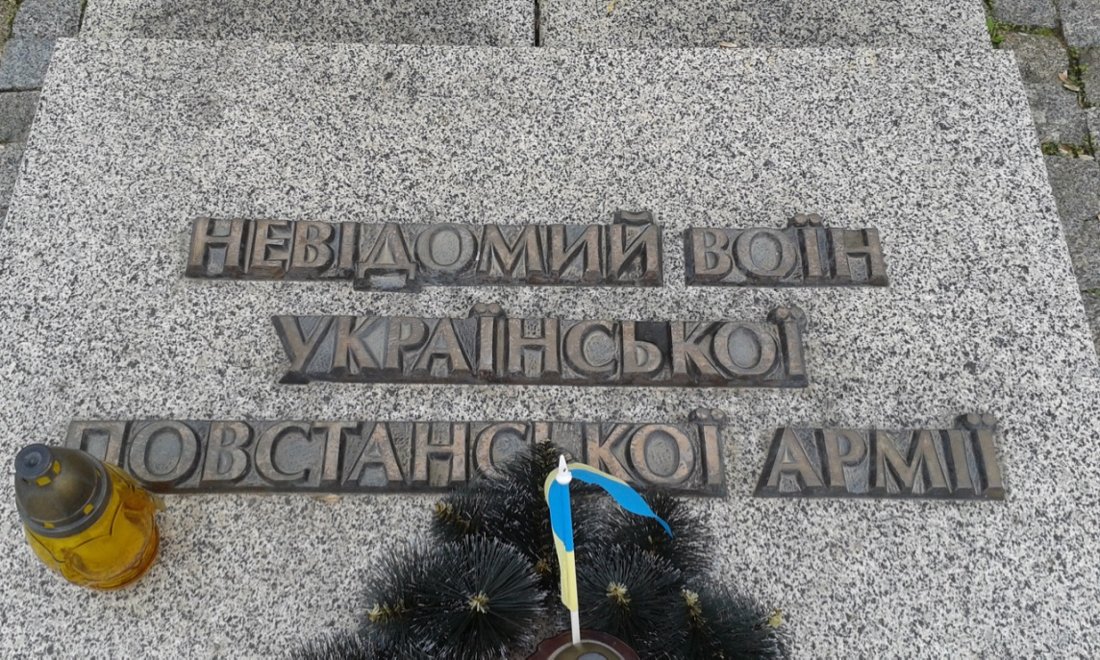
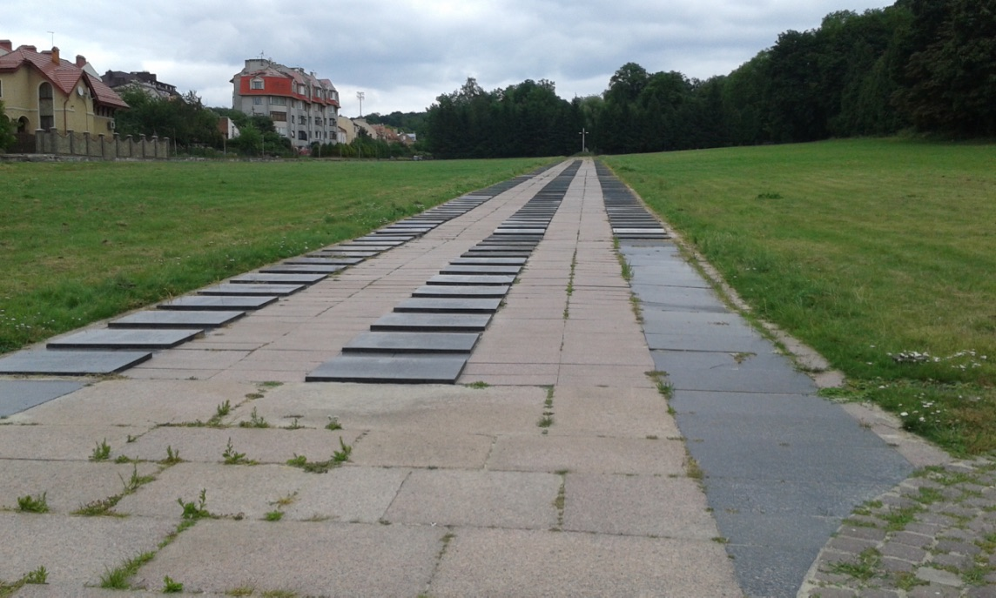
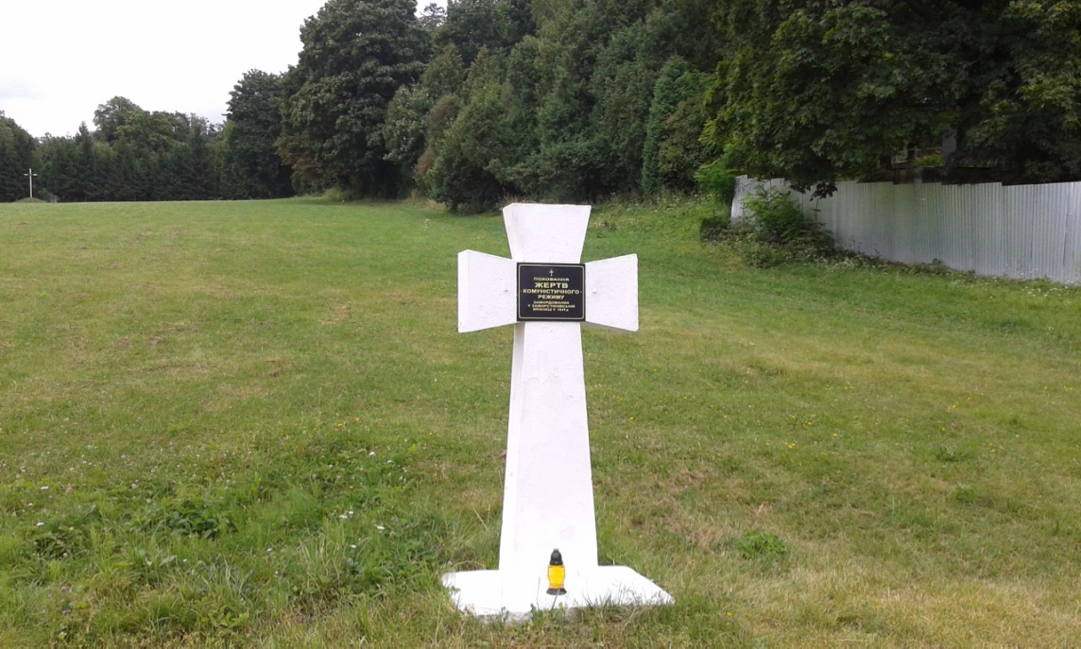
Soviet war memorial
UPA memorial and tomb of Unknown Soldier of Ukrainian Insurgent Army
Cross dedicated to Sich rieflemen 1918/19, erected in 1989
Soviet war graves
And NKVD graves 1945-1947

Slide 16
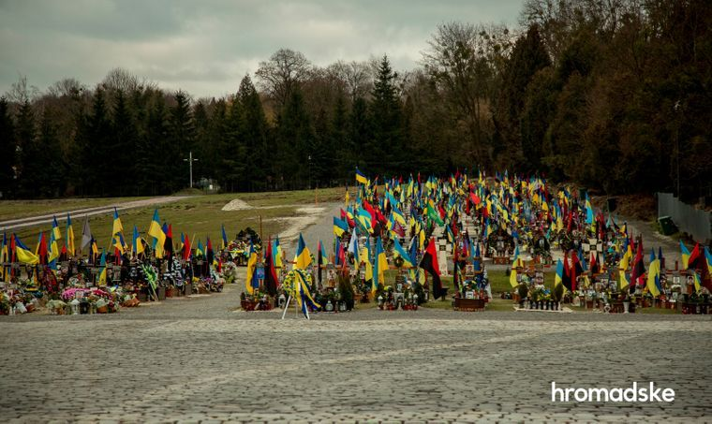

Slide 17
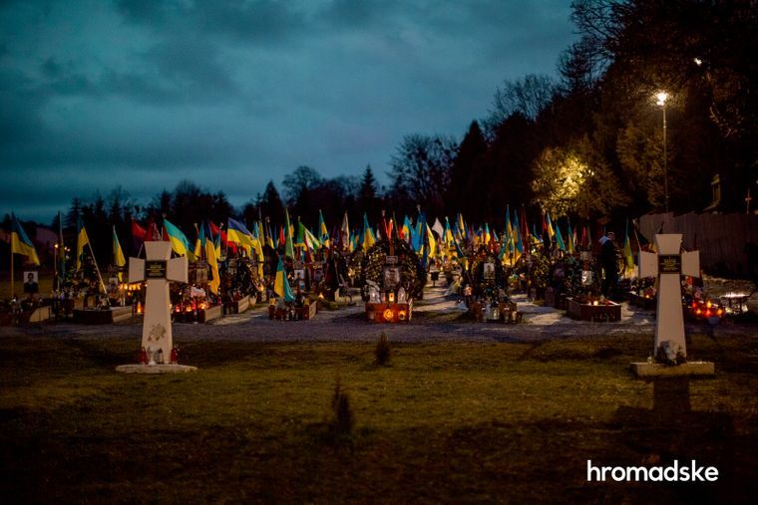

Slide 18
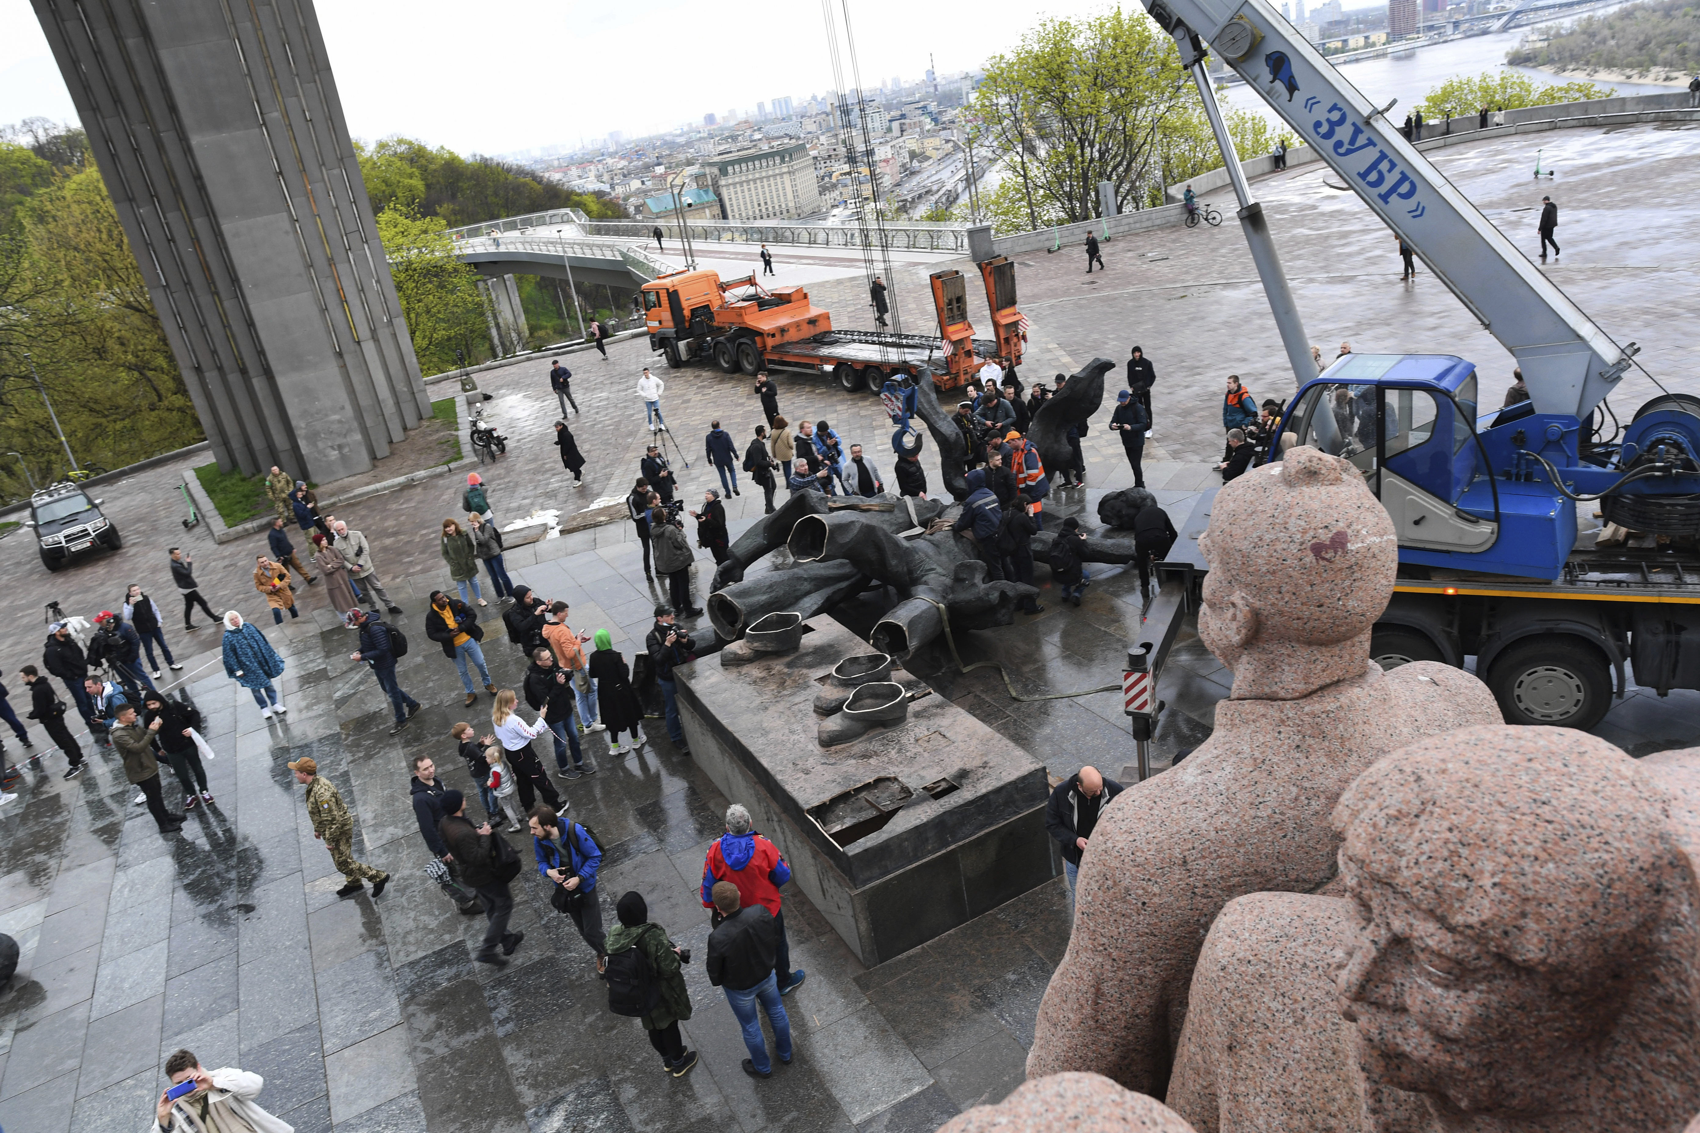
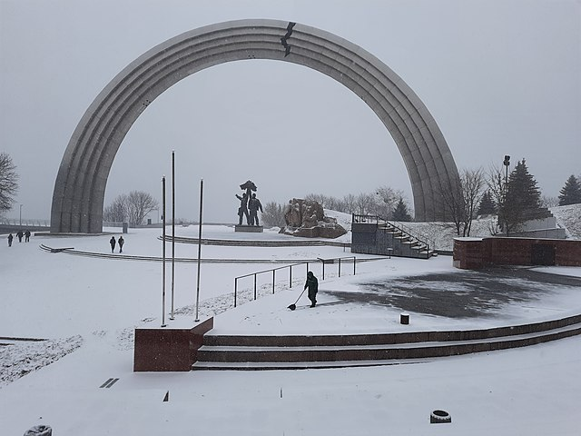
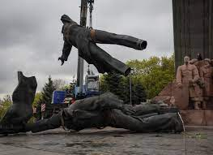
https://www.youtube.com/watch?v=vzYuecWK7P8

Slide 19
Current Situation and Outlook
Trump-factor
Erosion of deterrence by questioning NATO doctrine
Less of support for Ukraine in Western societies – ‘coalition of willing’ struggling to keep population on board
Rise of extremist parties in Europe – beneficial for Russia
Support of China, neutrality of India, traditional Russian (Soviet) influence in global South
Problems in Ukraine: legitimacy eroding without elections, controversial recruitment policy – hunting down draft dodgers – lack of volunteers, militarily on the backfoot
Still apparently support of population for continuing war
Lack of military resources can be compensated as long as defending
Fighting for survival as an independent state and nation – strong motivation of those fighting
Stepping up of European support?

Slide 20
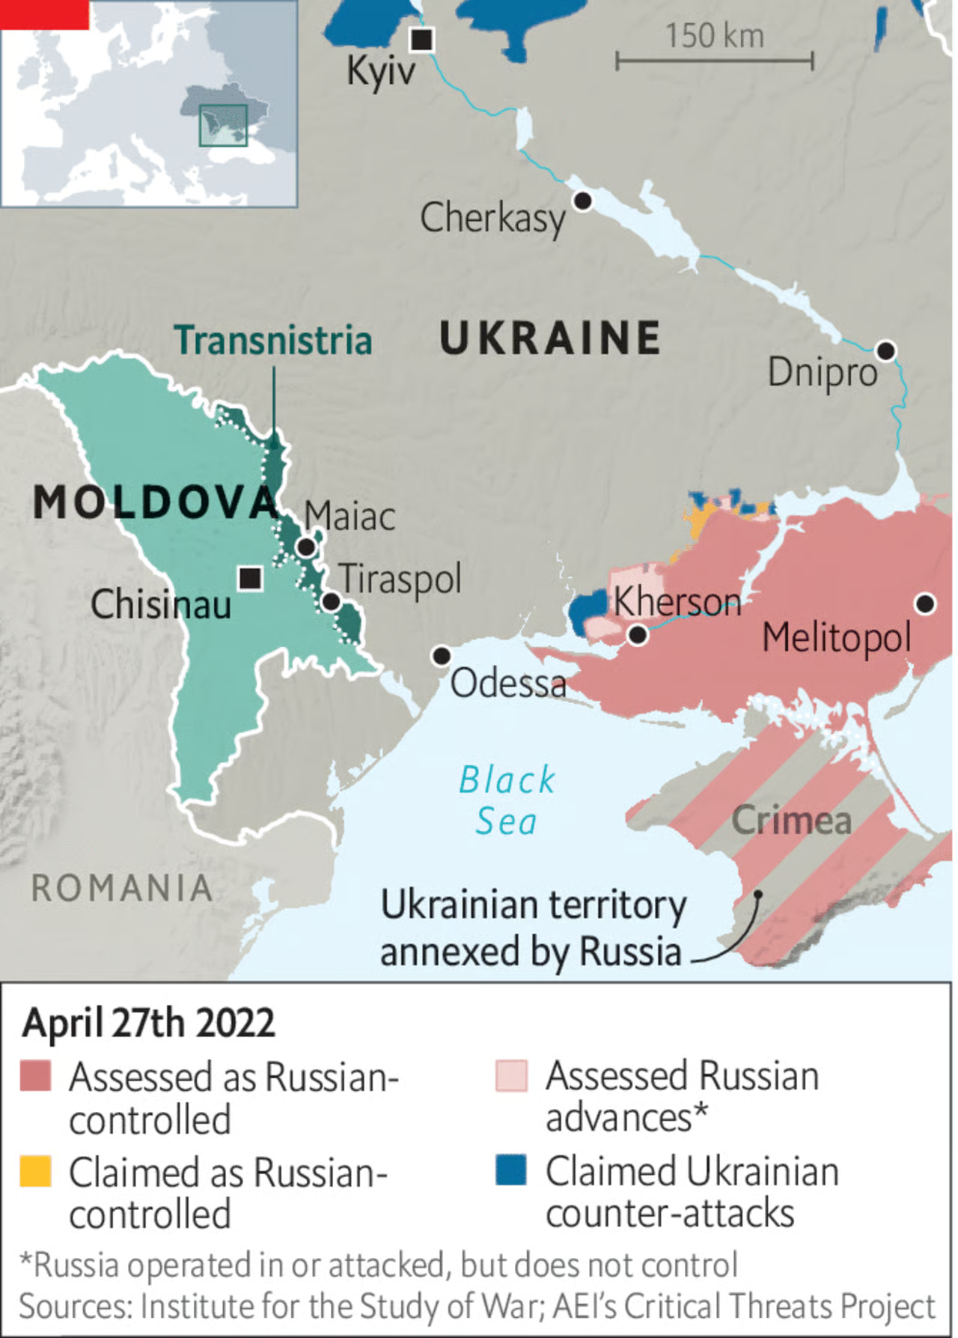
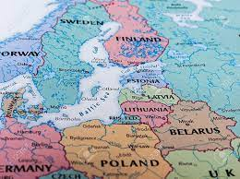
If Russia wins

Slide 21
Exam Topics
Kyivan Rus
Ideologies of Muscovy and the Russian Empire
Cossacks in history and memory
‘Ukrainian question’ in the Russian Empire
Culture and nationalism in Eastern Europe
Ukrainians and WWI
Ukrainians in the Soviet Union and Poland
Ukrainian nationalism during WWII and its role
Memory and Ukrainian-Russian relations

