Slide 1
Entangled History: Ukraine and her neighbours from the Middle Ages to the present
Lecture 5, wk. 7
The Fight for the ‘land of the Rus’

Slide 2
Outline
Introduction
The Cossacks
The Great Revolt and the Cossack Hetmanate
The Treaty of Pereyaslav
The Partition of Ukraine
Legacy

Slide 3
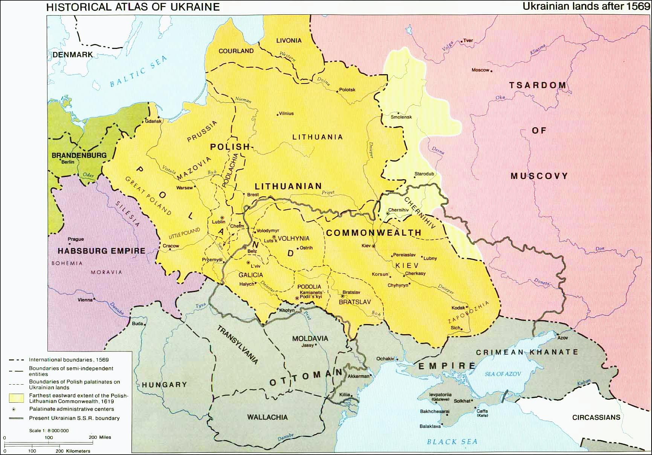

Slide 4
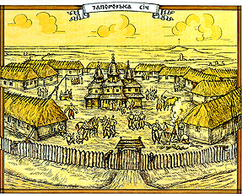
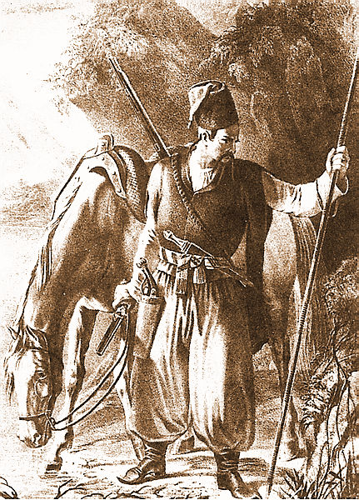
The Cossacks – ‘Frontier Society’
Cossack (ukr. Kozak) – from the Turkic kazak (free man), meaning anyone who could not find his appropriate place in society and went into the steppes, where he acknowledged no authority.
By the end of the 15th c. – a wider meaning and was applied to those who went to the steppes
In the mid 16th c. the Cossack structure in Zaporizhia created (headquarter on an island in the Dnipro river, south of the rapids) – support steppe settler’s struggle against Tatar raids, did also raid Tatar territory
Cossack Hetman – elected leader of Cossacks (confirmed by King). Cossacks elect their officers (after defeats in rebellions sometimes need to concede this right to crown)
1569 Union of Lublin between Poland and Lithuania, protection against raids from “Wild Field” now task of Polish crown
Growth of cossackdom after Polish magnates established manorial system of agriculture (freedom of movement was limited, corvee was expanded) – profitable grain trade: many peasants fled to steppe

Slide 5
Cossack Dilemmas
Dilemma for Polish crown: Cossacks needed to defend the steppe frontier, especially against Tatar raids (in 16th and 17th centuries between 1.5 and 3 million inhabitants of Ukraine sold on Ottoman slave markets); but militarily trained and armed men (many of them serfs) – threat to Polish magnates and nobility. One solution: register Cossacks (first 300, later 6,000, than 8,000). Crown tries to appoint leaders (elder, colonels)
Magnates have many estates, work through middlemen, poorer noblemen but often Jews as administrators, exercising magnates’ alcohol monopoly, work as money lenders (overwhelming majority of Jews, however, were merchants/traders and artisans), sometimes pay fixed sum for 2- or 3-year lease to magnate – incentive to maximally exploit serfs. Magnates invite peasants from Poland, with tax-free promise for 10, 20 years but then try to enforce corvée.
Power of magnates, old Ruthenian families like Ostrozky or Vishnovetsky or Polish ‘immigrants’, lower percentage of nobility in Rus’ land than in Polish heartlands, magnates have private armies
Ordinary Cossacks – participating in military campaigns of Polish king, after returning home meant to be serfs again. 1591 First Cossack uprising, several more uprisings until 1638
Tensions/conflicts in Cossack society – registered Cossacks vs unregistered Cossacks and serfs

Slide 6
1596-1648: Run-up to the Great Revolt
1596 Union of Brest – Uniate (Greek—Catholic) Church - 1598-1632 Orthodox Church illegal in Polish-Lithuanian Commonwealth – many Orthodox bishops join Uniate Church but resistance from below – confessional conflict
Orthodox clergymen find refuge in Muscovy but tsar reluctant to intervene
1620 Cossack Hetman Sahaidachny enrols himself and entire Zaporizhian Host in Kyivan (Orthodox) Brotherhood – connection between Orthodox confession and Cossacks
Sahaidachny invites Patriarch of Jerusalem to Kyiv, to consecrate new Orthodox hierarchy (bishops)– who then can consecrate priests - Cossacks as protectors of Orthodox Church
1637 Petro Mohyla establishes a Collegium in Kyiv, becomes metropolitan of Kyiv – Kyivan Renaissance – high quality of theological learning, book-printing in Church-Slavonic
After Cossack uprisings of the late 1630’s register was significantly reduced
1648 Beginning of Cossack uprising, led by Hetman Bohdan Khmelnytsky in alliance with Tatars from Crimea

Slide 7
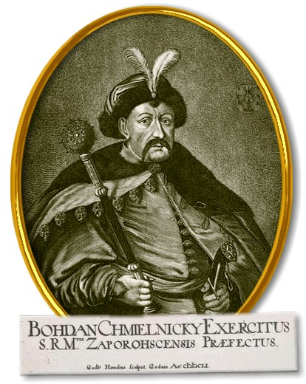
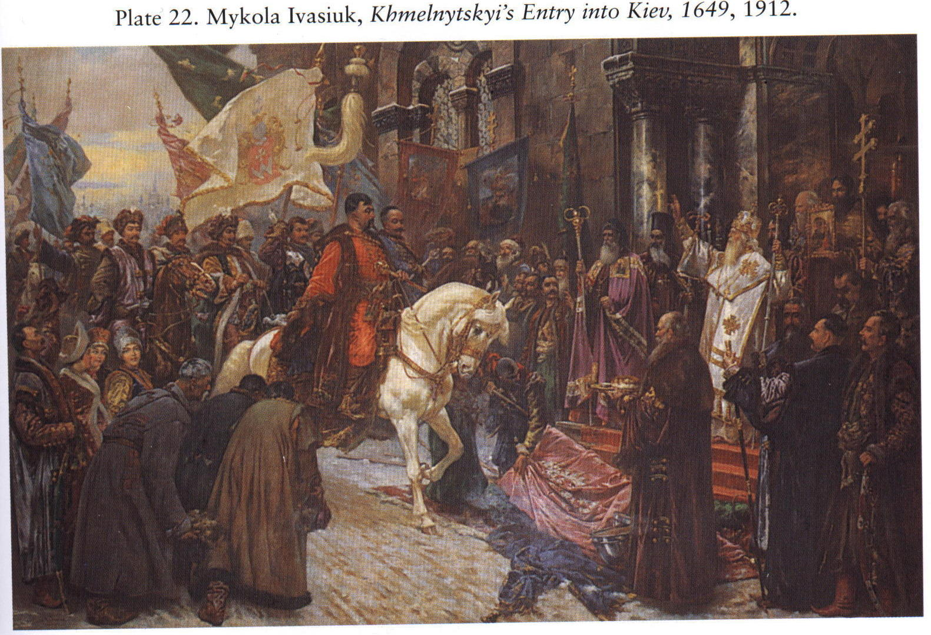
Bohdan Khmelnytsky, 1596-1657

Slide 8
The Great Revolt – I
April 1648 Battle of Zhovti Vody – Advance force of Polish crown army defeated by Cossacks/Tatars
May 1648 Battle of Korsun: Desaster for crown army, massive victory for Cossack/Tatar forces
More and more peasants join rebellion: attacks on Polish estate owners and noblemen and Jewish middlemen and generally Jewish population
September 1648 Battle of Pyliavtski: Cossack/Tatar victory, Polish army and their leaders run away
October 1648 Cossacks besiege Lviv – retreat after payment of large sum in gold
Spring 1649 Partly a Civil War: Jeremi Wiśniowiecki (magnate with possibly 300,000 serfs), had converted in 1632 to Roman-Catholicism, led the fight of the Commonwealth against the Cossacks – committed numerous atrocities. In negotiations with the Cossacks the Commonwealth was represented by the Orthodox magnate Adam Kysil.
Siege of Zbarazh: Polish troops in Zbarazh with King Jan Kazimierz surrounded by Cossack/Tatar troops but then Tatar cavalry withdraws (Khan Islam Girei), Khmelnytsky forced to negotiate with Poles

Slide 9
The Great Revolt – II
18 August 1649 Zboriv treaty, Roman-Catholic and Uniate Church expelled from provinces of Kyiv, Bratslav and Chernihiv, number of registered Cossacks raised to 40,000 – growing tensions between ordinary Cossacks and Cossack elite.
Problems with Tatar allies: not satisified with just getting Polish prisoners, raiding Cossack region, taking prisoners – selling them as slaves – Tatar policy: play Christian rulers against each other
June 1651 Battle of Berestechko – crushing defeat for Cossacks – initiative in war now with Poland-Lithuania
September 1651 Bila Tserkva agreement: register reduced to 20,000. Backed by crown: Polish noblemen/magnates return to Ukraine – many Cossacks again threatened by serfdom
April 1652 Cossacks attack Polish troops at Bati, victory, kill all prisoners
Stalemate
Religious war? Social war – revolutionary war? State-building war? Anti-colonial war?

Slide 10
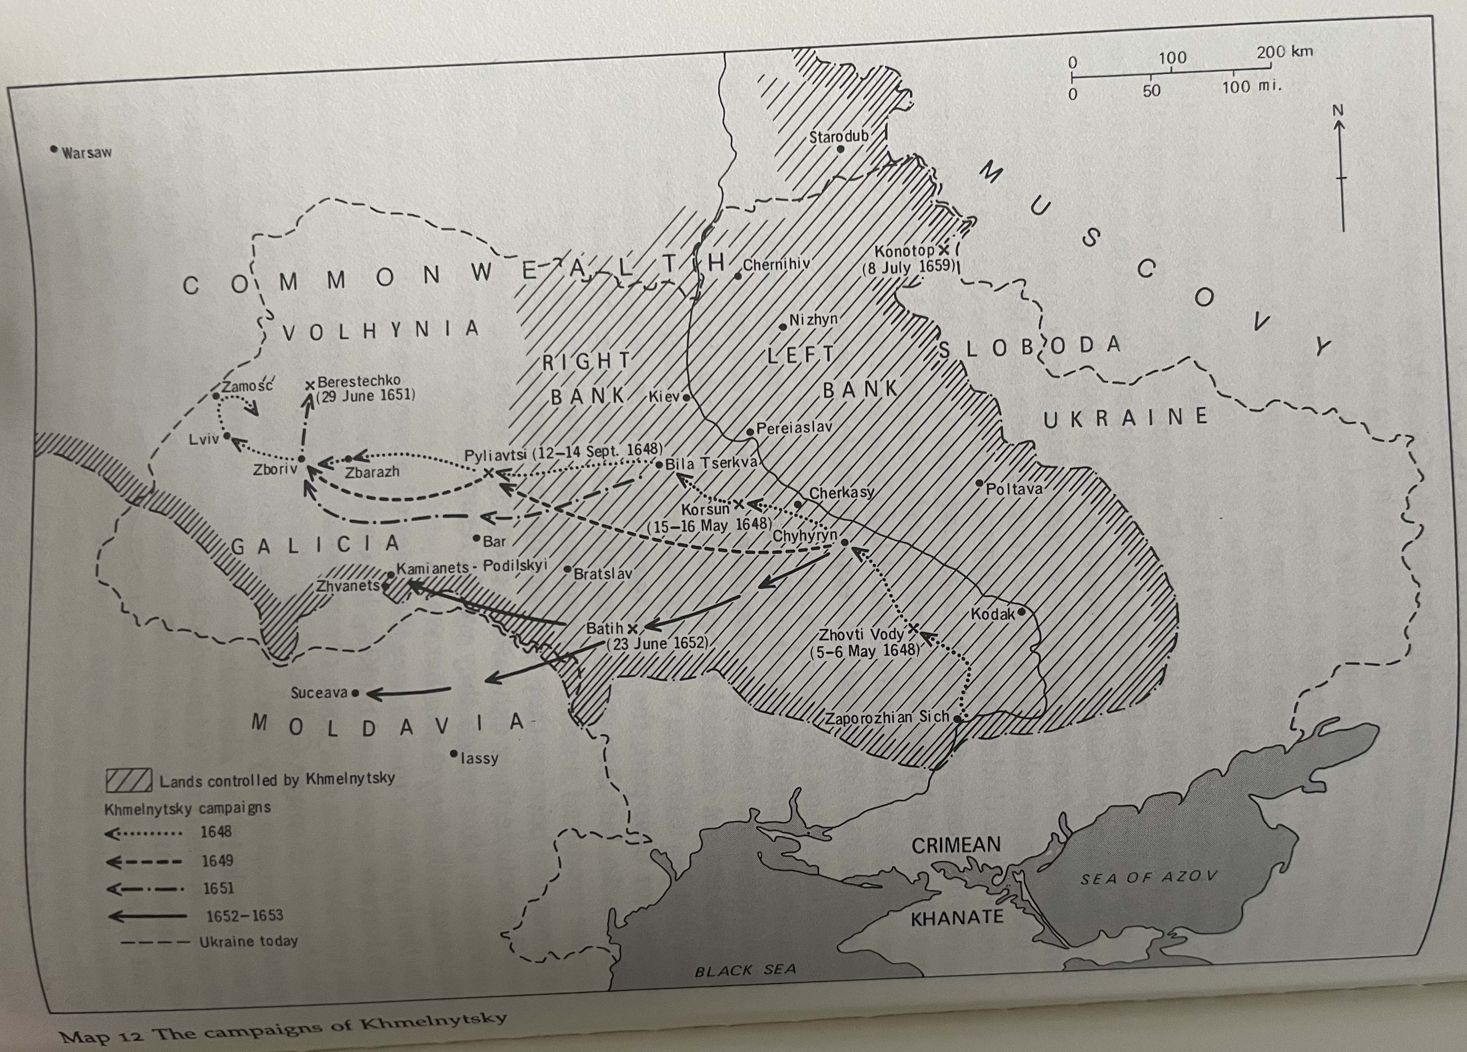

Slide 11
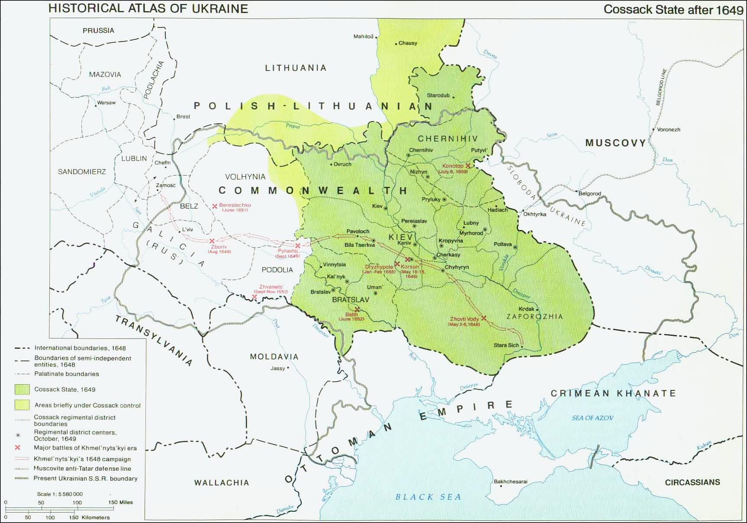

Slide 12
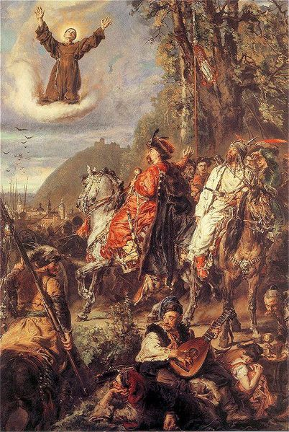
Halych (Galicia)
Already since 1387 (and not only 1569) with Poland
1596 after Union of Brest, region becomes stronghold of Uniate Church (Greek-Catholic Church) – also after revival of Orthodox Church after 1632
1648 and 1655 Siege of Lviv by Cossack troops
Bohdan Khmelnytsky with Tugaj or Tuhaj Bej, Painting by Jan Matejko, 1885 on Siege of Lviv

Slide 13
The Cossacks under Pressure
Khmelnytsky first tries again to come to arrangement with Poland-Lithuania, ends in failure
Khmelnytsky aware that Cossacks not strong enough to hold out against Commonwealth without allies
Renews search for allies and accepts overlordship of Ottoman Sultan
Sultan busy in Mediterranean – war against Venice – not much support for Cossacks forthcoming.
Khmelnytsky responds to wishes of Cossacks who struggle to be allied with non-Christian ruler and turns to tsar Aleksei of Muscovy – united by Orthodox Faith – seems to be natural ally.

Slide 14
Troubled Times in the Tsardom of Muscovy
1605-1613 – Times of Trouble, Polish invasion
1613 – Michael Romanov becomes tsar, Romanov Dynasty
1653 – Patriarch Nikon starts with Church reforms
1667 – Raskol – Split (Schism) of Orthodox Church in Official Church and Old Believers

Slide 15
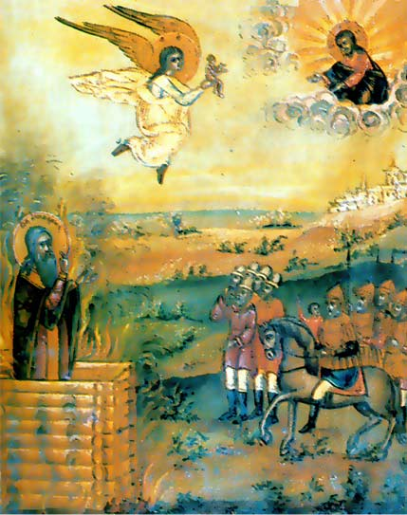
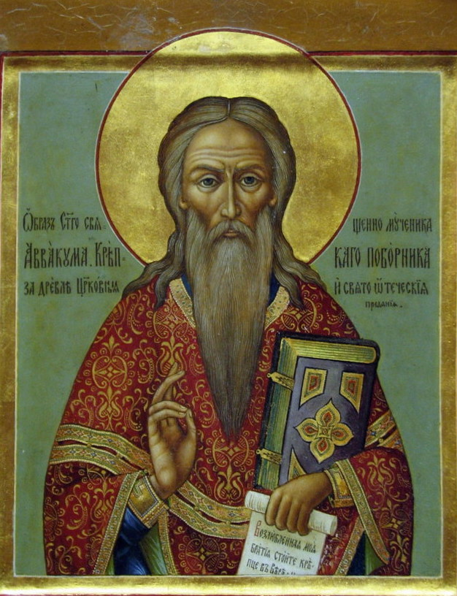
The Burning of Arch Priest Avvakum (1620/21-1682), Old Believer icon
Icon of Saint (for Old Believers) Avvakum

Slide 16
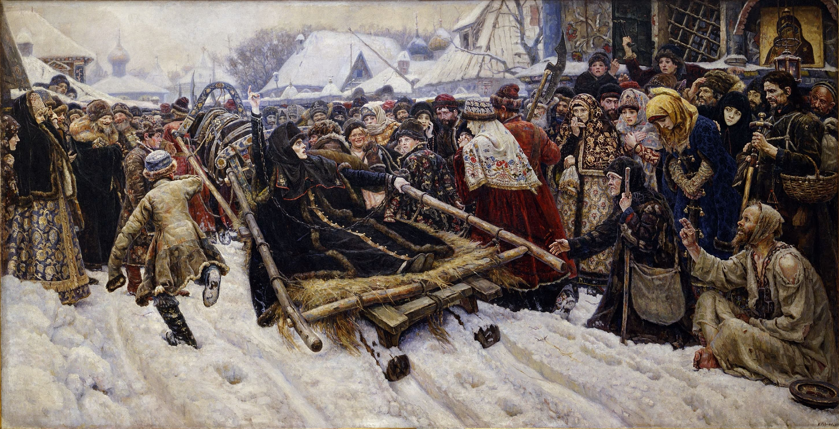
Boyaryna Morozova by V.Surikov (1884-1887, Tretyakov gallery, Moscow)

Slide 17
Treaty of Pereyaslav with Muscovy, 1654
Khmelnytsky wants to win Muscovy and Orthodox tsar as ally against Poland-Lithuania
Khmelnytsky tries to negotiate as he used to negotiate with Polish King
Muscovite ambassador Buturlin refuses to enter into any negotiations, but privileges are granted by tsar – not negotiable
Cossack officers swear allegiance to tsar - recognise suzerainty of tsar for ever – expectation that tsar would offer protection (military support against Poland)
Muscovite ambassador refused to swear oath to agreement – tsar does not swear oath to subjects
But ‘granted‘ were 60,000 registered Cossacs, recognition of Cossack statehood, privileged status for the Cossack estate, recognized liberties other groups had enjoyed in Polish-Lithuanian Commonwealth

Slide 18
Interpretations of the Pereyaslav Agreement of 1654
Personal Union (Russian version 1)
Real union and permanent integration of Cossacks lands in Tsardom of Muscovy (Russian version 2)
Vassal relationship with obligations on both sides: protection for tribute, military assistance but not interfering in domestic affairs (Russian historian Venedikt Makotin and Ukrainian historian Mykhailo Hrushevsky)
Temporary military alliance (Ukrainian historian Viacheslav Lypynsky)
Union of two peoples, Ukrainians and Russians, following the desire of the masses (Soviet version after WWII)
Khmelnytsky – traitor, pogromist, national hero, statesman and state-builder, Unifier of Russia and Ukraine
Legacy: Khmelnytsky and Cossack hetmanate – pre-modern ‚national‘ identity, massive importance for Ukrainian history, memory of Cossacks and Cossack way of life and freedoms deeply influence Ukrainian nation building in 19th century

Slide 19
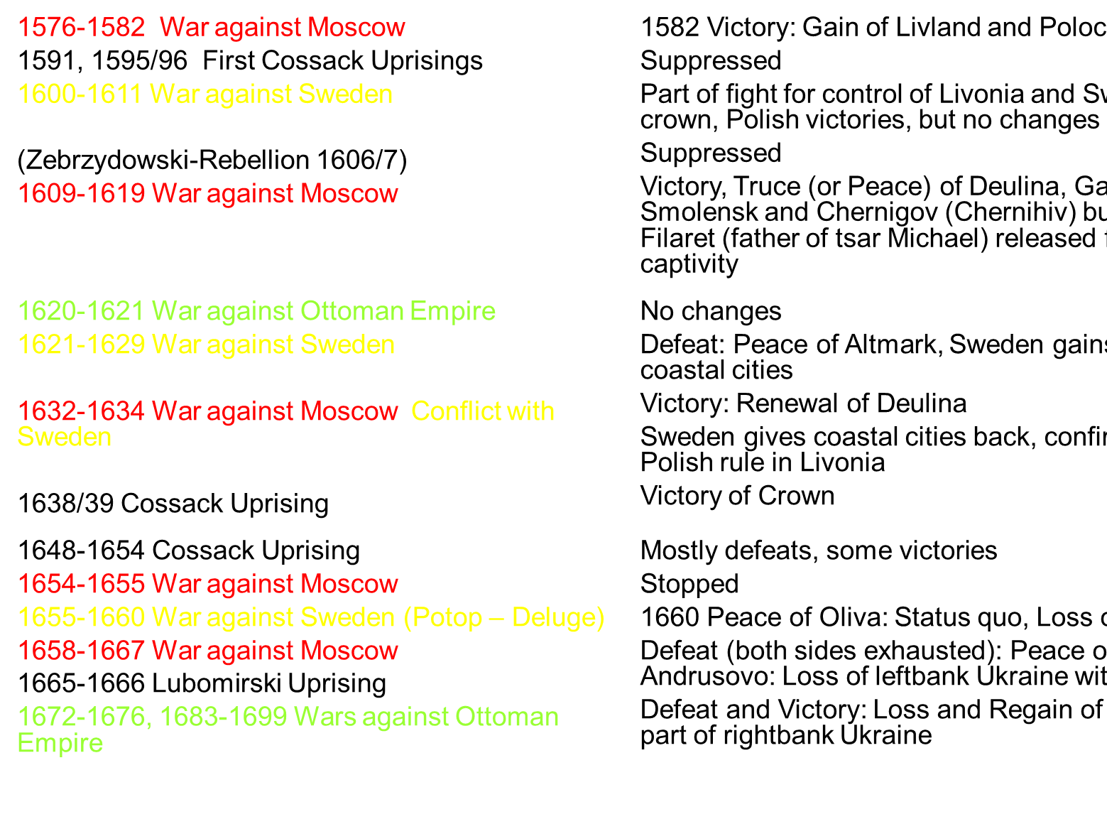
Polish Wars, 1576-1699

Slide 20
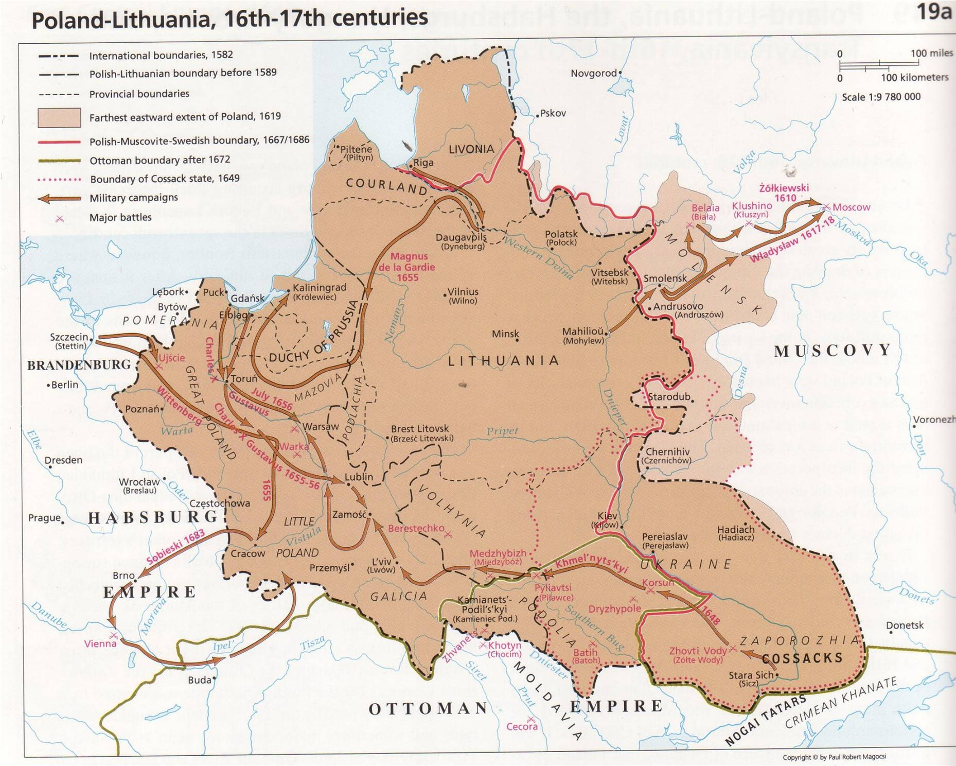

Slide 21
The Partition
Cossack leaders suspicious of Muscovy‘s attempt of total contral (no oath on Pereyaslav treaty by Buturlin, the Muscovian ambassador).
Shortly before his death in 1657 Khmelnytsky turns to Sweden – accuses tsar of not honouring agreement
Successor Vyhovsky tries again to find a ‚Polish solution‘ – in favour: elite and registered Cossacks – Cossack masses against – rebellion – battle between two Cossack armies ends with costly victory for Vyhovsky
1658, Treaty of Hadiach: Provinces of Kyiv, Bratslav, and Chernihiv would form Ukrainian principality within Commonwealth, Union of Brest abolished, 100 members of Cossack elite would be admitted to Polish nobility
Muscovites invade, Vyhovsky defeats Muscovite Army but new rebellion by pro-Muscovite Cossack officers, Vyhovsky retires and goes to Poland
1660 new war between Poland-Lithuania and Muscovy –pro-Polish hetman on Right-Bank, pro-Muscovite hetman on Left Bank
1666 Right-Bank Hetman Doroshenko tries to unite Cossack territory again, tries to form alliance with Ottoman Empire – Attempts of unification end in failure
Often now right-bank with Poland, left-bank with Muscovy. Cossack territory divided
1667 Peace treaty of Andrusovo between Muscovy and Polish-Lithuanian Commonwealth – left bank Ukraine to Tsardom of Muscovy

Slide 22
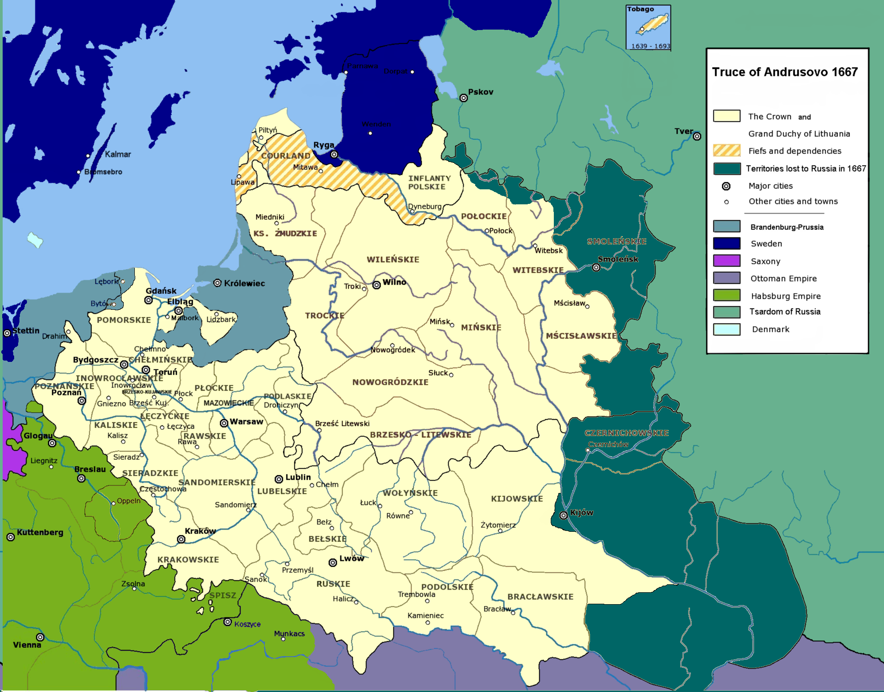

Slide 23
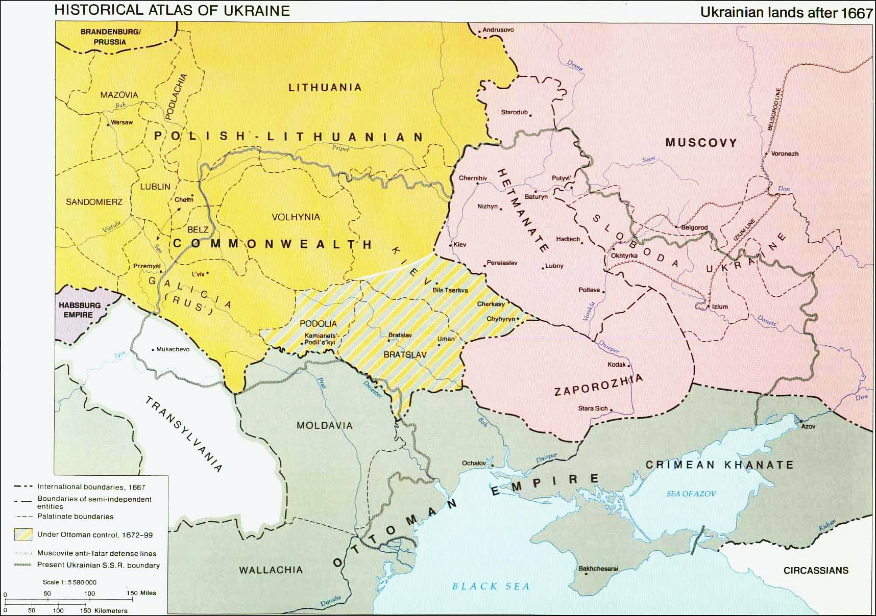

Slide 24
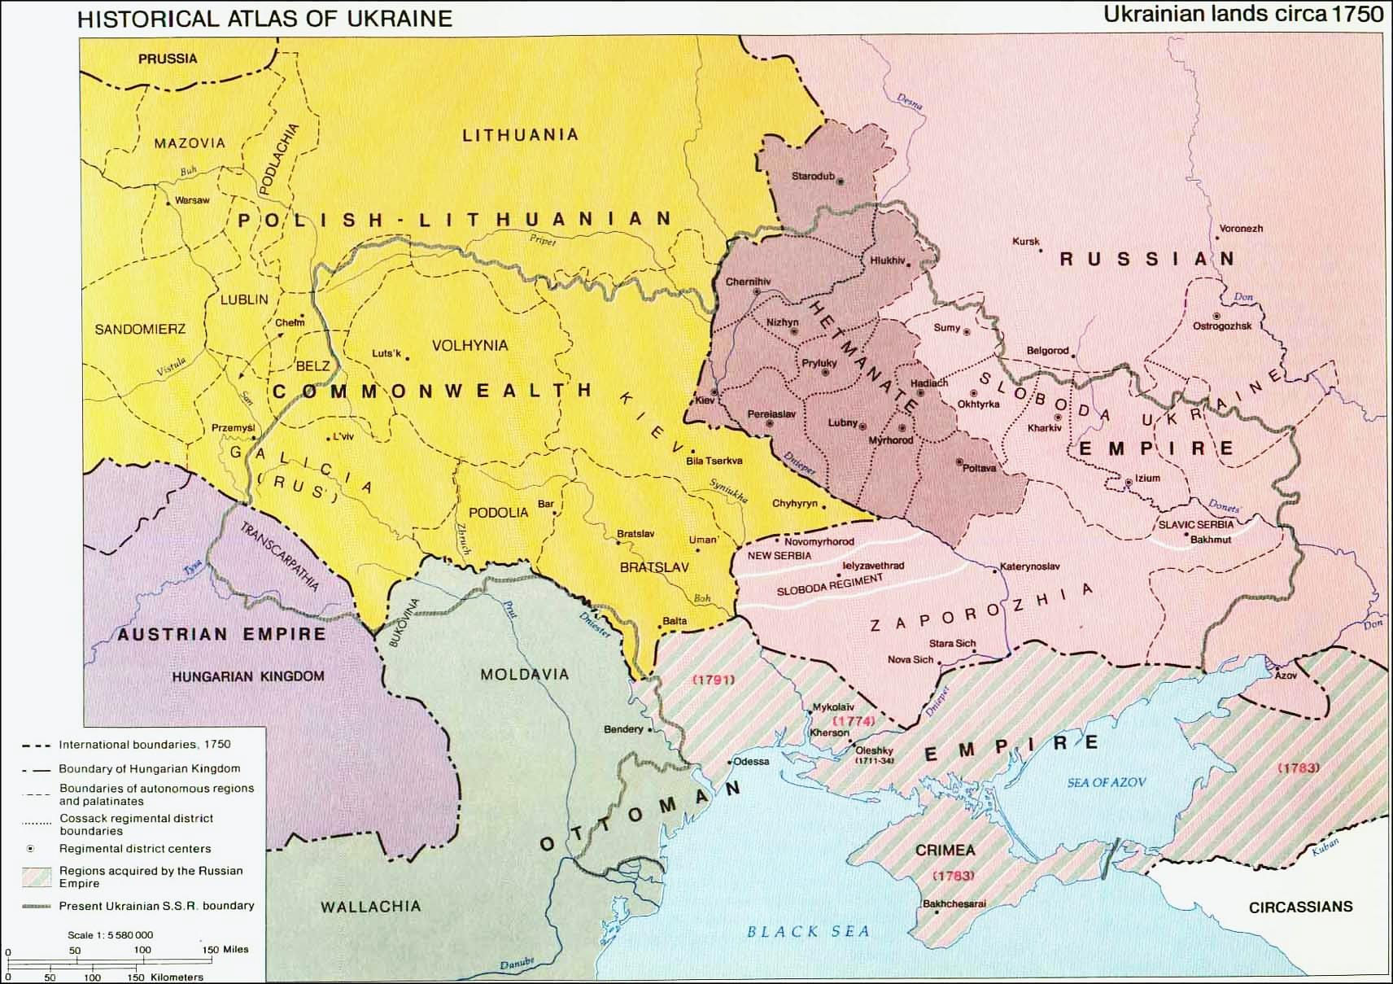
The Hetmanate in the 18th century
1685 Kyiv Orthodox Church Metropolitan becomes a division of Moscow Metropolitan
1709 Battle of Poltava, Hetman Mazepa in alliance with Charles XII defeated by Peter the Great
1722 First Ukrainian Hetman appointed by Russian Tsar
1772 First partition of Poland
1775 Zaporiz’ka (Zaporizhian) Sich destroyed by Russian army
1780 End of Hetmanate

