Slide 1
Entangled History: Ukraine and her neighbours from the Middle Ages to the present
Lecture 6, wk. 8
Becoming an empire: Russia’s long eighteenth century

Slide 2
Outline
Introduction
Changes under tsars Aleksei, Fyodor, and regent Sophia
From the Tsardom of Muscovy to the Russian Empire
Little Russia and Great Russia
Enlightenment, Europeanisation‚ Russianness
The Partitions of Poland and the end of Cossack autonomy
The Napoleonic Wars

Slide 3
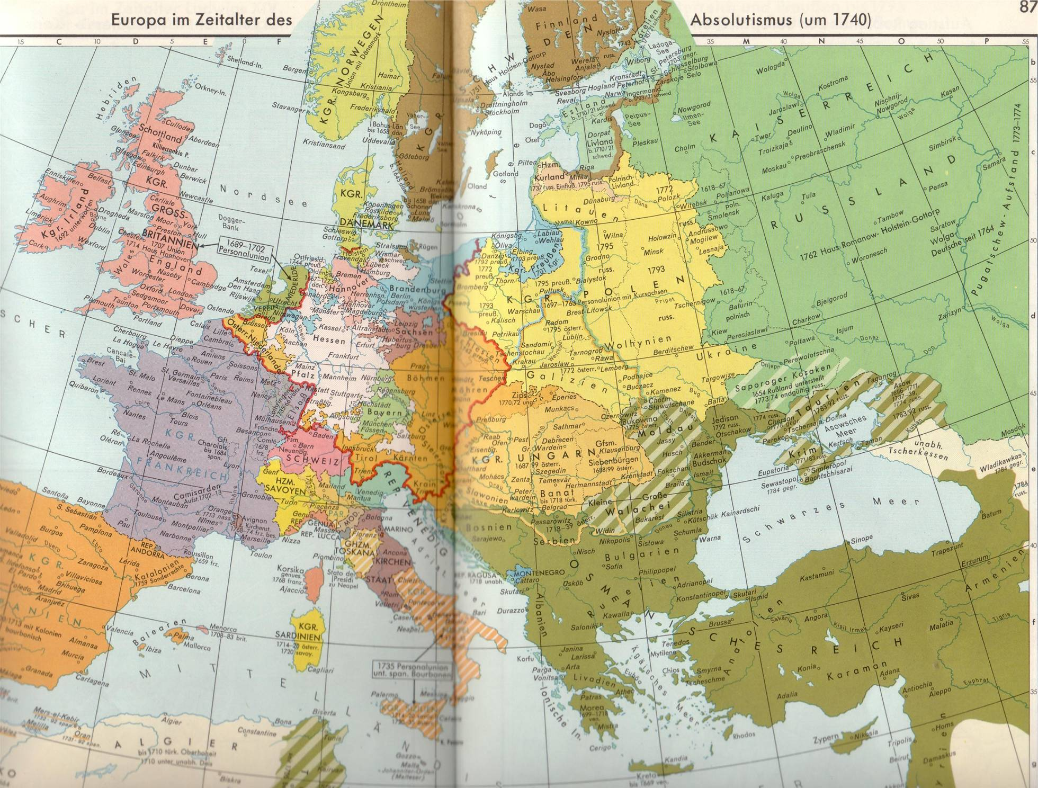
Europe in 1740

Slide 4
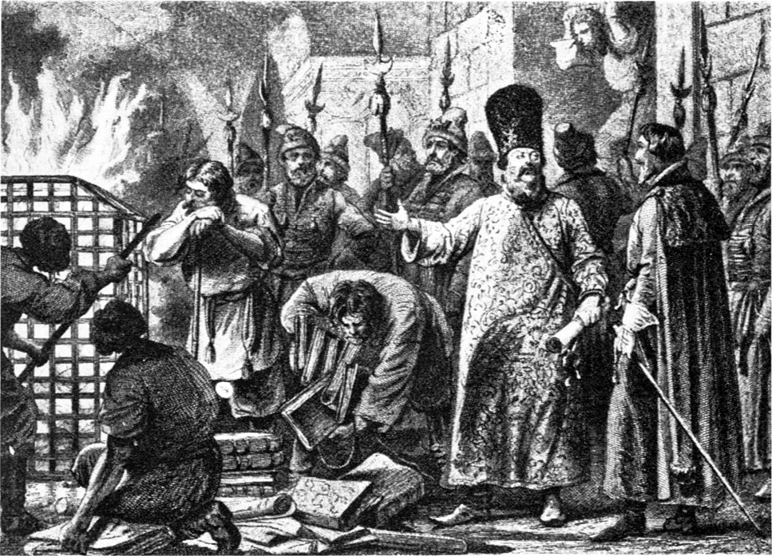
Changes under tsars Aleksei (born 1629, 1645-1676), Feodor (born 1661, 1676-1682), and regent Sophia (born 1657, 1682-1689), regent for Ivan V and Peter I
Mestnichestvo is abolished in 1682
Church reforms under Nikon after 1653, followed by schism and emergence of Old Believers
Expansion towards the Black Sea and Crimea: failed wars 1687 and 1689 (already under Peter I)
The German quarter (Nemetskaya sloboda) – in 1665 1200 foreigners
Introduction of New Order troops
Burning Razriady, registry books, in 1682

Slide 5
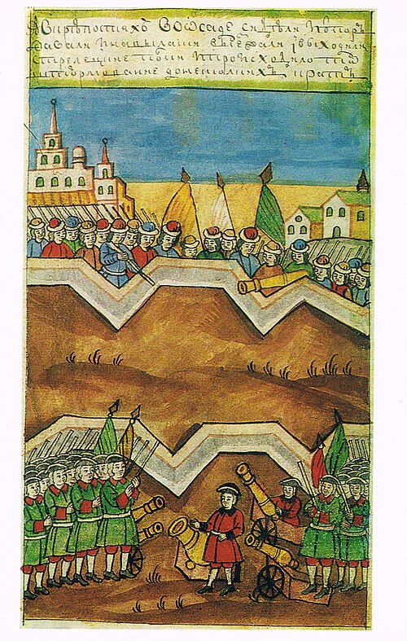
Peter the Great – (born 1672, died in 1725)
Succession problems after tsar Aleksey’s death
Early death of Feodor III
Ivan V (Peter’s half brother) not capable of ruling, sister Sophia takes over with help of Streltsy (riflemen), military units permanently based in Moscow
Traumatic experience for 10 year old Peter who becomes co-tsar of Ivan
Two factions (families and friends) fighting against each other
Peter‘s ‘amusement forces’ (toy army)
Peter takes over in 1689 with help of play regiments (becoming the imperial guard), Sophia forced to go in convent
After his mother’s Natalya Naryshkyna’s death in 1694, Peter takes full control
Peter I (the Great), 1672-1725 (tsar from 1682 – 1725), ruling from 1689

Slide 6
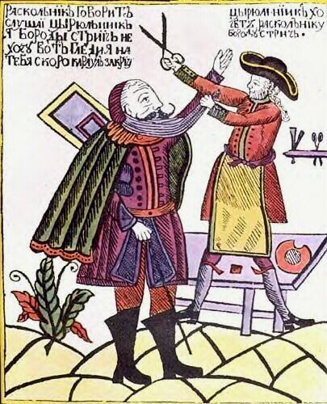
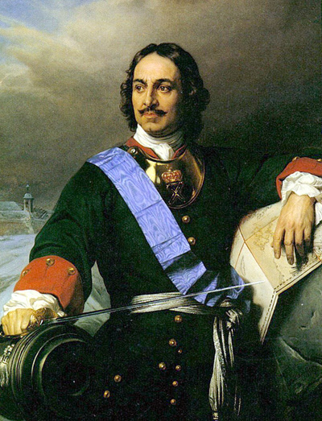
Peter the Great, portrait by Paul Delaroche

Slide 7
From Tsardom to Empire
1682/1689-1725 Peter I. (the Great)
1697 ‘Grand Embassy’ to Western Europe
Government and administrative reforms – more effective administration: Swedish, Dutch, German examples
Heavy reliance on foreign advisers
Land tax and household tax replaced by capitation: payable also by serfs
Reform of the Russian Orthodox Church: Patriarch of Moscow replaced by Holy Synod (10 clergymen)
1721 Title ‘Emperor’
1722 Introduction of a new order of precedence: the Table of ranks: privileges of nobility based on state service
Education: Academy of Science – foreign scholars and students in Russia

Slide 8
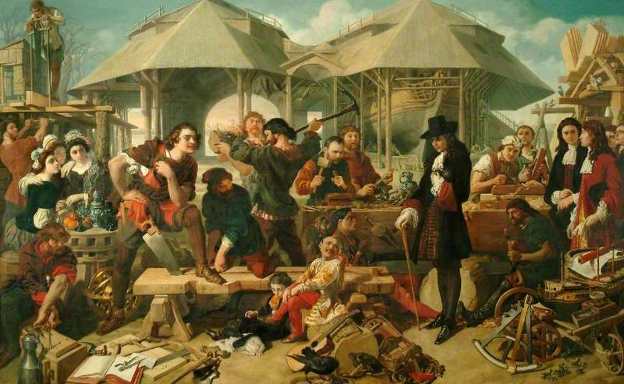
Daniel Maclise (1806-1870) - Peter the Great at Deptford Dockyard

Slide 9
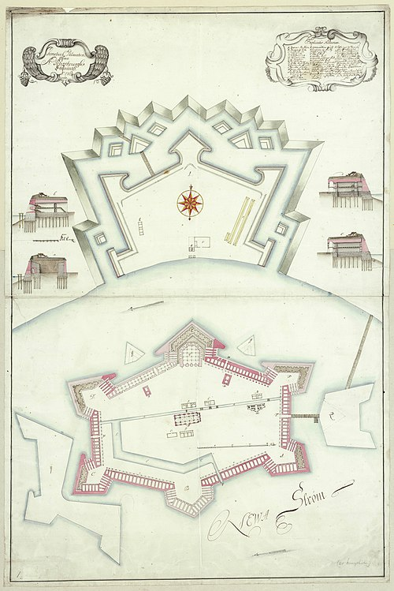
Expansion: Access to the Baltic Sea
Great Northern War against Sweden 1699-1721
Conquest of Ingermanland
1703 Foundation of St.Petersburg (1712 – capital)
Integration of Estonia and Livonia 1721
1809 Finland becomes part of the Russian Empire

Slide 10
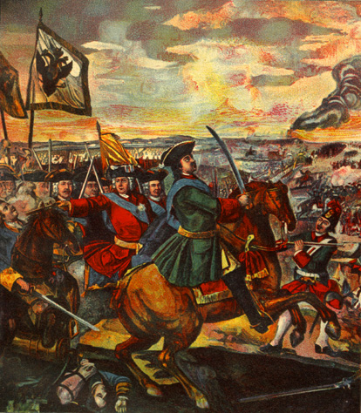
Battle of Poltava, 1709: Russia vs. Sweden and Cossack Allies (Mazepa)
Beginning of end of Cossack autonomy

Slide 11
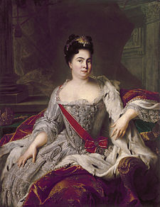
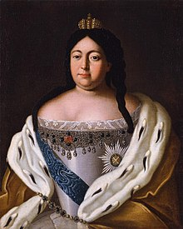
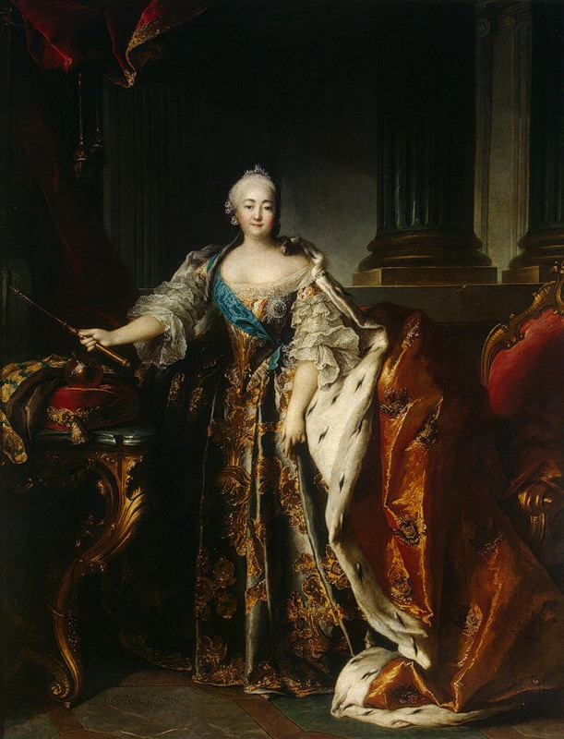
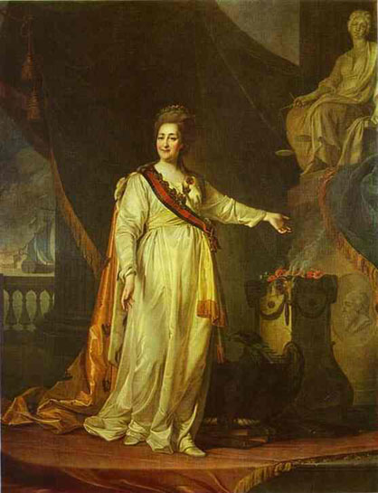
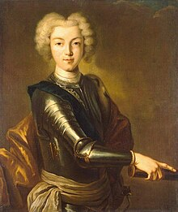
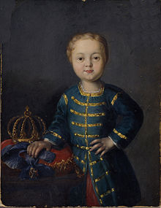
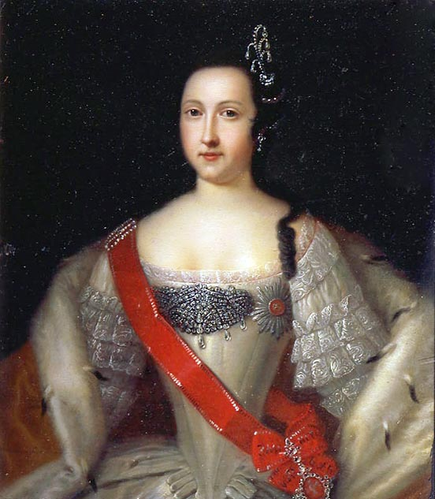
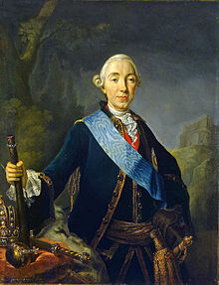
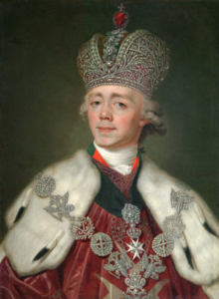
Catherine I, wife of Peter I (1725-1727)
Anna, daughter of Ivan V (1730-1740)
Elisabeth, daughter of Peter I (1741-1761)
Catherine II (the Great) (1762-1796), wife of Peter III
Peter III, grandson of Peter I (1762)
Anna Leopoldovna regent 1740-1741 (granddaughter of Ivan V)
Paul I, son of Catherine II (1796-1801)
Peter II (1727-1730), son of Peter I and Catherine
Ivan VI (1740-1741)

Slide 12
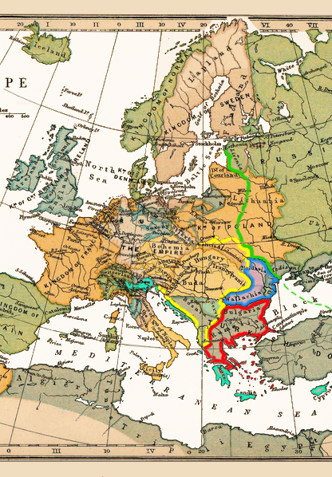
Ukraine – ideological concepts
Little Russia – Great Russia
Ukrainians in service of Russian empire – apologists of imperial power and concepts of ‘Great Russia (Muscovy)’ and Little Russia
Ukrainian writers: emphasising difference between Great Russia and Little Russia (Little Russian nation)
Imperial ideology – Russia from the Baltic to the Pacific
Greek project of Catherine II (map on the right)

Slide 13
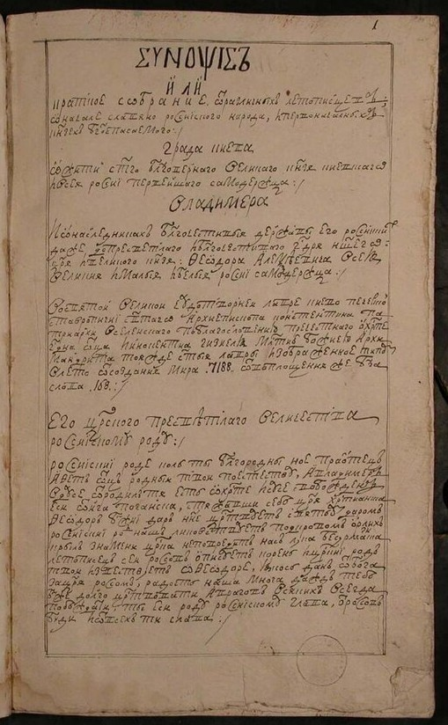
Kievan or Kyivan Synopsis of 1674
Author: possibly Innokenty Gizel (Prussian-born, converted to Orthodoxy) became archimandrite of Monastery of the Caves in Kyiv
Argues that tsars of Muscovy are legitimate heirs of grand princes of Kyiv uniting all East-Slavs under their rule
Historical justification of the tsars ‘gathering of the land of the Rus’
Becomes standard text book on Russian history, until mid-19th century 30 editions
In Moscow – old-Believers led by Avvakum against these Western ideas and against Ukrainian (perceived as Latin) influence, emphasise the special character of Muscovy (also against Greek influence)
Simeon of Polatsk 1656: welcomes tsar Aleksey in Kyiv as true Orthodox ruler and legitimate master of Rus’ land but not as member of same nation (Plokhy, Lost Kingdom, p. 38). Differentiating between White Russia and Little Russia while tsar came from abroad

Slide 14
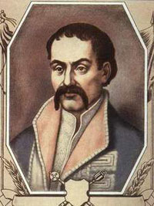
The Constitution of Bendery 1710 (Hetman Pylyp Orlyk, successor of Mazepa) Fatherland is Little Russia,
Tsars have violated agreements of Pereyaslav
‘Therefore, if God our Lord, strong and mighty in battle, should assist the victorious armies of His Royal Majesty the King of Sweden to liberate our fatherland from the Muscovite yoke of slavery, the present newly elected Hetman will be bound by duty and put under obligation to take special care that no alien religion is introduced into our Ruthenian fatherland’
Not permit any dissenters ‘most of all the adherents of deceitful Judaism, to live in Ukraine‘
Kings of Sweden ‘in eternity’ title ‘protectors of Ukraine‘

Slide 15
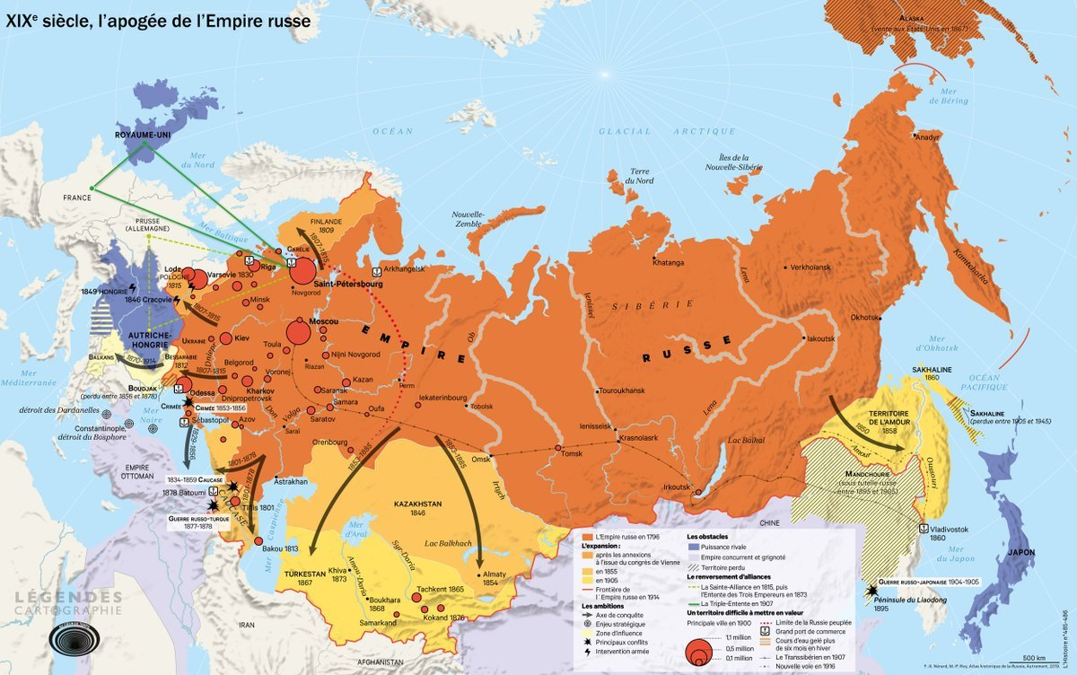

Slide 16
Semen Divovych, 1762, scribe in Hetmanate’s hedquarters: Poem A Conversation between Great Russia and Little Russia (Excerpt, Plokhy, Lost Kingdom, p. 58)
Great Russia:
Do you know with whom you are speaking or have you forgotten?
I am Russia, after all: do you ignore me?
Little Russia:
I know that you are Russia; that is my name as well.
Why do you intimidate me? I myself am trying to put on a brave face.
I did not submit to you but to your souvereign,
Under whose auspices you were born of your ancestors.
Do not think that you are my master:
Your souvereign and mine is our common ruler.
Hryhorii Poletyka (1724-1784) educated at Mohyla Academy, elected to Catherine II Legislative Commission, defended Ukrainian autonomy and the rights of the Ukrainian Szlachta
Reforms of nobility: ‘I am of the opinion that they should state that the Little Russian szlachta retain all their earlier rights, privileges, preferences, and freedoms’. (confirmed by all Russian monarchs as well as by Her Imperial Majesty) Lindheim/Lucky, p. 71-73

Slide 17
Catherine the Great: Westernisation II or 2.0
1762 under Peter III: Liberty of nobility: no longer obliged to serve in the military or civil service
1762-1796 Catherine II. (the Great): Westernisation continues
Autocracy justified by size of Russian Empire
Enlightened Absolutism: administrative reforms, attempt to organise society in well-defined social groups – estates
Charter to the Nobility (1785) and Charter to the Towns
1790 Aleksandr N. Radishchev publishes ‘Journey from St. Petersburg to Moscow’: attack on serfdom and autocracy
Problem: Serfdom and weakness of towns
Russian backwardness, empire under-administrated
Autocracy depends on nobility

Slide 18
Catherine II (the Great) (1762-1796)
Enlightened Absolutism
Catherine and Potemkin
New Russia
Wars against Ottoman Empire
Conquest and annexation of Steppe region and Crimea
Building of towns in New Russia
Settlement policy

Slide 19
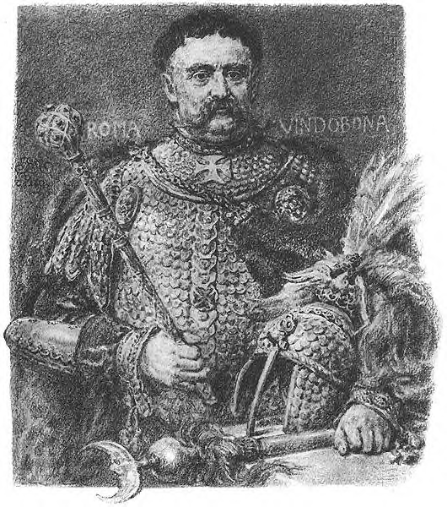
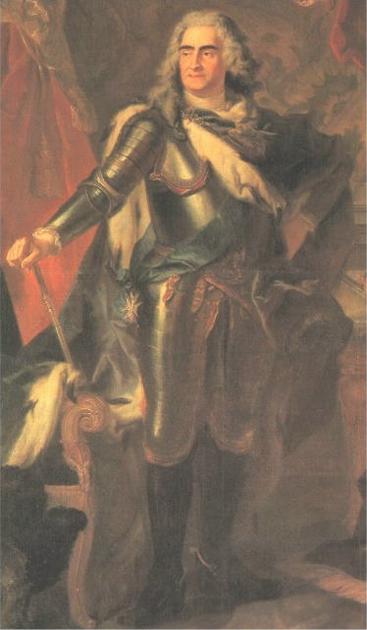
August the Strong
Elector of Saxony, King of Poland
King Jan III Sobieski

Slide 20
Polish struggles
1657 Treaty of Wehlau: Independence of Duchy of Prussia
1699-1721 Great Northern War
1717 Silent Sejm: Start of Russian Protectorate
1730 Russia, Prussia, Austria agree to uphold status quo in Poland
1733-35 War of succession
1764 Stanislaw August Poniatowski
1768-1772 Confederation of Bar against Russia (and King)
1772 First Partition of Poland
1773-1794 Polish Commission for National Education
1786 Haydamak uprising
1788-1792 Great Sejm or 4 year Sejm (a confederation Sejm)
3 May 1791 May Constitution
1792 Confederation of Targowica – against constitution – supported by Russia
1793 Second Partition of Poland
1795 Third Partition of Poland

Slide 22
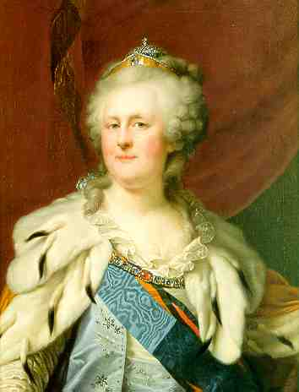
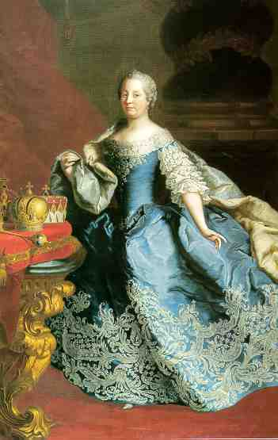
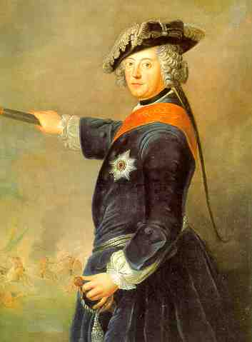
Catherine II (the Great) of Russia
Painting by Johann Baptist Lampi, 1794
Maria Theresia of Austria
Ölgemälde von Martin van Meytens, 1747-49
Frederik the Great) of Prussia
Painting by Antoine Pesne, 1745

Slide 23
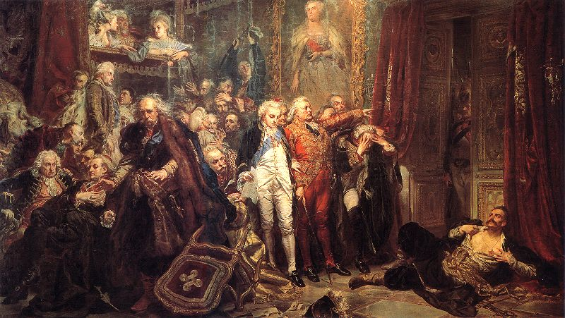
Rejtan or Poland‘s Fall (1772), Jan Matejko 1866

Slide 24
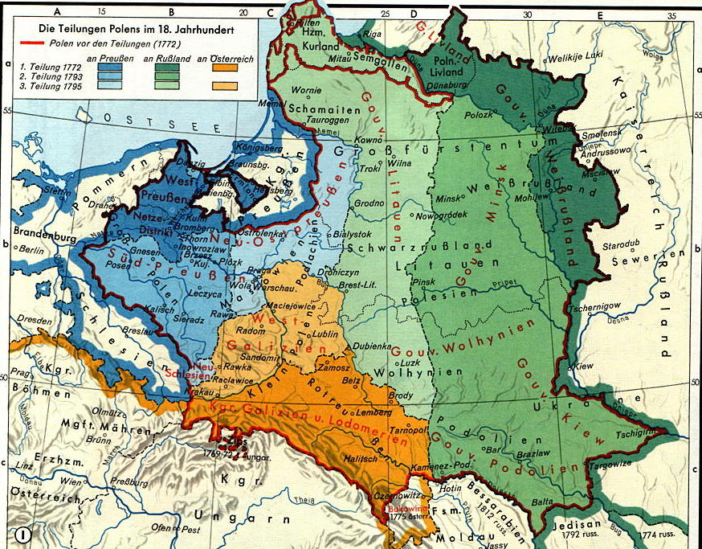
1772-1791 Reform efforts culminating in Great or Four-Year-Sejm (1788-1791)

Slide 25
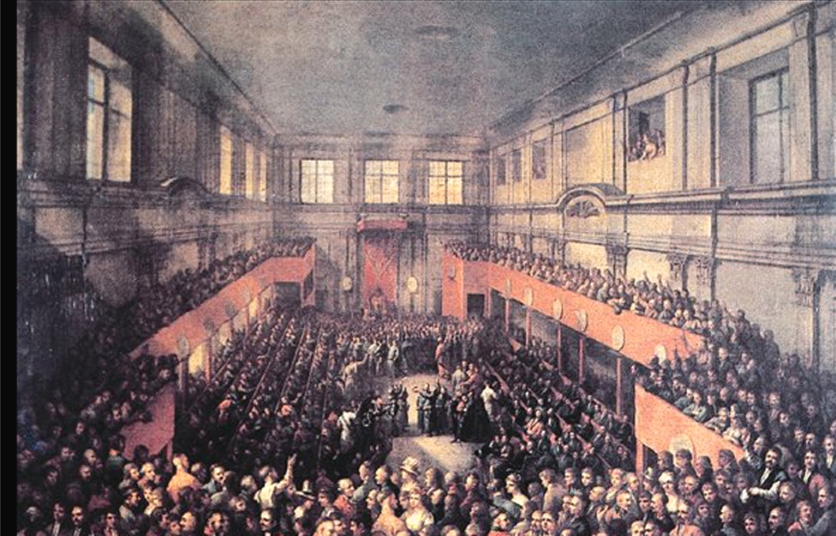
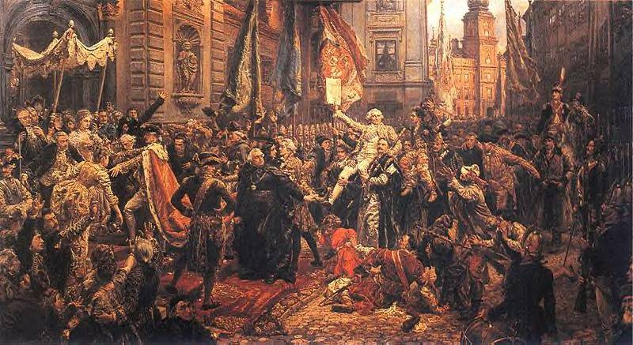
Constitution of May 3rd, 1791
Catholic confession – state religion, other confessions/religions tolerated
Nobility: liberties and rights confirmed
Towns and burghers: habeas corpus, right to buy land, access to many offices, not represented in Parliament (Sejm)
Peasants: legal protection, rights and possessions guaranteed, new foreign settlers completely free
Division of power: Executive (King and government), Legislation (Sejm), independent judicial system
King from House Wettin (Saxony) – new ruling family
Army: Polish people/nation has to defend herself – people‘s army

Slide 26
Confederation of Targowica (against reforms, appealing to Catherine II for help)
1792 Second Partition of Poland

Slide 27
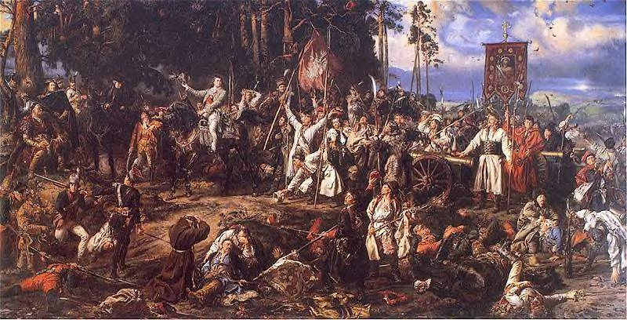
1794 Kosciuszko uprising
1795 Third Partition of Poland
After the Battle of Racławice (1794), painting by Jan Matejko (end of 19th c.)

Slide 28
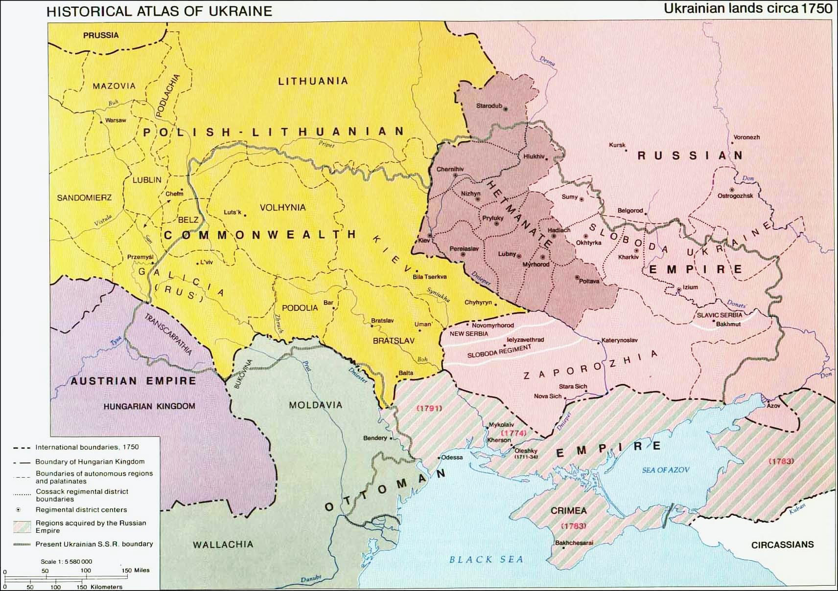
The Hetmanate in the 18th century
1685 Kyiv Orthodox Church Metropolitan becomes a division of Russian Orthodox Church (autocephalous since 1589)
1709 Battle of Poltava, Hetman Mazepa in alliance with Charles XII defeated by Peter the Great
1722 First Ukrainian Hetman appointed by Russian Tsar
1772 First partition of Poland
1775 Zaporiz’ka (Zaporizhian) Sich destroyed by Russian army
1780 End of Hetmanate

Slide 29
Timeline: Foreign and Imperial Policy 1800 - 1850
1772, 1792, 1795 – 3 partitions of Poland, large territorial gains, lion share of Poland-Lithuania to Russian Empire
1801 – Acquisition of eastern Georgia
1806 – Conquest of Daghestan and Baku
1809 – Annexation of Finland
1812 – Napoleon‘s invasion of Russia
1815 – Congress of Vienna and Holy Alliance; Kingdom of Poland (Congress Poland) in personal union with Russia
18th c. – Series of Russo-Turkish wars: conquest of Crimea, North Coast of Black Sea, Bessarabia

Slide 30
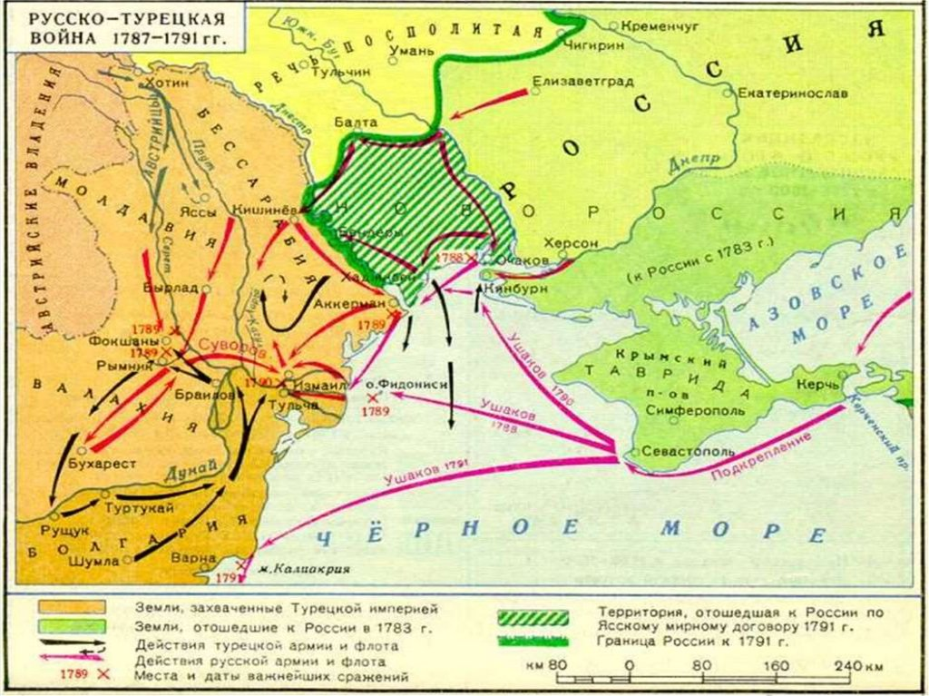

Slide 31
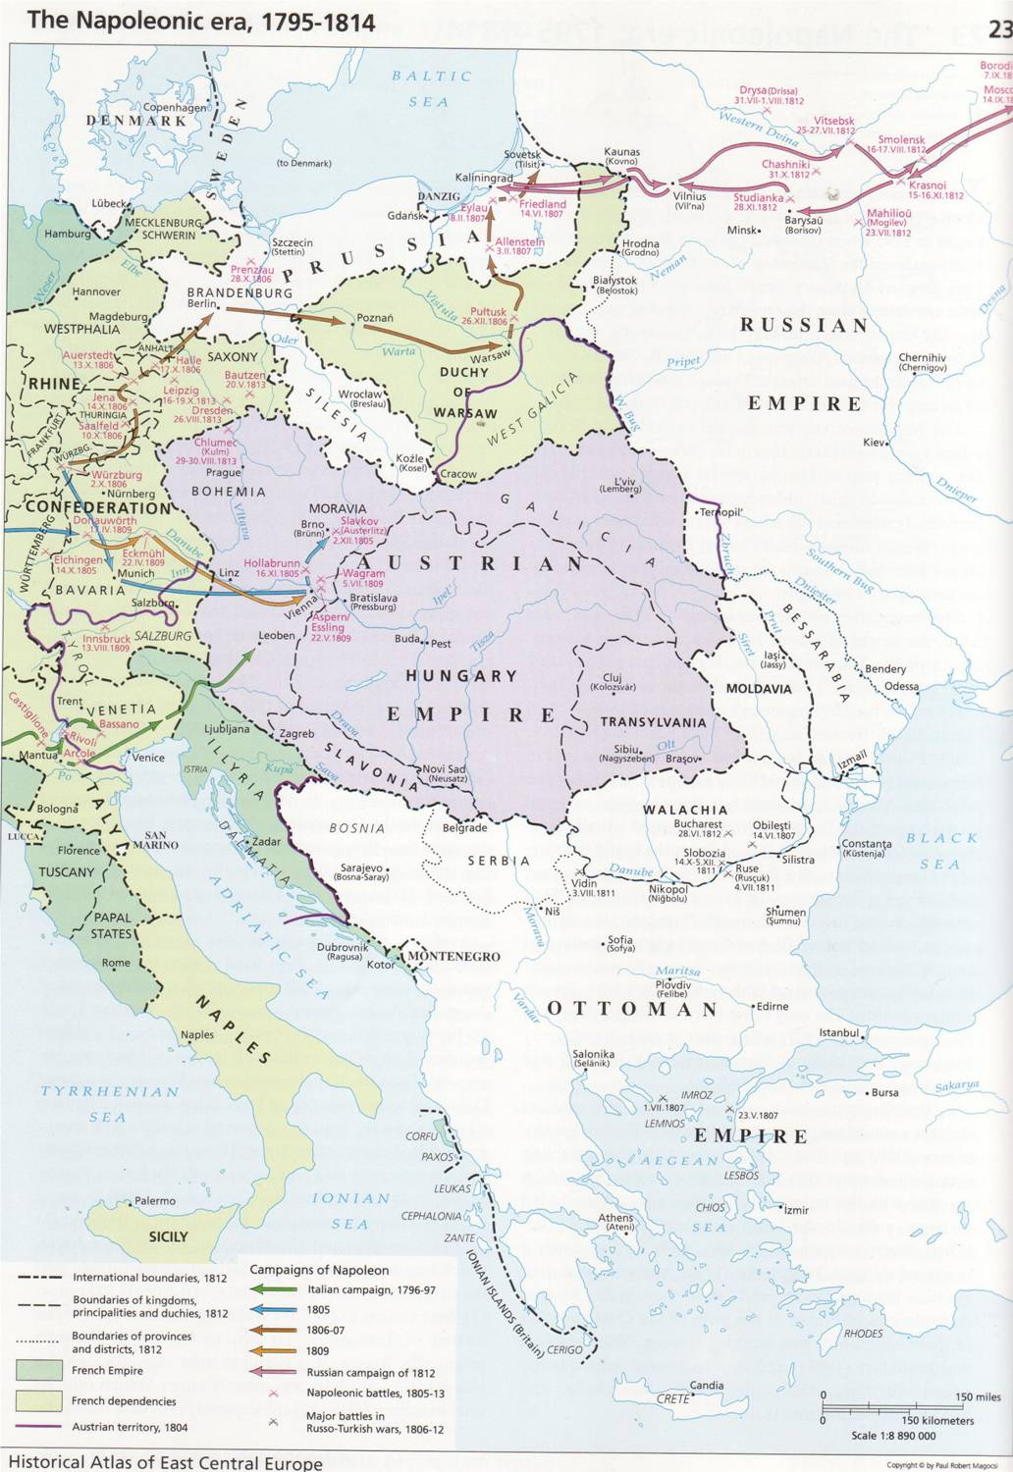
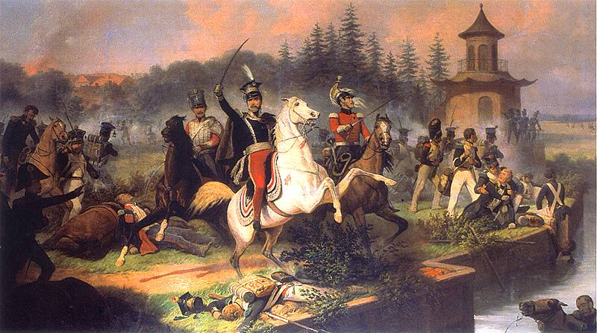
Suchodolski: The death of Józef Poniatowski at Leipzig

