Slide 1
Entangled History: Ukraine and her neighbours from the Middle Ages to the present
Lecture 7, wk. 9
Russia’s mission and Ukraine

Slide 2
Outline
Introduction
Russia in Europe
Thinking about Russia
Challenges in the Age of Nationalism
Domestic and foreign policy

Slide 3
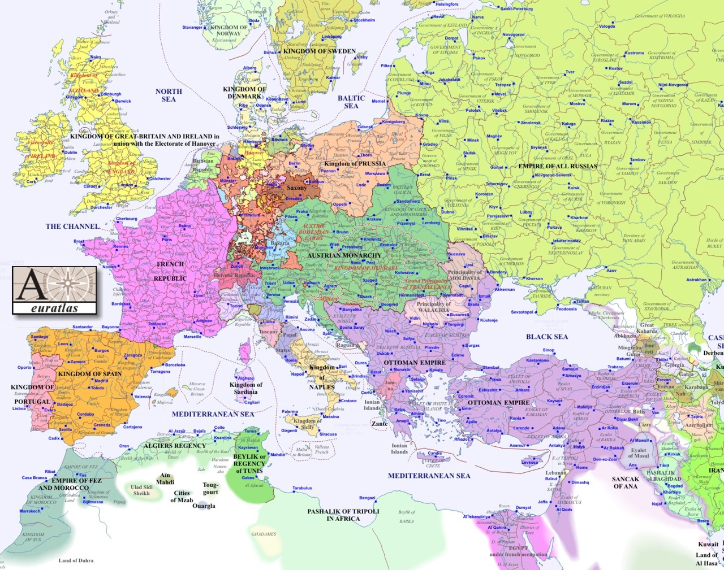
Russia growing into Europe
Speaking French
‚Russia is a European power‘ (Catherine the Great – Nakaz 1767 ‚Great Instruction‘
The Greek Project
Protector of the Orthodox
What remains to be gathered from the Kievan Rus‘ (English transliteration from Russian)
1800

Slide 4
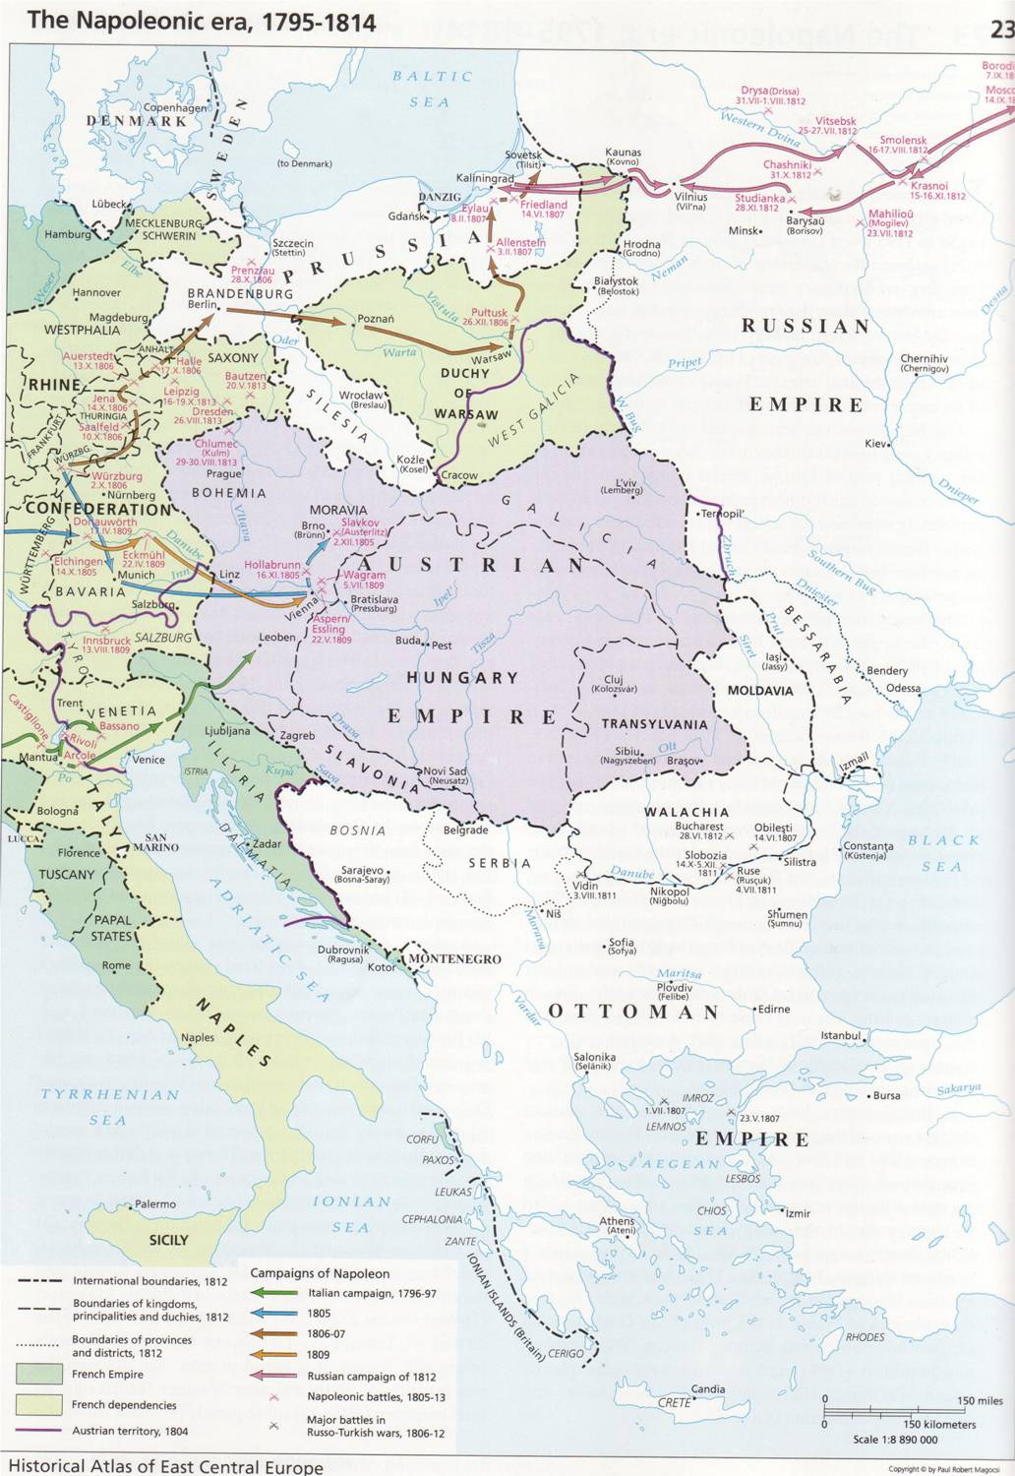
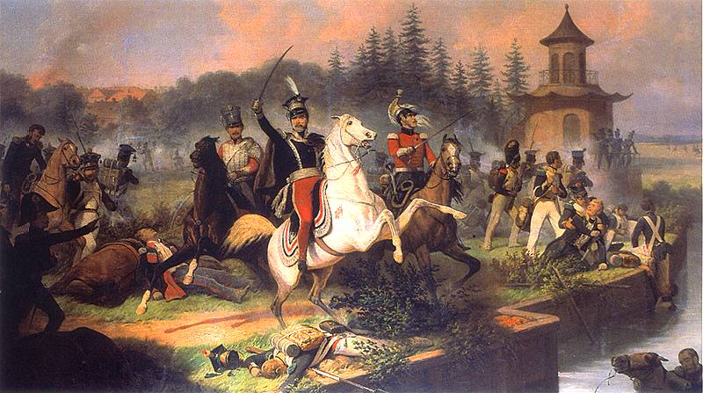
Suchodolski: The death of Józef Poniatowski (1763-1813) at Leipzig

Slide 5
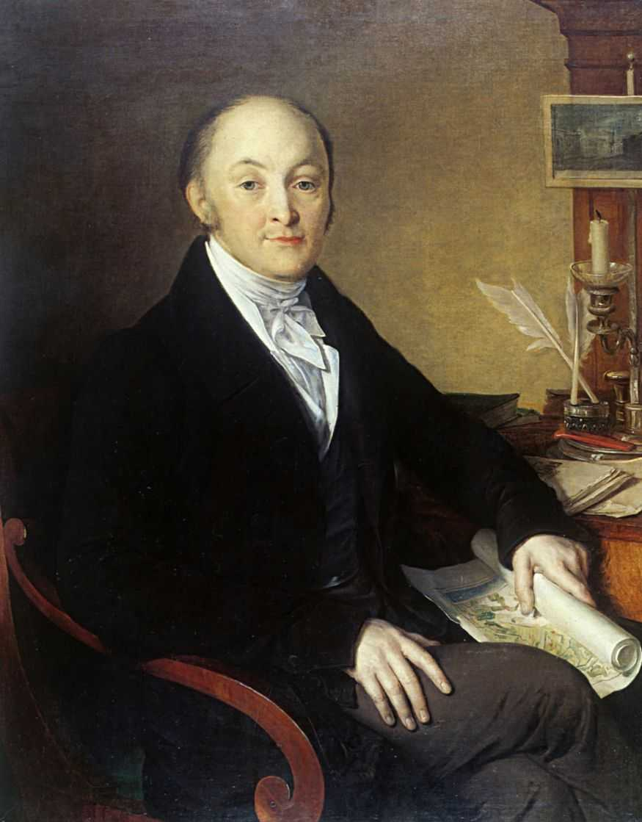
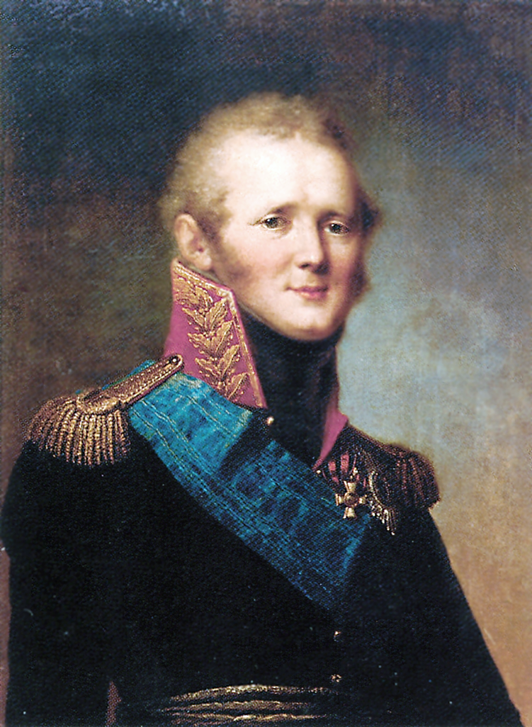
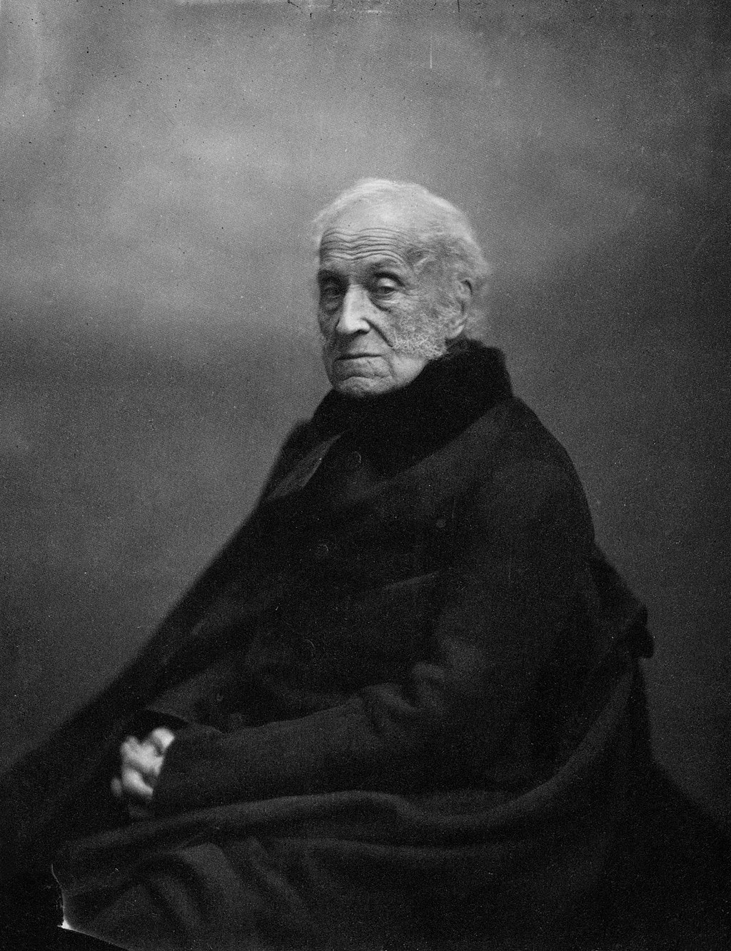
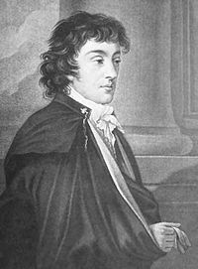
Alexander I, born 1777, ruled 1801-1825
Mikhail M. Speransky (1772-1839)
Adam Czartoryski (1770-1869)

Slide 6
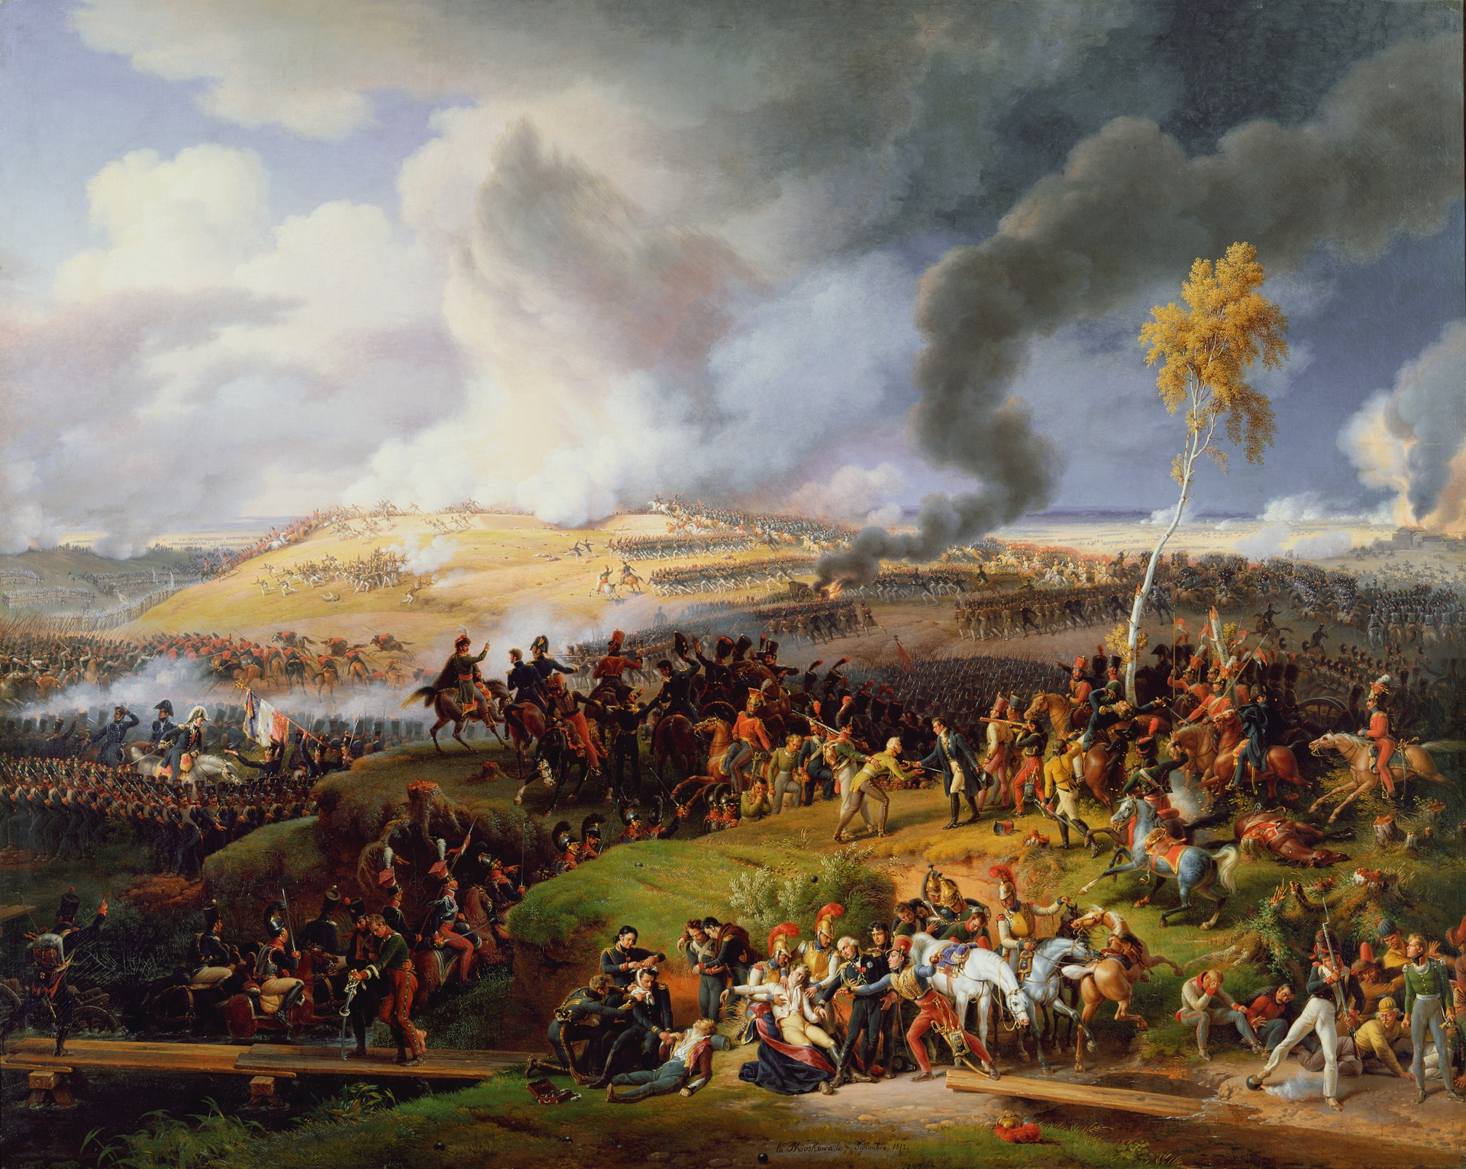
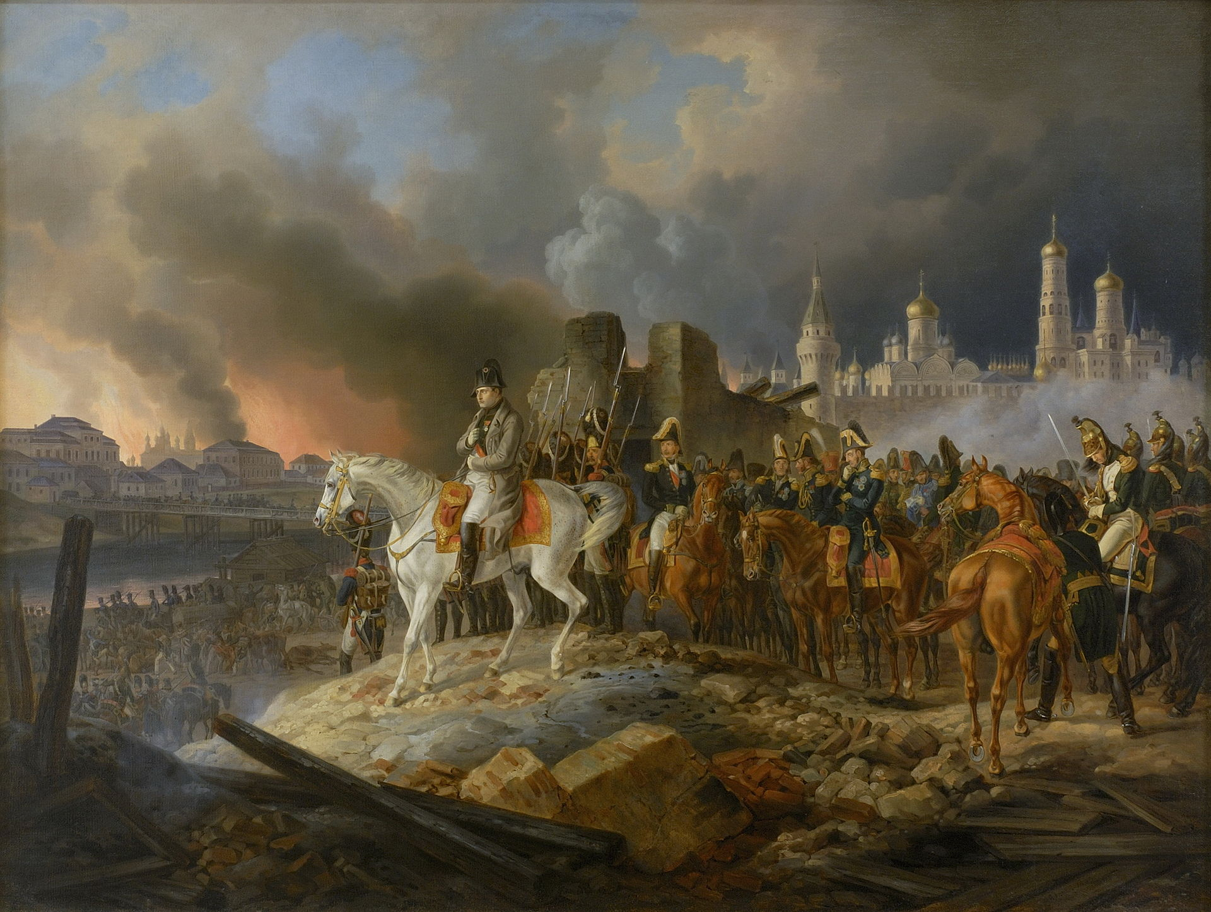
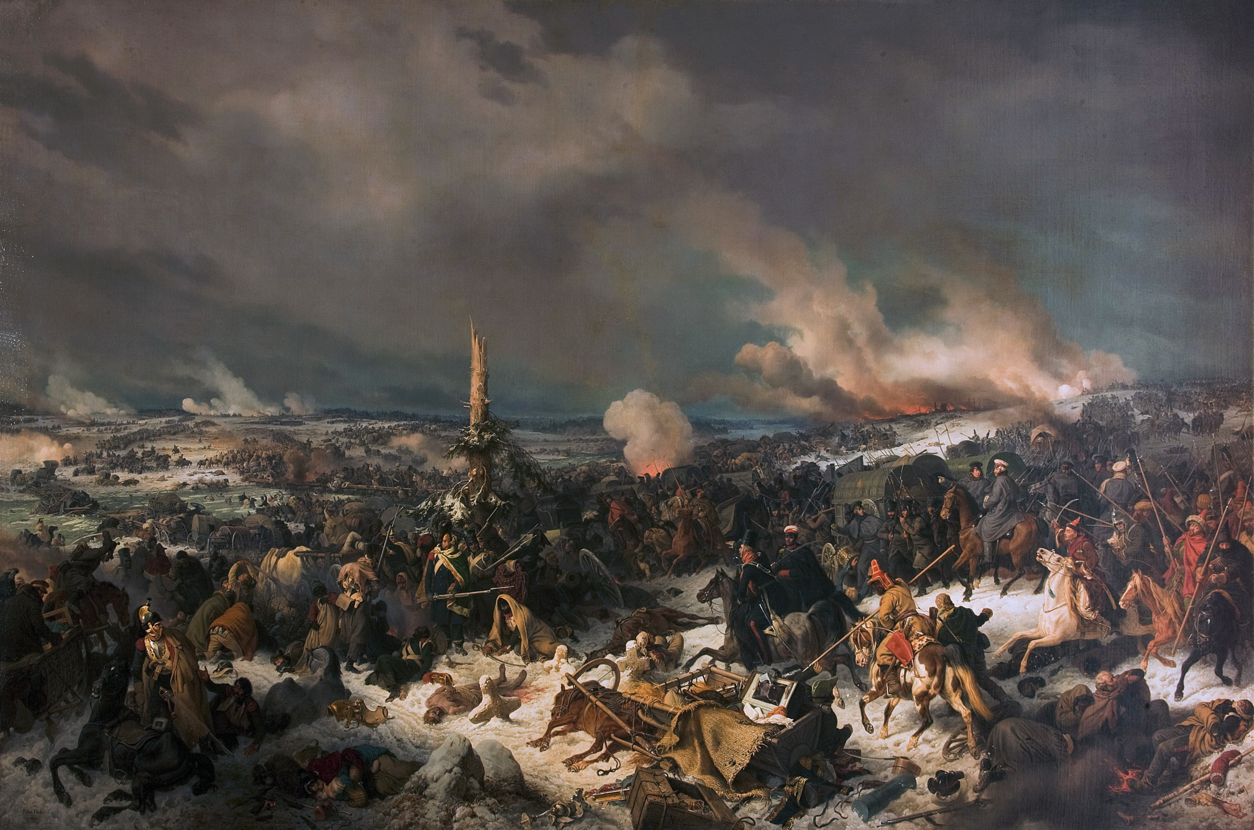
The Patriotic War, 24 June – 28 November 1812
Peter von Hess, The Crossing of the Beresina (1844), 26-28 November 1812
Louis-Francois Lejeune, Battle of Borodino (1822), 1812 – 7 September
Adam Albrecht, Napoleon at the burning of Moscow (1841, 14 September 1812

Slide 7
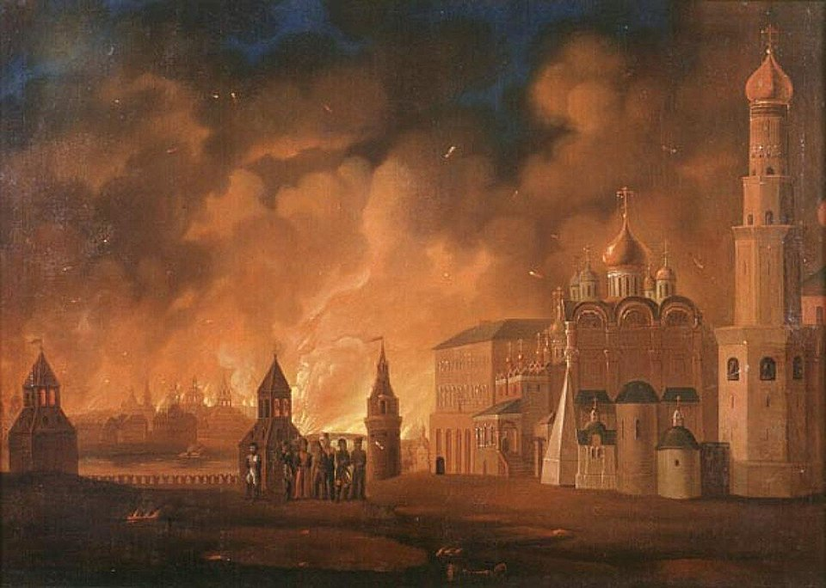
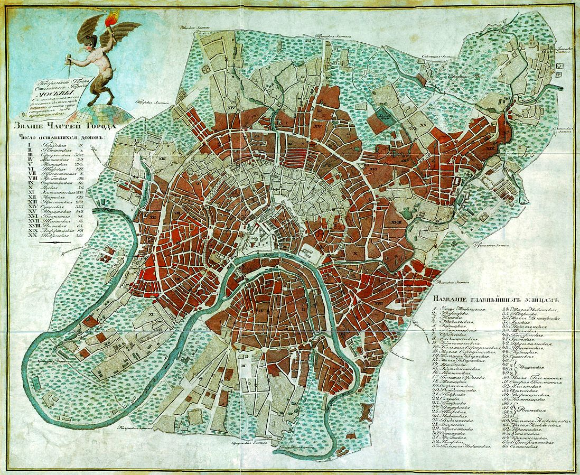
Areas of Moscow destroyed by fire (in red)

Slide 8
Timeline: Foreign and Imperial Policy 1800 - 1815
1801 | Acquisition of eastern Georgia
1806 | Conquest of Daghestan and Baku
1809 | Annexation of Finland
24 June 1812 1815 | Napoleon's invasion of Russia Congress of Vienna and Holy Alliance Kingdom of Poland (Congress Poland) in personal union with Russia

Slide 9
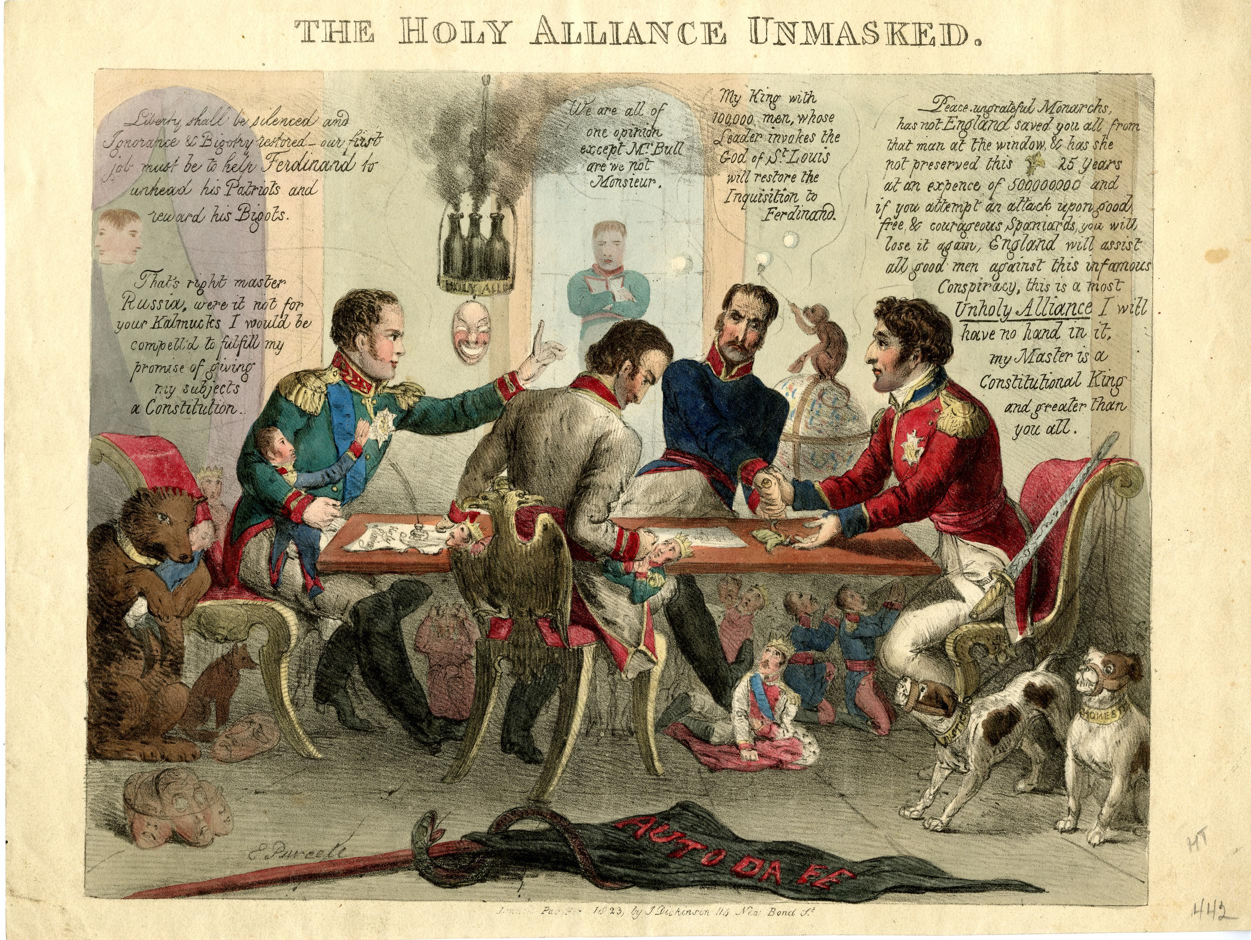
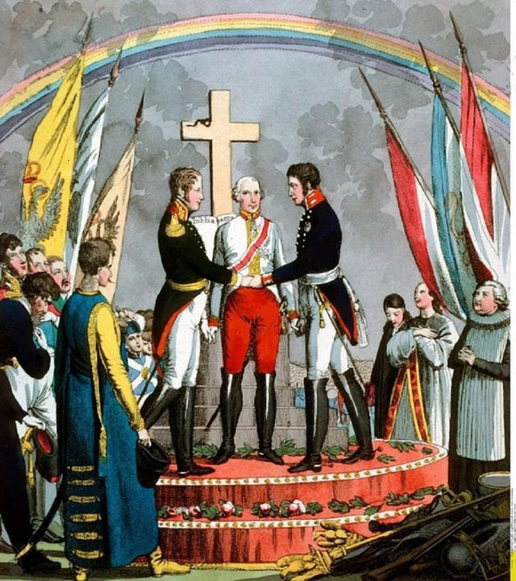
Congress of Vienna and Holy Alliance

Slide 10
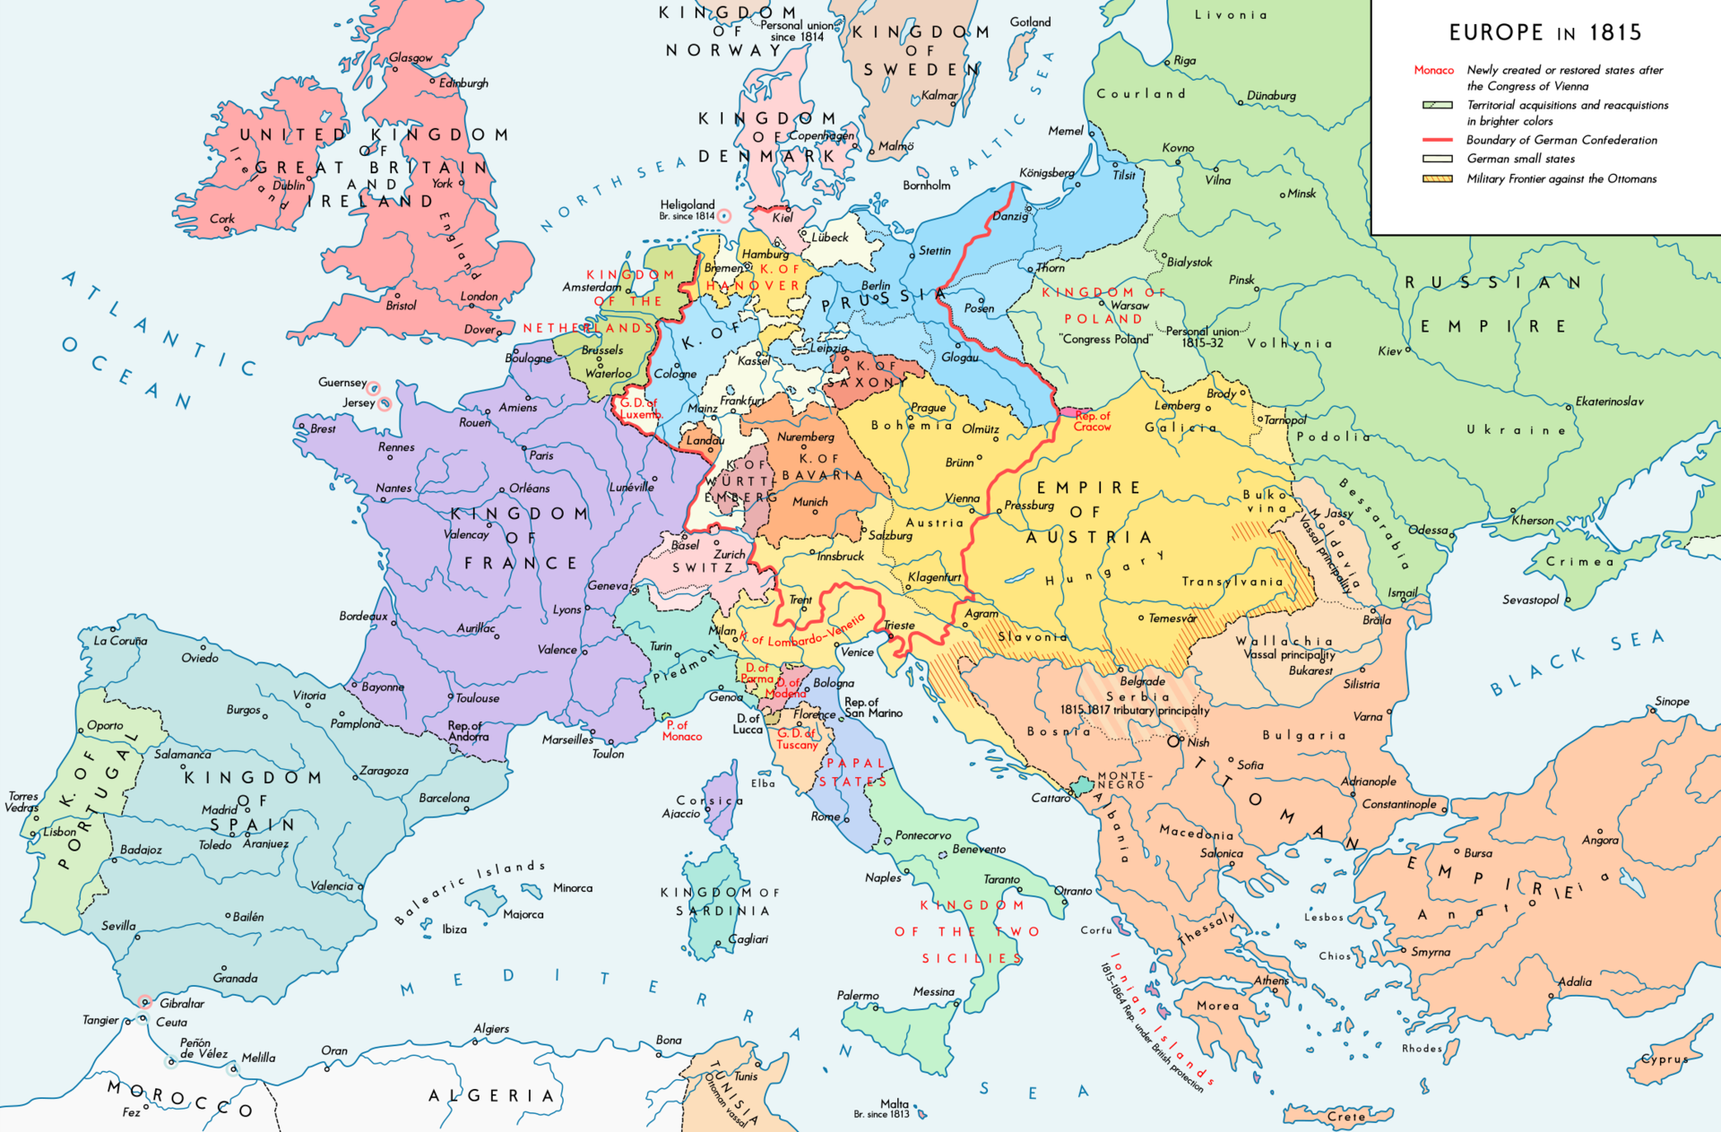

Slide 11
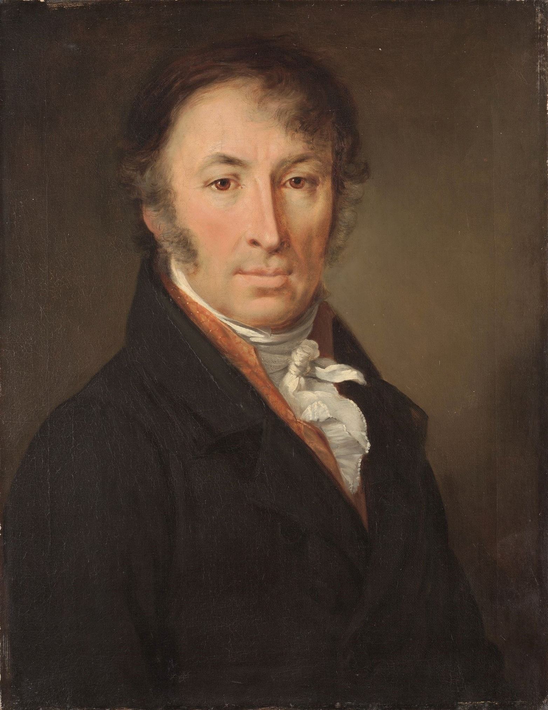
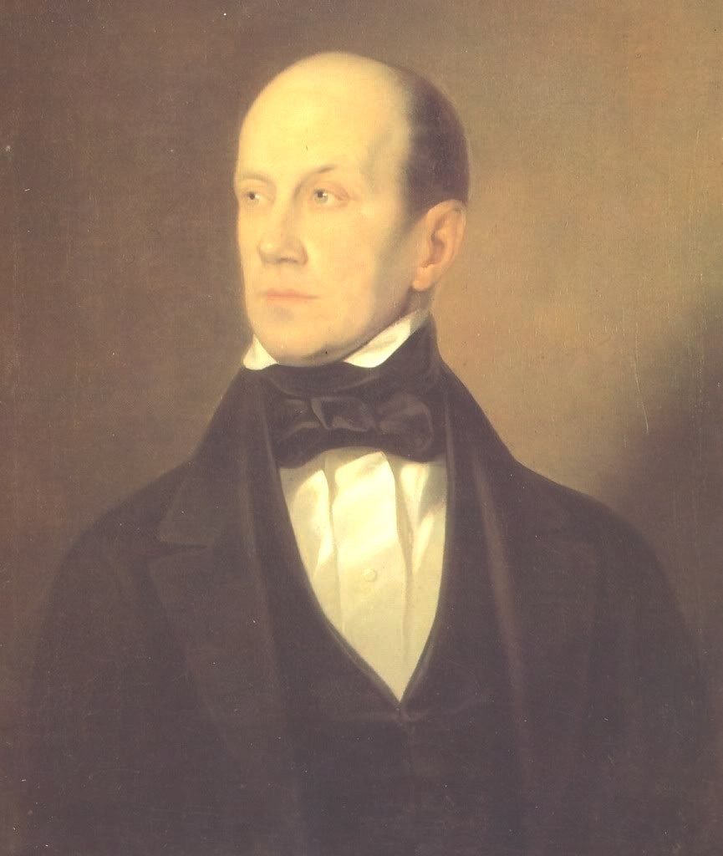
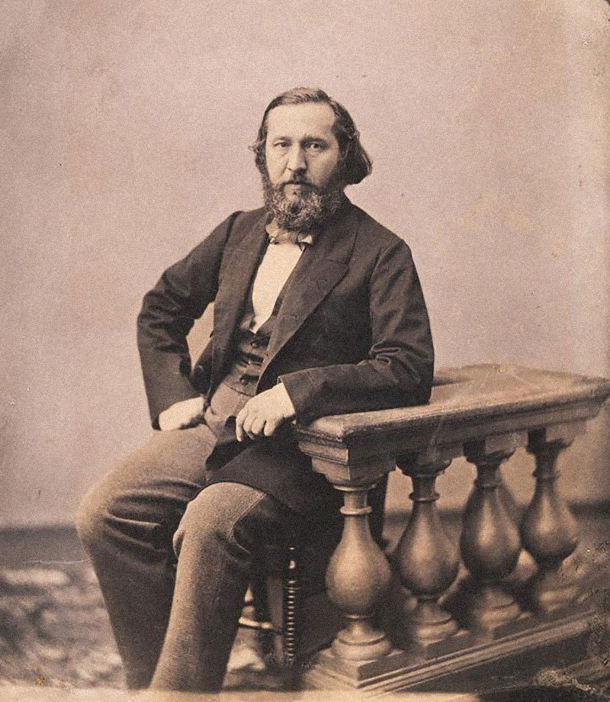
Nikolay M. Karamzin
(1766-1826)
Pyotr Y. Chaadayev
(1794-1856)
Konstantin S. Aksakov
(1817-1860)

Slide 12
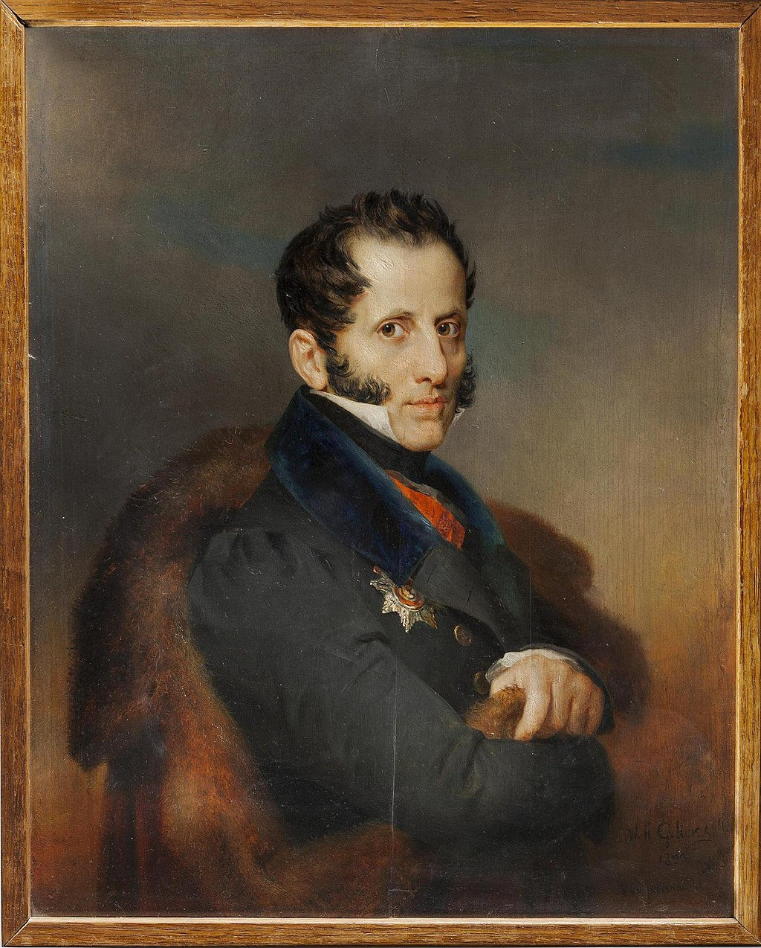
Autocracy, Orthodoxy, and Nationality/National Character (narodnost’)
Count Sergey S. Uvarov, Minister for Education 1832
Sergey S. Uvarov (1786-1855)
“’narodnost’underlines the originality and uniqueness of the Russian people, the fundamental values of Russian culture and society, as opposed to Westernization.
“To turn Russians back to Russian ways,” (“возвраща́ть ру́сских к ру́сскому”). Uvarov

Slide 13
New challenges in the age of nationalism 1800 to 1881
The Birth of the Russian intelligentsia
Relationship to Europe: Follow Europe (Westernisers), Lead Europe (Slavophiles); Russia is a European Power – Russia (Muscovy) is a world of its own
Until 1860s no fundamental difference in attitude to Ukraine/Ukrainians and Belarus/Belarusians between Westernisers and Slavophiles: love of Ukrainian folklore, sympathy for Ukrainians, but not considering them politically separated from Russia
‘Backwardness’ – catch up – reform backlog but (Belinsky) Ukrainians even more backward – catch up with Russians
Autocratic tradition – no estates: weakness of society
Nobility vs. Peasants: in 1857 37.7% (23.1 Million) of a population of 62.5 Million or 45% of the 49.5 Million peasants were serfs)
Weak middle class – intelligentsia as substitute
Empire vs. Nation: Russian nationalism and imperial patriotism – Imperial overstretch
Challenge by socialism, anarchism, and minority nationalism

Slide 14
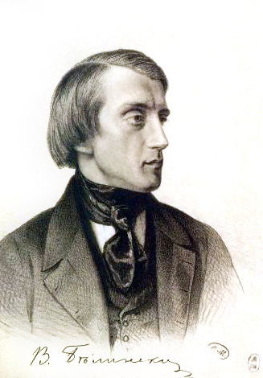
Vissarion G. Belinsky (1811-1848), leading Westerniser and literary critic: Ukrainians becoming ‘civilized’ by becoming Russians: “Merging forever with consanguineous Russia, Little Russia opened the door of civilization, enlightenment, art, science, from which it had previously been separated by the insurmountable barrier of its semibarbaric way of life. Together with Russia, she now stands before a great future.” (1843)
“The literary language of the Little Russian must be the language of a civilized society – the Russian language.” (1841)
quoted in: Andrea Rutherford, Vissarion Belinskij and the Ukrainian National Question, The Russian Review, 54 (1995), no. 4, pp. 500-15, here: p. 511, 513.)

Slide 15
Timeline: Domestic 1800 - 1850
1801 | Sale of serfs without land prohibited
1816-1819 | Abolition of serfdom in Baltic provinces
1819 | University of St. Petersburg founded
1825 | Decembrist uprising
1830 | Polish Uprising
1832 | Uvarov's three principles enunciated: autocracy, orthodoxy, nationality
1833 | Code of Laws
1834 | Kiev University founded
1835-1839 | Campaign against Uniate Church on Russian territory, 1839: Synod of Polotsk Uniate bishops, representatiaves of clergy and laity, request annexation by Russian Orthodox Church

Slide 16
Timeline Imperial and Foreign Policy 1850 - 1881
1830/31 | Polish rebellion (November uprising)
1848 | Intervention in Hungary
1853-1856 | Crimean War
1858-1860 | Acquisition from China of Amur and Maritime provinces
1859 | Surrender of Shamil; conquest of Caucasus completed
1863/64 | Polish rebellion (January uprising)
1864-1885 | Conquest of Central Asia
1867 | Alaska sold to the United States of America
1877-1878 | Russo-Turkish War

Slide 17
Timeline: Domestic Policy 1850 - 1881
1860-1873 | First railway boom
19 Feb 1861 | Emancipation of the serfs
1863-1865 | Law (courts) and education reform, Zemstvo instituted
1873 1874 | Populist movement To the People (V narod) Universal Military Training Act, military reforms
1879 | People's Will Party – terrorism
1 March 1881 | Assassination of Alexander II
1861 ff: Railways in Ukraine, industrialization of the Donbas, iron ore mining in Kryviy Rih
1863 Use of Ukrainian language prohibited by Russian government (Valuev Decree) –
Prohibition confirmed 1876 (Ukas of Ems)

Slide 18
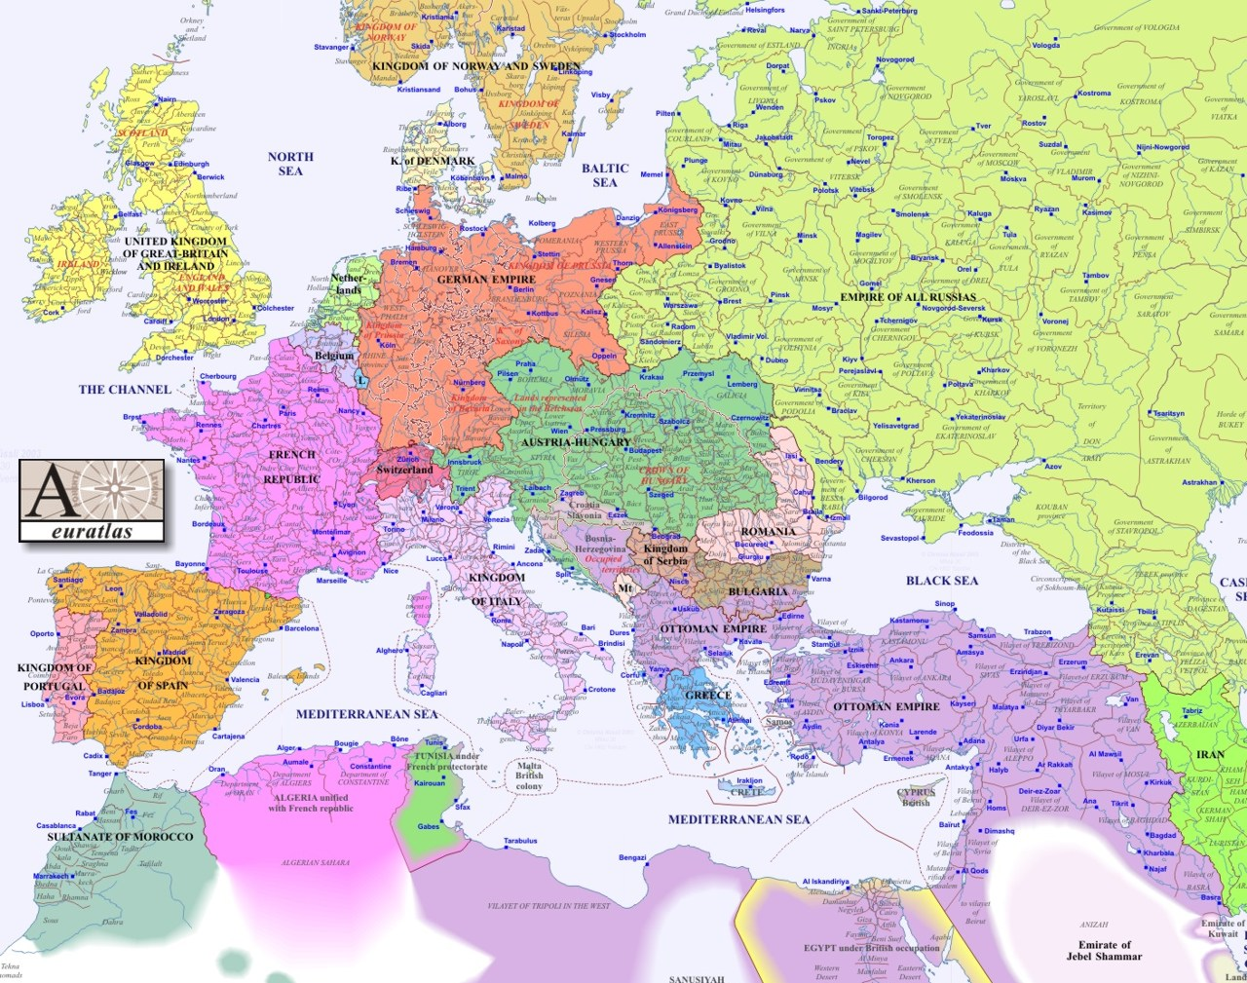
1900

