Slide 1
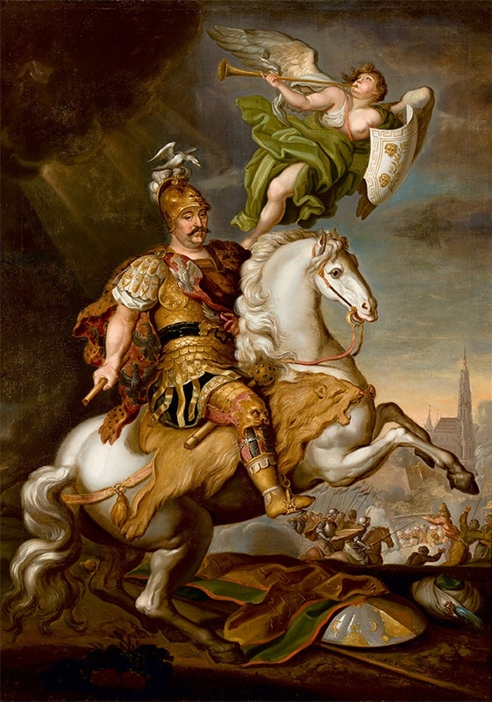
Entangled History: Ukraine and her neighbours from the Middle Ages to the present
Lecture 8
Poland’s Struggle

Slide 2
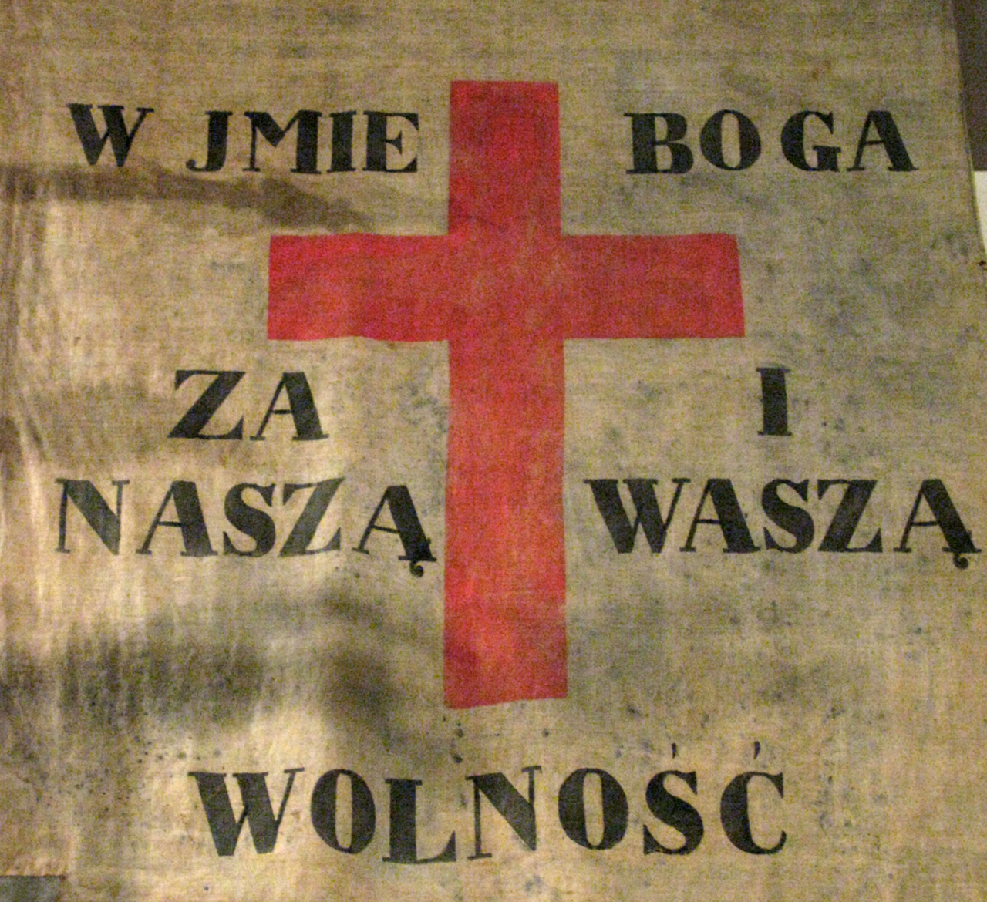
Outline
1. Introduction
2. Key question – Polish responses to the partitions
3. Polish uprisings
4. Organic Work
5. Polishness

Slide 3
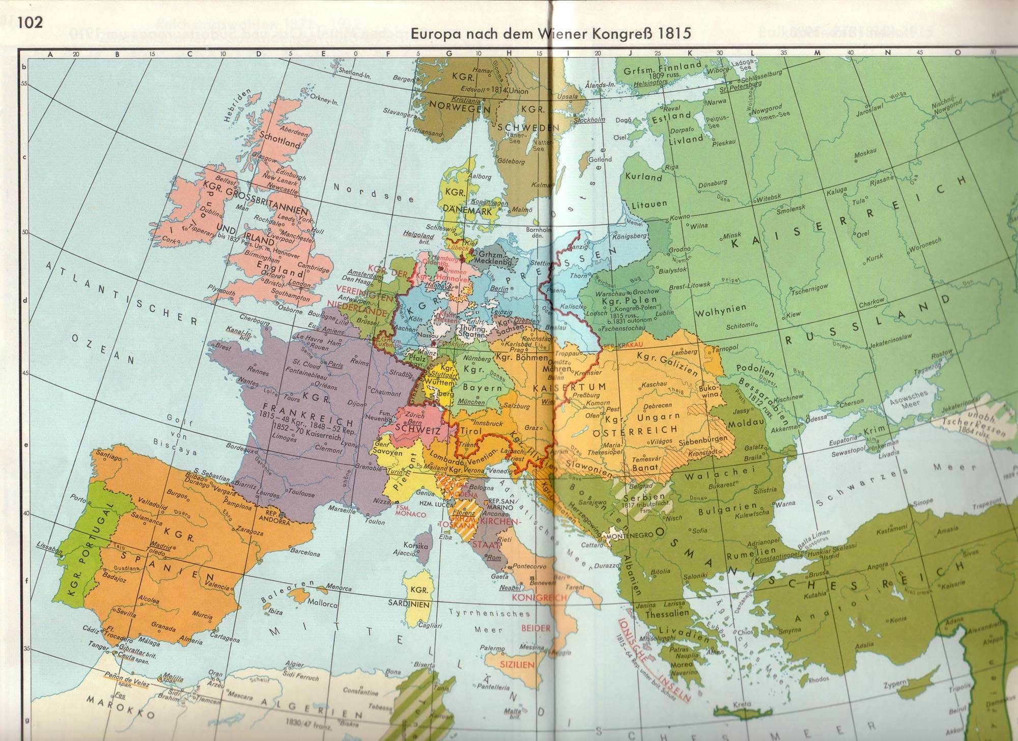

Slide 4
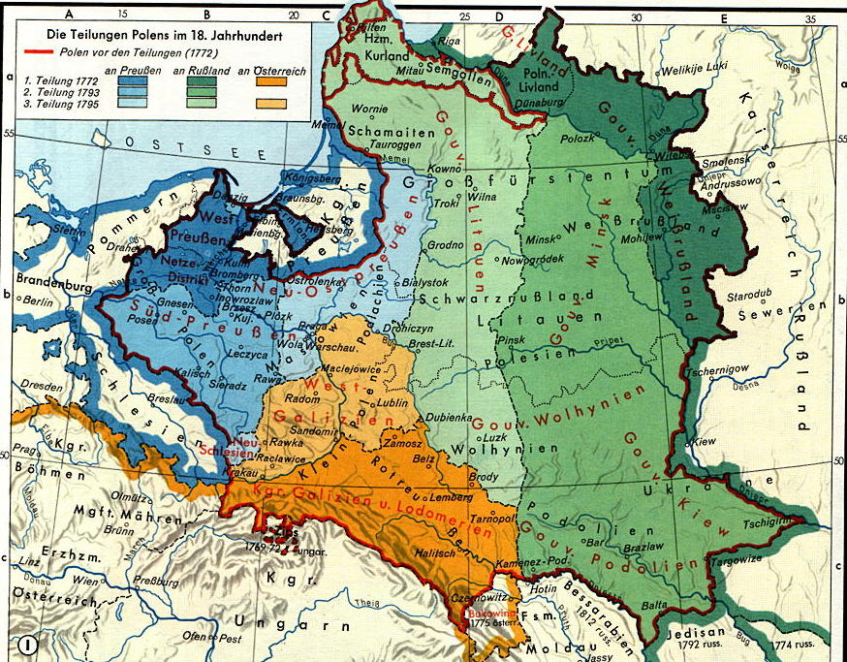
1772-1791 Reform efforts culminating
in Great or Four-Year-Sejm (1788-1791)

Slide 5
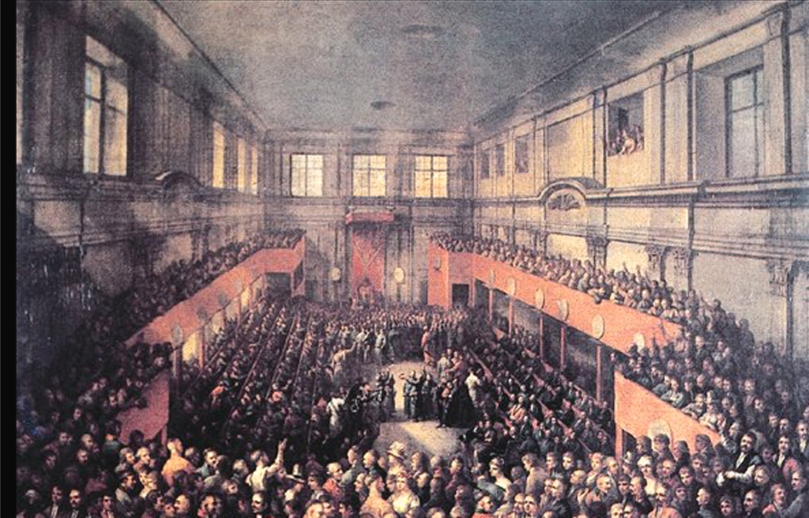
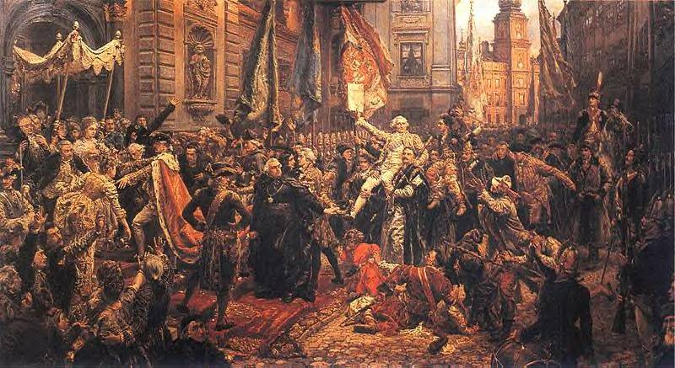
Constitution of May 3rd, 1791
Catholic confession – state religion, other confessions/religions tolerated
Nobility: liberties and rights confirmed
Towns and burghers: habeas corpus, right to buy land, access to many offices, not represented in Parliament (Sejm)
Peasants: legal protection, rights and possessions guaranteed, new foreign settlers completely free
Division of power: Executive (King and government), Legislation (Sejm), independent judicial system
King from House Wettin (Saxony) – new ruling family
Army: Polish people/nation has to defend herself – people’s army

Slide 6
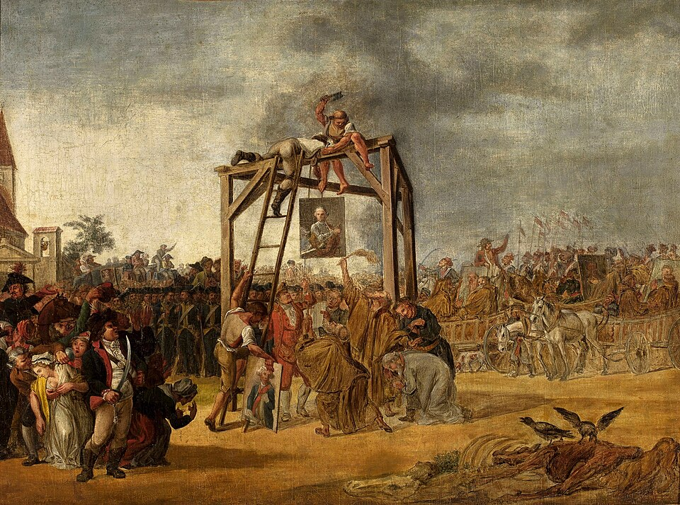
Confederation of Targowica (against reforms, appealing to Catherine II for help) – 1792 Second Partition of Poland
‘Each true Pole, not blinded by the Prussian and royalist cabal, is convinced, that our Fatherland can only be saved by Russia, otherwise our nation will be enslaved’
Stanisław Szczęsny Potocki

Slide 7
Dilemmas and Questions
Key questions: Why did Poland fall?
Shall Poland become independent again?
How can Poland become independent again?
What would be the borders?
‘Minorities’ questions (Lithuanians; Ruthenians – Ukrainians/Belarusians; Jews)
National or social priorities (how to – do one need to – involve peasants? Nobility/aristocracy connections more important)
Common strategy for one ‘Poland’ or different strategies for three ‘Polands’

Slide 8
Why was Poland partitioned and what can be done to regain independence?
God’s Punishment – Sins
Evilness of Prussia, Austria, Russia – Break of international law
Weakness of old Polish Constitution – Anarchy, not Liberty
Guilt of noble factions - treason
Oppression of peasants
Polish Backwardness
Back to Catholic values, support Catholic Church, pray and live virtuous life
Uprisings, waiting for international crisis, European war
Restitution of May Constitution 1791, liberal Constitution, stronger government
Sarmatism, Fight against traitors, replacement of nobility in national leadership
Liberation of peasants, (National) Education of Peasants
Modernisation, Polish Middle Class, Organic Work

Slide 9
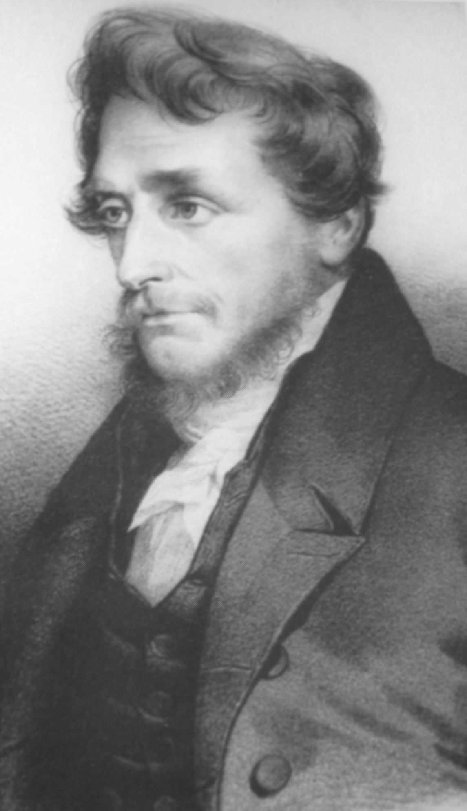
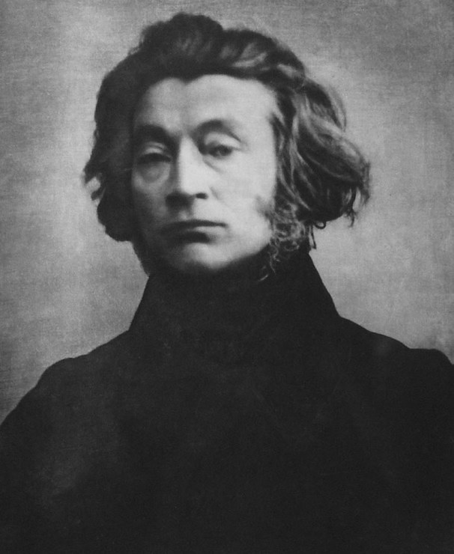
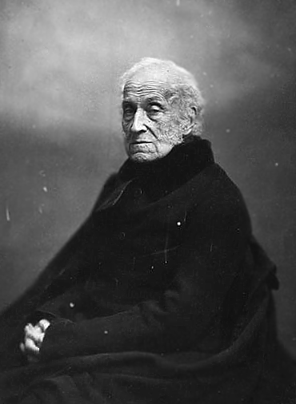
Joachim Lelewel
1786-1861
Adam Mickiewicz
1798-1855
Adam Czartoryski
1770-1861
Loyalism – Resistance/Insurrection – Conciliation – Emigration

Slide 10
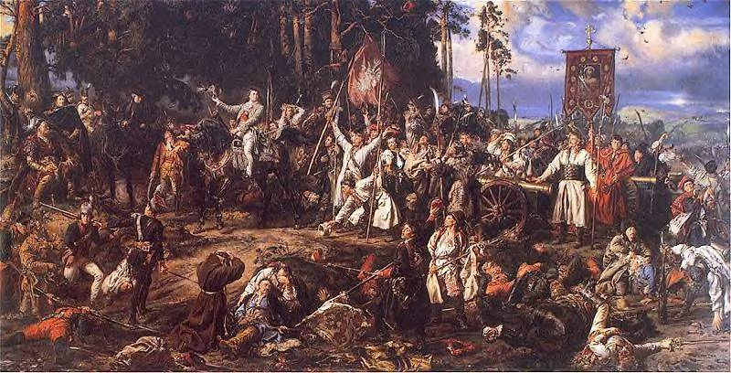
1794 Kosciuszko uprising
1795 Third Partition of Poland
After the Battle of Racławice (1794)
painting by Jan Matejko (end of 19th c.)

Slide 11
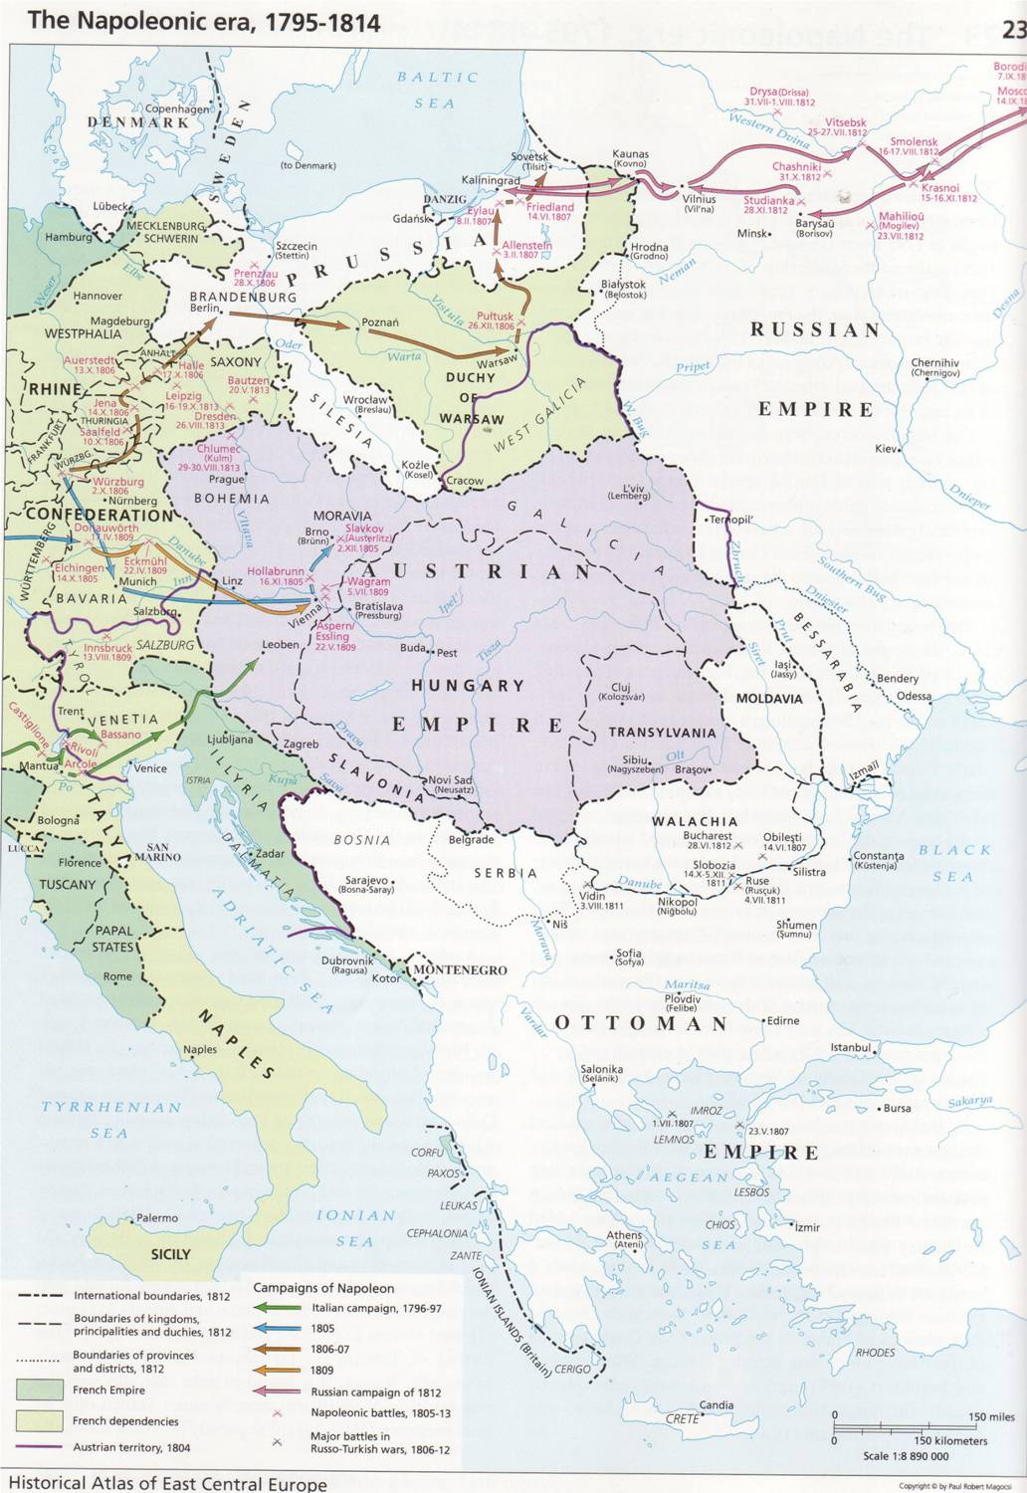
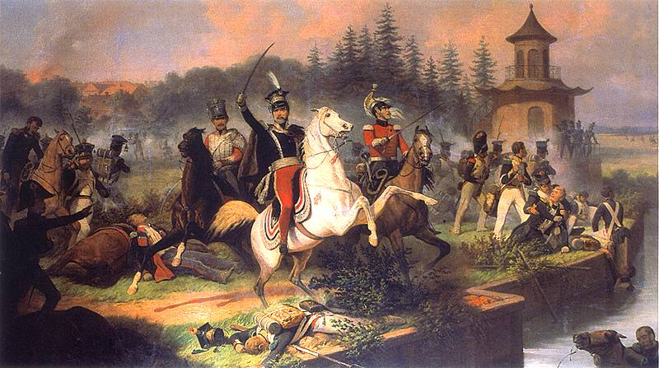
Suchodolski: The death of Józef Poniatowski at Leipzig

Slide 12
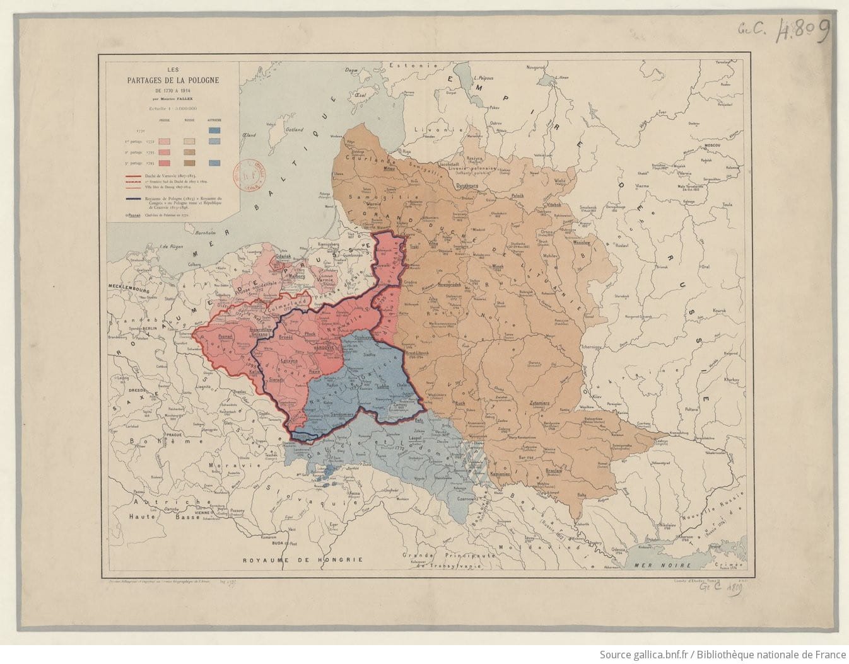

Slide 13
National Anthem: "Mazurek Dabrowskiego" (Dabrowski's Mazurka)
Words by: Jozef Wybicki 1795 in Reggio Emilia, Italy
Music: traditional; Adopted: 1927
1. Jeszcze Polska nie zginela, Kiedy my zyjemy. Co nam obca przemoc wziela, Szabla odbierzemy. CHORUS: Marsz, marsz, Dabrowski, Z ziemi wloskiej do Polski, Za twoim przewodem Zlaczym sie z narodem. | 1. Poland is not yet lost while we live We will fight (with swords) for all That our enemies had taken from us. Refrain: March, march Dabrowski from Italy to Poland Under your command we will reunite with the nation.
2. Przejdziem Wisle, przejdziem Warte, Bedziem Polakami, Dal nam przyklad Bonaparte, Jak zwyciezac mamy. CHORUS | 2. We will cross the Vistula and Warta, we will be Poles, Bonaparte showed us how to win. Refrain: March, march...
3. Jak Czarniecki do Poznania Po szwedzkim zaborze, Dla ojczyzny ratowania Wracal sie przez morze. CHORUS | 3. Like Czarniecki to Poznan, after Swedish annexation, We will come back across the sea to save our motherland Refrain: March, march...
4. Juz tam ojciec do swej Basi mowi zaplakany: "Sluchaj jeno, pono nasi bija w tarabany!" CHORUS | 4. Father, in tears, says to his Basia: "Just listen, It seems that our people are beating the drums." Refrain: March, march...
https://www.youtube.com/watch?v=vdYCbAjgfh4

Slide 14
Boże coś Polskę (extract) (God save Poland)
http://www.youtube.com/watch?v=Jsoj_8Fp1qA
Words by Alojzy Felinski (1816)
Changes by Antoni Gorecki (1817)
Music (different versions), final version taken from a Cracow song “Hail to you, Blessed Virgin Mary” 1861
O, God who, through so many centuries,
surrounded Poland
with the brilliance of power and glory,
who has protected it
with the shield of your defence,
against the disasters that
were meant to defeat it.
Refrain:
To your altars we carry a prayer:
Save our King, Lord ! (1816)
Return our Homeland to us, Lord ! (1830)
Bless our Homeland and freedom, Lord ! (1989)
Bless our free Homeland, Lord ! (1996)

Slide 15
Poland – Uprisings before 1900
1794 Kosciuszko-Uprising (Russia)
Also in Greater Poland (Prussia)
1806 Uprising in Greater Poland (Prussia)
1830 November Uprising (Russia)
1846 Greater Poland (attempt, Prussia)
and Galician Slaughter, Kraków (Austria)
1848 Greater Poland (Prussia)
1863 January Uprising (Russia)

Slide 16
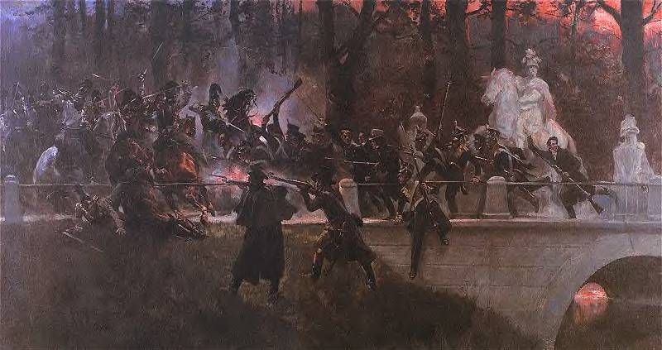
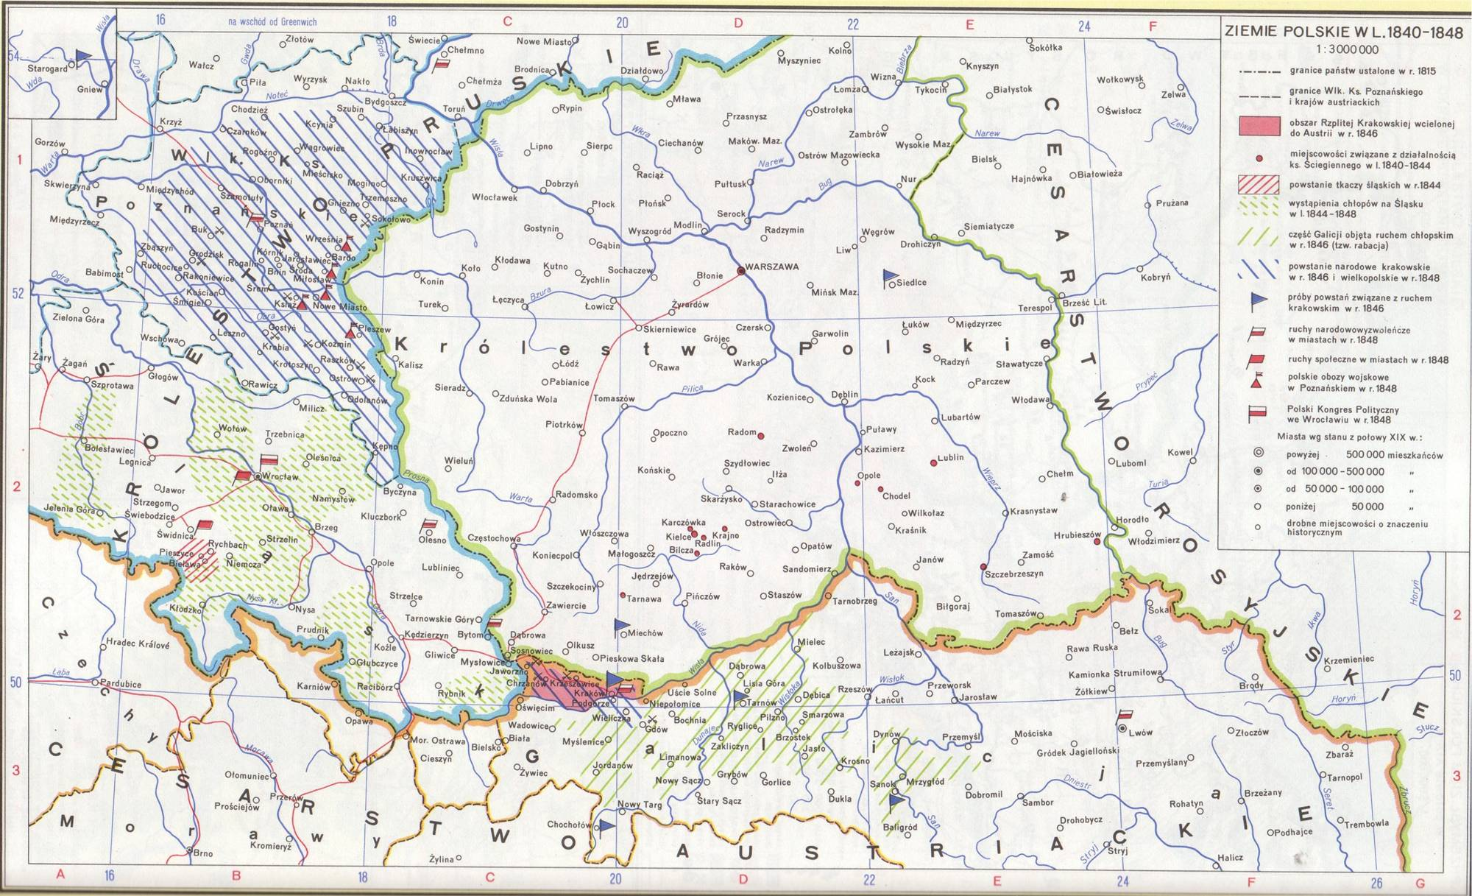
November Uprising, 1830
Polish lands, 1840-1848

Slide 17
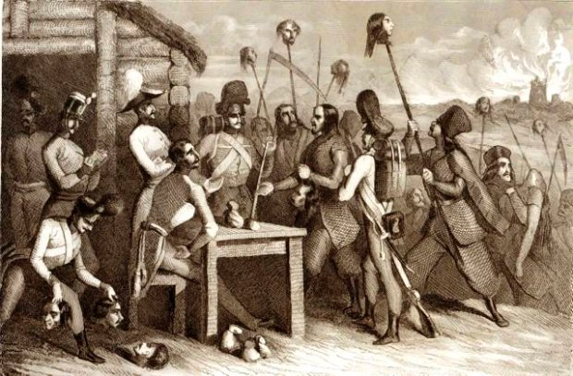
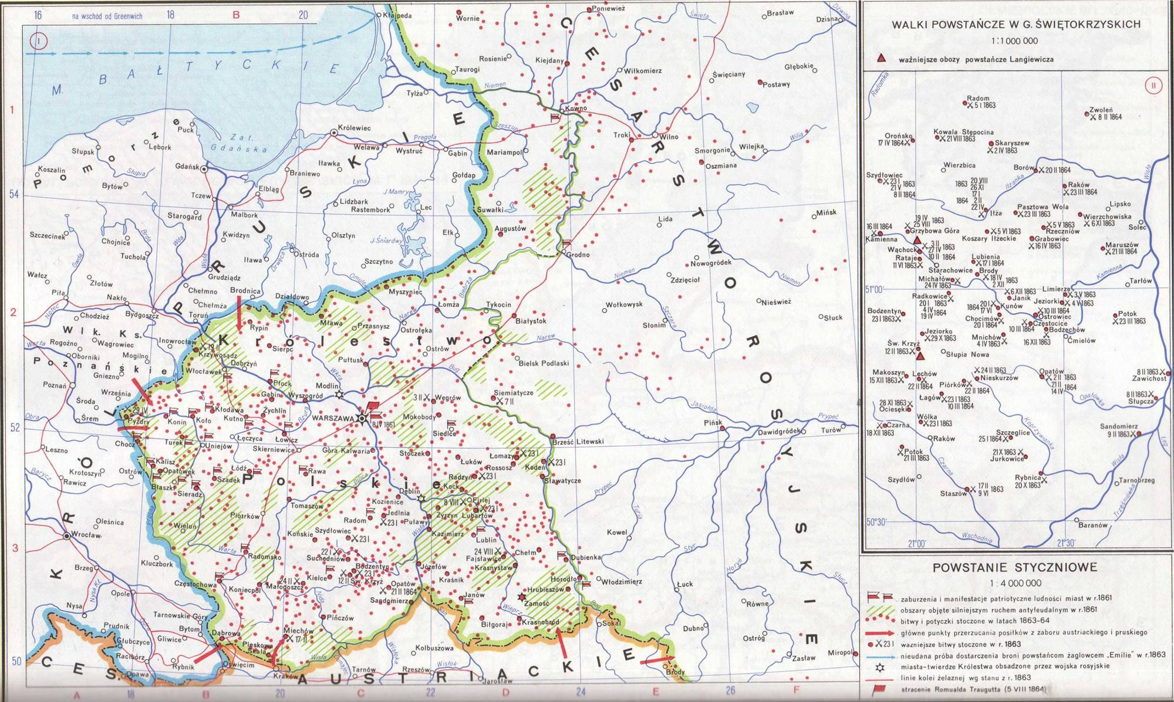
Galician Slaughter1846
January Uprising, 1863/64

Slide 18
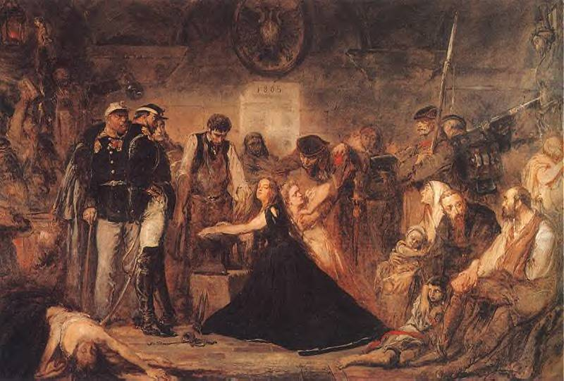
Emigration
Polish Refugees 1863

Slide 19
Organic Work
Starting point: failed insurrections
Poland culturally and economically too underdeveloped to sustain an independent state
New strategy:
Improve industry and trade in the Polish provinces
Build towns and railways
Organize cooperatives and organize Polish peasantry
Raise the literacy level and the national consciousness of the population
Important advocates: Stańczyk group in Cracow and Warsaw positivists

Slide 20
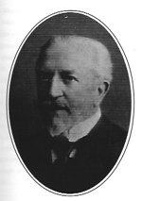
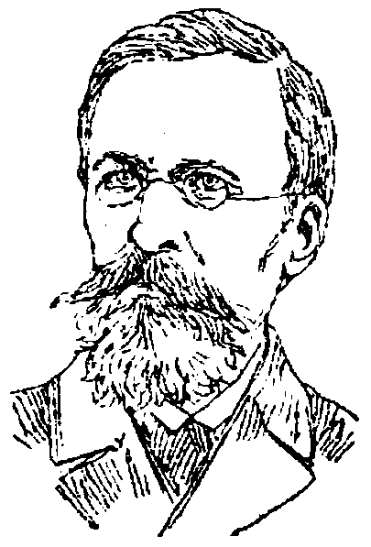
Realism and Positivism vs. Romanticism
Cracow School:
Michał Bobrzyński
1849-1935
A short history of Poland, 1879
The Birth of the Polish State,
2 vols., 1914-22
Warsaw School:
Tadeusz Korzon
1839-1918

Slide 21
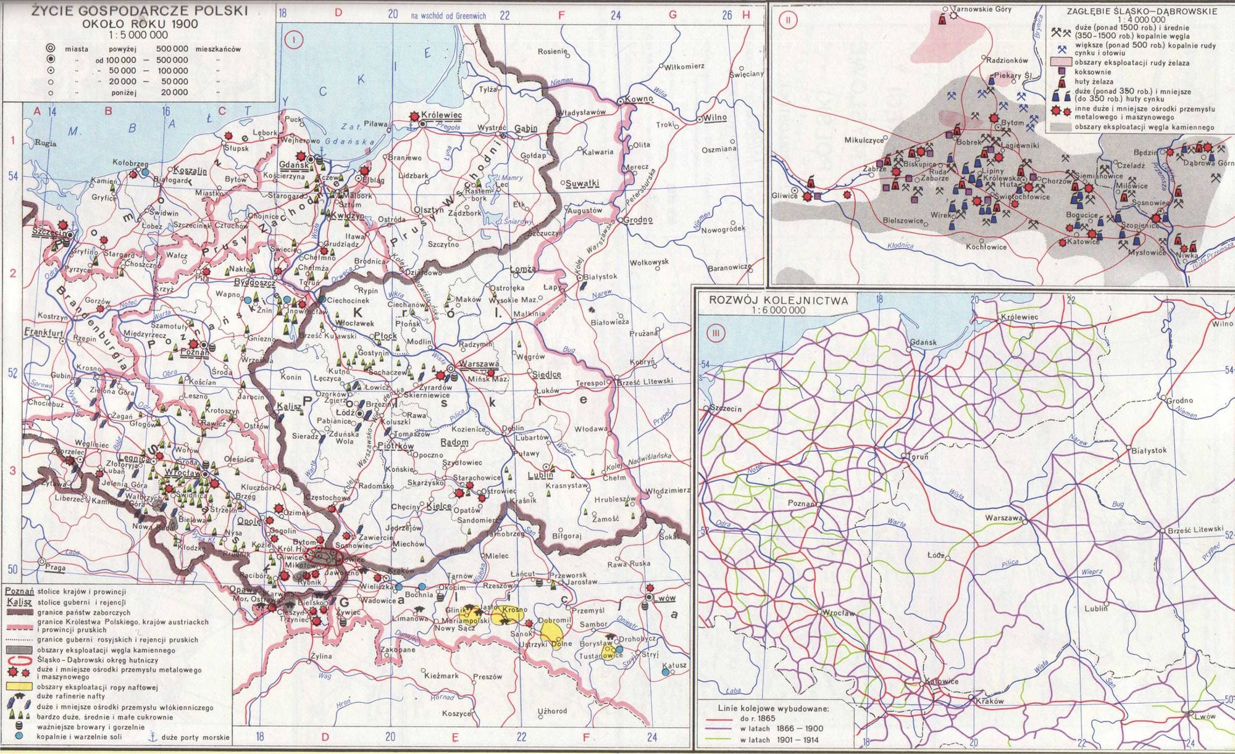
Economic development of Poland in 1900

Slide 22
The Polish lands 1863 - 1914
Austrian Empire
semi-Autonomy in crownland Galicia and Lodomeria
Russian Empire
Kingdom of Poland becomes Vistula land
Russification
Discrimination of Roman Catholic Church,
already earlier destruction of Uniate Church
University of Warsaw replaced by Imperial University
of Warsaw (Teaching in Russian)
German Empire
Anti-Catholic policy under Bismarck
Germanisation of School system
School strike (1901-1907) after attempt to introduce German language
in religious instruction
Policy to promote settlement of ethnic Germans
Discrimination of ethnic Poles

Slide 23
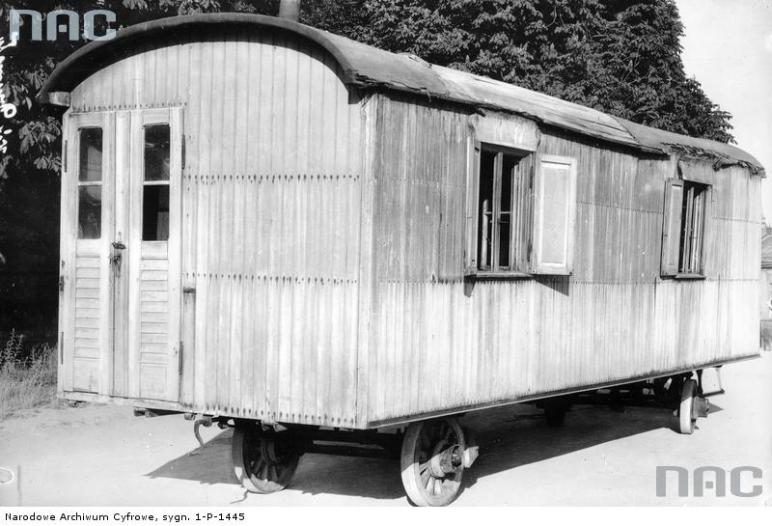
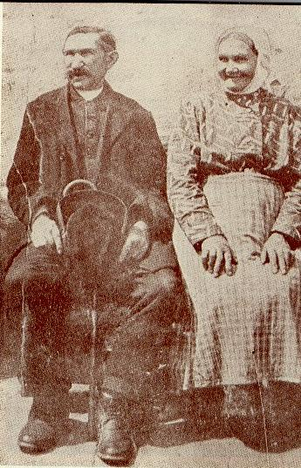
Michał Drzymała, his wife and his wagon

Slide 24
Nie rzucim ziemi, skąd nasz ród. Nie damy pogrześć mowy. Polski my naród, polski lud, Królewski szczep Piastowy. Nie damy, by nas zgnębił wróg. | We will not abandon the land of our clan. We will not allow our language to be buried. We are the Polish nation, the Polish people, The royal tribe of the Piasts. We will not allow the enemy to repress us.
Tak nam dopomóż Bóg! Tak nam dopomóż Bóg | So help us God! So help us God
Do krwi ostatniej kropli z żył Bronić bedziemy ducha, Aż się rozpadnie w proch i w pył Krzyżacka zawierucha. Twierdzą nam będzie każdy próg. | To the last drop of blood in our veins We will defend our soul Until into ashes and dust The Teutonic storm collapses. Every doorstep shall be our fortress.
Tak nam dopomóż Bóg! Tak nam dopomóż Bóg | So help us God! So help us God
Nie będzie Niemiec pluł nam w twarz Ni dzieci nam germanił, Orężny wstanie hufiec nasz, Duch będzie nam hetmanił. Pójdziem, gdy zabrzmi złoty róg. | The German will not spit in our face, Nor will he Germanize our children, Our battalion will armed arise, And the spirit will be our commander. We will go when the golden horn calls.
Tak nam dopomóż Bóg! Tak nam dopomóż Bóg | So help us God! So help us God
Rota
Words by Maria Konopnicka 1908
Music by Feliks Nowowiejski, Cracow 1910

Slide 25
Who is Polish?
Subjective: identifying as Pole sufficient?
‘Objective’: Which boxes need to be ticked?
Social: noblemen, townspeople, peasants
Religious/Confessional: Roman-Catholic, Christian, Jewish, other- non-believers
Cultural: Polish speaker
Geographical: living or ancestors have lived on Polish
Historical territories – but within which borders?
Political: support for Polish independence
National indifference – and hybrid ‘identities’
National indifference – and hybrid ‘identities’

