Slide 1
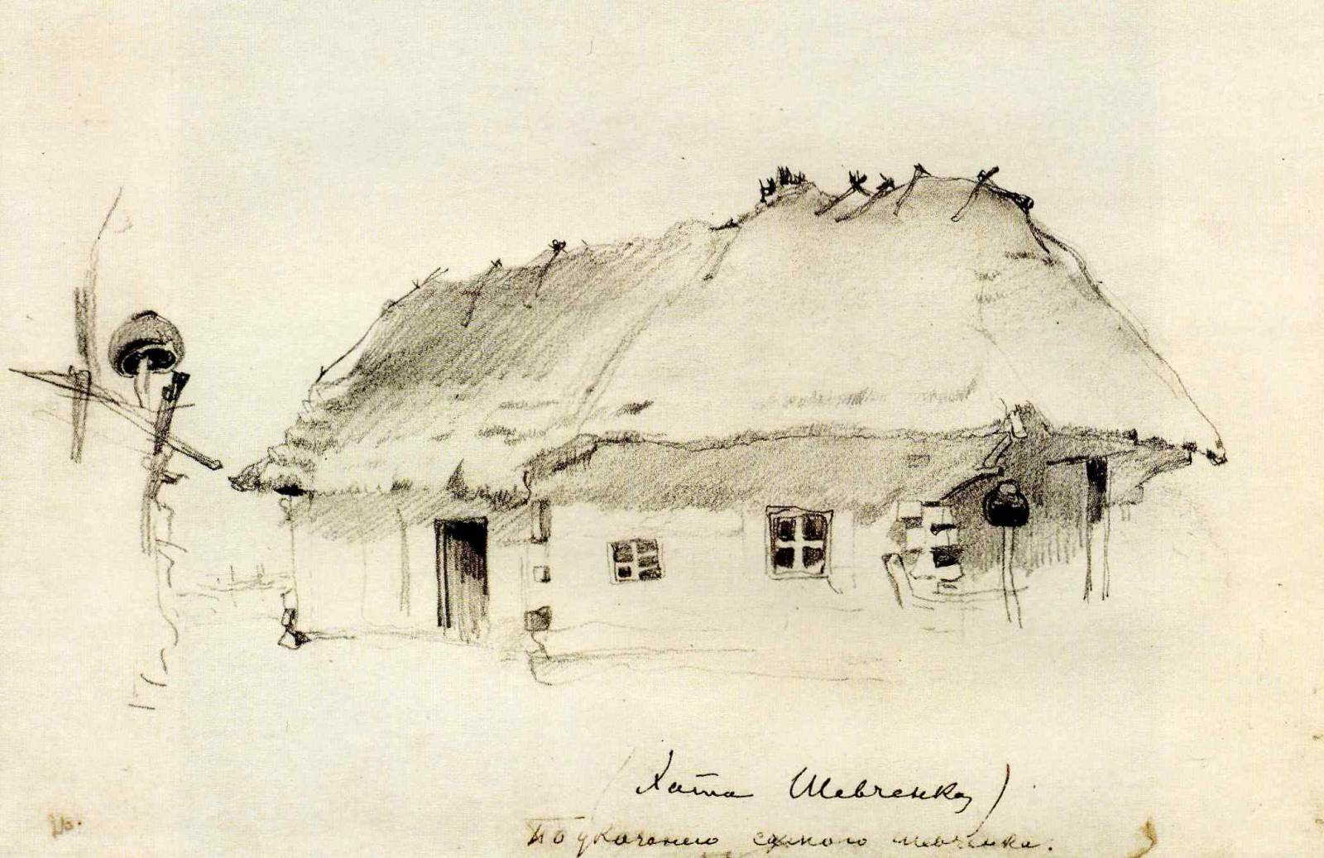
Entangled History: Ukraine and her neighbours from the Middle Ages to the present
Lecture 9
Ukraine’s self-discovery

Slide 2
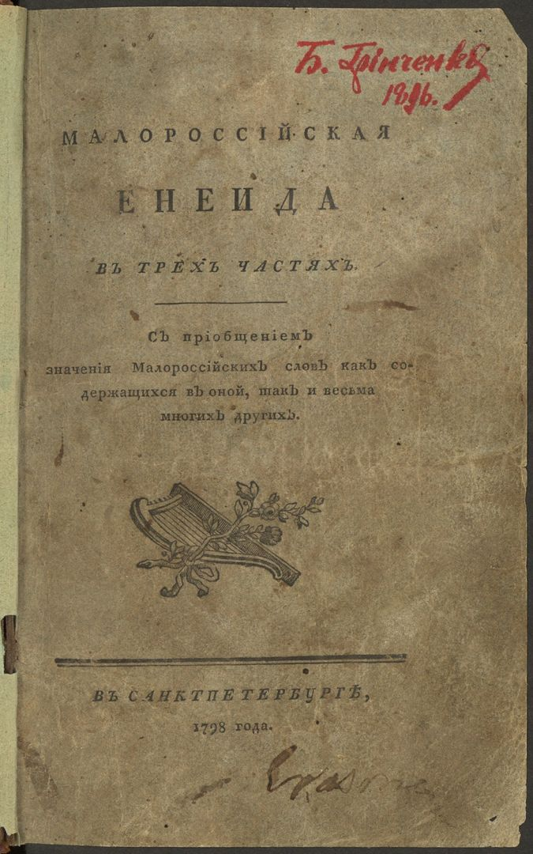
Outline
1. Introduction
2. Herder and Hroch
3. Nation builders – the role of intellectuals
4. Language and Literature
5. Discourses about Ukraine
6. Conclusion

Slide 3
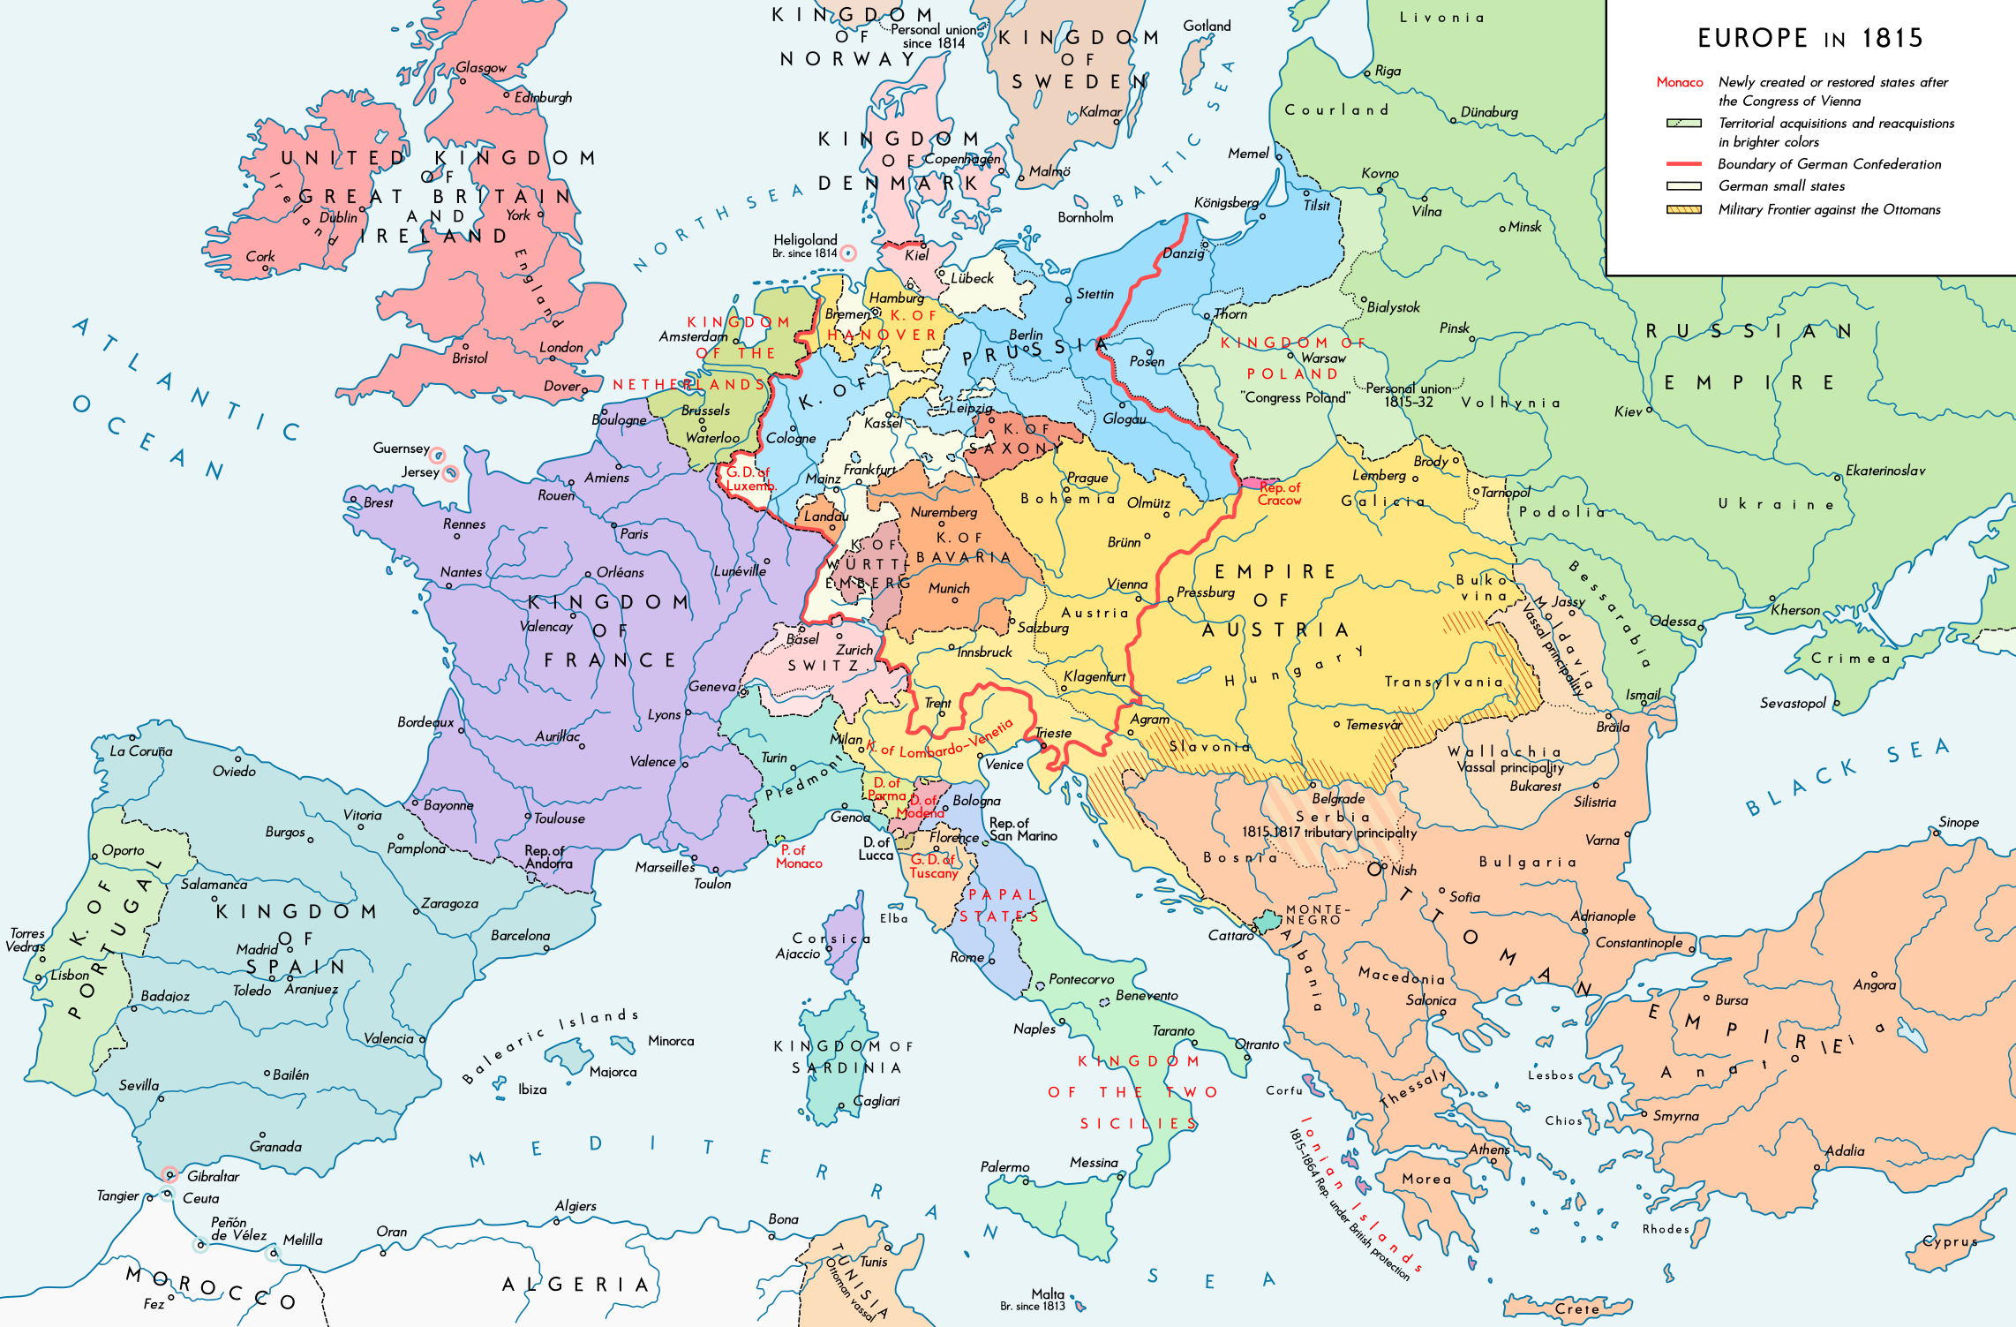

Slide 4
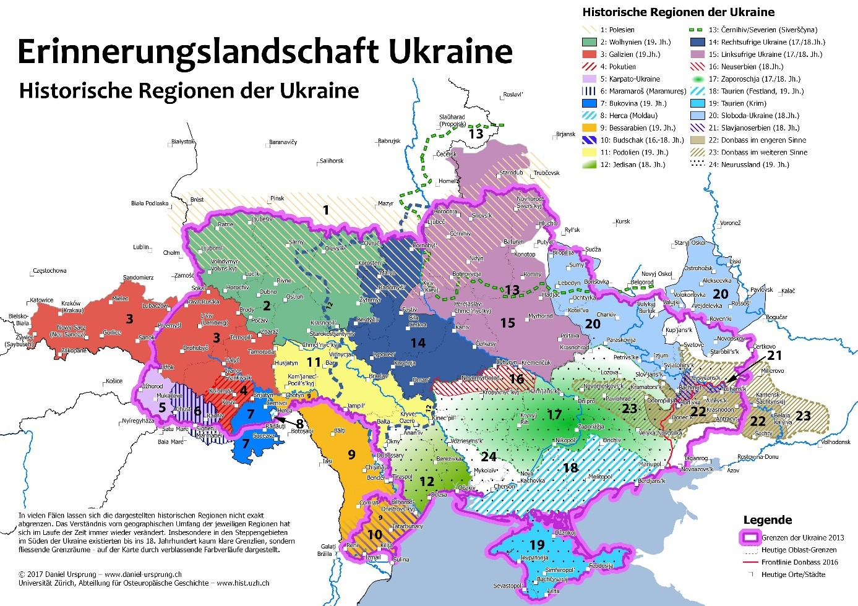

Slide 5
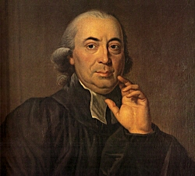
“Nature brings forth families; the most natural state therefore is also one people, with a national character of its own. For thousands of years this character preserves itself within the people and, if the native princes concern themselves with it, it can be cultivated in the most natural way: for a people is as much a plant of nature as is a family, except that it has more branches...
As the mineral water derives its component parts, its operative power, and its flavour from the soil through which it flows, so the ancient character of peoples arose from the family features, the climate, the way of life and education, the early action and employments, that were peculiar to them. The manners of the fathers took deep root and became the internal prototype of the descendants...
No greater injury can be inflicted on a nation than to be robbed of her national character, the peculiarity of her spirit and her language.“
Johann Gottfried Herder, 1744-1803
Johann Gottfried von Herder: Materials for the Philosophy of the History of Mankind, 1784

Slide 6
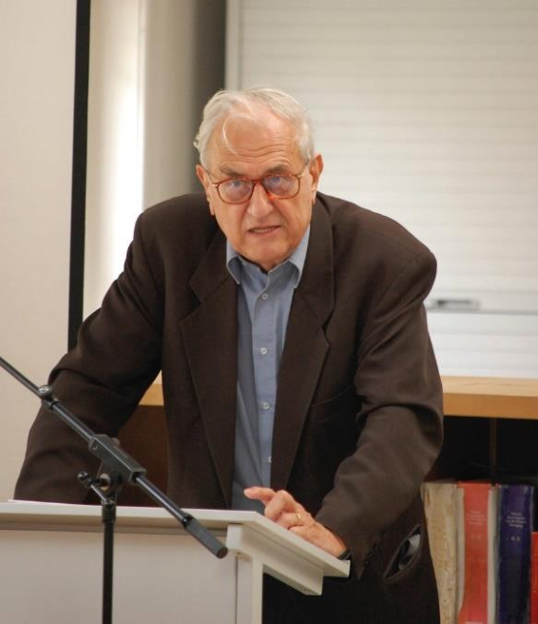
Pattern of a successful national movement from below (Miroslav Hroch)
A crisis of legitimacy
A certain amount of vertical social mobility (educated people from the non-dominant group)
High level of social communication (literacy, schooling, market relations)
Nationally relevant conflicts of interest

Slide 7
Nation-Building in Non-Dominant Ethnies
(Phase A) Groups in the ethnic community start to discuss their own ethnicity and conceive of it as a nation-to-be: scholarly enquiry into and dissemination of an awareness of the linguistic, cultural, social and historical attributes of the nation-to-be – folklore collection (sometimes ‘invented’ traditions)
(Phase B) A new range of activists try to “awaken” national consciousness and to persuade as many members as possible of the ethnic group – the potential compatriots – that it is important to gain all the attributes of a fully-fledged nation: (1) development of a national culture based on the local language and its use in education, administration and economy, (2) civil rights and self-administration, (3) creation of a complete social structure – beginning of a national movement
(Phase C) A mass movement is formed which pursues these aims: a fully-fledged social structure of the would-be nation comes into being

Slide 8
Further Considerations
Hroch scheme captures some developments (a useful tool), but with limitations
Attention to (competing) discourses, language(s), symbols
Competing political projects (a) within the group; (b) with the dominant (e.g. imperial) power or group; (c) with other non-dominant ethnies
What are the characteristics of a specific nation (almost always contested, negotiated and renegotiated): language, religion, history, ‘historical’ territories
Ethnic groups living intermixed
Nationalism as a set of (everyday) practices, discourses, and institutions (Verdery)
Nations can be made, remade, and unmade

Slide 9
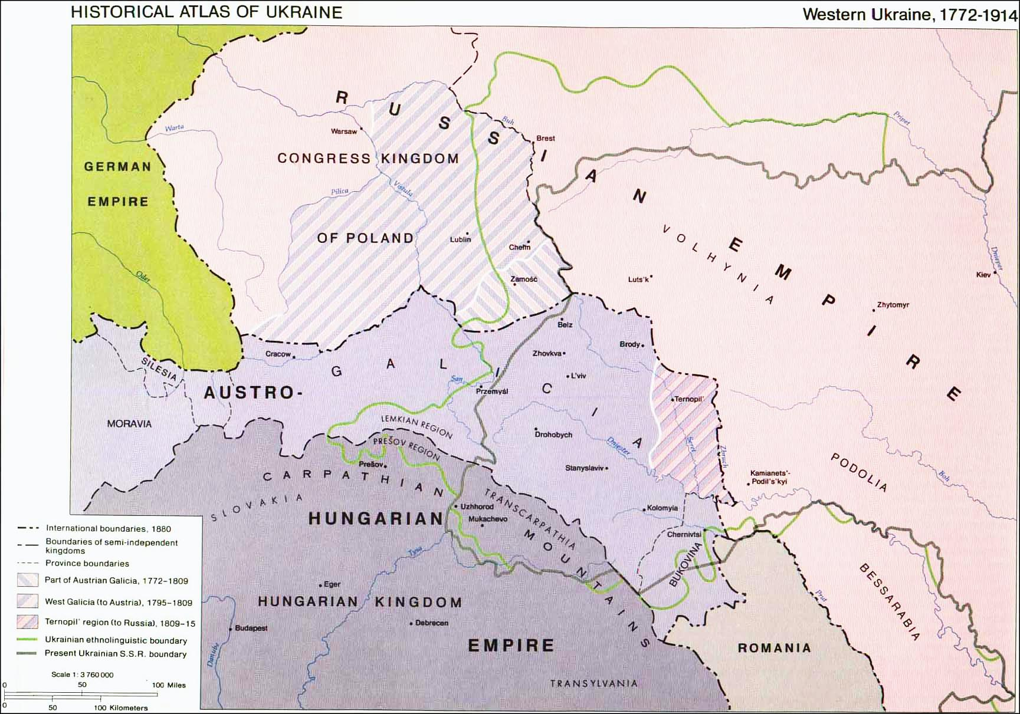

Slide 10
Phase A (in black Russian Empire, in red Austrian Empire / Austria-Hungary
1798 Ivan Kotlyarevsky publishes “Eneyida” (in the vernacular, i.e. script based on spoken Ukrainian)
1804/5 Foundation of University of Kharkiv in Sloboda Ukraine
1819 Appearance of Natalka Poltavka
1823-1825 Secret Brotherhood of Slavs
1830 November Uprising in Poland
1834 Founding of the University of Kyiv (Russian)
1837 Appearance of “Dnister Rusalkas” (Ruthenian Triad: Markiian Shashkevych, Yakiv Holovatsky, and Ivan Vahylevych)
1839 Dissolution of Uniate Church in Russian Empire
1840 Taras Shevchenko publishes “Kobzar” – Transition to Phase B
1846/47 Brotherhood of Sts. Cyril-Methodius (Kyiv)

Slide 11
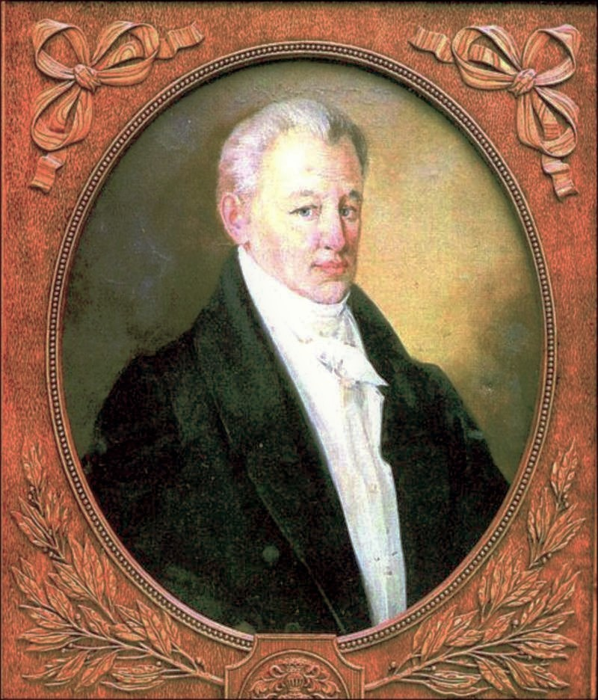
Ivan Kotliarevs‘kyi
1769-1838
* in Poltava
Tutor/teacher, poet, writer, social activist, pioneer of Ukrainian literature, served as officer in Russian Army
Family: poor gentry

Slide 12
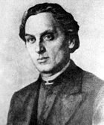
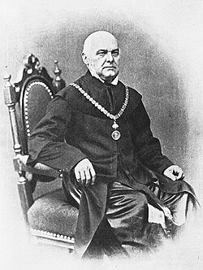
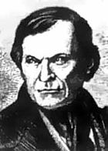
Ruthenian Triad (1832-1837), formed by three students of Greek Catholic Theological Seminary in Lemberg
Markiian Shashkevych
1811-1843 * In Pidlyssia (Galicia)
Parish priest
Father: Parish priest
Ukrainian hero
Yakiv Holovatskyi
1814-1888 * In Chepeli (Galicia)
Parish priest, since 1848 professor of Ruthenian philology and literature at Lemberg University
Father: Parish priest
In 1850s becomes Russophile, fired from University and moves to Vilnius
Ivan Vahylevych
1811-1866 * In Yasen (Galicia)
Parish priest
Father: Supported democratic Polish-Ukrainian federation,
Sanctioned by Greek-Catholic Church, becomes Lutheran, since 1862 employed by city archives in Lemberg

Slide 13
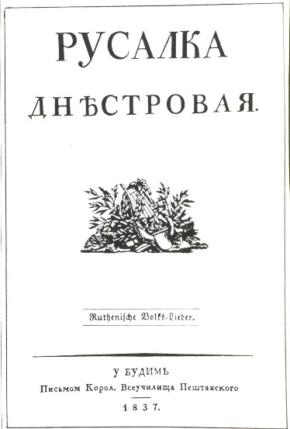
Romantic nationalism in (Western) Ukraine – pan-Slavic unity
Publication of collection of folk stories: Rusalka Dnistrovaia (Mermaid of the Dniester), published in 1836 in Budapest
Banned by Austrian government

Slide 14
Preconditions for a national literature
Standardised national literary language
Themes which are relevant for the nation
Expresses the national essence
Educated elite – reading public and literary criticism
Market for publications in the national language

Slide 15
Ukrainian language
Kotliarevs‘kyi publishes in ‘Little Russian‘ language Eneyida (based on Virgil’s Aeneid)
Following that, people collect songs/stories in Ukrainian vernacular
Authors are publishing in ‘Little Russian, ‘Southeastern dialects‘, Ruthenian language.
Romantic schools Poltava and Kharkiv (1830s and 1840s) – Taras Shevchenko tries to forge synthetic pan-Ukrainian language. Not standardised yet. Journal Osnova published in Sankt Petersburg tries to give direction, dictionary produced.
Literary standard Ukrainian used in early 1860s.
Attempts in Russian Empire stopped by Valuev circular 1863
Centre of Ukrainian publication now in East Galicia, by Ukrainophiles

Slide 16
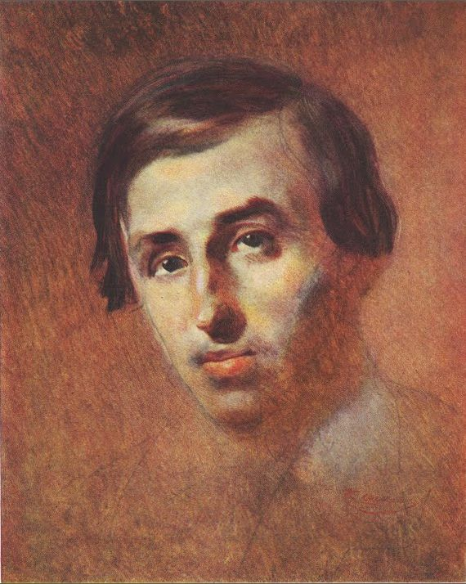
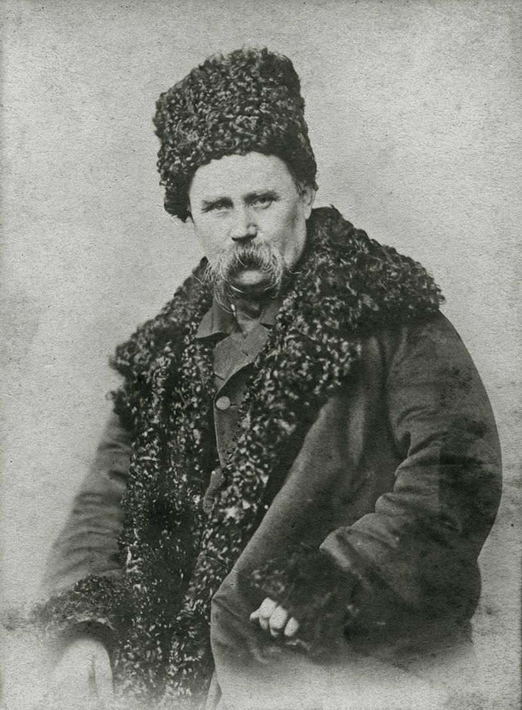
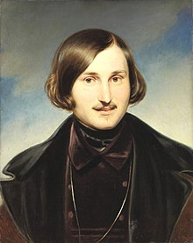
Taras Shevchenko (1859)
1814-1861
* In Morynzi (Kiev/Kyiv)
National poet
Family: Serfs
Education organised by his ‘owner‘
Studied painting in St. Petersburg, bought free by St. Petersburg artists (lottery - Briullov painting)
Member of St. Cyril and Methodius Society, sentenced 1847 to military service in Russian east, 1857 released
Nikolai Gogol‘/Mykola Hohol‘
1809-1852
* In Velyki Vorotchyntsi (Poltava)
Writer
Family: Cossack gentry, father‘s last name is Janowski
Satires of Russian provincial bureaucracy and criticism of serfdom, collects Ukrainian folklore, writes in Russian with Ukrainisms and often stories from Ukraine (Taras Bulba)
First loved by Russian liberals, then condemned after defending autocracy, serfdom and Orthodox Church
Panteleimon Kulish
1819-1897
(Portrait by Taras Shevchenko)
* In Voronesh
Writer, translator
Father: poor Cossack gentry
Translated Bible in modern Ukrainian, critical of Cossacks
Member of St. Cyril and Methodius Society

Slide 17
What is the connection between literature and nation building?
Creation of a national high language
Poets who represent the national spirit
High quality literature – “cultural capital” in nation building
Use of texts in national language to nationalise the peasantry
Novels, stories, poems with historical topics show the greatness and the suffering of the nation
Taras Shevchenko ‘Testament’

Slide 18
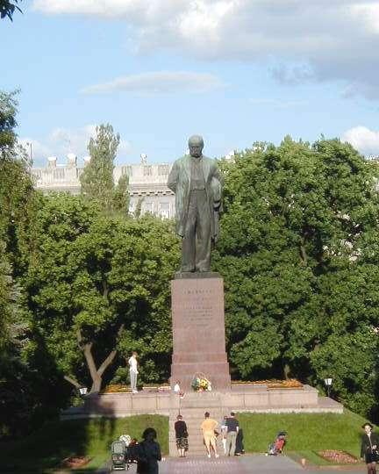
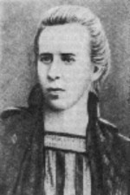
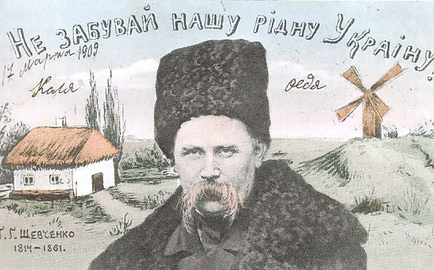
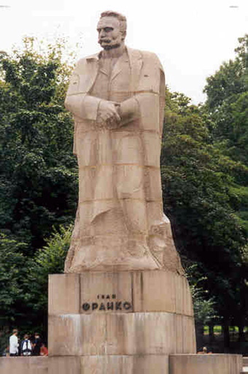
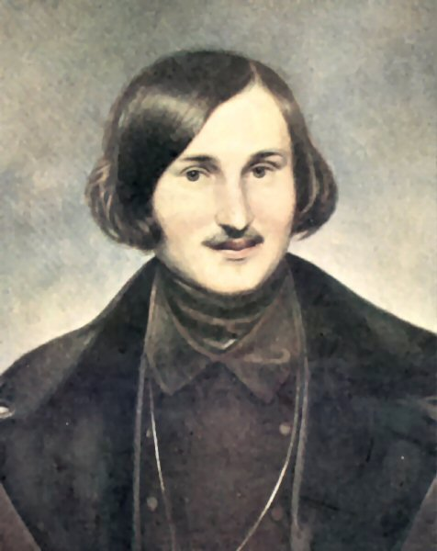
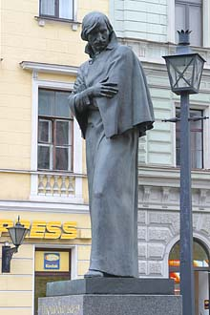
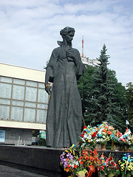
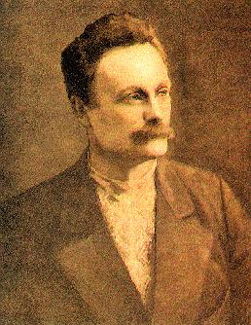
Taras Shevchenko ‘Do Not Forget Our Native Land Ukraine’ Published by D. Markov Kiev 1908
Shevchenko Monument Kyiv, Ukraine
Lesya Ukrainka, 1871-1913
Ivan Franko, 1856-1916
Nikolai Gogol or Mikolai Hohol, 1809-1852

Slide 19
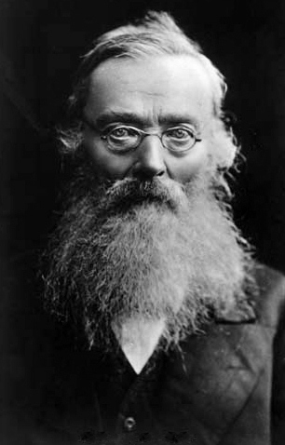
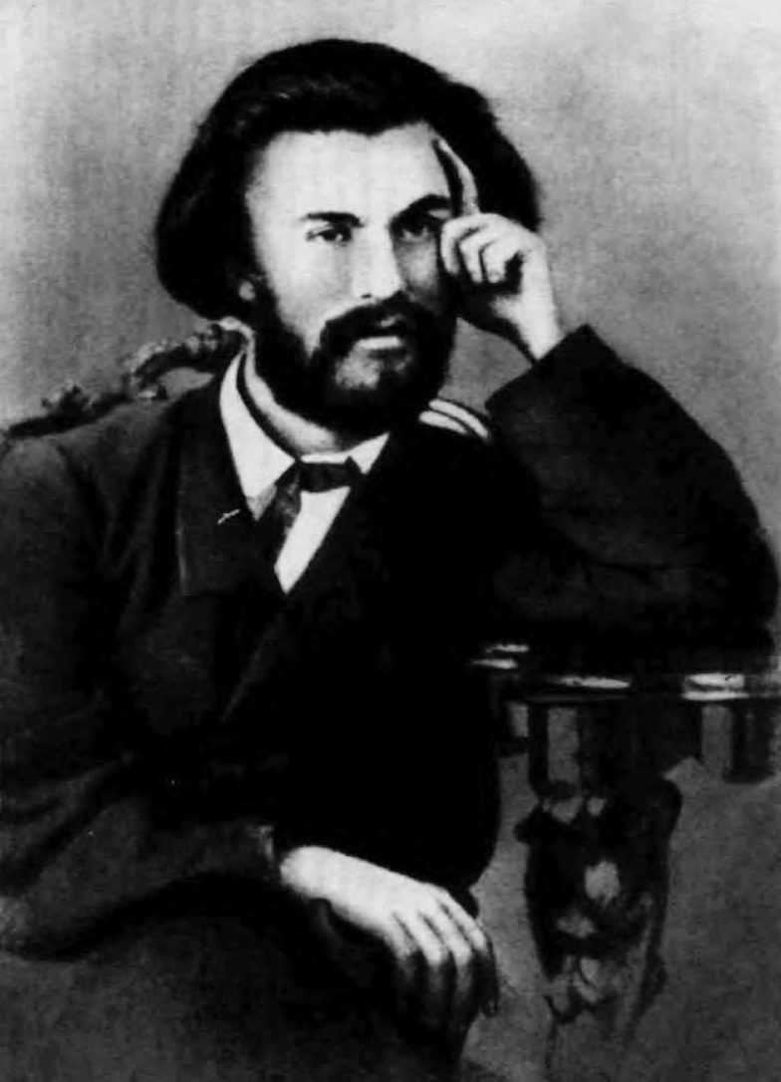
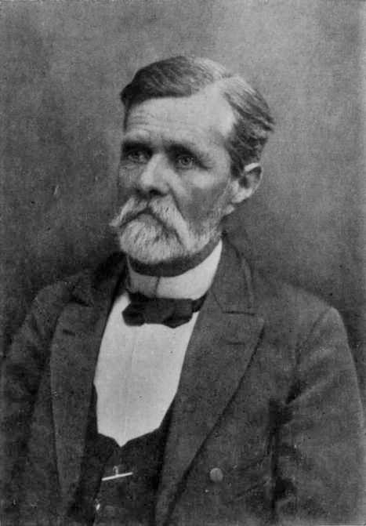
Mykola Kostomarov 1817-1885
* In Jurasovka (Voronesh)
Father: Russian nobility
Mother: Ukrainian peasant and one of his father’s serfs
Historian, Professor in Kiv, St. Petersburg, poet, ethnographe
Mykhailo Drahomanov 1841-1895
* In Hadiach (Poltava)
Family: Cossack noble
Historian, political philosopher, socialist
Hoped for democratic Russian Federation with autonomous Ukraine as part
Ivan Nechuy-Levytsky
1838-1918
* In Stepliv (Cherkasy Oblast)
Father: parish priest
Went to Kiev Theological Academy, teacher and writer,died of hunger an illness in a Kyiv almshouse on 2 April 1918

Slide 20
Nation building from below
Loss of considerable part of elite – becoming Polonised or Russified
Influence of Herder: Romantic nationalism
Remnants of old Cossack elites, parish priests and their children take the lead
Task: use and emphasise cultural differences and relevant conflicts
Role of language, literature, and history
The role of the Other: mostly Poles and Russians
Nation building in imperial contexts – as non-dominant ethnie
Imperial measures and counter-measures

