Slide 1
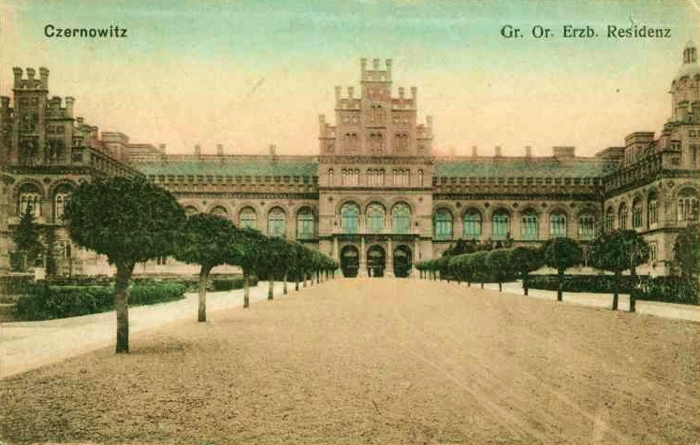
Entangled History: Ukraine and her neighbours from the Middle Ages to the present
Lecture 1, wk. 2
Entangled or colonised? How to write a history of Ukraine

Slide 2
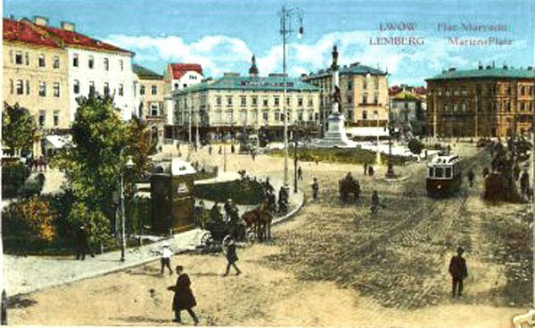
Outline
Introduction
Recent context
How (not) to write Ukrainian history
Challenges
Broader issues
A thousand years in maps
Lviv / Lemberg / Lwów, 1915

Slide 3
Recent Context
Declaration of independence of Ukraine on 24 August 1991 and dissolution of Soviet Union on 31 December 1991
Orange Revolution in Autumn 2004
Euromaidan or Revolution of Dignity November 2013
Ukraine moving out of Russian orbit
War in Ukraine since 2014, Russian annexation of Crimea, proxy war in Donetsk und Luhansk
24 February 2022 full-scale Russian invasion of Ukraine
Putin‘s use of history (as he understands it) to legitimise attack on Ukraine and Russia‘s land grab
Genocidal dimensions of war: kidnapping children, destroying or appropriating Ukrainian cultural heritage, denying the existence of the Ukrainian nation by denying that Ukraine has a history outside of the framework provided by the Russian narrative, or a future outside of the ‚Russian World‘

Slide 4
How (not) to write Ukrainian history
Does Ukraine have a history? Question asked by Mark von Hagen in 1995 (Slavic Review) followed by debate
How to write the history of Ukraine? State, territory, people
Nationalism, imperialism and national and imperial narratives: writing history from the perspective of the nation state or empire
Decolonising or reframing Ukrainian history (no longer looking at it through a Russian – or Polish – lense)
Uncovering and focusing on local actors; their agendas and agencies
Dominance of Russian narrative (including in Western academia): Russian view shaped Western (or rather global) view of Ukraine and its history
Historians of Russia are criticised for reproducing Russian colonialist/imperialist attitudes to Ukraine and Ukrainians
Un-learning, overcoming biases, developing new concepts and taking a fresh view at the history of Ukraine and its neighbours and at times imperial masters: Lithuania, Poland, Polish-Lithuanian Commonwealth, Muscovy/Russia.

Slide 5
To keep in mind
Having a unique shared national language can be decisive for nation building (especially of non-dominant nations/ethnic groups) but is not conditio-sine-qua-non.
Look at the British Isles: Welsh language important for Welsh identity but non-conformism and rich cultural heritage and medieval Welsh history at least as important: Welsh, Irish, Scottish identity not dependent on speaking Welsh, Irish or Scottish Gaelic, many Welsh, Irish, Scottish are English nativespeakers) – see Russian-speaking Ukrainians
Even more so: the same language, but different nations – Austria and Germany
Ukraine as a historically multiethnic, multicultural, multilingual region

Slide 6
Challenges I
De-colonizing Ukrainian history: Russia/Russians and Poland/Poles as colonizers, Ukraine/Ukrainians as colonized or subalterns – complexities of relations
Does decolonisation necessarily mean to replace the Russian imperial/national narrative by a Ukrainian national narrative?
Tasks:
to understand historical events, acteurs and actions within the context of their time (a classic Rankean approach)
to understand Ukrainian history (as any other history) as entangled
to understand how the regions which constitute today‘s Ukraine influenced and were influenced by neighbouring political and cultural centres
Module will therefore also be on Poland, Russia, Lithuania and touch on Bulgaria, the East-Roman (Byzantine) Empire, the Ottoman Empire and others

Slide 7
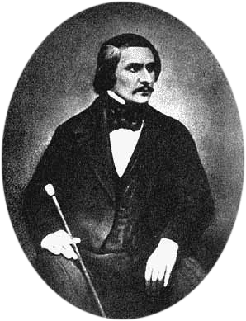
Challenges II
Language and terminology matter: Київ (Kyiv/Kyjiv), Киев (Kiev), or Kijów. Lemberg, L‘viv/Lviv, Lwów, Lvov. ‘The Ukraine‘ or ‘Ukraine‘
Ukrainian or Russian: Appropriation of Ukrainian culture. Calling Ukrainian poets, writers, artists etc. Russian: Gogol‘ or Hohol‘
The lasting influence of Pushkin and Tolstoevsky‘ (Tolstoy and Dostoevsky) of our views of everything east of Poland
Who knows Hryhory Skovoroda? Taras Shevchenko? Ivan Franko? Lesia Ukrajinka? Oksana Zabushko? Yurii Andrukhovych?
You might know the names of Russian tsars, but do you know Bohdan Khmel‘nytskyi or Mykhailo Hrushevs‘kyi or Simon Petliura or King Danylo of Halych-Volhynia. You might have heard of Stepan Bandera.
This is also partly valid for Poland: Can you name a Polish writer? It might be easier for you to name a Polish composer. You certainly can name a Russian composer. But do you know the name of a Ukrainian composer?

Slide 8
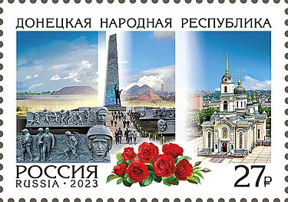
Broader issues
Contested nation- and state- building; contested borderlands
Modern nationalism and local historical traditions
Political developments and everyday life in the context of competing (geo)political projects
Fluidity and multilayered character of identity/identities
Highlighting local voices and their historical contributions
Understanding of historical alternatives
Memory politics and the instrumentalisation of the past
WWII memorial ((Savur-Mohyla) from the occupied and annexed part of Eastern Ukraine on a Russian postmark

Slide 9
Tentative Schedule
 | Weeks | Lectures | Seminars
1 | 2 | Entangled or colonised? How to write a history of Ukraine? | What is a nation? Modern nations and their history
2 | 3 | Stories of origin: the Kyivan Rus | Language, religion, and geography
3 | 4 | The ‘Mongol yoke’ and the rise of Muscovy | Autocracy and ‘Third Rome’
4 | 5 | The Polish-Lithuanian Commonwealth | The Union of Lublin and the ascendancy of Polish culture
5 | 7 | The fight for the ‘land of the Rus’ | The Cossack Hetmanate and the ‘Kyivan Renaissance’
6 | 8 | Becoming an empire: Russia’s long 18th century | From the Great Northern War to the partitions of Poland
7 | 9 | Russia’s mission | Thinking about Russia: From the Enlightenment to Panslavism
8 | 10 | Poland’s struggle | Thinking about Poland: From Sarmatism to Warsaw positivism
9 | 11 | Ukraine’s self-discovery | Thinking about Ukraine: From Kotliarevsky to Hrushevsky
10 | 12 | Peasants into …: How the national message was spread | National literature, music, and art
11 | 13 | National boundaries and hybrid identities | The ‘Jewish question’ and other questions
12 | 14 | The Great War: Hopes, aims, and expectations | Playing the national card: the self-destruction of empires
13 | 15 | The Russian and the Ukrainian Revolution | From the Treaty of Brest-Litovsk to the Treaty of Riga
14 | 17 | Nation building Soviet style | Affirmative action and genocide
15 | 18 | Poland and her minorities | Polish and Ukrainian nationalism
16 | 19 | Bloodlands I: Soviet rule | Sovietisation, Katyn, and the prison murders
17 | 20 | Bloodlands II: German rule | Pogroms, Holocaust, and Volhynian massacres
18 | 21 | From Soviet to independent Ukraine | Resistance, Russification, and disentanglement
19 | 22 | Trials, tribulations, and choices: Ukraine and her neighbours after the fall of the Soviet Union | The shadows of the past: the use and misuse of history
20 | 23 | The Russian war against Ukraine | Current situation and perspectives
Assessments deadlines are available on Tabula

Slide 10
Resources
All seminar questions and readings are here: https://rl.talis.com/3/warwick/lists/2FD99EFE-1723-4084-907C-246C045C1398.html?lang=en-GB&login=1
General information on the website: https://warwick.ac.uk/fac/arts/history/students/modules/hi2j8/
Power points of lectures are uploaded the day before the lecture to the website:
https://warwick.ac.uk/fac/arts/history/students/modules/hi2j8/schedule/
Short essay questions (which are also suggestions for long essay topics) are on the website: https://warwick.ac.uk/fac/arts/history/students/modules/hi2j8/shortessays/
Links to captured lectures are on Moodle: https://moodle.warwick.ac.uk/course/view.php?id=72667

Slide 11
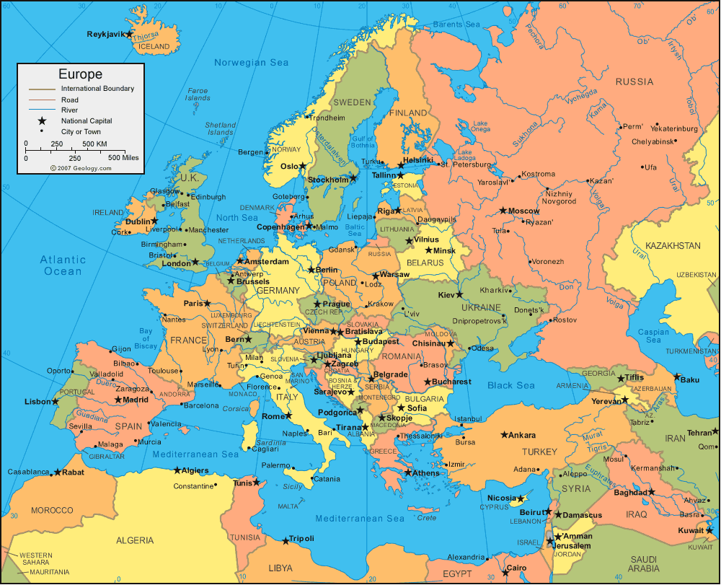

Slide 12
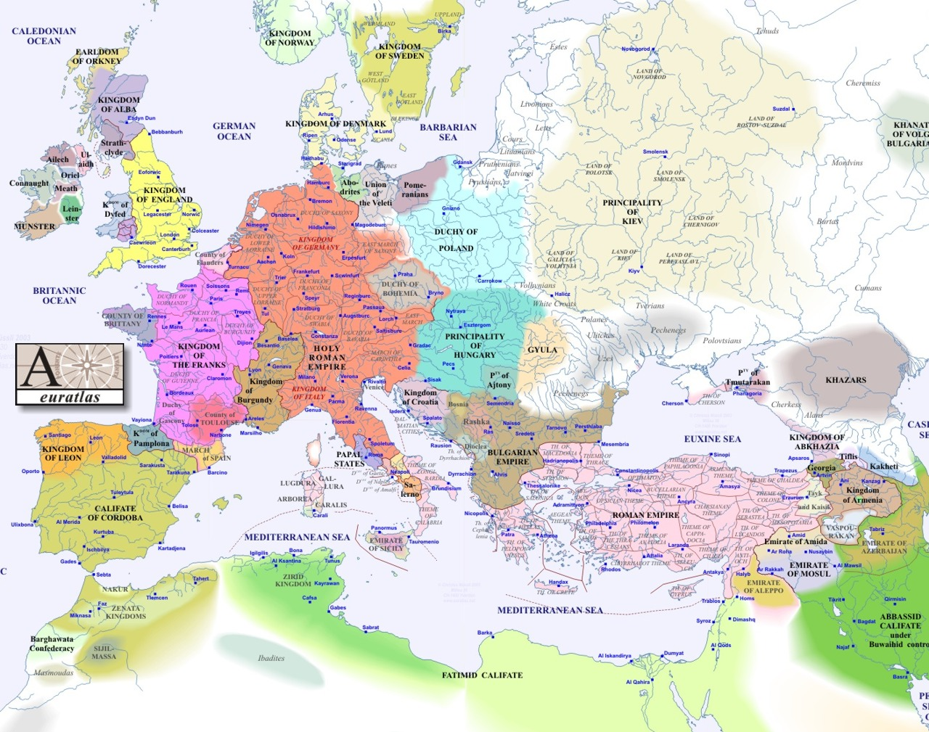
1000

Slide 13
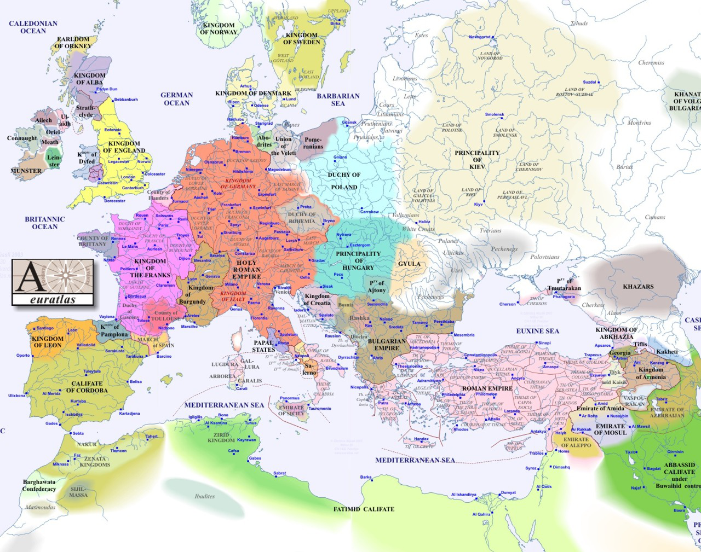
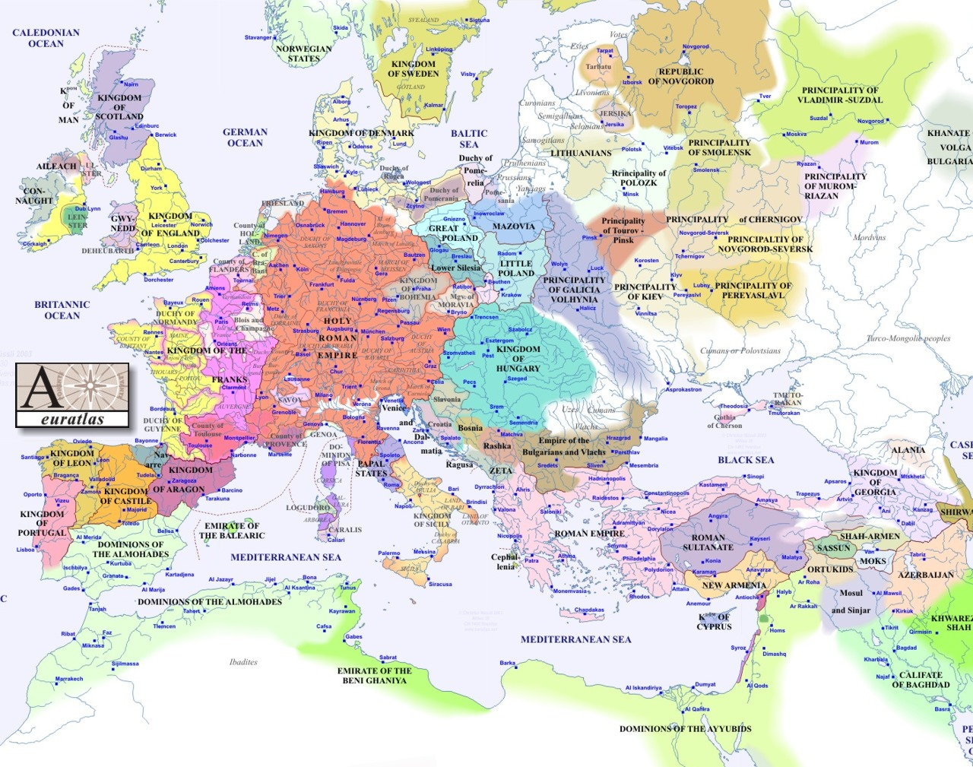
1000
1200

Slide 14
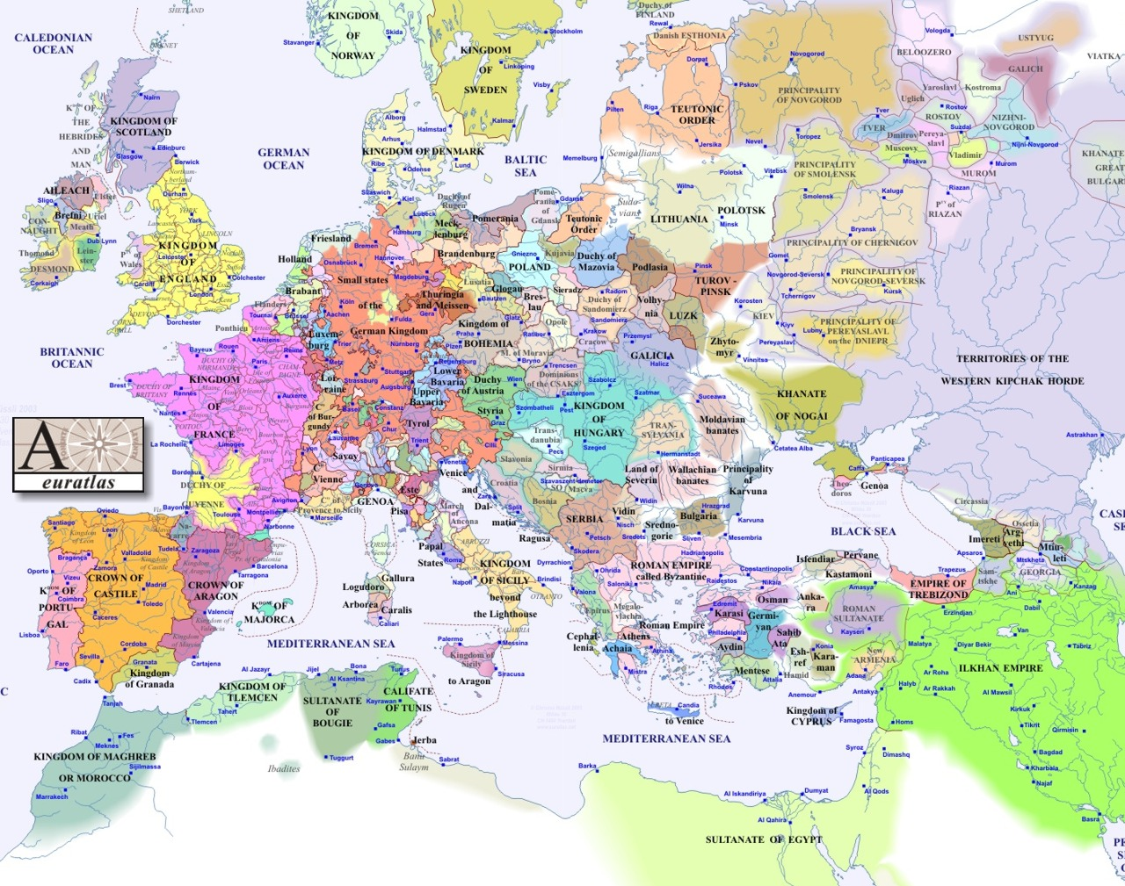
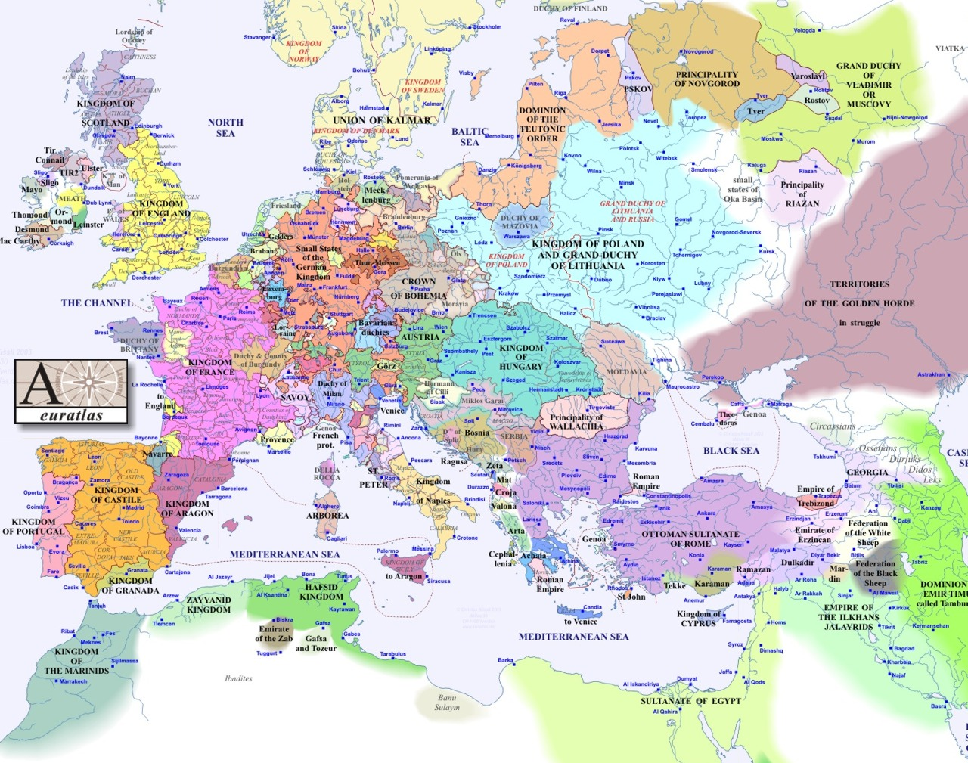
1300
1400

Slide 15
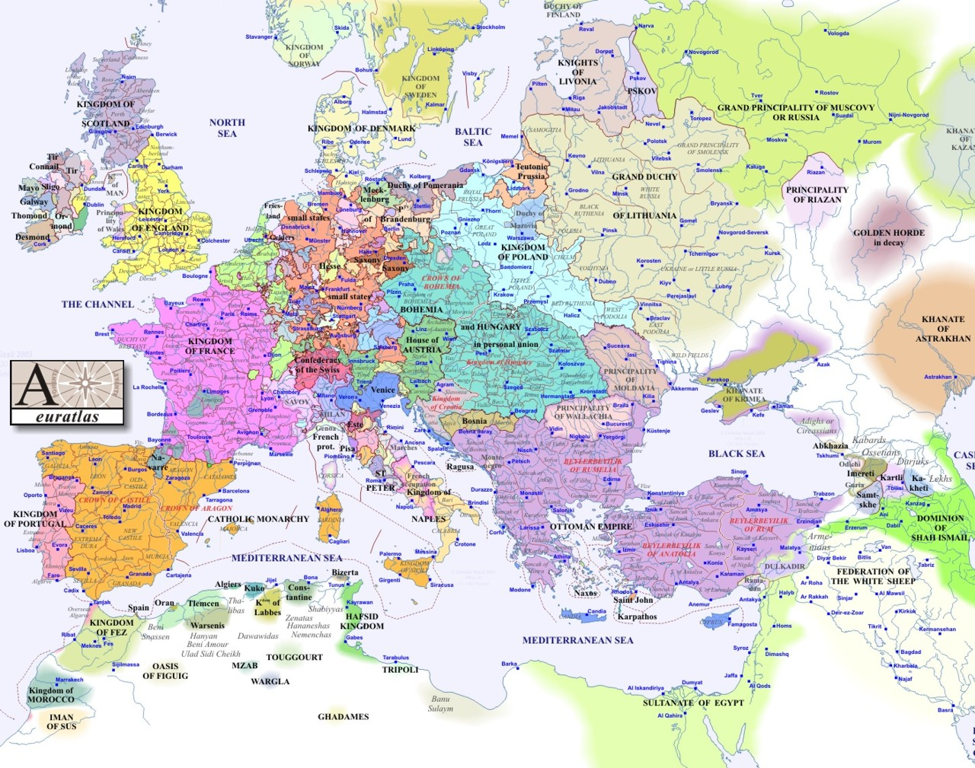
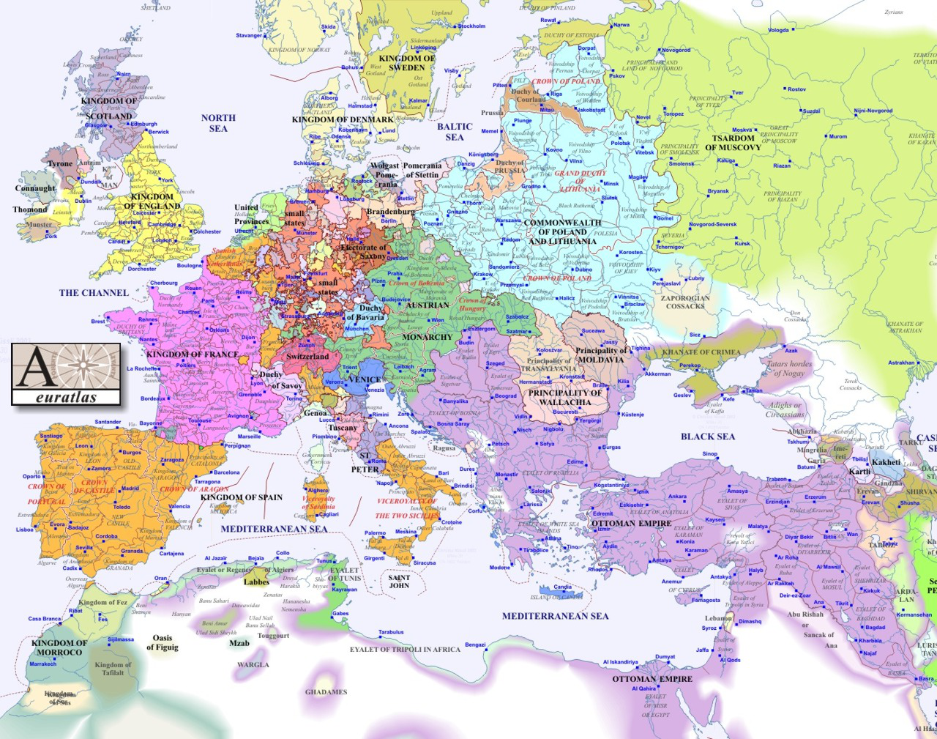
1500
1600

Slide 16
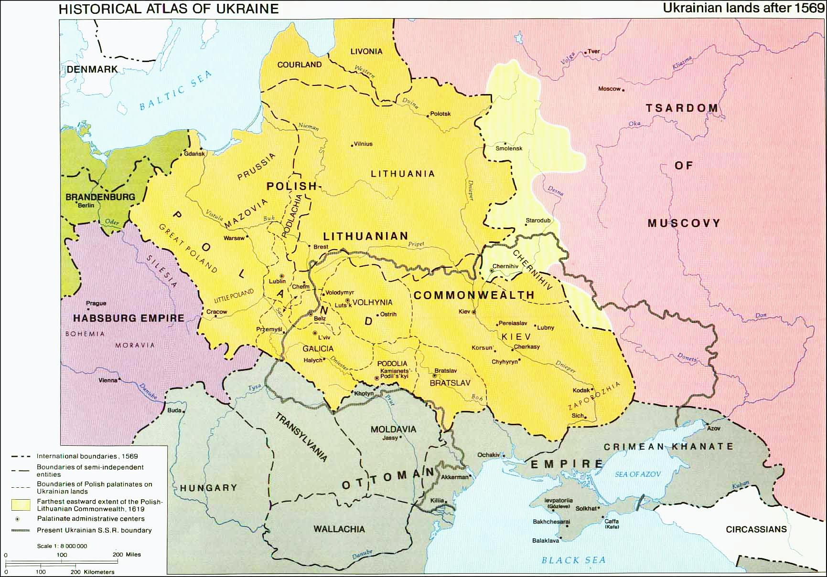
1569

Slide 17
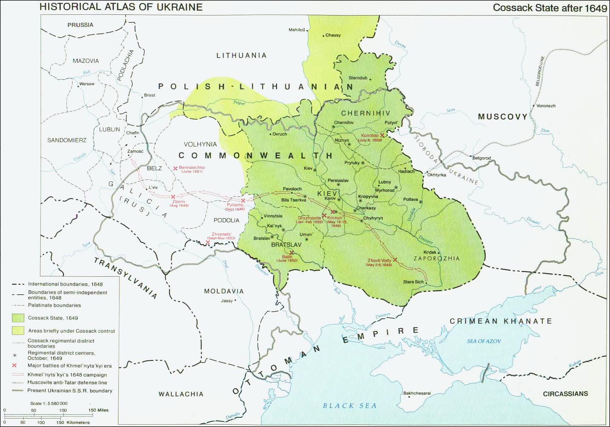
1649

Slide 18
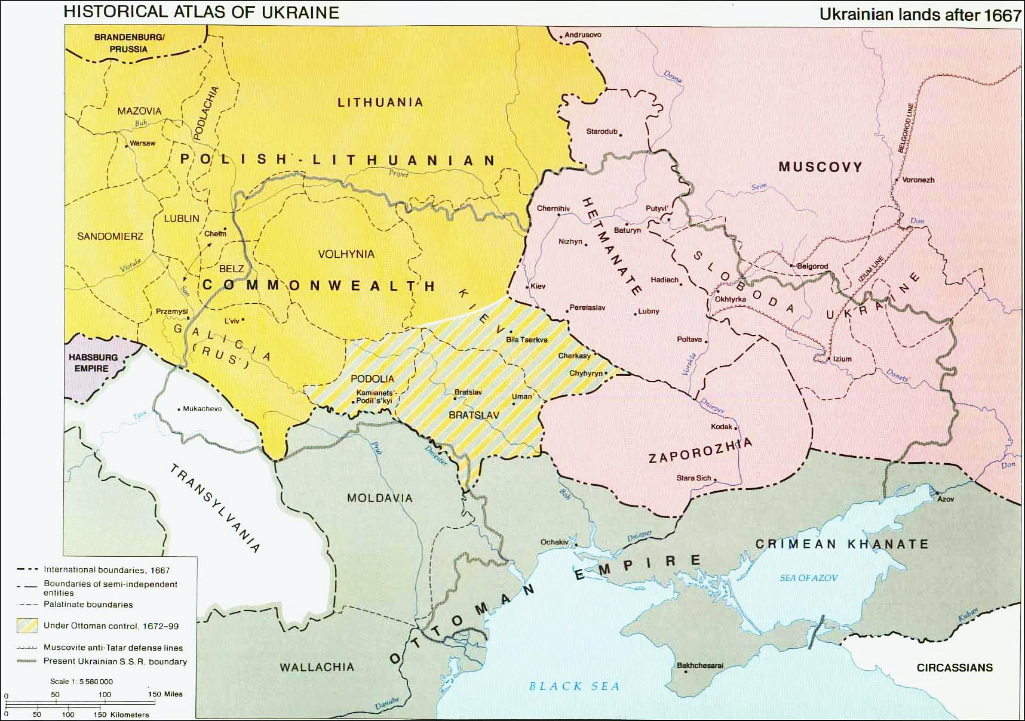
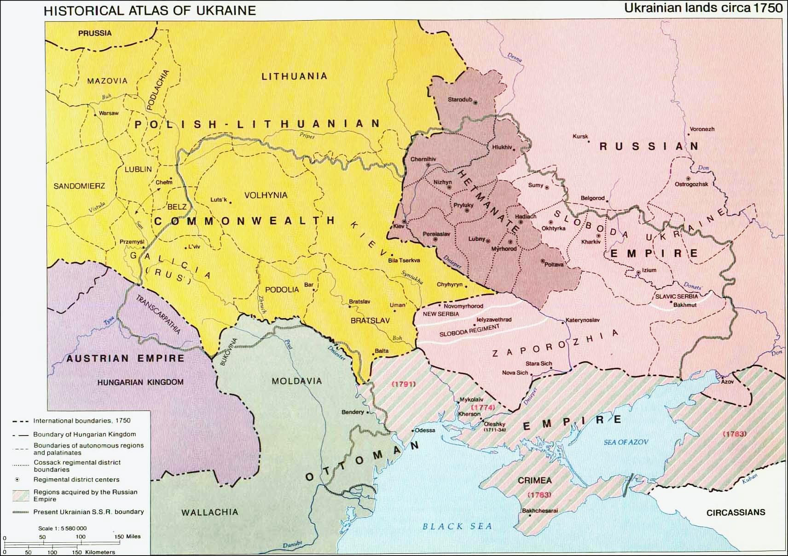
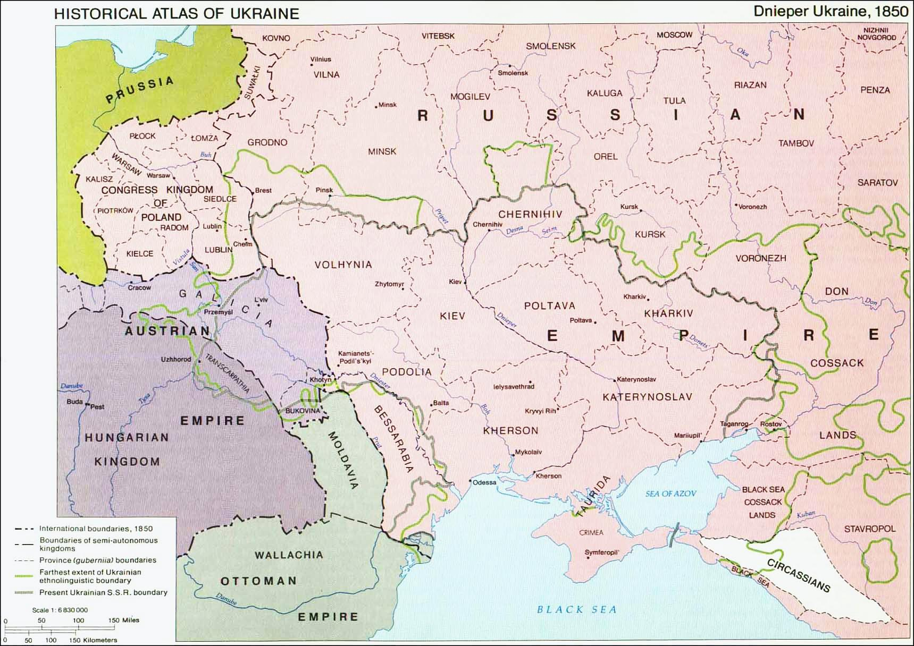
1569 to 1850

Slide 19
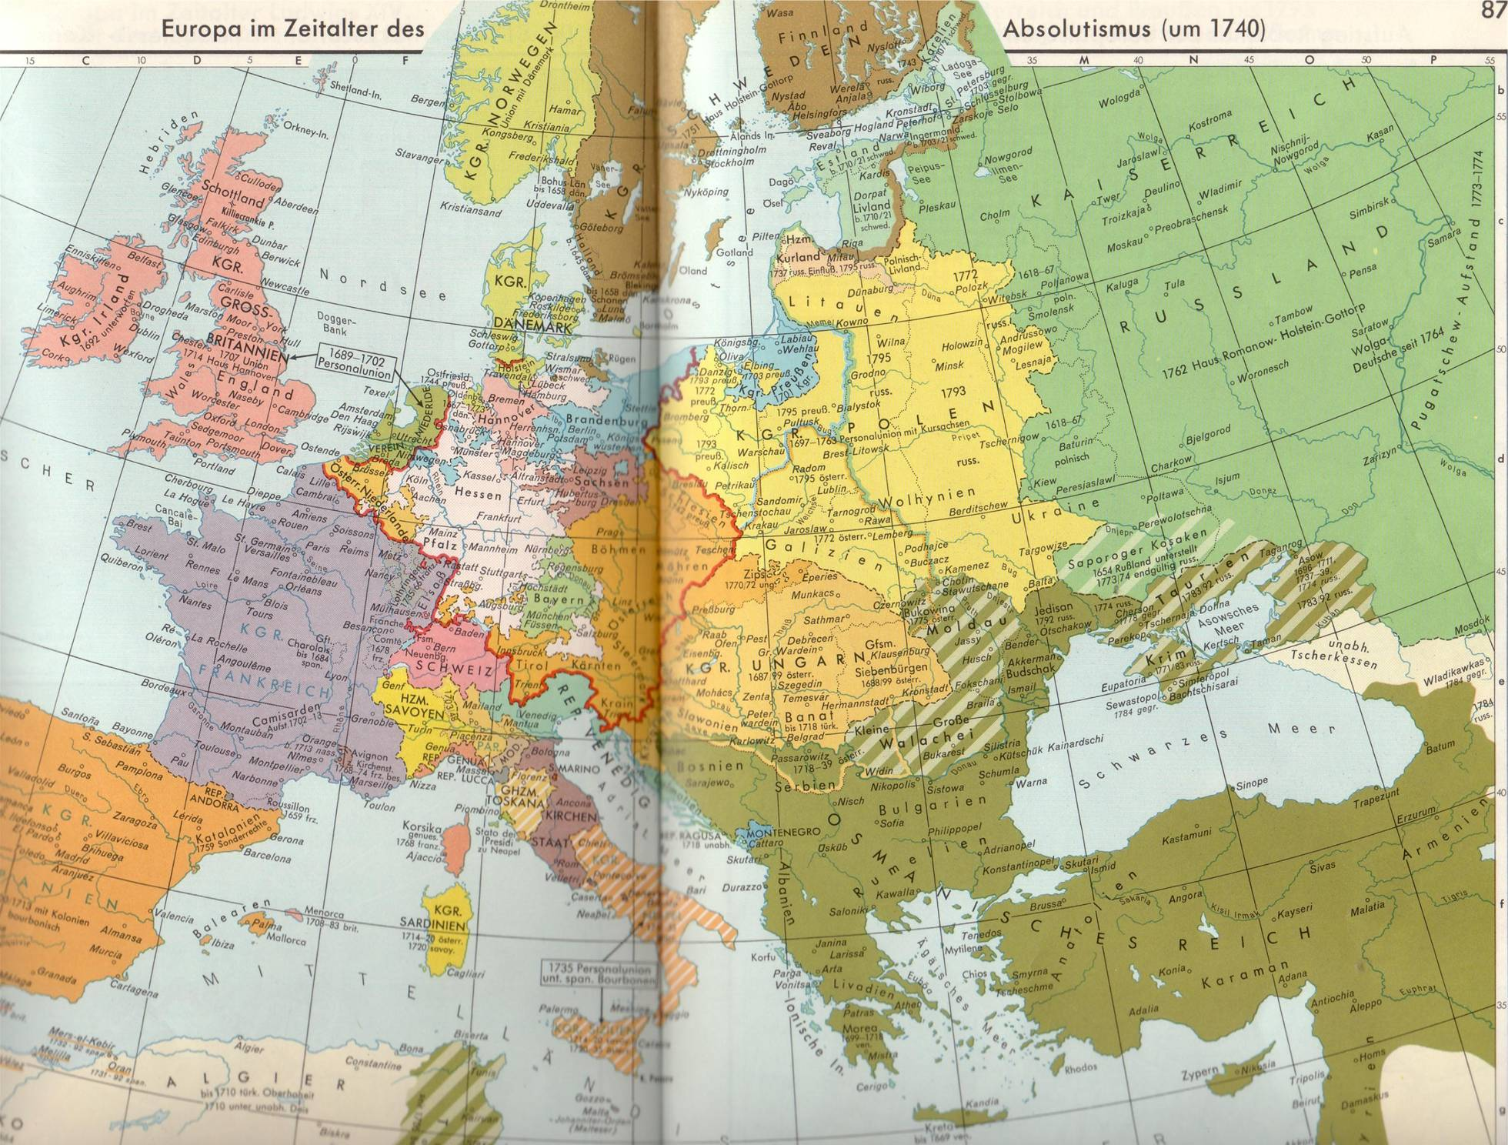
1740

Slide 20
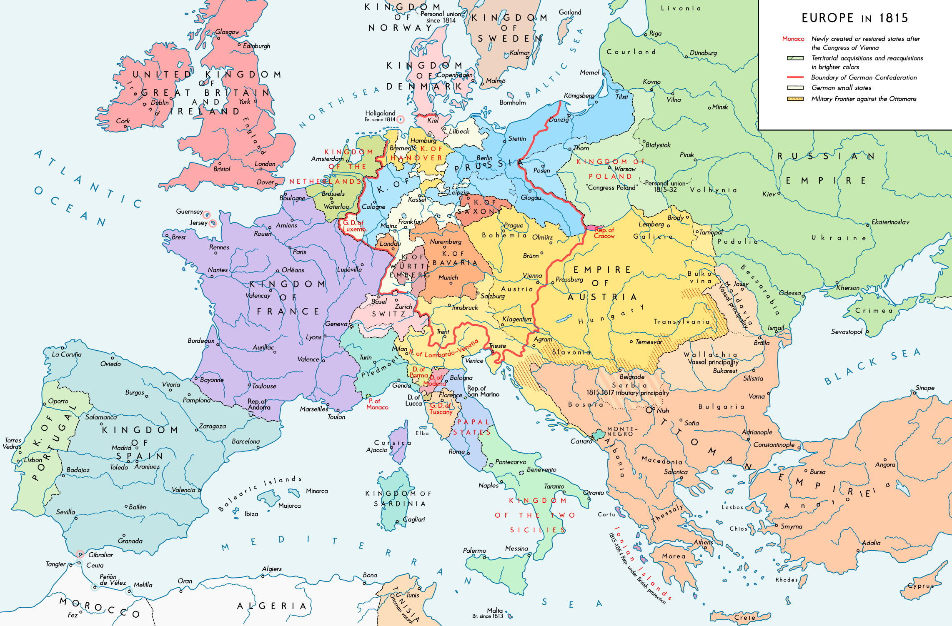
1815

Slide 21
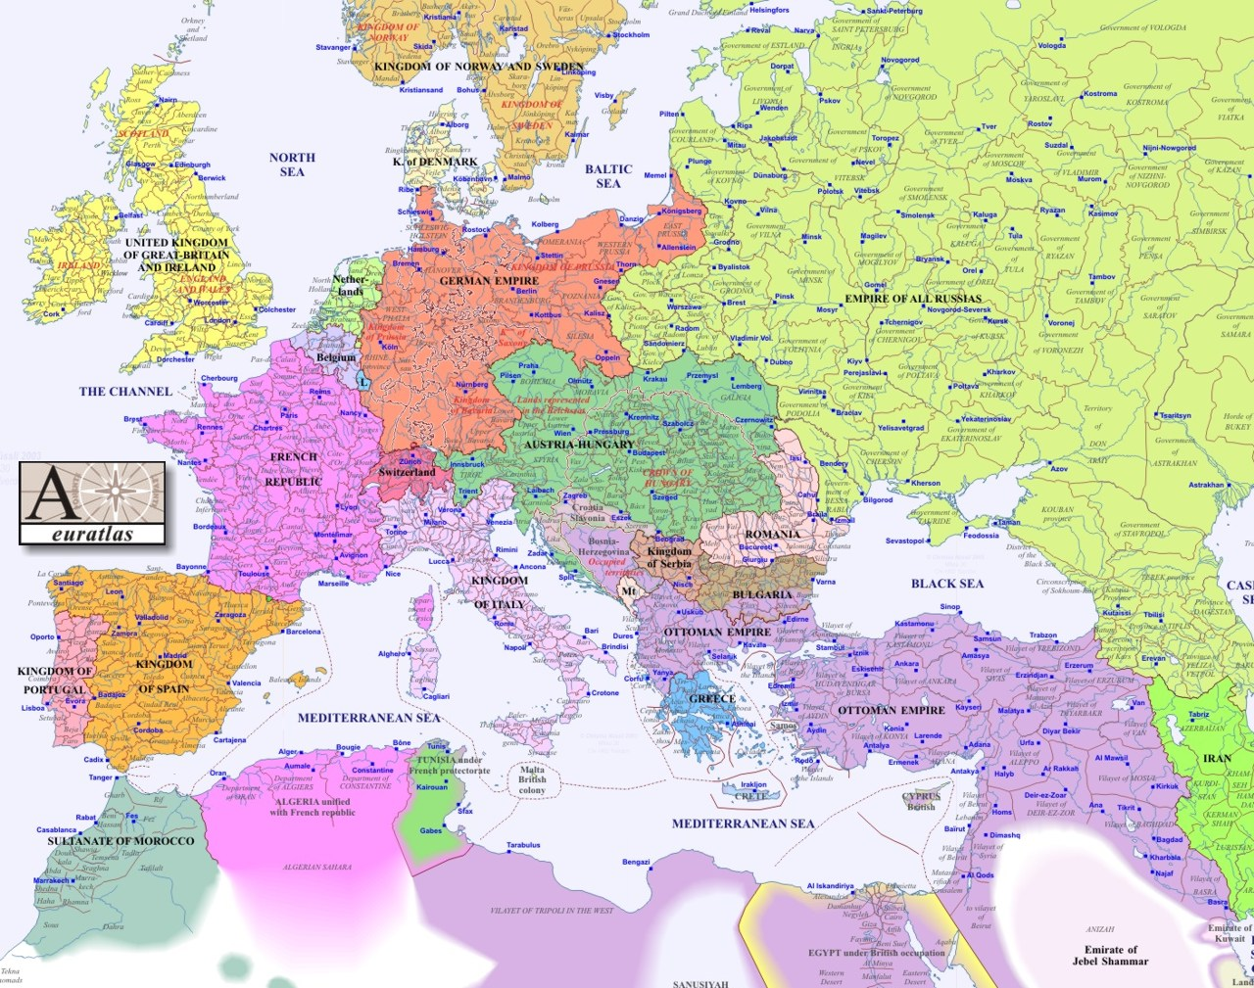
1900

Slide 22
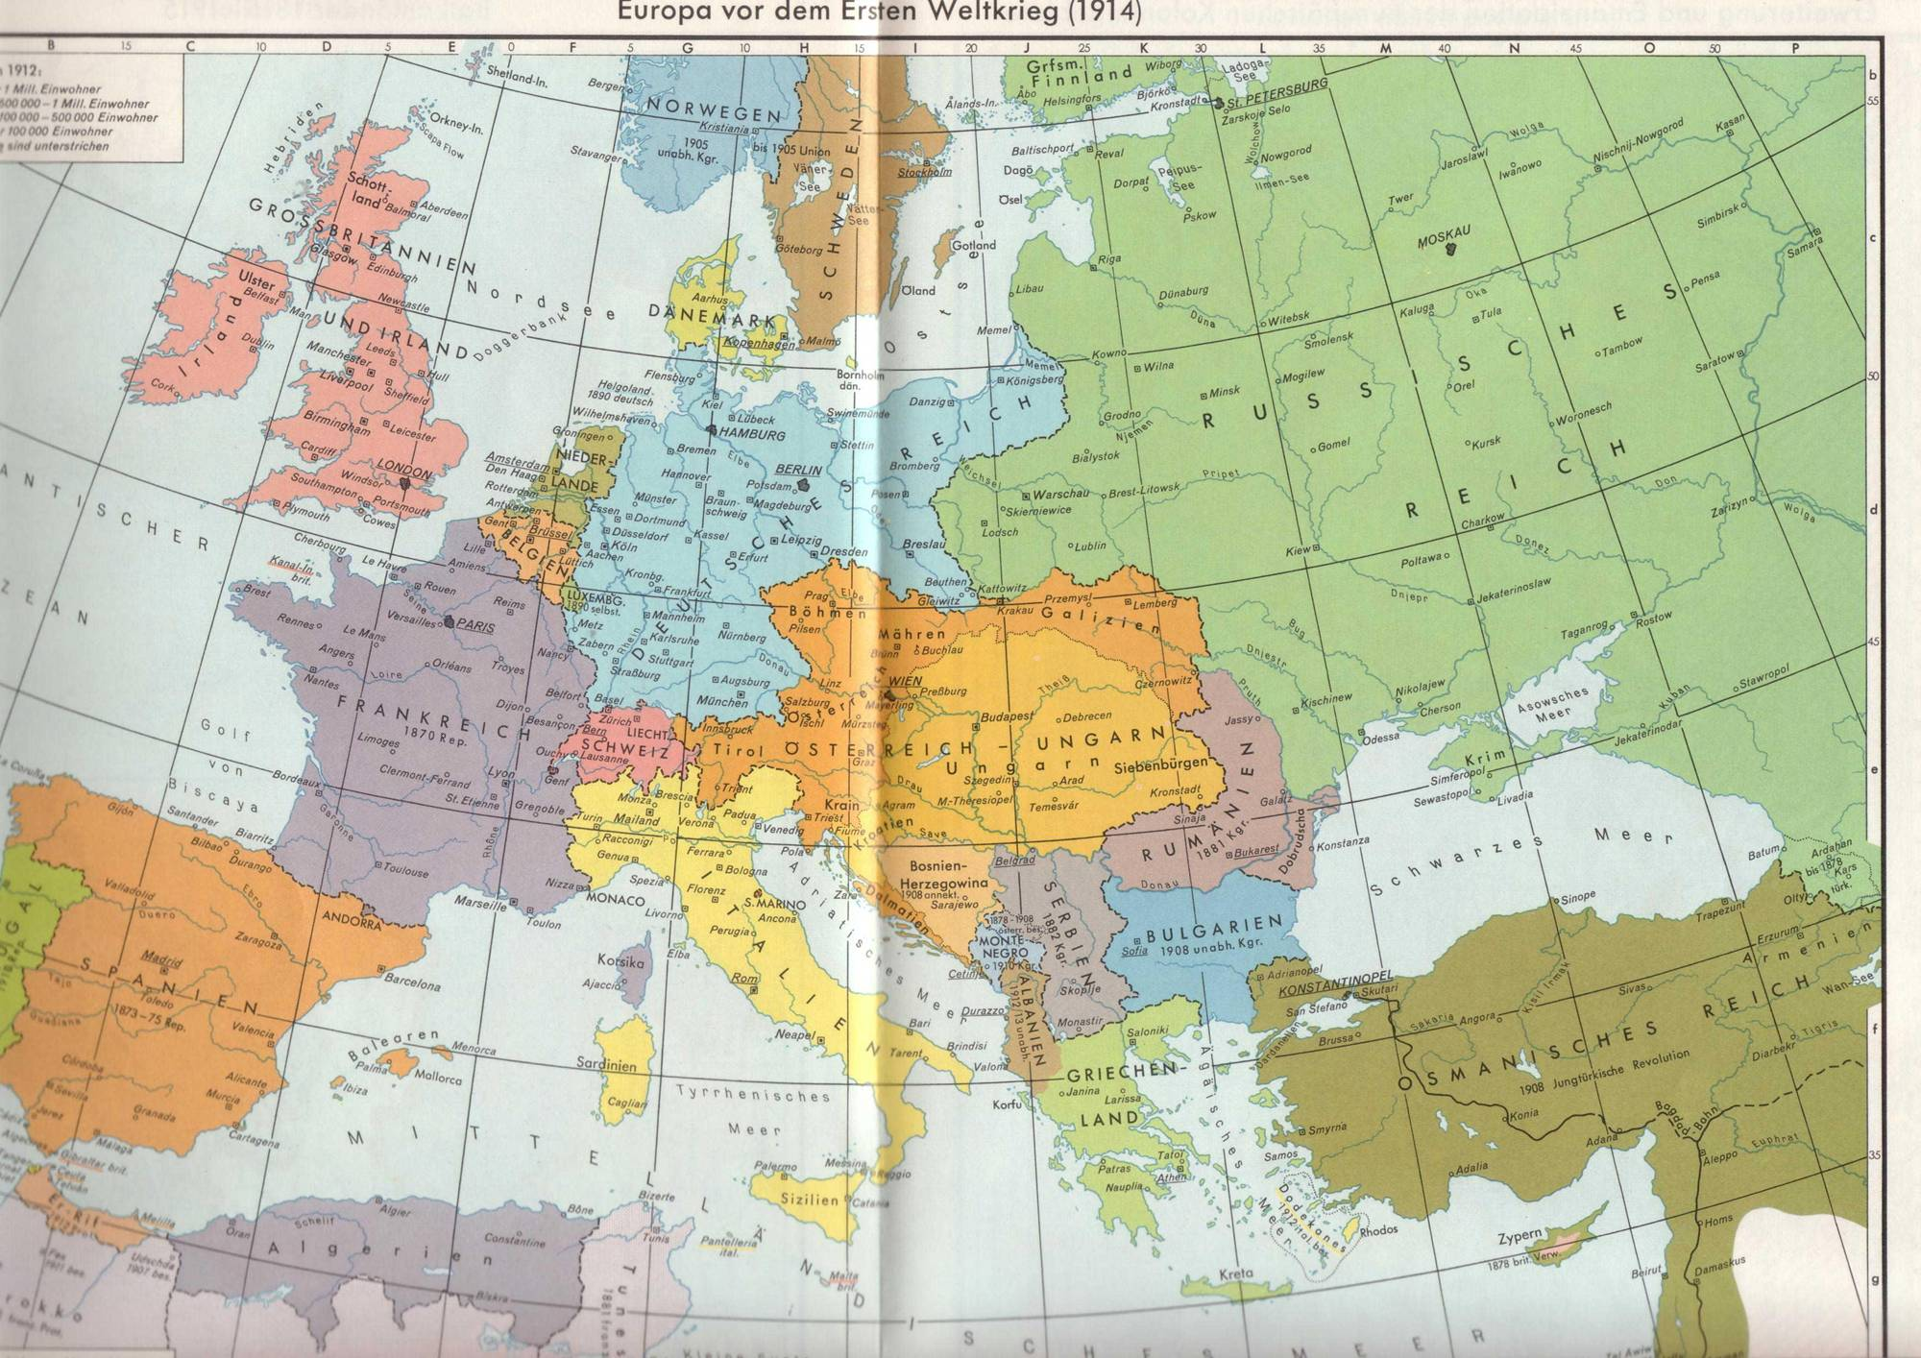
1914

Slide 23
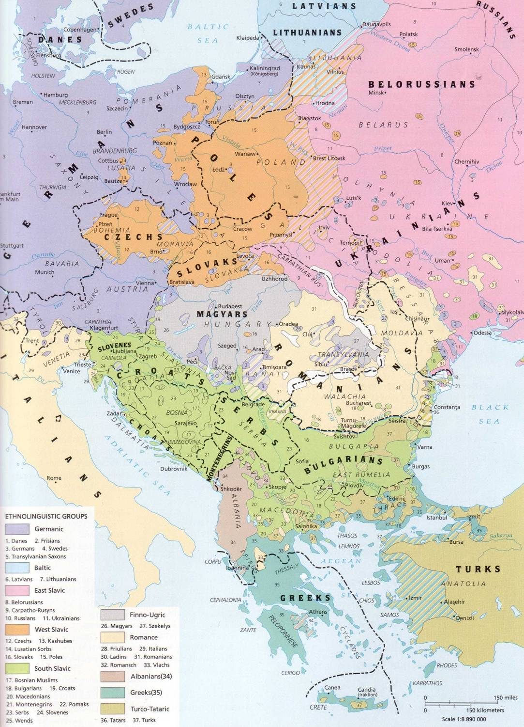
ca. 1910

Slide 24
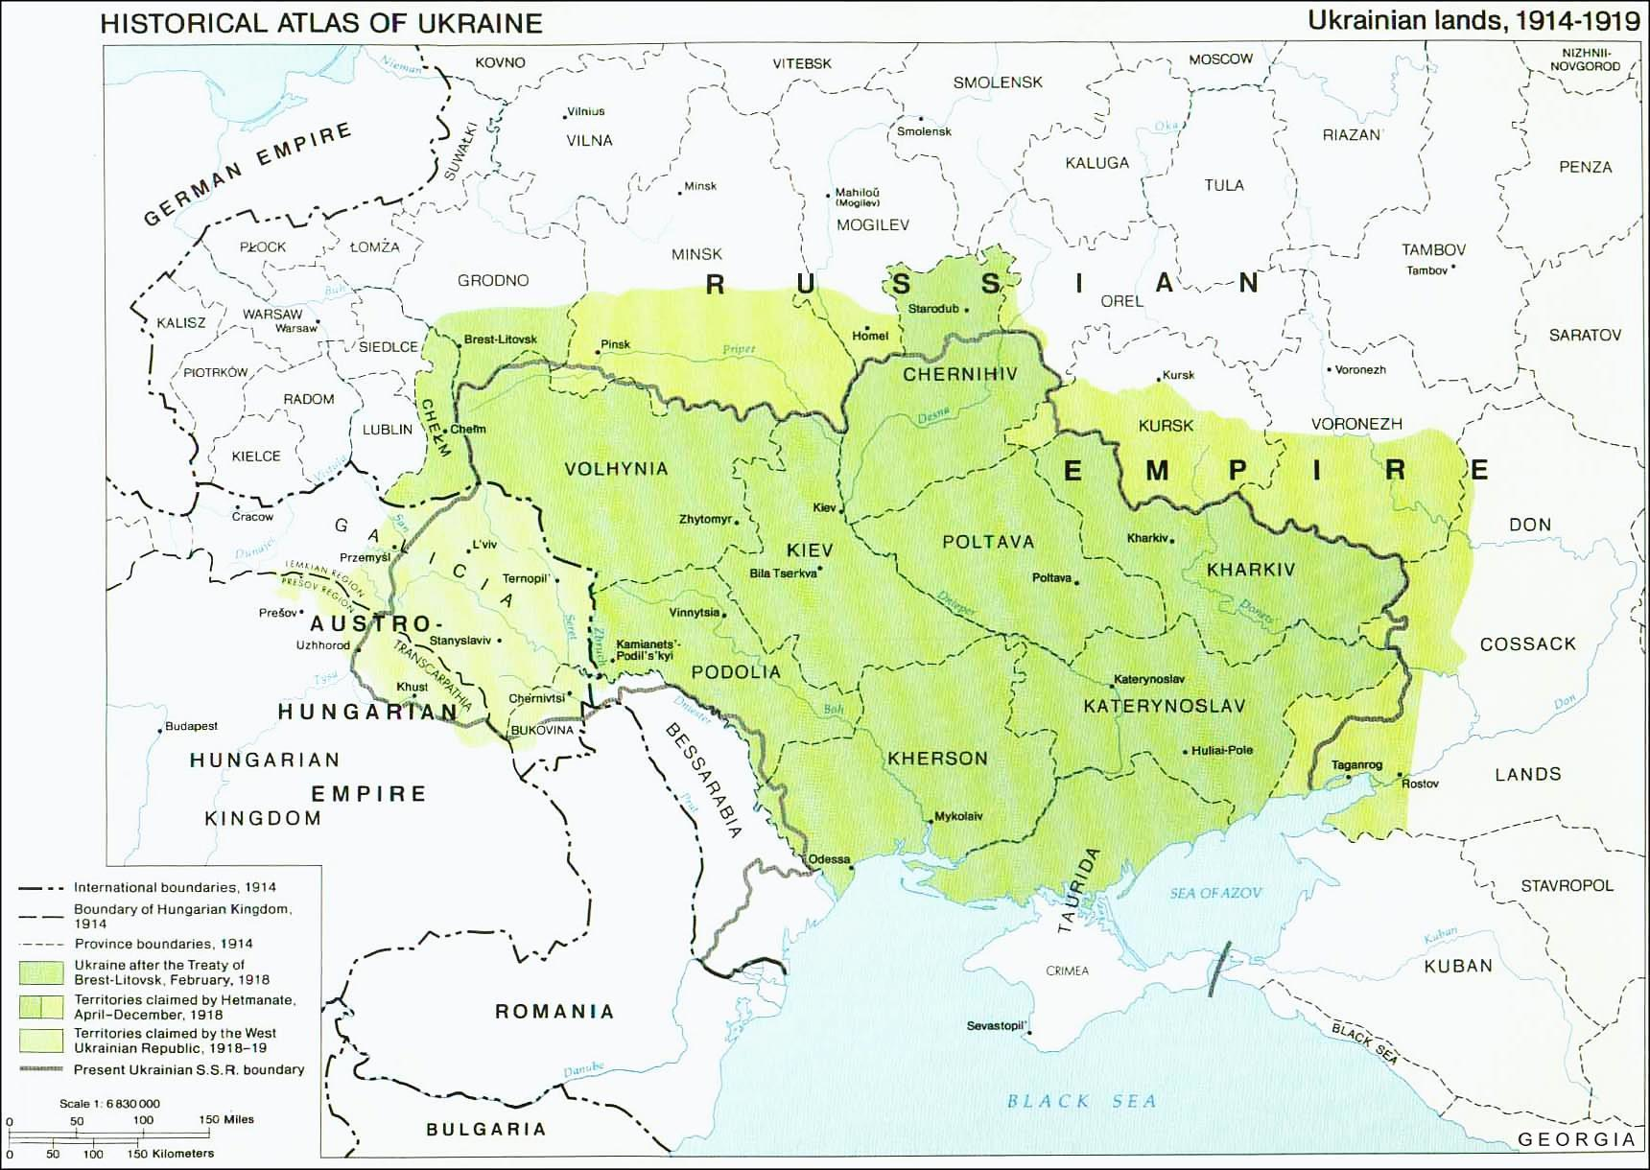

Slide 25
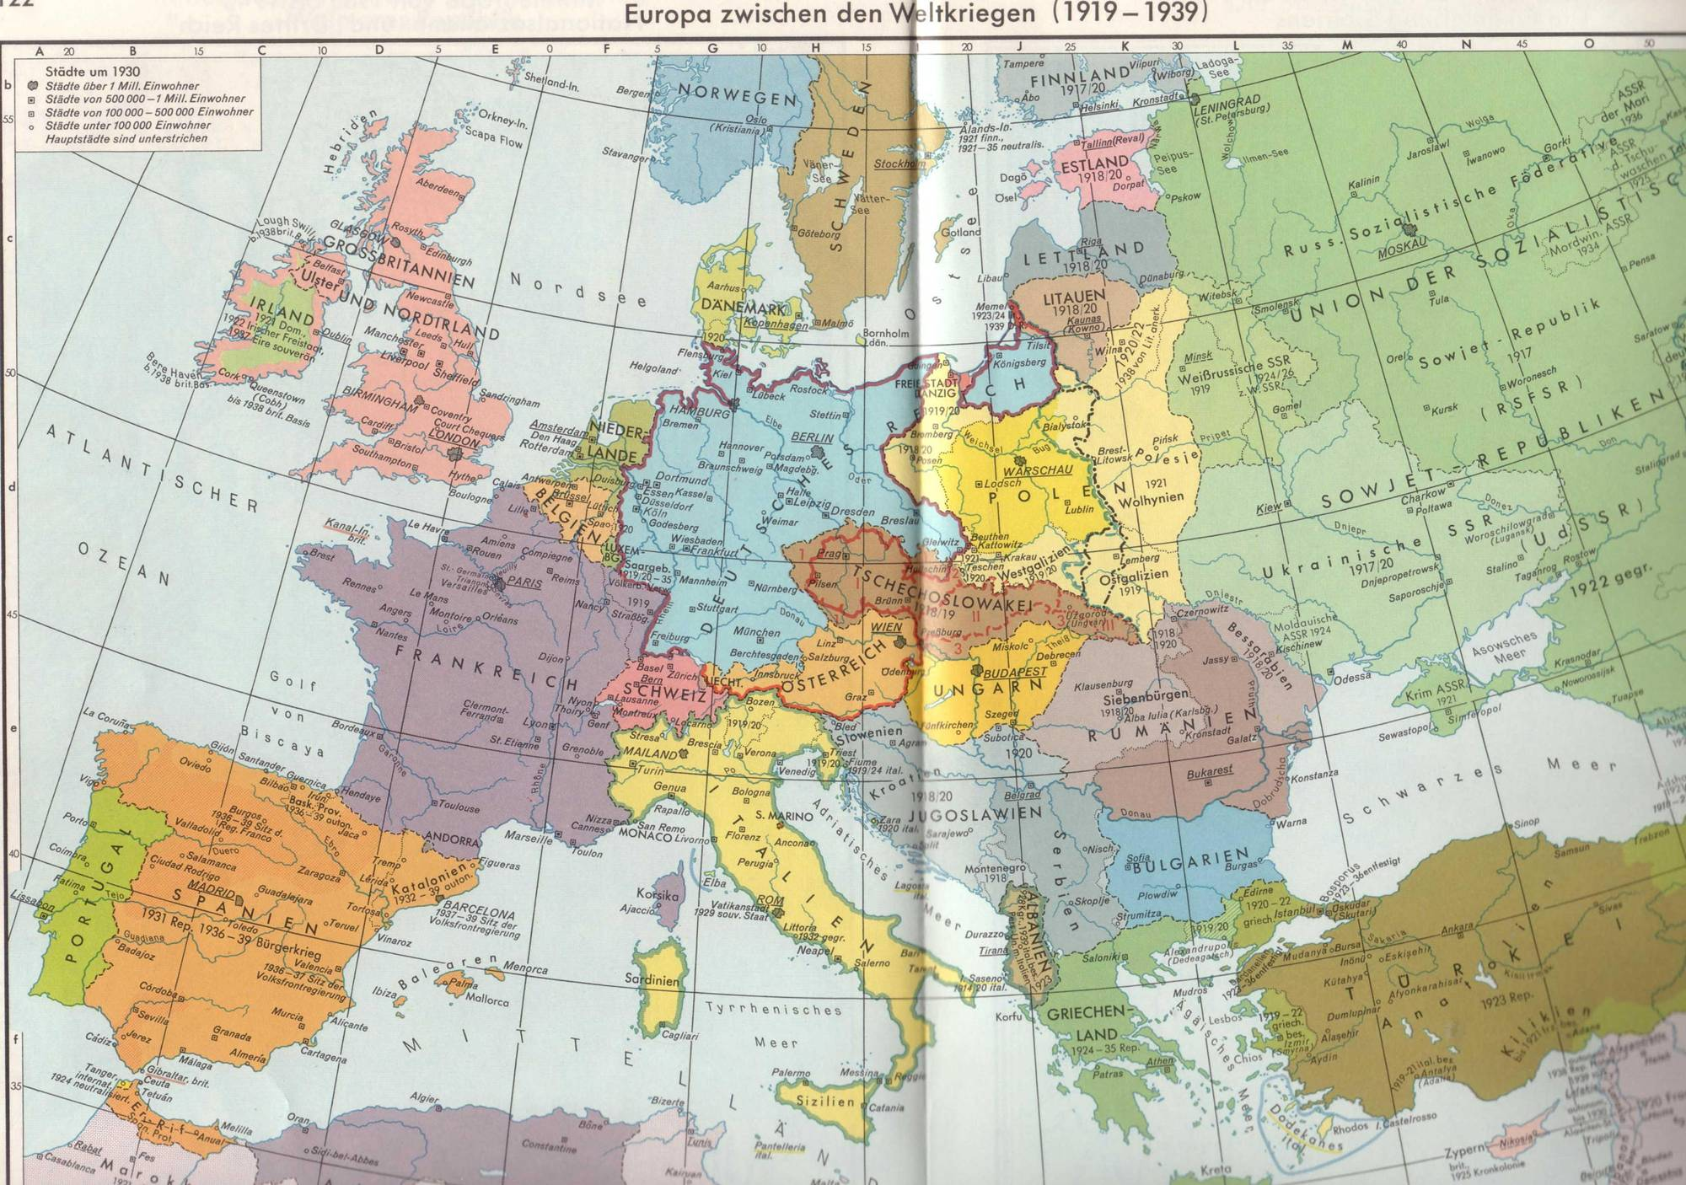
Putzger, Historischer Weltatlas, pp. 122-123

Slide 26
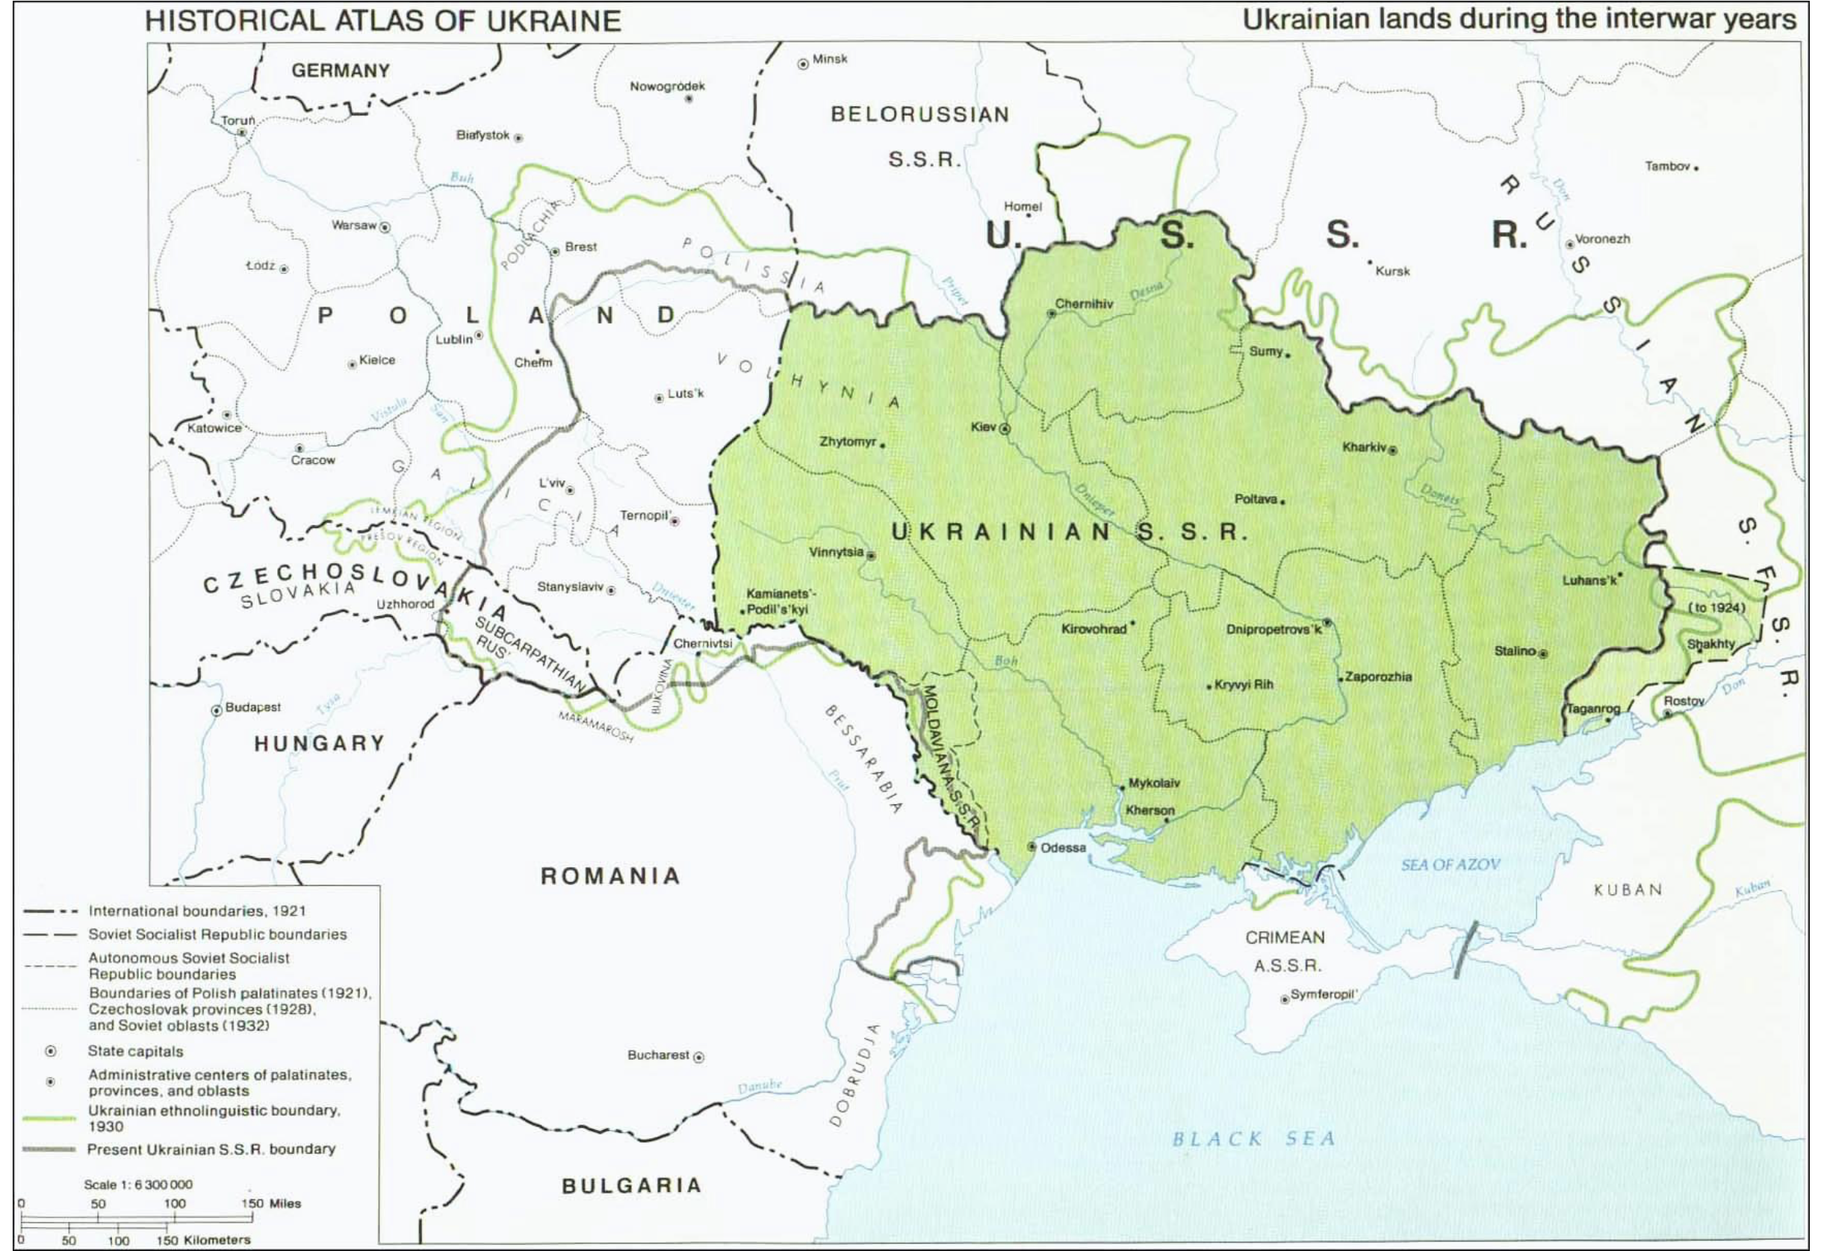

Slide 27
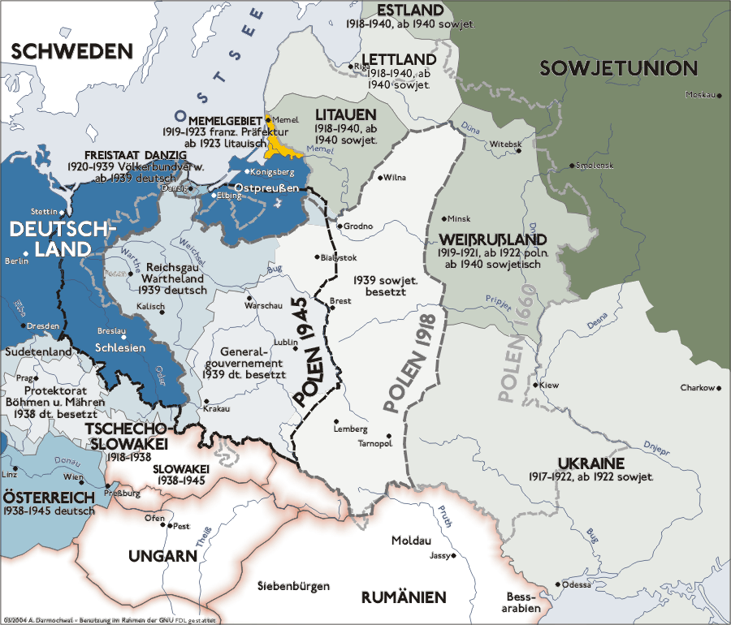

Slide 28
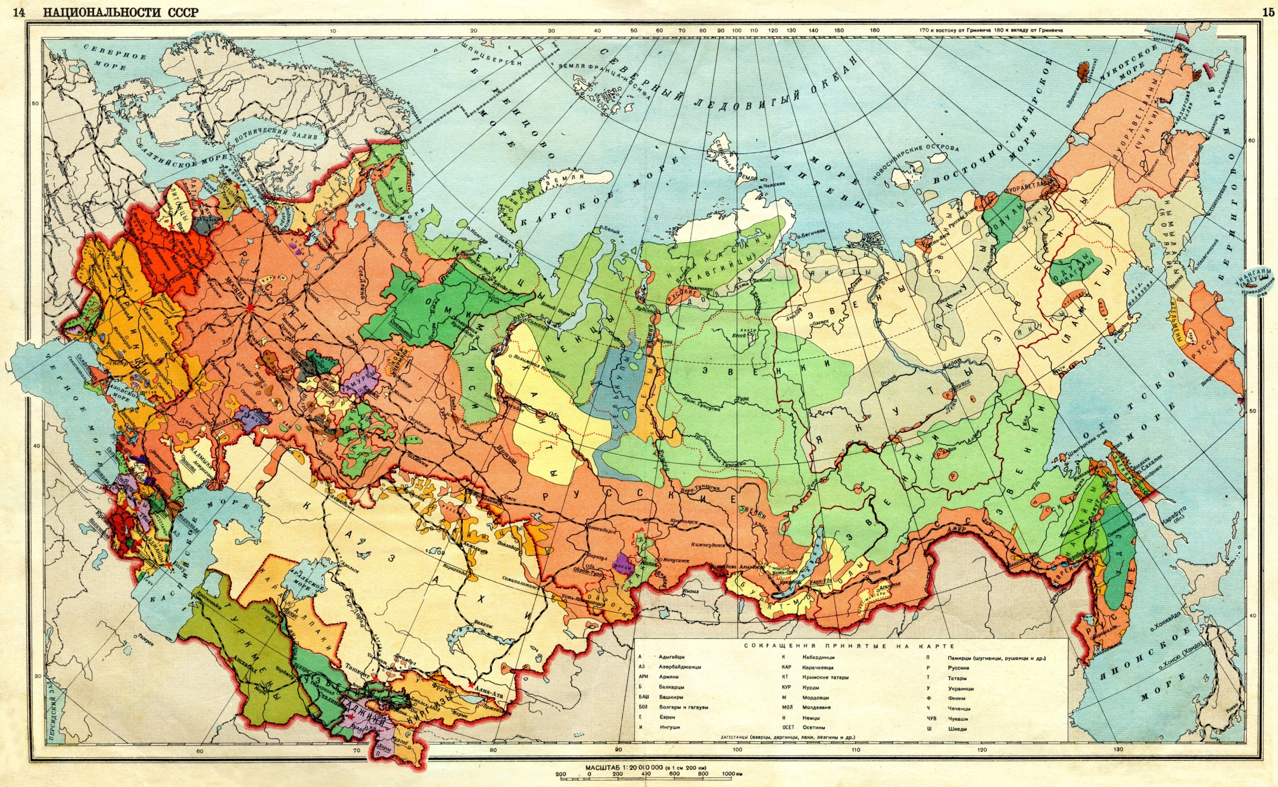

Slide 29
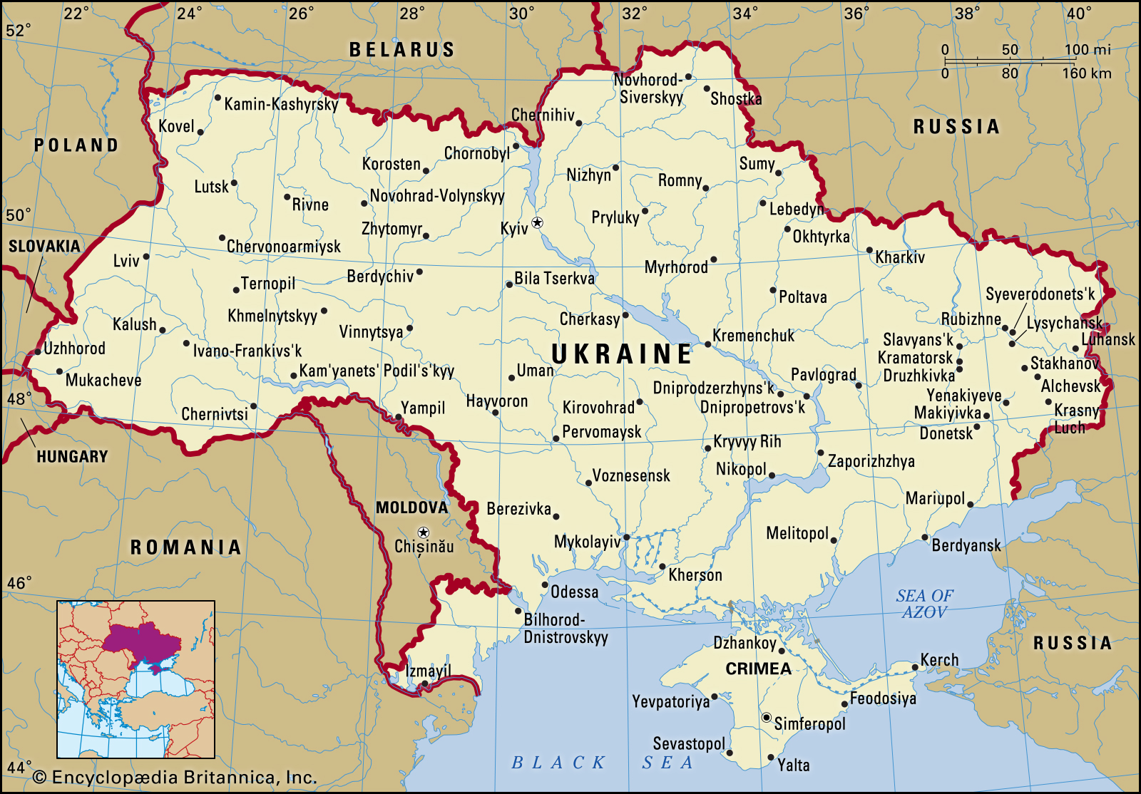

Slide 30
