Slide 1
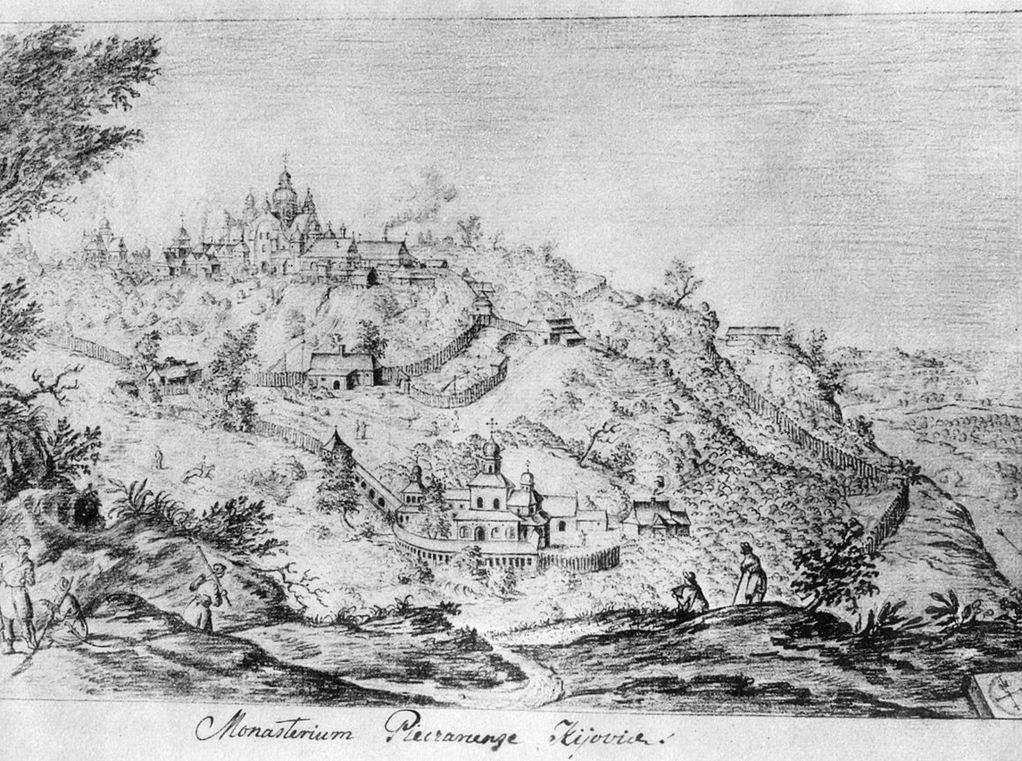
Entangled History: Ukraine and her neighbours from the Middle Ages to the present
Lecture 2, wk. 3
Stories of origin: The Kyivan Rus’

Slide 2
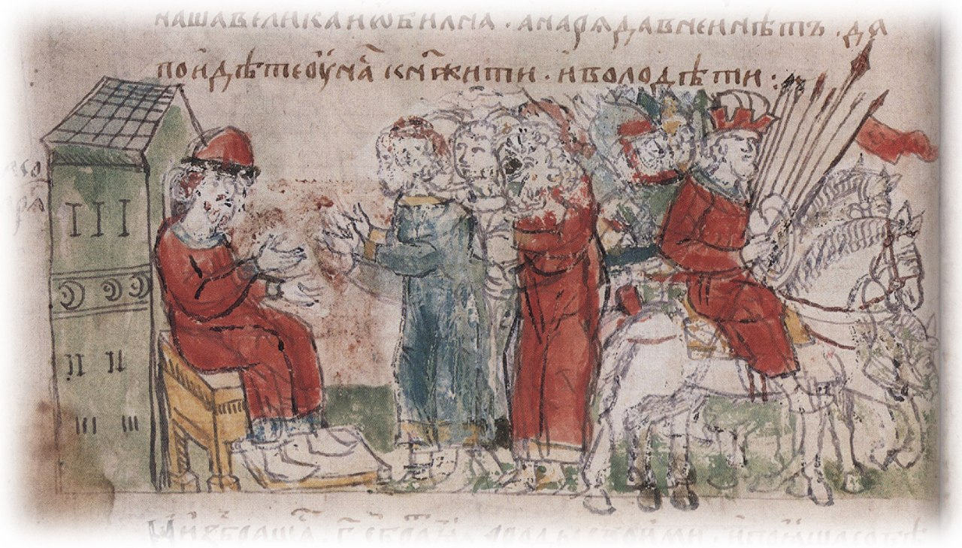
Outline
Introduction
Starting point: geography and trade routes
The Varangians arrive
Christianisation
Fragmentation and desintegration

Slide 3
Recent Context
Russians, Ukrainians, and Belarusians are all descendants of Ancient Rus, which was the largest state in Europe. Slavic and other tribes across the vast territory – from Ladoga, Novgorod, and Pskov to Kiev and Chernigov – were bound together by one language (which we now refer to as Old Russian), economic ties, the rule of the princes of the Rurik dynasty, and – after the baptism of Rus – the Orthodox faith. The spiritual choice made by St. Vladimir, who was both Prince of Novgorod and Grand Prince of Kiev, still largely determines our affinity today.
The throne of Kiev held a dominant position in Ancient Rus. This had been the custom since the late 9th century. The Tale of Bygone Years captured for posterity the words of Oleg the Prophet about Kiev, ”Let it be the mother of all Russian cities.“
Later, like other European states of that time, Ancient Rus faced a decline of central rule and fragmentation. At the same time, both the nobility and the common people perceived Rus as a common territory, as their homeland.
Vladimir Putin, ‘On the Historical Unity of Russians and Ukrainians‘, 12 July 2021
http://en.kremlin.ru/events/president/news/66181

Slide 4
Starting point: geography and trade routes
Geography: River network – North-South (Dnipro/Dnepr and (Volga) West-East
Good agricultural land between steppe and forests
Forests in the North
In 8th century Baltic tribes in North-West, Finno-Ugric tribes in North and North-East, Slavic tribes in middle, Nomadic – often turkic - tribes in steppe region, Khasar Khaganat in South-East, Greek colonies on Black sea coast and on Crimea
Steppe (wild field to the south): regular attacks by nomadic tribes – also of those on the way to Europe: Huns, Alans (Iranian tribe), Germanic tribes, Turkic tribes, Pechenegs, Avars, Magyars (Hungarians) – finally Mongols and Tatars

Slide 5
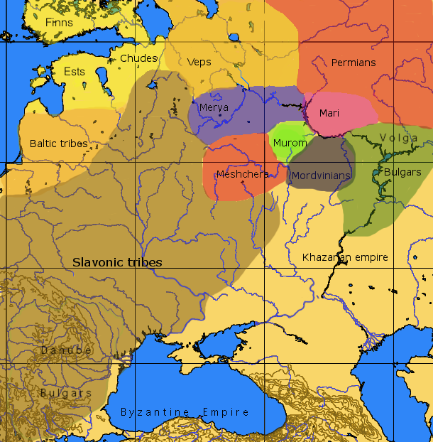
8th Century

Slide 6
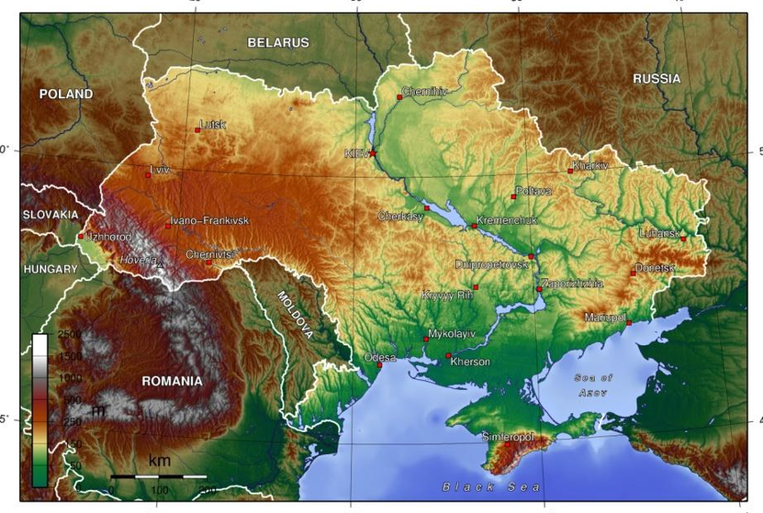
Contemporary geography

Slide 7
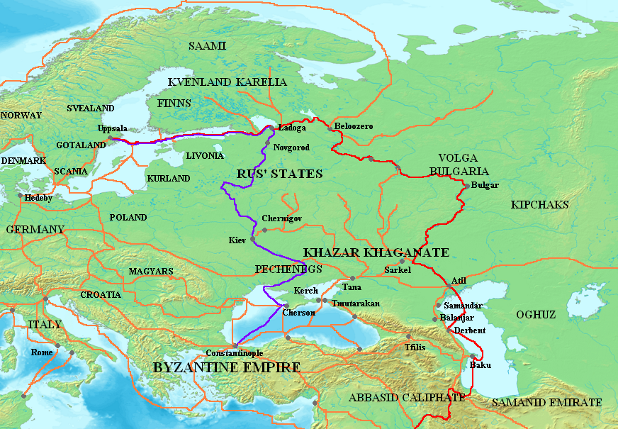
The Varangians arrive
8th to 11th century: Varangian trade routes, in Red the Volga route, in purple the route from the Varangians to the Greek

Slide 8
Why did the Varangians/Vikings come?
Warrior-traders
Establishing and securing trade route from Scandinavia to Constantinople
Creating bases to secure route
Already in early 9th century some Slavic tribes pay tribute to Varangians, others pay tribute to Khazar Khagan
Story goes that after being kicked out, Rurik was called back to rule over Slavic tribes
Base was Novgorod
Fur, honey, timber, wax, slaves (Slav – Slave)
Prince + retinue come from Scandinavia – relatively small number of people – still close connections to Scandinavia – new arrivals
Mixing with elite of Slavic tribes: Slavicisation

Slide 9
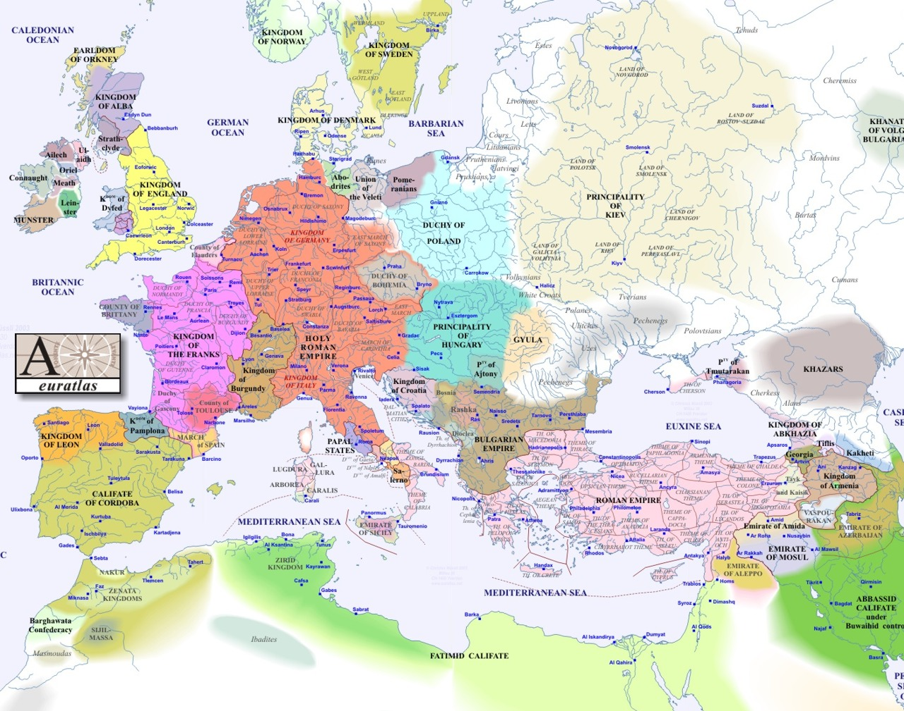
1000

Slide 10
Christianisation
The land of the Rus‘ I
793 | Viking attack on Lindisfarne, followed by attacks throughout Europe
859-862 | Arrival of Varangians/Rusians in Eastern Europe (Rurik), base in Novgorod
882 | Oleg/Oleh/Helgi moves to Kyiv (which already exists and controlled by Varangians)
9^{th-}11^{th/}centuries | Relations to Byzantium: sometimes at war, more often trading, sometimes winning sometimes losing: attack in 907 on Constantinople – successful leading to good trade deal, attack in 941 failure, not so good trade deal, 1043 another attack
 | Olha/Olga/Helga widow of Ihor/Igor/Ingvar becomes Christian, rules for her son Sviatoslav
869-872 | Sviatoslav is overdoing it: overambitious, challenging Byzantine emperor. Bad move: his destruction of the Khazar Khaganat, killed by nomadic Pechenegs on way back from Bulgaria
988-89 | Volodymyr/Vladimir the Great: support for Byzantine emperor, price: hand of his sister Anna Porphyrogenetos – after victory against emperor’s rivals: does not want to ‘pay’ – Volodymyr occupies Khersones, marries Anna – followed by Christianisation of Rus’
9th century | Konstantin/Cyril (826-869) and Methodius (815-885): Cyrillic alphabet developed in First Bulgarian Empire by disciples of Cyril/Methodius in 10th century before introduced in Kyiv after Christianisation (together with Old Church Slavonic language - becomes written language of Rus’)
 | Flourishing culture, literary culture base on Church Slavonic – different from vernacular, Church Slavonic shared with orthodox East Slavs beyond Kyivan Rus, many churches built followed by monasteries
1018 | St. Sophia Cathedral in Kyiv

Slide 11
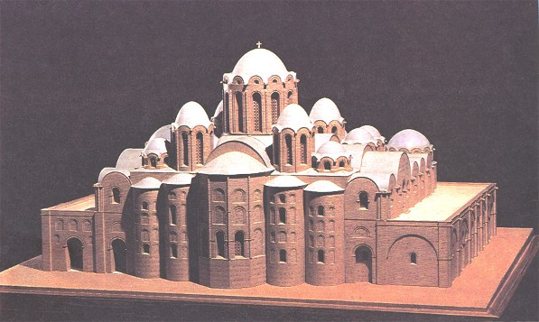
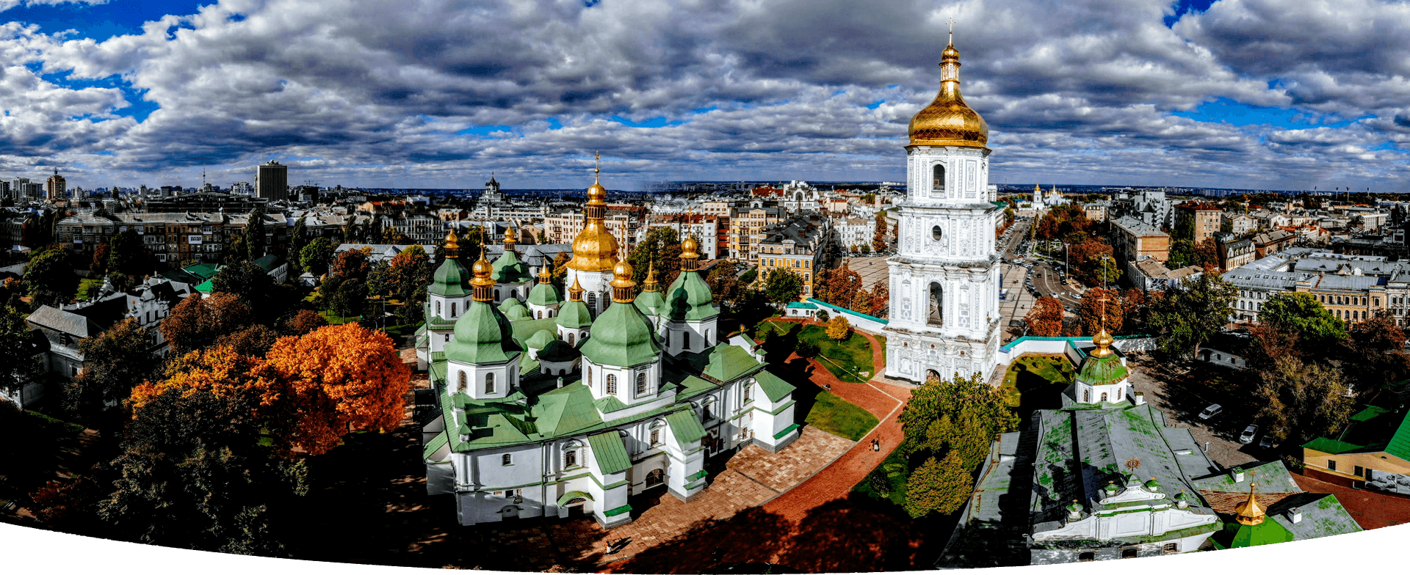
St. Sophia Cathedral, Kyiv

Slide 12
Christianisation
Christian influences before the arrival of the Varangians
Civilisational choice? Retrospective interpretation
‘State religion‘ to bind territories and people together
Side effect: no longer in danger of being enslaved by Christian rulers
Mini-Christendoms (Raffensperger)
Konstantin (Cyril) and Methodius from Thessaloniki
The Moravian connection: Konstantin and Methodius sent by Byzantine Emperor, asked for by Moravian ruler: to reduce dependence (of his church) on German King Louis the German. Development of cyrillic script, translations of religious texts into Old Church Slavonic – Popes sometimes supportive sometimes against but eventually insist on Latin as only religious language
The Bulgarian connection
1054: The Great Schism
Before 13th century not such a big deal whether Greek or Latin Church

Slide 13
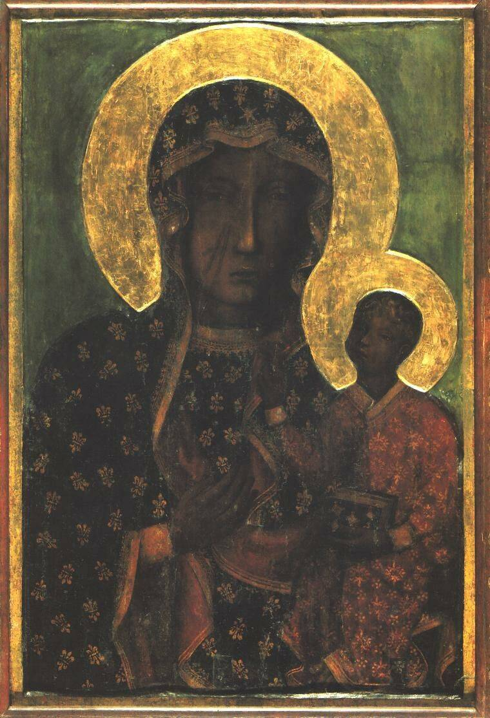
Poland
966 Mieszko I (Piast dynasty) was baptised – Latin Church
997 Bishop Adalbert (Wojciech) dies – first national saint Polands
1000 Act of Gniezno, Otto III and Bolesław the Brave
1025 Bolesław crowned as first Polish King
1050 Polish court to Cracow
1126 Mazovian Prince Conrad invited the Order of Teutonic Knights to Northern Poland
1241 Mongol invasion, stopped in Silesia

Slide 14
The land of the Rus‘ II
1042-1049 | European connections and (marriage) alliances – with France, Sweden, Norway, Poland, German Empire, Byzantium, Rome Examples: Yaroslav’s daughter marries Harald Hardrada, Son Iziaslav marries Gertrude, the daughter of Mieszko II (King of Poland), Anna of Kyiv (another daughter) is married to Henry Capet, ruler of France, later Anna is regent for Philip I after Henry’s death. Son Vsevolod marries daughter of Byzantine Monomakhos Clan
1051 | Monastery of the Caves
1054 | Iziaslav follows father Yaroslav – rules for 14 years
1054 | Great Schism between Greek and Latin Church (real consequences only later)
1066 | Battles of Stamford Bridge and Hastings – William the Conqueror – King of England, Harold Godwinsson’s daughter Gyta marries in Kyiv Volodymyr, grandson of Yaroslav the Wise
1068 | Iziaslav expelled by Kyivians (failure to defend them against nomadic Polovtsy), goes to Poland, returns with Polish troops, expelled again in 1071, tries to find help in Poland and German Empire, Iziaslav dies in 1078, followed by brother Vsevolod (father of Volodymyr Monomakh). His daughter Evpraksia marries (second marriage) Emperor Henry IV of German Empire – later sides with pope Gregor VII
1075 - 1122 | In Europe Investiture controversy – Pope Gregor VII and Emperor Henry IV
1093 | Vsevolod dies, succeeded by nephew Sviatopolk, succeeded in 1113 by nephew Volodymyr Monomakh (married to daughter of Harold Godwinsson)
12th century | Pressure from the Steppe, contested succession, unity of Rus’ replaced by semi-independent principalities of different princely families. Novgorod without prince – joins Hanseatic League,

Slide 15
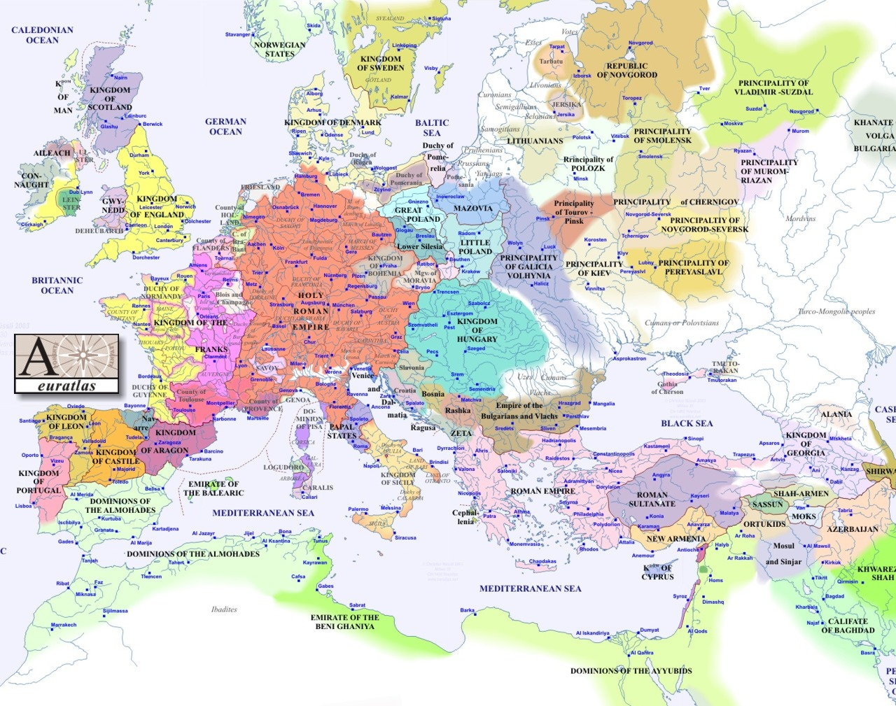
1200

Slide 16
The land of the Rus‘ III
1147 | Foundation of Moscow
1150s and 1160s 1238 | Yurii Dolgorukii, son of Vladimir/Volodymyr Monomakh and son Andrei Bogoslubski develop northeast of Rus’, power centre in Vladimir-Suzdal, multipolarity of Rus’ Danylo Halytsky becomes Prince of Halychyna, unites Halychyna with Kyiv
Late 12th century | Crusader Knights (Teutonic Knights and Brothers of the Sword) turn up (are initially invited) at Baltic coast – Teutonic Knights to fight against pagan Baltic Prussians, 1126 invited by Conrad of Mazowia (a Polish duke)
1237-1240 | Mongols (Tatars) under Batu Khan invade and devastate Rus’
Sources | Tale of Bygone years (chronicle written in late 10th/11th century) probably by a monk called Nestor – close to court of grand prince – which informs story. Travel report of Ahmad Ibn Fadlan, some other sources of 11th and 12th centuries, now also Byzantine and Polish, German sources, Thietmar of Merseburg

Slide 17
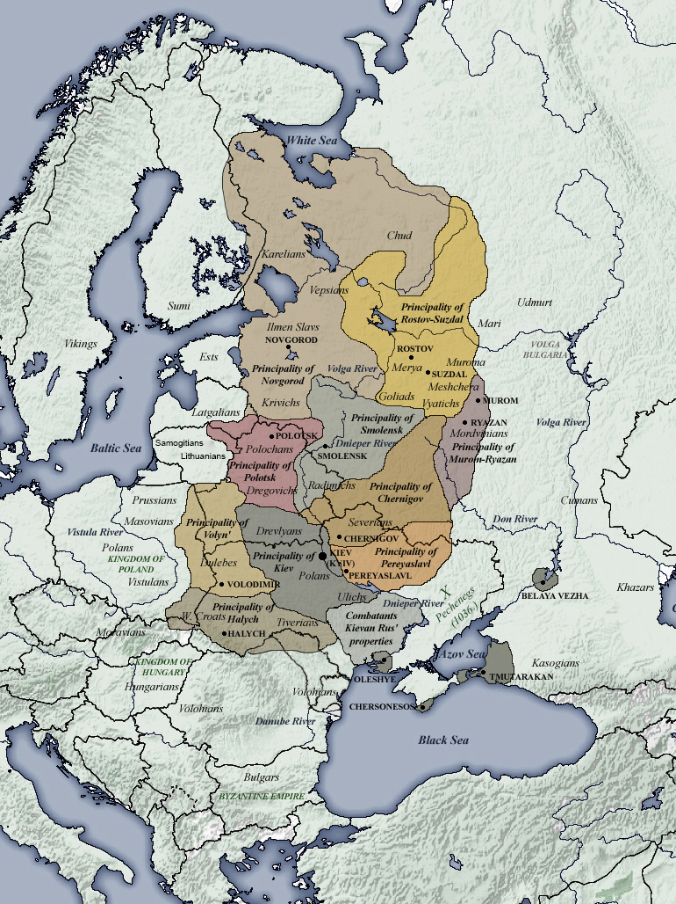
1154-1232

Slide 18
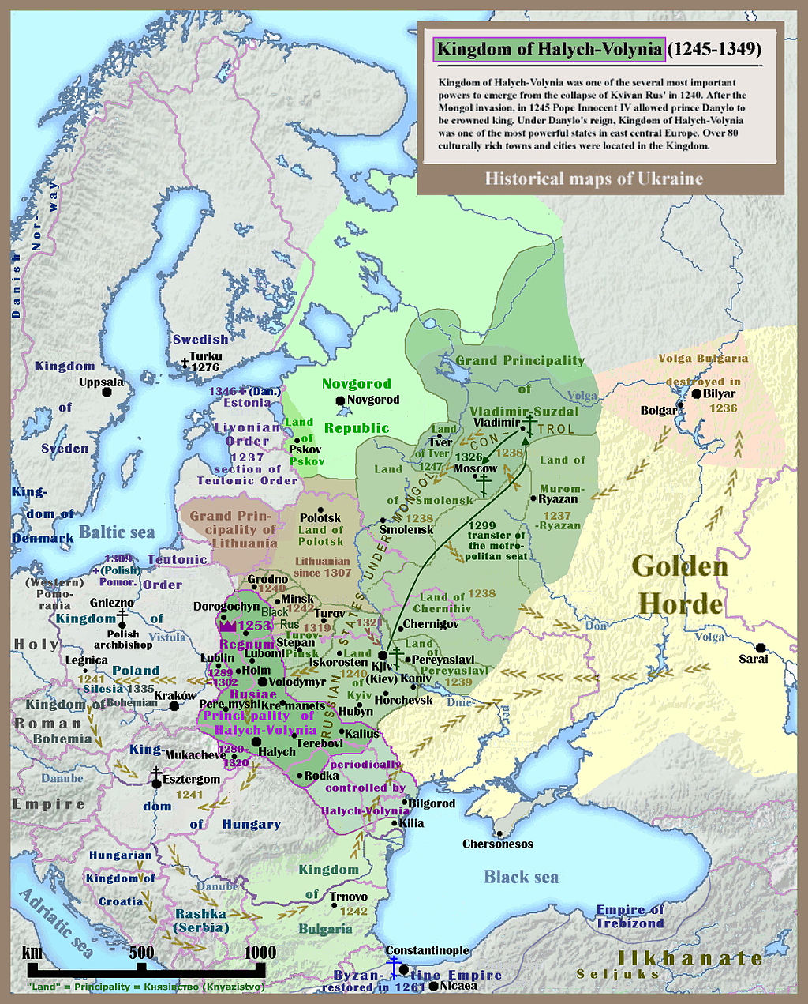
Map of Kievan or Kyivan Rus (Principality of Kiev Kyiv), 1245-1349

Slide 19
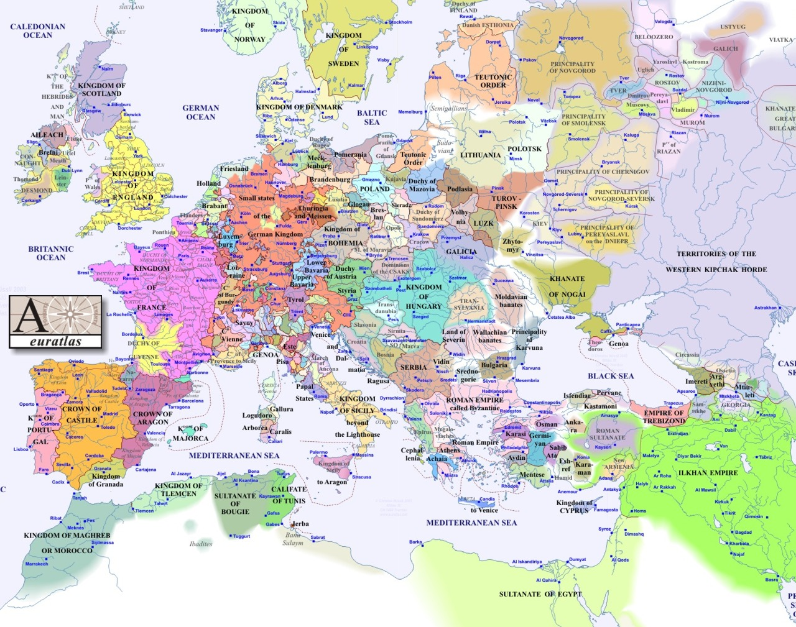
1300

Slide 20
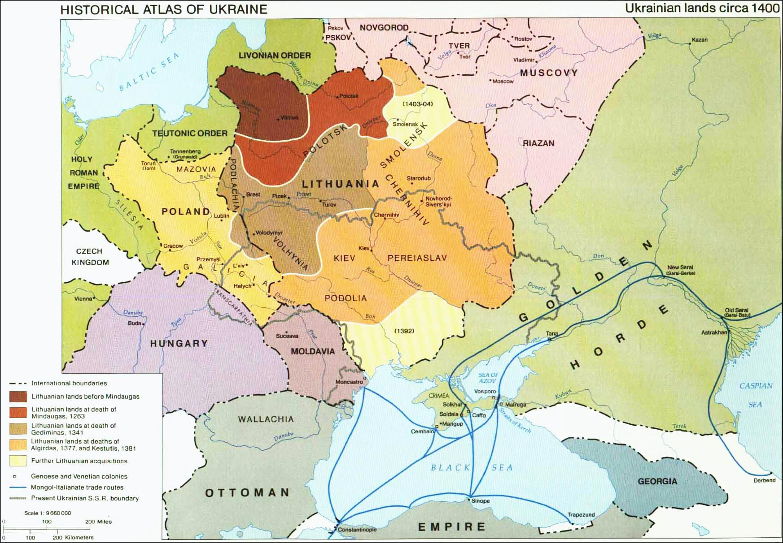

Slide 21
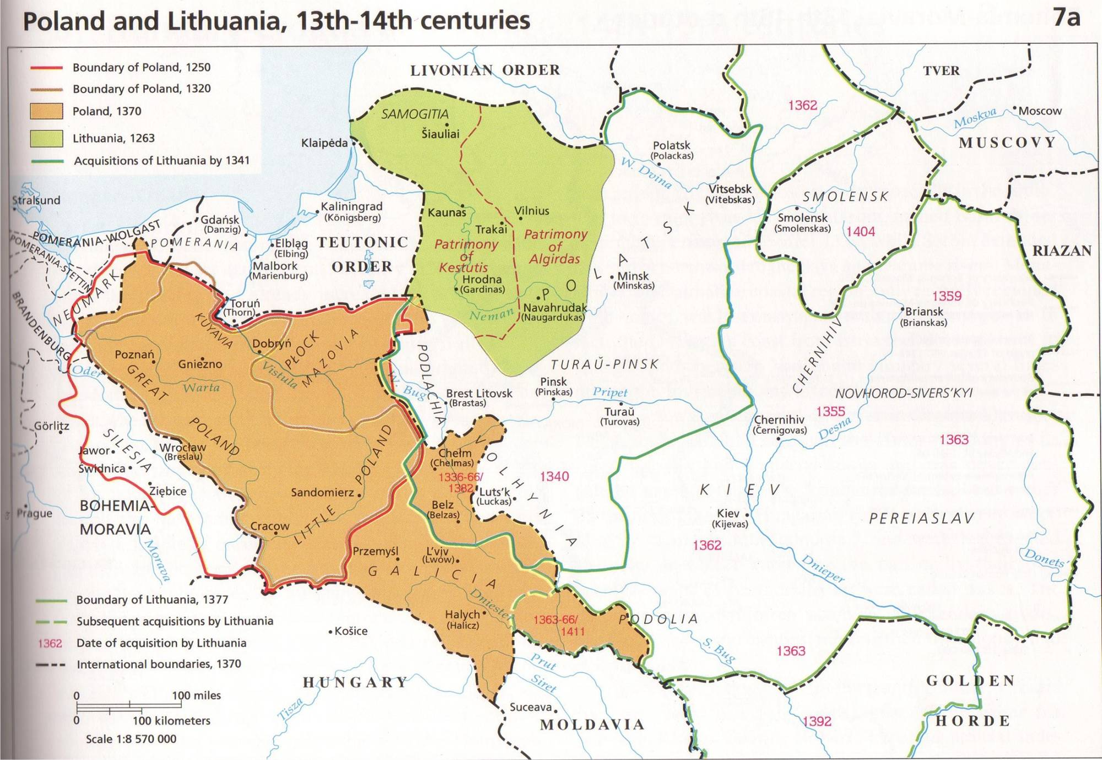

Slide 22
Two narratives
Rus‘ (Kyivan Rus)
Mongol invasion: ethnic continuity: people stayed
Not Muscovy but Kingdom of Halych-Volhynia successor state of Rus‘
Unfortunately, lost independence, but culture preserved as part of Lithuania, Poland, and Polish-Lithuanian Commonwealth – part of Europe
17th century Cossack Hetmanate was a Ukrainian state
Muscovians and Great Russians: rather finno-ugric than Slavic, strong Mongol influence
Today‘s Ukrainians are the true descendants of Rus‘, Rus‘ were Rusians, not Russians
Ukrainians and Russians are fundamentally different as a result of historical developments since 13th century: language, (political) culture, mentality
Rus‘ belongs to Ukrainian history, has been usurped by Russian imperialists and colonialists.
Rus‘ (Kievan Rus‘)
Mongol invasion: many Rus‘ people fled to forest – Muscovy
In North East new centre of Rus‘, eventually Muscovy dominant
Grand princes, tsars and emperors unified land of Rus‘, liberating it from foreign control
The inhabitants of Rus‘ were united by language, religion and culture
There is a direct link between the land of the Rus‘, the Russian Empire, the Soviet Union and the Russian Federation
Rus‘ are Russians, the Rus‘ was the first Russian state as the Russian Federation is the last political form the Russians gave themselves
The legitimate heir of Rus‘ is Muscovy, then Russia – which ended the foreign dominance and re-united the land of the Rus‘

