Slide 1
Entangled History: Ukraine and her neighbours from the Middle Ages to the present
Lecture 3, wk. 4
The ’Mongol yoke’ and the Rise of Muscovy

Slide 2
Outline
Introduction
The Mongol Empire and its successor states
From Vladimir-Suzdal to Muscovy
The first stages of the ‚collection of the land of the Rus’
Mongol and Byzantine influences: ‘translatio imperio’

Slide 3
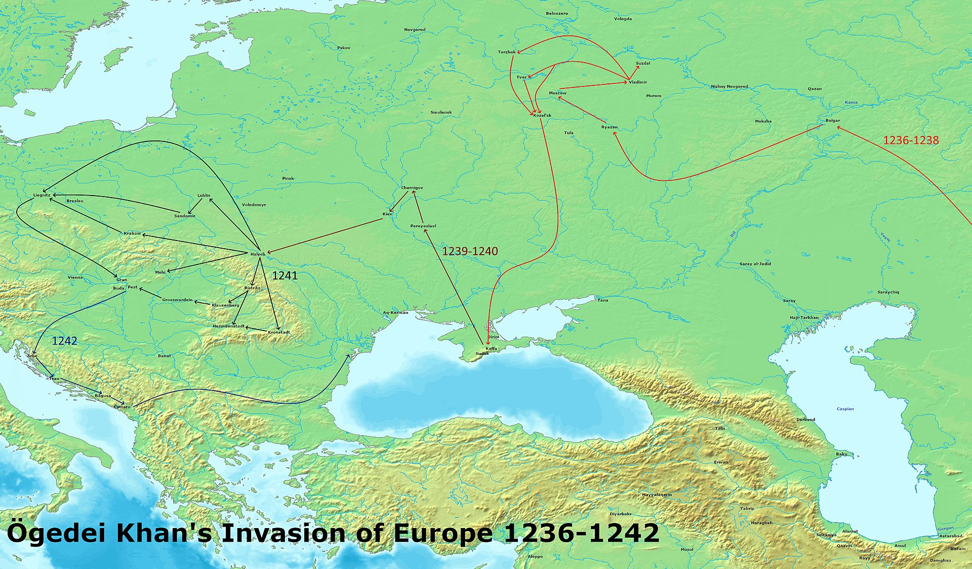

Slide 4
Timeline : the ‘Mongolian yoke’
Mongolian heritage – for 200 years Muscovy was part of a Mongolian empire (1240 – middle of the 15th c.)
1237-1240 - The Mongols (Rusians called them Tatars – name of the tribes fighting with Mongols) under Batu Khan, invade and devastate Rus‘, take and destroy Kyiv on 6 December 1240
1259 - Partition of Mongol Empire in four parts, ruled by descendants of Dshinghis Khan, Northwest: Kipchak Khanate (Rusians call it Golden Horde)
Rus‘ princes pay tribute to Kipchak Khanate/Golden Horde – Grand prince title needs to be confirmed by Khan
Princes of Muscovy become Khan‘s tax collector
Golden Horde sends troops to enforce its rule if necessary (if a prince refuses to pay tribute and/or tries to ally with Lithuania)
14th century – often fighting within Golden Horde and between successor states of Mongol Empire

Slide 5
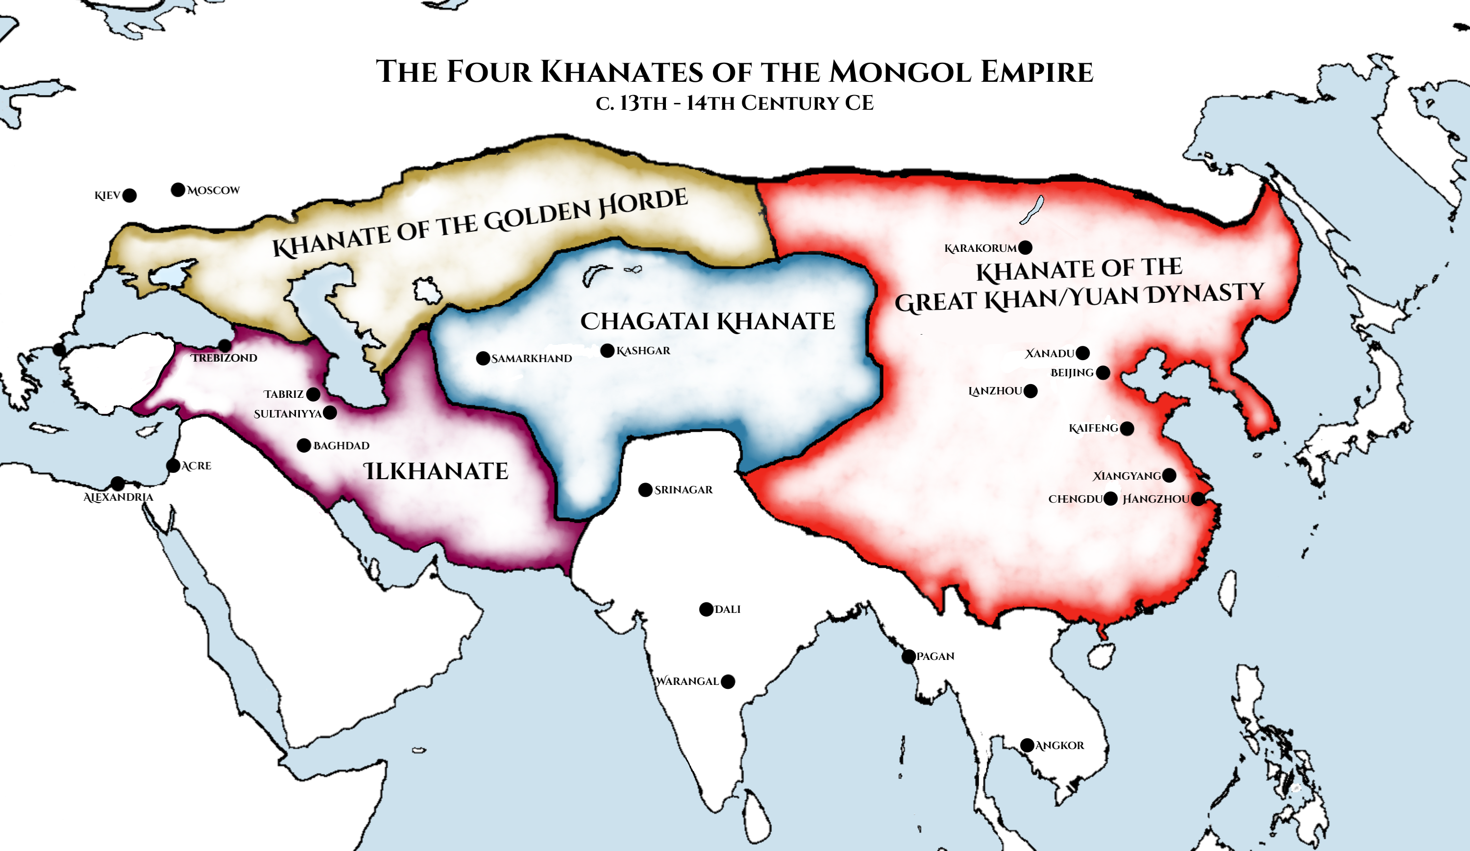

Slide 6
A new start or the continuation of Kyiv/Kiev? The Principality of Muscovy: Geography
Forests in Moscovian heartland
Peripheral location
Vast Russian plain to South
Dense and viable network of rivers
Spring and autumn: mud, time of immobility

Slide 7
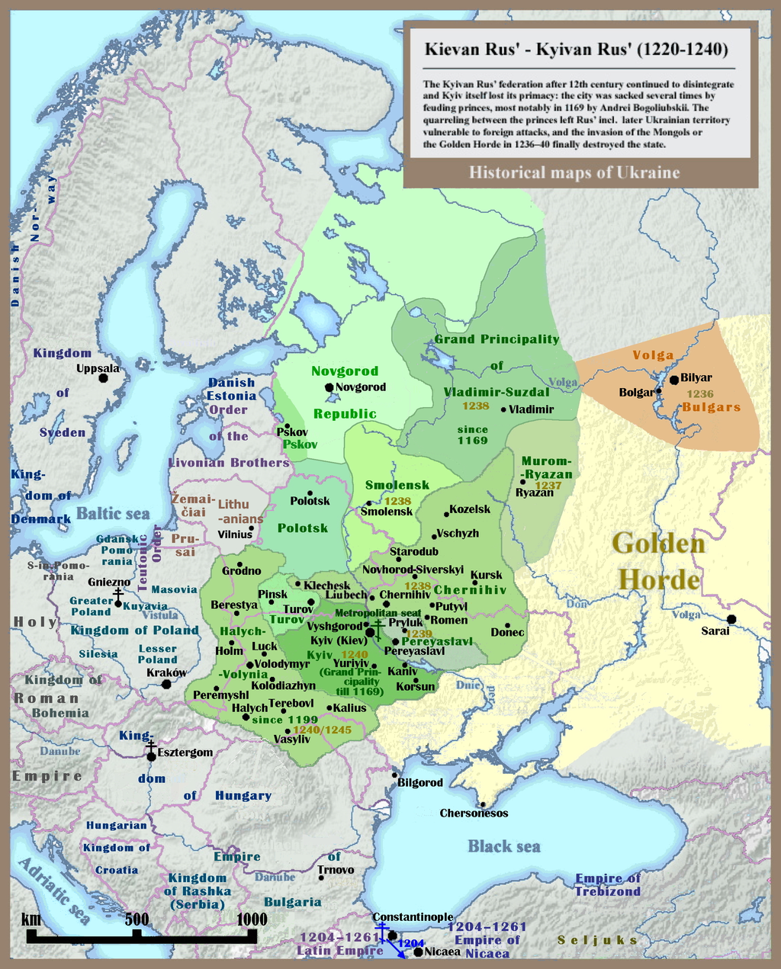
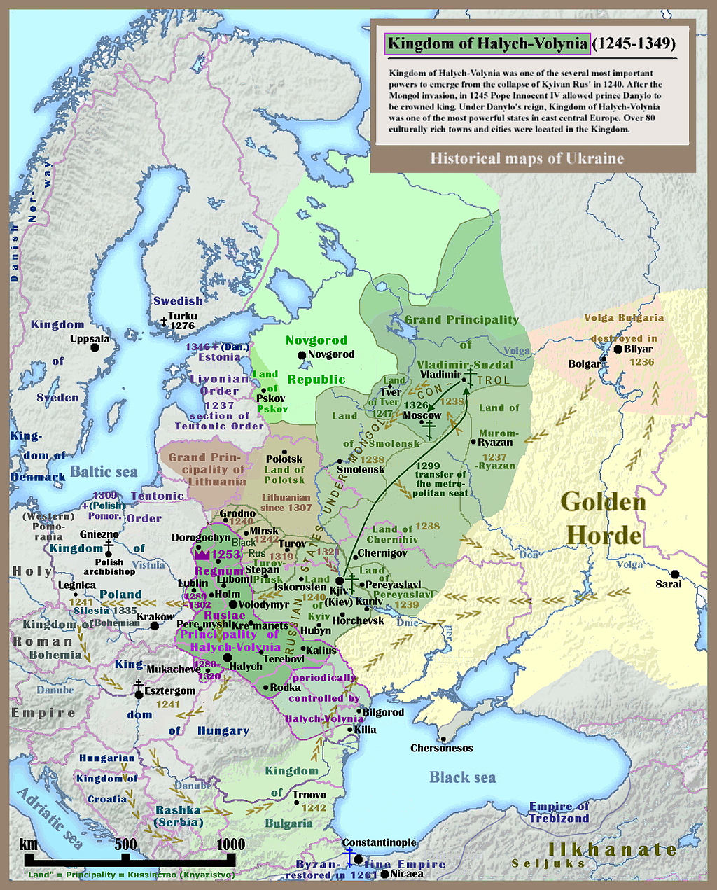

Slide 8
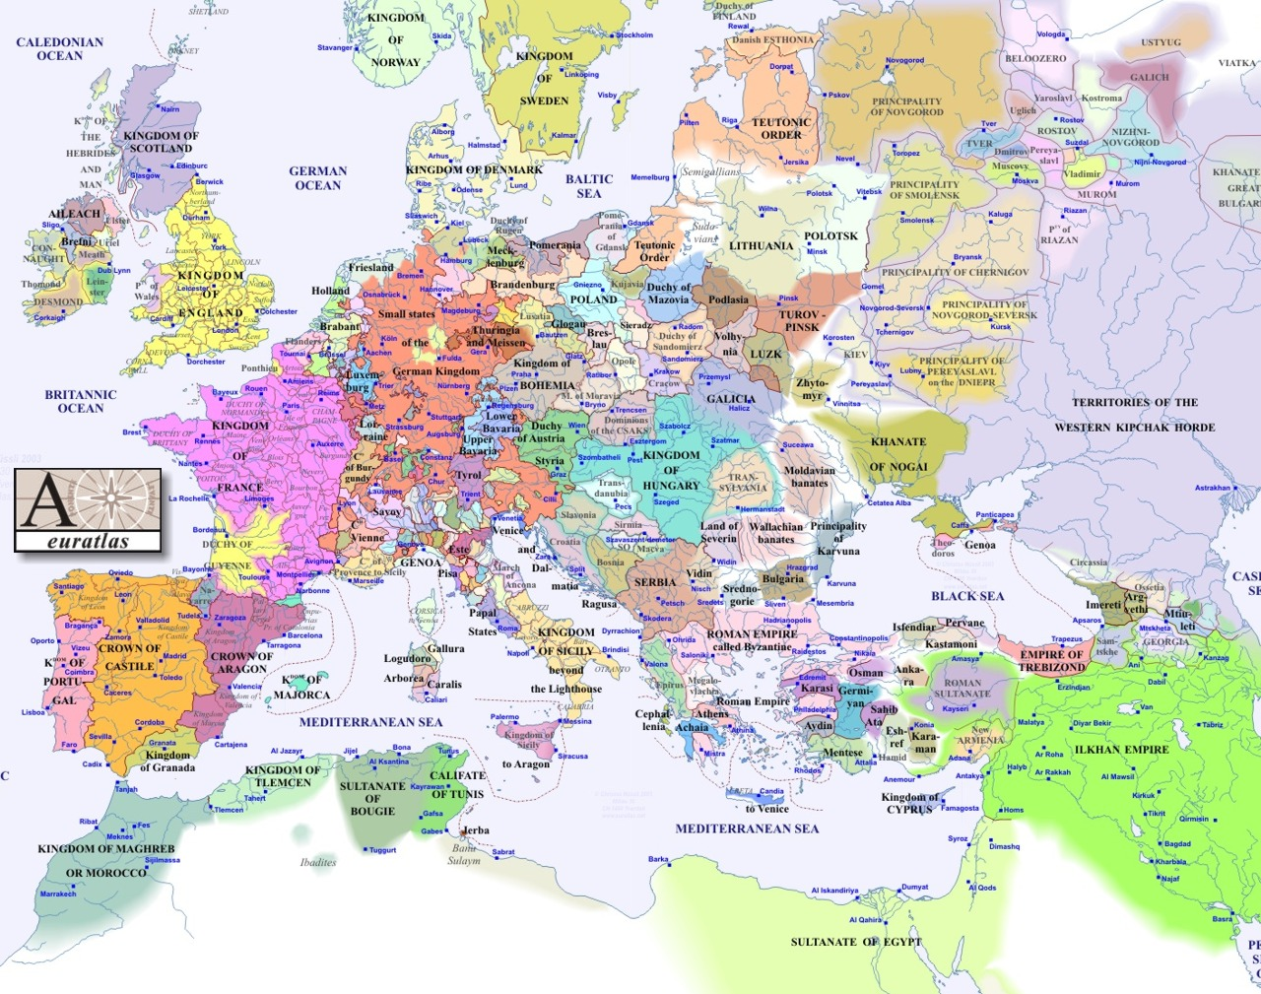
1300

Slide 9
Gathering of land of Rus - preconditions
Acquiring title of grand prince –originally Kyiv, then Vladimir, importance watered down by several rulers in the North acquiring this title
Ca 1271 Moscow becomes capital of Grand Principality of Vladimir
During Mongol rule: title was given by Khan – Rus’ prince had to travel to Golde Horde capital Sarai to get appointed by Khan, several executed.
Aleksandr Nevsky – 1236 Prince of Novgorod, since 1249 Grand Prince of Kyiv, since 1252 Grand Prince of Vladimir – fights against Sweden (15 July 1240 in Battle of the Neva) and Teutonic Knights (5 April 1242 in Battle on the Ice/Battle on Lake Peipus)– but always pays tributes to Golden Horde
Later Competition of Princes of Muscovy with Tver – also at Khan‘s court (Michael of Tver executed)
Muscovy eventually wins power struggle - with support of Khan. Tver is often allied with Lithuania from which not much help is forthcoming
Grand Prince Ivan Kalita (1325-1341) of Muscovy – tax collector for Khan – close connection and fulfilling Khan‘s demands precondition for rise of Moscow
Grand Prince Vasily II (1425-1462) starts with acquiring more and more territory of other princely families in North Eastern Rus’

Slide 10
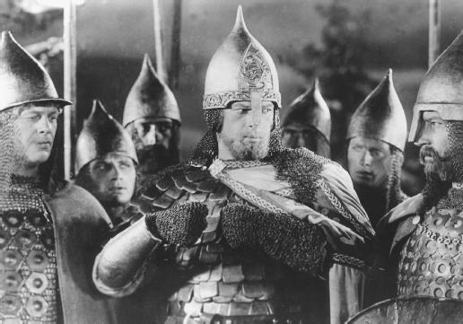
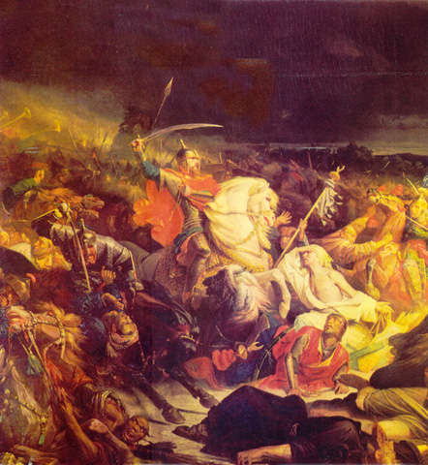
Aleksander Nevsky during the Battle of Lake Peipus or Battle on the Ice, 1242, scene from Alexander Nevsky by Sergei Eisenstein, 1938
Battle of Kulikovo, 1380, Painting 1850

Slide 11
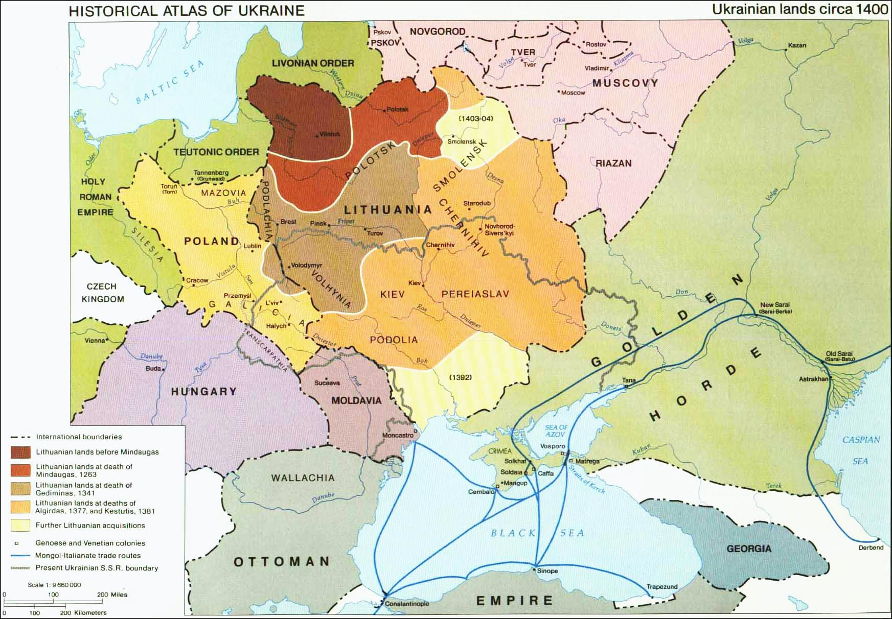

Slide 12
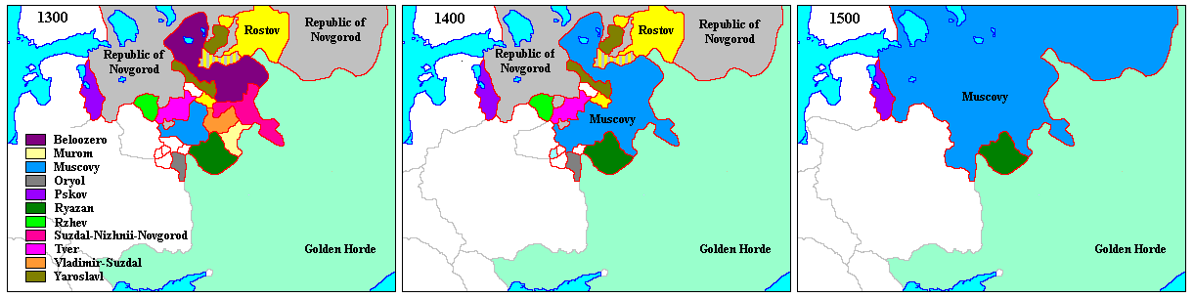
1380 | Dmitri Donskoi defeats Tatars, takes title Grand Prince of Muscovy but Rus princes continue to pay tribute to Golden Horde
1480 | Battle of the Ugra – Grand Prince Ivan III (the Great) of Muscovy against Akhmet Khan – ruler of the Golden Horde – who waited in vain for arrival of his Lithuanian Ally – end of Mongol dominance

Slide 13
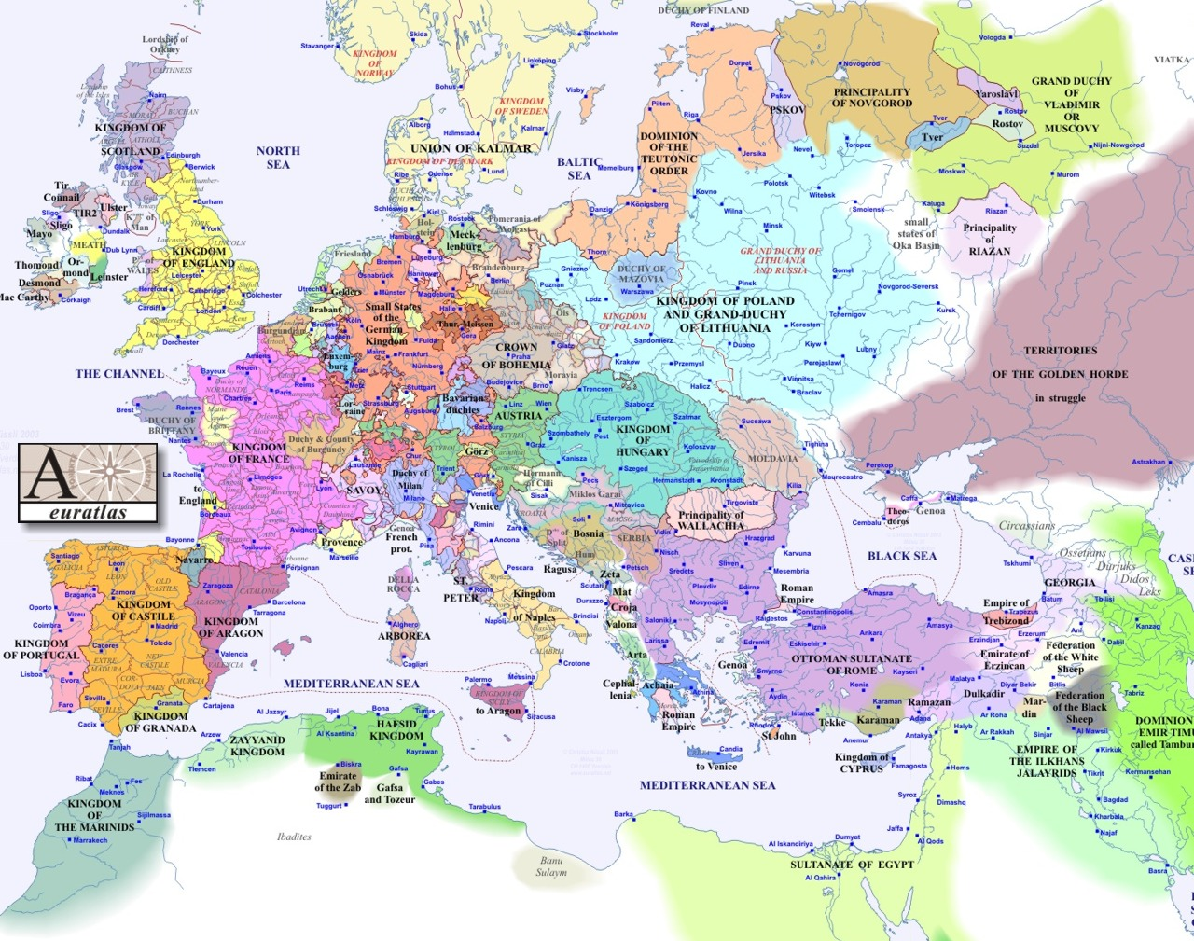
1400

Slide 14
The Rise of Muscovy – The Gathering of the Land of the Rus’
1425-1462 – Grand Prince Vasily II – annexes many small principalities in North-East – rulers of Muscovy often allied to Golden Horde while rival Tver and city republic of Novgorod allied to Lithuania
1462-1505 – Ivan III (the Great) begins annexing surrounding areas, conquers Republic of Novgorod (alternative model with self-administration), lays foundations of autocratic state
1505-1533 – Vasiliy III – acquires more land in North: Pskov, Rjazan, Novgorod-Seversky
Born 1533 - Died 1587 – Ivan IV (the Terrible) calls himself tsar (since 1547, before that only Khan and Byzantine Emperor called tsar), expands autocracy, begins annexation of Siberia, wars against Sweden and Poland, conquest of Tatar principalities Kazan and Astrachan

Slide 15
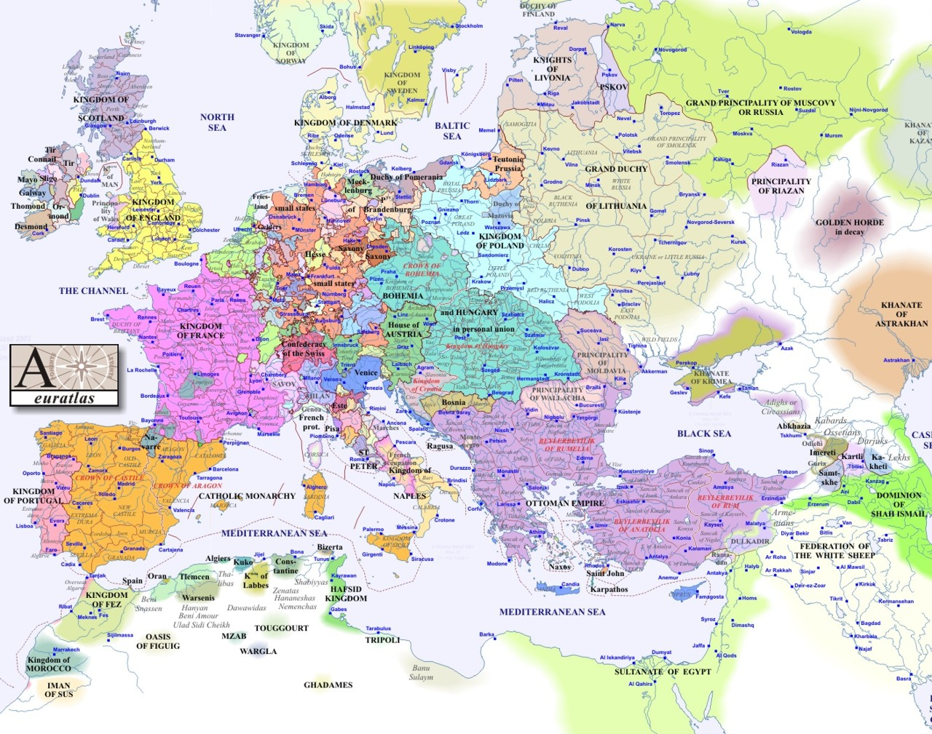
1500

Slide 16
Expansion: The Gathering of the Lands of the Golden Horde
After end of Mongol Empire and defeat of successors – power vacuum in the East, filled by tsardom of Muscovz
Conquest of Kazan and Astrakhan 1555
Conquest of Kazakh steppe
Colonization of Siberia
Subjugation of Central Asia

Slide 17
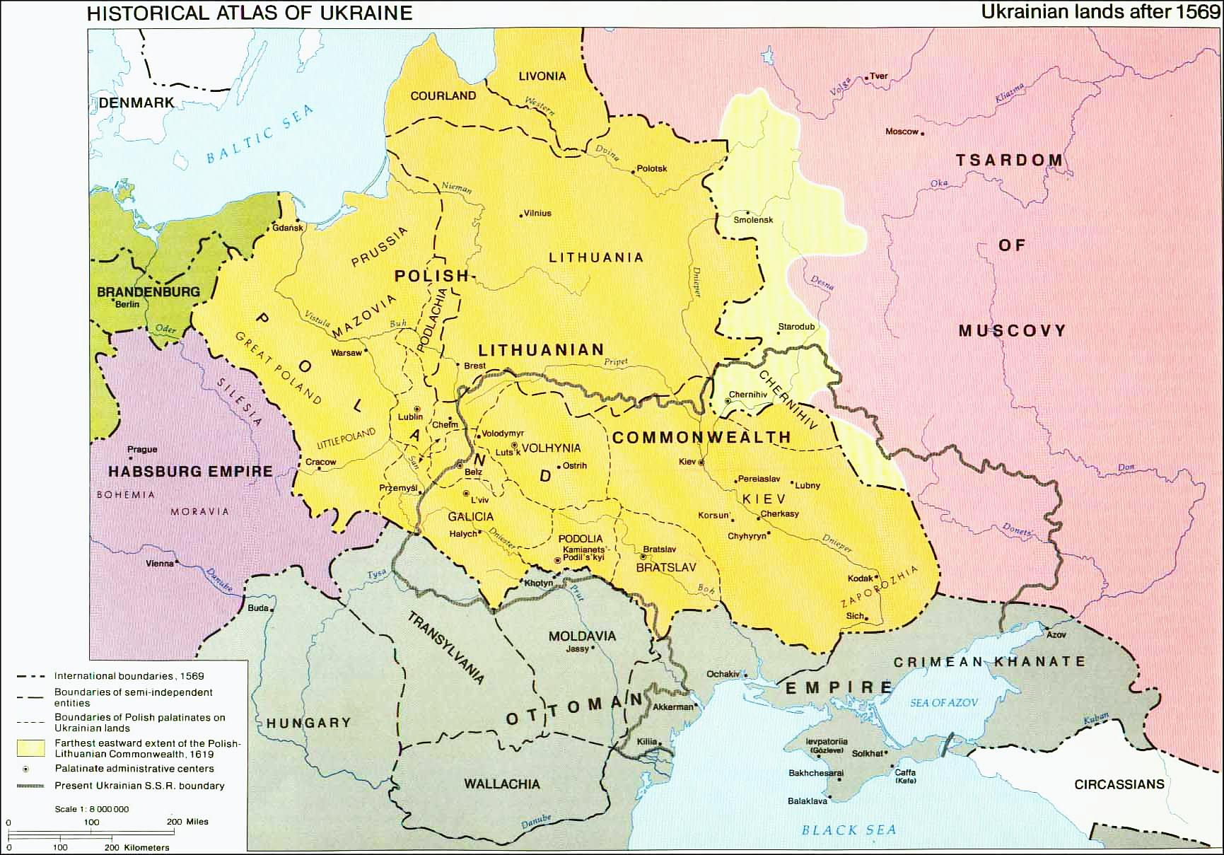

Slide 18
The rise of Muscovy
Nobility
Members of former princely families
Boyars
New service nobility
Boyars changing service – ancient right
Princes of Muscovy – happy to accept them, and then (increasingly since Ivan III) prevent boyars from leaving their service
Social structure
Merchants and artisans in towns + Kreml with men of prince
Peasants on state land / land of grand prince
Peasants on land of boyars and service nobility
Peasants on Church land
Different levels of servitude but more and more land (and peasants) come under control of nobility
Right of peasants to leave – more and more reduced – interest of nobility to prevent peasants from leaving
The acquisition of territory
Concept of votchina (patrimony)
Conquering land
Buying land
Acquiring by marriage
Acquiring by taking boyars in service
Votchina and land coming with title – grand prince – Vladimir
Muscovian rulers – expanding share of ‘votchina’ which could be passed on to heir
The growth of Muscovy
Northeastern and Northwestern principalities first target
Competition with Riazan and others, but especially Tver
Princely brothers, little brothers and older brothers
The Republic of Novgorod – an alternative path of Russian history
Seniorat - vs primogeniture – danger of fragmentation
Several rulers of Muscovy with only one surviving male heir

Slide 19
Autocracy
Greek origin: self-ruler (samoderzhets)
Form of government
Unlimited power held by one individual
Used by Byzantine Emperor
Transferred to or rather adopted by Grand prince/tsar of Muscovy – role of Orthodox Church/clergy
Measures:
Ivan IV: Oprichnina 1564 ff: persecution of old nobility with help of ‘oprichniki’ (from new service nobility)
Sack of Novgorod in 1570 under Ivan IV

Slide 20
Byzantine heritage – Orthodox faith – Translatio Imperii
1322 Moscow becomes seat of Metropolitan of Kyiv and All-Rus’ (appointed by Ecumenical Patriarch in Constantinople)
1439 Union of Florence between Greek and Latin Church
1448: Metropolitan Isidore supporting Union, arrested in Moscow after arrival – instead without patriarch’s approval Jonah appointed metropolitan of Muscovy – split from Kyiv and all Rus’ metropolitinate
1453 Fall of Constantinople: conquest by Ottoman Empire
Religious Orthodox leaders refer to Ivan III as ‘new Constantine’
1472 Ivan III of Muscovy marries Zoe, the niece of the last Byzantine emperor
1510 Monk Filofei from Pskov proclaims Moscow the Third Rome
Caution: does not seem to inform foreign policy of grand princes / tsars of Muscovy in this period
Expansion of Muscovy – but direction not driven by acquisition of territory of former Byzantine empire – rather gathering of land of Rus’
But – now Grand prince of Muscovy most powerful Orthodox ruler – growing into role and utilising idea of being protector of Orthodox believers – also outside of Muscovy
Close alliance between Russian Orthodox Church and Grand prince/Tsar
1589: Orthodox Church of Tsardom of Muscovy now fully independent from other Orthodox Churches: Patriarchate of the Russian Orthodox Church

Slide 21
Orthodox Church
Folk beliefs
White and Black Clergy
Proliferation of monasteries
Many churches built
Wealth of Orthodox Church
Subordinated to ruler
Flourishing culture – stories of saints in Church-Slavonic, icons, church buildings
Greek influence but developing (already since Kyiv times) into a separate Orthodox culture

Slide 22
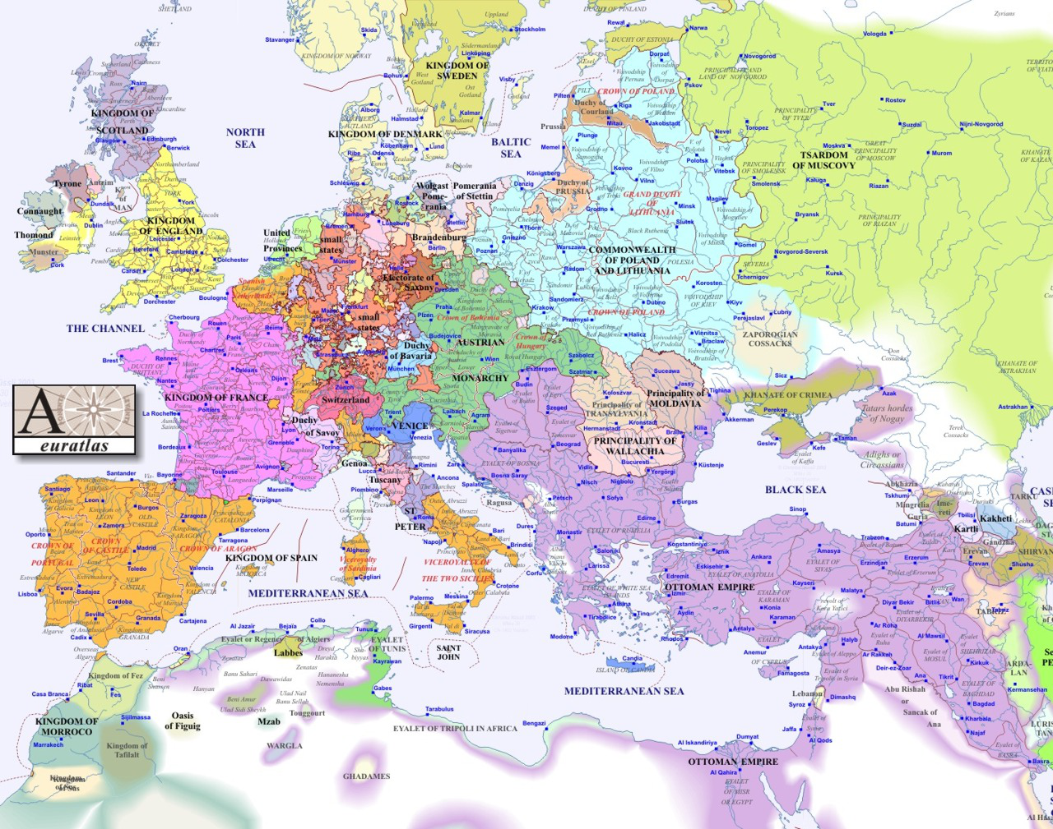
1600

Slide 23
Long game (retrospectively): Muscovy and Byzantium
After fall of Constantinople 1453 Muscovian princes see themselves increasingly as legitimate heirs of Orthodox emperor – not necessarily out of conviction but for prestige
17th – 19th centuries: several wars against Ottoman Empire
Access to the Black Sea
Conquest of Crimea
Caucasus and Transcaucasia with Orthodox Georgian nation
Russian Emperor: Protector of Orthodox population in Ottoman Empire

Slide 24
