Slide 1
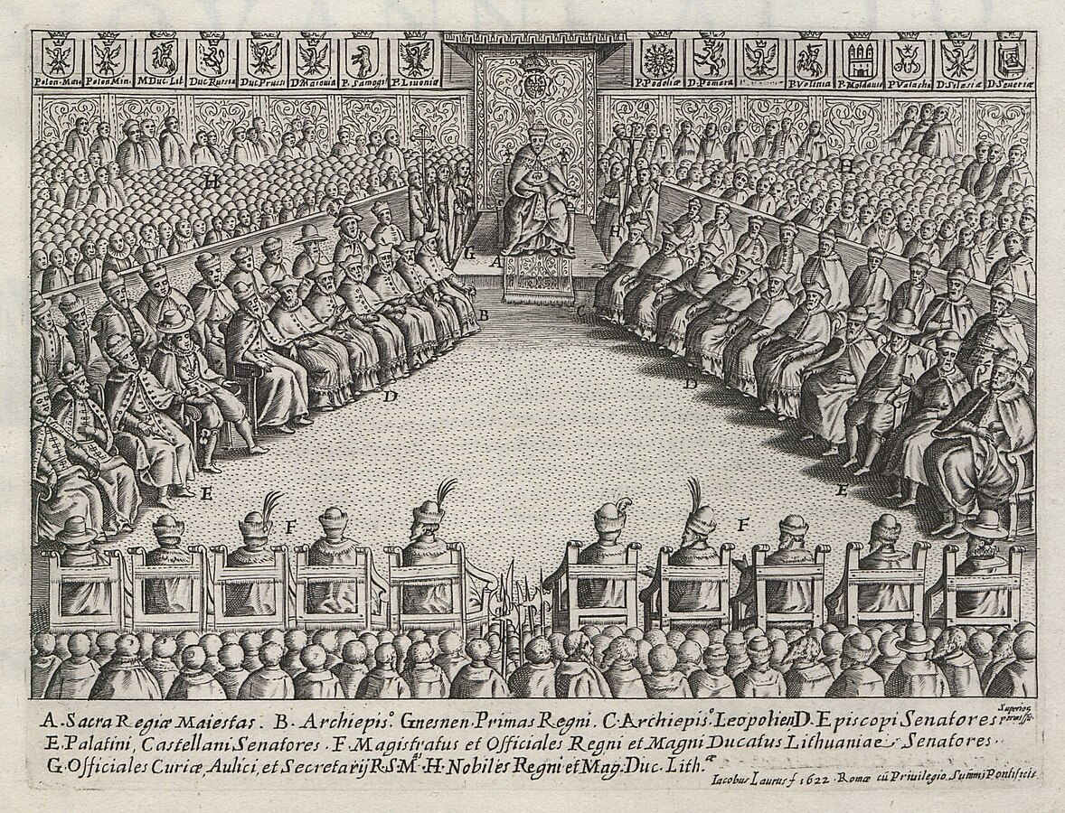
Entangled History: Ukraine and her neighbours from the Middle Ages to the present
Lecture 4, wk. 5
The Polish-Lithuanian Commonwealth

Slide 2
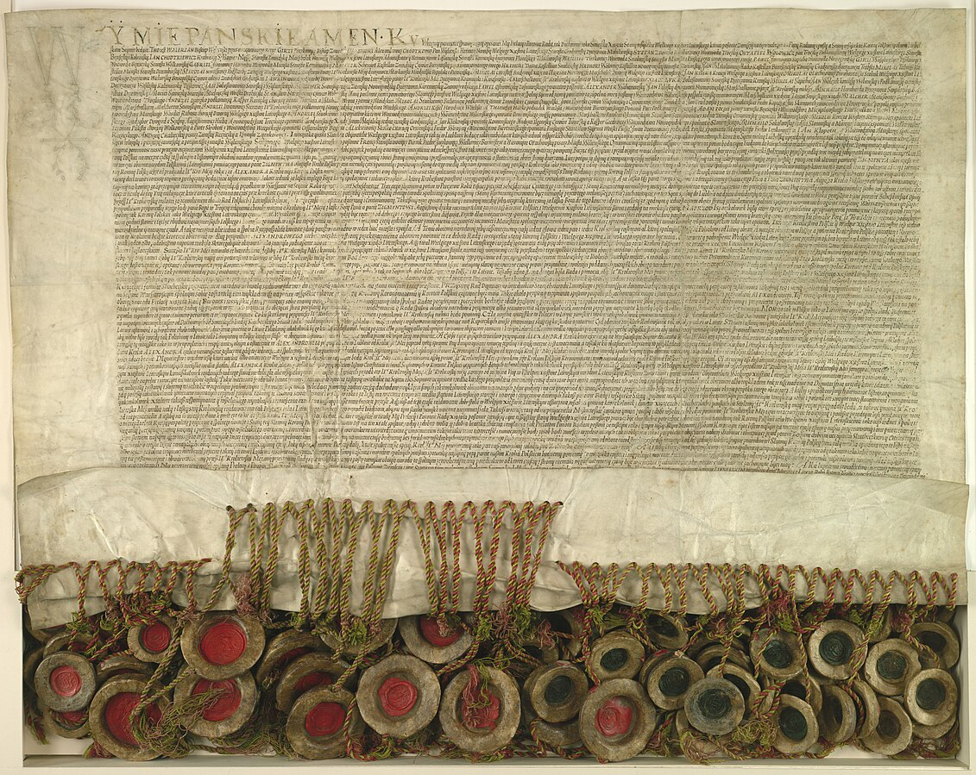
Outline
Introduction
The personal union between Poland and Lithuania
The conflict with the Teutonic Knights
(Polish-)Lithuanian-Muscovian fight for Rus‘
The Union of Lublin and the ‘Noble Republic‘
Polish troops in the Moscow Kremlin: the Time of Troubles

Slide 3
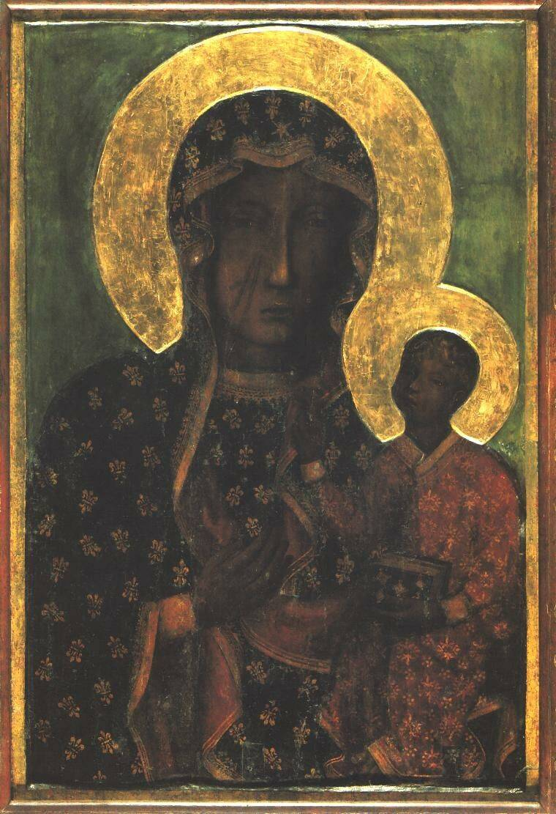
Poland
966 Mieszko I (Piast dynasty) was baptised – Latin Church
997 Bishop Adalbert (Wojciech) dies – first national saint Polands
1000 Act of Gniezno, Otto III and Bolesław the Brave
1025 Bolesław crowned as first Polish King
1050 Polish court to Cracow
1126 Mazovian Prince Conrad invited the Order of Teutonic Knights to Northern Poland
1241 Mongol invasion, stopped in Silesia

Slide 4
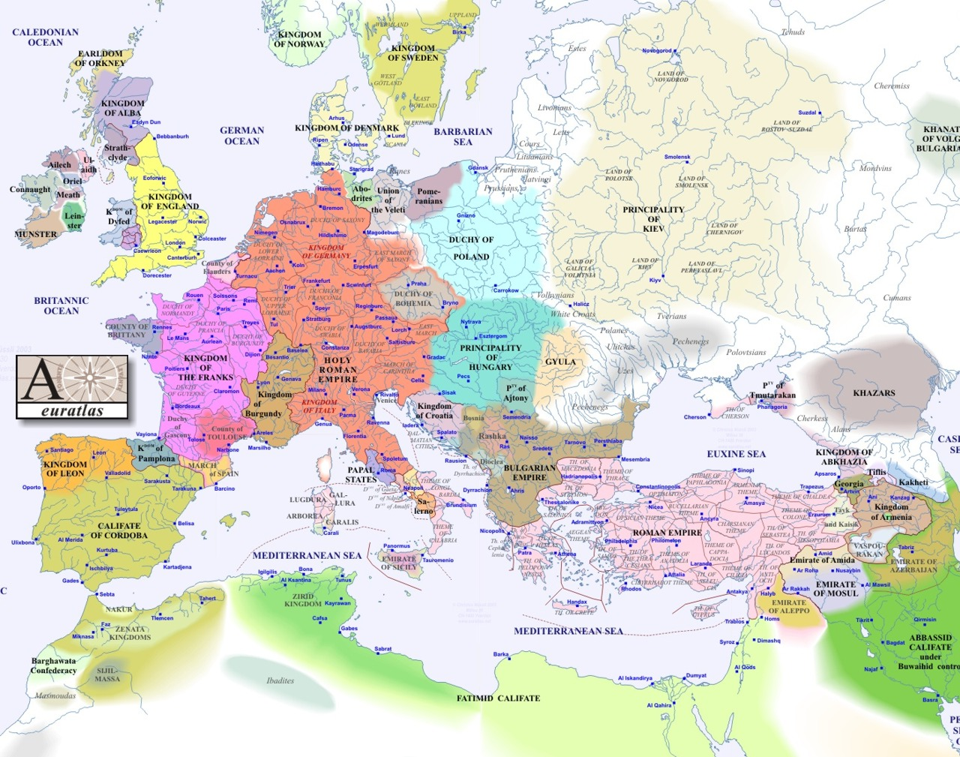
1000

Slide 5
Grand Duchy of Lithuania
Lithuanians: pagan (until 1386), Baltic tribe (princes/dukes and knights: war lords of Medieval Europe)
Expansion under Mindaugas (ruled 1238-1263) and Gediminas (ruled 1316-1341)
Gediminas formed alliances with Daniel of Halych-Volhynia against Mongols
Lithuanians managed after initial problems to push Mongols out of heartlands of Kyivan Rus’ – gaining prestige and extending rule over heartlands of Kyivan Rus
Most of Rus’ land around 1500 part of Lithuania and Poland (Red Ruthenia or Halych)
Elite: after territorial expansion - Lithuanian and Ruthenian (Rus’) knights and princes
Majority of population: Orthodox Ruthenians (Belarusians, Ukrainians)
Peasants: Ruthenians and Lithuanians
Court language: Court Slavonic

Slide 6
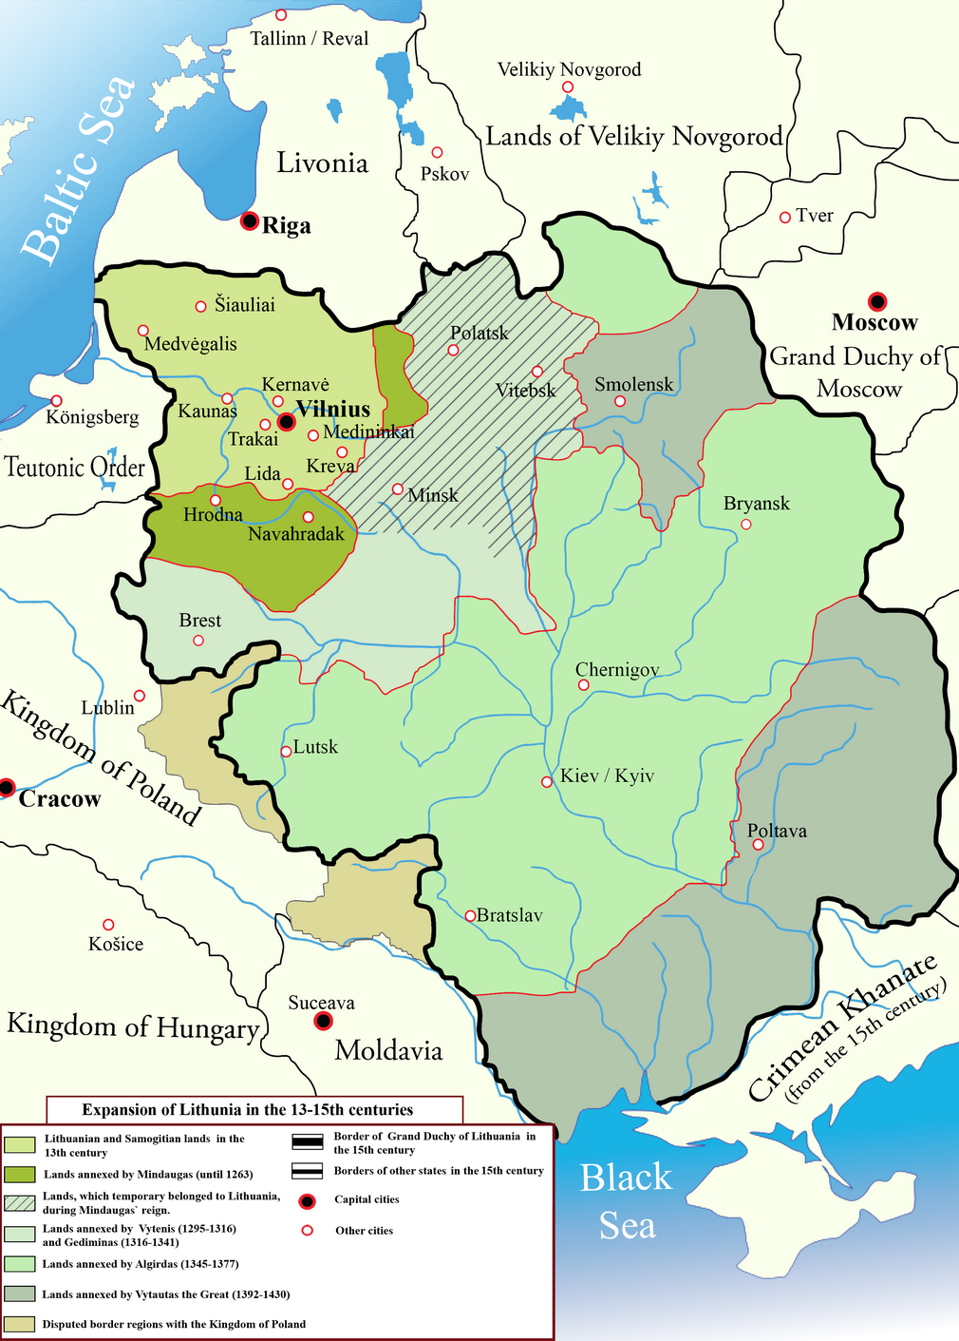
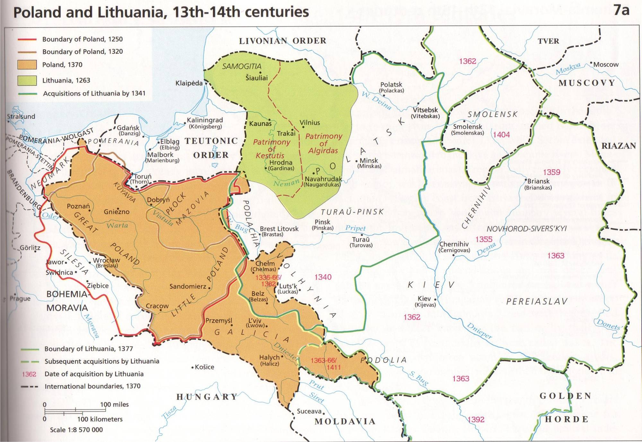
Lithuanian expansion 13-15th centuries

Slide 7
The beginning of the Polish-Lithuanian Union
Kazimierz (Casimir) IIII followed by nephew Louis of Hungary (Polish-Hungarian Union)
Louis has no male heir, one daughter gets Hungary, second daughter Jadwiga/Hedwig ‘King’ of Poland, selected by Council of Polish noblemen, bishops, senators. Concept of unity of Polish lands, belonging to ‘crown’. Separation of Polish lands from to ruler or dynasty, not their property (different development in Muscovy – everything becomes patrimony of tsar)
1386 Personal Union between Grand Duchy of Lithuania and Kingdom of Poland, Polish heiress Jadwiga marries (following the wish of the Polish notables) Grand duke Jogaila (Jagiełło) of Lithuania (followed by baptism of Lithuanians) – beginning of Jagiellonian dynasty
Lithuania ruled by Jogaila’s cousin Vytautas who had previously contested Jogaila’s rule and pursued a semi-independent foreign policy. Also, after Vytautas’ death – Lithuania has for a while separate grand dukes, but subordinated to Polish king
Union fragile and contested, renewed in several treaties
Questions: why in 1385/86 Christianisation of Lithuania by Latin Church and not Greek Church, why did Jogaila decide to go for a connection with Poland and not with Muscovy?

Slide 8
Conflict with Teutonic Knights
1226 Polish duke Konrad of Mazowsze (a Piast duke) invites the Military Order of the Teutonic Knights to fight against pagan Prussians (Baltic tribe). The Order was founded in 1190 in Acre – Crusader Kingdom of Jerusalem. After defeat of crusaders in ‘Holy Land’, order went to Transylvania, fighting against pagan Cumans, in 1225 kicked out by King Andreas of Hungary.
Konrad gives them land, Teutonic Knights establish towns and build castles, exercise control over large territory at Baltic coast. Part of a ‘crusade’, reinforcements with new knights coming from German lands and beyond
Conflicts with Polish dukes and kings about land and people, conflicts with pagan (later Christian) Lithuanian rulers
Also, long periods of peace with Poland
1410 Battle of Grunwald (in German history: Tannenberg), Polish-Lithuanian-Ruthenian troops defeat Teutonic Order
1466 Treaty of Toruń between Poland and Teutonic Order, Gdańsk to Poland, Polish control of West Prussia
1525 following the Reformation Teutonic Order was secularized and became vassal of Polish crown
Teutonic knights vilified in Polish, Russian, and Soviet historiography ‘German Drang nach Osten’
More balanced approach in last 20, 30 years in Poland

Slide 9
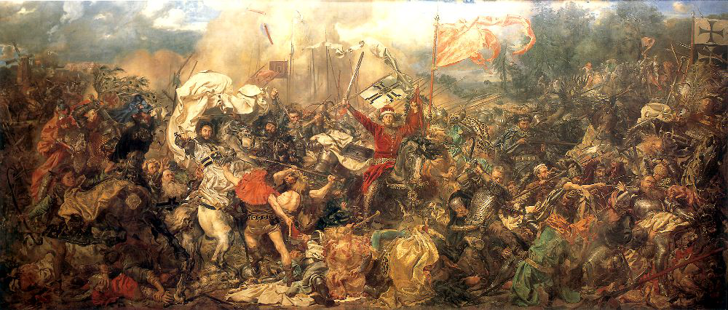
The Battle of Grunwald 1410, (Jan Matejko, 1878)
Notes:
9

Slide 10
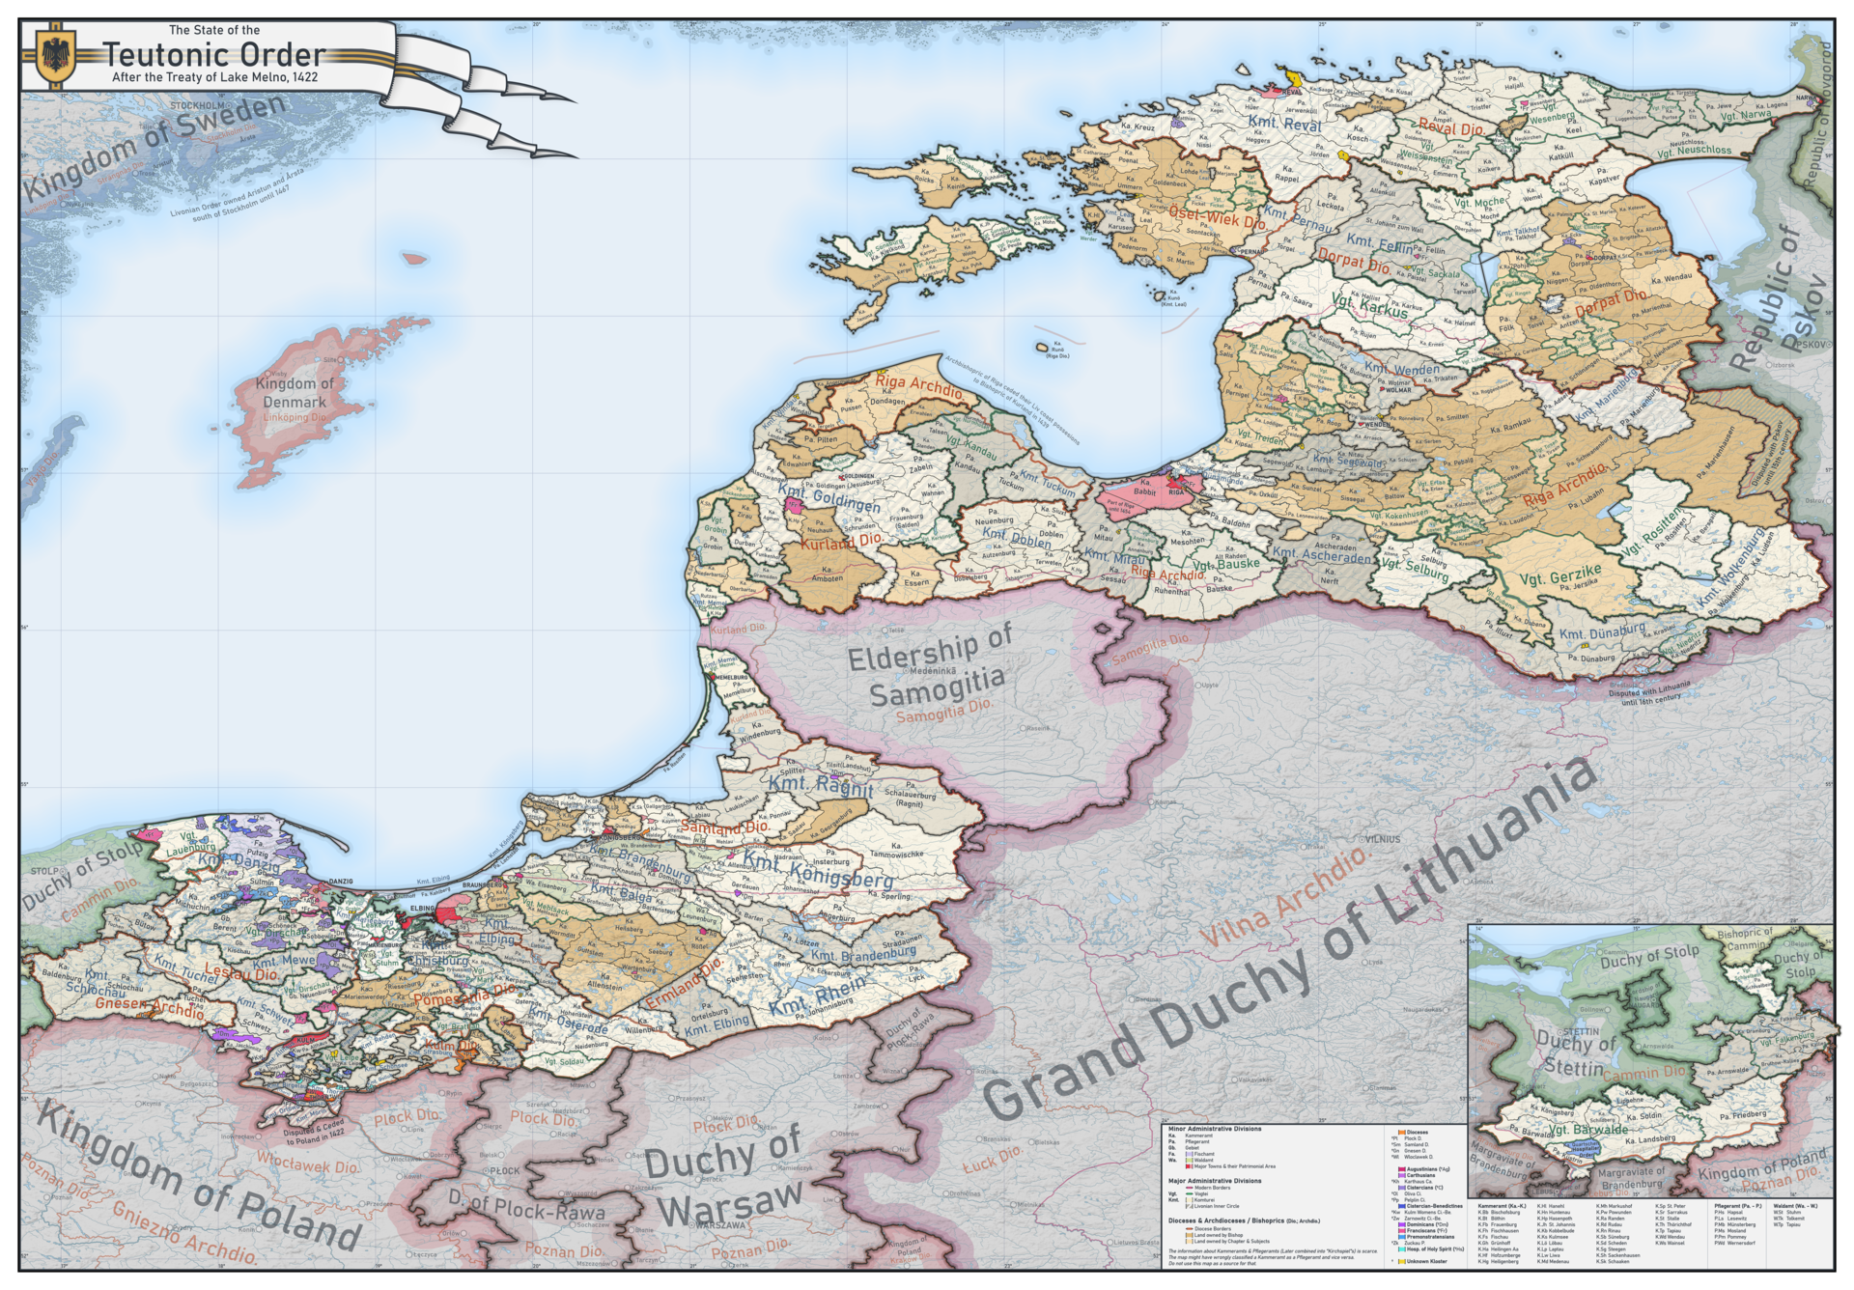
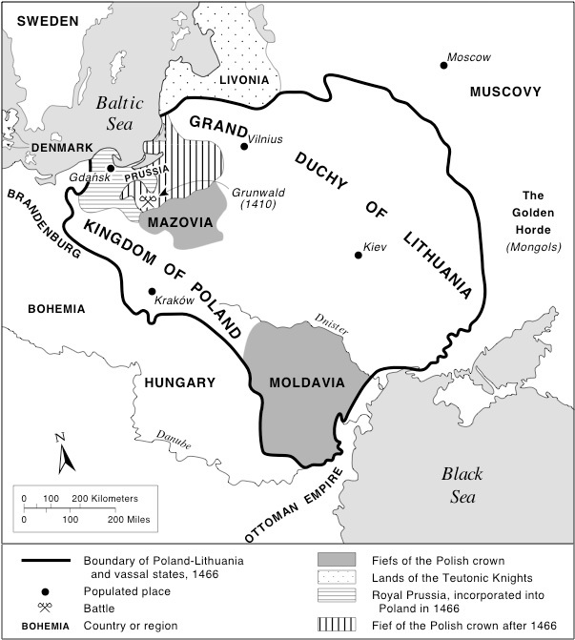
Territory controlled by the Teutonic Knights in 1422

Slide 11
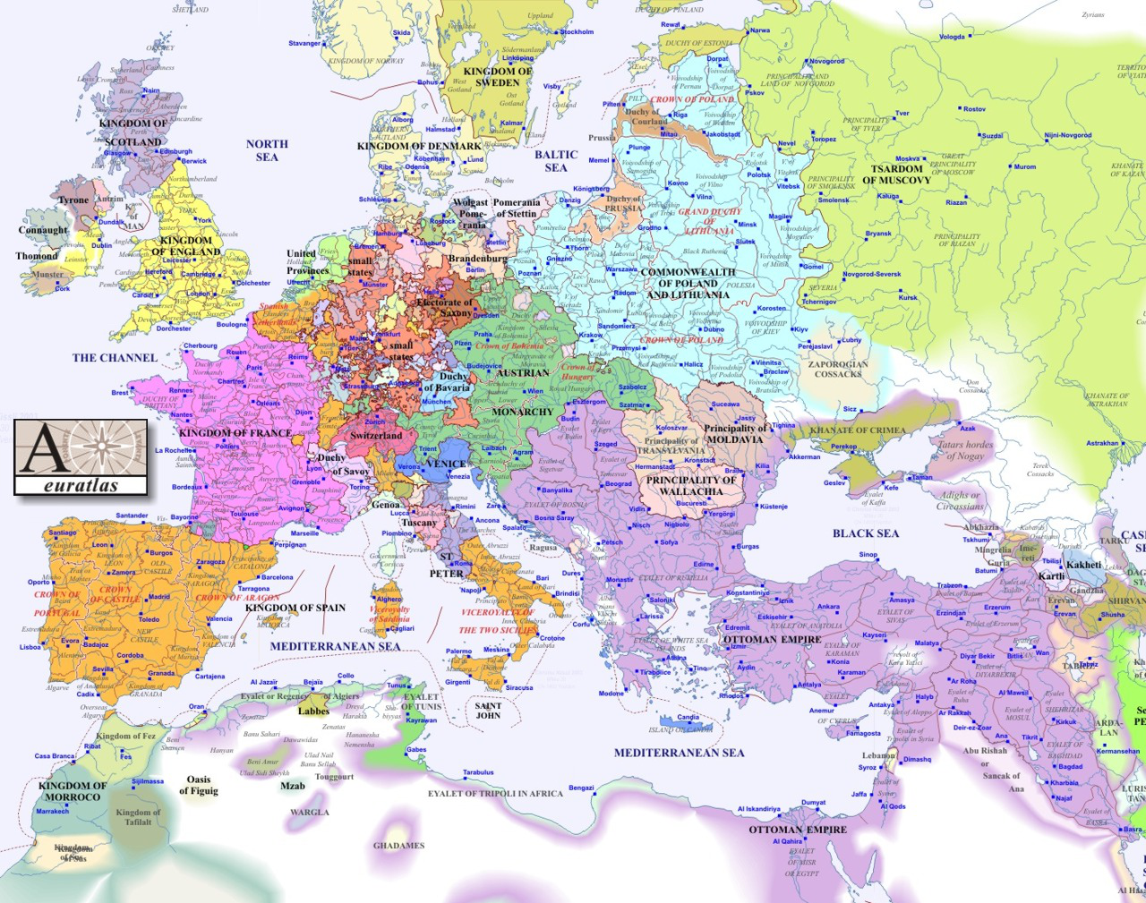
1600

Slide 12
The fight for the land of the Rus‘: Muscovite-Lithuanian wars
Both – grand dukes of Lithuania and grand princes of Muscovy (since Ivan III increasingly) called themselves ruler of all-Rus’
1368-1372, 1375, 1394 mostly Lithuanian successes
1487-1494 First war (Ivan III), many Rus’ boyars switch allegiance to Ivan, some territorial gains for Muscovy
1500-1503 Second war (Ivan III) Grand Duchy of Lithuania lost 1/3 of territory, mostly part of today‘s Russia
1507-1508 Third War (Vasily III), allied with leader of Orthodox rebellion (not supported by majority of Orthodox in Lithuania) famous Polish-Lithuanian victory in Battle of Orsha
1512-1522 Fourth War (Muscovites capture and keep Smolensk)
1534-1537 Fifth War (Ivan IV)
1547-1581 Livonian war (interrupted by several truces) – unsuccessful for Ivan who had to concede Polatsk and Livonia but no other former Rus’ territories

Slide 13
Ruthenian lands (former heartland of Kyivan Rus’) after the Polish-Lithuanian Union
Lithuanian court continues to have Court-Slavonic as language of administration
Attraction of Polish culture for Orthodox noblemen
Attraction of privileges/rights of Polish noblemen
Education – Polish
Books – Polish
Catholic Church – Polish
Royal court – Polish and at court of grand duke strong Polish influence
Polonisation of considerable part of Orthodox, Ruthenian elite
Cities/towns multiethnic, strong German presence, but also Armenians, Jews, Moldavians, Wallachians, Greeks, Tatars
Jews – protection by crown: Persecuted in Europe – find refuge in Poland
Polonisation of elites accelerates after Union of Lublin in 1569

Slide 14
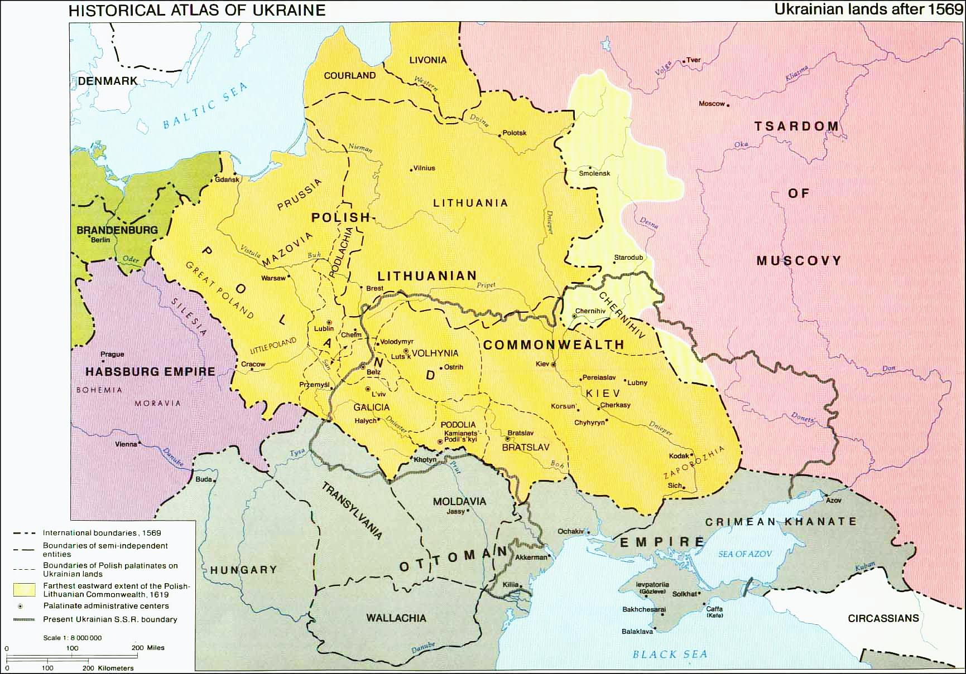

Slide 15
Orthodox and Uniate Church: Muscovy
1299 Metropolitan for Kyiv and All-Rus’ moves from Kyiv to Vladimir
1325 Metropolitan for Kyiv and All-Rus’ moves from Vladimir to Moscow
1441 Metropolitan Isidore brings news about Union of Florence to Moscow, rejected by Grand Prince Vasily II
1448 Ionah installed by council of Orthodox Bishops in Moscow as Metropolitan for Kyiv and All-Rus’ (without consent of Patriarch of Constantinople – still for Union)
1484 Patriarch Simeon of Constantinople repudiates Union of Florence
1589 recognised by Ecumenical Patriarch of Constantinople, 1592 by Council of Patriarchs, Iob becomes first Patriarch of Moscow

Slide 16
Orthodox and Uniate Church: Poland-Lithuania before Brest
1303 and 1317 additional metropolis approved by Byzantine Emperor: for Halych and for Lithuania
1439 Union of Florence (Greek and Latin Churches), Promoting Union in interest of Polish and Lithuanian rulers
Since 1441 no generally recognised Metropolitan for Kyiv and All-Rus – dominance of supporters of Union, Isidore (released from Moscow) operates as Cardinal of Latin Church
1458 Metropolitinate of Kyiv and All-Rus installed (under jurisdiction of Patriarchate of Constantinople), united with Lithuanian metropolitinate, at first Uniate, then after end of Union Orthodox (after 1481/84, continued to be linked to Patriarch of Constantinople)
Reformation and Counter-Reformation (led by Jesuits): Often Orthodox noblemen become Protestant (Calvinist), then during counter-reformation Roman-Catholics

Slide 17
Orthodox and Uniate Church: Poland-Lithuania after Brest
1586 Union of Brest (limited to part of Orthodox Church in Poland-Lithuania), metropolitan of Kyiv joins Union, is until 1620 Uniate metropolitan, residing in Kyiv
Split: Union supported by many bishops and Ruthenian noblemen, against: Cossacks, parish priests, monasteries
1620 Orthodox Metropolitinate of Kyiv restored (under jurisdiction of Patriarch of Constantinople)
Uniate (later Greek-Catholic) and Orthodox Church coexist - one Uniate (until 1805) and one Orthodox metropolitan residing in Kyiv
1686 Metropolitinate of Kyiv and All-Rus‘ in Kyiv (provisionally) transferred (by Patriarch of Constantinople) to jurisdiction of Patriarchate of Muscovy, contested by today‘s autocephalous Ukrainian Orthodox Church
1300-1600 Orthodoxy tolerated but also at times discriminated against, Loyalty of most Orthodox princes and boyars to Lithuania and then Polish-Lithuanian Commonwealth, relatively few defections, also Orthodox boyars princes and boyars sometimes switch loyalty from Muscovy to Lithuania

Slide 18
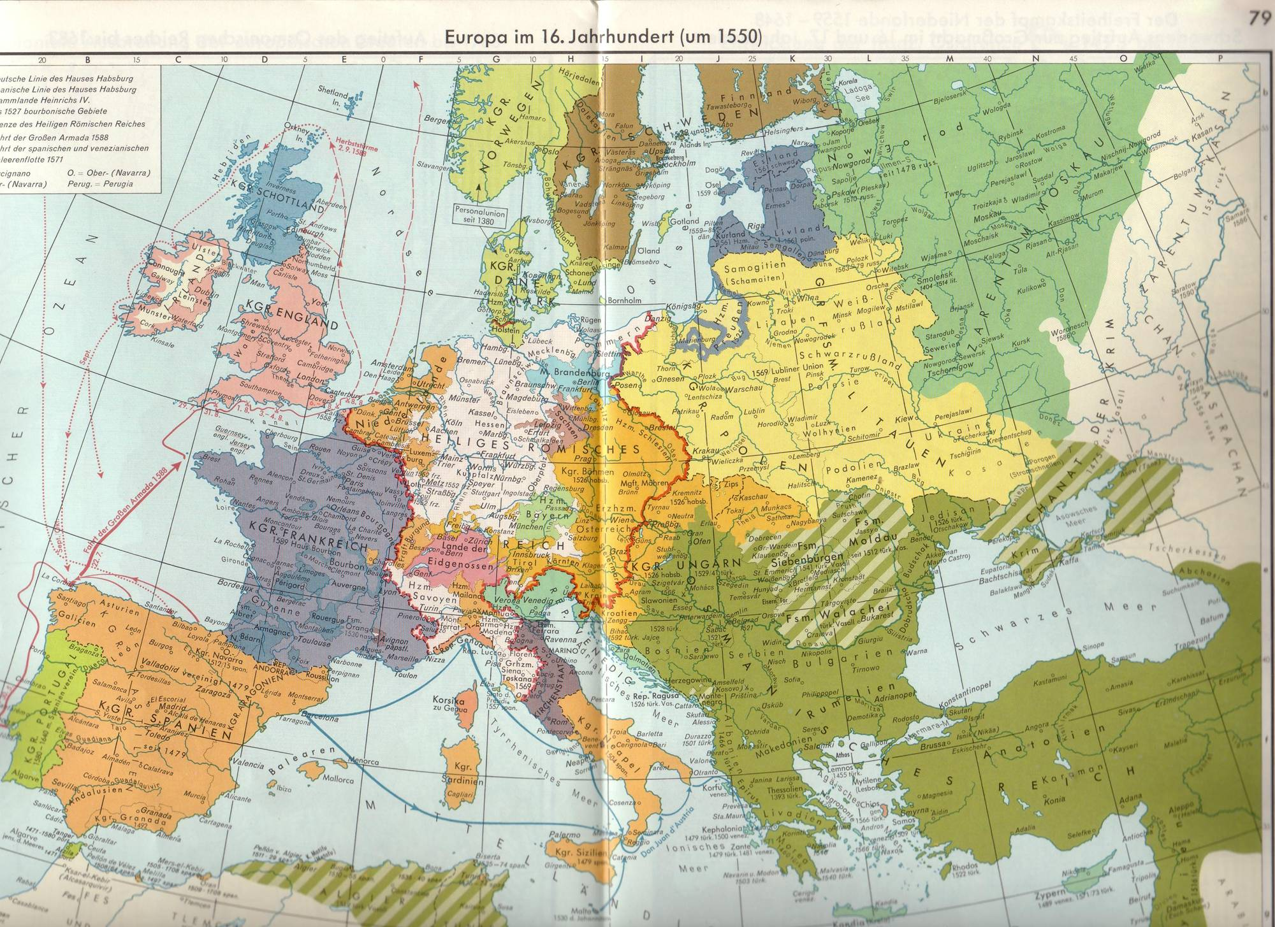

Slide 19
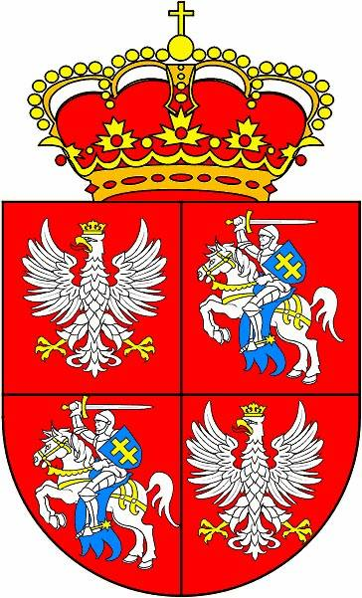
Union of Lublin 1569
United Kingdom of Poland and Grand Duchy/Principality of Lithuania in one single state – the Polish-Lithuanian Commonwealth
The monarch (King of Poland and Grand Prince of Lithuania) was elected by the Polish and Lithuanian nobility and crowned in Cracow
Common Parliament (Sejm)
Common Foreign Policy and Currency
But separate administrations, judicial systems, finances, armies
Territorial: Volhynia and Podolia transferred from Grand Duchy of Lithuania to Kingdom of Poland – wish of Ruthenian princes/knights – against will of Lithuanian elite
With Lithuania stay what becomes Belarus – under Polish crown territories which become Ukraine

Slide 20
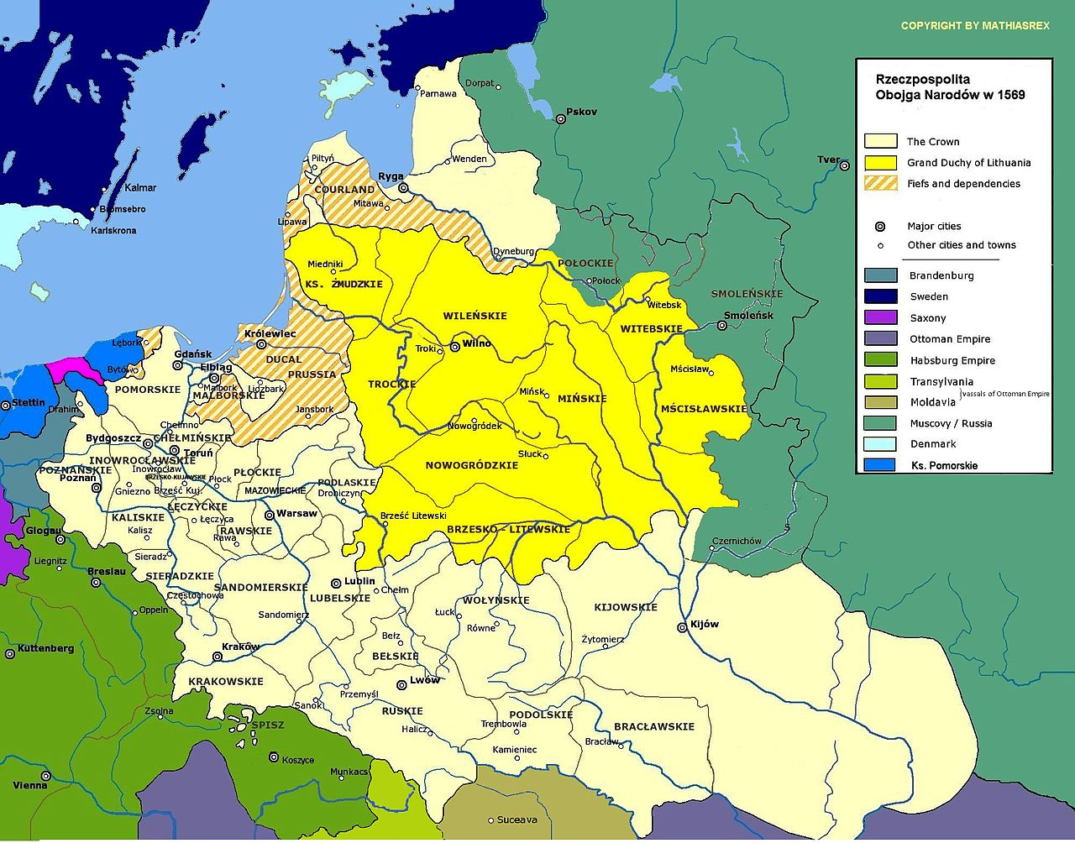
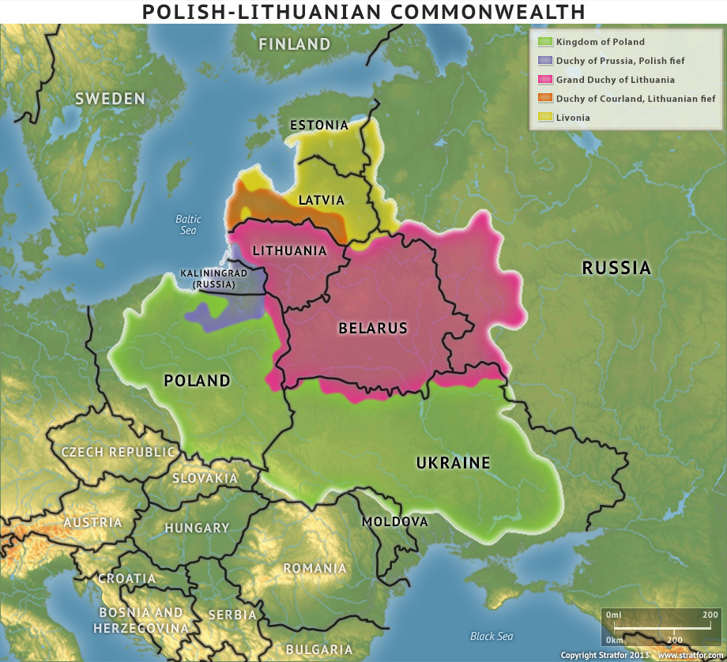
1569
With today’s border

Slide 21
Polish kings and queens, 1386 – 1696
1386-1434 Jadwiga (1384-1399) and Władysław II Jagiełło
1434-1444 Władysław III
1447-1492 Kazimierz IV Jagiellończyk
1492-1501 Jan I Olbracht
1501-1506 Aleksander Jagiellończyk
1506-1548 Zygmunt I Stary
1548-1572 Zygmunt II August (last male monarch of Jagiellonian dynasty))
1573-1575 Henry Valois (French)
1575-1587 Anna Jagiellonka and Stefan Batory (1576-1586), also King of Hungary
1587-1632 Zygmunt III Wasa (Swedish Wasa dynasty)
1632-1648 Władysław IV Wasa
1648-1668 Jan II Kazimierz (last Wasa)
1669-1673 Michał Korybut (Polish magnate)
1i674-1696 Jan III Sobieski (Polish magnate)

Slide 22
Prerogatives of the King (ca. 1600)
Commands the Army
Calls the banns of the nobility together, but needs the approval of the Sejm
Is not responsible to the Sejm, but has to obey the Articuli Henriciani and the Pacta Conventa
Supreme power off sessions of the Sejm
Appoints ambassadors, but his right to give them directives is restricted
Appoints high officials and commanders of the Army, but cannot easily dismiss them
Appoints bishops
Controls crownland and can give land as a feud to noblemen
The Noble Republic

Slide 23
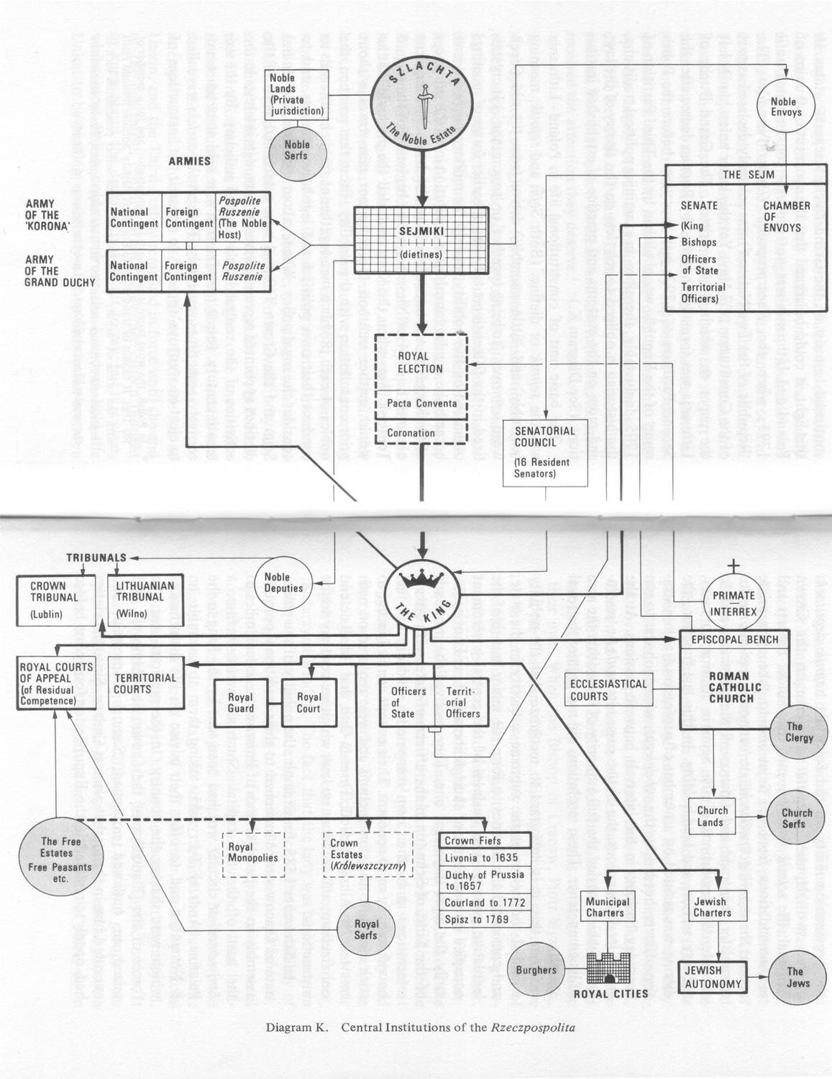
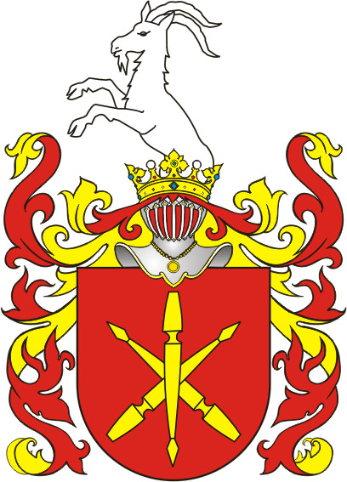
From: Norman Davies: God‘s Playground. A History of Poland. Vol 1. New York 1982
Wappen „Jelita“

Slide 24
Liberum Veto
Right of Resistance
Nihil Novi
Confederation
Zerrissener Reichstag
Liberum Veto (Latin "free veto") was a parliamentary device in the Polish-Lithuanian commonwealth that allowed any deputy of the Sejm to force an immediate end to the current session and nullify all legislation already passed during the session. The first time used in 1652.
If the king violates ‚natural law‘, the Articuli Henriciani or the Pacta Conventa (de non praestanda-obedienta) give the nobility the right to organise military resistance against the king
‚Nothing about us without us‘ 1505, conceded by King Alexander
An alliance of noblemen, to act for national interests but also to act for particular interests, the King can be part of such a confederation
Parliament, which finishes a session period without having made any decisions, without a law having passed – because of use of Liberum Veto

Slide 25
An old Latin proverb proclaimed that the Polish Commonwealth was "heaven for the nobles, purgatory for the townsfolk, hell for the peasants, and paradise for the Jews."
Noblemen – political nation – elect representatives to diets and parliament (Sejm) – but differentiation – wealthy magnates and poor noblemen (economically not much better than free peasants), noblemen as clients of magnates, some of richest: Ruthenian noblemen (Orthodox or converted to Catholicism)
Towns – some self-administration but not represented in Sejm
Peasants – especially those on large estates, increased pressure, manorial courts, bound to land, serfdom – also introduced in Ukrainian lands transferred to the Polish crown in 1569 (intensification of exploitation of - Ruthenian/Ukrainian peasantry)
Money by grain trade via Baltic Sea
Jews – having found refuge, protection by crown, self-administration but also violence against them, often from townspeople (competition)

Slide 26
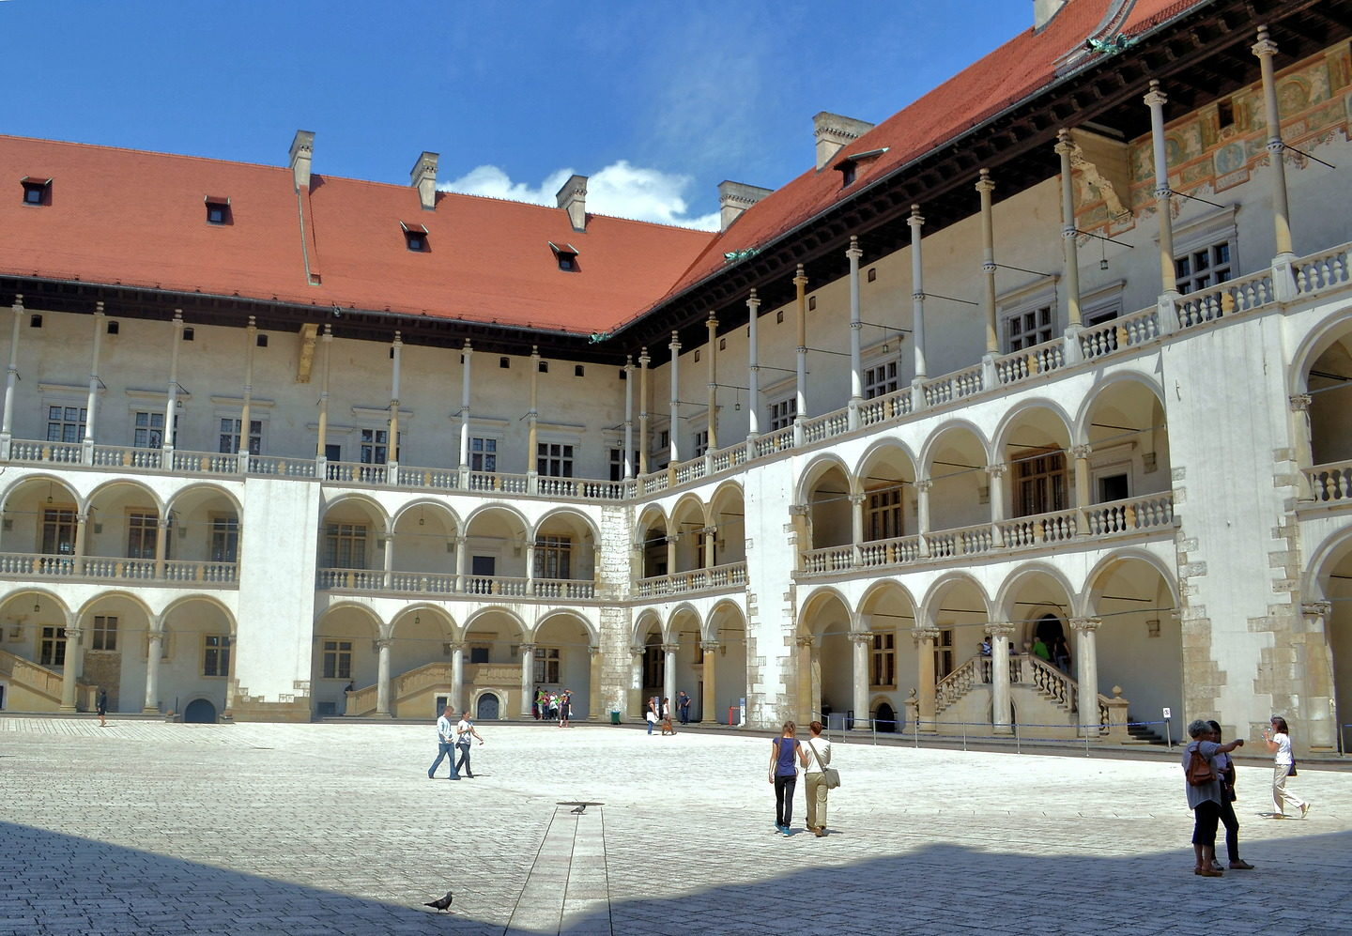
Renaissance in Poland
Bona Sforza – by marriage with Zygmunt I Stary – Queen of Poland and Grand Duchess of Lithuania
Italian influences: architects, painters, buildings in Renaissance style
Reformation and counter-Reformation, influence of Jesuits, foundation of theological academies, from training also profit Orthodox clergymen
Poland-Lithuania is up to the partitions an integral part of European political system
Polish becomes literary language and language of administration
Golden Age (only in Poish historiography) 1573-1648
Via Poland – all these influences come to Lithuania and Ruthenian lands
University of Cracow, founded in 1364
Astronomer Copernicus in Toruń/Thorn
Polish, Lithuanian, Ruthenian noblemen studying in Italy, Germany, France
Wawel, Cracow, Italian courtyard

Slide 27
Time of Troubles, 1586-1613
1581 Ivan IV (the Terrible) kills heir and son Ivan
1584 Death of Ivan IV, succeeded by other son Fedor, but country effectively ruled by F.‘s father-in-law Boris Godunov
1591 Death of Ivan IV youngest son Dimitry (slit either his own throat or was murdered)
1598 Death of tsar Fedor without heir, Boris Godunov (who is not a descendant of Rurik) wins power struggle and becomes tsar
1601-1603 Famine, previously permanent wars have ruined country
1603 False Dimitry I turns up, supported by Polish nobles
1605 tsar Boris Godunov dies, False Dimitry I crowned, becomes Catholic, marries Catholic, supported by Polish noblemen, leads to rebellion
May 1607 False Dimitry I killed by mob, Vasily Shuyski (a Rurikide boyar) supported by one faction becomes tsar
July 1607 False Dimitry II turns up, supported by some boyars and Poles, murdered in 1610 by a Tatar nobleman he previously had flogged
September 1609 King Zygmunt III Wasa invades Muscovy
1610-1612 Moscow occupied by Polish-Lithuanian troops and German mercenaries, Boyars force Shuysky to become monk, Zygmunt and son Władysław, both have intentions to become tsar, 1611 also appearance of False Dimitry III
1611-1613 Popular uprising, led by Boyars and townspeople (merchant Minin and boyar Pozharsky) against Catholic Polish rule, 1612 Poles forced to leave Moscow Kremlin
1613 Boyar Zemski Sobor elect Mikhail Romanov from Kostroma (son of metropolitan, later patriarch Filaret, a Rurikid) tsar

Slide 28
1600

