Slide 1

Entangled History: Ukraine and her neighbours from the Middle Ages to the present
Lecture 1, wk. 2
Entangled or colonised? How to write a history of Ukraine.

Slide 2
Outline
Introduction
Recent context
How (not) to write Ukrainian history
Challenges
A thousand years in maps

Slide 3
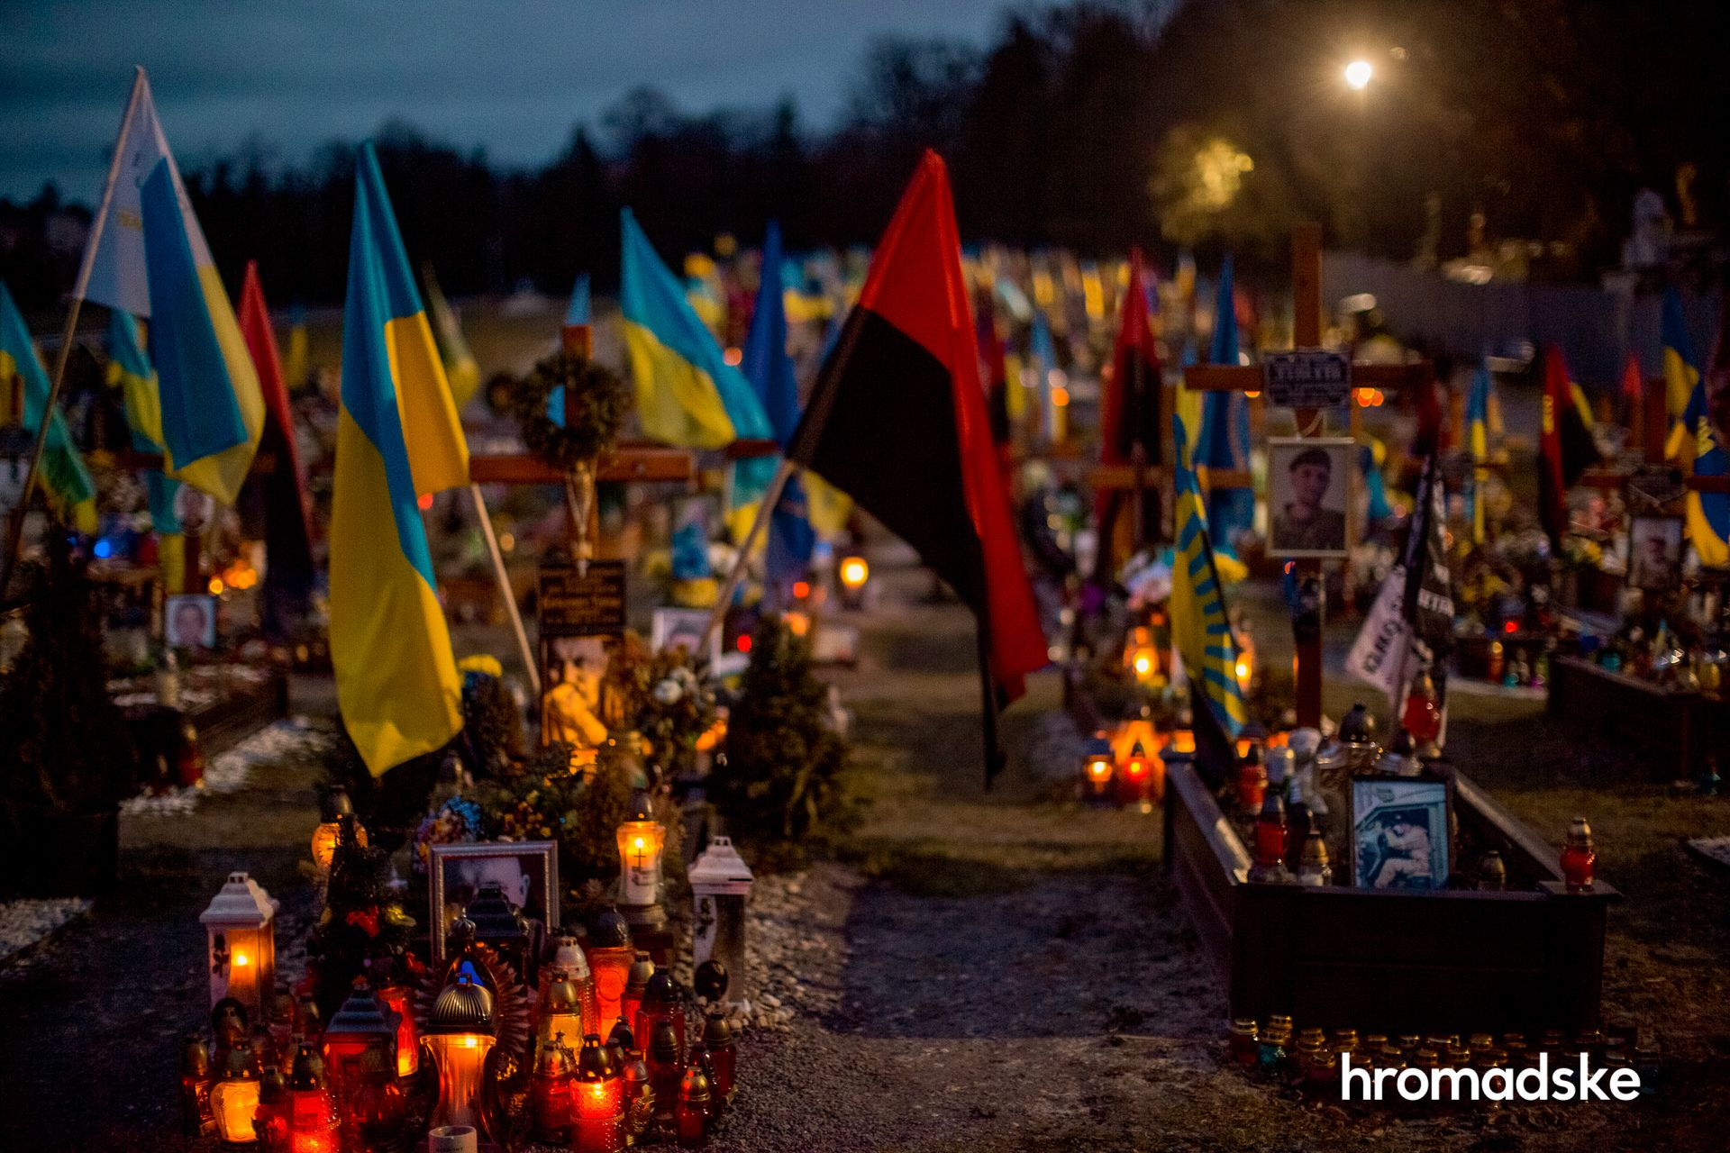
2. Recent context
Declaration of independence of Ukraine on 24 August 1991 and dissolution of Soviet Union on 31 December 1991
Orange Revolution in Autumn 2004
Revolution of Dignity or Euromaidan November 2013
Ukraine moving out of Russian orbit
War in Ukraine since 2014, Russian annexation of Crimea, proxy war in Donetsk und Luhansk
24 February 2022 full-scale Russian invasion of Ukraine
Putin‘s use of history (as he understands it) to legitimise attack on Ukraine and Russia‘s land grab
Genocidal dimension of war: kidnapping children, destroying or appropriating Ukrainian cultural heritage, denying the existence of the Ukrainian nation by denying that Ukraine has a history outside of the framework provided by the Russian narrative, or a future outside of the ‚Russian World‘

Slide 4
3. How (not) to write Ukrainian history
Does Ukraine have a history? Question asked by Mark von Hagen in 1995 (Slavic Review) followed by debate
How to write the history of Ukraine? State, territory, people
Nationalism, imperialism and national and imperial narratives: writing history from the perspective of the nation state or empire
Decolonising Ukrainian history (meaning no longer looking at it through a Russian – or Polish – lense)
Dominance of Russian narrative (including in Western academia): Russian view shaped Western (or rather global) view of Ukraine and its history
Historians of Russia are criticised for reproducing Russian colonialist/imperialist attitudes to Ukraine and Ukrainians
Un-learning, overcoming biases, developing new concepts and taking a fresh view at the history of Ukraine and its neighbours and at times imperial masters: Lithuania, Poland, Polish-Lithuanian Commonwealth, Muscovy/Russia.

Slide 5
To keep in mind
Having a unique shared national language can be decisive for nation building (especially of non-dominant nations/ethnic groups) but is not conditio-sine-qua-non.
Look at the British Isles: Welsh language important for Welsh identity but non-conformism and rich cultural heritage and medieval Welsh history at least as important: Welsh, Irish, Scottish identity not dependent on speaking Welsh, Irish or Scottish Gaelic, many Welsh, Irish, Scottish are English nativespeakers) – seee Russian speaking Ukrainians

Slide 6
4. Challenges I
De-colonizing Ukrainian history: Russia/Russians and Poland/Poles as colonizers, Ukraine/Ukrainians as colonized or subalterns
Does decolonisation necessarily mean to replace the Russian imperial/national narrative by a Ukrainian national narrative?
Tasks:
to understand historical events, acteurs and actions within the context of their time (a classic Rankean approach)
to understand Ukrainian history (as any other history) as entangled
to understand how the regions which constitute today‘s Ukraine influenced and were influenced by neighbouring political and cultural centres
Module will therefore also be on Poland, Russia, Lithuania and touch on Bulgaria, the East-Roman (Byzantine) Empire, the Ottoman Empire and others

Slide 7
Challenges II
Language and terminology matter: Київ (Kyiv/Kyjiv), Киев (Kiev), or Kijów. Lemberg, L‘viv/Lviv, Lwów, Lvov. ‘The Ukraine‘ or ‘Ukraine‘
Ukrainian or Russian: Appropriation of Ukrainian culture. Calling Ukrainian poets, writers, artists etc. Russian: Gogol‘ or Hohol‘
The lasting influence of Pushkin and Tolstoevsky‘ (Tolstoy and Dostoevsky) of our views of everything east of Poland
Who knows Hryhory Skovoroda? Taras Shevchenko? Ivan Franko? Lesia Ukrajinka? Oksana Zabushko? Yurii Andrukhovych?
You might know the names of Russian tsars, but do you know Bohdan Khmel‘nytskyi or Mykhailo Hrushevs‘kyi or Simon Petliura or King Danylo of Halych-Volhynia. You might have heard of Stepan Bandera.
This is also partly valid for Poland: Can you name a Polish writer? It might be easier for you to name a Polish composer. You certainly can name a Russian composer. But do you know the name of a Ukrainian composer?

Slide 8
Schedule
 | Weeks | Lectures | Seminars
1 | 2 | Entangled or colonised? How to write a history of Ukraine? | What is a nation? Modern nations and their history
2 | 3 | Stories of origin: the Kyivan Rus | Language, religion, and geography
3 | 4 | The ‘Mongol yoke’ and the rise of Muscovy | Autocracy and ‘Third Rome’
4 | 5 | The Polish-Lithuanian Commonwealth | The Union of Lublin and the ascendancy of Polish culture
5 | 7 | The fight for the ‘land of the Rus’ | The Cossack Hetmanate and the ‘Kyivan Renaissance’
6 | 8 | Becoming an empire: Russia’s long 18th century | From the Great Northern War to the partitions of Poland
7 | 9 | Russia’s mission | Thinking about Russia: From the Enlightenment to Panslavism
8 | 10 | Poland’s struggle | Thinking about Poland: From Sarmatism to Warsaw positivism
9 | 11 | Ukraine’s self-discovery | Thinking about Ukraine: From Kotliarevsky to Hrushevsky
10 | 12 | Peasants into …: How the national message was spread | National literature, music, and art
11 | 13 | National boundaries and hybrid identities | The ‘Jewish question’ and other questions
12 | 14 | The Great War: Hopes, aims, and expectations | Playing the national card: the self-destruction of empires
13 | 15 | The Russian and the Ukrainian Revolution | From the Treaty of Brest-Litovsk to the Treaty of Riga
14 | 17 | Nation building Soviet style | Affirmative action and genocide
15 | 18 | Poland and her minorities | Polish and Ukrainian nationalism
16 | 19 | Bloodlands I: Soviet rule | Sovietisation, Katyn, and the prison murders
17 | 20 | Bloodlands II: German rule | Pogroms, Holocaust, and Volhynian massacres
18 | 21 | From Soviet to independent Ukraine | Resistance, Russification, and disentanglement
19 | 22 | Trials, tribulations, and choices: Ukraine and her neighbours after the fall of the Soviet Union | The shadows of the past: the use and misuse of history
20 | 23 | The Russian war against Ukraine | Current situation and perspectives

Slide 9
Lord’s prayer in Russian
Отче наш
Отче наш, Иже еси на небесех!
Да святится имя Твое,
да приидет Царствие Твое,
да будет воля Твоя,
яко на небеси и на земли.
Хлеб наш насущный даждь нам днесь;
и остави нам долги наша,
якоже и мы оставляем должником нашим;
и не введи нас во искушение,
но избави нас от лукаваго.
Аминь.
Lord’s prayer in Ukrainian
Отче наш
Отче наш, Ти що єси на небесах,
нехай святится ім'я Твоє,
нехай прийде царство Твоє,
нехай буде воля Твоя,
як на небі, так і на землі.
Хліб наш насущний, дай нам, днесь,
і прости нам довги наші,
як і ми прощаємо довжникам нашим
і не введи нас у спокусу,
а ізбави нас від лукавого.
Амінь.
Lord’s prayer in Polish
Ojcze Nasz
Ojcze nasz, któryś jest w niebie
święć się imię Twoje;
przyjdź królestwo Twoje;
bądź wola Twoja jako w niebie tak i na ziemi;
chleba naszego powszedniego daj nam dzisiaj;
i odpuść nam nasze winy, jako i my odpuszczamy naszym winowajcom;
i nie wódź nas na pokuszenie;
ale nas zbaw od złego.
Amen
Lord’s prayer in Lithuanian
Tėve Mūsų
Tėve Mūsų, kuris esi danguje!
Teesie šventas tavo vardas,
teateinie tàvo karalystė
Teesie tàvo valià, kaip danguje, taip ir žemėje.
Kasdienes mūsų dúonos dúok mùms šiañdien
ir atlèisk mums mūsų kaltès,
kaip ir mes atleidžiame sàvo kaltiniñkams.
Ir neléisk mūsų gùndyti,
Bet gelbėk mus nuo pikto.
Amen.
How does Yiddish sound like?

Slide 10
Outline
Introduction
Recent context
How (not) to write Ukrainian history
Challenges
A thousand years in maps

Slide 11
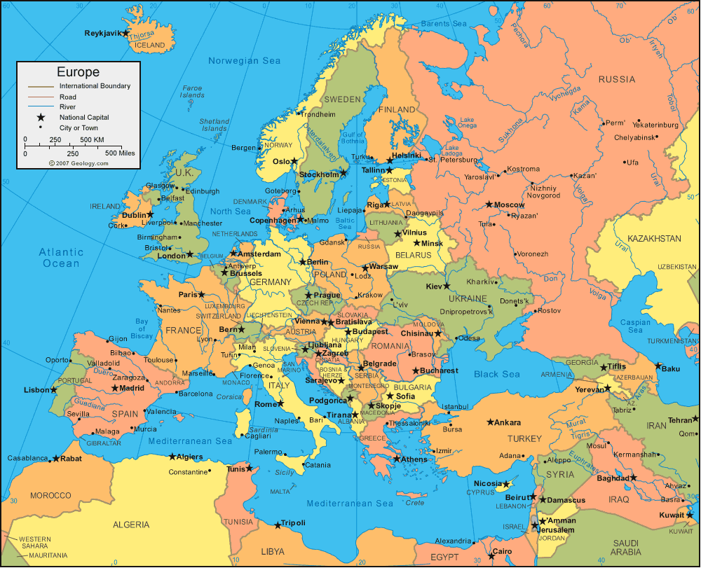
Europe 2012

Slide 12
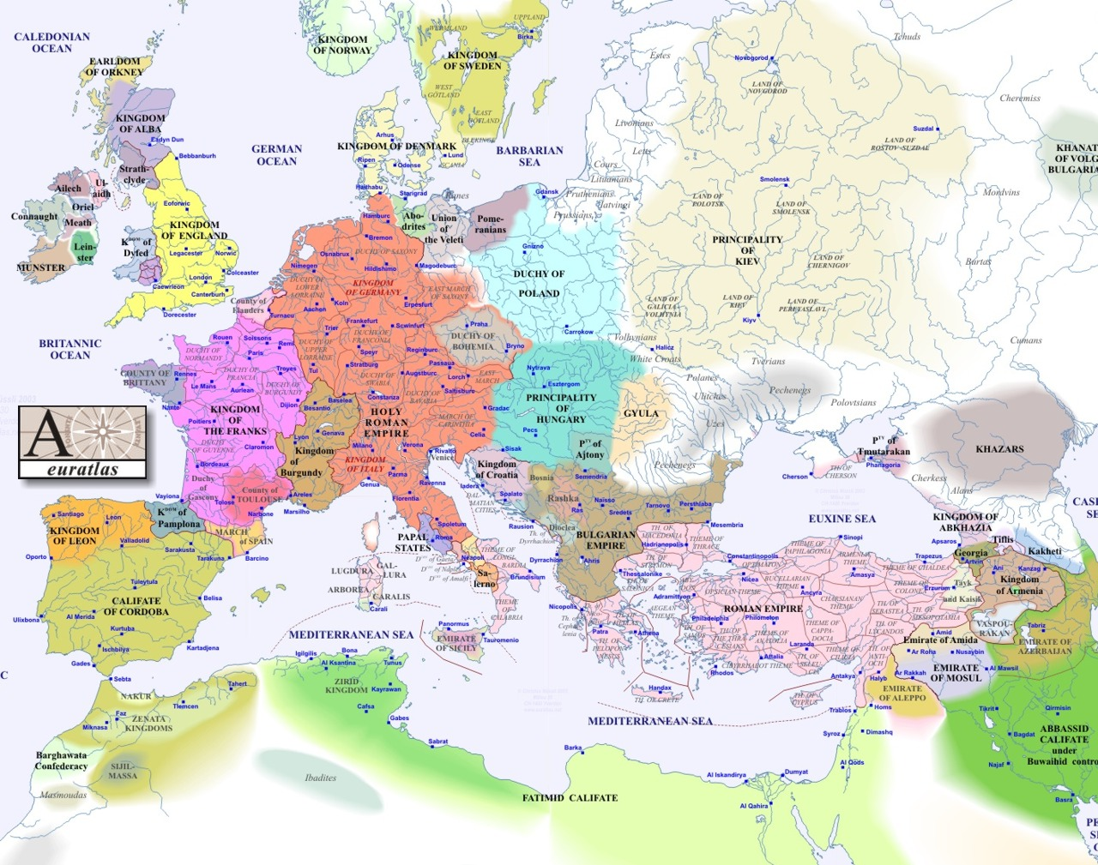
1000

Slide 13
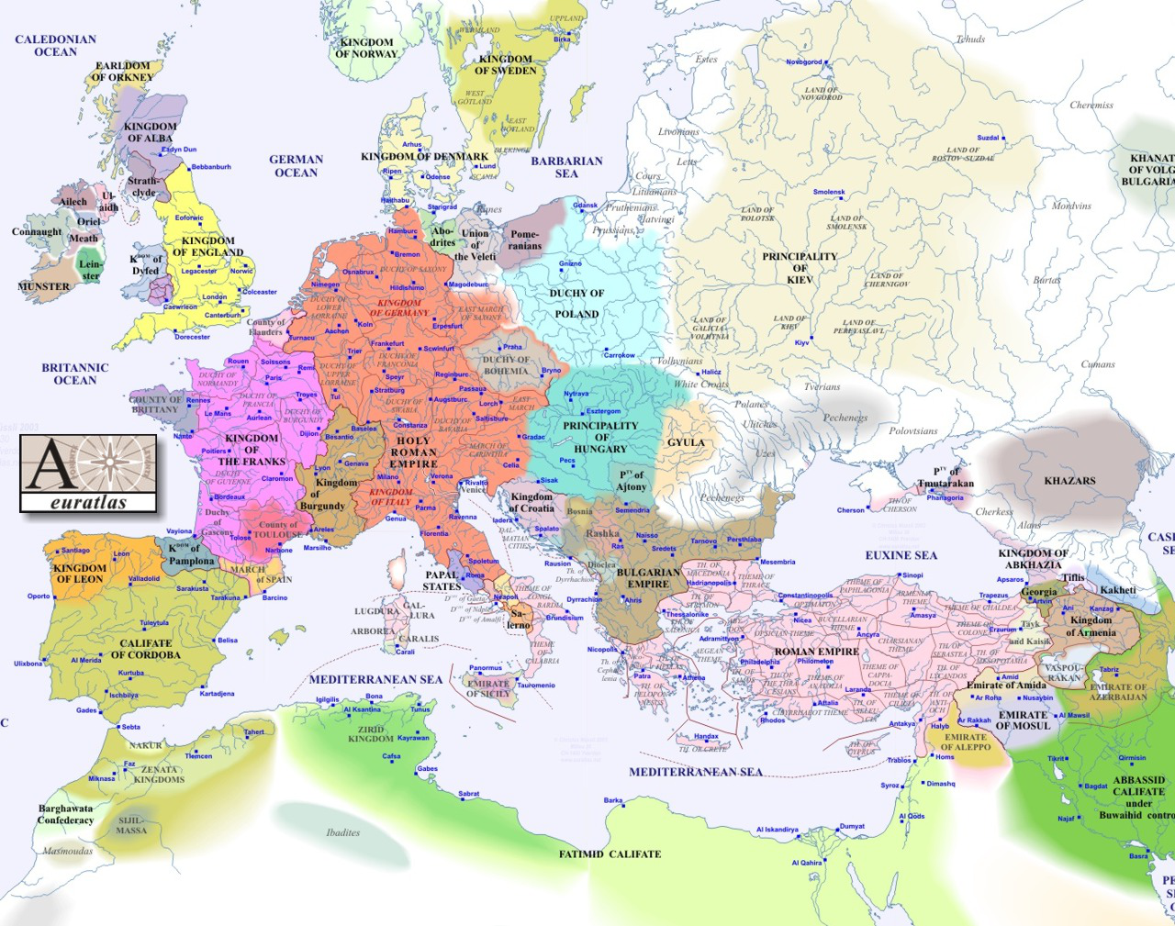
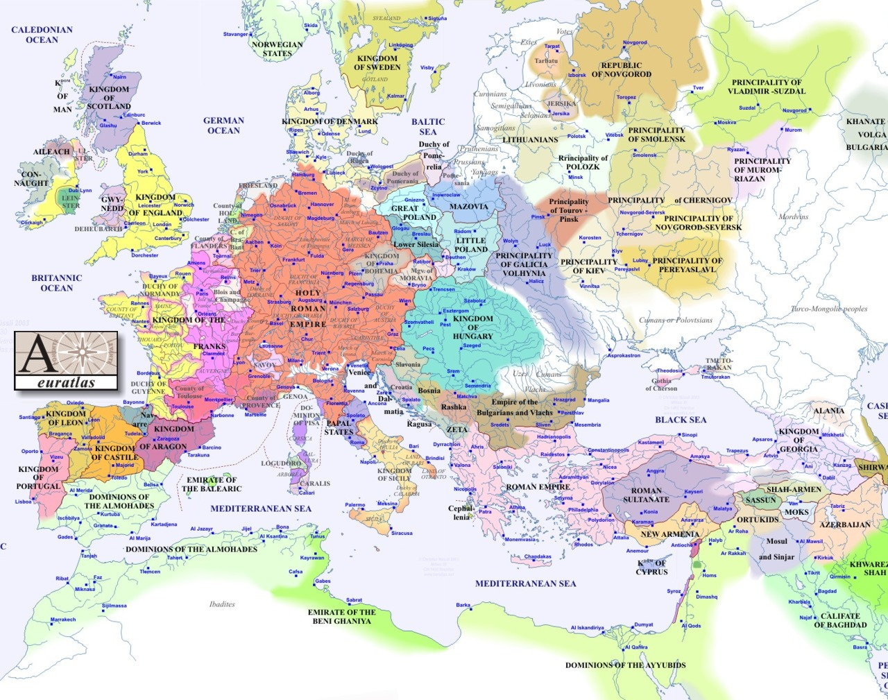
Period I: the Kyivan/Kievan Rus: 9th century – mid 13th century
1000
1200
Notes:
13
13

Slide 14
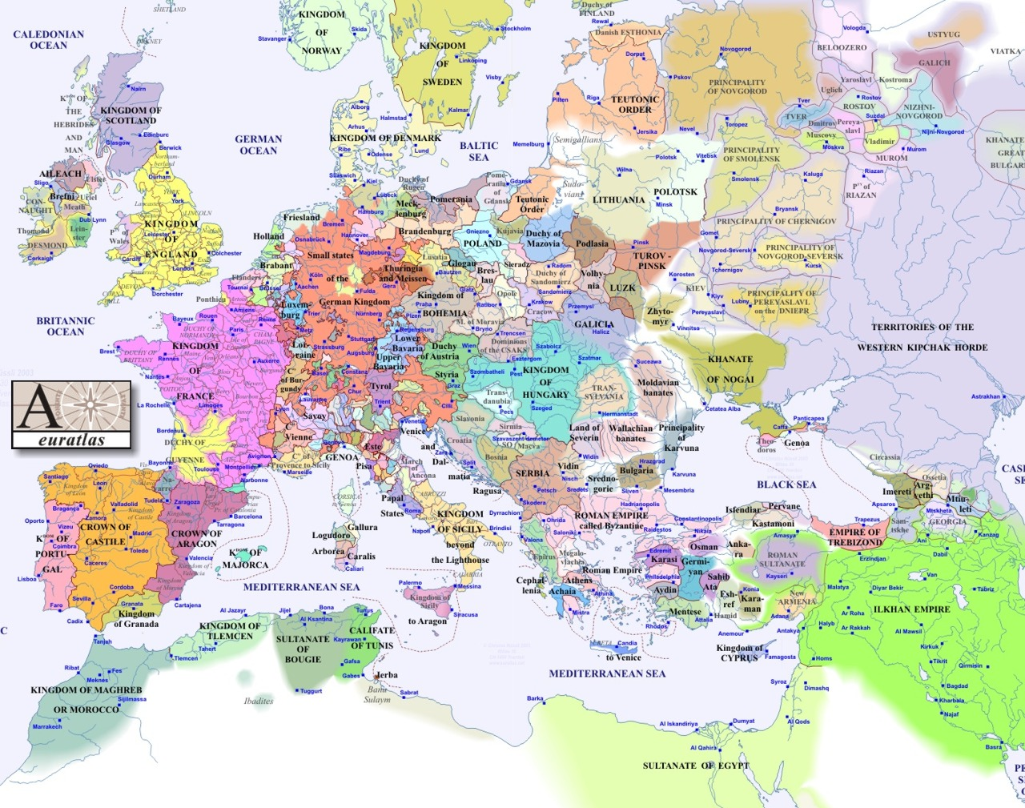
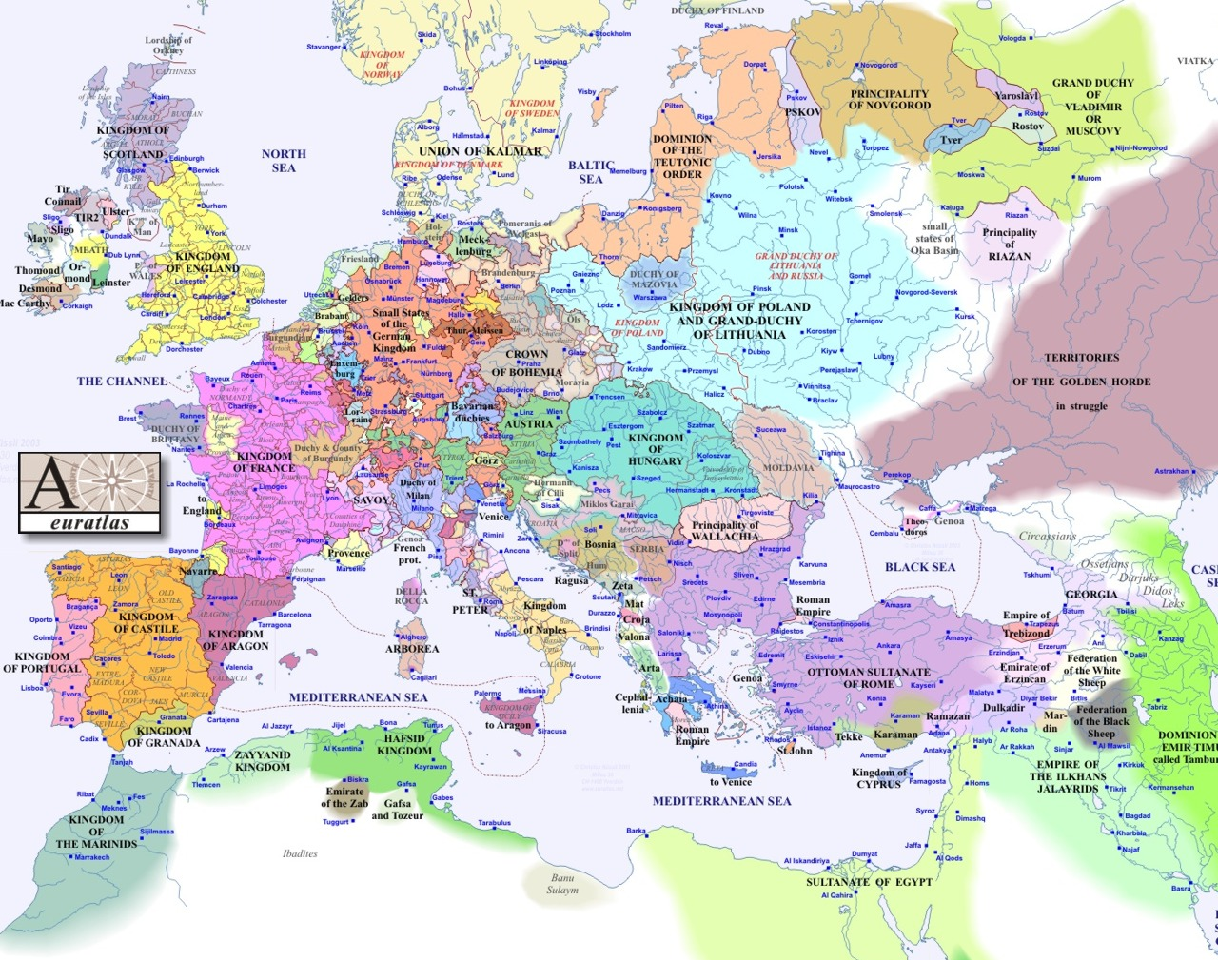
1400
1300
1400
Notes:
14
14

Slide 15
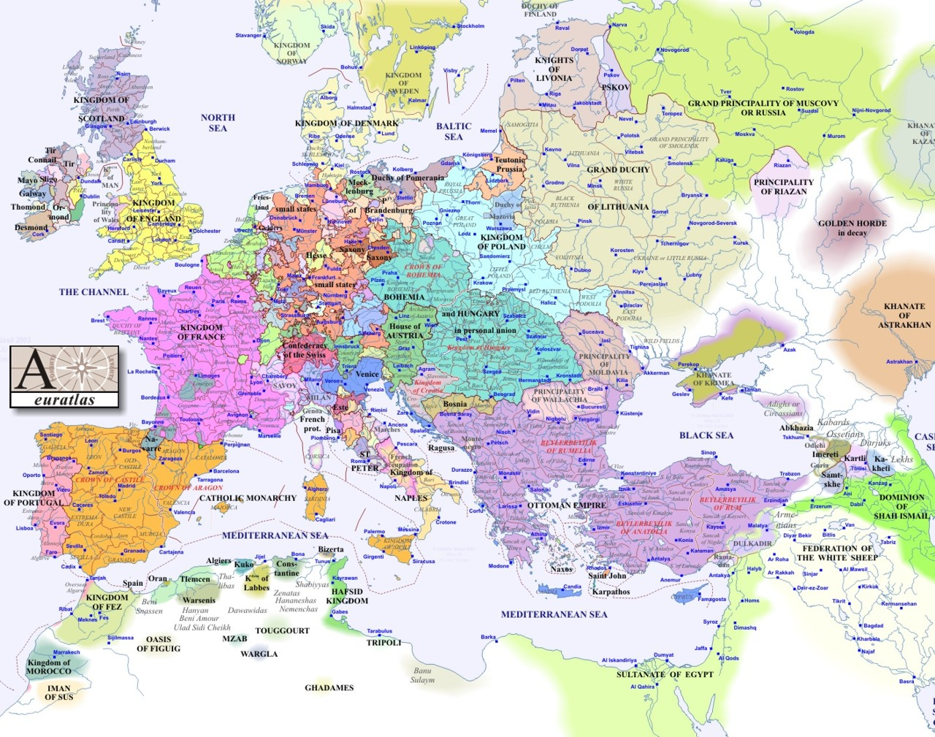
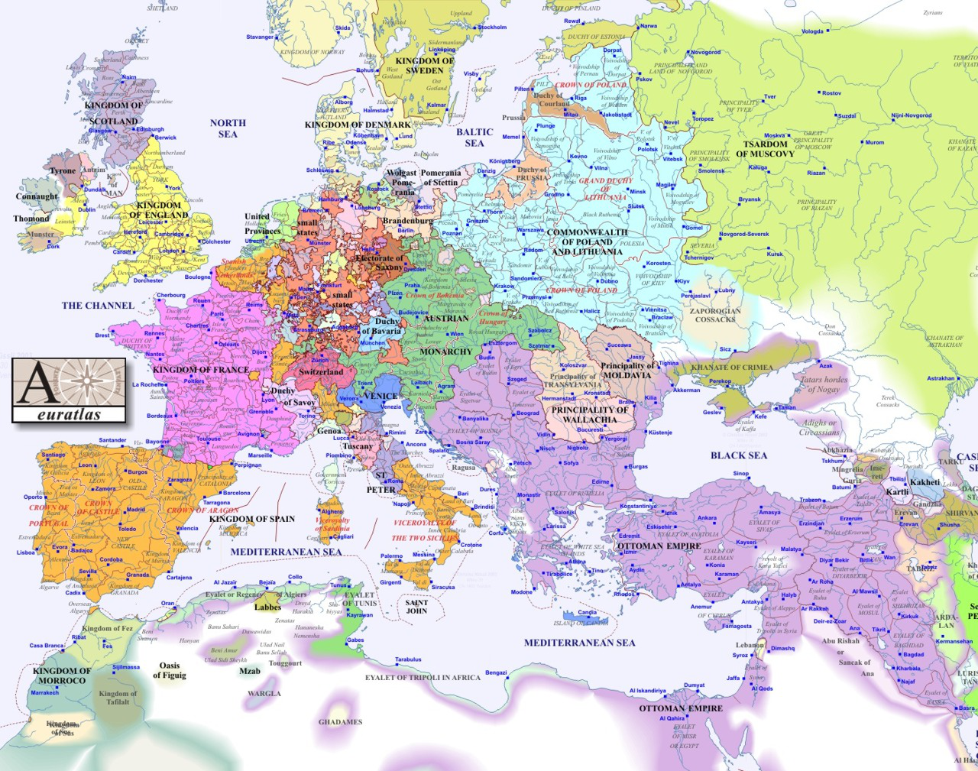
1600
1500
1600
Notes:
15
15

Slide 16
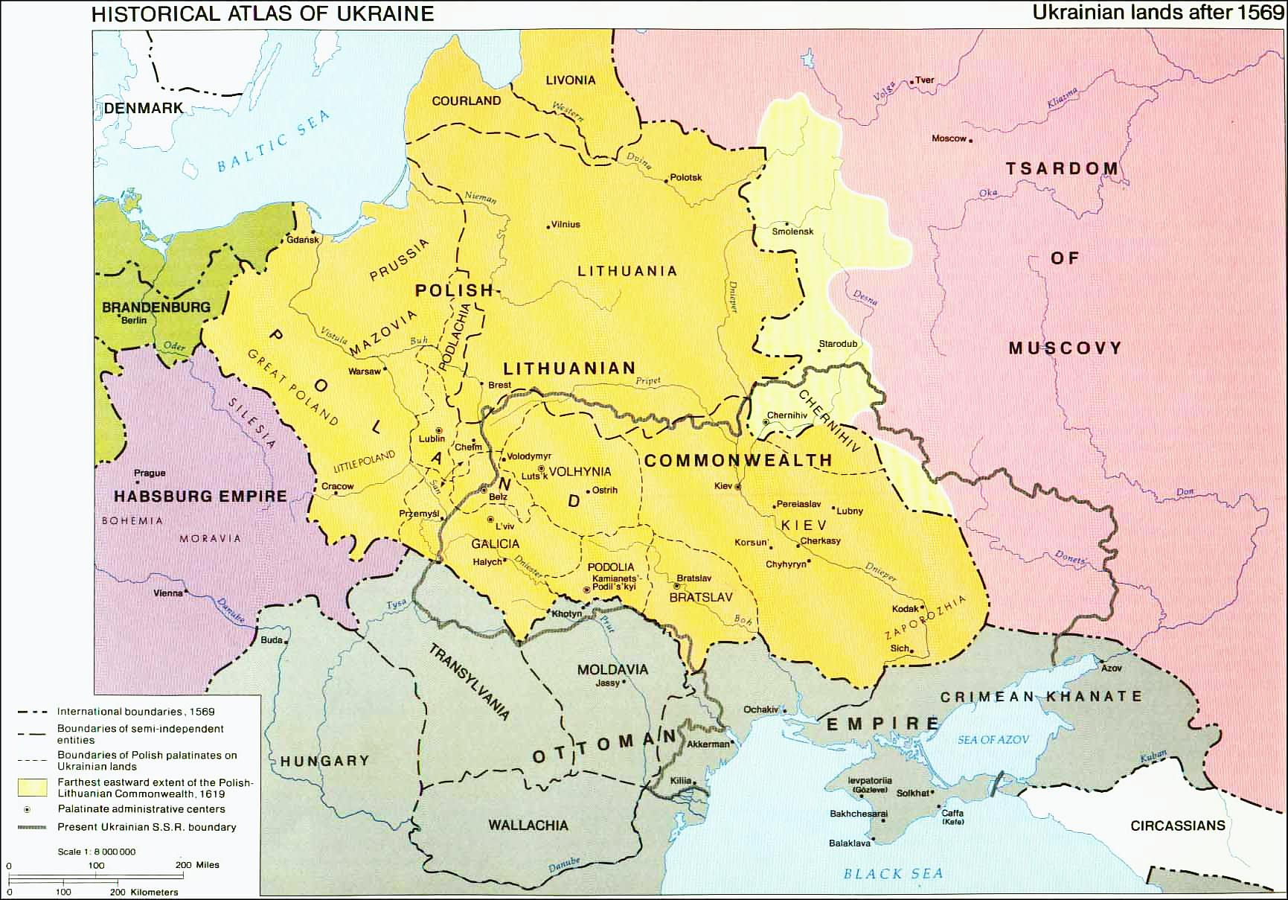
1569
Notes:
16

Slide 17
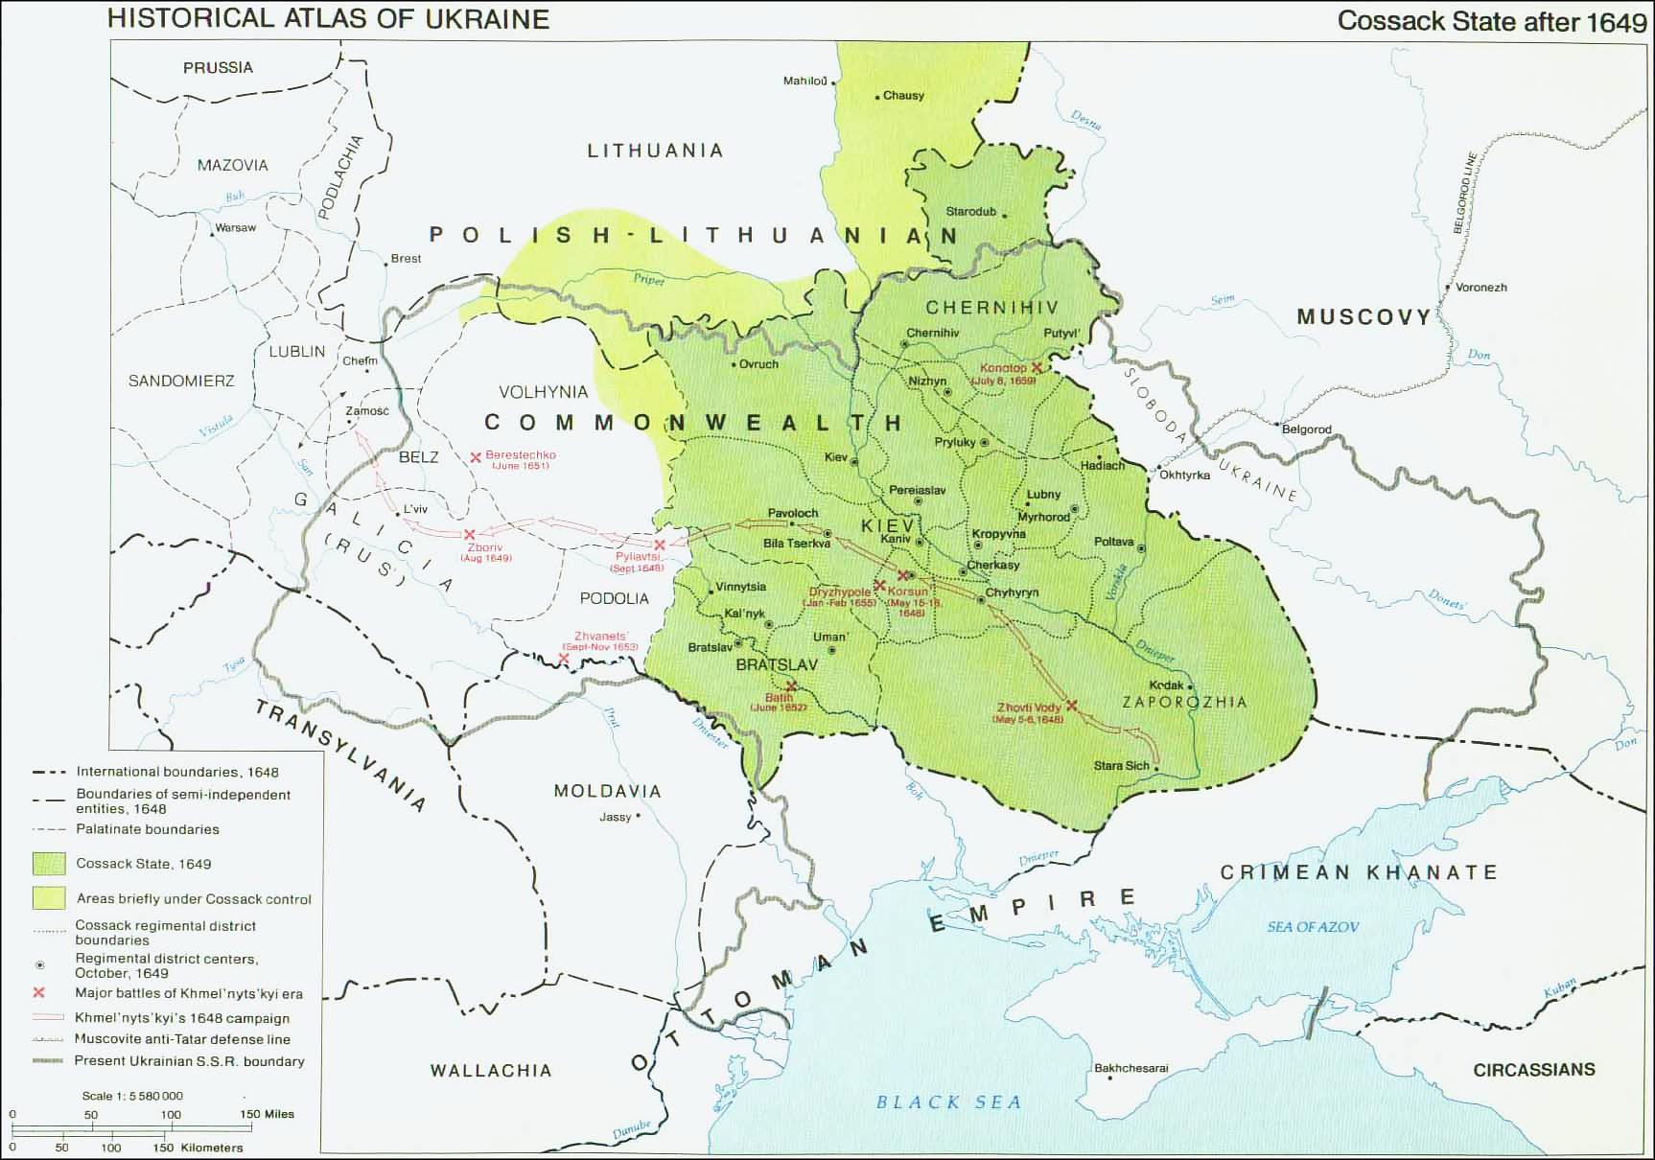
1649
Notes:
17

Slide 18
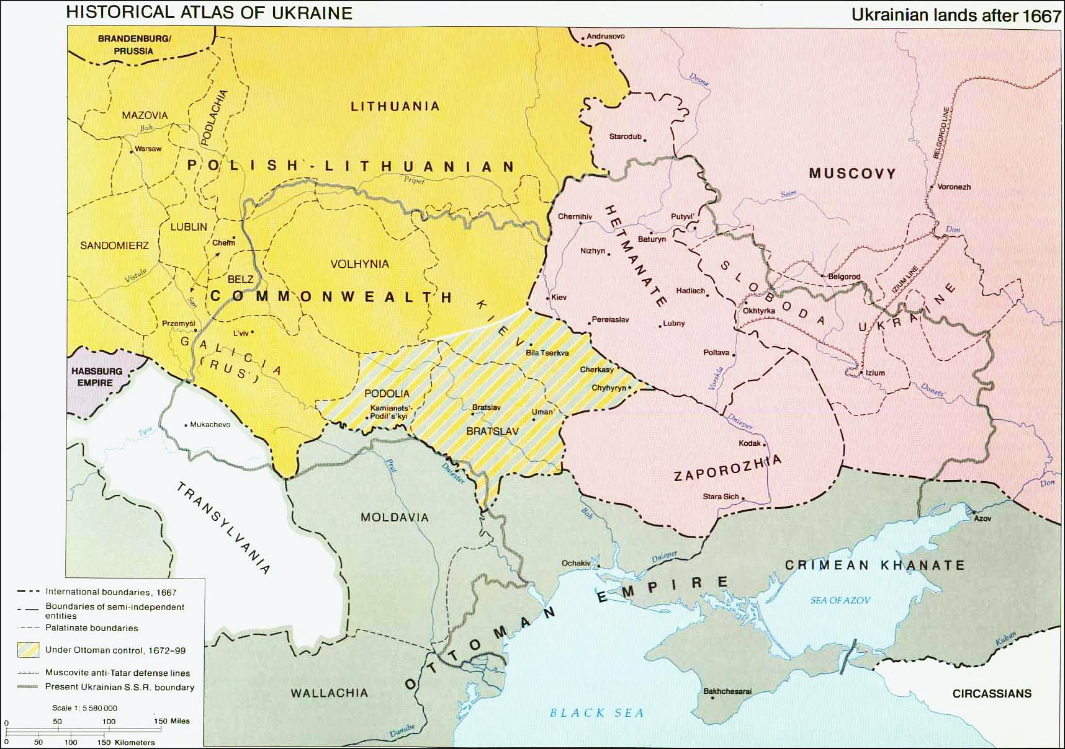
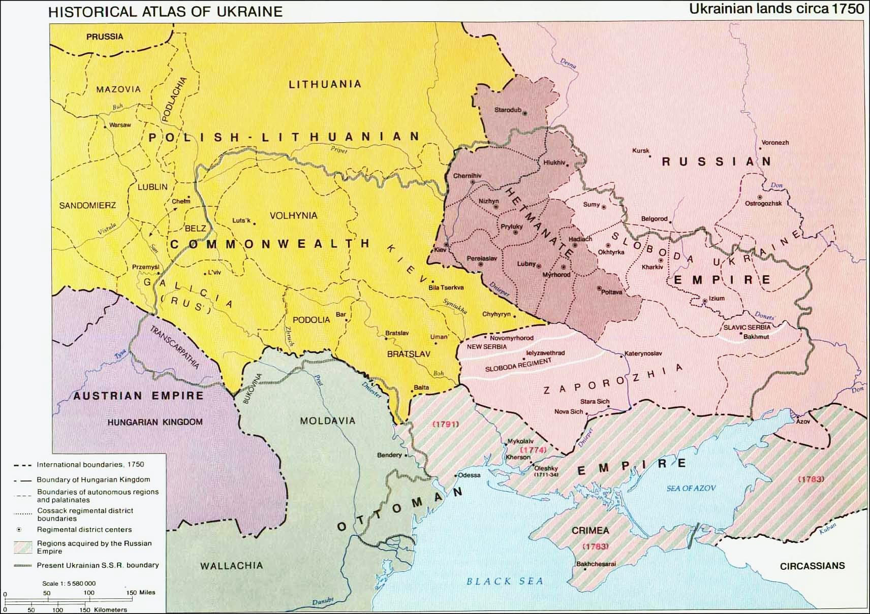
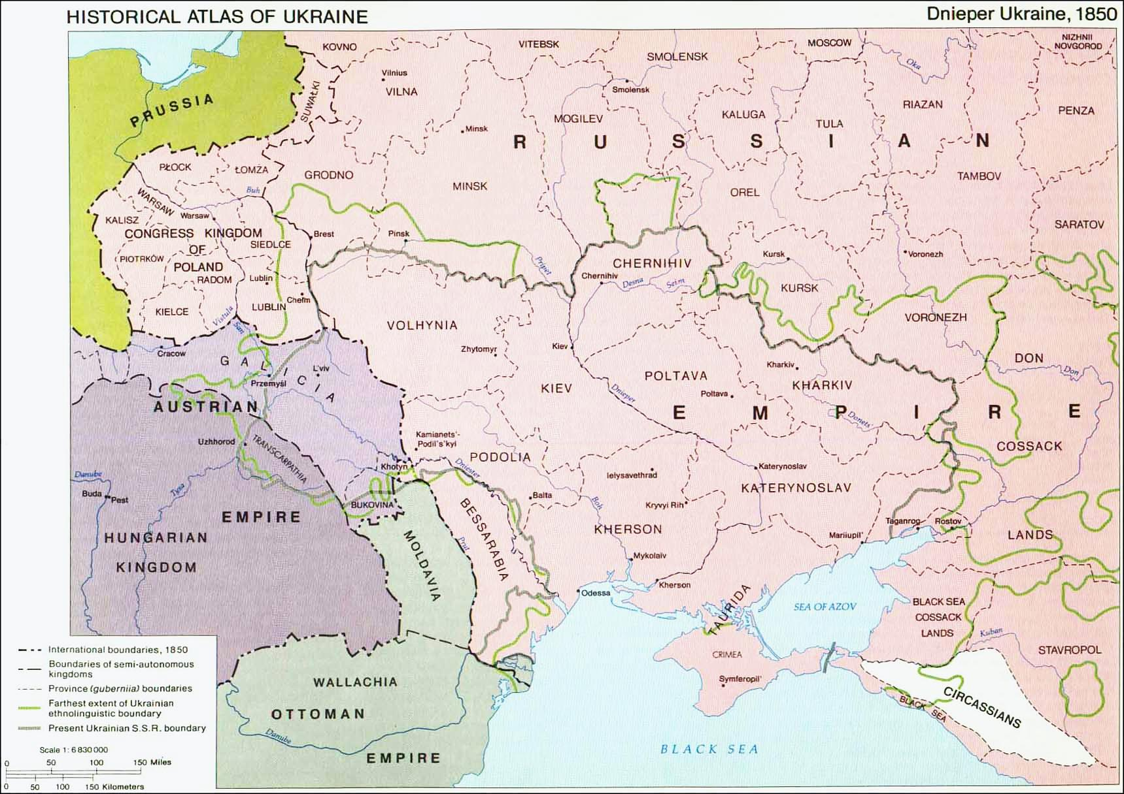
Notes:
18

Slide 19
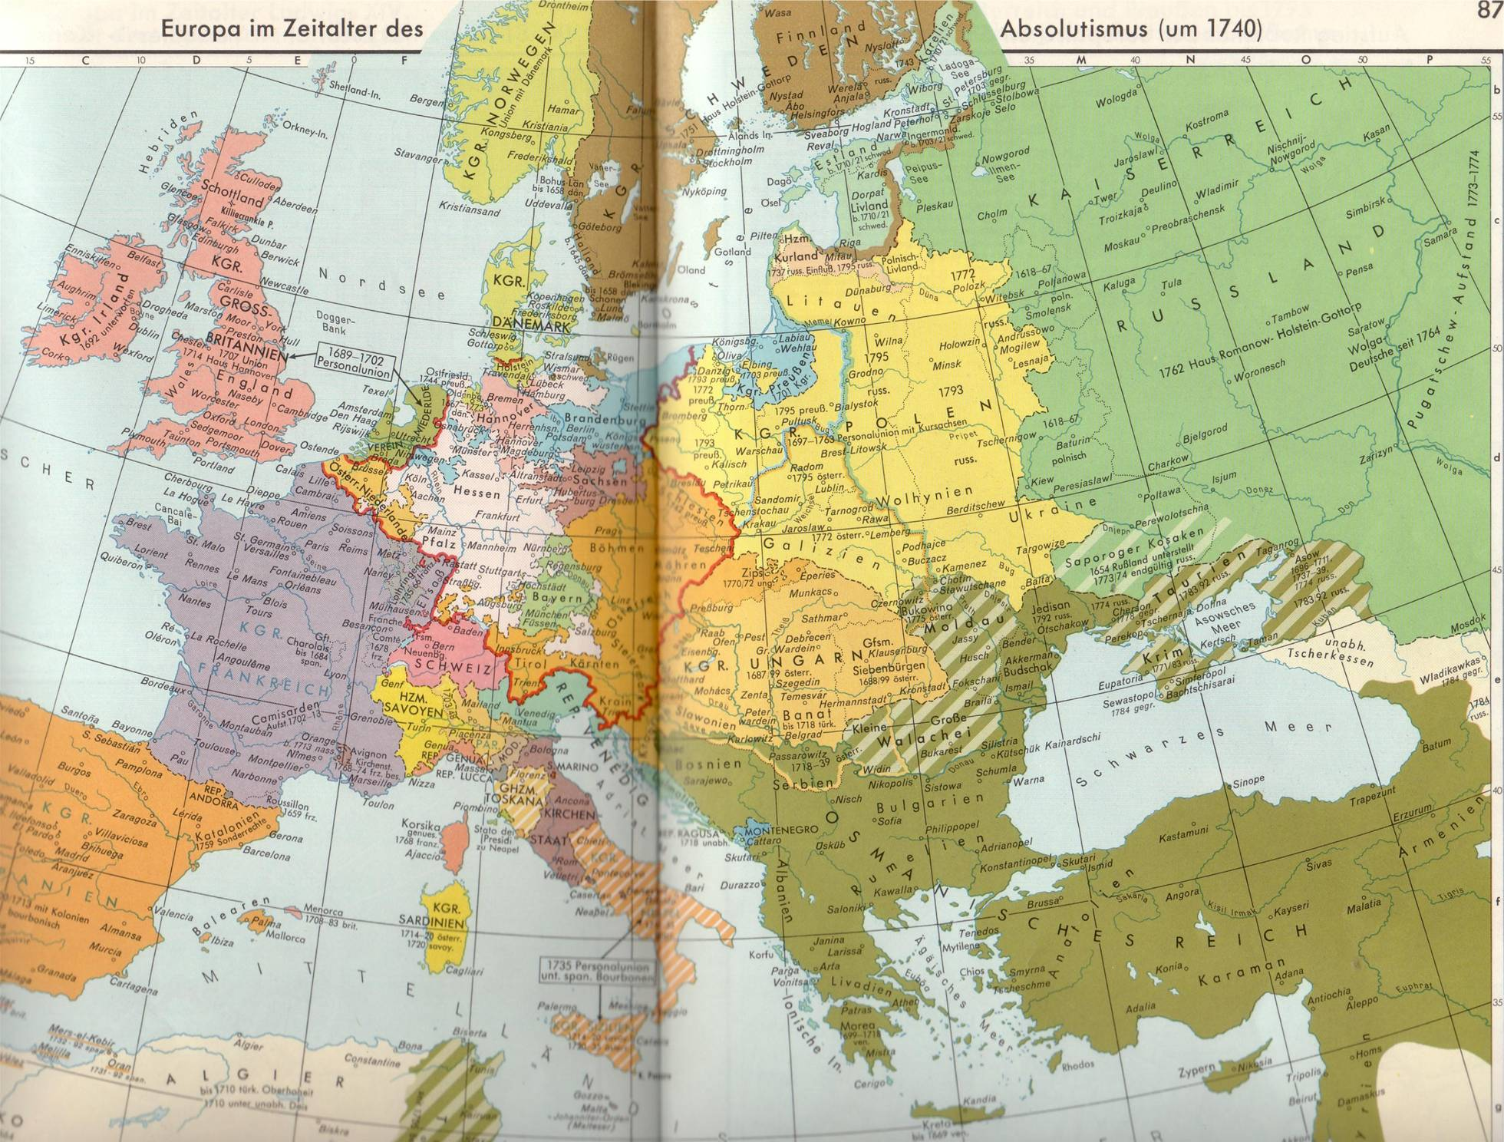
Notes:
19

Slide 20
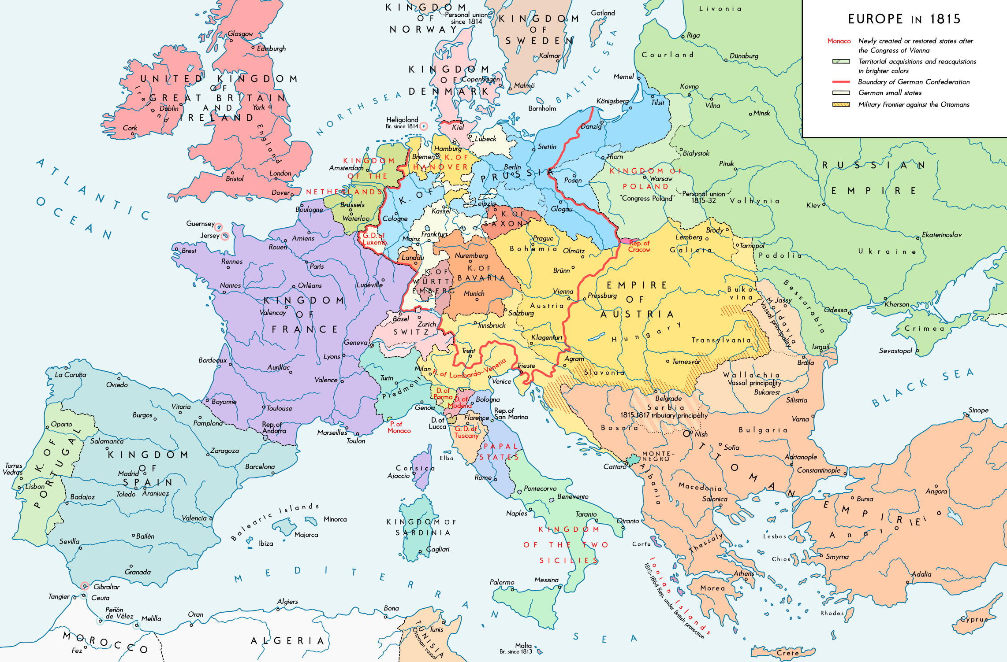
1815

Slide 21
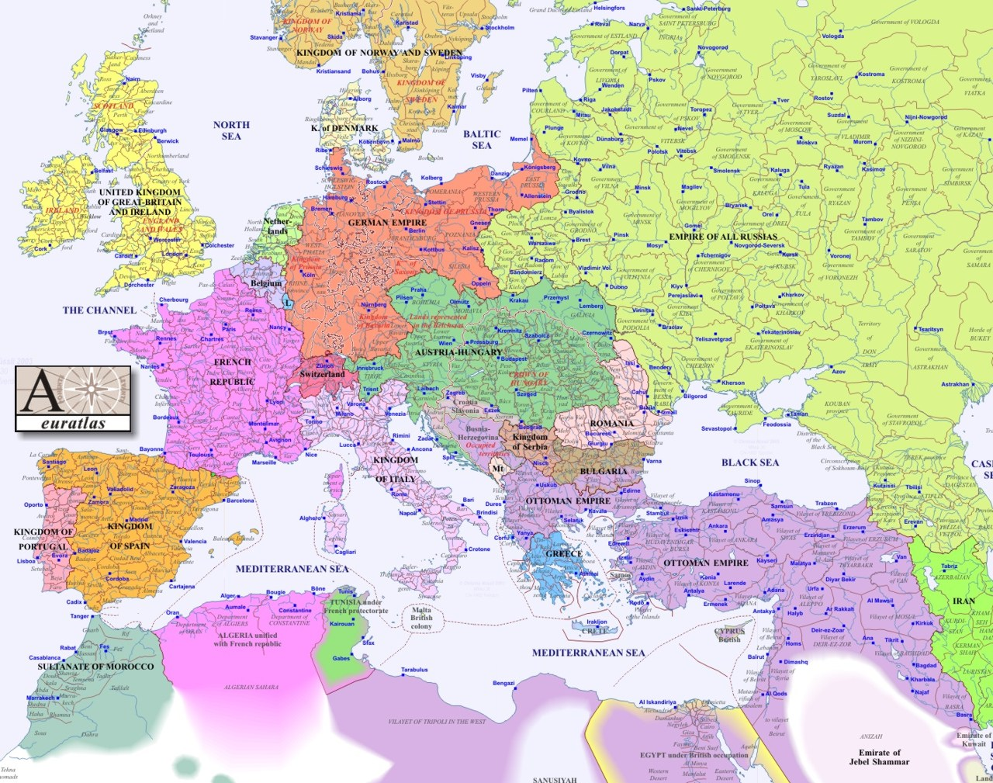
1900

Slide 22
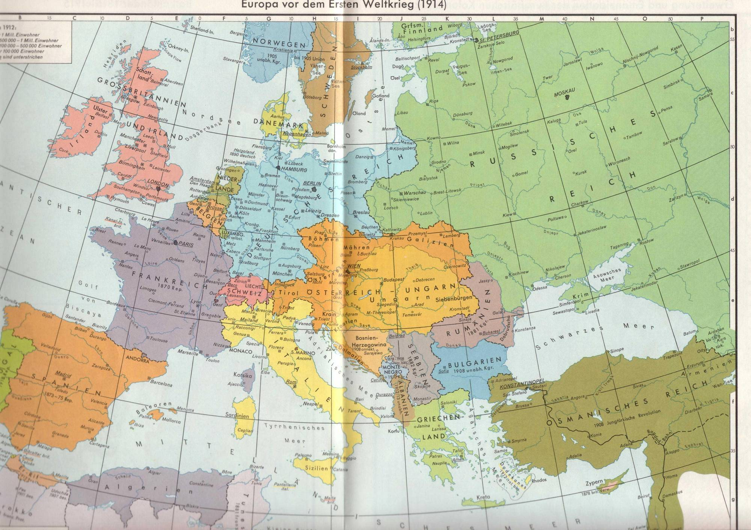
Putzger, Historischer Weltatlas, pp. 106 f.
1914

Slide 23
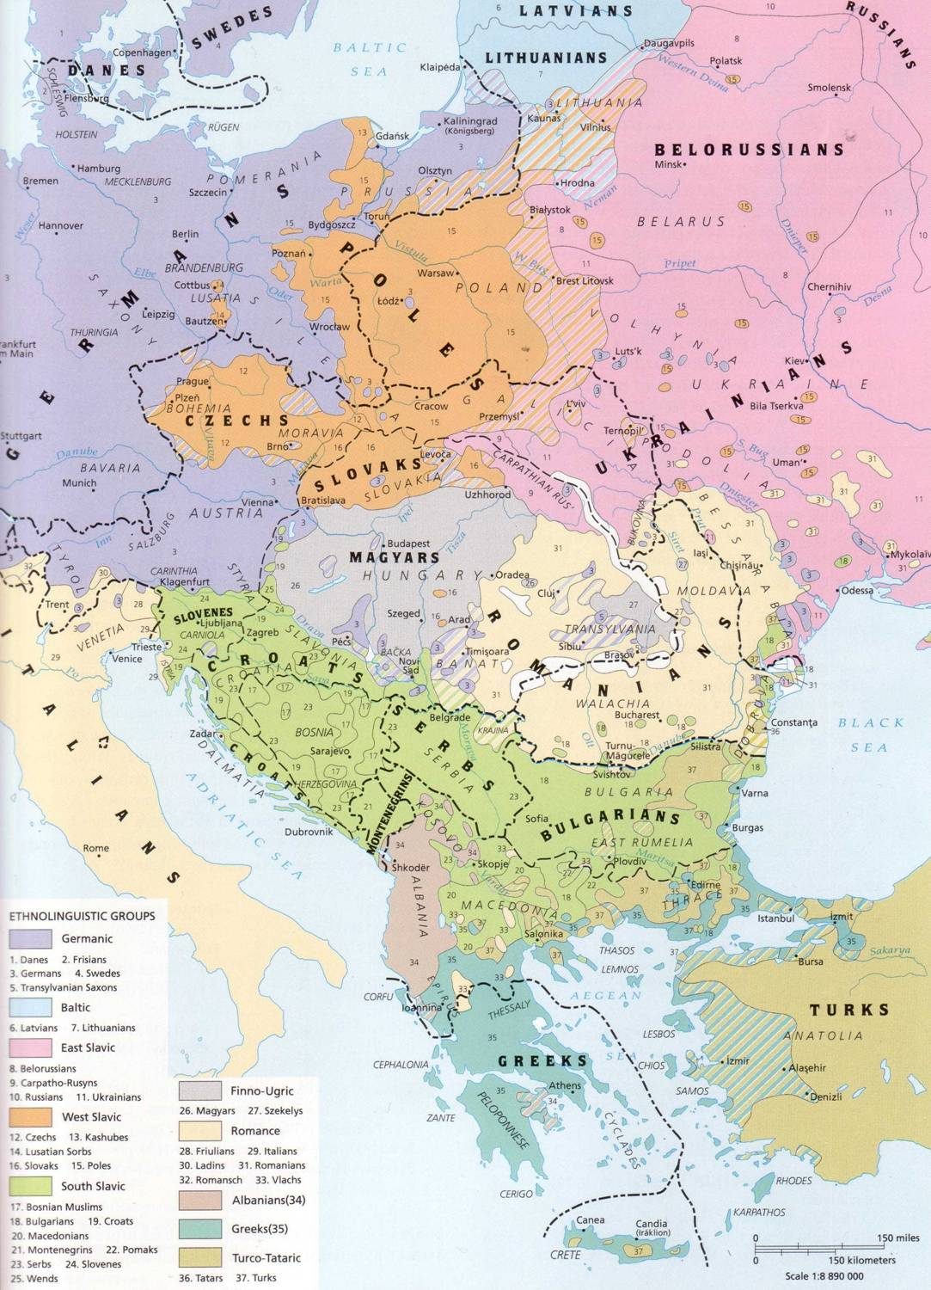
Ca 1910

Slide 24
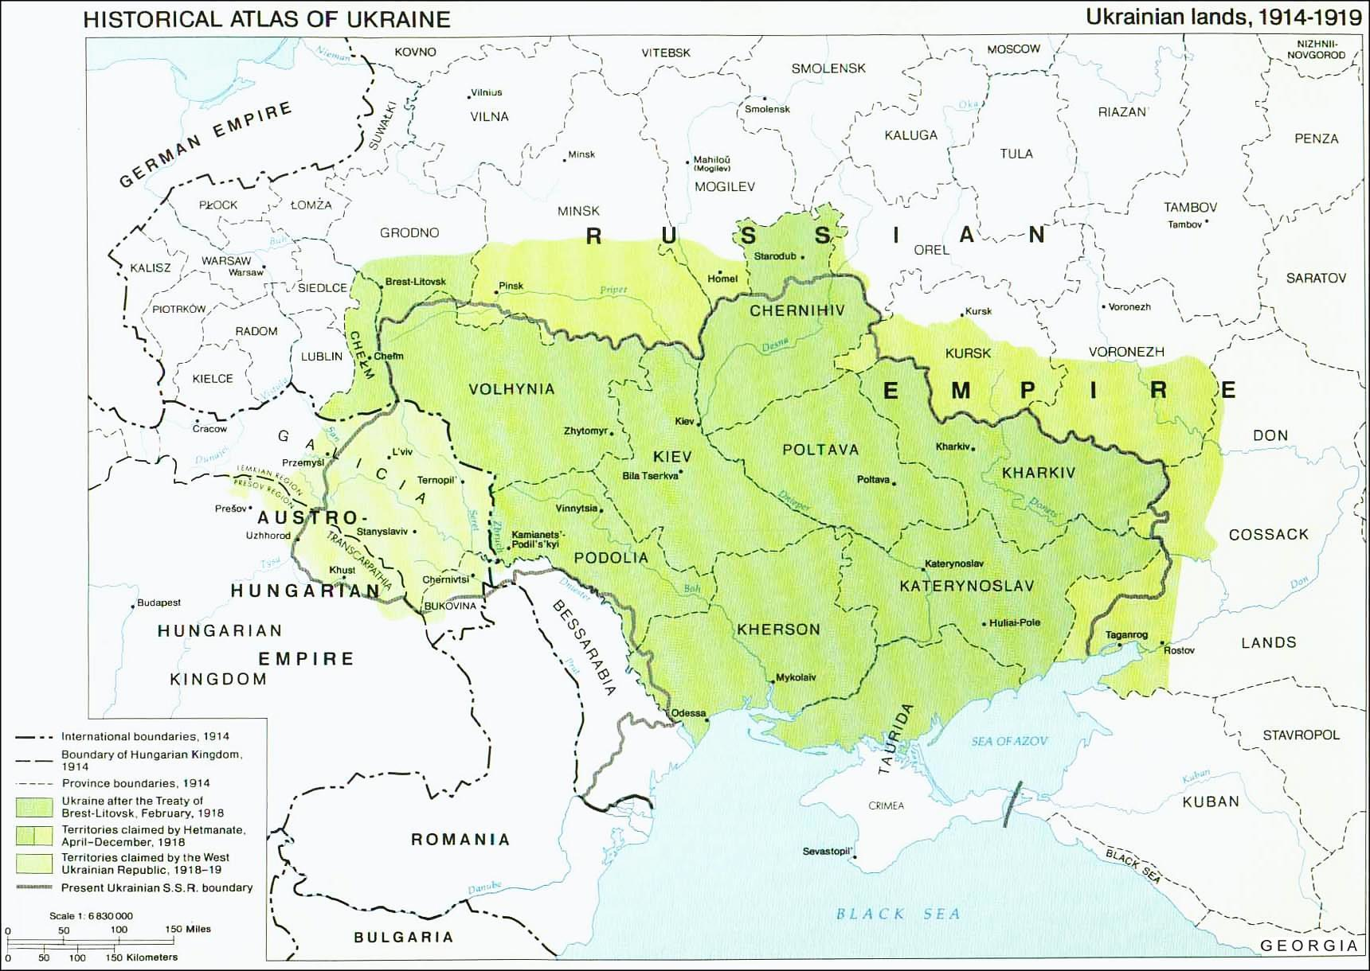

Slide 25
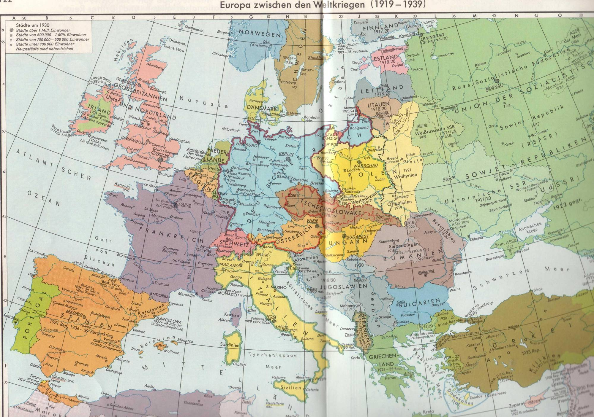
Putzger, Historischer Weltatlas, pp. 122-123

Slide 26
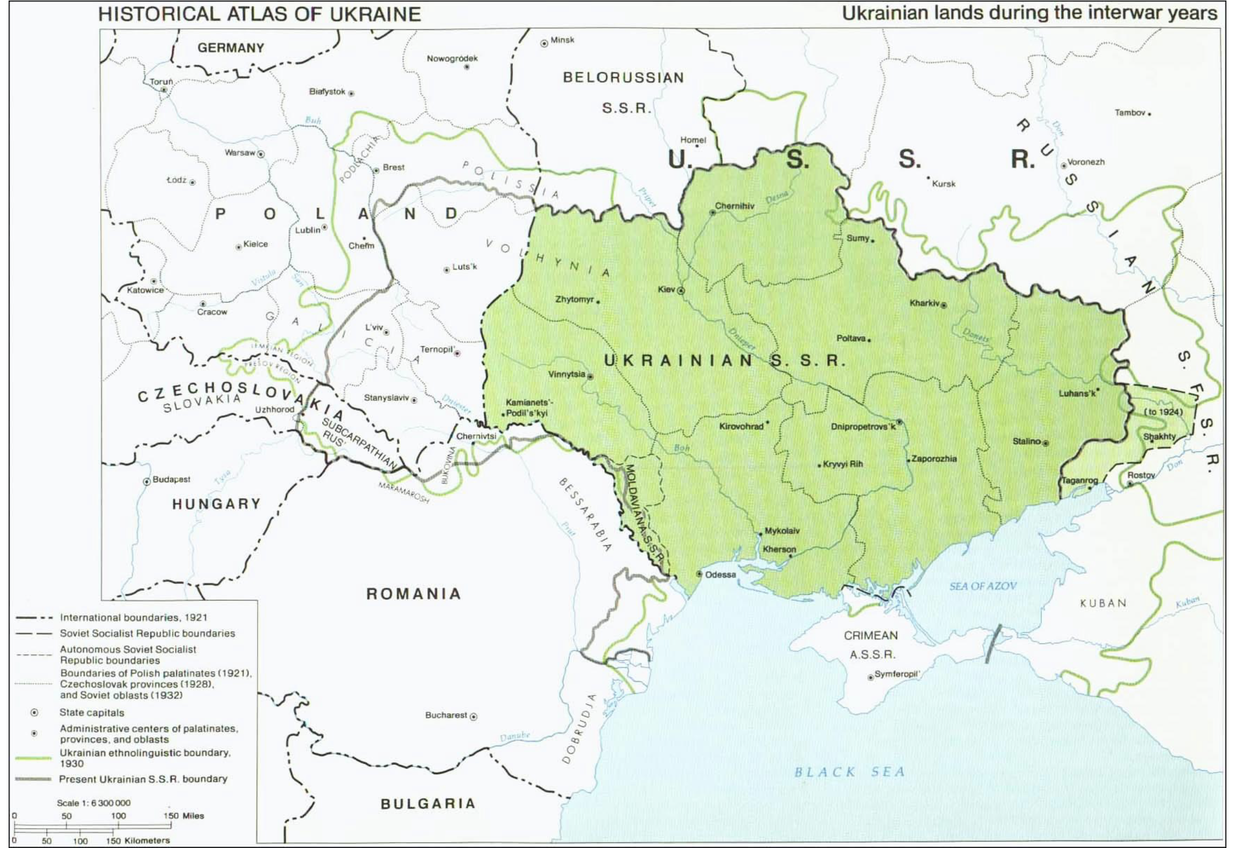

Slide 27
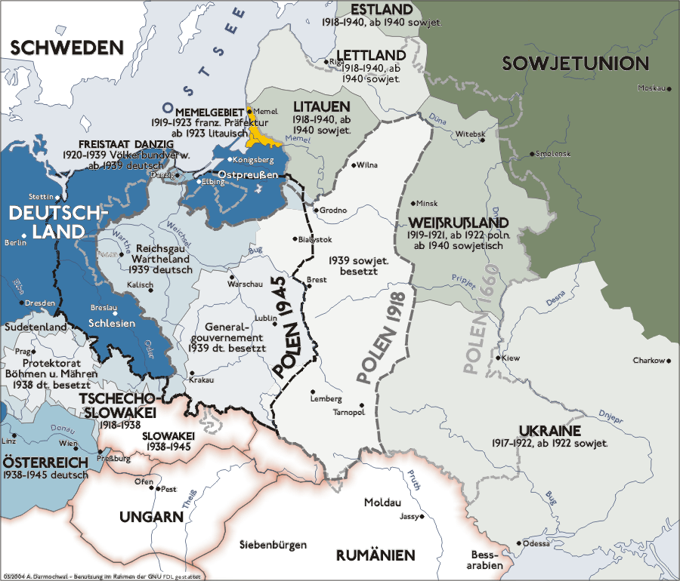

Slide 28
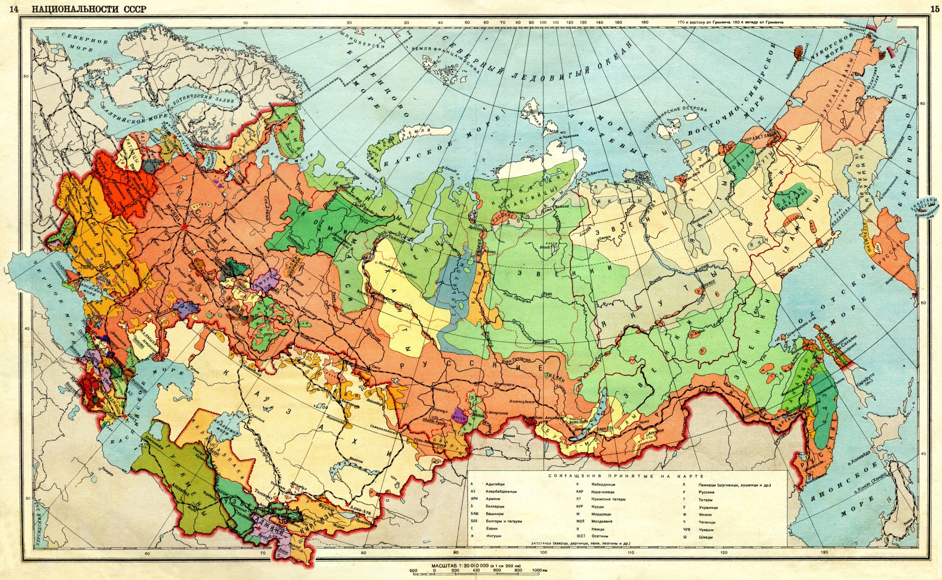

Slide 29
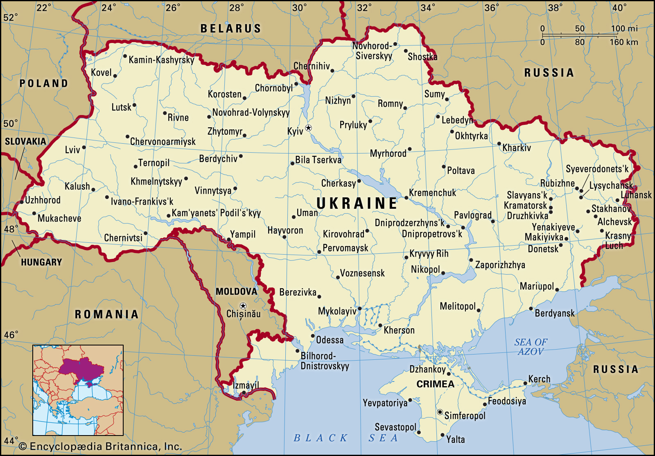

Slide 30
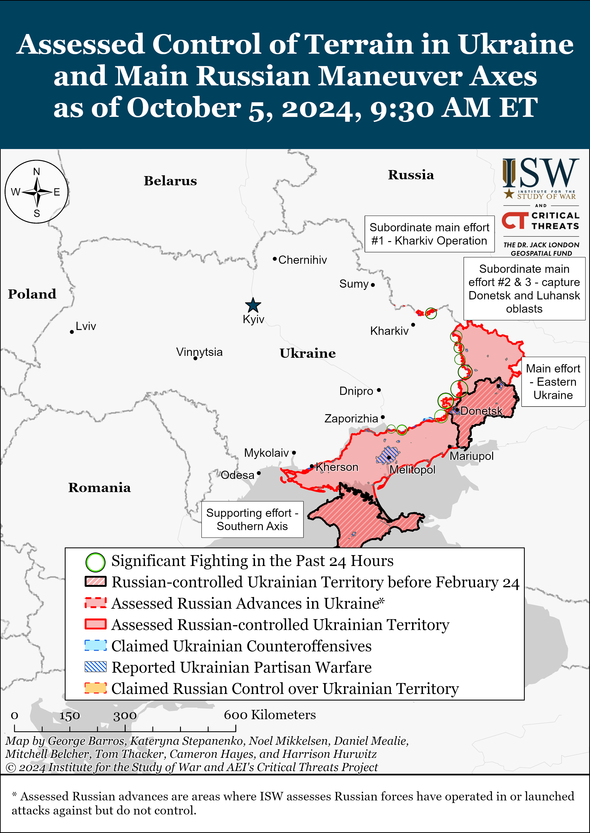

Slide 31
Resources
All seminar questions and readings are here: That‘s the main page for preparing seminar sessions: https://rl.talis.com/3/warwick/lists/7E83A72A-3F99-0691-83B7-C953ECE1095D.html
General information on the website: https://warwick.ac.uk/fac/arts/history/students/modules/hi2j8/
Power points of lectures are uploaded the day before the lecture to the website:
https://warwick.ac.uk/fac/arts/history/students/modules/hi2j8/schedule/
Short essay questions (which are also suggestions for long essay topics) are on the website: https://warwick.ac.uk/fac/arts/history/students/modules/hi2j8/shortessays/
Links to captured lectures are on Moodle: https://moodle.warwick.ac.uk/course/view.php?id=66359

