Slide 1
Entangled History: Ukraine and her neighbours from the Middle Ages to the Present
10 Peasants into …
Week 2 Spring Term
Notes:
1

Slide 2
Introduction
Phase B (Hroch) of Ukrainian Nation Building: 1840 to 1880
Reaching out to the peasantry
Phase B/C in Austria Hungary: Galicia as Ukrainian and Polish Piedmont
Conclusion

Slide 3
Phase A (In white Ukrainophile activities in the Russian Empire, in yellow such activities in the Austrian Empire/ Austria-Hungary, in orange actions of Russian imperial authorities, in red Polish actions
1798 Ivan Kotlyarevsky publishes “Eneyida” (in the vernacular, i.e. script based on spoken Ukrainian)
1804/5 Foundation of University of Kharkiv in Sloboda Ukraine
1819 Appearance of Natalka Poltavka
1823-1825 Secret Brotherhood of Slavs
1830 November Uprising in Poland
1834 Founding of the University of Kyiv (Russian)
1837 Appearance of “Dnister Rusalkas” (Ruthenian Triad: Markiian Shashkevych, Yakiv Holovatsky, and Ivan Vahylevych)
1839 Dissolution of Uniate Church in Russian Empire
1840 Taras Shevchenko publishes “Kobzar” – Transition to Phase B
1846/47 Brotherhood of Sts. Cyril-Methodius (Kyiv)

Slide 4
Phase B
1848 Liberation of peasants in Galicia
1848 Supreme Ruthenian Council in Lemberg/Lviv
In 1850s first Hromada in St. Petersburg, secret Ukrainian education and culture societies (Hromada) in the Ukrainian provinces of Russian Empire– private Sunday Schools in Right-Bank Ukraine (in Ukrainian)
1861 Emancipation of serfs in the Russian Empire
1861 ff: Railways in Ukraine, industrialization of the Donbas, iron ore mining in Kryviy Rih
1863 Polish January Uprising in the Russian Empire
1863 Use of Ukrainian language prohibited by Russian government (Valuev Decree)
1876 in the Ukas of Ems prohibition confirmed

Slide 5
Valuev Circular (1863)
Religious and secular writings in Ukrainian are not allowed to be published in the Russian Empire.
Kiev Censorship Committee: ‘the Ukrainian language never existed, does not exist, and shall never exist‘
Ems Ukas (1876)
‘The importation into the Russian Empire, without special permission of the Central Censorship over Printing, of all books and pamphlets in the Little Russian dialect, published abroad, is forbidden.
The printing and publishing in the Empire of original works and translations in this dialect is forbidden with the exception of (a) historical documents and monuments; (b) works of belles lettres but with the provision that in the documents the orthography of the originals be retained; in works of belles lettres no deviations from the accepted Russian orthography are permitted and permission for their printing may be given only by the Central Censorship over Printing.
All theatrical performances and lectures in the Little Russian dialect, as well as the printing of text to musical notes, are forbidden.*

Slide 6
Major Ethnic Groups in the Russian Empire 1897 (125,640,000)
Russians 44.31%
Ukrainians 17.81%
Belarusians 4.68%
Poles 6.31%
Jews 4.03%
Other ethnic groups in the West 4.47%
Ethnic groups in the North 0.42%
Ethnic groups Volga/Ural 5.85%
Ethnic groups in Siberia 0.99%
Ethnic groups in the Steppe 1.99%
Ethnic groups in the Transcaucasia 3.53%
Ethnic groups in the Caucasus 1.05%
Ethnic groups in Central Asia 5.69%
Diaspora groups (1.43% Germans) 1.91%

Slide 7
Introduction
Phase B (Hroch) of Ukrainian Nation Building: 1840 to 1880
Reaching out to the peasantry
Phase B/C in Austria Hungary: East Galicia as Ukrainian and Polish Piedmont
Conclusion

Slide 8
Peasants into …
Task: Make peasants into Russians, Poles, Ukrainians
Precondition: End of serfdom. Abolished in Prussia 1807/10, in Austria 1848, in Russia 1861
Problems
Liberation without land (peasants have to pay for it): sharp social and economic conflicts between peasants and estate owners persist
Gulf between nobility and nationally mobilised urban elite on the one side and peasants on the other side
Level of literacy: 1850 in Prussia 85%, 1873 in Austrian Galicia 20%, 1897 in Russian Empire 21.1%
Fear of estate owners and conservatives of effect of better education and literacy on peasants
Ukrainian nationalism is competing with Russian nationalism and socialism for mass support – Russian imperial authorities support in the case of Ukraine Russian nationalists but fight against Ukrainian nationalism, and socialism

Slide 9
Imperial dilemmas (Russian Empire)
Dilemma 1: to compete with the other great powers modernisation is needed, for effective modernisation the co-operation and support of the elites and the education of the population is necessary. But… end of autocratic rule, sharing of power, education also vehicle for ‘wrong’ – revolutionary ideas – elites are scared of peasant uprising – enormous gulf between elite and peasants (no matter whether Ukrainian, Russian, or whatever speaking)
Dilemma 2: Russification of minorities aimed at transforming Russia into a Russian national space. But… Russification could provoke resistance of other ethnic groups

Slide 10
The Ukrainian problem in the Russian Empire
For Russian authorities and for Russian nationalists – Ukrainian speaking peasants (18% of the population of the Russian Empire) were essentially Russians, sometimes called South Russians or Little Russians. In 1880 almost all of them are Russian-Orthodox, but speak Ukrainian dialects (not Russian) and have customs and traditions different from those of the Great Russians. Russian authorities and nationalists compete with Ukrainophile activists and intellectuals for the ‚souls‘ of these peasants. One can safely assume that most Ukrainian speaking peasants were nationally indifferent but had strong local and regional loyalties.

Slide 11
What is Russification?
Three varieties (Thaden)
Unplanned: certain individuals take on Russian culture and language, takes several generations
Administrative: demand by the Russian government that Russian must be used in administration everywhere in the empire
Cultural: active policy that aims to replace a population’s native culture with Russian
Edward C. Thaden et al., Russification in the Baltic Provinces and Finland, 1855-1914 (Princeton, 1981), pp. 7-8
Theodore R. Weeks, ‘Russification: Word and Practice 1863-1914’, in Proceedings of the American Philosophical Society Vol 148, No. 4, December 2004, pp. 473-474

Slide 12
The Ukrainian question and the Polish question
In the Russian Empire, imperial authorities, Russian nationalists, and Ukrainophiles were united in their efforts to reduce Polish influence. The sharp social conflict between Ukrainian peasants and Polish estate owners made any attempts of Polish nationalists to ‚acquire‘ Ukrainian speaking peasants for the Polish nation doomed to fail. There was also the language barrier and the identification of Polish culture with the culture of the ‚masters‘ and the religious difference. Poles were Roman-Catholics – Ukrainians Russian-Orthodox (in the Russian Empire after the dissolution of the Uniate Church in 1839) or Uniate or Greek-Orthodox (in Austria-Hungary.
Towards Lithuanian-speaking peasants the Russian authorities pursued a flexible policy. They did not necessarily try to Russify them (they were Baltic, not Eastern Slavs) but to reduce the Polish influence. The authorities did that by supporting the Lithuanian language (including school education) against the Polish language.

Slide 13
Ukrainians in the Russian Empire
Assimilation
“Little Russians”
Valuev Decree and Ems Ukaz
Orthodox faith
Attraction of Russian culture
Upward mobility - chances
Ukrainian nationalism
Ethnicity and historical traditions
Small group of pro-Ukrainian noblemen
Ukrainian language and literature
Partial coincidence of social and ethnic boundaries

Slide 14
Introduction
Phase B (Hroch) of Ukrainian Nation Building: 1840 to 1880
Reaching out to the peasantry
Phase B/C in Austria Hungary: East Galicia as Ukrainian and Polish Piedmont
Conclusion

Slide 15
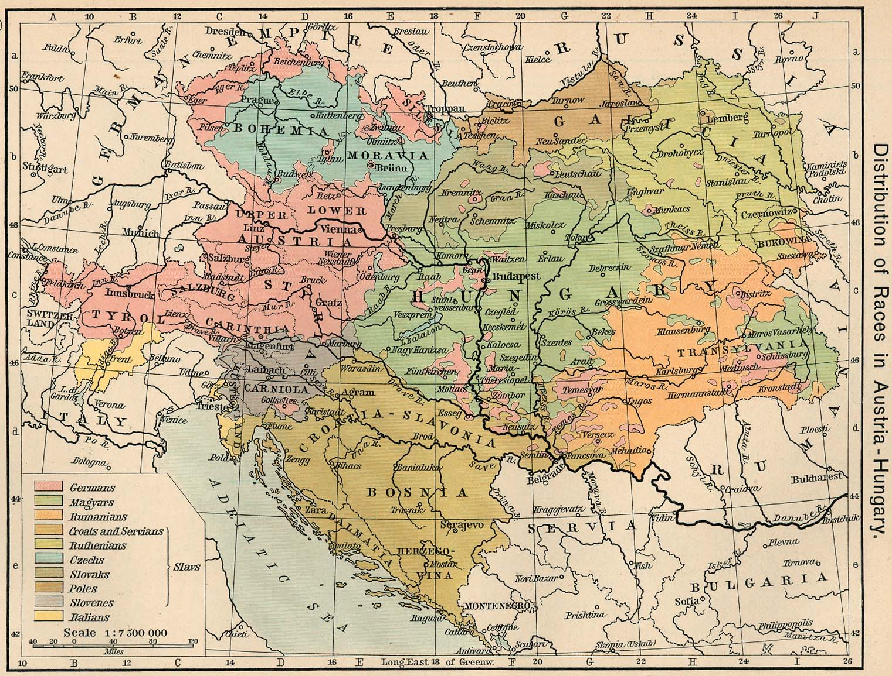

Slide 16
Austrian Crownland Galicia and Lodomeria, 1910
Population: 8 Million
 | West Galicia in % |  | East Galicia in % |  | Together
Roman-Catholic | 2,381,940 | 88.6 | 1,349,630 | 25.3 | 3,731,570 | 46.5
Greek-Catholic | 86,585 | 3.2 | 3,294,420 | 61.7 | 3,381,005 | 42.1
Jewish | 213,173 | 7.9 | 658,722 | 12.4 | 871,895 | 10.9
Protestant | 7,953 | 0.3 | 30,371 | 0.6 | 28,324 | 0.5
Orthodox | 165 | 0.0 | 2,680 | 0.0 | 2,845 | 0.0

Slide 17
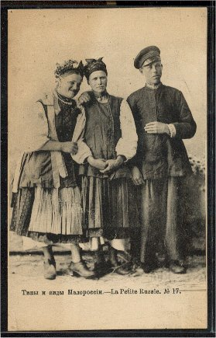
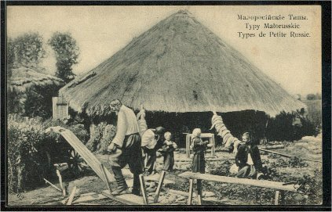
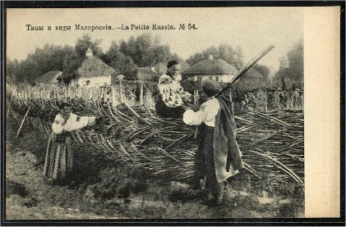
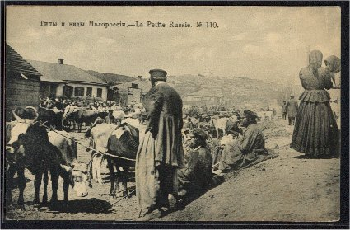

Slide 18
Phase B/C in Galicia
1848 Supreme Ruthenian Council
Competition between Old-Ruthenians, Ukrainophiles, Russophiles, Polonophiles
Options for Ukrainian speakers in Galicia
Polish option – “gente ruthenus, natione polonus”
Ruthenian option – “Rusyny”
Russian option – Russophiles
Ukrainian option – Ukrainophiles
(Panruthenian option) – including Belarusians
John-Paul Himka, ‘The Construction of Nationality in Galician Rus’: Icarian Flights in Almost All Directions’, in Ronald Grigor Suny and Michael D. Kennedy (eds.), Intellectuals and the Articulation of the Nation (Ann Arbor, 1999), pp. 109-64.

Slide 19
Austria-Hungary after 1867
Crownland Galicia and Lodomeria
Polish elite profits from imperial reforms
Close cooperation of Austrian authorities with Polish elites
Social, political, economic and cultural dominance of Poles
Polonisation of administration, education – but some protection for Ruthenians
Dominance of Polish language in universities in Cracow and Lwów
Modern political parties develop (Polish and Ukrainian)
Hundreds of Polish and Ukrainian newspapers and journals, thousands of books are published
Polish politicians (Polish club in Austrian parliament) very influential, but also Ukrainians represented in parliament and diet
Polish ministers and gouvernors, Ukrainians in Austrian civil service and some Ukrainian professors at Lviv University
Galicia – the Polish and the Ukrainian Piedmont

Slide 20
Phase B/C in Galicia
1848 Supreme Ruthenian Council
Competition between Old-Ruthenians, Ukrainophiles, Russophiles, Polonophiles
Reading Clubs (Prosvita – Ukrainophiles and Kachkovsky Society - Russophiles) in Galicia
Co-operative movement in Galicia
Emergence of a secular elite
Ruthenian-Ukrainian parties (since 1890s)
Ruthenians/Ukrainians represented in Austrian parliament and in Galician Diet

Slide 21
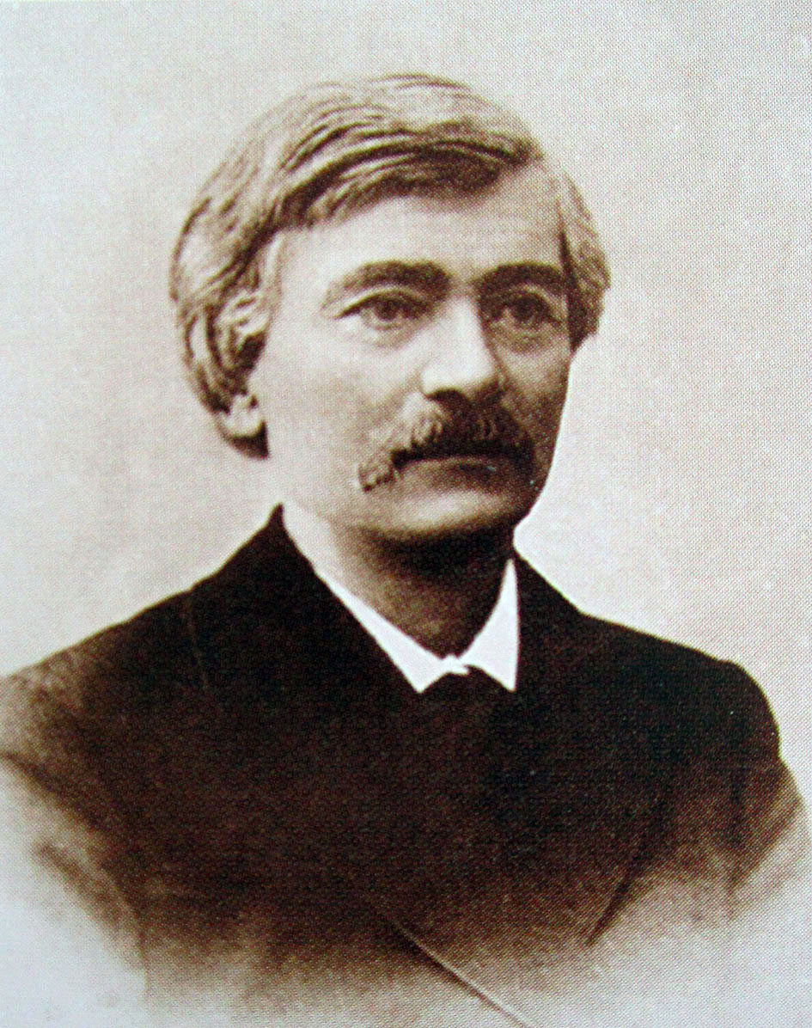
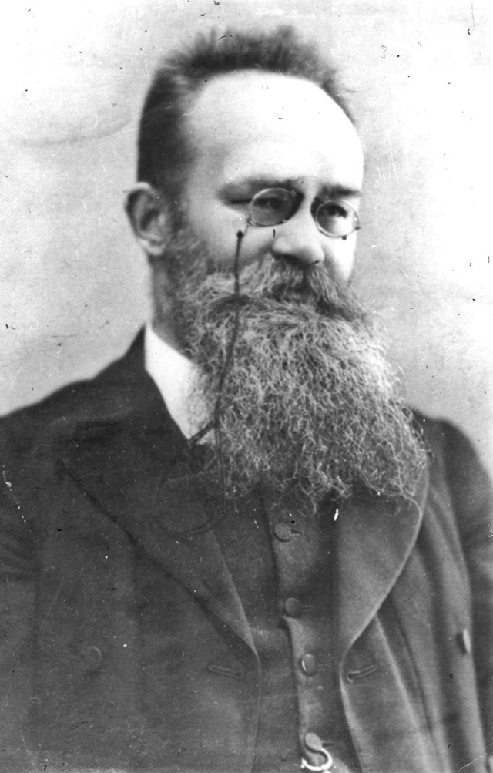
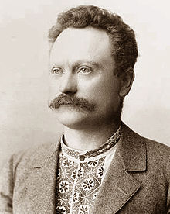
Volodymyr Antonovych 1834-1908
* In Makhnivka (Kyiv/Kiev)
Family: impoverished Polish gentry
Historian, Professor at Kyiv/Kiev University
Populist and ‘peasant-lover’
Mykhailo Hrushevs’kyj 1866-1934
* In Chełm (Russian Empire)
Father: University professor, family priests and parish servants
Historian, Professor in Lemberg, politician and head of first Ukrainian state 1918/19
Ivan Franko
1856-1916
* In Nahujevychi (Galicia)
Writer, journalist, translator, and politician
Father: Blacksmith of German origin
Mother: poor Ruthenian-Polish noblewoman
Socialist and Ukrainophile, spent time in Austrian prison

Slide 22
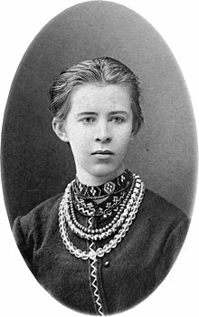
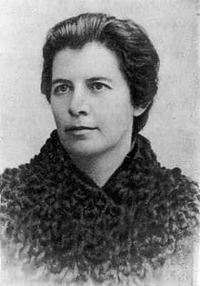
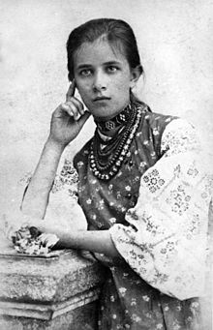
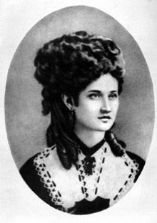
Lesya Ukrainka (Larysa Kosach)
1871-1913
* In Novohrad-Volynskyi (Russian Empire)
Politician, feminist, author
Mother: writer and publisher Olena Pchilka
Father: noble Ruthenian
Niece of Drahomanov
Olena Pchilka (Olha Kosach, née Drahomanova
1849-1930
* In Hadiach (Poltava)
Publisher, translator, ethnographer, feminist
Family: local gentry
Olena Zirka (Olha Kosach-Kryvniuk)
1877-1945
* In Novohrad-Volynskyi
Translator, writer, physician, feminist
Nataliya Kobrynska (Nataliya Ozarkevych)
1851-1920
* In Beleluia (Galicia)
Father: parish priest
Writer, socialist, feminist

Slide 23
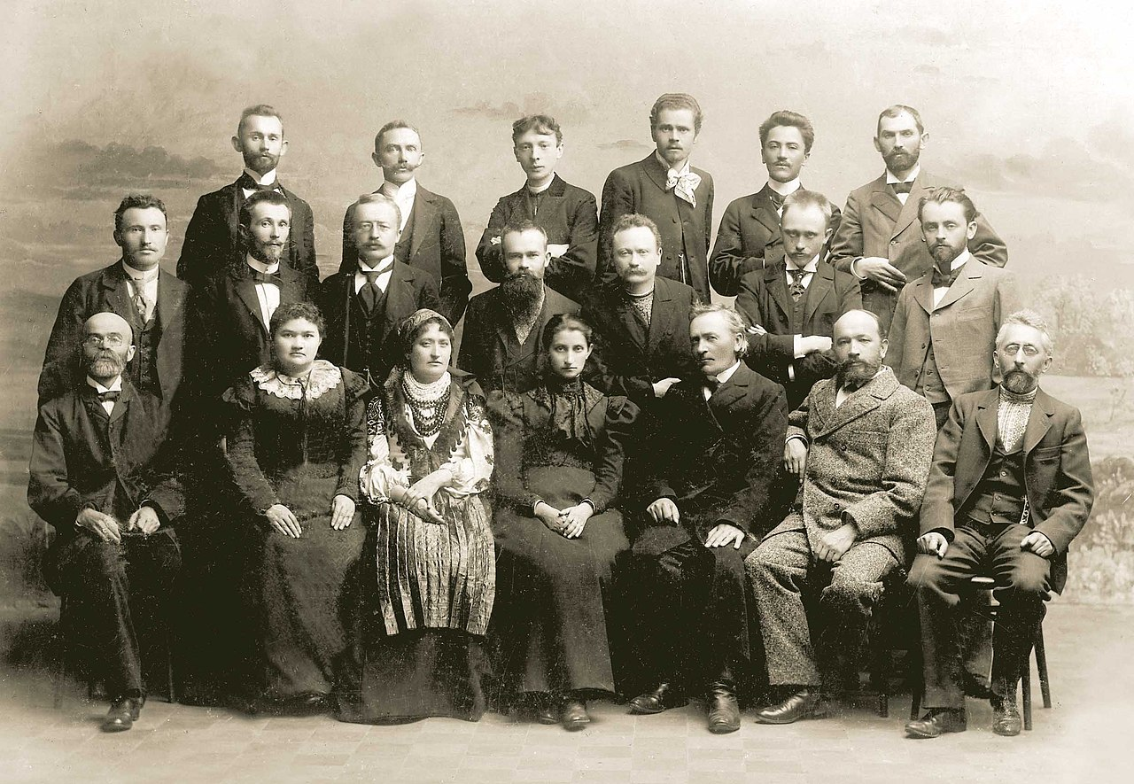
Deutsch: Mitglieder des Kongresses der ukrainischen Schriftsteller anlässlich des 100. Jahrestages der Veröffentlichung der „Aeneis“ von Iwan Kotljarewskyj, Lwiw, 31. Oktober 1898. Von links nach rechts: 1. (untere) Reihe: Mychailo Pawlyk, Jewhenija Jaroschynska, Natalija Kobrynska, Olha Kobyljanska, Sylwestr Lepkyj, Andrij Tschaikowskyj, Kostjantyn Pankiwskyj 2. Reihe: Iwan Kopatsch, Wolodymyr Hnatjuk, Ossyp Makowej, Mychajlo Hruschewskyj, Iwan Franko, Oleksandr Kolessa, Bohdan Lepkyj 3. (oben) Reihe: Iwan Petruschewytsch, Filaret Kolessa, Jossyp Kyschakewytsch, Iwan Trusch, Denys Lukijanowytsch, Mykola Iwasjuk

Slide 24
Polish nationalists and activists focused in their attempt to make peasants into Poles on the Polish-speaking, Catholic peasantry. Wherever possibly they created Polish cooperatives, education socities and Polish-language schools and used many other cultural activities to reach out to the peasants – to make them Polish.
They also attempted to appeal to Ruthenian peasants but were not very successful.

Slide 25
Case study: The Prosvita society
1st Prosvita society founded in Lviv in 1868, mostly intellectuals
Educative and cultured society to ‘know and edify the people’.
to ‘collect and publish all the fruits of oral folk literature.’
(1870) to promote education among the Ruthenian (Ukrainian) people by means of popular publications in the vernacular and the organisation of county committees
in 1876: the admission fee was abolished, annual dues were drastically reduced, and all members received a free popular booklet each month
In 1881–5 there were 320 reading rooms in Galicia under the care of Prosvita, but unconnected
Between 1891 and 1914 the number of reading rooms within Prosvita increased from 5 to 2,944, and the number of branches from 7 to 77
In 1914, 75% of the cities, towns, and villages in Galicia had a reading room, and 20% of the province's Ukrainian population belonged to Prosvita

Slide 26
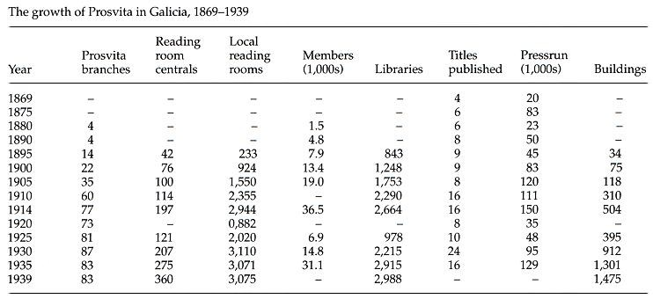

Slide 27
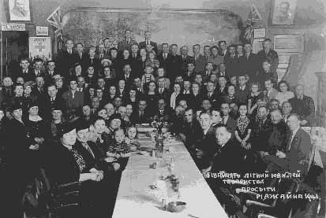
Ukrainian Society of Prosvita
Meeting of the Ukrainian Society of Prosvita

Slide 28
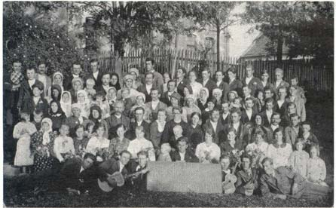
Members of the Ukrainian Society of Prosvita in Kamenyca in 1934)

Slide 29
Testament" (Zapovit’)
When I die, bury Me in a grave, Among the wide steppes, In my beloved Ukraine, So that the wide-brimmed plains, And the Dnieper, and steep slopes There could be seen, could be heard, How the wailing wail. When from Ukraine is carried Into the blue sea The blood of the enemy. . . then I And the plains and hills—
Will drop everything and bow To God Himself Praying. . . until then God I do not know. Bury me and arise, Break your chains, And with the enemy's evil blood Baptize freedom. And myself in a big family, In a family free, new, Don't forget to remember With a pleasant quiet word.
24 December 1845, Pereyaslav

Slide 30
National anthem (today only the first 6 lines) "Shche ne vmerla Ukraina" (Ukraine's Glory Has Not Perished)
Words by: Paul Chubynskyi (1862) Music by: Mikhail Verbytskyi Adopted: 1917, abolished 1920, restored 1991
Ще не вмерла Україна, і слава, і воля, Ще нам, браття молодії, усміхнеться доля. Згинуть наші вороженьки, як роса на сонці, Запануєм і ми, браття, у своїй сторонці. CHORUS Приспів Душу, тіло ми положим за нашу свободу. І покажем, що ми, браття, козацького роду. Станем, браття, в бій кровавий від Сяну до Дону В ріднім краю панувати не дамо нікому;Чорне море ще всміхнеться, дід Дніпро зрадіє, Ще у нашій Україні доленька наспіє. CHORUS Приспів завзяття, праця щира свого ще докаже, Ще ся волі в Україні піснь гучна розляже, За Карпати відоб’ється, згомонить степами, України слава стане поміж народами. CHORUS | Ukraine has not perished, neither her glory, nor freedom, Upon us, fellow--Ukrainians, fate shall smile once more. Our enemies will vanish, like dew in the morning sun, And we too shall dwell, brothers, in a free land of our own. CHORUS: We'll lay down our souls and bodies to attain our freedom, And we'll show that we, brothers, are of the Cossack nation. We'll stand together for freedom, from the Sian to the Don, We will not allow others to rule in our motherland. The Black Sea will smile and grandfather Dnipro will rejoice, For in our own Ukraine fortune shall flourish again. CHORUS Our persistence and our sincere toils will be rewarded, And freedom's song will resound throughout all of Ukraine. Echoing off the Carpathians, and rumbling across the steppes, Ukraine's fame and glory will be known among all nations. CHORUS
1st line (before 2003): Shche ne vmerla Ukrajina, ni slava, ni volja,
1st line (after 2003): Shche ne vmerla Ukrajini i slava, i volja,
Notes:
30

Slide 31
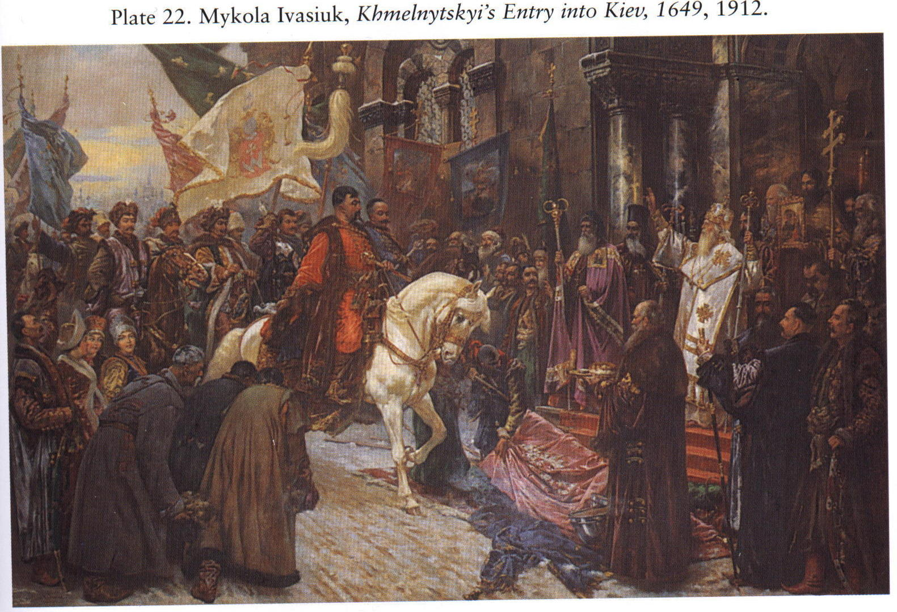
Notes:
31

Slide 32
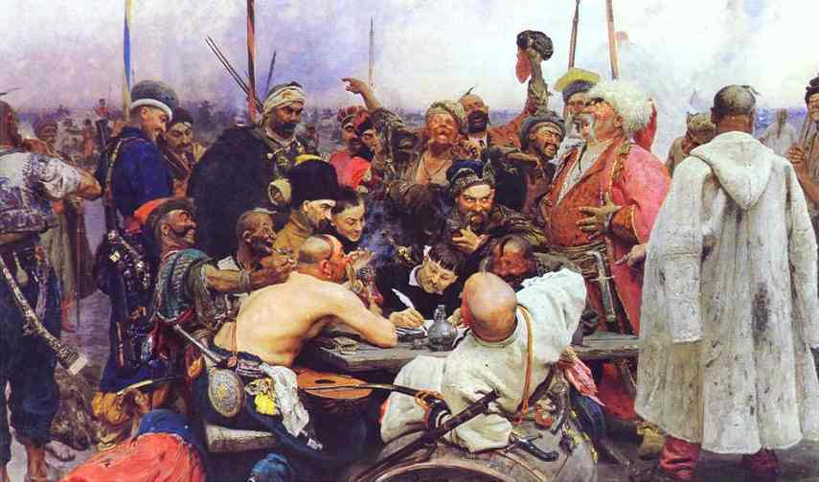
Ilja Repin: The letter of the Zaporizhian cossacks to Sultan Mahmud IV (1880-1891)
Notes:
32

Slide 33
The Making of the Ukrainian Nation
CONTRA
Ukrainian language not yet a fully developed “high language”, Russian and Polish available as alternative languages for higher education
Since 1667/1772 Eastern part has common history with Russia, Western part with Poland/Austria and Hungary
traditional elites have become Russians or Poles
no uncontested Ukrainian state in history
Potential members of the nation live in different empires as non-dominant ethnic groups
Opportunities for educated Ukrainians in Russian Empire
almost no middle class
Different religious denominations
Politics of Russification/Polonisation
PRO
Ukrainian language and literature in the vernacular since 1798
Greek-Catholic faith in Galicia a barrier to assimilation by the Polish nation
Common history until the 17th c.
Social antagonism to Polish/Polonised or Russian/Russified overlords
Cossack autonomy in early modern Europe and short period of independence
Cultural bonds: similar traditions, costumes, songs and so on
Children of Orthodox and Uniate Priests – core of educated national elite

