Slide 1
Entangled History: Ukraine and her neighbours from the Middle Ages to the Present
14 Nation-building Soviet style
Week 7 Spring Term
Notes:
1

Slide 2
Outline
Soviet nationality policy
2. Ukrainians in the Soviet Union
3. Russian nationalism and Soviet patriotism
4. Conclusion
Notes:
2

Slide 3
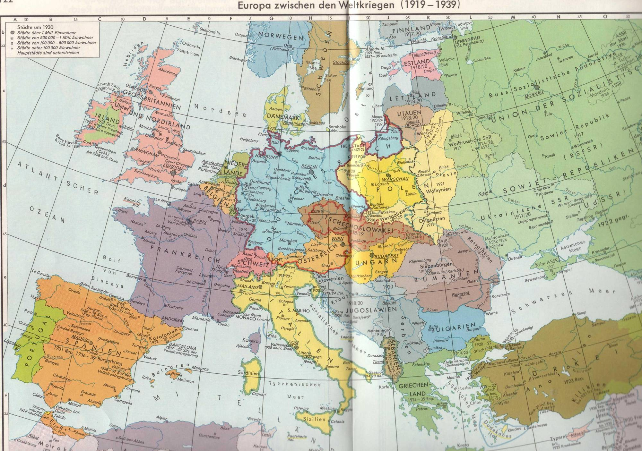
Putzger, Historischer Weltatlas, p. 122 f
Notes:
3

Slide 4
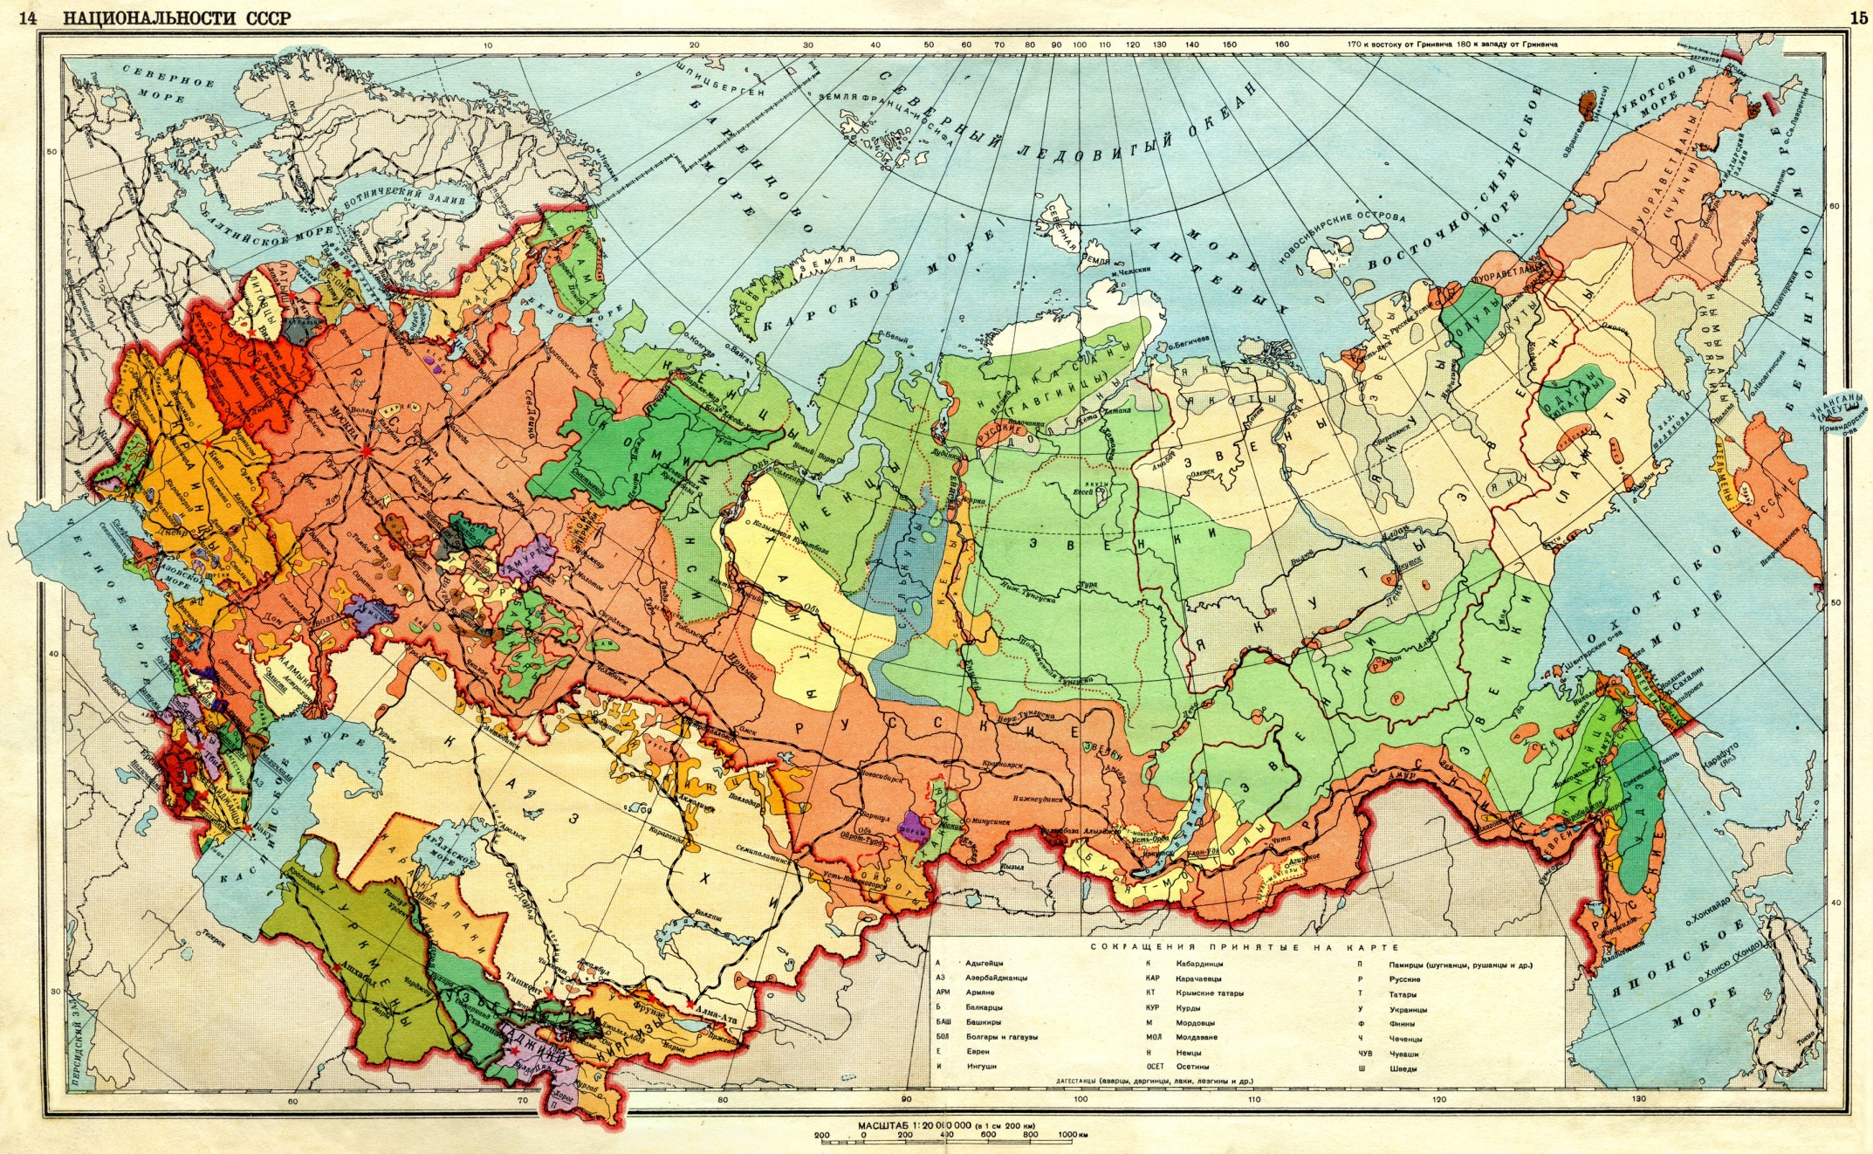
The Soviet Union: Facts, Descriptions, Statistics (published by the Soviet Information Bureau, Washington 1929)
Nationalities
The population of the U.S.S.R. is composed of 182 different nationalities, speaking 149 different languages or dialects. Under the census of December, 1926, the following thirty nationalities composed 97.6 per cent of the total population:
Russians 77,760,100 52.9
Ukrainians 31,194,800 21.2
White-Russians (West-Russia) (Belarusians) 4,739,900 3.2
Kazaks 3,959,900 2.7
Uzbeks (Central Asia) 3,904,500 2.6
Tatars (Middle Volga and Crimea) 3,015,200 2.0
Jews 2,600,900 1.8
Georgians (Transcaucasia) 1,821,200 1.2
Azerbaijan Turks 1,706,600 1.2
Armenians (Transcaucasia) 1,567,500 1.1
Mordvinians (Middle Volga) 1,340,400 0.9
Germans (Lower Volga) 1,238,500 0.8
Chuvashes (Middle Volga) 1,117,400 0.7
Tajiks (Central Asia) 978,200 0.7
Poles (chiefly Ukraine and White Russia) 782,300 0.5
Kirghizes (Central Asia) 768,700 0.5
Turkomans (Central Asia) 766,100 0.5
Bashkirs (Ural) 713,70 0 0.4
Votyaks (Eastern Russia) 504,20 0 0.3
Man (Eastern Russia) 428,20 0 0.3
Chechens (Northern Caucasus) 392,60 0 0.3
Moldavians (Southwestern Ukraine) 278,80 0 0.2
Ossetes (Caucasus) 272,20 0 0.2
Karelians (Northwestern Russia) 248,10 0 0.2
Meshcheriaks (Eastern Russia) 242,60 0 0.2
Buryats (Eastern Siberia) 237,50 0 0.2
Komi 221,30 0 0.2
Circassians (Northern Caucasus) 219,00 0 0.2
Yakuts (Eastern Siberia) 214,80 0 0.2
Greeks (South Russia and Ukraine) 213,80 0 0.2

Slide 5
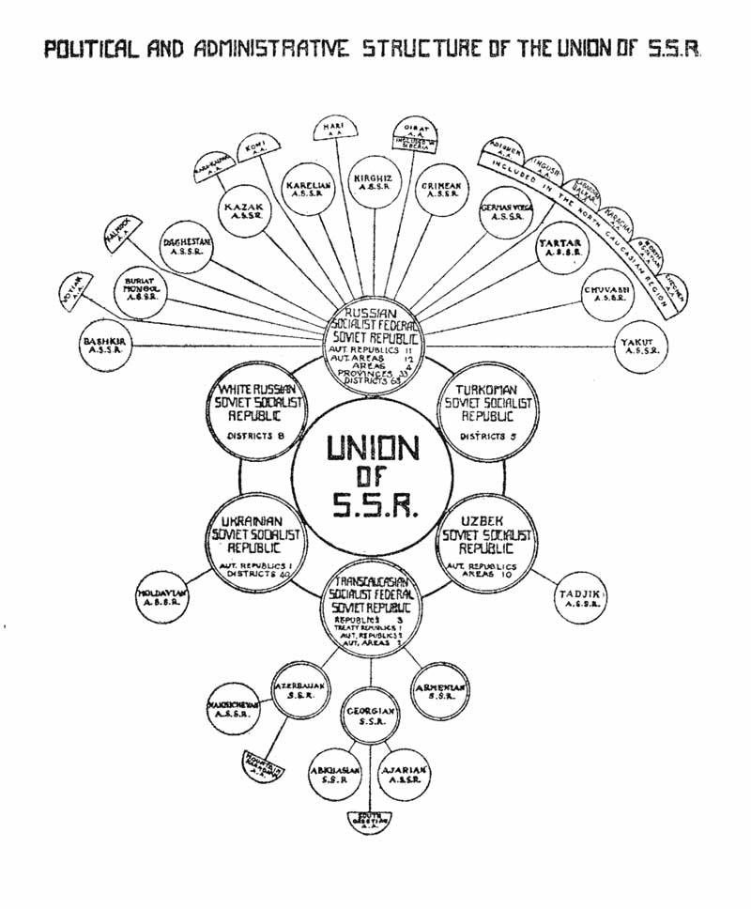
From the Soviet Information Bureau, 1927

Slide 6
Korenizatsiya ("putting down roots")
“nativization” or “indigenization”
Promoting representatives of titular nations of Soviet republics and lower levels of territorial subdivisions of the state into local government, management, bureaucracy and nomenklatura in the corresponding national entities.
Notes:
6

Slide 7
National in form, socialist in content (1920s)
Cultural autonomy for Soviet nationalities
Territorial principle: rights linked to the territory, not to the individual
Soviet Union as a federation of republics
Nation building of titular nations: preferential treatment
Some limited regional and local autonomy
But: has to be socialist in content
Unifying effect of Communist Party
Greatest danger for the Soviet Union – Russian nationalism, not nationalism of other national/ethnic groups (Lenin)
Suppression of Russian nationalism
Notes:
7

Slide 8
Outline
Soviet nationality policy
2. Ukrainians in the Soviet Union
3. Russian nationalism and Soviet patriotism
4. Conclusion
Notes:
8

Slide 9
Ukrainian SSR in the 1920s
Weakness of Bolsheviks in villages
Towns and cities mostly Russian speaking – villages Ukrainian speaking
Efforts under Ukrainian party leader Skrypnyk to promote Ukrainian culture and language and promote them in urban population while fighting against ‘bourgeois nationalism‘
Ukrainization of UkrSSR quite successful: Ukrainian schools teach Ukrainian children reading and writing in Ukrainian
Career opportunities for educated Ukrainians in Ukraine without identifying as Russian
Instilling pride in being Ukrainian – flourishing of Ukrainian folk culture but also support for developing of Ukrainian high-brow art and culture
Some political activists from East Galicia (now part of Poland) settling in UkrSSR, aiming to help building Ukrainian culture and state structures
Success of nationality policy in Ukraine raises suspicions in Moscow, especially with Stalin

Slide 10
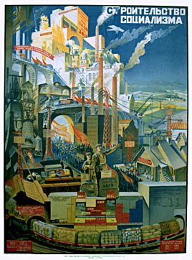
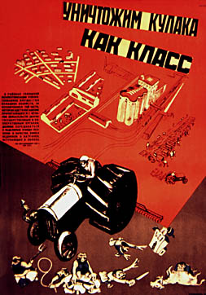
Notes:
10

Slide 11
Ukrainian SSR 1930-1934
Forced collectivisation – end of private agriculture: a war against the peasantry
Dekulakisation – terror against (moderately) successfull peasants, called kulaks
Disruption of agriculture + bad weather, leading to bad harvest in 1932/33
Famine in Soviet Union, most affected Kazakhstan and Ukraine
3 – 5 Million Ukrainians starve to death – demographic impact even bigger
Holodomor – a genocide
Purge of Ukrainian Communist Party – accused of 'bourgeois nationalism‘
Arrest and killing of Ukrainian intellectuals
Holodomor – a genocide?

Slide 12
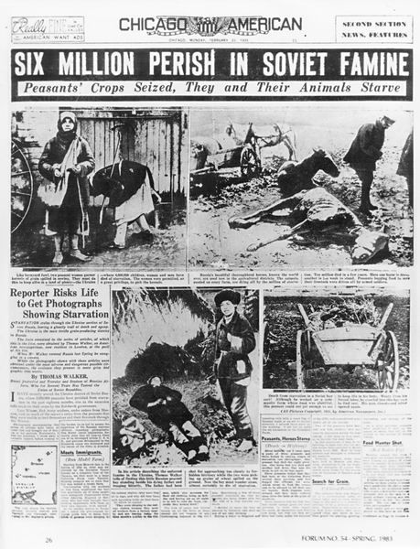
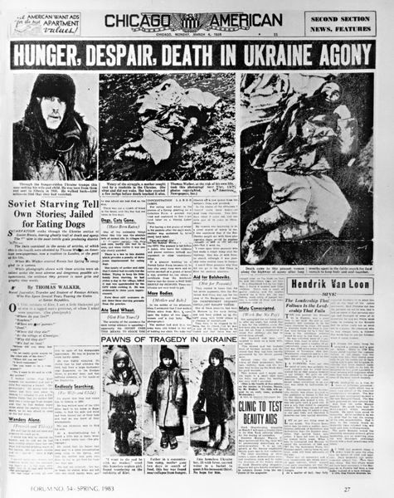
http://www.holodomor.org/
Notes:
12

Slide 13
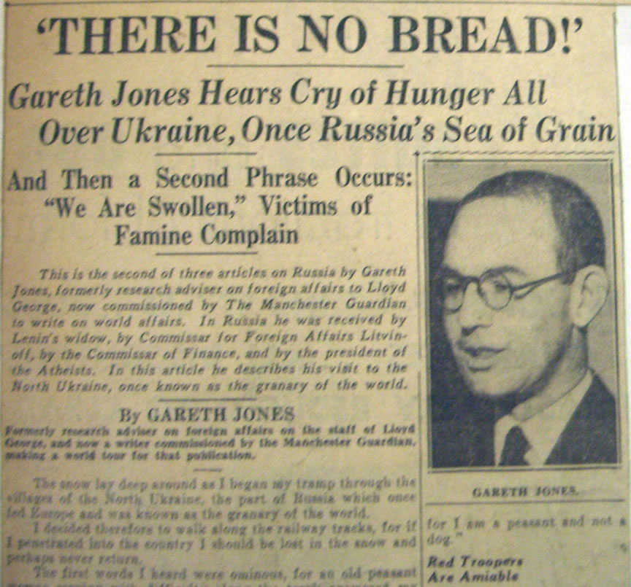
13 January 1935
Sunday American / Los Angeles Examiner
Notes:
13

Slide 14
Soviet nationality policy (1930s)
National communism seen as a threat (especially in Ukraine), as a deviation from socialism
Measures against national-communist leaders in Soviet republics
Central authority re-established
But: nation building in republics not stopped, but their extent is reduced
Notes:
14

Slide 15
The Pyramid of National Soviets, 1932-1938
1932 | 1938
Soviet Union 1 Federal republic 2 Union republic 7 Autonomous republic 15 Autonomous oblast 16 Autonomous okrug 10 National district 290 National village soviet 7,000 National kolkhoz 10,000 Personal nationality 147,027,915 | Soviet Union 1 Federal republic 1 Union republic 11 Autonomous republic 16 Autonomous oblast 8 Autonomous okrug 10 Personal nationality 161,753,176
Terry Martin, The Affirmative Action Empire. Nations and Nationalism in the Soviet Union, 1923-1939 (Ithaca, London 2001), p. 413

Slide 16
Nationality Policy and the Great Terror
Fascism and growing nationalism in Europe: move against diaspora minorities: Poles, Germans, Koreans, Romanians, Latvians and other
Elimination of potential irredentist movements – enemy nations
About 111,000 people were executed in the so-called Polish Operation, almost all other members of the Polish minority (700,000) in the Soviet Union deported to Siberia or Kazakhstan
National operations during Great Terror: deportation of diaspora nations
Tens of thousands of members of national elites killed
Reducing national complexity: many national territorial units dissolved (Polish, German and other local and regional Soviets/units)
Soviet nation building now limited to key nations
Notes:
16

Slide 17
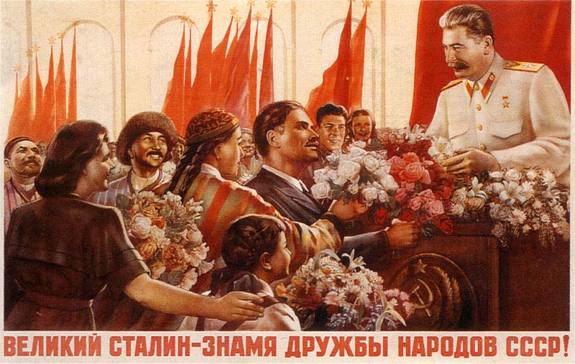
Notes:
17

Slide 18
Outline
Soviet nationality policy
2. Ukrainians in the Soviet Union
3. Russian nationalism and Soviet patriotism
4. Conclusion
Notes:
18

Slide 19
The rehabilitation of Russian history
Rehabilitation of Russian history in connection with etatist move of Soviet Union
No longer Russian nationalism, but nationalism of other ethnic/national groups seen as greatest danger for Soviet Union
Partly russification, national (for example Ukrainian) version of history could be taught as long as it was compatible with friendship with Russia
Socialism and shared Russian culture (brother nation) as unifying element
Notes:
19

Slide 20
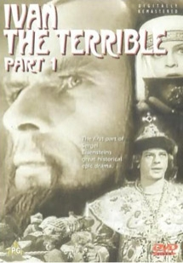
‘Ivan IV was an outstanding political figure of sixteenth-century Russia. He completed the establishment of a centralized Russian state, a progressive endeavor initiated by Ivan III. Ivan IV fundamentally eliminated the country’s feudal fragmentation, successfully crushing the resistance of representatives of the feudal order…
All of these reforms met with vigorous resistance on the part of the representatives of the feudal order – entrenched patrimonial estate-holders, tenaciously insisting on the preservation of the feudal order. Ivan the Terrible was forced to resort to harsh measures in order to strike at the feudal patrimonial privileges of the boyars.’
Excerpt from A. S. Shcherbakov, ‘Memorandum to Stalin concerning A. N. Tolstoi’s play Ivan the Terrible’ (1941-1943), Kevin M. F. Platt and David Brandenburger (eds), Epic Revisionism. Russian History & Literature as Stalinist Propaganda (Madiscon, Wisconsin, 2006), pp. 179-189.
Notes:
20

Slide 21
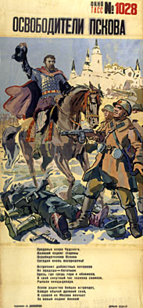
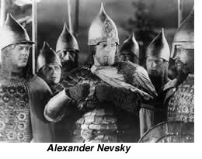
A.T. Danilichev, The Liberator of Pskov
1944

Slide 22
National anthem (today only the first 6 lines) "Shche ne vmerla Ukraina" (Ukraine's Glory Has Not Perished)
Words by: Paul Chubynskyi (1862)
Music by: Mikhail Verbytskyi
Adopted: 1917, abolished 1920, restored 1991
Ще не вмерла Україна, і слава, і воля, Ще нам, браття молодії, усміхнеться доля. Згинуть наші вороженьки, як роса на сонці, Запануєм і ми, браття, у своїй сторонці. CHORUS Приспів Душу, тіло ми положим за нашу свободу. І покажем, що ми, браття, козацького роду. Станем, браття, в бій кровавий від Сяну до Дону В ріднім краю панувати не дамо нікому;Чорне море ще всміхнеться, дід Дніпро зрадіє, Ще у нашій Україні доленька наспіє. CHORUS Приспів завзяття, праця щира свого ще докаже, Ще ся волі в Україні піснь гучна розляже, За Карпати відоб’ється, згомонить степами, України слава стане поміж народами. CHORUS | Ukraine has not perished, neither her glory, nor freedom, Upon us, fellow--Ukrainians, fate shall smile once more. Our enemies will vanish, like dew in the morning sun, And we too shall dwell, brothers, in a free land of our own. CHORUS: We'll lay down our souls and bodies to attain our freedom, And we'll show that we, brothers, are of the Cossack nation. We'll stand together for freedom, from the Sian to the Don, We will not allow others to rule in our motherland. The Black Sea will smile and grandfather Dnipro will rejoice, For in our own Ukraine fortune shall flourish again. CHORUS Our persistence and our sincere toils will be rewarded, And freedom's song will resound throughout all of Ukraine. Echoing off the Carpathians, and rumbling across the steppes, Ukraine's fame and glory will be known among all nations. CHORUS
1st line (before 2003): Shche ne vmerla Ukrajina, ni slava, ni volja,
1st line (after 2003): Shche ne vmerla Ukrajini i slava, i volja,
Notes:
22

Slide 23
Anthem of Soviet Ukraine (1949-1991)
Words by Pavel Tychina and Mikola Bazhan (1948?), changed in 1978 (2nd stanza to remove mention of Stalin)
Music by Anton Dmitrievich Lyebyedinyec (1948?)
https://www.youtube.com/watch?v=sKB91zS2x6c
1. Live, Ukraine, beautiful and mighty, -
In the Soviet Union you have found happiness.
Equal between the equal ones (other republics), free between the free ones,
Under the sunrays of freedom you have bloomed as a flower.
CHORUS:
Glory to the Soviet Union, Glory!
Glory to the Motherland in the eternity!
Live, Ukraine, Soviet power,
In the united homeland of fraternal nations.
2. In battles for people’s fate
Russian people were always our friend and brother.
Lenin led us in a victorious campaign
Under October’s banner to brilliant heights.
CHORUS
3. We fame our mighty Fatherland with labour,
Affirm the truth of immortal ideas.
To the shining communism – the great future -
Lenin’s party wisely leads us.
CHORUS
Notes:
23

Slide 24
The Hymn of the Soviet Union 1944-1977 (1955-1977 performed without words)
Music by Aleksander Aleksandrov (1943)
Words by Sergey Mikhalkov (1943)
1. The unbreakable union of free republics
Great Russia has joined forever;
Long live that which was created by the will of the people,
The united, mighty Soviet Union! .
Refrain
Be renowned, our free Fatherland,
Reliable bulwark of the friendship of peoples!
Soviet flag, people’s flag Let it lead from victory to victory!
Through days dark and stormy where great Lenin led us
Our eyes saw the bright sun of freedom above
and Stalin our leader with faith in the People,
Inspired us to build up the land that we Love.
Refrain
We fought for the future, destroyed the invader,
and brought to our Homeland the laurels of fame.
Our glory will live in the memory of nations
and all generations will honour her name.
Refrain
https://www.youtube.com/watch?v=EuDzrndmnVU
Notes:
24

Slide 25

The Internationale, Soviet Anthem 1917-1944
Music by Pierre Degeyter (1888)
Words by Eugène Pottier (1871)
1. Arise, ye workers from your slumber, Arise, ye prisoners of want. For reason in revolt now thunders, and at last ends the age of cant! Away with all your superstitions, Servile masses, arise, arise! We'll change henceforth the old tradition, And spurn the dust to win the prize! | 2. No more deluded by reaction, On tyrants only we'll make war! The soldiers too will take strike action, They'll break ranks and fight no more! And if those cannibals keep trying, To sacrifice us to their pride, They soon shall hear the bullets flying, We'll shoot the generals on our own side. CHORUS
CHORUS So comrades, come rally, And the last fight let us face. The Internationale, Unites the human race. So comrades, come rally, And the last fight let us face. The Internationale, Unites the human race. | 3. No saviour from on high delivers, No faith have we in prince or peer. Our own right hand the chains must shiver, Chains of hatred, greed and fear. E'er the thieves will out with their booty, And give to all a happier lot. Each at the forge must do their duty, And we'll strike while the iron is hot. CHORUS
https://www.youtube.com/watch?v=t8EMx7Y16Vo
Notes:
25

Slide 26
Outline
Soviet nationality policy
2. Ukrainians in the Soviet Union
3. Russian nationalism and Soviet patriotism
4. Conclusion
Notes:
26

Slide 27
Russians in USSR:
1920s give up Russian nationalism and adopt Soviet patriotism and idea of socialist fatherland
1930s rehabilitation of Russian nation - Russian nationalism and Soviet patriotism go hand in hand
Ukrainians in USSR:
defeat in state building wars 1918-20: satisfied with Ukrainian Socialist Republic as part of Soviet Union or resistance against Soviet/Russian oppression? Collectivization and Ukrainian famine as traumatic experiences.
Poles in USSR:
Minority rights in 1920s, in 1930’s ‘enemy nation’, executions (ca. 100,000) and deportation
Notes:
27

