Slide 1
Entangled History: Ukraine and her neighbours from the Middle Ages to the Present
20 The Russian War against Ukraine
Week 3 Summer Term
Notes:
1

Slide 2
Outline
Introduction
Annexation of Crimea and war in Donbas
NATO expansion and other pretexts
The Russian invasion on 24 February 2024
Developments and Outlook
Notes:
2

Slide 3
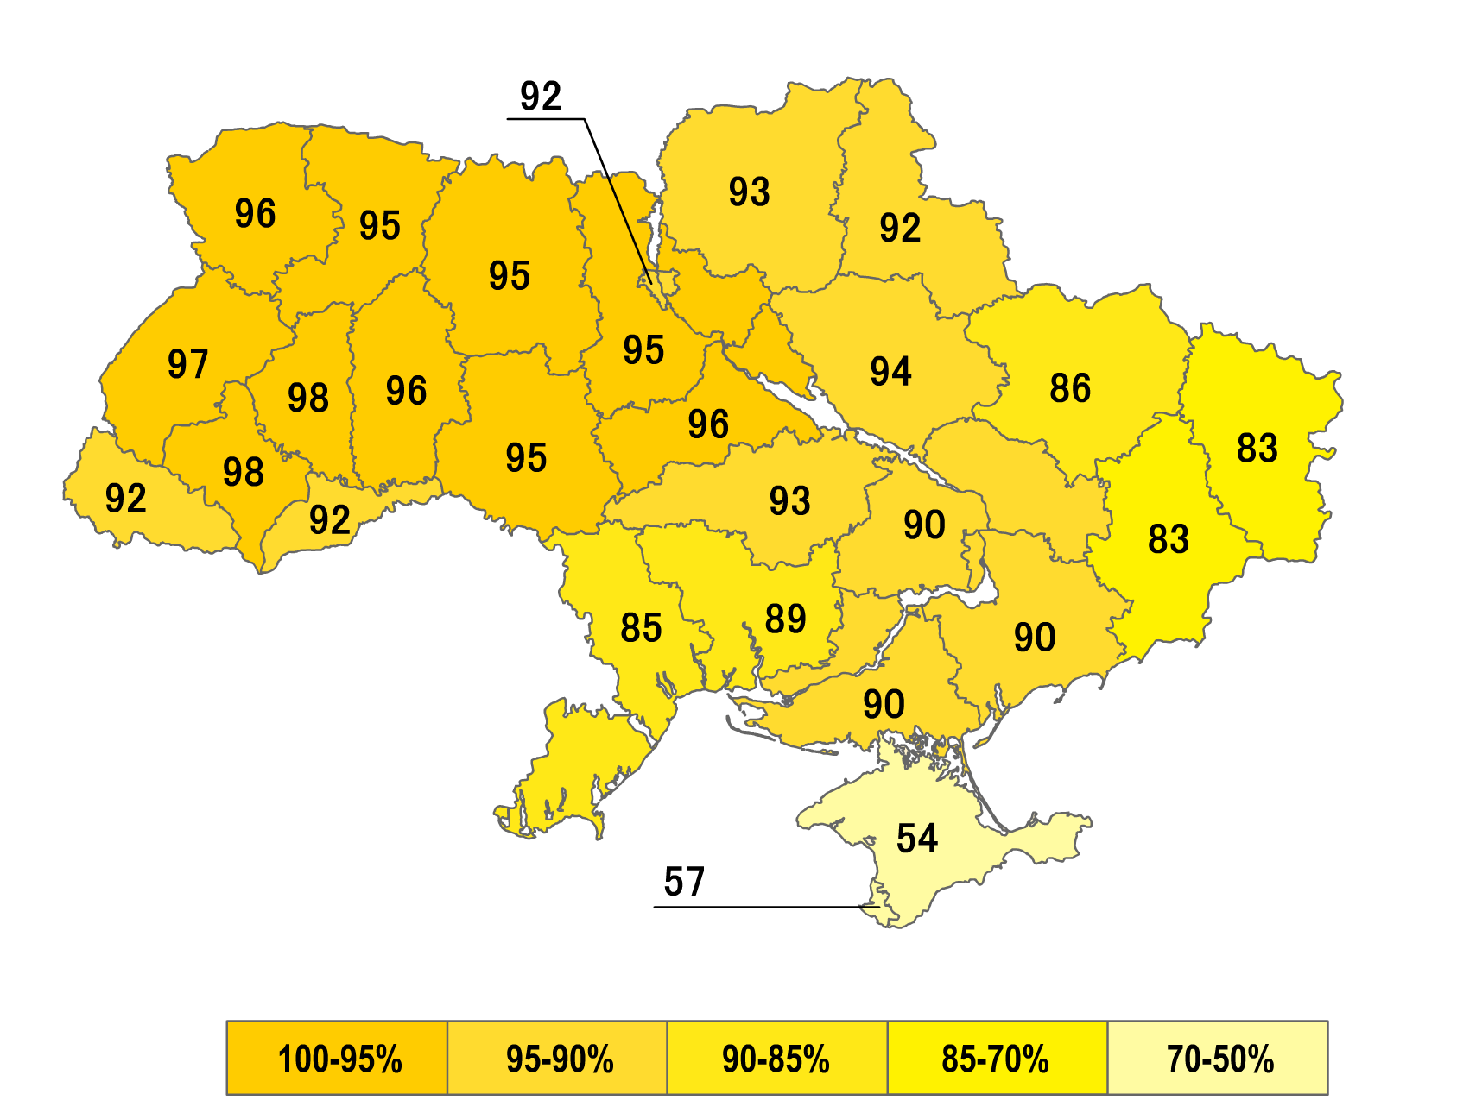
Recent context
Plebiscite, December 1, 1991: ”Do you support the Declaration of Independence of Ukraine?” Yes-vote
Declaration of independence of Ukraine on 24 August 1991 and dissolution of Soviet Union on 31 December 1991
Orange Revolution in Autumn 2004
Revolution of Dignity or Euromaidan November 2013
Ukraine moving out of Russian orbit
War in Ukraine since 2014, Russian annexation of Crimea, proxy war in Donetsk und Luhansk
24 February 2022 full-scale Russian invasion of Ukraine

Slide 4
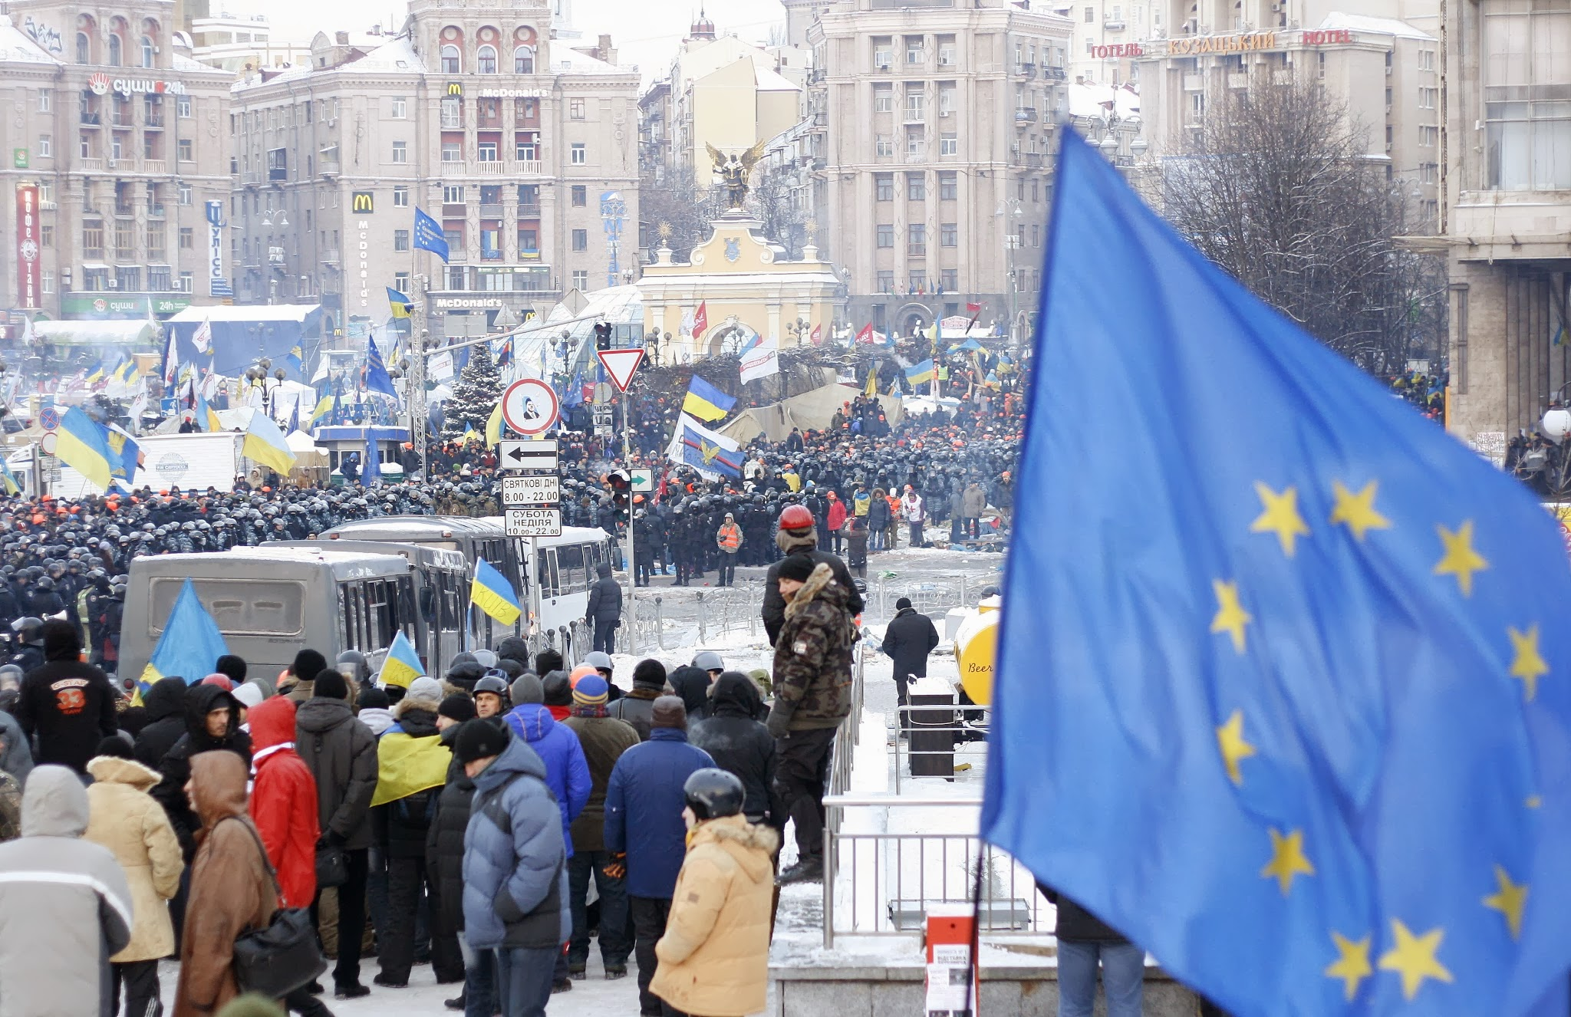
Euromaidan December 2013, Kyiv

Slide 5
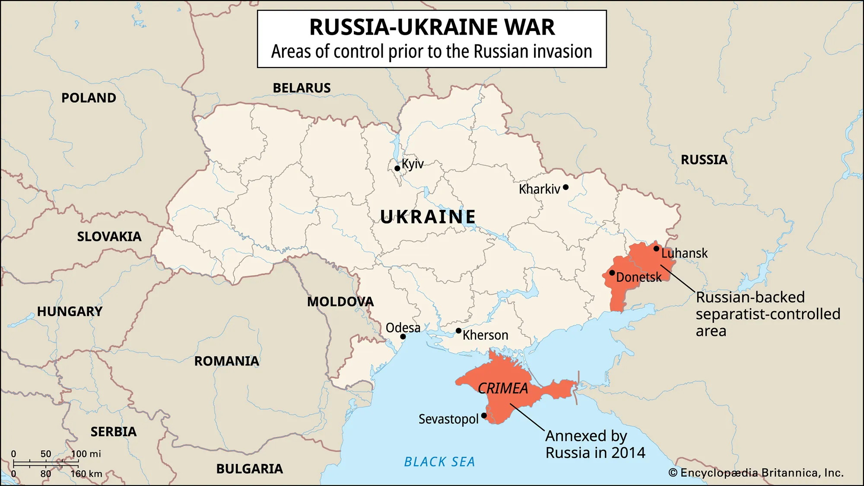
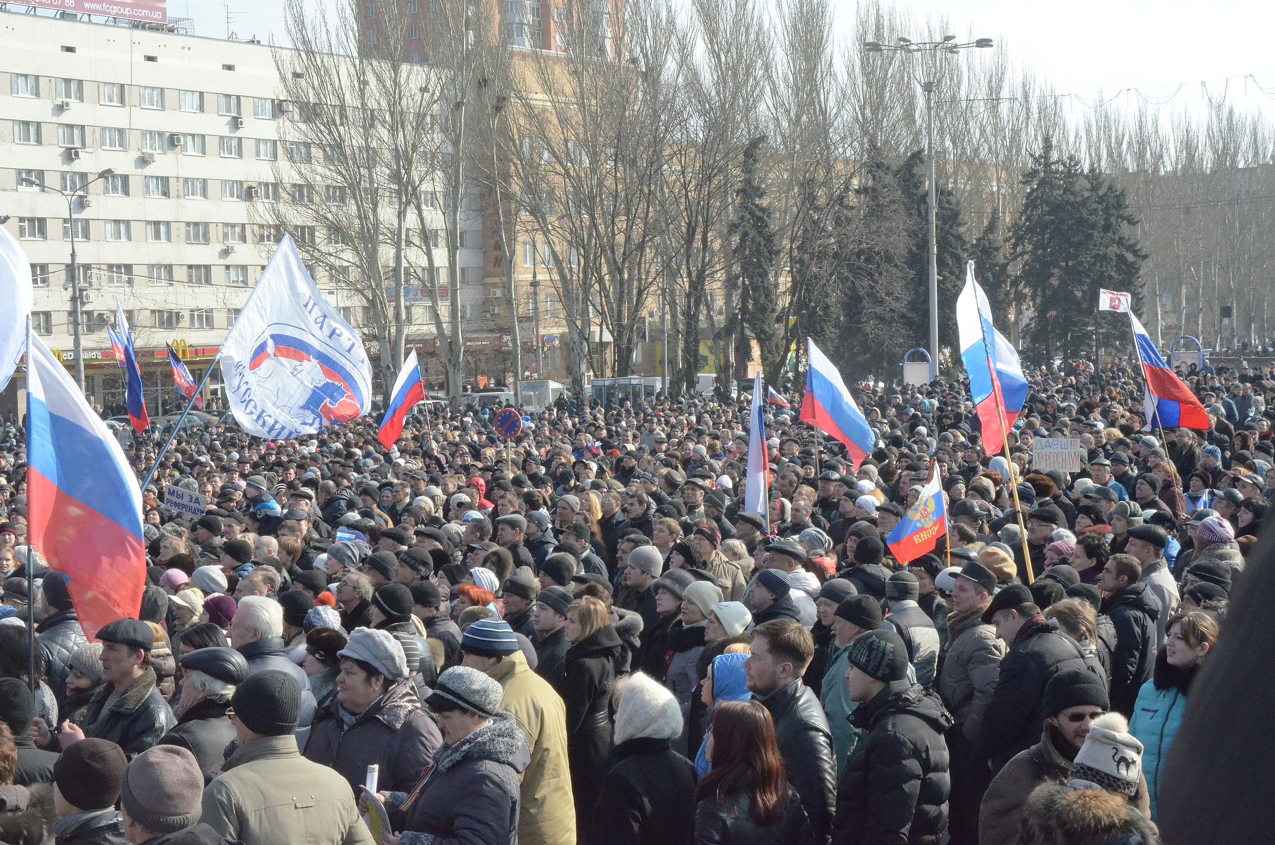
For a timeline of the conflict since 2014 click here: https://researchbriefings.files.parliament.uk/documents/CBP-9476/CBP-9476.pdf

Slide 6
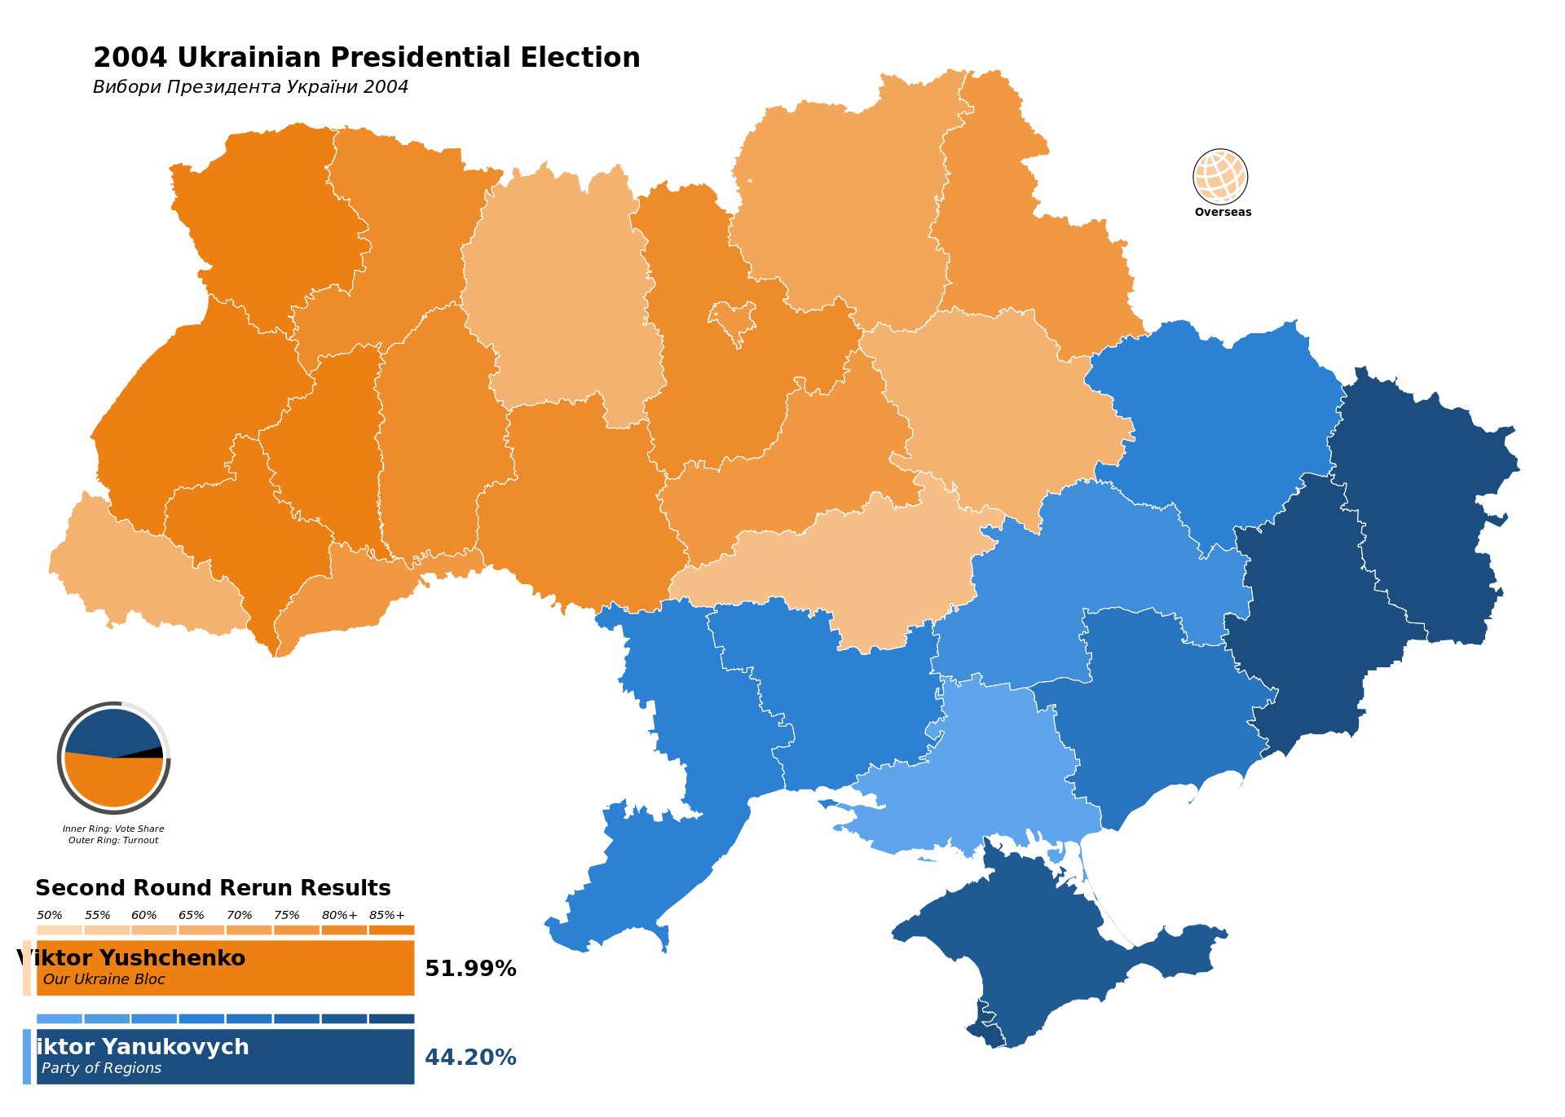
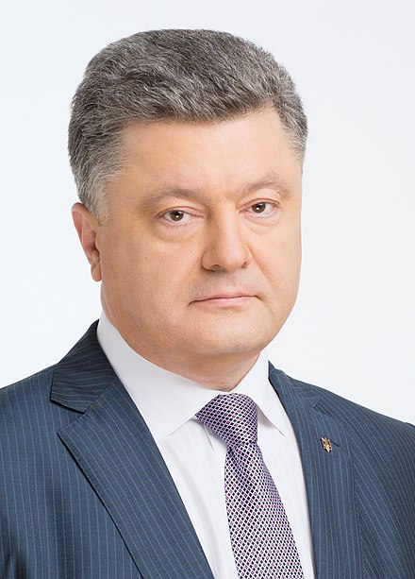
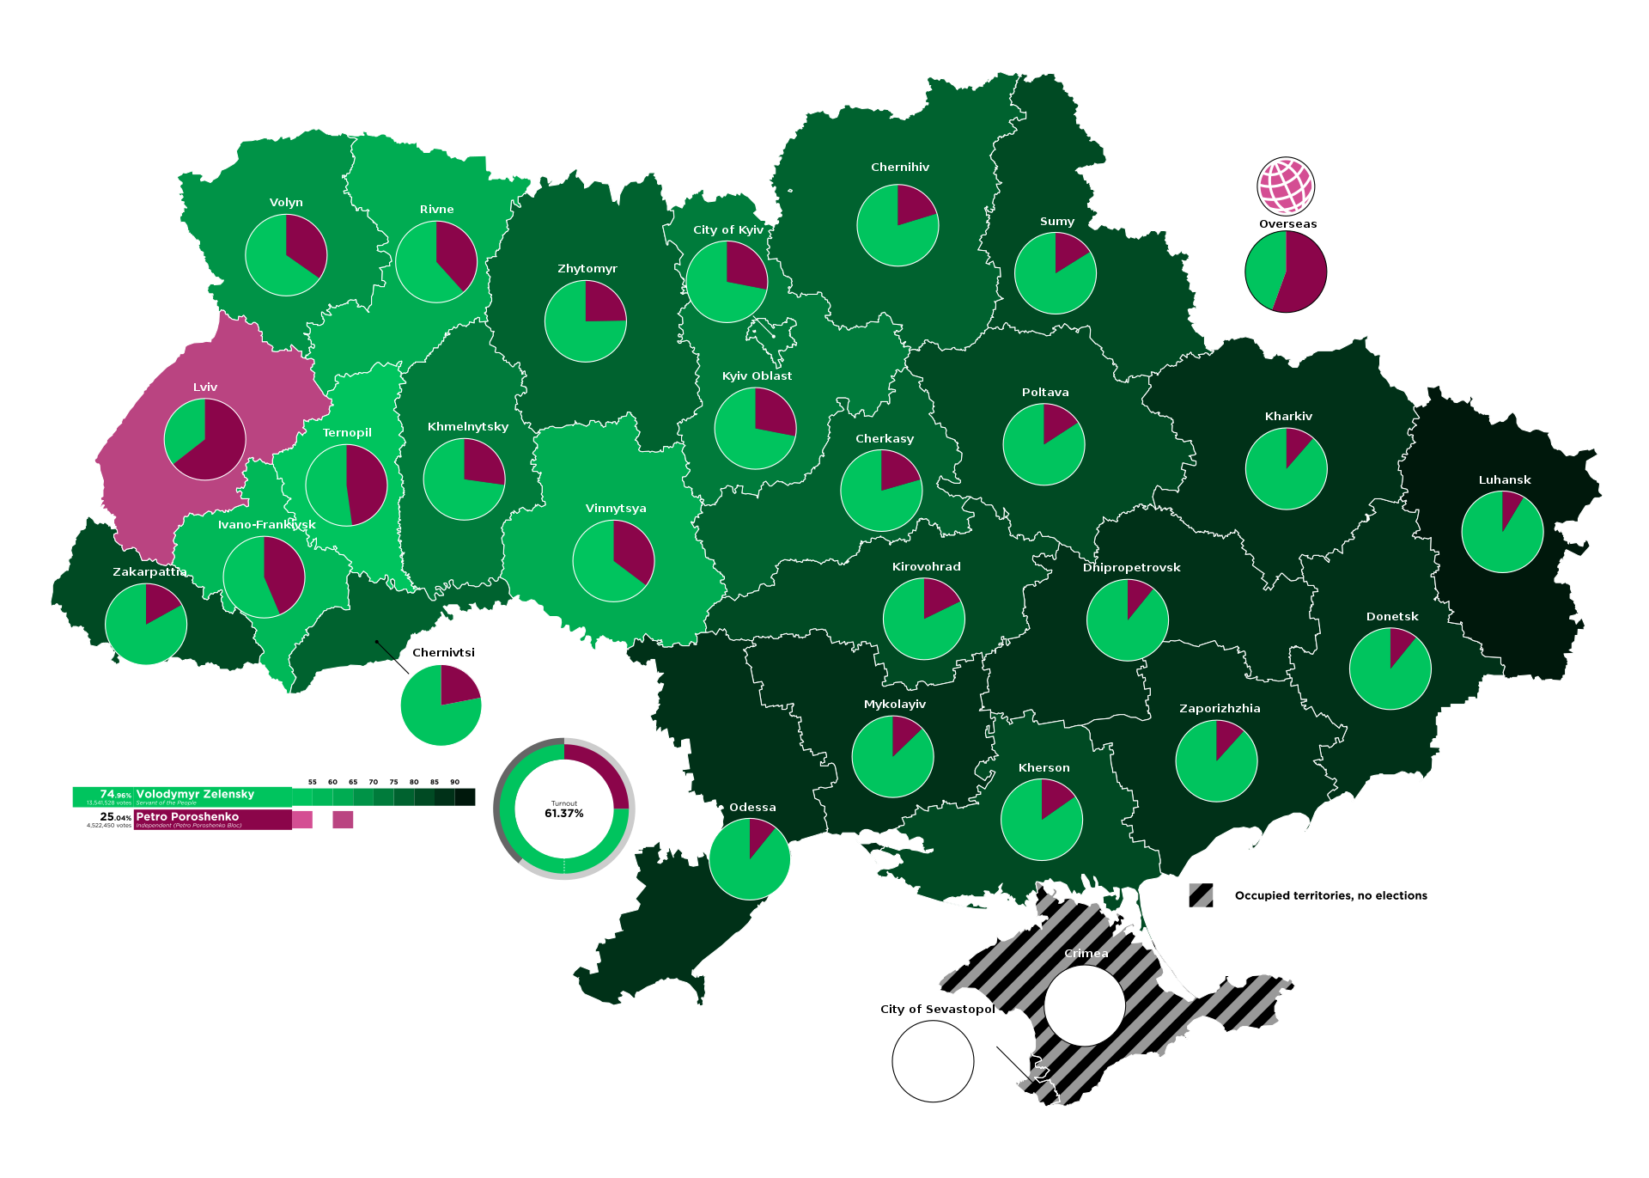
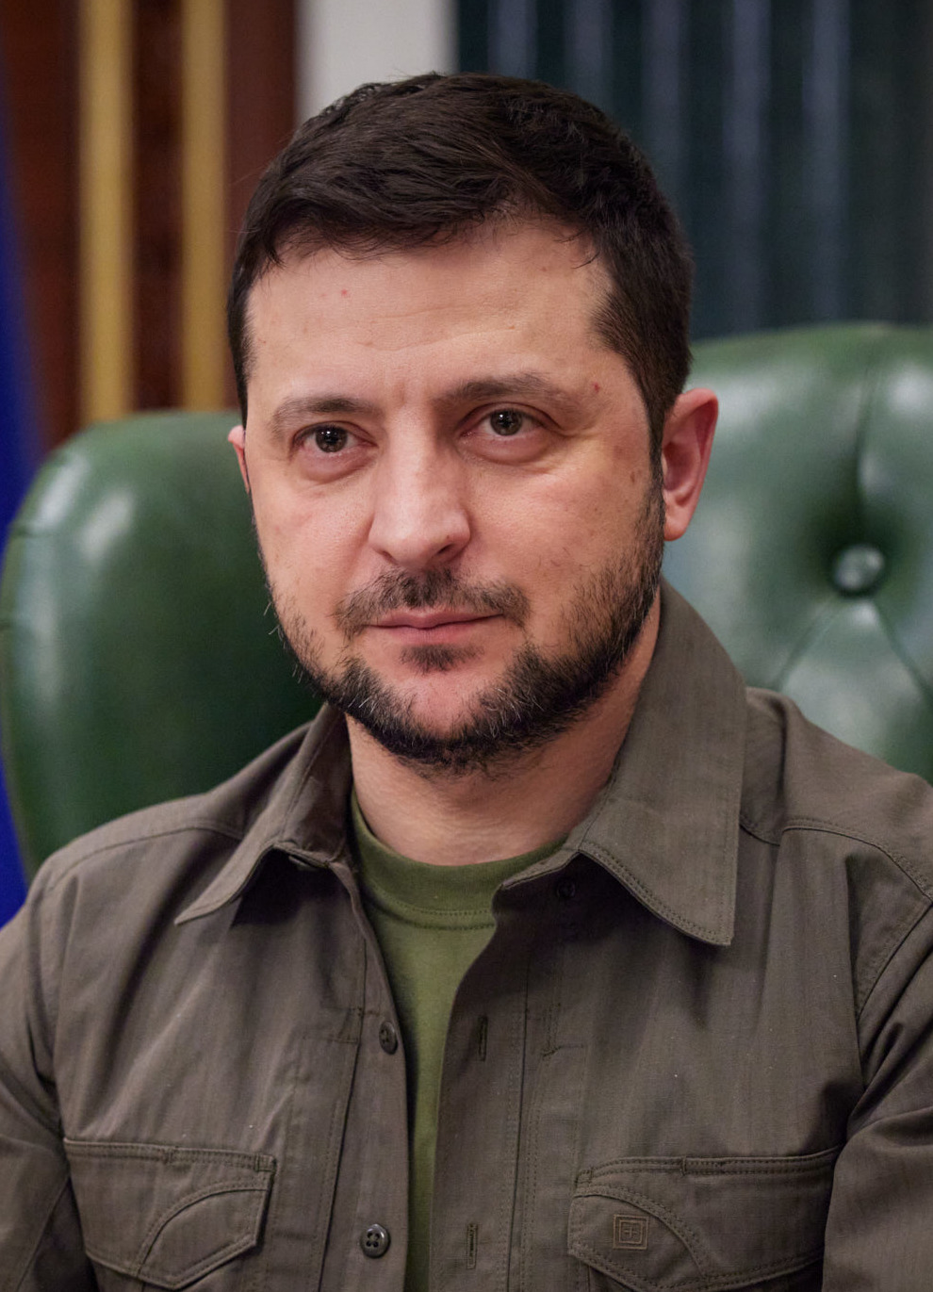
Presidential elections 2019, Zelensky green, Poroshenko red

Slide 7
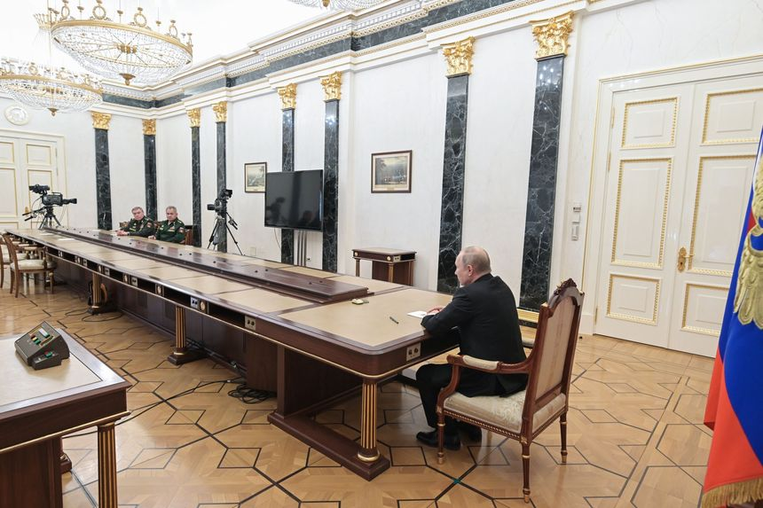

Slide 8
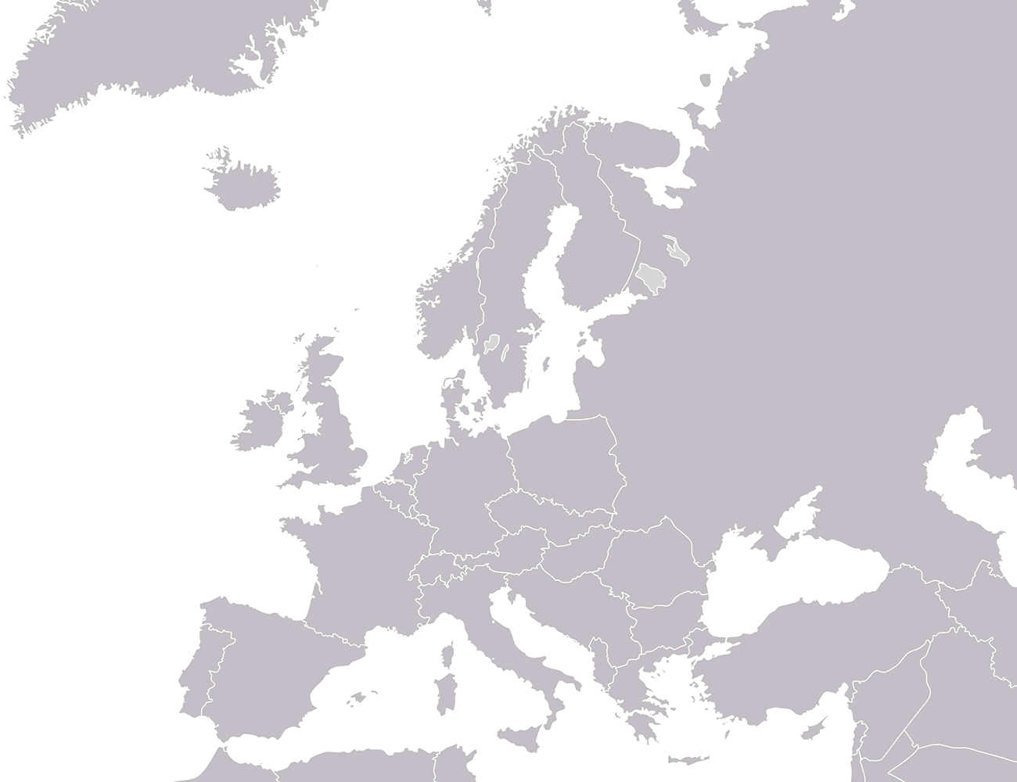
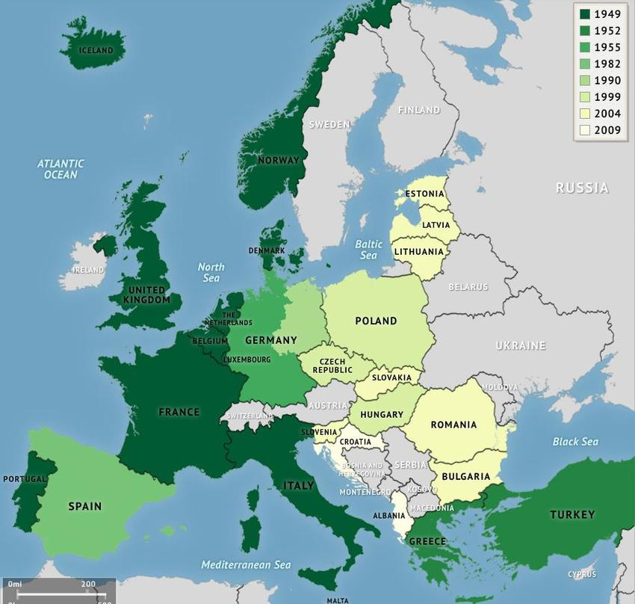
Stages of NATO enlargement

Slide 9
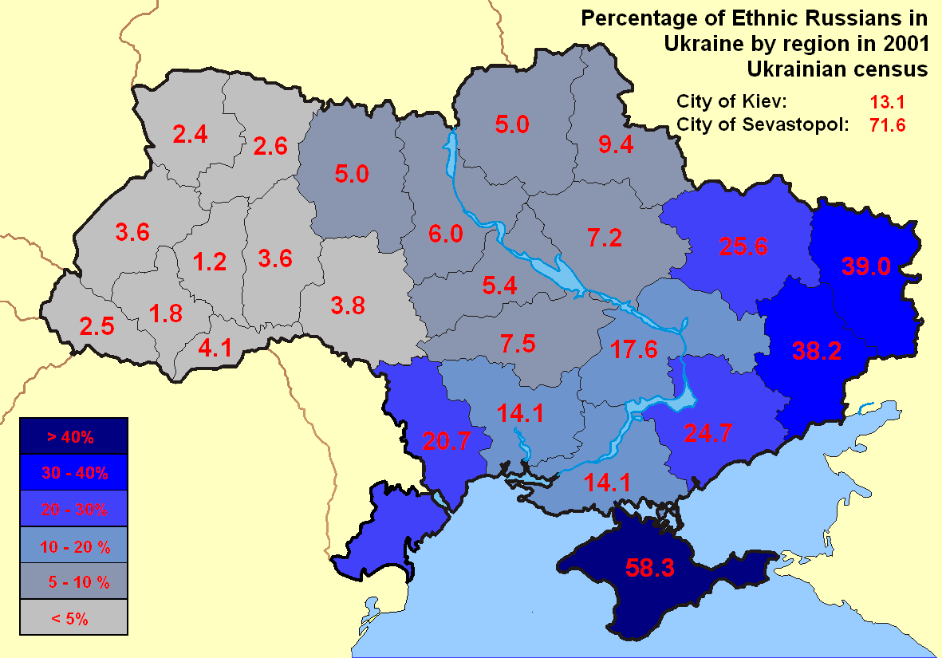
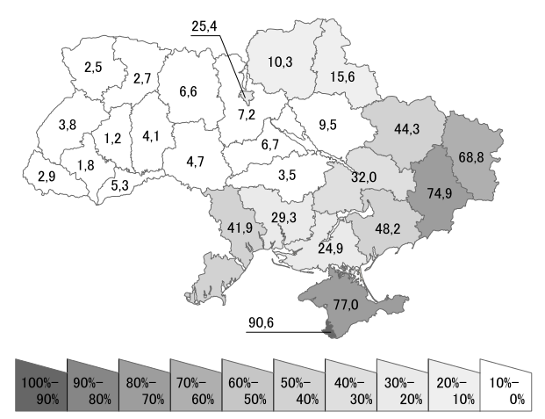
Share of people with Russian as first language in % (Census 2001)

Slide 10
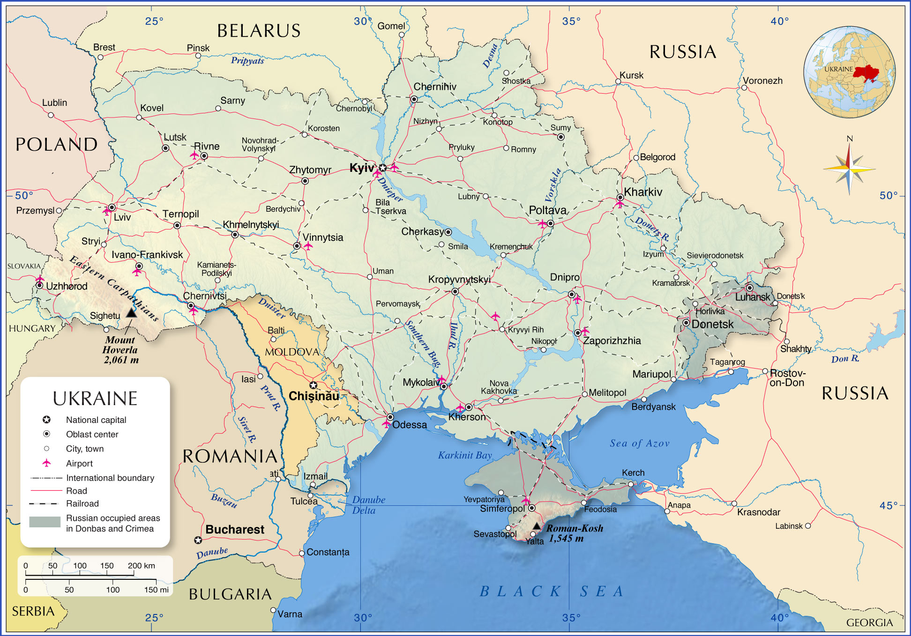
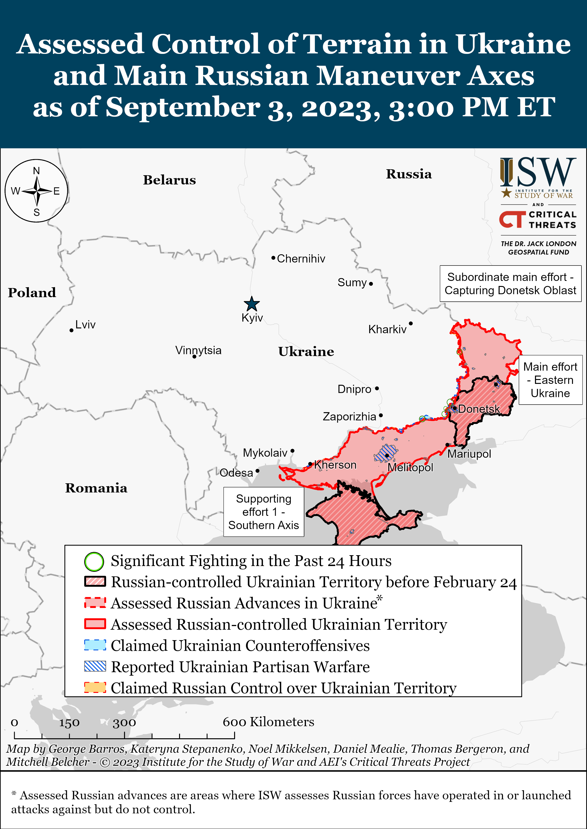

Slide 11
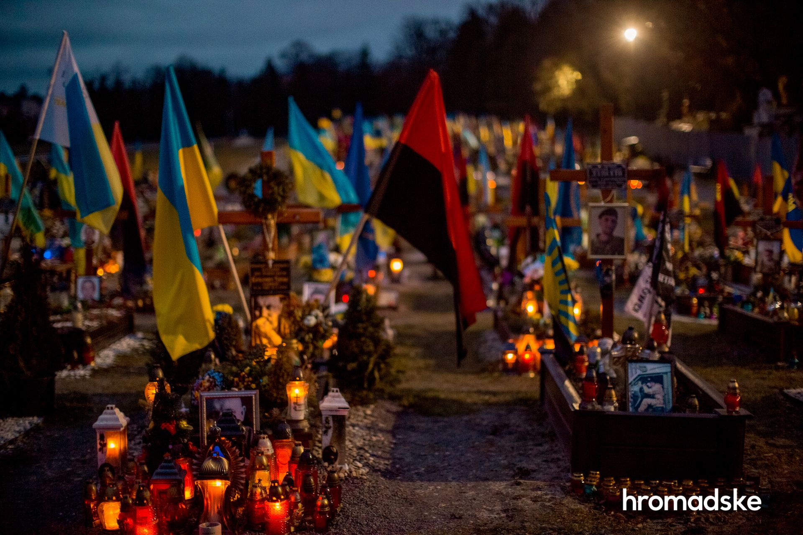
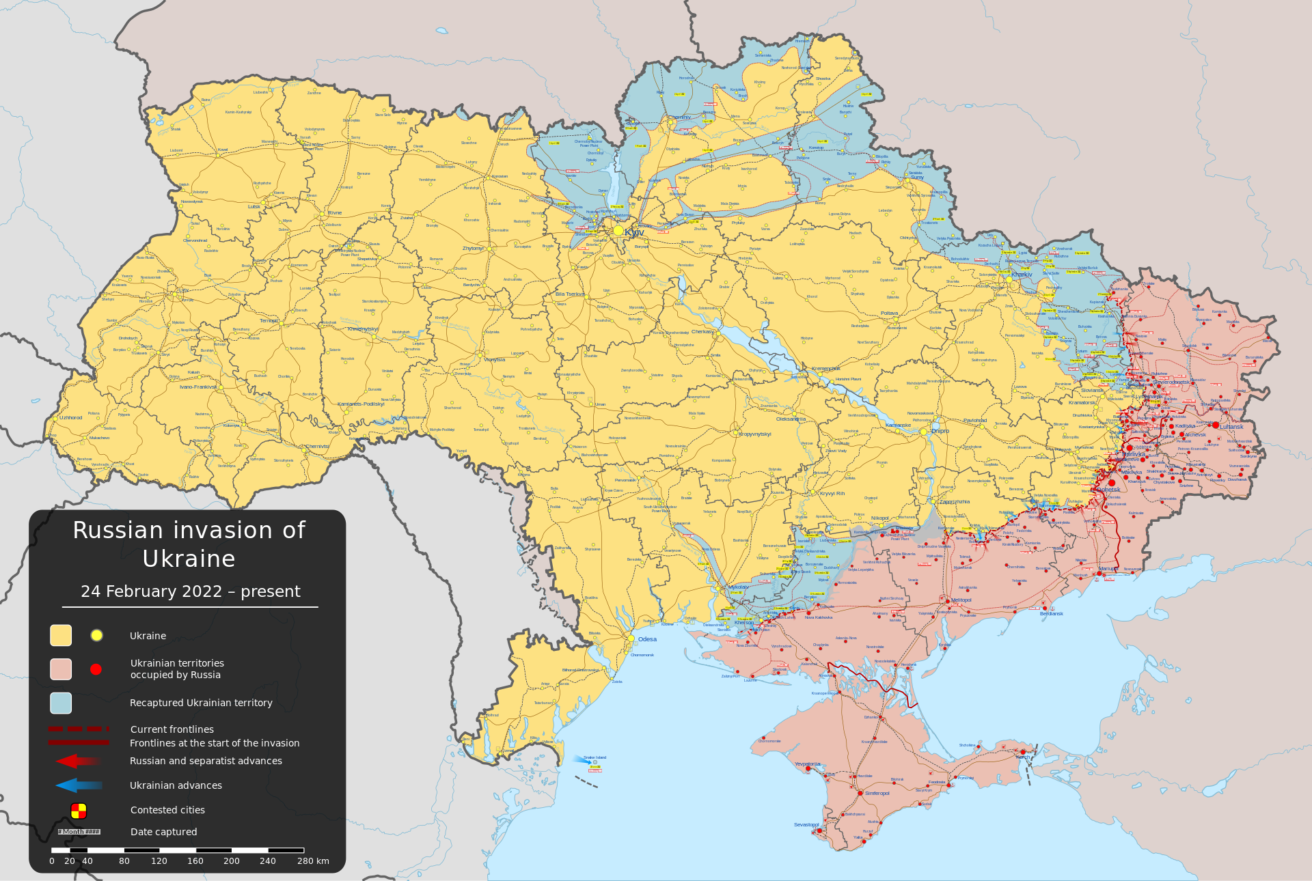
Cemetery of fallen Ukrainian soldiers in Lviv, 2023
Putin‘s uses history (as he understands it) to legitimise the attack on Ukraine and Russia‘s land grab
Genocidal dimension of war
  kidnapping children
  destroying or appropriating Ukrainian cultural heritage
  denying the existence of the Ukrainian nation by
  denying that Ukraine has a history outside of the framework provided by the Russian narrative,
  or a future outside of the
  ‚Russian World‘
By Viewsridge - Own work based on: Russo-Ukrainian conflict (2014-2022).svg by Rr016 &amp; Ukraine adm location map improved.svg by Yakiv GluckTerritorial control sources:Template:Russo-Ukrainian War detailed map / Template:Russo-Ukrainian War detailed relief mapISW, CC BY-SA 4.0, https://commons.wikimedia.org/w/index.php?curid=115506141

Slide 12
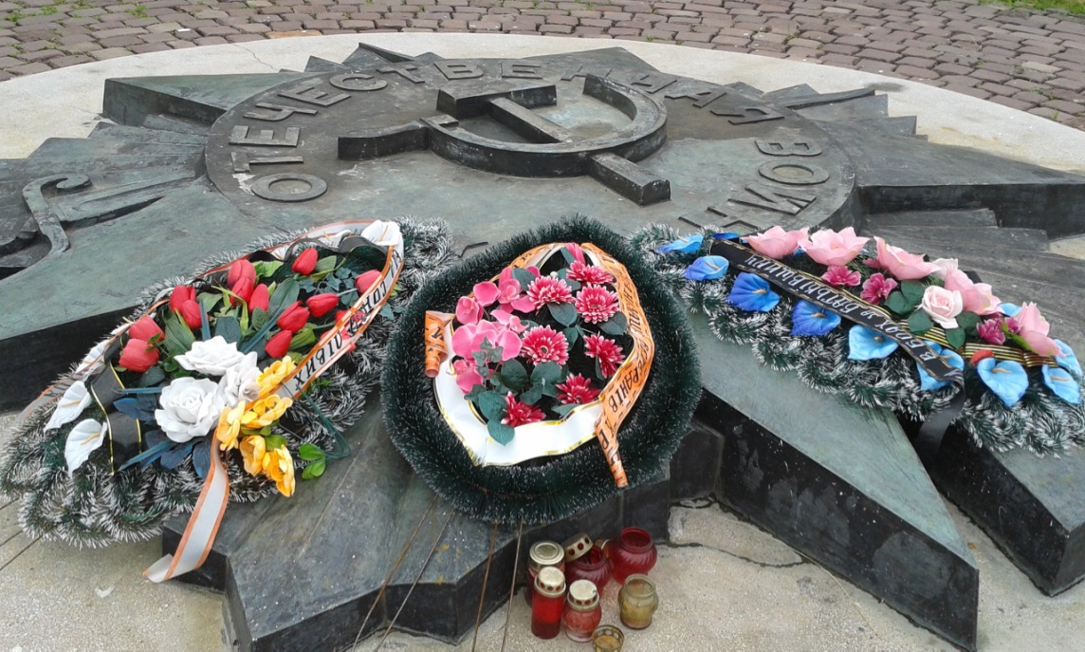
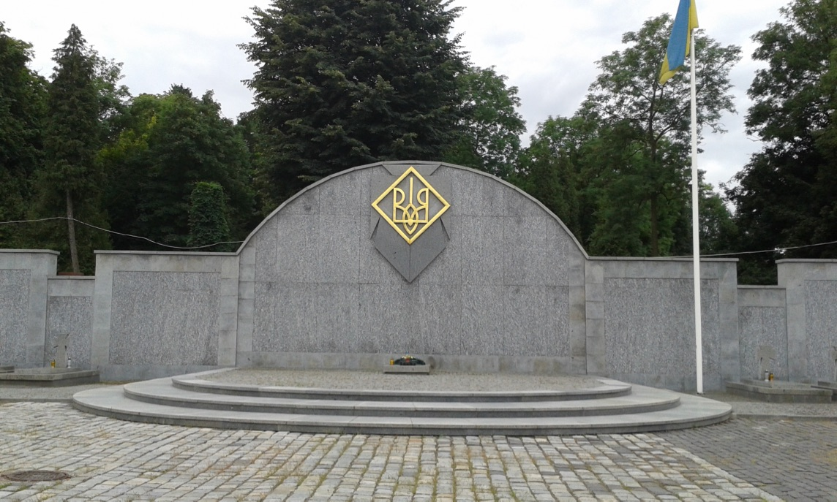
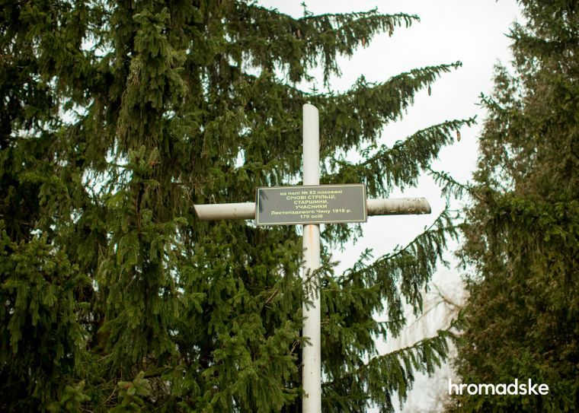
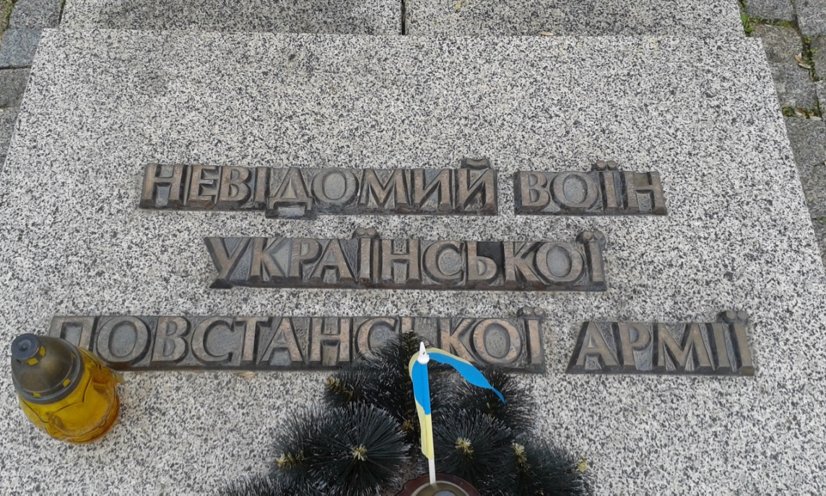
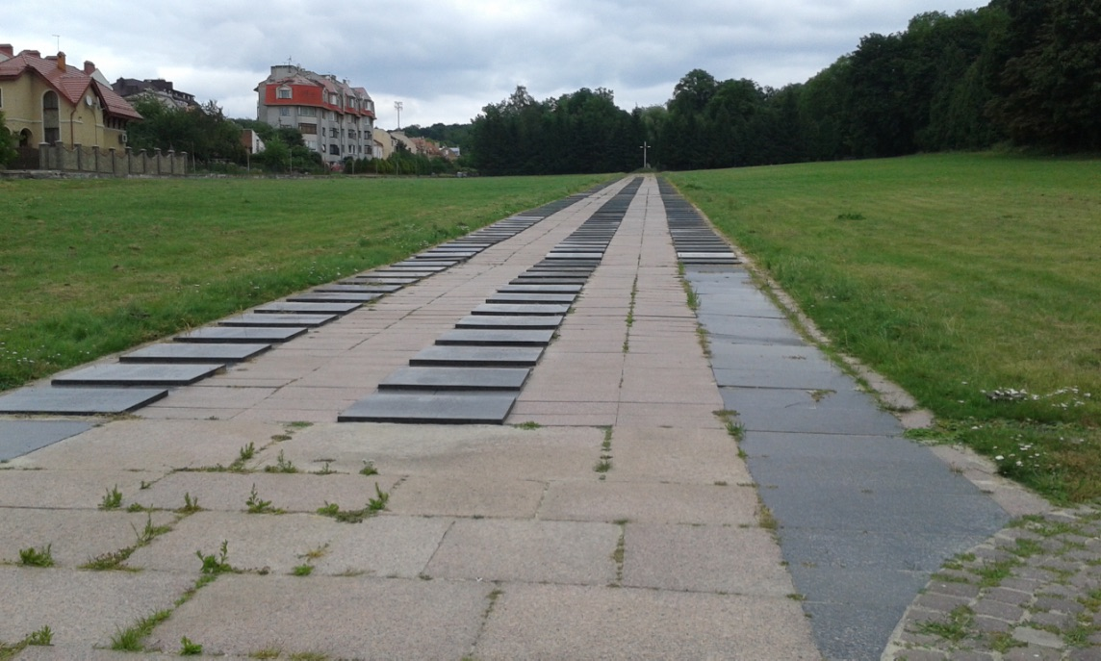
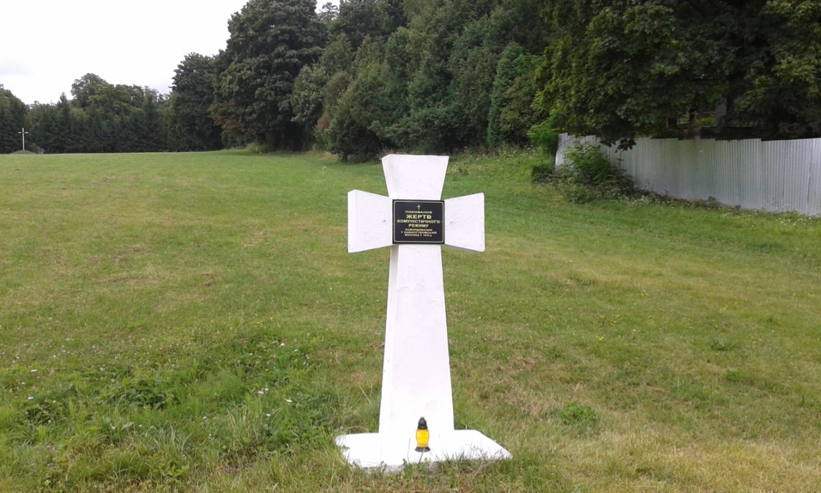
Soviet war memorial
UPA memorial and tomb of Unknown Soldier of Ukrainian Insurgent Army
Cross dedicated to Sich rieflemen 1918/19, erected in 1989
NKVD victim
Soviet war graves
And NKVD graves 1945-1947

Slide 13
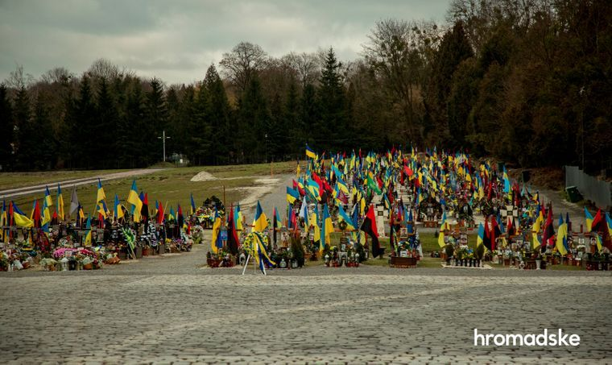

Slide 14
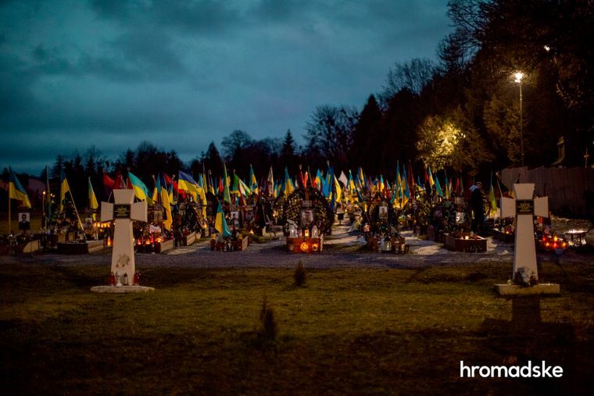

Slide 15
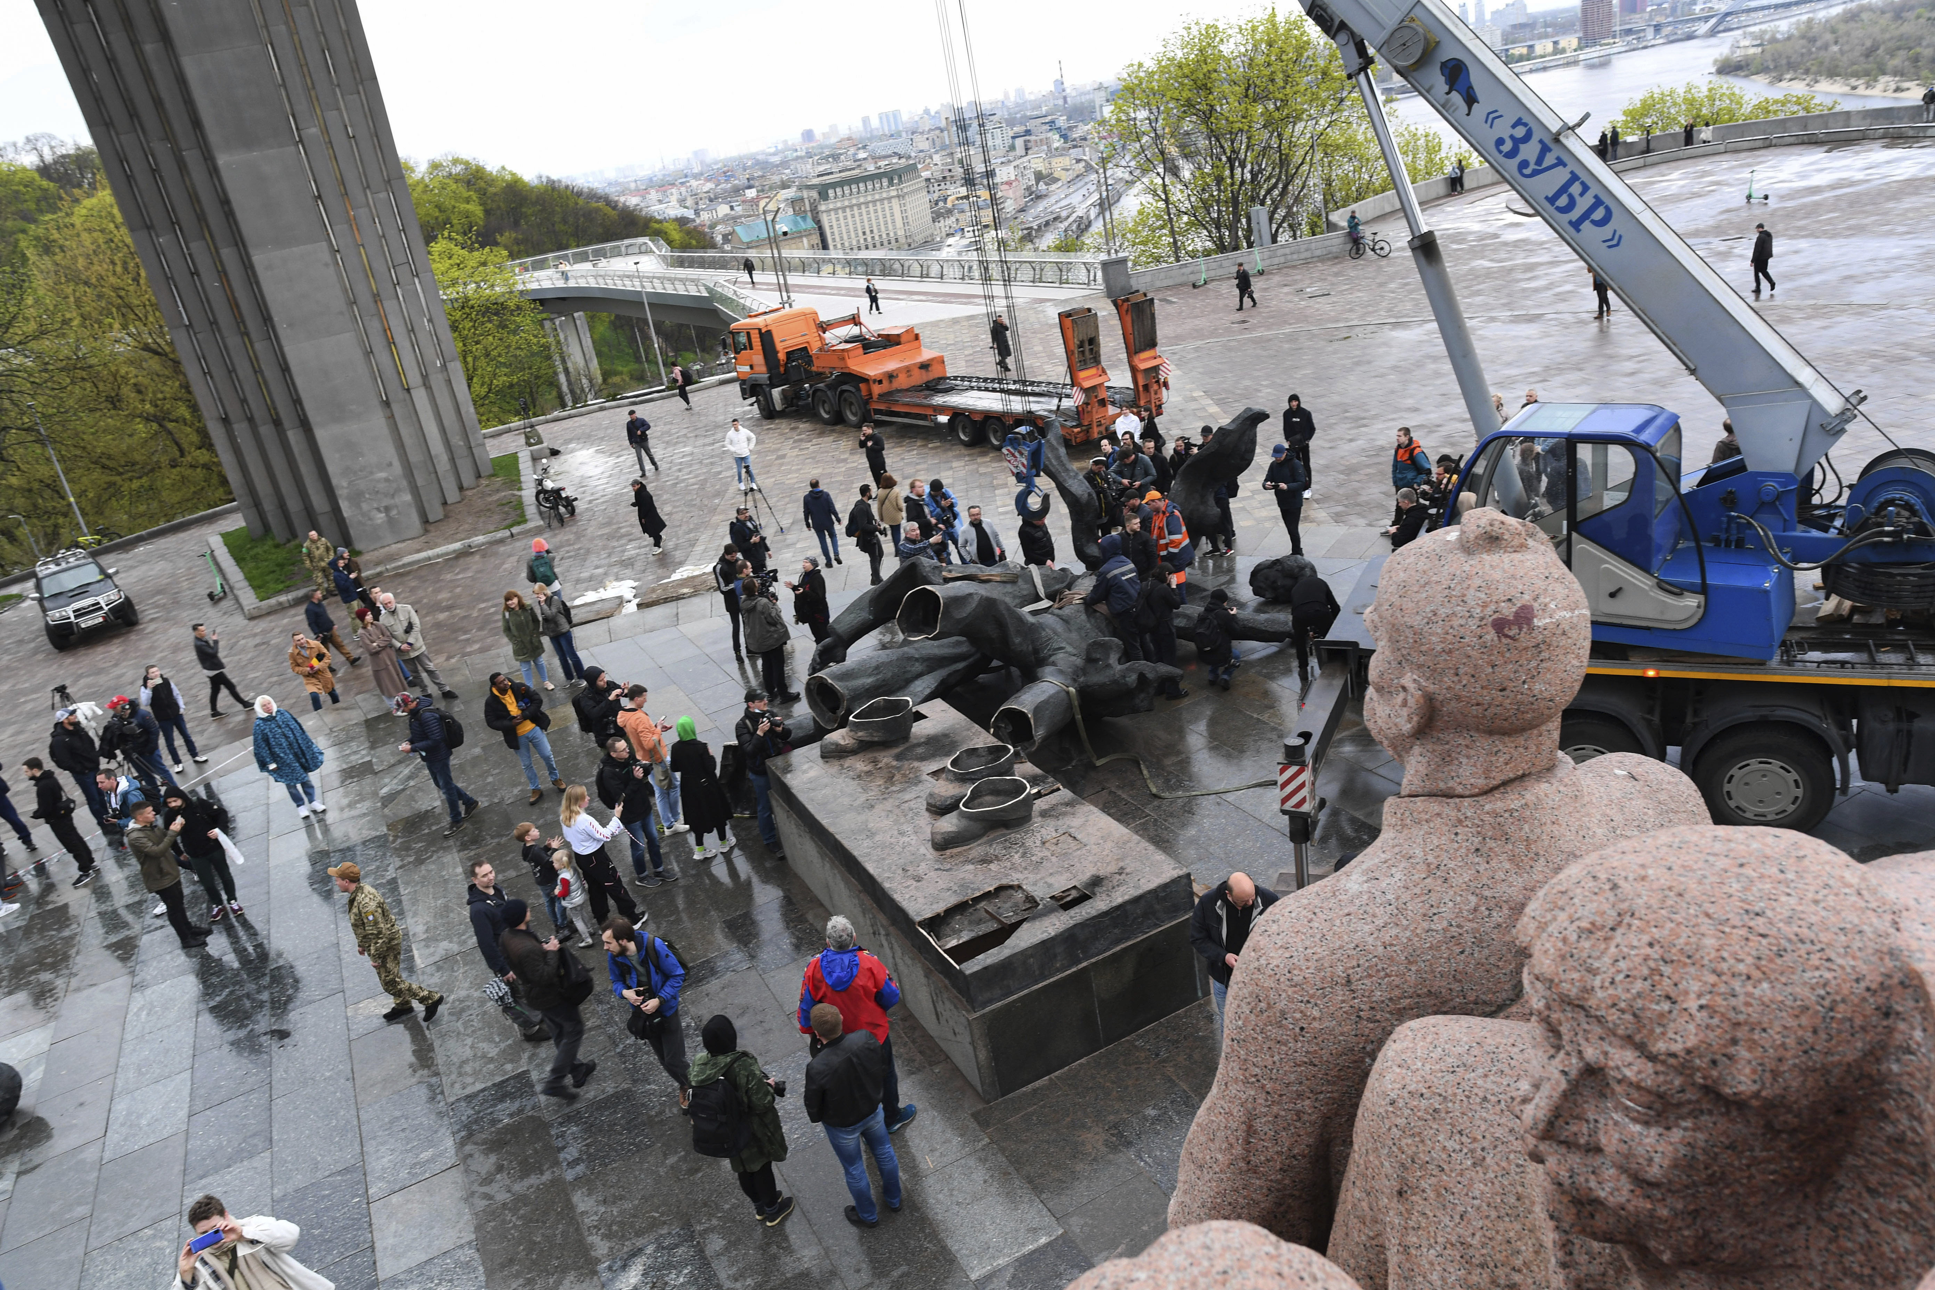
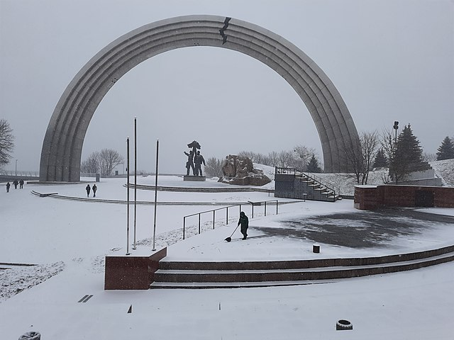
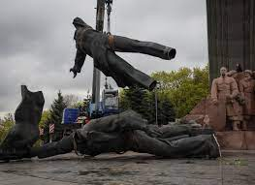
https://www.youtube.com/watch?v=vzYuecWK7P8

Slide 16
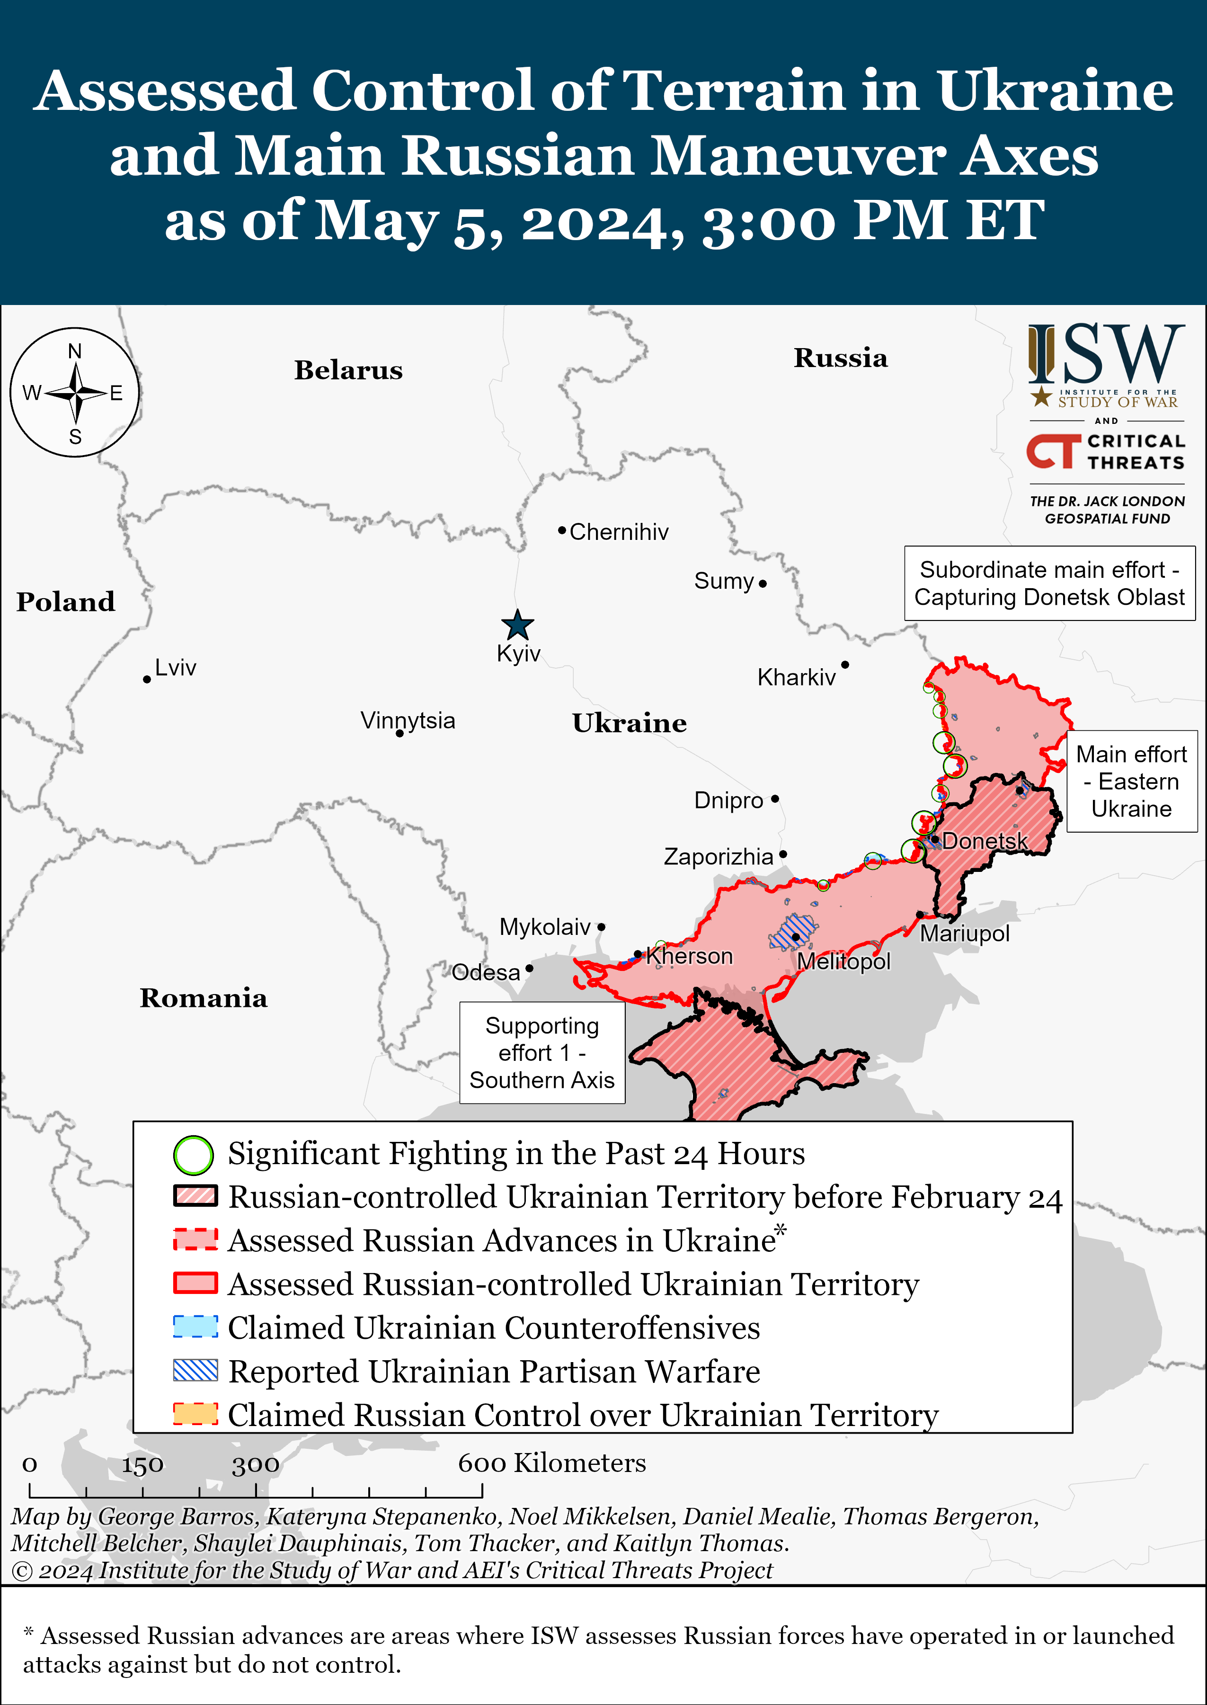
https://www.nzz.ch/english/ukraine-war-interactive-map-of-the-current-front-line-ld.1688087

