Slide 1
Entangled History: Ukraine and her neighbours from the Middle Ages to the Present
20 War and revision
Week 4 (2024/25) Summer Term
Notes:
1

Slide 2
Outline
Introduction
Annexation of Crimea and war in Donbas
NATO expansion and other pretexts
The Russian invasion on 24 February 2024
Developments and Outlook
Notes:
2

Slide 3
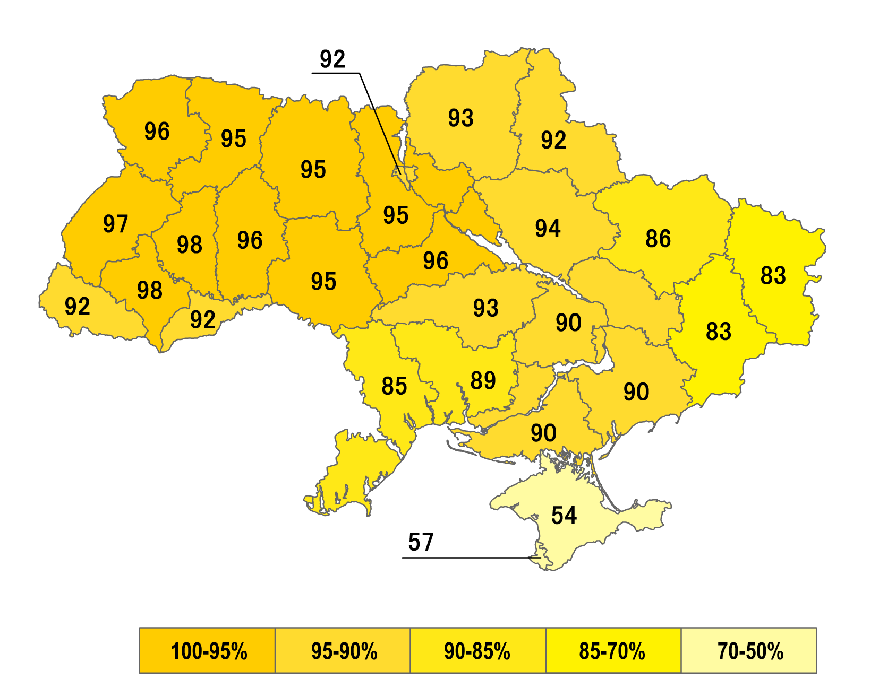
Recent context
Plebiscite, December 1, 1991: ”Do you support the Declaration of Independence of Ukraine?” Yes-vote
Declaration of independence of Ukraine on 24 August 1991 and dissolution of Soviet Union on 31 December 1991
Orange Revolution in Autumn 2004
Revolution of Dignity or Euromaidan November 2013
Ukraine moving out of Russian orbit
War in Ukraine since 2014, Russian annexation of Crimea, proxy war in Donetsk und Luhansk
24 February 2022 full-scale Russian invasion of Ukraine

Slide 4
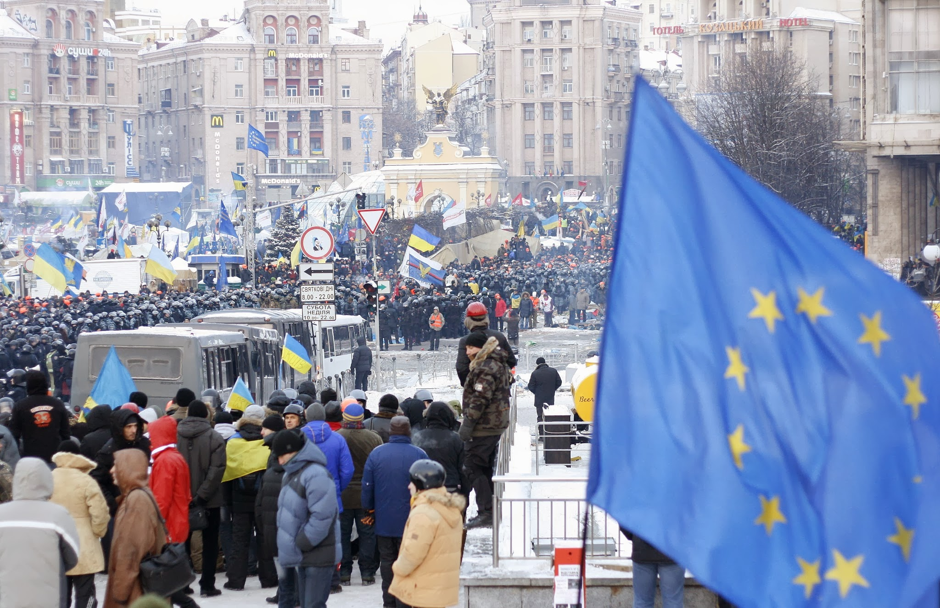
Euromaidan December 2013, Kyiv

Slide 5
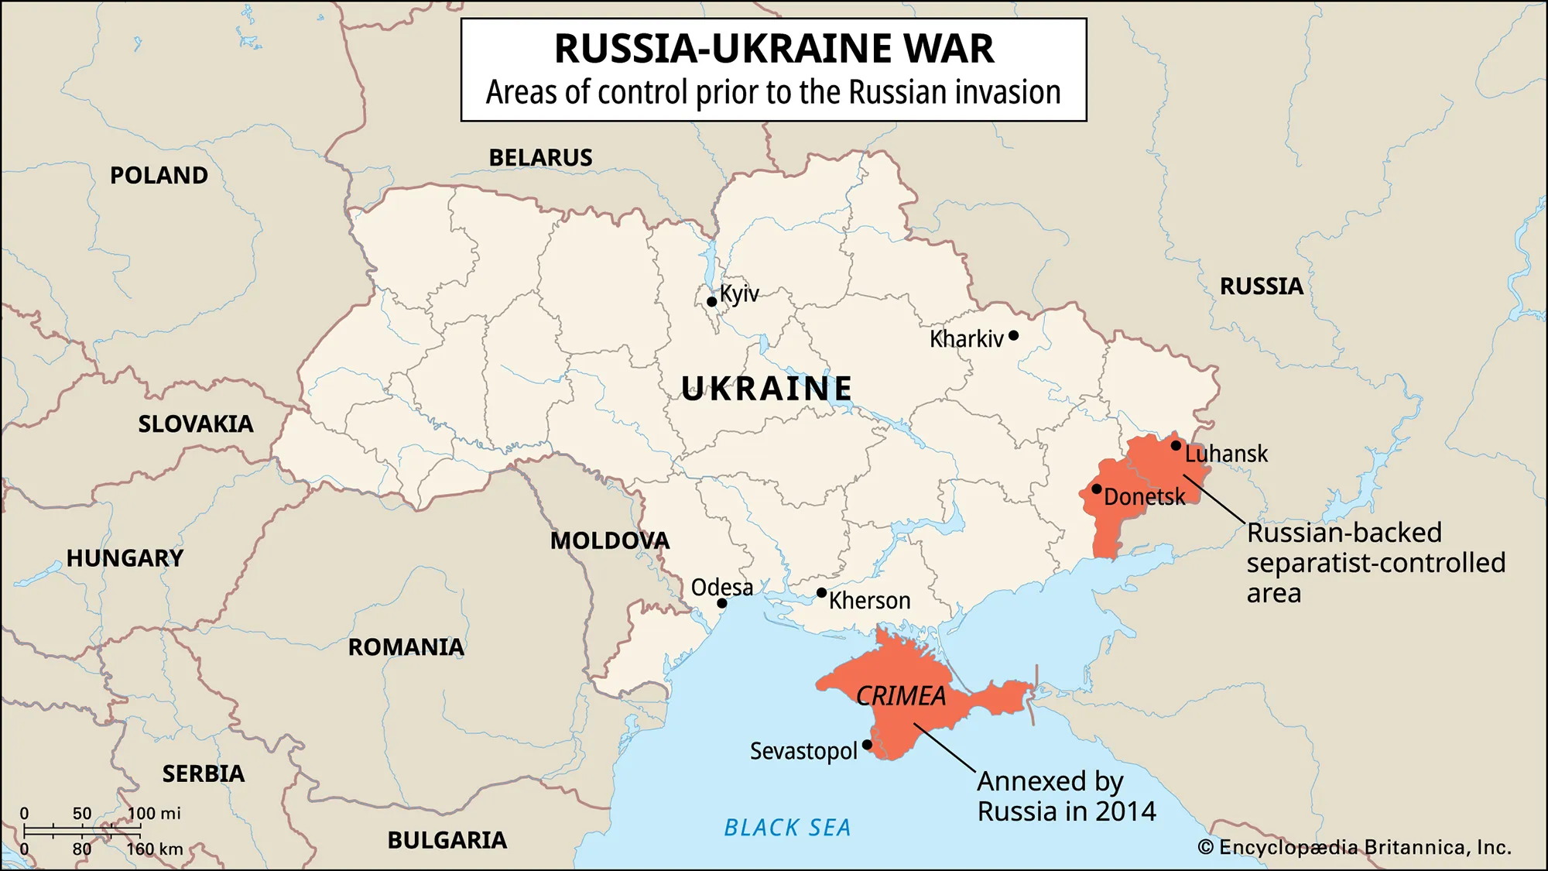
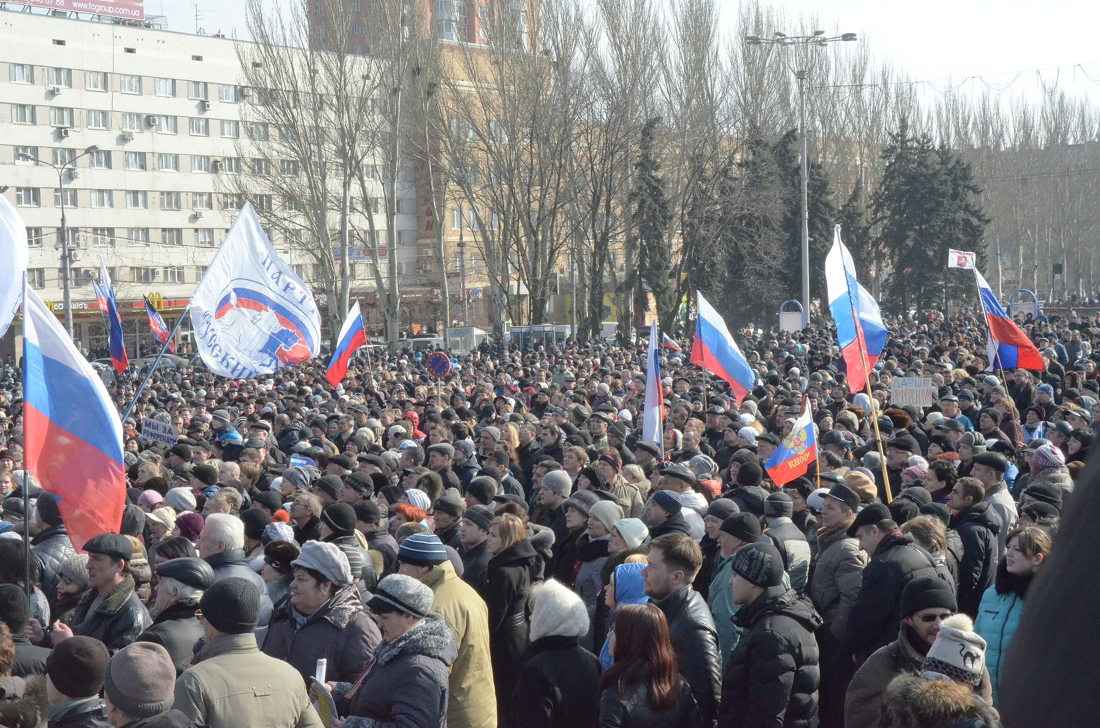
For a timeline of the conflict since 2014 click here: https://researchbriefings.files.parliament.uk/documents/CBP-9476/CBP-9476.pdf

Slide 6
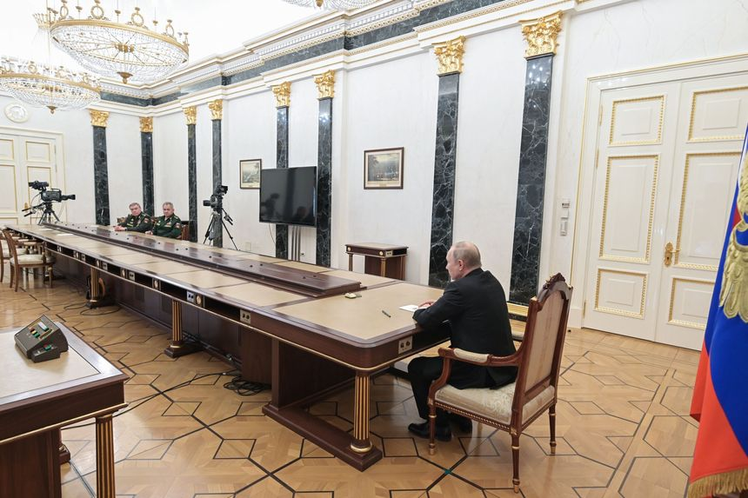

Slide 7
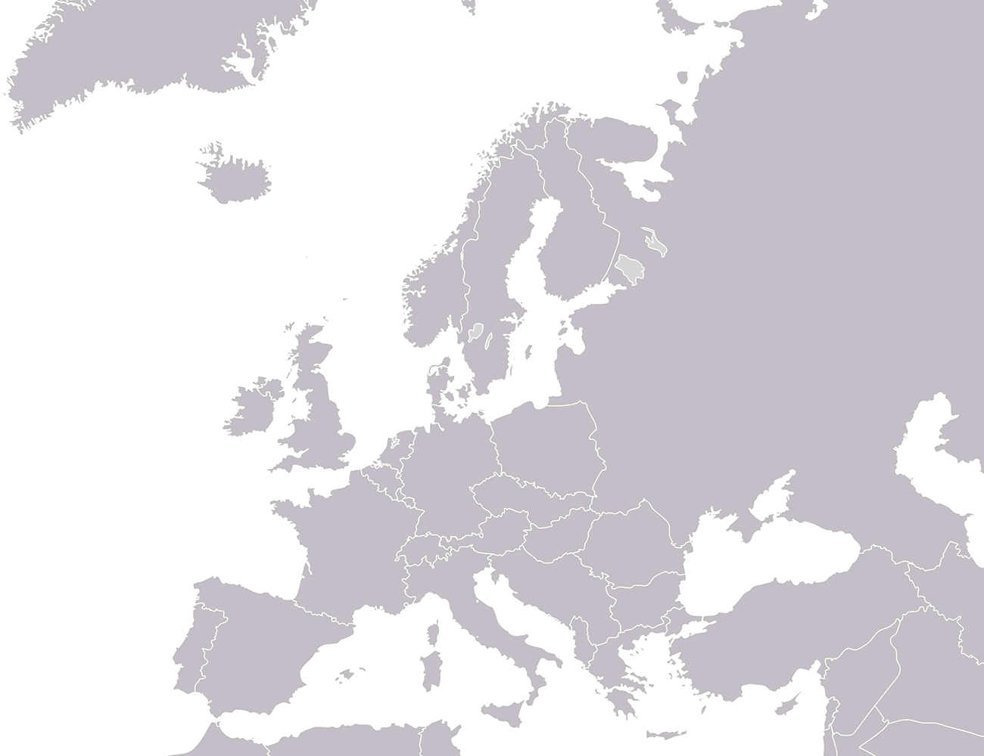
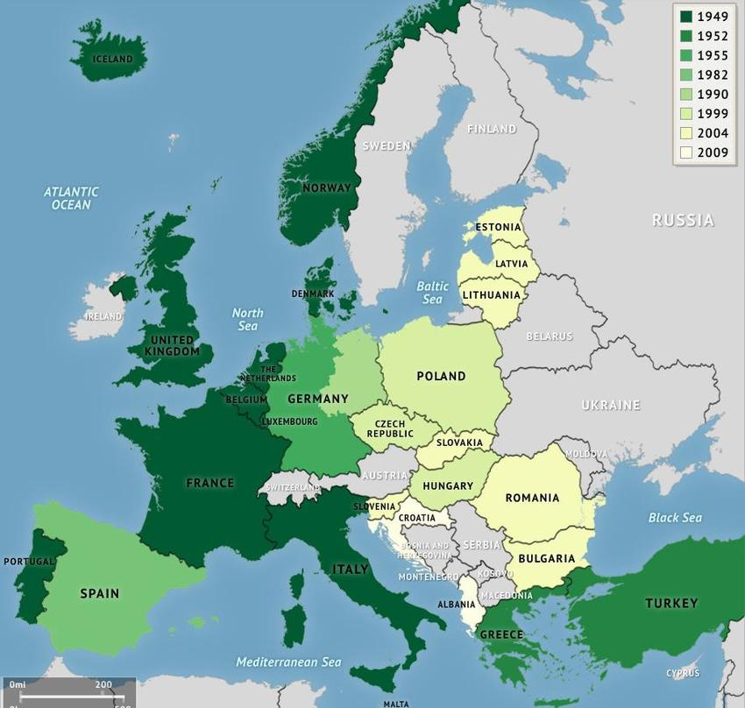
Stages of NATO enlargement

Slide 8
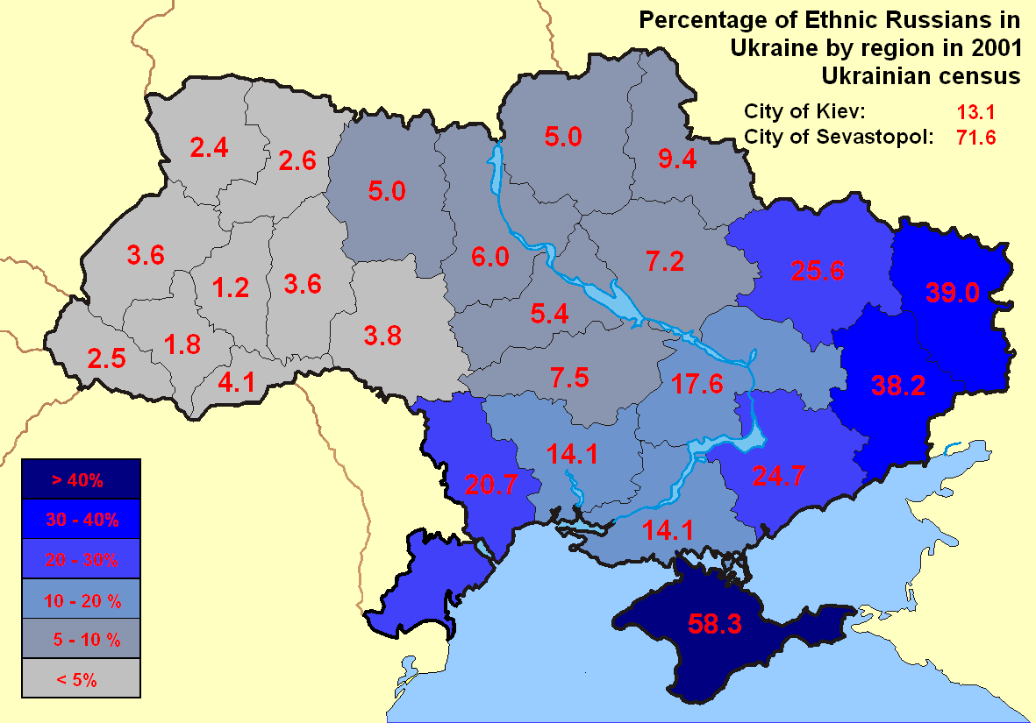
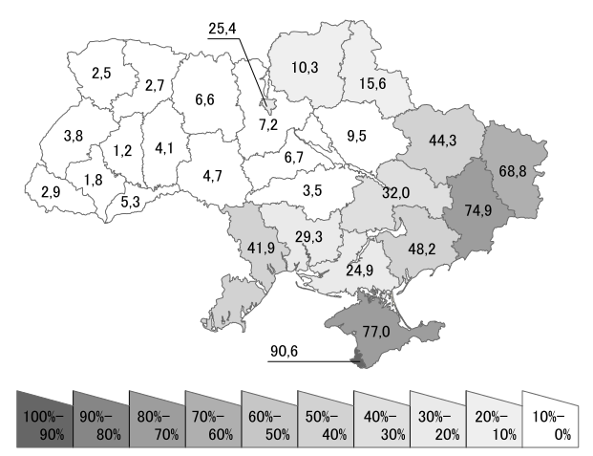
Share of people with Russian as first language in % (Census 2001)

Slide 9
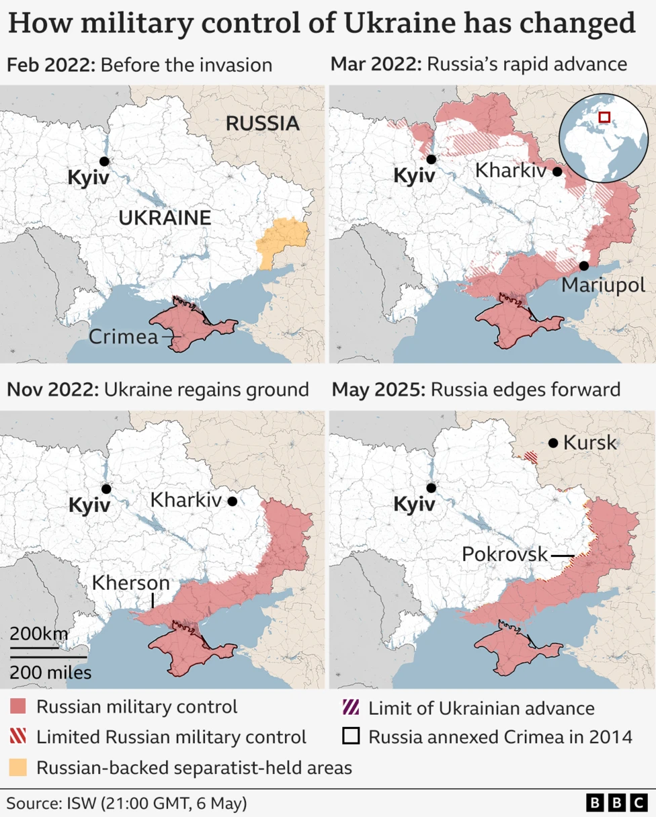
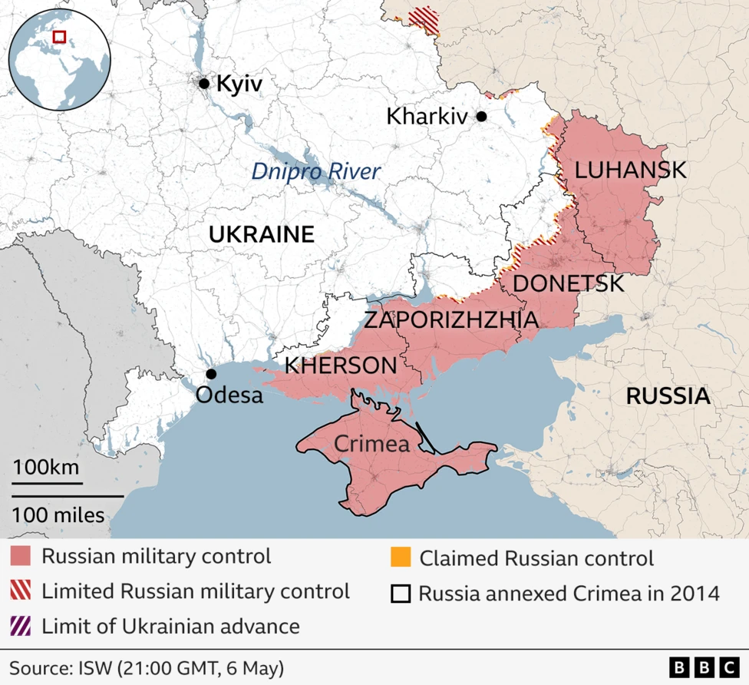
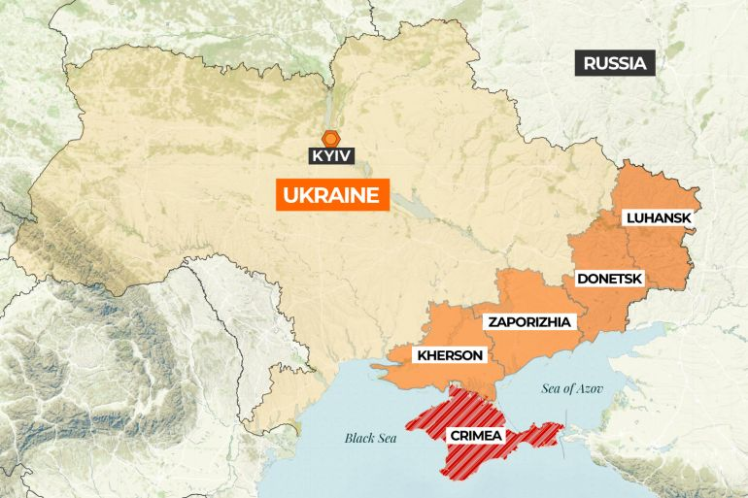
Source: Institute for the Study of War
Source: Al Jazeera

Slide 10
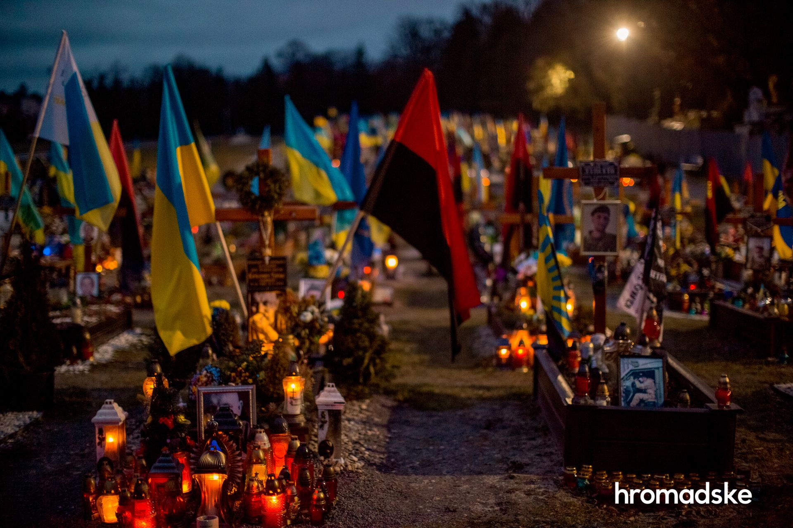
Cemetery of fallen Ukrainian soldiers in Lviv, 2023
Putin‘s uses history (as he understands it) to legitimise the attack on Ukraine and Russia‘s land grab
Genocidal dimension of war
kidnapping children
destroying or appropriating Ukrainian cultural heritage
denying the existence of the Ukrainian nation by
denying that Ukraine has a history outside of the framework provided by the Russian narrative,
or a future outside of the ‚Russian World‘
By Viewsridge - Own work based on: Russo-Ukrainian conflict (2014-2022).svg by Rr016 &amp; Ukraine adm location map improved.svg by Yakiv GluckTerritorial control sources:Template:Russo-Ukrainian War detailed map / Template:Russo-Ukrainian War detailed relief mapISW, CC BY-SA 4.0, https://commons.wikimedia.org/w/index.php?curid=115506141

Slide 11
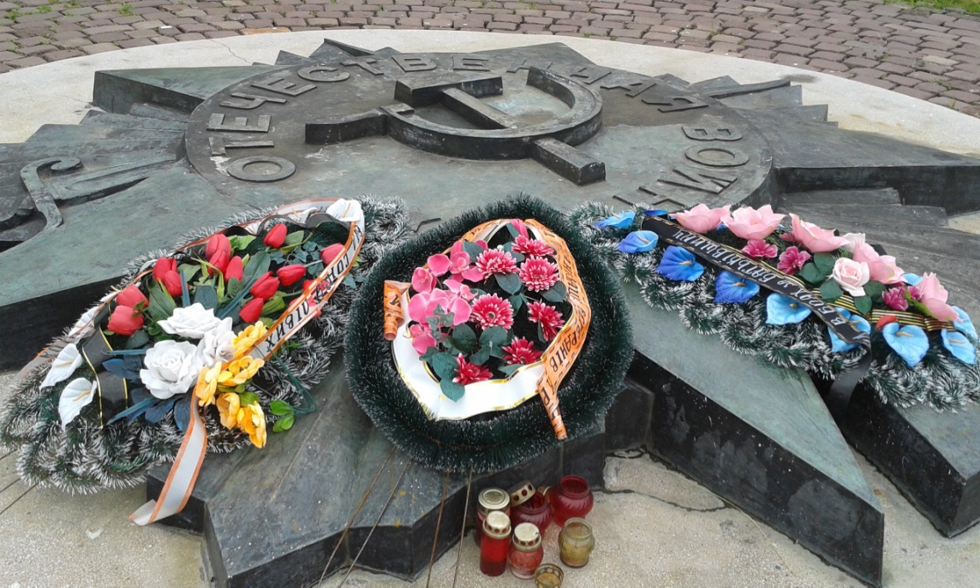
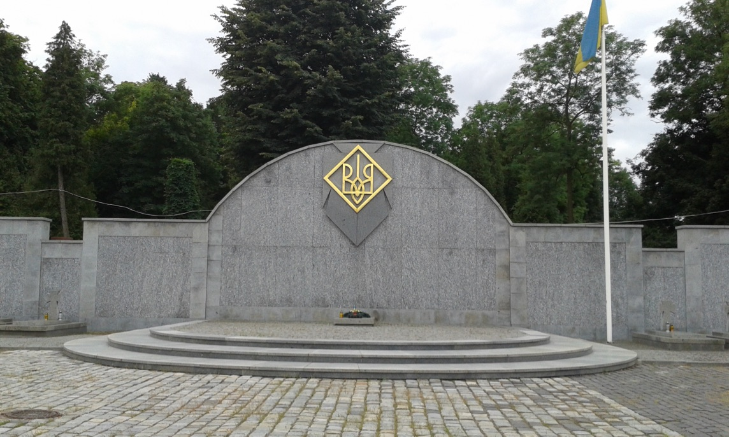
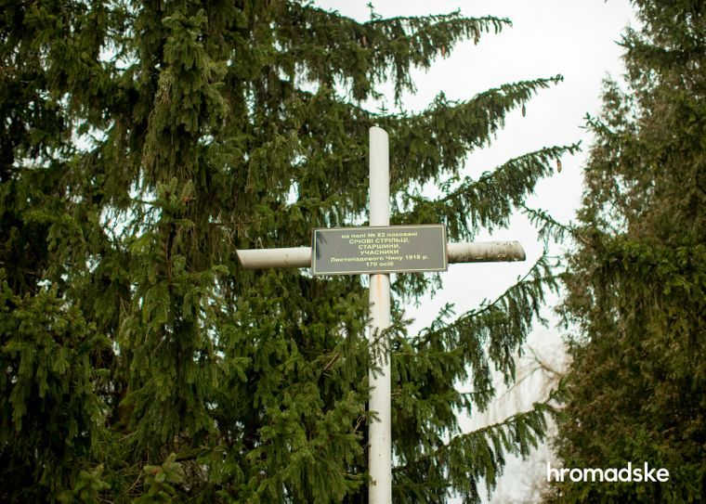
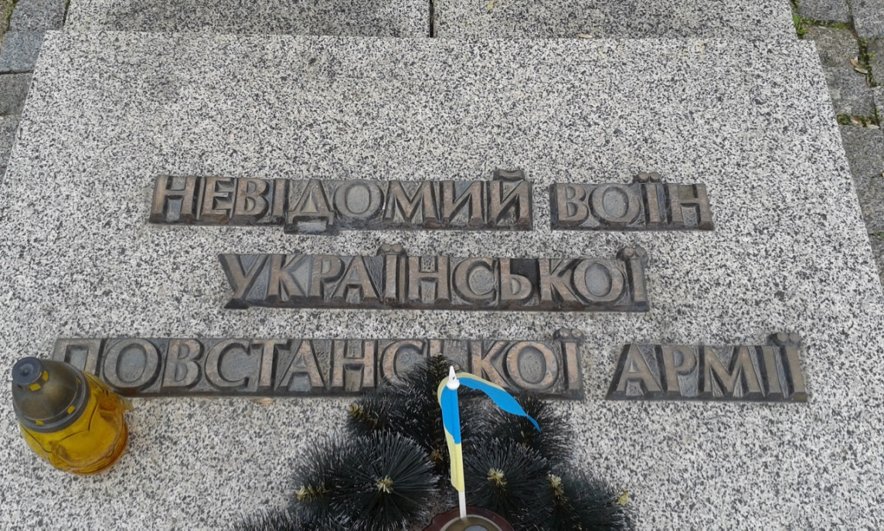
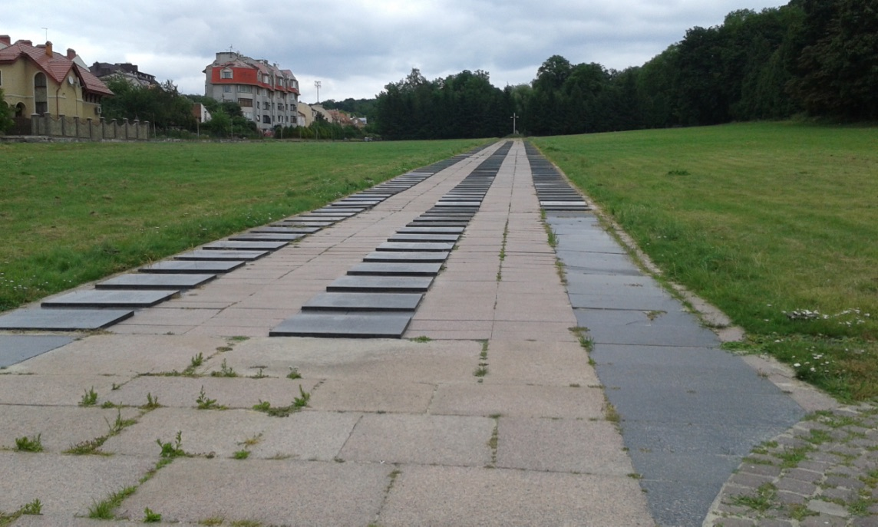
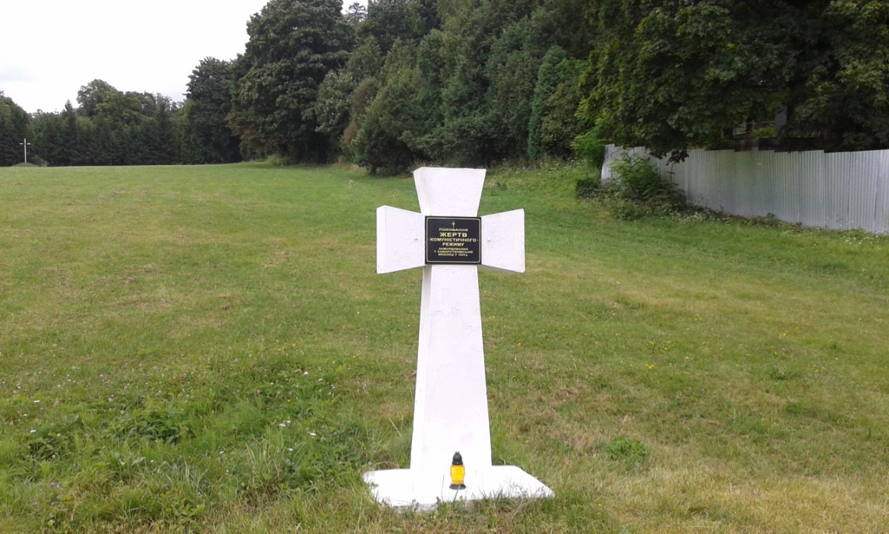
Soviet war memorial
UPA memorial and tomb of Unknown Soldier of Ukrainian Insurgent Army
Cross dedicated to Sich rieflemen 1918/19, erected in 1989
NKVD victim
Soviet war graves
And NKVD graves 1945-1947

Slide 12
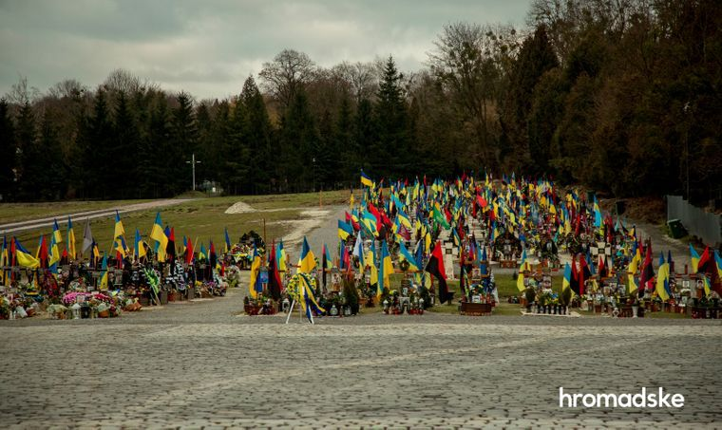

Slide 13
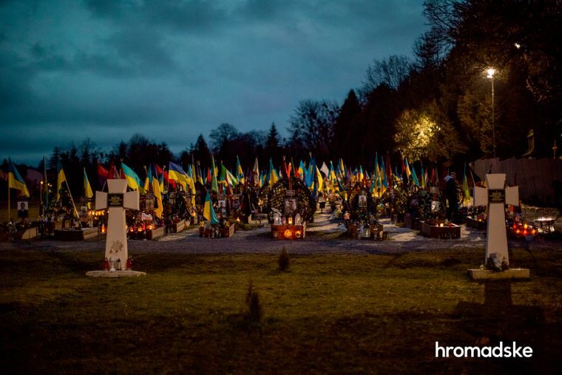

Slide 14
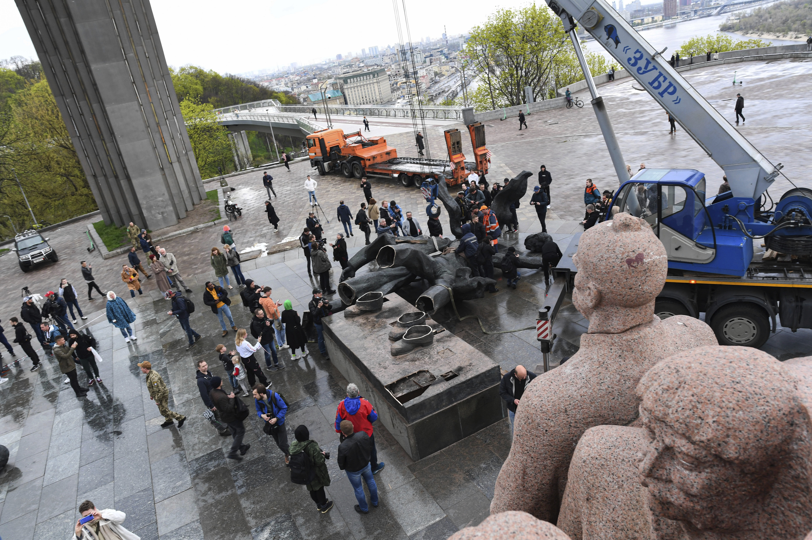
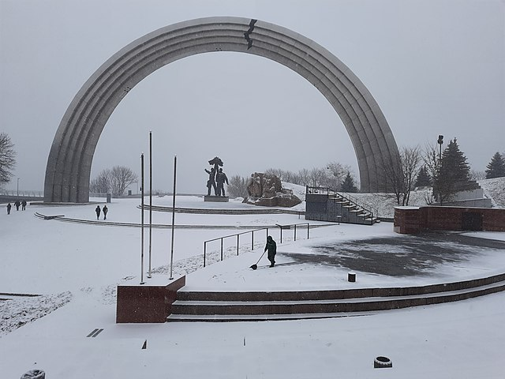
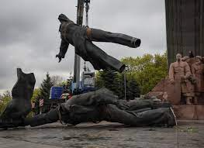
https://www.youtube.com/watch?v=vzYuecWK7P8

Slide 15
Putin‘s demands
International recognition of annexation of Crimea, Kherson, Luhansk, Donetsk, Zaporizhia (including territories currently not controlled by Russia)
Guarantee that Ukraine never will join NATO
End of Western military support and demilitarisation of Ukraine
No foreign troops on Ukrainian territory
And
‚De-nazification‘
End of Western economic sanctions against Russia
Rolling back of NATO membership of
Ukraine no longer a fully souvereign country
At best an inferior (for Ukraine) ‚Finlandization‘, rather ‚Belarusification‘

Slide 16
Current situation and outlook
Trump-factor – clueless, transactionist, unprincipled
Erosion of deterrence by questioning NATO doctrine
Less of support for Ukraine in Western societies – ‘coalition of willing‘ struggling to keep population on board
Rise of extremist parties in Europe – beneficial for Russia
Support of China, neutrality of India, traditional Russian (Soviet) influence in global South
Problems in Ukraine: legitimacy eroding without elections, controversial recruitment policy – hunting down draft dodgers – lack of volunteers, militarily on the backfoot
War-tiredness and Millions of emigrants
Still apparently support of population for continuing war
Astonishing resilience of Ukrainian soldiers and army against superior firepower
Lack of military resources can be compensated as long as defending
Fighting for survival as an independent state and nation – strong motivation of those fighting
Stepping up of European support?

Slide 17
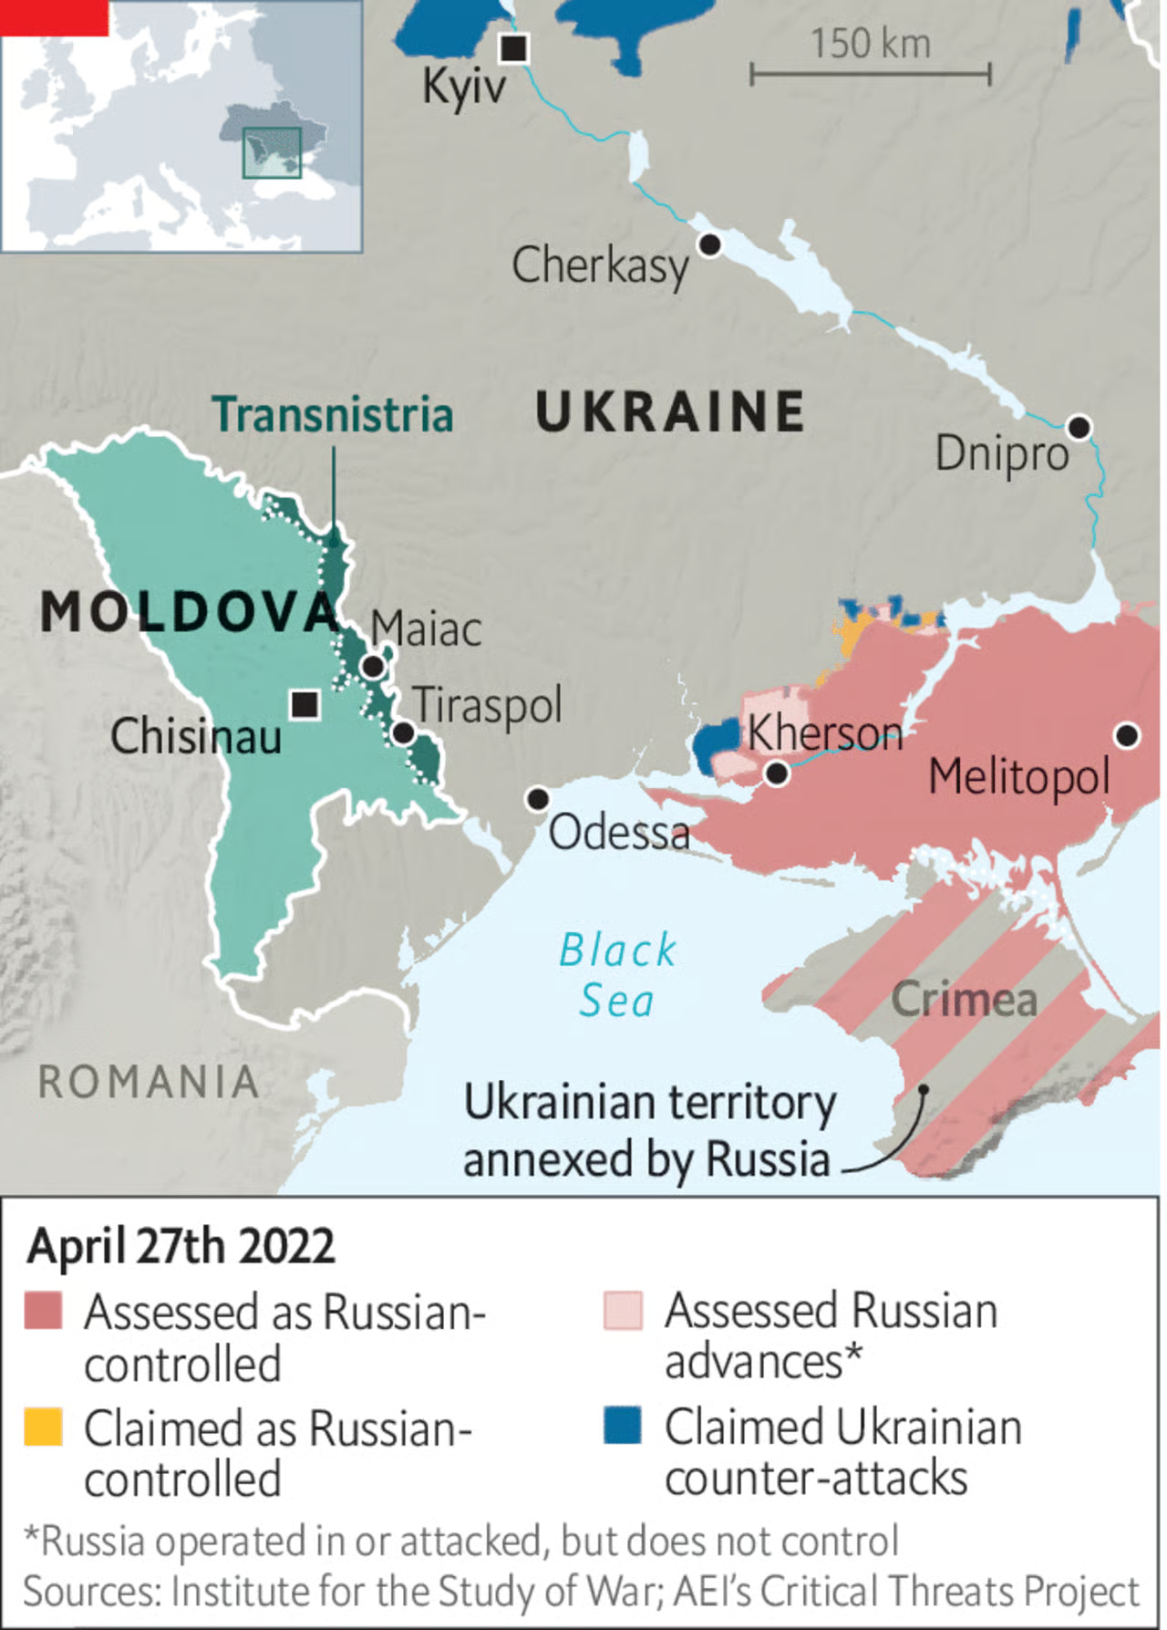
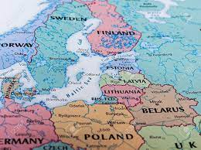
If Russia wins…

Slide 18
Exam questions
Kyivan Rus and Christianisation
Rise of Muscovy
Cossacks between Poland-Lithuania and Muscovy
Ukrainian language 19th century
Russian imperial and/or Soviet nationality policy
Ukrainian state building until formation of Soviet Union
Memory conflicts related to World War II
Soviet Ukraine after World War II
Independent Ukraine
Russian-Ukrainian war

