Slide 1
Ukraine in historical perspective
Open Day Talk, 14 June 2025
Christoph Mick
Professor of Modern European History
Department of History
University of Warwick

Slide 2
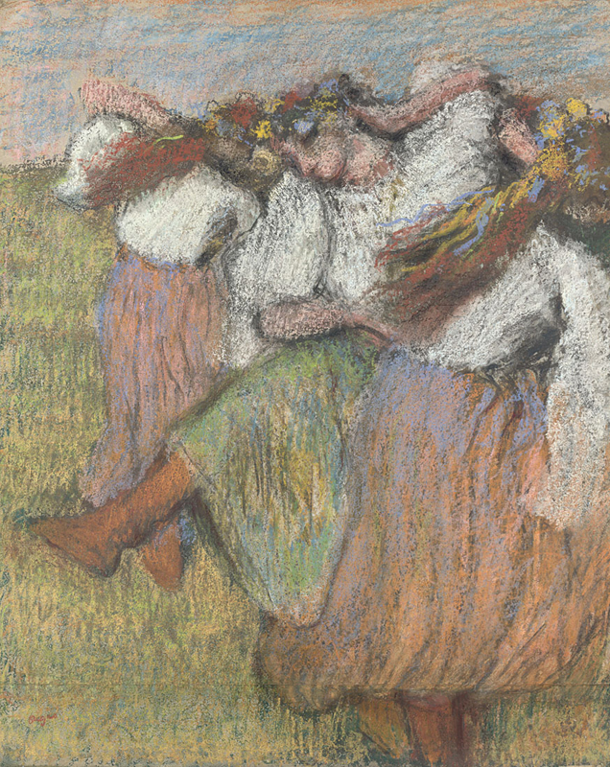
Ukrainian Dancers
Edgar Degas
About 1899
pastel and charcoal
National Gallery, London

Slide 3
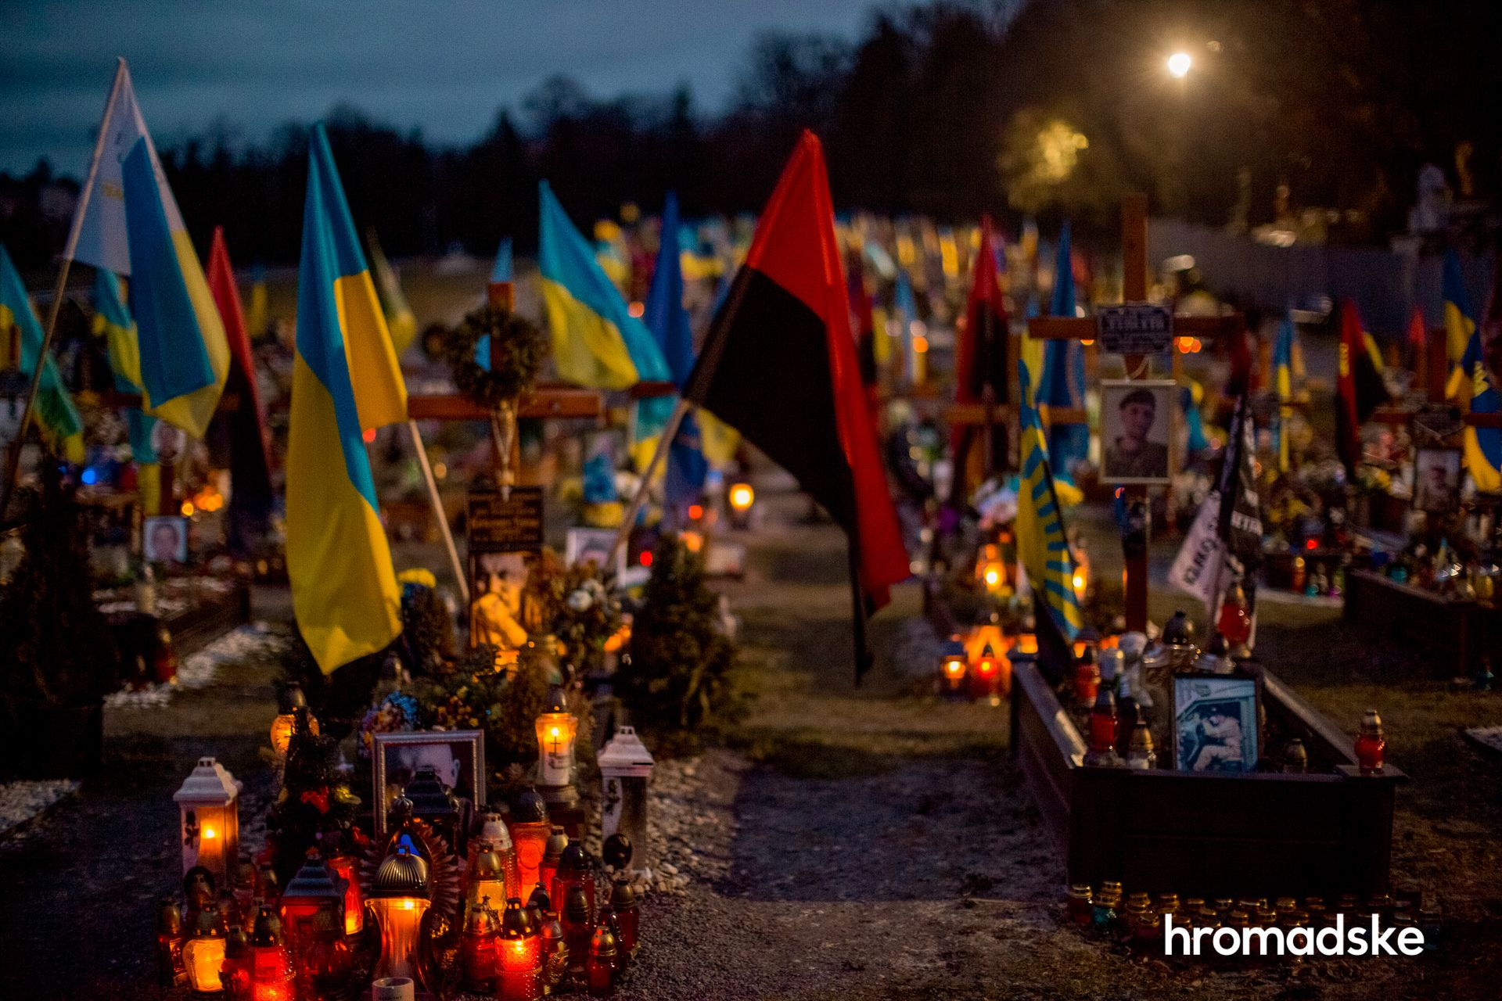
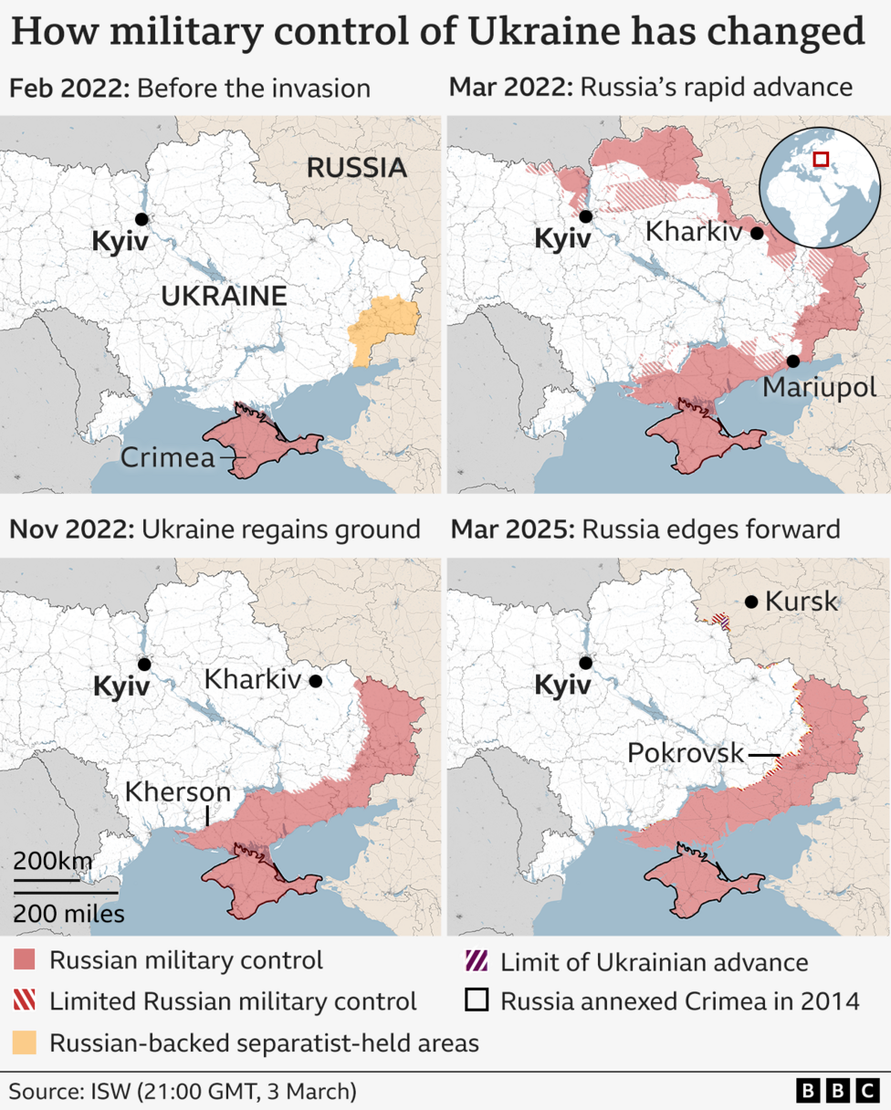
Cemetery of fallen Ukrainian soldiers in Lviv, 2023
Putin‘s uses history (as he understands it) to legitimise the attack on Ukraine and Russia‘s land grab
Genocidal dimension of war
kidnapping children
destroying or appropriating Ukrainian cultural heritage
denying the existence of the Ukrainian nation by
denying that Ukraine has a history outside of the framework provided by the Russian narrative,
or a future outside of the ‚Russian World‘
By Viewsridge - Own work based on: Russo-Ukrainian conflict (2014-2022).svg by Rr016 &amp; Ukraine adm location map improved.svg by Yakiv GluckTerritorial control sources:Template:Russo-Ukrainian War detailed map / Template:Russo-Ukrainian War detailed relief mapISW, CC BY-SA 4.0, https://commons.wikimedia.org/w/index.php?curid=115506141

Slide 4
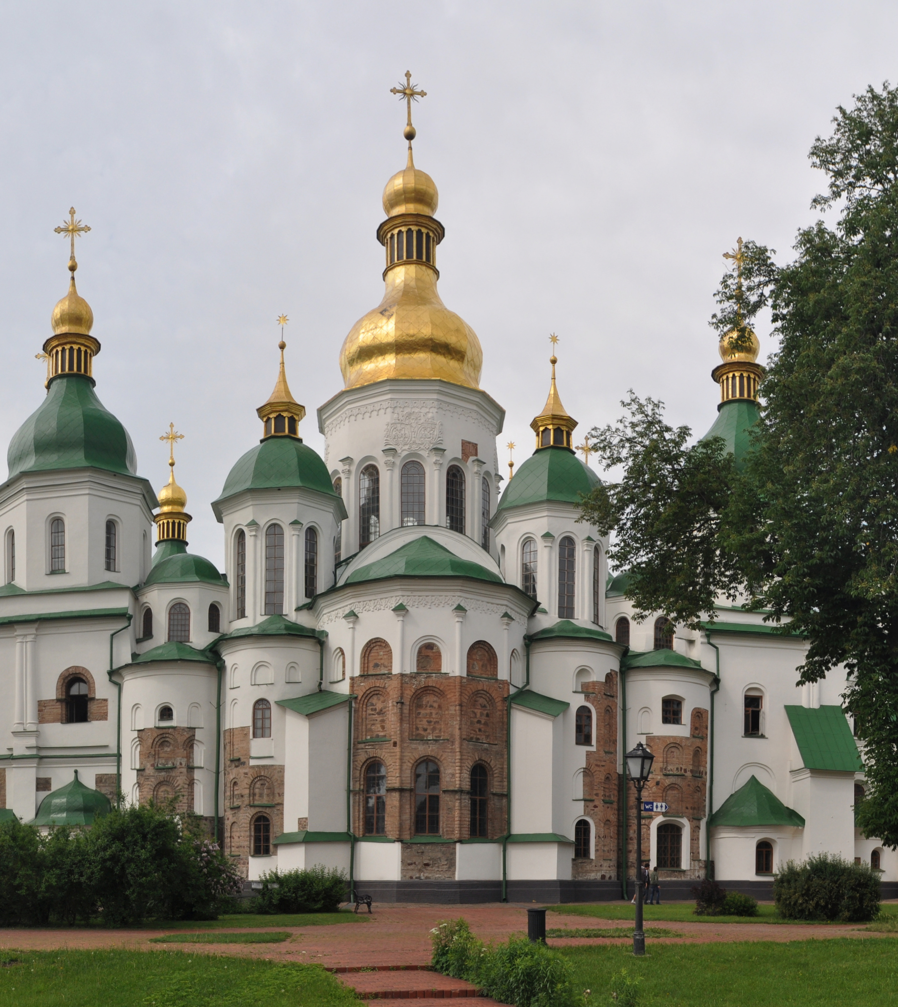
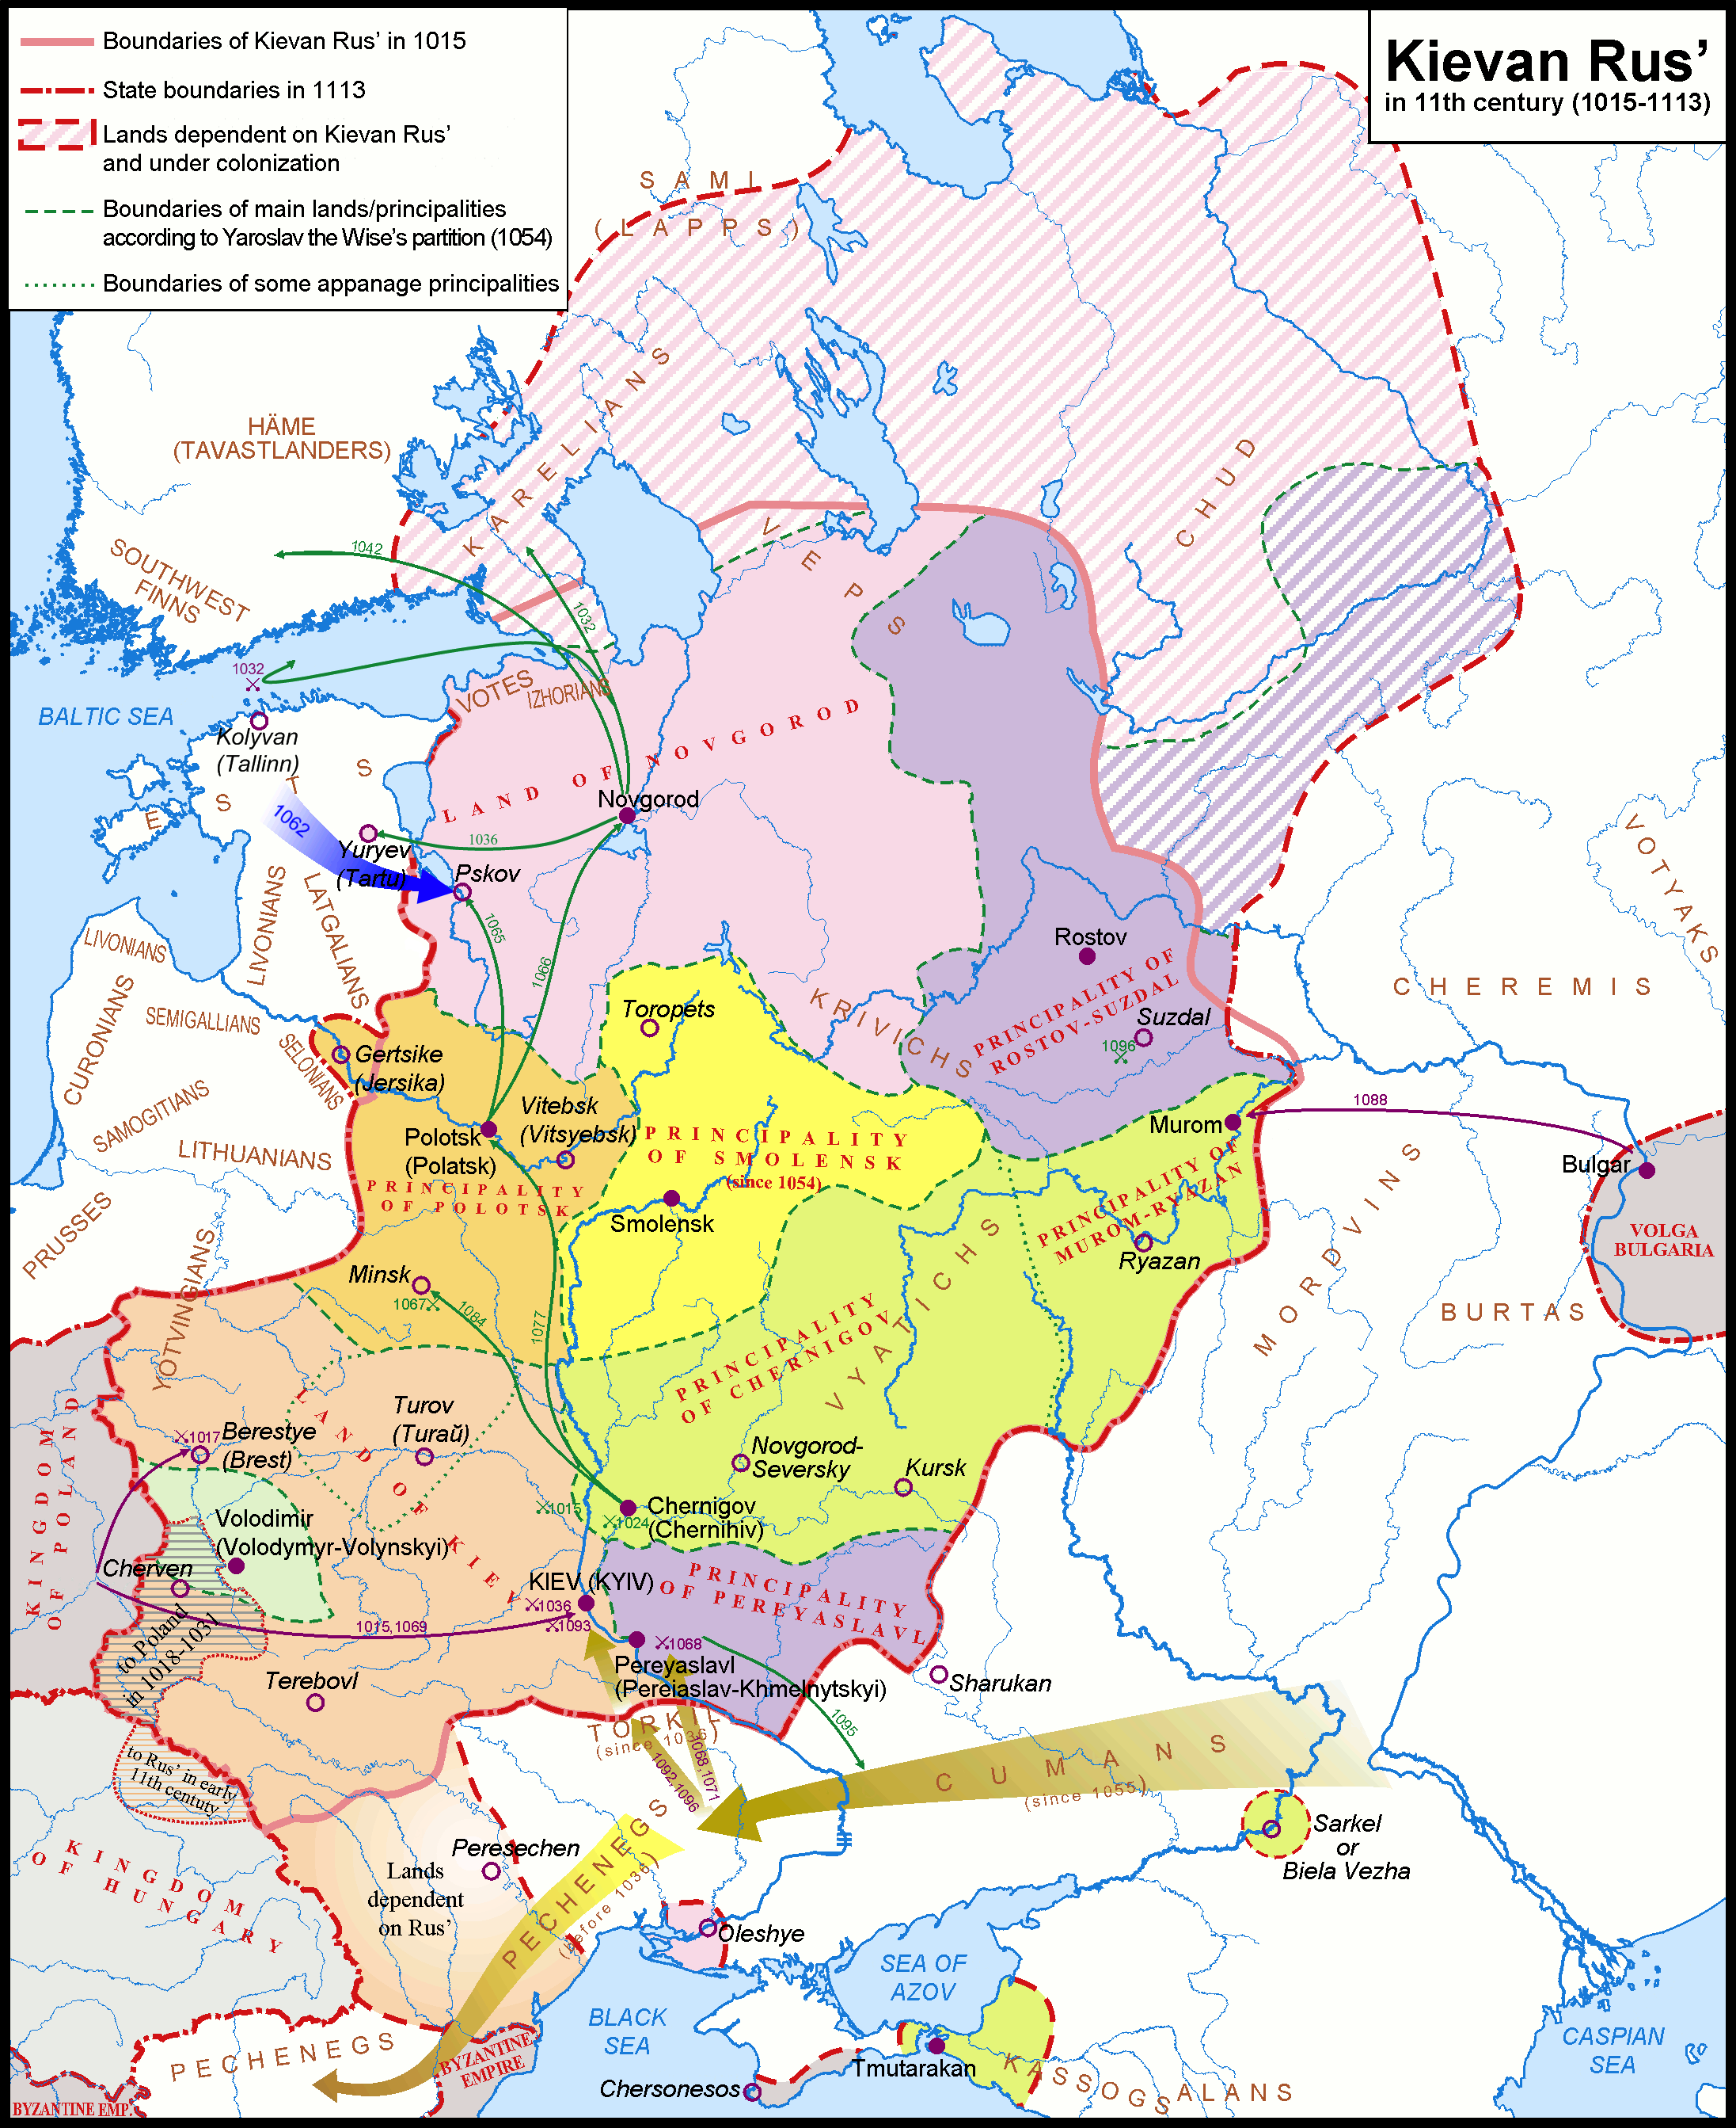
M
Saint Sophia Cathedral, Kyiv, 11th century, rebuilt in 16th century

Slide 5
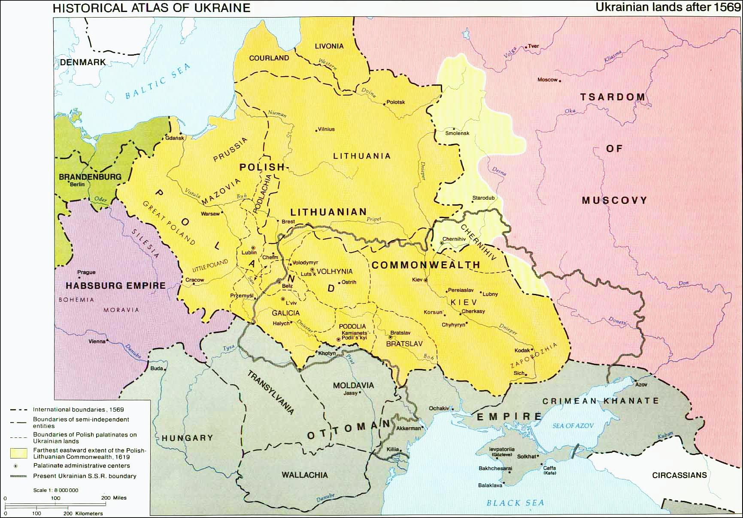
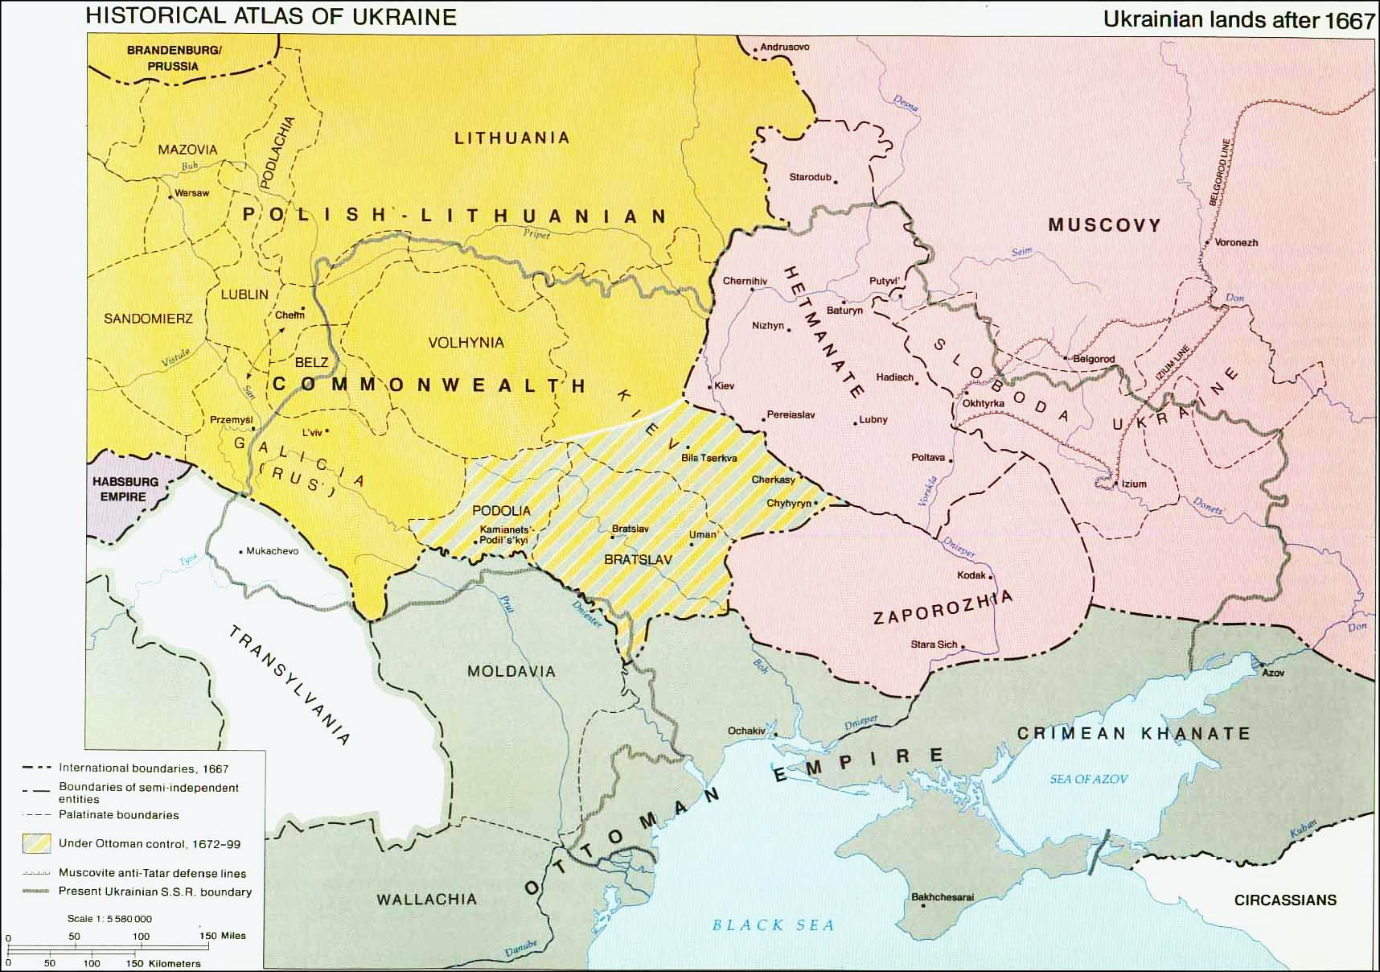
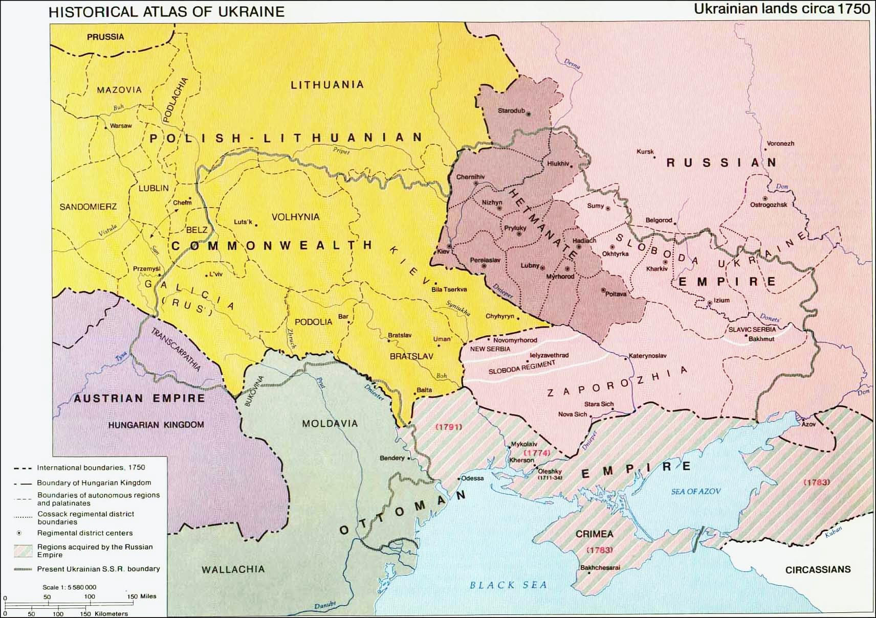
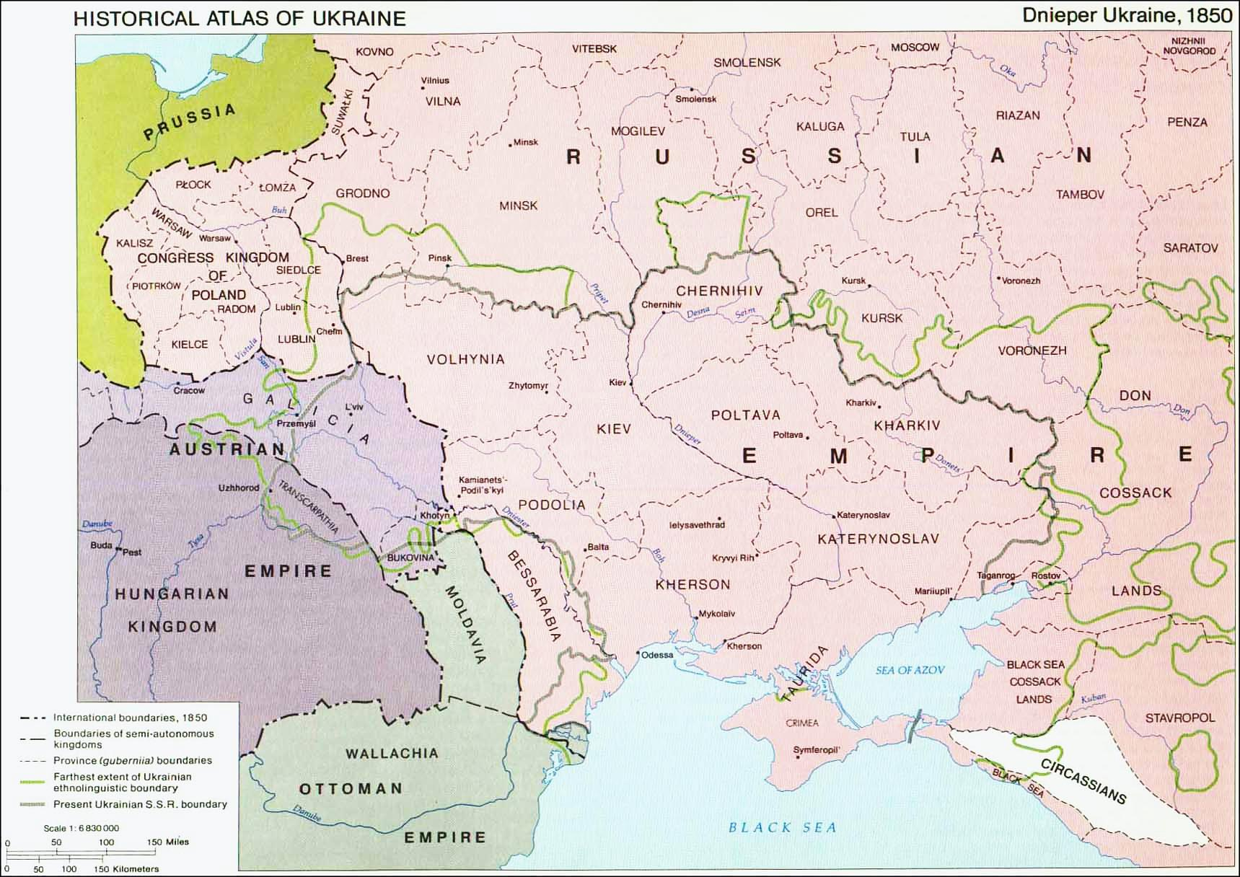
Notes:
5

Slide 6
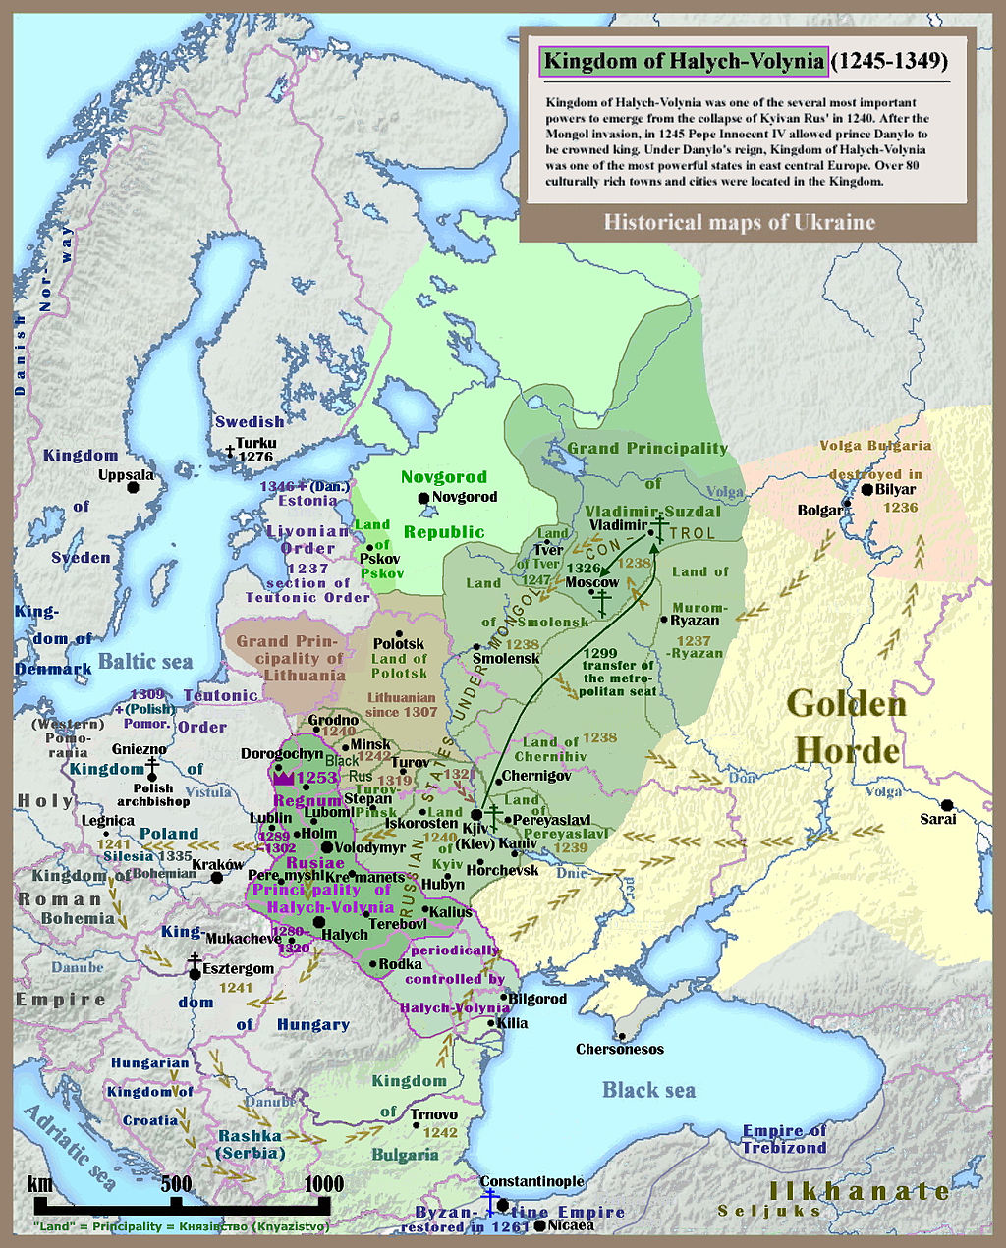
Contested History
Map of Kievan or Kyivan Rus (Principality of Kiev Kyiv), 1245-1349

Slide 7
Notes:
7

Slide 8
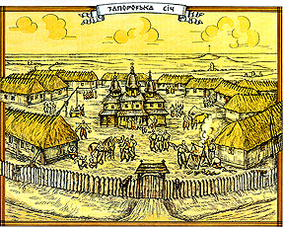
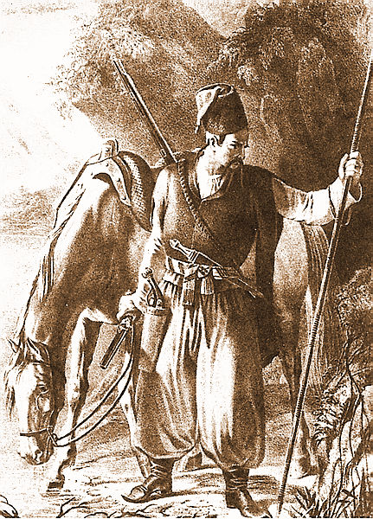
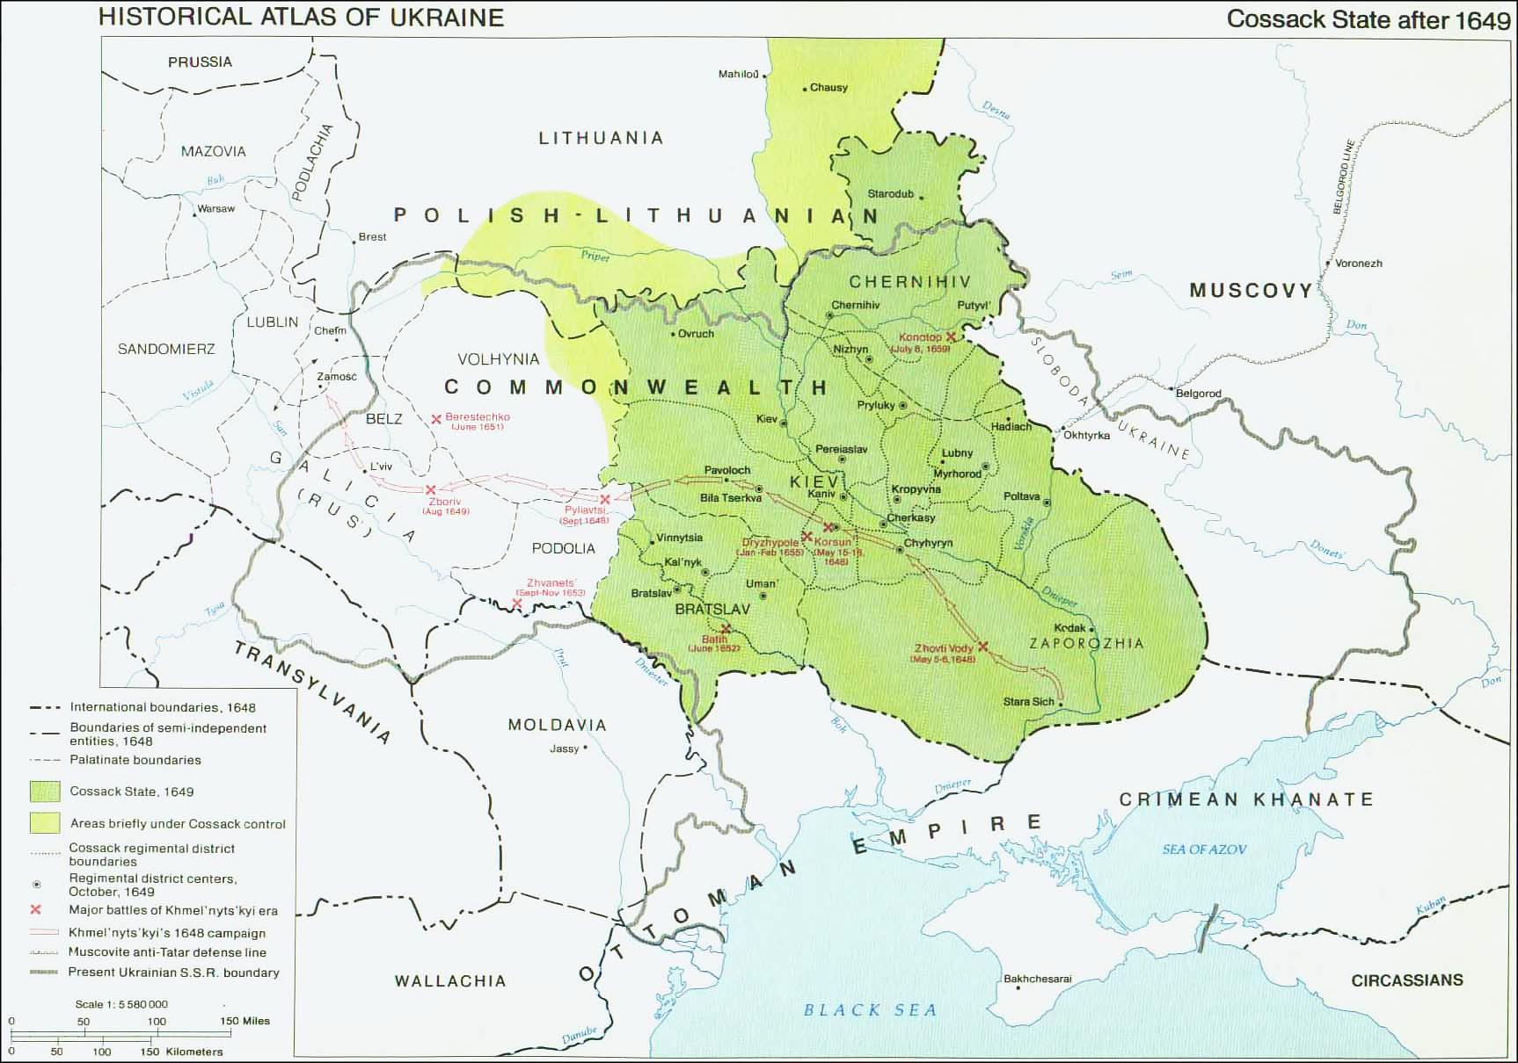
Frontier Society
Cossack (ukr. Kozak) is derived from the Turkic kazak (free man), meaning anyone who could not find his appropriate place in society and went into the steppes, where he acknowledged no authority.
By the end of the 15th c. the name acquired a wider meaning and was applied to those who went to the steppes
In the mid 16th c. the Cossack structure in Zaporizhia was created (headquarter on an island in the Dnipro river, south of the rapids) to support steppe settler’s struggle against Tatar raids, did also raid Tatar territory
Cossack Hetman – elected leader of Cossacks (confirmed by Polish King). Cossacks elect their officers (after defeats in rebellions sometimes need to concede this right to crown)
1569 Union of Lublin between Poland and Lithuania, protection against raids from “Wild Field” now task of Polish crown
Growth of Cossackdom after Polish magnates established manorial system of agriculture (freedom of movement was limited, corvee was expanded) – profitable grain trade: many peasants fled to steppe
The Cossacks
Notes:
8

Slide 9
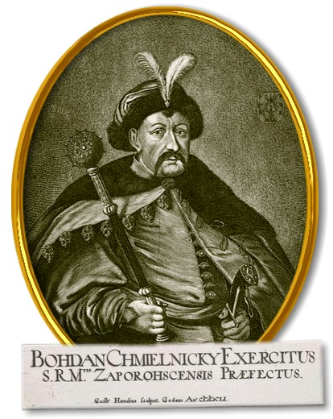
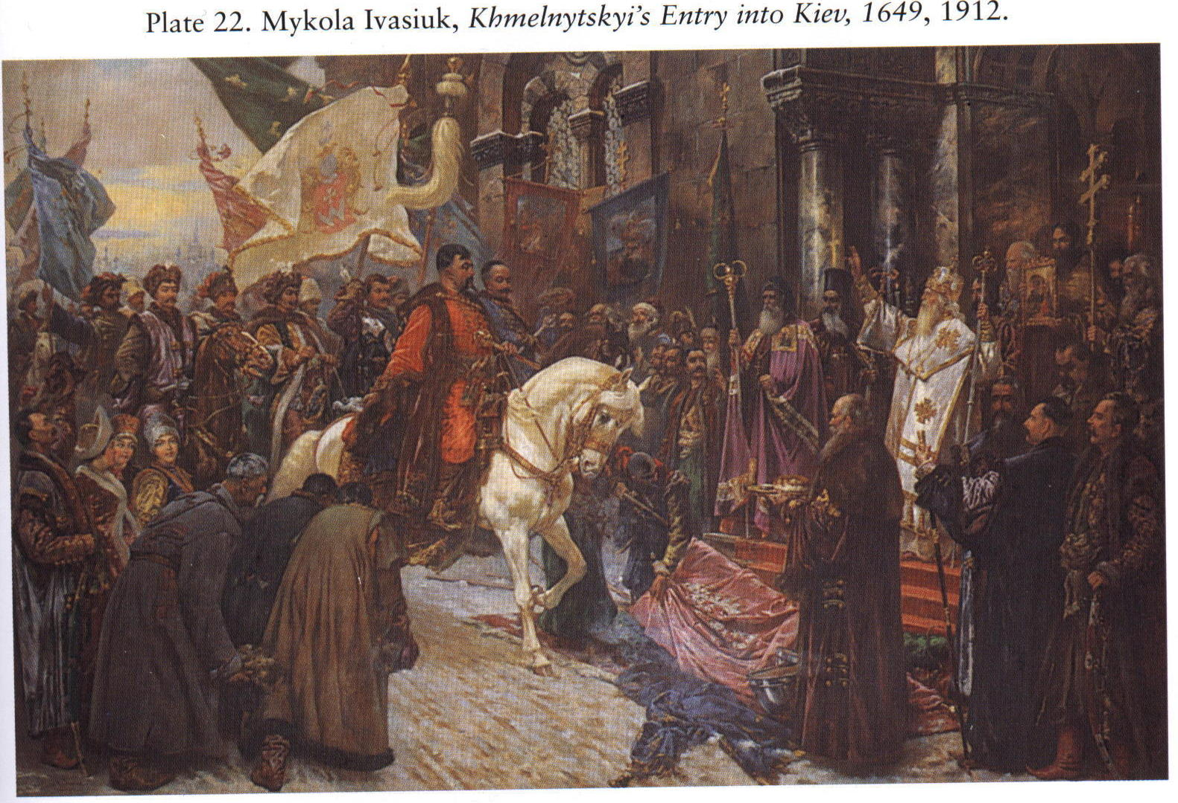
Bohdan Khmelnytsky, 1596-1657
Notes:
9

Slide 11
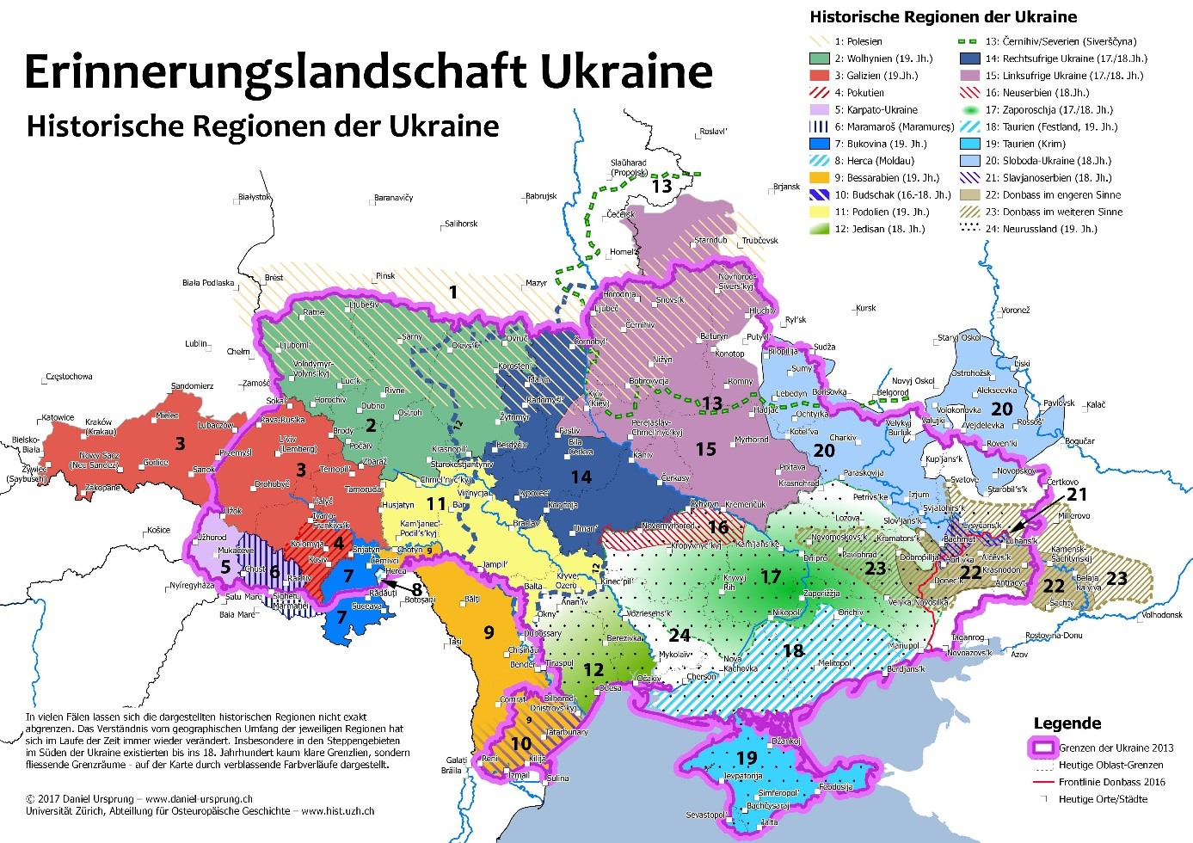
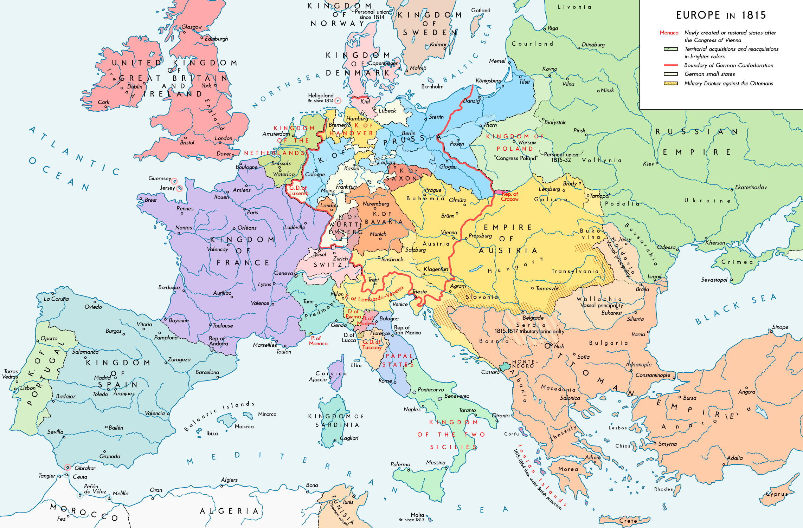

Slide 12
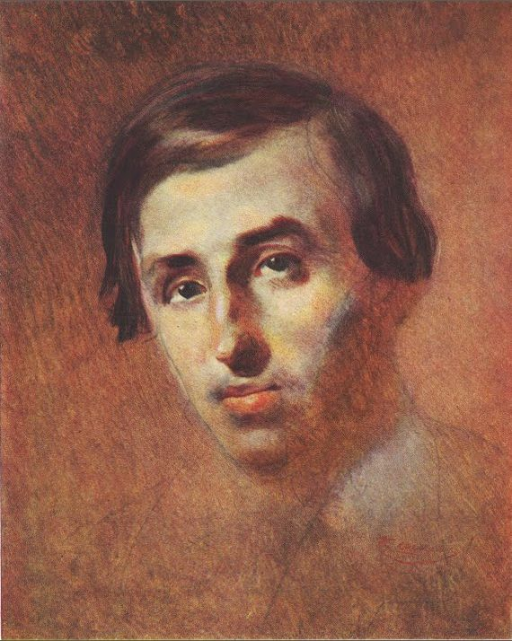
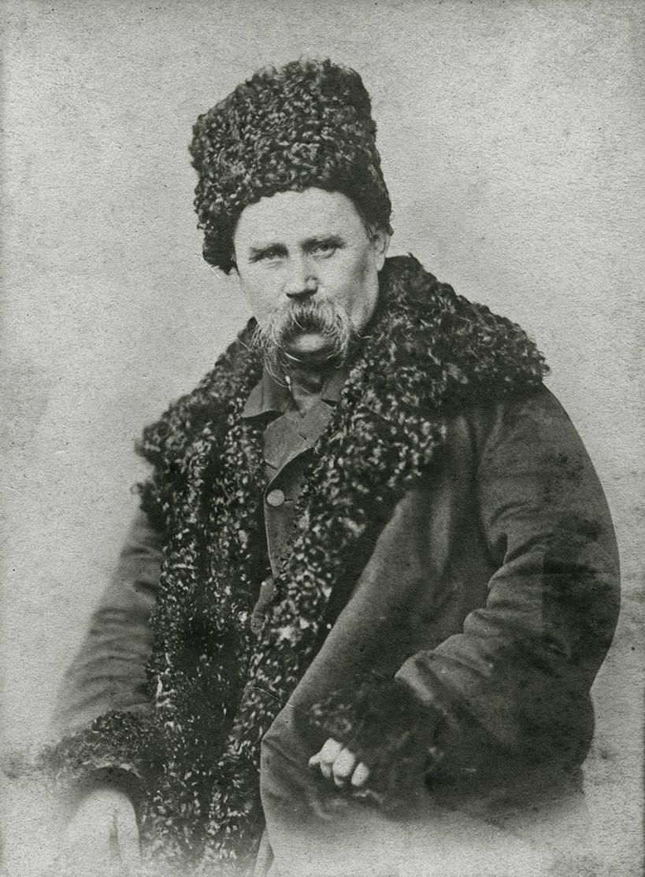
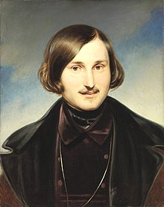
Panteleimon Kulish
1819-1897
(Portrait by Taras Shevchenko)
* In Voronesh
Writer, translator
Father: poor Cossack gentry
Translated Bible in modern Ukrainian, critical of Cossacks
Member of St. Cyril and Methodius Society
Taras Shevchenko (1859)
1814-1861
* In Morynzi (Kiev/Kyiv)
National poet
Family: Serfs
Education organised by his ‘owner‘
Studied painting in St. Petersburg, bought free by St. Petersburg artists (lottery - Briullov painting)
Member of St. Cyril and Methodius Society, sentenced 1847 to military service in Russian east, 1857 released
Nikolai Gogol‘/Mykola Hohol‘
1809-1852
* In Velyki Vorotchyntsi (Poltava)
Writer
Family: Cossack gentry, father‘s last name is Janowski
Satires of Russian provincial bureaucracy and criticism of serfdom, collects Ukrainian folklore, writes in Russian with Ukrainisms and often stories from Ukraine (Taras Bulba)
First loved by Russian liberals, then condemned after defending autocracy, serfdom and Orthodox Church

Slide 13
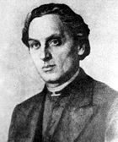
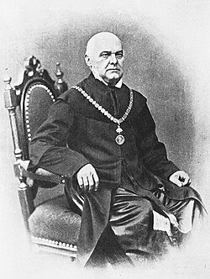
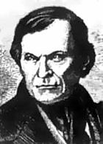
Ruthenian Triad (1832-1837), formed by three students of Greek Catholic Theological Seminary in Lemberg
Markiian Shashkevych
1811-1843
* In Pidlyssia (Galicia)
Parish priest
Father: Parish priest
Ukrainian hero
Yakiv Holovatskyi
1814-1888
* In Chepeli (Galicia)
Parish priest, since 1848 professor of Ruthenian philology and literature at Lemberg University
Father: Parish priest
In 1850s becomes Russophile, fired from University and moves to Vilnius
Ivan Vahylevych
1811-1866
* In Yasen (Galicia)
Parish priest
Father:
Supported democratic Polish-Ukrainian federation,
Sanctioned by Greek-Catholic Church, becomes Lutheran, since 1862 employed by city archives in Lemberg
Romantic nationalism in (Western) Ukraine – pan-Slavic unity
Publication of collection of folk stories: Rusalka Dnistrovaia (Mermaid of the Dniester), published in 1836 in Budapest
Banned by Austrian government

Slide 14
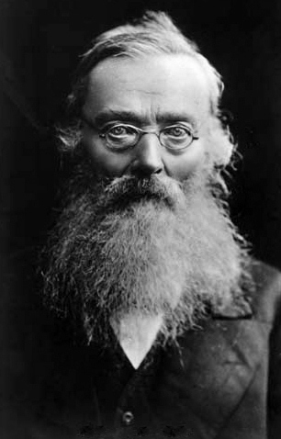
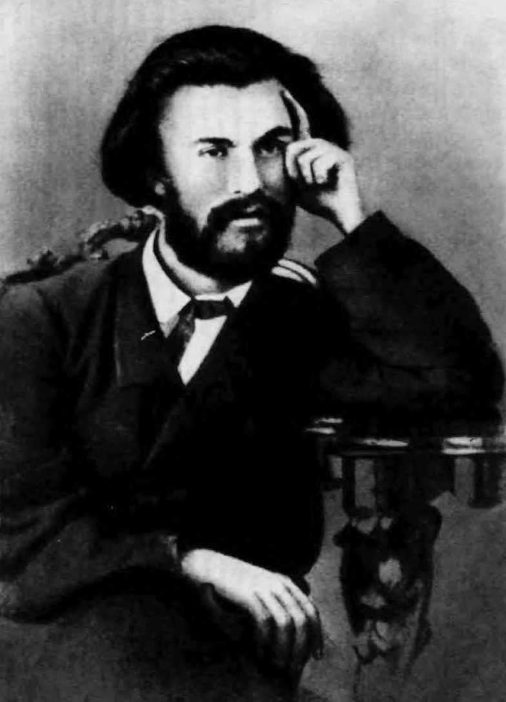
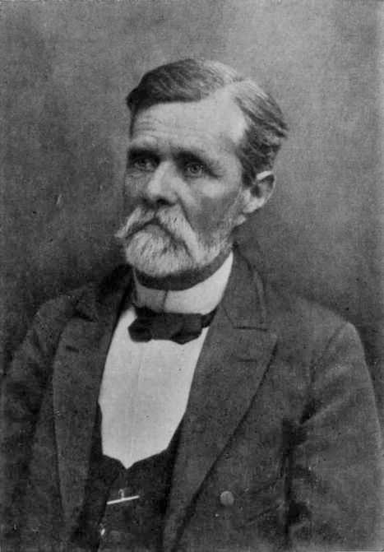
Mykola Kostomarov 1817-1885
* In Jurasovka (Voronesh)
Father: Russian nobility
Mother: Ukrainian peasant and one of his father’s serfs
Historian, Professor in Kyiv, St. Petersburg, poet, ethnographer
Mykhailo Drahomanov 1841-1895
* In Hadiach (Poltava)
Family: Cossack noble
Historian, political philosopher, socialist
Hoped for democratic Russian Federation with autonomous Ukraine as part
Ivan Nechuy-Levytsky
1838-1918
* In Stepliv (Cherkasy Oblast)
Father: parish priest
Went to Kiev Theological Academy, teacher and writer,died of hunger an illness in a Kyiv almshouse on 2 April 1918

Slide 15
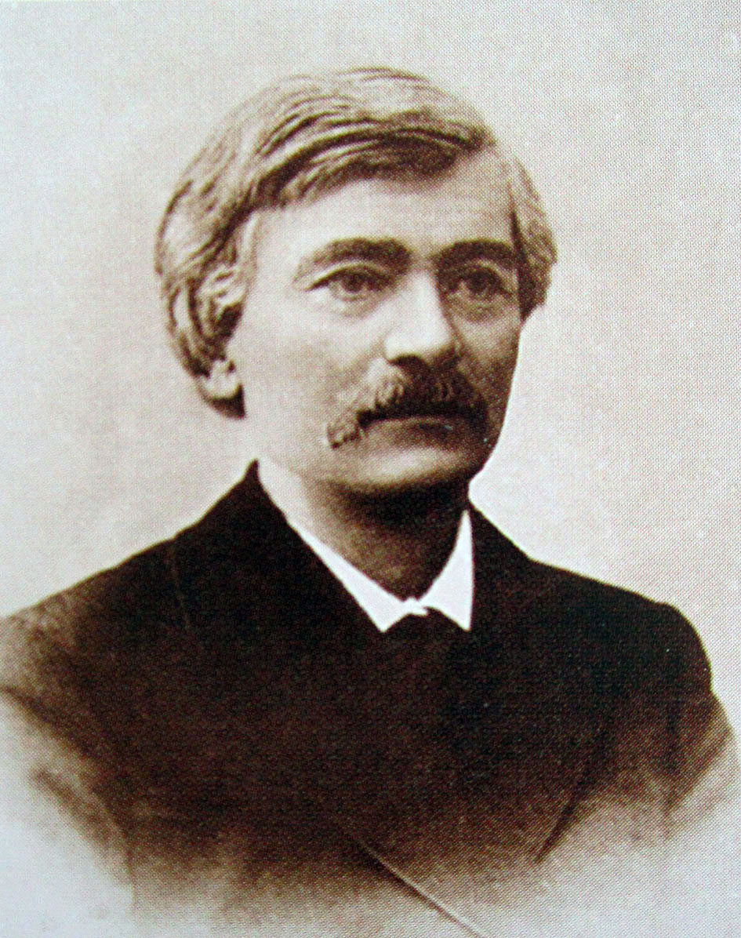
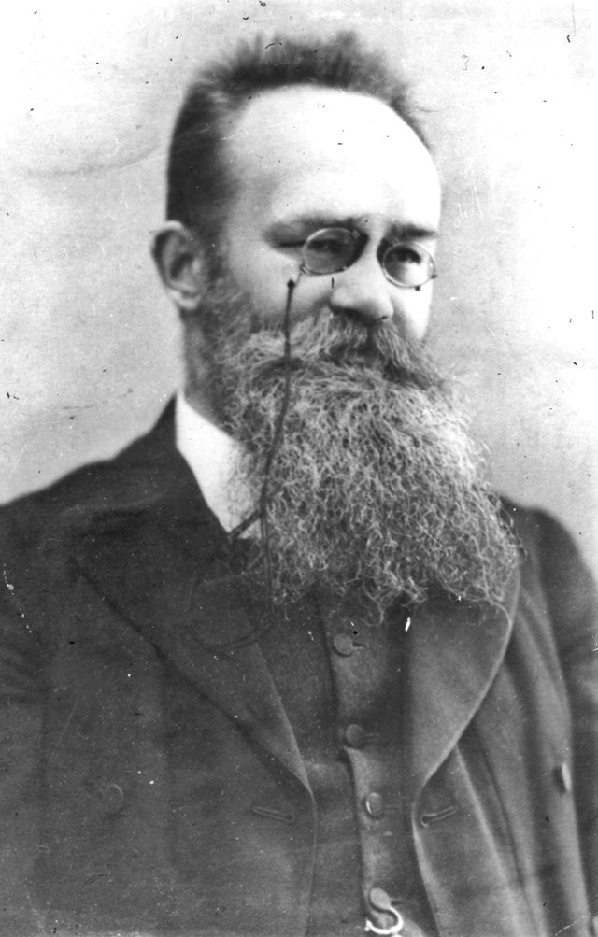
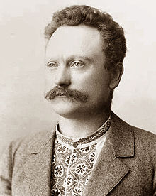
Volodymyr Antonovych 1834-1908
* In Makhnivka (Kyiv/Kiev)
Family: impoverished Polish gentry
Historian, Professor at Kyiv/Kiev University
Populist and ‘peasant-lover’
Mykhailo Hrushevs’kyj 1866-1934
* In Chełm (Russian Empire)
Father: University professor, family priests and parish servants
Historian, Professor in Lemberg, politician and head of first Ukrainian state 1918/19
Ivan Franko
1856-1916
* In Nahujevychi (Galicia)
Writer, journalist, translator, and politician
Father: Blacksmith of German origin
Mother: poor Ruthenian-Polish noblewoman
Socialist and Ukrainophile, spent time in Austrian prison

Slide 16
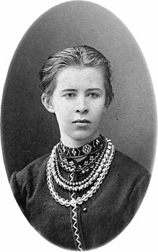
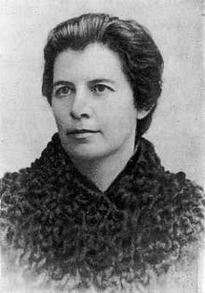
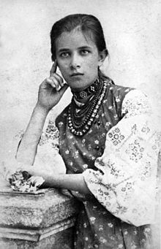
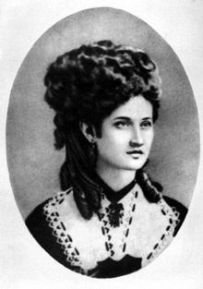
Lesya Ukrainka (Larysa Kosach)
1871-1913
* In Novohrad-Volynskyi (Russian Empire)
Politician, feminist, author
Mother: writer and publisher Olena Pchilka
Father: noble Ruthenian
Niece of Drahomanov
Olena Pchilka (Olha Kosach, née Drahomanova
1849-1930
* In Hadiach (Poltava)
Publisher, translator, ethnographer, feminist
Family: local gentry
Olena Zirka (Olha Kosach-Kryvniuk)
1877-1945
* In Novohrad-Volynskyi
Translator, writer, physician, feminist
Nataliya Kobrynska (Nataliya Ozarkevych)
1851-1920
* In Beleluia (Galicia)
Father: parish priest
Writer, socialist, feminist

Slide 17
Ukrainian nation building by culture
1798 Ivan Kotljarevs’kyj (1769-1838) publishes Enejida (in the vernacular, i.e. Ukrainian)
1823-1825 Secret Brotherhood of Slavs
1837 Appearance of The Mermaid of Dnister (Ruthenian Triad)
1840 Taras Shevchenko publishes Kobzar
1846/47 Brotherhood of Sts. Cyril and Methodius (Kyiv)
1860s ff Hromada movement
Center of Ukrainian nation building – now East Galicia
1898 Publication of the first volume of Mykhailo Hrushevsky’s History of Ukraine-Rus (in Austria)
Reaction of imperial authorities
1834 Founding of the University of Kyiv/Kiev (Russian)
1863 Valuev Decree: Use of Ukrainian in print restricted
1876 Ukas of Ems – restrictions expanded
1881 Slight relaxation under Alexander III
1905 Russian Revolution: restrictions on the use of Ukrainian language in Russian Empire lifted
1910: Restrictions partly re-introduced

Slide 18
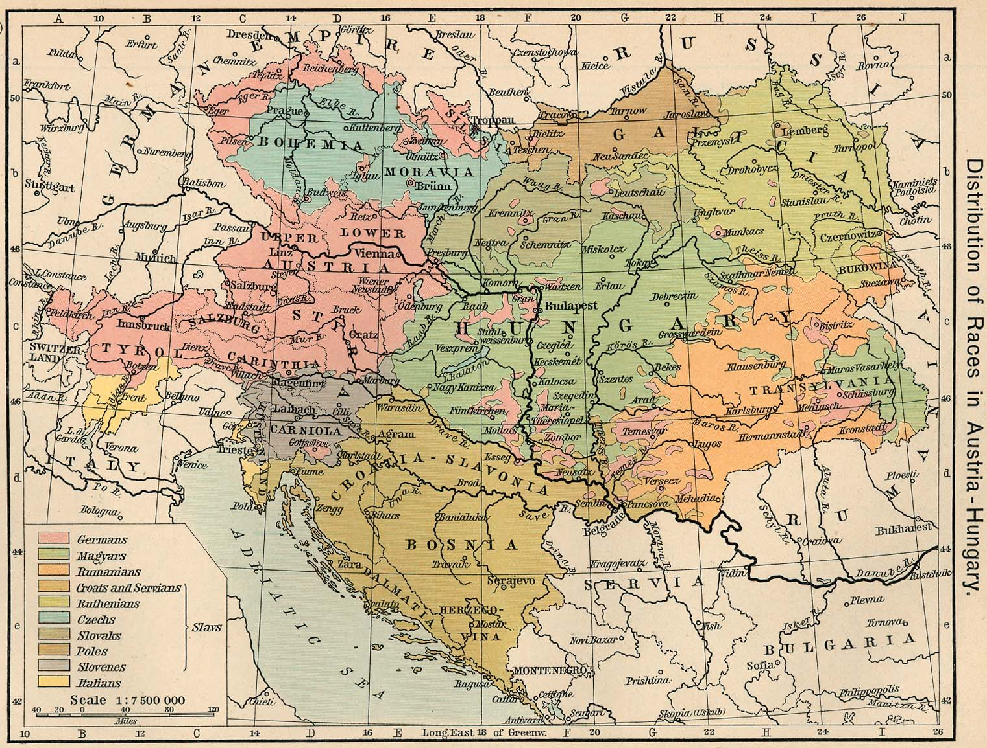

Slide 19
Map from Andrew Andersen, Centre for Military and Strategic Studies, University of Calgary

Slide 20
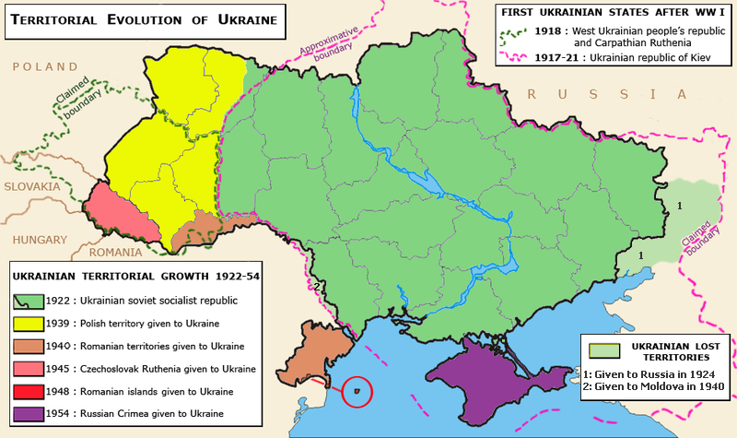

Slide 21
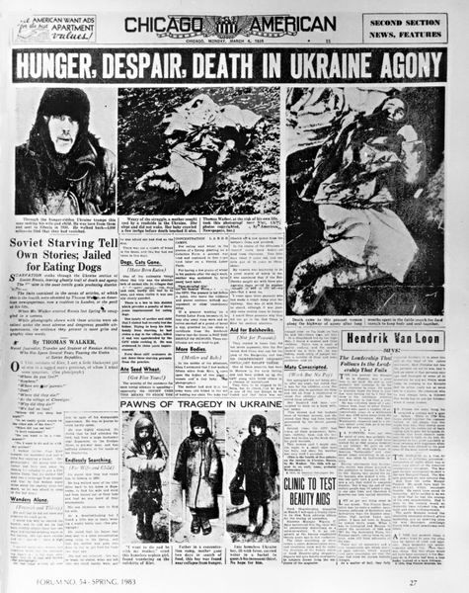
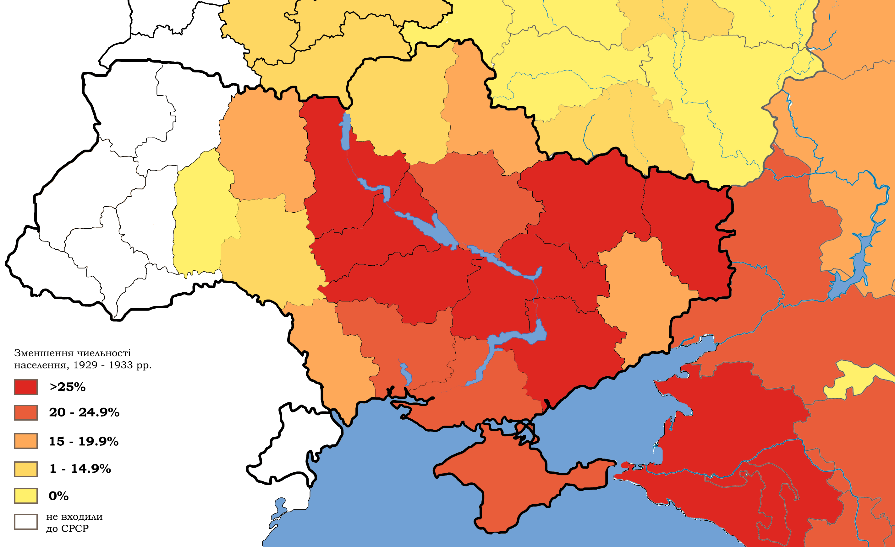
Holodomor: The Ukrainian Famine 1933
Population losses between 1929-1933: at least 4 to 5 Million
Dark red: 25%
Notes:
21

Slide 22
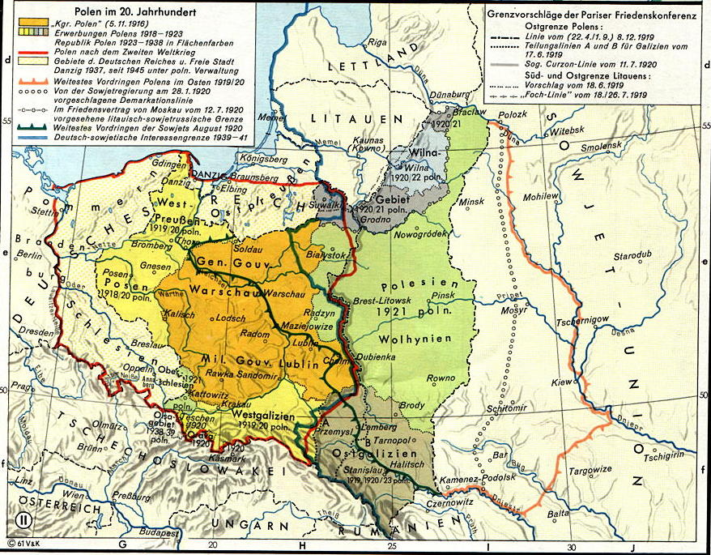
Poland in the 20th century (source: Putzger)
Notes:
22

Slide 23
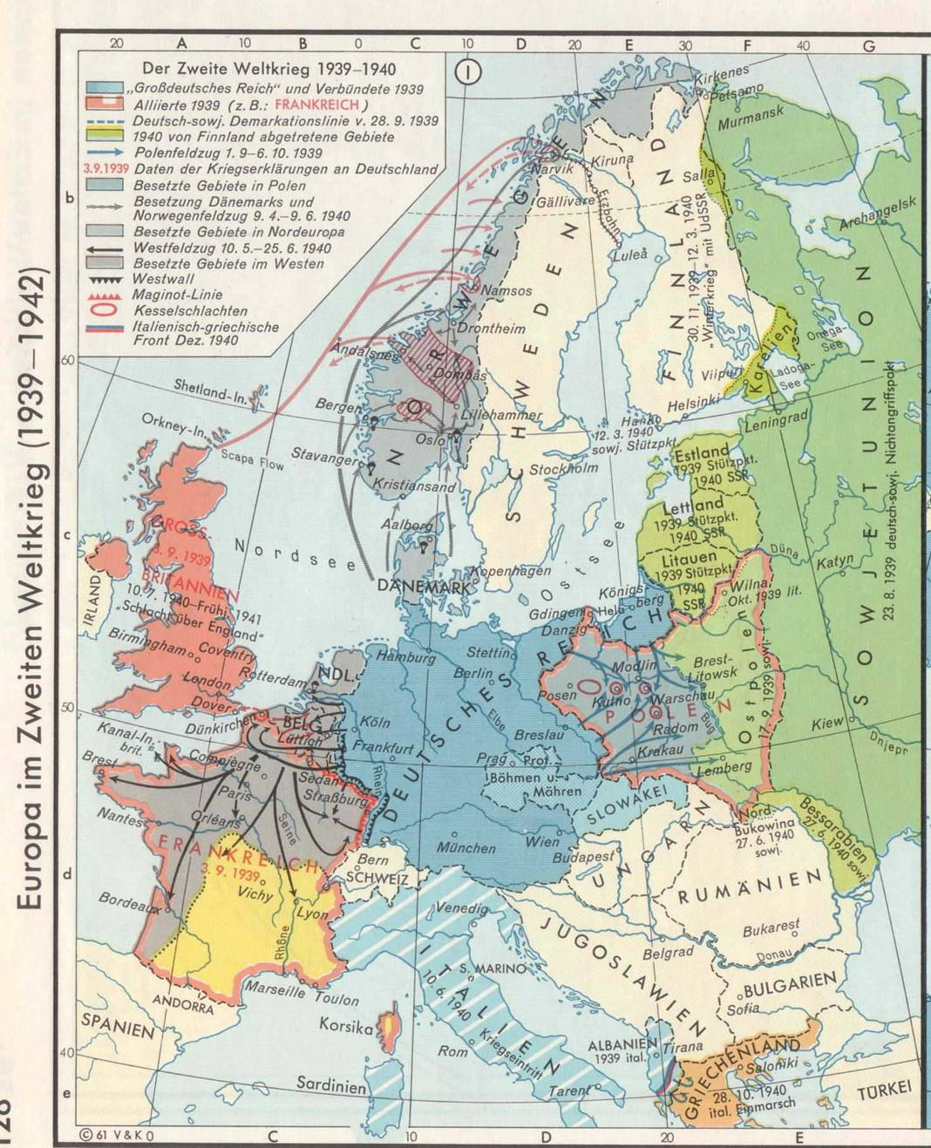
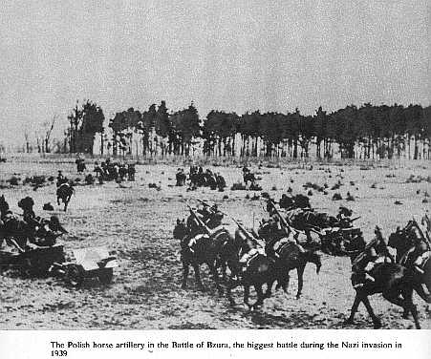
Blitzkrieg strategy

Slide 24
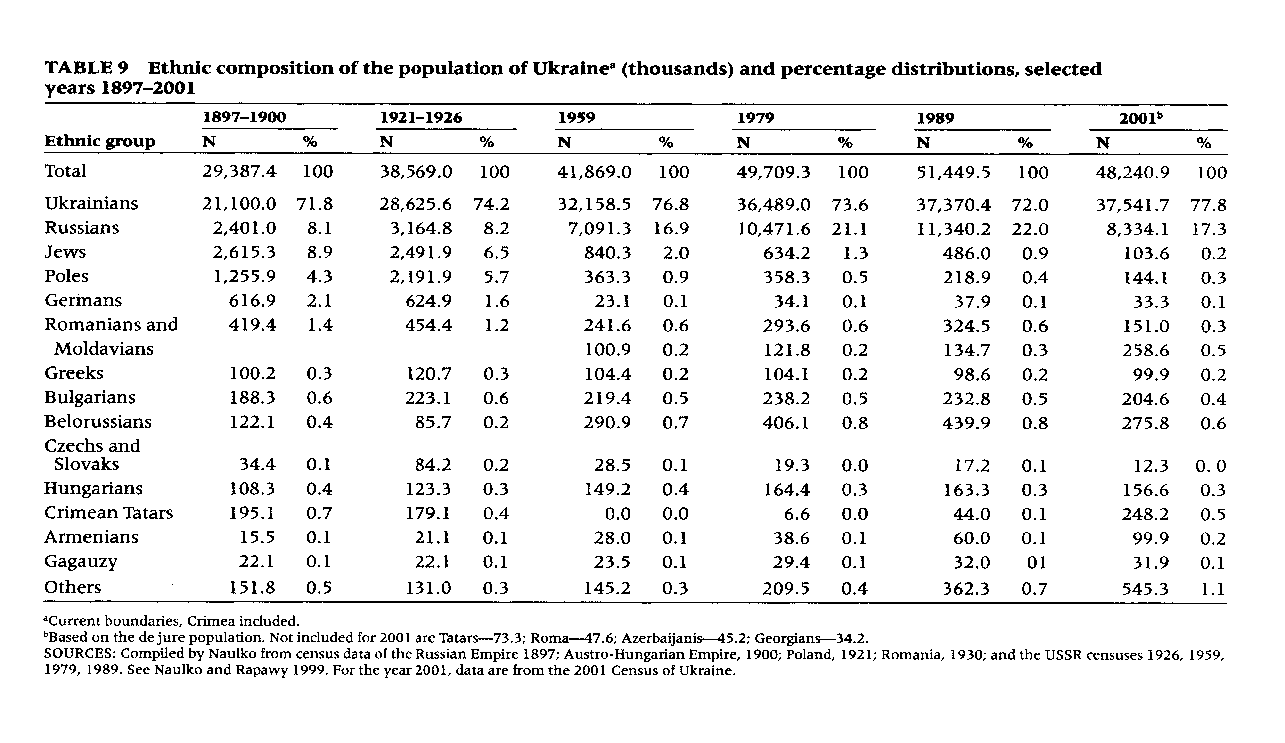
Anatole Romaniuk and Oleksandr Gladun, Demographic Trends in Ukraine: Past, Present and Future, in: Population and Development Review, June 2015, Vol. 41, No. 2, p 325

Slide 25
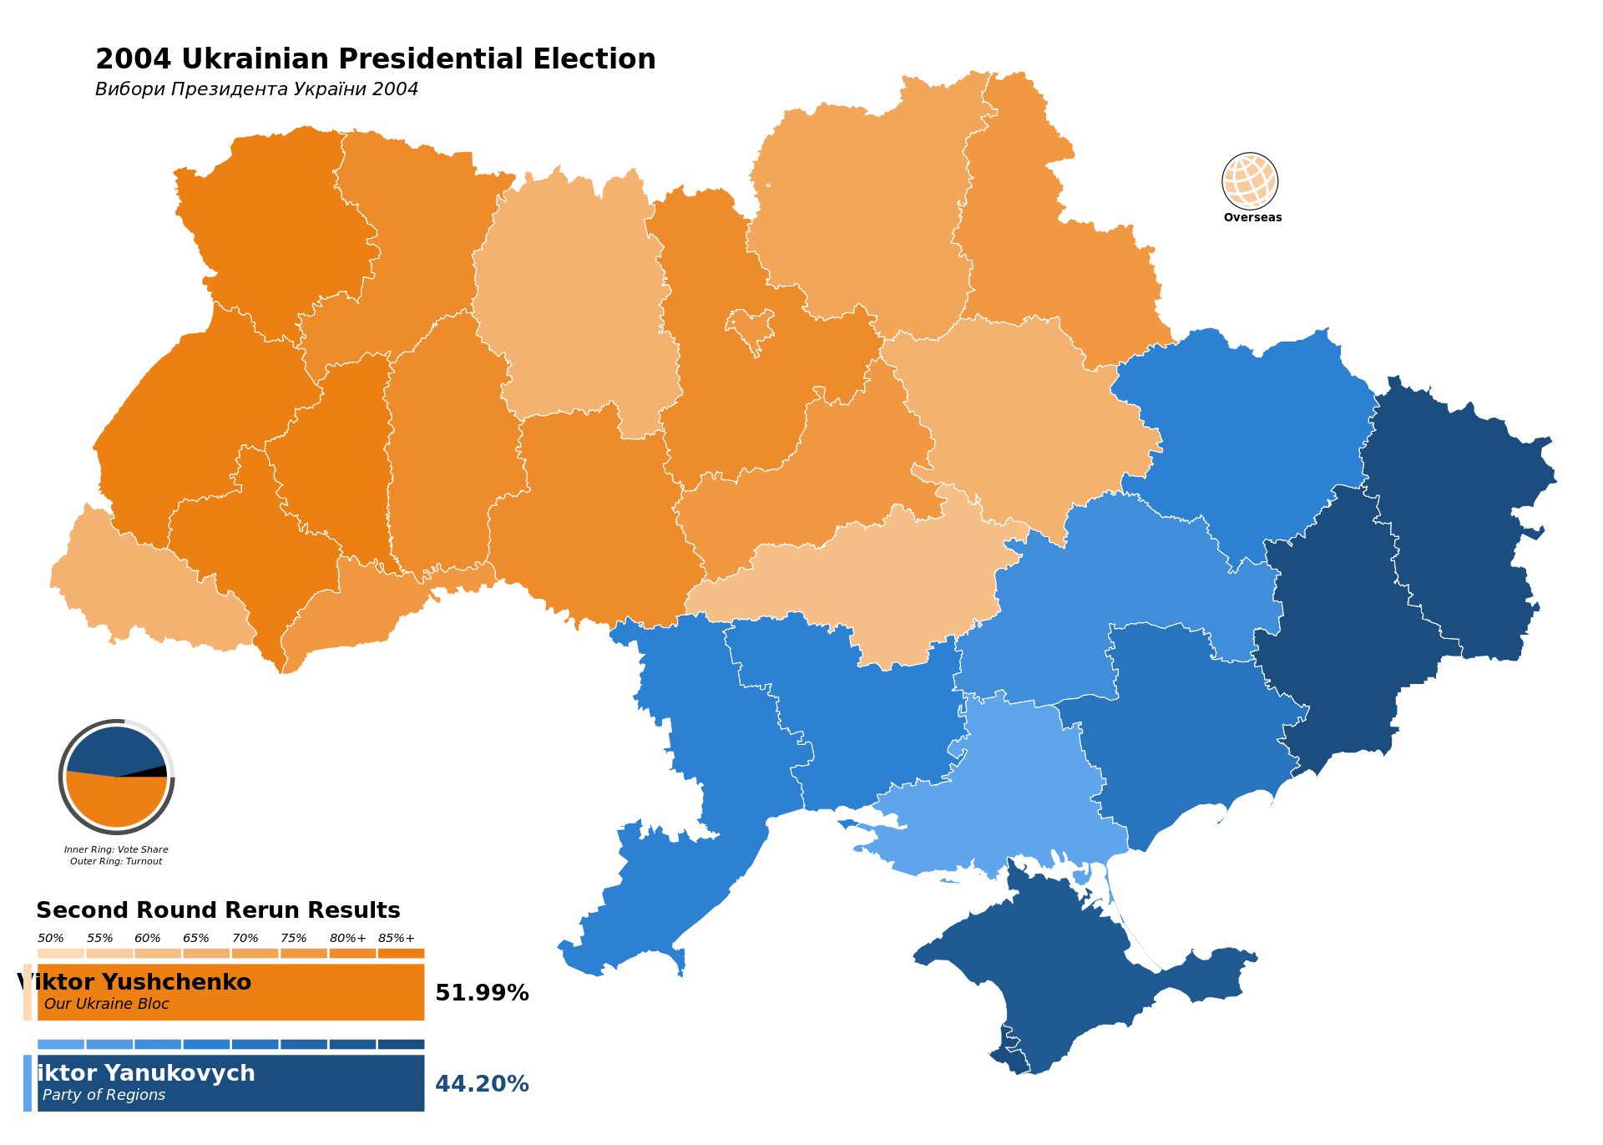
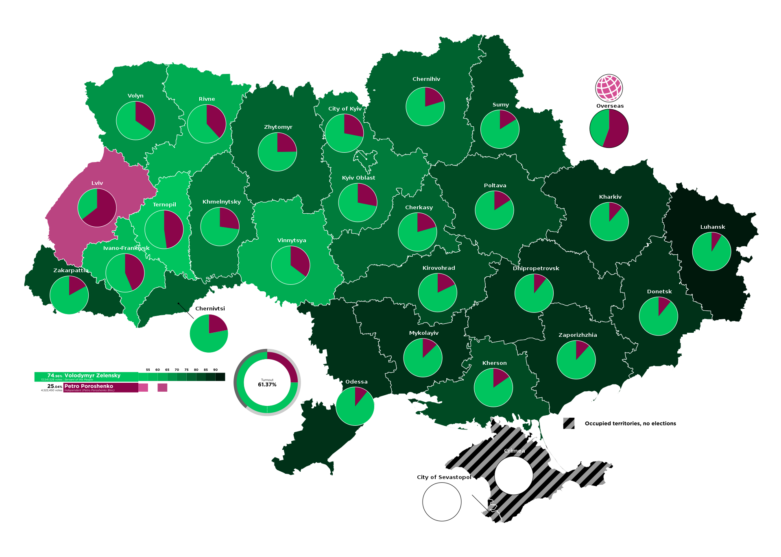
Presidential elections 2019, Zelensky green, Poroshenko red

Slide 26
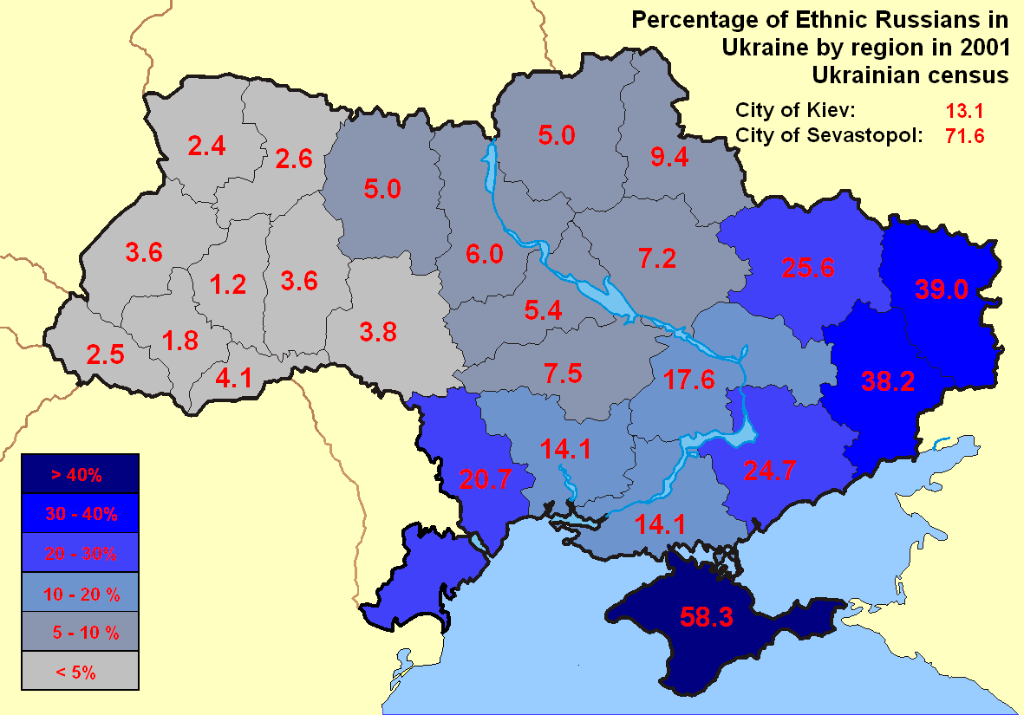
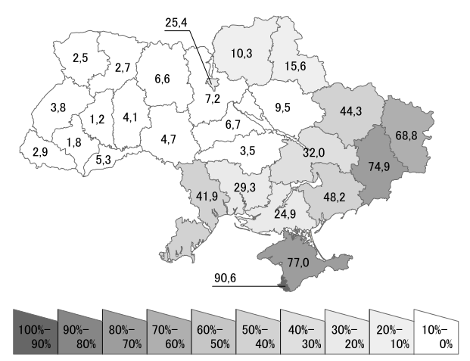
Share of people according to first language, in % (Census 2001) The darker the higher the share of Russian native speakers
Share of the population, who identify as ethnic Russians % (Zensus 2001)
M

Slide 27
Anatole Romaniuk and Oleksandr Gladun, Demographic Trends in Ukraine: Past, Present and Future, in: Population and Development Review, June 2015, Vol. 41, No. 2, p 325

Slide 28
Anthem of Soviet Ukraine (1949-1991)
Words by Pavel Tychina and Mikola Bazhan (1948?), changed in 1978 (2nd stanza to remove mention of Stalin)
Music by Anton Dmitrievich Lyebyedinyec (1948?)
https://www.youtube.com/watch?v=sKB91zS2x6c
1. Live, Ukraine, beautiful and mighty, - In the Soviet Union you have found happiness. Equal between the equal ones (other republics), free between the free ones, Under the sunrays of freedom you have bloomed as a flower.
CHORUS: Glory to the Soviet Union, Glory! Glory to the Motherland in the eternity! Live, Ukraine, Soviet power, In the united homeland of fraternal nations.
2. In battles for people’s fate Russian people were always our friend and brother. Lenin led us in a victorious campaign Under October’s banner to brilliant heights. CHORUS
3. We fame our mighty Fatherland with labour, Affirm the truth of immortal ideas. To the shining communism – the great future - Lenin’s party wisely leads us.
CHORUS
Notes:
28

Slide 29
National anthem (today only the first 6 lines) "Shche ne vmerla Ukraina" (Ukraine's Glory Has Not Perished)
Words by: Paul Chubynskyi (1862) Music by: Mikhail Verbytskyi Adopted: 1917, abolished 1920, restored 1991
Ще не вмерла Україна, і слава, і воля, Ще нам, браття молодії, усміхнеться доля. Згинуть наші вороженьки, як роса на сонці, Запануєм і ми, браття, у своїй сторонці. CHORUS Приспів Душу, тіло ми положим за нашу свободу. І покажем, що ми, браття, козацького роду. Станем, браття, в бій кровавий від Сяну до Дону В ріднім краю панувати не дамо нікому; Чорне море ще всміхнеться, дід Дніпро зрадіє, Ще у нашій Україні доленька наспіє. CHORUS Приспів завзяття, праця щира свого ще докаже, Ще ся волі в Україні піснь гучна розляже, За Карпати відоб’ється, згомонить степами, України слава стане поміж народами. CHORUS | The glory and freedom of Ukraine has not yet perished, And yet still upon us, brothers, fate shall smile once more. Our enemies shall melt away, like the dew in the sun. And we too shall rule, O brethren, the homeland of our own. CHORUS: We'll lay down our souls and bodies to attain our freedom, And we'll show that we, brothers, are of the Cossack nation. We'll stand together for freedom, from the Sian to the Don, We will not allow others to rule in our motherland. The Black Sea will smile and grandfather Dnipro will rejoice, For in our own Ukraine fortune shall flourish again. CHORUS Our persistence and our sincere toils will be rewarded, And freedom's song will resound throughout all of Ukraine. Echoing off the Carpathians, and rumbling across the steppes, Ukraine's fame and glory will be known among all nations. CHORUS
1st line (before 2003): Shche ne vmerla Ukrajina, ni slava, ni volja,
1st line (after 2003): Shche ne vmerla Ukrajini i slava, i volja,
Notes:
29

