Slide 1
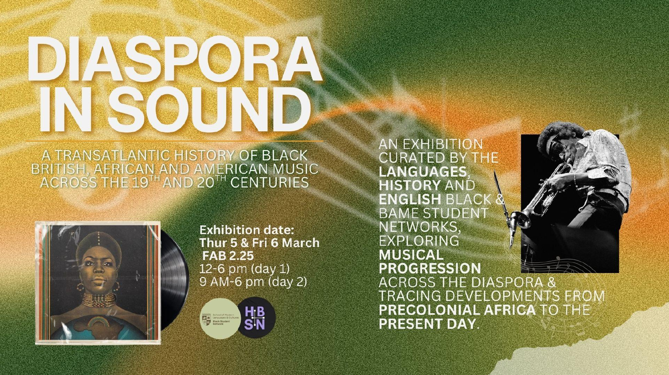

Slide 2
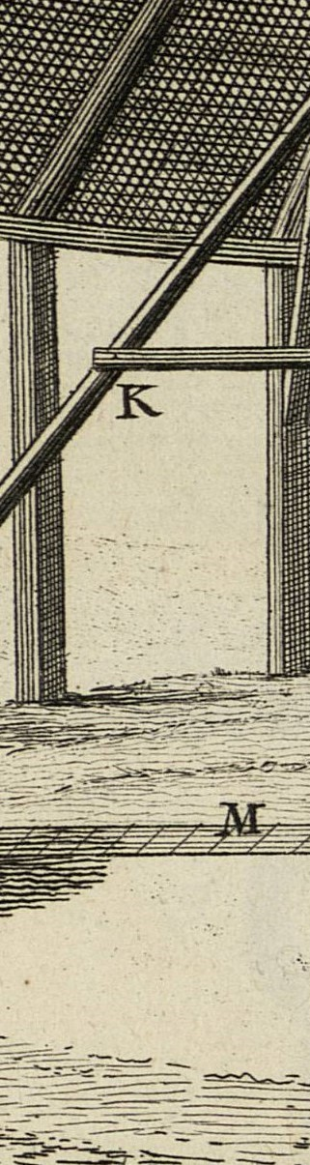
Historical Argument
HI2K9
Dr. Michael Bycroft
2026, term 2, week 8

Slide 3
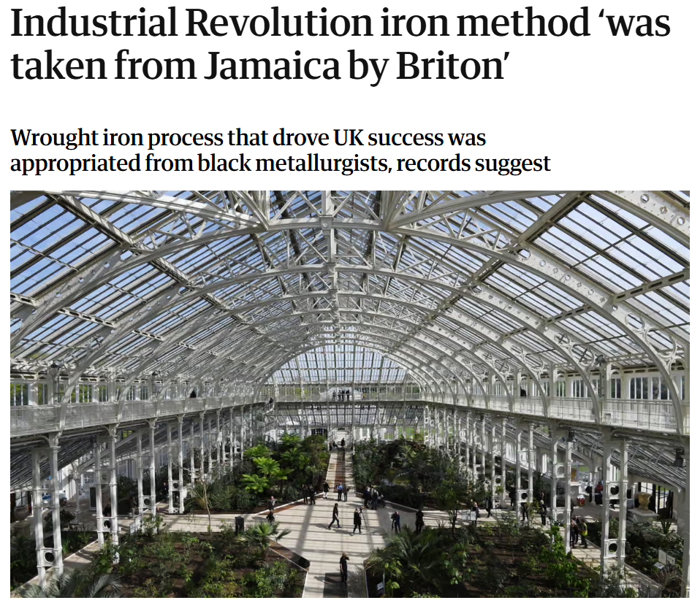
Hannah Devlin, The Guardian Online, Wed 5th July, 2023
Temperate House, Kew Gardens

Slide 4
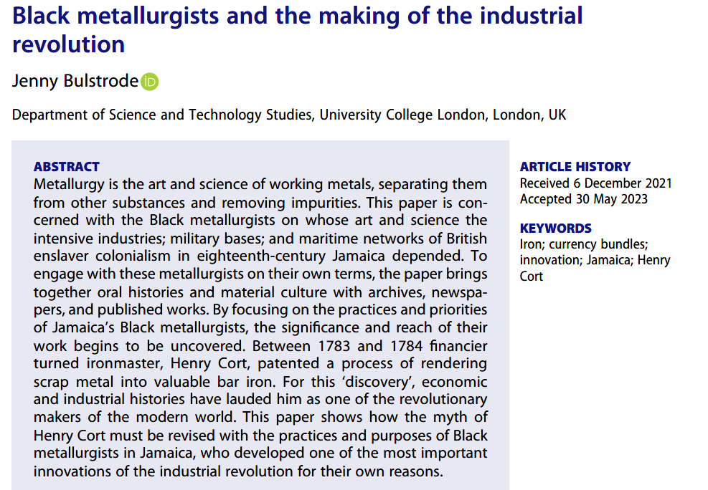
History and Technology, vol. 39, no. 1 (2023): 1-41

Slide 5
“…there is absolutely no evidence to suggest that Henry Cort’s iron-rolling process originated at John Reeder’s foundry [in Jamaica], or with any of the people who worked there.”
Oliver Jelf, “The Origin of Henry Cort’s Iron-Rolling Process: Assessing the Evidence.” Historical Metallurgy 55, no. 2 (2025): 70–80
“We so rarely get the privilege of finding a smoking gun...But what we have here is not just the lack of a smoking gun. There isn’t a body, and there isn’t even any blood. There hasn’t been report of a loud bang, or really anything at all.”
Anton Howes, “How to Be A Public Historian,” Age of Invention [blog], Nov 23, 2023

Slide 6

Disclaimer:
No historical debates are settled in this lecture!

Slide 7
Metallurgy in Jamaica
Voyaging in Polynesia
The British Empire
Conclusions

Slide 8
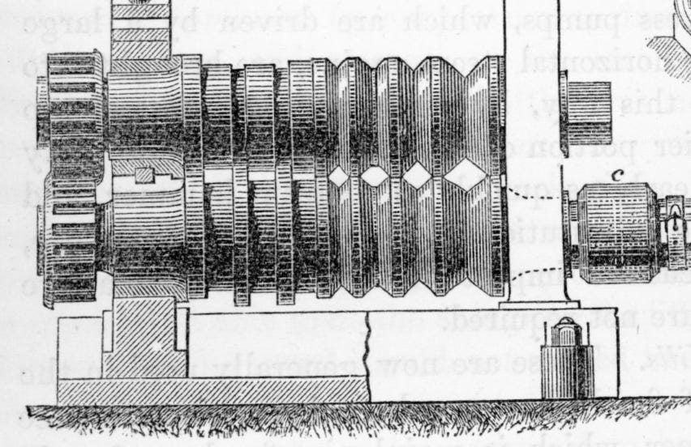
Grooved rollers used in the iron industry in the nineteenth/twentieth century, similar to those described in Henry Cort’s 1783 patent for ‘rolling’ scrap iron to make iron bars
Reproduced in Anton Howes, “Cort Case,” Age of Invention [blog], 29th August, 2023

Slide 9
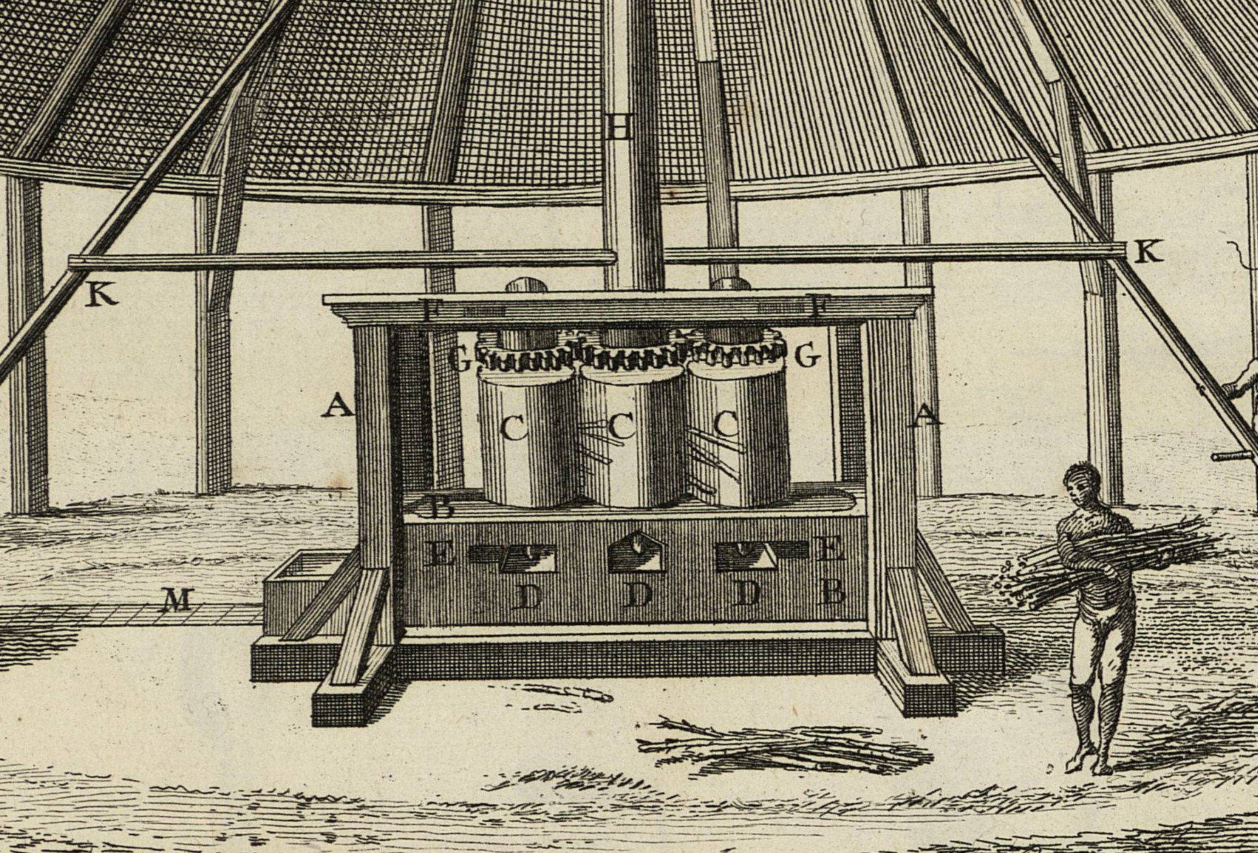
Depiction of eighteenth-century sugar mill, showing three vertical rollers and worker carrying bundle of canes
From Diderot and d’Alembert, Encyclopédie, vol. 1 of the plates (1762), under “Sucrérie”

Slide 10
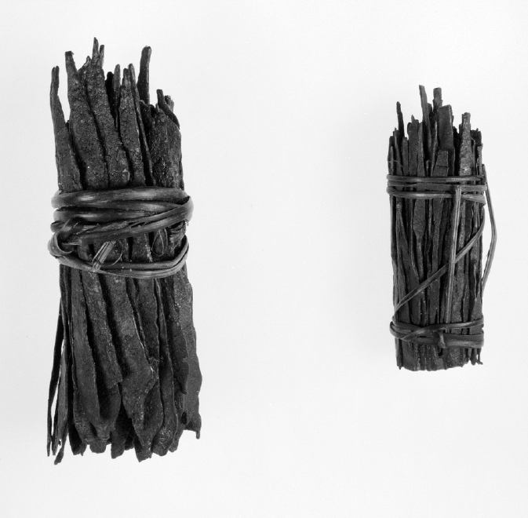
Bundles of iron rods or currency blades, linked to the Fang people of West Africa.
Peabody Museum of Archaeology and Ethnology, Harvard University.
Creation date unknown, purchased 1920.
Reproduced in Bulstrode, "Black metallurgists."

Slide 11
An ingenious hypothesis

Slide 12
A persuasive argument?
That grooved rollers were used to process scrap metal at Reeder’s foundry in Jamaica
That sugar mills were fed with bundles of cane in Caribbean plantations
That Reeder mentioned the innovation in a document somewhere
That Reeder’s foundry was exceptionally successful
That iron bundles and grooved rollers were the essence of Cort’s 1783 patent
That Henry Cort had some way of finding out about the innovation at Reeder’s foundry
…

Slide 13
^{Empty footnote}
“...they [metallurgists at Reeder's foundry] had grooved rollers.”²⁰⁴
204. Copy memorandum of Eliza L. Crosse concerning Reeder's appeal, c. 1850, Devon Heritage Centre (1160 M/C/J/30)
Bulstrode, “Black Metallurgists,” p. 19
“The document makes absolutely no mention of a rolling mill, or of grooved rollers, and is entirely irrelevant to Bulstrode’s assertion (see full transcription in Appendix).”
Jelf, “Cort’s Iron-rolling Process,” p. 72

Slide 14
Lop-sided quotation
“The difference of labour ... is obviated by my being possessed of [Black metallurgists] sufficient, many of which are perfect in every branch of Iron Manufactory.”
Bulstrode, “Black Metallurgists,” quoting John Reeder, p. 11
“The difference of labour ... is obviated by my being possessed of [Black metallurgists] sufficient, many of which are perfect in every branch of Iron Manufactory so far as relates to casting and turning Mill Cases, Cannon, Iron Boilers & & and in wrought Iron Anchors, Mill Gudgeons, Axels & &”
Jelf, “Cort’s Iron-rolling Process,” quoting John Reeder, p. 73

Slide 15
Second-best sources
“[Jean-Baptiste] Labat [French engineer and sugar estate manager in Martinique] writes that bundles were placed on a workbench, untied, and the canes removed to be fed between the rollers. He was adamant that his enslaved workers should not push whole bundles into the mill...”
Jelf, “Cort’s Iron-rolling Process,” 599
Diderot and d’Alembert, Encyclopédie, vol. 1 of the plates (1762)

Slide 16
Silent silences
“…Reeder, in his letters and papers, never once mentions a new technique for processing iron, nor any kind of newly developed equipment…
It is hard to believe that a man as driven and acquisitive as Reeder would not, on finding himself in such a situation [having his foundry demolished by a militia], attempt to capitalise on a secret so valuable…
We know that he made several patent applications [for other inventions]…Yet he made no such application for any invention relating to wrought iron.”
Jelf, “Cort’s Iron-rolling Process,” 73

Slide 17
Ignoring alternative explanations
“Reeder’s considerable profits are easy to understand in the context of his operations: his overheads, in terms of labour (mostly unpaid) and materials (apparently plentiful), were comparatively very low. He enjoyed a captive market of planters and faced no competition from within the island…”
Jelf, “Henry Cort’s Iron-rolling Process,” 72
“The prior development in Europe of many of the elements included in Cort’s patent (which the above-mentioned historians of metallurgy have established) gives credibility to the view that he possessed all the ingredients necessary to develop his technique without recourse to intellectual theft from Reeder’s workers.”
Jelf, “Cort and the ‘Black metallurgists’”, p. 607

Slide 18
A lesson to draw from this example
An ingenious hypothesis (or good story) is not the same as a persuasive argument

Slide 19
2. Voyaging in Polynesia

Slide 20
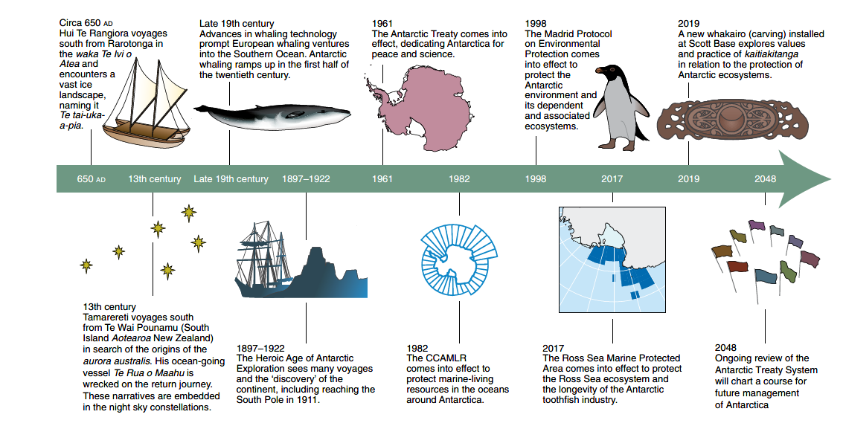
Priscilla M. Wehi, “Transforming Antarctic Management and Policy with an Indigenous Lens,” Nature Ecology and Evolution, vol. 5 (2021): 1055-1059

Slide 21
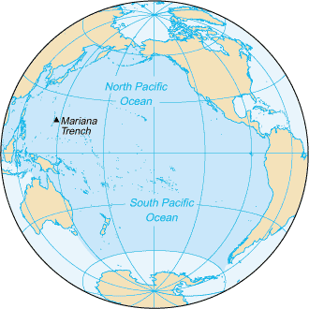
Rapa
Rapa Nui / Easter Island
Rarotonga
Aotearoa / New Zealand
Te Waipounamu / South Island
Antarctica
Enderby Island

Slide 22


Slide 23
A frozen sea?
...the rocks that grow out of the sea, in the space beyond Rapa; the monstrous seas...the frozen sea of pia, with the deceitful animal of the sea who dives to great depths...
From Percy Smith, “Hawaiki: Being An Introduction to Rarotongan History,” The Journal of the Polynesian Society 8 (1899): 1-48, on p. 10
This is an English translation of texts originally written down in the 1860s and based on the spoken words of a Rarotongan scholar (tōhunga)
The text tells of a voyage made by Hui Te Rangiora 48 generations previously, in about the fifth century AD

Slide 24
Problems with the frozen sea
“frozen sea” is a translation/interpretation by Percy Smith of “tai-uka-a-pia”
“tai-uka-a-pia” is better translated as “white sea foam”
this translation was preferred by some early Māori scholars, e.g. Peter Buck / Te Rangi Hīroa
Pre-European ships and clothing were badly suited to the rigours of the South Seas
No archaeological evidence of pre-European occupation of Enderby Island
No reference to Antarctica in Ngāi Tahu oral histories with accuracy up to 20 generations (c. 1200 AD)

Slide 25
A lesson to take from this example
“…uncritical acceptance of Māori knowledge is arguably just as patronising as its earlier blanket rejection.”
Michael J. Stevens, Atholl Anderson, and Te Maire Tau. ‘“Our Ultimate Duty”: Defending the Integrity of Māori Tradition’. Karaka, 1 January 2022

Slide 26
3. The British Empire

Slide 27
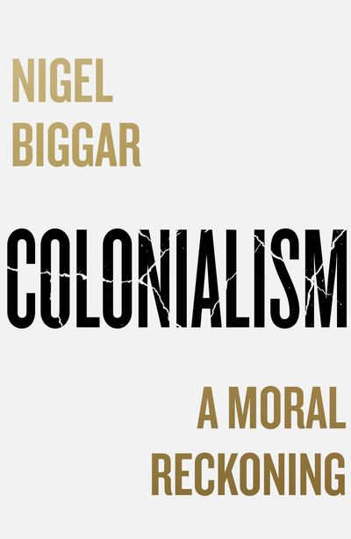
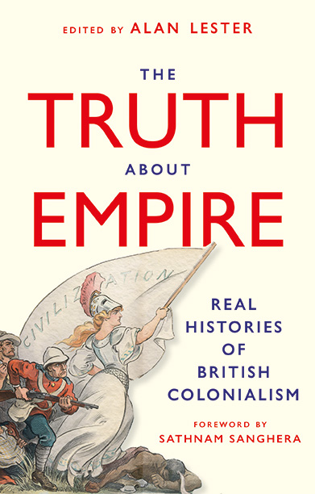
Published by William Collins, 2023
Published by Hurst, 2024

Slide 28
Beyond the pale?
“[The] ‘anti-colonialist’ misperception is often shaped and promoted by people who are not historians or not academics at all.”
Nigel Biggar, “A Reply to Alan Lester,” p. 801
“There is an area of disputation, occupied by historical scholars, that different interpretations of the evidence allows. This disputation is the bread and butter of our trade, but Biggar’s and others’ culture war interventions have nothing to do with the practice of the historian’s craft.”
Alan Lester, “The British Empire in the Culture War: Nigel Biggar’s Colonialism: A Moral Reckoning,” in The Journal of Imperial and Commonwealth History 51, no. 4 (2023): 763-795

Slide 29
Politics v. the past
“…many of my critics are really not interested in the complicated, morally ambiguous truth about the past…[I intend to] lay bare the gap between the data…and the anti-colonialist assertions and judgments made on the other.”
Biggar, Colonialism, p. 2, p. 14
“[Biggar is] motivated wholly by politics and patriotic emotion rather than any desire to understand the past.”
Lester, “British Empire in the Culture War,” p. 765

Slide 30
The state of public opinion
“I do not suppose that all scholars of empire are ‘anti-colonialist’ in my sense…My primary concern…is with public misperception (as I see it) and its effects upon public life.”
Biggar, “Reply to Alan Lester,” p. 801
“…it’s not only those on the right who are inclined to excess when it comes to imperial history…But the crucial difference is that, in Britain, the Left has not been in power for more than a decade.”
Sathnam Sanghera, “Foreword,” in Lester, ed., The Truth About Empire, p. 5

Slide 31
Who to cite?
“Historians of South Asia will be surprised to find no Indian representatives of the Subaltern Studies school cited in either the bibliography or text...”
Margot Finn, “Colonialism: A Methodological Reckoning,” in Lester, ed., The Truth About Empire, pp. 238-9
“[Lester shows] a consistent pattern of selective citation, which places various controversies in British imperial history in a highly misleading and partisan light.”
Alexander Morrison, “Partisanship and Parochialism in the History of the British Empire,” Ab Imperio 1 (2025), on p. 47

Slide 32
A lesson from this example
Arguments are not just about (primary-source) evidence

Slide 33
3. Conclusions

Slide 34
An ingenious hypothesis (or good story) is not the same as a persuasive argument
Oral traditions (etc.) should be treated critically, like any other source
Arguments are not just about (primary-source) evidence

Slide 35
The logic of argument
My grandmother was an accountant.
I am descended from my grandmother.
Therefore, I am an accountant.

Slide 36
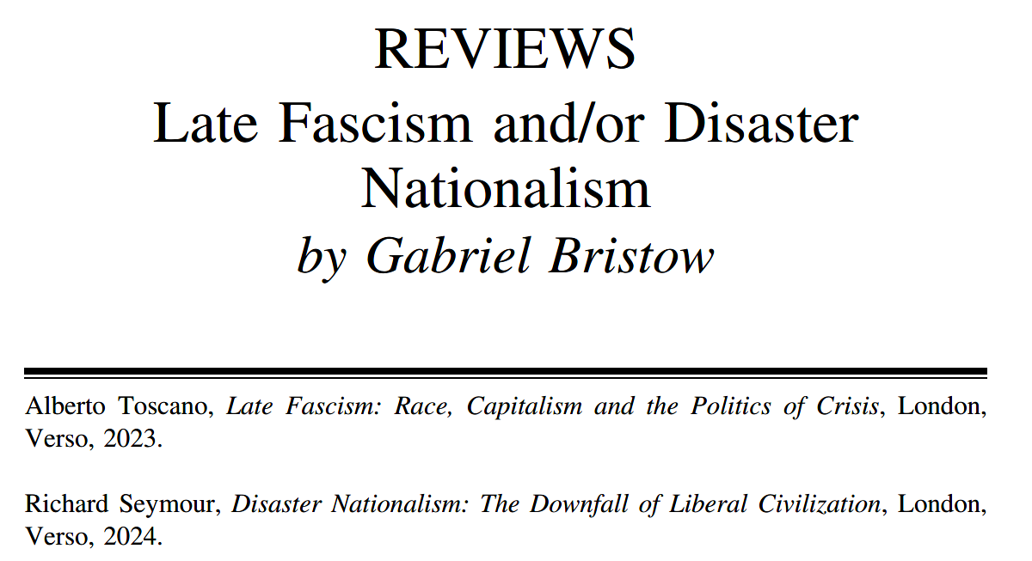
The infrastructure of argument
History Workshop Journal, issue 99, Book Review section

Slide 37
