Slide 1
Historical Research, term 2, lecture 3
Feeling and Sensing the Past: The History of the Emotions
Dr Claudia Stein

Slide 2
Lecture outline
What is the wider context of the rise of the history of emotions in the 1990s: neoliberalism
What is ‘the history of emotions’ as promoted in general introductions to the subject?

Slide 3
What is neoliberalism?
Daniel Rodgers, The Uses and Abuses of “Neoliberalism, Dissent, Volume 65, Number 1, Winter 2018, pp. 78-87
‘”Neoliberalism” was a term advanced by different groups for different purposes and at several times left orphaned. And then, suddenly, in the mid-1990s, it took off.’ (p. 80)
‘The problem with term neoliberalism is neither that it has no meaning nor that it has an infinite number of them. It is that the term has been applied to four distinctly different phenomena. “Neoliberalism” stands, first, for the late capitalist economy of our times; second, for a strand of ideas; third, for a globally circulating bundle of policy measures; and fourth, for the hegemonic force of the culture that surrounds and entraps us.’ (p. 81)

Slide 4
Four phenomena of neoliberalism
Finance capitalism: Neoliberalism as economy
‘It stands for the economic regime that global finance capital has unleashed upon the world. Neoliberalism (1) inscribes on politics and culture the needs of a global capitalism that sustains itself on the free flow of capital, goods, disembedded labor, and market-friendly state policies. It does not rely on the state in the same way that the “embedded” corporate capitalism of the mid- twentieth century did, but it is not a creature of the minimal state either. It depends, rather, on complex structures of institutional supports, business-friendly regulations, and free-range investment opportunities arrayed in different ways across the globe.’ (p.81)
2. Market fundamentalism: Neoliberalism as an intellectual project
‘Neoliberalism (2) refers not to an economic structure but to a strand of ideas, an intellectual project: the restructuring of late-twentieth-century economic thought around the paradigm of the efficient market.,, Theories of human capital, consumer choice and preference satisfaction, individual utility maximization, the mutual benefits of free trade and comparative advantage, and, above all, the axioms of market efficiency, began their long march into the paradigmatic heart of the economics profession.’ (p. 82)

Slide 5
3. Neoliberalism as policy
‘It points to the bundle of business-friendly policy measures that has circulated more and more widely through domestic and global politics since the 1970s. Some of these policy measures originated with the economic theorists. Many were the work of freelance policy entrepreneurs. Increasingly, they now issue from policy think tanks and advocacy groups, or government.’ (Or, individual-and government funded NGOs).
4. Commodifying the self: neoliberalism as cultural regime
‘Neoliberalism (4), the latest entry into this parade, is the most enveloping of them all. It names a cultural regime that stamps price and profit onto the very souls of those who live under it. In the terms Wendy Brown takes from Foucault in her witheringly critical Undoing the Demos (2015), neoliberalism is not a stage of the economy, a strand of ideas, or a set of policies but, rather, the “governing rationality” of our times.’

Slide 6
Let’s dwell on the 4th phenomenon of neoliberalism for a moment ….
Neoliberalism is the ‘governing rationality’ of our times – what does that mean?
This view and approach to neoliberalism is inspired by Michel Foucault’s lectures, ‘The Birth of Biopolitics: Lectures at the College de France, 1978-1979’, on the topic in the late 1970s (first published into English in 2008), and his concept of ‘governmentality’:
‘Neoliberalism should be understood as a ‘rationality’ in which generalised competition has become the societal norm, and in which individual subjectivity has been reformed according to the ideal of entrepreneurialism.’

Slide 7
A definition of neoliberalism, inspired by the view that is is a form of ‘governmentality’, characterized by based generalized competition in society and individual entrepreneurship
Julie A. Wilson, Neoliberalism (New York, 2018)
‘Generally speaking, neoliberalism is a set of social, cultural, and political-economic forces that puts competition at the centre of social life. According to neoliberalism, government’s charge is not the care and security of citizens, but rather the promotion of market competition….Competition is heralded to ensure efficiency and incite creativity. Spurred by competition, individual organisations, companies, and even the government itself, will seek to optimize and innovate, creating a truly free social world where the best people and ideas come out at the top.
Put it little differently, neoliberalism aims to create a market-based society, where there are only competing private enterprises. Since the 1970s, neoliberal ideas have increasingly guided the politics and practices of government and other social institutions, and as a result, we have come to live in competition with ourselves, others, and our social world.’ (p. 2)

Slide 8
‘….as a result, we have come to live in competition with ourselves, others, and our social world.’
Living in competition as self-interested entrepreneurs turns us into certain kind of people:
The self-enclosed individual, a form of ‘hyper-individualism’
‘Self-enclosed individualism relies on a dichotomous framework that positions the individual I n opposition to all other human and non-human beings (“it is me against the world.”) In this binary oppositional structure, each individual is entirely separate from the external world. Self and society are mutually exclusive: to survive and thrive, each person must focus entirely on herself, evaluating all action in ego-centric terms: ”What’s in it for me?” “How can I succeed?” “How will this event, this situation, affect me?” What can you do for me?” “What can I take from you?”
(AnaLouise Keating, Transforming Now!: Towards a Post-Oppositional Politics of Change (Champaign: University of Illinois Press, 2012), p.171)
‘Neoliberalism ask us to constantly calculate potential gains, losses, and risks, to be thinking about how
this or that decision might or might not give us a competitive edge over the rest of the field. To ensure our success and survival, we must play to win. According to neoliberalism one is first, and foremost, a “firm”, an “enterprise”, the “CEO of oneself”’ (Wilson, Neoliberalism, p. 4)

Slide 9
The self-enclosed neoliberal individual is driven by a deep-rooted ‘anxiety’
We are told that we are alone responsible and in charge of our own fate.
BUT: individuals cannot control their fates in a global, complex, capitalistic society, no matter how
much they compete. We are interdependent beings, vulnerable and interconnected to one
another by a number of infrastructures (e.g.institutions, school, university, roads, bridges, water/energy supply,
communication) that bring us in context with each other.
So, although individual control is not achievable by the individual, neoliberal society reinforces this message
in endless ways every single day.
‘No wonder that we are anxious. Our lives, our well-being, our success, and even our citizenship are
defined by impossibility.’ (p. 4)
what follows? Anxiety, anger, fear, despair, hatred, withdrawal form the world, depression….or hope, short but intense spells of happiness and joy to have succeeded in some task or having consumed something …

Slide 10
Neoliberalism governmentality ‘feeds’ on our emotions
Neoliberalism as a form of governmentality draws on the full range of human ‘felt experience’ or emotions in every aspect of our daily lives (e.g. consumption/advertisement, social media, ‘nudging ‘ and public relations in politics/policies, ‘crisis’ mode in social/environmental activism, or education (e.g. have I invested enough in my human capital? Do I need to do more investments?)

Slide 11
What is the history of emotion as a ‘historiographical moment’
Following the central claim of this module on historiography, which is that, in order to understand history writing, one needs to first understand the time in which a history wrote history, I argue:
The history of emotion is a reflection of our current ‘lived experience’ in today’s neoliberal world.

Slide 12
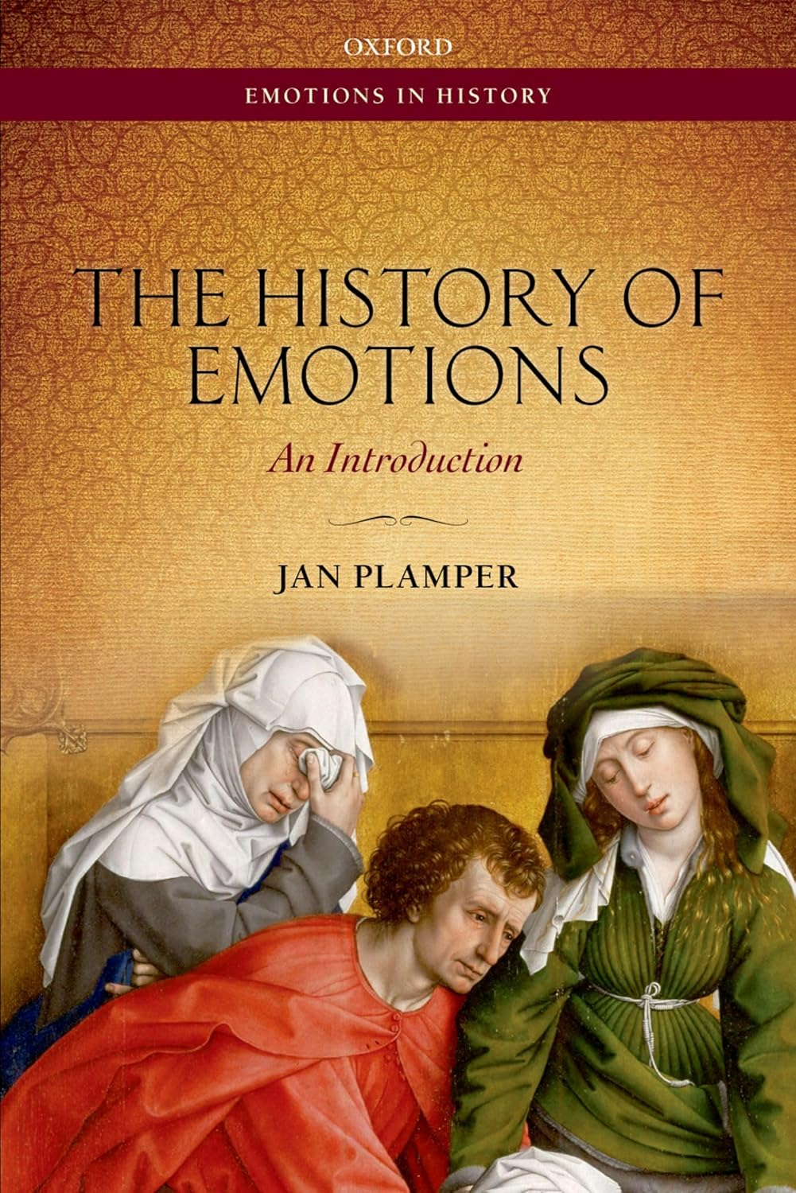
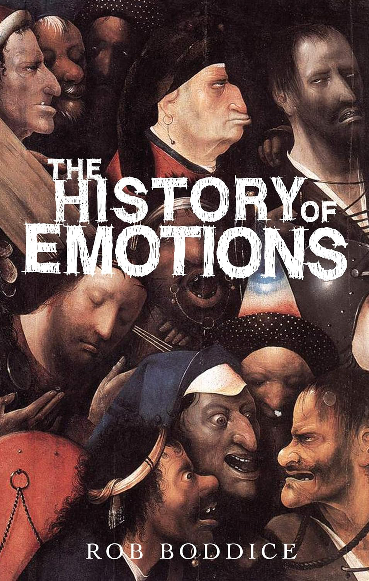
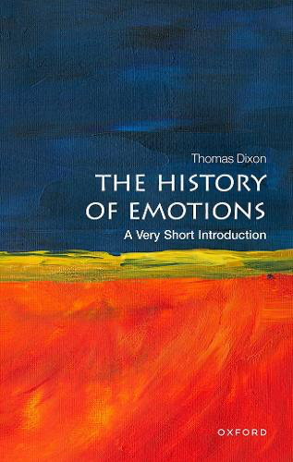
2. The history of emotions according to some general introductions to it
Claim: synthesis of current knowledge on the subject of the history of emotions. Help to ‘navigate’ the huge field of historical research
Why general introductions are such
an interesting genre of history
writing?
(German 2012.2015 English
2018

Slide 13
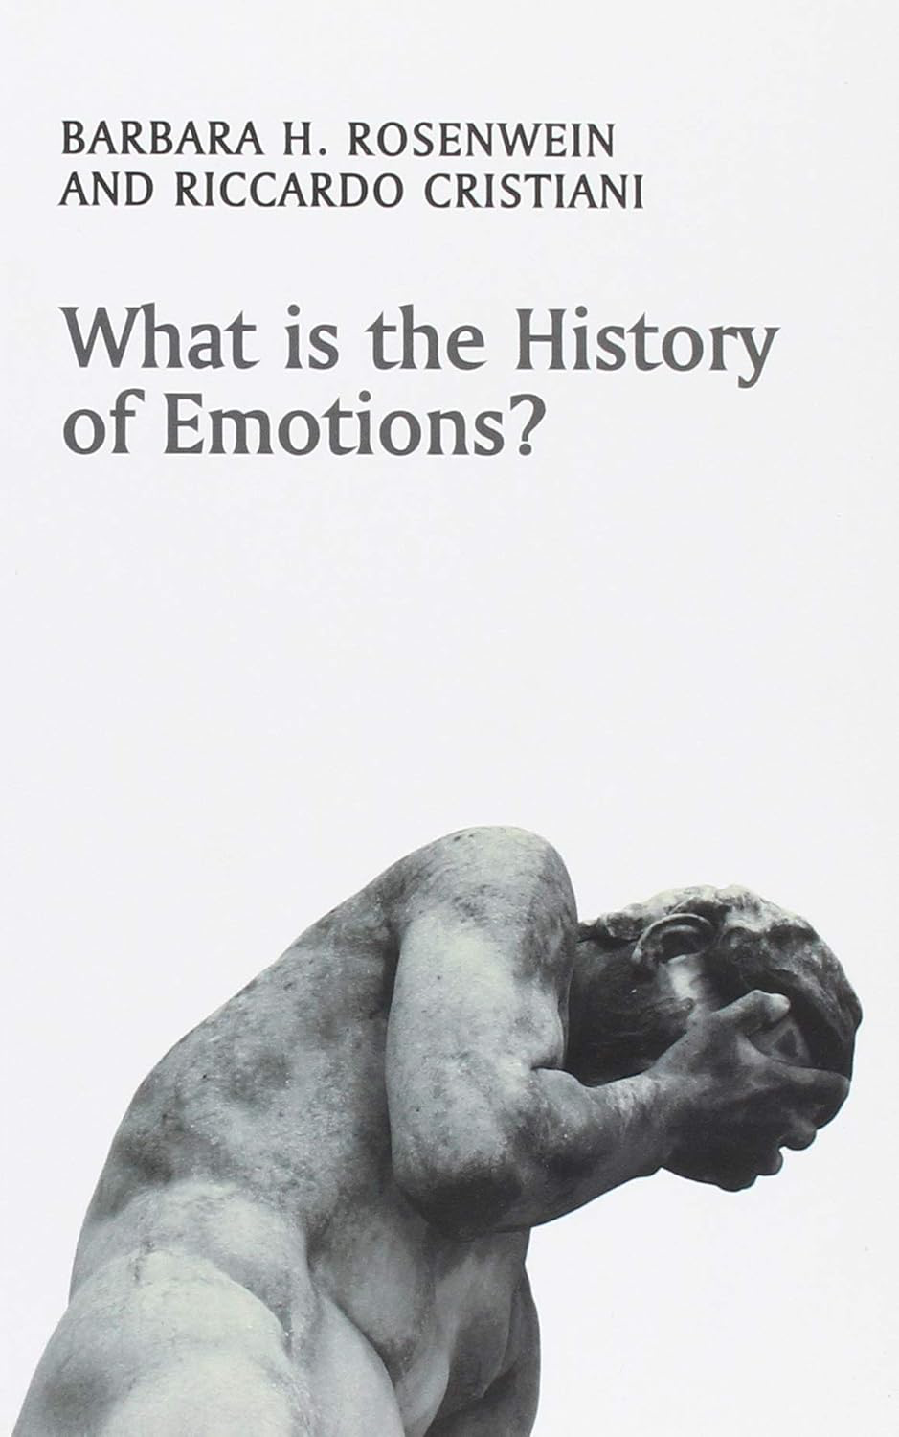
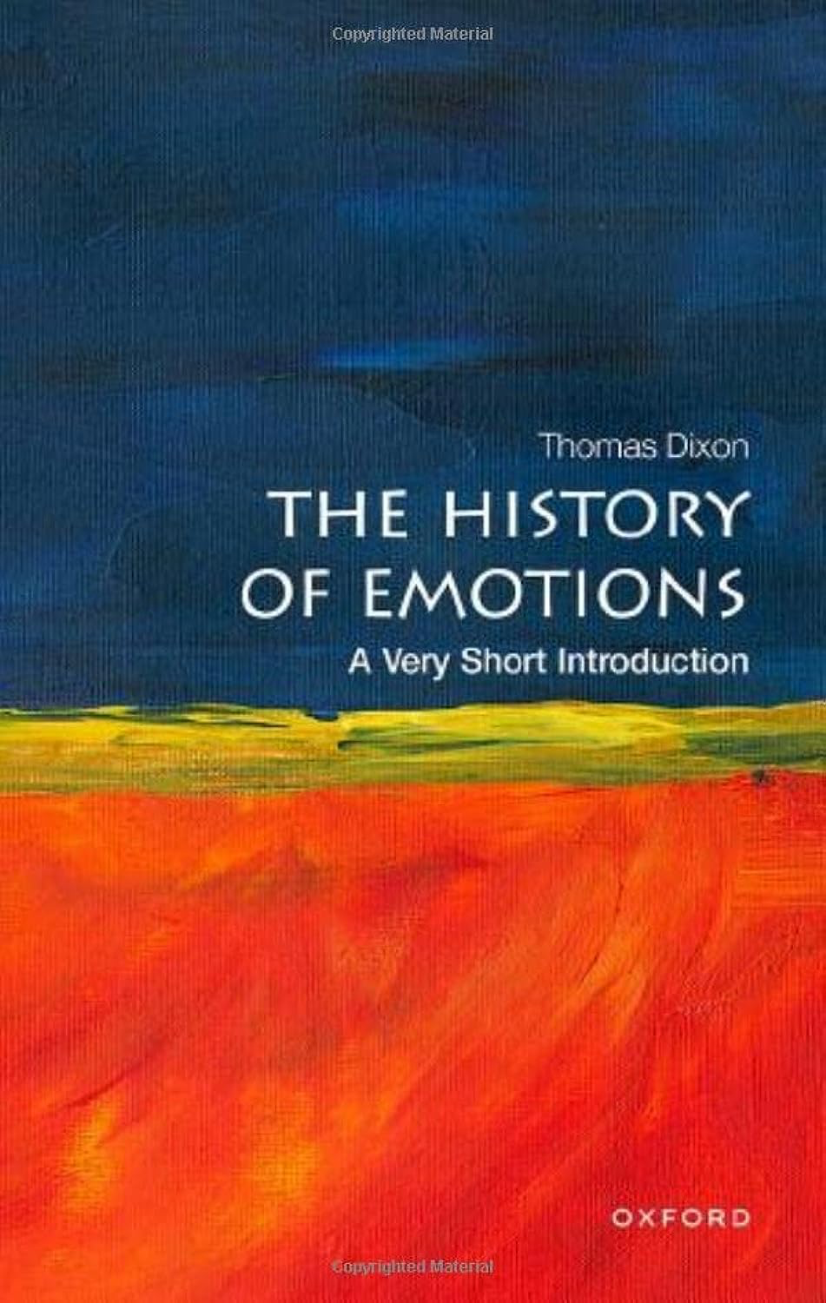
What
2018
2023

Slide 14
What is the history of emotions? What does it do that other fields in general history
writing don’t do? Why do all other historians benefit from the history of emotions?
‘It (the history of emotions) has the potential to unlock – at the level of experience – that thing that historians have always searched for: namely, what it means to be human.’
(Boddice, History of Emotions, p. 7)
Note: Emotion is human experience

Slide 15
Observation; The term emotion or ‘felt experience’ is used interchangeably with ‘experience’ throughout the Introductions
Note: ‘emotions’ are not understood in the traditional Cartesian sense as the opposite of ‘reason’, of something that human reason needed to control and overcome to be fully human (remember the belief of Enlightenment society in the power of human ‘reason’).
Definition: Emotions are ‘cognitive judgements’
posits that emotions are not merely raw, instinctual feelings, but intelligent, value-laden responses to our sensory perceptions of the world (e.g. philosophy, often inspired by cognitive neuroscientific knowledge)
Emotions/felt experience is human experience – ‘thinking’ is emotion

Slide 16
How useful is the term emotion as ‘brand name’ for the entire field?
Problem: term emotion only comes into wider usage in the English language during the 19th century, mainly through the new discipline of experimental psychology. Isn’t the use of the term emotions for history writing before the 19th century anachronistic?
During the 1990s there were furious debates among historians of emotions about these issues
One answer: Let’s leave the old debates alone, they are no longer important…
‘debates about certain concepts and their naming are tired and old, and there is no benefit to us in re-opening them’. (Boddice, History of Emotions, p. 41).
‘past societies defined emotions in ways that may seem odd today: even in Western once used words like passion, affects, affection, sentiment, but had no word for ‘emotion as such… Historians have known that – whatever term – these things that we call emotions have been defined differently at different times.’(Rosenwein/Cristiani, Emotions, p. 2-3).

Slide 17
Another answer: anachronism is methodologically useful
‘To discover how radically different the interpretations, expressions, and the categories of feelings were in the past is to loosen the hold of our contemporary psychological notions over us. The awareness of radical difference in human emotional understandings, can open our eyes to a much richer set of affective possibilities than the theories of 21st-century psychology at first seem to allow.’ (i.e. usage makes historians critical vis-à-vis their own understanding of emotions)
(Dixon, Emotions, p.18)
To use the term of emotions as brand name – or ‘meta-category - allows historians to identify and detect the existing continuities and communalities between the past and present.

Slide 18
Let us look at the two previous suggestions: to use the term emotion is perhaps anachronistic but useful…
To detect difference in emotional behavior and understanding of emotions between the past and present and to draw attention to the great variety and diversity of emotional differences in a past society
To detect similarities and communalities in emotional behaviour and understanding of emotions between
and the past and present (‘common emotional repertoire’). (Joan Scott would fundamentally disagree!)
‘It is not enough to define emotions according to the manner historical actors define (synchronic).
Historical study is naturally diachronic (…). In order to determine its object of study, historical
investigation has need of a transtemporal category, which supposes much is shared in common.
If there is very little shared in common between the feelings of Napoleon expressed as sentiments in his French love letters to Josephine around 1800 and what was considered ‘emotional’ in the letter that Barack Obama sent to his daughters, then a relapse into pure contingency can hardly be avoided.’
(Jan Plamper, Emotions, p. 38)

Slide 19
How to understand ‘difference’?
History of emotion is committed to the methods and theories of social constructivism
Method of ’social constructivism’
On the basis of historians’ ‘natural’ knowledge that the past is different form the present, their job is to ‘reconstruct’ how emotions were different in the past from the empirical evidence they find in archive, libraries, museums etc.
On a fundamental level ‘social constructionism’ suggests that there are no natural, timeless, self-evident or universal phenomena in the world but they are always historically specific. (i.e. emotions are not universal or transhistorical or transcultural, but what people believe they are depends on the historical context in which emotions were experienced and how people in the past explained them.
What emotions are depends largely on the many social and cultural practices of actors in a specific historical context.
Strong reliance on a social-constructivist history of the body and the senses which is a major trend during the 1990s

Slide 20
But not all social constructivist approaches are equally valid. some are even dangerous the discipline of history as a whole!
‘Poststructuralism (e.g. Joan Scott and her claim that we need to deconstruct our own ‘experiences’ in the present and detect the inherent biases in the rules of the languages were using to express them.
She suggests that there is simply NO continuity of experience between the past and present possible.
All Introductions consider this ‘radical’ form of social constructionism unacceptable. Indeed, they claim it would threaten the historical discipline as a whole.
To go down this ‘radical’ makes history writing relative – and there is no way to explain similarities and communalities of emotional behavior and knowledge and historical change

Slide 21
How to explain continuity and similarities– a common emotional repertoire - between past and present emotions if social constructivism is mainly about showing ‘difference’?
‘At the core of this project is an understanding that human beings – human bodies/minds – are made and making meaning in the world. But we should not read it as a radical statement aligning the history of emotions solely with the adherents of social constructionism.’
‘Knowledge of the human brain is increasingly proving to be a key source for historians of emotions. It is not that we empirically examine the brains of the dead and gone, but rather that we can extrapolate from the living what synaptic development might have been like in the past in order to say something about the way in which culture nscribes the brain as the brain creates experience.
We can also speculate on the ways in which experiences were altered by psychotropic effects of coffee and chocolate, alcohol and opium, as well as by the less obvious psychotropics such as reading and writing, new forms of transport and new media, up to and including the Internet.’
(Boddice, Emotions, p. 39)

Slide 22
What do cognitive neuroscientists offer historians of emotions who aim to trace human ‘common emotional repertoire’ ?
Evolution (and the evolutionary brain, the centre of production of emotions.
‘How we feel, and how we think about how we feel, has changed radically, and that has created new and different emotional experiences. Nonetheless, historians of emotions and their subject remains beings of the same species, possessing similar power of mind. (Dixon, Emotion, p.19)
‘We are connected to all organisms that are alive today, and all the organisms that have ever lived, via the branches of the Tree of Life (TOL).’
(Bernard Wood, Human Evolution: A Very Short Introduction, 2005, p.1)
History of emotion as a history of the human species?

Slide 23
Historian have the duty to work with ‘critical’ neuroscientists..no problem.
‘We do not have to be competent in running neuroscientific experiments. We do not have to appropriate all of the technological jargon of that discipline. We do, however, a duty to understand the implications of neuroscience and its variety of research agendas…
Neuroscience is much more open now to biocultural interpretations of brain function and meaning-making. We have entered the age of brain plasticity -- the shaping and making of brain patterns in the world – and the possibilities for historians are immense. As neuroscience confirms the contingency of experience, the prospects for historical revisionism become manifest.’ (Boddice, Emotion, p. 34).
Critical neurosciences: approaches that understand the brain not as universal (let’s say a universal computer) but has an object that is malleable and constantly recreated through history and culture. The brain is every changing; it is ‘plastic’, shaped by culture and natural environment as well as interactions with other brain bearers.

Slide 24
The overall aim of the history of emotions – unity of all knowledge about emotions
to bring together and use all the different knowledge of emotions that are produced and circulate at a given moment in time
to overcome the division between disciplines in the natural sciences and the humanities in terms of knowledge production about emotions (the end of the division between nature/culture debates
Historians will lead these collaboration and will work together with politicians, policy-makers, educator – those who create ‘consensus’ in society – to transform current society and pave the way for a prosperous future in which emotions are recognized as a central and important feature of Western liberal societies. (note: neoliberalism).
How do we have to imagine these productive research relationships? Is it really so easy to understand the current research in the cognitive neurosciences? Do historians need to study neuroscience
while they study history? Do neuroscientist study history too? What will their conversations be about?

Slide 25
The constructed history of the history of emotions
A constructed ‘history’ that is entirely based on works that are already written through the lens of the history of emotions; ‘creative forgetfulness’ of other historiography or misinterpretations.
A history from ‘dead ends’ to ‘final victory’: From a universalist understanding of emotions to their understanding as social constructions AND outcomes of continuous human evolution and the brain during the 1990s
Carol Z. Stearns and Peter Stearns -- ‘emotionology’
Barbara Rosenwein – ‘emotional communities’
William Reddy – ‘emotives’
The discipline of history doesn’t contribute much: until 1990s emotions are either ignored or understood as essentialist and universalist; historians remain ed stuck in ‘the grande narrative’ of the Enlightenment and its focus on ‘reason’ (emotions were actively downplayed); some notable exceptions:
Johan Huizinga
Norbert Elias
Lucien Febvre
‘…there are not one, but at least three men who stand at the beginning of the history of emotions: Lucien Febvre, Benito Mussolini, and Adolf Hitler.’ (Plamper, Emotions, p. 43)

Slide 26
The history of emotions and neoliberalism, before I forget….
Why do historians of emotions go crazy about cognitive brain sciences during the 1990s?
The Decade of the Brain, a designation for 1990s – 1999 by U.S. president George H. Bush as part of a larger effort to ‘enhance public awareness of the benefits to be derived from brain research’ and to encourage public dialog on the ethical, philosophical, and humanistic implication of the discoveries.
With huge funding available we see a virtual ‘neuro-mania’ emerging, virtually everything could be explained through the brain somehow: neuro-philosophy, neuro-economics, neuro-art history, neuro-theology.

