Slide 1
What is a Primary Source? Historical Evidence and How to Interpret it
Dr Sophie Mann
Historical Research (HI2K9)

Slide 2
Lecture Structure
1. The links between term 1 and term 2, or, between historiographical approaches and the selection and interpretation of primary sources.
2. What is a primary source, and how do we assess a source’s status and uses?
3. Analysing and Interpreting primary sources.
4. From sources to arguments…
5. The Research Proposal and Research Project.

Slide 3
History in Practice
How we ask questions.
How we select and analyse primary sources.
How we construct a piece of historical research through interpretation and argument.
“One point is crystal clear: when it comes to formulating a problem, we depend on the work of other historians. For a problem to be really generative, a researcher requires the sources, the time, the framework and a sense of how their project fits into larger patterns of scholarship”.
Ludmilla Joranova, History in Practice, 201.

Slide 4
Facts alone do not amount to a historical explanation
Knowing that a law was passed, that a war took place, or that social change occurred does not explain:
- Why it happened.
- Who or what drove it.
- What its wider significance was.
Historians answer these questions differently depending on their historiographical and theoretical assumptions about what matters in history.

Slide 5

The Relationship Between Historiography and Historical Research
Historiography is not something you add after the research is complete. It shapes the research process from the very beginning:
It shapes…
Your research question: what you think is worth investigating.
Your selection of primary sources: which materials you treat as central.
Your reading of the evidence: how you interpret what the primary source is doing/what it reveals.
Your argument: The argument you build using evidence reflects your own position within a field of competing historical interpretations.

Slide 6
Assumptions and Methods
Every historiographical approach carries assumptions about:
what drives historical change.
where historical agency is located.
what kinds of explanation count as persuasive.
and what counts as a meaningful historical problem in the first place.
These assumptions directly influence the methods and processes of selection adopted
what kinds of questions seem worth asking.
the scale at which you work — state, community, household, individual, body.
what kinds of sources even appear relevant.

Slide 7
Source Selection
Because different historical schools of thought prioritise different kinds of historical problems, this shapes what historians treat as usable evidence.
For example:
Political history: traditionally focused on sources produced by institutions of power: laws, state papers, diplomatic correspondence, because it starts from the premise that formal political structures and state actors drive historical change.
Social history: parish registers, court records, census data, household accounts. These sources are chosen because they record demographic patterns, and forms of social organisation and behaviour, that lie beyond elite narratives.
Cultural history: texts, images, rituals, objects are analysed not as transparent reflections of reality, but as ways in which meaning is constructed, communicated, and contested.
Gender history: “normative texts” such as conduct literature, legal codes and medical writing to uncover the expectations, prescriptions and anxieties surrounding femininity, masculinity and sexual difference.
E.H. Carr, What is History, “It used to be said that facts speak for themselves. This is, of course, untrue. The facts speak only when the historian calls on them: it is he who decides to which facts to give the floor, and in what order or context”.

Slide 8
What is a Primary Source?
At its most basic level, the term “primary source” covers all original documents produced at the time one is studying. The implication is that they bear witness to the events, people, processes etc. of that moment.
Writings about the past are generally considered secondary sources in that they result from the study of and reflection upon another type of material that was produced in the past – primary sources.
Types/genres of primary source
Textual sources
Visual sources
Material sources
Audio-visual sources
Oral histories

Slide 9
The status and use of sources
What might be a primary source for one research project could be considered a secondary source for another.
Example:
A nineteenth-century antiquarian book could be a secondary source for an early modernist, but a primary source for a historian of nineteenth century cultural history.
Two implications follow:
The status of sources changes depending on the research project being pursued.
The primary/secondary distinction is less important than an assessment of whether the chosen source is relevant to a given project, and how well it is used.
You don’t get to say: “This is a primary source, therefore it proves something”. You have to explain:
Why it counts as a source for your research project.
What kind of claims it can reasonably support.

Slide 10
The Authority of Sources
Terms such as ‘original’, ‘raw’, ‘direct’ imply a special kind of authority that comes from first-hand testimony, from closeness to the events themselves.
‘This is a relatively trivial form of accuracy, and next to it we have to consider the possibility that those bearing direct testimony are also interested parties, who shape the evidence even as they are recording it’.
‘Most sources are mediations, the products of complex minds, composed of conscious and unconscious dimensions. No sources are transparent records of a past situation, not even archaeological fragments. So historians need to be able to imagine the kinds of mediations at work in any given artefact’.
Ludmilla Jordanova, History in Practice, 40, 160.

Slide 11
Sources are not evidence until they are analysed
Description: What does the source say?
Analysis: What is the source doing, and why?
Examples of analytical questions:
Who produced this source?
How might the author’s gender, beliefs, age, marital status, economic background, race, and so on shape what is being produced?
Under what conditions was it created?
For what purpose and audience?
What assumptions or norms shape it?
What does it leave unsaid?

Slide 12
Interpreting Sources
The same source can be read differently depending on the historian’s approach.
Example: A diary recording illness
A social historian might focus on everyday experience and coping strategies.
A gender historian might analyse how masculinity or femininity shapes expressions of pain.
A cultural historian might examine how language and metaphor shape how the body’s physiology gets imagined and assigned meaning.
Nothing about the source itself has changed. What’s changed is the set of questions being asked of it.

Slide 13
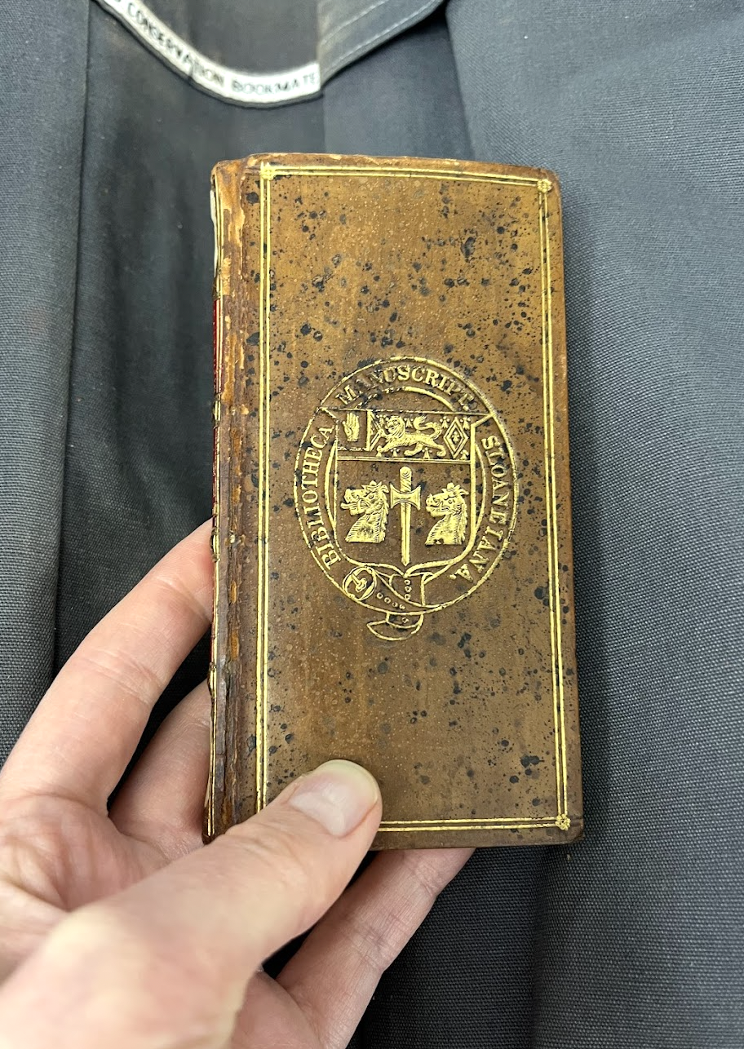
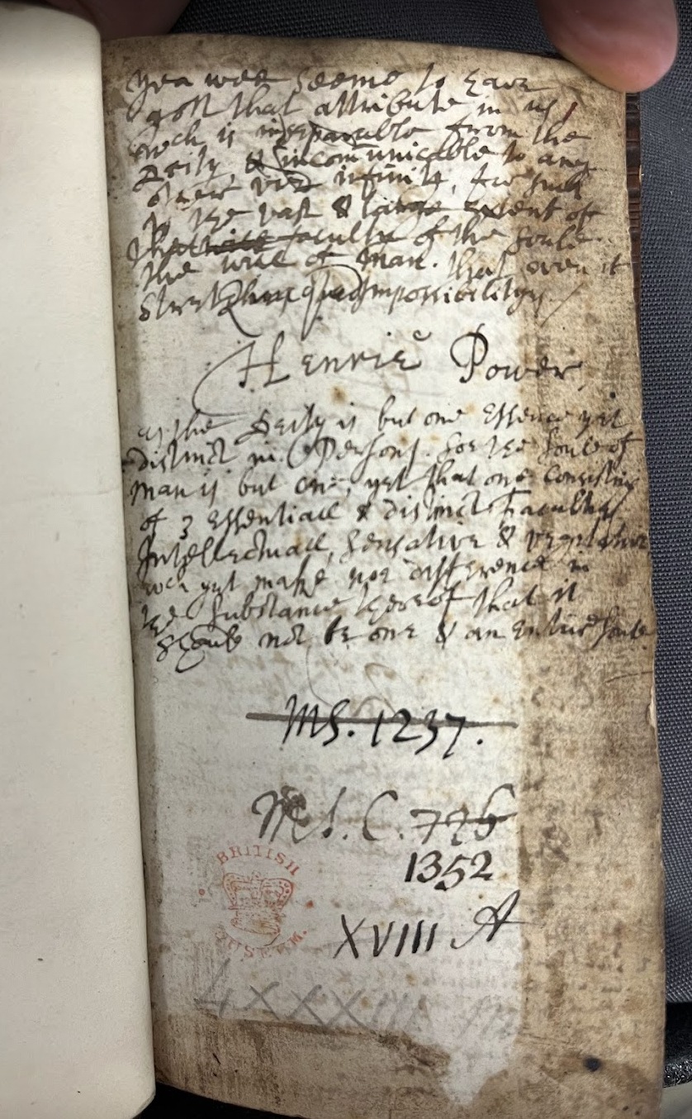
What this looks like in practice…
An example from my own research
Primary Sources: physicians’ commonplace books and casebooks.
My research focus in this book chapter:
How physicians grounded their therapeutic reputation and medical practices in a capacity to minister to both the bodies and souls of patients.
How a physician’s religious identity might have influenced their interactions with patients.
British Library, MS 1352, Henry Power’s Commonplace book.

Slide 14
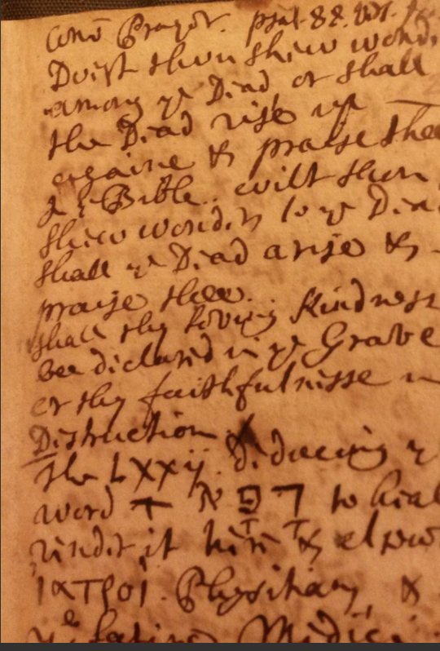
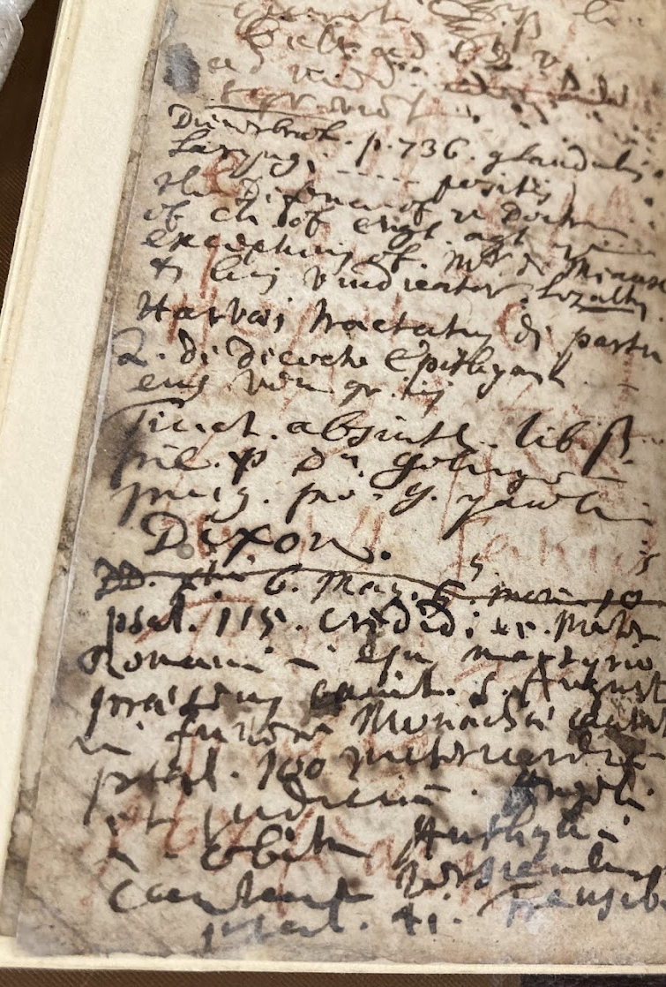
Analysis and Argument
Analysis: Amongst notes documenting patients’ names, conditions, dates of consultation and prescriptions, spiritual instructions for the sick have been penned. His notes also suggest he discussed specific parts of scripture, and intricate theological matters, with some patients.
Argument: religious exercises were incorporated into medical care strategies at every stage, from diagnosis and treatment to instances of recovery or relapse. A soul orientated to piety was believed to induce spiritual and bodily realignment in a living patient.
Historiographical significance: While scholars acknowledge that physicians were deeply committed Christians, and interpreted sickness within a providential framework, they have argued these religious practices did not feature significantly during clinical consultations. For example, Andrew Wear has stated that ‘at the bedside there was usually no mention of a religious ceremony associated with medical treatment’, as physicians practiced a ‘secular medicine’ in their ‘own relatively undisturbed space’. The cases presented invite a reconsideration of the boundaries between religion and medicine in this specific occupational context.
British Library, folios from MS Sloane 188, the casebook of Dr John Downes.

Slide 15
From Sources to Arguments
Primary sources do not generate arguments on their own.
Historical arguments are constructed by:
Selecting sources within a framework.
Interpreting them.
Linking them to arguments, for example: claims about beliefs and practice, claims about causation or change, claims about where power or agency lies.
Different approaches can legitimately produce different arguments from similar evidence.
What matters is whether the interpretation is:
Explicit about its assumptions.
Demonstrates a self-aware use of the complexities of evidence (a source’s richness, limitations, and the kinds of mediations at work).
Uses the evidence to produce a coherent and persuasive argument that engages fruitfully with existing historiography.

Slide 16
Your Research Proposal and Research Project
Assignment 2: 2000-word Research Proposal
This assignment is designed to enable you to develop a detailed research proposal for the research project that you will complete for assignment 3.
Developing a research proposal is a crucial part of the research process: it is how historians plan their research questions, which sources they will use, and how they will manage their time. In this assignment you will cover an outline and explanation of: your research questions, the primary sources you intend to look at, relevant secondary literature, parameters and feasibility.
Assignment 3: 4500-word Research Project
This assignment gives you the opportunity to conduct an extended, independent piece of historical research. Your project will investigate a focused historical topic, grounded in the critical use of primary sources and situated within relevant historiography. A central aim of the project is to develop your ability to use primary evidence not just descriptively, but analytically, to advance a clear line of argument that engages meaningfully with existing scholarship.

Slide 17
What historical skills these assignments are designed to nurture
How to…
Identify and define a research topic or question.
Situate it in existing historical debates.
Select relevant primary sources and subject them to effective analysis and interpretation.
Develop a sustained, evidence-based argument.

Slide 18
