Slide 1
AI and the Values of History
HI2K9 Historical Research

Slide 2
Lecture outline
What is generative AI? What can it do, and what can’t it do?
What are the shared values of historians?
How does AI fit into our work as historians? How might AI be useful for historians?
Caveat: AI is developing every day – some of this information may already be out of date!
Note: the History UG handbook has been updated *today* with more information on our AI policy – please read this before your seminar!

Slide 3
Join the Vevox session
Go to vevox.app
Enter the session ID: 132-919-298
Or scan the QR code

Slide 4
What one word would you use to describe generative AI?
##/##
Join at: vevox.app
ID: XXX-XXX-XXX
Question slide

Slide 5
What one word would you use to describe generative AI?
##/##
Join at: vevox.app
ID: XXX-XXX-XXX
Results slide
RESULTS SLIDE

Slide 6
What is “AI” and what can it do?

Slide 7
What is AI? I asked it…
Prompt: provide a definition of generative AI suitable for second year university history students
“Generative AI refers to a type of artificial intelligence that can create new content—such as text, images, audio, or data—by learning patterns from large amounts of existing material. Rather than retrieving information from a database, it produces original‑seeming outputs based on what it has learned.
In practice, this means tools like ChatGPT or image generators work by detecting patterns, styles, and structures in the data they were trained on, and then predicting what should come next in a sequence (for example, the next word in a sentence).
For historians, this matters because generative AI can:
summarise or rephrase texts,
generate drafts or ideas,
help organise complex information,
and model different writing styles.
But it can also:
invent details,
produce historically inaccurate statements,
or reflect biases in the data it was trained on.
So, while generative AI can be a useful tool, it must be used critically, with the same source‑evaluation skills historians apply to any evidence.”

Slide 8
Is it either “artificial” or “intelligent”?
Identifies and reproduces patterns from training data – no direct experience or understanding of the world
Probabilistic prediction – generates likely next words, does not provide “answers” or critically analyse what it is saying
Simulates human language, but is not sentient: it does not think.

Slide 9
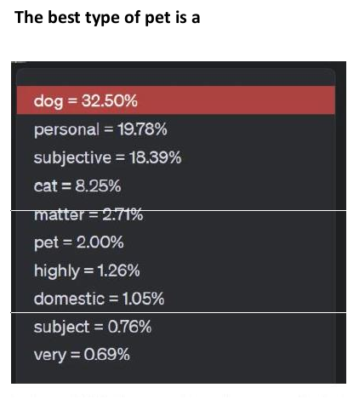
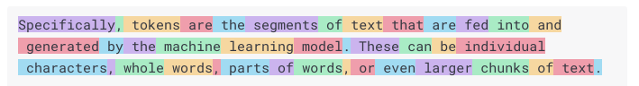
How does it work?
It trains on data
  Large Language Models (LLMs) take text that is available online
  It learns patterns
Text is broken up into “tokens”
It predicts the next tokens based on what has been previously written

Slide 10
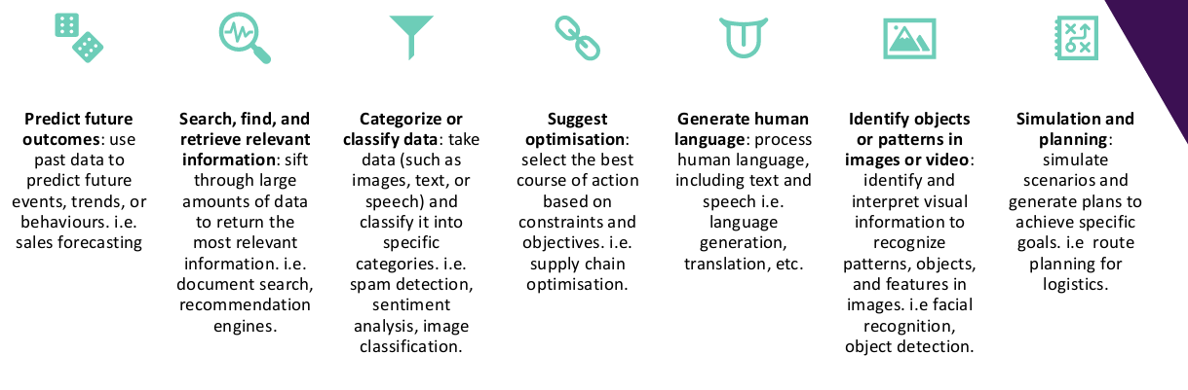
What AI says it can do
Slide courtesy of Academic Development Centre, Warwick, 2025

Slide 11
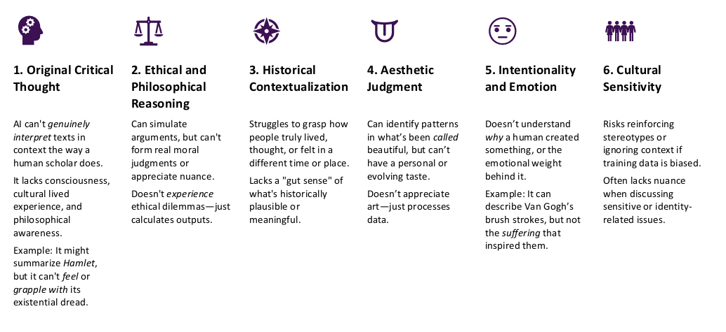
What AI says it can’t do (well or at all)
Slide courtesy of Academic Development Centre, Warwick, 2025

Slide 12
Other Limitations
Hallucinations – it sometimes simply makes things up, and it doesn’t know when it’s wrong
Unpredictable and inconsistent – probabilistic nature means same prompt = different outputs
No self-awareness or introspection – it has no access to its own internal processes
Context bound – only as good as the data it is trained on, including biases and priorities of designers
Sycophantic – it is designed to please us, so tells us the answer (or makes one up) that it believes we want to hear.

Slide 13
The environmental impact (according to AI)
Prompt: what is the environmental impact of ai? give me stats for data centres and individual users with easy comparisons
Data Centres (AI infrastructure)
  currently consume 1-2% of all electricity worldwide – roughly the same as the entire UK uses in a year
  currently generate 2.5-3.7% of global greenhouse gas emissions – more CO₂ than all global air travel
  could be 24-44 million tonnes per year by 2030 – like adding 5-10 million cars to the road
  Used 17 billion gallons of water in 2023, projected to reach 68 billion gallons by 2028 – enough to fill 100,000 Olympic swimming pools
Individual users
  A typical ChatGPT query uses c. 3Wh electricity and produces 2-3g CO₂ – roughly the same as running a small LED lightbulb for 1-2 minutes or driving a car for 10-20 metres
  All queries use 10x more electricity than a standard Google search
  ChatGPT’s 300 million weekly users collectively consume 621.4MWh of electricity per day – enough to power 35,000 US homes for a year
“The real environmental cost comes from the scale: billions of daily queries + energy needed to power data centres.”

Slide 14
The ethical and political impact (according to AI)
Prompt: what are the ethical and political impacts of gen ai on society?
Reproduces and amplifies societal biases because training data draws on historically biased sources
Challenges / undermines copyright, privacy, and data laws
Potential to threaten democracy through political manipulation, misinformation, and algorithmic bias
Potential for economic growth but also increased instability and marginalisation of workers
Risks of “AI colonialism” – “where Western or dominant data sources shape global narratives”
AI Tech leaders working with authoritarian regimes, including providing military innovations (e.g. OpenAI and DoD)

Slide 15
How does AI reinforce colonial power dynamics and Western biases?
“AI offers powerful tools for decolonization, especially when designed with the explicit goal of including marginalized perspectives and alternative epistemologies…
Many AI systems are trained on datasets predominantly sourced from Western contexts, with methodologies rooted in Eurocentric epistemologies. These frameworks risk perpetuating the dominance of colonial narratives by privileging Western data and ways of knowing. Consequently, AI may unintentionally reinforce the very colonial power structures that digital humanities scholars seek to deconstruct.”
- Kostas Karpouzis, ‘AI, Digital Humanities, and the Legacies of Colonial Power https://www.preprints.org/manuscript/202502.1823

Slide 16
The Shared Values of Historians

Slide 17
Join the Vevox session
Go to vevox.app
Enter the session ID: 132-919-298
Or scan the QR code

Slide 18
What do you think are the most important shared values for historians?
##/##
Join at: vevox.app
ID: XXX-XXX-XXX
Question slide

Slide 19
What do you think are the most important shared values for historians?
##/##
Join at: vevox.app
ID: XXX-XXX-XXX
Results slide
RESULTS SLIDE

Slide 20
American Historical Association, ‘Shared Values of Historians’ in Statement on Standards of Professional Conduct https://www.historians.org/resource/statement-on-standards-of-professional-conduct/
Critical dialogue: understanding the past collectively, incorporating multiple perspectives and those previously unrepresented
Trust and respect: practicing our craft with integrity and honoring the integrity of the historical record; ensuring that evidence is not invented, altered, removed, ignored or destroyed
Documenting sources: using references, bibliographies and other scholarly apparatus accurately and thoroughly enables future historians to follow a clear trail
Acknowledging one’s debts to the work of other historians: abhorring plagiarism and fraud, and citing our sources clearly
Having a point of view: understanding that all knowledge is situated in time and place, and open to interpretation
Accepting multiple, conflicting perspectives: seeking to understand the views of others, both in the past and amongst historians
Mutual respect and constructive criticism: disagreeing with civility and using reasoned discourse

Slide 21
AI and the work of historians

Slide 22
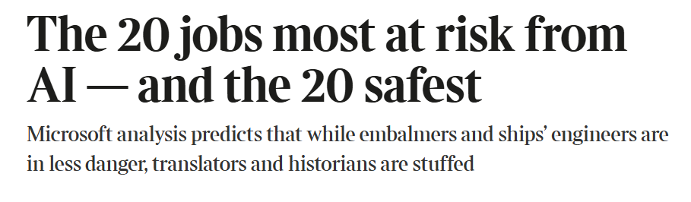
Will AI make historians obsolete?
Microsoft researcher report:
“Working With AI” (July 2025)
identified that 91% of a historian’s
“work activities” could be done
by generative AI
Chris Campbell, ‘The Historian in the Age of AI’ (December 2025): “It makes its ignorance of a historian’s job particularly clear by classifying it as ‘knowledge work’ – in other words, historians know things about the past, and since AI can know things about the past too, up to 91% of their work can be completed by it.”

Slide 23
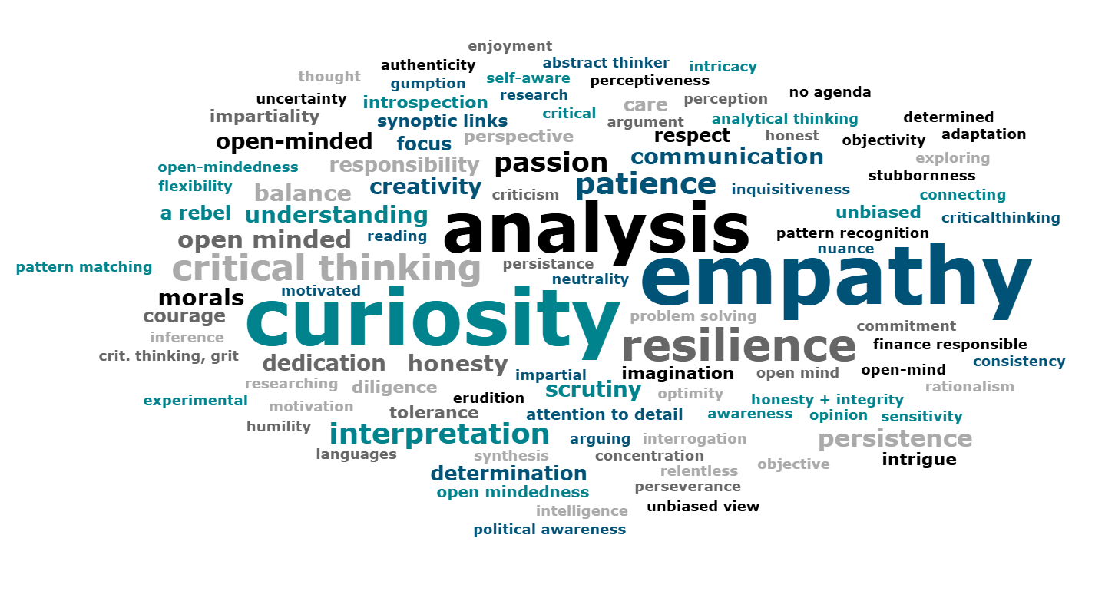
What are the key strengths and skills of a historian?
In your first week at Warwick, you said…

Slide 24
American Historical Association, ‘The Value of Historical Expertise’ in Guiding Principles for Artificial Intelligence in History Education https://www.historians.org/resource/guiding-principles-for-artificial-intelligence-in-history-education/#expertise
“Historical inquiry involves gathering information, making connections, and interpreting evidence in ways that reflect both an individual mind and established disciplinary standards. As a deeply human endeavor, writing history is both science and art… [Gen AI tools] do not think historically; they predict based on past data rather than questioning or reinterpreting it… AI cannot surprise us with new historical arguments, creative reframings, unpublished materials, or original narratives that challenge established understandings…
these tools cannot substitute for rigorous historical methods: finding new sources, posing generative questions, weighing evidence, assessing context, grappling with uncertainty, and constructing original arguments.”

Slide 25
James Poskett, ‘AI and the Myth of the Total Archive’ https://withoutmachines.substack.com/p/ai-and-the-myth-of-the-total-archive
“there’s another obvious part of historical research which cannot be done by AI. It’s called “going to an archive”. Yes, historians get in a car, or on a bus, or sometimes on a plane, and go to a library or alike… Once we get there, we turn the pages of old bits of paper, and begin reading, transcribing, and taking notes. AI can’t do that for one simple reason—this stuff isn’t on the Internet… the vast majority of the world’s manuscripts, have not been digitised and, frankly, never will…
If I had to guess, I’d say that LLMs have likely been trained on less than half of the world’s entire textual output. And if we expand that to include historical sources beyond the textual, LLMs have barely scratched the surface.”

Slide 26
Graham Burnett, ‘Will the Humanities Survive Artificial Intelligence?’ The New Yorker (26 April 2025)
“factory-style scholarly productivity was never the essence of the humanities. The real project was always us: the work of understanding, and not the accumulation of facts… no amount of peer-reviewed scholarship, no data set, can resolve the central questions that confront every human being: How to live? What to do? How to face death?
The answers to those questions aren’t out there in the world, waiting to be discovered. They aren’t resolved by “knowledge production.” They are the work of being, not knowing—and knowing alone is utterly unequal to the task…
to be human is not to have answers. It is to have questions—and to live with them. The machines can’t do that for us. Not now, not ever.”

Slide 27
How might AI be useful to historians?
Locating relevant secondary literature in the early stages of research
Navigating large data sets and digital collections
  Identifying themes, patterns, or connections in large data sets
  Training LLMs to extract specific information from sources to create a dataset
Translation and transcription
  Transcription of oral history interviews
  Handwriting-to-text conversion
Critically interrogating AI itself as a knowledge system
See UG Handbook for a list of acceptable and unacceptable uses of AI in history assignments

Slide 28
Tatiana But, ‘AI in Historical Research: 2025 Insights and Trends’ https://www.historica.org/blog/ai-in-historical-research-2025-insights-and-trends
In 2025, AI is proving to be an increasingly indispensable partner in historical research, not by replacing human expertise but by amplifying it. Across diverse applications—from large-scale text analysis and manuscript preservation to multilingual translation and postcolonial scholarship—AI enables historians to process vast data, uncover hidden patterns, and engage with sources in novel ways.
At the same time, these advancements highlight enduring responsibilities: the interpretive judgment, ethical considerations, and critical oversight that only human scholars can provide…
The future of historical inquiry lies not in choosing between humans or machines, but in a collaborative synergy where AI tools expand the horizons of scholarship while historians remain the guiding intellects behind interpretation, argumentation, and ethical stewardship.”

Slide 29
Example: Jacob Forward, PhD research on US presidential rhetoric https://www.hist.cam.ac.uk/news/history-age-ai
Project examines the language of crisis in post-Cold War American politics – examination of c. 20 million words
“A good way of thinking about how best to involve AI in one’s work is to consider, what if there were two, three or four of me? What would I task each “me” with?... I calculated that it would have taken ten months of reading – nine to five – for me to work through my last example. Instead, using my AI model took seven hours… [But] This is a search layer, an initial stage of analysis, not the final stage… [and the AI model took 8 months to refine]
By understanding this technology, its limitations and capabilities more deeply, I've become more acutely aware of what makes me human, and therefore different from this technology.”

Slide 30
How can historians demonstrate that AI cannot replace our expertise without being elitist?
“Asserting the inability of AI to take on the role of the historian also necessarily elevates the expertise of the academically trained – it is to make the distinction, for example, between simply ‘gathering info from various sources’ and detailing the precise nature and manner in which that information was gathered, and unpicking its relevance to inform a cogent analysis of historical events…
How, then, can we stake out the importance of academic historical training and expertise as something which, first of all, exists as a separate roster of skills from those of historical knowledge possession and communication and which, secondly, cannot be undertaken lightly by the untrained, or by AI, without also succumbing to elitist rhetoric that privileges academic historians above all others?”
- Chris Campbell, ‘The Historian in the Age of AI’, Transactions of the Royal Historical Society (2025)

