Slide 1
Black Studies: Critical Race Theory and Decolonising History
HI2K9 Historical Research
Prof. Lydia Plath

Slide 2
Outline
I: “race,” “racism” and “Blackness”
II: Black Studies in the US
III: (Black) Cultural Studies in the UK
IV: Contemporary Black Studies
V: Decolonising History

Slide 3
Part I: “race,” “racism” and “Blackness”

Slide 4
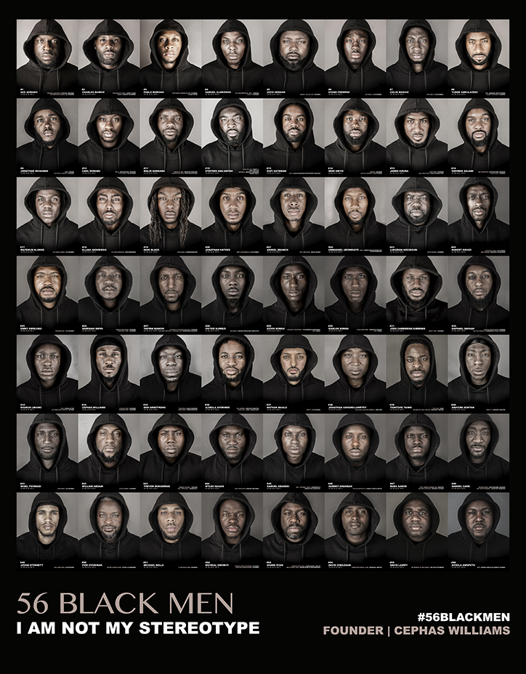
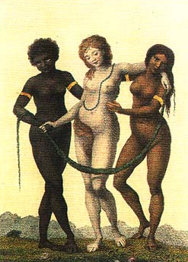
What is “race”?
No biological meaning
Social “construction” / “invention” / “idea”
Varying categorizations
Historically and culturally contingent
Lived reality of racism
‘Europe Supported by Africa and America’ William Blake, c.1777

Slide 5
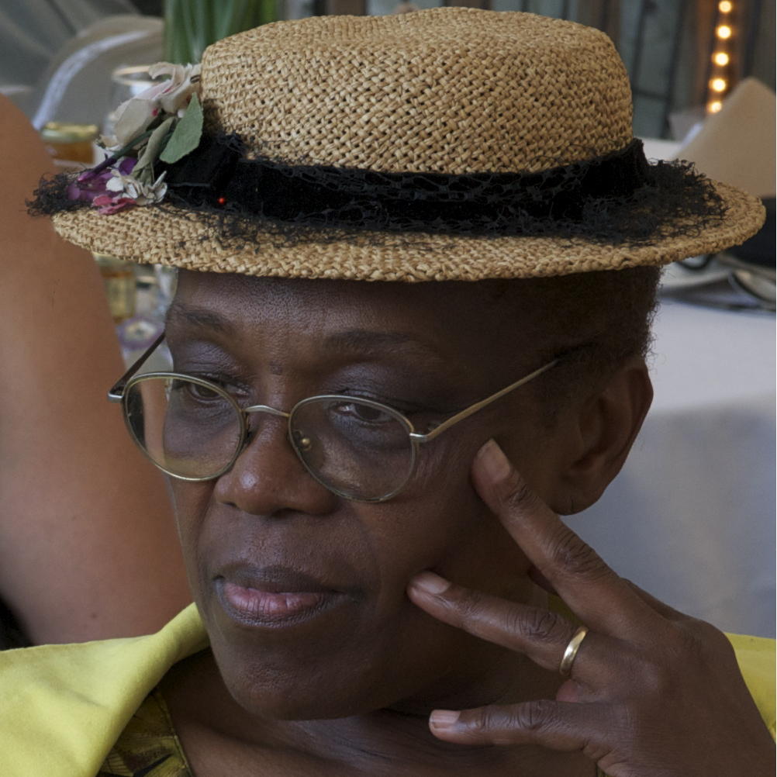
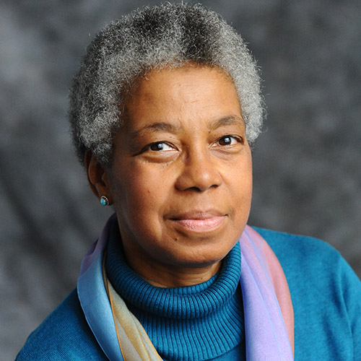
Fields & Fields: “race” vs “racism” (2014)
“The term race stands for the conception or doctrine that nature produced humankind in distinct groups…”
“Race is the principle unit and core concept of racism”
“Racism refers to the theory and practice of applying a social, civic, or legal double standard based on ancestry, and to the ideology surrounding such a double standard . . . not an emotion or state of mind . . . Racism is first and foremost a social practice . . . an action and a rationale for action”

Slide 6
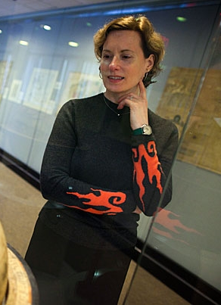
Chaplin: Race as “Atlantic” (2009)
“racism in its present form is a specific product of Atlantic history. . . this idea was peculiar to the Atlantic world created by European colonization.”
“The history of slavery makes especially clear that racism took strong hold in the western Atlantic, with powerful implications for the populations that mingled in the Americas, for the social structures of colonial societies, and for ideas of political rights on either side of the Atlantic. It is the continuing legacy of these implications that interests us in race and makes it necessary for us to see how it so deeply marked the modern world.”

Slide 7
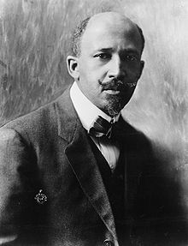
W. E. B. Du Bois on “double consciousness” (1903)
“the Negro is a sort of seventh son, born with a veil, and gifted with second-sight in this American world,—a world which yields him no true self-consciousness, but only lets him see himself through the revelation of the other world. It is a peculiar sensation, this double-consciousness, this sense of always looking at one's self through the eyes of others, of measuring one's soul by the tape of a world that looks on in amused contempt and pity. One ever feels his twoness,—an American, a Negro; two souls, two thoughts, two unreconciled strivings; two warring ideals in one dark body, whose dogged strength alone keeps it from being torn asunder.”

Slide 8
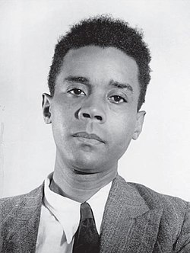
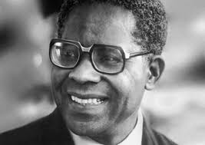
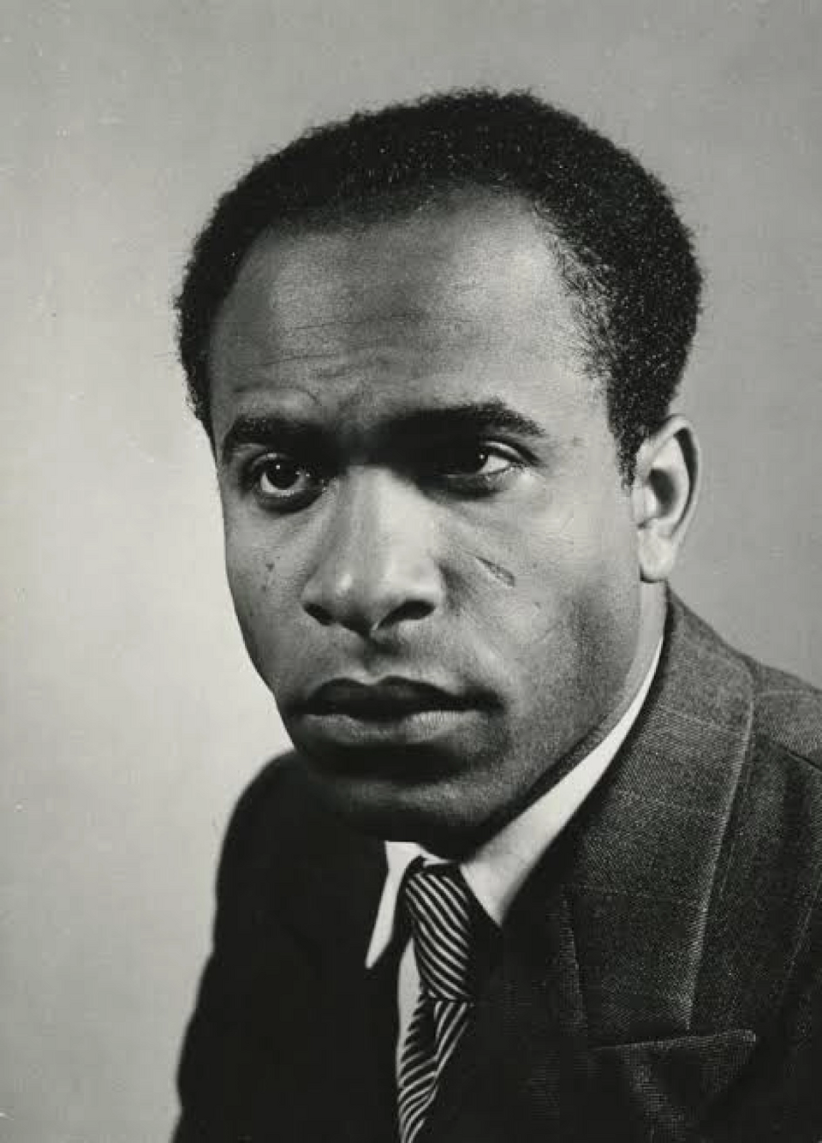
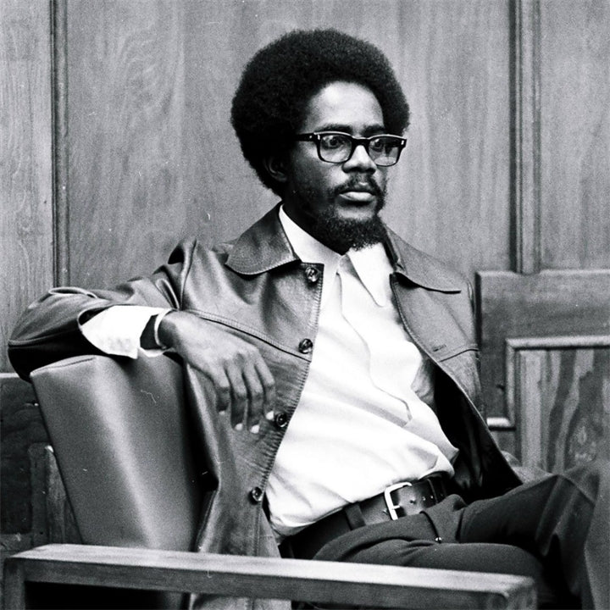
Caribbean intellectuals’ critiques of colonialism in mid-20th century
C.L.R. James, The Black Jacobins (1938)
Aimé Césaire Discours sur le colonialisme (Discourse on Colonialism, 1955)
Founder of négritude movement
Franz Fanon,
“the white man, who had woven me out of a thousand details, anecdotes, stories” (Black Skin, White Masks, 1952)
The Wretched of the Earth (1961)
Walter Rodney, How Europe Underdeveloped Africa (1972)

Slide 9
Part II: Black Studies in the US

Slide 10
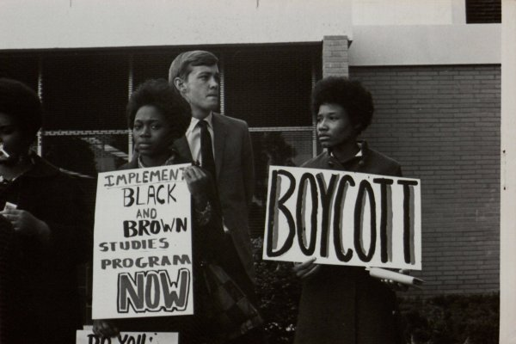
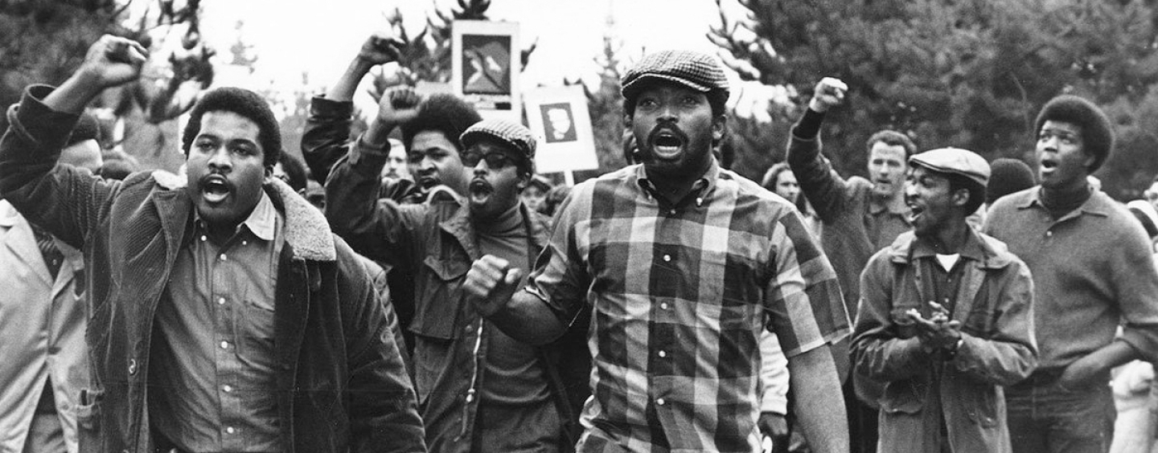
The Black Studies Movement
Roots in 1960s Black Power movement
1968 San Francisco State University following 5 month strike
Departments and programmes a result of widespread protests on US university campuses in late 1960s, including sit ins and boycotts
c.1000 colleges offer Black Studies by 1970

Slide 11
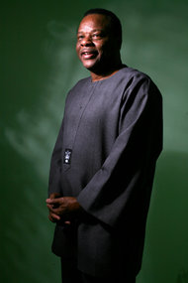
Molefi Kete Asante on “Afrocentricity” (2009)
“We know that Africans have thought about the universe longer than any other people. The people of the world have been black longer than any other color. In fact philosophy itself originated in Africa and the first philosophers in the world were Africans. The African tradition is intertwined with the earliest thought.”
Includes:
“a defense of African cultural elements as historically valid in the context of art, music, and literature.
a celebration of “centeredness” and agency and a commitment to lexical refinement that eliminates pejoratives about Africans or other people.
a powerful imperative from historical sources to revise the collective text of African people.”

Slide 12
Critical Race Theory
Structural
Institutional
Interpersonal
Internalised
Established by critical legal scholars questioning the assumptions of impartiality in the justice system
Focused on structural and institutional inequalities, i.e. systemic racism
Key thinkers:
Derrick Bell, “the permanence of racism”
Kimberle Crenshaw, “intersectionality”

Slide 13
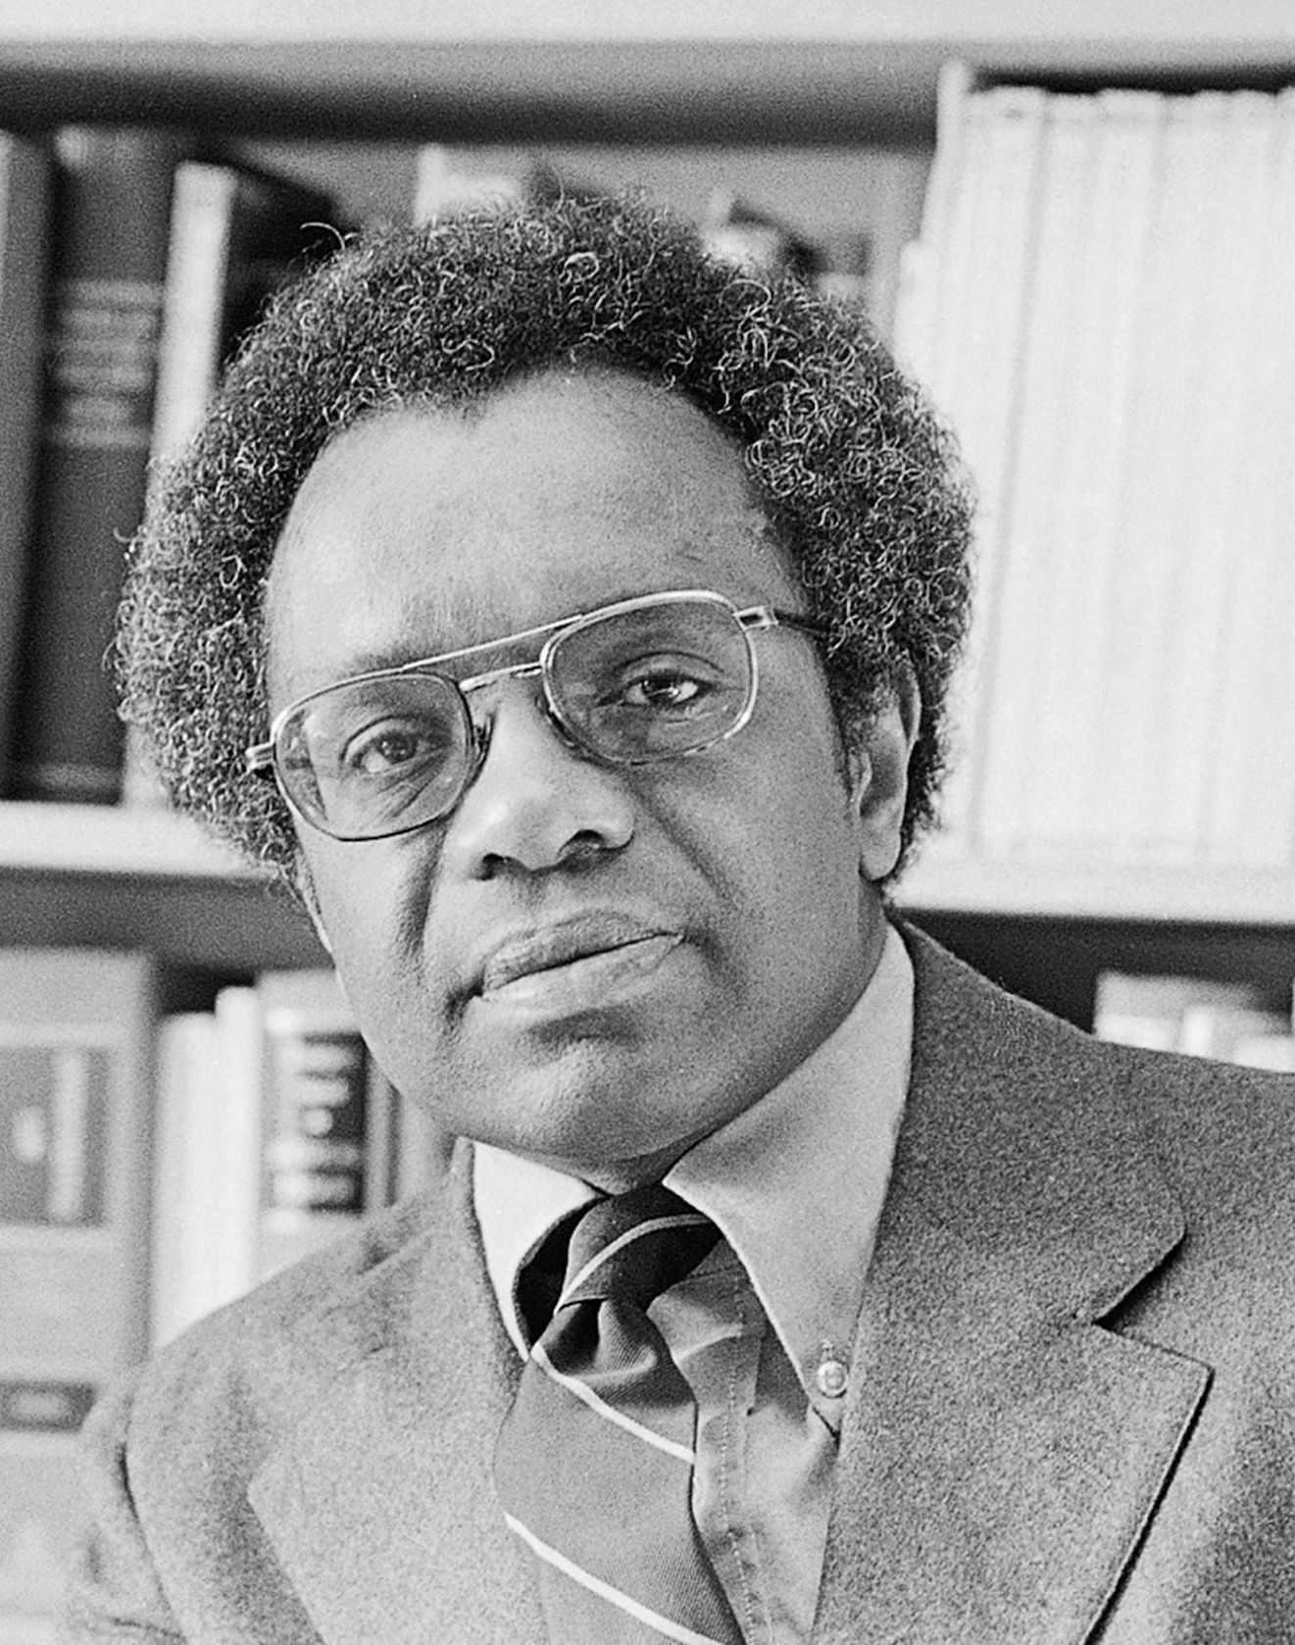
Derrick Bell & “the permanence of racism” (1992)
saw racism as ordinary, permanent, and central to US history
Concept of “interest convergence”
“Black people will never gain full equality in this country. Even those herculean efforts we hail as successful will produce no more than temporary “peaks of progress,” short-lived victories that slide into irrelevance as racial patterns adapt in ways that maintain white dominance. This is a hard-to-accept fact that all history verifies. We must acknowledge it, not as a sign of submission, but as an act of ultimate defiance”
“it is not a matter of choosing between the pragmatic recognition that racism is permanent no matter what we do, or an idealism based on the long-held dream of attaining a society free of racism. Rather, it is a question of both, and. Both the recognition of the futility of action—where action is more civil rights strategies destined to fail—and the unalterable conviction that something must be done, that action must be taken.”

Slide 14
Part III: (Black) Cultural Studies in the UK

Slide 15

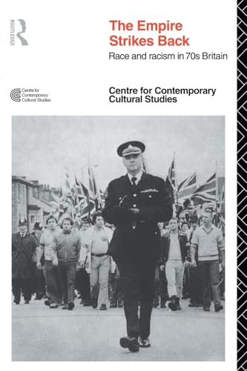
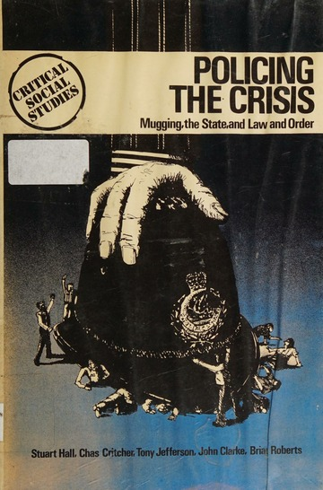
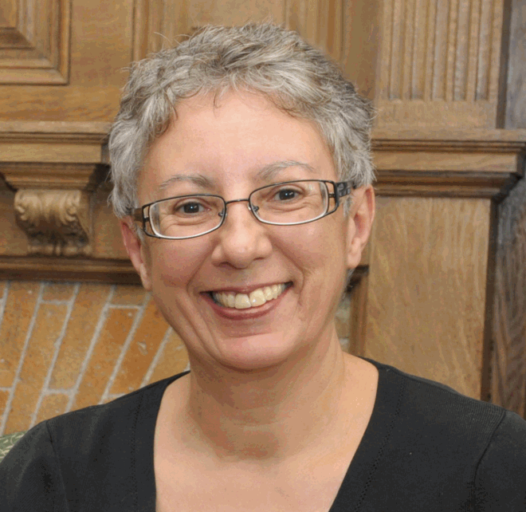
The “Birmingham School”
Centre for Contemporary Cultural Studies founded in 1964
Roots in postwar Marxist theory and poststructuralism
Key thinkers:
Stuart Hall
Raymond Williams
Richard Hoggart
Links to E. P. Thompson
Paul Gilroy
Hazel Carby [these] “were years of seemingly inexhaustible intellectual energy, passionate commitment and political vision. Pessimism of the intellect, a response to a rapidly increasing state authoritarianism, the brutal effects of everyday racism and gender inequality, and what appeared to be the continual defeat of left and progressive agendas, was countered by an optimism of the will exercised in intellectual activity in the service of social, political and economic transformation”

Slide 16
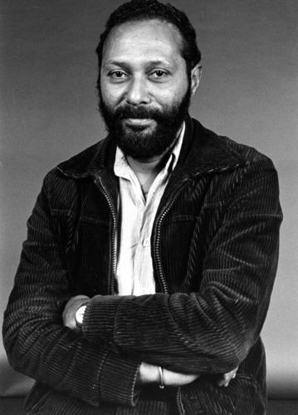
Stuart Hall on “Race, the Floating Signifier” (1997)
“the argument that I want to make to you is that race works like a language. And signifiers refer to the systems and concepts of the classification of a culture to its making meaning practices. And those things gain their meaning, not because of what they contain in their essence, but in the shifting relations of difference, which they establish with other concepts and ideas in a signifying field. Their meaning, because it is relational, and not essential, can never be finally fixed, but is subject to the constant process of redefinition and appropriation. To the losing of old meanings, and the appropriation and collection on contracting new ones, to the endless process of being constantly re-signified, made to mean something different in different cultures, in different historical formations, at different moments of time.”

Slide 17
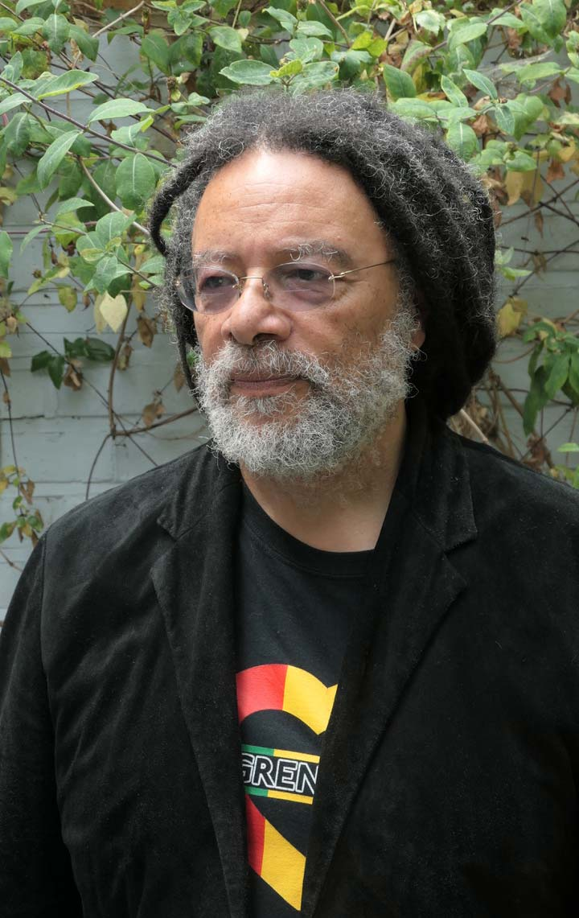
Paul Gilroy on the “Black Atlantic” (1993)
“Striving to be both European and black requires some specific forms of double consciousness … The contemporary black English, like the Anglo-Africans of early generations and perhaps, like all blacks in the West, stand between (at least) two great cultural assemblages, both of which have mutated through the course of the modern world that formed them”
“a nationalistic focus… is antithetical to the rhizomorphic*, fractal structure of the transcultural, international formation I call the black Atlantic”
* An aggregation of threads intertwining like the strands of a rope

Slide 18
Part IV: Contemporary Black Studies

Slide 19
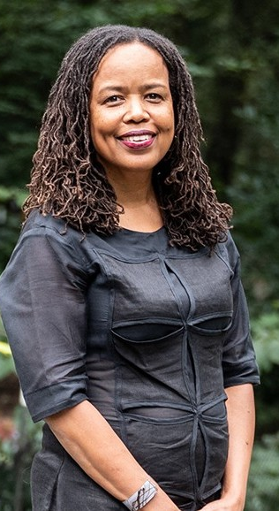
Saidiya Hartman on “critical fabulation” (2008)
“The intention here isn’t anything as miraculous as recovering the lives of the enslaved or redeeming the dead, but rather laboring to paint as full a picture of the lives of the captives as possible. This double gesture can be described as straining against the limits of the archive to write a cultural history of the captive, and, at the same time, enacting the impossibility of representing the lives of the captives precisely through the process of narration… By playing with and rearranging the basic elements of the story, by re-presenting the sequence of events in divergent stories and from contested points of view, I have attempted to jeopardize the status of the event, to displace the received or authorized account, and to imagine what might have happened or might have been said or might have been done. By throwing into crisis “what happened when” and by exploiting the “transparency of sources” as fictions of history, I wanted to make visible the production of disposable lives (in the Atlantic slave trade and, as well, in the discipline of history), to describe “the resistance of the object,” if only by first imagining it, and to listen for the mutters and oaths and cries of the commodity. By flattening the levels of narrative discourse and confusing narrator and speakers, I hoped to illuminate the contested character of history, narrative, event, and fact, to topple the hierarchy of discourse, and to engulf authorized speech in the clash of voices.”

Slide 20
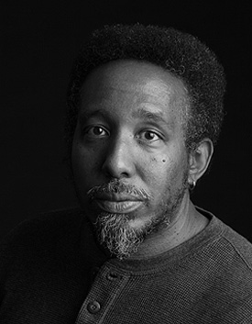
Frank B. Wilderson III on “Afro-Pessimism” (2010)
“The Afro-pessimists are theorists of Black positionality who share Fanon’s insistence, that though Blacks are sentient, the structure of the entire world’s semantic field…is sutured by anti-black solidarity”
“Whereas Humans exist on some plane of being and thus can become existentially present through some struggle for, of, or through recognition, Blacks cannot reach this plane”

Slide 21
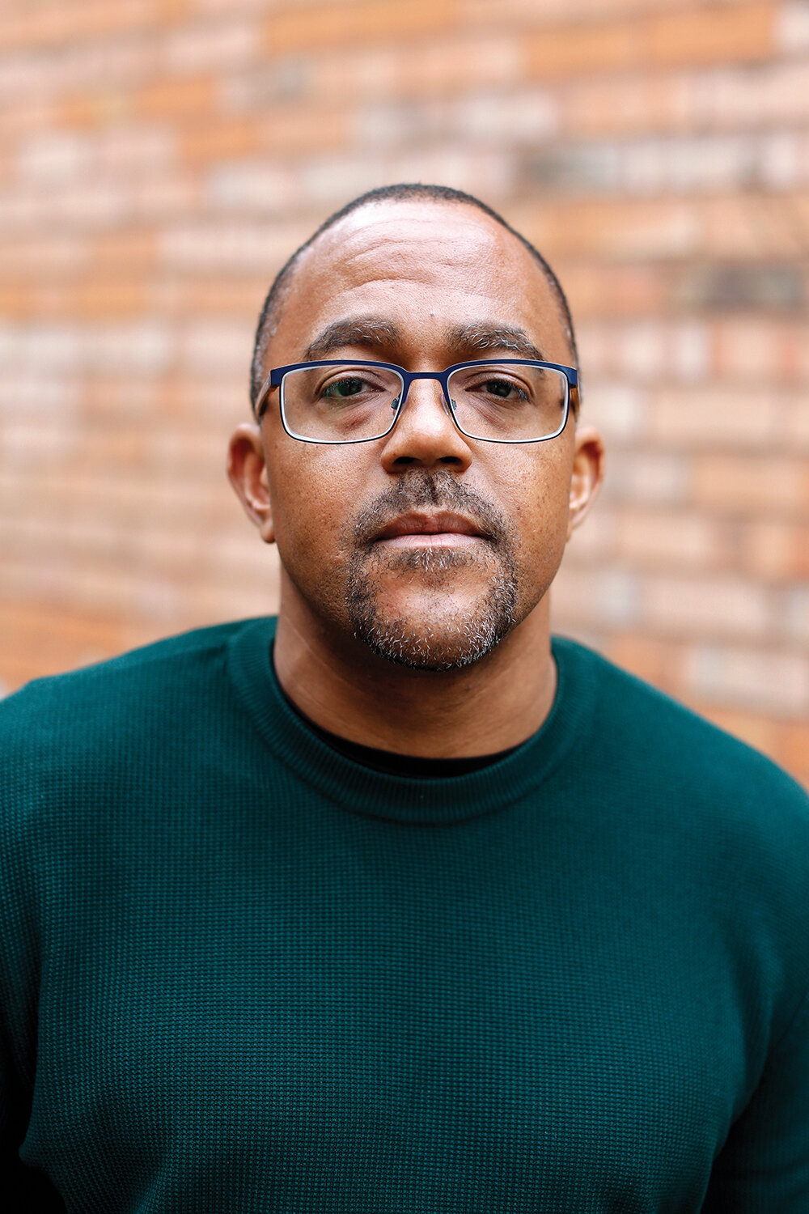
Black Studies in Britain
Black supplementary schools (“Saturday Schools) established in 1960s
2017 establishment of first Black Studies UG programme in Europe at Birmingham City University by Kehinde Andrews (programme cancelled in 2024)
“A degree in Black Studies is nothing to celebrate until we can prove that it is useful in terms of changing the conditions facing Black communities.”

Slide 22
Part V: Decolonising History

Slide 23
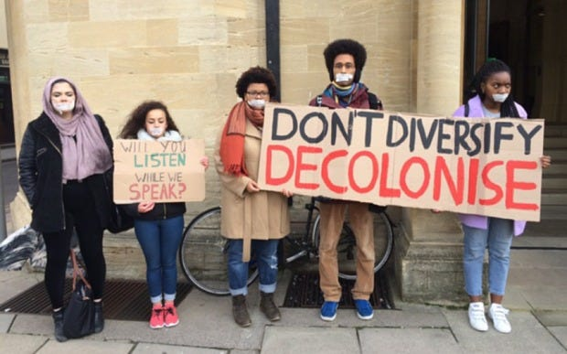
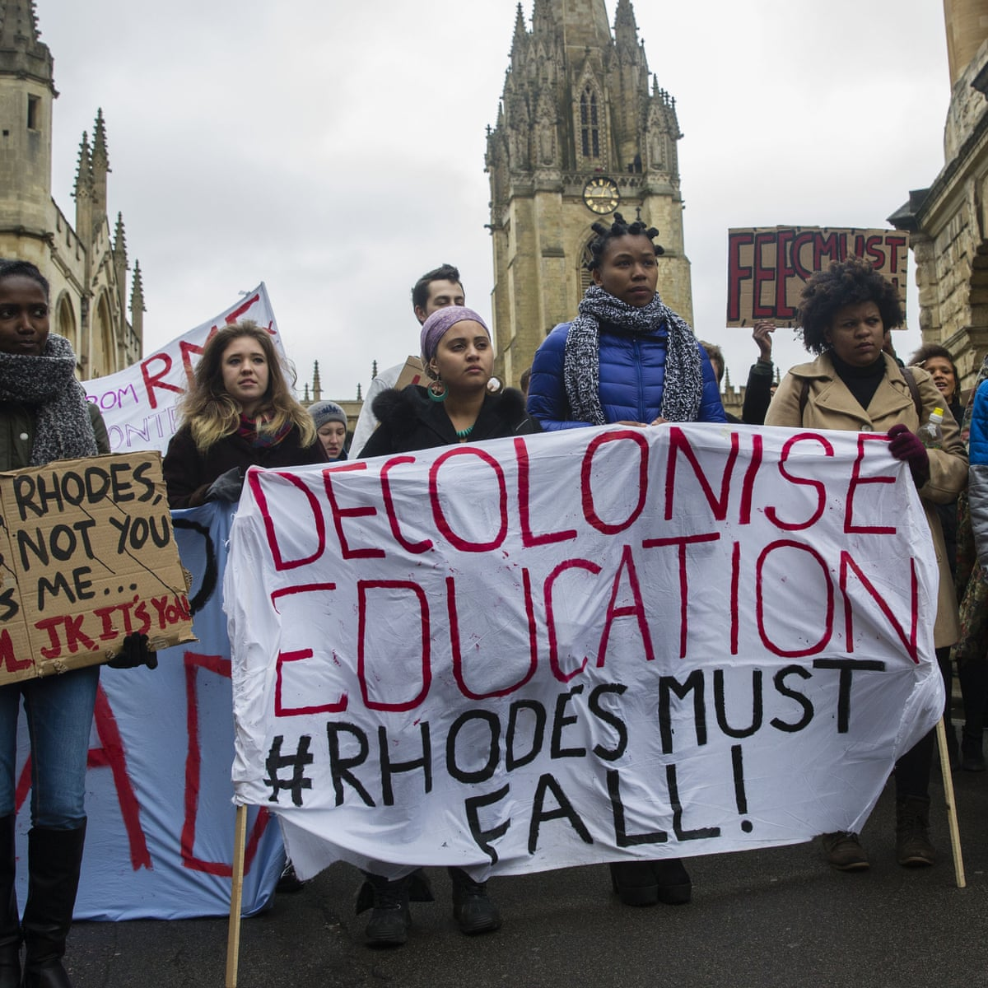
The 21st century movement to decolonise the university: historical contexts
Long history of anti-colonial resistance in both colonies and metropole
Caribbean intellectuals in Europe
Black Power movement in the US
Postcolonial Studies and Subaltern Studies in India
Walter Mignolo (Argentinian scholar) – “ there is no modernity without coloniality”
Rhodes Must Fall at the University of Cape Town, South Africa
Widespread discussion of the role of universities in perpetuating slavery and producing colonial knowledge
Remi Joseph-Salisbury – the British university is a “space of institutionalised whiteness, a space for white bodies” (2019)

Slide 24
What would it mean to decolonise the university?
Behm et al – “a constant critical perspective” (2020)
Seeks to transform how knowledge is created and shared
Critical reconsideration of the relationship between intellectual work (what we study), the people who do that work (historians) and the spaces in which we work (universities)
NOTE: Specific to national / (post-)colonial context
Tuck and Yang – “Decolonisation is not a metaphor” (2012)

Slide 25
What would it mean to decolonise the discipline of history?
Which archives are we drawing on?
Whose accounts do we trust?
What perspectives do we bring to our research?
What knowledge, which researchers, and whose perspectives are we drawing on and perpetuating?
Who designs our curricula, and what is included and excluded?
Who are our staff and students?
What is our experience of working and studying in history departments?

