Slide 1
Gender, Sexuality and Categories of Analysis
HI2K9 Historical Research
Prof. Lydia Plath

Slide 2
Disrupting the narrative
19th & early 20th century suffrage movements
1960s “second wave” feminism
Women’s history
Gender history
Black feminism / intersect-ionality
Queer and trans histories

Slide 3
Key questions:
What is “gender,” and how does it relate to “sex” and “sexuality”?
What is the difference between “women’s history” and “gender history”?
What is (or should be) the goal of a feminist approach to history?
How have Black feminists theorised Black women’s history?
How do ideas about gender and power relate to the material lives and experiences of women, queer people, and trans people?
What is the difference between “LGBT history”, “queer history”, and “trans history”?
Is gender a useful category of historical analysis?

Slide 4
Part I: “Gender”, Gender History, and Women’s History

Slide 5
The origins of “gender” as a concept
1880s-1940s key period for shift in focus from sexual “acts” to “identities”
Sexologists, doctors, and psychologists in mid-20th century seek to define “normal” sexual identities and behaviour.
John Money (psychologist working with intersex children in 1950s) and Robert Stoller (psychiatrist working with trans people in 1960s) saw gender as social/psychological/cultural component of “sex”
  “The term gender role is used to signify all those things that a person says or does to disclose himself or herself as having the status of boy or man, girl or woman, respectively” (Money)
  Gender is a term that has psychological or cultural rather than biological connotations. If the proper terms for sex are "male" and "female," the corresponding terms for gender are "masculine" and "feminine"; these latter may be quite independent of (biological) sex… gender role is determined by postnatal forces, regardless of the anatomy and physiology of the external genitalia” (Stoller)

Slide 6
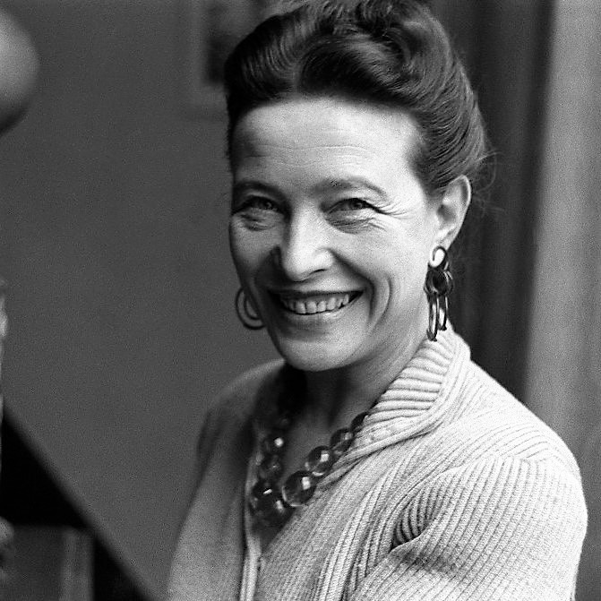
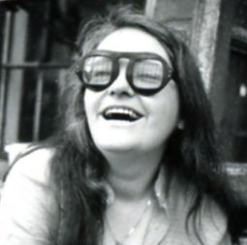
Feminists and “gender”
Simone de Beauvoir, The Second Sex (1949): “one is not born, but rather becomes a woman”
Kate Millett, Sexual Politics (1970) cites Stoller in support of her argument that gender is social/cultural and “that sex is a status category with political implications”

Slide 7

Sheila Rowbotham, Hidden From History: 300 Years of Women’s Suppression and the Fight Against it (1973)
“in what conditions have women produced and reproduced their lives, both through their labour and through procreation; how has the free expression of this activity been distorted and blocked by the circumstances of society? I have tried to explore both what has been specific to women as a sex and the manner in which class has cut across this oppression”
Focuses on relationship between capitalism and patriarchy

Slide 8
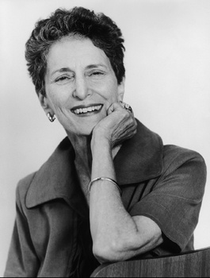
Natalie Zemon Davis, “Women’s History in Transition”, Feminist Studies (1975)
“It seems to me that we should be interested in the history of both women and men, that we should not be working only on the subjected sex any more than an historian of class can focus entirely on peasants. Our goal is to understand the significance of the sexes, of gender groups in the historical past. Our goal is to discover the range in sex roles and in sexual symbolism in different societies and periods, to find out what meaning they had and how they functioned to maintain the social order or to promote its change.”

Slide 9
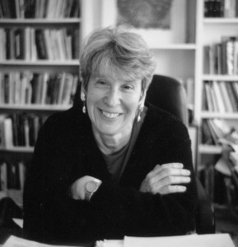
Joan Scott, “Gender: A Useful Category of Historical Analysis”, American Historical Review (1986)
“gender is a constitutive element of social relationships based on perceived differences between the sexes, and gender is a primary way of signifying relationships of power.”
“a history that will provide new perspectives on old questions (about how, for example, political rule is imposed, or what the impact of war on society is), redefine the old questions in new terms (introducing considerations of family and sexuality, for example, in the study of economics or war), make women visible as active participants, and create analytic distance between the seemingly fixed language of the past and our own terminology.

Slide 10
Gender & History (1989)
“Why Gender and History?”
“Gender and History brings to the study of history the centrality of gender relations and to the study of gender a sense of history. As its editors, we seek to examine all historical social relations from a feminist perspective, to construct a comprehensive analysis of all institutions that takes their gender-specific characters into account. In addressing men and masculinity as well as women and femininity, the journal will illuminate the ways in which societies have been shaped by the relations of power between women and men”
In Gender and History we intend to set studies of the less powerful firmly in the context of the more powerful. We seek to examine all aspects of gender in all places - in the home and in the workplace, in the neighbourhood and in diplomacy, in play and in war, in private relations and in parliaments”
But gender is not only a set of lived relations; it is also a symbolic system. Gender attributes have often been used as metaphors for other divisions, other hierarchies, including national characteristics and even nations themselves. Such devices constitute facets of the relationship between women and men in the past, but they are not direct reportage of that past. Such gender-specific metaphors must be integrated into the analysis of relations of domination and subordination and in this effort, we will benefit from the insights of our colleagues in other fields who study language, symbol and form”

Slide 11
Journal of Women’s History (1989)
“Statement of Purpose”
“[the] disagreement between those who think that women are an unchanging social category and those who want to emphasize the diversity and variability of the gendered identity of both women and men demonstrates the continued vitality and importance of women's history.”
“The Journal of Women’s History believes in the importance of gender as a category of analysis. However, it will not only seek out those poststructural studies that attempt to do more than simply demystify or eliminate traditional binary oppositions… but it will also encourage gender analysis that continues to focus on women's commonalities. While acknowledging the importance of investigating differences among women, the Journal of Women’s History is committed to the principle that feminist historians should not weaken their focus on women in the name of gender nor ignore the political potential of historical works about the past to shape feminist public policy in the future. Therefore, as important as research on masculinity or masculinism may be, much historical work remains to be done on women qua women.”

Slide 12
Part II: Black Feminism, Intersectionality and Gender

Slide 13
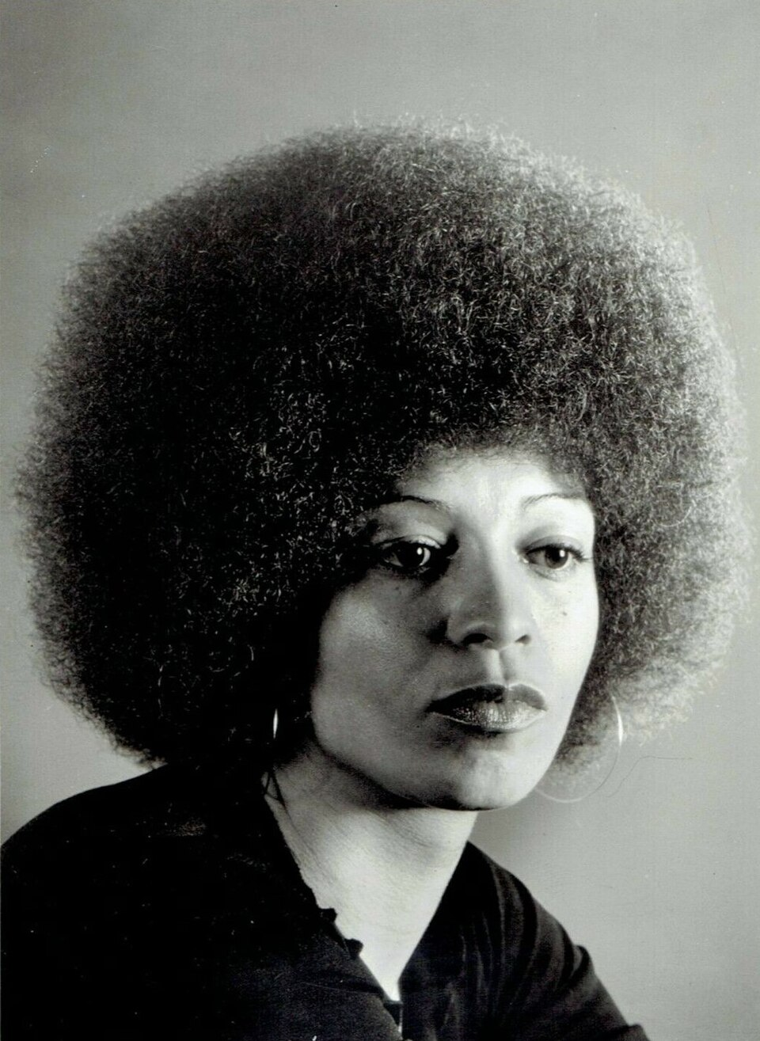
Angela Davis, “Reflections on the Black Women’s Role in the Community of Slaves” (1971)
The chief problem I encountered stemmed from the conditions of my incarceration: opportunities for researching the issue I wanted to explore were extremely limited. I chose, therefore, to entitle this piece "Reflections . . ." It does not pretend to be more than a collection of ideas which would constitute a starting point—a framework within which to conduct a rigorous reinvestigation of the black woman as she interacted with her people and with her oppressive environment during slavery”
This process did not end with the formal dissolution of slavery. Under the impact of racism, the black woman has been continually constrained to inject herself into the desperate struggle for existence. She—like her man—has been compelled to work for wages, providing for her family as she was previously forced to provide for the slaveholding class. The infinitely onerous nature of this equality should never be overlooked. For the black woman has always also remained harnessed to the chores of the household. Yet, she could never be exhaustively defined by her uniquely “female” responsibilities.”

Slide 14
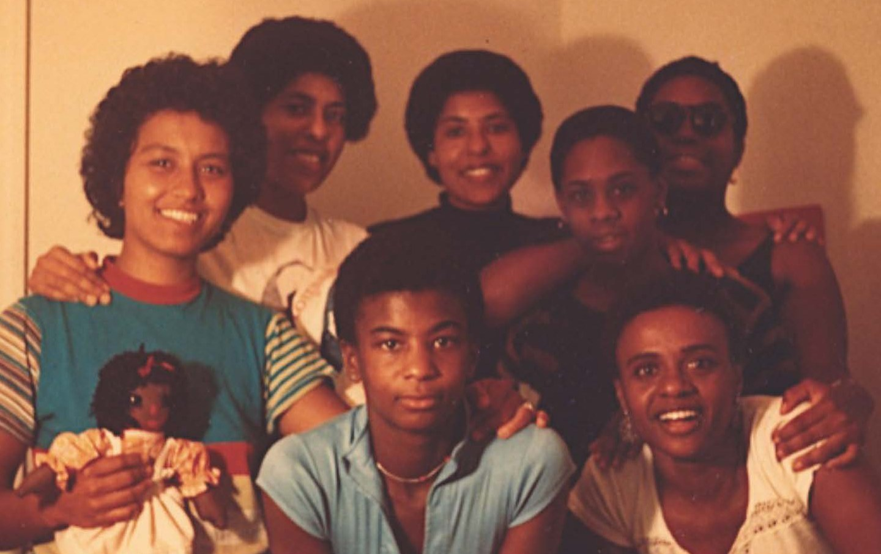
Combahee River Collective
Statement (1977)
“The most general statement of our politics at the present time would be that we are actively committed to struggling against racial, sexual, heterosexual, and class oppression, and see as our particular task the development of integrated analysis and practice based upon the fact that the major systems of oppression are interlocking. The synthesis of these oppressions creates the conditions of our lives.”
“We also often find it difficult to separate race from class from sex oppression because in our lives they are most often experienced simultaneously… we have in many ways gone beyond white women's revelations because we are dealing with the implications of race and class as well as sex.”
“As BIack women we find any type of biological determinism a particularly dangerous and reactionary basis upon which to build a politic.”

Slide 15
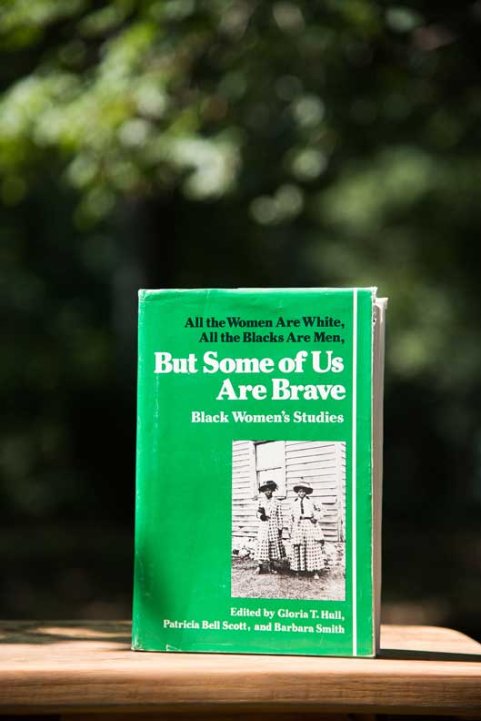
Akasha Gloria Hull, Patricia Bell-Scott, and Barbara Smith, All the Women are White, All the Blacks are Men, But Some of Us Are Brave (1982)
“Like any politically disenfranchised group, Black women could not exist consciously until we began to name ourselves. The growth of Black women’s studies is an essential aspect of that process of naming.”
“Naming and describing our experience are important initial steps, but not alone sufficient to get us where we need to go. A descriptive approach to the lives of Black women, a “great Black women” in history or literature approach… will not result in intellectually groundbreaking or politically transforming work.”

Slide 16
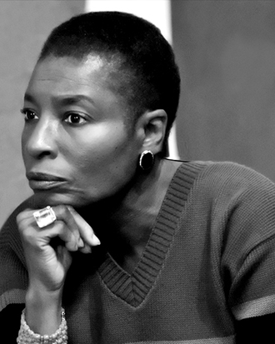
Hortense Spillers, “Mama’s Baby, Papa’s Maybe: An American Grammar Book” (1987)
“gender, or sex-role assignation, or the clear differentiation of sexual stuff, sustained elsewhere in the culture, does not emerge for the African-American female in this historic instance, except indirectly, except as a way to reinforce through the process of birthing”
Argues that the dehumanisation of slavery led to Black women being “ungendered”

Slide 17
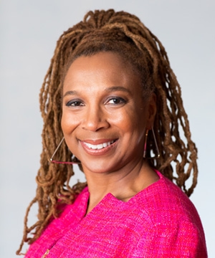
Kimberlé Crenshaw, “Demarginalizing the Intersection of Race and Sex” (1989)
“I argue that Black women are sometimes excluded from feminist theory and antiracist policy discourse because both are predicated on a discrete set of experiences that often does not accurately reflect the interaction of race and gender. These problems of exclusion cannot be solved simply by including Black women within an already established analytical structure. Because the intersectional experience is greater than the sum of racism and sexism…”
Also see: “Mapping the Margins: Intersectionality, Identity Politics, and Violence Against Women of Color” (1991)

Slide 18
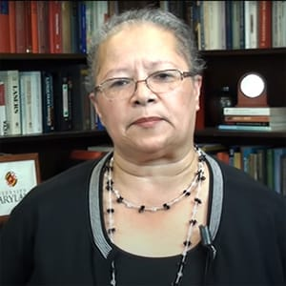
Elsa Barkley Brown
“Polyrhythms and Improvization: Lessons for Women’s History (1991)
  “We have still to recognize that being a woman is, in fact, not extractable from the context in which one is a woman—race, class, time, and place. That is as true for white women as it is for African American, Latina, Asian, and Indian women. We have still to recognize that all women do not have the same gender.”
“What has happened here: The Politics of Difference in Women’s History and Feminist Politics” (1992)
  “White women and women of color not only live different lives but white women live the lives they do in large part because women of color live the ones they do.”
  “some historians have a vested interest in duplicating that privilege within historical constructions”

Slide 19
Part III: Sexuality, Queer and Trans Histories

Slide 20
LGBT History, Queer History, Trans History
  “the framework of queer history is used to recognize the social and historical situatedness of sexual and gender identities, although it most often refers to those who participate in same-sex intimacy or adopt non-conventional gender and who today might be marked by an L, G, B and/or T.” – Christina B. Hanhardt (2019)
Regina Kunzel “The Power of Queer History” (2018)
  “LGBT history… is a clumsy moniker for a field so committed to rigorously historicizing the very terms that name it”
  ‘“Queer” describes a critical lens rather than a set of linked sexual and gender identities, offering historians new insight into broader structures of power.’ –
  “If “queer” indexes the uncanny, the unpredictable, the untimely, and the askew, “trans” references movement, passages, “categorical crossings, leakages, and slips of all sorts.””

Slide 21
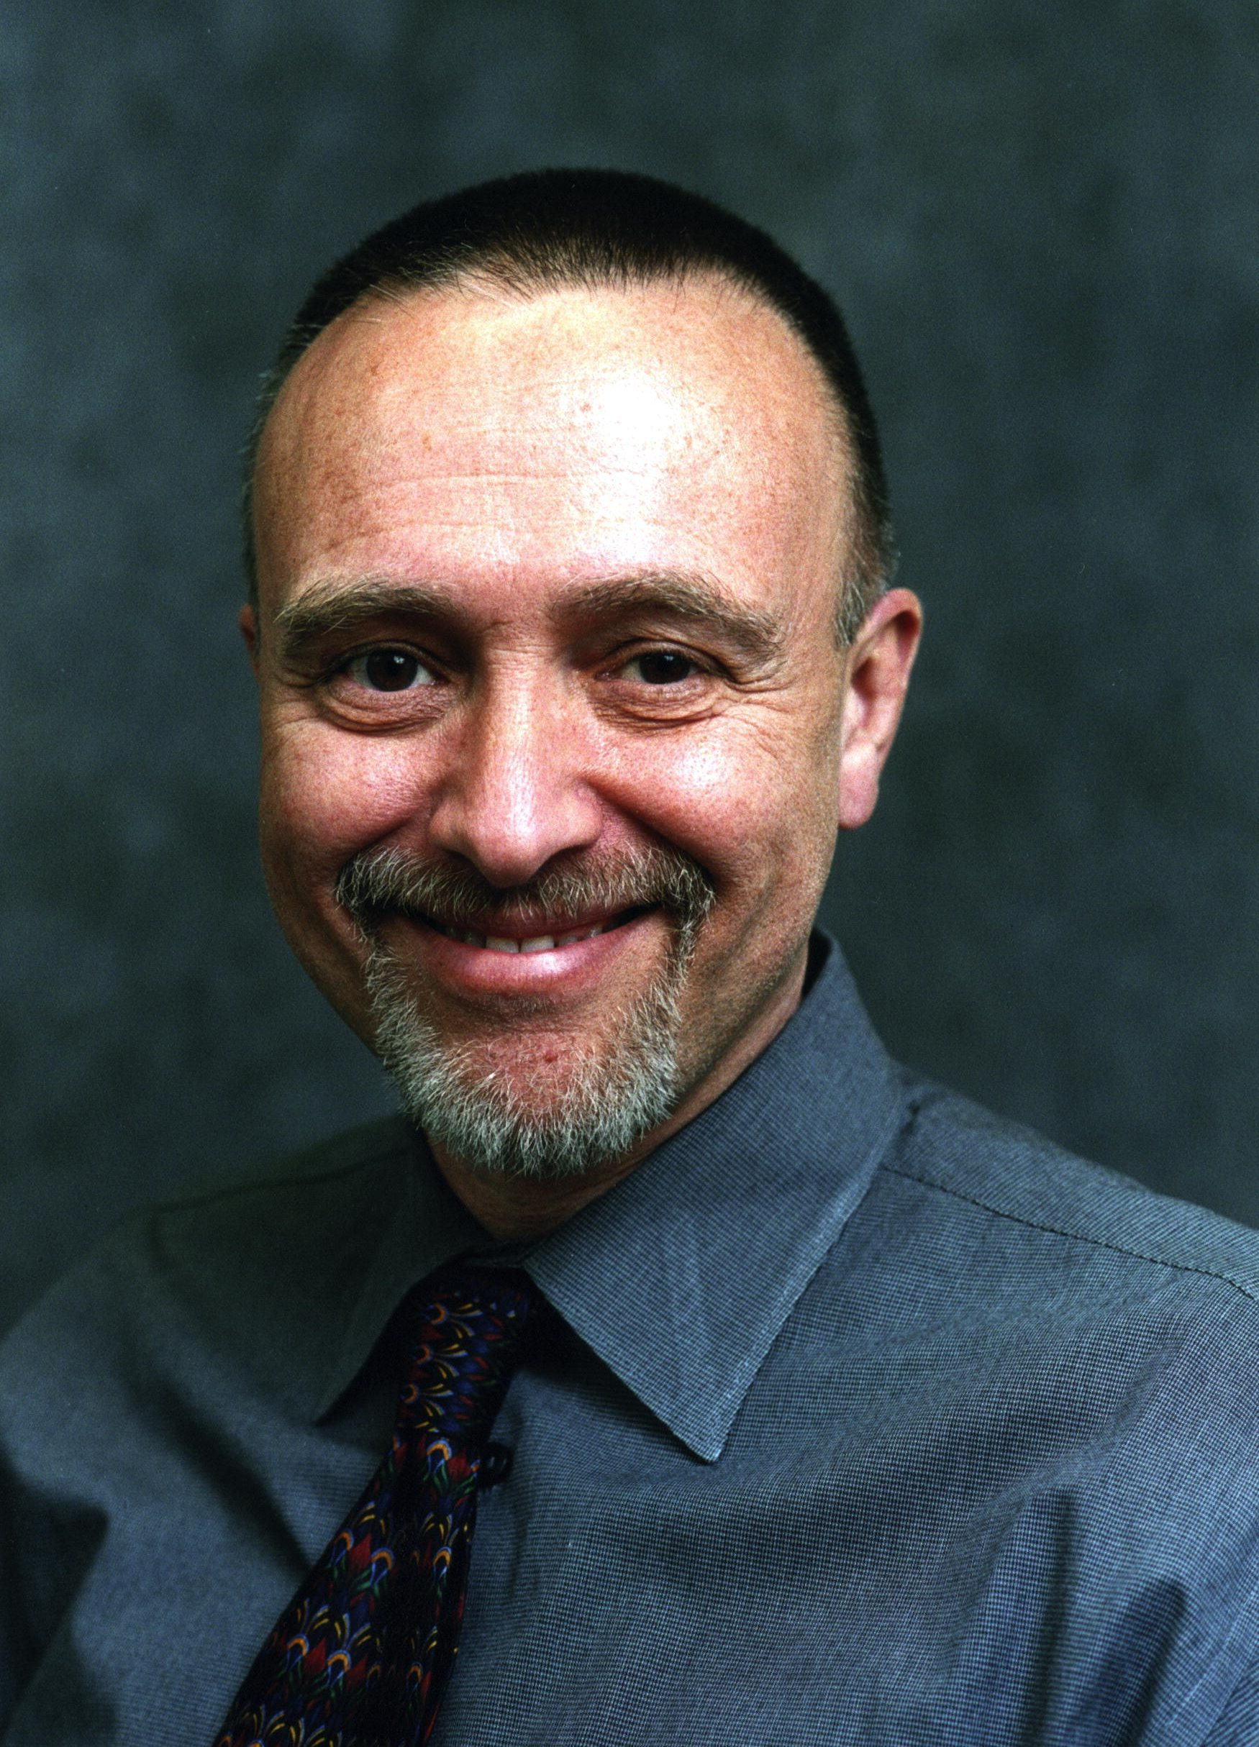
John D’Emilio, “Not a Simple Matter: Gay History and Gay Historians” (1989)
“I defined myself in part by what I had decided I was most definitely not – a professional historian… The one exception to that detachment was women’s history, a field exploding with new and exciting scholarship in the mid-1970s. The understandings of the historical construction of gender that feminist historians were developing seemed central to my own enterprise”
“at least in the 1970s and 1980s, the doing of gay and lesbian history has been more than a form of intellectual labor… it was transforming… inherently political.”

Slide 22
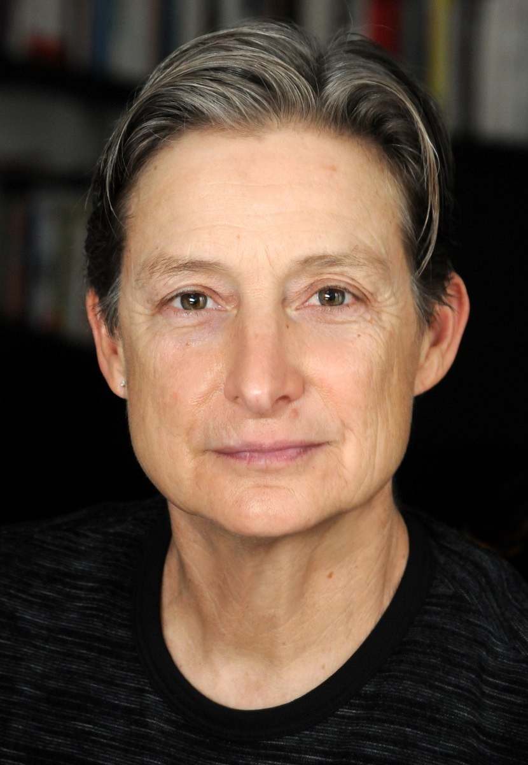
Judith Butler, Gender Trouble (1990)
“gender is a kind of persistent impersonation that passes as the real… Is drag the imitation of gender, or does it dramatize the signifying gestures through which gender itself is established? Does being female constitute a “natural fact” or a cultural performance, or is “naturalness” constituted through discursively constrained performative acts that produce the body through and with the categories of sex?”
“The complexity of gender requires an interdisciplinary and postdisciplinary set of discourses in order to resist the domestication of gender studies or women studies within the academy”
argues sex is actually constituted of gender, produced retrospectively to lend the appearance of physical substance

Slide 23
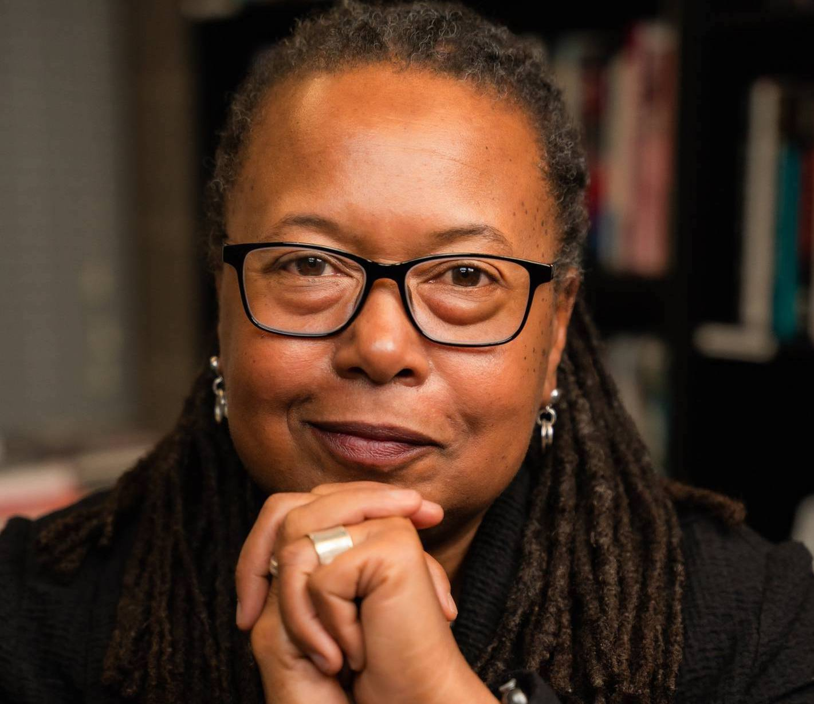
Cathy Cohen, “Punks, Bulldaggers, and Welfare Queens” (1997)
“Despite the possibility invested in the idea of queerness and the practice of queer politics, I argue that a truly radical or transformative politics has not resulted from queer activism… instead of destabilizing the assumed categories and binaries of sexual identity, queer politics has served to reinforce simple dichotomies between heterosexual and everything “queer.” An understanding of the ways in which power informs and constitutes privileged and marginalised subjects on both sides of this dichotomy has been left unexamined”
“beyond a mere recognition of the intersection of oppressions, there must also be an understanding of the ways our multiple identities work to limit the entitlement and status some receive from obeying a heterosexual imperative. For example, how would queer activists understand politically the lives of women – in particular women of color – on welfare, who may fit into the category of heterosexual, but whose sexual choices are not perceived as normal [or moral]… [in contrast to] those whose same-sex sexual identities position them within the category of queer, but who hold other identities… which provide them with membership in and the resources of dominant institutions and groups?”

Slide 24
Disrupting the narrative
Women’s history
Gender history
Black feminism / intersectionality
Queer and trans histories

Slide 25
Coda

Slide 26

C Riley Snorton, Black on Both Sides: A Racial History of Trans Identity (2017)
Uses term “racialized gender”
“Although the perception that “race” and “gender” are fixed and knowable terms is the dominant logic of identity, in this book “trans” is more about a movement with no clear origin and no point of arrival, and “blackness” signifies upon an enveloping environment and condition of possibility. Here, trans—in each of its permutations—finds expression and continuous circulation within blackness, and blackness is transected by embodied procedures that fall under the sign of gender”

Slide 27
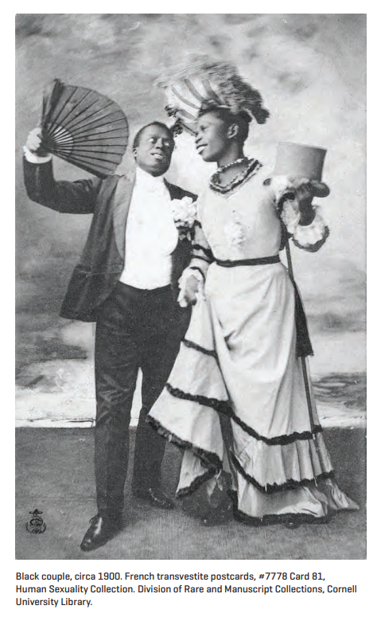
C. Riley Snorton
“the sex/gender of both figures is uncertain… The interchange of gendered accessories amplifies the sense of gender indefiniteness”
“What can the image reveal about the histories of blackness, transness, and sexual cultures? about their indefinities and irreducibilities? about their temporalities of emergence? The postcard … depicts the transitivity and transversality of blackness and transness”

