Slide 1
Global History and the Networked World
Professor David Lambert
Historical Research (HI2K9)
19th January 2026

Slide 2
Until very recently, the practice of modern history centred on, and was dominated by, the nation state. Most history was the history of the nation. If you wander through the history and biography aisles of either brick-and-mortar or virtual bookstores, the characters and heroes of patriotism dominate.
…
Then, along came globalisation and the shake-up of old, bordered imaginations. Historians quickly responded to the fall of the Berlin Wall, the crumbling protective ramparts of national capitalism, the boom in container shipping, and the rise of the cosmopolis. New scales and new concepts came to life.
Jeremy Adelman, ‘What is global history now?’ (2017)

Slide 3
Lecture structure
What is global history?
Precedents for global history
Globalisation
The rise of global history
Critiques and subsequent developments

Slide 4
What is global history?
The history of the entire globe?

Slide 5
What is global history?
The history of the entire globe?

Slide 6
What is global history?
The history of the entire globe?
Global history as an approach
​Studies connections and interdependencies
Concerned with trans-regional processes and phenomena
Other key concepts: flow, exchange, circulation, entanglement, networks, webs…
Challenges Eurocentrism and other centrisms
Varied in terms of methodology and areas of focus

Slide 7
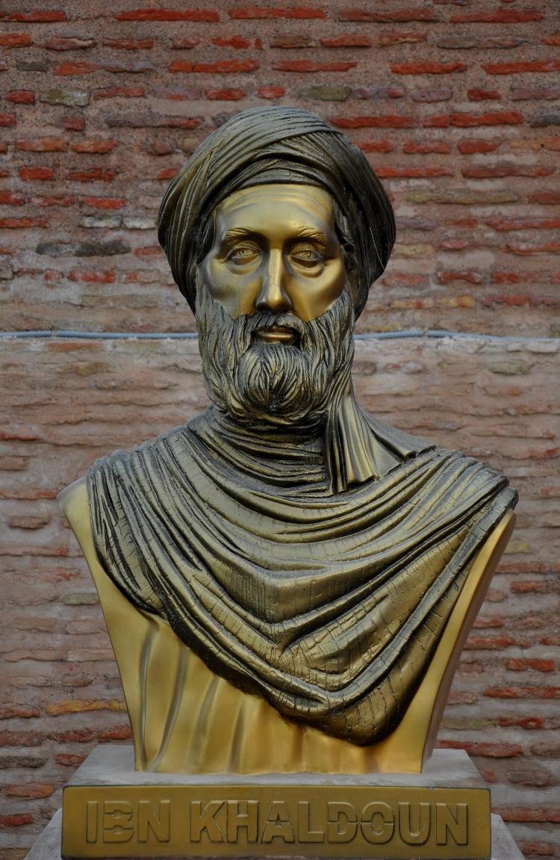
Precedents: Universal history
Long-standing interest in many historiographical traditions to try and write a ‘history of everything’, e.g.
Herodotus, Greek historian, c.484-c.425 BCE
Sima Qian 司馬遷, Chinese historian, c.145-c.86 BCE
Ibn Khaldun, Tunisian historian, 1332-1406 CE

Slide 8
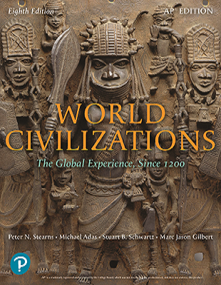
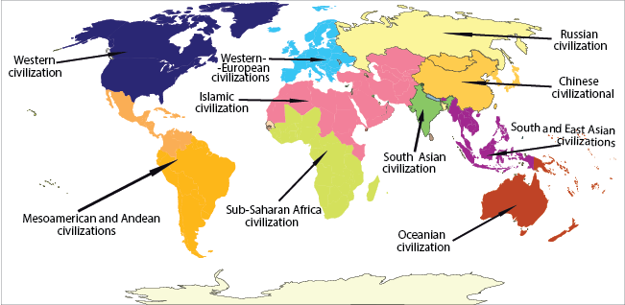
Precedents: World History

Slide 9
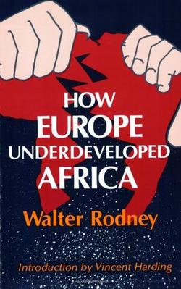

Precedents: Dependency Theory and World Systems Theory

Slide 10
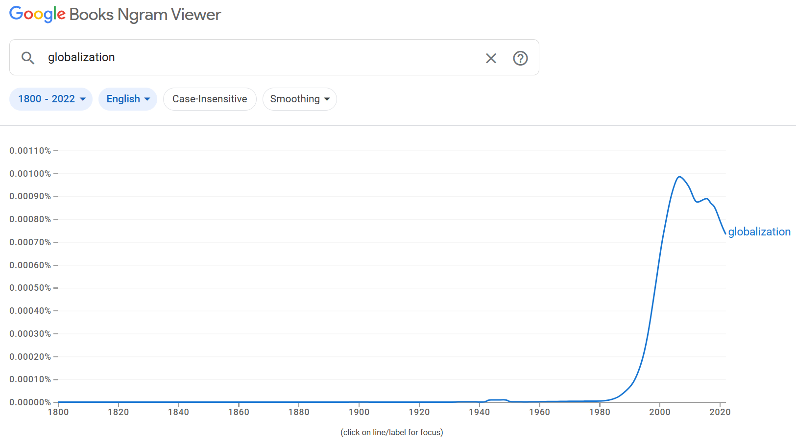
‘Globalization’

Slide 11
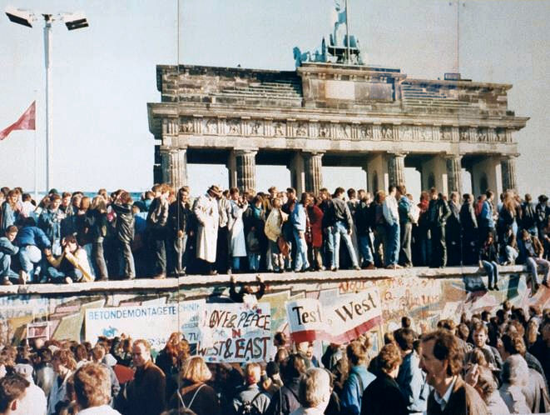
End of the Cold War

Slide 12
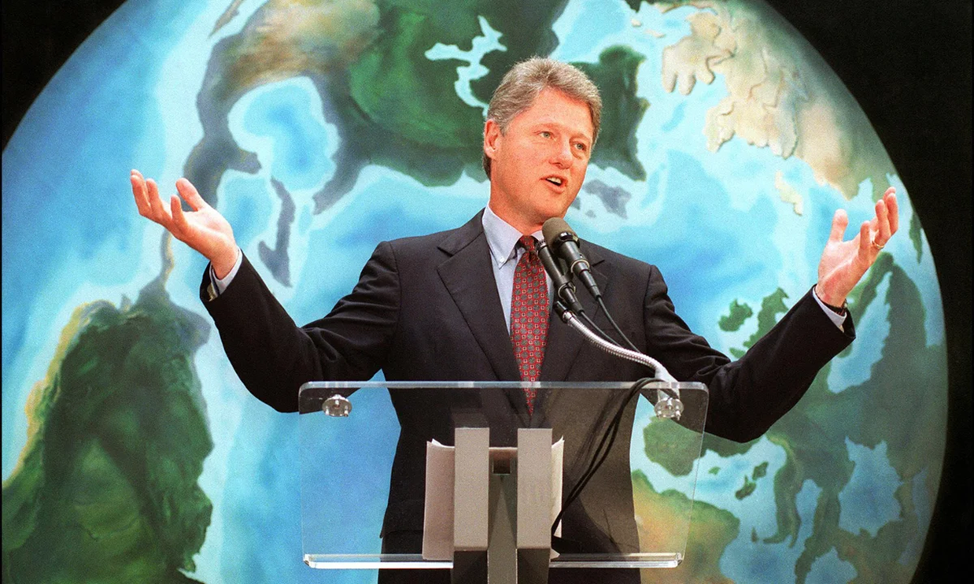
Neoliberalism

Slide 13

End of the nation-state?

Slide 14
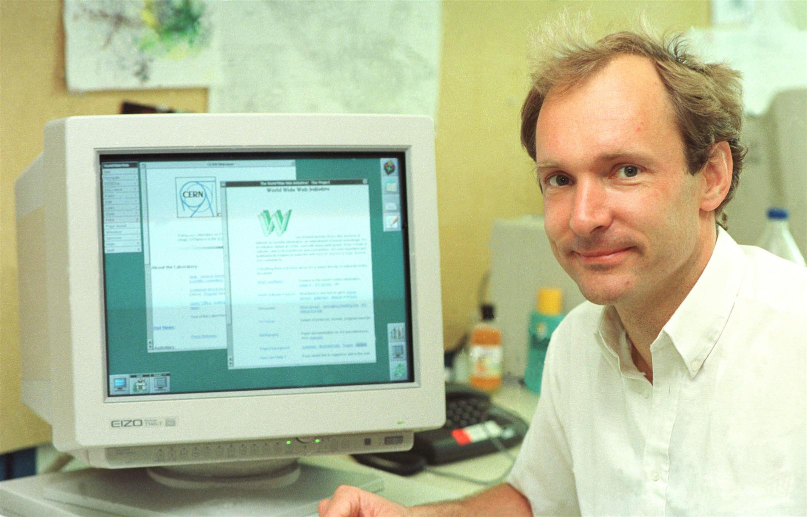
Information and communication technologies

Slide 15
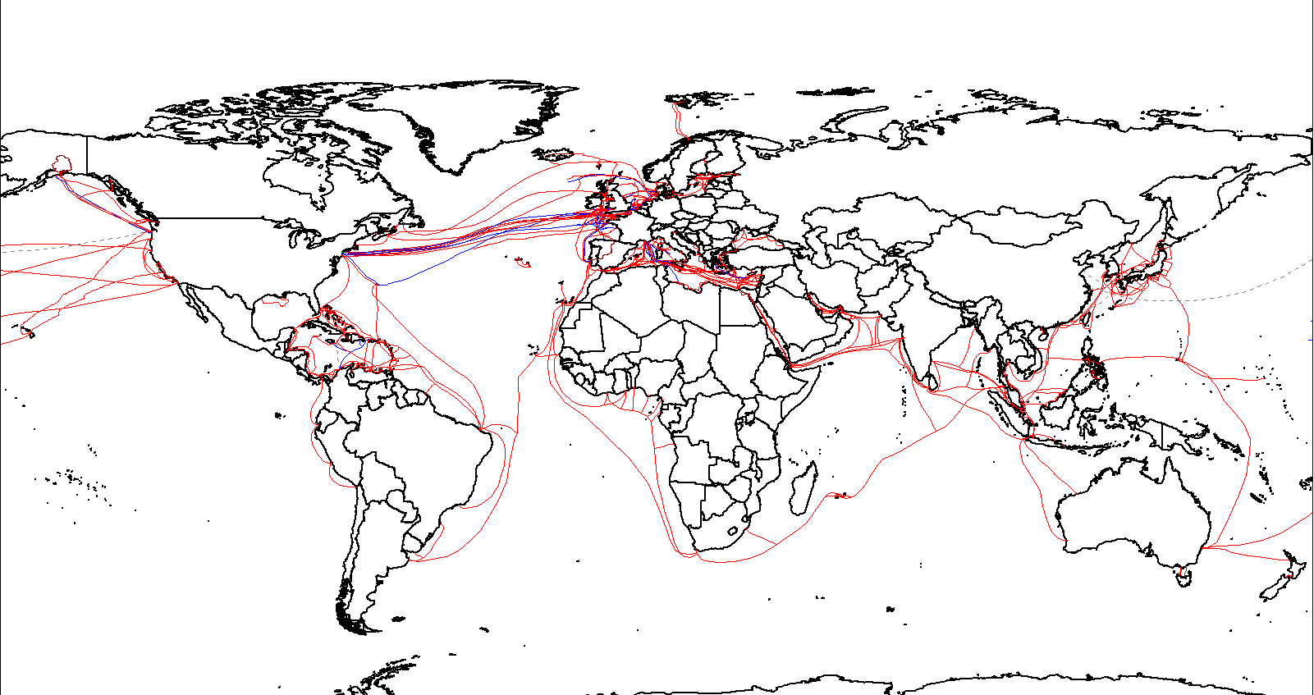
Material networks

Slide 16
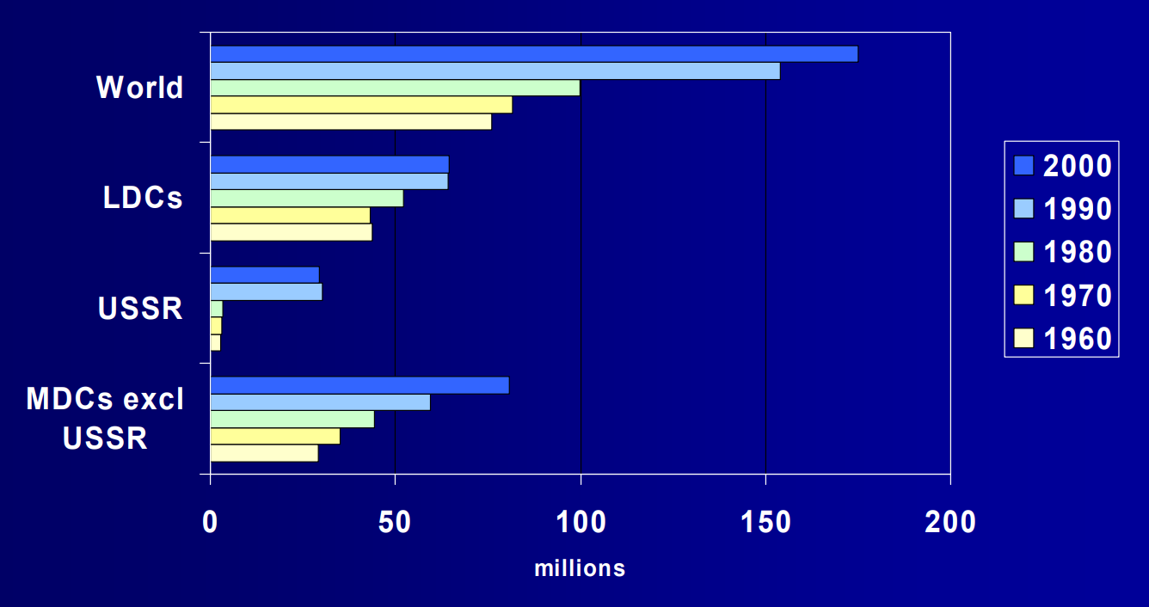
International migration

Slide 17
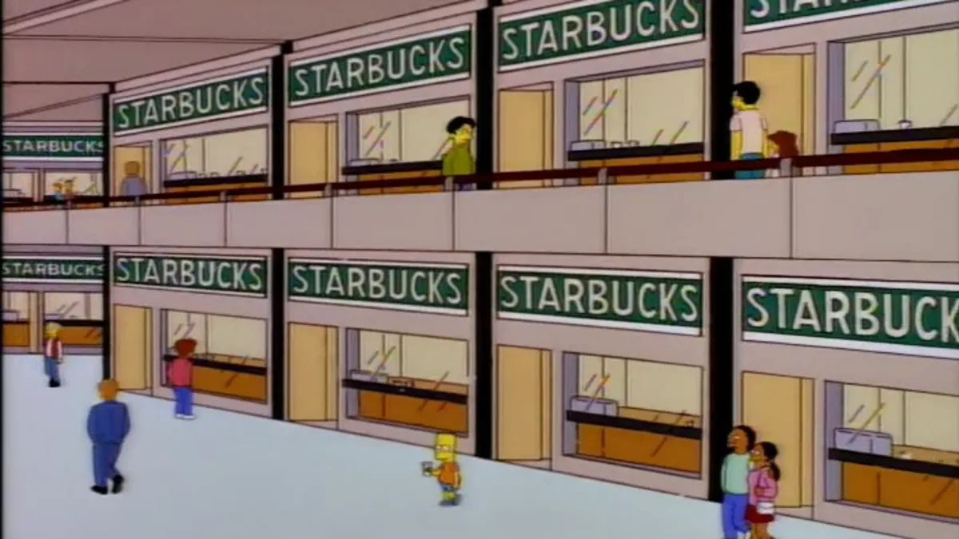
‘Starbucksification’

Slide 18
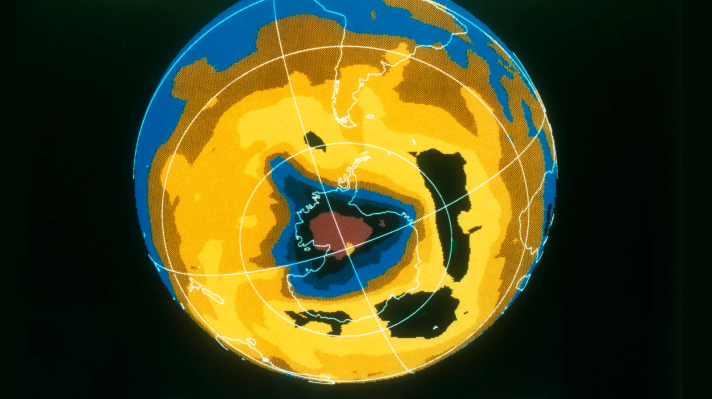
Global Environmental Problems

Slide 19
Social scientists on globalisation
Anthony Giddens, The Consequences of Modernity (1990) – ‘intensification of worldwide social relations’
Arjun Appadurai – Disjuncture and Globalization (1990) – ‘ethnoscape’, ‘mediascape’, ‘ideoscape’ etc.
Manuel Castells (1996-1998) – the ‘network society’; ‘space of flows’ vs ‘space of places’

Slide 20
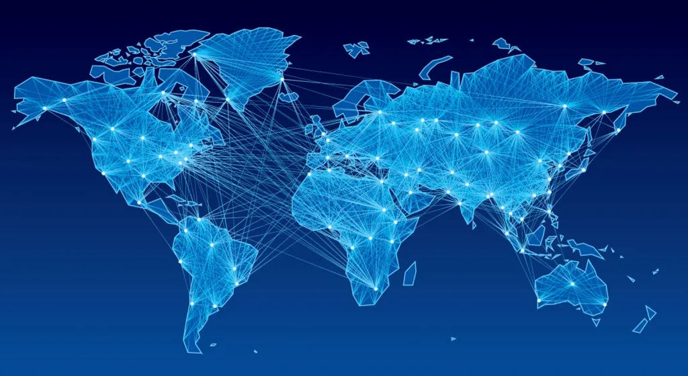
Connections and networks

Slide 21

‘The End of History’?
‘What we may be witnessing is not just the end of the Cold War, or the passing of a particular period of postwar history, but the end of history as such: that is, the end point of mankind’s ideological evolution and the universalization of Western liberal democracy as the final form of human government’ (1992).

Slide 22
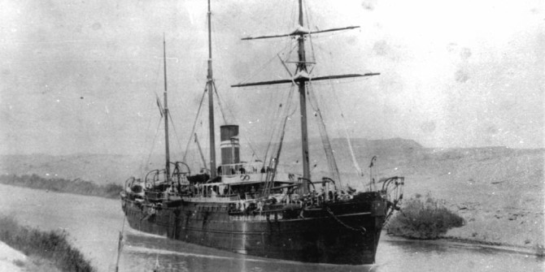
Histories of globalisation

Slide 23
Global history as a ‘cosmopolitan endeavour’
[According to some], [g]lobal history is an inherently cosmopolitan endeavor. At its core, it is an inclusive project, both geographically and normatively. To begin with, it provides a broad account of humanity’s past. At a time when news is no longer confined to one’s own society; when tourists roam the planet, and migration links labor markets in different parts of the world; when we eat food grown in faraway locations and buy goods produced elsewhere: in our globalized present, in other words, global history is a contribution to making sense of the world in which we live...Herein lies the utopian promise of global history: to turn us into citizens of the world.
Conrad, What Is Global History? (2016), p. 155.

Slide 24
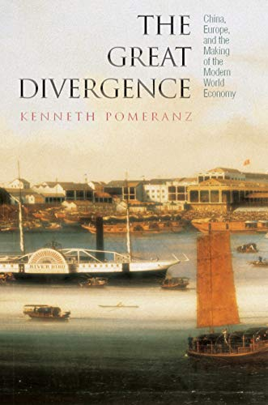
Globalization and ‘divergence'
Why did Britain industrialise, but not China?
Search for the origins of the globalised and connected world of the 1990s
When did the ‘the west’ ‘diverge’ from ‘the rest’?
Focus on economic history

Slide 25
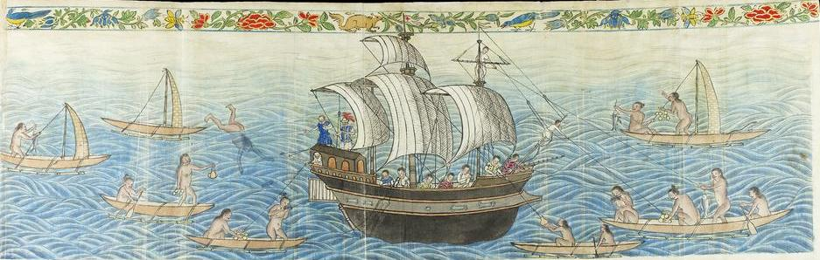
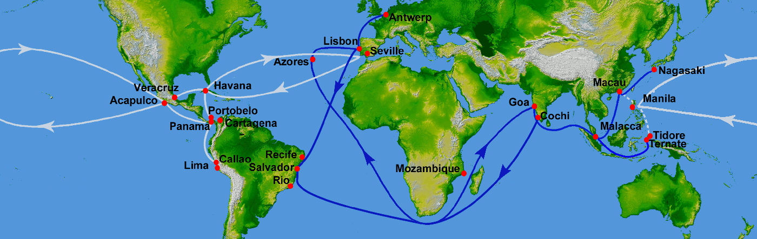
Manila Galleon Trade (16th-century)

Slide 26
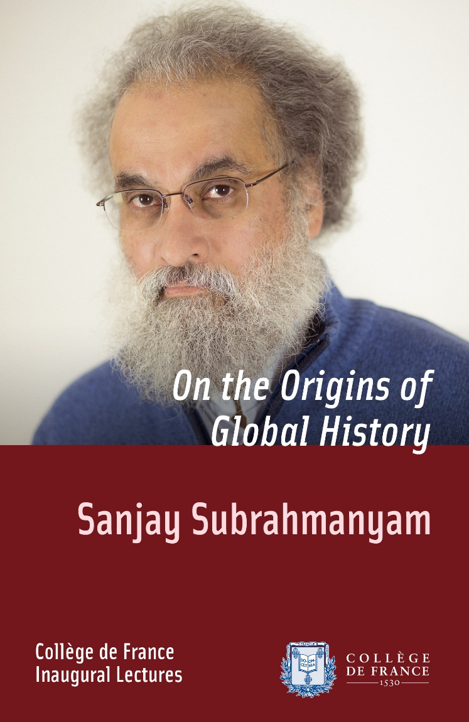
‘Connected history’: Sanjay Subrahmanyam
‘Like any historian, I remain attached to particular places and spaces, and my knowledge is the direct product of training in the reading of texts, archives and images. But these materials are not limited to a national space, and it has always seemed somewhat artificial to me to identify myself simply as a historian of India, Portugal or the British or Dutch Empires, as I have sometimes been compelled to do. It turns out that in today’s world there is growing interest and curiosity in this type of history’ (2013).

Slide 27
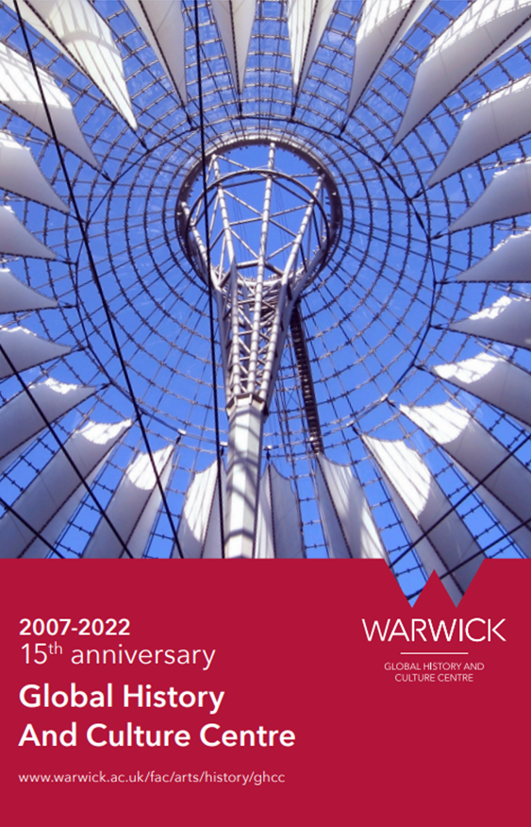
Institutionalising global history
Journal of Global History (2006)
Global History and Cultural Centre at Warwick (2007)
‘Writing the History of the Global’ conference (2009)
Maxine Berg (ed.), Writing the History of the Global: Challenges for the 21st Century (Oxford UP, 2013)

Slide 28
Critiques of global history
Eurocentricity of conceptual frameworks
Marginalisation of concepts and perspectives originating in Global South
Euro-American in intellectual orientation and institutionally
Dominance of Global North-based authors and publishers
Questions of access to academic resources

Slide 29
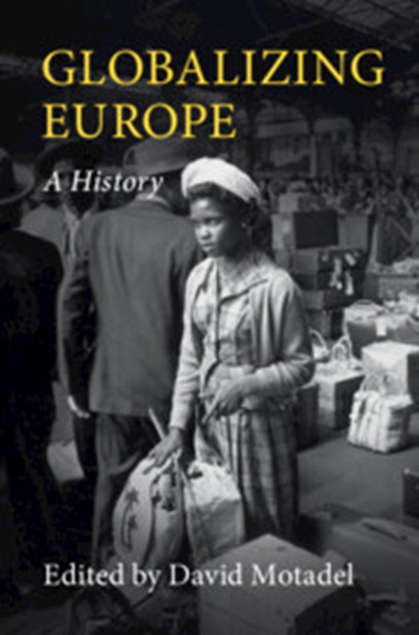
Globalizing European history
‘The rise of global history over recent years has affected almost every field of historical study. Historians of Europe, however, have seldom played a central role in these debates…Some see global history by definition as non-European history…Yet European and global history do not, of course, contradict each other. Global history should not only be defined by the geographical location of its subject. Its aim should not be to examine far-flung regions, as distant from Europe as possible. Instead, global history provides a conceptual approach, namely the study of global interrelations as well as parallel and divergent developments and transformations in different parts of the world’ (2025, pp 6, 7).

Slide 30
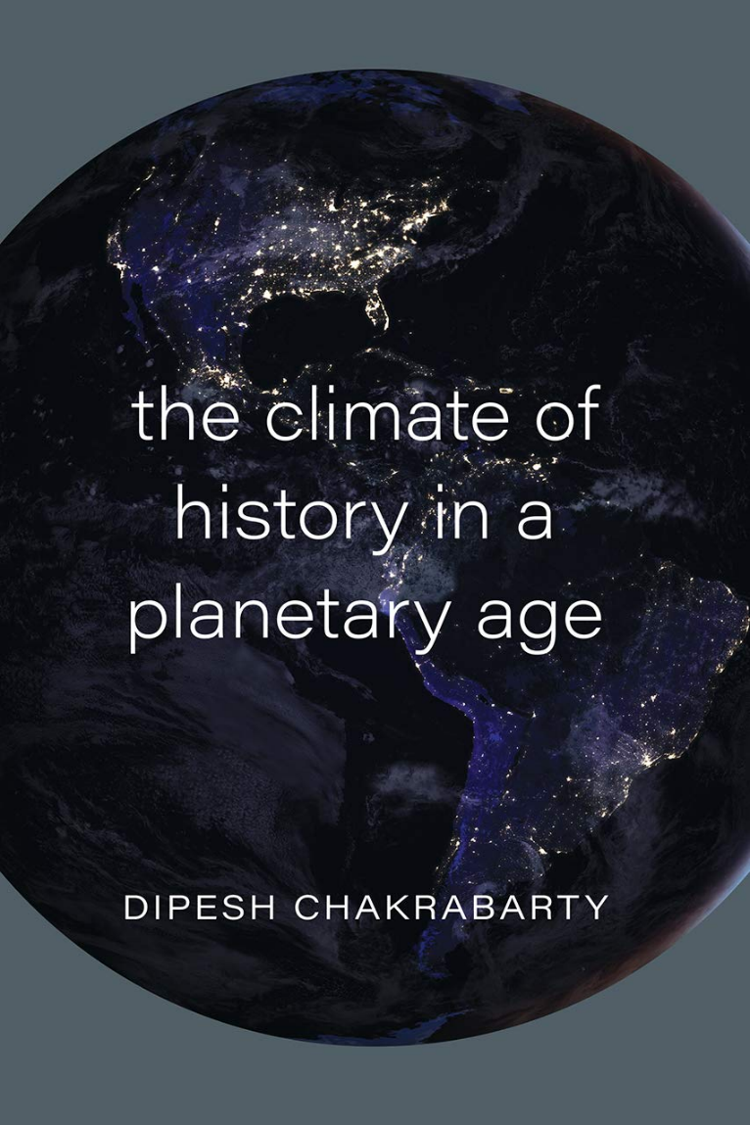
Planetary history
‘We see the globe as created by human institutions and technology…The nature of this new category planet is best explored…by distinguishing it from the idea of the globe with which it has often been identified in the past’ (2025, pp 83, 84).

Slide 31
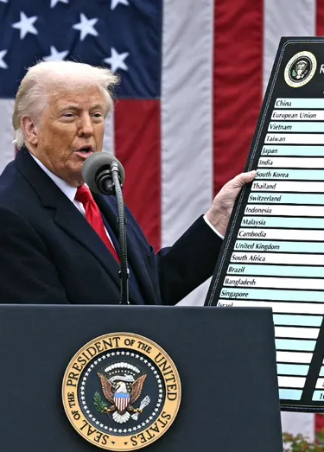
Globalization in crisis?
‘Much of the field’s self-image, conceptual basis and success rests on what is ultimately a tautology: that global history is the history befitting a global age, connected histories suitable for a connected world. That is unlikely to suffice in the long run. By the third decade of the twenty-first century, with globalisation in crisis and universal values under threat, our era remains irrefutably global…but no longer consistently or affirmatively, let alone enthusiastically so’ (Gänger and Osterhammel, 2020, pp 1-2).

Slide 32
Global History and the Networked World
Professor David Lambert
Historical Research (HI2K9)
19th January 2026

