Slide 1
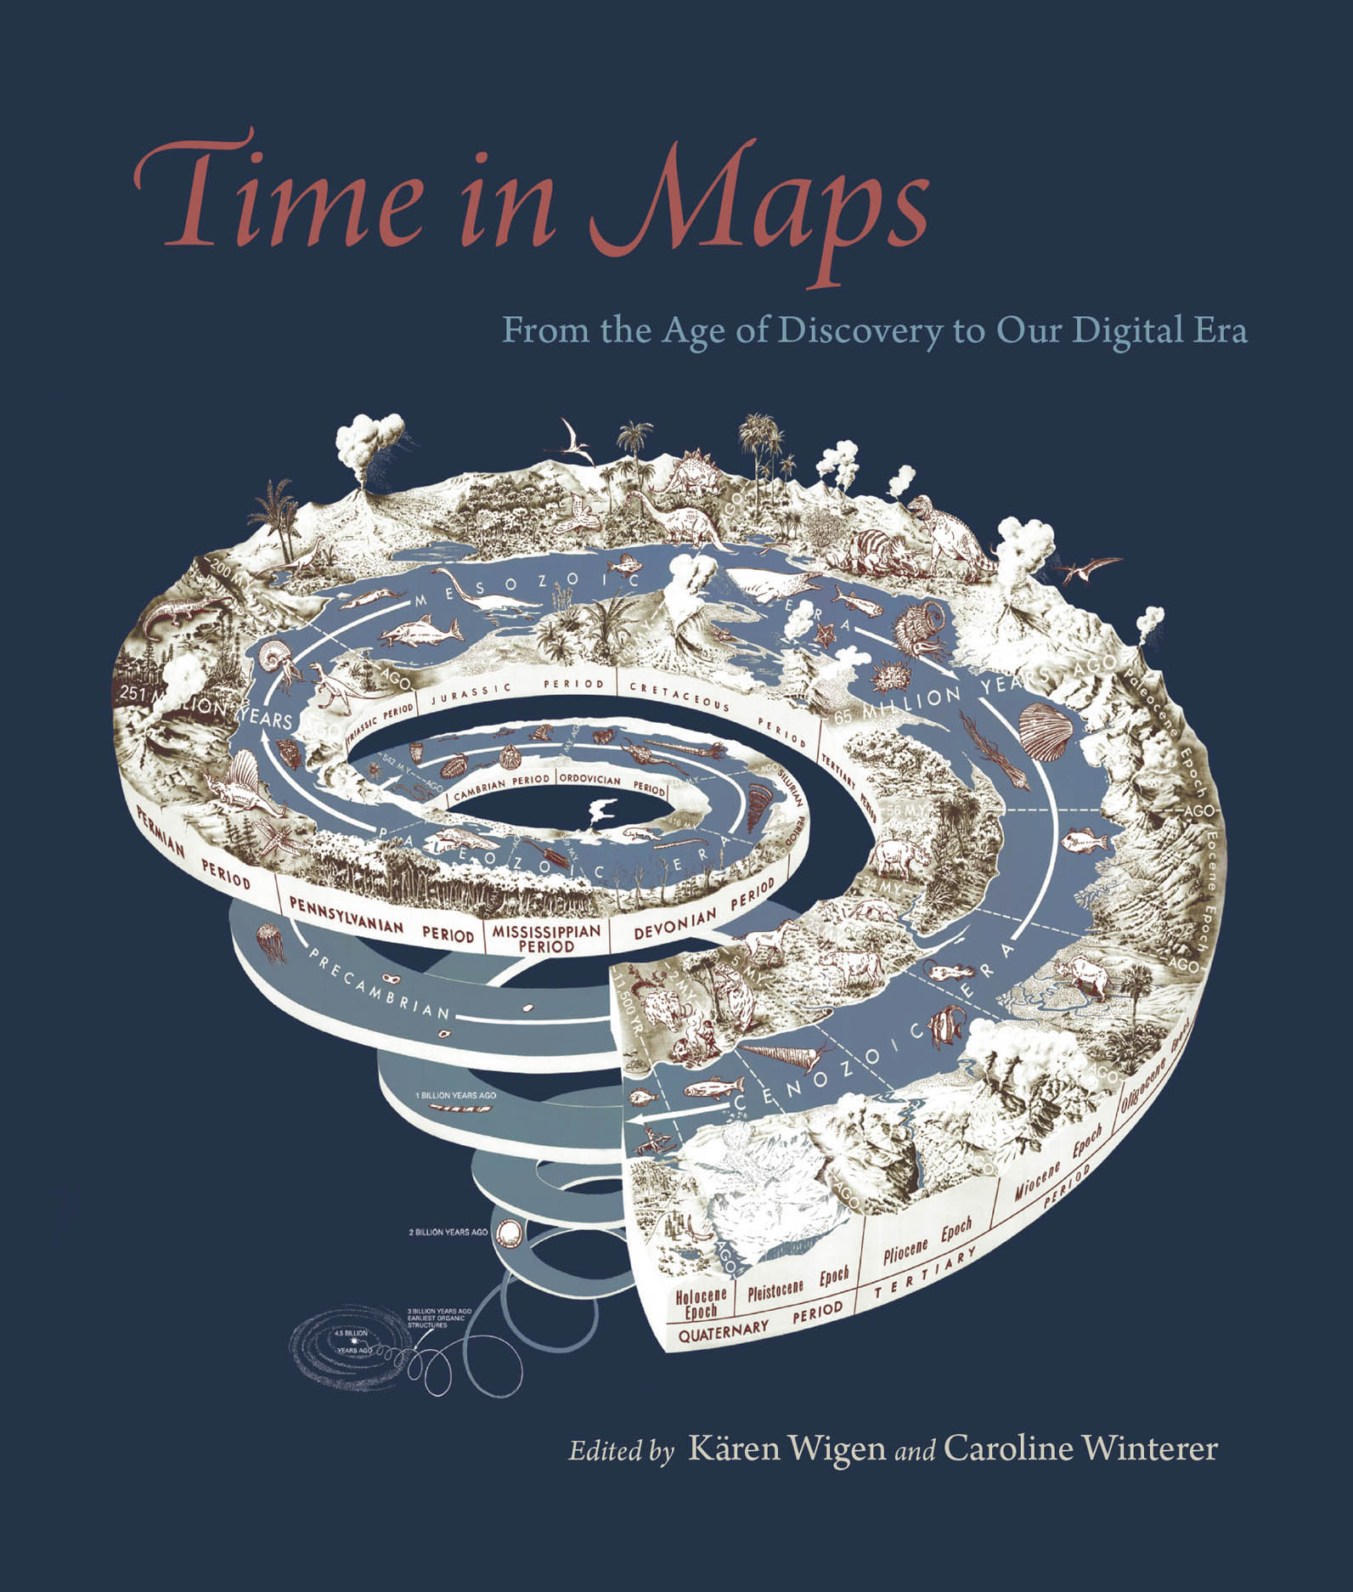
Scale
HI2K9: Historical Research
Tom Simpson

Slide 2
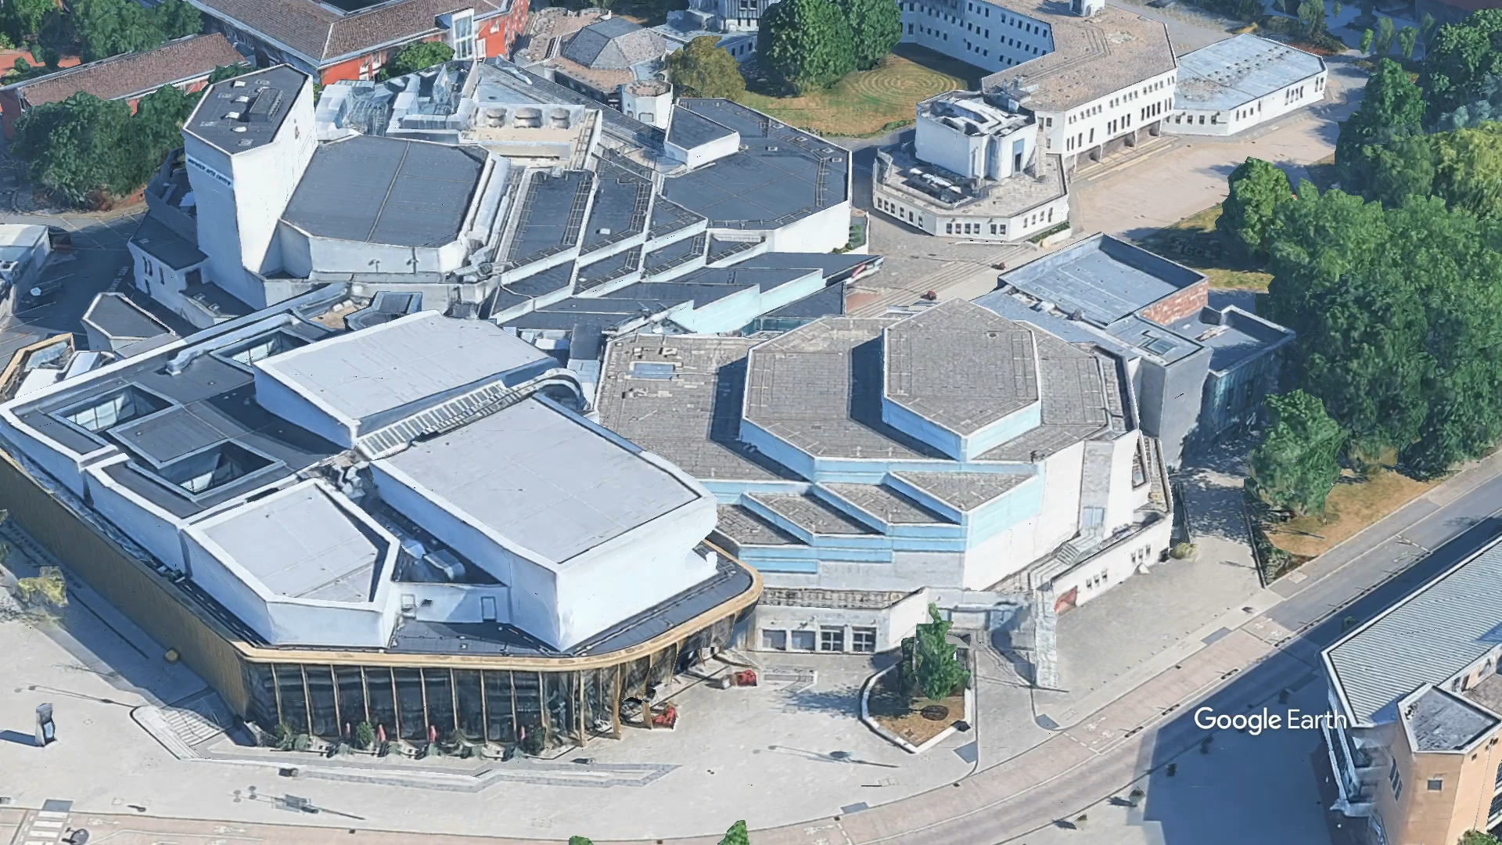

Slide 3
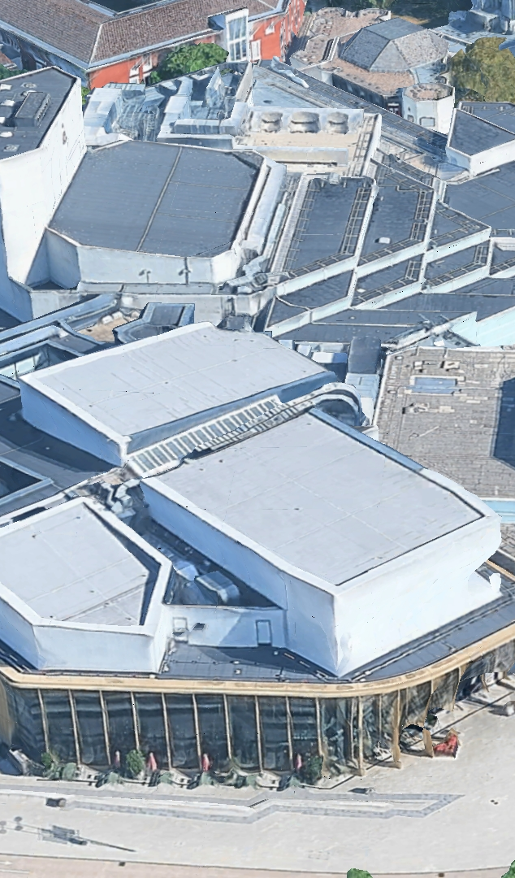
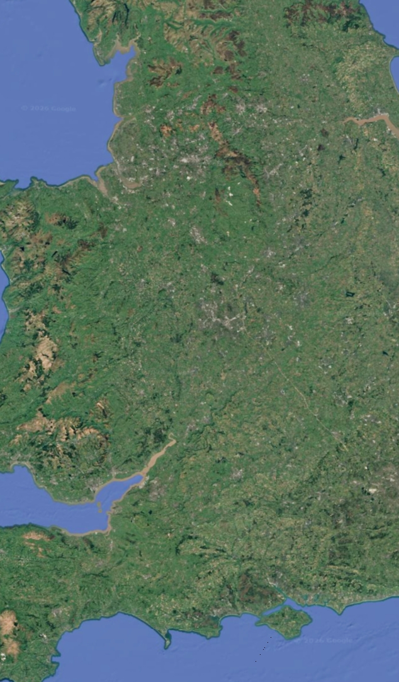
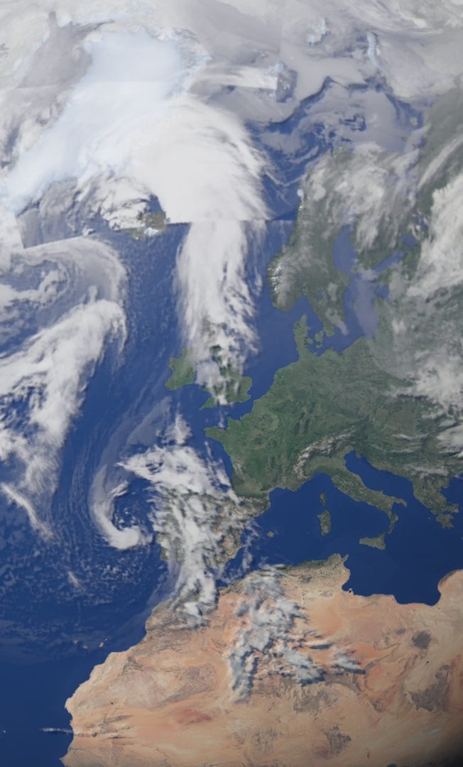
The choices we historians make about scale are consequential and controversial

Slide 4
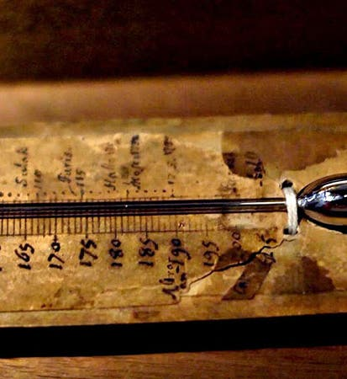
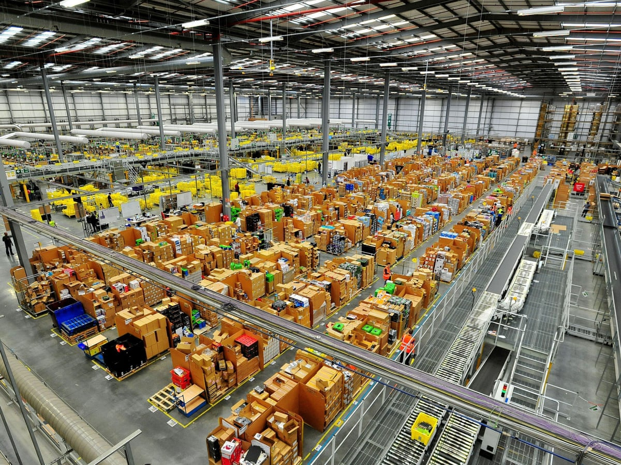
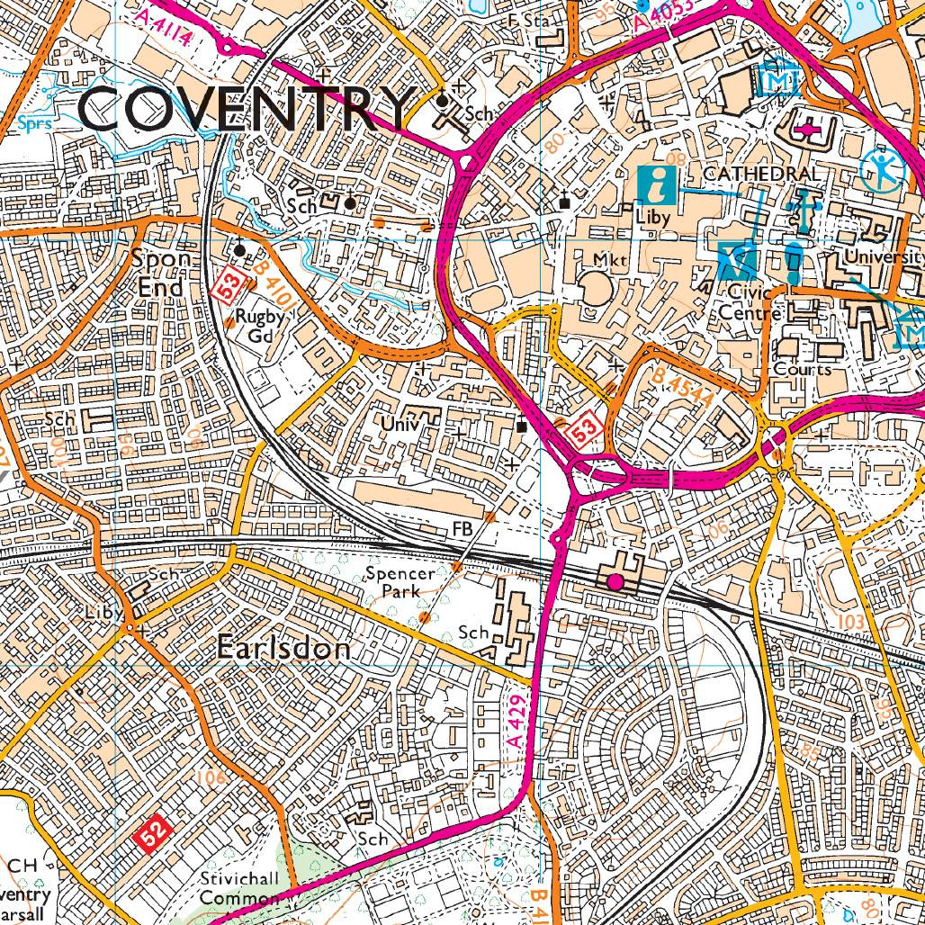
Scale and scaling: some basics
Scale =
Size (e.g., “on a massive scale”)
A graduated series (e.g., thermometric scale)
The proportion between two objects (e.g., a 1:25,000 map)

Slide 5


Scale and scaling: some basics
Scaling = moving between or bringing together distinct scales
Material entities

Slide 6
Scale and scaling: some basics
Scaling = moving between or bringing together distinct scales
Material entities
Ideas and proxies
To see a world in a grain of sand
And a heaven in a wild flower,
Hold infinity in the palm of your hand
And eternity in an hour.
William Blake, ‘Auguries of Innocence’ (c. 1803)

Slide 7
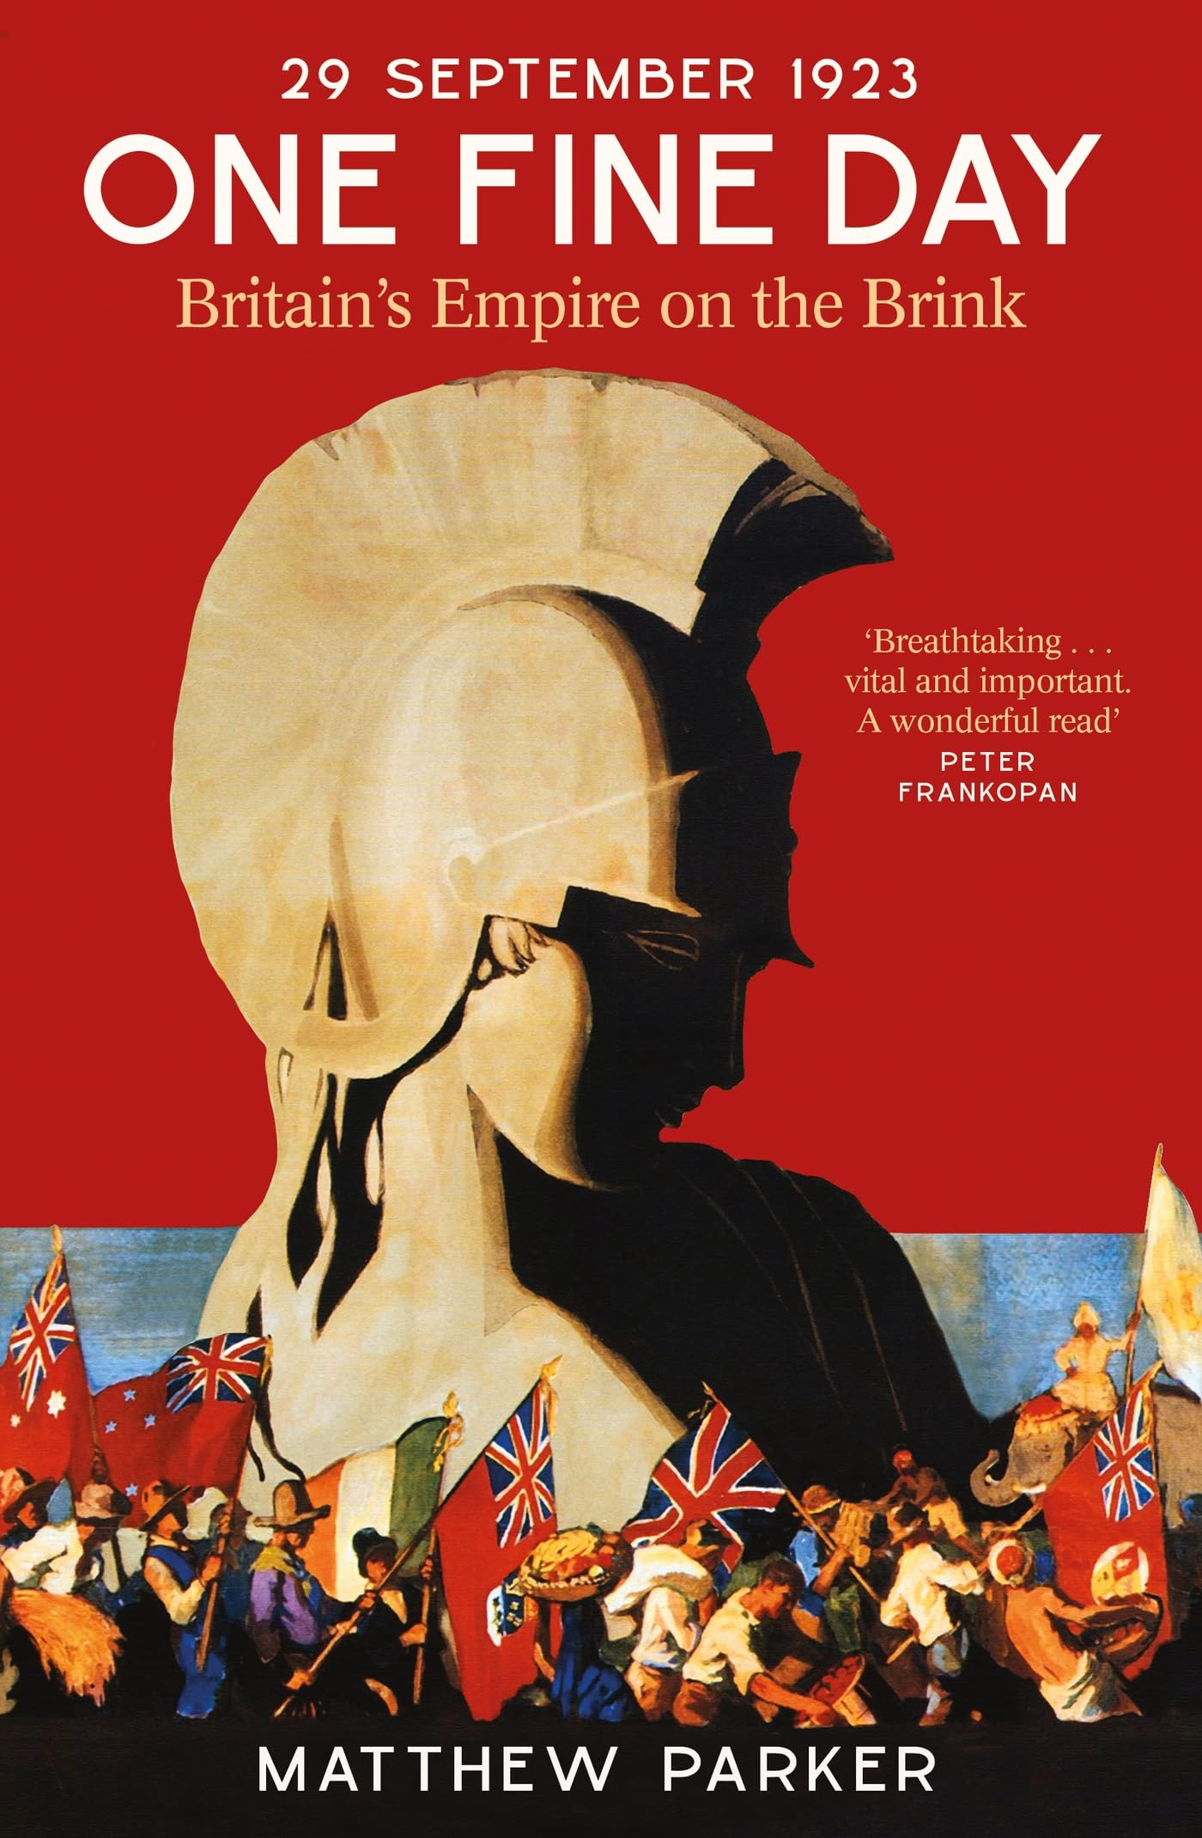
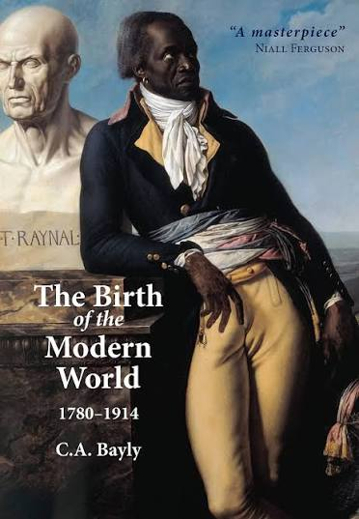
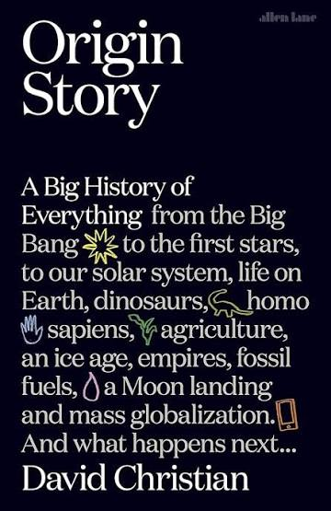
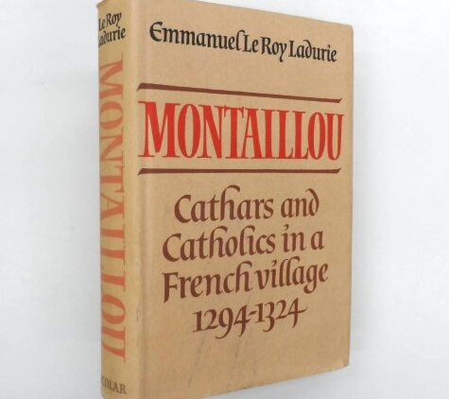
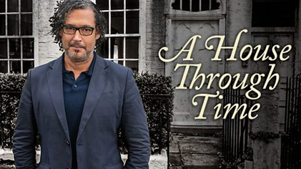
Small SPACE Large
Small TIME Large

Slide 8
The rest of the lecture
Why historians now care about scale
Big histories, small histories
Combining the big and the small
Histories of scale and scaling
What this means for you

Slide 9
Why historians now care about scale
Not an entirely new thing (as we’ll see shortly). But more explicit focus than before.
Weakening of ‘default’ scales (nation, area)
Critical work on scale in social sciences (e.g., “glocalization”, space and scale as socio-political construct)
Blurring of human history and natural/earth history (historical time entangled with deep time)
Digital history and work with larger source bases/data sets

Slide 10
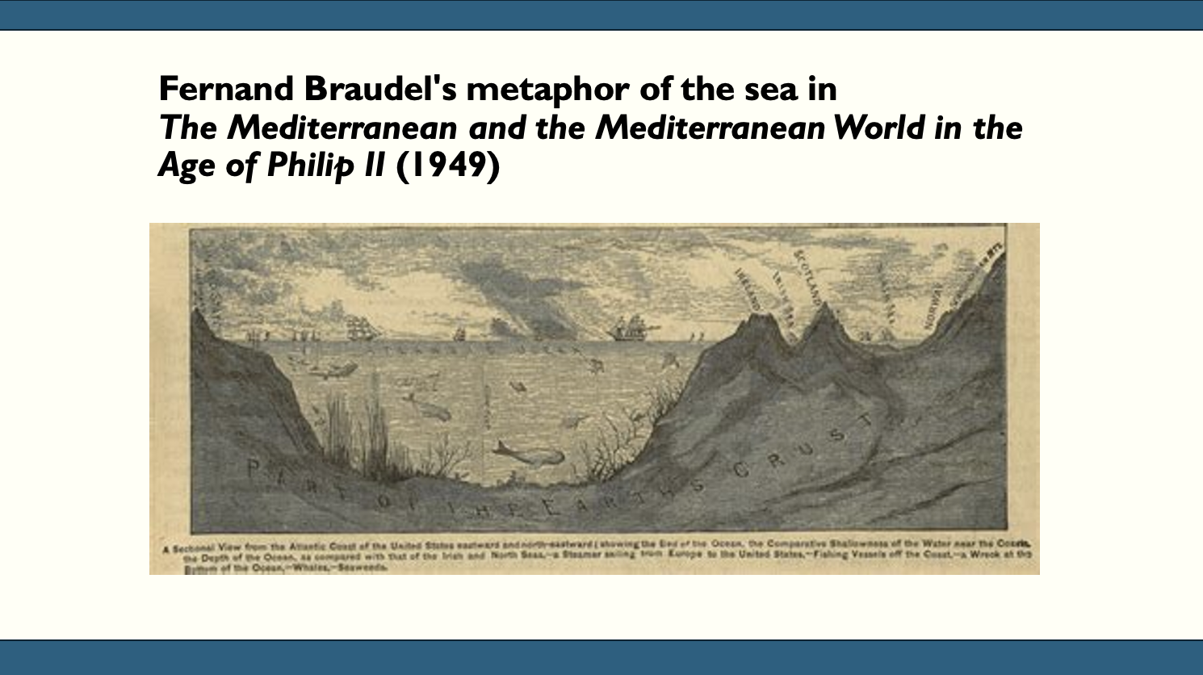
A callback to last week’s lecture on agency
‘Perhaps the day will come when we shall no longer be working on the great sites of history with the methods of small craftsmen’ (p. 18)

Slide 11
Braudel’s three levels of history
‘A history whose passage is almost imperceptible, that of man in his relation to the environment.’
‘The history of groups and groupings [...] these swelling currents [… including] economic systems , states, societies, and civilizations.’
‘Traditional history—history, one might say, on the scale not of man, but of individual men […]: surface disturbances, crests of foam that the tides of history carry on their strong backs.’
→ Environmental and economic structure over individual or group agency

Slide 12
Braudel’s three levels
‘Braudel emphatically believed that the direction of influence primarily flowed in one direction … Braudel’s world was not one in which humans could easily induce climate change on a global scale.’
Daniel Margócsy, ‘Scales: From Shipworms to the Globe and Back’, in Rethinking Global History, ed. Stefanie Gänger and Jürgen Osterhammel (Cambridge: Cambridge University Press, 2024), pp. 161–82, here p. 165

Slide 13
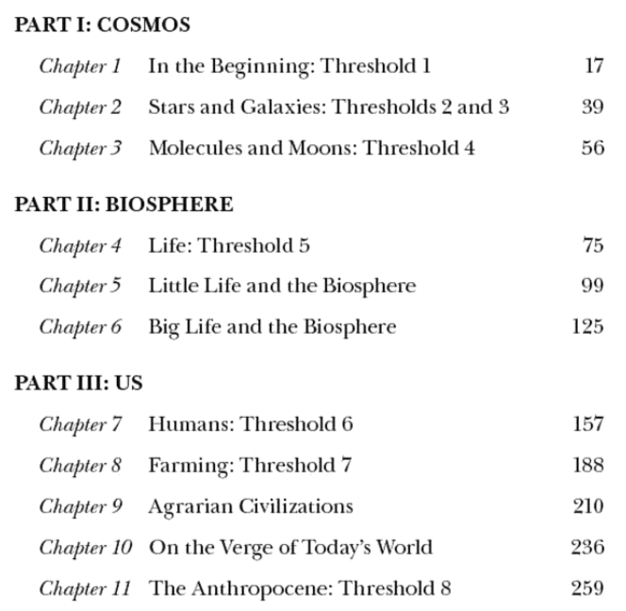

Big History

Slide 14
Big History
‘The heritage shared by all humans’ (xiii)
‘I have written this book in the optimistic belief that we moderns are not doomed to a chronic state of fragmentation and meaninglessness’ (ix)
Speaking to and influenced by post-Cold War globalization.

Slide 15
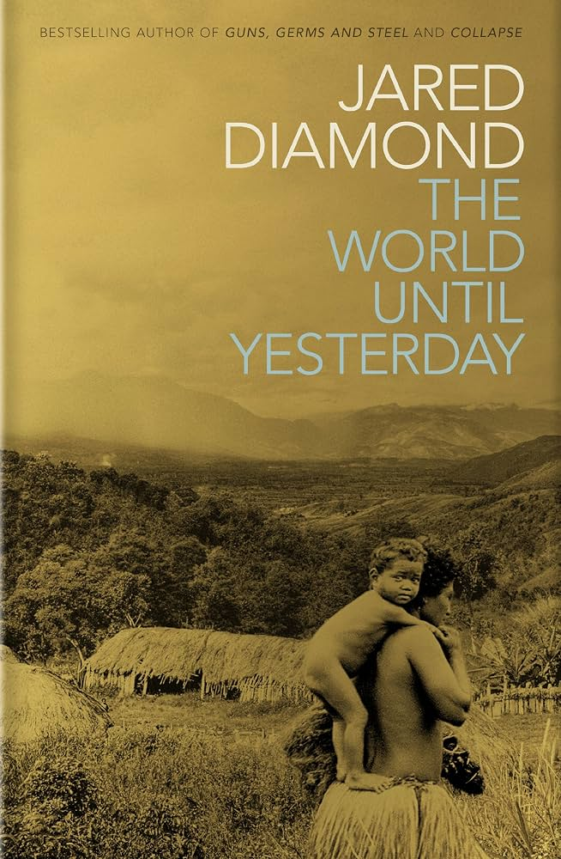
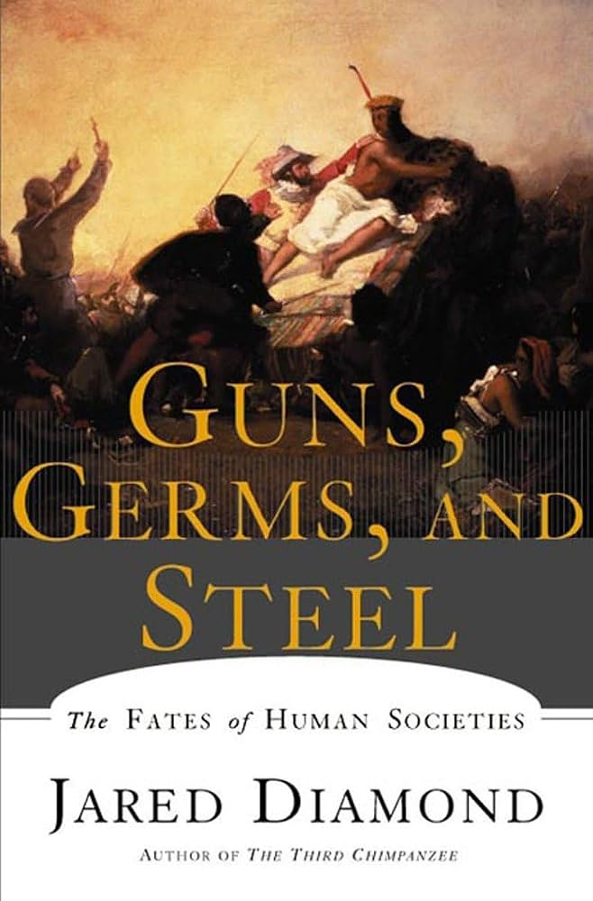
Big History
Mass-market popularity
Necessarily stretching beyond (sub-) disciplinary training
Common criticisms:
Limited grounding in primary sources (and therefore loss of nuance?)
Weakness of inductive reasoning in human affairs

Slide 16
Big History
‘Contemporary hunter-gatherer life can tell us a great deal about the world of states and empires but it can tell us nothing at all about our prehistory. We have virtually no credible evidence about the world until yesterday and, until we do, the only defensible intellectual position is to shut up.’
James C. Scott on Jared Diamond’s The World Until Yesterday, in The London Review of Books 35, 22 (21 November 2013).

Slide 17
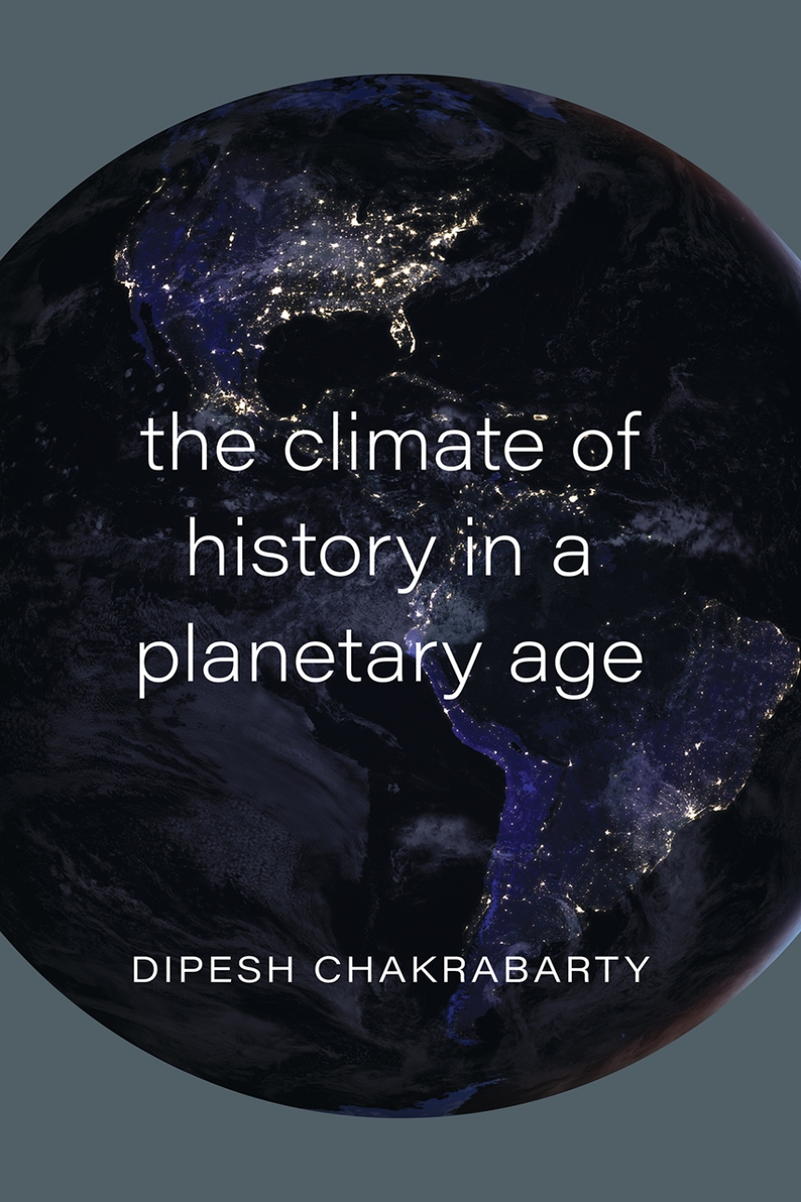
Planetary History
Completely opposed to Braudel’s idea of human relations with environment as ‘constant repetition, [...] almost timeless’.
Chakrabarty: humans have ‘emerging planetary agency’; and the changing planet in turns impacts humans.
Problem of how to deal with variability of …
Responsibility for planetary change
Local impacts of Earth System processes, e.g. climate change (see Dezateux’s article)

Slide 18
‘Perhaps the day will come when we shall no longer be working on the great sites of history with the methods of small craftsmen.’
Braudel (1949)

Slide 19
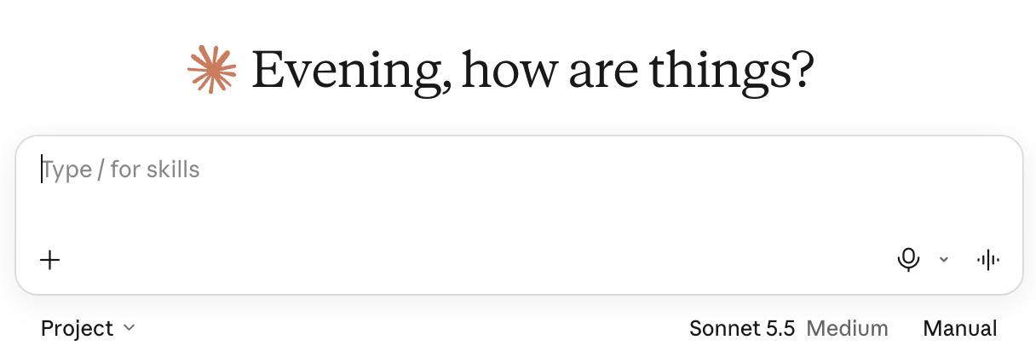

Is today that day?

Slide 20
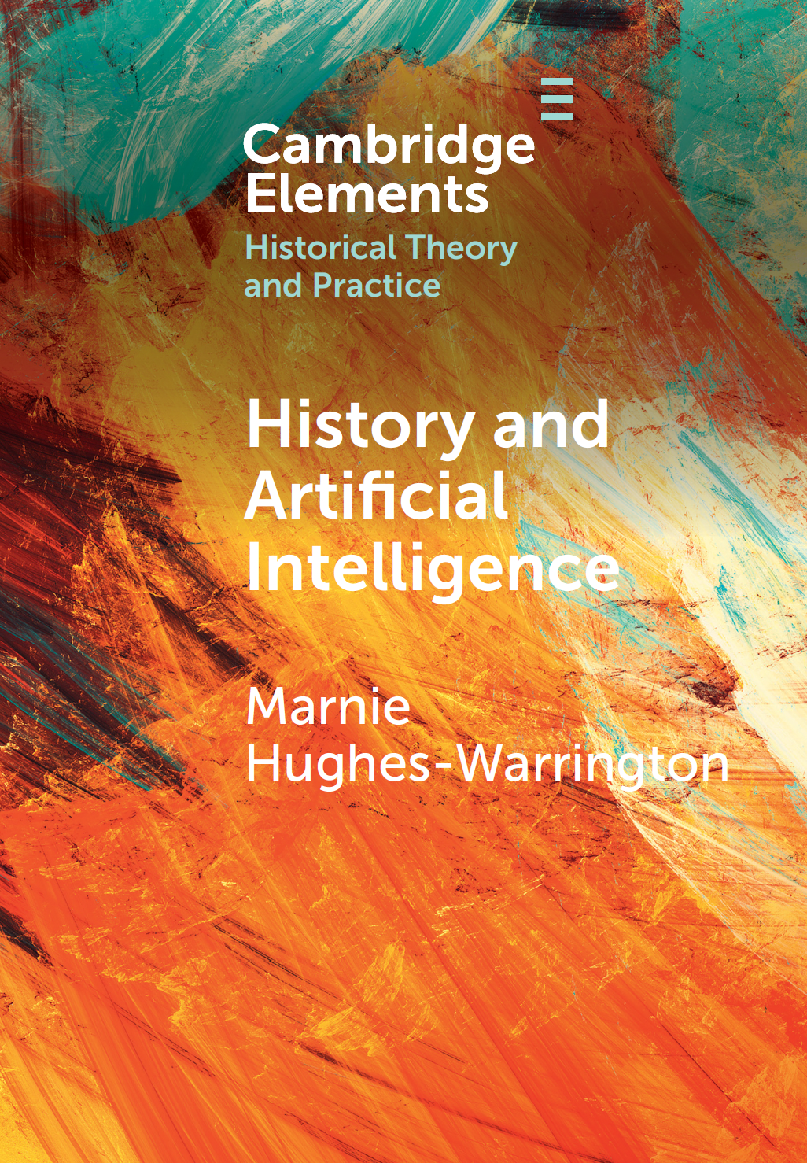
Big data and history
‘Up until now […] we have seen only glimpses of how history makers may be able to shift between small and large scales and produce works that advance our understanding of the strengths of each scales and of both in combination. AI is strengthening our sense of how this might work on account of advances in processing and analysing large volumes of data from the past’ (p. 19).

Slide 21
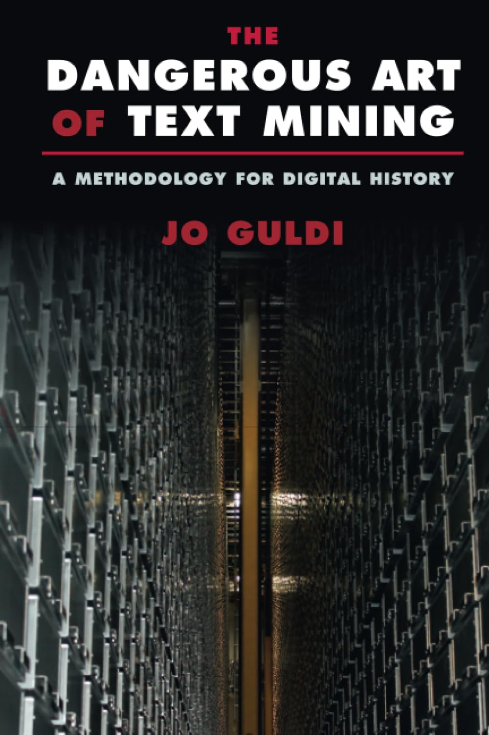
Big data and history
Bespoke A.I. tools might enable historians to perform ethically engaged tasks
Example of monitoring different institutions’ discourse on climate change (Jo Guldi)
“Auditing” how institutions’ climate commitments change over time and in response to particular events.
“Automating” the process of holding institutions to account.

Slide 22
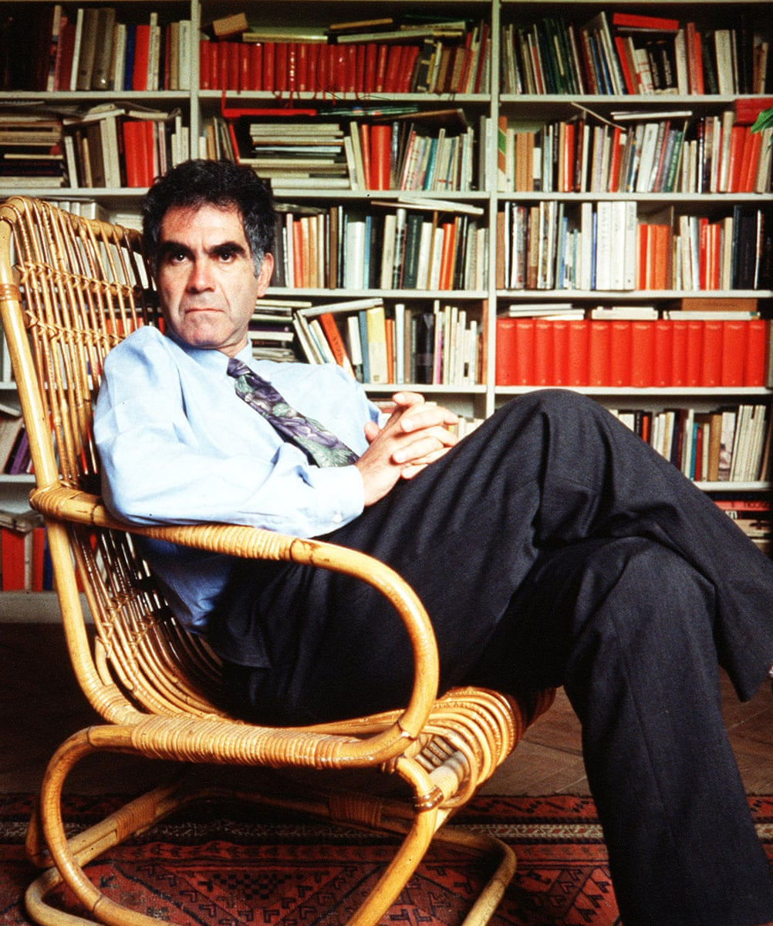
Microhistory
‘The reduction of scale suggested by the word microhistory fits in with the acknowledgement of the limits of existence.’
‘The hypotheses, the doubts, the uncertainties become part of the narration.’
‘A close-up look permits us to grasp what eludes a comprehensive viewing, and vice versa.’
Foreground the anomalies!
Carlo Ginzburg, ‘Microhistory: Two or Three Things That I Know about It’, trans. John Tedeschi & Anne C. Tedeschi, Critical Inquiry 20, 1 (1993), pp. 10–35
Carlo Ginzburg (1939–2026)

Slide 23
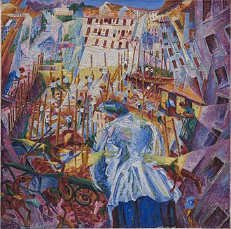
‘If this is a self-portrait, then its model is Boccioni’s paintings in which the street leads into the house, the landscape into the face, and the exterior invades the interior, the “I” is porous.’
Ginzburg, ‘Microhistory’, p. 34
→ Compare Blake’s ‘To see the world in a grain of sand’
Umberto Boccioni, ‘The Street Enters the House’ (1911)

Slide 24
Crossing scales: “interscalar vehicles”
‘Microhistorians kept on understanding scale as an organisational feature limited to humans alone. Ginzburg, for instance, considered worms only to the degree that people turned them into a cosmological metaphor, and never treated them as independent agents of history. As a result, microhistorians reduced scale to a simple binary dichotomy between the micro and the macro—a dichotomy that has persisted in the discipline ever since.’
Margoscy, ‘Scales’, p. 169

Slide 25
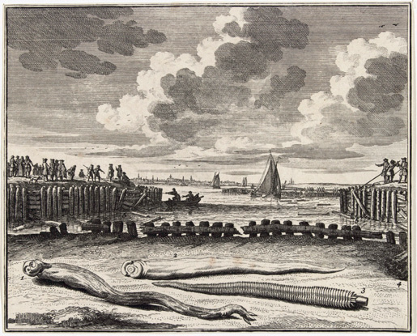
Crossing scales: “interscalar vehicles”
‘Like humans, shipworms travelled and propagated across the globe in the early modern period […] As they quickly multiplied in these new places, they were able to jump scale, destroying the wooden infrastructure of ports to an alarming degree, thereby keeping globalisation at bay.’
Margoscy, ‘Scales’, p. 181
Abraham Zeeman, ‘Paalwormen die de dijkbeschoeingen aantasten’ (1731–3)

Slide 26
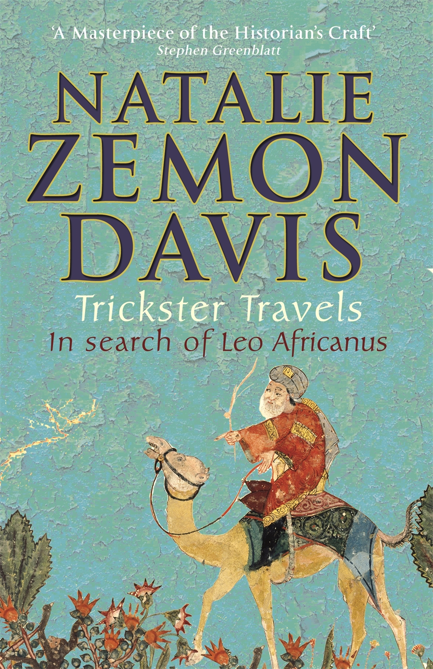

Crossing scales: Global microhistories
People (and things) that travel—the global through an individual
‘Broadly comparative → narratives’ to show large-scale influences on/ commonalities between localities and individuals

Slide 27
Histories of scale and scaling
‘What is needed is a history of scaling [… that] must attend not only to the ideas but also to tools and practices [… that] attemp[t] to situate the known world in relation to times or places that are distant, intangible, or otherwise inaccessible to direct experience.’
‘A history of scaling would […] demonstrate the flexibility of the spatial and temporal horizons of human thoughts, while also revealing what had been lost with each shift in scale.’
Deborah R. Coen, ‘Big Is a Thing of the Past: Climate Change and Methodology in the History of Ideas’, Journal of the History of Ideas 77, 2 (2016), pp. 305-21, here pp. 312–14

Slide 28
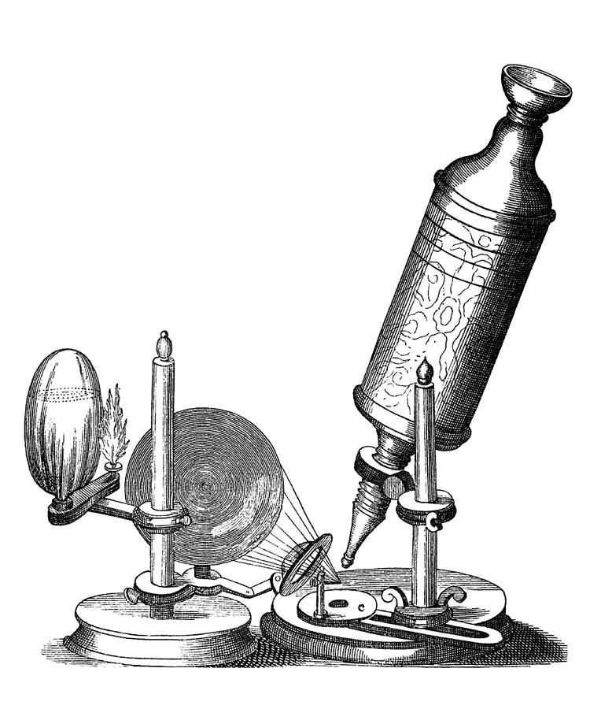
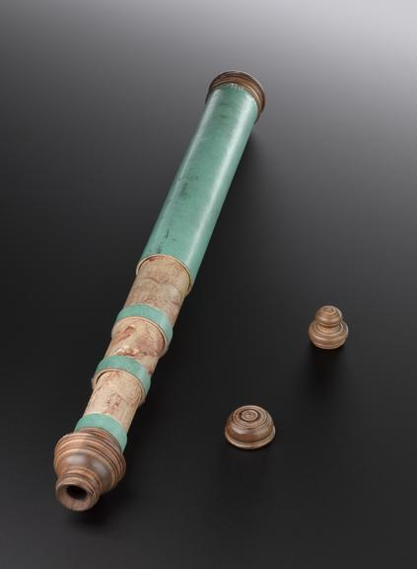
Histories of scale and scaling
Optical technologies and the ‘scientific revolution’
(Note: technologies have been defined (by e.g. Marshall McLuhan) as ‘extensions’ of human bodies in time and/or space)

Slide 29
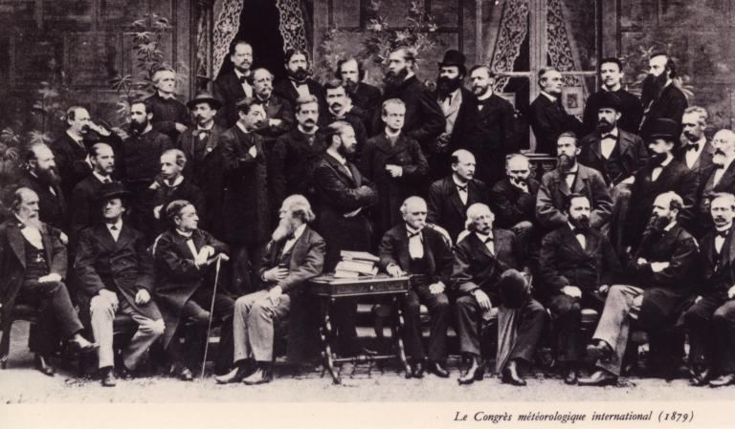
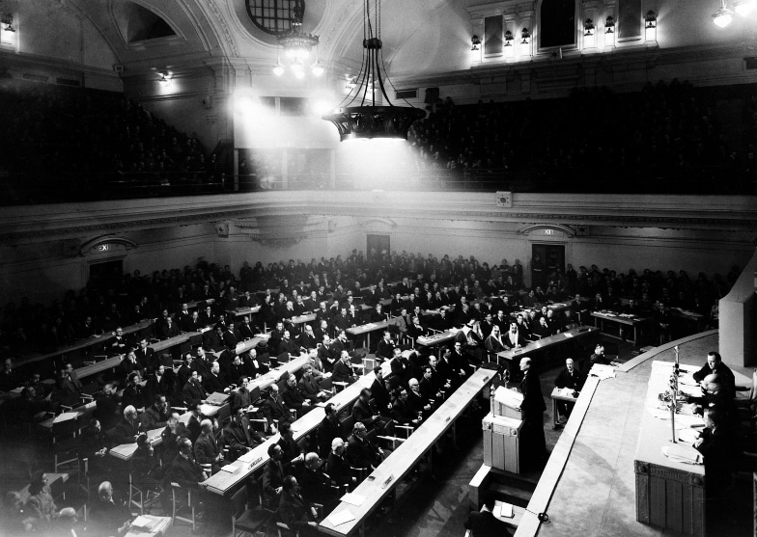
Histories of scale and scaling
Changing definitions of internationalism
Left: The International Meteorological Congress (1879, est. 1873)
Right: First meeting of the United Nations in London (1946)

Slide 30
Histories of scale and scaling
Planetary timescales:
‘Discovery’ of deep time in European sciences from the late C18 to mid-C19 → expansion of 6000-year biblical chronology
Non-Western cosmologies, e.g., Hindu conceptions of deep cyclical time

Slide 31
What this means for you
Choose your scales with care and creativity
Be constructively critical about the implicit scaling we do as historians (and people), e.g.:
  Making big claims from limited and local evidence
  Attributing individual actions and specific occurrences to large structures
Ask whether your historical subjects are thinking about, and doing things with, scale

