Slide 1
The Rise of ‘Experience’ in History Writing, 1960s-2000

Slide 2
Problem in the Present:
The inflationary use of the term ‘lived experience’ in all aspects of our daily life and history writing in Western liberal societies
Questions:
Experience is always ‘lived’, so why do we insist to add the adjective ‘lived”.
How does it differ from ‘experience’?
What do we mean by ’lived experience’ ? What effect does it have on others when we use it as part of an argument?

Slide 3
Lecture Outline
Why is human ‘experience’ central tohistory writing ?
What was the role of human experience in history writing before the second half of the 20th century? Examples Ranke and Marx/Engels, Annales School (Bloch, Febvres, Braudel)
Why and how human’ experience became central to history writing after WWII? New Social history, microhistory, new cultural history
The fate of ‘experience in poststructuralist History writing (Joan Scott)
Brief outlook: What is then ‘lived experience’?

Slide 4
Central claim of the lecture
The understanding and reconstruction of human ‘experience’ is a central theme in history writing to explain agency, knowledge, and historical change since the Enlightenment. But what historians understood as human ‘experience’ underwent dramatic changes.
The aim of understanding human experience is somehow a ‘hidden’ theme in all history writing writing. Historians use it all the time, but what it exactly and what analytical role it plays in their narrative remains often ill defined. Is it individual experience or collective experieces? Are bodily experiences included? What are the forces that produce individual and collective experience?
How do historians reconstruct the relationship between individual and collective human experience? And, what sources (written, material, visual or oral) allow the historian to claim that they can understand past human experiences, which they didn’t share? Are past experiences entirely ‘different’ from today or are there communalities between past and present human experiences? Are there areas in history writing which do not deal with human experience (e.g. history of science (physics, mathematics, earth sciences) or are such areas of history writing also based on human experiences, packaged in the language of science?

Slide 5
What is ‘Experience’
‘Experience remains one of most obscure concept we have.’
(Martin Jay, Songs of Experience, p. 2)
Why does it remain obscure?
The term is used in everyday language (e.g. the almost inflationary use of ‘lived experience’ today in the English-speaking world). The meaning of ‘experience’ changes simply by its daily usage.
The term is also the focus of endless philosophical investigation since Antiquity because it stands at the core of the biggest questions of all: What does it mean to be human, and its close links to human knowledge.
Different languages uses different terminology. The English term ‘experience’ is not easily translatable into many other European language such as German, French, Italian, Spanish, Hungarian, Polish, Russian etc.
These languages use not only different terms (German: Erfahrung, Erlebnis).
These different terms are also connected to often very different philosophical
systems developed in these languages, trying to understand the human
condition and human knowledge.

Slide 6
What ‘hides’ behind the English term ‘experience’ and its links to ‘knowledge’ and ‘knowing something’
A.
Past experience, accumulated knowledge
1. Experiences in the past that gave you knowledge of something in the past – often accumulative
2. You experienced doing something in the past using that knowledge – you add to your existing
3. You observed something and use your past accumulated knowledge to understand it
4. Past bodily experiences
B.
Current experience
4. Your experience of a place in time
5. You experience something by observing or doing something
6. Your record your experiences while you have them
7. Your bodily reactions to what you are currently experiencing
Of course, in real life, none of these separate aspects of ‘experience’ occur in isolation. And there are even more aspects….
And what about ‘collective experiences’? How do these link to individual perception, knowledge, feelings in the past and present?

Slide 7
Central iquestions of the lecture
So, what do historians mean when the use the term ‘experience’ (or ‘lived experience’? What aspects of human experience are they engaging with? All? A ‘total history’ of human experiences in the past? Again, what do their sources tell them – and not – about human experience in the past?
And how do historians suggest that we get at ‘experiences’? What do they tell us about the origin of experience, how they
create human agency and knowledge, and historical change?

Slide 8
Central Claim
What historians value as important experiences underlay their approach to history writing,
the topics they choose, the methods and theories, they select and the source they consider meaningful.
Their understanding of ‘experience’ guides their understanding of human agency, knowledge, and historical change.
These understandings of experience changed over time.

Slide 9
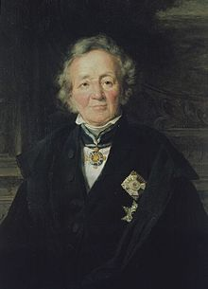
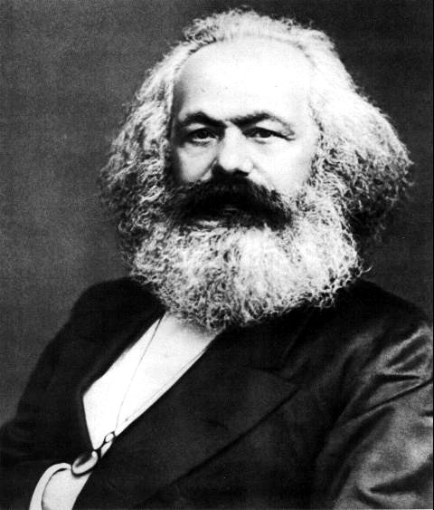
‘Human experience’ and ideas about human agency, knowledge, and historical change in some forms of history writing before the mid-20th-century
Leopold von Ranke, 1795-1886
Karl Marx, 1818-1883

Slide 10
Leopold von Ranke
Human ‘experience’ was granted to humans by Providence; humans simply ‘have’ it and act accordingly.
,
Individual and collective human agency and historical change were grounded in ‘spirit of a time’, governed by God’s will.
The Historian’s job is to empirically collects the traces God left for them (written political documents, male, European)
It is the historian’s ‘divine’ job to immerse himself into these collected ‘facts’ and – with God’s help – intuitively grasp the unique spirit of the time (‘divine’ the past).
‘Every epoch is immediate to God, and its worth is not at all based on what derives from it but rests in its own existence, in its own self’
‘Every human being, something eternal, comes from God, and this is a vital principle.’
‘It is not necessary for us to prove at length that the eternal dwells in the individual. This is the religious foundation in which our efforts rest. We believe that there is nothing without God, and nothing lives except through God.’

Slide 11
Marx and Experience on human experience
‘Historical materialism’ its stage of history
Communism
Society free of class
Socialism
Dictatorship of the Proletariat
SOCIALIST REVOLUTION
Expropriation of Expropriators
Capitalism
Bourgeoisie against Proletariat
Feudalism
Feudal lords against Peasants
Slaveholder Society
Slaveholders against Slaves
Primitive Communism
Hunter-gatherer societies

Slide 12
Any ‘experience’ (and any human knowledge or practices) -- Marx/Engels call it ’consciousness -- are not ‘authentic’ but a form of human ‘alienation’

Slide 13

Superstructure:
Superstructure:
comprises the cultural, ideological, political, legal, and social institutions (like governmental agencies, culture, family, or religion, ideology, etc.) that are shaped and determined by the economic base (the mode of production and class relations). The superstructure's primary function is to reproduce and legitimize the interests of the ruling class by promoting ideologies that obscure class conflict and maintain the existing power structure.
Societies in each stage of historical development are organized from ‘the bottom up’. All human ‘experiences’ – expressed in the superstructure -- are grounded in the forces of production/relations of production!
The ruling classes create ‘experiences’
for all to keep themselves in power – ‘experiences’ are NOT authentic
but a form of alienation
Relations of Production
Relations of production: the social relationships that emerge between people during the process of production, distribution, and exchange of material wealth.
Class: class is defined by a person’s/groups relationship to the forces of production—either owning them or selling their labour to survive (in capitalism: proletaria -
bourgeoisie)
Forces of Production
Forces and means of production: These are the tools, technology, and raw materials society uses to produce goods, as well as the collective labour and knowledge of the laboring people.

Slide 14
The overarching aim of Marx/Engels is ‘human freedom’
‘Men make their own history! And all human ‘thinking’ is the outcome of their active real lives!’
‘The philosophers have only interpreted the world in various ways; the point, however, is to change it’
They do not aim to make all human experiences the same or all humans ‘the same’! They wish to make people rationally aware of their situation in life and the alienated state of their experiences. United by class consciousness they can understand their own suppression in which they are kept by the superstructure. But they can take rational decisions and collective steps to free themselves and their experiences.
The key to freedom of humankind is labor; meaningful labor allows human
potential to be actualized

Slide 15
Summary
Ranke and Marx’ ‘experience’ (simplified overview on agency, knowledge, and historical change)
Experience is not individual daily experience produced through thinking or practice. Human ‘experience’ is ‘given’ in a specific historical period.
Experience is organized by a hidden ‘force’ or ‘structure that drives human agency, knowledge and historical change
Ranke:
humans/historians are fulfilling God’s will
all human activity and historical change are predestined
historians’ job is to reconstruct the will of God in the past by collecting human produced ‘facts’ (inherent to each fact is God’s will); historians are doing a ‘divine’ job.
He rejects the idea of progressive stages of history because all periods and all human beings are by definition equal
to an omnipotent God.
Marx/Engels:
Human experiences is structured by material forces of production which give rise to human ‘experience’;
in capitalism humans are alienated from what their true human experiences are and kept in ‘alienation’ from themselves. (Today’s ‘lived experience, Marx/Engels would argue, is to be treated with utmost suspicion!)
By understanding what keeps them alienated humans and gaining ‘class consciousness, oppressed classes can gain control and overthrow those who keep them in alienation.

Slide 16
French Annales School and Human Experience: 1930s to 1960s
(Bloch, Febvres, Braudel)
Founded as a reaction to domineering Rankean academic historiography (focused on elite politics and nationalism) as well as Historical Materialism.
Focus on collective experience of non-elites, long-term collective social and environmental forces, shaping human collective mentalities. Downplaying of individual action and experience in favor of the collective (inspired by the sociology of Emile Durckheim).
Problem: Bloch realizes before his death in 1944 that the rise of fascism in Europe at this own time could not be explained by the Annales agenda!

Slide 17
Some of the concepts by which Annales Scholars tried to trace this ‘collective’ experiences in history
Histoire totale / “total history”: the discipline of history needs to integrate insights from other disciplines (social sciences and natural sciences); attempt to achieve as “complete” a treatment of a historical problem as possible from all available knowledges produced in the present.
Scientific history: trust in the experimental approaches of the modern ‘natural sciences’ , including experimental psychology. Natural science is truth and its data gets us there!
Longue durée / “long run”: associated with innovative new ways of thinking about historical time in relation to space. Primacy of long-term environmental change, medium term changes such as economic cycles, downplaying of human-produced ‘events’ (e.g. Braudel’s three-parted idea of historical time and change (scale)).
Mentalités/mentalities: concept of mentalités (French for ‘mentalities’ or ‘attitudes’), which involves the study of a collective mindset, worldview, feelings, as well as unconscious attitudes of a specific group of people in a particular historical period. (Reliance on experimental psychology of their time)

Slide 18
The Fate of Experience after WWII
Existing traditions in history writing and their dealings with ‘experience’ were seriously challenged
The experiences of WWII: leads to a wider questioning of ‘what it means to be human’ which had been grounded in the Enlightenment and its ‘grand narrative’: Human are driven by reason and rationality (not emotions), celebration of technological and scientific progress leading to freedom and equality of all. The trust in human rationality as the basis of human equality and freedom becomes suspicious. Some even claim that Western obsession with reason and rationality allowed ‘fascism’ to emerge and unfold its destructive powers (e.g. Adorno/Horckheimer, Dialectic of the Enlightenment, 1944).
End of European empires (note: postwar period is the rise of the US global empire); non-European culture can no longer be treated in history as ‘uncivilised subjects’ of a civilised European Empire.
Beginning of Cold War; battle of ideologies over ‘experience’: socialist collective experience – liberal democratic individualised experience organized in a welfare state?
Rise of unprecedented ‘consumer capitalism’ and new mass media (TV) in the Western liberal democracies; focus on individual ‘wants’ (rather than individual and collective ‘needs’). Rise of what contemporaries called ‘the experience society.
The traditional understanding of human ‘experience’ in history writing won’t do any longer to understand this dramatically different world.

Slide 19
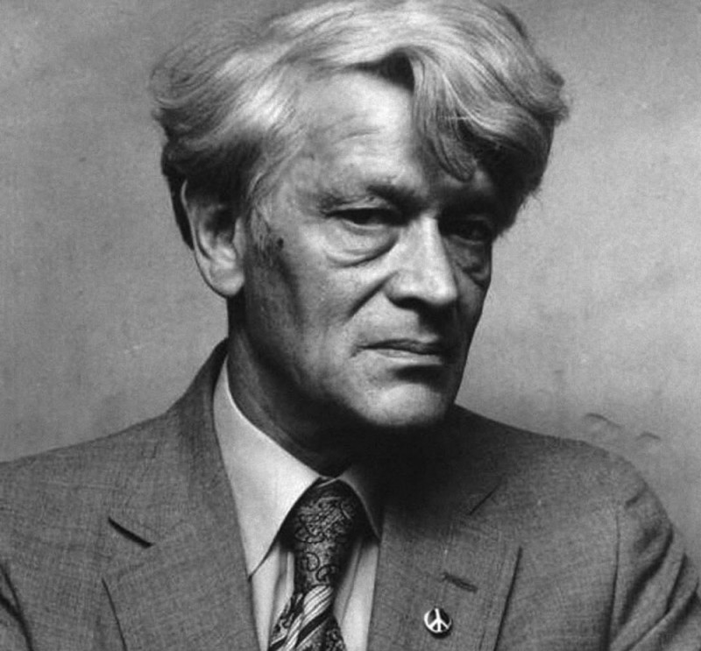

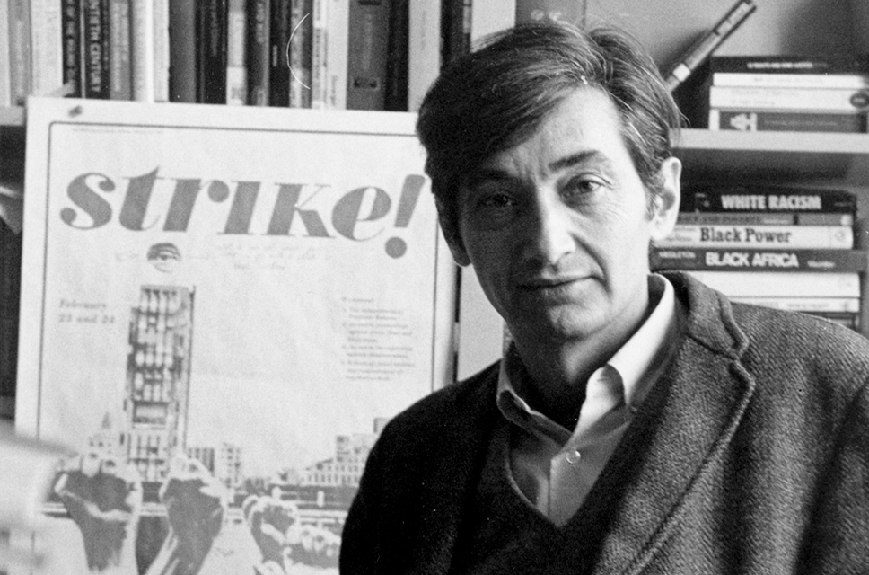
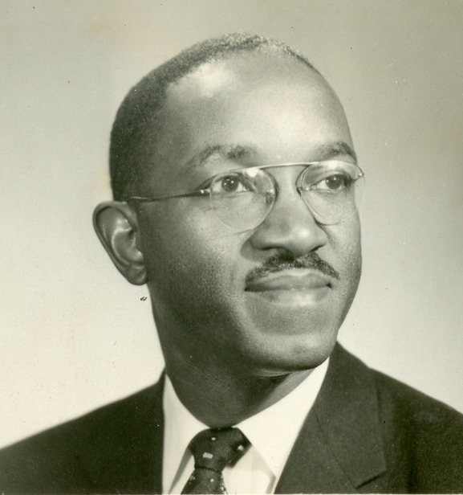
The turn to ‘ordinary experience’ in 1960s/70s: ‘history from below’, ‘everyday history’, 2nd wave feminism, subaltern history, and black history
Inspired by civic rights movements and Cold War geopolitical events, new wars, and the rising of concern for environmental issues, historians turned their attention to ‘the forgotten’ masses of men and women. Their everyday life, however mundane, was taken to be a worthy subject of historical inquiry. Their ‘experiences’ become central to young historians who considered themselves ‘political activists’.
‘Experience’ remains to be understood within leftist, (neo)-Marxist conceptions of power, agency and historical change (Revolutions to overthrow capitalistic systems, preventing human freedom and equality)
History writing is understood as a political act of resistance, an expression of rational political will to foster human freedom/equality.

Slide 20
Suppressed groups in the present required a ‘history’ to be able to claim ownership of their experience
By offering those without a history a ‘history of their experiences in the past’, the historian politically empowered oppressed groups in postwar Western society and gave them an important tool to free themselves. Human agency is understood as ‘collective’; historical change through revolution.
Examples we talked about in this module:
2nd wave feminism insists on ‘the personal is political’: opens new areas of female experience in history, domestic life and family, motherhood, women’s work outside the home, women’s political and intellectual activities, and female sexuality. Women gain access to universities for the first time.
Subaltern history aims to ‘read against the grain’ of imperial archives to retrieve the voices of those oppressed by British rule. How to make the ‘subaltern’ speak?
Black history in the US aims to make the experiences of American slavery and US black community visible. History as a revolutionary tool for the political struggle for equality.

Slide 21
‘Experience’ and Micro-History
Micro-history is rooted roots in ‘the histories of everyday live’ and ‘history of below’ and their leftists/Marxist political agenda. It is directed against:
traditional Marxist historiography which focusses on the masses not the individua experiences; fixated on scientific data; non- narrative style.
against the overwhelming dominance of the Annales School in Italian history writing at the time and its ’collective’ approach to human experience. Ginzburg & Co believed that the individual experienced of the lower classes needed to be ‘rescued’ from traditional Marxist historiography and the Annales School.
The focus of microhistory becomes the individual within its social cultural and political environment (Ginzburg’s miller Menocchio).
Questions which arose and are still debated:
do these individual experiences, often minutely reconstructed, represent wider ‘experiences’ at the time? Can this one experience be ever representative of the experiences of others at the time?
What aspects of ‘experience’ is microhistory reconstructing? Ginzburg only reconstructs the miller’s intellectual world not his daily practice, for example.
Historical change: Microhistory is focused on a particular moment in time (synchronic approach) and offers no answers to how historical change does occur (diachronic approach).

Slide 22
The New Cultural History: ‘Making Meaning’ of Experiences
‘the Anthropological Turn” (1980s/90s)
Emerges in the course of the 1980;1990s in the US ; fundamentally shaped by theories and methods in cultural and symbolic anthropology. Wider context: a radically changing social-cultural, political and economic society in the US, celebrating new values and norms: individual choice, global consumerism, competition over social cohesion, social/political consensus and collectivism. Rise of identity politics.
Experience are no longer understood in the framework of neo-Marxistm. In fact, the question of power (who has it; what does it do; who is suppressed) becomes secondary for cultural historians; the idea of history writing as a ‘political act’ to created societal change and the historian as a fighter for freedom and equality is getting lost.
Increasingly focus on experiences of members of the middling classes (no longer the suppressed or marginalized in past societies)
Method: history is likened to anthropological fieldwork’; the historian as the ‘observer’ of past human experiences in the archive. The past is ‘a foreign land’; historians are the anthropologist of the past!
  Focus on ‘symbolic’, extraordinary, surprising and weird dimensions of human actions and experience; aim is to show that the past is utterly ‘different’ from the present and that there is not only one interpretation (e.g. Darnton’s Cat Massacre; or Davies’ Martin Guerre).
  ‘Thick description’: History writing is ‘making-meaning’ of collected past experiences.
Important: New cultural historians are keen to bring in their own ‘experiences’ into the writing of their histories!

Slide 23
Recap
While historians inspired by the new cultural history tend to highlight the ‘differences’ of human experiences in the past, they remain committed to the following fundamental beliefs:
Today’s historians can get at the ‘experiences’ of the past – but they do not ‘own’ the past, they ‘make-meaning’ of it.
While it is admitted that the past is ‘different’ from the present (and so are human ‘experiences’), they do believe that such experiences are couched in some sort of ‘reality’ of the past. Empirical work gets historians to reality-based experiences.
While they reject the idea of writing an ‘objective’ history, the insist that historian can carefully reconstruct their experiences or at least offer a truthful ‘representation’ of human experience within the specific historical context.
In sum: the term ‘experience’ is used all the time, but what it actually means remains unclear. While historians reconstruct the experiences of the past, they are taking their own experiences more or less for granted. Also, how to explain change?
These certainties are going to be shattered by the 1990s and the impact of the ‘linguistic turn’
Experience will never be the same!

Slide 24
The ‘;inguistic turn’ and its attack on ‘experience’
Definition reminder
The term was first used by the American philosopher Richard Rorty in an edited volume, entitled The Linguistic Turn (1967).
At its core stands a new focus in academia after WWII on the relationship between language, language users, and the world – perceived through human ‘experience’ and expressed through language.
The ‘linguistic turn’ is rooted in philosophy and literature studies/literary criticism and later spreads to other subjects in the humanities. Its most radical versions emerged in postwar France philosophy/semiotics. These theories only ‘travelled’ to the Anglo-American world during the 1980s. By the 1990s ‘’poststructuralism’ or ‘deconstructionism’ also hits the discipline of history!

Slide 25
Joan Scott on the reasons for writing ‘On the Evidence of Experience’ (1992)
‘My paper on ‘Experience’ was influenced by what I had been reading in the Pembroke seminar. It was written in direct response to an article in the American Historical Review by an intellectual historian called John Toews. My article embodied my growing impatience with my fellow social historians who assumed that experience was transparent, that there was a direct relationship between, say, economic circumstances and political action, that there was no need to ask what counted as experience – we could know what that was from a sociological description of the conditions of life of groups and individuals.
The telling point in Toews' article was the absence of any definition of the term experience – he assumed we all knew what it meant. My readings of Foucault, Derrida, Freud, Lacan, Irigaray and others had led me to doubt that words like experience were self-evident; the point was to ask what kind of work they were doing, how they were establishing meaning, how some things and not others came to be included in the term.
When ‘experience’ was alluded to by historians what did they mean by the term? What were they including and excluding? How were they measuring the impact of ‘experience’ on the psyches of individuals? How did an appeal to a communality of experience create a sense of membership in a group?
These were the kinds of questions that seemed to me to be left aside when the meaning of experience was taken to be known by historians.’
Hesford, Victoria, and Lisa Diedrich, ‘On ‘The evidence of experience’ and its reverberations: An interview with Joan W. Scott’, Feminist Theory, 15, 2 (2014): 197-207; the article of John Toews, ‘Intellectual History after the Linguistic Turn: The Autonomy of Meaning and the Irreducibility of Experience’, American Historical Review 92,4 (1987)

Slide 26
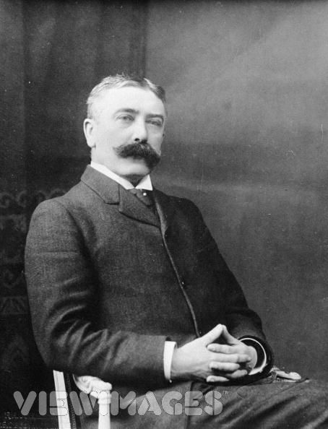
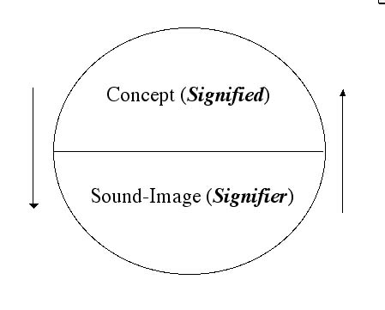
What theoretical thinking did inspire Joan Scott?
1. A specific linguistic understanding of language based on the sign/signifier theory of Ferdinand Saussure
Languages are not confined to words but include any system of communication that uses ’signs’ (traffic signs, sign language).
A sign is composed of a ‘signifier’ (vocal sound, image, gesture) and a‘signified’ (the mental concept that speaker and listener share).
The mental concept/structure (signified’ precedes the ‘signifier’ in existence (according to Saussure) It is the hidden ‘structure’ of and that is what ‘structuralists’ follow (and what later poststructuralists such as Scott undermine)
The relationship between ‘signifier/signified’ is established arbitrarily. and bears no resemblance to the’ signified’ (different language use different ‘signifiers’ for the same mental images)
Every sign acquires meaning only by belonging to a network of other signs. There is in every sign a suggestion of another, oppositional sign (binary relations: women/man; child/adult; animal/human etc.)

Slide 27
Significance of these claims:
Relationship to knowledge becomes uncertain by undermining the connection between a ‘word’ (signifier) and a ‘thing’ (signified) with no relation to the real thing. ‘Meaning’ and ‘sign’ are separated.
The notion of arbitrariness of the sign deeply challenged the correspondence theory of truth: if words relate only to each other within an own structure, how could language be deemed to refer to the world out there? And how would historians argue that their discourse about the past matched up with ‘what really happened’ as Ranke, for example, had famously argued?
During the ‘linguistic turn’ Saussure’s ideas about language were applied to wider human culture (politics, social life etc.)

Slide 28
What are the consequences for the understanding of human experience and knowledge?
The reality of any human experience is NOT representable in any form of human culture (whether written, spoken, visual or dramatic) – there is no authenticity in any human experience
Because ‘reality’ of experience is not representable in any form, no authoritative account can exist of anything.
Nobody (including historians) can make claims of possessing a ‘universal’ truth of anything, particularly human experience. There is never a single authority on a given subject of knowledge, such as human experience.

Slide 29
2. Another inspiration for Joan Scott is Michel Foucault’s theory of knowledge/power: key ideas
Based on Saussure’s theory of language, Foucault argued that any human ‘experience’ and the knowledge that arises from such experiences – including scientific knowledge about bodily experiences, for example – are strictly historical. There are no universal human experiences that connect the past with the present!
No knowledge (and no human experience) can ever claim to be neutral. There is no authentic experiences that creates neutral, universal and transhistorical knowledge. No experience and knowledge can therefore be authoritative (He was particularly interested in debunking such claims made by the biological sciences and medicine of his time in regard to the human body
All knowledge (arising from human experiences and expressed through language) is always shot through with power. Power produces knowledge (like medicine, psychiatry) that justifies and reinforces existing power structures. It is not always repressive – as Marxism suggested – but often pleasurable (e.g. social media). Knowledge, in turn, creates new forms of control, discipline, and regulations through institutions (prisons, schools, universities, hospitals etc.), shaping individuals' bodies, minds, and behaviours.

Slide 30
Foucault’s History of the Present
He suggests that historians must become acutely aware of the knowledge/power nexus that underlies their very own experiences (and the knowledge/power nexus) in the present. They must see their own experiences as a ‘problem’ not as ’authentic’ representations of reality.
Historians must investigate the changing meanings of concepts or practices which they they take for ‘granted’ and ‘normal’. There is no straightforward line from the past to the present.
Joan Scott founds a journal, dedicated to Foucault’s aims: History of the Present

Slide 31
What does Scott say about ‘experience’ then is a total turn upon the categories of early 1970s’ feminism
who had searched for women’s ‘authentic’ experiences
‘…We need to attend to the historical processes that, through discourse, position subjects and
produced their experiences. It is not individuals who have experience but subjects who are constituted through experience’.
(Scott, Experience, 779)
Turning against older feminist idea of ‘female authenticity’ of experience she says it would more sense to teach students
‘ ‘To makes more sense to each out students and tell ourselves that identities are historically conferred,
The the conferral is ambiguous (…), that subjects are produced through multiple identifications; some
become politically salient for a time in certain contexts, and that the project of history is not to reify
identity but to understand its production as an ongoing process of differentiation, relentless in its
Repetition but also subject to redefinition and change.’
‘

Slide 32
Well, what is experience then, according to Scott?
She doesn’t say! She says we cannot really do without the concept of ‘experience’. Like all poststructuralist
she says it is important as a sort of structure – otherwise we couldn’t communicate as humans. But she
insists that such structure need to be not understood as universal or transhistorical.
Any historical research has to start with the deconstruction of the historians own experience.
Interestingly, she doesn’t put her own experiences in the wider political, social-cultural and economic context of
her own time. US society and also academia was undergoing massive changes.
She doesn’t do what F. asked her to do: Why do I think the way I think about experience in 1991?
What about historian change? Can historians still explain it when experiences are all individualized and constantly
deconstructed and only be understood in relation to other experiences?
Read her own reflections on these matters in her interview from 2014: Hesford, Victoria, and Lisa Diedrich, ‘On ‘The
Evidence of Experience’ and Its Reverberations: An interview with Joan W. Scott’, Feminist Theory, 15, 2 (2014): 197-207

Slide 33
So what is ‘lived experience’ then today?
We’ll see in the lecture on emotions in week 3

