Slide 1
Causality
Dr Claudia Stein

Slide 2
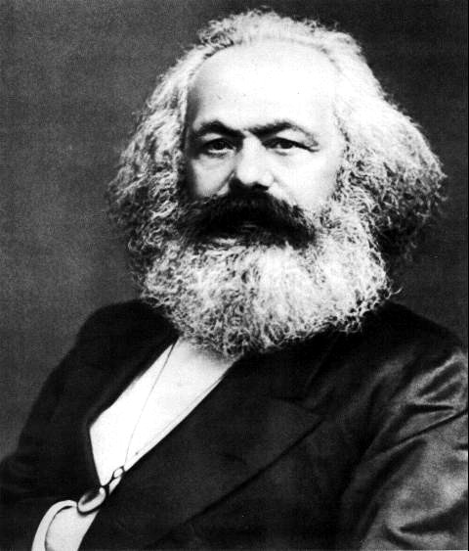
Marx work as a philosopher, political theorist, political economist, journalist and revolutionary socialist shaped the modern world.
Marx’ ‘historical materialism’ were not simply a theory of society and historical change. It also did change the world.
And his ideas about the causes of historical change continue to inspire.
2015 ‘The Communist Manifesto’ was the bestselling book worldwide.
Karl Marx, 1818-1883

Slide 3
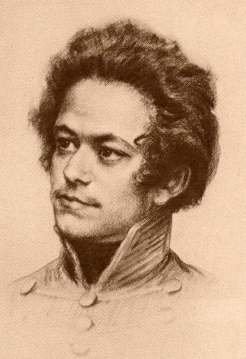
Marx’s Life
1818-35: childhood and early youth in a liberal bourgeois merchant family in Trier (assimilated Jewish family, he was raised in protestant faith. Exposed to Enlightenment, Romantic, liberal and radical world-views through family and acquaintances.
Engagement with Jenny von Westphalen who was older and of aristocratic background.
1835-36: University of Bonn. Heavy drinking, gambling, etc. – father intervenes to move him to Berlin.
1836-42: University of Berlin. Develops wide range of intellectual interests: jurisprudence, history, and especially philosophy. Involved in ‘Left-Hegelian’ circles.
1842-49: Cologne, Paris, Brussels, Paris, Cologne, Paris. Years of revolution and counter-revolution: for Marx, constant political exile and flight. Years of intense political agitation, radical political journalism (heavily censored). Marx begins studying political economy. Develops lifelong friendship with Friedrich Engels (son of wealthy manufacturer).
1849-1883: London.

Slide 4
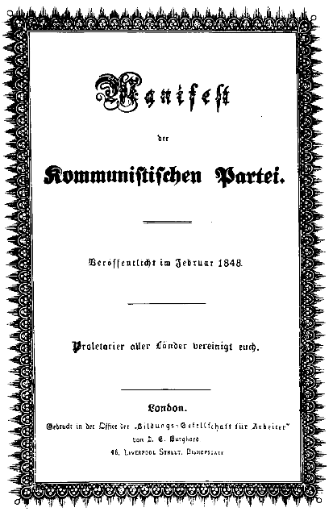
Marxism - an activist ideology
‘The philosophers have only interpreted the world in various ways; the point, however, is to change it.’
All previous historical movements were movements of minorities, or in the interest of minorities. The proletariat movement is the self-conscious, independent movement of the immense majority, in the interest of the immense majority

Slide 5
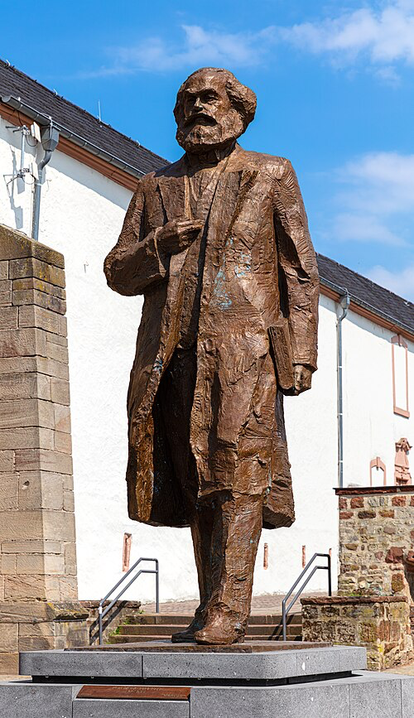
Is the admiration for Marx’ over? Don’t think so….
A new statue of Marx was unveiled on May 5, 2018, to mark the 200 anniversary of the Karl Marx’s birth in his hometown.
The work by sculptor Wu Weishan is a gift from the People’s Republic of China.

Slide 6
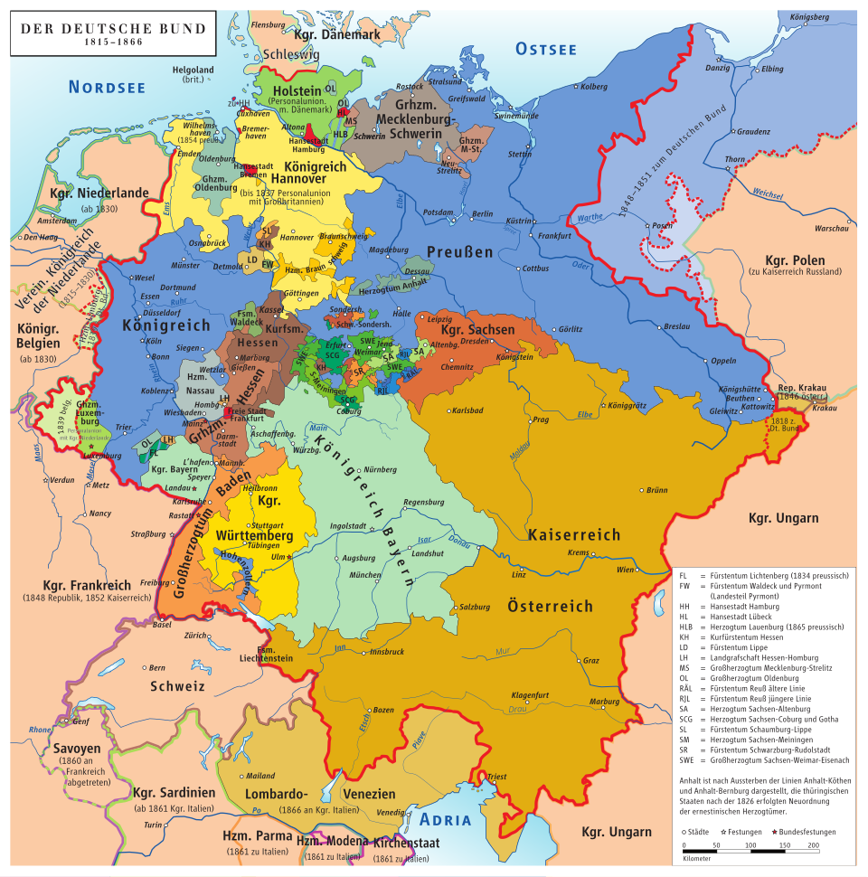
Wider political, social-cultural, economic context of the German-speaking landsuntil 1871…
There was no single German political nation; instead, there was a collection of separate states with different rulers, laws, religions, and customs. Industrialisation – like in Britain is still relatively unknown in most German territories (takes off in the last 3rd of 19th century).
There was enthusiasms for Enlightenment ideas and the achievements of the French Revolution, particularly among the bourgoisue, but majority of German rulers and their subjects were hesitant to fully embrace ideologies of the French (fear of violence); reliance on the importance of religion and traditional political powers to provide peace and societal order (enlightened absolutism)
But: Sparked by economic hardship, mass poverty, and political discontent, these were a series of protests and rebellions across the German states demanding national unity, individual freedoms like freedom of the press, and a unified German nation-state. While the initial phase saw rulers make concessions, including the formation of a national assembly, ‘the revolutions’ in the 1840s/50s ultimately failed as internal divisions between middle-class liberals and working-class radicals grew, and conservative forces reasserted control. (e.g. restauration)

Slide 7
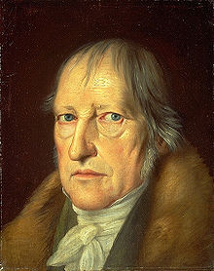
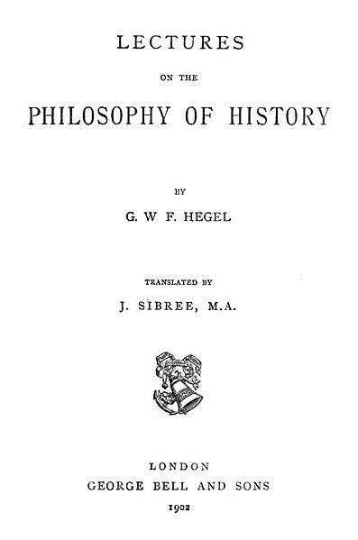
Marx as a student in Bonn and in Berlin
He was deeply influenced by Georg Friedrich Hegel, the then superstar of German intellectual life (idealism)
Hegel’s calls his own project philosophical history. He maintains that with philosophical history the historian cannot be content with finding empirical expressions of past experiences (e.g. the archival sources).
His task is to find the overall sense and the hidden ideas that created and drove such empirical expressions (and the sources there of) in the first place.
The Geist (spirit) is similar to the culture of people at a time and is constantly reworking itself to keep up with the changes of that culture, while at the same time working to produce changes in the culture (moving history on towards its aim of ‘freedom’.
Georg Friedrich Hegel (1770-1831)

Slide 8
The development of spirit is progressive, aiming to achieve its own freedom
‘World history... represents the development of the spirit's consciousness of its own freedom and of the consequent realization of this freedom.’
Hegel, Lectures on the Philosophy of History, 1831)
Hegel maintains that the consciousness of freedom in history moves from despotism to a sense that freedom is a privilege of a few, to a robust notion that humanity is free in and of itself.
Hegel’s philosophical history is a history of ‘thought’.
Note: Hegel believes that the spirit of human freedom is best nurtured within a constitutional monarchy in which the monarch embodies the spirit and desires of the governed.

Slide 9
Dialectic method of historical development
How does the spirit of a people in a particular epoch move from one historical stage to its next, more sophisticated stage of freedom?
Hegel's dialectic is a philosophical method of development and reasoning that involves a process of thesis, antithesis, and synthesis, where an initial idea (thesis) generates a contradictory opposing idea (antithesis), and their tension is resolved in a higher, more complex concept (synthesis) that preserves aspects of both.
This cycle drives progress and understanding in history, thought, and consciousness, moving from less sophisticated to more sophisticated forms
Thesis: An initial concept, idea, or state of affairs at a particular moment in time
Antithesis: The contradiction or opposing concept that arises from the thesis, highlighting its limitations or one-sidedness.
Synthesis (or Sublation): The resolution of the tension between the thesis and antithesis into a new, more comprehensive idea of spirit. This new concept "sublates" the previous stages, meaning it transcends them while also preserving their essential truths.
Note: In Hegel’s view the synthesis – the new stage of spirit of freedom – is reached through violent action (e.g. wars).

Slide 10
Marx remains vetted to Hegel’s dialect method of history all his life but will turn it on its head….

Slide 11
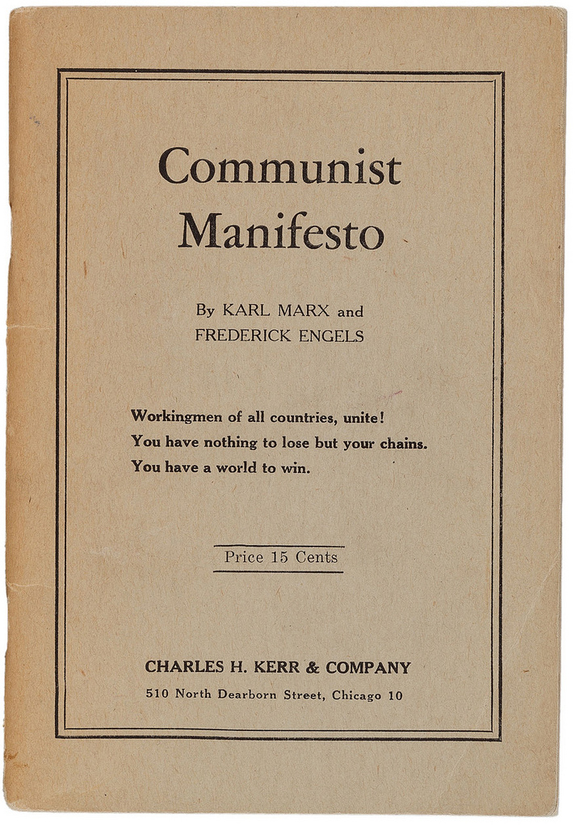
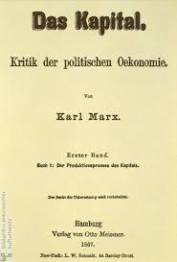
Most famous works
1848
Vol. 1-3
1867-1894

Slide 12
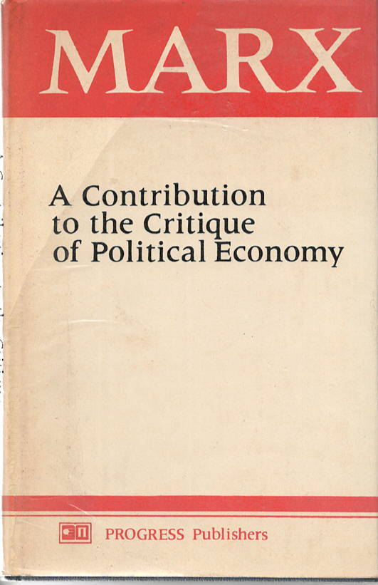
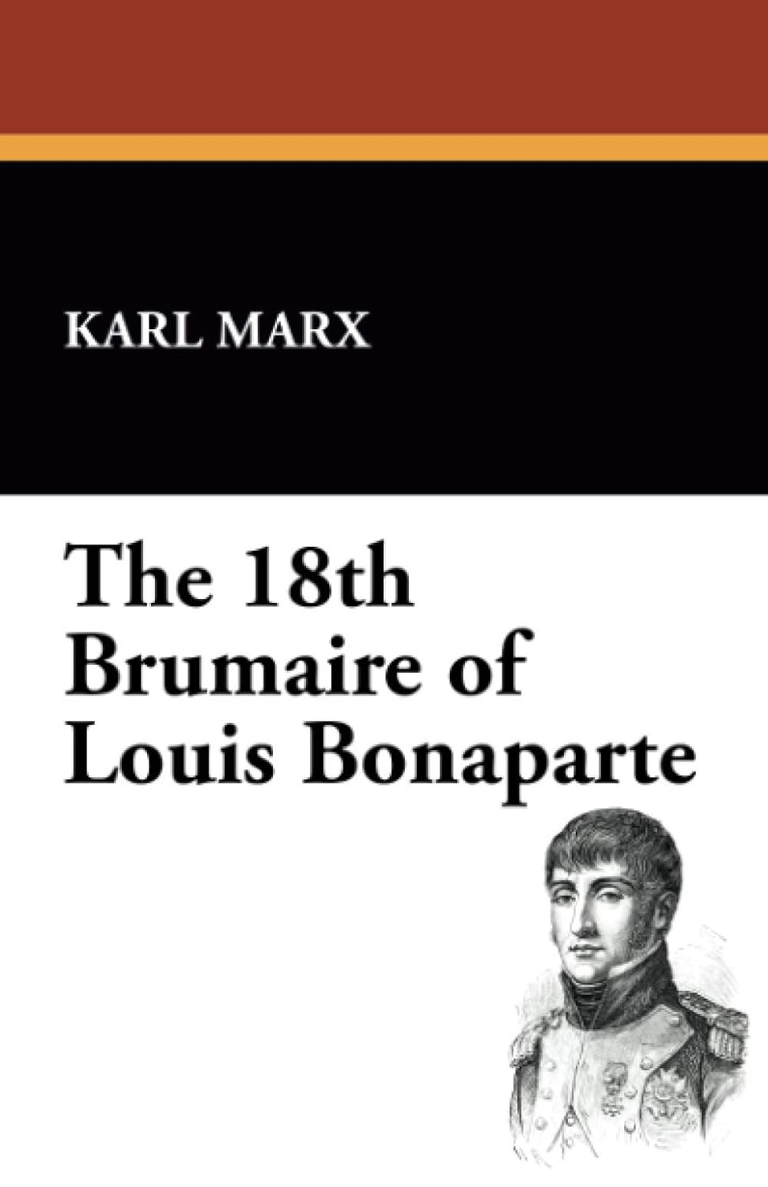
Karl Marx – influential works for historians
1844
1852

Slide 13
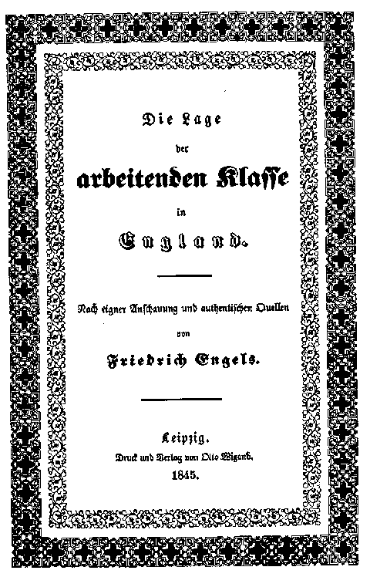
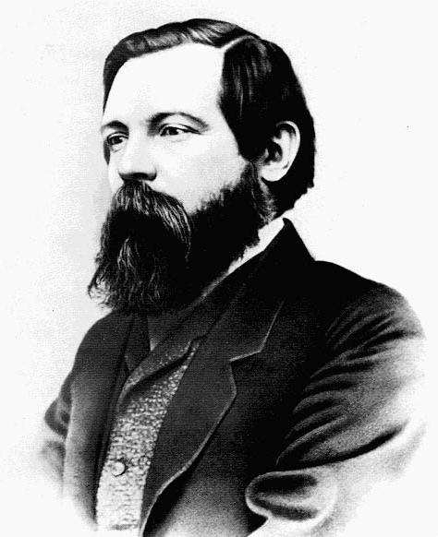
Marx has a lifelong
friendship and working
relationship with
Friedrich Engels
Engels edits and publishes most of Marx’s notes (e.g. 2nd, 3rd volume of the Capital)
Friedrich Engels
1820 – 1895

Slide 14
Progressive stages of history according to ‘historical materialism’
Communism
Classless society
Socialism
Dictatorship of the Proletariat
SOCIALIST REVOLUTION
Expropriation of Expropriators
Capitalism
Bourgeoisie against Proletariat
Feudalism
Feudal lords against Peasants
Slaveholder Society
Slaveholders against Slaves
Primitive Communism
Hunter-gatherer societies

Slide 15
What causes historical change in historical materialism?

Slide 16
Historical Materialism
(note: Marx never used the term himself!)
Historical materialism is Karl Marx's theory of history, which argues that economic conditions (the "mode of production") are the primary drivers of social, political, and intellectual change throughout history.
It posits that all societal institutions, from government and law to religion, family, and culture, are shaped by the underlying economic system and the resulting class struggles between those who own the means of production and those who do not.
Social change (and historical change) occur as contradictions within the mode of production lead to a new system, progressing history from one stage to the next.

Slide 17
Superstructure:
Superstructure:
comprises the cultural, ideological, political, legal, and social institutions (like governmental agencies, culture, family, or religion, ideology, etc.) that are shaped and determined by the economic base (the mode of production and class relations). The superstructure's primary function is to reproduce and legitimize the interests of the ruling class by promoting ideologies that obscure class conflict and maintain the existing power structure.
Societies in each stage are organized from ‘the bottom up’. The ‘modes’ of production’ produce social reality of people (superstructure)
Relations of production: the social relationships that emerge between people during the process of production, distribution, and exchange of material wealth, fundamentally based on the owner-
ship or lack of owner-
ship of the
means of
production
Relations of Production
Class: class is defined by a person’s/groups relationship to the forces of production—either owning them or selling their labour to survive (in capitalism: proletaria -
bourgeoisie)
Forces of Production
Forces and means of production: These are the tools, technology, and raw materials society uses to produce goods, as well as the collective labour and knowledge of the labouring people.

Slide 18
Human agency and causation
‘Men make their own history! And all human ‘thinking’ is the outcome of their active real lives!’
‘The philosophers have only interpreted the world in various ways; the point, however, is to change it’
(Karl Marx's 11th and final note in his Thesis on Feuerbach, written in 1845 and published posthumously in 1888)
‘In direct contrast to German philosophy, which descends from heaven to earth, here we ascend from earth to heaven. That is to say, we do not set out from what men imagine, conceive, nor from men as narrated, thought of, in order to arrive to men in flesh. We set out from real, active men and on the basis of their real life process we demonstrate the development of the ideological reflexes and echoes of this life process.’ (German Ideology, p. 7)
Note: Marx does not consider capitalism to be outcome of some sort of essential human nature and the motivation of man in capitalism to be universal motivation of humanity (as many intellectuals of his time did, including those who came to believe in Darwinism which spread at his time).

Slide 19
Marx’s understanding of ’Man’ agency and historical change
What is man ? He uses the term ‘man’ (germ. Mensch); stands for mankind/humankind. For Marx, man (which includes all human beings) is born with an inner invisible potential which differs from its raw material (we might say today human biology), which, as such, cannot be changed.
Yet, humans do change in the course of history, Marx argues, they develop and transform themselves.
Since humans makes their own history, humans are their very own product.
History, is the history of man’s very own self-realization. All humans are born with this potential of self-realization.
They activate this inherent potential through their labor, work and production.
History is nothing but the self-creation of humans through the process of their labor.

Slide 20
Concept of Labor and Man’s Alienation
Labor is the self-expression of man, an expression of his individual physical and mental power.
In this process of genuine activity man develops himself, becomes himself; work is not only a means to an end – the product – but an end in itself, the meaningful expression of human energy; hence, work, should be enjoyable.
Marx critiques of capitalism is not the injustice in the distribution of wealth; it is the perversion of labor into forced, meaningless labor, hence the transformation of man into a ‘crippled monstrocity’.
Alienation
Alienation (or estrangement) means that man does not experience himself as the acting agent in his grasp of the world but that the world (nature, others, and he himself) remain alien to himself. They stand above and against him as objects, even through they may be objects of his own creation e.g. invented concepts)
Alienation mean that man essentially experiences the world and himself passively, receptively; he is not in control of his world.
To be in an alienated state allows no grows, not development.
In his alienated state man doesn’t make his own history.

Slide 21
Alienation in capitalism
Marx viewed man not as an isolated or fixed biological creature, but as a "species-being" (Gattungswesen) whose nature is fundamentally social, cooperative, and shaped through active labor
As private property and division of labor develop in capitalism (machinery, industries but also AI) , labor loses its character of being an inner expression of man’s potential.
Power labor and his products assume an existence separate from man, his will and his planning.
Labor is alienated because the work has ceased to be a part of the worker’s nature.
Consequently, he does not fulfill himself in his work but denies himself, has a feeling of misery rather than well-being, does not develop freely his mental and physical energies but is physically exhausted and mentally debased. The worker therefore feels himself at home only during his leisure time, whereas at work he feels homeless.
        The superstructure is organized so to create ‘false consciousness’ in people, so that they alienate themselves.

Slide 22
The aim of socialism (and communism)
Marx looked at socialism as the condition of human freedom and creativity, not as in itself
the goal of man’s life.
It is the first real emergence, the genuine actualization of man’s nature as something real. Socialism
or communism is a society which permits the actualization of man’s inherent essence, by overcoming
his alienation. It is nothing less than creating the conditions for the truly free, rational, active and
independent man.
It is a society that serves the needs of man.
Question: Well, doesn’t modern capitalism serve our needs?
Aren’t big cooperation serving our needs (e.g. consumption)? Aren’t political elites endlessly trying to find out what our needs are, to understand us, and serve our needs? Or does religion serves our real needs?
Well, no, Marx would argue
Marx believed in true needs of humans and artificially produced needs of man (as capitalism does). Capitalism makes humans forget their true needs.

Slide 23
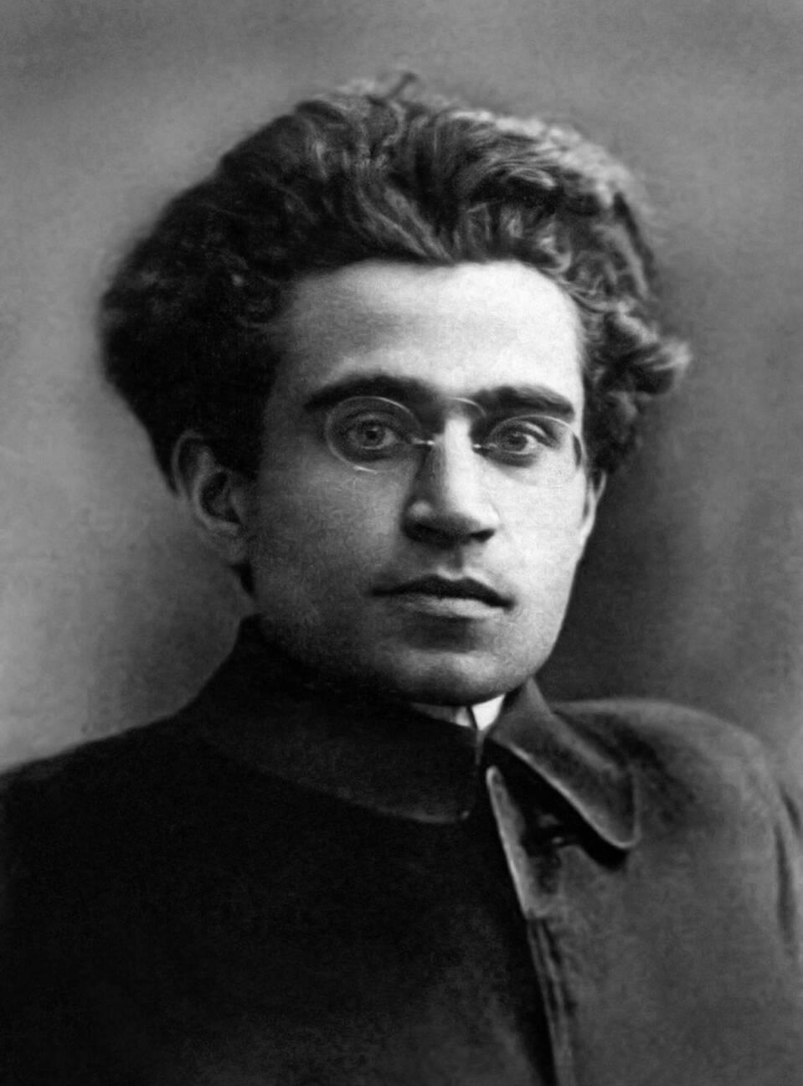
Adapting Marx’s Framework to Modern Times
Gramsci was a founding member and leader of the Italian Communist Party. An outspoken critic of Benito Mussolini and fascism, he was imprisoned in 1926 and remained in prison until shortly before his death in 1937.
During his imprisonment, Gramsci wrote more than 30 notebooks and 3,000 pages of history and Marxist analysis. Later published as his Prison Notebooks, they are considered one of the most original contribution to Marxist theory in the 20th century.
The Prison Notebooks were first published in English in 1971 and fundamentally shaped what Marxist historians at the time Marxism to be.
They are fundamental to the new social history, postcolonial history, gender history, and the history of race.
Antonio Gramsci

Slide 24
Mainly because his own country
Italy was still not industrialised at
Gramsci’s his own lifetime; there
is proletariat in Italy which is mainly agricultural. Coins the term ‘subaltern’ for all excluded groups.
Superstructure:
Gramsci identifies problems with Marx’ ‘classical’ model
Superstructure isn’t simply producing lies or fake news or ‘false consciousness’ – as classic Marxism had it.
It is it is a practical, lived worldview that organizes human behavior, culture, and institutions. It is ‘common sense’.
Relations of Production
Also, by the early 20th century, no promised revolution had occurred in the most advanced nations, and those revolution of 1917-1923, such as in Germany or the Bienno Rosso in Italy, had failed.
Forces of Production

Slide 25
Hegemony
The term was first used by Marxists such as Vladimir Lenin to denote the political leadership of the working class in a democratic revolution.
Gramsci greatly expanded this concept, developing a detailed analysis of how the ruling capitalist class—the bourgeoisie -- establishes and maintains its control over the masses.
As capitalism seemed more entrenched than ever, Gramsci suggested that it maintained control not just through violence and political and economic coercion but also through ideology.
ideology (according to Gramsci): a living, organized system of worldviews, values, and social practices that shapes how people understand reality and gives the ruling class cultural and intellectual leadership (e.g. via individuals but also institutions such as the media, schools, university etc.)
The bourgeoisie developed a hegemonic culture, which propagated its own values and norms so that they became the common sense values of all. People in the working class and other classes identified their own good with the good of the bourgeoisie and helped to maintain the status quo rather than revolting.
Capitalist power needed to be challenged by building a counter-hegemony.

Slide 26
What is the role of intellectuals in establishing a counter-hegemony
Gramsci believed that all men are intellectuals, in that all have intellectual and rational faculties, but not all men have the social function of intellectuals.
He argues against traditional views of intellectuals as a professional groups who see themselves as independent, autonomous, and neutral—standing above daily class struggles
He saw modern intellectuals not as thinkers and talkers (above daily politis and class struggle) but as practical-minded directors and organisers who produced hegemony through ideological apparatuses such as education and the media.
Organic intellectuals of the dominant class help build "consent" for the ruling order.
Conversely, counter-hegemonic organic intellectuals help oppressed or marginalized groups develop class consciousness and challenge ruling ideologies through a ‘war of position’
Particularly Gramsci fans of the 1960s understood themselves as counter-hegemonic intelectuals.

Slide 27
The end

