Slide 1
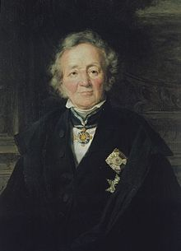
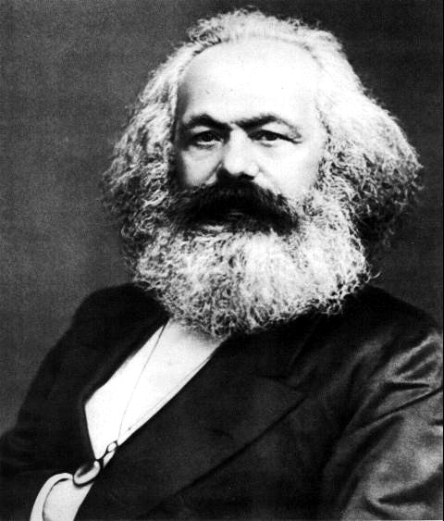
Two Germans scholars who shaped history writing in fundamental ways….until today
Leopold von Rank, 1795-1886
Karl Marx, 1818-1883

Slide 2
Why are these two Germans still important to the discipline of history?
Leopold von Ranke, 1795-1886
Provided the field with a method, based on empirical collection of sources and their critique
Institutionalised history writing
as a university ‘discipline’, first in
Berlin (then across the world).
His ideas of history and historical change are not longer used in history writing today
Karl Marx, 1818-1883
Marx work as a philosopher, political theorist, political economist, journalist and revolutionary socialist shaped the modern world not only in intellectual ways. Marx’ ‘historical materialism’ were not simply a theory of society and historical change, but it did change the world! And his ideas continue to do so…

Slide 3
Claim: Despite being radically different in character and intellectual interests, their ‘Germanness’ shaped their thinking and working fundamental ways
Lecture outline:
Explore ‘their Germanness’ – political, social-cultural situation of German lands in the first half of 19th century; a key intellectual figure that shaped both of their work: the philosopher Hegel; without Hegel no Ranke and no Marx
Ranke’s life and work – human agency and historical change
Marx’s life and work - human agency and historical change

Slide 4
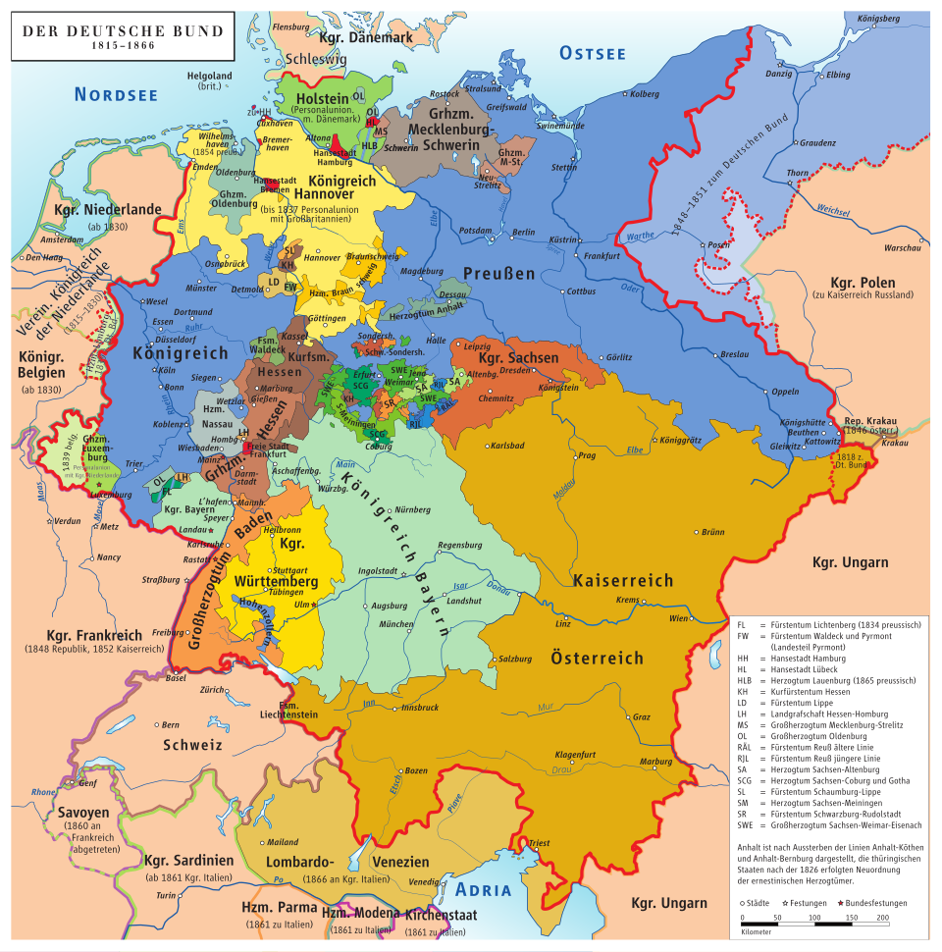
Wider political, social-cultural, economic context until 1871…
There was no single German political nation; instead, there was a collection of separate states with different rulers, laws, religions, and customs. Industrialisation – like in Britain is still relatively unknown in most German territories (takes of in the last 3rd of 19th century).
There was enthusiasms for Enlightenment ideas and the achievements of the French Revolution but majority of German rulers and their subjects were hesitant to embrace ideologies of the French; reliance on the importance of religion and traditional political powers to provide peace and societal order.
But: Sparked by economic hardship, mass poverty, and political discontent, these were a series of protests and rebellions across the German states demanding national unity, individual freedoms like freedom of the press, and a unified German nation-state. While the initial phase saw rulers make concessions, including the formation of a national assembly, ‘the revolutions’ in the 1840s/50s ultimately failed as internal divisions between middle-class liberals and working-class radicals grew, and conservative forces reasserted control. (e.g. restauration)

Slide 5
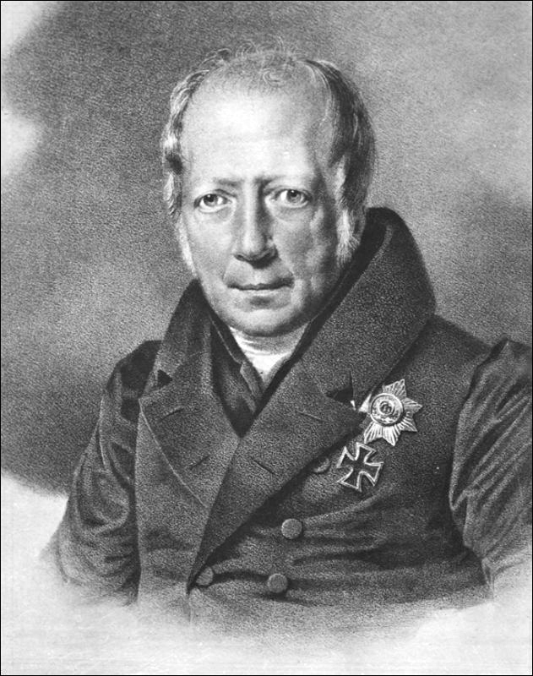
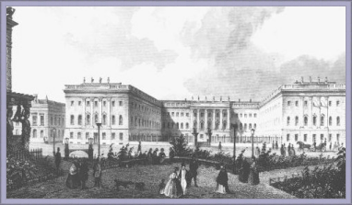
While German states lack modern political representation, they develop a world-famous education system ….particularly Prussia
The German states in the 19th century were world leaders in prestigious education and Prussia set the pace. The modern university system emerged from the 19th- century German universities, especially Friedrich Wilhelm University (now named Humboldt University of Berlin. It pioneered the model of the research university with well-defined career tracks for professors.
Humboldt University, Berlin (founded 1811)
Wilhelm von Humboldt (1767-1835); minister of education in Prussia
‘Bildung’: engl. ‘education’/’formation’ but has a much broader humanistic meaning
Humboldt believed that the university (and education in general, as in the Prussian education system) should enable students to become autonomous individuals and world citizens by developing their own reasoning powers in an environment of academic freedom. (e.g. Bildungsbürger und Weltbürger)

Slide 6
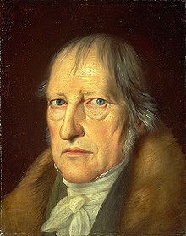
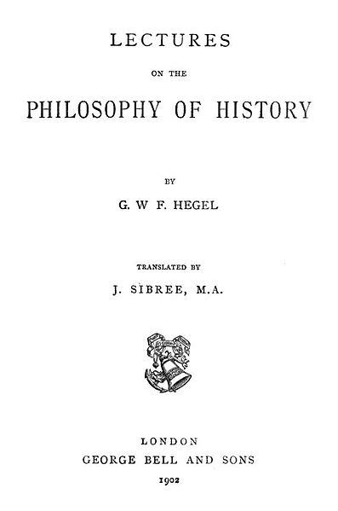
The superstar of German intellectual life at Berlin University who’s views on history and historical change dominated the academic and public spheres in the German-speaking lands
Hegel’s calls his own project philosophical history. He maintains that with philosophical history the historian cannot be content with finding expressions of past experiences (e.g. the archival sources).
His task is to find the overall sense and the hidden ideas that created and drove such expressions (and the sources thereof) in the first place.
The philosophical historian has to relate the evidence/facts to the unique ‘spirit’ (Geist) of a historical period.
Georg Friedrich Hegel (1770-1831)
The Geist (spirit) is similar to the culture of people at a time and is constantly reworking itself to keep up with the changes of that culture, while at the same time working to produce changes in the culture (moving history on towards its aim of ‘freedom’.

Slide 7
The development of spirit is progressive, aiming to achieve its own freedom
"World history... represents the development of the spirit's consciousness of its own freedom and of the consequent realization of this freedom.”
Hegel, Lectures on the Philosophy of History, 1831)
Hegel maintains that the consciousness of freedom in history moves from despotism to a sense that freedom is a privilege of a few, to a robust notion that humanity is free in and of itself. Hegel believes that the spirit of human freedom is best nurtured within a constitutional monarchy in which the monarch embodies the spirit and desires of the governed,

Slide 8
Now, how does the spirit of a people move from one historical stage to its next, more sophisticated stage?
Hegel’s dialectic method of historical development (important to Ranke and particularly Marx!)
Hegel's dialectic is a philosophical method of development and reasoning that involves a process of thesis, antithesis, and synthesis, where an initial idea (thesis) generates a contradictory opposing idea (antithesis), and their tension is resolved in a higher, more complex concept (synthesis) that preserves aspects of both. This cycle drives progress and understanding in history, thought, and consciousness, moving from less sophisticated to more sophisticated forms
Thesis: An initial concept, idea, or state of affairs
Antithesis: The contradiction or opposing concept that arises from the thesis, highlighting its limitations or one-sidedness.
Synthesis (or Sublation): The resolution of the tension between the thesis and antithesis into a new, more comprehensive idea. This new concept "sublates" the previous stages, meaning it transcends them while also preserving their essential truths
In his view the synthesis – the new stage of spirit – is reached through violent action (e.g. wars).

Slide 9
Part II: life and work of Leopold von Ranke – his views on the nature of history and history writing, human agency and historical change

Slide 10
All this is important when we talk about Leopold von Ranke......
The so-called ‘father’ of modern history writing. He invents history’s ‘critical method’ (e.g. the empirical collection of sources and their critical analysis) and he turned history into a rigorous academic discipline, studied at research universities (first in Germany, then all over the world).
Early life and education:
Ranke is born in 1795 in Thuringia into a family with a strong Lutheran background. He studied theology and philology at the University of Leipzig but rejected a career as a protestant minister. He decided to become a school teacher and began to think about the nature of history writing, while reading through the entire school library.
He is a romantic and strong believer in God’s power to govern human life in the present and past.
Leopold von Ranke (1795-1886)

Slide 11
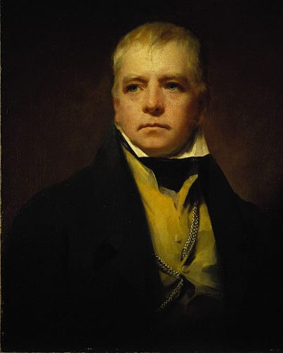
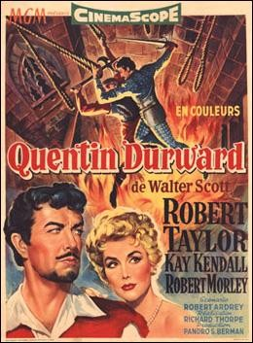
Two popular forms of history writing particularly upset Ranke:
1. Historical novels
Ranke loves historical fiction BUT........
He strongly dislikes that
such bestselling novels were often not based on ‘real’ facts or the wrong ‘facts’ as he figured out
Sir Walter Scott (1771-1832)

Slide 12
2. The second view of history, he disliked, was popular among academics at the time: Hegel’s philosophical history
Ranke object here that Hegel puts a philosophical idea first (universal idea) and then sets out to search for the facts to prove that.
Ranke begins to think that Hegel needs to be turned around:
Historians need to look for the facts (the particulars) first and on the basis of all their collected facts, offers a philosophical view of a historical period (universal claims).
Note: Ranke retains Ranke Hegel’s idea of the spirit of an historical age BUT: historians get at this spirit by empirically collecting facts first. On the basis of such facts they will then be able ‘divine’ the spirit of a historical period or age.
Georg Friedrich Hegel (1770-1831)

Slide 13
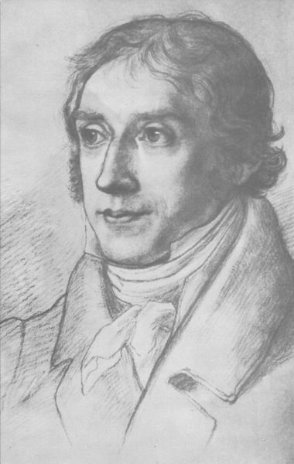
Ranke rejects both ways of doing history and invents a new method of doing it. He calls it his ‘critical method’ and he takes it from the from the study of languages at his time
Philology (lat. love for languages; study of language)
the study of language in written historical sources. It is a combination of literary criticism, history, and linguistics. It is more commonly defined as the study of literary texts and written records, the establishment of their authenticity and their original form, and the determination of their meaning; it aims to produce ‘critical editions’ full of footnotes so the reader can follow the reasoning of the author
Barthold Georg Niebuhr ( 1776-1831),
historian of antiquity and classical languages
He then transfers this ‘critical method’ to the study of history, to test whether sources are genuine or fake.

Slide 14
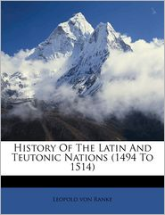
History is neither fiction nor is it the fulfillment of an abstract philosophical idea (e.g. Hegel’s freedom). Historians need facts, facts, facts…
‘The strict presentation of facts, no matter how condition and unattractive they might be is undoubtedly the supreme law of any historian.’
The book was a major success and earned him
a professorship at the world’s most prestigious university
of Berlin in 1824
In Berlin he institutionalized history writing:
Set up lectures and seminars in which students and professors discuss their findings and analyse ‘historical facts – history as an academic research discipline
‘critical method’ becomes the method of all academic history writing
He invents ‘the footnote’ in history.
1824

Slide 15
Ranke’s history writing and its underlying assumptions...
The most famous sentence ever uttered about the purpose history writing is also the most widely misunderstood in the English-speaking world!
… to such high office the present work does not presume; it seeks to only show the past ‘how it essentially was’ (German: ‘wie es eigentlich gewesen’)
(History of the Latin and Teutonic Peoples, 1824)
What Ranke means is: Historians do the humble job of empirically collecting what happened in the past in the
archive
But: he believes that when a historian collected a large amount of facts, she will then be able to understand or
as he says ‘divines’ the past. Via the particular fact the historian will come to understand the spirit of a time. He
Will understand the overarching essential spirit of a time. He will, as Ranke believed, understand God’s will
for that particular period of time. (He relies on Hegel here)

Slide 16
Now, what is the difference between a philosopher of history and a historian according to Ranke
How does the historian reach beyond the empirically collected facts according to Ranke?
Through the special power of ‘divination’ and human empathy.
Historians is not after empirical ‘laws’ but to divine the connection and grasp the epoch as a whole.
This begs the question: What is the difference between a philosopher of history and a Rankean historian?
The historian moves from individual facts (‘particulars’ collected by empirical research) to a grant thesis (universal thesis). The philosopher, moves the other way round: from a grant universals, not sustained by empirical evidence to empirical facts which support it (‘particulars’)
Rankean historians ‘feels’ themselves into the past and becomes part of it due to her knowledge of the facts.

Slide 17
The unity of a historical period was for Ranke ultimately provided by God; human
agency and historical change derive from God
As a Protestant he had a strong belief in Providence
‘Every epoch is immediate to God and its worth is not at all based on what derives from it but rests in its own existence, in its own self’
‘Every human being, something eternal, comes from God, and this is a vital principle.’
‘It is not necessary for us to prove at length that the eternal dwells in the individual. This is the religious foundation in which our efforts rest. We believe that there is nothing without God, and nothing lives except through God.’
For Ranke then follows:
never judge the past from one’s own standpoint but to grasp its uniqueness via divination or intuition
(because that is defying God’s will!)
there is no progress in history to a higher state of civilization in history because every historical period
is equal to God

Slide 18
The state, Ranke preferred constitutional monarchies -- were also God-given and
Ranke’s considers the state an individual and a living being, driven by an inner life force
‘A nation must feel independent in order to develop freely… It is necessary for the state to organise all its international resources for the purpose of self-preservation.’
Consequence: He and his followers in the later 19th century welcome war as necessary for a state’s self-preservation and self-development (which also relies on Hegel’s continous influence). After WWII Ranke’s history writing and that of his nationalistic followers falls entirely ‘out of fashion’ – for understandable reasons.

Slide 19
A warning! Ranke is probably the most misunderstood historian in the anglophone world
English-speaking world often understands Ranke’s ‘critical method’ simply as empiricist collection of facts that has to be neutrally and objectively
Why? Due to translation error of his famous motto:
… to such high office the present work does not presume; it seeks to only show the past ‘wie es eigentlich gewesen’
(History of the Latin and Teutonic Peoples, 1824)
‘Eigentlich’ continues to be translated as ‘really’ but it needs to be translated as ’essentially’ – ‘how it essentially was’
Ranke hopes to get at ‘the essential’ characteristics of an age (its spirit) by collecting the facts first! To reduce him to an empiricists is not getting at the philosophical and religious aim of what he considers history writing to be.

Slide 20
Another major misunderstanding due to another major translation error
‘The historians task, however, is at once art and science. It has to fulfil all the demands of criticism and scholarship to the same degree as a philosophical work; but at the same time it is supposed to give the same pleasure to the educated mind as the most perfect literary creation.
(Ranke, Wissenschaft und Kunst)
How can that be? Can history be an art AND a science at the same time? This confused already Ranke’s English-speaking students....

Slide 21
Yes, history can be a science and an art if we understand the German term for
Science
Wissenschaft(en) (engl. science(s)): any scholarship that follows a systematic methodology.
So, history with its ‘critical method’ is a science according to Ranke’s understanding of science.
And History is also an art because it requires literary skills, writing skills, narrative skills to express one’s findings in a story.

Slide 22
Seminar discussion
What does Ranke say about human agency, human experience and historical change? What are experiences for Ranke and is he interested in human experience?
How does historical change occur according to Ranke?

Slide 23
Part III: Marx’s life and work – notion of history, historical change and human agency

Slide 24
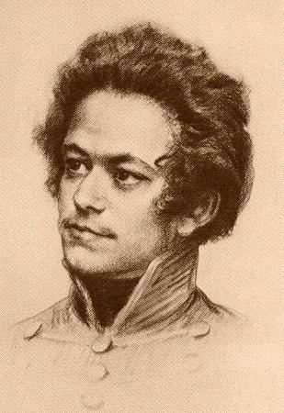
Marx’s Life
1818-35: childhood and early youth in a liberal bourgeois family in Trier. Exposed to Enlightenment, Romantic, liberal and radical world-views through family and acquaintances.
1835-36: University of Bonn. Heavy drinking, gambling, etc. – father intervenes to move him to Berlin.
1836-42: University of Berlin. Develops wide range of intellectual interests: jurisprudence, history, and especially philosophy. Involved in ‘Left-Hegelian’ circles.
1842-49: Cologne, Paris, Brussels, Paris, Cologne, Paris. Years of revolution and counter-revolution: for Marx, constant political exile and flight. Years of intense political agitation, radical political journalism (heavily censored). Marx begins studying political economy. Develops lifelong friendship with Friedrich Engels (son of wealthy manufacturer).
1849-1883: London.

Slide 25
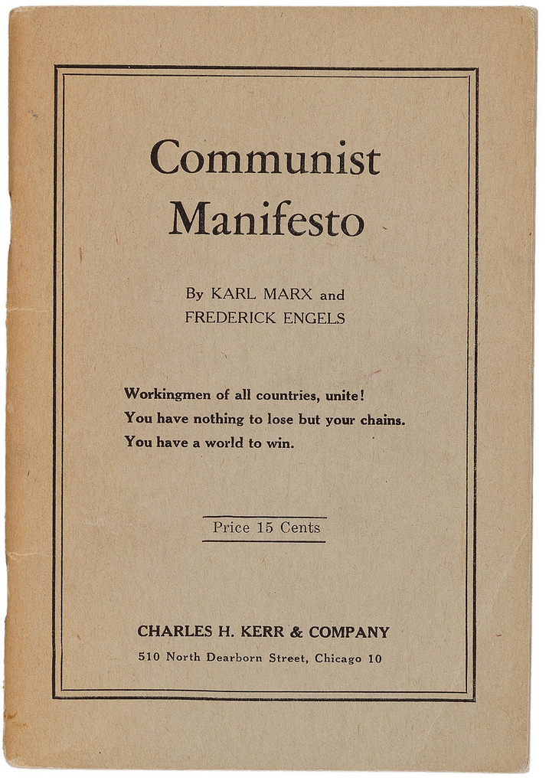
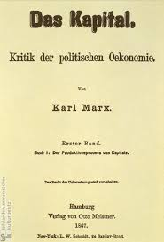
Most famous works
1848
Vol. 1-3
1867-1894

Slide 26
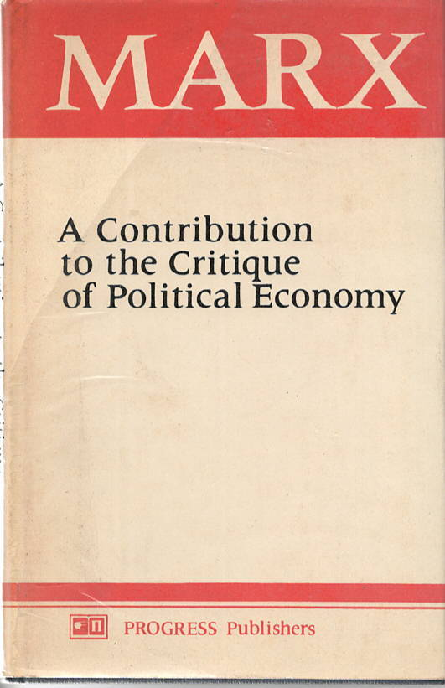
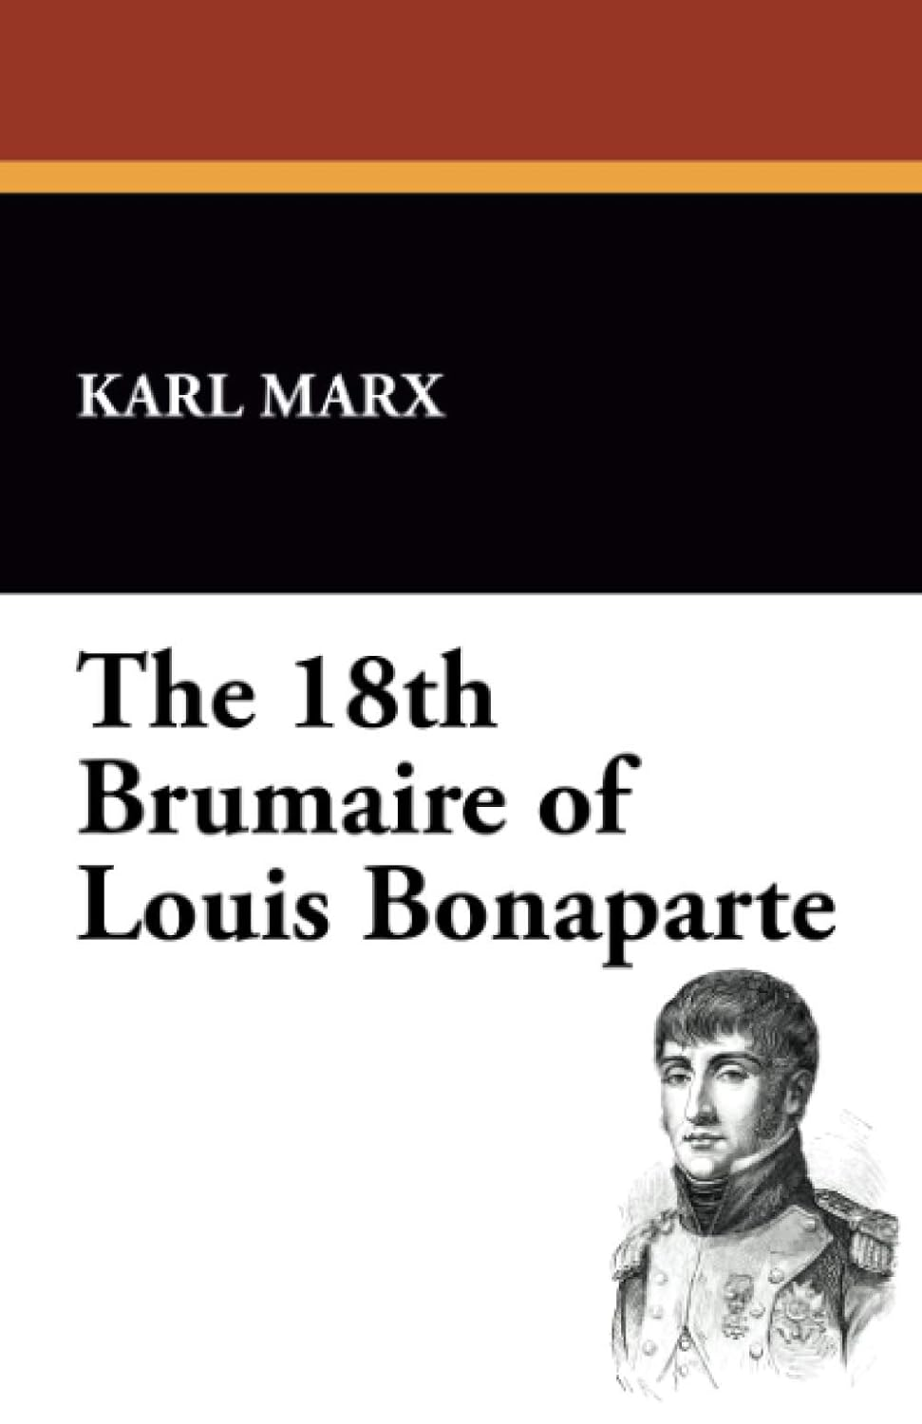
Karl Marx – influential works for historians
1844
1852

Slide 27
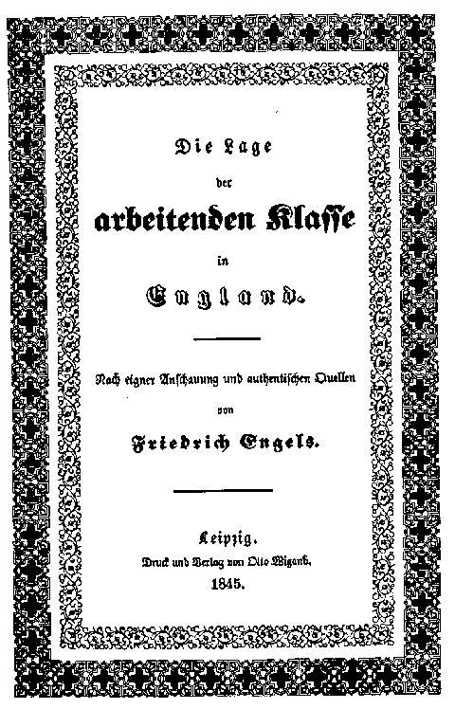
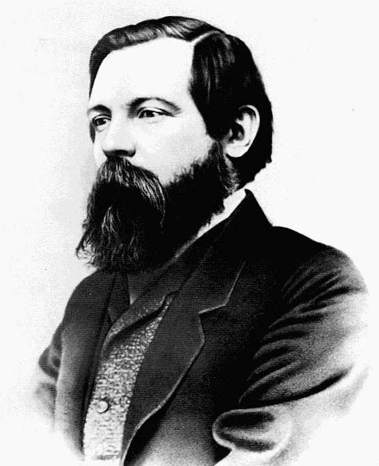
Marx has a lifelong
friendship and working
relationship with
Friedrich Engels
Friedrich Engels (1820-1895)

Slide 28
Stages of history according to ‘historical materialism’
Communism
Classless society
Socialism
Dictatorship of the Proletariat
SOCIALIST REVOLUTION
Expropriation of Expropriators
Capitalism
Bourgeoisie against Proletariat
Feudalism
Feudal lords against Peasants
Slaveholder Society
Slaveholders against Slaves
Primitive Communism
Hunter-gatherer societies

Slide 29
Historical Materialism (note: Marx never used the term himself!)
Historical materialism is Karl Marx's theory of history, which argues that economic conditions (the "mode of production") are the primary drivers of social, political, and intellectual change throughout history.
It posits that all societal institutions, from government and law to religion, family, and culture, are shaped by the underlying economic system and the resulting class struggles between those who own the means of production and those who do not.
Social change (and historical change) occur as contradictions within the mode of production lead to a new system, progressing history from one stage to the next.

Slide 30
Superstructure:
Superstructure:
comprises the cultural, ideological, political, legal, and social institutions (like governmental agencies, culture, family, or religion, ideology, etc.) that are shaped and determined by the economic base (the mode of production and class relations). The superstructure's primary function is to reproduce and legitimize the interests of the ruling class by promoting ideologies that obscure class conflict and maintain the existing power structure.
Societies in each stage are organized from the bottom up. The ‘modes of production’ produce social reality of people (superstructure)
Relations of production: the social relationships that emerge between people during the process of production, distribution, and exchange of material wealth, fundamentally based on the owner-
ship or lack of owner-
ship of the
means of
production
Relations of Production
Class: class is defined by a person’s/groups relationship to the forces of production—either owning them or selling their labour to survive (in capitalism:proletaria -
bourgeoisie)
Forces of Production
Forces and means of production: These are the tools, technology, and raw materials society uses to produce goods, as well as the collective labour and knowledge of the laboring people.

Slide 31
Marx reacted against Hegel’s philosophical history that traces the development of thought and spirit.
He and Engels argue:
‘Men make their own history! And all human ‘thinking’ is the outcome of their active real lives!’
‘The philosophers have only interpreted the world in various ways; the point, however, is to change it’ (11th thesis on Feuerbach)
‘In direct contrast to German philosophy, which descends from heaven to earth, here we ascend from earth to heaven. That is to say, we do not set out from what men imagine, conceive, nor from men as narrated, thought of, in order to arrive to men in flesh. We set out from real, active men and on the basis of their real life process we demonstrate the development of the ideological reflexes and echoes of this life process.’ (German Ideology, p. 7)
Note: Marx does not consider capitalism to be outcome of some sort of essential human nature and the motivation of man in capitalism to be universal motivation within Man (as many intellectuals of his time did, including those who came to believe in Darwinism which spread at his time).

Slide 32
Marx’s understanding of ‘Man’
What is man ? (He uses the term ‘man’ (germ. Mensch); stsnds for mankind or we would now say humankind.)
For Marx, man (which includes all human beings) is born with an inner invisible potential which differs from its raw material (we might say today human biology), which, as such, cannot be changed.
Yet, man do change in the course of history, Marx argues, he develops himself and transform himself. Man is a product of history.
Since he makes his history, man is his very own product.
History, is the history of man’s very own self-realization. All humans are born with this potential of self-realisation and they activate this inherent potential through their labor, work and production.
History is nothing but the self-creation of man through the process of his labor.

Slide 33
Concept of Labor and Man’s Alienation
Labor is the self-expression of man, an expression of his individual physical and mental power.
in this process of genuine activity man develops himself, becomes himself; work is not only a means to an end – the product – but an end in itself, the meaningful expression of human energy; hence, work, is enjoyable.
Marx critiques of capitalism is not the injustice in the distribution of wealth; it is the perversion of labor into forced, meaningless labor, hence the transformation of man into a ‘crippled monstrocity’.
Alienation
Alienation (or estrangement) means that man does not experience himself as the acting agent in his grasp of the world but that the world (nature, others, and he himself) remain alien to himself. They stand above and against him as objects, even through they may be objects of his own creation. Alienation mean that man essentially experiences the world and himself passively, receptively.
To be in an alienated state allows no grows, not development; man doesn’t make his own history.

Slide 34
Alienation in capitalism – state of alienation in capitalism
As private property and division of labor develop in capitalism (machinery, industries) , labor loses its character of being an expression of man’
Power labor and his products assume an existence separate from man, his will and his planning.
Labor is alienated because the work has ceased to be a part of the worker’s nature
‘and consequently, he does not fulfill himself in his work but denies himself, has a feeling of misery rather than well-being, does not develop freely his mental and physical energies but is physically exhausted and mentally debased. The worker therefore feels himself at home only during his leisure time, whereas at work he feels homeless’.

Slide 35
The aim of socialism (and communism)
Marx looked at socialism as the condition of human freedom and creativity, not as in itself
the goal of man’s life.
It is the first real emergence, the genuine actualization of man’s nature as something real. Socialism
or communism is a society which permits the actualization of man’s inherent essence, by overcoming
his alienation. It is nothing less than creating the conditions for the truly free, rational, active and
independent man.
It is a society that serves the needs of man.
Question: Well, doesn’t modern capitalism serve our needs?
Aren’t big cooperation serving our needs (e.g. consumption)? Aren’t political elites endlessly trying to find out what our needs are, to understand us, and serve our needs? Or does religion serves our real needs?
Well, no, Marx would argue
Marx believed in true needs of humans and artificially produced needs of man (as capitalism does). Capitalism makes humans forget their true needs.

Slide 36
Seminar questions:
How does Marx understand human experience, agency and historical change?
How does he differ from Ranke?

