Slide 1
Postcolonial Theory and Subaltern Studies
HI2K9, week 9
Aditya Sarkar with Michael Bycroft

Slide 2
Critical history after World War II
Much history-writing moved in a broadly ‘leftward’ and ‘critical’ direction: increasingly linked with critiques of social and political power, especially from 1960s
from ‘elitist’ histories focused on great events and personalities to forms of history from below
from narrative, empirically focused history to more theoretically self-conscious histories
From 1970s onward, a shift from social history to histories of culture and discourse
Postcolonialism was one of the great ‘critical’ shifts in post-1960s history

Slide 3
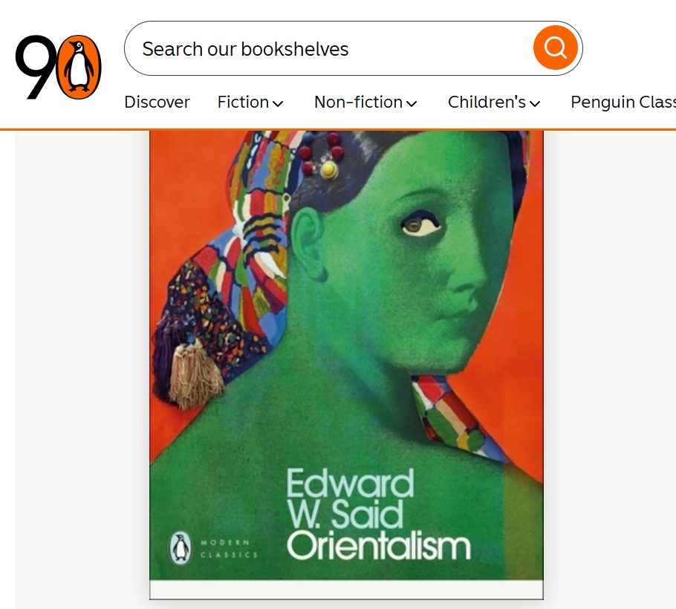
Penguin Modern Classics edition of Said’s Orientalism, first published 1978 (pictured edition published 2019)

Slide 4
Anti-colonial origins
Economic critiques of colonial rule, from 19th century onwards
Marxist anti-imperialism: a major impetus to anti-colonial struggles
Francophone anti-colonial writers in 1940s and 1950s, notably Frantz Fanon, The Wretched of the Earth (1961)
Fanon focused on the psychological deformities produced by colonialism in both colonizer and colonized.
Common theme: hopes for decolonization as key to a more equal world
Frustration by end of 1970s: persistence of Western power; authoritarian rule and widespread corruption and poverty in decolonized societies
Postcolonial theory a response to this much more fraught and complex world

Slide 5
Edward Said, Orientalism (1978)
Traces the ways in which an immense body of written and visual knowledge about the ‘Orient’ was produced by the West
West and East come to be defined as fixed, polar opposites of each other
Within this body of knowledge, ‘Oriental’ histories, cultures, languages and customs interpreted in ways which invariably foreground the theme of Western superiority
Orientalism a ‘distribution of geopolitical awareness into aesthetic, scholarly, economic, sociological and philological texts’ (seminar reading, p. 12)

Slide 6
Sources of Said’s critique
Political anger, esp. at the predicament of Palestinians, and the pervasiveness of racist stereotypes about Islam and the ‘Arab world’ in Western discourse
Said himself was a Palestinian exile working in US universities
Michel Foucault, ‘power/knowledge’ and the study of discourse
Antonio Gramsci and the concept of ‘hegemony’
Ultimately, however, Said is attached to liberal humanism and European culture (even while critiquing them)

Slide 7
Reception of Orientalism
Founding text of ‘postcolonial studies’: significant impact across the humanities from the 1980s onward
Right-wing criticisms: paint Said as an ‘enemy of the West’
Defensive criticism by Orientalist scholars – eg. Bernard Lewis.
From the left: critiques of the ‘discursive turn’ in anti-colonial critique, as well as of Said’s handling of Marx
Single biggest idea? Imperialism has a cultural dimension

Slide 8
Postcolonial Theory and Subaltern Studies
Edward Said’s Orientalism (1978) focuses on European ideas behind imperial power over the ‘East’
Said steered clear of events inside colonized (and later decolonized societies) societies
Subaltern Studies emerges among Marxist scholars in India beginning in early 1980s – gets inside colonial and post-colonial India
Subaltern Studies becomes, in time, perhaps the most influential imprint of ‘postcolonial studies’ within historical research

Slide 9
Antonio Gramsci
Italian Marxist thinker who died in jail in Fascist Italy in 1937
Very influential on Anglophone history-writing from 1960s
‘subaltern’ sometimes a code-word for the industrial proletariat
also, subordination which defies strict Marxist class categories, e.g. peasant societies
the subaltern is fractured and heterogeneous
but subaltern culture needs to be taken seriously by Marxists
In part because it counters the cultural power or ‘hegemony’ of the ruling classes

Slide 10
1980s India – socio-economic context
radical differences between colonial/post-colonial Indian society and industrialized West:
much weaker bourgeoisie and proletariat
largely agrarian society
vast range of social identities
much smaller ‘civil society’ in the Western European sense
All this linked to the peculiar conditions of colonial modernity

Slide 11
1980s India – political context
Disillusionment in 1970s after early hopes invested in decolonization seemed to fade
Authoritarianism, crippling poverty, widespread corruption, bitter and violent social struggles
Emergence of new forms of often violent militancy among subaltern classes

Slide 12
1980s India – intellectual context
History-writing by the 1970s dominated by the theme of the clash between colonialism and nationalism
‘Cambridge School’ approach: colonialism v nationalism as a cynical power-play between a colonial elite and a middle and upper-class Indian elite
Left-nationalist narrative: impoverishment of India by colonialism and capitalism; nation ‘came into its own’ as a result of the inspirational leadership of Gandhi and other nationalist leaders
Marxist scholars dissatisfied with both approaches by 1980

Slide 13
The emergence of the Subaltern Studies Group
Ranajit Guha (b. Bengal 1926, d. Vienna 2023)
By 1950s, established as a major heterodox Marxist historian
1970s, while teaching at the University of Sussex, begins to gather like-minded scholars around him
Forms international network with scholars in Delhi, Calcutta, Canberra, Sussex, Warwick
Key members include Partha Chatterjee, Shahid Amin, Dipesh Chakrabarty, Gautam Bhadra, Sumit Sarkar, Gyanendra Pandey, David Hardiman, David Arnold
Core publication is 12 volumes of Subaltern Studies published between 1982 and 2005

Slide 14
The founding argument
starts as critique of elitism of historiography of modern India
focus on peasants, industrial workers, tribal groups, agricultural workers, lower-middle classes...
their anti-colonial actions very different from those of middle-class activists
different culture: beliefs, customs, symbols, myths, traditions
this sometimes leads to tensions and struggles between elite and subaltern groups

Slide 15
Further arguments
Focus on peasant insurgency and reading against the grain to solve the primary-source problem (Ranajit Guha, 1982)
“Can the Subaltern Speak?” (Gayatri Chakravorty Spivak, 1983)
The disunity of the subaltern and the role of women (Spivak)
Nationalist Thought And The Colonial World: A Derivative Discourse? (Partha Chatterjee, 1986)
“The Decline of the Subaltern in Subaltern Studies,” (Sumit Sarkar, 1997)

Slide 16
“…the trajectory that has been outlined with considerable precision and frankness by [Dipesh] Chakrabarty has been debilitating in both academic and political terms.”
“The decisive shift in critical registers from capitalist and colonial exploitation to Enlightenment rationality, from multinationals to [Thomas Babington, d. 1859] Macaulay, has opened the way for a vague nostalgia that identifies the authentic with the indigenous, and locates both in the pasts of an ever-receding community, or a present than can consist of fragments alone.” -- Sarkar, 1997

Slide 17
Penguin Modern Classics edition of Said’s Orientalism, first published 1978 (pictured edition published 2019)

