Slide 1
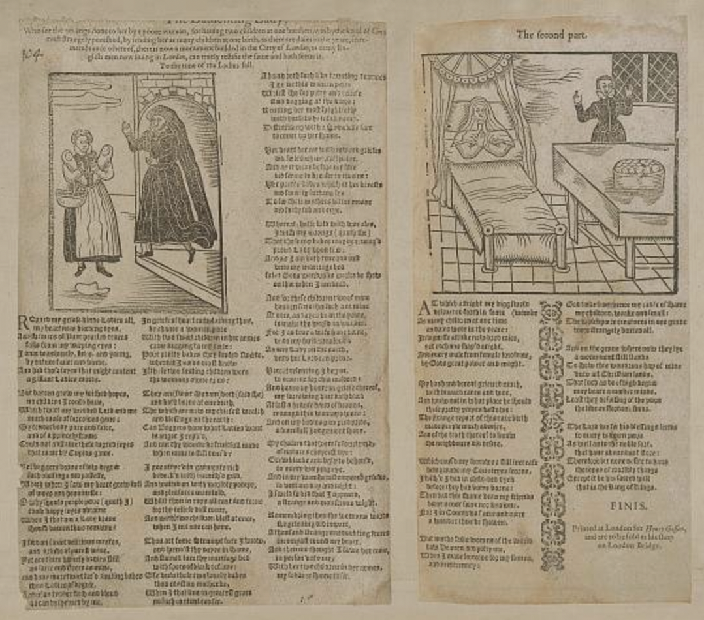
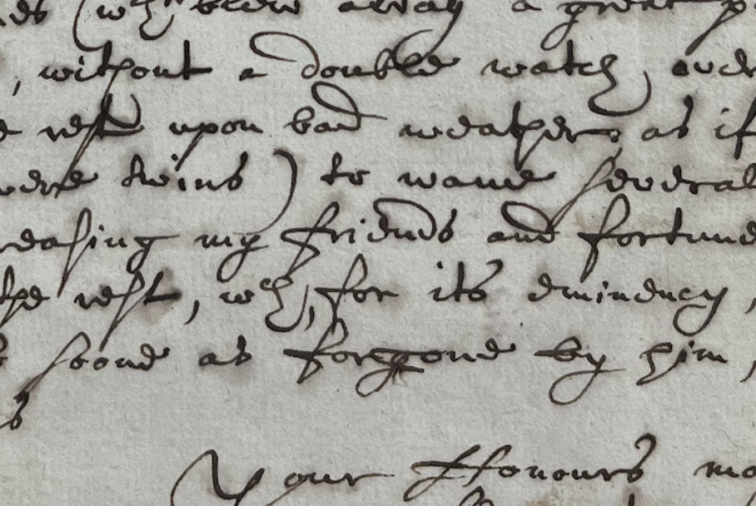
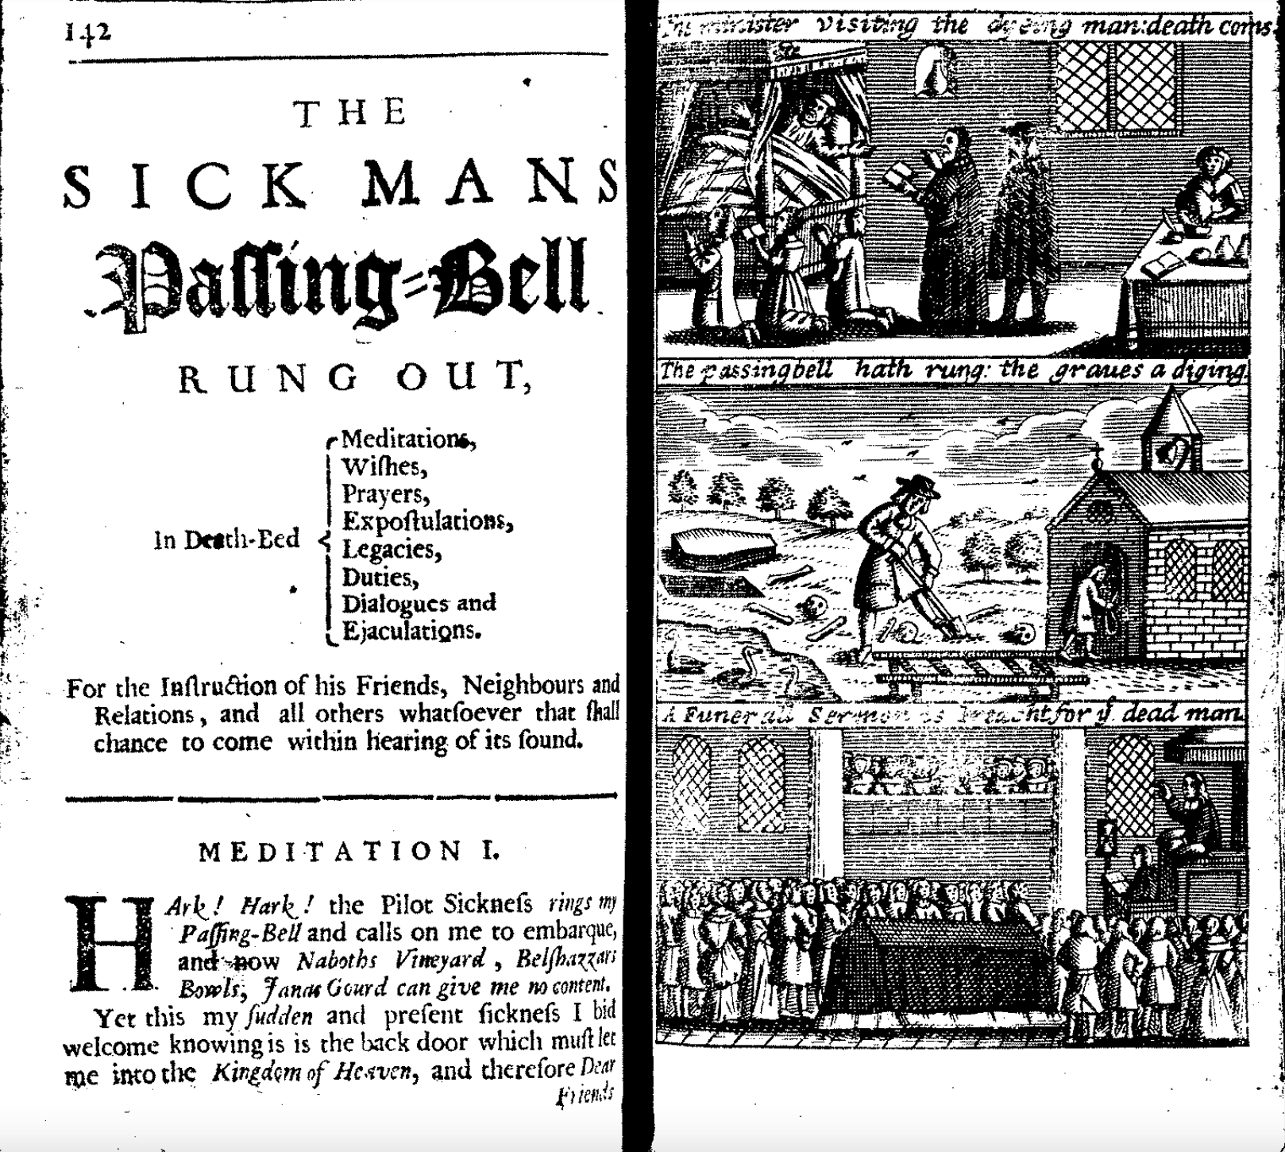
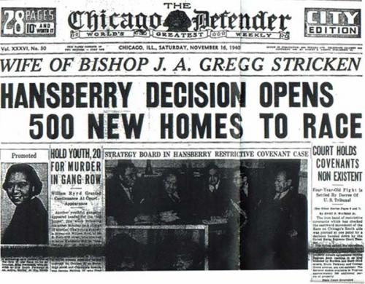
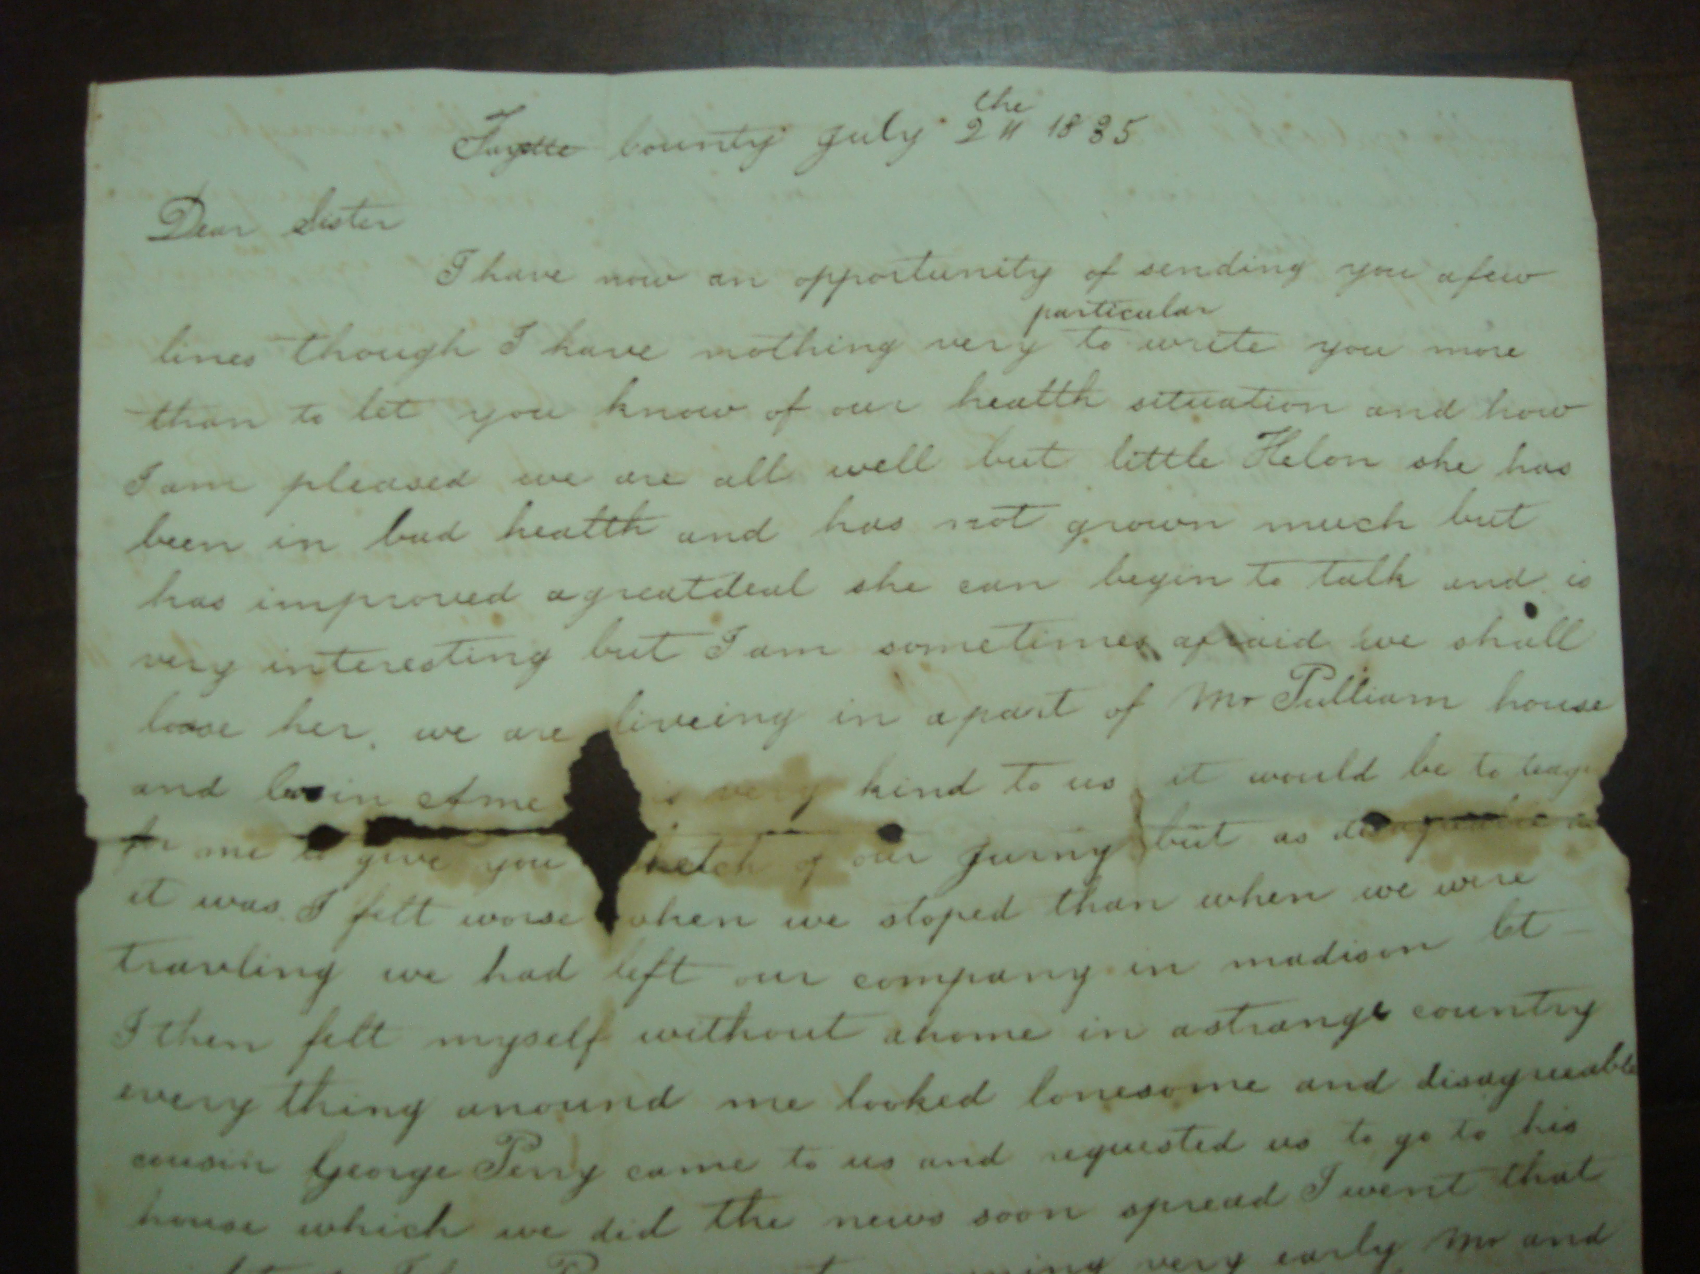
How to Use and Interpret Textual Sources
Sophie Mann and Lydia Plath
Historical Research (HI2K9)

Slide 2
Lecture Structure
1. Analysing sources
2. Early modern examples
Manuscript texts: diaries and letters
Printed texts: books of instruction, ballads and newspapers
Key themes: how to contextualise sources, how to gauge authorial intention and reader response, to what extent do these sources permit us access to past ideas, practices and experiences?
3. Modern examples
Printed texts: public letters, newspapers, autobiography, published speeches
Manuscript texts: letters
Key themes: Reading against the grain, reading for agency, reading texts that aren’t really texts (e.g. published speeches)

Slide 3
Sources are not evidence until they are analysed
Description: What does the source say?
Analysis: What is the source doing, and why?
Examples of analytical questions:
Who produced this source?
How might the author’s gender, beliefs, age, marital status, economic background, race, and so on shape what is being produced?
Under what conditions was it created?
For what purpose and audience?
What assumptions or norms shape it?
What does it leave unsaid?

Slide 4
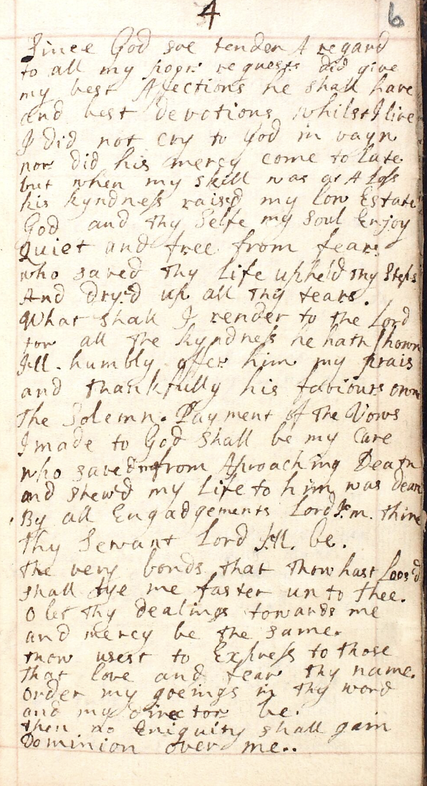
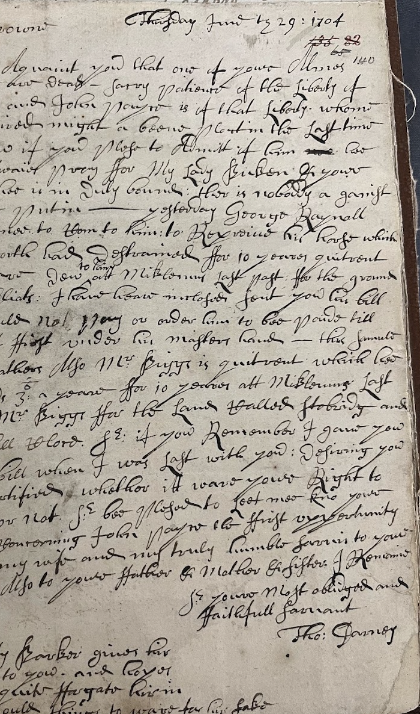
Manuscript Texts
Genre: Life-Writing
Examples:
Diaries
Letters
To what degree do these forms of life-writing grant us privileged access to subjectivity and lived experience?

Slide 5
Life-Writing
How to work with the complexity of first-person narratives…
Attend to genre conventions
Diaries
Most diaries in the early modern period were written for public or semi-public consumption.
Many diaries were composed retrospectively.
Letters
All letters are a form of self-presentation. Authors moderated their words, anticipated reader response, and drew upon literary patterns and conventions.

Slide 6
Life-Writing
What life-writing can and can’t tell us…
Diaries
Spiritual diaries and autobiographies are highly performative kinds of life-writing. While self-writing does not offer us immediate access to past experiences and practices, it does permit access to the ways in which experiences were articulated and ascribed meaning by individuals.
Olivia Weisser: ‘I do not approach first-hand accounts as clear reflections of experience but instead analyse the role of writing in constructing experience… self-writing is perhaps most valuable for revealing how gender operated in individuals written constructions of their lives – the nuanced ways patients chose to articulate their experiences on the page – metaphors they employed and scripts they appropriated – expose the impact of gender on bodily perceptions most clearly’.
Ill Composed: Sickness, Gender and Belief in Early Modern England (2016).
Letters
All letters are a form of self-presentation. Authors moderated their words, anticipated reader response, and drew upon literary patterns and conventions. Historians argue we can expect more transparency in letters exchanged between members of a household.
Sandra Cavallo: ‘Family letters are one of the few sources capable of providing vivid descriptions of everyday medical practice, thus offering a wealth of rare information about the perception of serious and less serious disorders, the way in which pathogenic logics were conceptualised, and how the various ailments were treated. They also help us reconstruct the medical vocabulary in use and what early modern people meant with expressions such as “fluxes” or “vapors”’.
“Family Letters” in Early Modern Medicine: An Introduction to Source Analysis (2024).

Slide 7
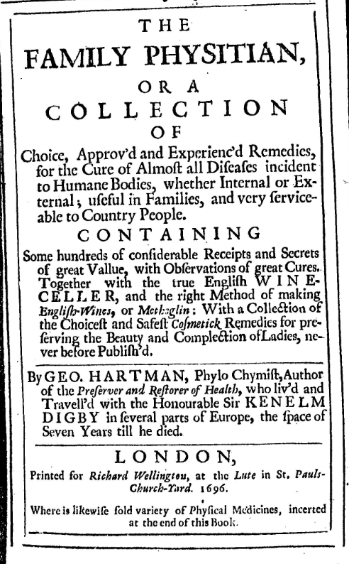
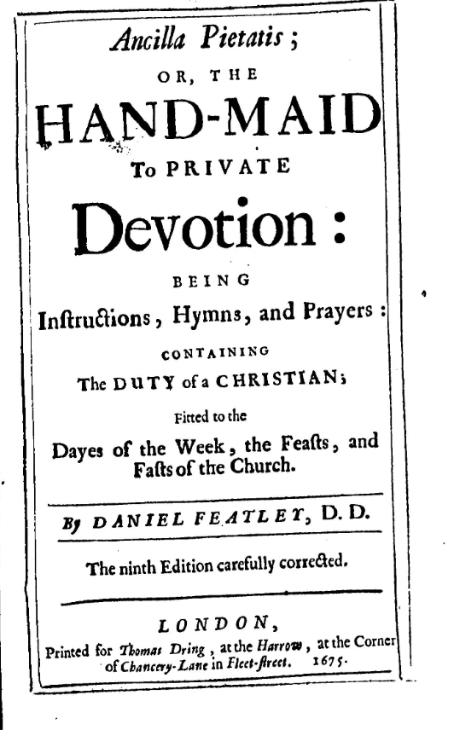
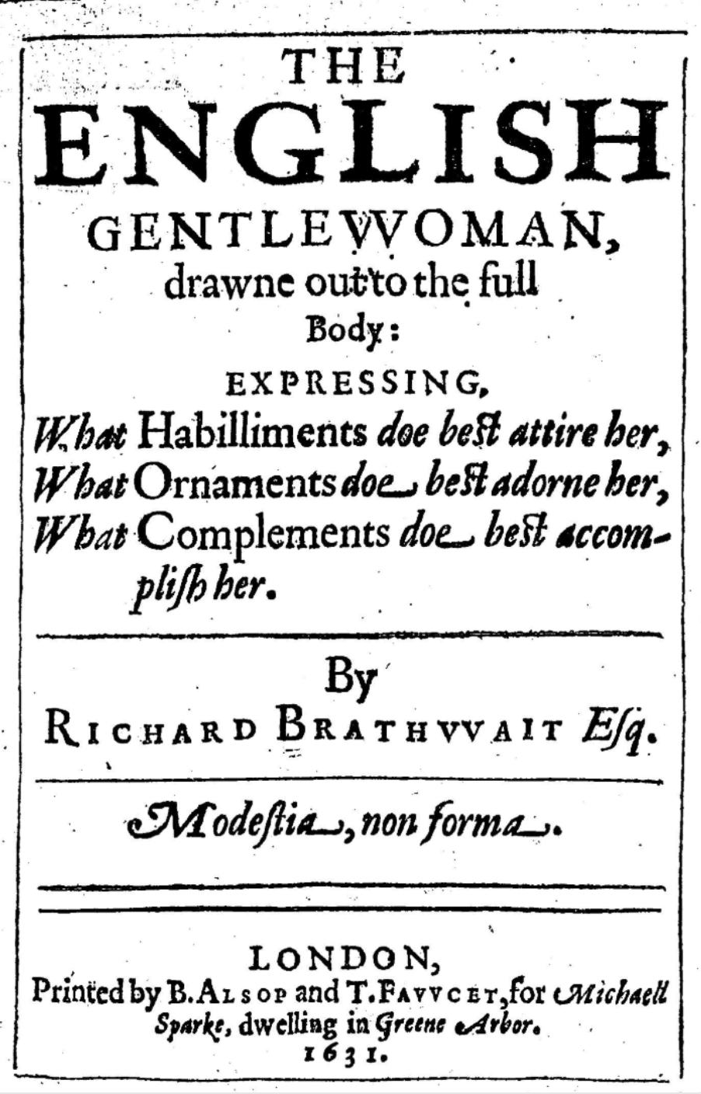
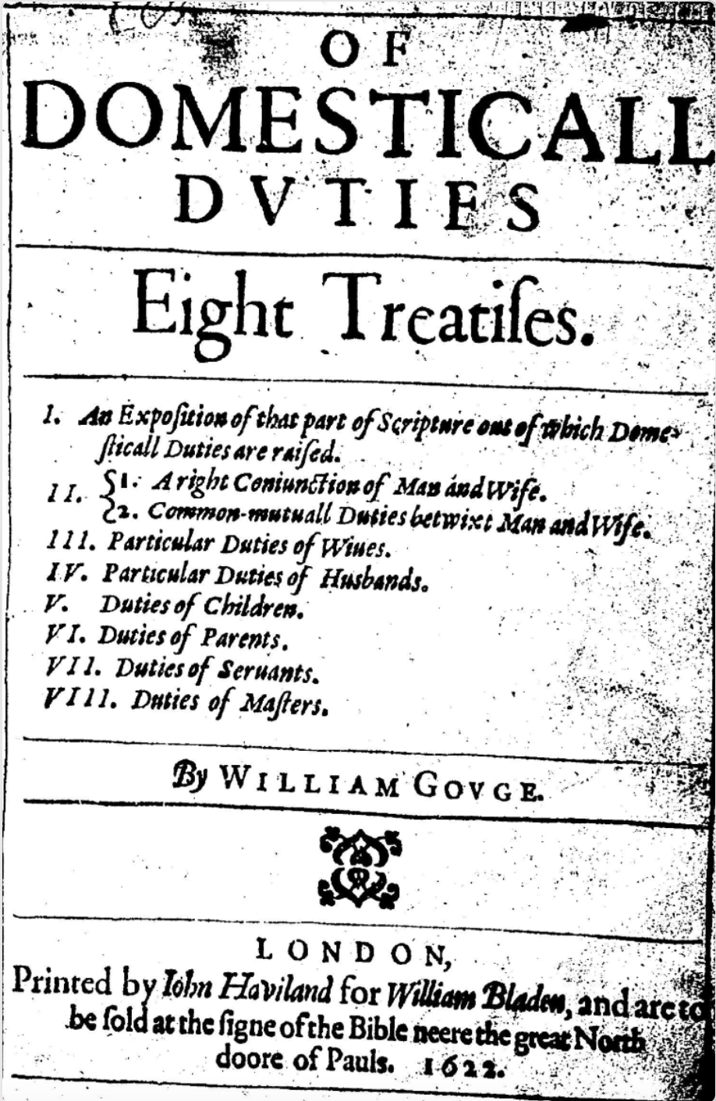
Printed texts
Genre: Books of Instruction
Examples
Vernacular medical guides
Prayer manuals
Household guides
Conduct books

Slide 8
George Hartman, The Family Physician, 1696
On its debut, the book entered a crowded field of similar titles offering instructions for the preparation and use of medicines in early modern English households.
Medical guides like The Family Physician became one of the best-selling genres by the end of the 17th century.
These texts have much to tell us about past ideas and practices related to health and medicine.

Slide 9
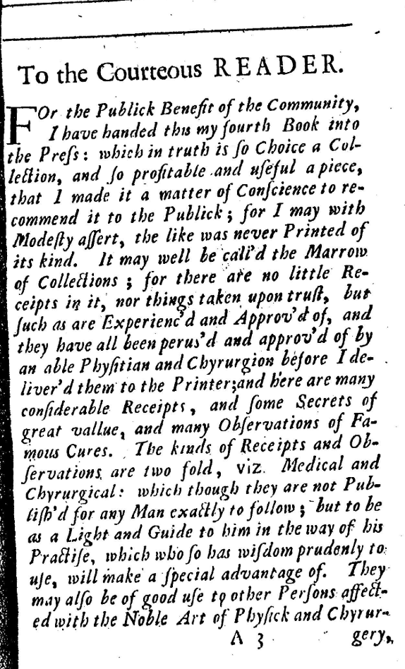
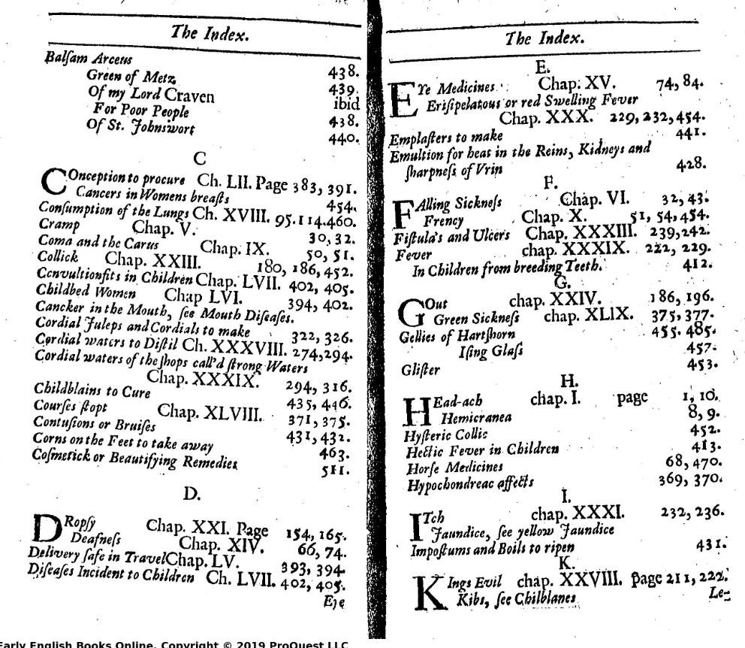
George Hartman, The Family Physician, 1696
Ways to analyse reader engagement and reception?
Content
Material form
Paratextual material
Signs of use

Slide 10
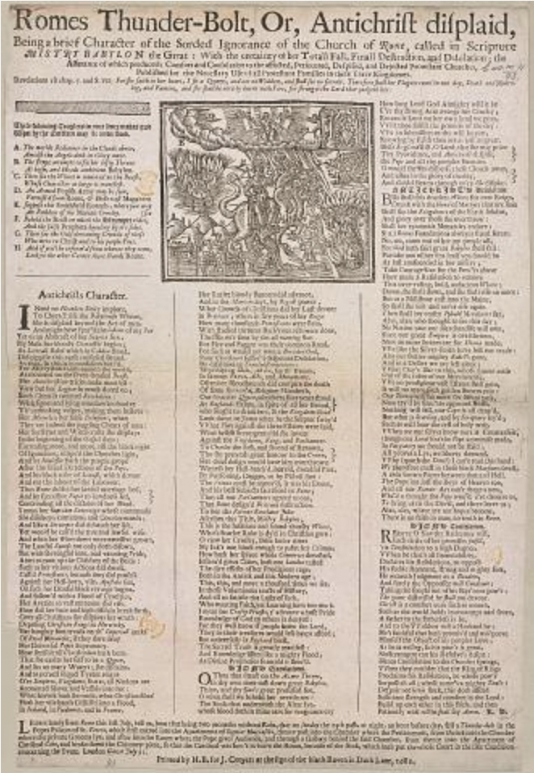
Printed texts:
Genre: Ballads
Researchers interested in ordinary people’s beliefs and ideas often turn to ballads.
Printed by the thousands. Single sheets costing as little as half a penny on a variety of topics: love, sex, marriage, politics, religion, plague.
Many heard them sung, but did not or could not read them (close relationship between oral and literate culture).
Ballads were a literary text, but they were not consumed passively on the printed page, they were performed. Sung in streets and pinned to walls of taverns and alehouses.

Slide 11
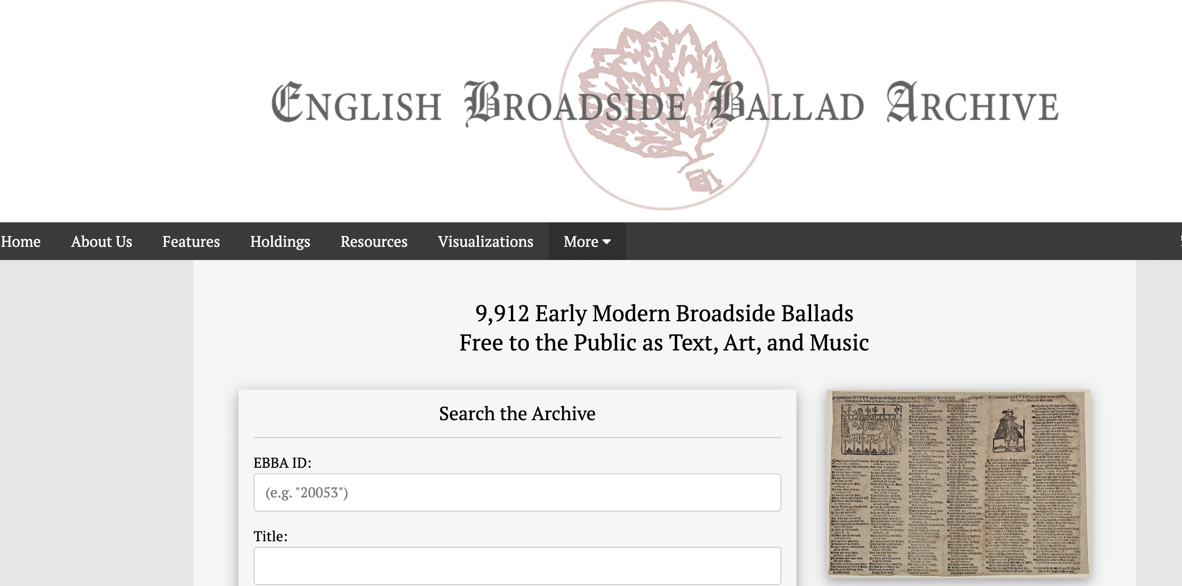
Ballads
Digital humanities has revolutionised the study of this genre.
https://ebba.english.ucsb.edu/
EBBA holds 9912 ballads that can be searched thematically, melodies can be traced, and sound clips of modern renditions are available.

Slide 12
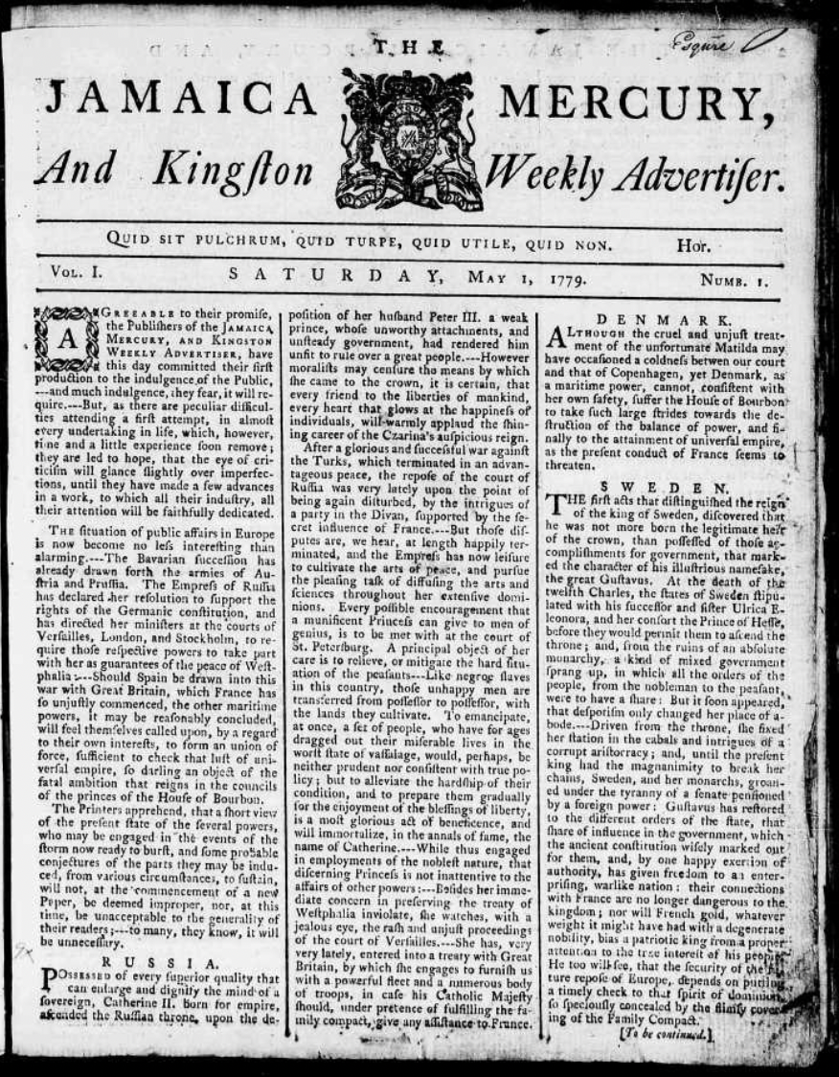
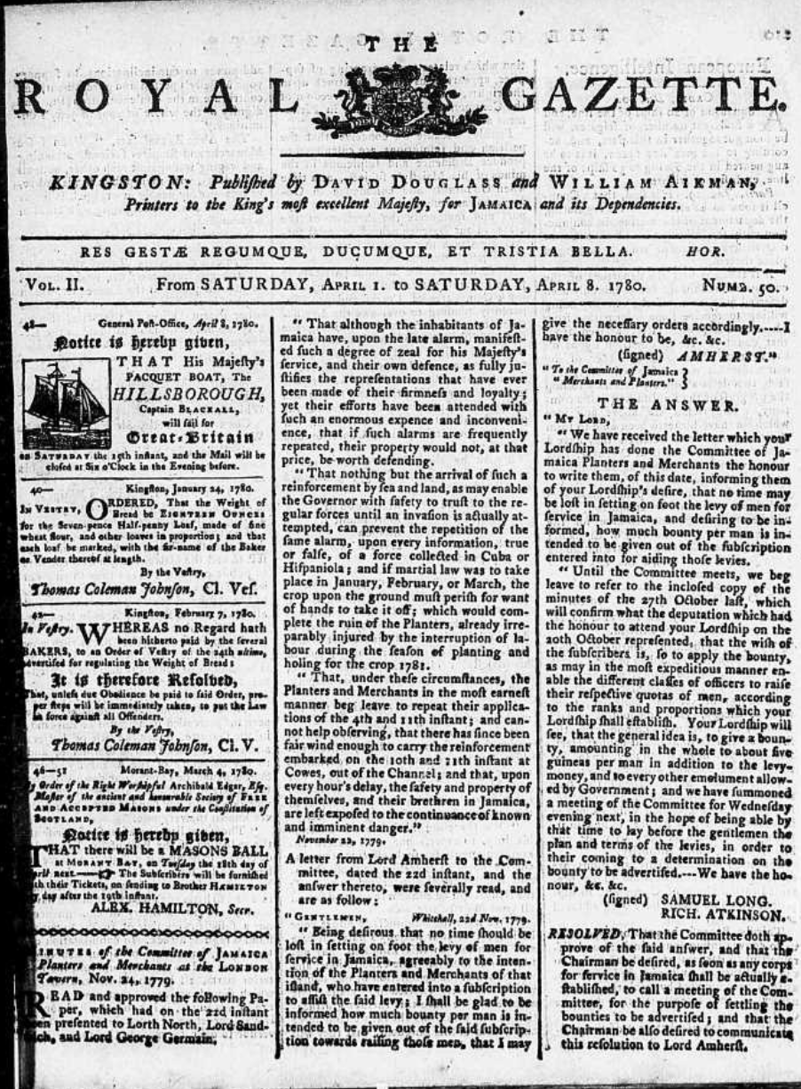
Printed texts
Genre: Newspapers
Circulation, authorship and readership?
A useful source for recovering aspects of popular opinion and everyday life?

Slide 13
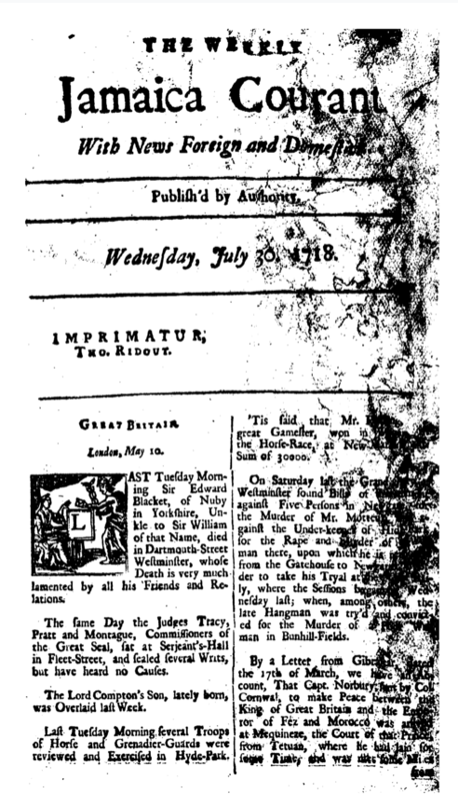
Example: British and French Caribbean Newspaper Adverts
How to read them to reconstruct aspects of everyday life
The method of triangulation
Extract:
The Weekly Jamaica Courant, 1719
To be Sold
A Negroe Man Boy, named Monmouth, who has been brought up under a Surgeon for Three Years past, aged about 20. Whoever has a mind to Buy him, may apply to his Master, Mr. Michael Diore, Surgeon at the Plantation of Daniel Gotier Esqe. in Liguanea, he intending to go off the island
Strengths and Limitations
Enslaved people’s representation in newspaper advertisements was never within their control. Their appearances in advertisements, as property for sale, as test subjects, or as runaways, reflect the priorities of enslavers rather than those of the enslaved themselves.
Even so, social and cultural historians have argued that when read critically, these sources can shed valuable light on the lives and interactions of elites, the middling and poor, as well as the enslaved themselves.

Slide 14
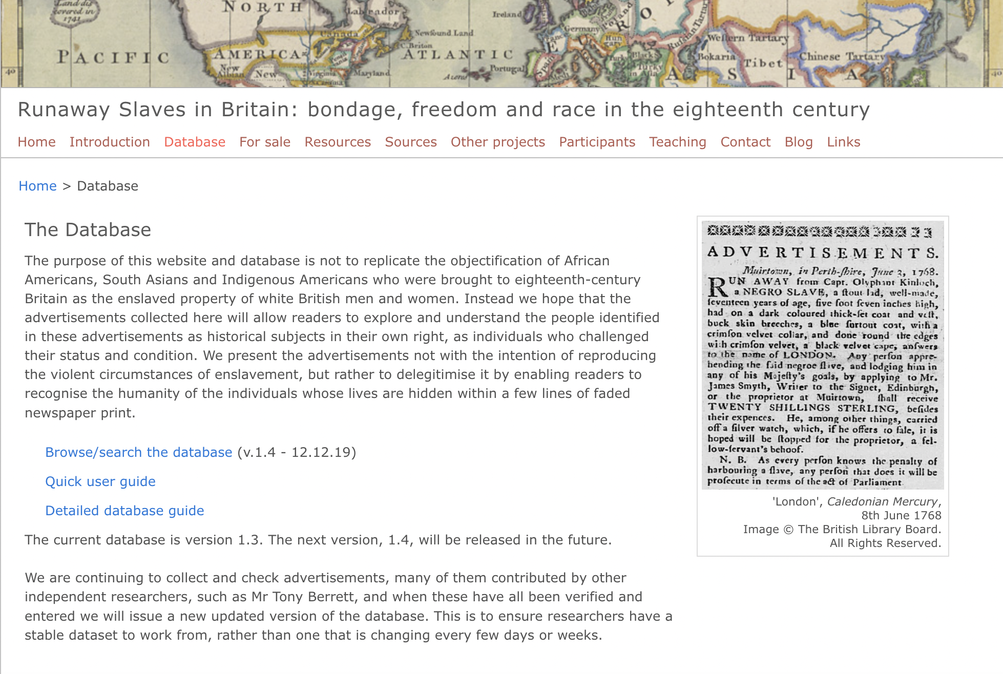
Newspaper advertisements for runaways
Through the aggregation of thousands of runaway advertisements historians have traced histories of emerging racial discourses, the incidence of injuries, diseases, and disabilities, and histories of the surveillance and violence used against the enslaved.
Digital humanists have used these advertisements to develop databases of advertisements and mapping projects that locate the origins and destinations of fugitive slaves.
https://runaways.gla.ac.uk/database/

Slide 15
Reading for “agency”
Sources written by marginalised people
  How does the author describe their experience or motivations, in their own words?
  Is the existence of the source, in itself, evidence of agency?
Sources written about marginalised people
  Often official, fleeting, or unflattering records!
  How does the author describe the marginalised person?
    How can we read “between the lines” or “against the grain” to uncover the experience or motivations of the person being described?
Reading for silence
  What does the source not say. Why? What might that tell us?

Slide 16
Reading “against the grain”
Ranajit Guha: “it is of course true that the [official evidence] hostile to insurgency register their sentiments, amount to a representation of their will. But these documents do not get their content from that will alone, for the latter is predicated on another will—that of the insurgent. It should be possible therefore to read the presence of a rebel consciousness as a necessary and pervasive element within that body of evidence… The words, phrases, and indeed, whole chunks of prose… are designed primarily to indicate the immorality, illegality, undesirability, barbarity, etc. of insurgent practice and to announce by contrast the superiority of the elite on each count. A measure of the difference between two mutually contradictory perceptions, they have much to tell us not only about elite mentality but also about that to which it is opposed—namely, subaltern mentality. The antagonism is indeed so complete and so firmly structured that from the terms stated for one it should be possible, by reversing their values, to derive the implicit terms of the other.”
Marisa Fuentes: “[I use] archival sources at times “for contrary purposes.” I stretch archival fragments by reading along the bias grain to eke out extinguished and invisible but no less historically important lives”

Slide 17
Reading “against the grain”
Instead of:
  Who wrote it?
  What does it say?
  Why did they write it?
  In what context were they writing?
Think about:
  Who is the source about - who is being described – and what can we learn about them?
  What does the source reveal that it does not intend to reveal?
  What glimpses of alternative perspectives, or otherwise unexplored lives, can we gain from the source?
  What other contexts might be relevant here?

Slide 18
Letter (public): Chicago Defender (1917)
Houston, Tx. April 30, 1917
Dear Sir: wanted to leave the South and Go any Place where a man will be any thing Except a Ker I thought I would write you for Advise as where would be a Good Place for a Comporedly young man That want to Better his Standing who has a very Promising young Family.
I am 30 years old and have Good Experience in Freight Handler and Can fill Position from Truck to Agt. would like Chicago or Philadelphia But I dont Care where so long as I Go where a man is a man.

Slide 19
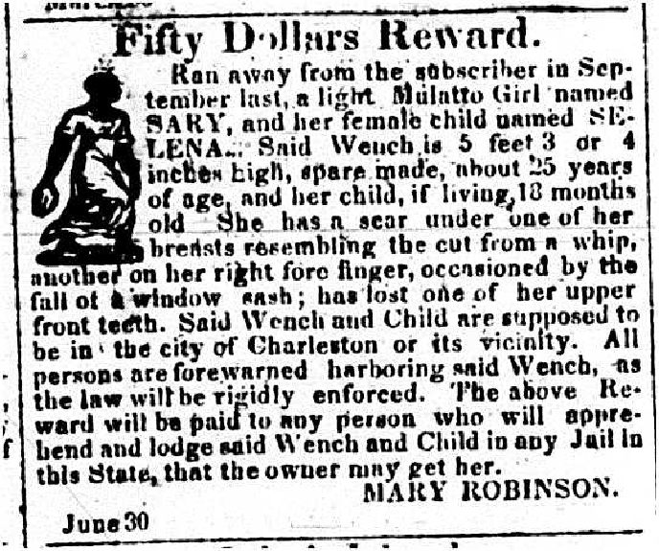
Newspaper Advertisement: Charleston Mercury (3 July 1829)
Fifty Dollars Reward.
Ran away from the subscriber in September last, a light Mulatto Girl named SARY, and her female child named SELENA. Said Wench is 5 feet 3 or 4 inches high, spare made, about 25 years of age and her child, if living, 18 months old. She has a scar under one of her breasts resembling the cut from a whip, another on her right fore finger, occasioned by the fall of a window sash; has lost one of her upper front teeth. Said Wench and Child are supposed to be in the city of Charleston or its vicinity. All persons are forewarned harboring said Wench, as the law will be rigidly enforced. The above Reward will be paid to any person who will apprehend and lodge said Wench and Child in any Jail in this State, that the owner may get her.
MARY ROBINSON
June30

Slide 20
Letter (private): archival document (Martha Fox to Elizabeth Neal, Fayette County [MS] 2 July 1835)
Dear Sister
I have now an opportunity of sending you a few lines though I have nothing very particular to write you more than to let you know of our health situation and how I am pleased we are all well but little Helen she has been in bad health and has not grown much but has improved a great deal she even begin to talk and is very interesting but I am sometimes afraid we shall lose her… I continued at Mr Neals while Mr Fox could hire his negroes and go to Mississippi he has been to Brothers and was very much pleased with that section of country but thinks it rather sickly Brother was very anxious for us to come and live with him and Mr Fox had a thought of doing so but there is a great talk of insurrection there and the people are so cruel and doing so much murder he has rather declined the idea…

Slide 21
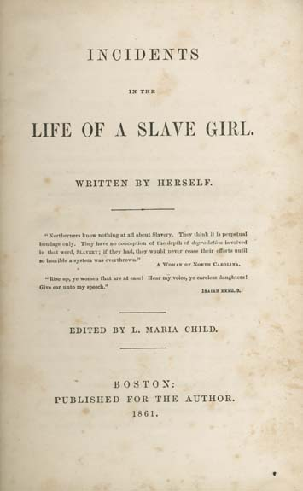
Publication: [Harriet Jacobs], Incidents in the Life of a Slave Girl. Written By Herself (1861)
But I now entered on my fifteenth year—a sad epoch in the life of a slave girl. My master began to whisper foul words in my ear. Young as I was, I could not remain ignorant of their import. I tried to treat them with indifference or contempt. The master's age, my extreme youth, and the fear that his conduct would be reported to my grandmother, made him bear this treatment for many months. He was a crafty man, and resorted to many means to accomplish his purposes. Sometimes he had stormy, terrific ways, that made his victims tremble; sometimes he assumed a gentleness that he thought must surely subdue. Of the two, I preferred his stormy moods, although they left me trembling. He tried his utmost to corrupt the pure principles my grandmother had instilled. He peopled my young mind with unclean images, such as only a vile monster could think of. I turned from him with disgust and hatred. But he was my master. I was compelled to live under the same roof with him—where I saw a man forty years my senior daily violating the most sacred commandments of nature. He told me I was his property; that I must be subject to his will in all things.

Slide 22
Reading “texts” that aren’t really “texts”
Speeches, oral histories, testimonies… many sources we encounter in writing, that were originally spoken
We also need to consider:
  In what tone was it delivered?
  Who were the audience / listeners and how did they engage with it?
  Transcription – is it accurate?
  Is a recording available? (or other versions)?

Slide 23
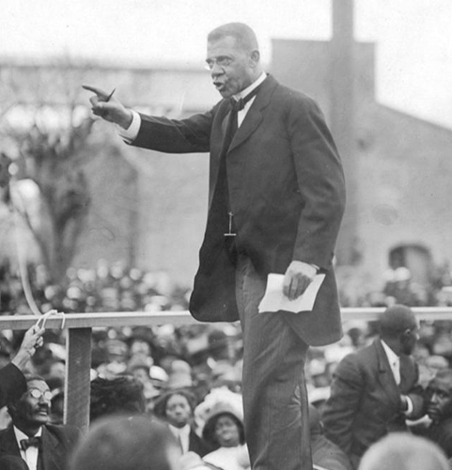
Political Speech: Booker T. Washington’s Address to the Atlanta Exposition (18 September 1895) aka the “Atlanta Compromise”
…I but convey to you, Mr. President and Directors, the sentiment of the masses of my race when I say that in no way has the value and manhood of the American Negro been more fittingly and generously recognized than by the managers of this magnificent Exposition at every stage of its progress. It is a recognition that will do more to cement the friendship of the two races than any occurrence since the dawn of our freedom. Not only this, but the opportunity here afforded will awaken among us a new era of industrial progress…. Ignorant and inexperienced, it is not strange that in the first years of our new life we began at the top instead of at the bottom; that a seat in Congress or the state legislature was more sought than real estate or industrial skill; that the political convention or stump speaking had more attractions than starting a dairy farm or a truck garden… To those of my race who depend on bettering their condition in a foreign land or who underestimate the importance of cultivating friendly relations with the southern white man who is their next-door neighbor, I would say, "Cast down your bucket where you are. Cast it down in making friends in every manly way of the people of all races by whom you are surrounded...

Slide 24
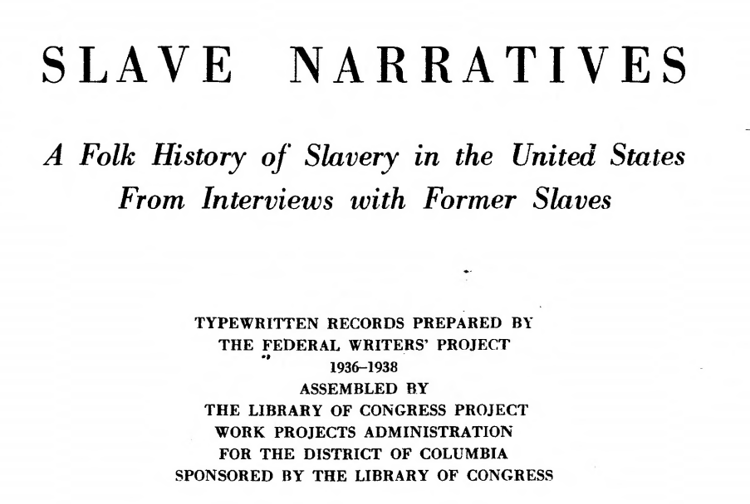
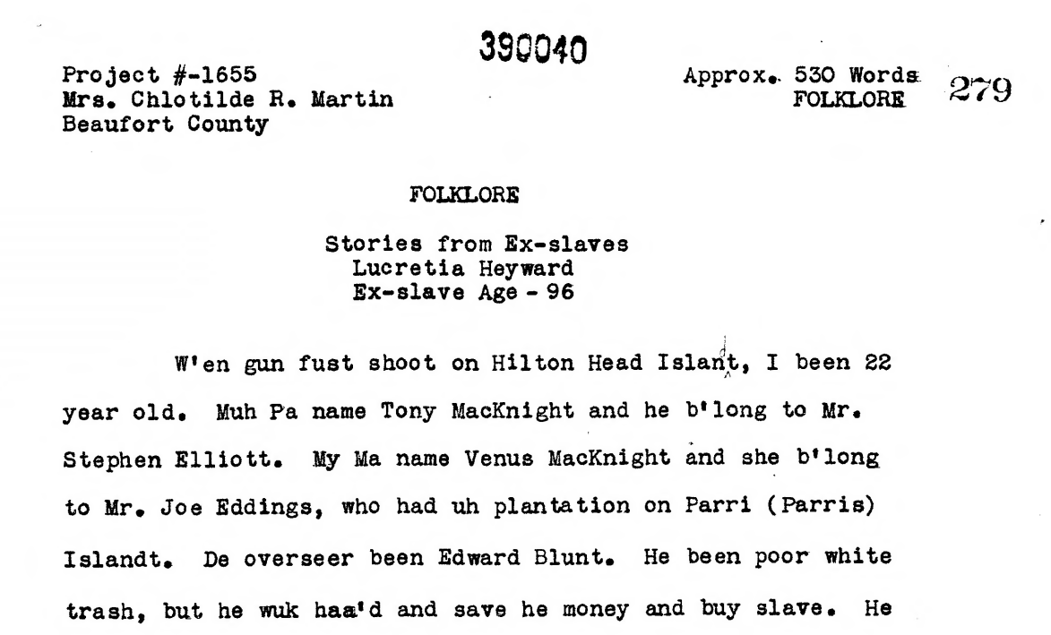
Oral History: Works Progress Administration interview (1930s)
W’en gun fust shoot on Hilton Head Islandt, I been 22 year old. Muh Pa name Tony MacKnight and he b’long to Mr. Stephen Elliott. My Ma name Venus MacKnight and she b’long to Mr. Joe Eddings, who had uh plantation on Parri (Parris) Islandt. De overseer been Edward Blunt. He been poor white trash, but he wuk haa’d and save he money and buy slave. He buy my Ma and bring she to Beaufort to wuk in de house by de Baptist chu’ch. I been born den. I hab seven brudder name Jacob, Tony, Robert, Moses – I can’t ‘member de odders, it been so long ago. I hab one sister Eliza – she die de odder day.
W’en I been little gal, I wuk in de house. Wuk all day. I polish knife and fork, mek bed, sweep floor, nebber hab time for play game… Does I hate Mr. Blunt? No, I ain’t hate um. He poor white trash but he daid now. He hab he self to look out for enty?

