Slide 1

History Research Project
Planning and Writing
Susan Carruthers

Slide 2
Getting started!
How to get started?
Don’t let yourself get intimated by “Writing” as an abstract idea– the thing you do (maybe at the last minute?) before a deadline
Writing– in the form of note-taking– is a routine activity. You do this in lectures, seminars and when reading for class and essay-writing
Taking good notes– that aren’t simply passive transcriptions of other people’s work (or cut and paste jobs)– is key. Use your note-taking to develop your own ideas; pose questions to yourself; jot down leads to pursue; and find a written voice that’s familiar, sounding like your own
Good notes– that carefully distinguish other authors’ words from yours– is also key to avoiding inadvertent plagiarism

Slide 3

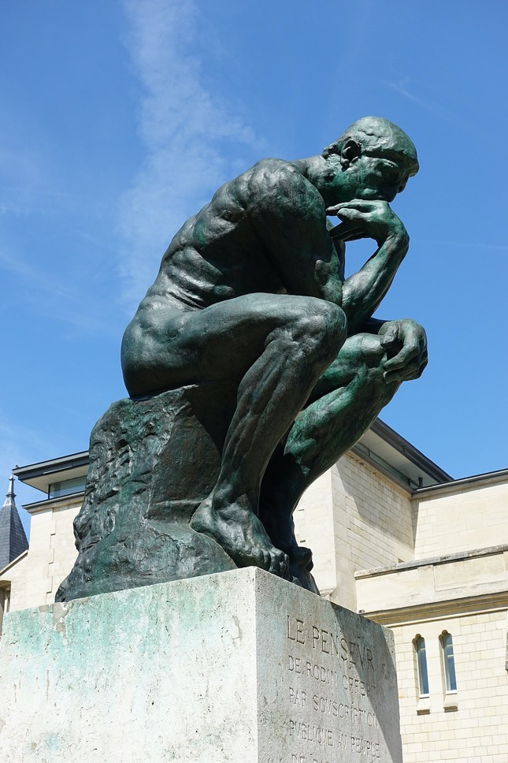

Writing and thinking
Le Penseur (1904) Auguste Rodin

Slide 4
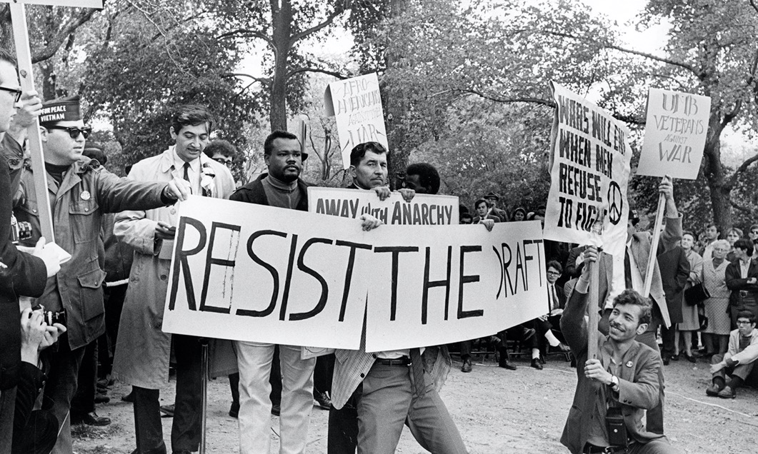
Embrace the draft!

Slide 5
Planning
Why Plan?

Slide 6
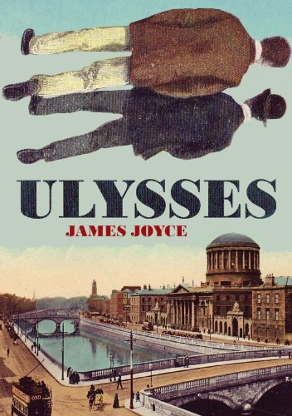
The importance of structure Every essay needs a clear and logical organization— decided before you start writing, but which can be re-thought in the process of drafting

Slide 7
Organizational logic
Play with different ways of structuring your material
Think in terms of SECTIONS
Which can have SUB-HEADINGS

Slide 8
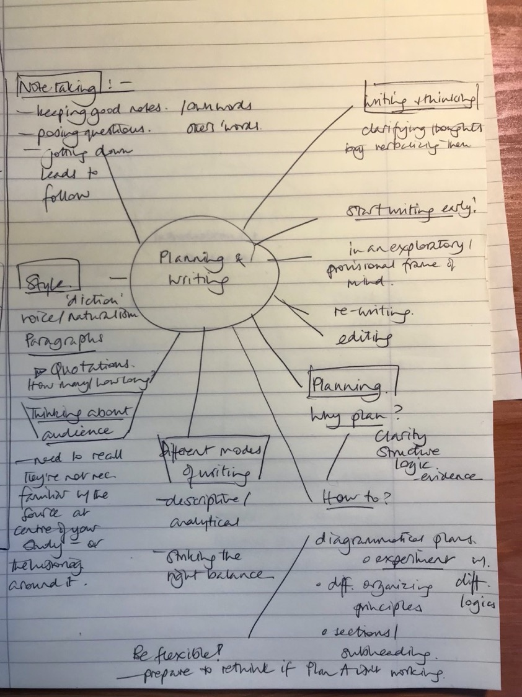
Diagrammatic plans—
Help you visualize the material and the
relationship between different elements/ideas
and how they relate to the core

Slide 9
Writing

Slide 10

The question of “audience”

Slide 11
Who is reading your essay?
What assumptions should you make about your reader’s prior knowledge?
In this case, assume that the reader does NOT possess detailed expertise in your topic
And assume that they are NOT already familiar with the source(s) at the heart of your research project
Provide enough descriptive content that readers get a textured appreciation of this source
But remember that you’re using this source to EXPLAIN and ILLUMINATE a larger historical issue/puzzle– so your essay can’t be purely descriptive
Make sure you weave into your analysis an appreciation of the secondary literature that has helped you understand the significance of your source

Slide 12
Making use of quotations
When is it appropriate to use a direct quotation?

Slide 13
Some tips
Use quotations sparingly. Quote directly from a primary source only when the quotation materially adds to your analysis.
For instance, you want to give your readers a flavour of the style in which the author of a primary source writes
you feel an author has made a point so well (or perhaps so unpersuasively) that it really must be shared with your own readers
Do NOT use quotations to convey factual information that you could simply paraphrase– with a footnote, of course, showing where you got this material from
DO introduce your readers to the author of quoted words in your own text (e.g, ‘As feminist historian Laura Schwartz has argued, “XXXX.”’) rather than simply plugging someone else’s words into your sentence and forcing your reader to look at your footnotes if they want to see whose words these are

Slide 14
Stylistic advice on quotations
In UK academic style, quotations are placed inside single inverted commas– ‘like this’– though you’ll see that work published in the US conforms to a different convention, using double parentheses– “like this”.
If your quote itself contains a quote, the rule of thumb is as follows:
‘In 1944, Home Intelligence reported criticism of “young women and girls with servicemen of every available nationality and colour”.’
Wendy Webster, Mixing It: Diversity in World War Two Britain (OUP, 2018), p. 199
In other words, the quote within a quote is placed in double parentheses, “like this”
Your footnote should cite– in this example-- both Webster’s book AND the primary source that she’s quoting, a War Office censorship report from the UK National Archives
NB: You should never try to pass off research that someone else did as your own, by citing ONLY their quoted primary source as though you yourself had looked at it. As a matter of professional ethics, you need to acknowledge your scholarly debts– in this case to Webster.

Slide 15
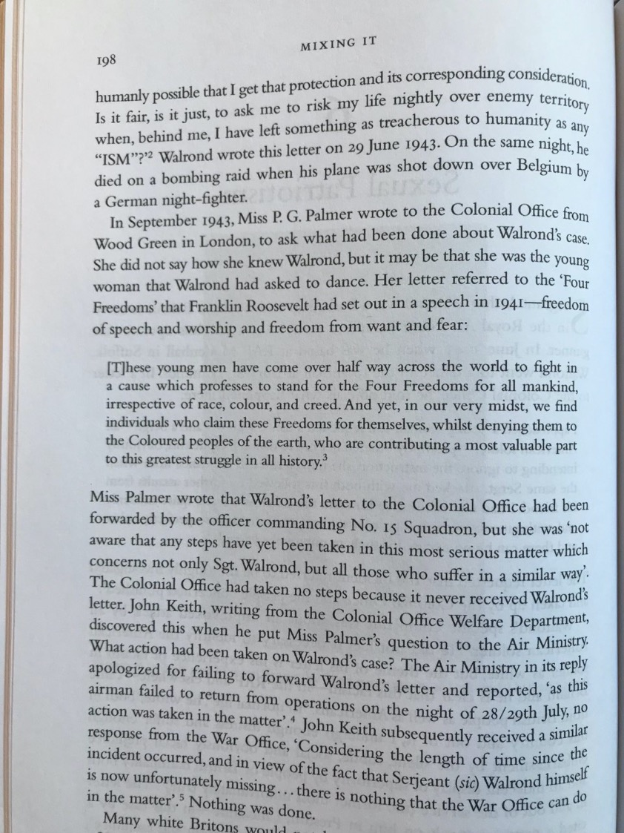
Brief quotes and block quotes
Quotes of a few words– or even a couple of lines-- can be embedded in your sentence without changing the layout or typography
NB: Quotes should NOT be italicized. Italics are used in academic writing for the titles of books, films, magazines, newspapers, journals etc.
If you have a quote that will run to four or more lines of typed text, the convention is that this material should be indented from the main body of the text– i.e. offset with a margin on either side, as in this example
Use block quotes even more sparingly than other quotes.
Make sure you introduce these quotes carefully, and integrate the quote into your analysis, as Webster does in this example from Mixing It.
Too many long quotes will make your essay seem ‘bitty’, interrupting the flow of your OWN argument, delivered in your own voice

Slide 16
Prose style
Some advice

Slide 17

Voice
Write in a voice that Sounds recognizably like your own

Slide 18
The first person pronoun?
Avoid The ‘Passive voice’
e.g. ‘In 1944, it was decided to launch an invasion of nazi-occupied France on the beaches of Normandy.’
Give your sentences a clear Subject– so there’s no confusion about agency.

Slide 19

Be kind to your reader!

Slide 20
Some tips on reader-friendliness
Keep a careful eye on paragraph length!
Paragraphs should not run over more than one double-spaced page of A4.
Although there is no single ‘correct length’, aim for approx. 200 words per paragraph, introduced with a strong ‘topic sentence’
Mix things up! A short, punchy paragraph– once in a while– is a good way to make an emphatic point, and to keep your writing lively.
Indent (using the tab key) each new paragraph.
Write in as clear and accessible prose as you can
Re-read your work not only to catch and correct errors but to make sure that your prose reads as smoothly as possible. Try reading it out loud. Your ear will readily detect awkward phrases.

