Slide 1
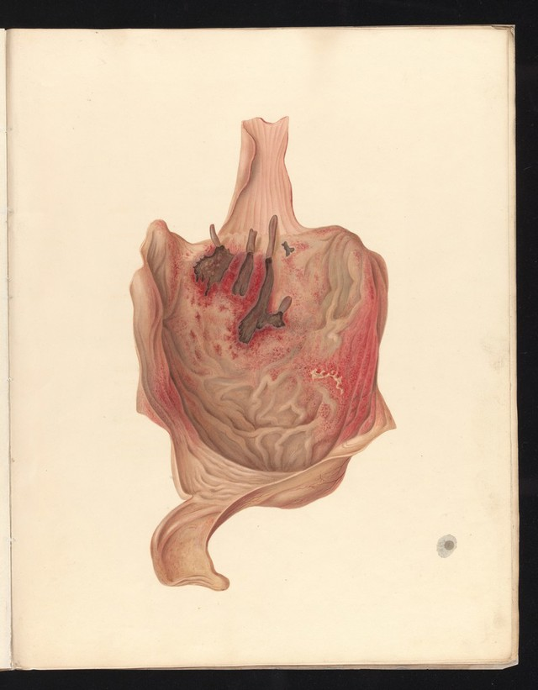
Interrogating the Dead: Forensic Medicine
HI2L2: Life After Death—A History of Human Remains
Week 8
George Leith Roupell, Illustrations of the effects of poisons (1833)

Slide 2
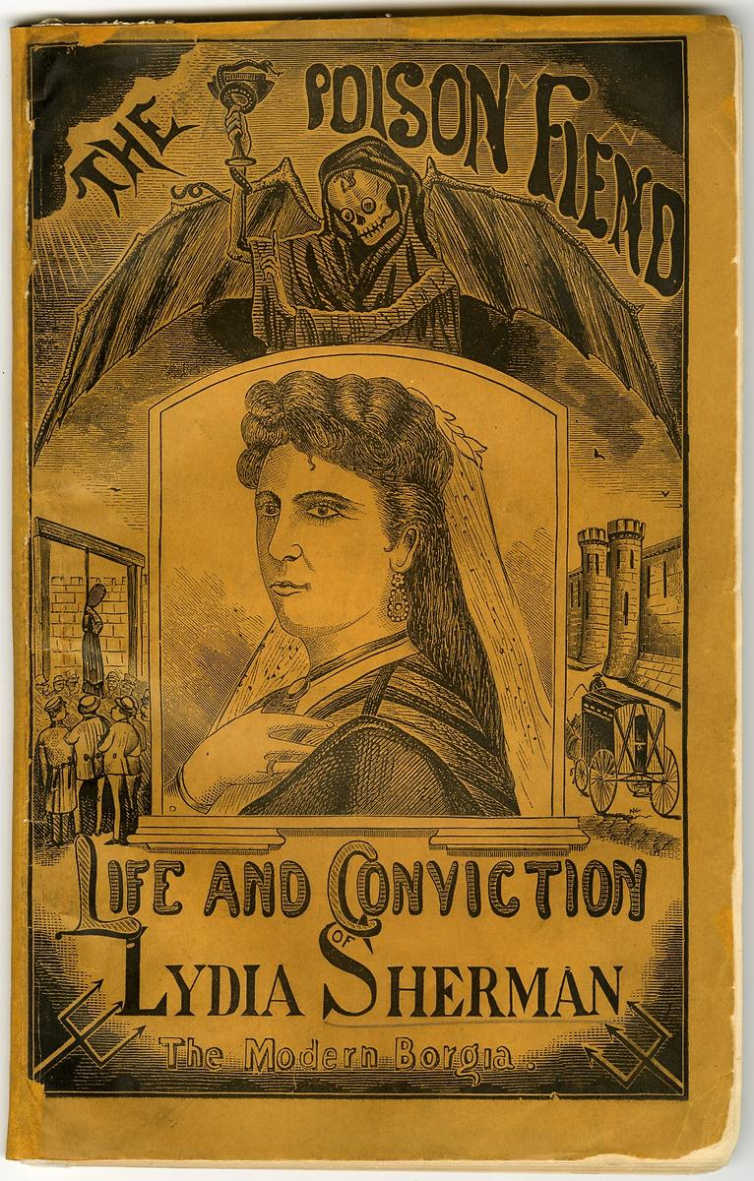
Lecture Outline
Autopsies and pathology
Medical jurisprudence
Forensic medicine
Toxicology
Decomposition
Identification
The CSI effect
The Poison Fiend; Life and Conviction of Lydia Sherman (1873)

Slide 3
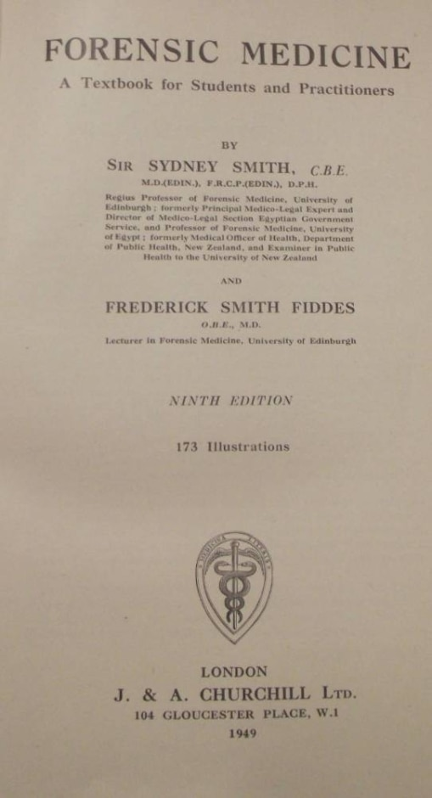
Definitions
Forensic: Pertaining to, connected with, or used in testimony or evidence in courts of law and governmental proceedings.
Forensic medicine: The field of medicine that interprets or establishes the facts pertaining to the unexplained or suspicious death of a human being or the suffering of grievous bodily harm, in civil or criminal law cases.
        The National Library of Medicine (USA)
Forensic methods developed to detect evidence of crimes in corpses: autopsies to look for signs of internal trauma, chemical analysis to find traces of poisons, microscopic analysis to show minute lesions, measurements to gauge time since death, etc.

Slide 4
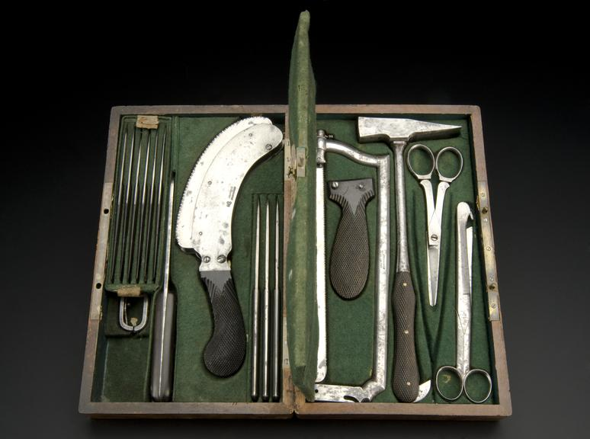
Autopsies/Postmortems
Postmortems: Medical inspection to determine cause of death, looking for external and internal signs.
Autopsies: internal examination of the body (i.e. dissection component of the postmortem).
Dates back to middle ages, but modern roots associated with the rise of clinical medicine in the early C19.
Less contentious that dissection for anatomical training. Public more persuaded of its necessity and families more likely to provide consent.
Increasingly autopsies conducted as part of coroners’ inquests into suspicious deaths.
Postmortem set, by Charriere of Paris, 1820-1860 (Science Museum, London)

Slide 5
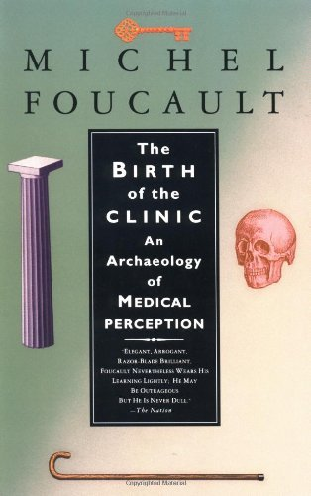
Pathological signs
Growth of pathology (study of disease in the body) associated with the ‘birth of the clinic’ in post-Revolutionary France, described by Foucault in 1963.
Hospital medicine allows medical practitioners to match symptoms in live patients to internal lesions after their deaths.
Diseases are associated with visible changes to organs, allowing pathologists to define diseases according to their effects on the body.
Determination of death by natural causes requires pathological knowledge.
Disciplinary development of forensic medicine in France accompanies the shift to clinical medicine.

Slide 6
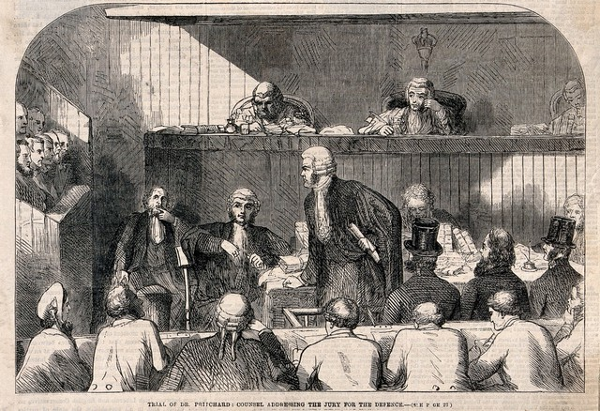
Medical practitioners as legal experts
Medical jurisprudence: applying scientific/medical knowledge to legal problems (inquests, trials)
Until the C18, medical experts worked on behalf of judges to relay facts.
Starting in the late C18, medical witnesses began to work either for the prosecution or defense teams, and both their evidence and their credibility could be challenged by the other side.
Role as ‘expert’ witnesses assumed professional knowledge and experience, even before formal establishment of forensic medicine as a sub-discipline.
Professional growth of forensic medicine responds to demand for expertise in the courtroom. It is reactive, with research motivated by specific cases.
Competing experts on cases leads to professional disputes being aired before the public.
The trial of Dr Edward William Pritchard for murder by poisoning (1865)

Slide 7
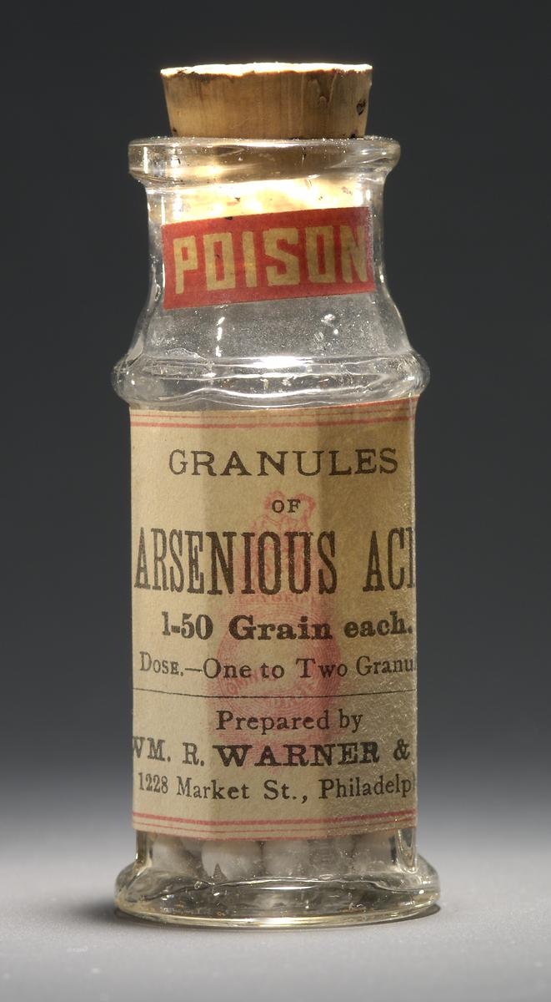
Toxicology
Toxicology: the study of the harmful effects of chemicals and other agents on living organisms. In medico-legal setting, focus has particularly been on poisoning.
Prior to mid-C20, few restrictions on sale of poisons, which were widely manufactured after the Industrial Revolution.
Their use in murders presumed to be widespread until the mid-C19, when chemical tests were devised to show signs of their presence in corpses.
1836 Marsh test for arsenic, devised by James Marsh following failure to establish its use in 1832 murder trial. Arsenic reactive with zinc and acid to produce arsine gas, which could be oxidized to produce arsenic deposit.
Arsenic-based medicine, Wm. R. Warner & Co., c.1900 (National Museum of American History)

Slide 8
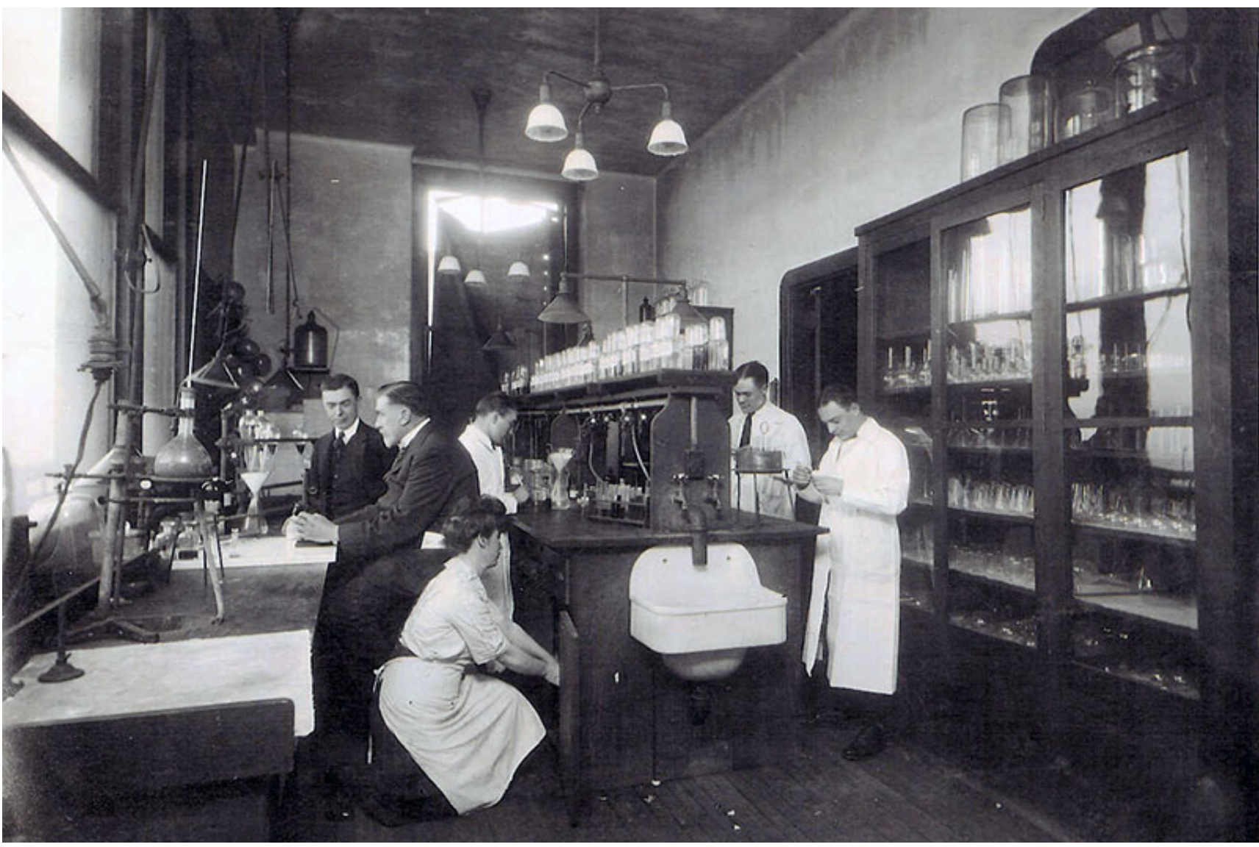
Toxicology, cont’d
Toxicological evidence sometimes ambiguous due to widespread use of substances in legitimate contexts, abundance of possible compounds, difficulties of isolating and identifying each one.
Dramatic decrease in murder by poison as chemical tests become more sophisticated and demonstrated experimentally and in published research.
By twentieth century, toxicology applied more widely than murder investigations to establish culpability in manslaughter investigations: exposure to lead, radium, carbon monoxide, etc.
Cadavers supply the evidence: toxicologists work with samples of stomach contents and lining, bones, soft tissue and hair to establish level of toxins in the body.
Bellevue Hospital Toxicology Laboratory, c. 1932

Slide 9
Decomposition
Study of decomposition of bodies began in mid-C19, to establish time elapsed since death, using anatomical observation, and entomology (study of insects). Phases of insect colonization of cadaver in different environments.
Temperature, rigor mortis, and livor mortis provided precise data to time recent deaths.
Pace of criminal investigations often meant bodies had to be exhumed (sometimes multiple times) for further forensic examinations.
Expertise to differentiate between signs of decay and signs of violence/toxins.
The evidence from corpses is inherently unstable because they are constantly changing.
Decomposition is not a uniform process, but varies according to environment.

Slide 10
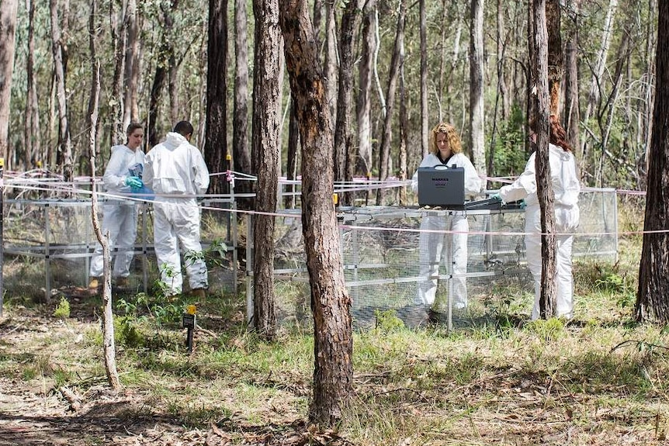
Body Farms
Used in taphonomy: study of processes that affect organic matter after death (e.g. decay, fossilization)
Developed by anthropologist William M. Bass in 1981, at University of Tennessee.
Bodies (usually) donated for research.
Decomposition studied in a wide variety of conditions, buried and exposed, wet and dry, at all stages—mass sample-taking, time-lapsed photography and recording of data.
‘Reverse’ observations to refine facial reconstruction techniques.
Ten facilities (in USA, Canada, and Australia), with other countries such as the UK preferring animal-based taphonomic research.
Australian Facility for Taphonomic Experimental Research

Slide 11
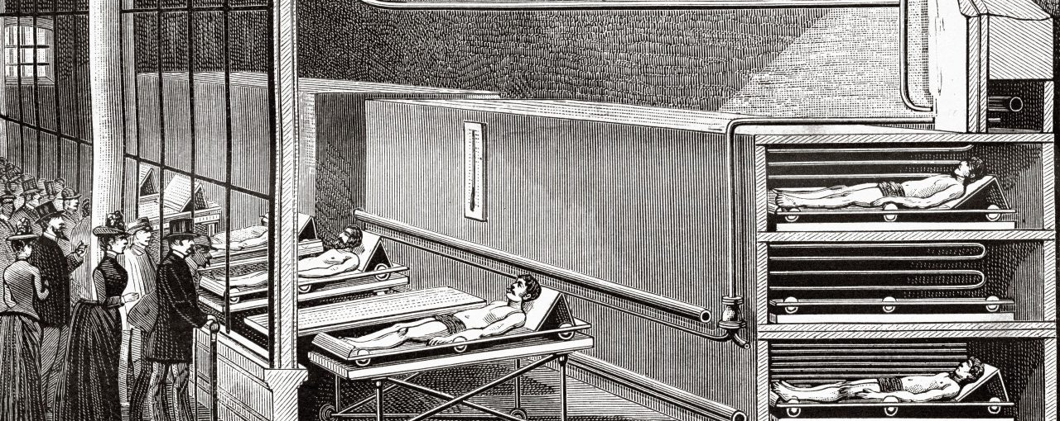
Identification as Spectacle: The Paris Morgue
The exhibition room at the Paris morgue, by Louis Poyet, 1887

Slide 12
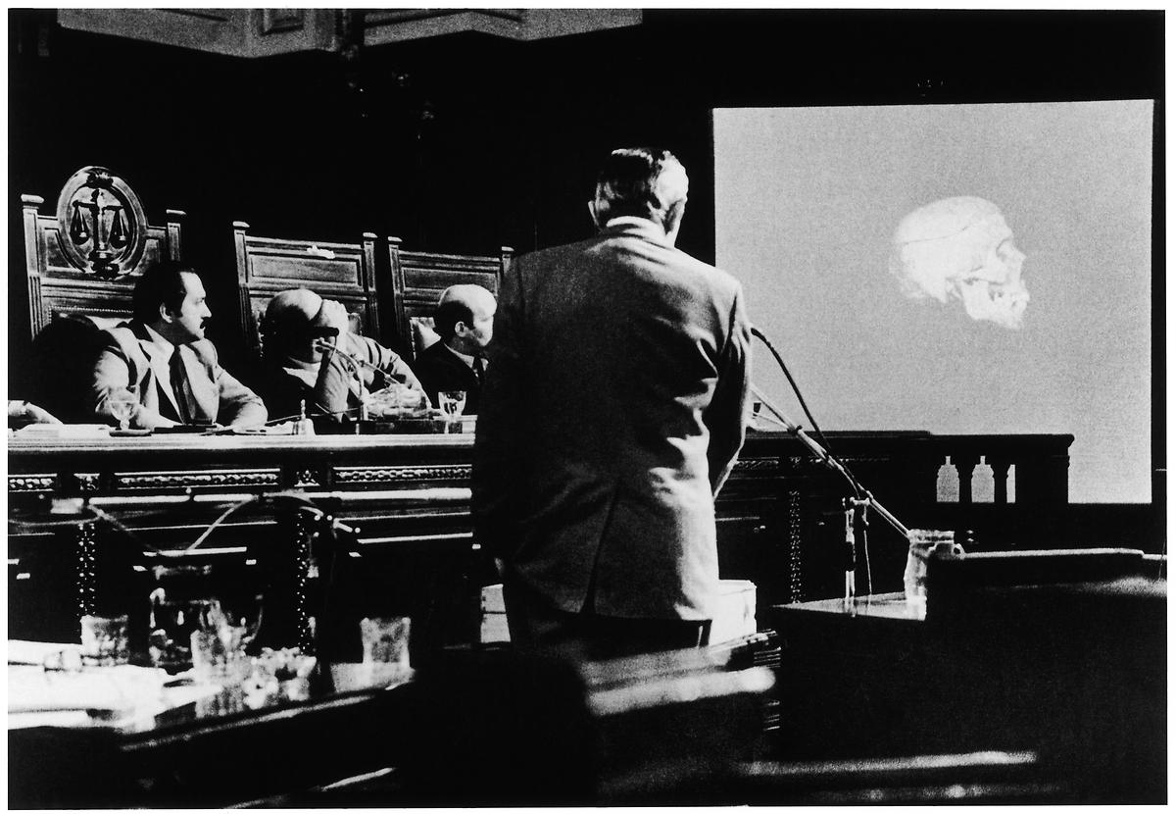
Identification
By late C19, criminal anthropometry was used to identify criminals through finger-printing and physical measurements. These techniques also used to identify victims of crime.
Biological evidence including the serological analysis of body fluids drawn from cadavers and suspects have helped to identify criminal perpetrators (and victims).
Forensic human rights investigations now critical to prosecuting war crimes, atrocities, political murders, and genocide, often led by NGOs and/or international tribunals. Establishing the identities of the dead to counter attempts at ‘cover-ups’ and support survivors.
  In 1984, anthropologists excavated mass graves to identify bodies of the ‘disappeared’ of Argentina’s ‘Dirty War’ (1976-1983) leading to convictions of junta leaders.
Identification techniques used by military to establish the ‘unknown’ dead in conflicts (e.g. Commonwealth War Graves Commission est. 1917 still works to recover, identify, and rebury war dead of UK, Australia, Canada, India, New Zealand and South Africa).
Clyde Snow at the trial of the Argentinean junta, 1985

Slide 13
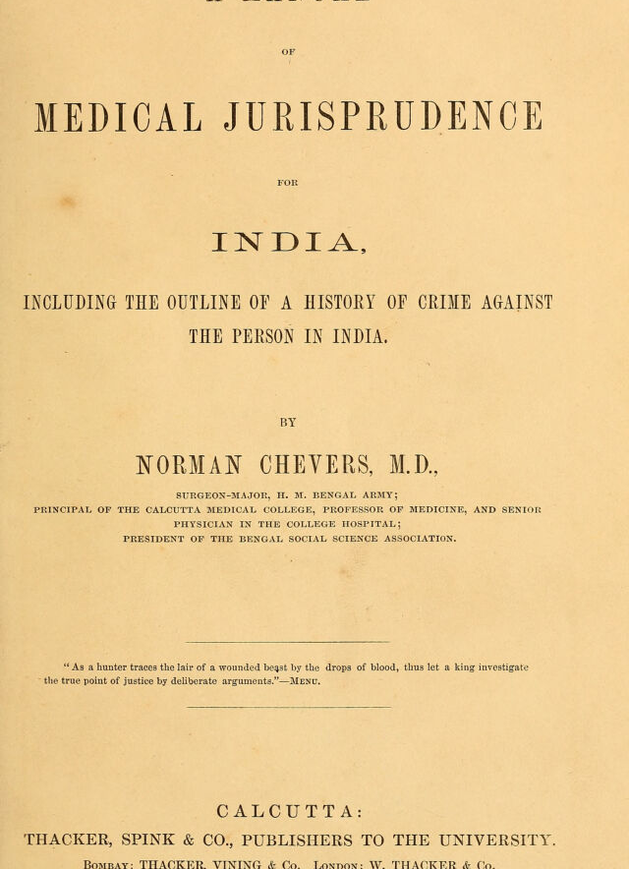
Exporting Forensic Medicine
European powers established parallel legal systems in their colonies, paving the way for medical jurisprudence to occupy similar role.
However, local adaptions required as medical examiners needed to work with local police force to ensure bodies were promptly delivered with case histories in instances of suspected murder.
Autopsies disrupted traditional funerary practices, discouraging cooperation.
Mistrust of colonial justice system and medical authorities due to engrained biases/racism.
Local knowledge required to correctly identify individuals, with distinct cultural signs of gender, age, religion marked on the body.
Different climates required adjustments of forensic data tables.

Slide 14
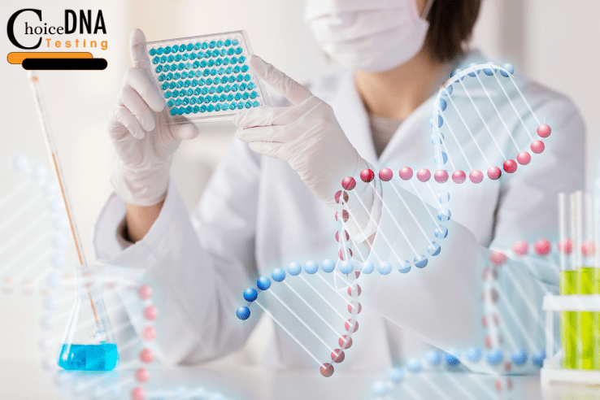
DNA
DNA discovered in 1953, began to be used to identify individuals in early 1980s (Alec Jeffreys)
DNA seen as more decisive than serological evidence for linking perpetrators to crime scenes, but still faced problems of standardization and admissibility in court.
DNA testing now seen as the gold standard, but still prone to error: contamination and degradation of samples.
Remains central to identification of corpses, but only when corroboration is possible.

Slide 15
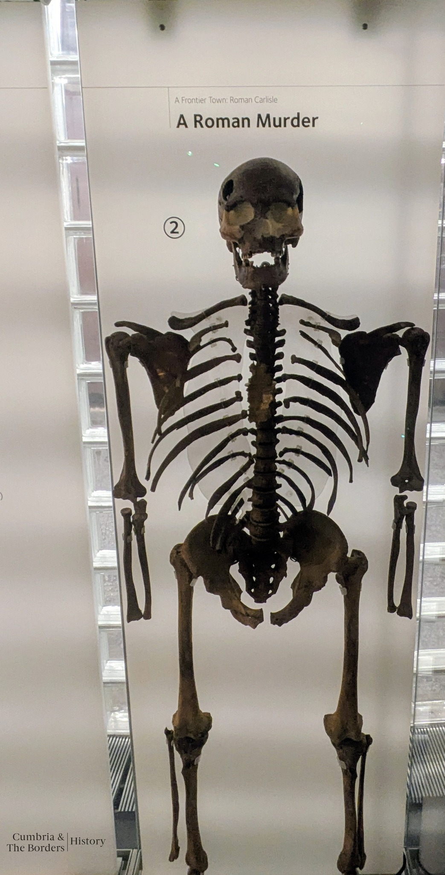
Bioarcheology
Bioarcheology: Study of human and animal remains to establish age, gender, origin, as well as to uncover evidence about past diet, health and culture.
Field associated with study of ancient/prehistoric dead, but its techniques also used in modern forensic investigations.
Forensic techniques incorporated into bioarcheology can reveal signs of past violence.
Ethical questions have recently been raised about lack of consent for work on the ancient dead, including mummified Egyptians.
‘Duncan’, in Tullie House Museum, Carlisle

Slide 16
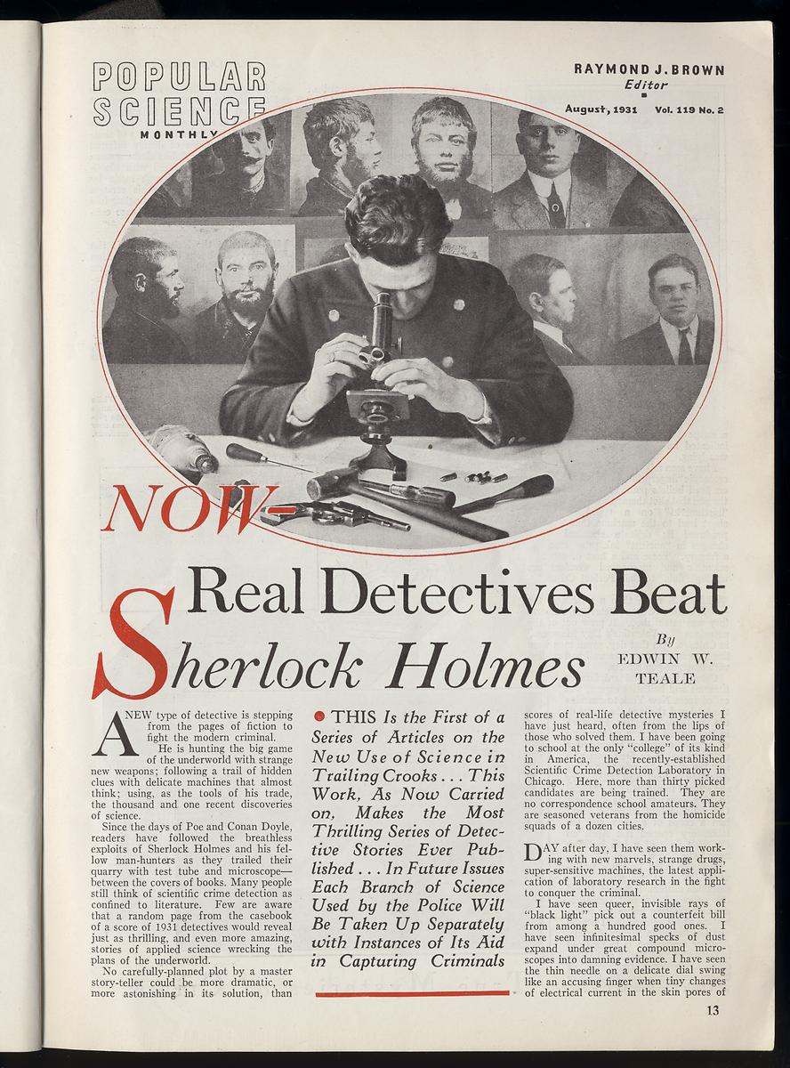
Theatricality and Personality
Use of scientific techniques to solve crimes moved from the courtrooms into sensationalized news stories and fictional accounts of policing/detective work—e.g. Holmes and Watson.
‘Celebrity’ pathologists and toxicologists created through involvement in high-profile murder cases.
When forensic evidence is undecisive, the reputation of particular experts enhances their testimony.
Importance of personality undermines sense that forensic experts are speaking for the dead.
Popular Science Monthly, August 1931

Slide 17
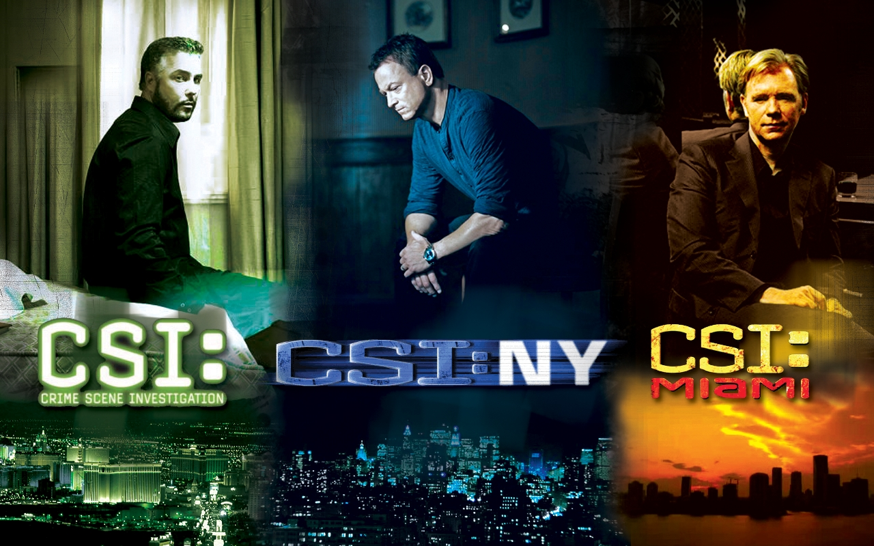
The ‘CSI Effect’
Portrayal of forensic medicine in popular media has created misleading impression of forensic evidence: its presence and decisiveness.
TV narrative structure ensures crimes are solved (and prosecuted) through investigative work.
Term coined by USA Today in 2004 to describe how CSI’s popularity led juries to expect use of forensic evidence, which they weighed more heavily than circumstantial evidence.
Juries do not have the expertise to understand forensic evidence or its limitations, but have been conditioned to expect/accept medical witnesses.
CSI (and spin-offs), c.2000-2024

Slide 18
Conclusion: Do Bodies Speak?
"A dead body tells no tales except those it whispers to the quick ear of the scientific expert, by him to be reported to the proper quarter.” --Andrew Douglas Maclagan, 1878
“Let conversation cease. Let laughter flee. This is the place where Death delights to help the living.” (Motto of the New York City Medical Examiner’s Office)
Forensic experts see themselves as reading/interpreting human remains—providing their testimony in court.
Pursuit of methods such as ‘optography’ (taking images off the retina of the dead) suggest belief that corpses could/can communicate.
The dead are both a presence and absence in the historiography on forensic medicine: central, but instrumental, a vehicle for research and a source of evidence, to be exhumed, dissected, fragmented, ground down. Forensic medicine far more often about its researchers/practitioners than the bodies they ostensibly speak for.
What role does consent, posthumous respect of bodies play in criminal investigations?

