Slide 1
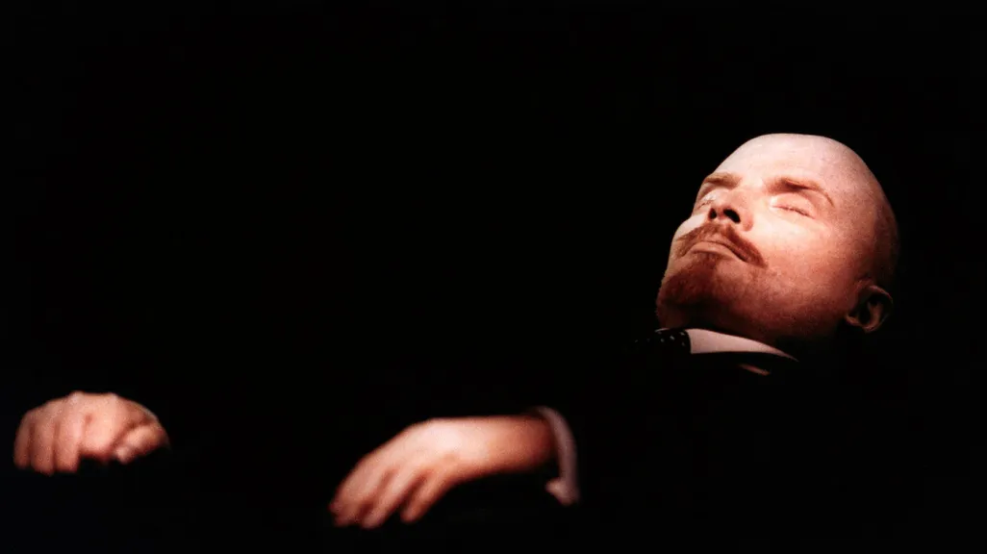
Preserving the Dead:
Holy and Secular Relics
HI2L2: Life After Death—A History of Human Remains
Week 1

Slide 2
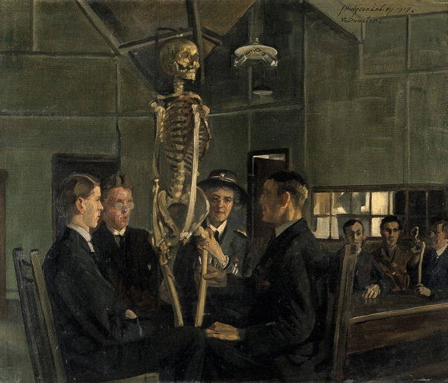
Core Concepts
Human remains are polysemic: they have multiple meanings. They are both people and things. They can be symbolic and/or invested with power and potency. In addition to their varied purposes (e.g. medical research, religious worship, battle trophies) they are also historical artefacts and form part of material culture.
These meanings are constantly in flux. Remains preserved and collected hundreds of years ago do not, inevitably, carry the same connotations in the present as they have in the past. Remains are constantly repurposed, reclassified, and reinterpreted within shifting ethical frameworks.
The dual nature of human remains as people and things raises ethical challenges. These are equally in flux, but frequently involve questions around the retention and display of remains obtained without consent, and the competing interests of researchers and community groups in deciding their future.
J. H. Lobley, ‘Anatomy Lesson at St Dunstan’s’ (1919)

Slide 3
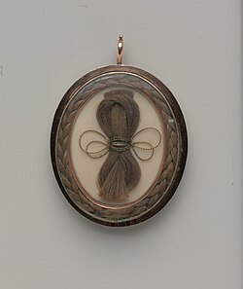
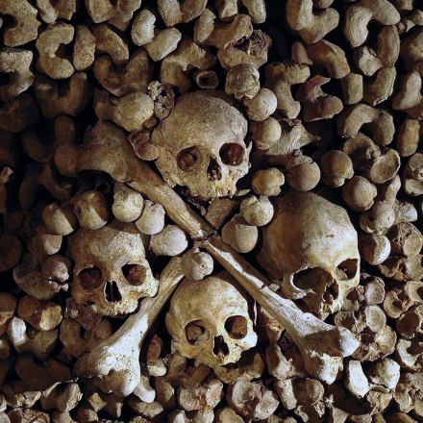
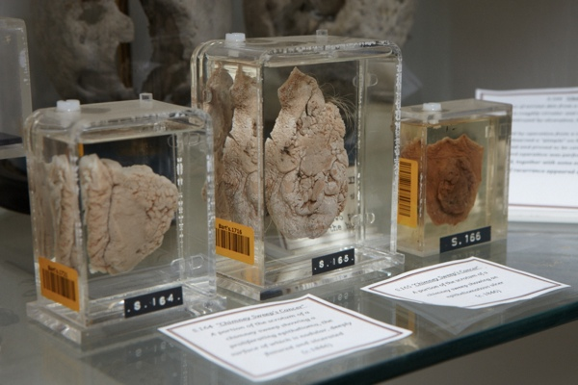
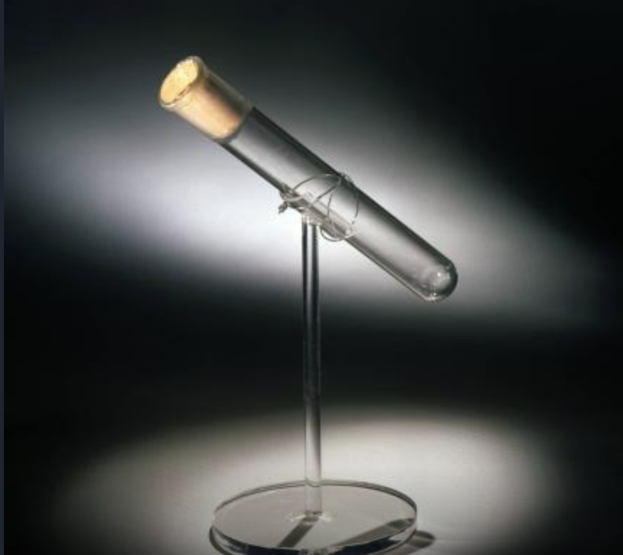
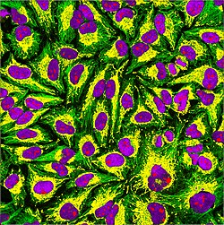
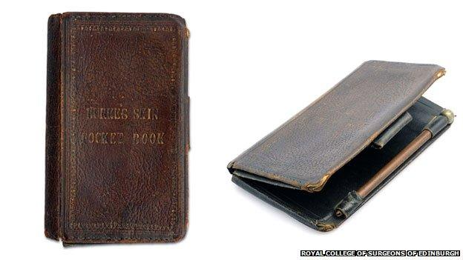
What are human remains?
Hairwork, c.1795
Paris Catacombs
Pathological Specimens, St Bart’s
William Burke pocketbook, Edinburgh
HeLa cells
Edison’s ‘last breath’

Slide 4
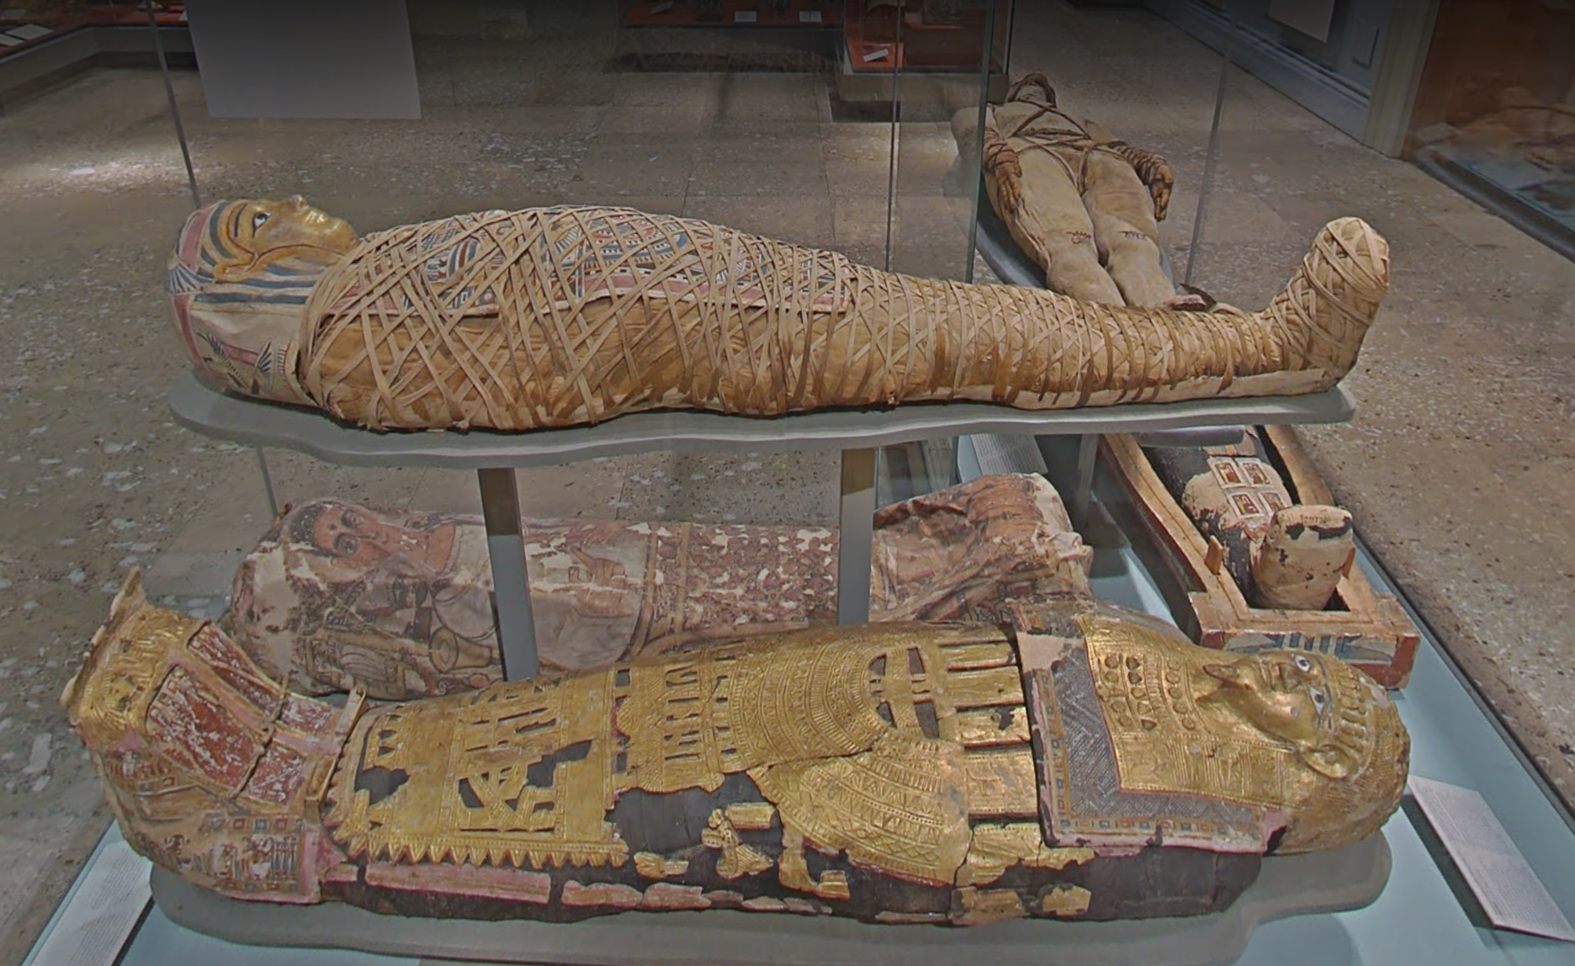
Mummification in Ancient Egypt
Over 3,000 years, millions of humans and animals mummified using a variety of techniques.
Process more accessible to affluent Egyptians and not representative of all funerary practices.
Preservation of the body integral to beliefs about the afterlife. The Book of the Dead (50 BC) refers to avoiding decay.
Spiritual elements (ka/ba) needed recognizable physical elements (sah) to return to, ensuring renewal/resurrection.
Mummified remains, cases, British Museum

Slide 5
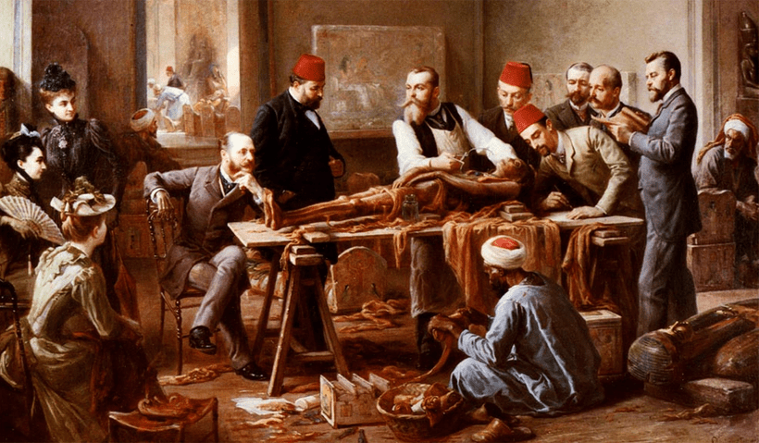
The Afterlife of Mummified People
Paul Dominique Philippoteaux, ‘Examination of a Mummy’ (c.1896-1910)

Slide 6
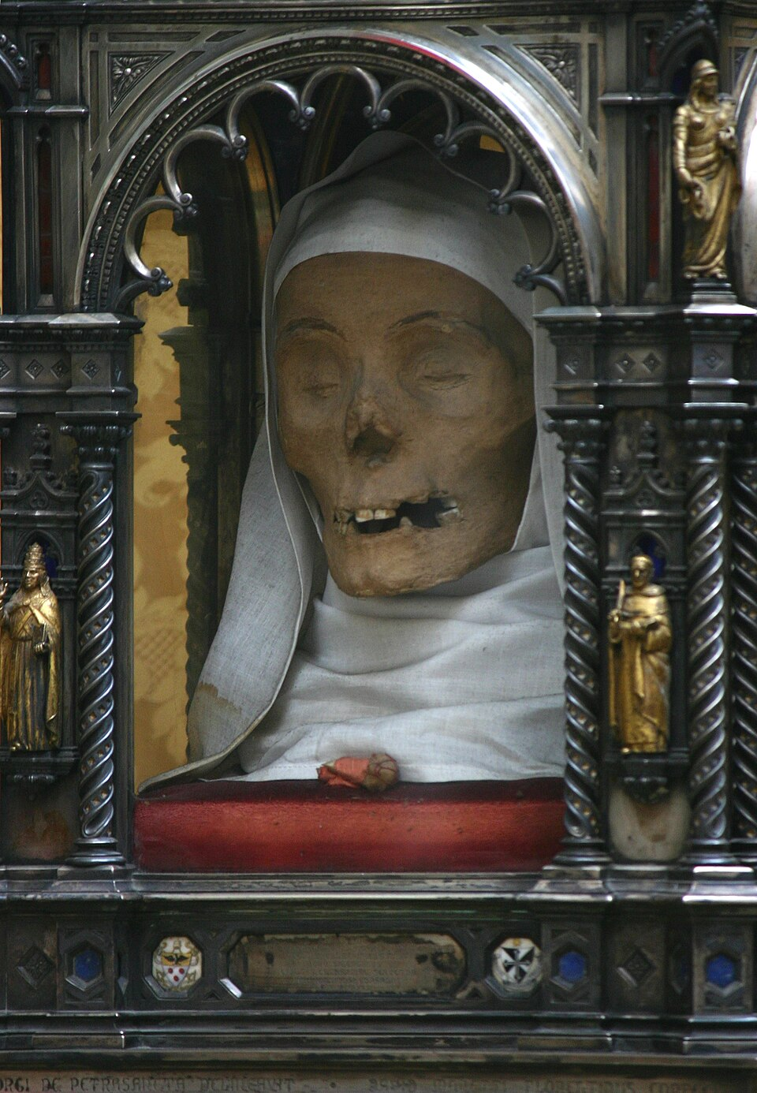
The ‘Incorruptibles’
Bodies/parts of bodies that seemingly resisted decay became associated with religious holiness in Catholic/Orthodox churches.
E.g. Catherine of Siena’s (1347-1380) head and finger still preserved and displayed.
Debates about divine ‘incorruptibility’ versus natural mummification. Signs of corruption/decay hidden?
Remains helped to enhance prestige/power of local churches, made them into sites of pilgrimage.
In turn, saintly remains ‘institutionalized’, protected, revered and cared for.

Slide 7
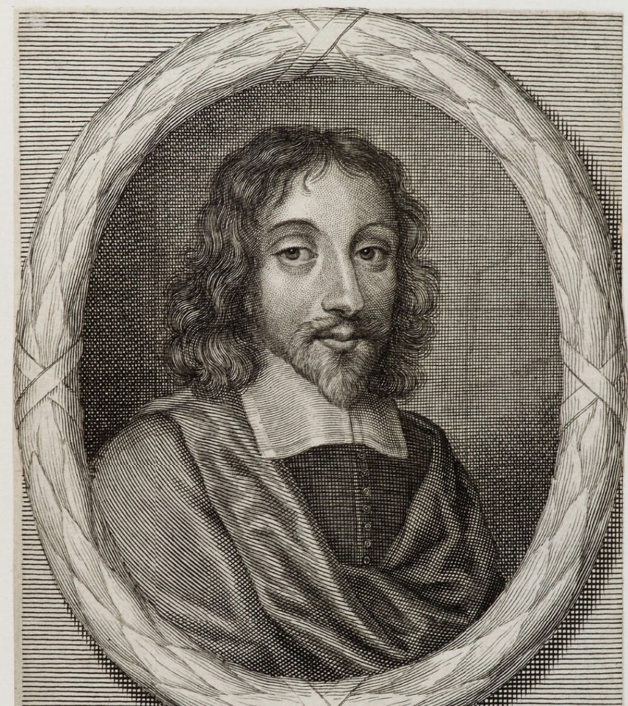
‘To be gnawed out of our graves, to have our skulls made drinking bowls, and our bones turned into pipes, to delight and sport our enemies, are tragical abominations escaped in burning burials.’
-Thomas Browne (1605-1682), Hydriotaphia (1658)
Thomas Browne, engraving, c.1683

Slide 8
Extracts from a TESTAMENT of P.H.J.B. (1829)
‘I request… not to allow my body to be submitted to the ridiculous, absurd and mischievous ceremony… of burying… but I wish that it should be delivered to such surgeon, or surgeons, most deserving of public support.’
‘In order that even the least particle of my extinguished frame should be rendered subservient to some useful purpose, I wish… that my SKIN should be taken off, tanned or prepared, coloured and employed, to manufacture some useful article of furniture.’
‘After a minute anatomical study, and a scrupulous investigation of the causes of my death, I wish that my full SKELETON should be offered to the anatomical, or a drawing class of the contemplated university.’
‘Should my said skeleton be deemed useless, I wish that my SKULL should be presented to the London Phrenological Society, and my BONES transformed, by a turner, into as great a variety of useful articles as possible, either knife-handles, pin-cases, small boxes, buttons, &c, &c, &c.’
‘I further desire that the REMNANTS of the dissecting-room should be put in one large, or two smaller china jars… after pouring upon the said remannts a sufficient quantity of quick-lime… in order to prevent for ever any bad smell, I wish that such vases should be filled up with good garden earth, and a beautiful ROSE-TREE…should be planted in the middle…’
Attributed to Peter/Pierre Baume, The Lion 3 (1829), pp. 396-8.

Slide 9
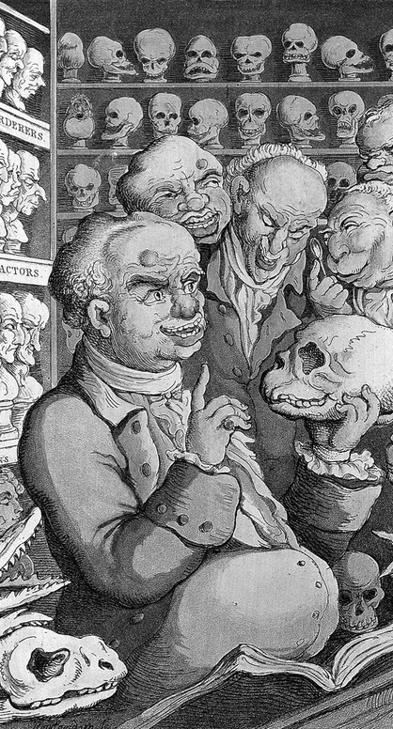
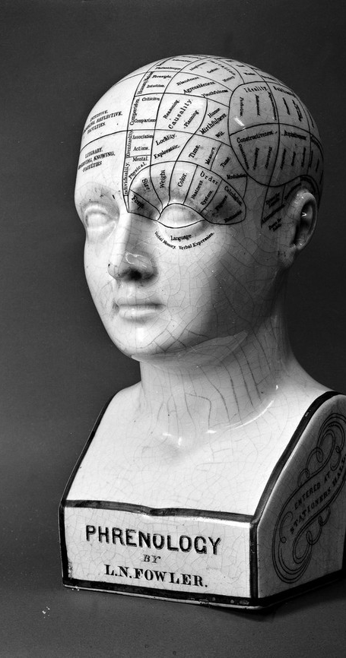
Phrenology: Mind as Matter
Doctrine devised by Gall/Spurzheim, c.1796-1810, mapping different personality traits to different regions of the brain.
Considered a materialist doctrine, for linking human essence to physical matter.
Attracts popular support and adherents around the globe, but not mainstream scientific legitimacy.
Lasting influence in connecting the mind/intelligence/personality to the brain.
Creates new basis for preserving the skulls/brains of prominent individuals.
The principles of phrenology are tested against the heads/skulls/brains of celebrities.
Franz Gall and colleagues, by T. Rowlandson, 1808
Fowler’s Phrenological Bust, undated

Slide 10
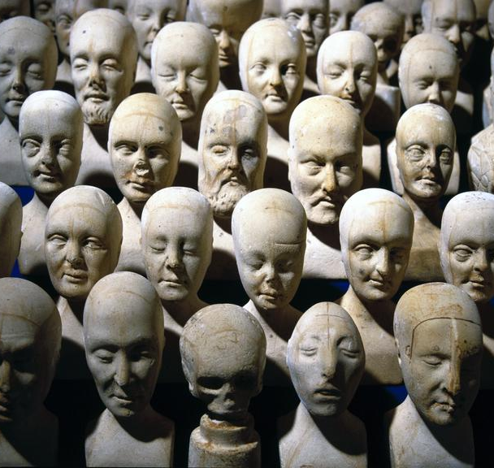
‘We have a very large collection of the skulls of murderers, who have been executed, and of soldiers killed on battle-fields, also of Indians, Africans, Egyptians, Chinese, and Cannibals, but we have only a few from the higher class of minds, such as Reformers, Statesmen, Scholars, & c. Of these we have hundreds of casts, and busts from living heads, but not their skulls. What a treasure it would be if some plan could be devised, by which these leading “types” could be preserved as specimens, for scientific purposes.’
-Phrenological Journal, 1855
Small phrenological heads, by William Bally, Manchester or Dublin, 1831
(Science Museum Group, London)

Slide 11
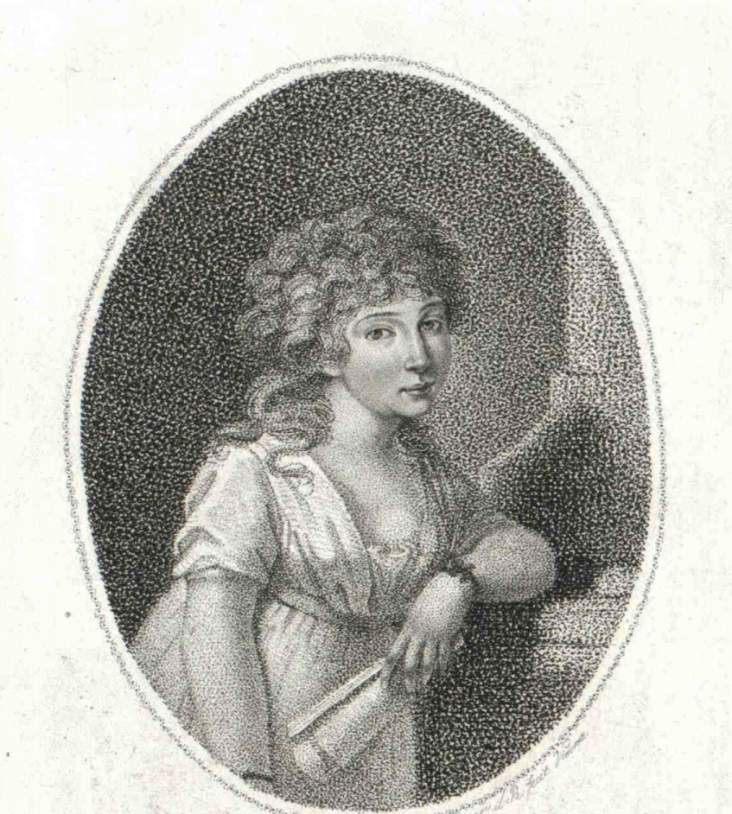
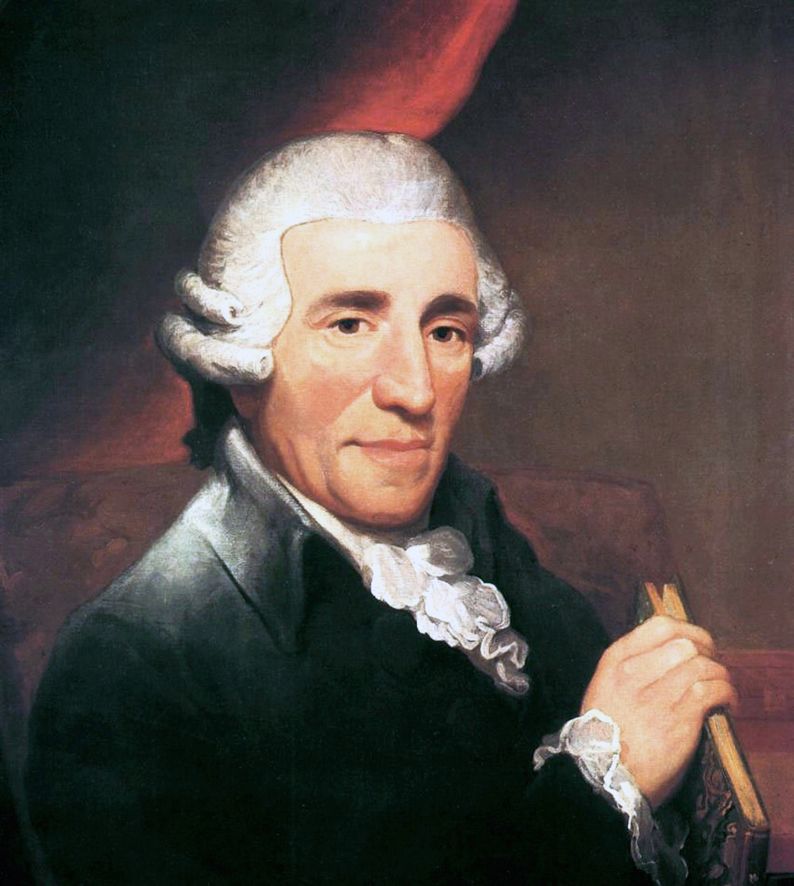
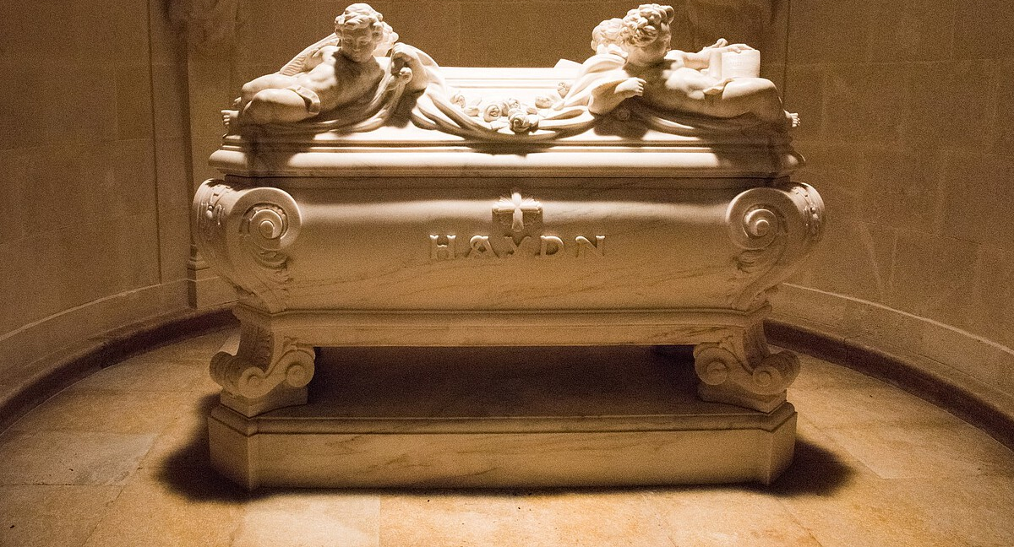
Trophy skulls
After Joseph Hadyn’s death in Vienna in 1809, skull stolen for phrenological research, to prove link between head shape and genius.
Heads of the famous treated as ‘trophies’.
Joseph Carl Rosenbaum and Johann Nepomuk Peter, the thieves, wrote extensively about their process, their reverence and love for the composer, and their belief that great heads should be displayed, not buried.
‘Practiced’ on actress Elizabeth Roose: the problems of decomposition, smell, maceration, medical waste (including brain) necessitated use of professional medical articulators for Hadyn.
Theft a crime but also a source of pride; evades detection for 145 years.
Hadyn’s skull reburied with his body (and substitute head) in Einsenstadt, Austria 1954.

Slide 12
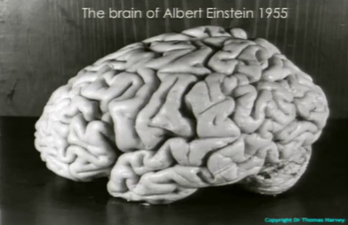
Scientific Brains and ‘Mutual’ Autopsies
Presumed link between brain (size/shape/appearance) and intelligence transcends phrenology and gets subsumed into racial anatomy, physical anthropology.
Absolute size/weight of brain as a measure of intelligence disputed, but notably, investigations required preservation of brains (not skulls/casts).
6 January 1861: meeting of the Société d'Anthropologie de Paris, where Louis Pierre Gratiolet challenges Paul Broca’s beliefs about brain size, citing famous intellects with small hat sizes (e.g. Georges Cuvier).
Persistence in belief that brain size/appearance has some correlation to genius leads scientists such as Broca to donate their brains for research.
Criteria shift to focus on convolutions rather than size. (e.g. Einstein’s brain).

Slide 13
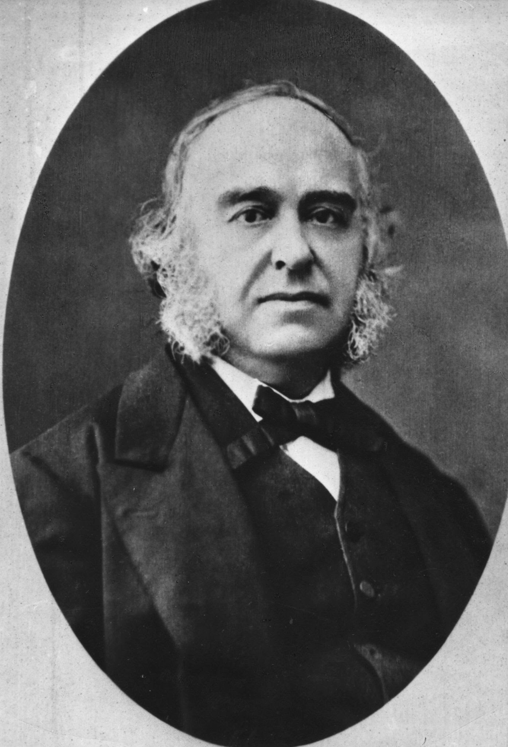
‘Is Paul Broca still there in his formalin-filled bottle?’
‘It was difficult to hold Broca’s brain without wondering whether in some sense Broca was still in there—his wit, his sceptical mien, his abrupt gesticulations when he talked, his quiet and sentimental moments. Might there be preserved in the configuration of neurons before me a recollection of the triumphant moment when he argued before the combined medical faculties on the origins of aphasia? … Is Paul Broca still there in his formalin-filled bottle? [Resurrecting his memories] would be the ultimate breach of privacy, but it would also be a kind of practical immortality, because especially for a man like Broca, our minds are clearly a major aspect of who we are.’
-Carl Sagan, ‘Broca’s Brain’, 1979

Slide 14
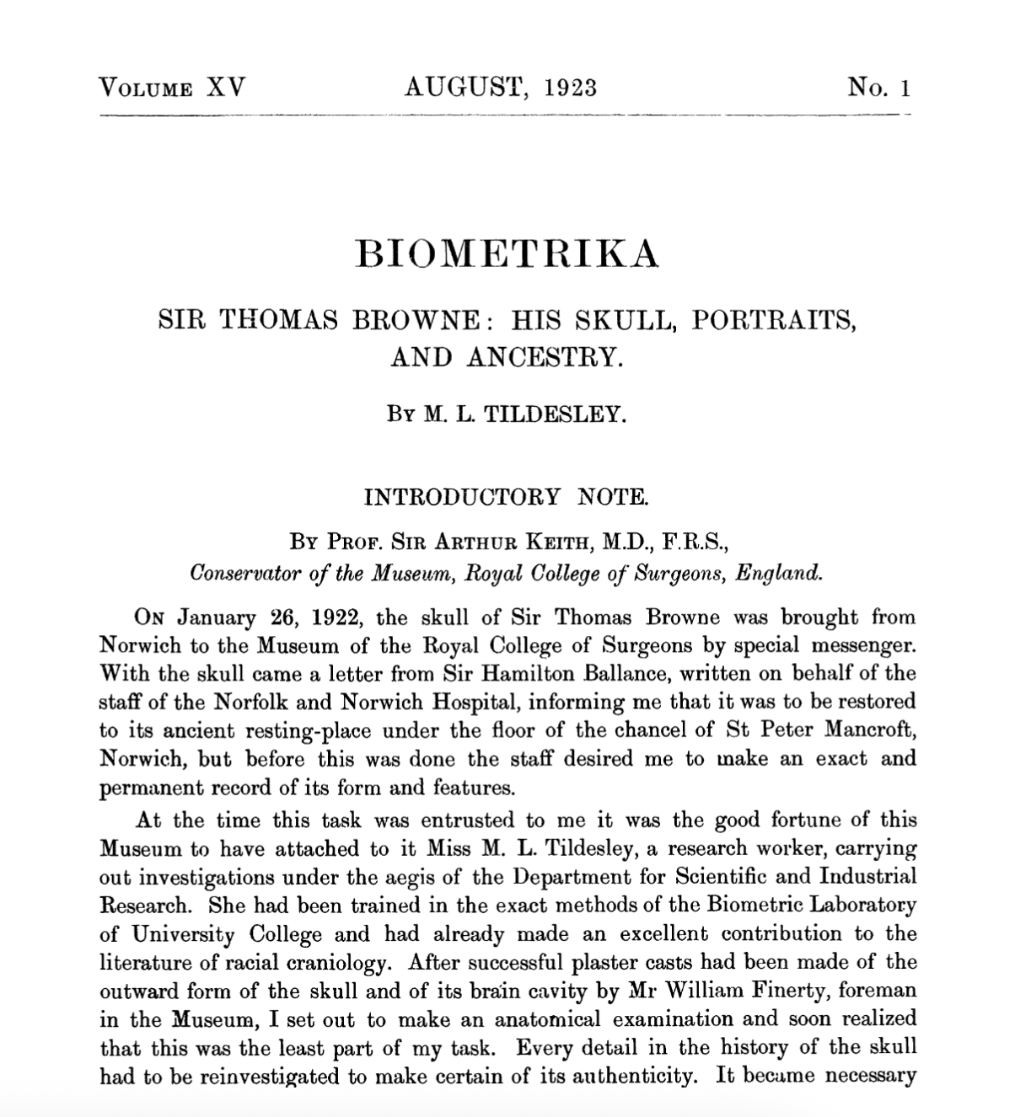
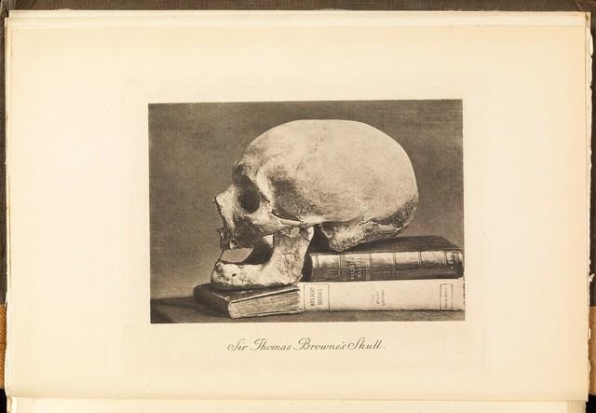
Phrenology Revived: Cranio-Biography
The Works of Sir Thomas Browne (1927)
Disinterred, St Peter Mancroft Church, Norwich 1840;
Reburied 1922.

Slide 15
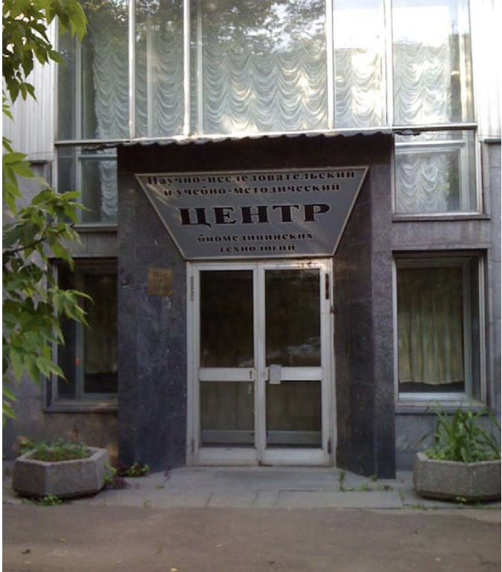
Communist Mummies: Preservation as Power
Vladimir Lenin’s declining health shortly after the Russian Revolution precipitated efforts to capitalize on his political iconography and cult of personality.
Lenin’s body is made into an icon of Leninism.
Bespoke process to preserve suppleness of Lenin’s corpse: requires continuous care and investment.
Lenin’s body becomes a symbol of Soviet science and ideology, but also of his ‘transcendent’ aura and influence.
Process replicated across other communist totalitarian regimes (Vietnam, China, North Korea, Angola, , allowing posthumous continuity of ‘cult of personality’ leadership.
‘Center for Scientific Research and Teaching Methods in Biochemical Technologies,’ (Photo: Yurchak, 2015)
Notes:
The party leadership saw Lenin’s body in a dual way: as the biological remains of an actual person and as a physical entity that had transcended individual biology.

Slide 16
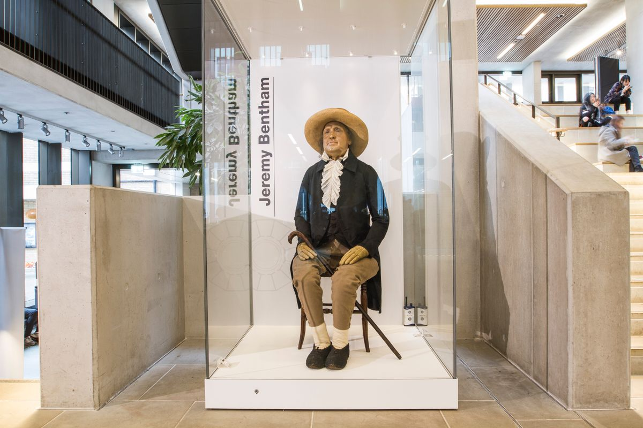
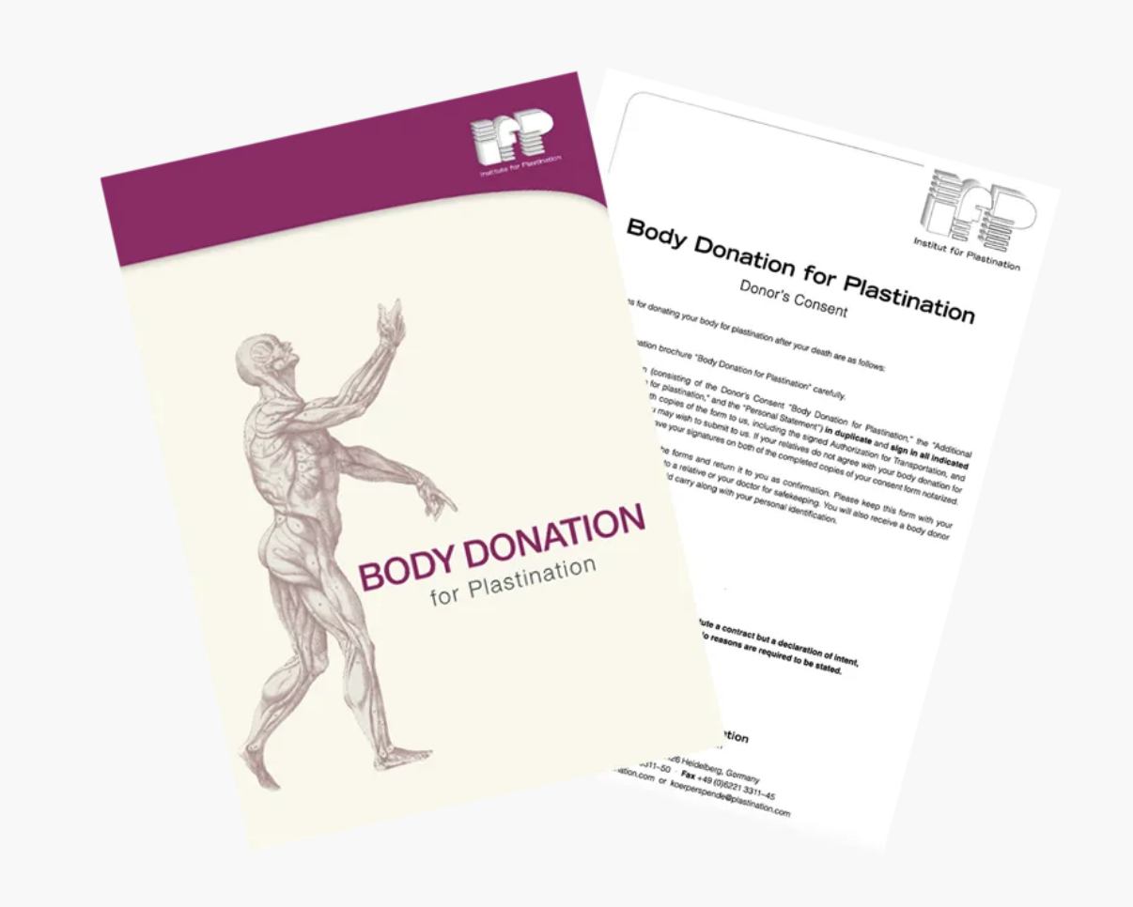
Self-Preservation:
From ‘Auto-icons’ to Cryonics
The challenge/expense of tissue conservation remain an obstacle for those wishing to be preserved.
Solutions include mummification, plastination, and cryonic freezing, but all have their drawbacks viz. cost/corruption.
In practice, very few people opt for such practices (e.g. 250 in cryonic storage).
What current beliefs/sensibilities shape attitudes towards the auto-preservation of remains?
What does the 200+ year history of preserving specific individuals’ remains for veneration/commemoration tell us about the desirability of this practice?

Slide 17
Concluding Thoughts
Human remains ‘outlive’ the belief systems. There is no guarantee that remains collected with reverence in a particular temporal/geographic context will continue to be revered other
Despite secular/materialist shift in the modern era, an ‘aura’ or ‘potency’ persists around human remains.
The treatment of the ‘eminent’ dead entailed ethical violations (theft, dismemberment, display) although many of their remains have been repatriated/reburied.
The practical challenges of preserving human remains, alongside persistent beliefs around/about death, means that it remains a niche practice.

