Slide 1

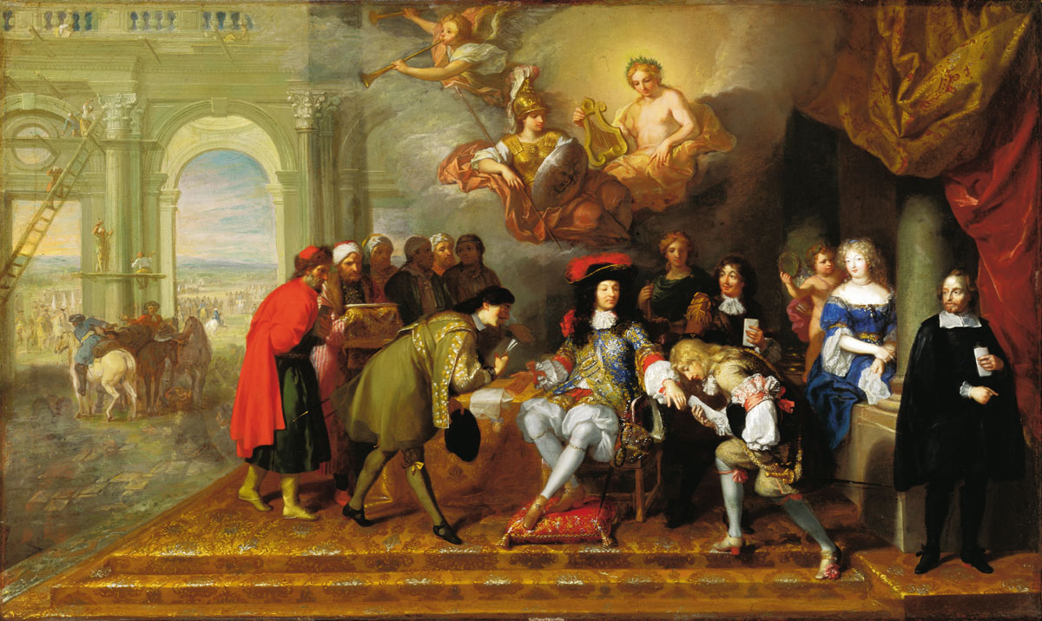
Espionage and intelligence in the C17th & C18th

Slide 2
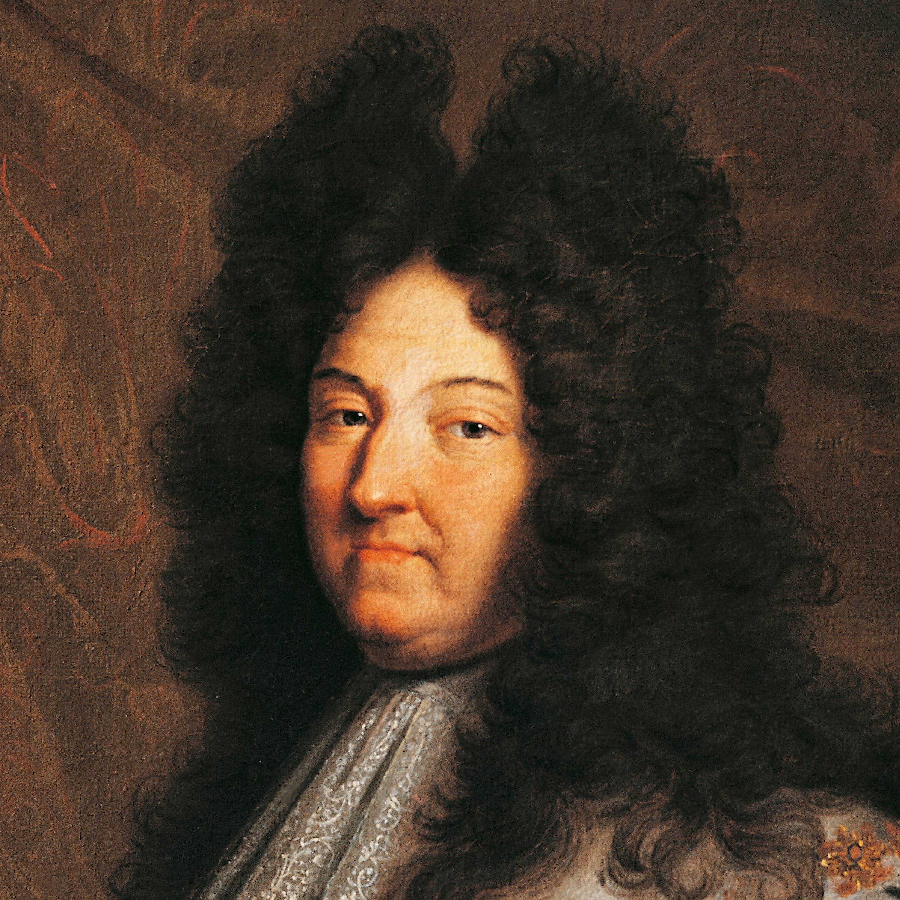
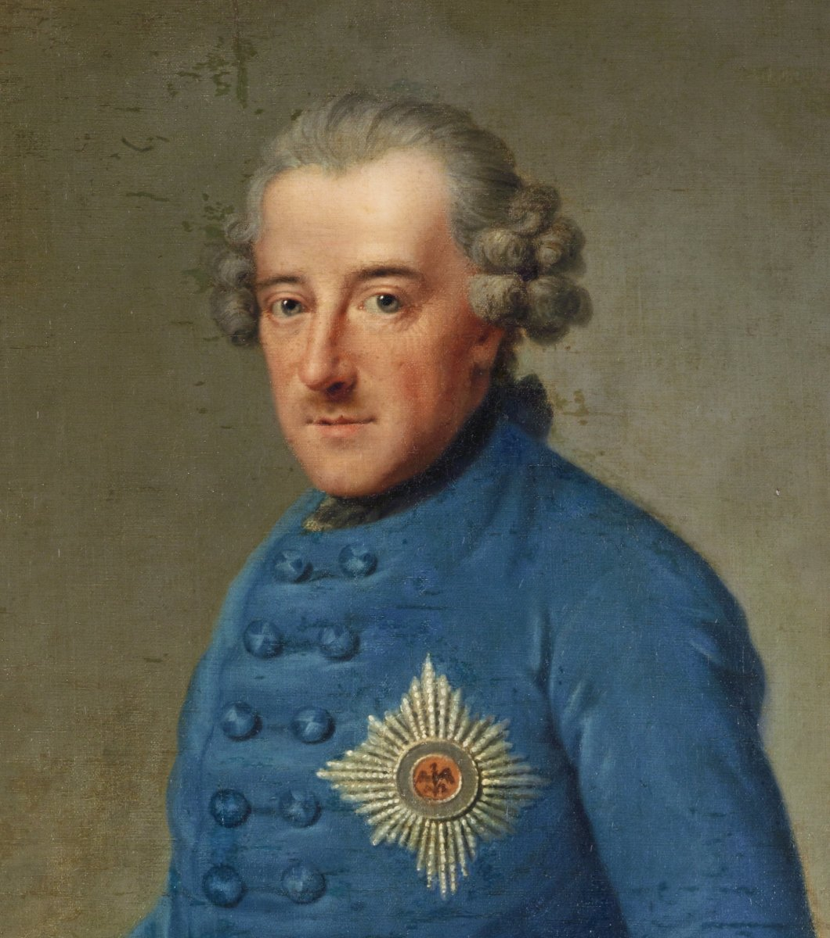
The Fiscal-Military State
Centralised states e.g. Bourbon France (Louis XIV), Prussia (Frederick II the Great), Sweden & Russia
Growth in administration to finance and service larger armies & navies (many wars, including 30, 9 & 7 years!)
Also Spanish & Austrian Habsburgs, Stuart & Hanoverian England; even Dutch Republic = leading economic power
Expansion overseas: economic/commercial as well as territorial competition (& espionage)
Context for ‘industrial’ growth in ‘secret services’: warfare but also vs internal opposition: domestic dissent & conspiracy; control of ‘public opinion’
Alan Marshall: intelligence gathering & espionage = distinctive part of exercise of secret power by many early modern states; semi-professional, still fluid
‘Black Chambers’ & ‘surveillance states’
What were they hiding in those wigs?!?

Slide 3
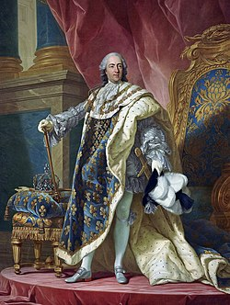
France (& Spain): Absolute Rule in action
Lucien Bély, Espions et ambassadeurs (1990): pioneering on networks of spies & informers under Louis XIV (1643-1715); cabinets & apartments at Paris & Versailles of ministers and secretaries of state = centre of French empire & its intelligence-gathering network
Alain Hugon, Au service du Roi Catholique (2004): examined Franco-Spanish diplomatic relations & espionage from 1598 to 1635 under Philip III & Philip IV
Cf Stéphane Genêt, Les espions des lumières (2013): focus on military espionage = quite decentralised, & counter-espionage under Louis XV (1715-1774)
‘Surveillance states’?: not just about interception of letters etc but listening in on & reporting conversations
Long history of this: when does it become more of an official practice? Embedding of (double) agents within communities to identify potential rebels/traitors

Slide 4
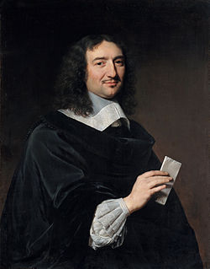
Colbert: the ‘Information Master’?
Jean-Baptiste Colbert (1619-1683): ‘Le Grand Colbert’
First Minister of State and Controller-General of Finances under Louis XIV
Soll: ‘how the state played a central and innovative, as well as repressive, role in the growth of modern information culture’ i.e. controlling the flow of info
Cf Dutch Republic = centre of open info exchange
Use of intendants = royal agents, observers & informers reported data-gathering direct to Colbert
Webs of inspectors & informants > reports from provinces & secret files on officials/judges/nobles
Creation of Royal Library (now BnF) as extension of administration > State Info Archive & Academies
New form of royal rule?: policing & manipulation of knowledge > control
Ultimate failure but model for others?

Slide 5
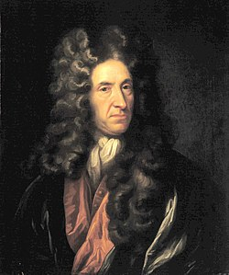
England: from Civil War to Repeated Royal Recovery
Secretary of State's office = hub for state intelligence matters from 1640s during British Civil Wars, continued under Republic & Protectorate of 1650s, & persisted after 1660 Restoration, even as political regimes & personnel shifted
Later Stuarts & Hanoverians (vs Jacobites) continued practice amid instability internally & externally
Cf Elizabethan and early Stuart regimes – more independent of monarch but still beholden
Role of key figures e.g. Thomas Scot, John Thurloe Robert Harley (and conciliar structures)
More centralised: administrative revolution & ‘paper empires’; proper office practices & security
Daniel Defoe (1660-1731): ‘Scheme of General Intelligence’ (1704) > greater secrecy cf ‘deep state’
Also A Continuation of the Letters Writ by a Turkish Spy (1718) = satire of European politics & religion
Daniel Defoe: writer, merchant & spy for both Tories & Whigs

Slide 6
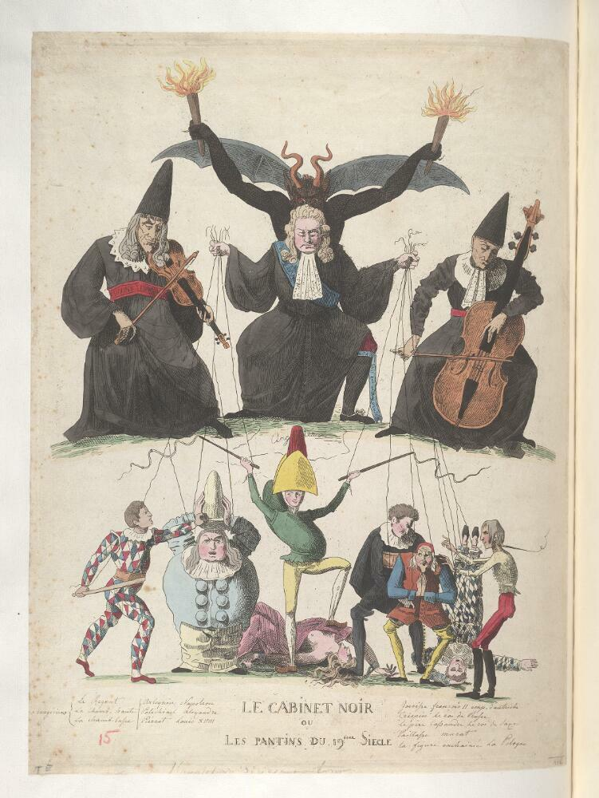
‘Cabinets noirs’
Louis XV: ‘first official French bureau of postal inquisition’, known as ‘Cabinet du secret des postes’ (cf ‘Secret du roi’)
But ‘cabinets noirs’ /‘black chambers’ much longer history back to 1630s: Richelieu (Louis XIII) & whoever oversight of postal services e.g. countess Taxis in Brussels > sell on info
Systematic opening, copying & decoding of letters of foreign diplomats & any others perceived as threat
Teams of clerks with language skills, forgers & code-breakers or crypanalysts (cf C16th Thomas Phelippes & François Viète; later John Wallis & Antoine Rossignol > Louis XIV)
Mainly C18th phenomenon > increasingly sophisticated administrations e.g. Vienna (Secret Cabinet Chancellery)
Formed often in response to networks of diplomatic exchange & competition
Cf The Hague known as ‘The Whispering Gallery of Europe’ & role of Amsterdam as mercantile & banking centre; Dutch Republic = economic & info hub (cf Venice, Istanbul)
Black chamber only briefly in C18th in response to threats
1815 caricature of ‘Cabinet noir’

Slide 7
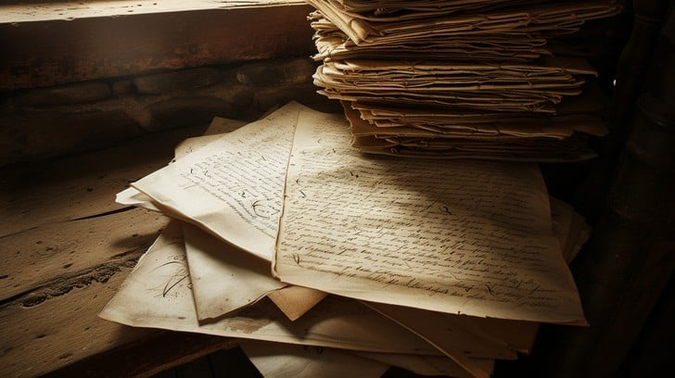
Innovation vs expansion/formalisation?
Many familiar features:
More centralised & bureaucratised, but still use of ad hoc agents vs professional spies
More professional cryptographers, codebreakers etc
Still competitive & reactive
Holders of office as well as institution itself still important (rulers less engaged)
Policing & manipulation more apparent
Have more capacity & resource (sometimes) including officials/administrators
More sophisticated postal networks/system
More documentation/archives
Fundamentals much the same = gradual development of practices & systems
Political & diplomatic reality: warfare & alliances
More industrial espionage with proto-industry

Slide 8
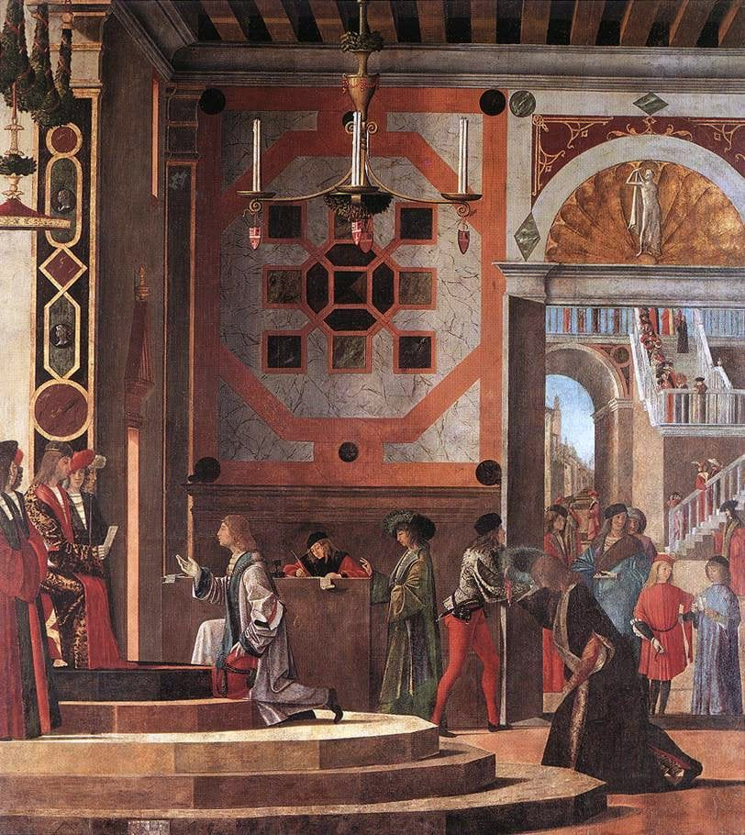
Premodern Espionage: Some Conclusions
Continuities and Contrasts:
Motivations: power, money, ideology, competition
Contexts & challenges: conflicts between & within territories, between rulers & regimes
Personnel: men & women, diplomats & soldiers, merchants & clergy, couriers & exiles, servants & eavesdroppers, i.e. varied social strata
Interception & intrigue: counter-espionage methods & concealment/disguise, plots & assassination
Differences historically & geographically in style vs substance, role of secrecy (contemporary comparison)
Particular moments & circumstances > notable developments: Renaissance Venice, Elizabethan England, Bourbon France (or have these just been more extensively studied?), more to be said re international networks – work together vs common foe

