Slide 1
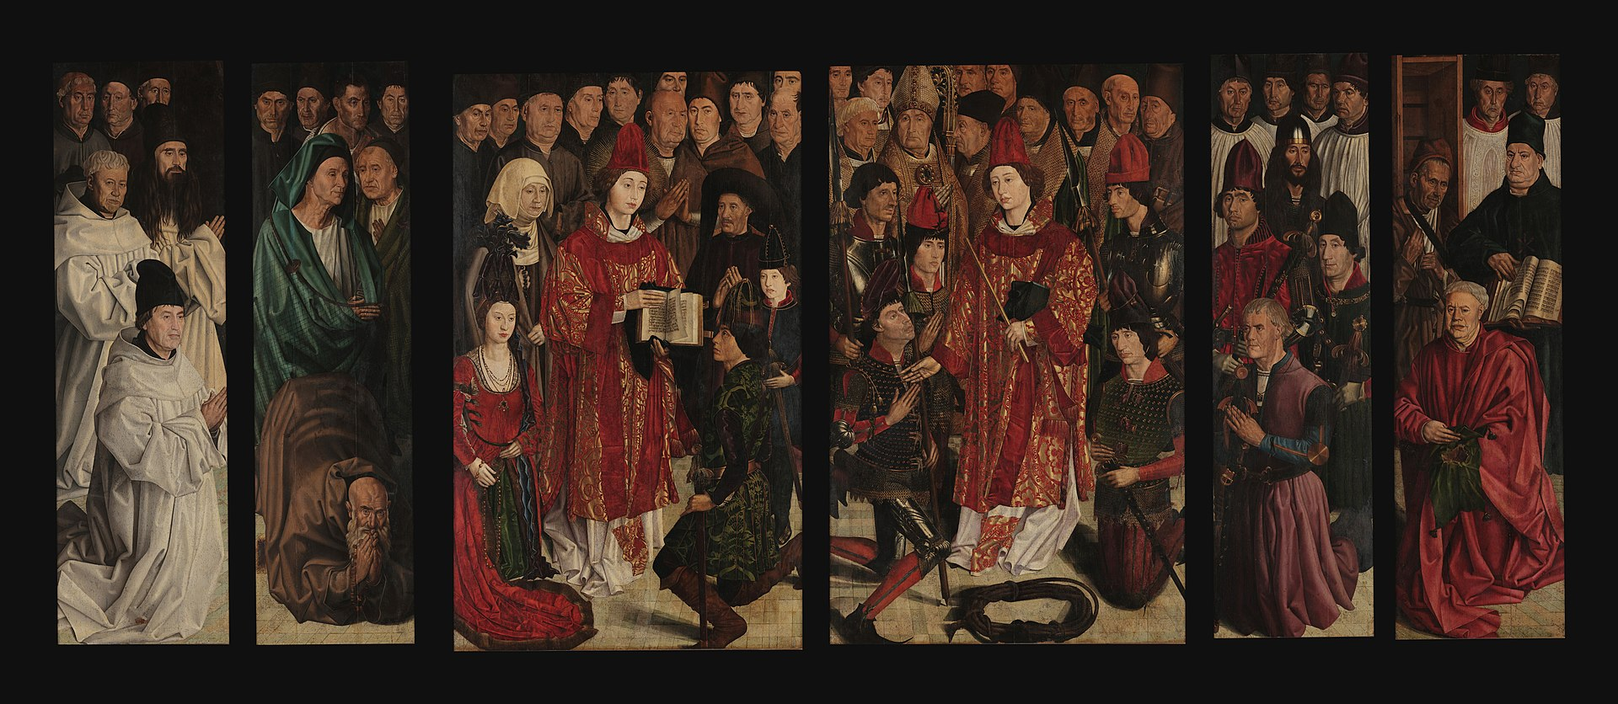
Religious and other considerations in Information-gathering
Nuno Gonçalves, ‘Altarpiece of St Vincent’, Portugal c. 1470
Europe less mixed society with expulsion of Jews/conversos & Muslims/moriscos from Iberian pensinsula c. 1492-1614, but trade & other relations still important

Slide 2
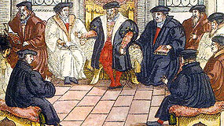
Religion as a factor in a confessionally-diverse world
Ministers & diplomats often drawn from nobility including higher clergy
Contexts: Reformation(s), cultural encounters, & diplomatic & commercial relations with other faiths
‘The early modern period witnessed a relative balance of power among Muslim- and Christian-ruled polities’ (Maartje van Gelder)
Religious minorities targeted by, & using own, espionage & intelligence networks
Role of exiles & underground movements, religious refugees as diplomatic go-betweens
Circulation of ambassadorial reports, newsletters & printed texts; also commercial espionage?
Correspondence (official & clandestine) essential for communications

Slide 3
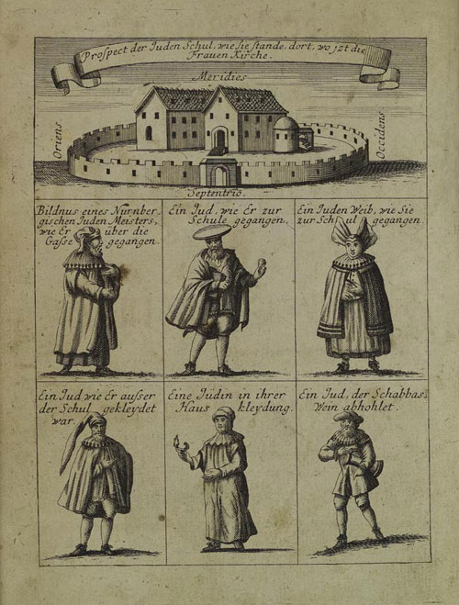
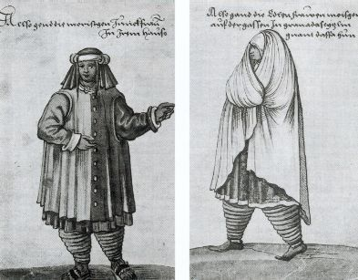
Differences in dress, but what if in disguise?

Slide 4
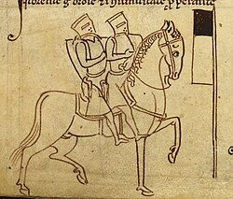
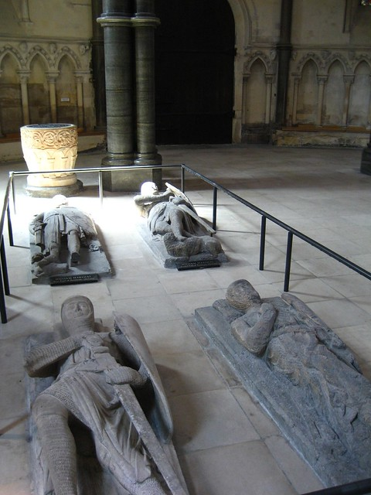
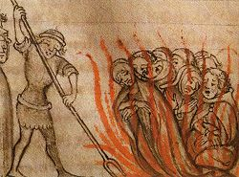
A History of Secretive Networks? The Templars c. 1118-1312
Trial of the Templars, 1307-12
Tombs, Temple Church, London
Templar knights, c.1250

Slide 5
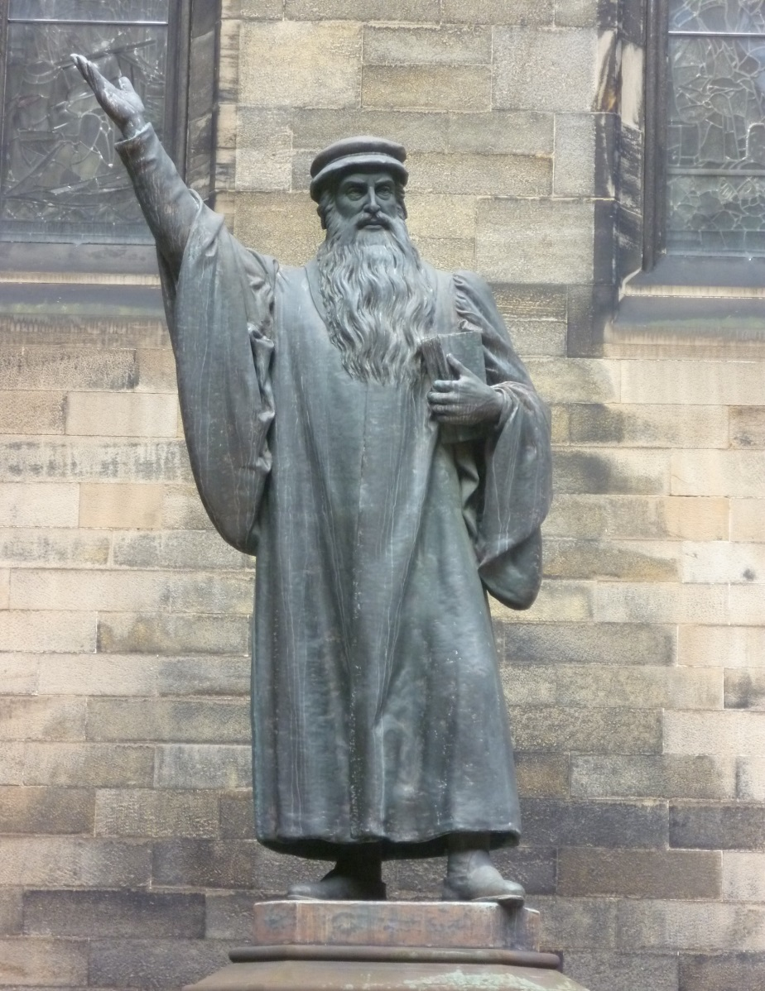
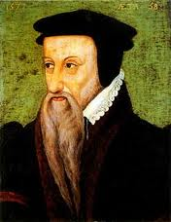
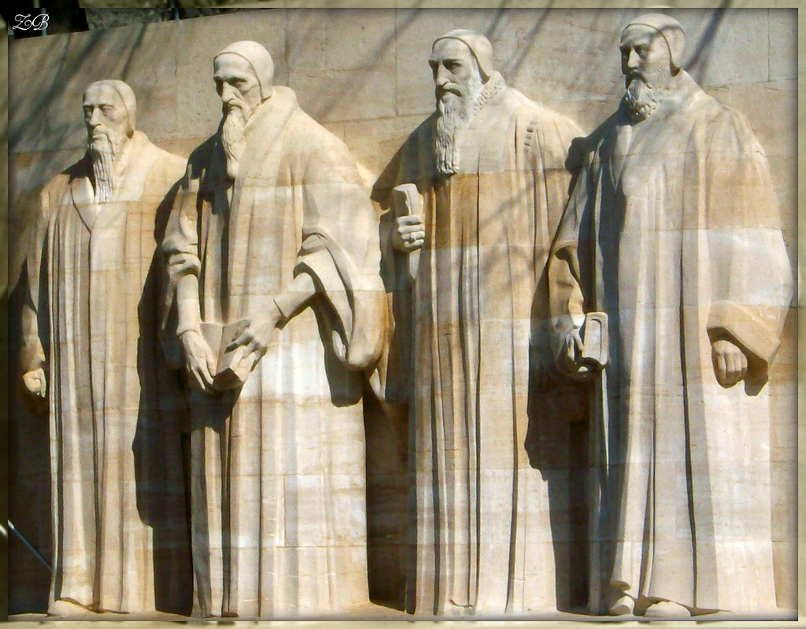
Protestant Secrecy in service of ‘Truth’
Calvinist Geneva: policy or rule of secrecy for ministers sent out
To uphold and advance ‘truth’ of their religion by whatever means possible
Operated in secret, often moving around in disguise, using pseudonyms and false identities
Despite denials, leadership implicated in clandestine activities to undermine opponents and even foster revolt e.g. 1560 conspiracies in France

Slide 6
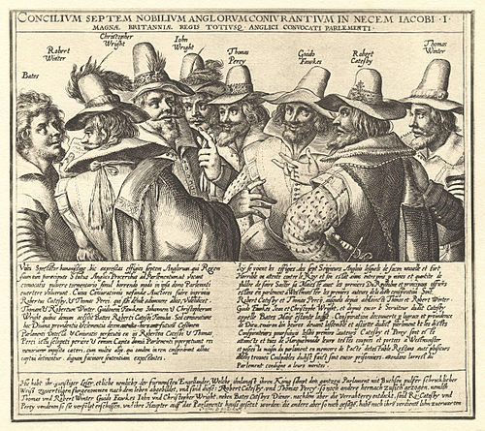
Recusants & Catholic missionaries
Networks & refuges across Catholic Europe: Rome, Paris & Spanish Netherlands
Clergy trained in seminaries and colleges e.g. Douai
Jesuits infiltrated schools/education
Priests carrying correspondence & involved in plots
In disguise and hidden in noble houses (priest-holes)
Concealment vital to maintain communication
Missions overseas also dependent on networks & activities
Gunpowder plotters, 1605

Slide 7
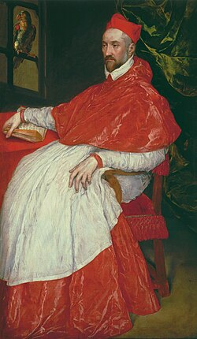
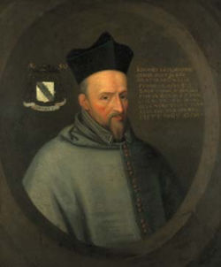
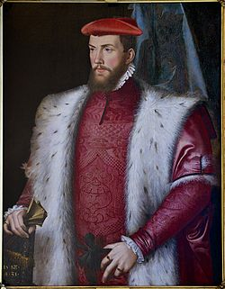
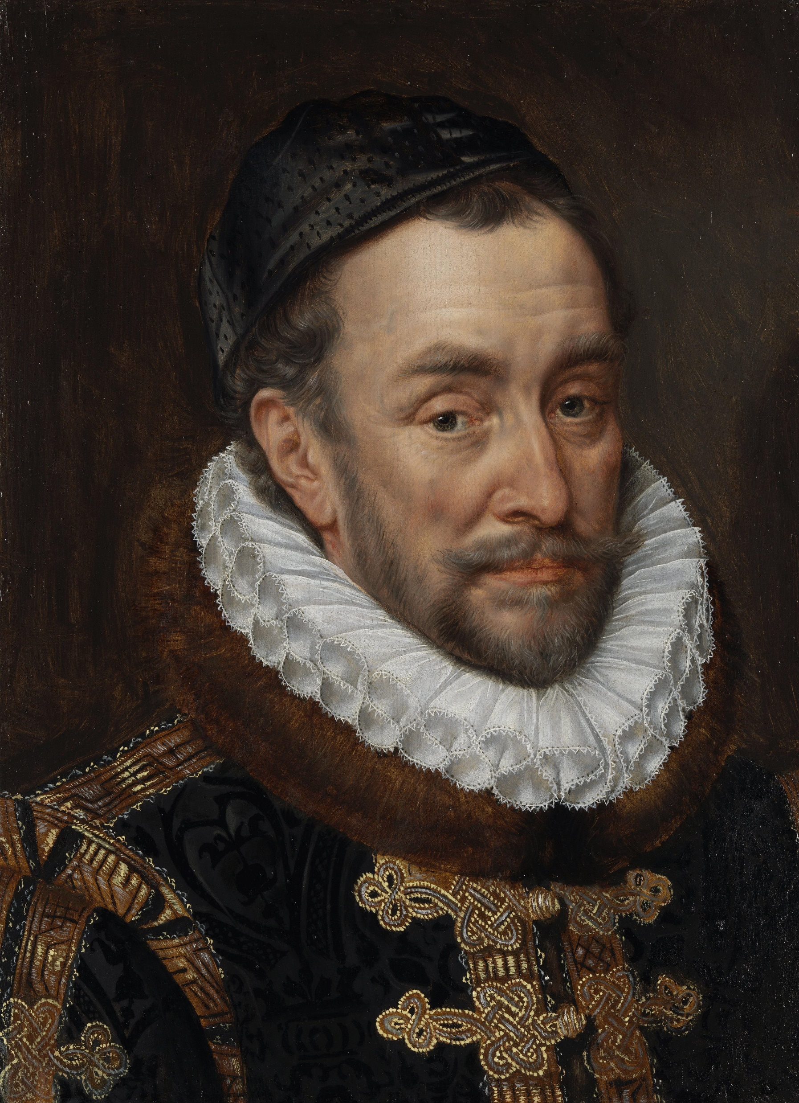
International Context of Reformation
John Lesley, Bishop of Ross (1527-96)
1560s-1570s:
Charles de Guise, Cardinal of Lorraine: support for Mary Queen of Scots & seeking to dominate French crown
Alliance of Catholic League in France with Philip II of Spain & papacy + other Catholic powers/groups/exiles
Exiled Huguenot leader, Odet de Coligny, Cardinal of Châtillon, at Elizabethan court, 1568-1571
International Protestant alliances & networks including German, Swiss, Flemish, Huguenot & Scandinavian churches, & Protestant refugees
From 1580s, threat from Spain & major Catholic plots; assassination of William of Nassau/Orange (1533-84)
Cardinal of Lorraine (1524-74)
Cardinal of Châtillon (1517-71)

Slide 8
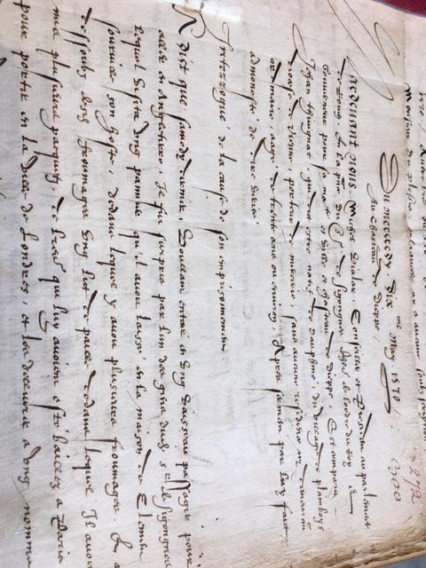
Uncovering a clandestine Huguenot network
Interrogation Document, 10 May 1570
Intercepted correspondence have letters but archival dead-end re carrier
Identifying the Supplier: what do we know from documents, clues & hunches?
Cardinal & Ambassador – locate links
Reconstruction of Clandestine Network – ministers & diplomats & couriers
Links to France & England but also Germany & Netherlands & Scotland
Filling gaps in individual biographies & filling out roles & networks, from info-gathering to double agents
Cf other cases - similarities & contrasts
Language of espionage sometimes fluid
Uncertain outcomes – often unknown

Slide 9
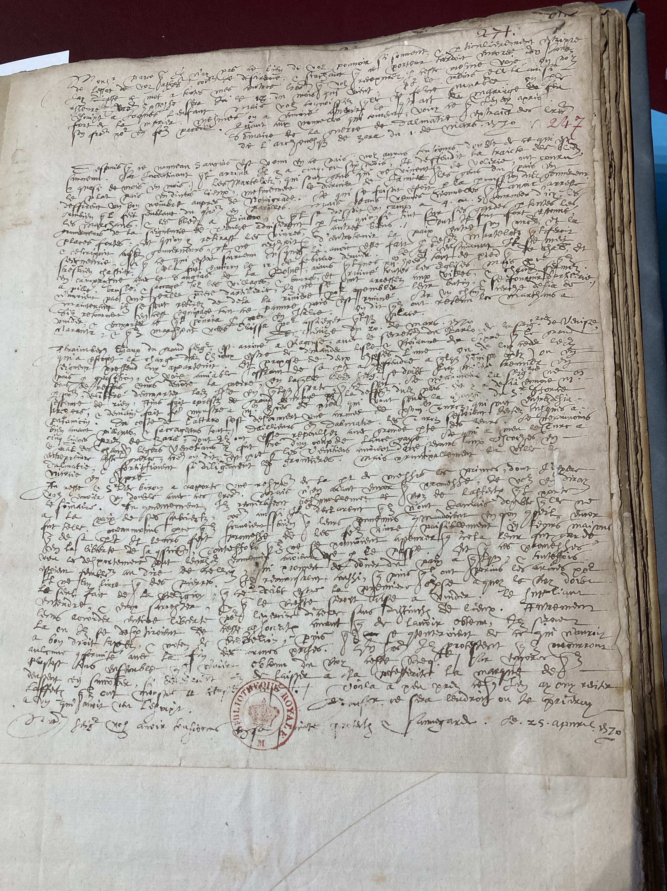
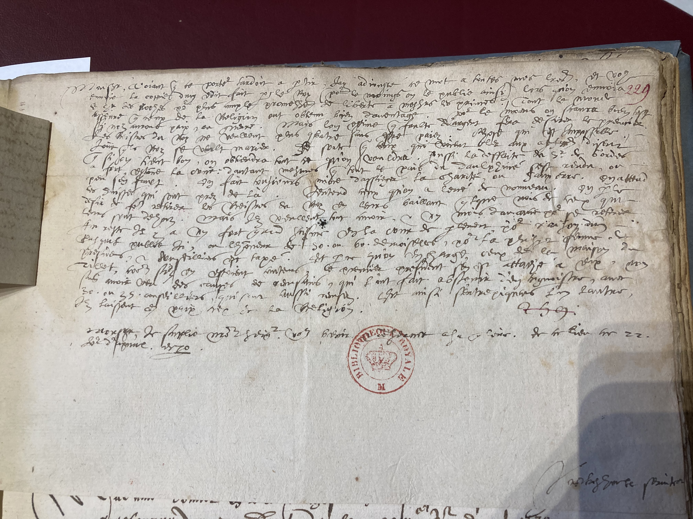
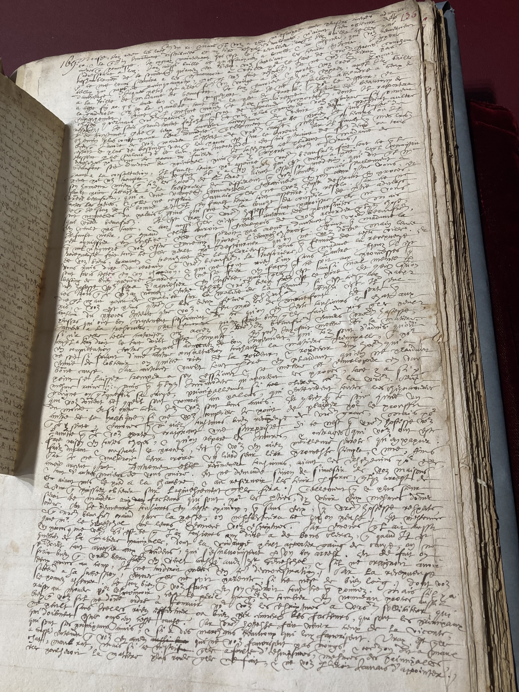
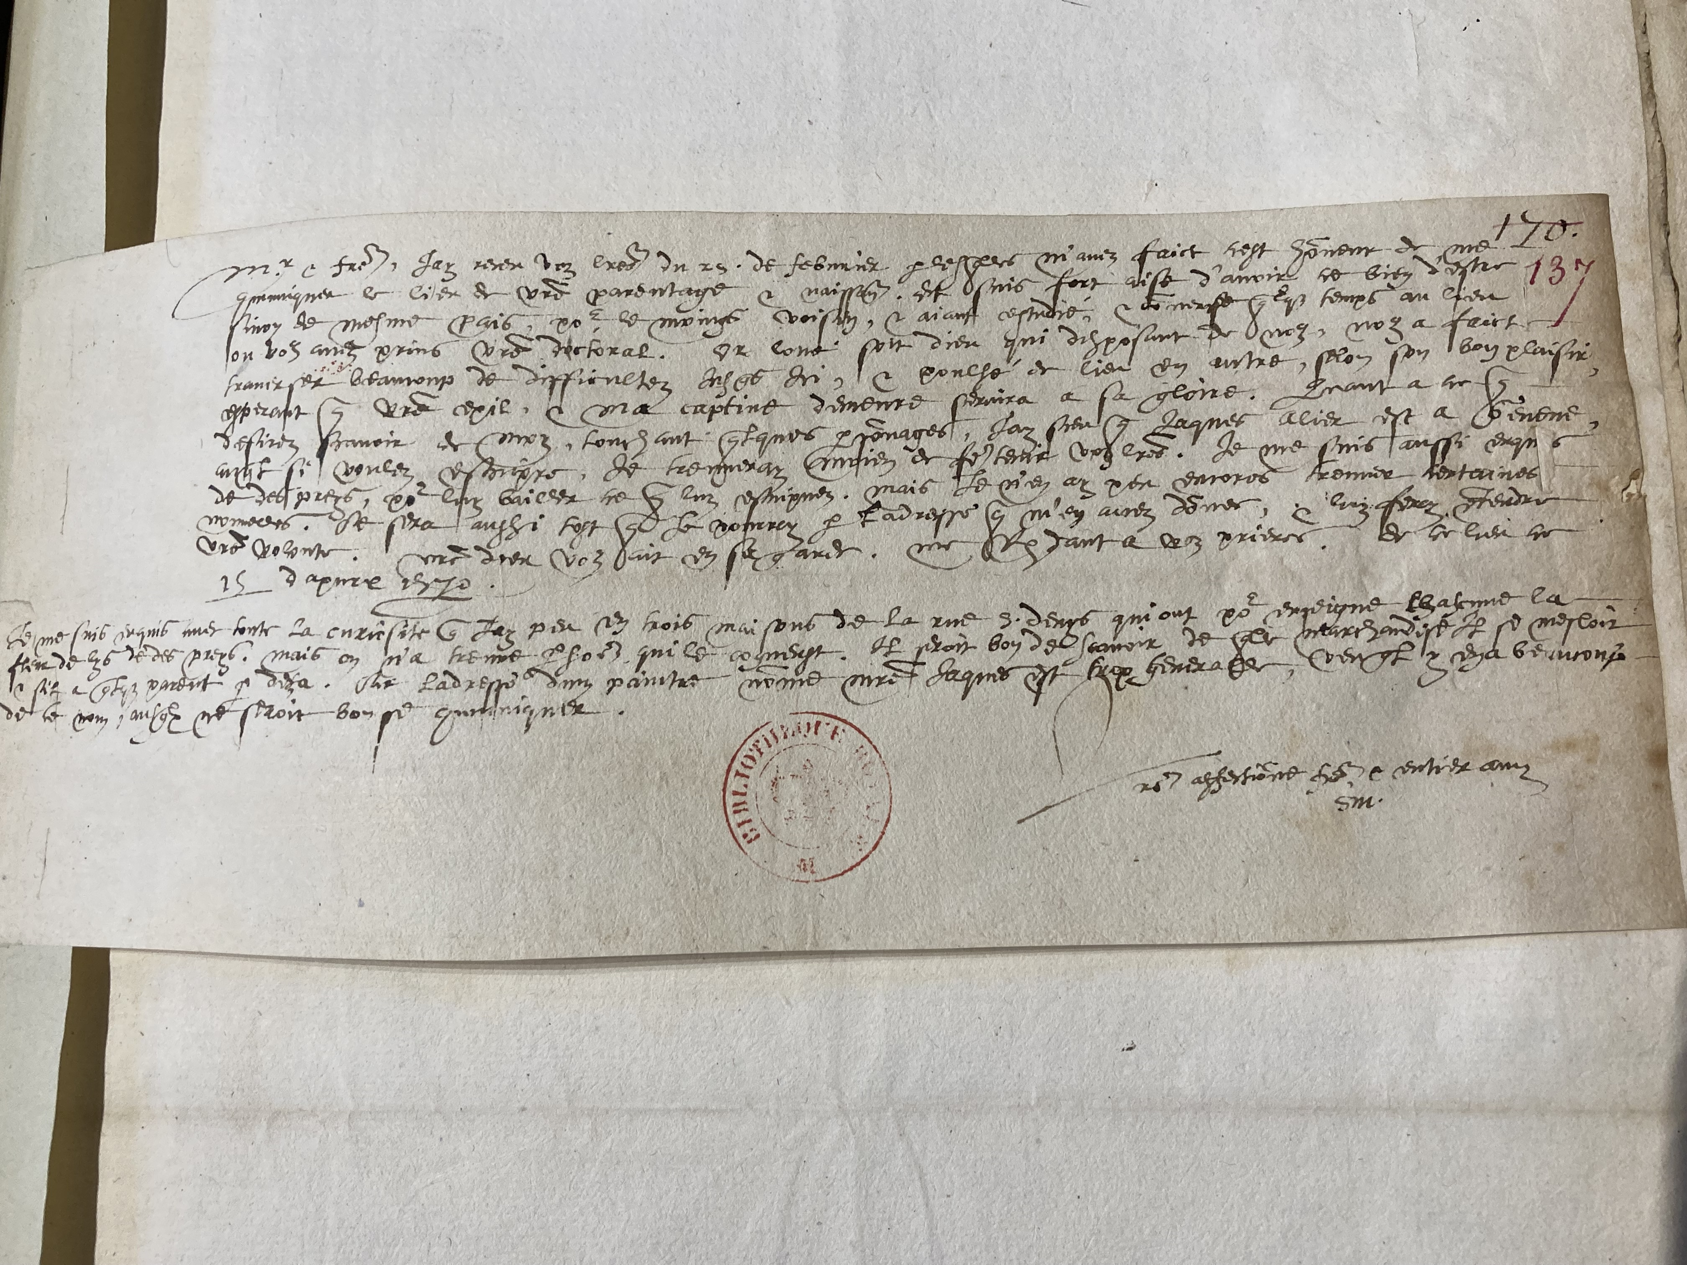
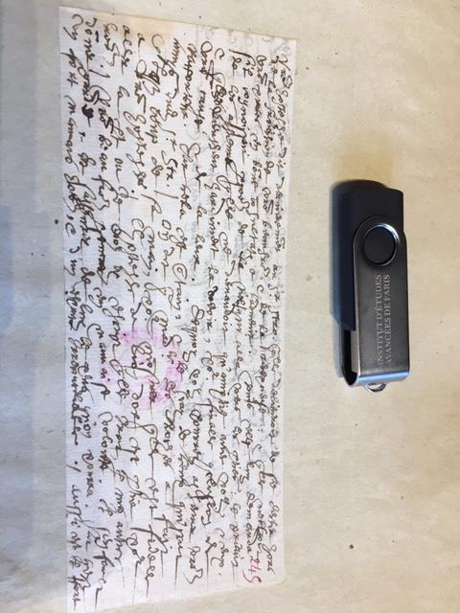
Some letters carried by Jean Tivinat in May 1570

Slide 10
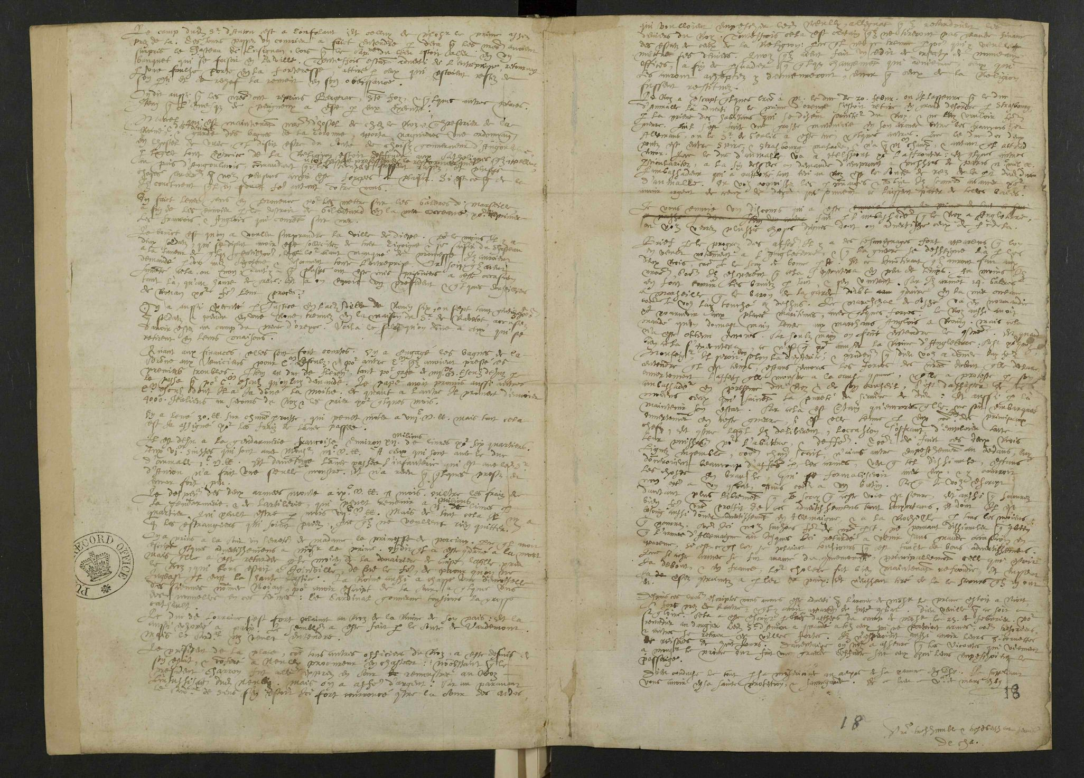
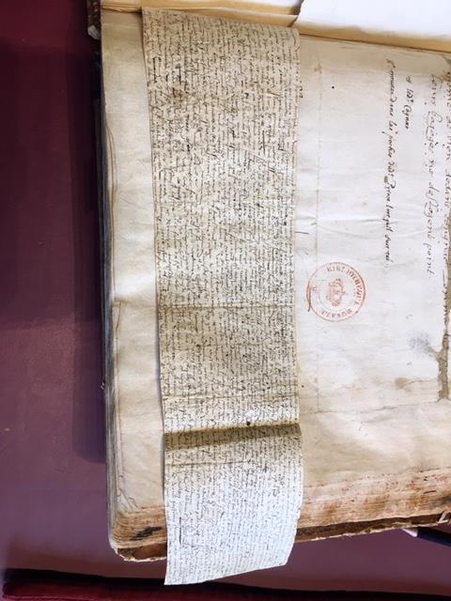
Identifying Handwriting in Other Letters

Slide 11
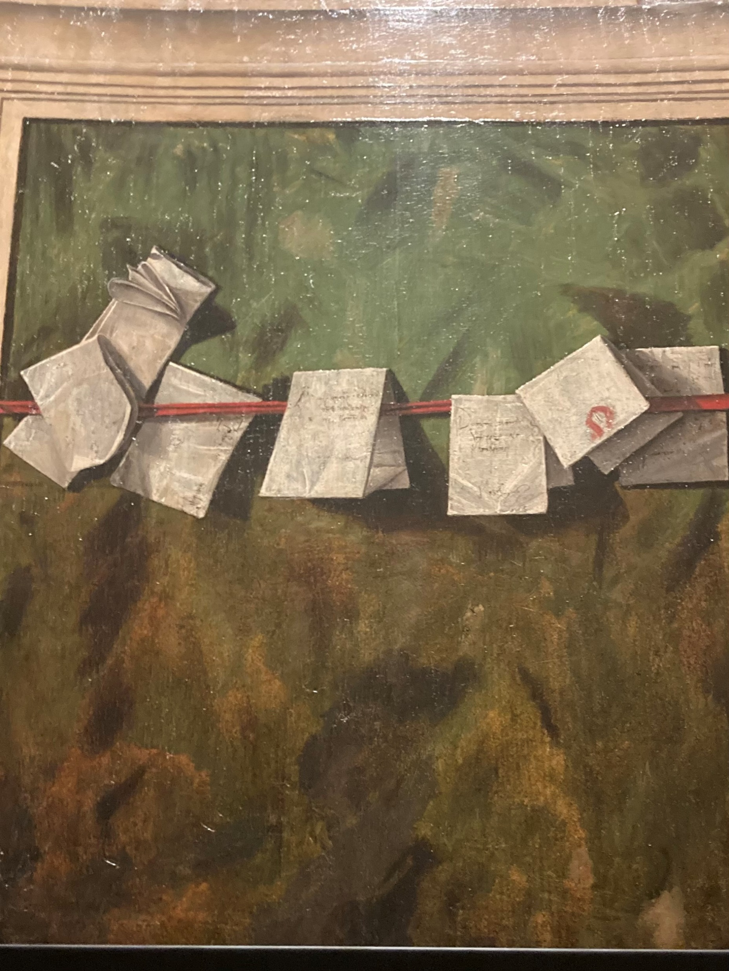
The role of news & postal networks
Spread of Print led to rise in literacy, correspondence & production of paper; letter-folding & seals > protect privacy
Also production of newsletters & news-sheets in response to growing public interest in more reliable newsgathering
Increase in correspondence, diplomacy & commerce led to development of postal services, private (royal/aristocratic) & public, with established charges, C15th-C18th
Challenges of carriage & delivery > regular provision of fresh horses at staging posts, offices abroad vs border charges
Interception, theft & destruction; postmasters/mistresses’ role
Improved road/river infrastructure halved time C17th to C18th
Importance of control: by C18th, more state-controlled & so-called ‘Black Cabinets’: ‘Although state-controlled postal services were not established solely for reasons of security, European governments immediately began using them for surveillance, as a means of unearthing conspiracies’ (Caplan)

