Slide 1
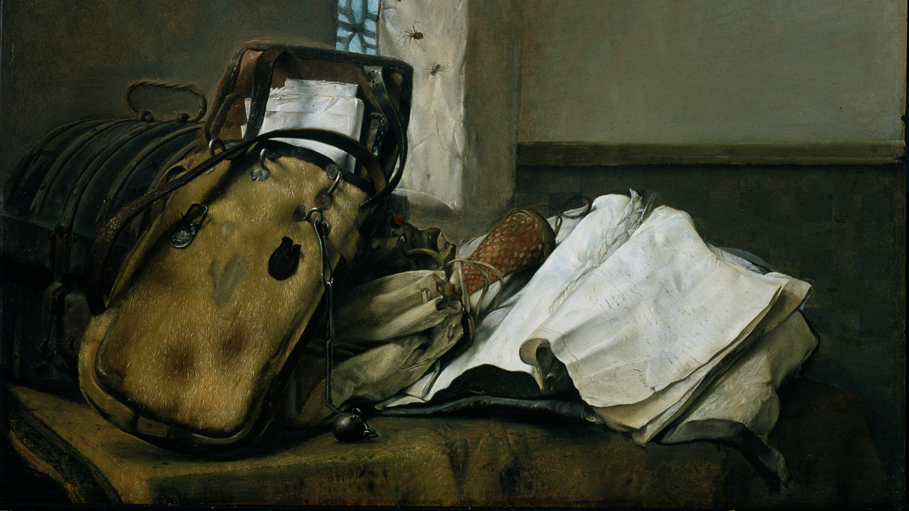
Espionage and Intelligence in premodern Europe

Slide 2
New Module looking at ‘Long History’ of Espionage & Intelligence
Explore how espionage used and understood
Coverage: from the Ancient World to the Enlightenment
Relationship with diplomacy (‘new diplomatic history’) and the development of communication and information-gathering (correspondence and news)
Focus on extensive historiography on spying in early modern Europe (c.1500-1800), primarily Elizabethan England
Compare and contrast with developments in other times and other places (in Europe & beyond e.g. Ottoman Empire, China) through variety of case studies and primary sources

Slide 3
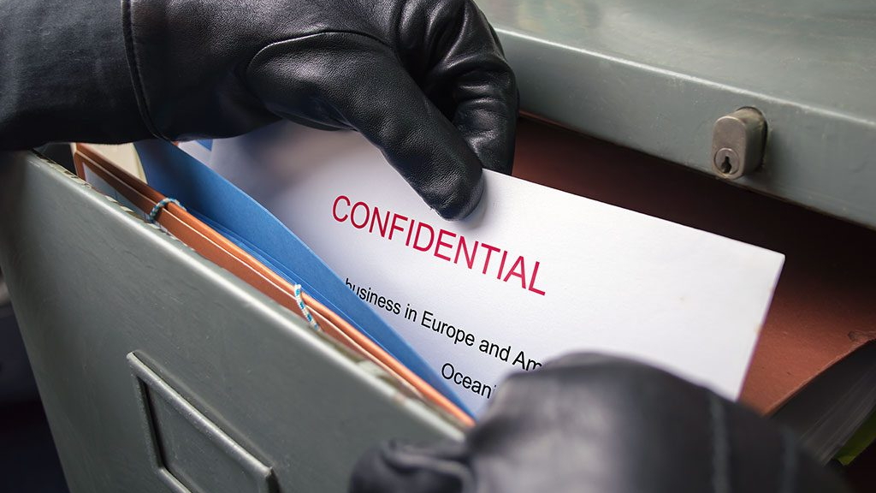
What is a Spy?

Slide 4
Questions to think about
Second oldest profession: honourable or dishonourable? Legitimate or illegitimate?
Might there be different understandings depending on who they were ‘working for’?
Do they need to be employed/paid/rewarded?
Secrets/intelligence vs information-gathering: ‘intelligencers’ vs ‘espions’
How might ancient/medieval/Renaissance/early modern/modern espionage differ?
What are the problems with studying espionage in the past?
Who are the spies? Is there a ‘type’?
How might our modern-day (ahistorical?) perceptions shape our identification of spies and their networks?

