Slide 1
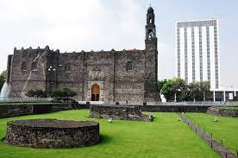
A History of Modern Mexico
Revision

Slide 2
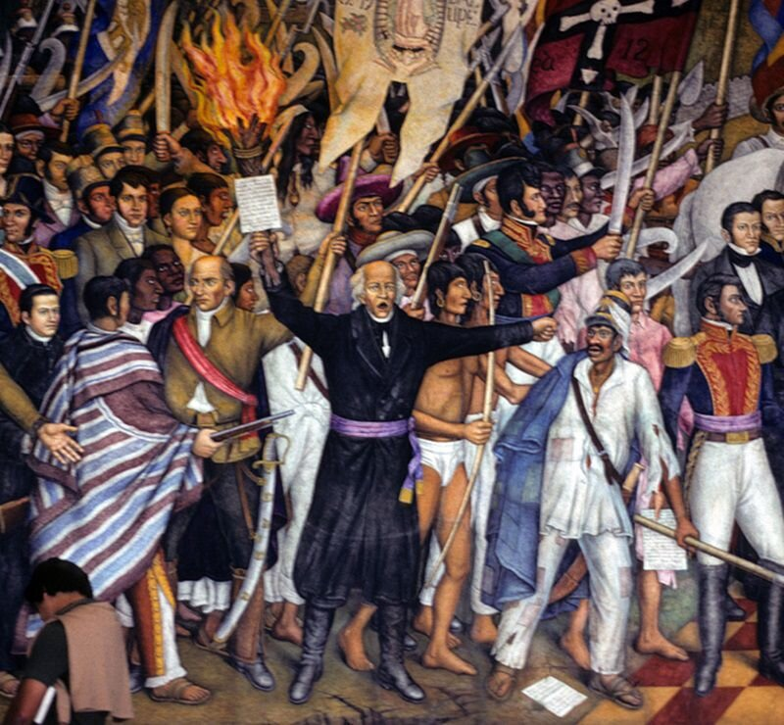
Mexican Independence (1810-1821)
Drought and recession
The popular revolt
Creole discontent
Bourbon Reforms
Napoleonic invasion of the peninsula
The Plan de Iguala- Independence
Age of Revolution?

Slide 3
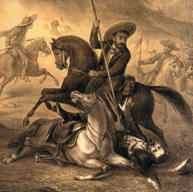
Democracy and Dictatorship (1821-1846)
Instability
Caudillos
Civil conflict
Foreign debt
Political divisions: federalism and centralism
Political culture-popular federalism
Age of Revolution?
Caste wars

Slide 4
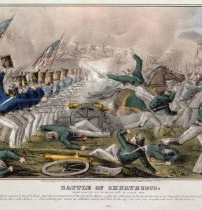
The Mexican American War (1846-1848)
US Revivalism and expansionism
Mexican ongoing concerns about territorial integrity
Instability in Mexico
Ideas of democracy: manifest destiny
Religion
Race
Borderlands
Treaty of Guadalupe Hidalgo
Civil wars

Slide 5
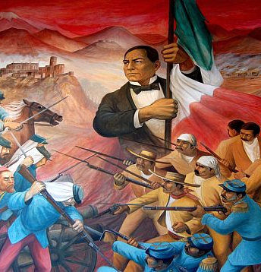
Civil War and Benito Juarez (1848-1876)
Reform War
French Intervention
New generation of politicians: liberals and conservatives
Secularisation
Benito Juarez legacy- first indigenous president, anti-imperialist, revolutionary?

Slide 6
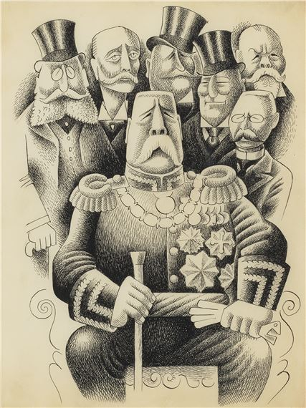
Porfirio Diaz: The Liberal Dictator
(1876-1910)
Conservative liberalism
Clientelism
Globalisation and industrialisation
Banking system
Oligarchy
Race, social Darwinism and mestizaje
Understanding the regime with the hindsight of the revolution

Slide 7
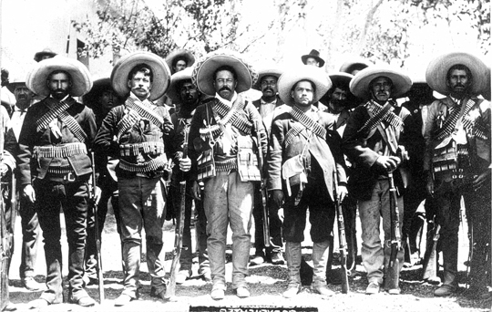
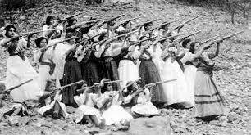
The Mexican Revolution (1910-1920)
Who participated? Middle class anti-re-electionists, the agrarian revolt and the Zapatistas, Villistas, Orozquistas, Carrancistas and Constitucionalistas.
Agrarian, Social, Cultural?
Was it a revolution or did the Carrancista state co-opt?
What about urban labour? How do we interpret article 123 of the constitution?
The consummation of liberalism?
What about the issue of reading from the legacy of the one party state?

Slide 8
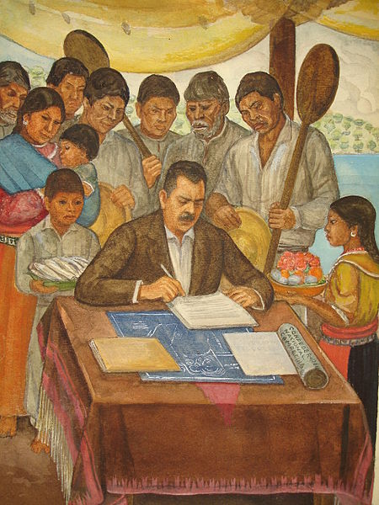
Land and Labour (1920-1940)
Land reform-ejidos
State Corporatism CNC
Labour CGT

Slide 9
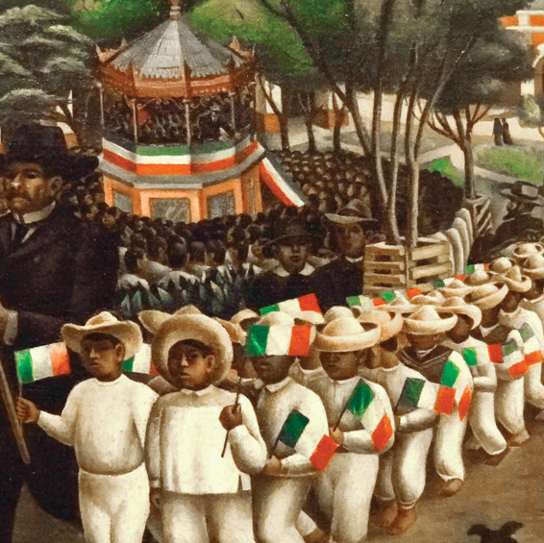
Cultural Reforms (1920-1940)
Indigenismo
Secularisation
Education
Gender

Slide 10
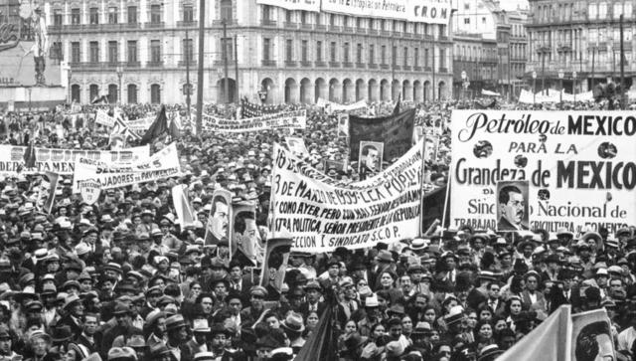
Counter-Revolution and the PRI state (1940-68)
The Golden Age of the PRI
The economic miracle
The one party state: labour, popular sectors etc.
Import Substitution Industrialisation
‘Labour aristocracy’
Agrarian economy in decline

Slide 11
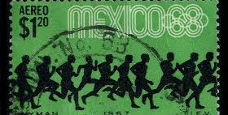
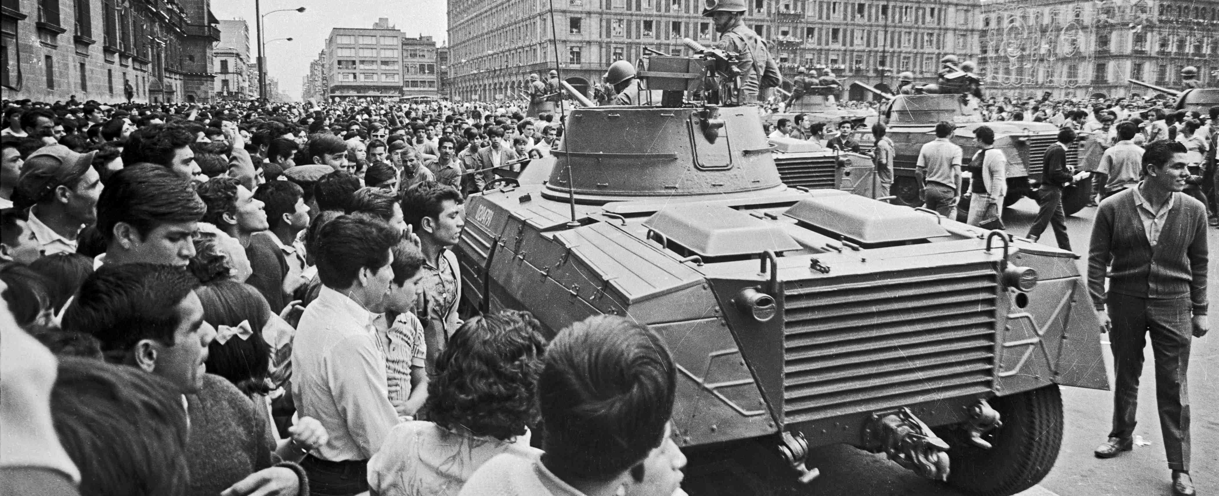
The 1960s in Mexico
The end of the PRI consensus?
Olympics
Tlatelolco

Slide 12
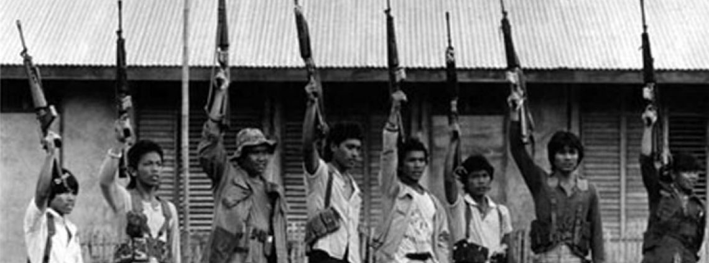
The Dirty War (1965-1982)
The influence of the Cuban Revolution
Echeverria and Cold War Politics
Guerrilla in Guerrero: The Party of the Poor
Memory and commemoration: Truth commission

Slide 13
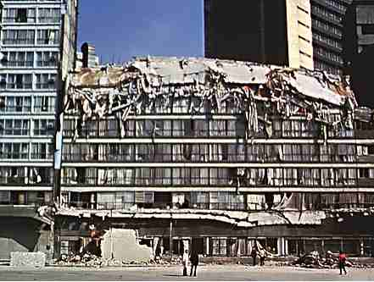
Modern Mexico: Neoliberalism and Democratization
The earthquake and civil society
Economic crisis
New parties
Opposition press
Mega corruption

Slide 14
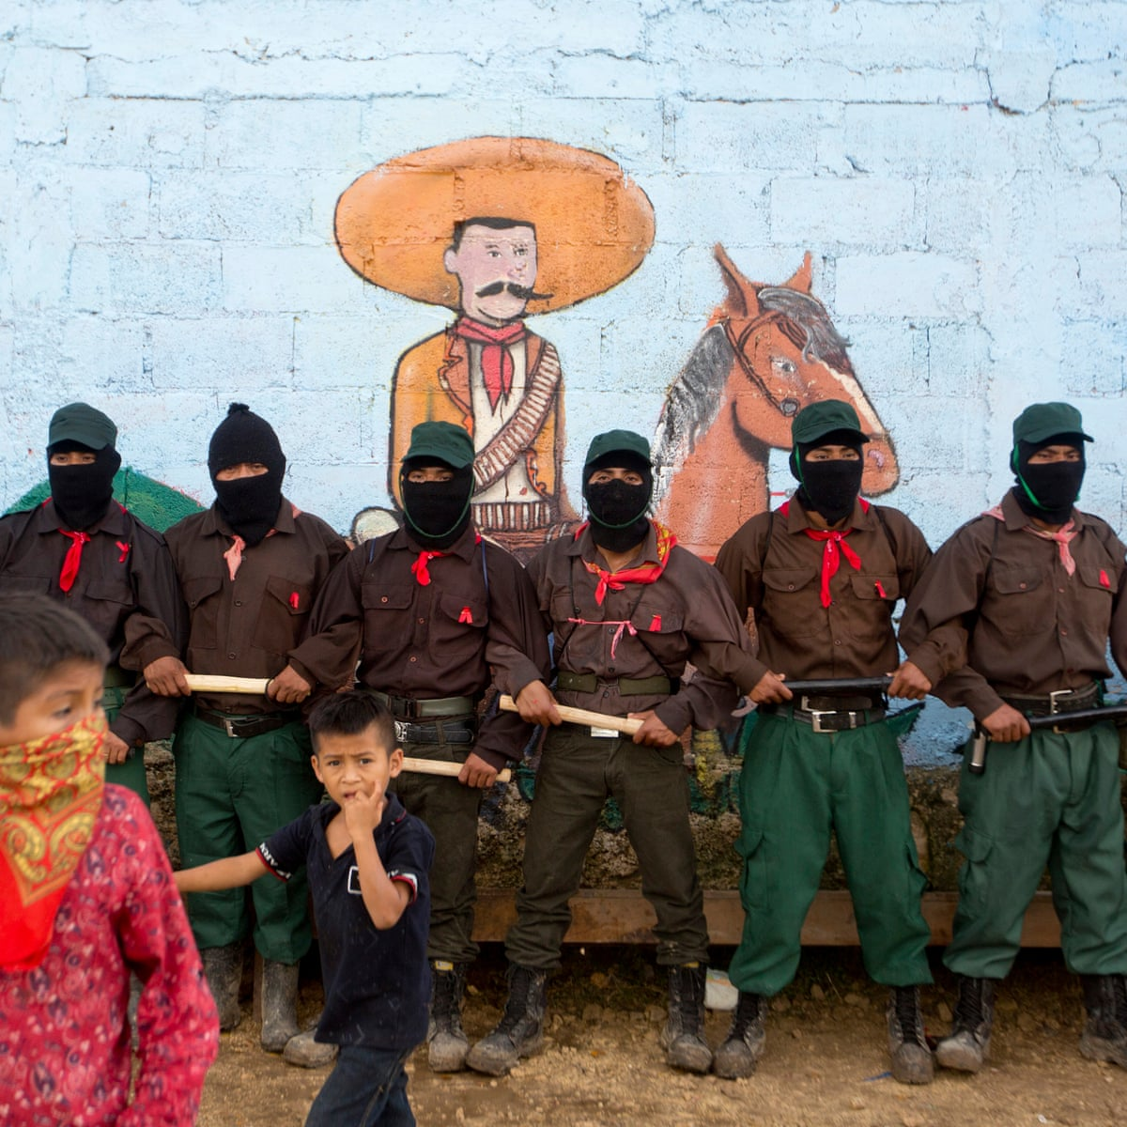
Modern Mexico: Zapatistas and Indigenous Rights
ILO 169 and multicultural constitutionalism
Globalization and NAFTA
Electoral fraud and the one party state
Guerrilla, student movement and some sectors of the church (e.g. Liberation Theology) have reached out to indigenous communities.
Demands: autonomy within the state not overturning the state, infrastructure, recognition of usos y costumbres.
Negotiations with the government, San Andres Agreements
A guerrilla, an NGO, a post-modern movement?

Slide 15
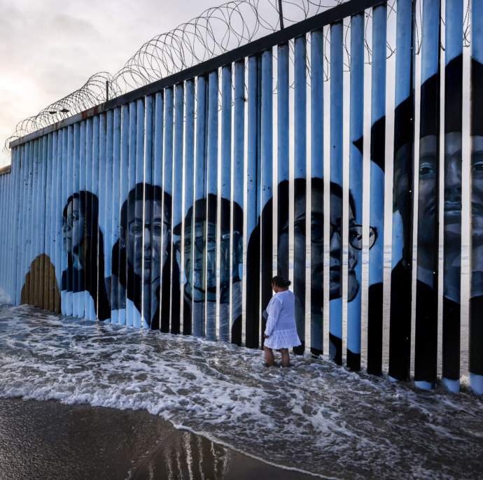
Migration and the Border
Bracero programme
Established networks
Push factors: Impact of ISI on the countryside, modernization and migration, 1980s economic crises, violence
Pull factors: employment, family networks
Central American migration
NGOs and organisations
Migrant caravans
US border policy
Policing and vigilantism

Slide 16
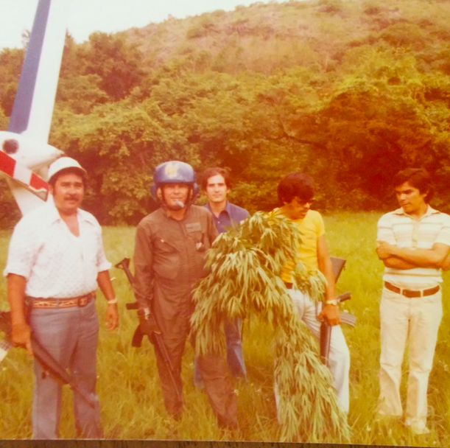
The Drug Trade
Stage 1 – 1910-1960
  1914 Harrison Act prohibits smoking opium, heroin, and cocaine.
  Marijuana, opium, protection rackets
  Stage 2: The Counterculture (1960-1975)
  Hippy tourists
  Post-1972 Increase in heroin trade
  Stage 3 1975-1990s : The First War on Drugs and Federal Control
  Militarisation of control
  Human rights, migration, distrust of the state
  Stage 4: Cracks in the System, 1990s-2006
  Neoliberalism and democratization
  Cartel takeover
  Stage 5: War and Total War, 2006-2022
  Fragmentation of cartels
  Diversification

