Slide 1
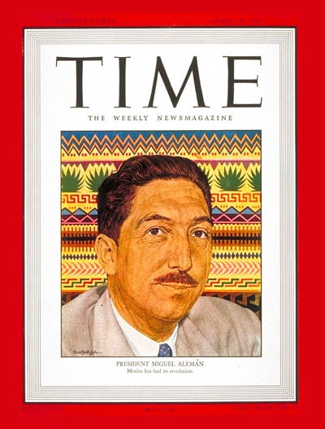
Politics in Golden Age Mexico, 1940-1968

Slide 2
The Revolution’s slow death (1940-1968)
Macro-economic success – Policy of Import Substitution Industrialization means that economic growth at 6 per cent per year
Growing urbanization
Literacy and life expectancy rise

Slide 3
But, this disguises massive imbalances
Huge inequality. Mexico’s Gini coefficient stood at 0.52, higher than any country outside sub-Saharan Africa
Concentration of wealth in Mexico City and northern states
Abject poverty in countryside. As countryside was meant to provide food for the cities, corn prices dropped 33 per cent, purchasing power of peasants by 47 per cent.

Slide 4
Creation of the revolutionary bourgeoisie
Group of rich former revolutionaries, who exchanged their revolutionary principals for self-enrichment. Often married into the Porfirian families they had helped to topple.
E.g. Jorge Pasquel (baseball magnet), Miguel Aleman (president 1946-52), Artemio Cruz

Slide 5
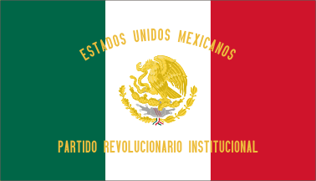
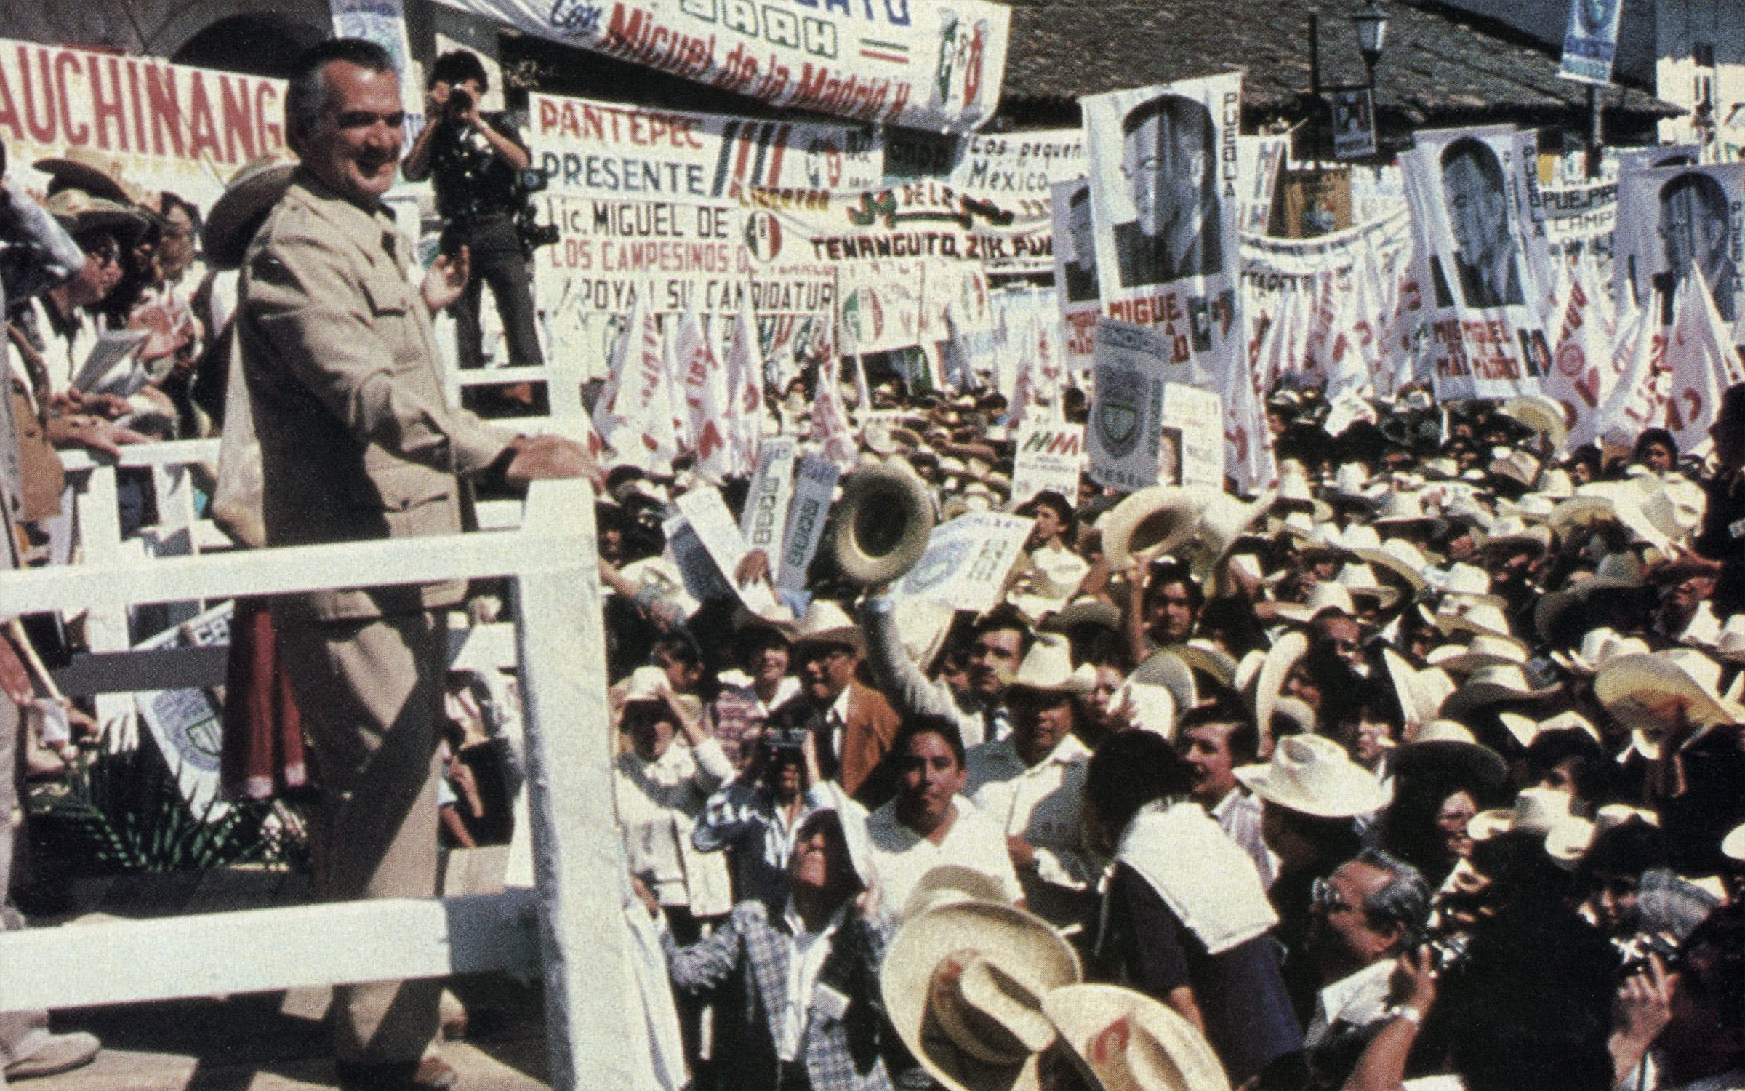
At the same time, decreasing democracy.
The PRI or Institutional Revolutionary Party won every election, from town councils to the presidency.
Only in 1980s, did PRI power start to decline.

Slide 6
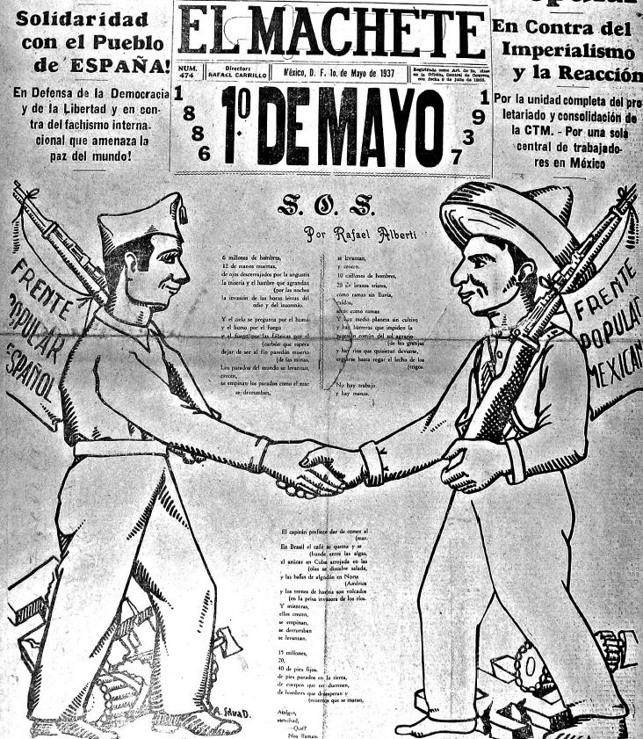
The History of the PRI
1929-1938 – President Calles creates the PNR (Partido Nacional Revolucionario)
The creation of the party is designed to keep revolutionary unity after the assassination of Alvaro Obregon (1928).
All governors and state parties join the PNR, which in turn dominates elections.
However the party does not have a strong popular base.
El Machete, Mexican Communist Party newspaper, 1937

Slide 7
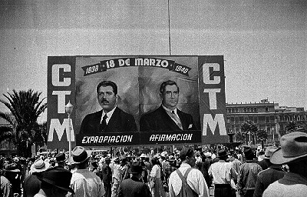
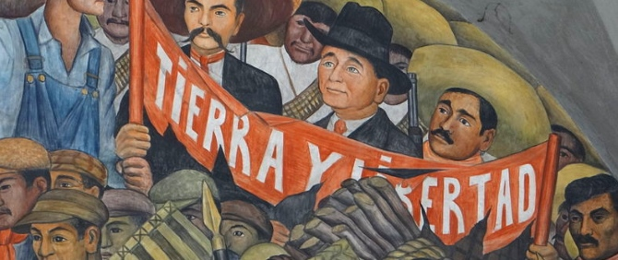
The History of the PRI
1938-1946 President Cardenas changes the name. PNR becomes Partido de la Revolución Mexicana (PRM). Widens popular base.
Party divided into three sectors: peasant, labour and military.
All members of peasant leagues (unions of ejidatarios), labor unions (particularly the CTM) and military have to join the party.
Detail, Diego Rivera History of Mexico (1929-35),
Palacio Nacional, Mexico City
CTM rally, 1940

Slide 8
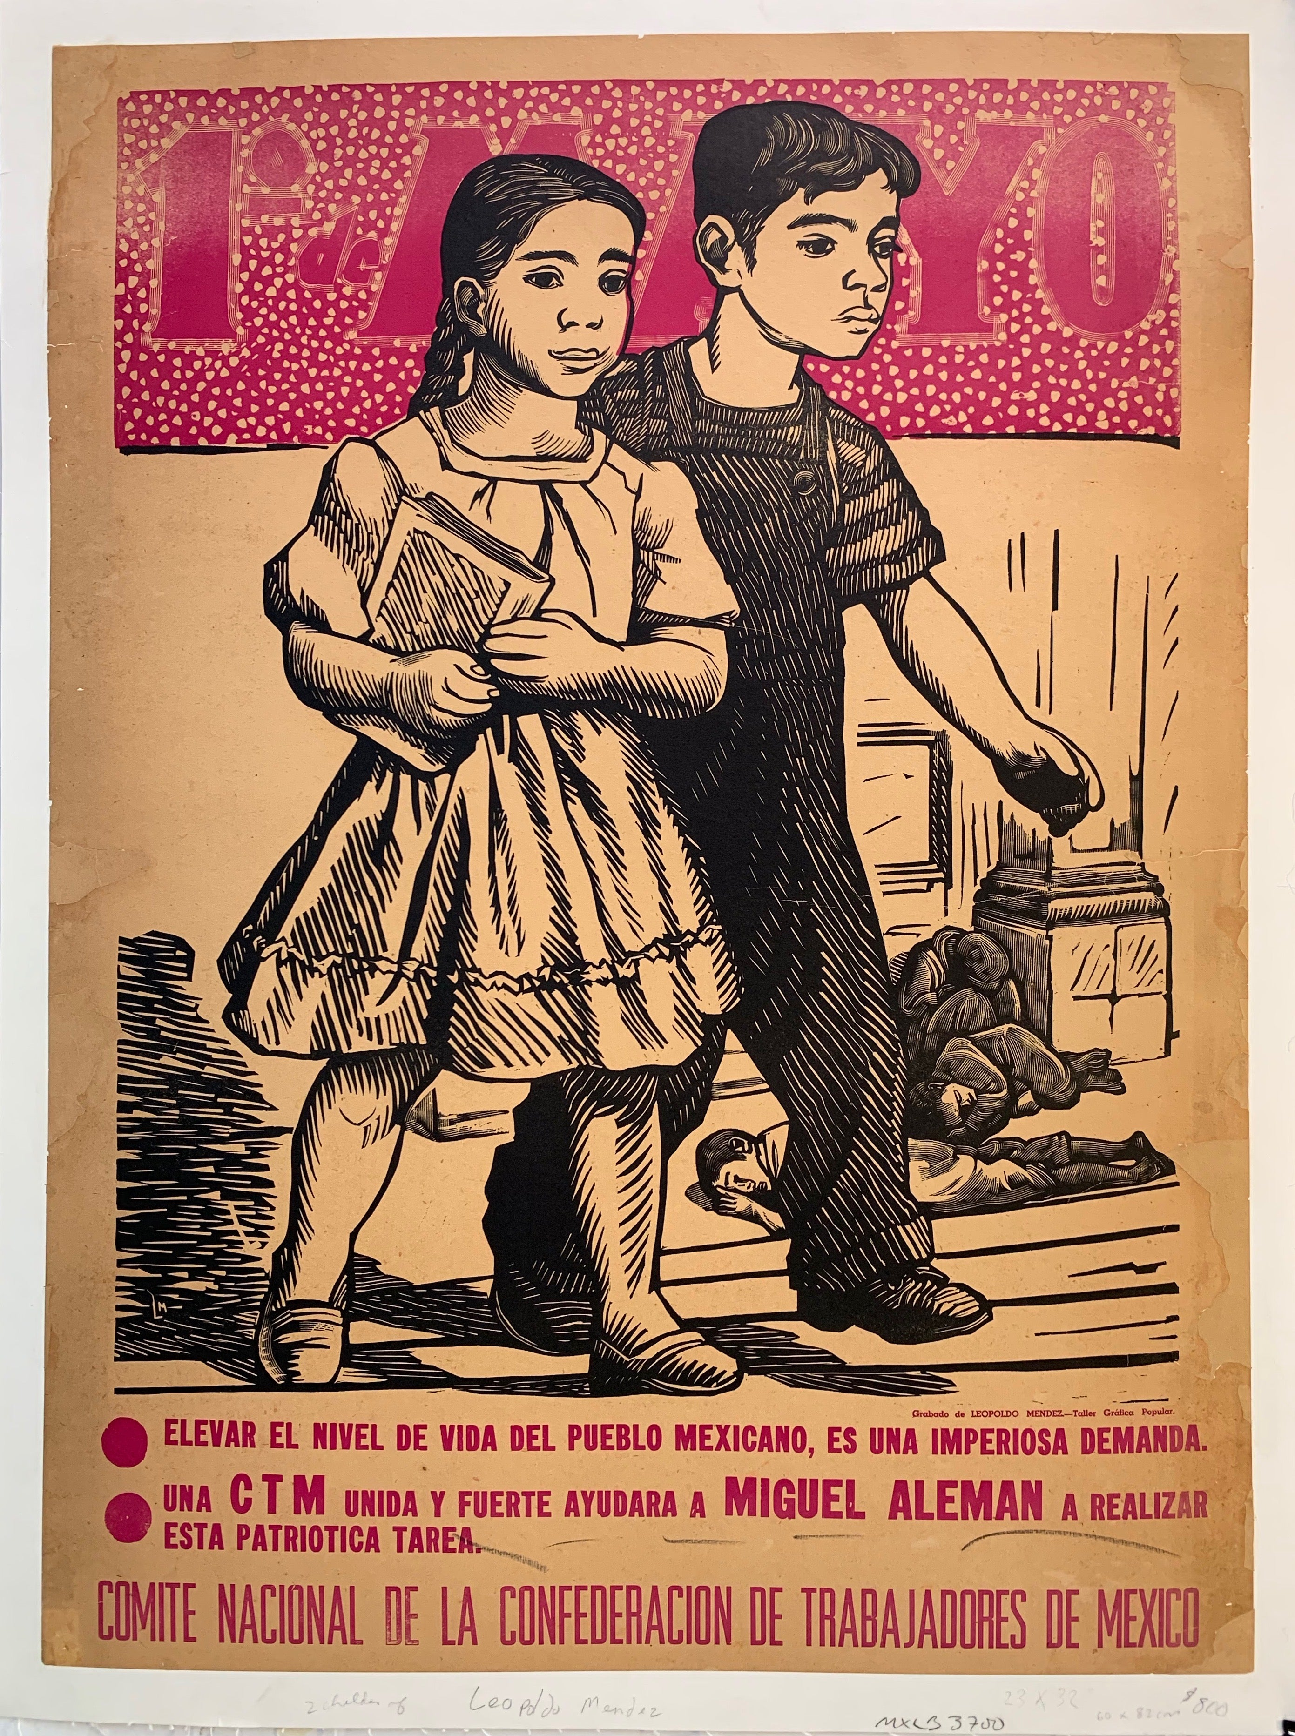
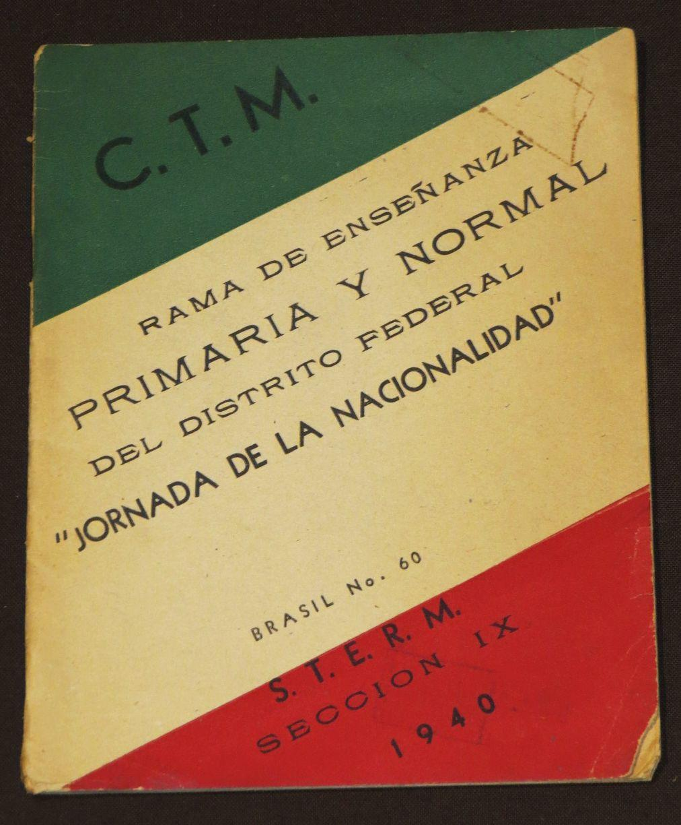
CTM POSTER AND EDUCATIONAL PUBLICATION, 1940

Slide 9
The PRM becomes the Institutional Revolutionary Party (PRI) in 1946
The peasant, labor and military sections are joined by the “seccion popular” (CNOP), which is designed to comprise the middle classes.
The PRI takes on a “corporatist” form.
Corporatism: State, through the process of licensing and regulating officially-incorporated organizations (Peasant leagues, labor unions etc), co-opts their leadership or circumscribes their ability to challenge state authority by establishing the state as the source of their legitimacy.
1946-2000 These organizations are forced to vote for the PRI, which wins every presidential election and until 1980s nearly 100 per cent of gubernatorial, congressional and municipal elections.
The CNOP plays the dominant role in this organization. Most senators, deputies and governors come from the CNOP.

Slide 10
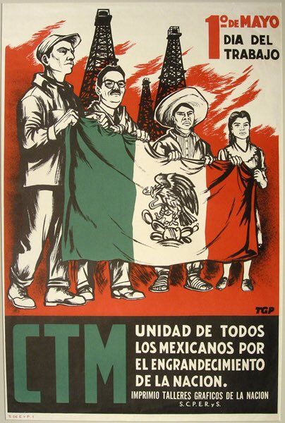
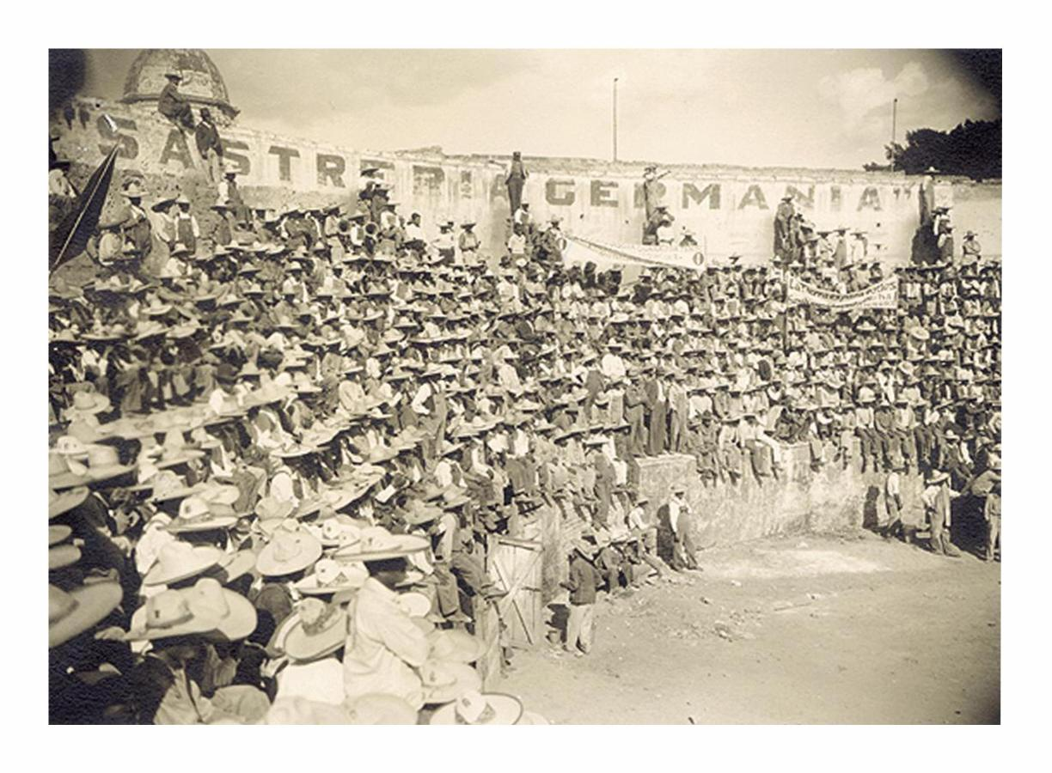
CTM Poster 1947

Slide 11
How corporatism works: Our way or the highway You are a peasant, you want to apply for an ejido from the local hacienda. You have two choices
1) The PRI way
Form a peasant league
Apply for entry into the official PRI peasant union (CNC)
Ask for the CNC to write to the government ejido administration on your behalf
Wait a long time, and eventually receive your ejido.
In return for the ejido and some credit from the Ejido Bank you will be expected to vote PRI at every election
2) The alternative way
Form a peasant league
Apply for entry into one of the peasant unions not attached to the PRI (CGT, Communist Party)
Try to apply to the government ejido administration independently
The government ignores your request.
Your only other course of action is land invasion.
The military throws you off the land.

Slide 12
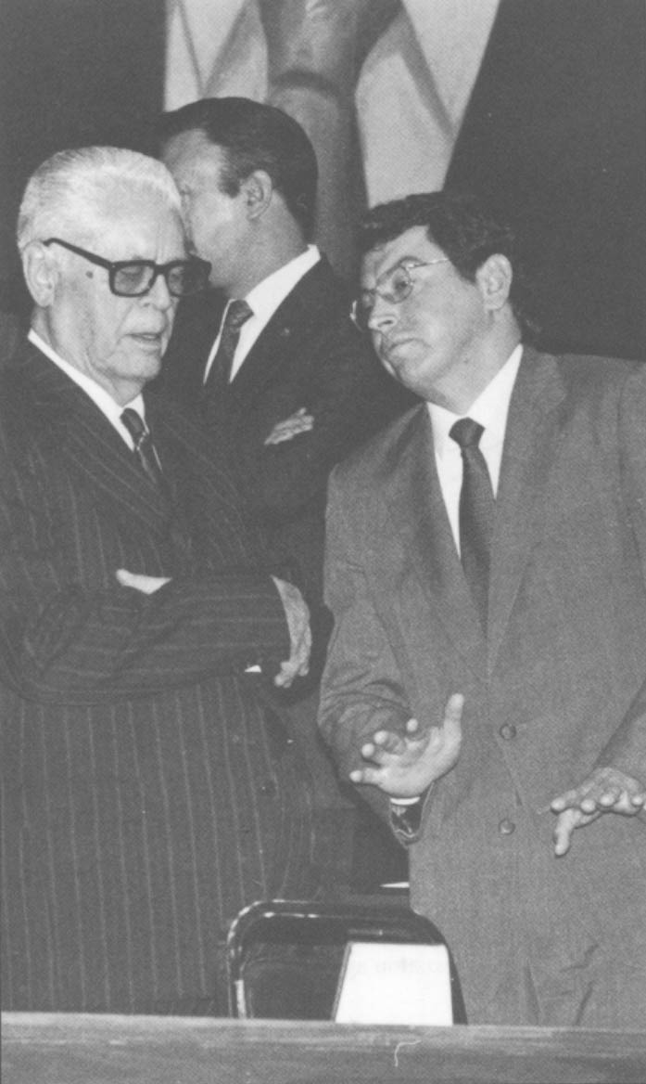
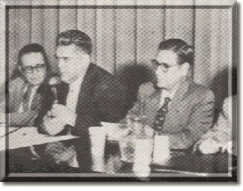
Corporate peasant and labor unions were run by loyal government appointees e.g. Fidel Velasquez, head of the CTM, 1946-1997

Slide 13
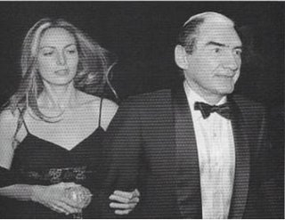
Other avenues of protest were also stopped
E.g. Newspapers. The PRI held the paper monopoly in Mexico. In order to acquire paper, you had to go through the PRI. The PRI would offer loyal newspapers cheap paper and disloyal newspapers expensive paper.
E.g. Television. The PRI offered the television monopoly to a loyal servant, Emilio Azcarraga Milmo. He established Televisa, which dominated Mexican television until the 1990s. The television station openly supported the PRI and played down difficult issues. Azcarraga’s attitude to television’s role can be summed up in the quote:
“Mexico is a country of a modest, very fucked class, which will never stop being fucked. Television has the obligation to bring diversion to these people and remove them from their sad reality and difficult future.” Emlio Azcaraga

Slide 14
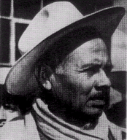
E.g. Rural Protest
Whereas peasants had previously invaded lands and received ejidos after 1940, the government started to support the big landowners (hacendados). Rebellious peasants were often murdered.
Army units in 20 per cent of municipalities
Paramilitaries e.g. La Mano Negra in Veracruz, “Los del monte” in Sinaloa or murderers of Ruben Jaramillo in Morelos in 1962.

Slide 15
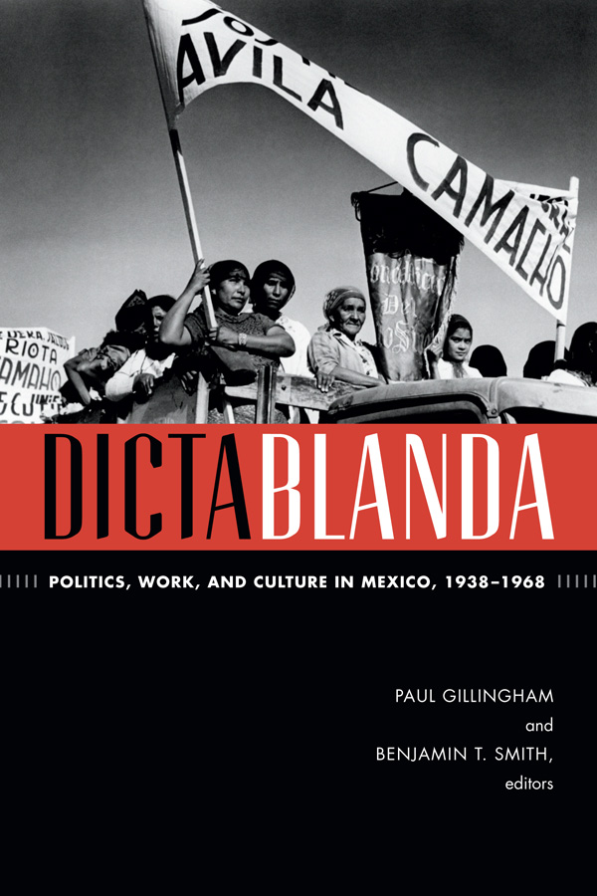
Mexico under the PRI has been described as la dictablanda, “soft authoritarianism” or “the perfect dictatorship”
Although there was only limited electoral freedom, Mexico was not China, Russia, Chile or Argentina.
There was an “economic miracle”
At the local level, there was some political freedom
Corruption

Slide 16
From 1940 to 1970, Mexico undergoes an “economic miracle”
Mexico’s economic miracle is produced by the policy of ISI (Import Substitution Industrialization)
ISI is based on premise that country should reduce foreign dependency through local production of industrialized products. It suggests state-induced industrialization through governmental spending.
ISI was fairly advantageous
Increased industrial production by 6 per cent per year.
Increased employment
Mexico was fairly resilient to global economic shocks
BUT Created inefficient and obsolete industries and relied on cheap raw materials from Mexican producers, thus not helping the peasants in the countryside.

Slide 17
Limited political freedom 1) Municipal elections
Although the PRI dominated the presidential, senatorial, gubernatorial and congressional elections, municipal elections were still fairly free. Small villages in the south of Mexico in particular could decide on their council, vote it in and then declare that it was PRI. The council could then follow policies outlawed by the PRI (e.g. it could build a Catholic school)

Slide 18
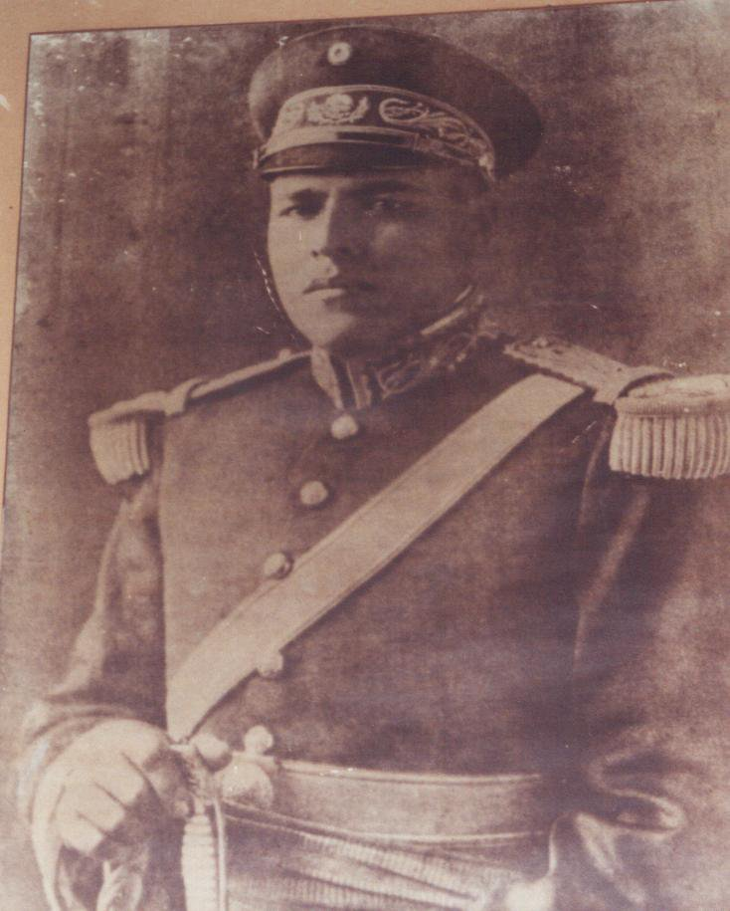
Limited Political Freedom 2) Caciques
Other regions were run by local strongmen (caciques) who remained fairly independent of the PRI. These were normally revolutionary generals, who power and charisma engendered strong local loyalties, and whom the PRI was not powerful enough to remove. Although these caciques were nominally PRI, they could impose any policies they wanted as long as they maintained a low profile. E.g. Heliodoro Charis in Juchitan (Rubin) or The Princes of Naranja (Paul Friedrich)

Slide 19
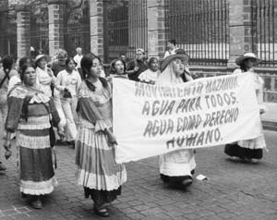
Limited Political Freedom 3) Urban protest
Historians are starting to discover waves of social protest in Mexico’s cities during the 1940s and 1950s. They protested
Increasing food prices
Water, electricity, sewage and other basic services
Taxes hikes
Squatters’ (paracaidistas) rights
Election infringements
They often received what they were asking for.

Slide 20
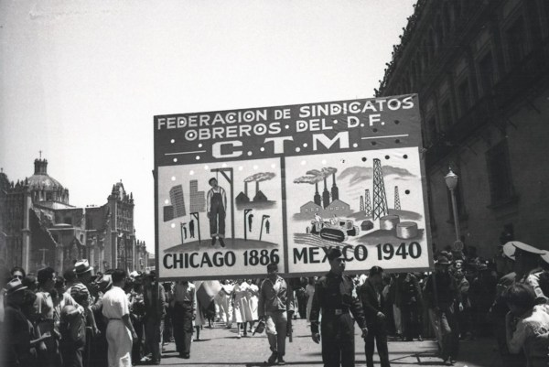
1 May rally, Mexico City, 1940

Slide 21
Limited Political Freedom 4) Corruption
In mid-century Mexico corruption was not so much an aberration as the oil that greased the political machine.
It was key to buying off disenfranchised groups and even building the state.
E.g. “Los del monte”, 1940s right-wing death squad in Sinaloa, were given franchise rights to grow and export opium and marijuana.
Or Informal drug tax. Local drug growers in Sinaloa paid state government 30% tax.

Slide 22
Conclusion: Why did the PRI last so long?
Most authoritarian regimes are fairly inflexible and strongly ideological.
The PRI was incredibly flexible and unideological. It incorporated Catholic extremists, militant peasants, factory workers, teachers, university professors and factory owning elites.
Each president tacked between the right and left wing, pleasing each group enough to avoid any rebellions or revolts.

