Slide 1

Late Stalinism
‘People’s Dreams Realised’ (1950)

Slide 2
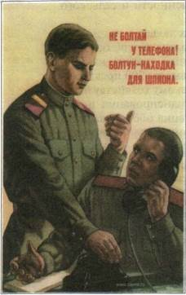
High/Mature Stalinism
Apogee of previous tendencies (from an ‘embryo’ to ‘full-fledged’)
  Stalin’s paranoia and some other psychological issues ‘flaring up’
  Highest level of centralisation of power in Stalin’s hands
  Repressive campaigns
  Atomised society
Cold War facilitates these developments
‘Don’t chat next to the phone! Loose lips sink ships!

Slide 3

Late Stalinism
A period with its own logic and peculiarities; not just a culmination of previous tendencies
Late Stalinism as a more chronologically defined period
Cold War
Ideological campaigns
War impact
Industrialisation, railway constructions
Postwar Stalinism does not always work (some key developments start before the end of the war, or significantly after)

Slide 4
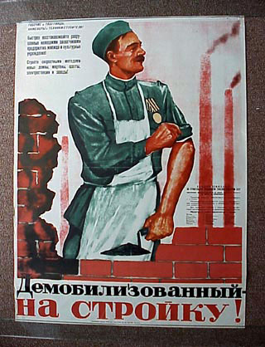
War Destruction
26 Million citizens of the Soviet Union have died
31 850 factories (1/3 of civilian production)
24% of sowing area
1710 cities and towns, 70 000 villages ?? (official data)
4.7 Million houses
Demobilisation challenge
War as a new foundational myth (Weiner), but others emphasise prewar ideological changes towards Russocentric etatism as a key element (Brandenberger)

Slide 5
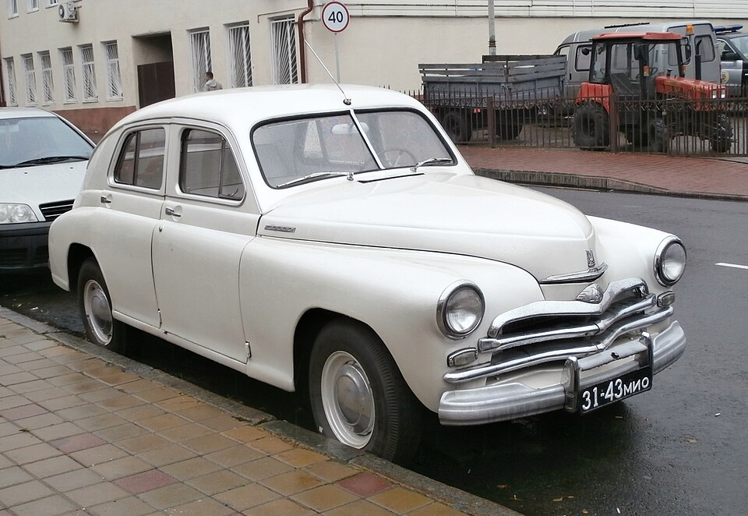
Economy
Reconstruction – end of lend lease, but reparations from Germany
Restructuring economy: conversion from military to civilian production
Re-Sovietisation of territories occupied by Germans
Food shortage or famine 1946/47
Only 1950-1952: living standard of 1928
Agrarian production 1940: 39.6 Million t, 1946-1950 (annual average): 35.7 Million t, 1950: 39.3 Million t
Industrial production during 4th Five-Year-Plan 1946-1950 (1940=100) 1950:173; Means of production: 205; production of consumer goods: 123.
GAZ M20 ‘Pobeda’

Slide 6
Politics and Culture
Cult of Stalin, 1949 70th birthday
GULag: many released 1944-1946, but new inmates – former Soviet prisoner of wars, Ukrainian, Lithuanian, Latvian, Estonian nationalists - 1950: 2.5 Million people in prisons or in GULag
Party, state and army: War had strengthened state, enormous prestige of army, role of party slightly reduced
Zhdanovshchina: population hoped for ‘liberalisation’, got more ideological control
Lysenkoism but … technological progress (nuclear weapons, rockets, jet engines)
Criticism and Self-Criticism
Anti-Cosmopolitanism and Anti-Zionism Campaign
Leningrad Affair
Mingrelian Affair
Doctors’ plot

Slide 7
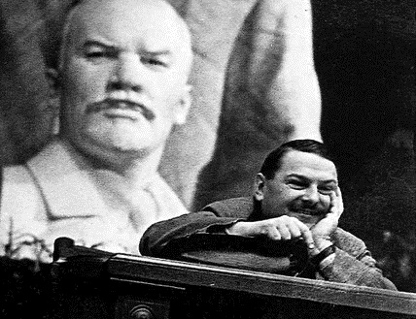
Zhdanovshchina
Akhmatova’s subject-matter is individualistic to the core. The range of her poetry is sadly limited; it is the poetry of a spoilt woman-aristocrat, frenziedly vacillating between boudoir and chapel… A sense of fatality (quite comprehensible in a dying group), the dismal tones of a deathbed hopelessness, mystical experiences shot with eroticism, make up Akhmatova’s spiritual world; she is a left-over from the world of the old aristocracy now irrevocably past and gone, the world of ‘Catherine’s good old days’. It would be hard to say whether she is a nun or a fallen woman; better perhaps say she is a bit of each, her desires and her prayers intertwined… Such is Akhmatova, with her petty, narrow personal life, her paltry experiences, and her religiously mystical eroticism.
Her poetry is far removed from the people. It is the poetry of the ten thousand members of the élite society of the old aristocratic Russia, whose hour has long since struck and left them with nothing to do but sigh for ‘the good old days’ (1946)

Slide 8
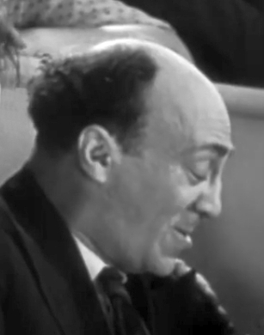
Antisemitic Campaigns
Zhdanov: ‘internationalism grows where national culture flourishes. To forget this is to lose one’s individuality and become a cosmopolitan without a country’
Jewish Anti-Fascist Committee, est. 1942
13 Jan 1948 – Murder of Solomon Mikhoels
20 Nov 1948 – JAC disbanded as ‘centre of anti-Soviet propaganda’
Arrests starting with 1948; trial – 1952
125 repressed, 23 executed, 6 dies during investigation

Slide 9
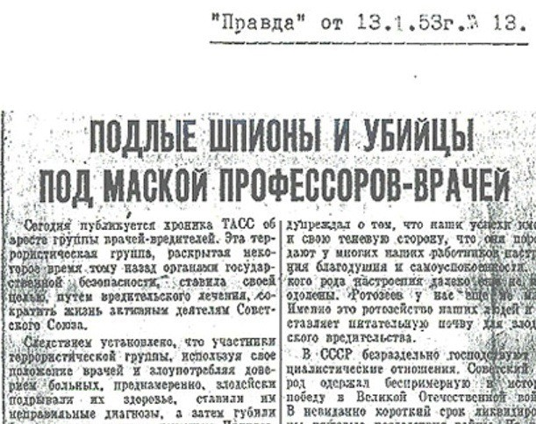
Antisemitic Campaigns – 2
‘Doctor’s Plot’
The case starts in January 1953
Gets all-Soviet tracking – local anti-Jewish campaigns
Myth and rumours of the deportation of Soviet Jews, as well as pogroms – have no documentary evidence

Slide 10
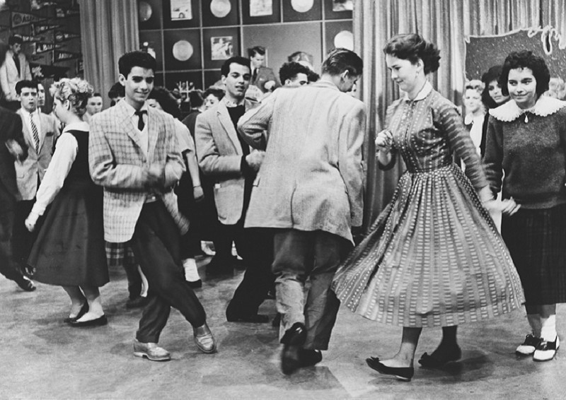
Social Issues
Not atomised
Some social bonds break up, but others emerge
Veteran / frontoviki movement (M. Edele)
New subcultures emerge (stiliagi, shtatniki)

