Slide 1
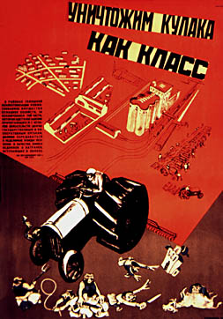

Slide 2
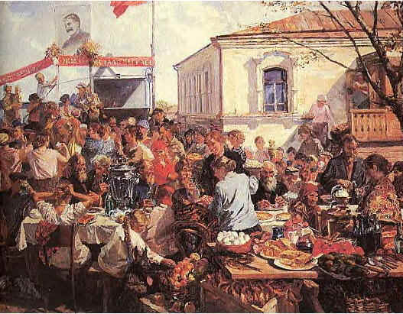
A collectivised farm, propaganda painting from 1937

Slide 3
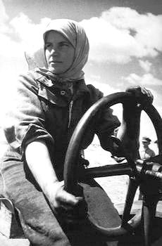
Simon Fridland
Woman Collective Farmer, 1932

Slide 4
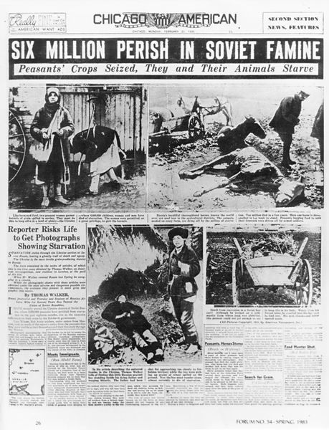
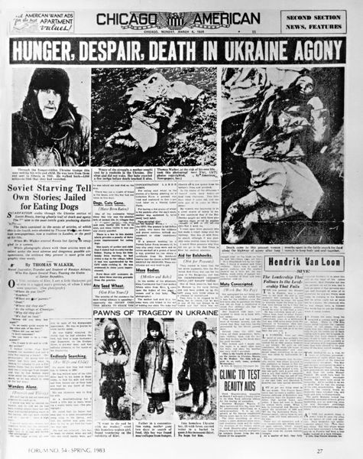
http://www.holodomor.org/

Slide 5
