Slide 1
Socialist Realism
Proletarian
Typical
Realistic
Partisan

Slide 2


Slide 3
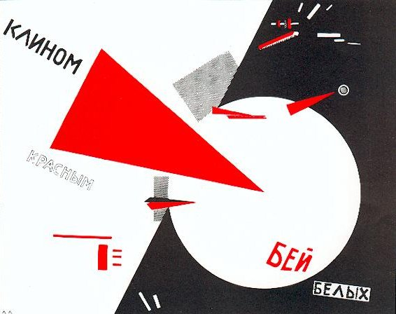

Slide 4
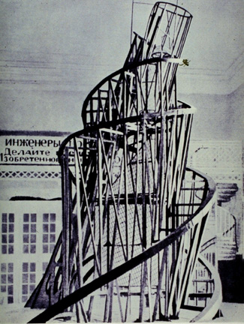
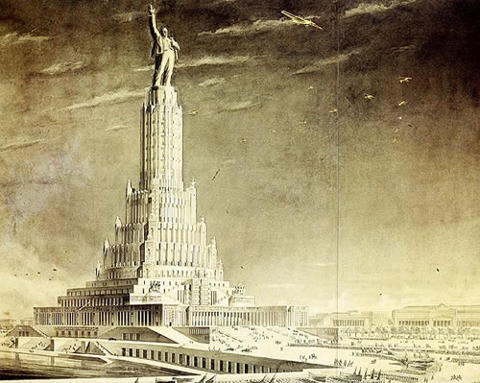

Slide 5
1934 Statute of the Union of Soviet Writers
Socialist realism is the basic method of Soviet literature and literary criticism. It demands of the artist the truthful, historically concrete representation of reality in its revolutionary development. Moreover, the truthfulness and historical concreteness of the artistic representation of reality must be linked with the task of ideological transformation and education of workers in the spirit of socialism

Slide 6
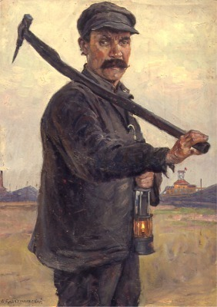
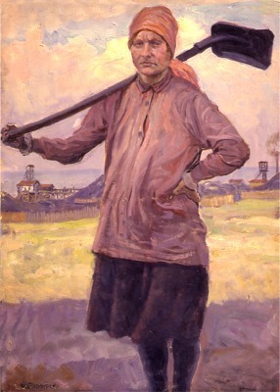
B.E. Vladimirski: Miner (1929)
B.E. Vladimirski: Female Worker

Slide 7
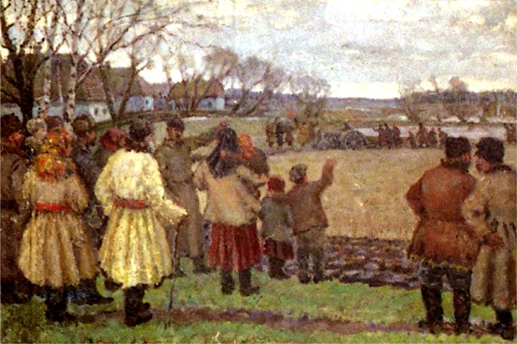
W. G. Krikhatsky: The First Tractor

Slide 8
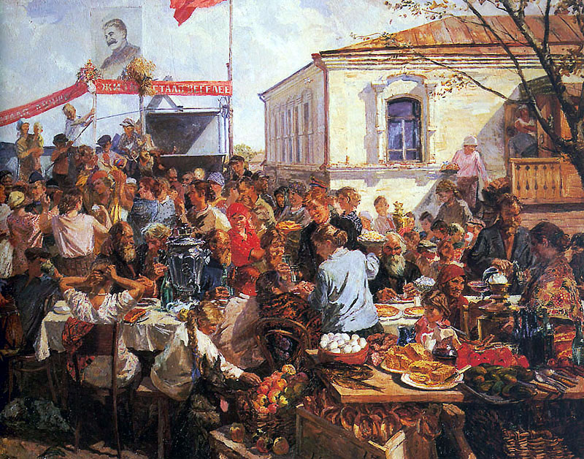

Slide 9
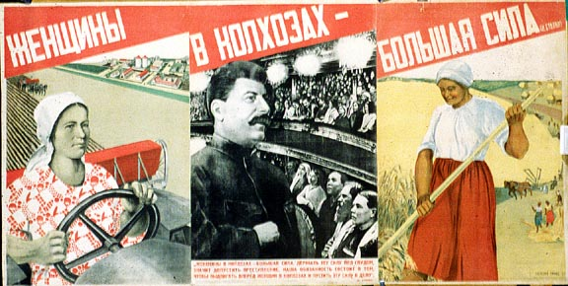

Slide 10
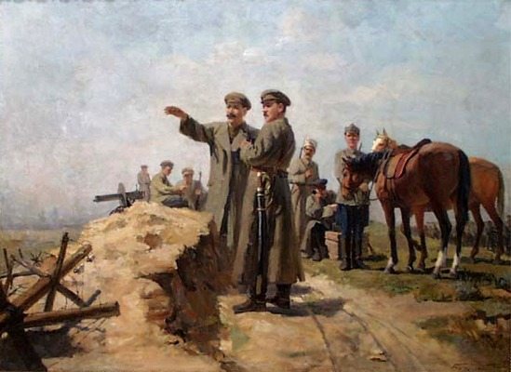

Slide 11
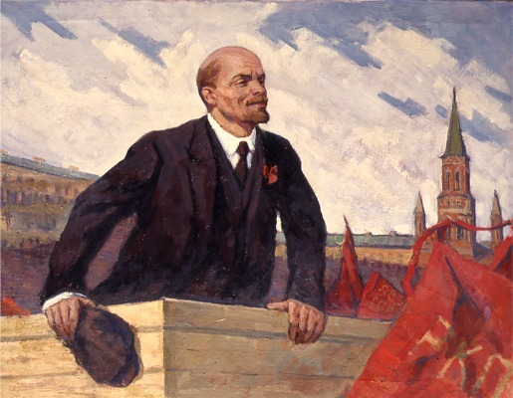

Slide 12
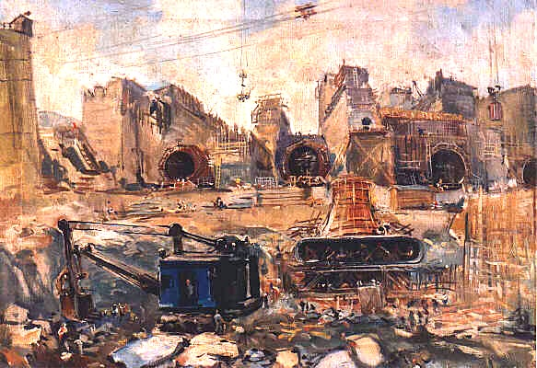

Slide 13
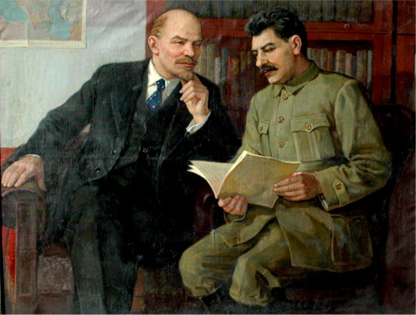

Slide 14
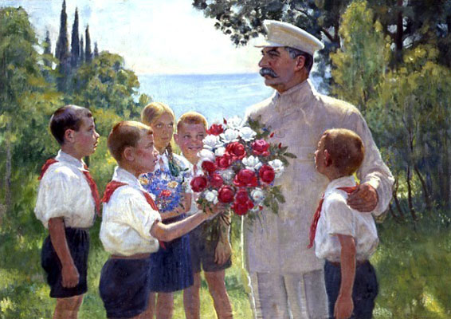

Slide 15
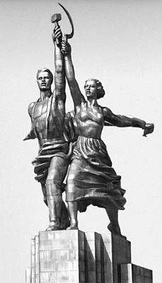
Vera Mukhina: Worker and Kolkhos Woman (1937) 24 m

Slide 16
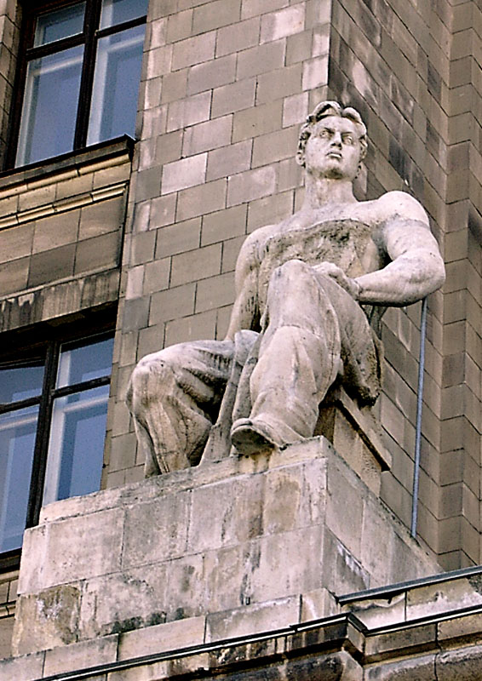
Sculpture of a Worker on one of Stalin’s skyscrapers in Moscow

Slide 17
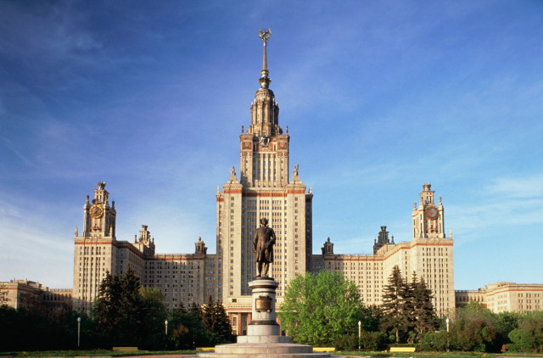

Slide 18
With Stalin’s eyes a mountain is pushed apart. The squinting plain looks far into the distance: Like a sea without seams, the future from the past — From a giant plow to where the sun’s furrow glistens. He smiles a reaper’s smile, the smiling friend, Reaper of handshakes in a conversation Which has begun and which will never end Smack in the middle of all of Creation. And every single haystack, every barn Is strong and clean and smart — a living chattel, A mankind miracle! May life be large. Listen to happiness’s axis roll and rattle.
From: Ode to Stalin (Osip Mandelstam 1937)

Slide 19
O great Stalin, O leader of the peoples, Thou who broughtest man to birth. Thou who fructifies the earth, Thou who restorest to centuries, Thou who makest bloom the spring, Thou who makest vibrate the musical chords... Thou, splendour of my spring, O thou, Sun reflected by millions of hearts.
---A. O.Avidenko (1935)

Slide 20
The production novel
The historical novel
The novel about a worthy intellectual or inventor
The novel of war and revolution
The villain or spy novel
The novel about the West
“Road to consciousness” and a “task”
Tale of moral and political growth + tale of task fulfilment
Fighting against a villain or overcoming love to a foe

Slide 21
Production novel
Prologue or “Separation”
Setting up the task
Transition (Trials etc.)
Climax (Fulfilment of the Task is Threatened)
Incorporation (Initiation)
Finale (or Celebration of Incorporation)
Katerina Clark, The Soviet Novel. History as Ritual. 3rd ed. (Bloomington, Indianapolis 2000)

