Slide 1
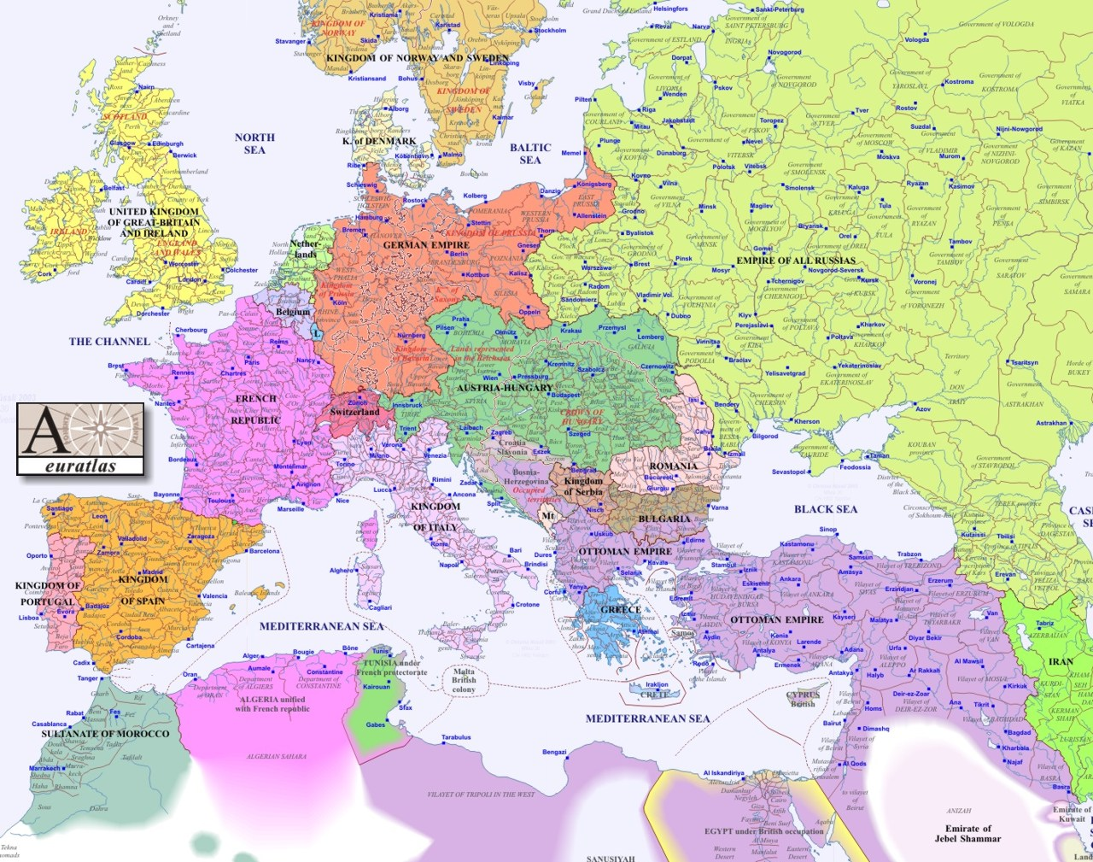

Slide 2
http://online.seterra.com/en/vgp/3048

Slide 3
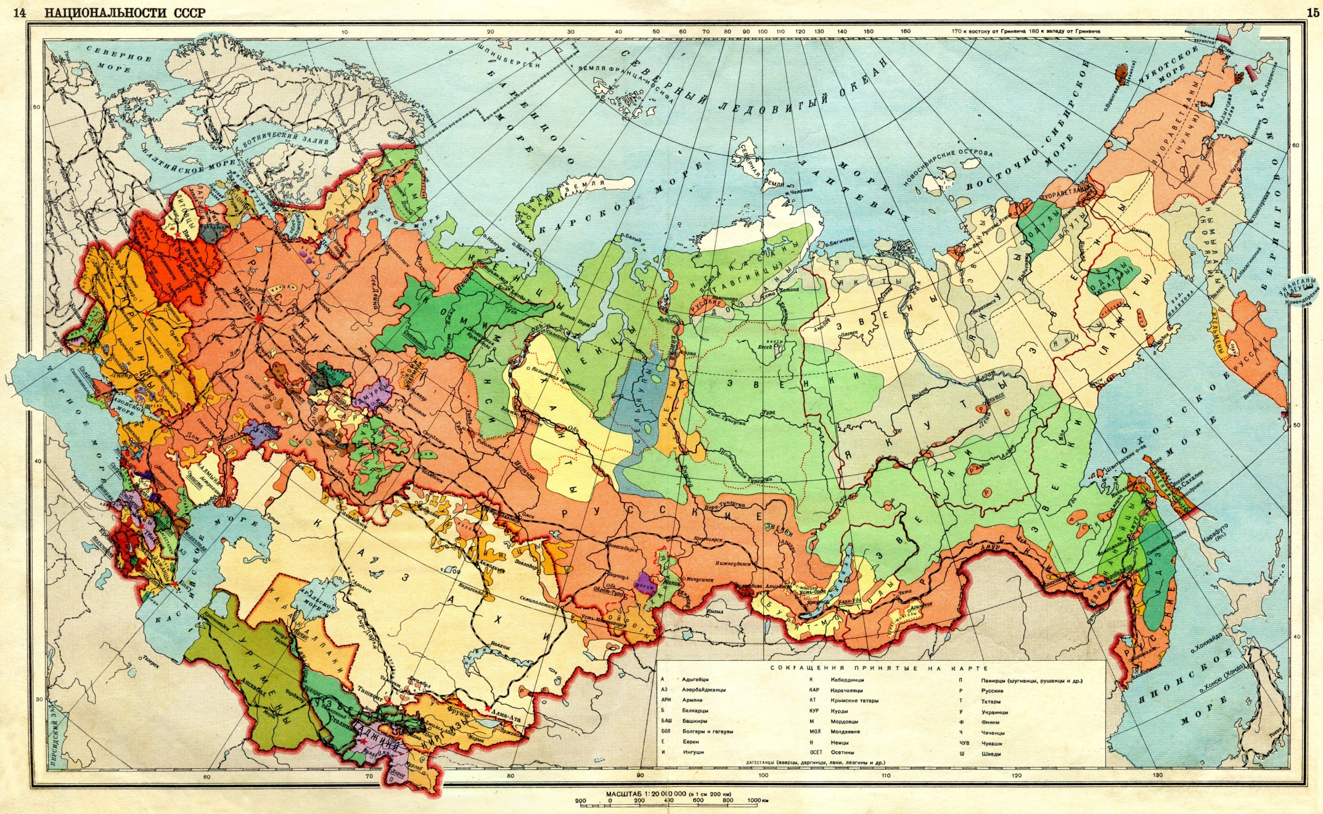

Slide 4
The Soviet Union: Facts, Descriptions, Statistics (published by the Soviet Information Bureau, Washington 1929)
Nationalities
The population of the U.S.S.R. is composed of 182 different nationalities, speaking 149 different languages or dialects. Under the census of December, 1926, the following thirty nationalities composed 97.6 per cent of the total population:
Russians 77,760,100 52.9
Ukrainians 31,194,800 21.2
White-Russians (West-Russia) 4,739,900 3.2
Kazaks 3,959,900 2.7
Uzbeks (Central Asia) 3,904,500 2.6
Tatars (Middle Volga and Crimea) 3,015,200 2.0
Jews 2,600,900 1.8
Georgians (Transcaucasia) 1,821,200 1.2
Azerbaijan Turks 1,706,600 1.2
Armenians (Transcaucasia) 1,567,500 1.1
Mordvinians (Middle Volga) 1,340,400 0.9
Germans (Lower Volga) 1,238,500 0.8
Chuvashes (Middle Volga) 1,117,400 0.7
Tajiks (Central Asia) 978,200 0.7
Poles (chiefly Ukraine and White Russia) 782,300 0.5
Kirghizes (Central Asia) 768,70 0 0.5
Turkomans (Central Asia) 766,10 0 0.5
Bashkirs (Ural) 713,70 0 0.4
Votyaks (Eastern Russia) 504,20 0 0.3
Man (Eastern Russia) 428,20 0 0.3
Chechens (Northern Caucasus) 392,60 0 0.3
Moldavians (Southwestern Ukraine) 278,80 0 0.2
Ossetes (Caucasus) 272,20 0 0.2
Karelians (Northwestern Russia) 248,10 0 0.2
Meshcheriaks (Eastern Russia) 242,60 0 0.2
Buryats (Eastern Siberia) 237,50 0 0.2
Komi 221,30 0 0.2
Circassians (Northern Caucasus) 219,00 0 0.2
Yakuts (Eastern Siberia) 214,80 0 0.2
Greeks (South Russia and Ukraine) 213,80 0 0.2

Slide 5
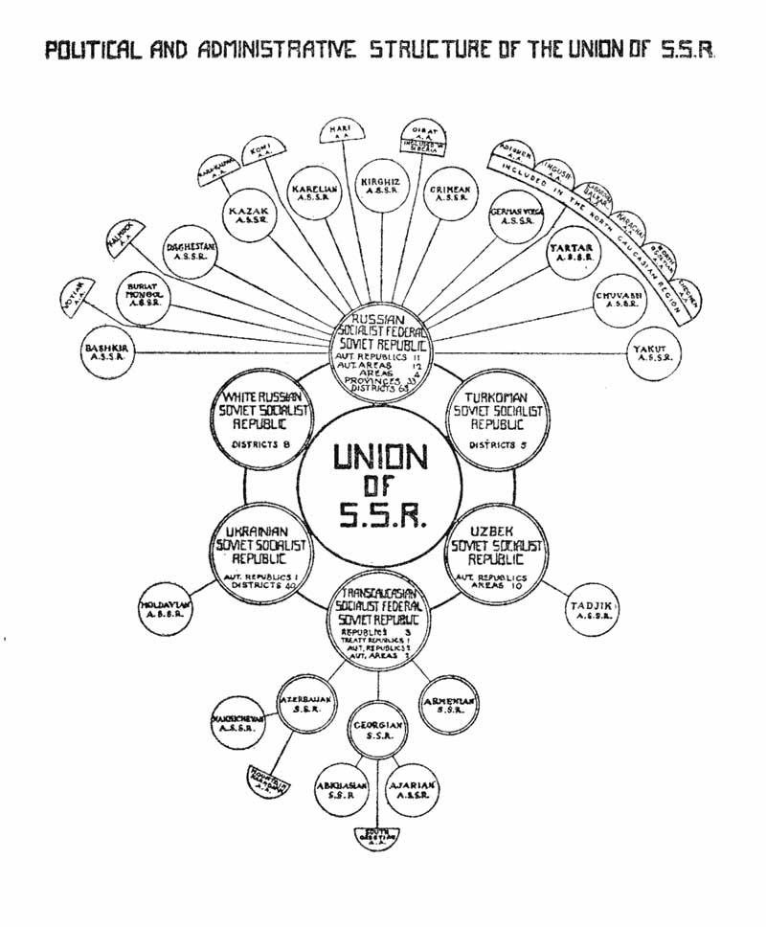
From the Soviet Information Bureau, 1927

Slide 6
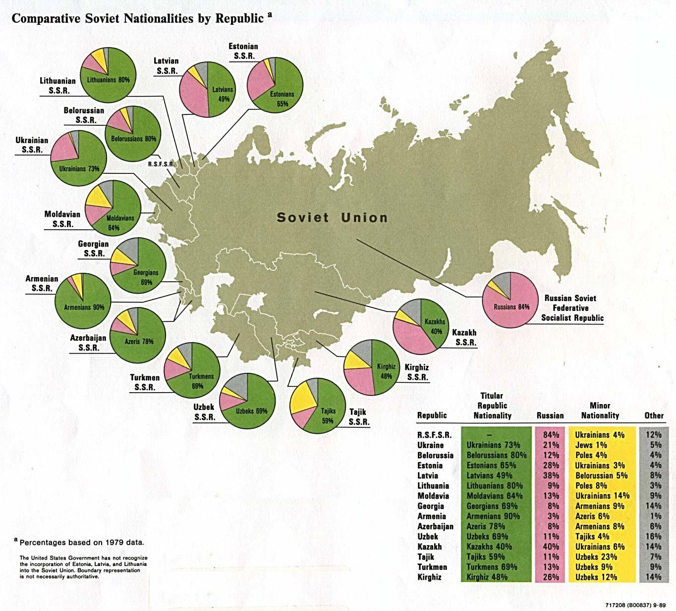

Slide 7
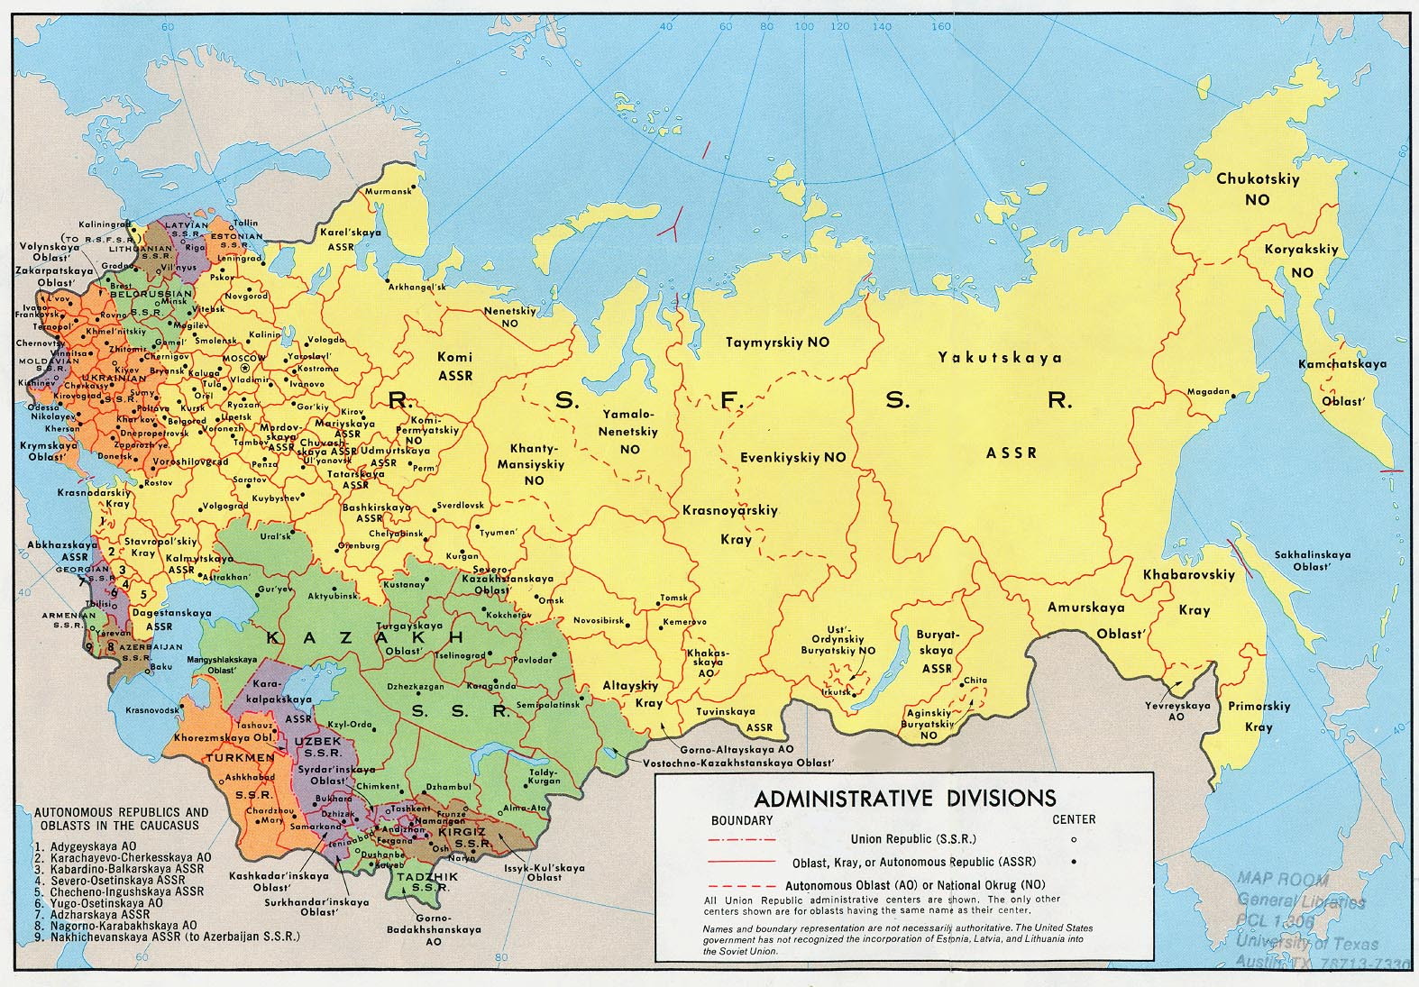

Slide 8
Korenizatsiya ("putting down roots")
“nativization” or “indigenization”
Promoting representatives of titular nations of Soviet republics and lower levels of territorial subdivisions of the state into local government, management, bureaucracy and nomenklatura in the corresponding national entities.

Slide 9
National in form, socialist in content (1920s)
Cultural autonomy for Soviet nationalities
Territorial principle: rights linked to the territory, not to the individual
Soviet Union as a federation of republics
Nation building of titular nations: preferential treatment
Regional and local autonomy
But: has to be socialist in content
Unifying effect of Communist Party
Greatest danger for the Soviet Union – Russian nationalism, not nationalism of other national/ethnic groups (Lenin)
Suppression of Russian nationalism

Slide 10
Soviet nationality policy (1930s)
National communism seen as a threat (especially in Ukraine), as a deviation from socialism
Measures against national-communist leaders in Soviet republics
Central authority re-established
But: nation building in republics not stopped, but their extent is reduced

Slide 11
Nationality Policy and the Great Terror
Fascism and growing nationalism in Europe: move against diaspora minorities: Poles, Germans, Koreans, Romanians, Latvians and other
Elimination of potential irredentist movements – enemy nations
National operations during Great Terror: deportation of diaspora nations
Tens of thousands of members of national elites killed
Reducing national complexity: many national territorial units dissolved (Polish, German and other local and regional Soviets/units)
Soviet nation building now limited to key nations

Slide 12
