Slide 1
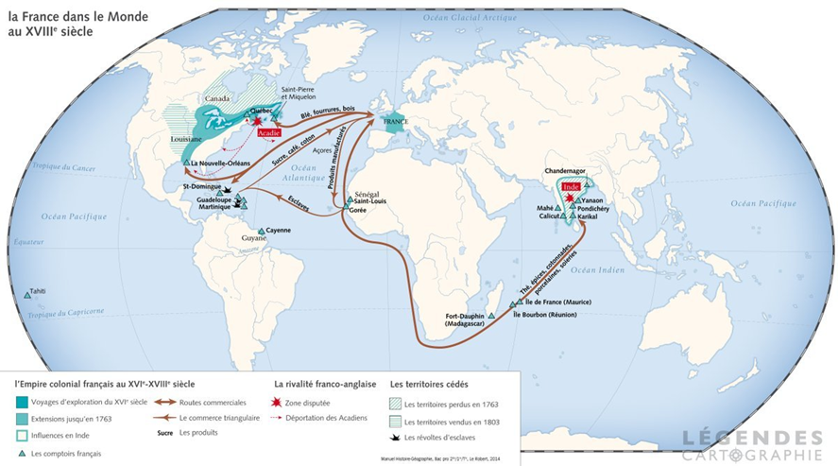
Global and Economic Origins
Ronan Love
r.love.1@warwick.ac.uk

Slide 2
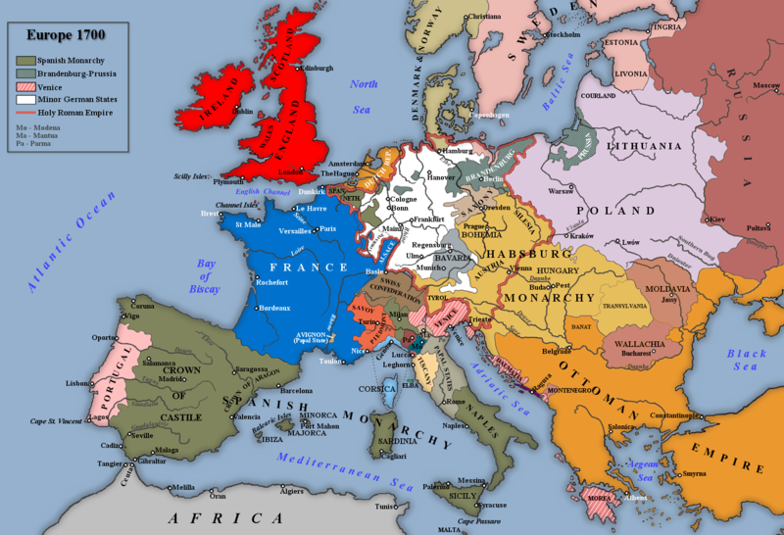
18C France and the Global Scene
Great Power Competition
Rivals: Holy Roman Empire, Prussia, the Habsburg Monarchy, the Dutch Republic, Britain
Major Transcontinental Wars:
War of the Spanish Succession from 1701-1714
War of the Austrian Succession from 1740-1748
Seven Years’ War from 1756-1763
American Revolutionary War from 1778-83

Slide 3
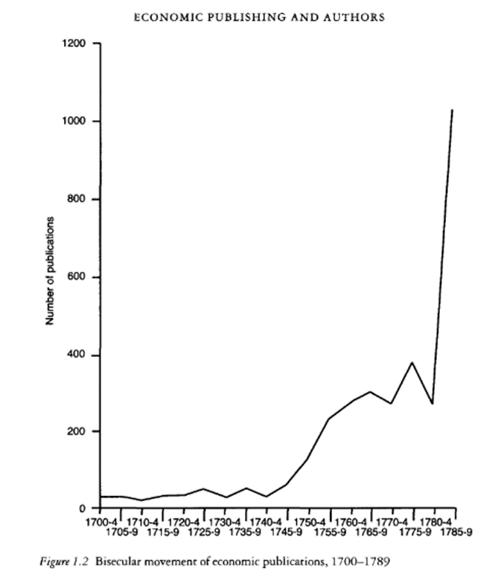
18C France and the Global Scene
Exchange of Ideas and Transnational Networks
Source: C. Théré, “Economic Publishing and Authors, 1566-1789” in Studies in the History of French Political Economy: From Bodin to Walras, ed. G. Faccarello (London: Routledge), 15.

Slide 4
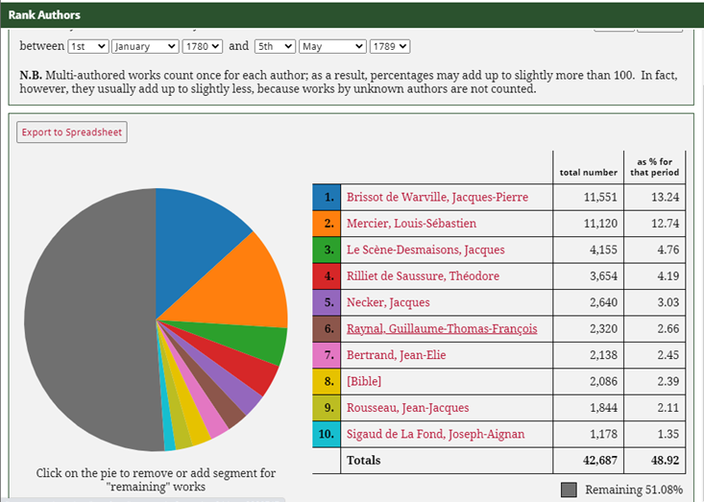
Global networks, French authors: Top 10 ranking authors by sales to metropolitan France from the Société Typographique de Neuchâtel between 1 January 1780 to 5 May 1789.

Slide 5
France and its Empire

Slide 6
The Historiography: From Economic Causes to Global Financial Origins
Do “origins” = causes?
What sort of claim is being made when historians talk about the Revolution’s “origins”?
Hunt on the global vs ‘internal’ financial crisis:
‘the size of the deficit, an inability to pay the interest on the debt, the failure of efforts to rationalize and equalize taxation, the limitations of the financial administration, or the reluctance of the king’s government to develop accountability to the public… [were] essentially internal causes of the fiscal crisis. While it would be foolish to downplay their significance, especially when taken together, a global perspective casts them in a different light and offers a more convincing explanation of the origins of the French Revolution.’
Hunt, ‘The Global Financial Origins of the French Revolution’ in Desan, Hunt, Nelson (eds.), The French Revolution in Global Perspective (Cornell, 2013), p. 32.

Slide 7
The Historiography: From Economic Causes to Global Financial Origins
Orthodox Marxist Interpretation (Soboul, Mathiez, Lefebvre)
Revisionist Challenge (Cobban, Doyle)
Linguistic/Cultural Turn (Baker, Furet, Chartier, Ozouf)
The ‘Global Turn’
Global Economic and Financial Origins (Lynn Hunt, Gail Bossenga)
Global Commerce and Consumption (Paul Cheney, Michael Kwass, Daniel Roche)
Global Politics (Annie Jourdan, Manuela Albertone)
Saint-Domigue, the Colonies, and their Influence on Metropolitan France (Pierre Serna, Manuel Covo, Frédéric Régént)

Slide 8
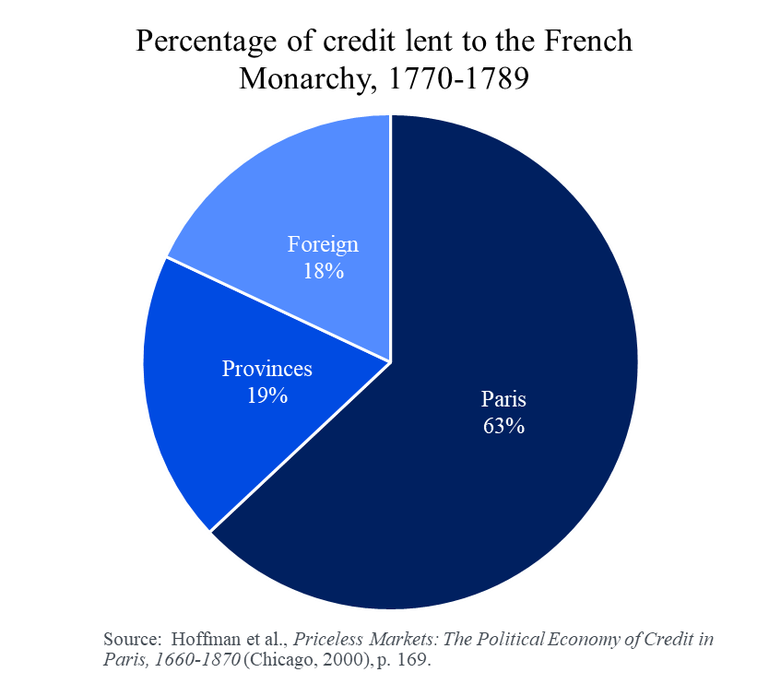
The Historiography: From Economic Causes to Global Financial Origins
The Historiography: From Economic Causes to Global Financial Origins
Orthodox Marxist Interpretation (Soboul, Mathiez, Lefebvre)
Revisionist Challenge (Cobban, Doyle)
Linguistic/Cultural Turn (Baker, Furet, Chartier, Ozouf)
The ‘Global Turn’
Global Economic and Financial Origins (Lynn Hunt, Gail Bossenga)
Global Commerce and Consumption (Paul Cheney, Michael Kwass, Daniel Roche)
Global Politics (Annie Jourdan, Manuela Albertone)
Saint-Domigue, the Colonies, and their Influence on Metropolitan France (Pierre Serna, Manuel Covo, Frédéric Régént)

Slide 9
Debt and Default
1. The problem in 1788: 51% of France’s yearly revenues went towards paying off interest on the debt.
2. Solving the problem: the monarchy had defaulted several times in the eighteenth century.
First in 1716 (Philippe II, Duke of Orléans, Regent of France)
then in 1759 (Louis XV)
again in 1763 (Louis XV)
and finally in 1770 (Louis XV).
Source: Eugene White, "Retour sur les Origines Financières de la Révolution Française." Annales Historiques De La Révolution Française, no. 356 (2009), p. 198.

Slide 10
The Financial Crisis of the State: What Made France Unique?
Why were the interest rates on French debt so high?
Why did the King not simply default on his debts as he had done in the past?
Why not create more taxes/reform the financial administration?

