Slide 1
Thermidor, Directory, Consulate, Empire
Charles Walton
French Revolution
HI31J

Slide 2
Robespierre’s fall – 9 Thermidor Year II (27 July 1794)
Thermidor (a month according to revolutionary calendar)
‘Therm’ = heat, summer
Thermidor as a historical phase: post-Terror but pre-Directory
27 July 1794 to 2 November 1795 (15 months)
Thermidor as metaphor: any phase of abrupt deradicalisation
Directory: 2 November 1795 to 9 November 1799

Slide 3
Early Thermidor phase - 1794
Purge of Robespierristes (August-September 1794)
Re-organization of Paris to break up sans-culottes (from Paris ‘sections’ to ‘arrondissements’)
October: clubs in France forbidden to correspond with each other
November: closure of the Jacobin Club

Slide 4
Thermidor
September 1794: the last ‘Jacobin’ act
Overturn Civil Constitution of the Clergy – state no longer finances the Church. In reality, the clergy hadn’t been paid for quite some time anyway.
Former committee members and key figures of the Terror struggle to defend themselves but moves to indict them are held at bay until spring 1795.
Some former ‘terrorists’ lead the right-wing reaction: Fréron, Tallien

Slide 5
Thermidorian Reaction (1794-1795)
Convention dominated by
former Girondins
The Plain (moderate deputies during the Terror)
Anti-robespierriste Jacobins
Many prisoners awaiting trial were released… but not all. Took time for many.

Slide 6
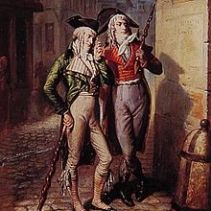
Thermidorian Reaction – intensifies in 1795
Return of émigrés… royalism on the rise
Street attacks on sans-culottes and Jacobins on the rise
Jeunesse dorée – Muscadins -- Gilded Youth (Paris)
Young men, dressed like dandies… anti ‘sans-culotte’ aesthetic
Attacked Jacobins and sans-culottes
Burned Jacobins in effigy
Carried sticks, which they called ‘constitutions’

Slide 7
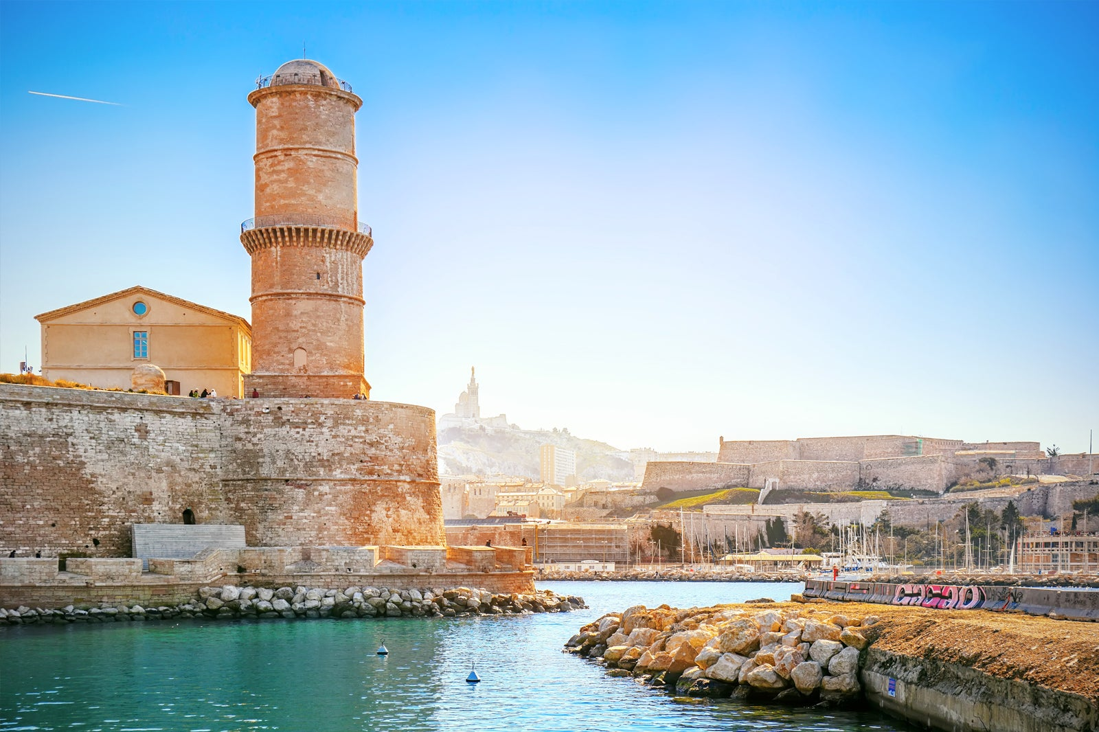
Thermidorian Reaction – White Terror
Law of 10 April 1795: disarm and arrest of former ‘terrorists’
80-90K ‘terrorists’ imprisoned
White Terror – thousands killed
2000 victims alone in Southeast of France
Prison massacres of ‘terrorists’ (word is invented at this time)
Authorities turn blind eye: Fort Saint-Jean Prison in Marseilles
Fort Saint-Jean
Marseilles

Slide 8
Economic Crisis
General Maximum overturned in December 1794.
Return of laissez faire, which the Girondins had always supported
1794-95: worst winter since 1709. Rivers froze, preventing food transportation and milling of grain. Ground frozen 2 feet deep.
Thaw = floods. Armies prioritized.
Famished died in the streets.

Slide 9
Economic Crisis
Inflation: Bread prices increase 750%
Assignats loses nearly all their value. By May 1795, they are at 8% their original value of 1790.
Some farmers, awash with cash, quickly buy biens nationaux. On the whole, however, the urban bourgeoisie had bought up the best biens nationaux (nationalized Church property) at auctions in 1791-92. Rural resentment of urban bourgeoisie.
Agricultural workers demand higher pay (fewer workers are available due to conscriptions)
Starvation in the cities -- unrest

Slide 10
Spring 1795
21 February – Freedom of all cults, but no public display or public funding. Separation of Church and state. Religious cults must fund themselves.
Spring: some émigrés and Federalists are allowed to return
Spring: Former members of the Revotionary Government and Revolutionary Tribunal indicted
Deported to Guiana (the ‘dry’ guillotine) or
Guillotined (including Fouquier-Tinville, public prosecutor during the Terror)

Slide 11
Spring 1795 – Germinal Revolt
Germinal Revolt: 1 April (12 Germinal):
Crowds of 10,000 march on the Convention. They brush the ‘Muscadins’ protecting the Convention out of the way.
They demand ‘Bread and the Constitution of 1793’ (which included social rights and the right to insurrection) – a call to return to pre-Thermidor policies.
Without clear agenda, they were eventually persuaded to leave the Convention.
Consequently,
4000 Parisians were arrested.
1700 stripped of their civil rights
Many sent to Guiana or Seychelles (dry guillotine). Many died in Guiana

Slide 12
Spring 1795 – Prairial Revolt (21 May)
Sectional assemblies begin meeting in defiance
Another march on Convention – crowd of 20,000 on 21 May
The deputy Féraud resists crowd, is shot and dies
Crowd demands the release of imprisoned ‘patriots’ (i.e., radical Jacobins)
They demand the arrest of returning émigrés
Call for food searches, inventories of food stocks

Slide 13
Spring 1795 – Prairial Revolt (21 May)
Convention promises bread. Crowds disperse.
Convention reverses its concessions.
11 deputies supporting the crowd were arrested. Most would commit suicide or be executed.
Next day, 22 May: Convention wreaks vengeance on the sans-culotte district of Saint Antoine, with the help of the Muscadins
3000-6000 radicals are arrested.
Radicals are forcibly disarmed
Prairial Revolt → The last sans-culotte uprising of the Revolution

Slide 14
Thermidorian purges
Irony: more national deputies were purged from the Convention after the fall of Robespierre than before
Putting a definitive end to radicalism.

Slide 15
Main points of contention in 1795
Religion – Freedom of religion restored but the Catholic Church is no longer state-funded. End of the Civil Constitution of the Clergy.
Monarchy – calls for accession of Louis XVII (son of Louis XVI), who dies of scrofula in June 1795. Louis XVI’s brother, the duc de Provence, becomes Louis XVIII in exile.
War – economic strains; should war be only defensive or expansionist?
Economy – should it be regulated or not? How to provision armies while maintinaing social provisions for the population.
Royalism vs. Jacobinism – the latter is now equated with the Terror, ‘terrorisme’ and ‘terrorists’ by many on the right and the centre

Slide 16
Directory – Constitution of the Year III (1795)
Constitution
Liberal/Conservative
De-democratization
Steep property requirements to participate in electoral colleges (which voted for Departmental officials and national deputies)
Electoral college: only 30,000 men could vote. Many didn’t bother.

Slide 17
Directory – Constitution of the Year III (1795)
Legislature: bi-cameral
Council of Five Hundred
Council of Elders
Executive: Five Directors
appointed by the Councils. One director changes each year.
First election (autumn 1795): it is decided that only 1/3 of the deputies will be elected in each two-year cycle. Aim → stability and continuity (unlike in 1791, when no deputy from the Constituent Assembly was allowed to run for the Legislative Assembly.)

Slide 18
Directory – Vendémiaire Revolt (Oct 1795)
Royalists were furious that 2/3 of the Council of Five Hundred would be comprised automatically of deputies from the Convention (many former Jacobins). This dashed their hopes of using the election to elect royalists and restore the monarchy.
13 Vendémiaire (5 Oct): Royalist uprising in Paris. Crushed by Barras and Bonaparte: ‘whiff of grapeshot’.
Last mass uprising of the French Revolution. Insurrections will be replaced by government coups.

Slide 19
Brigandage - epidemic
Widespread gang violence
Not always political, but sometimes (Chouanerie in Brittany)
Extremely violent – theft, murder
Need for greater police force – military commissions
Targets: wealthy farmers, war zones, esp. in northern conquered territories [today Belgium])

Slide 20
Wars of the First Coalition (1793-97)
First Coalition members: Austria, Prussia, Britain, Spain, Dutch Republic
Victory of Battle of Fleurus in June 1794 – opened door to expansionary wars
Prussia and Spain negotiate peace with France in 1795.
Bonaparte’s Campaign against Austrian-controlled Northern Italy begins in 1796
Treaty of Campo Formio (1797) – Austria relinquishes control of northern Italy

Slide 21
Wars of the First Coalition (1793-97)
Creation of Sister republics
Batavian Republic (formerly the Dutch Republic, 1795)
Cisalpine Republic (northern Italy, 1797)
Ligurian Republic (Genoa territories, 1797)
Helvetic Republic (Switzerland, 1798)
Ideological warfare and pillage
Constitutional changes imposed on conquered territories
Intense pillage. War = new political economy
Guerilla warfare increases
Wars of extermination: treat as ‘animals’ those who refused to be ‘civilized’

Slide 22
François-Noël Babeuf Conspiracy of Equals
Autodidact from northern France
Radical politics
Called for Progressive Taxation
Supported women’s political clubs after their abolition
Insisted on the restoration of the Constitution of 1793
‘Nature has given every man the right to the enjoyment of an equal share in all property’.
Conspiracy of Equals: aimed to overthrow the Directory
Opposed gov’t liberalization --> withdrawal of assignats and repeal of Maximum
1796: Demanded Constitution of 1793 and called for insurrections

Slide 23
Babeuf’s Trial
Show trial in the high court of Vendôme, February 1797
Highly publicized, since the Directors believed Babeuf’s radicalism would disgust the public and lend support to the Directory
Drawn out trial. Babeuf executed in May 1797
During the trial, he laid out his political philosophy of abolishing private property.
Was a hero and martyr to 19th century socialists.

Slide 24
First Directory (1795-97) - Achievements
National elite education system (grandes écoles)
Expansion of empire
Spread of constitutions in Sister Republics
More efficient tax collection

Slide 25
First Directory - Flaws
Deeply corrupt and perceived as such
Military and military contractors – locus of power
See-saw politics (Royalists vs. Jacobin) and chronic coups

Slide 26
Fructidor coup of 1797
France is divided between royalists, constitutional monarchists and republicans
Elections of spring 1797
Many royalists win – wish to further purge the Jacobins (‘terrorists’)
Only 13 out of 216 ex-Conventionnels re-elected. Victory for the right.
Council of 500 divided, as are the 5 Directors
18 Fructidor Coup (Sept 4) : 2 Directors are purged by the other three, who are backed up by the army. 177 royalist deputies are purged. 65 people deported.

Slide 27
Second Directory
30 royalist newspapers are shut-down.
More aggressive state propaganda
Annuls public debt in 1797 (what if they had done this back in 1789… there would not have been a revolution !!??)
Campo Formio Treaty (1797)
Austria gives up Northern Italy and Netherlands. Napoleon leading army in Italy.

Slide 28
Wars of the Second Coalition (1798-1802)
Members: Austria, Russia, Britain, Ottomans, Italian states, German states
Napoleon’s aborted attack on Britain via Ireland, where there were Irish supporters of the French Revolution (1797).
Plan B: attack Britain and the Ottomans by threatening Britain’s over-land trade with India and taking Egypt.
Invasion of Egypt (May 1798)
Napoleon gets bogged down in Syria and Egypt in spring 1799.
Military setbacks but cultural and scientific victory: Discovery of the Rosetta Stone. Public opinion fascinated with news coming from ‘exotic’ region.
French setbacks in Europe (1799)
Russians enter Northern Italy (thanks to Austria’s help)
Italian states revolt – brutal repression by French troops
New troops needed. Attempts to conscript them trigger revolts in western France again (the counterrevolutionary Chouans in Brittany)

Slide 29
Second Directory (1797-1799)
Militant Jacobins on the rise – they do well in local and regional elections of 1798
Floréal coup of 1798
Directory ‘corrects’ election results, annulling Jacobin victories and installing its own centrist candidates. Roughly 1/3 of the elections at various levels were annulled.
All elections have very poor turnout
Directory lacks legitimacy

Slide 30
Road to Brumaire
Spring 1799
Defeats on many fronts
Egyptian campaign flagging
Military collapse looming
Bonaparte heads back to the Continent in August 1799, abandoning his troops. Two-thirds will die. Britain will take over Egypt in 1801, sending remaining French troops back to France.
Louis XVIII exploits resistance to conscription, stokes revolts in Brittany, Normandy, Anjou
Prairial coup of 1799 (3rd coup of the Directory!)
Councils demand accountability for the defeats of 1799
Neo-Jacobin deputies accuse the Directory of corruption – reason for defeats
The Councils purge the Directory by forcing resignations
Sieyès, back from his ambassadorship in Berlin, becomes a Director
Regime change in the air… no one knew from which direction the Directory would be toppled.

Slide 31
Road to Brumaire
Neo-Jacobins gaining strength in 1799
Jacobin Club re-opens in Paris
Sieyès – more conservative, wants a new constitution to protect the regime from relentless ‘see-saw’ politics.
The republic needs a king who will uphold revolutionary principles – someone who could enforce order from above with popular support from below. Sieyès starts casting about for a popular general…

Slide 32
Coup of 18 Brumaire – rise of Napoleon
Napoleon arrives in Paris in October 1799
Very popular because of Italian victories but also propaganda in Mediterranean…
Sieyès arranged for him to be put in charge of Paris troops

Slide 33
Coup of 18 Brumaire
Council of 500 was tricked into leaving Paris for suburb of Saint-Cloud
(Deputies were told they were under threat in Paris.)
Napoleon enters the meeting space to address deputies in Saint Cloud but is shouted down as dictator.

Slide 34
Coup of Brumaire
Napoleon leaves the hall and faints.
His younger brother, Lucien, misinforms troops outside that Napoleon had been mistreated by deputies.
The soldiers storm the hall, prompting many deputies to flee.
Deputies who remain authorize Sieyès to draft a new constitution
Brief Triumvirate: Napoleon (First Consul), Sieyès, Ducos

Slide 35

Consulate (1799-1804)
Bonaparte takes charge of new constitution (Revolution’s fourth)
New Triumvirate: Napoleon (First Consult), with Le Brun and Cambacérès (advisors)
Bonaparte: ‘A constitution should be short and obscure’.

Slide 36

Consulate (1799-1804)
Constitution approved by public referendum in February 1800
Initial structure
Council of State: drafted bills
Tribunate: debated the bills but could not vote on them
Legislative Body (inverse): could not debate the bills but could vote on them
Senate: verifies the laws
After December 1800, only the Senate remained as omnipotent in legislative and constitutional matters.

Slide 37
Consulate
Creation of Prefecture system (centralizing state)
Like intendents but without corporate ’privileged’ bodies frustrating them
Finances improve along with tax collection
Paying one’s taxes was a precondition for being identified as a ‘notable’ and thus worthy of receiving Napoleon’s patronage
Creation of a National Bank (1803)
Police system, with elaborate spy network
Got brigands and chouans under control

Slide 38
Consulate – France defeats Second Coalition
Austria defeated. Treaty of Lunéville 1802
Russia gradually withdraws from fighting
Britain – stopgap Treaty of Amiens (1802). Britain recognizes France’s predominance on the Continent.
Kingdom of Naples – defeated. Diminished sovereignty.
Germanic principalities – forced to accept French terms of peace.

Slide 39
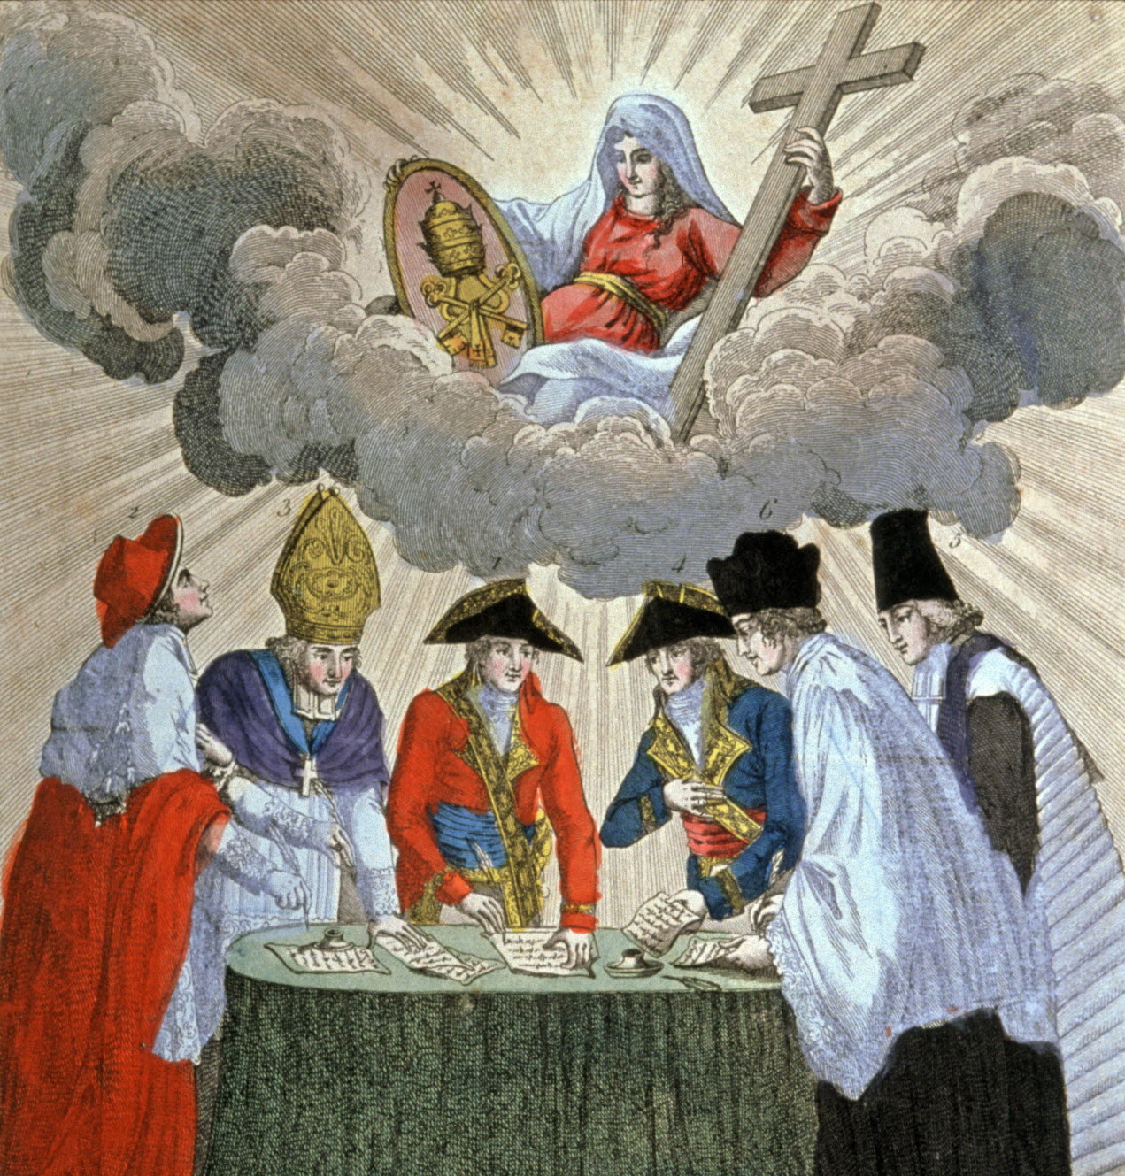
Concordat of 1801
Roman Catholicism → declared to be the official ‘religion of the majority of the French’.
No return of the Church’s property; the Church would have no role in public (national) education, though Catholic private schools existed.
Religious minorities were constitutionally protected.

Slide 40
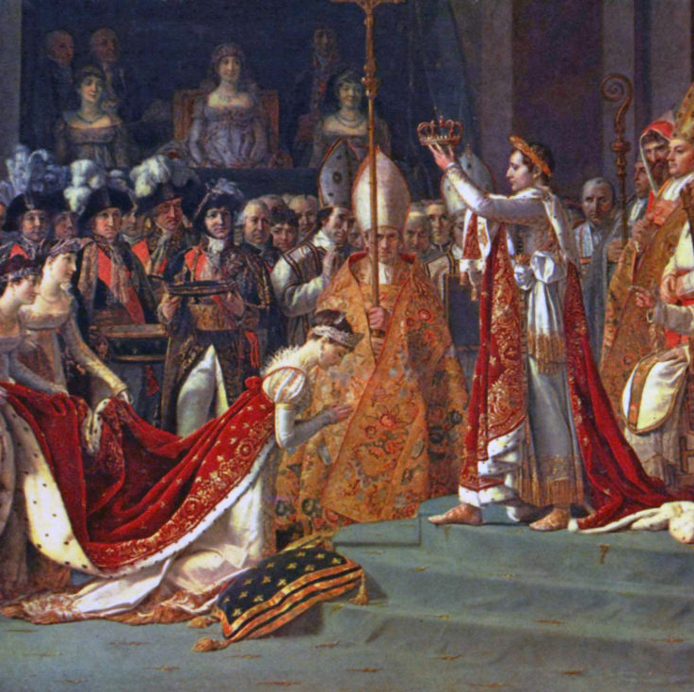
Consulate
Napoleon becomes First Consul for Life by plebiscite in 1802
Becomes Emperor in 1804
He crowns himself and Josephine

Slide 41
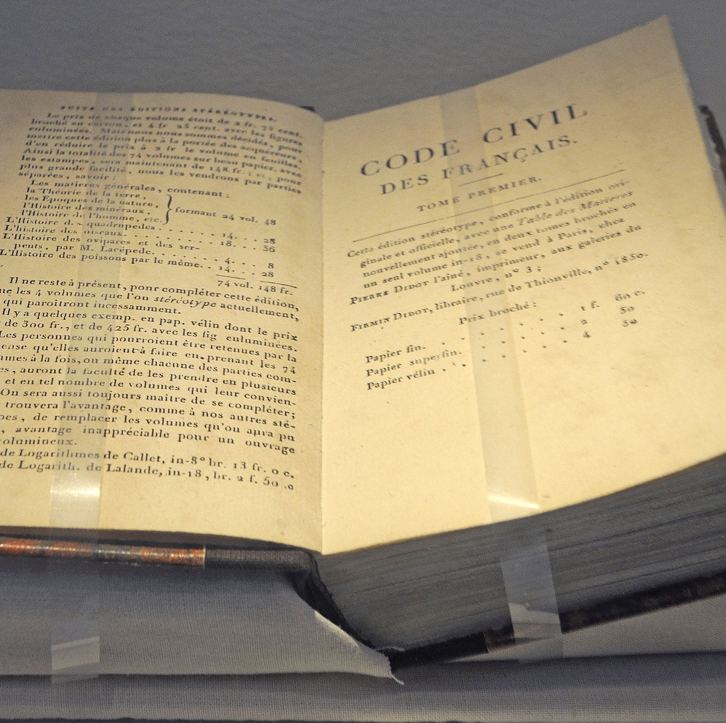
Civil Code of 1804
Still exists today, amended and modified of course.
Equality before the law
Banned any notion of ‘religious’ crimes
Allowed some heirs to receive more than others but no children could be excluded from inheritance (still true today)
Retreat on divorce rights for women but divorce as a civil matter
Reinforced property rights
Patriarchal: fathers and husbands control property (until 1960s!!!)

Slide 42
Empire: Battles (1804-1814)
1805
Battle of Austerlitz (victory over Austro-Russian forces)
1806
Berlin Decree, enforcing the Continental System
1808
Peninsula War (Spain/Portugal)… mired in guerilla warfare
1812
Disastrous invasion of Russia, weakens French Army
1814
Paris seized by the Allied Coalition. Napoleon abdicates
1815
Hundred Days. Napoleon returns from Elba. Defeat at Waterloo

