Slide 1
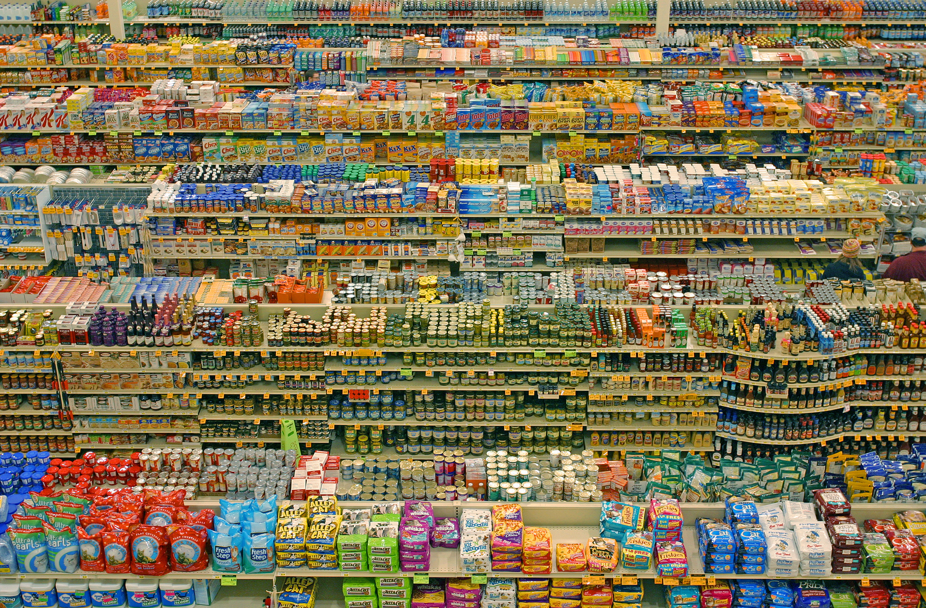
Week 11. Consumption and the Global Consumer

Slide 2
Term 1
Week 1. What is Globalization?
Week 2. Globalisation in History: Waves and Cycles
Week 3. Population and Demography: Globalisation in Numbers
Week 4. Globalisation between History and Theory
Week 5. Human Movements: Migrations, Diasporas and Global Communities
Week 7. The Environment and the Age of the Anthropocene
Week 8. Global Exchange: Trading Commodities Worldwide
Week 9. Communication and Technology: From the Telegraph to Internet
Week 10. Long Essay and Dissertation

Slide 3
Term 2
Week 11. Consumption and the Global Consumer
Week 12. Organisations: The Business of the Global Corporations
Week 13. Global Capitalism: Inequality and The World Economy
Week 14. Global Power: Nations, Empires and Civilizations
Week 15. Global Cities as Nodes of Globalization
Week 17. Globalisation, Human Rights and International Law
Week 18. Global, Glocal and the Global Imaginary
Week 19. The End of Globalisation?l
Week 20. Dissertation and Long Essay workshops

Slide 4
Week 11. Consumption and the Global Consumer
Is globalisation linked to the emergence of global consumer products?
Are these products Western in nature and manufacturing? Is there a ‘global consumer’?
What is the role of businesses, the state and of people in shaping global consumption?
Does the use of similar commodities create uniformity across the globe?
This week will focus on two global consumer goods (clothing and food) in order to analyse the role of consumers, technologies, the meaning of power and the creation of hybridity

Slide 5
Week 11. Consumption and the Global Consumer
1. Institutions
Trade
Empire
Legislation
2. Commodity approach
- cotton
- footwear
3. Production
- technologies (1st and 2nd IR)
- work (slavery, workers’ rights)
4. Consumption
- consumer rights (coops; warfare; etc.)
- boycotts and buycotts
- green consumerism
- fair trade
- slow food movement

Slide 6
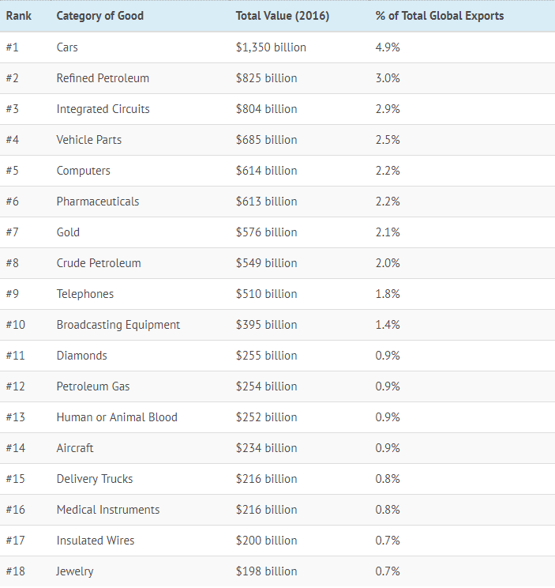
The Most Traded Goods
Here are the good categories, along with the total dollar value and percentage of total exports that each category represents on the global market.

Slide 7
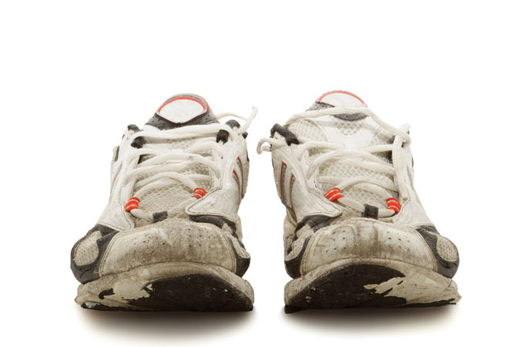

Slide 8
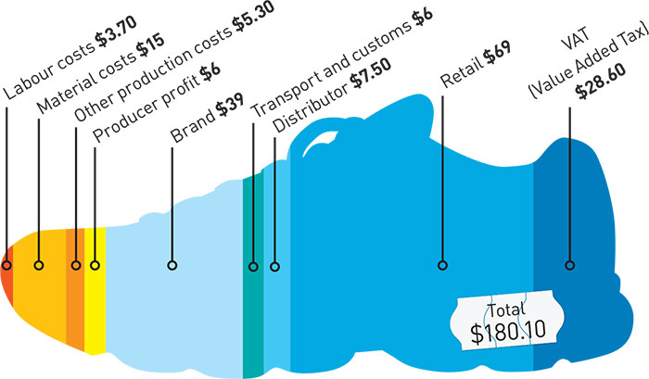

Slide 9
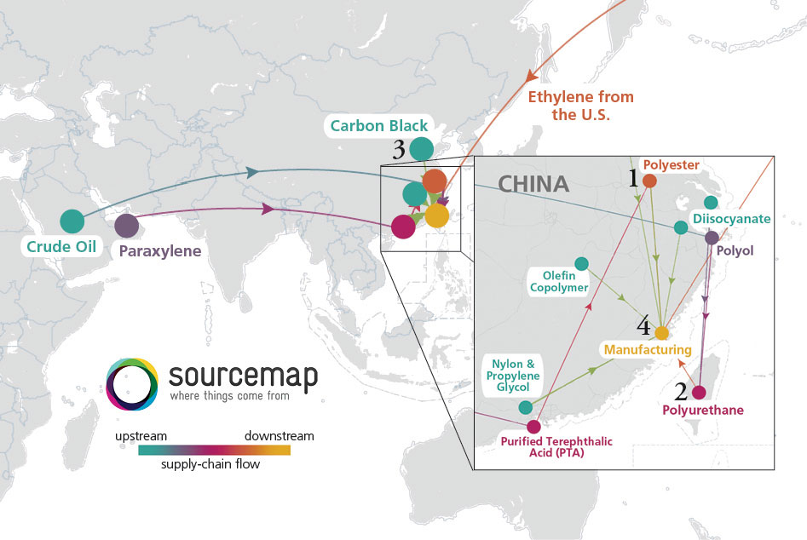
https://www.conservationmagazine.org/2012/12/the-origins-of-running-shoes/

Slide 10
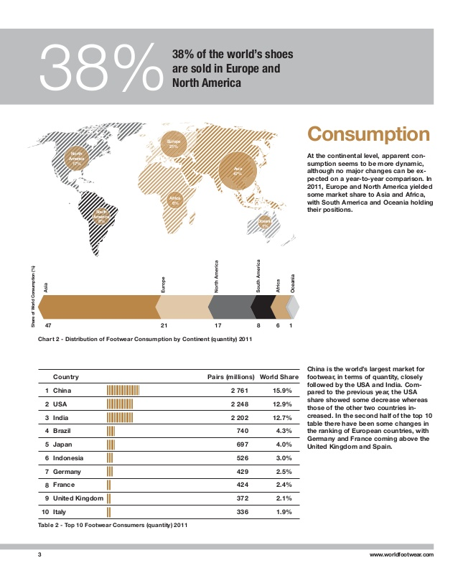

Slide 12
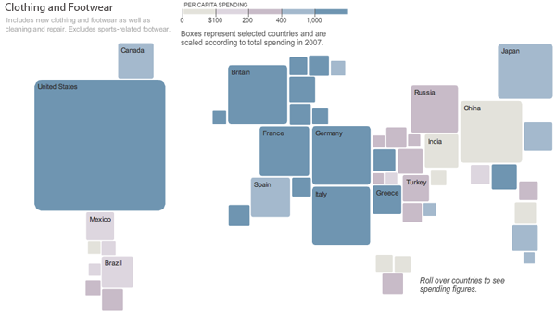

Slide 13
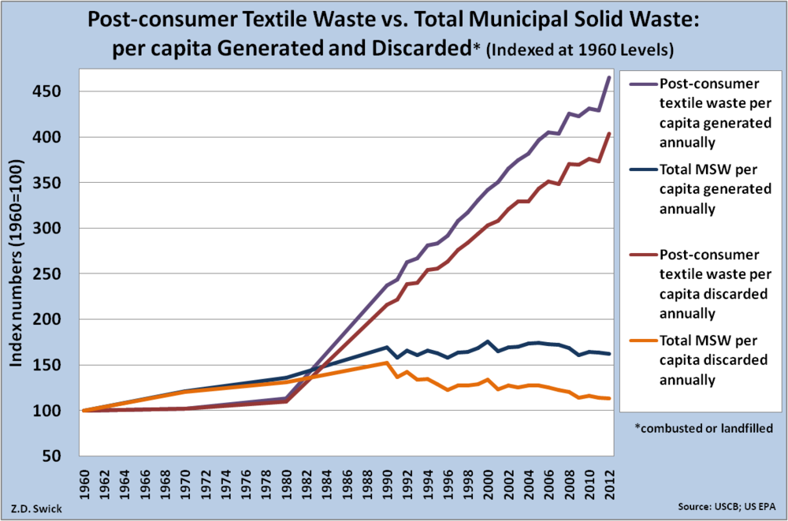

Slide 14
